Slide 1

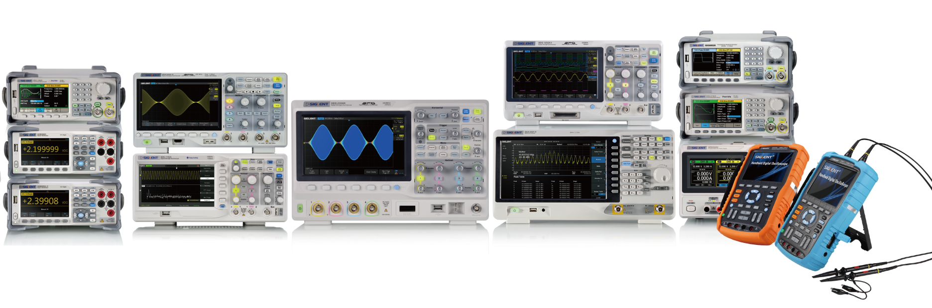
The Best Value in Electronic Test & Measurement

Slide 2
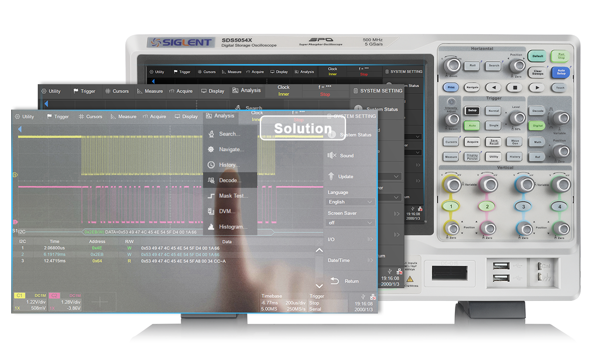

SDS5000X
Introduction
Features & Benefits
Ordering Info
Touch for a solution

Slide 3

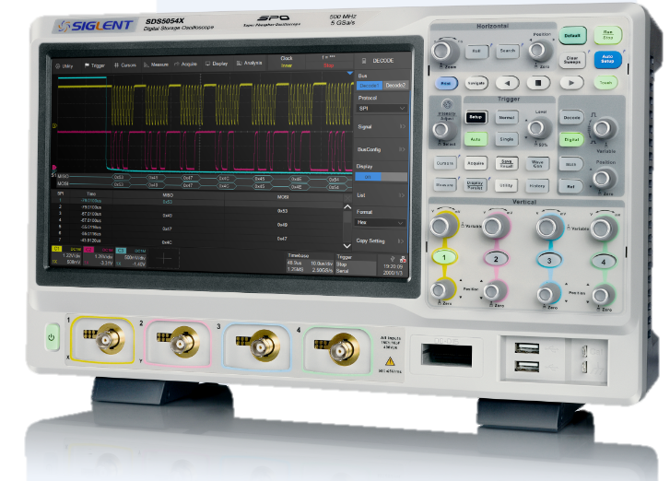
Front Panel
Quick Search/Navigate
Play, FFW, Replay capture data frames
10.1’’ Touch Screen
Easy use
supports gestures
Probe Calibration Signal
3.3 V, 1 kHz Square wave
4 Analog Channels
Auto attenuation and power for active probes
2 * USB HOST
Keyboard mouse and USB memory devices
MSO/Logic analysis
16 digital channels

Slide 4
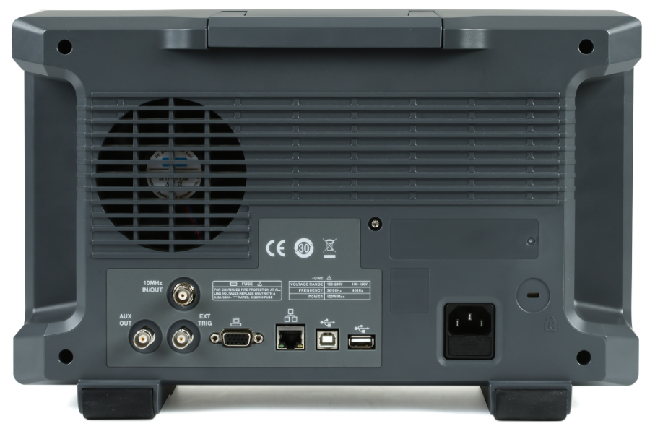
Rear Panel
10 MHz IN/OUT
USB-DEVICE(USBTMC)
AUX OUT
USB HOST
LAN INTERFACE
(VXI-11, telnet, socket, web)
VGA OUTPUT
EXT TRIG

Slide 5


LESS PRICE & MORE Power
110,000
wfm/s
Waveform Capture Rate
1 GHz
Bandwidth
5 GSa/s
Sample Rate
10.1’’
Touch Screen
250 Mpts
Record Length

Slide 6


Bandwidth
Increased accuracy for fast rise-time pulses and complex waveforms
Precisely reproduce waveforms with high frequency components

Slide 7
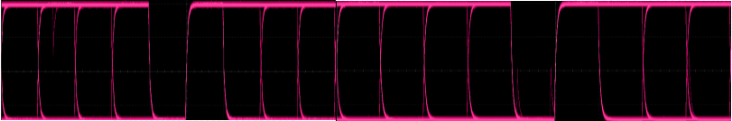
Waveform Capture Rate
Higher Capture Rate
Up to 110,000 wfm/s (Normal mode)
Up to 480,000 wfm/s (Sequence mode)
Collect measurement data more quickly
Quickly identify problems = Faster results
Shorter Dead Time
Dead time
Dead time
Long dead time
You miss the glitch!!

Slide 8
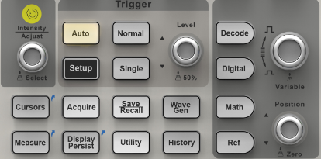
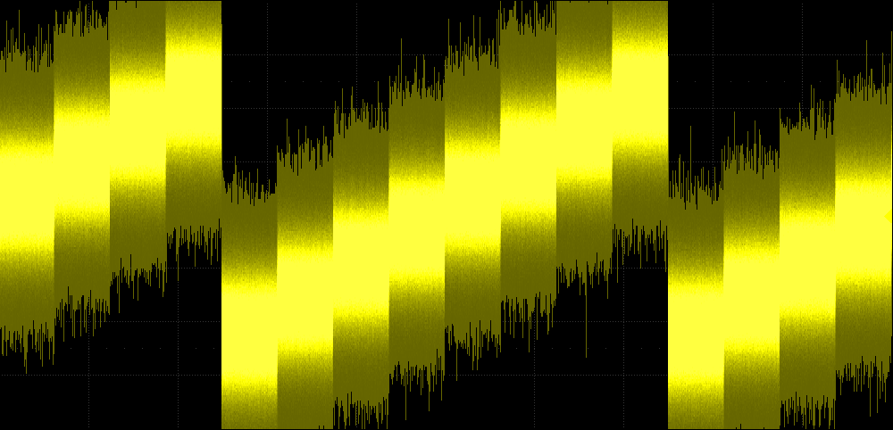
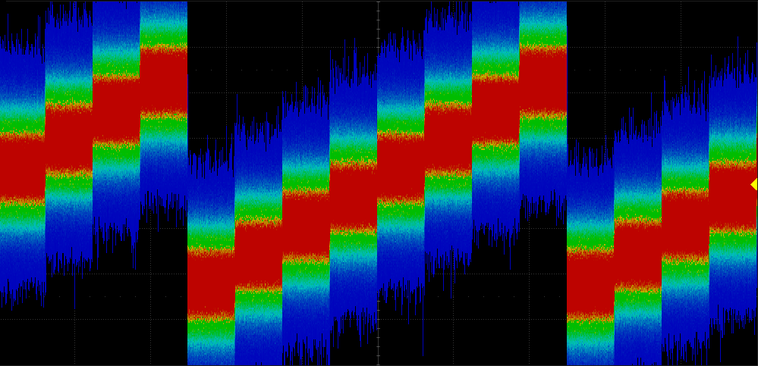
Color and intensity Display
More frequent events are brighter, or “hotter” (color display mode)
Significantly increase the probability of observing intermittent and elusive events
Reveal dynamic signal behavior
256-level intensity
Color temperature display

Slide 9
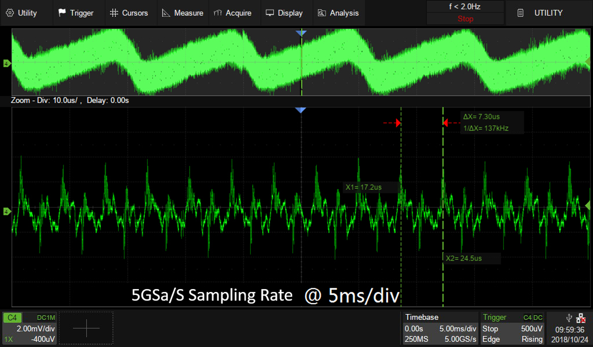
250 Mpts Record Length
Hardware-based Zoom function
Benefits: Capture more of signal and zoom in areas of interest
Don’t lose horizontal resolution, don’t miss short intermittent signals.
Monitor slow signals with high sample rate.. Capture seconds of data and still have resolution to see nanosecond scale details
CH1 & CH2 share 250 Mpts memory
CH3 & CH4 share 250 Mpts memory

Slide 10
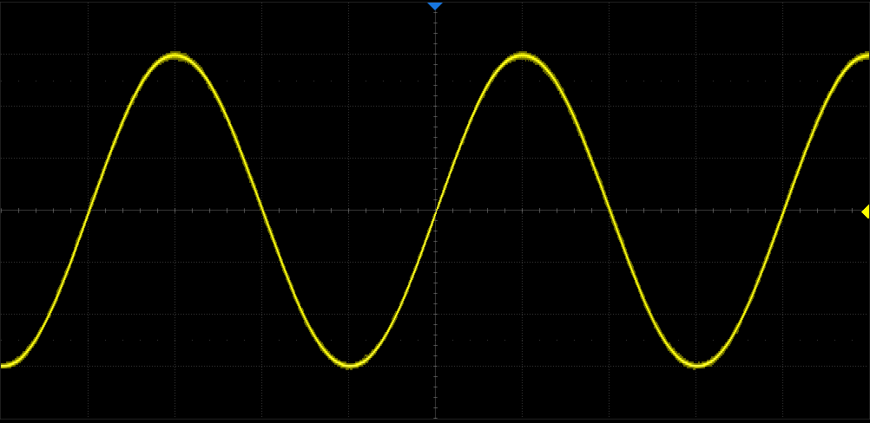
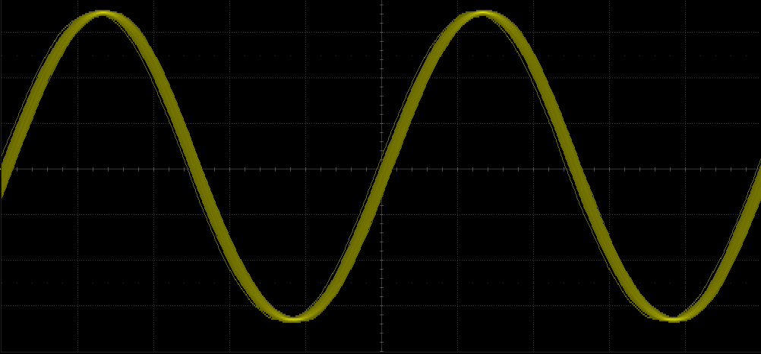
Digital Trigger System
SDS5000X Digital Trigger
Analog Trigger
Trigger the same 25 MHz Sine wave
Unique digital trigger system: higher trigger sensitivity, lower trigger jitter (less than 100 ps)

Slide 11
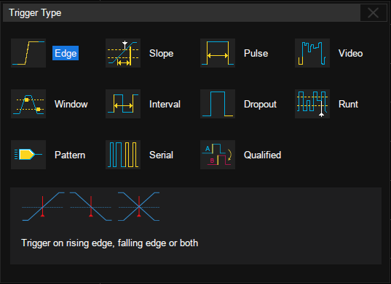
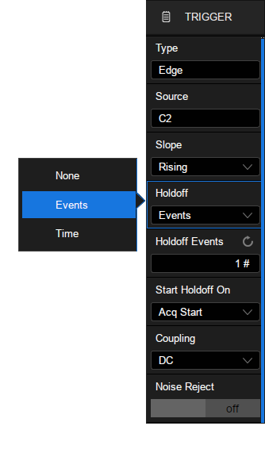
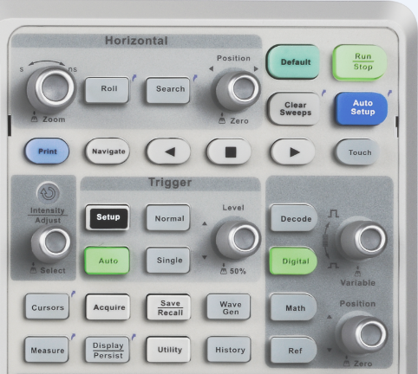
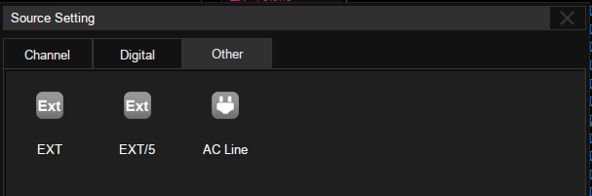
Intelligent Triggers
Featuring Qualified and Zone Trigger
Hardware trigger: Faster, less jitter
Multiple trigger types
Trigger source analog + digital channels + Other
Hold off by Events or Time
Setup

Slide 12
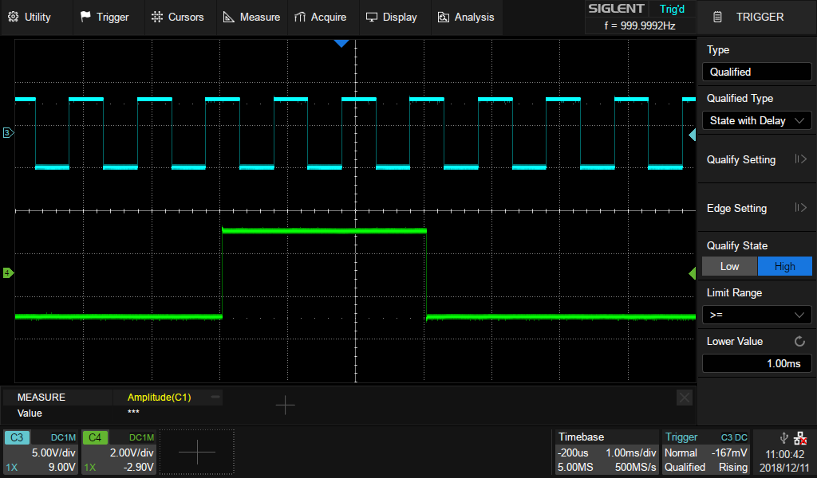
Qualified Trigger
State
State with Delay
Edge
Edge with Delay
Trigger on the first Rising Edge after 1ms High State
1ms

Slide 13
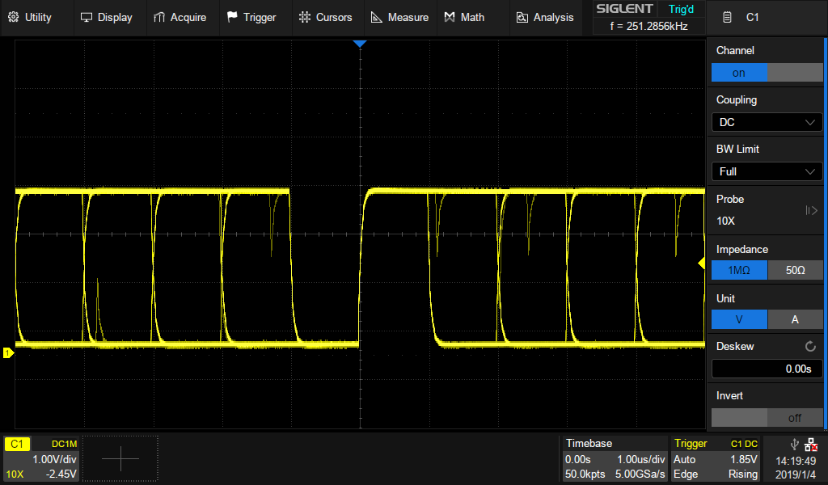
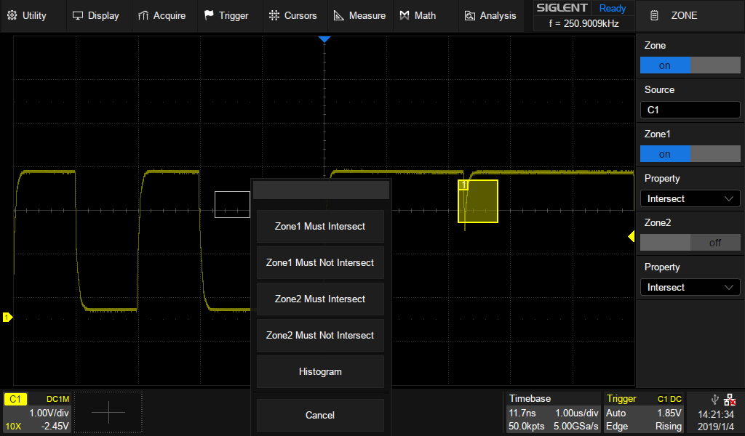
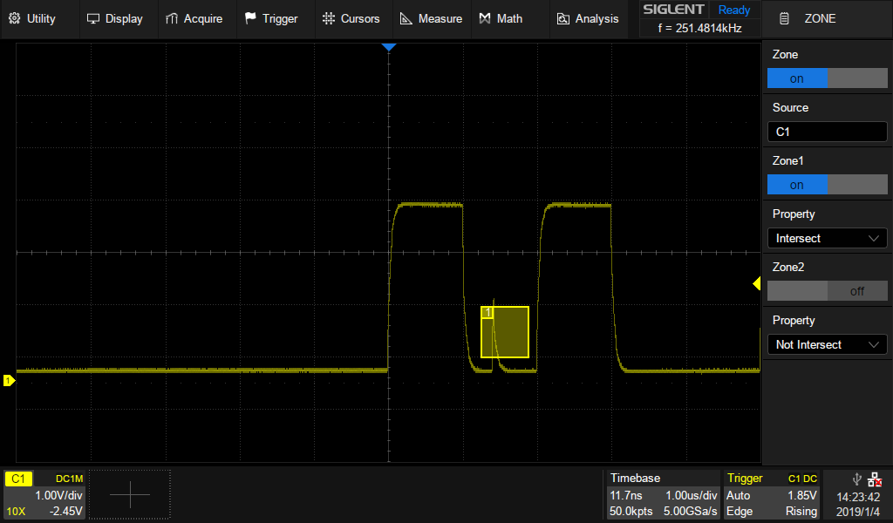
Zone Trigger
High waveform capture rate
allows you to see the anomaly
Once you see a glitch, draw a Zone Trigger box to locate it
Zone trigger easily isolates it without complicated traditional trigger settings.
Draw a zone trigger box to see the details

Slide 14
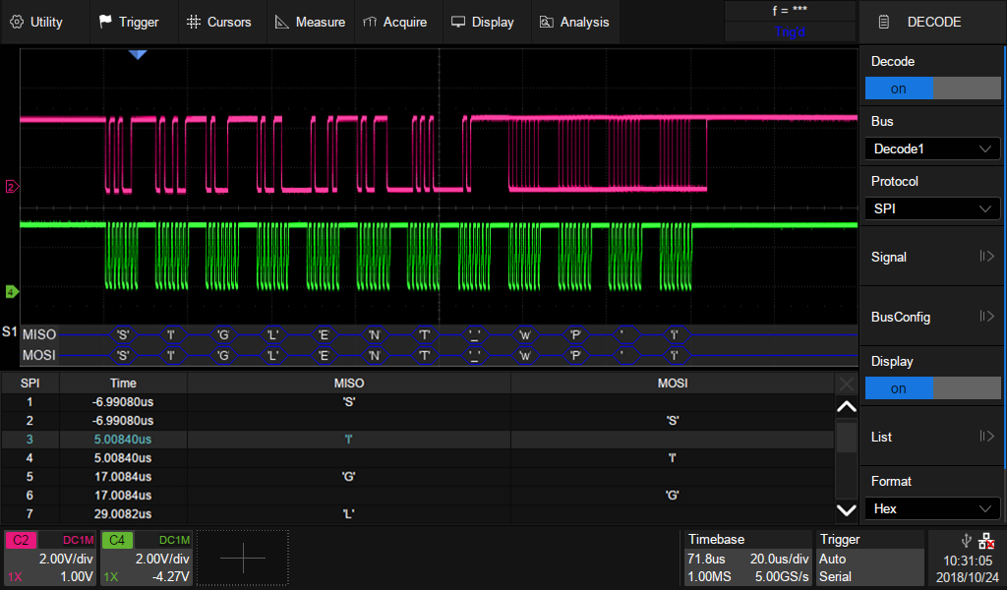
Serial Bus Trigger and Decode
Trigger source: 2/4 analog + 16 digital channels
Protocol
I²C, SPI Embedded serial trigger and analyze
UART Computer serial trigger and analyze
CAN, CAN FD, LIN Automotive serial trigger and analyze
FlexRay serial trigger and analyze
I2S Audio serial trigger and analyze
MIL-STD 1553B serial trigger and analyze
Format
Binary
Decimal
Hex
ASCII
Event List

Slide 15

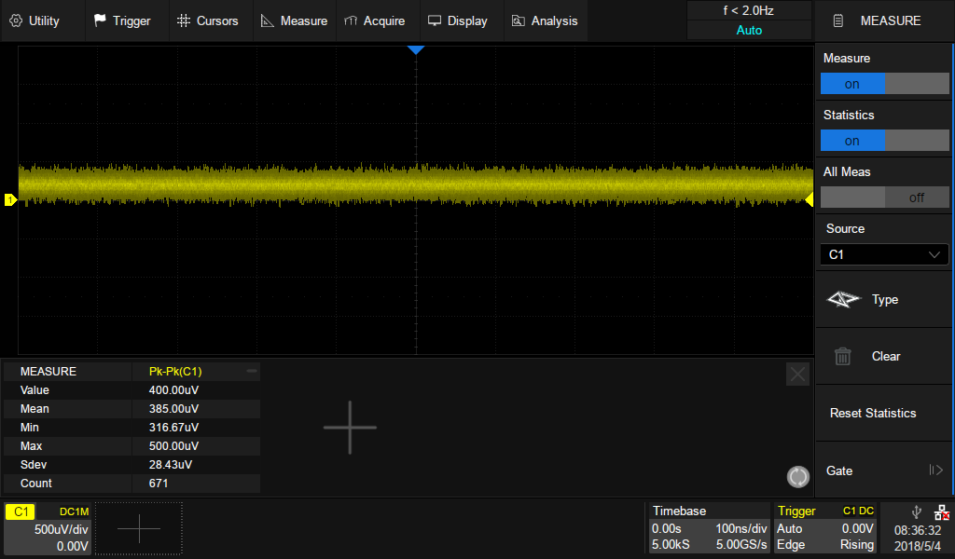
Analog Front End
Extremely low back ground noise
Vertical scale full bandwidth 500μV/div-10V/div
Benefits
High SNR increase the ability to identify a small signal from the noise

Slide 16
Sequence
In Sequence mode, the dead time is only 1/5 of normal mode. Increasing the probability to capture anomalies.
Sequence N-1
Sequence N
Sequence N+1
Long Interval between two signals
Only save interested part

Slide 17
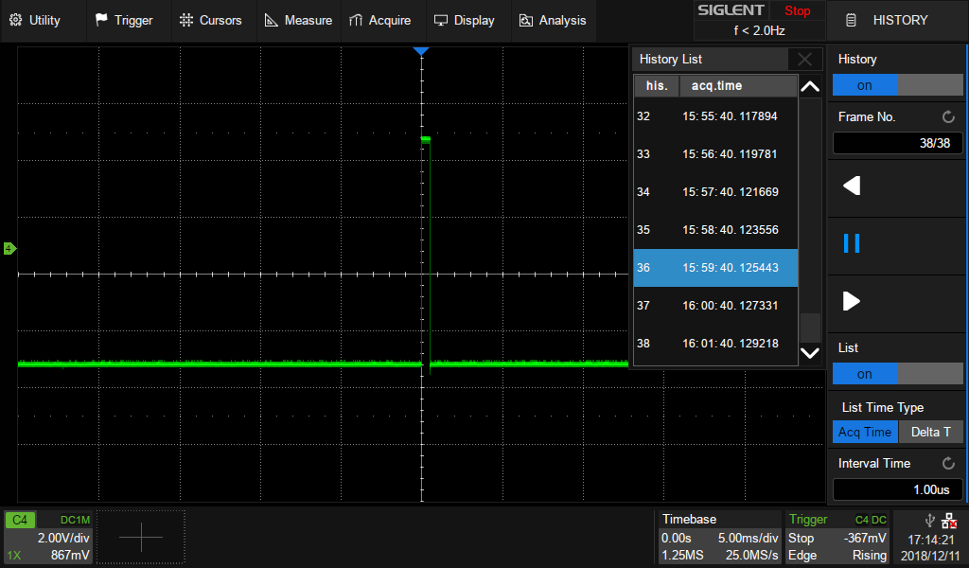
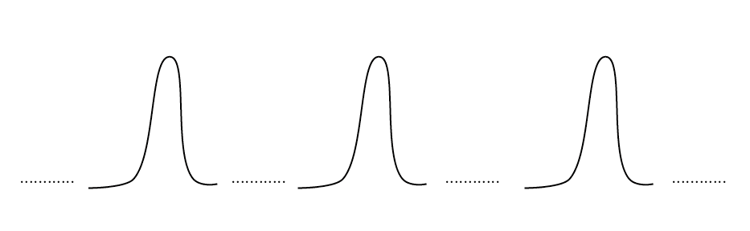
Sequence
Capture long interval important signals and leave out idle time
Time stamp of each segment to analyze the frequency of the event.
ΔT = 60s
60S
60S
Combine with History

Slide 18
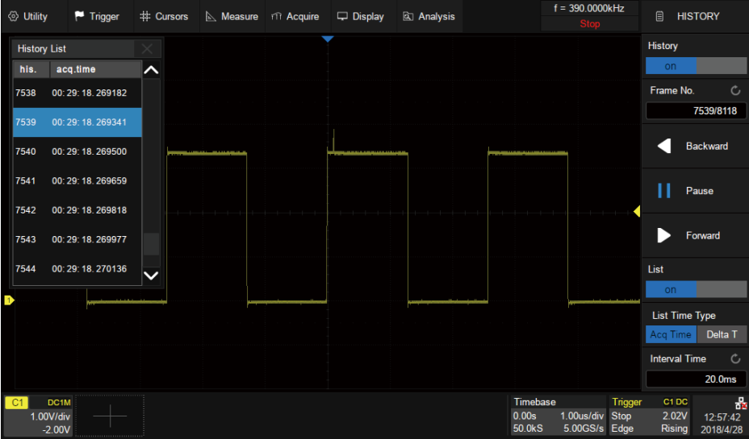
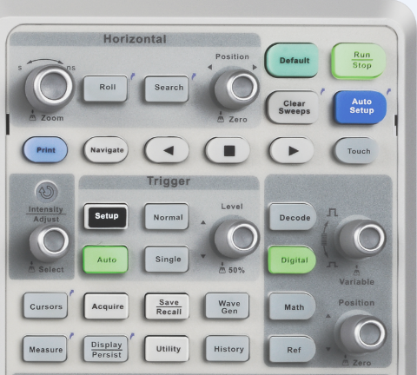
History
Navigation between frames
Running in background
Maximum records 100,000 frames

Slide 19
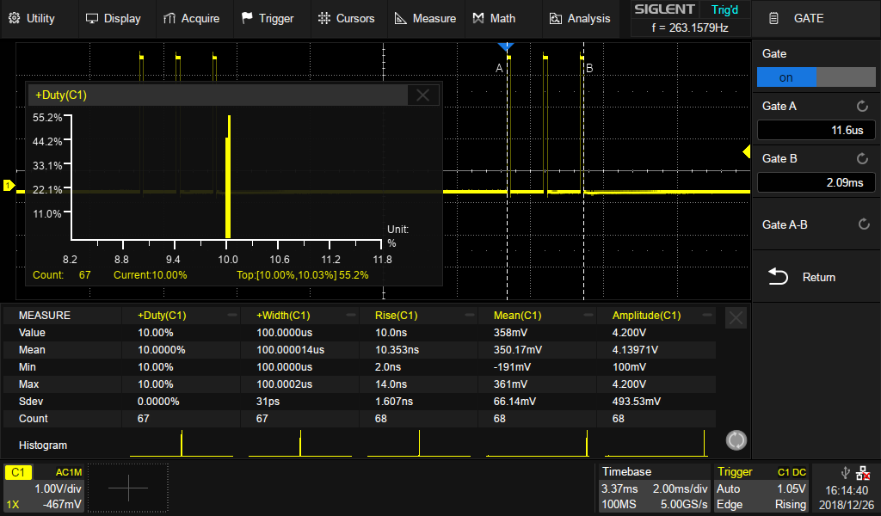
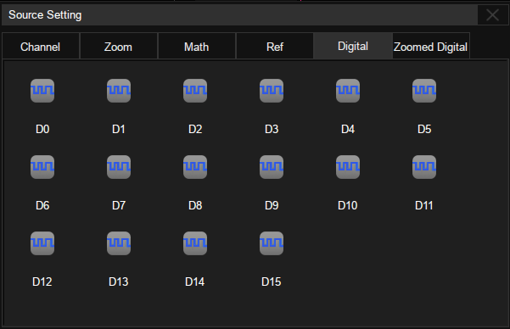
Measurement
Histogram
Gate
Measurement
38 kinds of measurements
Vertical: Amplitude values, Mean&Stdev&RMS calculations , Overshoot parameters, Level measured at trigger position
Horizontal: Period, Frequency, Time difference between edges, Rise/Fall time, Duty, Delay,
Difference between two continuous periods
CH Delay: Phase difference, Time interval between two channels edges, Skew
Display 5 measurement statistics simultaneously
38 automatic measurements
Gate measurement by cursors supported
Measure on analog and digital channels, zoom, math, and Ref

Slide 20
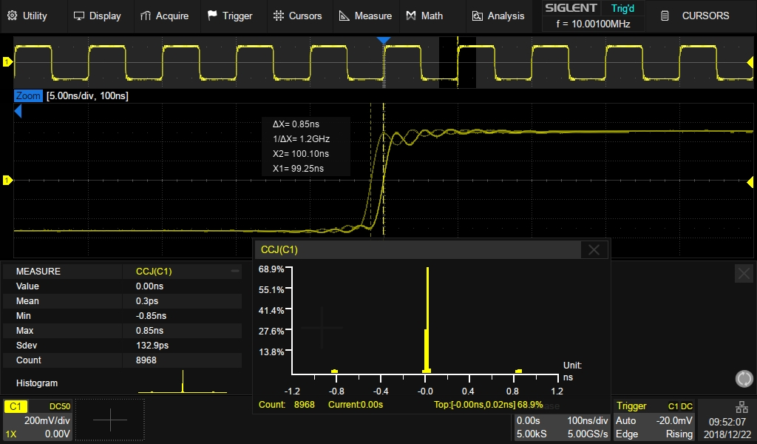
Jitter Measurement
Measure the jitter of a 10.001 MHz signal generated by DDS technology.
Simple steps: Trigger, Zoom, Measure
Histogram to indicate the noise distribution

Slide 21
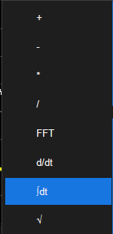
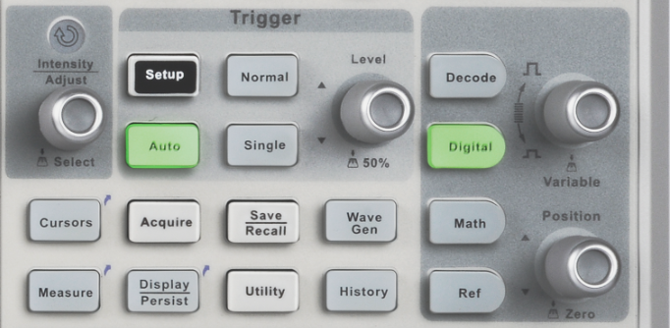
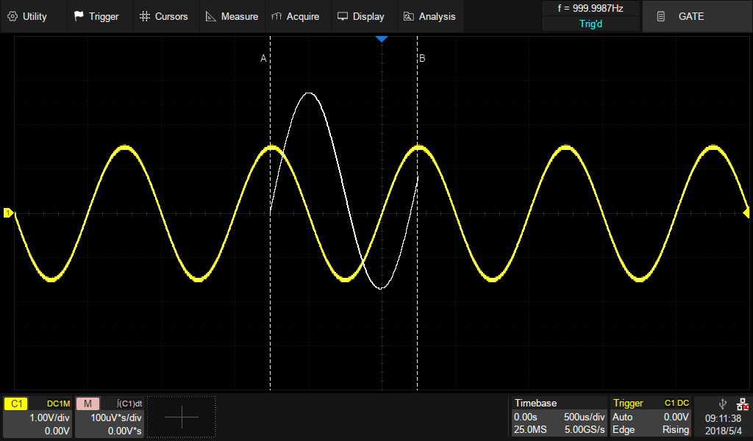
MATH
View a differential signal without differential probe
Power Calculations (P = IV onscreen)
Integrate power to calculate energy
Ratio of amplified signals
GATE INTEGRAL

Slide 22
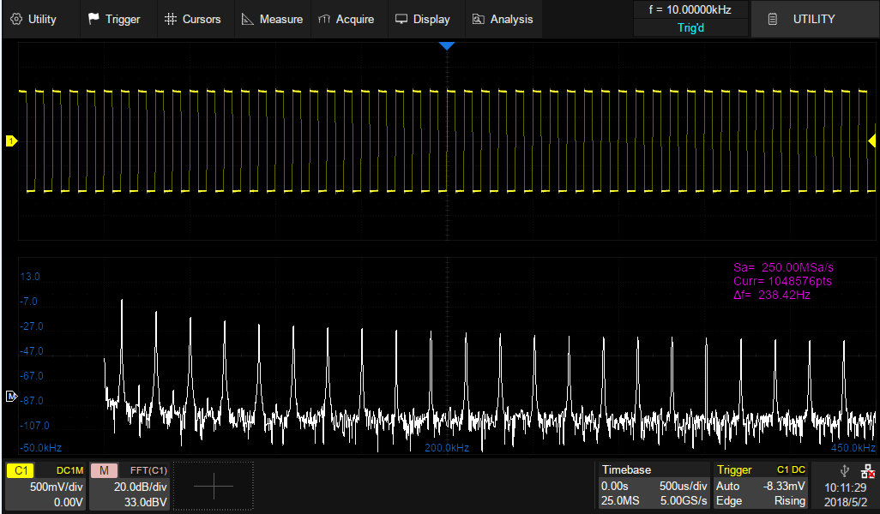
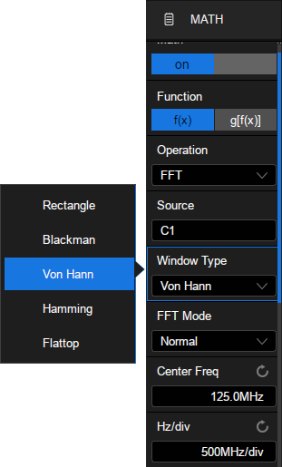
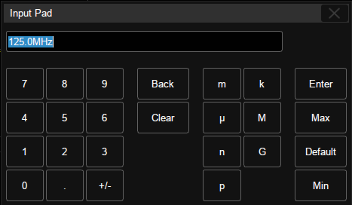
2Mpts FFT
High calculation speed
Five types of Windows
Normal, Max-Hold, Average
FFT mode
Extremely high FFT resolution
The frequency resolution depends on the
sampling rate and the number of FFT points
(fs/N).
Edit Center Freq and division with pop-up keyboard easily

Slide 23
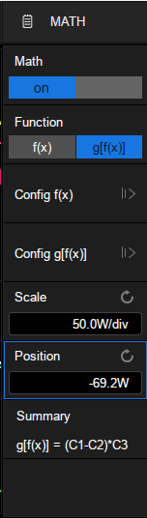
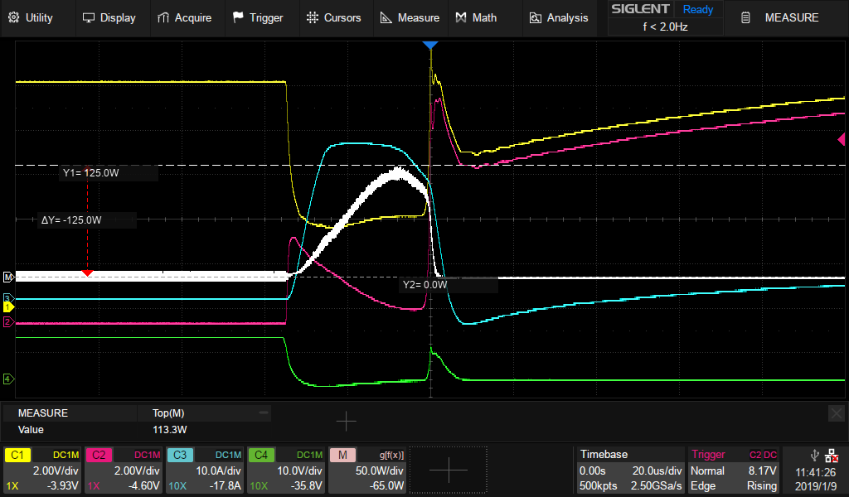
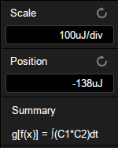
MATH on MATH
Measure the instant power on a MOSFET without a differential probe
P = V_{DS} * I_{D}
CH1 = V_{D}, CH2 = V_{S}, CH3 = I_{D}, CH4 = V_{G,} P = (CH1 – CH2) * CH3
Use a differential probe to measure V_{DS} then perform an integral on power to calculate the energy generated when MOSFET is powered on

Slide 24
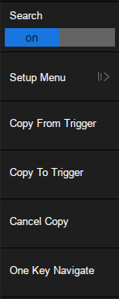
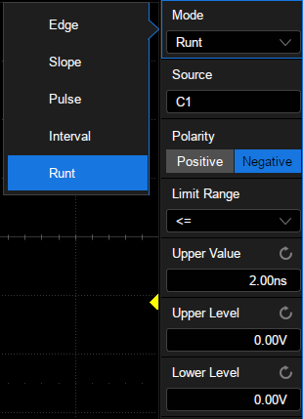
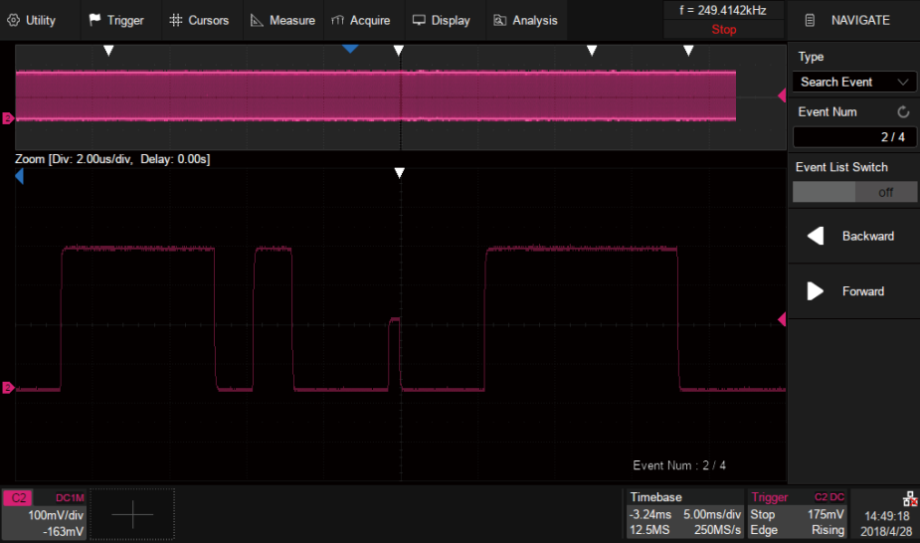
Search and Navigate
Set up search criteria
One Key Navigate – Elements that match search are marked with a white arrow for easy identification.
Find and mark events you are interested within one second

Slide 25
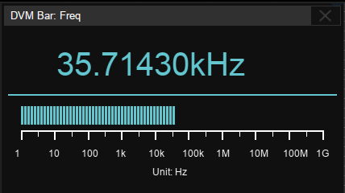
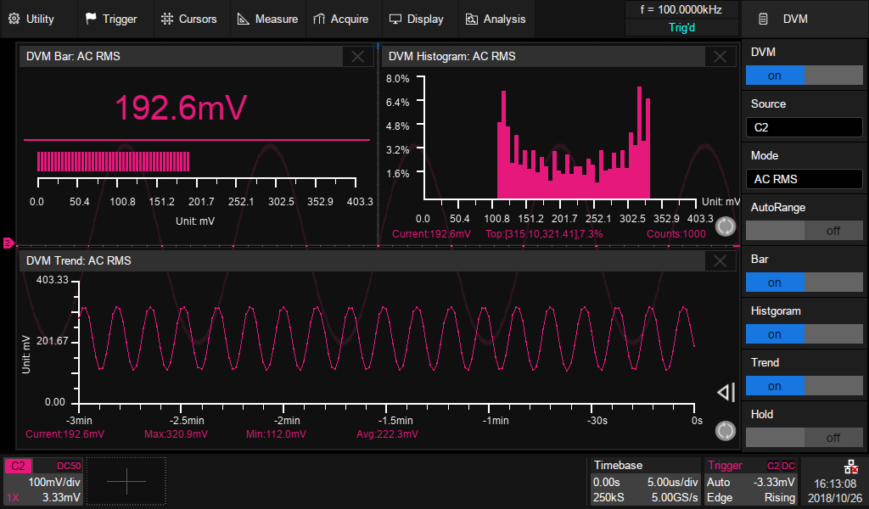
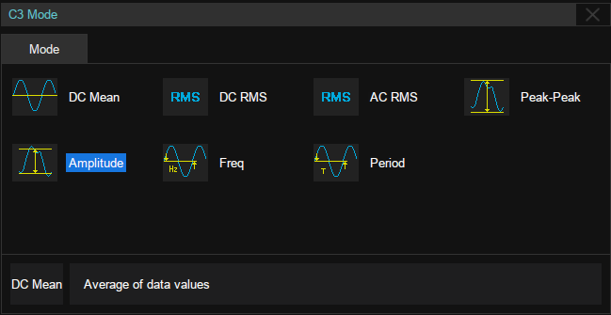
DVM & Frequency Counter
7-digit frequency counter with bandwidth up to 1 GHz, useful in many high frequency applications
Built-in standard 4-digit digital voltmeter
Support Auto Range, Bar, Trend, Histogram
The same probe as the oscilloscope channels
DVM measurements and scope acquisition are independent

Slide 26
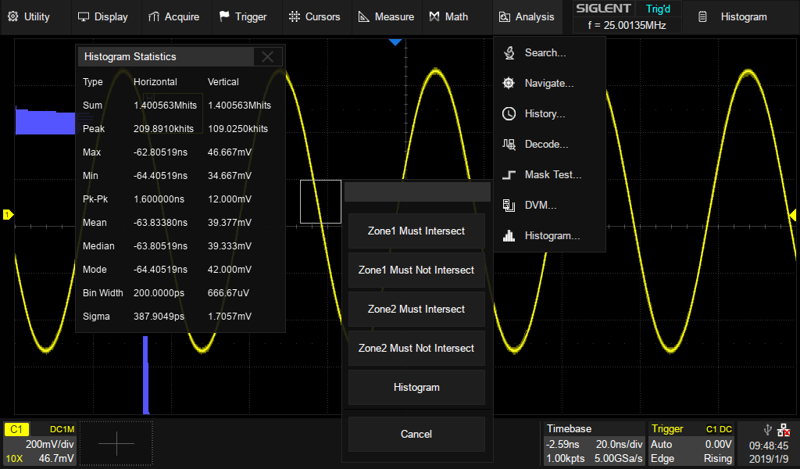
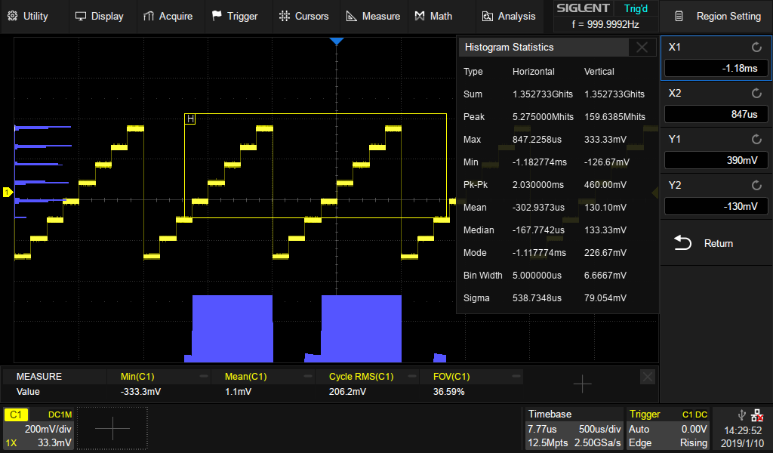
Waveform Histogram
Draw a box to locate area of interest
See the vertical and horizontal signal value changes

Slide 27
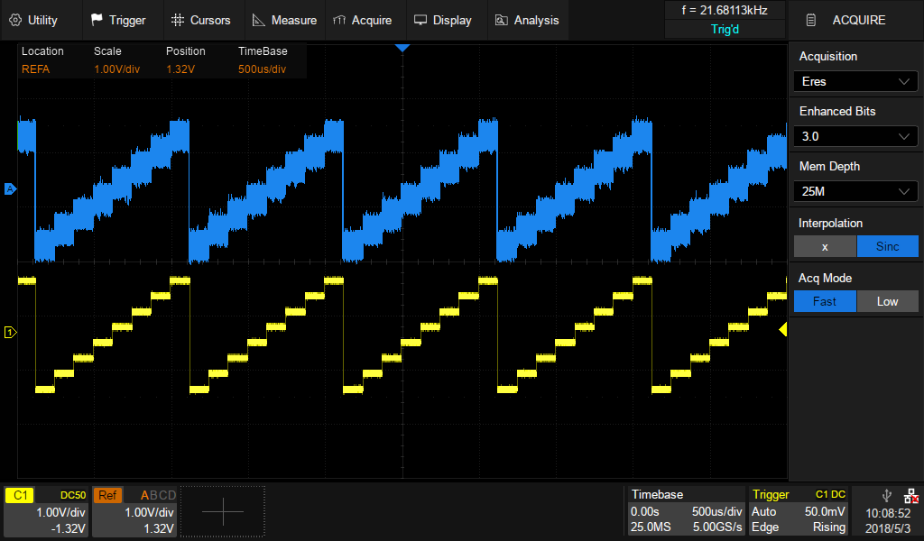
Eres Mode
Eres Mode
Enhance SNR by decreasing BW of
noise via digital filter
Improve ENOB (Effective number of
bits) by 3 Bit at most. Means
enhancement of vertical resolution
Independent on signal period and stability
of trigger point

Slide 28
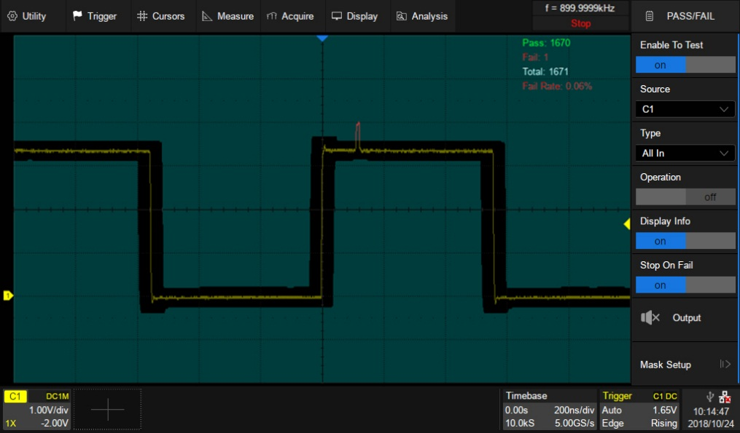
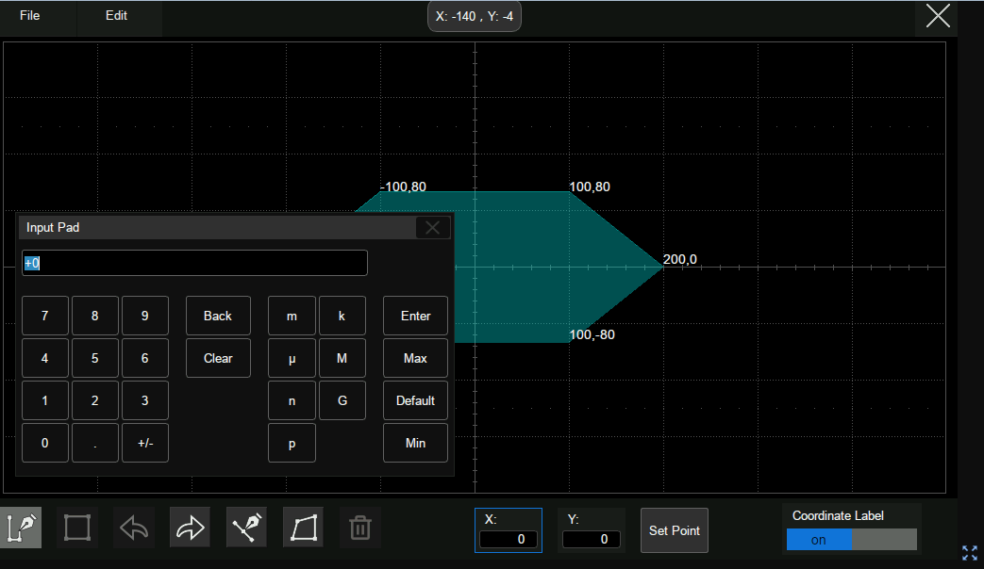
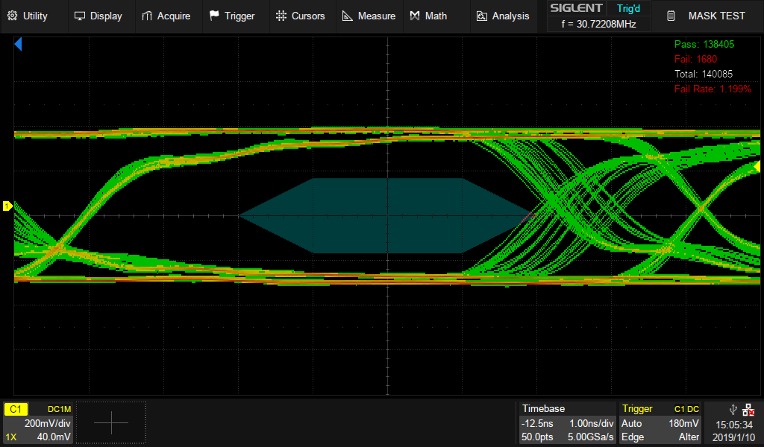
MASK TEST
High speed Pass/Fail test
Customize template, specified standards in manufacturing
Automatic test environment: stop acquiring, beep alert, 3.3V
TTL output as external source (Pass/Fail out)
Implemented by hardware, test rate up to
110,000 times/s
Functional MASK EDITOR with touch screen
Create MASK point-by-point
Input coordinates by touch screen
Draw polygon on screen
Easy to save and load mask files

Slide 29
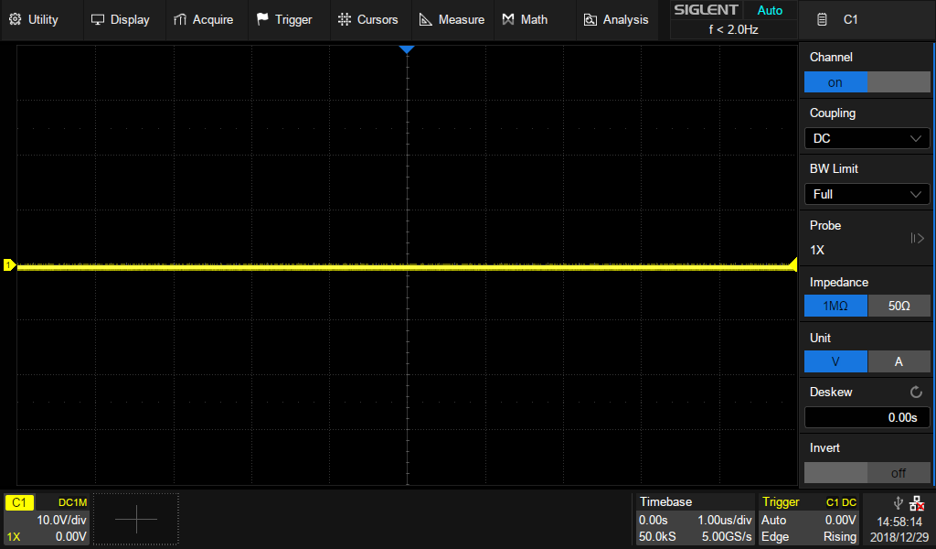





Easy to learn, gesture support
Easy Of Use
10 kinds of one button quick access
Measure
Navigate
10.1’’ Touch Screen
Cursors
Clear
1024 * 600
Display
History
Print
Auto
Search
Default
Multi -Touch
Four ways to control scope:
Touch screen like your smart phone
Front panel buttons and knobs for traditional users
USB Keyboard and Mouse support
Web server for remote control
Focus on your design, but not instruments
Increase work efficiency and productivity

Slide 30


Easy to learn, gesture support
Ease-Of-Use
10 kinds of one button quick access
Deep on-board Help for quick access to information:
Four ways to control scope:
Touch screen like your smart phone
Front panel buttons and knobs for traditional users
USB Keyboard and Mouse support
Web server for remote control
Focus on your design, but not instruments
Increase work efficiency and productivity

Slide 31



Web Server
Insert IP address of SDS5000X into browser
Go to Home page see the SDS5000X info
Remote control scope without software
Save time to export measurement data to PC
Monitor and control SDS5000X from anywhere via the internet
Control scope via mouse in real time
Take screen shot , save data and FW upgrade

Slide 32


16 Digital Channels / MSO (Option)
View digital and analog channels on one timebase
Full trigger and decoding on all analog and digital channels
16 channels; maximum waveform capture rate up to 1.25GSa/s; record length up to 62.5 Mpts
User defined label names, channel groups, and more

Slide 33



25 MHz Function/Arbitrary
Waveform Generator
(Option)
Connect via USB Host
Stimulus output of Sine, Square, Ramp, Pulse, Noise, DC and 45 built-in waveforms to DUT
Edit arbitrary waveforms via Easy Wave PC software
Store waveforms from analog channels then output

Slide 34
Model Selection
SDS5000X Models | SDS5034X SDS5032X | SDS5054X SDS5052X | SDS5104X SDS5102X
Bandwidth | 350 MHz | 500 MHz | 1 GHz
Rise time (typical) @50 Ω | 1.0 ns | 0.7 ns | 0.4 ns
Analog Channels | 2/4 CH + EXT
Sample Rate (Max.) | 5G Sa/s (single-channel),2.5G Sa/s (dual-channel)
Record Length (Max.) | 250 Mpts (single-channel),125 Mpts (dual-channel)
Waveform Capture Rate (Max.) | 110,000 wfm/s (normal mode),480,000 wfm/s (sequence mode)
Trigger Types | Edge, Slope, Pulse, Window, Runt, Interval, Dropout, Pattern, Qualified, Video, Zone
Serial Trigger and Decode | I2C, SPI, UART, CAN, LIN, CAN FD, FlexRay, MIL 1553B, I2S
I/O | USB Host, USB Device, LAN, Pass/Fail, Trigger Out, 10 MHz In,10 MHz Out, VGA Output
Probe (standard) | SP2035A: 350 MHz or SP3050A: 500 MHz 1 probe supplied for each channel
Display | 10.1” TFT-LCD with capacitive touch screen(1024*600)

Slide 35
The reason to Choose SDS5000X
Touch for a solution
Flat frequency response curve
High waveform capture: Quickly identify problems
Color display: Reveal dynamic signal behavior
Large memory: Capture seconds of data and still have
resolution to see nanosecond scale details
Digital trigger: Higher trigger sensitivity, lower trigger jitter
Hardware intelligent trigger: Faster, less jitter
Zone trigger: Draw a box to locate interested signals
Multiple serial protocols trigger and decode
Extremely low back ground noise
Standard Sequence, History, Search, Navigate
Measurement with Histogram; Jitter measurement
Math on Math, 2 Mpts FFT
Standard DVM & Frequency Counter
Eres Mode: Improve resolution up to 11 bits
Mask test and Mask creator with touch screen
Quick access Help
Web control
16 digital channels
25 MHz function generator

Slide 36
Ordering information
Optional Accessories | Description
SDS-5000X-BW05 SDS-5000X-BW10 | 350 MHz to 500 MHz bandwidth upgrade 500 MHz to 1 GHz bandwidth upgrade
SDS-5000X-FG | Waveform generator software
SAG1021 | 25 MHz USB function/arbitrary waveform generator
SDS-5000X-16LA | 16 digital channels (software)
SPL2016 | 16-channel logic probe
STB3 | STB3 demo signal source
SAP1000 | 1 GHz active probe
HPB4010 | High voltage probe
CP4020/CP4050/CP4070/ CP4070A/ CP5030/ CP5030A/CP5150/CP5500 | Current probe
DPB4080/DPB5150/ DPB5150A/ DPB5700/ DPB5700A | High voltage differential probe
SDS-5000X-I2S | I2S trigger & decode
SDS-5000X-CANFD | CAN FD trigger & decode
SDS-5000X-FlexRay | FlexRay trigger & decode
SDS-5000X-1553B | MIL-STD-1553B trigger & decode
 | Standard Accessories
 | USB cable*1
 | Quick start*1
 | Passive probe*2 (2-ch model); *4(4-ch model) SP2035A: 350 MHz or SP3050A: 500 MHz
 | Certificate of calibration*1
 | Power cord*1

Slide 37

Thank You
SIGLENT—The Best Value in Electronic Test & Measurement
Contact Info
Company Address
www.siglent.com/ens
Email：sales@siglent.com
Tel：+86-755-36615186
Building No.4 & No.5，Antongda Industrial Zone，3rd Liuxian Road,Bao’an District, Shenzhen, China

