Slide 1

SDS3000X HD Oscilloscope

Slide 2
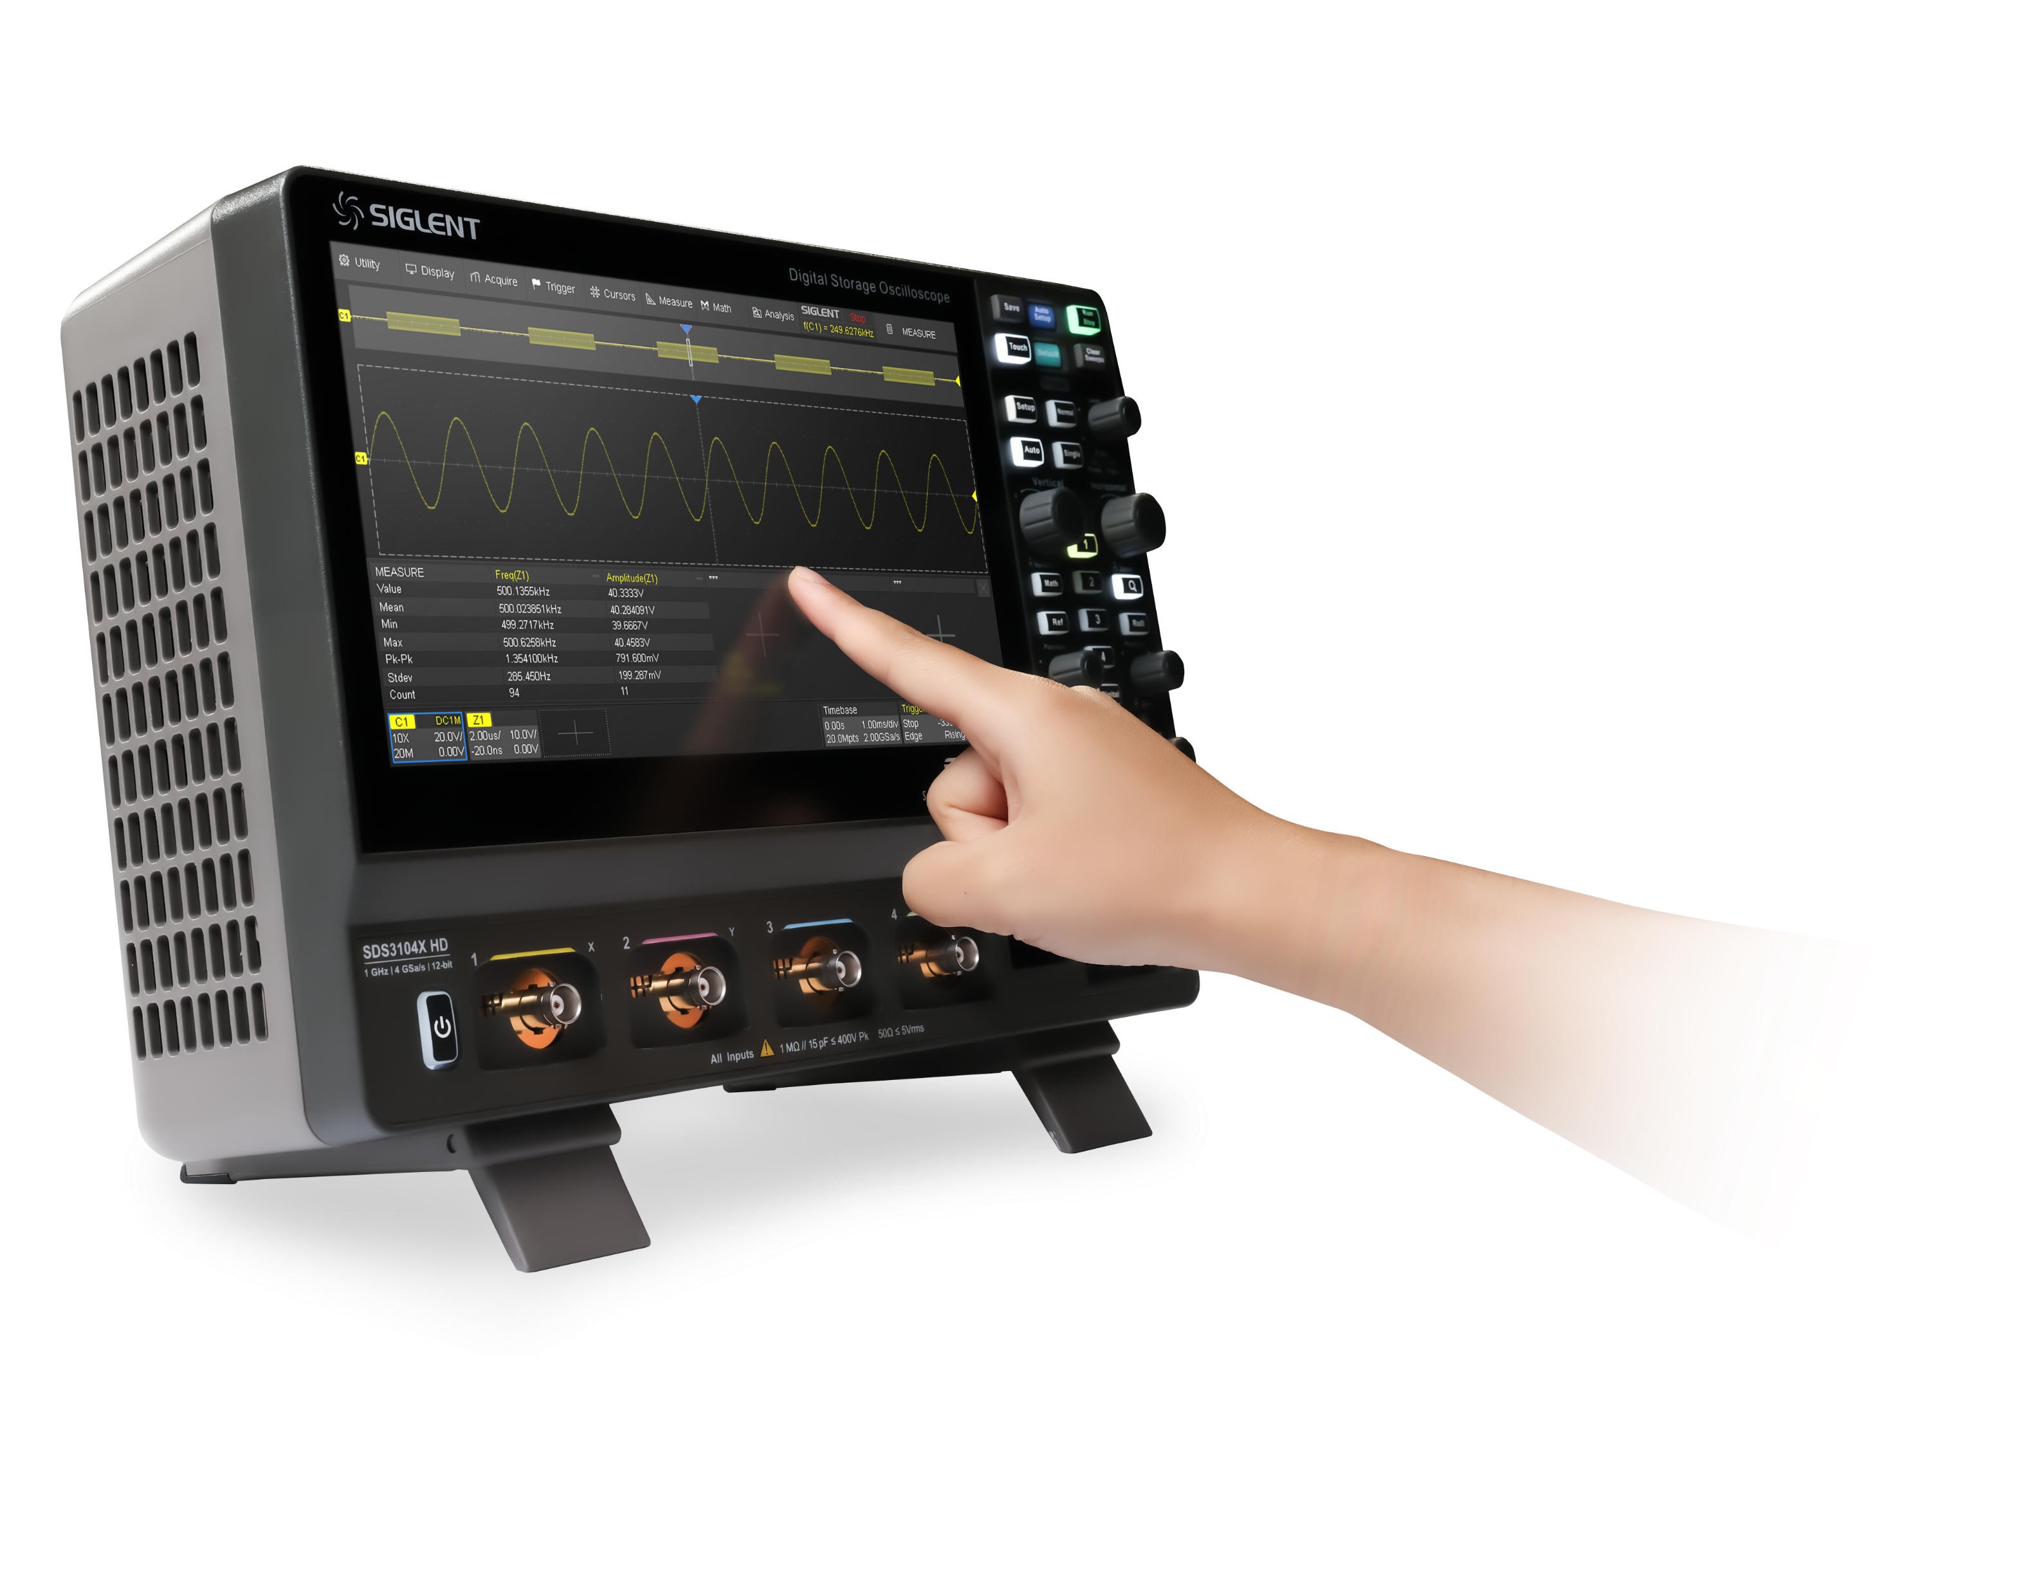
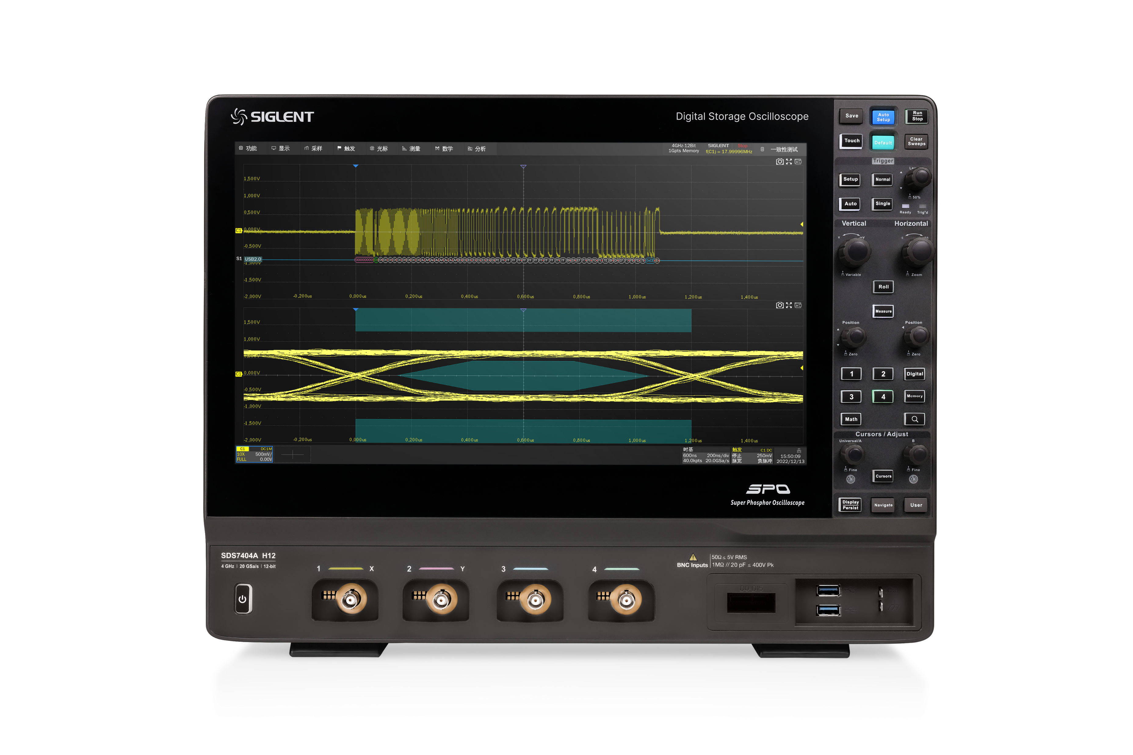
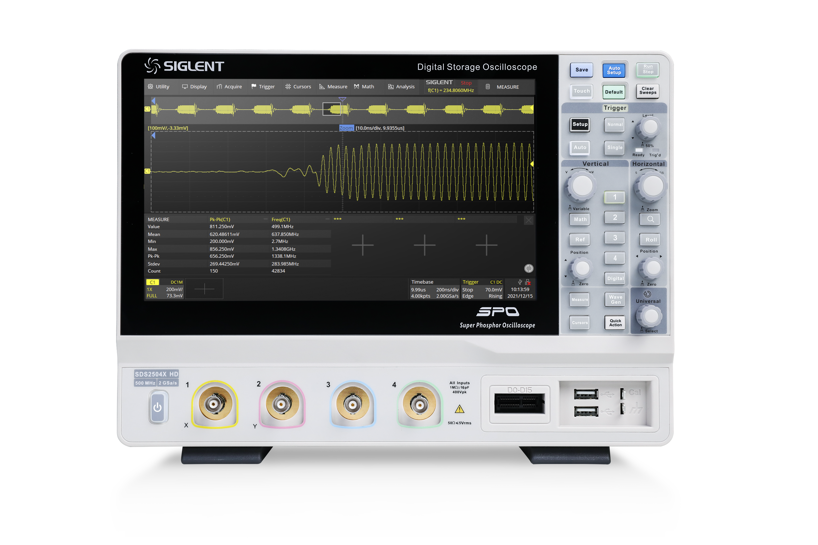
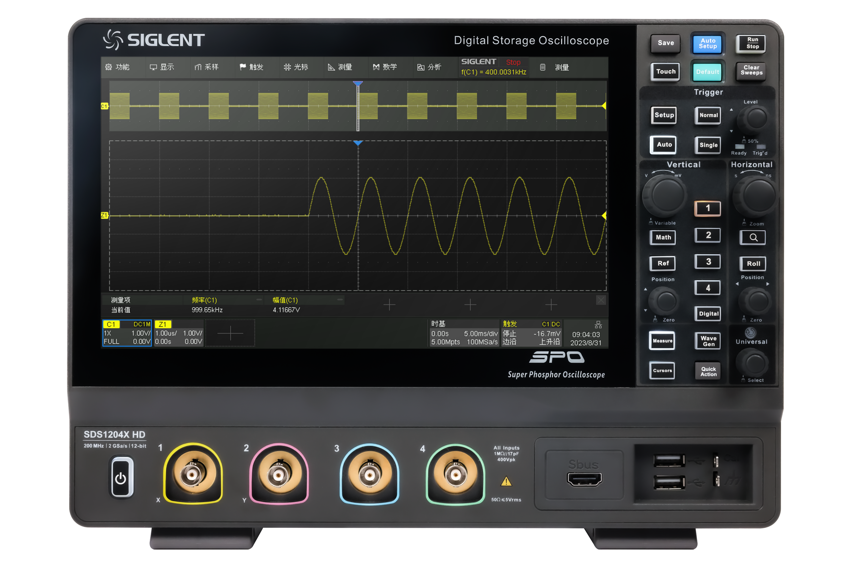
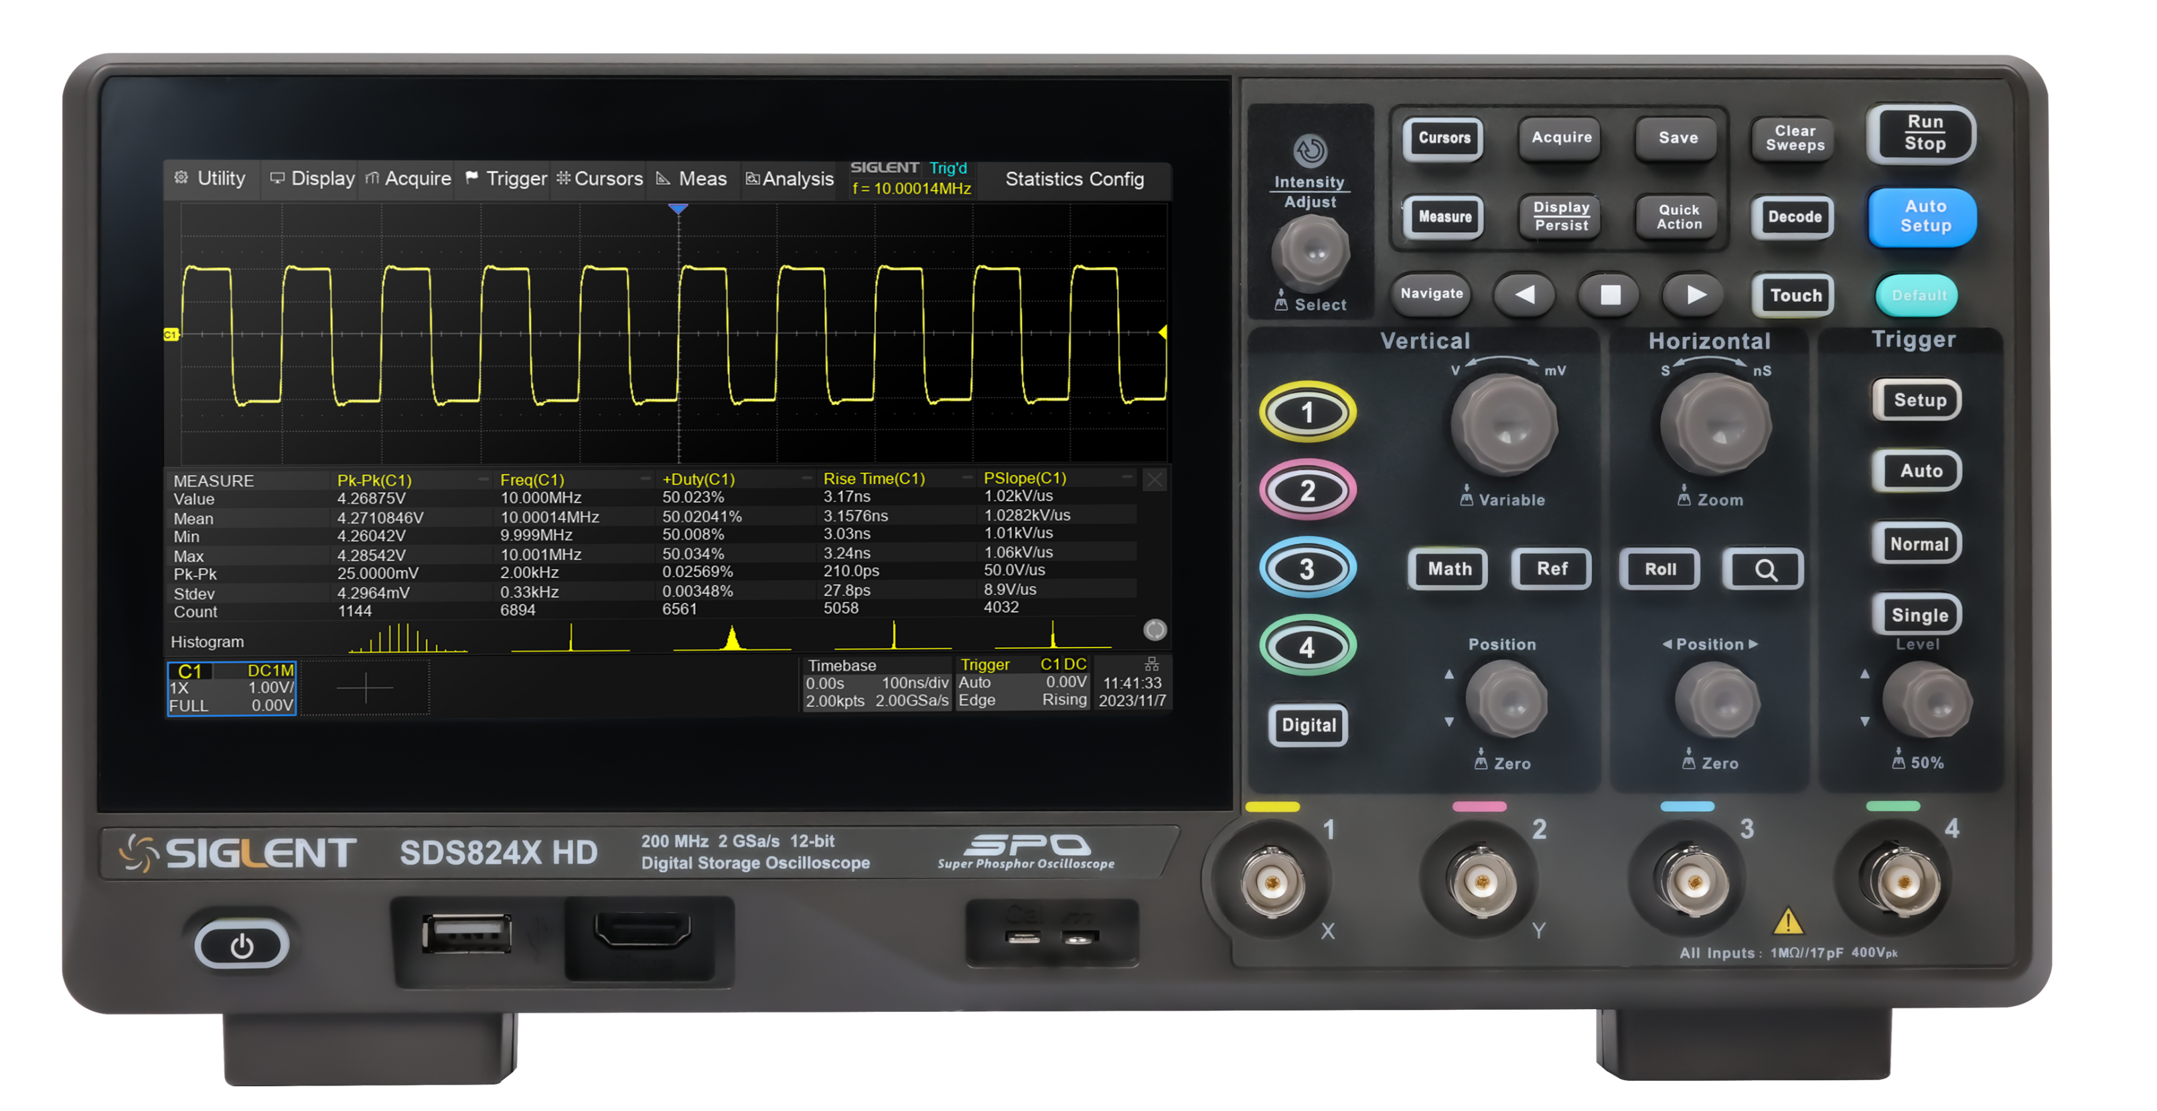
High Resolution Oscilloscope
SDS3000X HD series high resolution oscilloscopes have a maximum bandwidth of 1GHz, a resolution of 12-bit, and up to 16-bit in high-resolution mode, which make waveform details clearly and enable accurately detect tiny waveform changes; with a sampling rate of 4GSa/s and a memory depth of 400Mpts/ch, the waveforms are still free of waveform distortion even after long-time waveform capturing; The Sequence mode is capable of capturing 890,000 waveforms per second, which can produce reliable statistics based on a large number of waveforms in short time, helping users to quickly find rare abnormal signals.
SDS3000X HD not only supports basic functions such as search and navigation, FFT, history mode, multimeter and counter, but also supports important functions such as power analysis, bode plot, mask test and mixed signal analysis, making it a powerful tool for accurate measurement and reliable analysis.
SDS7000A
SDS2000X HD
SDS1000X HD
SDS800X HD

Slide 3



Features & Benefits
Intuitive menu structure: easy to use and understand
Sturdy foot support: two visual angles
Multiple shortcuts: saves operating time
Remote control: free from space constraints
10.1-inch touch screen: adjust waveforms quickly
Friendly Interactivity
ENOB up to 8.6-bit
4GSa/s sampling rate & 12-bit: perfect reproduction of measured waveforms
Noise floor as low as 125 μVrms @ 1GHz: more accurate signal measurements
400Mpts/ch storage depth: provide longer recording capability
400V offset range: meets most board-level power supply and sensor tests
890, 000wfm/s waveform capture rate: rapid detection of occasional abnormal events.
Excellent Specifications
FFT: analyze the characteristics of signals in frequency domain
Search and Navigation: quickly locating events of interest
16 digital channels: analyze mixed signals
Power analysis: analyze power supply quality, switching loss, etc.
28,000 mask tests per second: verify product quality quickly
History mode: record the waveform in real time,
Vertical & horizontal Zoom: observe the waveform details.
Arbitrary waveform generator: carry out margin test.
Powerful Features

Slide 4
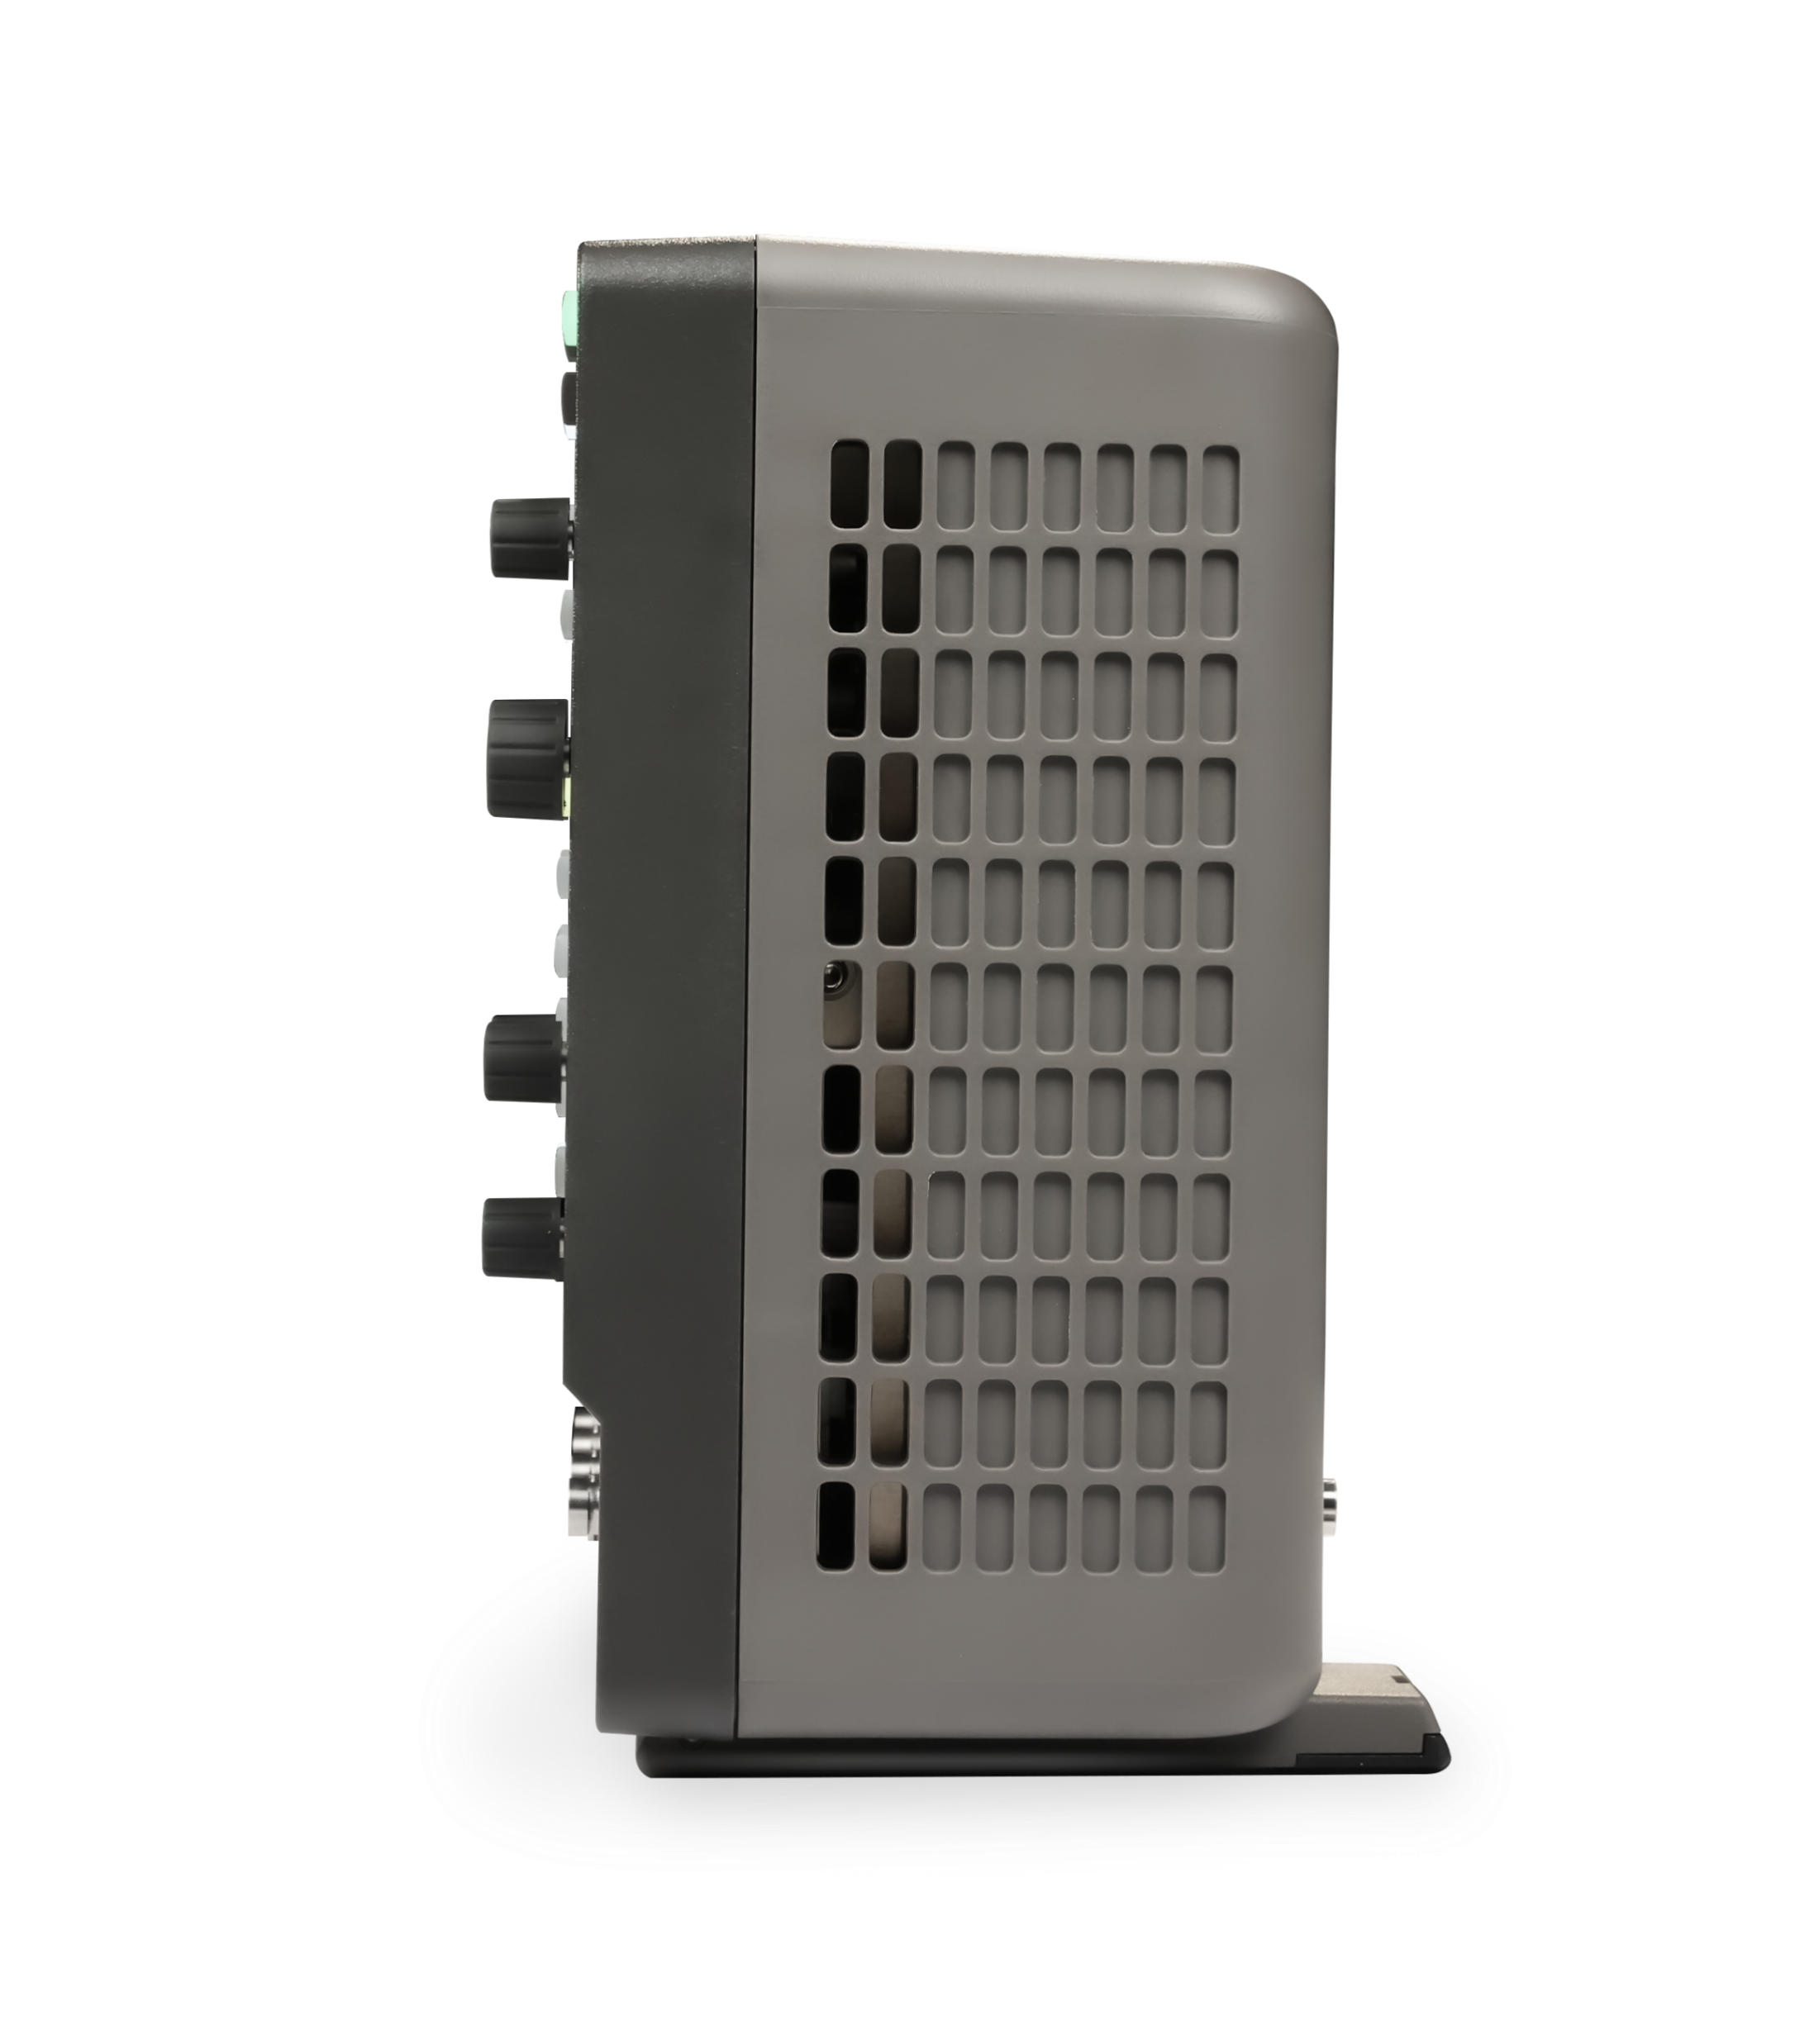
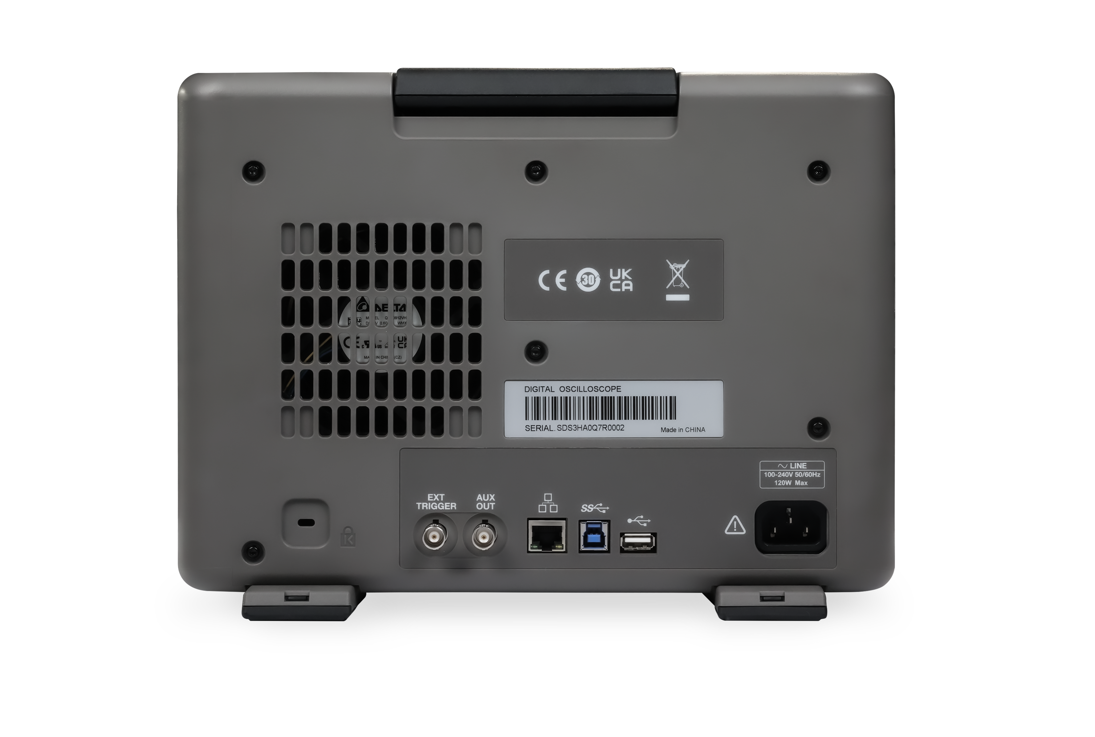
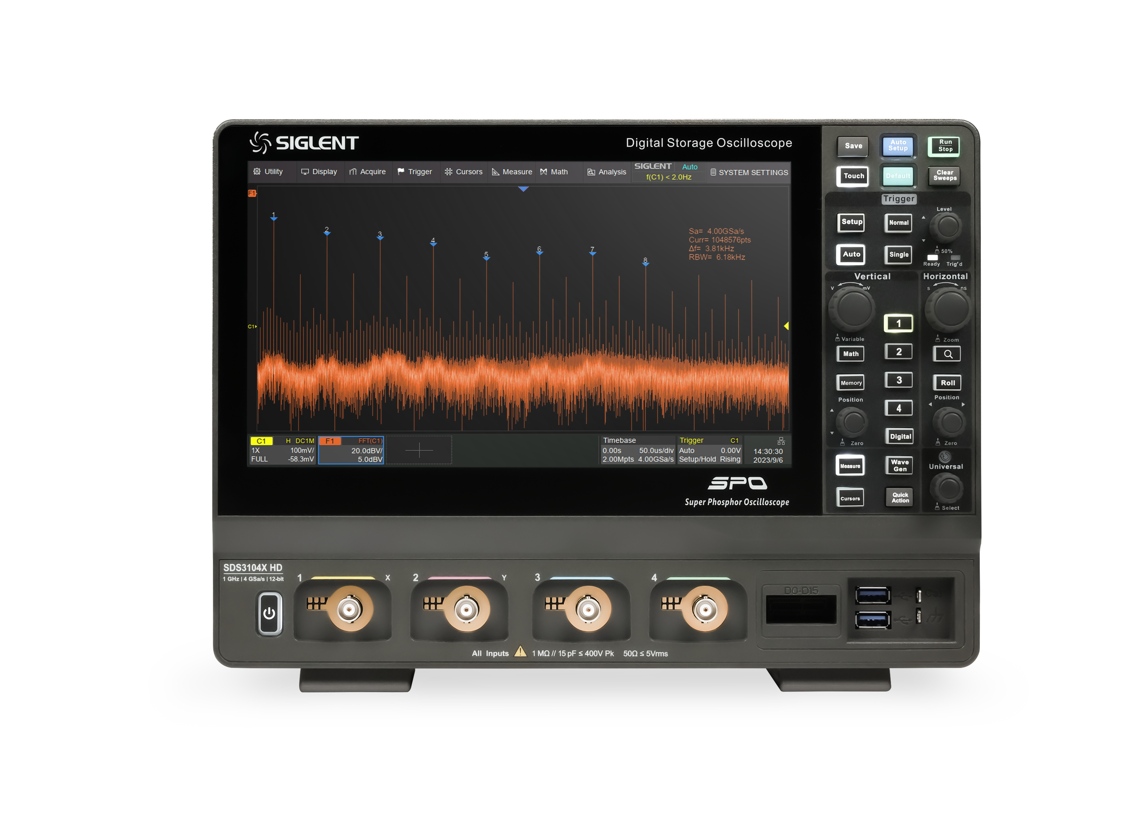
Design
10.1‘’ touch screen
Touch screen control buttons
Custom channel colors
Arbitrary Waveform Generator
16 digital channels

Slide 5
Main Specifications
Bandwidth
350/500MHz, 1GHz
4
Channels
Resolution
12-bit
8.3~8.6-bit
ENOB
Sample rate
4 GSa/s
890,000 wfm/s
Capture rate
采样率
Memory depth
400 Mpts/ch
125 μVrms@1 GHz
Noise floor
存储深度

Slide 6
Other Specifications
ERES
Time base Accuracy
Display
Enhanced bit: 0.5, 1, 1.5, 2, 2.5, 3, 3.5, 4 bits
±2 ppm initial
±0.5 ppm 1st year aging
±3 ppm 20-year aging
10.1 TFT-LCD with capacitive touch screen
Sequence
DC gain accuracy
Weight
80,000 frames
0.5 mV/div ~ 4.95 mV/div: ±1.5 %
5 mV/div ~ 10 V/div: ±0.5 %
Net Weight 4.1 kg
Gross Weight 5.6 kg
CH to CH Isolation
I/O
Dimensions
60 dB up to 200 MHz
50 dB up to 500 MHz
40 dB up to 1 GHz
USB 3.0 Host x2
USB 2.0 Host x1
USB 3.0 Device
10M/100M/1000M LAN
TRIG OUT, PASS/FAIL
W × H × D =
317.2 × 236.0 × 149.0mm

Slide 7
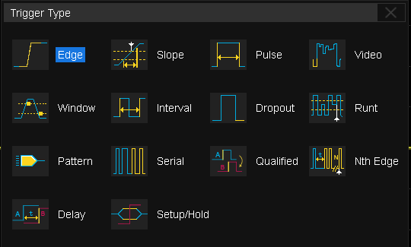
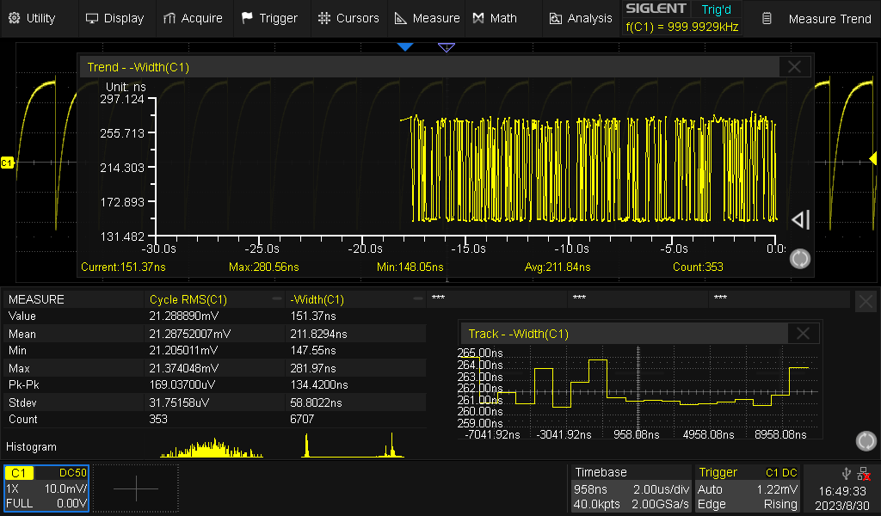
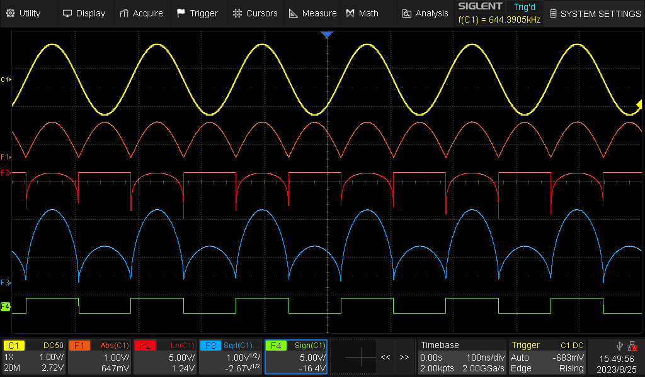
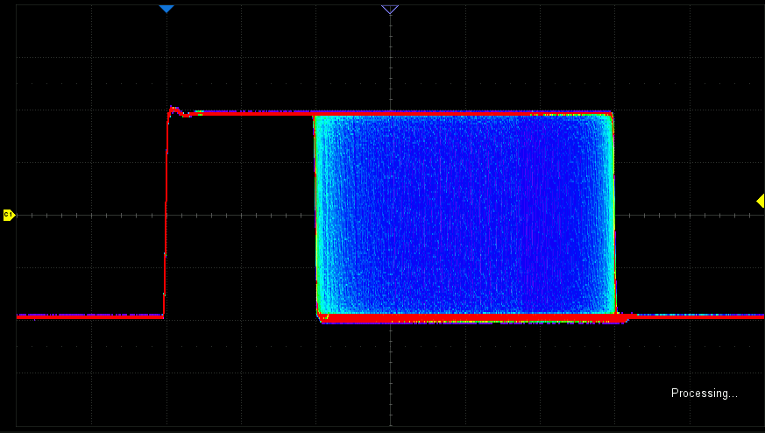
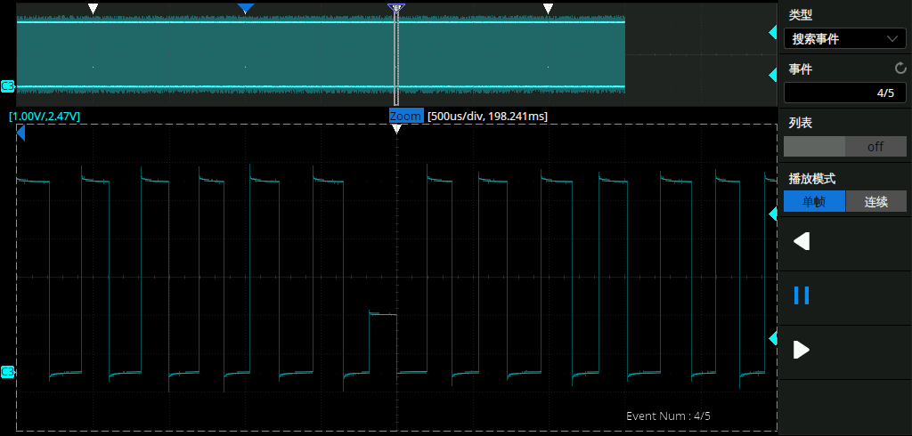
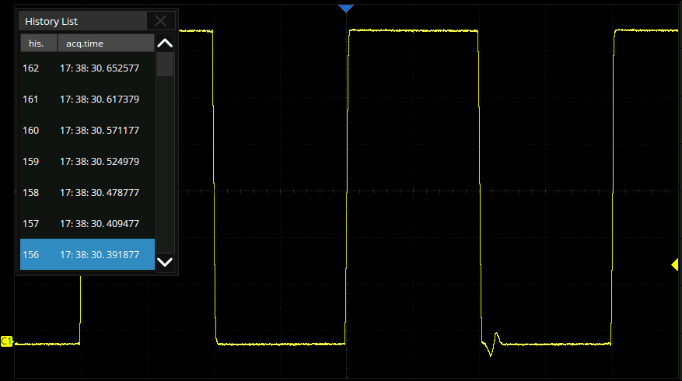
Basic Functions
Measurement
Math
Trigger type
Sequence mode
History mode
Search and Navigate
Notes:
测量：60多种参数；测量对象有实际波形、运算波形、放大波形、参考波形；统计
搜索与导航：搜索模式：边沿、脉宽、斜率、间隔、欠幅；导航类型：搜索事件、事件、历史帧
运算：公式编辑器、滤波器
分段采集：80000段，触发事件之间的间隔时间小至1.12 μs
历史模式：80000段，时间戳标识，单帧/滚动回放
触发：区域触发、串行总线：标配：I²C, SPI, UART, CAN, LIN；选配：CAN FD, FlexRay, I²S, MIL-STD-1553B, SENT

Slide 8
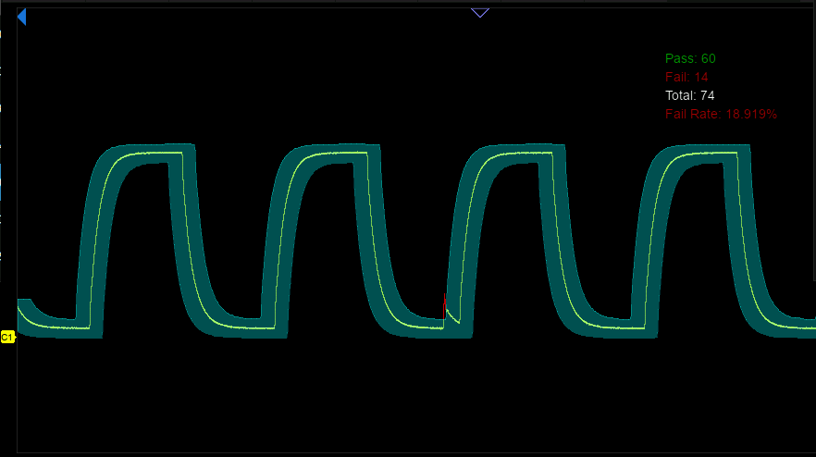
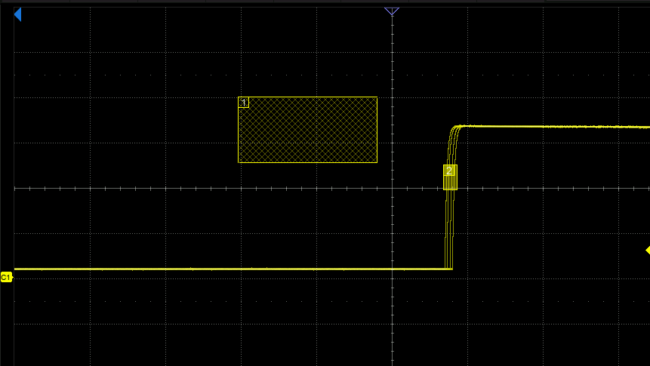
Feature Functions
01
02
Mask Test
Display failure rate, store failure frames
Built-in Mask Editor helps to create custom masks
Perform up to 80,000 tests per second
Quickly verify product quality
Ideal for long-term monitoring of anomalous signals
Zone Trigger
For occasional signals with unclear parameter characterization
Create areas using the mouse or touch screen

Slide 9
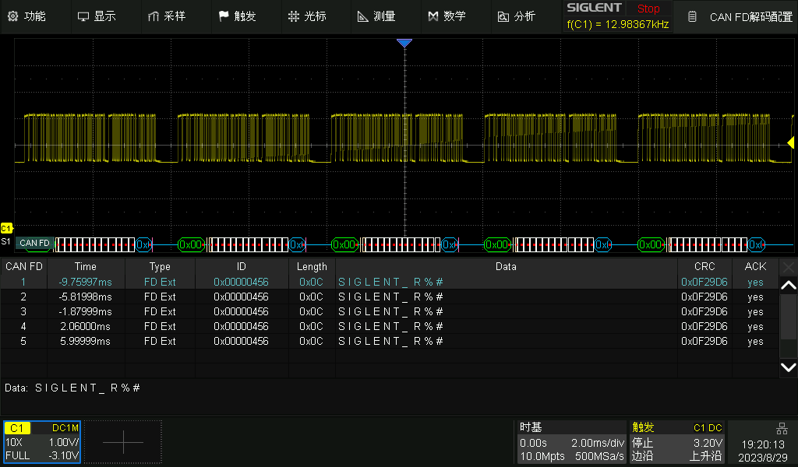
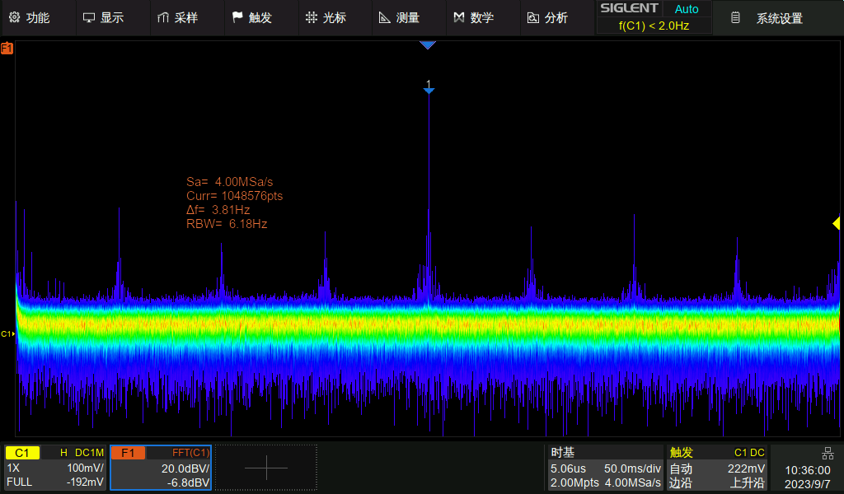
Feature Functions
03
04
Protocol Decode
Stabilize waveforms and complete debugging
Include automotive, embedded, audio and other protocols
Multiple forms of display decoding results
FFT
Peak marking and list display
Easy to analyze disturbing noise in circuits
Perfect combination of time and frequency domain testing
standard：I2C, SPI, UART, CAN, LIN
optional：CAN FD, FlexRay, I2S, MIL-STD-1553B, SENT, Manchester

Slide 10
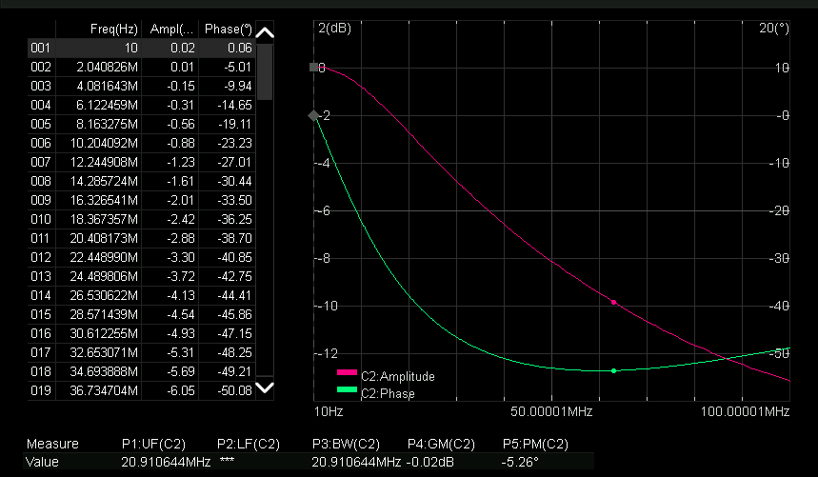
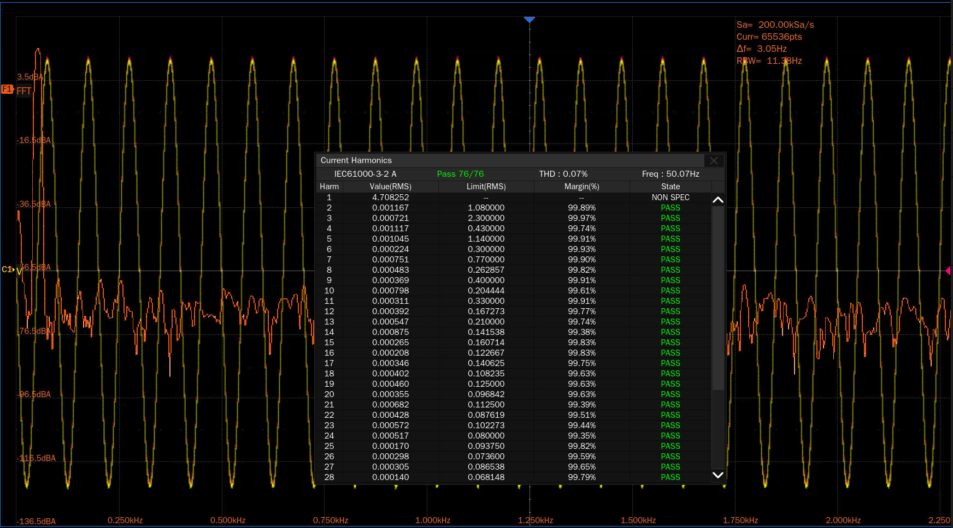
Feature Functions
05
06
Bode Plot
Power loop response analysis
Obtaining frequency, gain, and phase information at each point
Low-frequency response of passive filters, amplifier circuits
Power Analysis
Eliminates manual configuration and formula calculations
12 common power supply parameters
Switching power device parameter measurement
Line power harmonic analysis

Slide 11
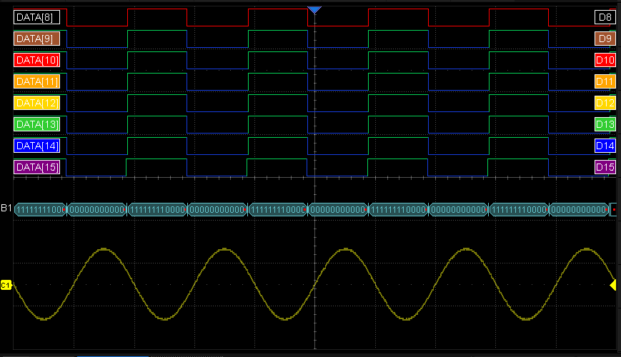
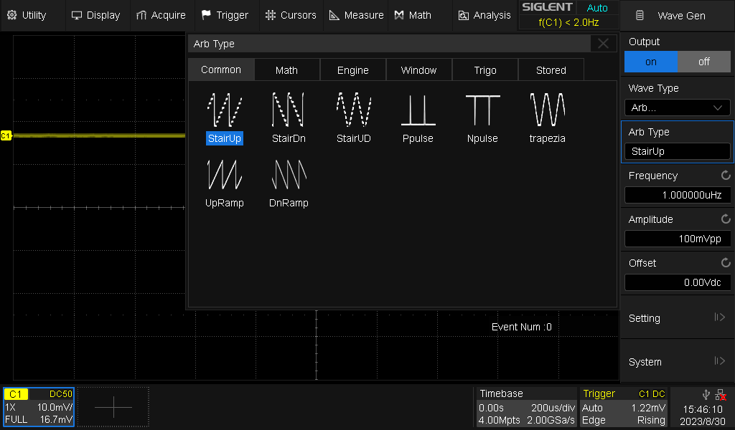
Feature Functions
07
08
Digital Channel
Observe two different signals at the same time
solves mixed analog-digital signal design and analysis problems
Reflects the timing relationship of the signal under test
USB AWG
50 MHz predefined waveform output
Arbitrary waveform editing with EasyWaveX
Power loop analysis (no isolation transformer required)
Space and budget saving

Slide 12
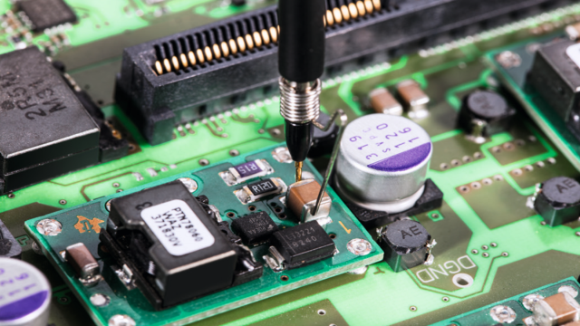
Two Major Applications
Power Measurement and Analysis
Loop analysis
By measuring the actual gain and phase (bode plot) of the circuit in a certain frequency range, the power supply can respond quickly, but it will not produce too much ringing or oscillation.
Switch Loss
The power dissipated during a switching cycle can be calculated, which determines the overall efficiency of the thermal effect of the power supply
SOA
When testing, as soon as the waveform touches an area outside the safe zone, the device is overworked and dangerous.
Oscillation analysis
Some new devices, such as silicon carbide, have high oscillation frequencies and require high bandwidth with high accuracy to measure overshoot during double-pulse testing.

Slide 13
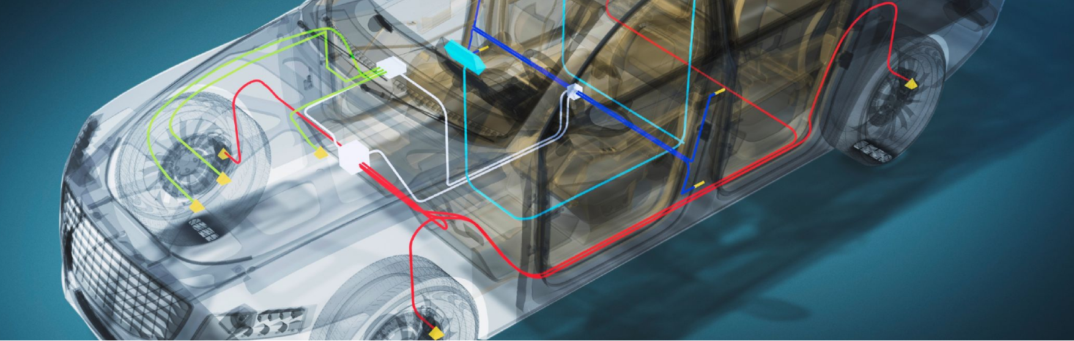
Two Major Applications
Automotive Electronic Test and Circuit Design
ECU design and in-vehicle networks
Provides CAN FD, CAN, LIN, FlexRay, IIC, SENT triggering and decoding functions, can simultaneously observe the transmission protocol and various sensor analog signal waveforms, and is able to convert complex waveform signals into data.
drive system
Ignition pulses are important for proper engine operation. Together with the high voltage probe it is possible to capture the shape of the ignition pulses of the individual spark plugs and accurately measure the time intervals between them.
FFT
By observing the frequency range of the noise distribution, we can know which chip or component in the circuit is causing the noise, and we can target the circuit causing the noise for filtering.

Slide 14
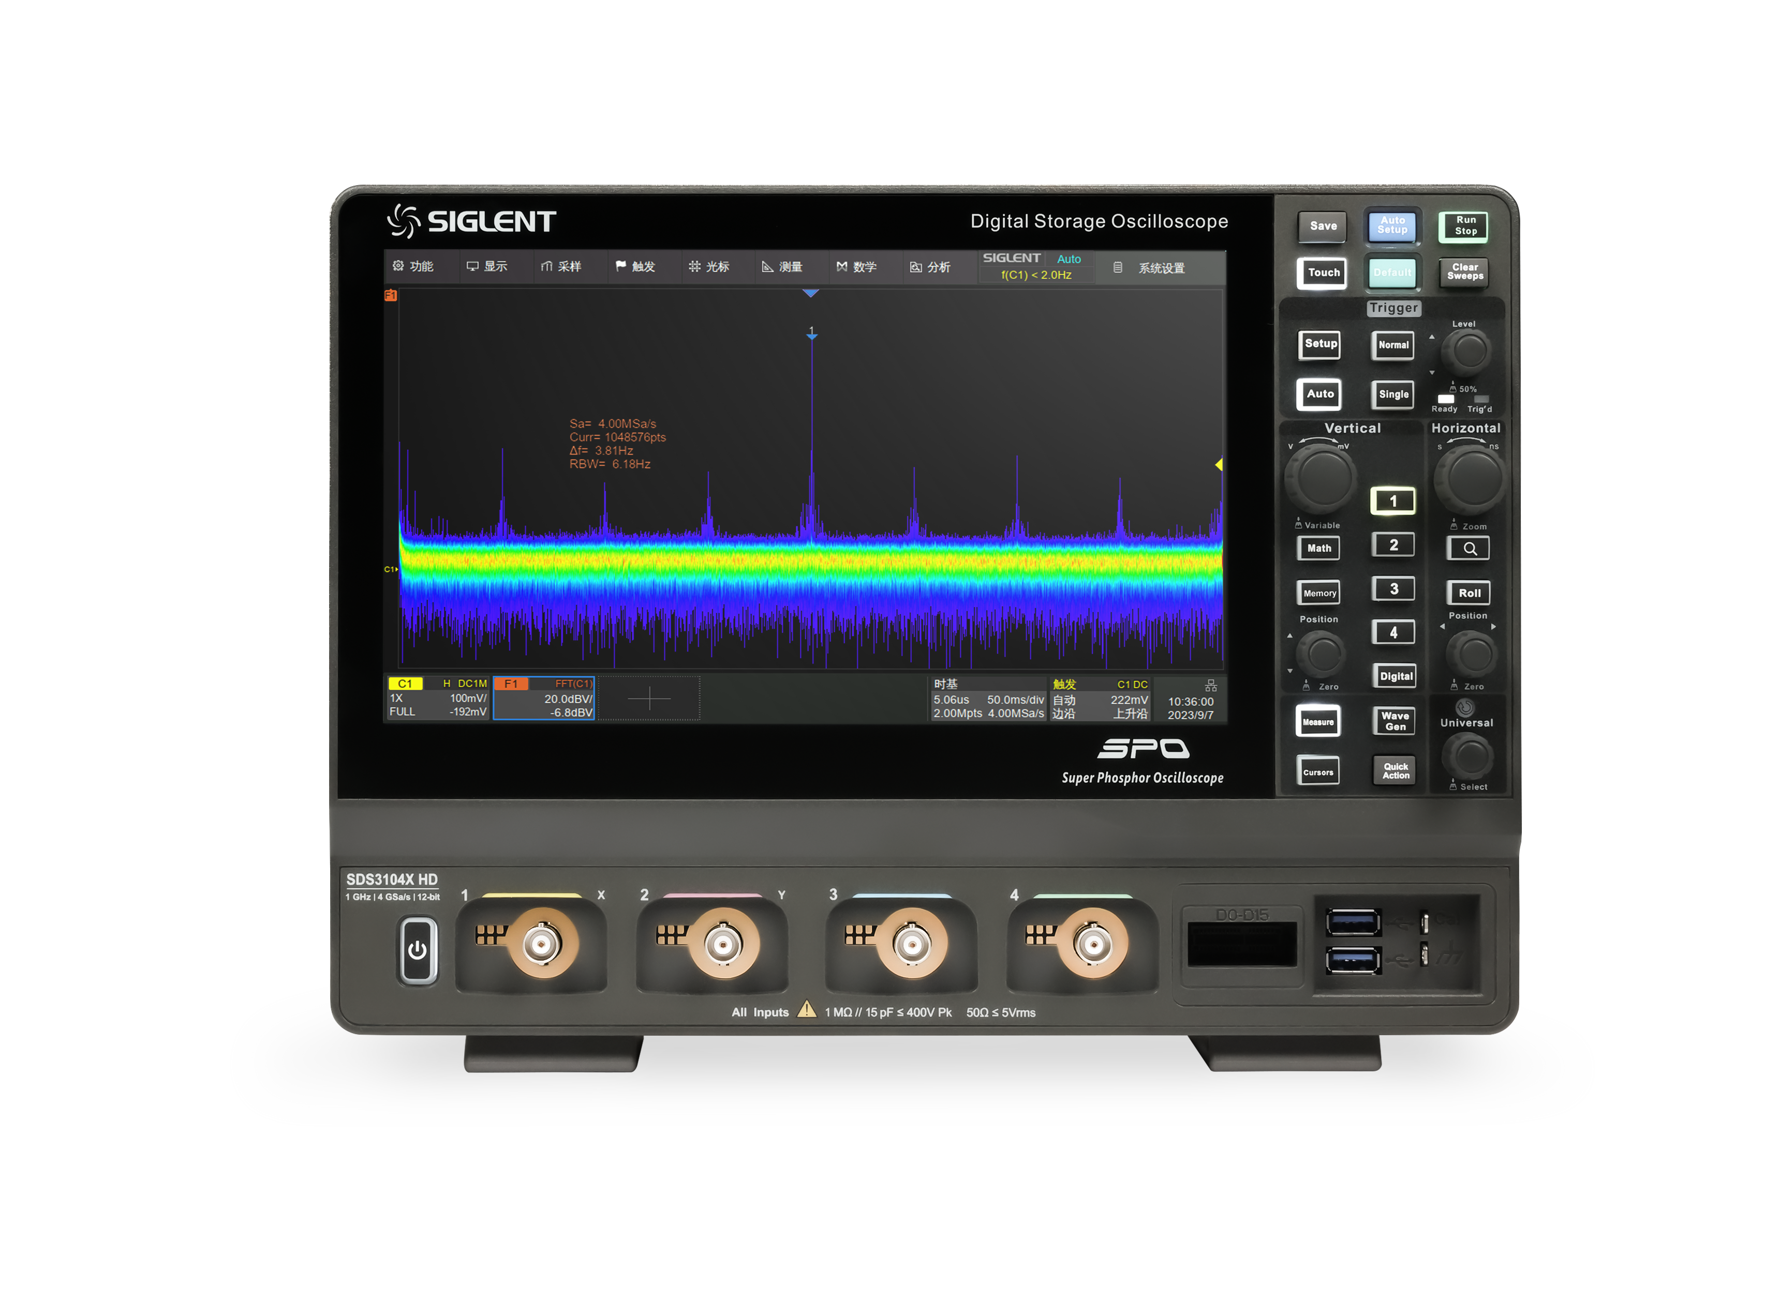
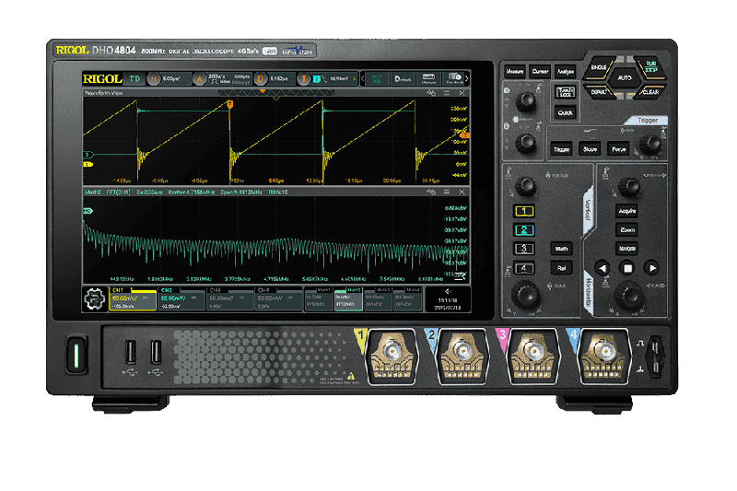
Comparison
models | Siglent SDS3000X HD | RIGOL DHO4000
channels | 4 | 4
Bandwidth | 350 /500 MHz, 1 GHz | 200/400/800 MHz
Vertical resolution | 12-bit 16-bit（ERES） | 12-bit
Sample rate | One/Two channel mode:4 GSa/s Four channel mode: 2 GSa/s | One channel mode:4 GSa/s Two channel mode: 2 GSa/s Four channel mode: 1GSa/s
Memory depth (Max.) | 400 Mpts/ch (interleaving mode: single-channel 200 Mpts/ch (interleaving mode: dual-channel) 100 Mpts/ch (non-interleaving mode) | standard: One channel mode:250 Mpts/ch Two channel mode:125 Mpts/ch Four channel mode: 62.5 Mpts/ch optional: One channel mode:500 Mpts/ch Two channel mode:250 Mpts/ch Four channel mode:125 Mpts/ch
Waveform capture rate | Normal mode：200,000 wfm/s; Sequence mode：890,000 wfm/s | Vector Mode:50,000 wfms/s UltraAcquire Mode:1,500,000 wfms/s
Noise floor （50Ω,1mV/div) | 70 µVms@350MHz 90 µVms@500MHz 125 µVms@1 GHz | not mentioned
ENOB | 8.3-bit@1GHz 8.5-bit@500MHz 8.6-bit@350MHz | >8-bit
Zone Trigger | support | not support
Serial trigger and decode | standard: I2C, SPI, UART, CAN, LIN optional: CAN FD, FlexRay, I2S, MIL-STD-1553B, SENT, Manchester (decode only) | standard： I2C, SPI, RS232/UART, CAN optional: CAN-FD, LIN, FlexRay, I2S, MIL-STD-1553
bode plot | standard | not support
Mask Test | standard | standard
Power Analysis | optional | optional （only power quality output ripple)
Waveform generator | optional (50 MHz） | not support
digital channels | optional（16） | not support

Slide 15
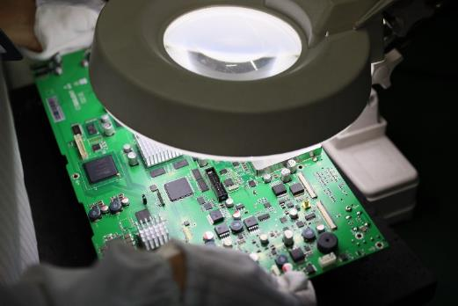
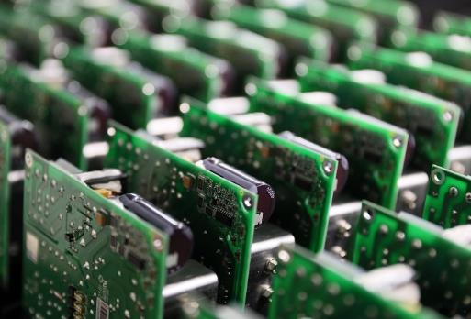
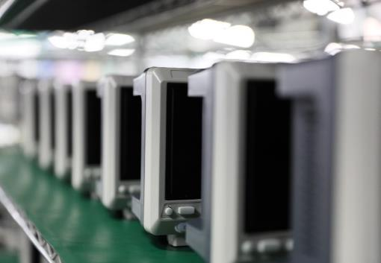
We Promise
Carry out multiple professional tests (reliability test, function test and temperature test) on the products before leaving the factory.
Three-year warranty for the mainframe, one-year warranty for modules, probes and batteries.
Provide on-site/remote technical support

Slide 16
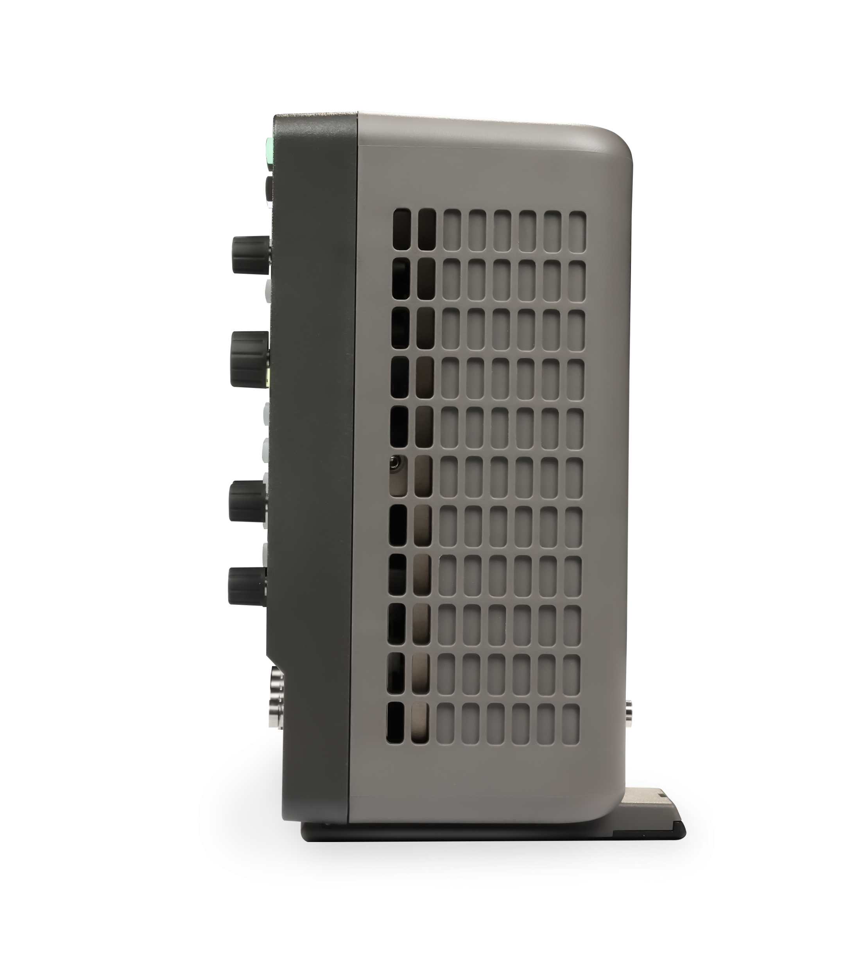
Ordering Information
Model | Description
SDS3104X HD | 1 GHz, 4 GSa/s, 4-CH, 12-bit, 400 Mpts/ch memory depth, 10.1” capacitive touch screen
SDS3054X HD | 500 MHz, 4 GSa/s, 4-CH, 12-bit, 400 Mpts/ch memory depth, 10.1” capacitive touch screen
SDS3034X HD | 350 MHz, 4 GSa/s, 4-CH, 12-bit, 400 Mpts/ch memory depth, 10.1” capacitive touch screen
Standard Accessories | Quantity
USB cable | 1
Quick start | 1
Passive probe (500 MHz) | 1/channel
Certificate of calibration | 1
Wireless mouse | 1

Slide 17
Ordering Information
Optional Accessories | Part No. | Optional Accessories | Part No.
USB isolated waveform generator | SAG1021I | 16 digital channels (software) | SDS3000HD-16LA
16-channel logic probe | SPL2016 | Power Analysis (software) | SDS3000HD-PA
Power Analysis deskew fixture | DF2001A | I2S trigger & decode (software) | SDS3000HD-I2S
STB3 demo signal source | STB3 | MIL-STD-1553B trigger & decode (software) | SDS3000HD-1553B
USB-GPIB adapter | USB-GPIB | FlexRay trigger & decode (software) | SDS3000HD-FlexRay
High-speed active probe | SAP1000, SAP2500 | CAN FD trigger & decode (software) | SDS3000HD-CANFD
High voltage probe | HPB4010 | SENT trigger & decode (software) | SDS3000HD-SENT
High-speed differential probe | SAP2500D | Manchester decode (software) | SDS3000HD-Manch
High voltage differential probe | DPB1300/DPB4080/DPB5150/ DPB5150A/DPB5700/DPB5700A | ARINC429 trigger & decode (software) | SDS3000HD-ARINC
Current probe | CPL5100/CP4020/CP4050/CP4070/CP4070A CP6030/CP6030A/CP6150/CP6500 | 350 MHz to 500 MHz bandwidth upgrade (software) | SDS3000HD-BW3T5
Bag | BAG-S2 | 350 MHz to 1 GHz bandwidth upgrade (software) | SDS3000HD-BW3TA
Waveform generator (software) | SDS3000HD-FG | 500 MHz to 1 GHz bandwidth upgrade (software) | SDS3000HD-BW5TA

Slide 18

Thank You
通用电子测试测量仪器领域的行业领军企业
联系方式
公司地址
www.siglent.com
服务电话：400-878-0807
电话：0755-36887876
深圳市宝安区68区安通达工业园4栋&5栋

