Slide 1


Slide 2
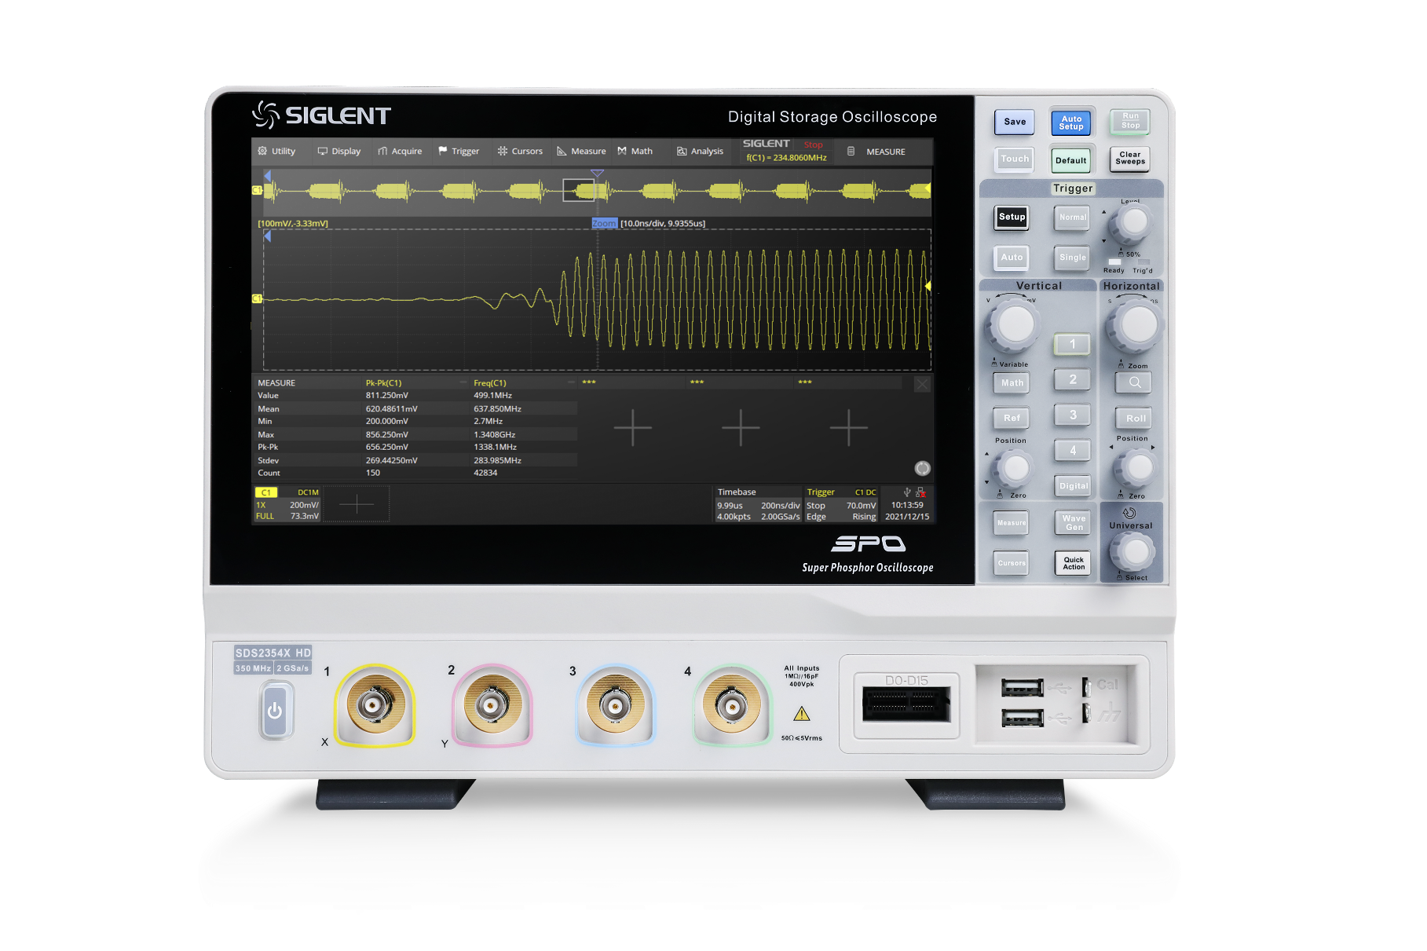
SDS2000X HD 12-bit High Resolution Oscilloscope
SDS2000X HD
SDS2104X HD - 100 MHz
SDS2204X HD - 200 MHz
SDS2354X HD - 350 MHz
(Upgradable to 500 MHz max.)

Slide 3
Vertical Resolution
Differences Between
8-bit and 12-bit
Content
Brief Introduction
Comparison
Notes:
目录字体放大

Slide 4
PART ONE
01
Vertical Resolution
The Best Value In Electronic Test & Measurement

Slide 5


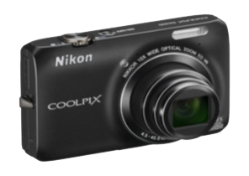


What’s resolution?
Resolution refers to the ability of a device to build details
Many mass-consumer products have resolution metrics
Resolution has gradually improved as the next generation continues to roll out
iPhone Original display becomes retina display
Digital Camera
3 Megapixels become 15 Megapixels
Television
Standard definition TV becomes HDTV
4X
5X
6X
Notes:
目录字体放大

Slide 6
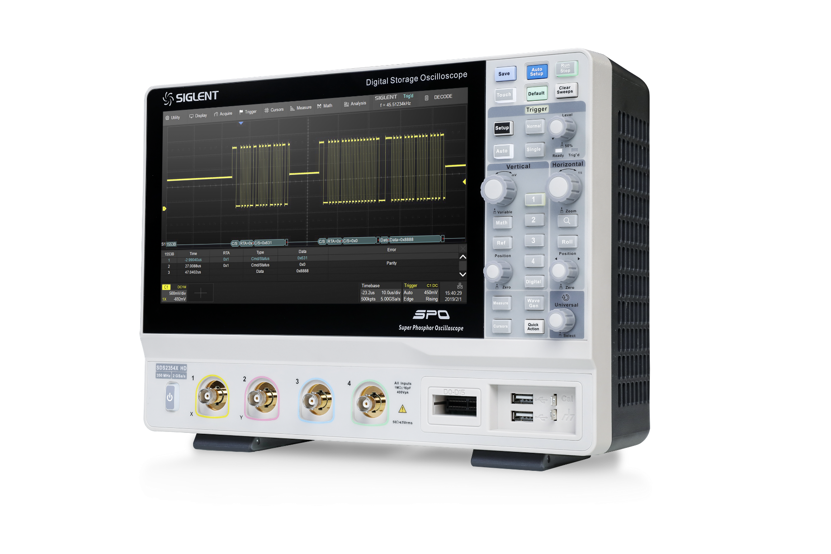
Oscilloscope resolution?
The oscilloscope's ADC bits characterize the oscilloscope's signal resolution
High resolution means the oscilloscope can display signal details in finer detail and make more precise measurements
The Siglent SDS2000X HD high-resolution oscilloscope is a next-generation oscilloscope using a 12bit ADC, which is 16 times the signal resolution capability of a traditional 8bit oscilloscope
16X
Notes:
目录字体放大

Slide 7
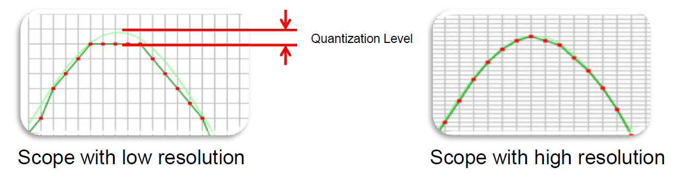
12-bit ADCs provides 16 times the resolution of 8-bit ADCs
ADC Resolution | Number of Steps | Dynamic Range
8 | 256 | 48 dB
12 | 4096 | 72 dB
ADC Dynamic Range = 20 log₁₀ (2^{N}) dB (ideal)
Available Quantization Levels = 2 ^{N bits of Resolution}
DC Gain accuracy is +/- 0.5% (12-Bit) vs.
+/- 1.5 – 2.0% (8-Bit)
Notes:
目录字体放大

Slide 8
Highest Resolution Provides Small Voltage Step Size
12-bit resolution allows detection of smaller signal variations
Full Scale | Smallest Voltage Step
 | 8-bit | 12-bit
80 V | 312.5 mV | 19.5 mV
40 V | 156.2 mV | 9.76 mV
20 V | 78.1 mV | 4.88 mV
8 V | 31.3 mV | 1.95 mV
4 V | 15.6 mV | 976 μV
1.6 V | 6.3 mV | 390 μV
800 mV | 3.1 mV | 195 μV
400 mV | 1.56 mV | 97.6 μV
160 mV | 625 μV | 39 μV
80 mV | 313 μV | 19.5 μV
40 mV | 156 μV | 9.76 μV
16 mV | 62.5 μV | 3.9 μV
8 mV | 31.2 μV | 1.95 μV
When measuring an 8 V signal, the smallest detectable voltage variation is 1.95 mV, compared with 31.3 mV on an 8-bit ADC.
Quantization levels:
16 times more for 12-bit scopes

Slide 9
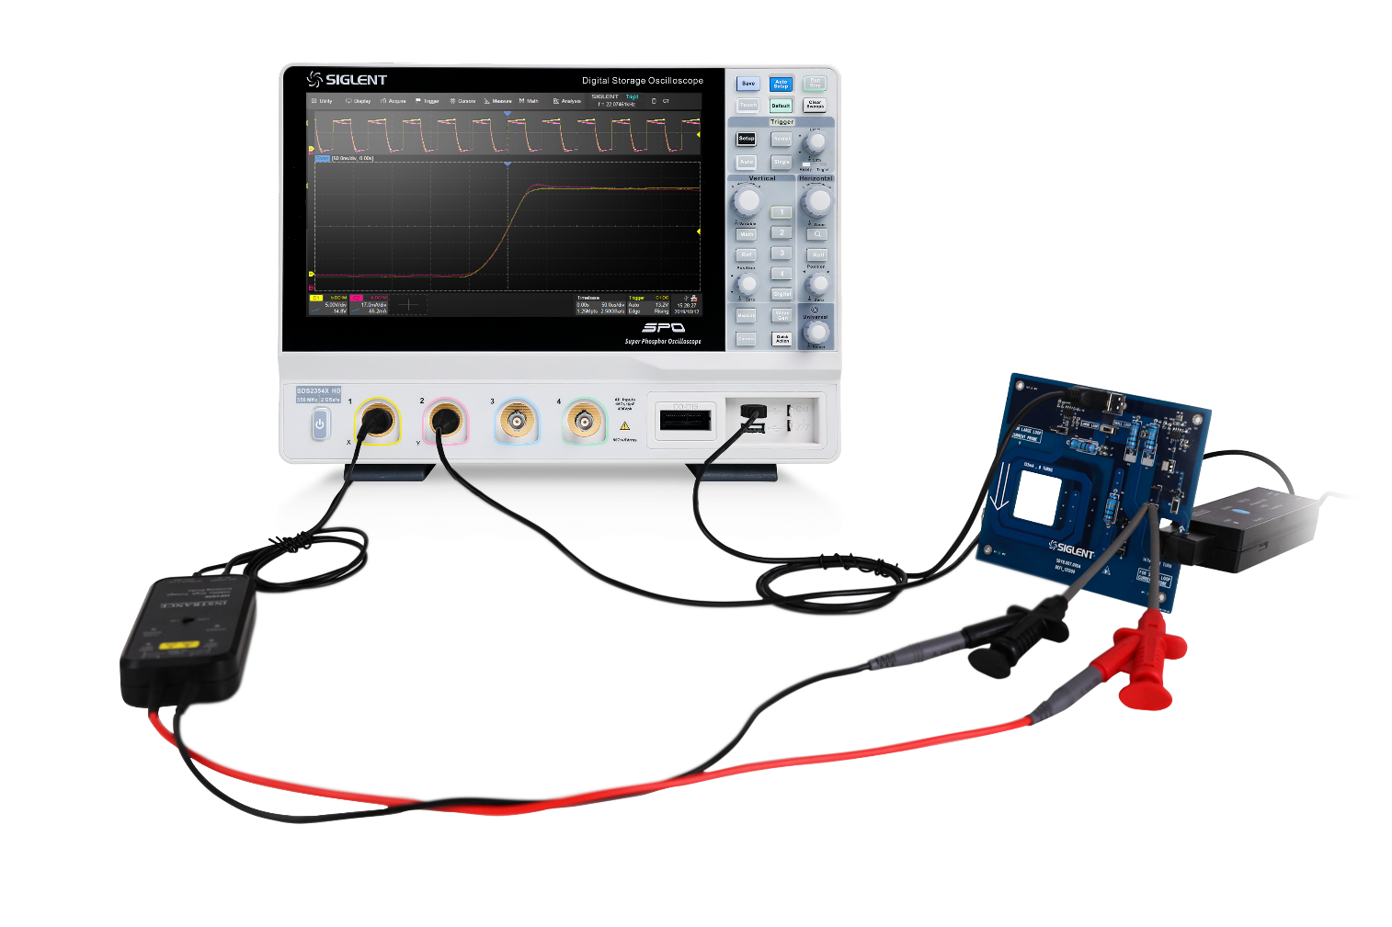
12-bit high resolution Oscilloscope
Guaranteed high accuracy:
High sampling rate 12-bit ADCs
lower noise floor
The resolution accuracy is more than 16 times higher than that of the 8-bit oscilloscope in the current oscilloscope market
More "cleaner", "clearer" waveform display
Viewing more signal details
More accurate waveform measurements
Notes:
目录字体放大

Slide 10
PART TWO
02
Differences Between 8-bit and 12-bit
The Best Value In Electronic Test & Measurement

Slide 11
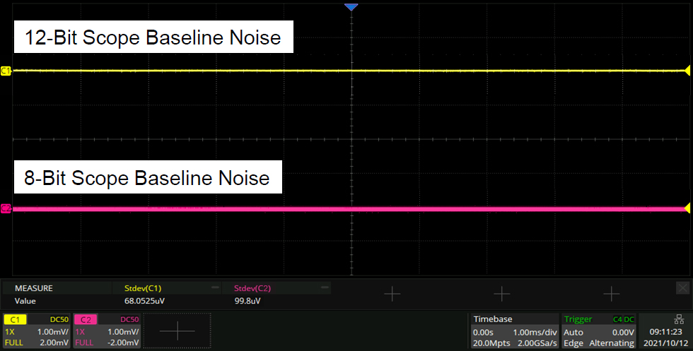
Lower Baseline Noise
Notes:
目录字体放大

Slide 12
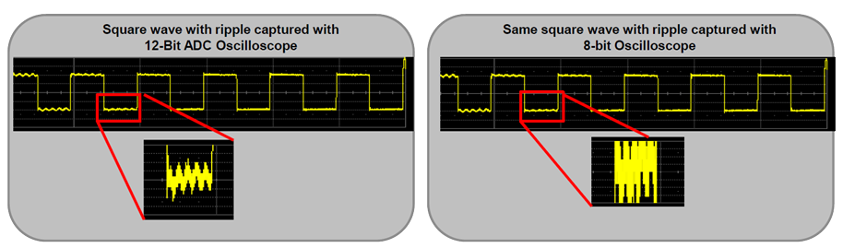
ADC Resolution – Comparison 12-bit vs. 8-bit
Waveform details become more visible, quantization noise is reduced, and measurement accuracy improves with additional vertical bits
High resolution allows ripple signal to be seen above the noise
Ripple hidden in noise of the signal
Notes:
目录字体放大

Slide 13
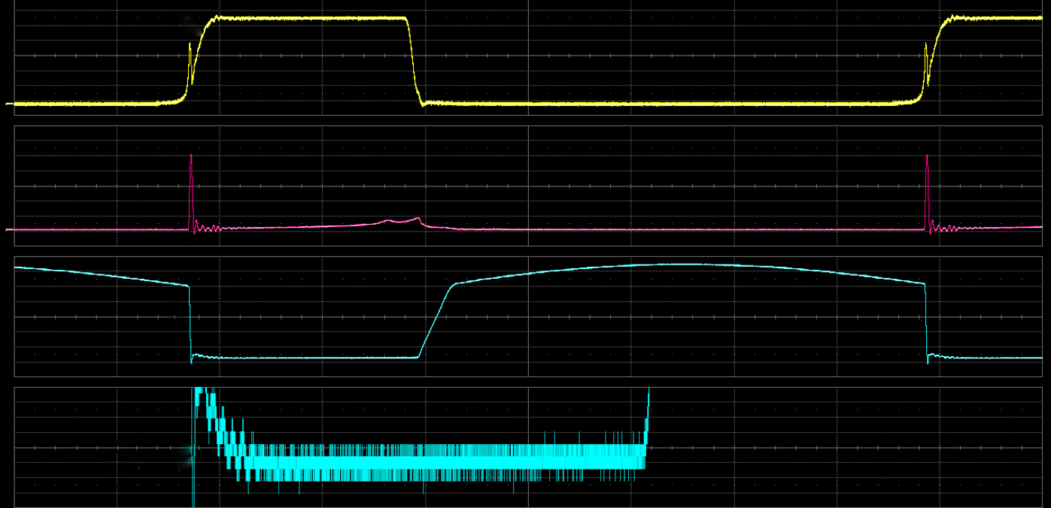
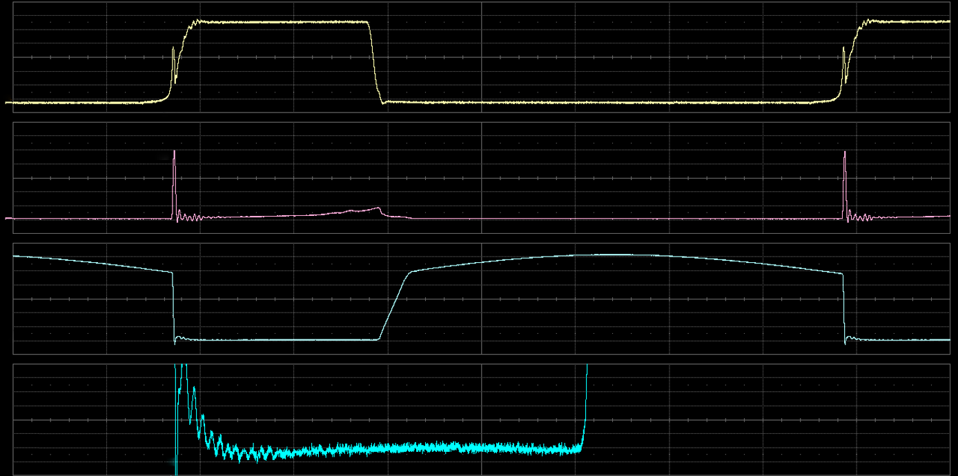
Viewing more signal details
The figure below shows the MOSFET signals in a switching power supply test application
Users needs to see VDS saturation voltage drop
8-Bit
8-bit oscilloscope shows blurred saturation voltage trace, details are buried in quantization noise
12-Bit
The 12-bit oscilloscope clearly shows details of saturation voltage
Notes:
目录字体放大

Slide 14
PART THREE
03
Brief Introduction
The Best Value In Electronic Test & Measurement

Slide 15
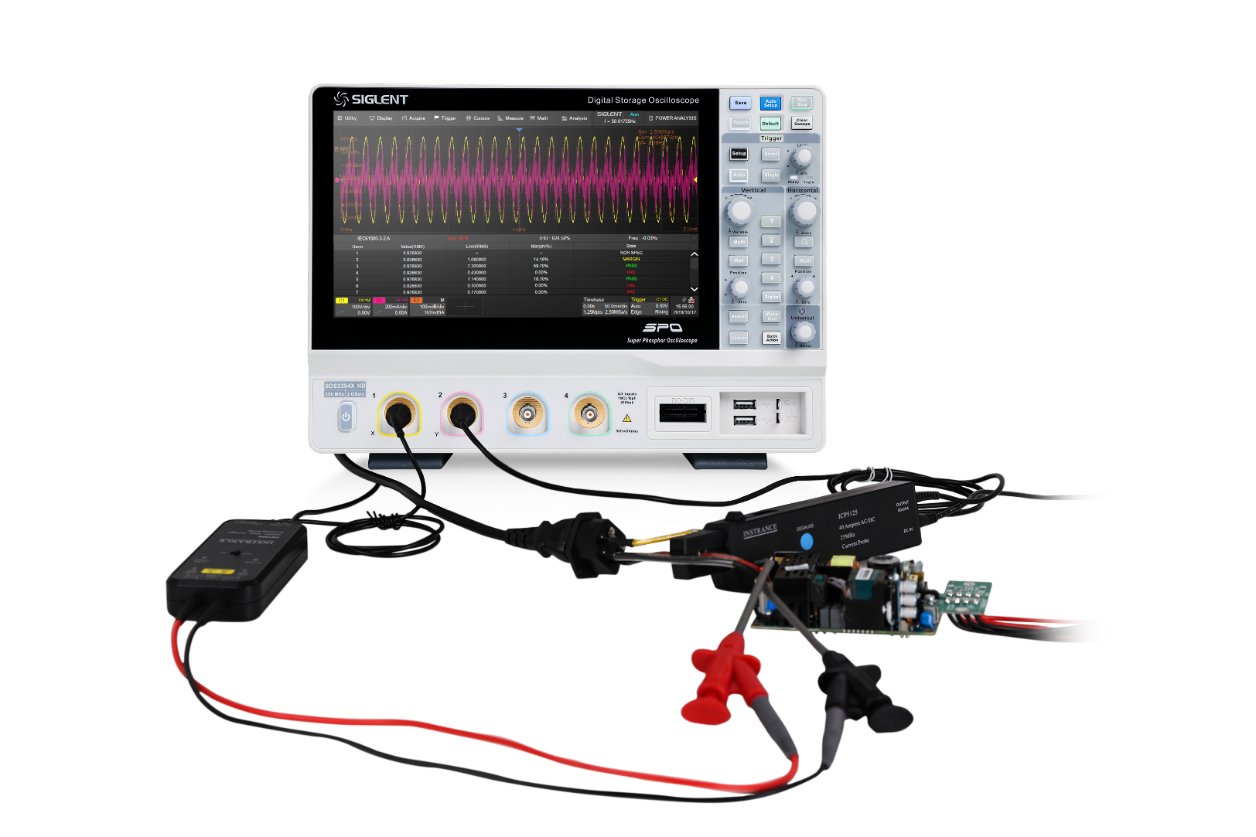
SDS2000X HD High Resolution Oscilloscope
12-bit ADC resolution, enhanced resolution to 15 bit
100 MHz，200 MHz，350 MHz (upgradable to 500 MHz) models
  Front ends with 70 μVrms noise floor @ 500 MHz bandwidth and 0.5% DC gain accuracy
Deep Record Length 0f 200 Mpts
Large 10.1” TFT-LCD display
Capacitive touch screen supports multi-touch gestures
Automatic measurements on 50+ parameters
Search & Navigate
Segmented acquisition (Sequence) mode
History-Waveform playback
MSO function
Bode Plot
Built-in web server supports remote control
FFT-2 Mpts
Power analysis
Serial bus triggering and decoder

Slide 16
SDS2000X HD Main Specs
Model | Bandwidth | Channel | Sampling Rate | Memory Depth | Screen
SDS2104X HD | 100 MHz | 4 | 2 GSa/s | 200 Mpts | 10.1 inch Touch Screen
SDS2204X HD | 200 MHz | 4 | 2 GSa/s | 200 Mpts
SDS2354X HD | 350 MHz | 4 | 2 GSa/s | 200 Mpts
SDS2354X HD can be upgraded to 500 MHz by license

Slide 17
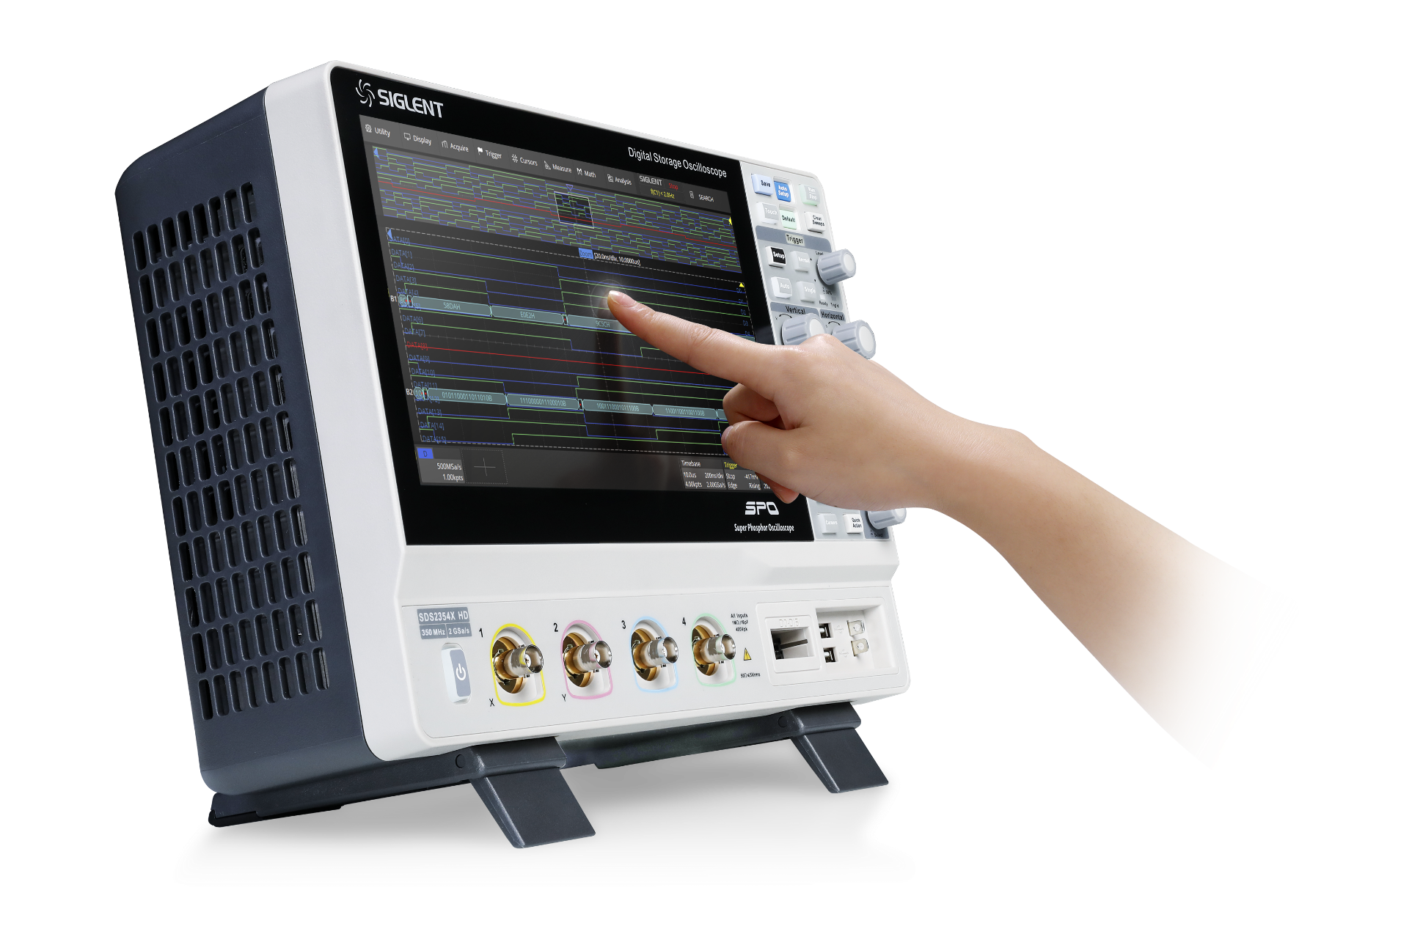
10.1" large screen display with multi-touch
The touch screen greatly facilitates the following operations:
Channel settings
Trigger settings
Math
Parameter measurement
Advanced multi-touch display
Stretch zoom operation
Finger drag

Slide 18
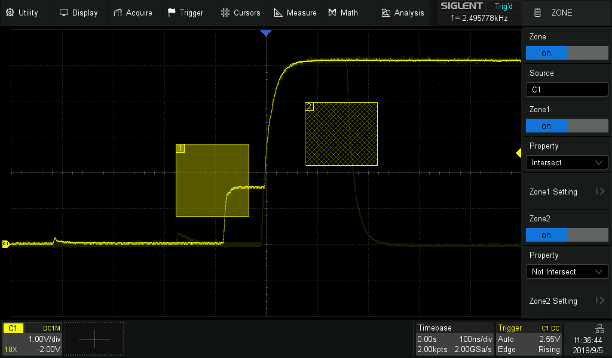
Zone Trigger
Quickly define trigger zones and isolate faults using the touch screen
Traditional trigger types can take time to configure for complex trigger conditions
With Zone Triggering, simply draw a zone and select Intersect or Not Intersect

Slide 19
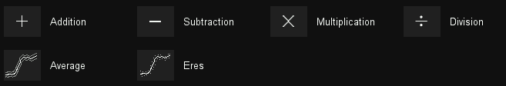


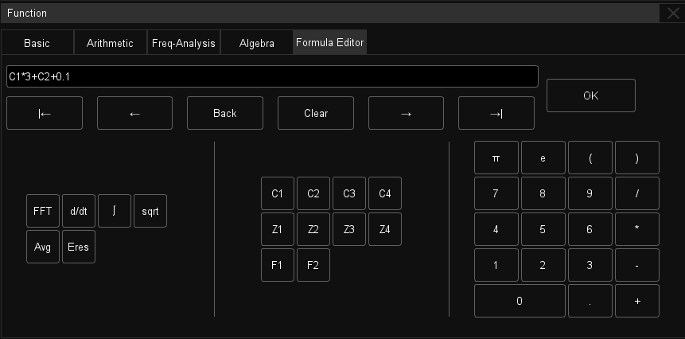
Advanced Math Functions
Calculate power, energy, and more using the powerful equation editor
No differential probe?
No problem. Simply use the subtract
operator so simulate a differential circuit
Multiple kinds of operators, including derivative and integral
Formula editor for advanced modifications of signals

Slide 20
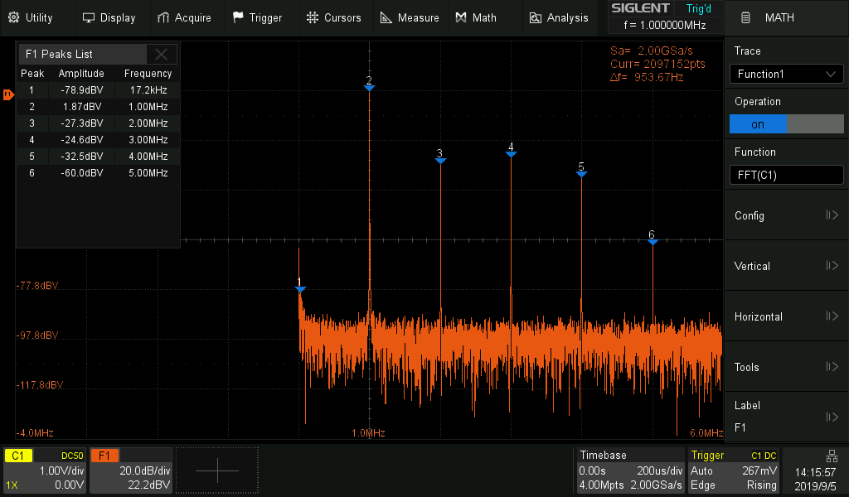
Hardware Accelerated FFT
High frequency resolution with fast refresh rate
Up to 2 M FFT points provides high frequency resolution with fast refresh rate.
A variety of window functions adapt to different spectrum measurement needs.
Three modes (Normal, Average and Max hold) can satisfy different requirements for observing the power spectrum.
Auto peak detection and markers are supported.

Slide 21
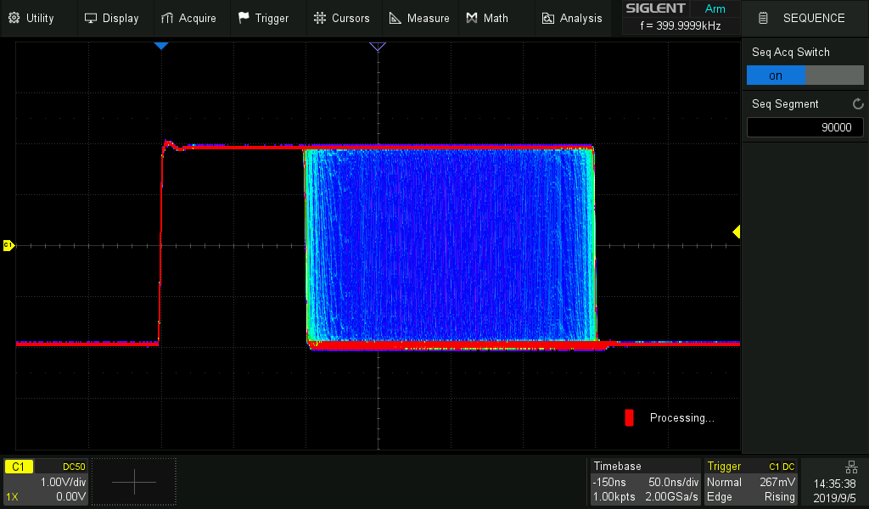
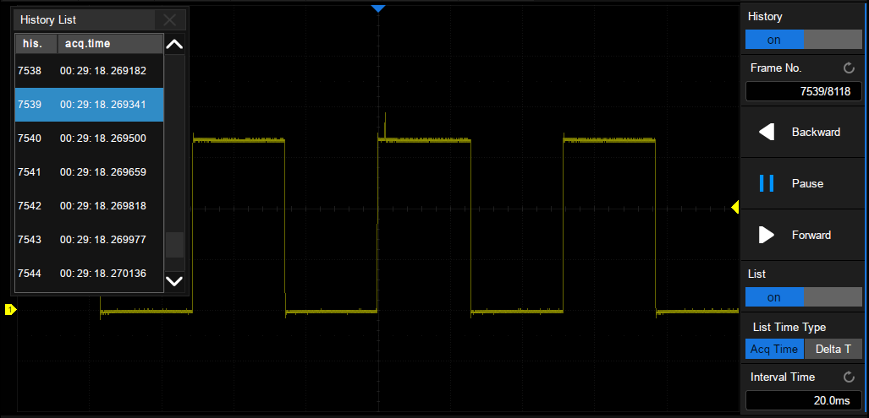
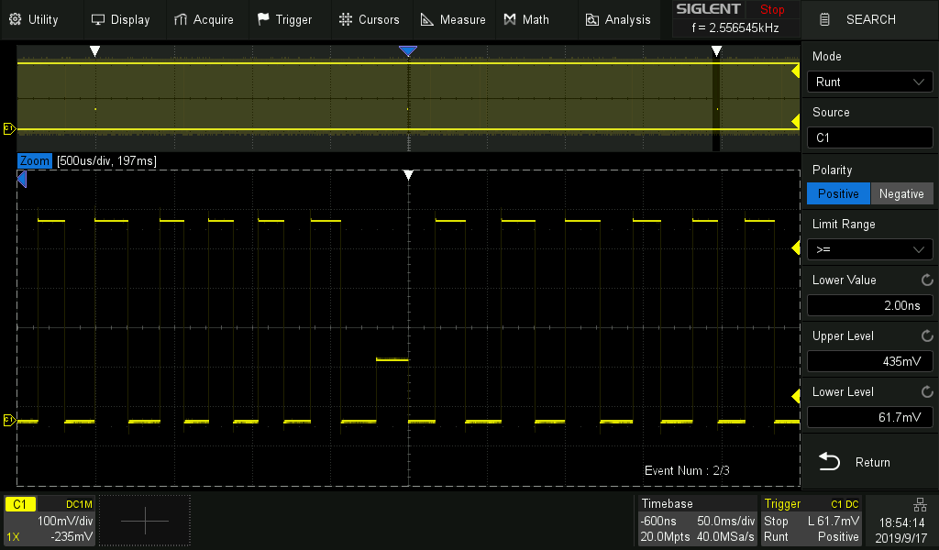
Powerful debugging tools
Segmented memory
  Save memory
  Up to 80,000 segments
  Interval between segments as small as 2 µs
Background running History
  Serial Decode, Zoom, and cursors measurements can be used.
  Records up to 80,000 triggered waveforms.
Search and Navigate
  Easily find events within a record and history based on user specified trigger conditions.
  Useful in zoom view
Sequence mode
History
Search and Navigate

Slide 22
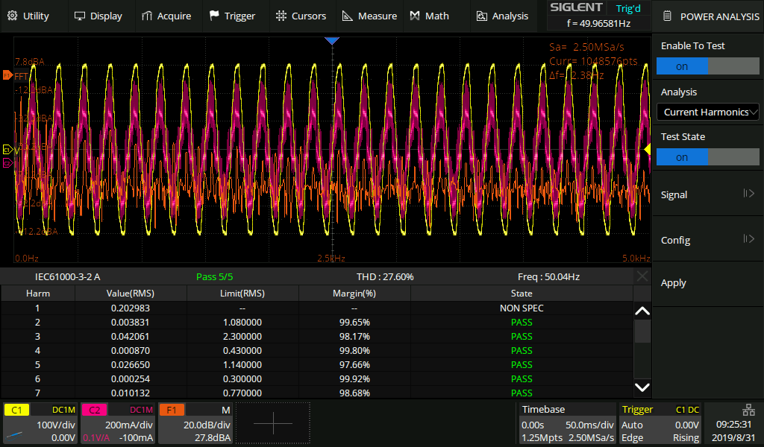
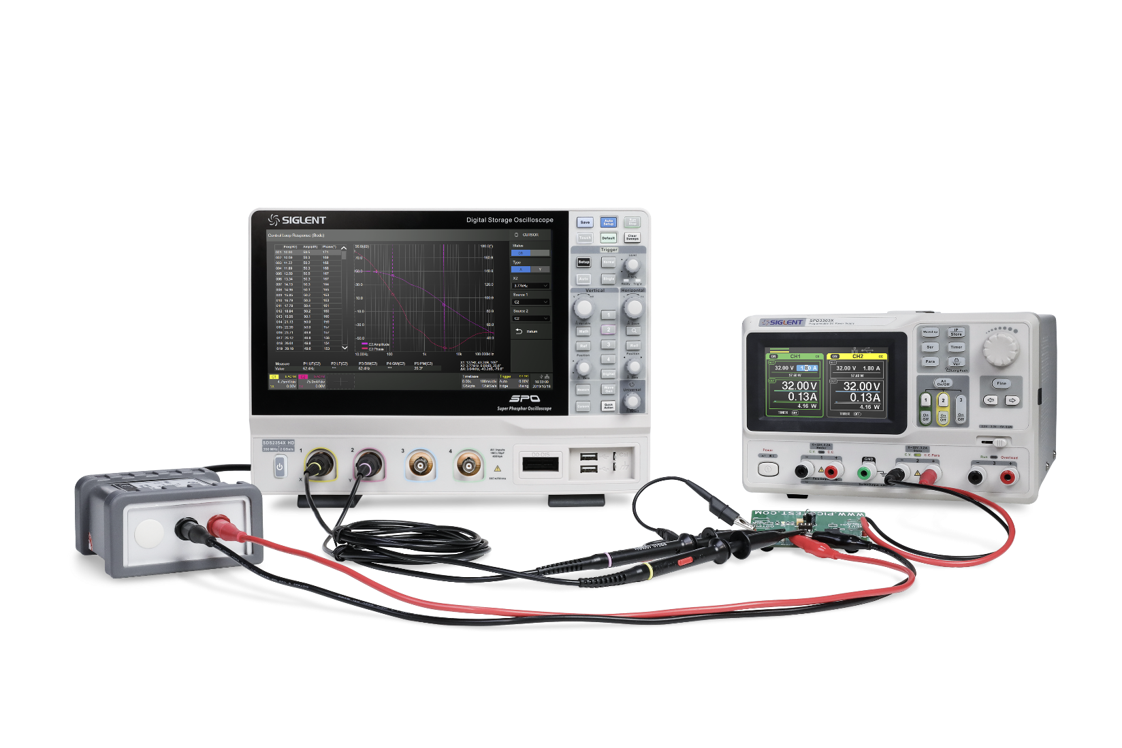
Power Analysis and Bode Plot
Powerful tools for power engineers
Power Analysis (Opt.)
  Provides a full suite of power measurements and analysis
  Improving the efficiency of measurement in switching power supplies and power device designs
Bode Plot (Std.)
  Control the built-in waveform generator or any stand-alone SIGLENT SDG device
  Scan the amplitude and phase response over frequency
  Possible to replace expensive network analyzers in less demanding applications.
Power Analysis Function
Power Supply Control Loop Response with Bode Plot

Slide 23
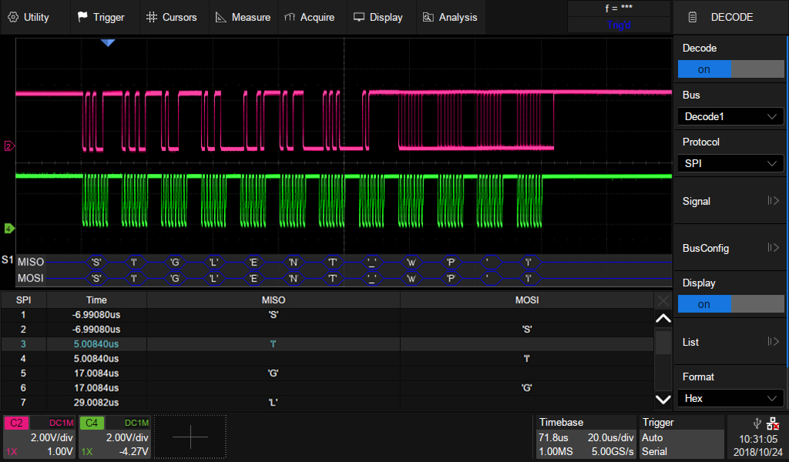
Wide range of Serial Decoders
Help to debug in various industries
Independent trigger and decoding. Increased flexibility.. Trigger and/or decode from any input source: 2/4 analog + 16 digital channels
Export decoding event list as a CSV file type for offline analysis
Return Format
Binary
Decimal
Hex
ASCII
Event List
Standard included Decoding:
I2C, SPI Embedded serial trigger and analyze
UART Computer serial trigger and analyze
CAN, LIN Automotive serial trigger and analyze
Optional Decoding:
CAN FD Automotive serial trigger and analyze
FlexRay Automotive serial trigger and analyze
I2S Audio serial trigger and analyze
MIL-STD 1553B serial trigger and analyze
SENT Automotive serial trigger and analyze
Manchester Serial trigger and analyze

Slide 24
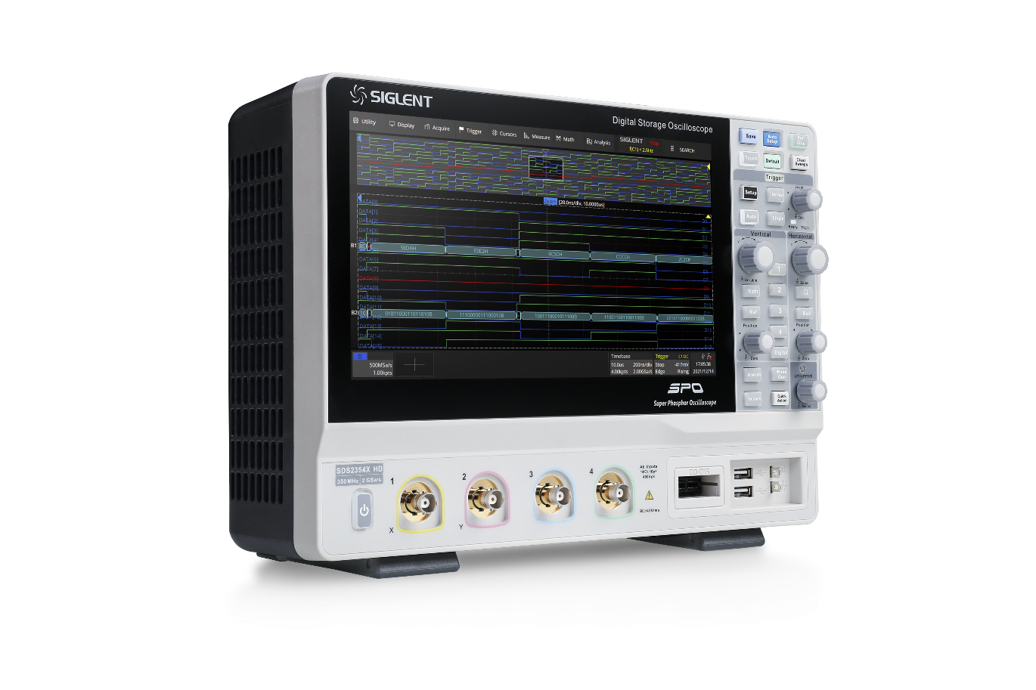
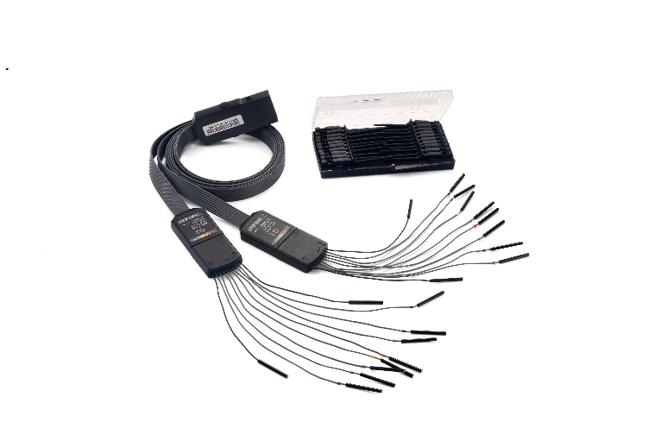
MSO Function
Mixed signal oscilloscope, solution for both digital and analog problems
View digital and analog channels on one timebase
Full trigger and decoding on all analog and digital channels
16 channels; maximum waveform capture rate up to 500 MSa/s; record length up to 50 Mpts
User defined label names, channel groups, and more

Slide 25
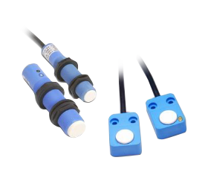


Application field for a 12-bit resolution Oscilloscope?
1, Measuring High-precision sensors and actuatior
2, Medical equipment (many signals in the medical field, such as EKG, ECG signal or EEG, EMG
signal, etc., are very close to noise, so a high-precision oscilloscope is required.
3, Laser pulses (weak overshoots, dips, etc. in fast pulses)
4, RF signal/modulated signal (UWB/OFDM/IQ, etc. For IQ signal, the vector magnitude error
"EVM" is an important measurement parameter)
5, Power measurement (noise overlay analysis)
6, Others... (when it is necessary to observe small signals appearing in large signals, such as
phase-locked loops)
Notes:
目录字体放大

Slide 26
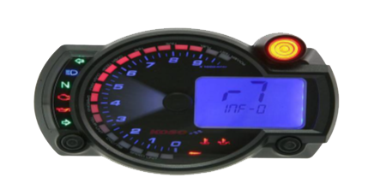
High Precision Sensor and Actuatior Measurement
Sensors and Actuatiors are usually very accurate
8-bit oscilloscopes can only provide a maximum resolution of the order of 256
If measurements beyond 256-order resolution are required, then a higher precision oscilloscope will be required
Example:
Measurement of rotational speed (Revolutions PER minute, RPM)
Height difference measurement
discharge flow-through measurements

Slide 27
8-Bit
8-Bit
with ERES
12-Bit
12-Bit
with ERES
Notes:
目录字体放大

Slide 28
High Precision Sensor and Actuatior Measurement
Results:
High-precision sensors and Actuatior require higher-resolution oscilloscopes
Using an 8-bit oscilloscope to measure high-resolution sensors and actuatiors can be very noisy.
For better results, a noise filter (ERES - Enhanced Resolution Function) can be used.
The ERES function sometimes filters out fast oscillations (or high frequency glitches) superimposed on the waveform.

Slide 29
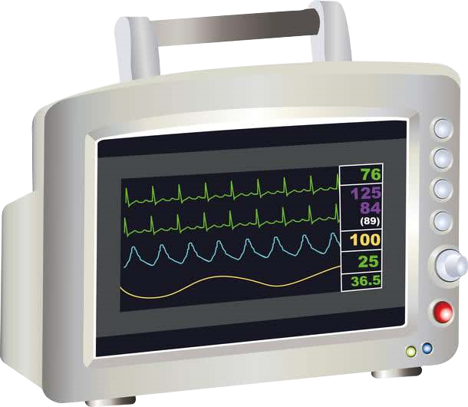
Measurement for medical applications
Medical measuring instruments must be able to detect very low amplitude measurement signals, such as ECG signals or EEG signals
Since 8-bit oscilloscopes do not have enough dynamic range, it is difficult to accurately measure such signals

Slide 30
Measurement for medical applications
8-Bit
When testing ECG analog signals, the test difference between 8-bit oscilloscope and 12-bit oscilloscope
12-Bit

Slide 31
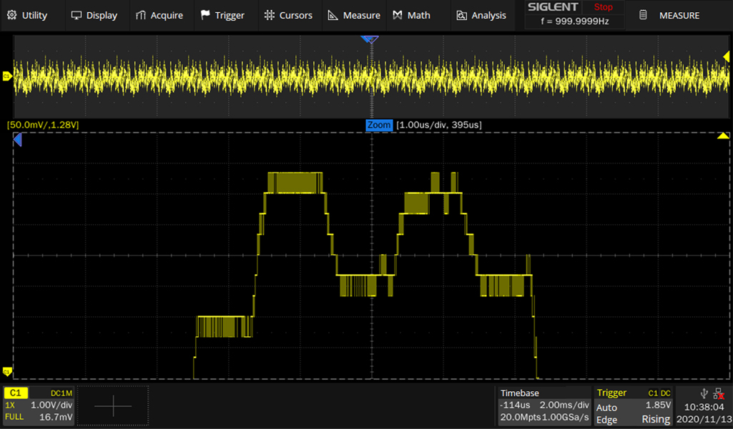
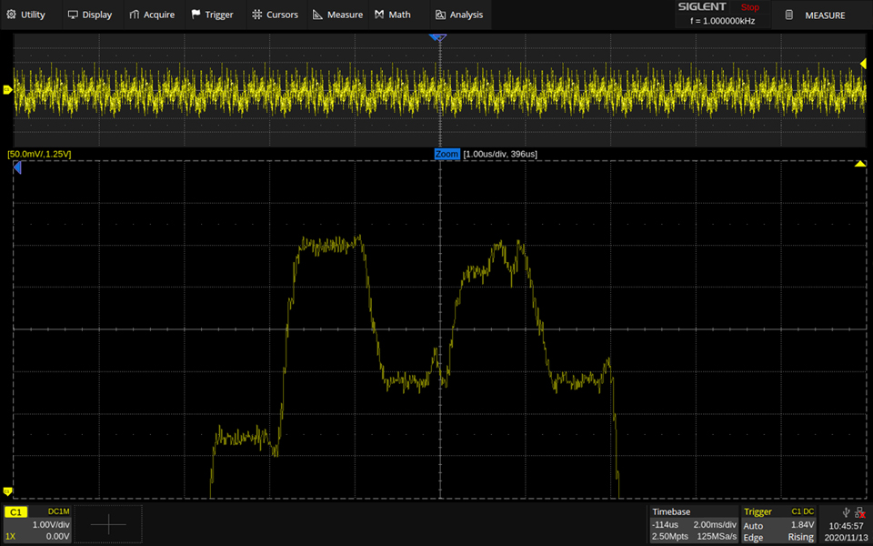
Measurement for medical applications
When testing EEG brainwave signals, the test difference between 8bit oscilloscope and 12-bit oscilloscope
8-Bit
12-Bit

Slide 32
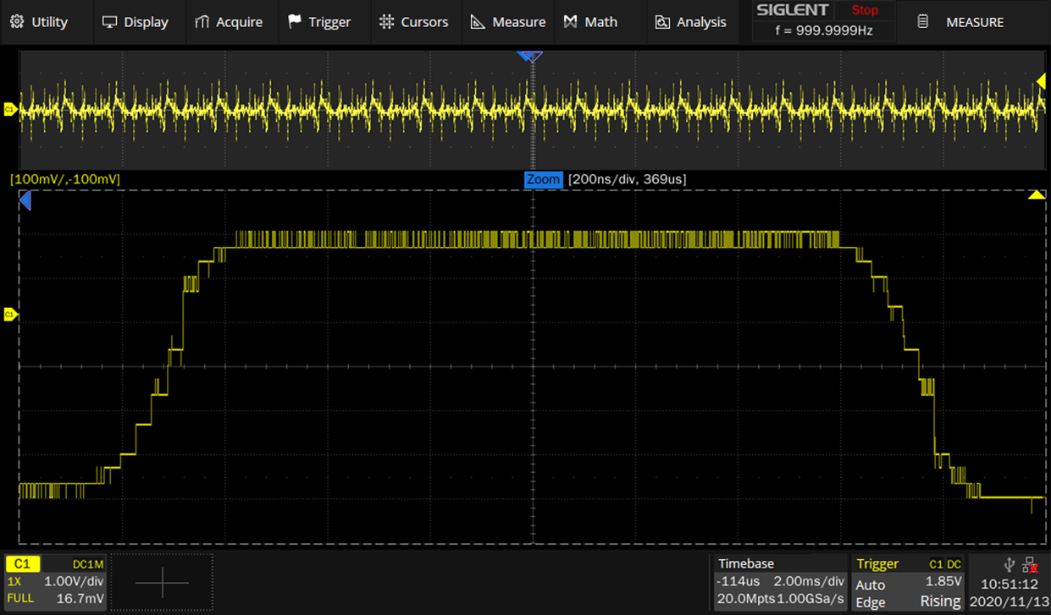
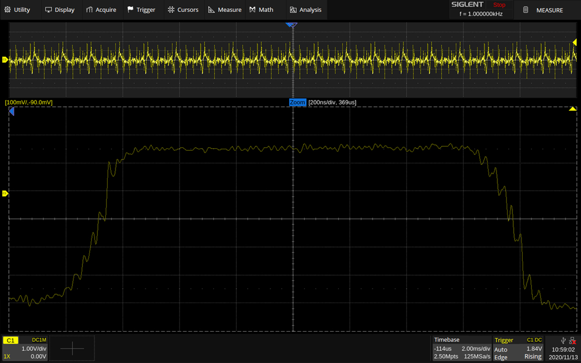
Measurement for medical applications
When testing EMG signal, the test difference between 8-bit oscilloscope and 12-bit oscilloscope
8-Bit
12-Bit

Slide 33
Measurement for medical applications
Results：
Signals in medical fields such as electrocardiograms are very close to the noise floor of an 8-bit oscilloscope.
Such weak signals can only be detected using the noise filter (ERES) function, but the signal quality is still poor.
Important signal integrity issues such as overshoot or undershoot can only be measured by an oscilloscope using a 12-bit ADC

Slide 34
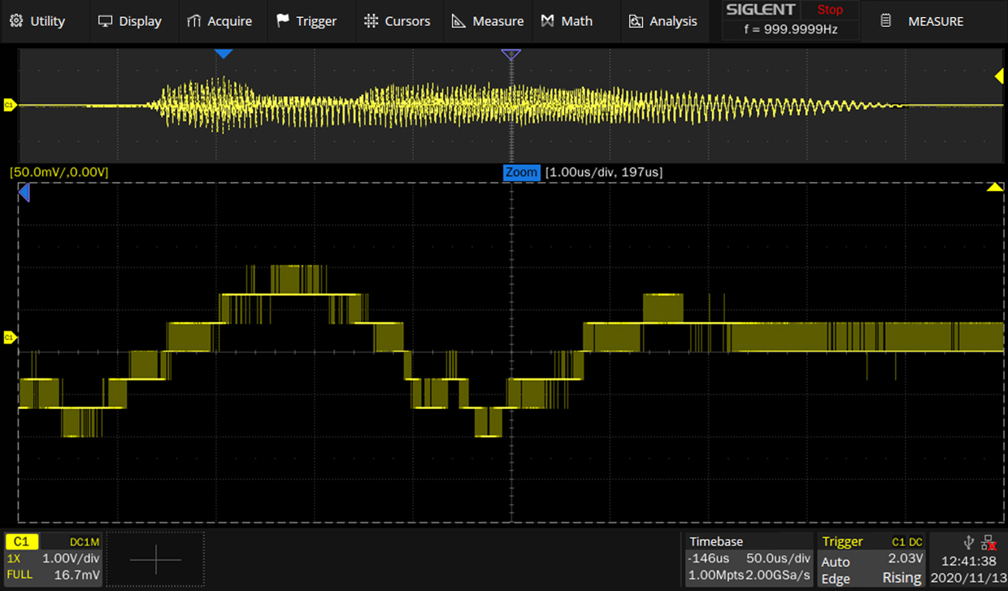
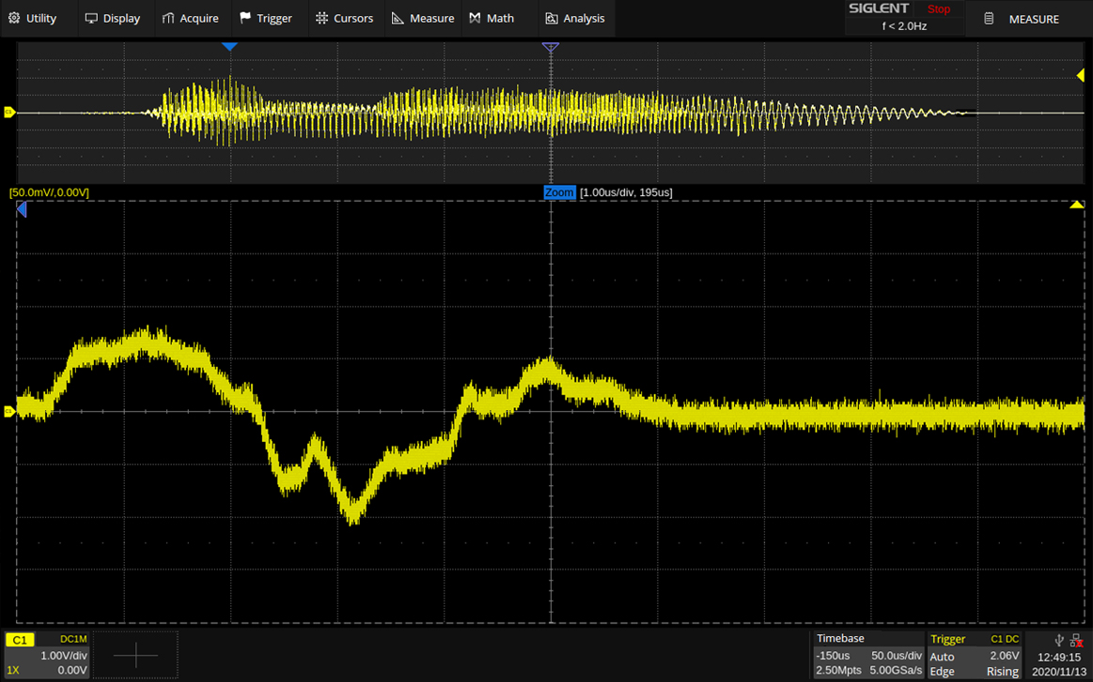
Audio Signal Measurement
Test the audio signal, check the end oscillation, the test difference between 8-bit oscilloscope and 12-bit oscilloscope
8-Bit
12-Bit

Slide 35
Power measurement
Power measurement mainly includes the measurement of two parameters
Measurement of current
Voltage measurement
The swing range of the measured value is usually very large and it must be accurate enough to observe small voltage or current changes
It requires a for a long time to collect data, because it must ensure that at least one power cycle signal is collected, so the test instrument needs to have a deep acquisition memory depth

Slide 36
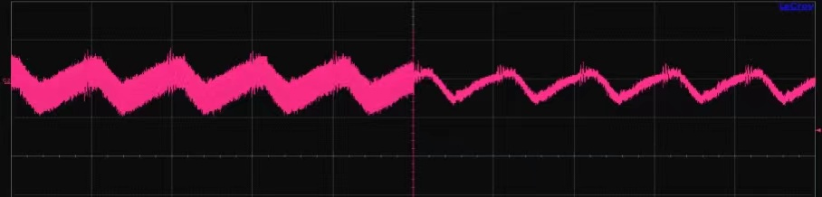
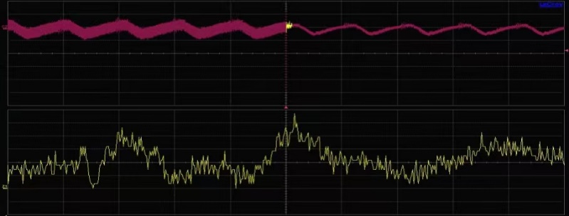
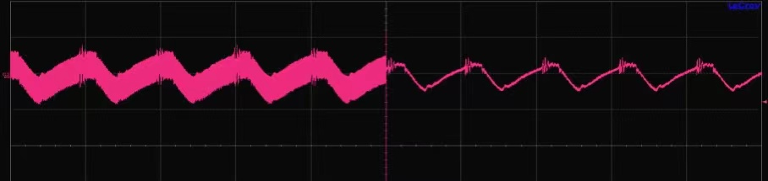
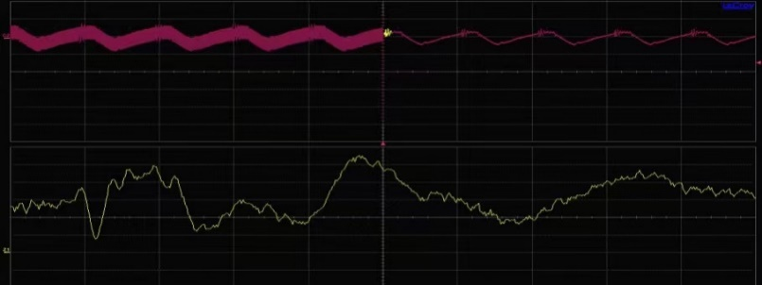
Power measurement
Switching power supplies are widely used due to their high efficiency, low cost, and small size.
The figure shows the output of the switching power supply when the load produces a small step change
8-bit Oscilloscope
12-bit Oscilloscope
The 8-bit oscilloscope can measure the step change of the voltage output but only the 12-bit oscilloscope can clearly display the details of the fluctuation superimposed on the voltage.

Slide 37
Power measurement
Results:
Use a 12-bit high-precision oscilloscope to capture some important undershoot or overshoot Power calculations (voltage x current) will benefit even more from high-precision oscilloscope measurements.
8-bit voltage x 8-bit current = 256 Points x 256 Points = 65,536 Points
12-bit voltage x 12-bit current = 4096 Points x 4096 Points = 16,777,216 Points
Small-amplitude ripple can only be captured with a high-precision oscilloscope
Only using the ERES function to enhance the resolution will also filter out some high-frequency oscillations or overshoots.

Slide 38
PART FOUR
04
Comparison
The Best Value In Electronic Test & Measurement

Slide 39

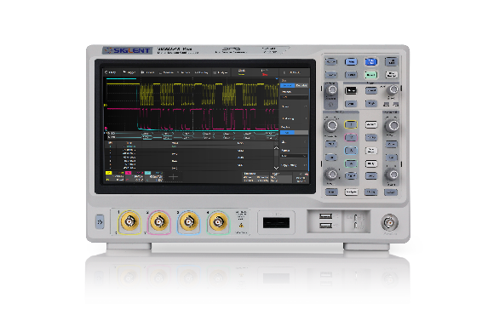
Model | Siglent SDS2000X HD |  | Siglent SDS2000X Plus
Bandwidth | 100/200/350 MHz | √ | 100/200/350 MHz | √
Vertical Resolution | 12-bit | √ | 8-bit | X
Average | Hardware based | √ | Only supported in Math | X
Analog Channel | 4 | X | 2/4 | √
Sampling rate | 2 Gsa/s | √ | 2 Gsa/s | √
Memory Depth | 200 Mpts | √ | 200 Mpts | √
Wavefrom Capture Rate | 100,000 wfm/s normal mode | X | 120,000 wfm/s normal mode | √
ERES | ERES 3-bit，hardware based | √ | ERES 3-bit, only supported in Math | X
Vertical Scale | 1 Mohm: 500 uV/div ~ 10 V/div 50 ohm: 500 uV/div ~ 1 V/div | √ | 1 Mohm: 500 uV/div ~ 10 V/div 50 ohm: 500uV/div ~ 1 V/div | √
DC Gain Accuracy | 0.5mV/div ~ 4.95mV/div: ±1.5%; 5mV/div ~ 10V/div: ±0.5% | √ | ≤ 3.0% | X
Time base Accuracy | ±2ppm initial; ±0.5ppm 1st year aging; ±3ppm 20-year aging | √ | ±1ppm initial; ±1ppm 1st year aging; ±3.5ppm 10-year aging | X
Nose floor | 70 uVrms @ 500 MHz | √ | 80 uVrms @ 500 MHz | X
SFDR | ≥ 45 dBc | √ | ≥40 dBc | X
CH to CH Isolation (@50Ω) | > 60 dBc, < 500MHz > 70 dBc, < 350MHz | √ | DC～100 MHz: >40 dB 100 MHz ~ BW: ≥34 dB | X
Trigger types | Edge, Slope, Pulse, Window, Runt, Interval, Dropout, Pattern, Video, Qualified, Nth edge, Delay, Setup/Hold time, Serial | √ | Edge, Slope, Pulse, Window, Runt, Interval, Dropout, Pattern, Video and Serial | X
Serial trigger and decode | Standard: I2C, SPI, UART, CAN, LIN Optional: CAN FD, FlexRay, I2S, MIL-STD-1553B, SENT, Manchester(decode only) | √ | Standard: I2C, SPI, UART, CAN, LIN Optional: CAN FD, FlexRay, I2S, MIL-STD-1553B, SENT, Manchester(decode only) | √
Sequence | Up to 80,000 segments | X | Up to 90,000 segments | √
History | Up to 80,000 frames | X | Up to 90,000 frames | √
Display | 10.1'' touch screen, 1024*600 | √ | 10.1'' touch screen, 1024*600 | √
SDS2000X HD
SDS2000X Plus

Slide 40
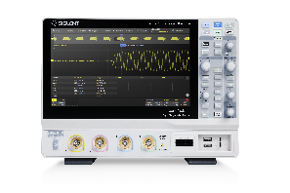
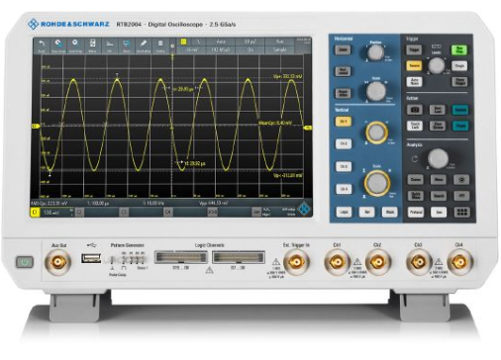
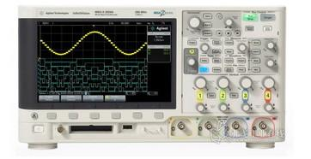
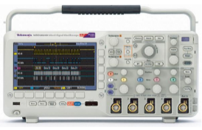
Model | Siglent SDS2000X HD | R&S RTB2000 | Keysight MSO/DSOX2000A | Tektronix MSO/DPO2000B
Bandwidth | 100/200/350 MHz | 70/100/200/300 MHz | 70/100/200 MHz | 70/100/200 MHz
Vertical Resolution | 12-bit | 10-bit | 8-bit | 8-bit
HiRes/ERES | ERES 3-bit，hardware based | HiRes 6-bit | - | -
Analog channel | 4 | 2/4 | 2/4 | 2/4
Sampling rate | 2 Gsa/s | 2.5 Gsa/s | 2 Gsa/s | 1 GSa/s
Memory Depth | 200 Mpts | 20 Mpts | 1 Mpts | 1 Mpts
Wavefrom Capture Rate | 100,000 wfm/s (normal mode), 400,000 wfm/s (sequence mode) | 50,000 wfm/s (normal mode) | 200,000 wfm/s | 5,000 wfm/s
Vertical Scale | 1 Mohm: 500 uV/div ~ 10 V/div 50 ohm: 500 uV/div ~ 1 V/div | 1 mV/div to 5 V/div | 1 MΩ: 1 mV/div ~ 5V/div | 2 mV/div ~ 5 V/div
DC Gain Accuracy | 0.5mV/div ~ 4.95mV/div: ±1.5%; 5mV/div ~ 10V/div: ±0.5% | ≤ 5 mV/div: ±2 % of full scale; > 5 mV/div: ±1.5 % of full scale | ± 3% full scale (≥ 10 mV/div); ± 4% full scale (< 10 mV/div) 2 | 10 mV/div ~ 5V/div: ±3% 2 mV/div ~ 5mV/div: ±4%
Timebase Scale | 1 ns/div ~ 1000 s/div; 0.5 ns/div ~ 1000 s/div (500 MHz) | 1 ns/div and 500 s/div | 5 ns/div to 50 s/div 2 ns/div to 50 s/div | 2 ns ~ 100s (200 MHz) 4 ns ~ 100s (70/100 MHz)
Time base Accuracy | ±2ppm initial; ±0.5ppm 1st year aging; ±3ppm 20-year aging | ±2.5 ppm | 25 ppm ± 5ppm per yaer(aging) | ±25 ppm, at any ≥1 ms interval
Trigger Zone | Support | No | No | No
FFT points | 2 Mpts | 128 kpts | 64 kpts | -
AWG/FG | 25 MHz | 25 MHz | 20 MHz | No
Bode plot | Support | Option | No | No
Logic analyzer | 16 digital channels, 500 MSa/s | 16 digital channels, 1.25 GSa/s | 8 digital channels | 16 digital channels (MSO), 1GS/s
Counter | 7 digits | 6 digits | 5 digits | No
Digital multimeter | Support | Support | No | No
Screen | 10.1'' touch screen, 1024*600 | 10.1'' touch screen, 1280*800 | 8.5'' WVGA color TFT LCD, 800*480 | 7'' WQVGA color screen, 480*234

Slide 41
Thank You
The Best Value in Electronic Test & Measurement
Headquarters
NA
Europe
SIGLENT TECHNOLOGIES CO., LTD.
Add: Blog No.4 & No.5, Antongda Industrial Zone, 3rd Liuxian Road, Bao’an District, Shenzhen, 518101, China
Tel:+ 86 755 3688 7876
Fax:+ 86 755 3359 1582
sales@siglent.com
int.siglent.com
SIGLENT Technologies NA, Inc.
Add: 6557 Cochran Rd Solon, Ohio 44139
Tel: 440-398-5800
Toll Free:877-515-5551
Fax: 440-399-1211
info@siglent.com
www.siglentna.com
SIGLENT TECHNOLOGIES GERMANY GmbH
Add: Staetzlinger Str. 70 86165 Augsburg, Germany
Tel: +49(0)-821-666 0 111 0
Fax: +49(0)-821-666 0 111 22
info-eu@siglent.com
www.siglenteu.com

