Slide 1


Slide 2
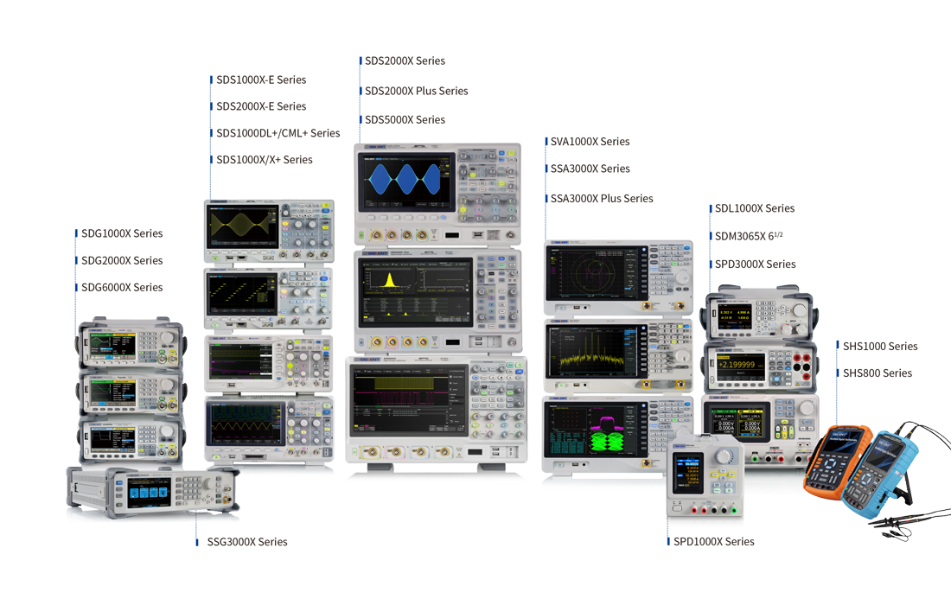
Product Families

Slide 3
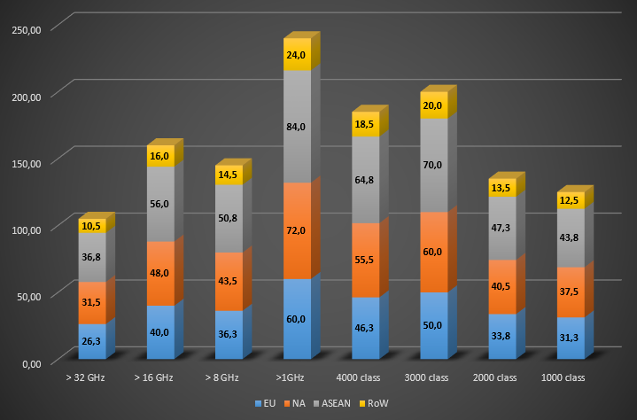


2000 Class Oscilloscope Market
Total Market Size for Oscilloscopes is ~ USD 1.3 Billion
Segmentation by Performance Class [M$]
Classes vs. Siglent Models:
1000 Class: SDS1000X-E
Intermediate SDS2000X-E
2000 Class: SDS2000X
SDS2000X Plus
3000 Class: SDS5000X
4000 Class: partly SDS5000X
Market Leaders 2000 Class:
Tektronix – Many old models
Keysight – DSOX2000 (older)
R&S – most modern
Many smaller Brands
* all Market Sizes are estimates

Slide 4
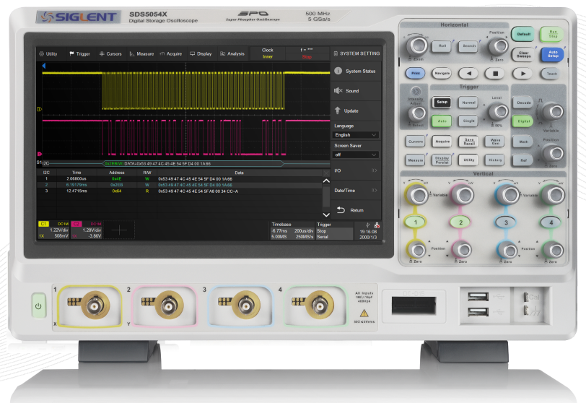
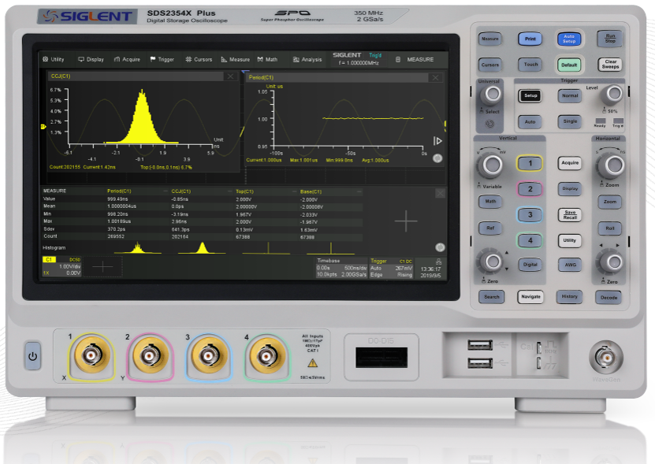
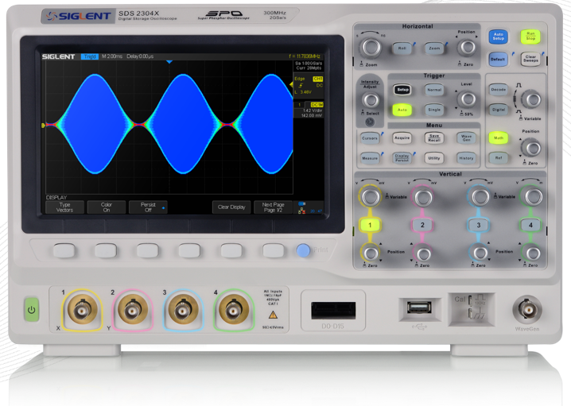
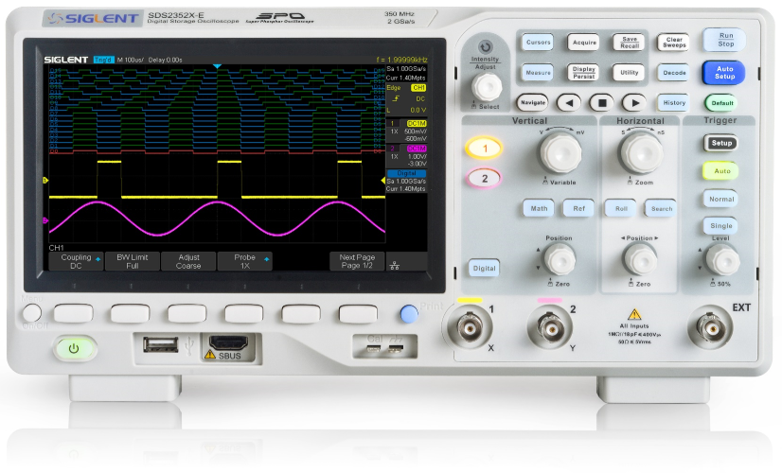
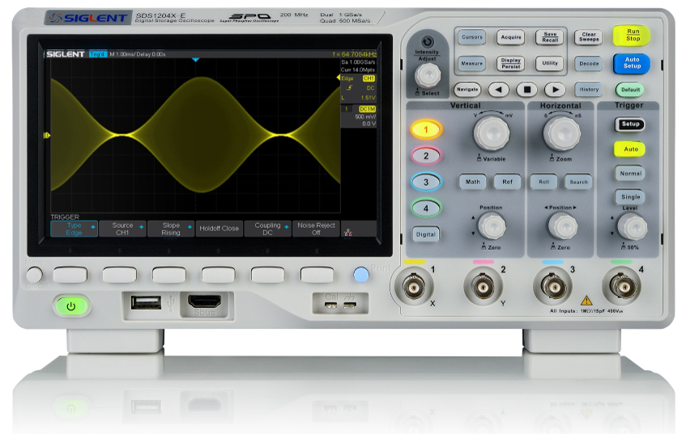
SDS2000X Plus Positioning VS. Siglent Scope Portfolio
Price
SDS2000X
100/200/300MHz
2 GS/s, 2/4 Ch.
140Mpts/2Ch
SDS5000X
350/500 MHz,1GHz
5 GS/s, 2/4 Ch.
250Mpts/2Ch
Big step in Performance
SDS2000X Plus
100/200/350MHz
2 GS/s, 2/4 Ch.
200Mpts/2Ch
SDS1000X-E
100/200MHz
1 GS/s, 2/4 Ch.
14Mpts/2Ch
SDS2000X-E
200/350MHz
2 GS/s, 2 Ch.
28Mpts/2Ch
Functions & Performance

Slide 5
SDS2000X Plus Positioning
The SDS2000X Plus is clearly positioned to compete with the 2000 class Oscilloscopes from Competition
It is a classical (lower-)mid-range product, but with higher performance functions and features, which are mostly known form higher performance Scopes.
Great general purpose Oscilloscope. It’s very well equipped for almost all tasks.
Applications: Analog Design debugging
Digital Design debugging incl. serial Bus decoding and analysis
Embedded Power Electronics
Power Converter Design
…
It’s perfectly usable as door opener for SDS5000X → up-sell
If your customer who can’t afford a SDS5000X → easy down-sell
If your customer has already a SDS5000X, doesn’t need high performance, lower price: “work horses”

Slide 6

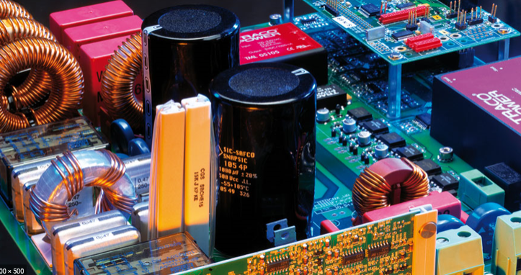
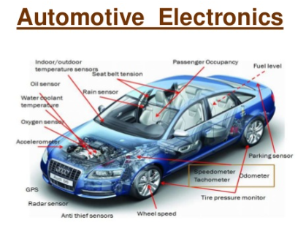
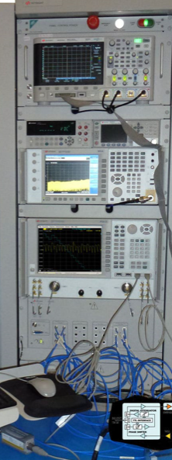
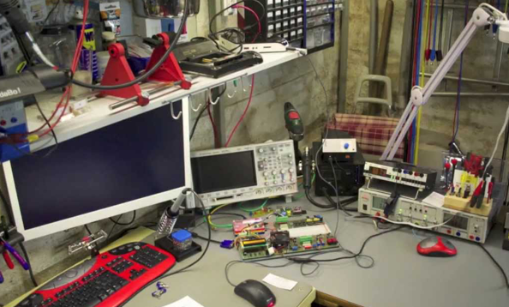

SDS2000X Plus Target Customer
The price and positioning make the SDS2000X Plus fit for:
  Hobbyist Market
  Professional Market
  Education (higher level/advanced classes and research)
Electrical Engineering Institutes
Small & Medium Size Enterprises (SME)
IoT
Medical
Consumer
Start ups
Sub-contractors
Industry
Automotive
Power Electronics
ATE
Electronic Enthusiasts

Slide 7
SDS2000X Plus Main Specs
Model | Bandwidth | Channel | Sampling Rate | Memory Depth | Screen
SDS2102X Plus | 100 MHz | 2 | 2 GSa/s | 200 Mpts | 10.1 inch Touch Screen
SDS2104X Plus | 100 MHz | 4 | 2 GSa/s | 200 Mpts
SDS2204X Plus | 200 MHz | 4 | 2 GSa/s | 200 Mpts
SDS2354X Plus | 350 MHz | 4 | 2 GSa/s | 200 Mpts
SDS2102X Plus can be upgraded to 350 MHz by license SDS2354X Plus can be upgraded to 500 MHz (Only 2 channels) by license

Slide 8
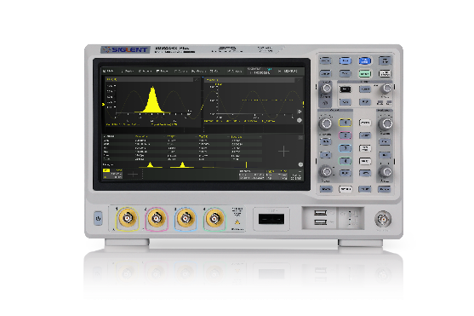
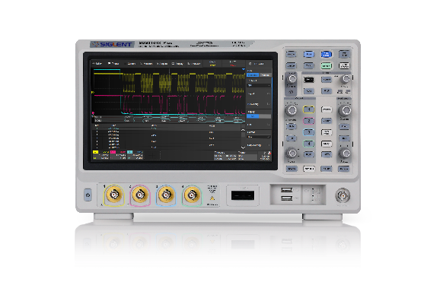

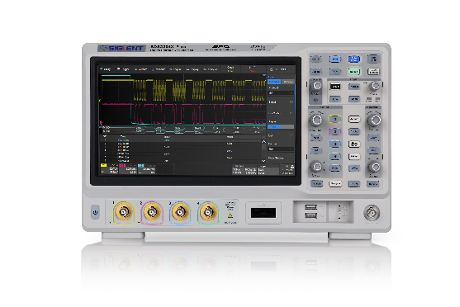
SDS2000X Plus
4x Hardware Models
Bandwidth Upgradeable
plus 2x Software Models
SDS2354X plus
Software Model
BW 500MHz
SDS2000XP-4BW05
SDS2204X plus
SDS2000XP-4BW03
4 Channel, BW 350 MHz
SDS2104X plus
SDS2000XP-4BW02
4 Channel, BW 200 MHz
4 Channel, BW 100 MHz
SDS2102X plus
Software Model
2 Channel, BW 350 MHz
SDS2000XP-2BW03
2 Channel, BW 100 MHz

Slide 9
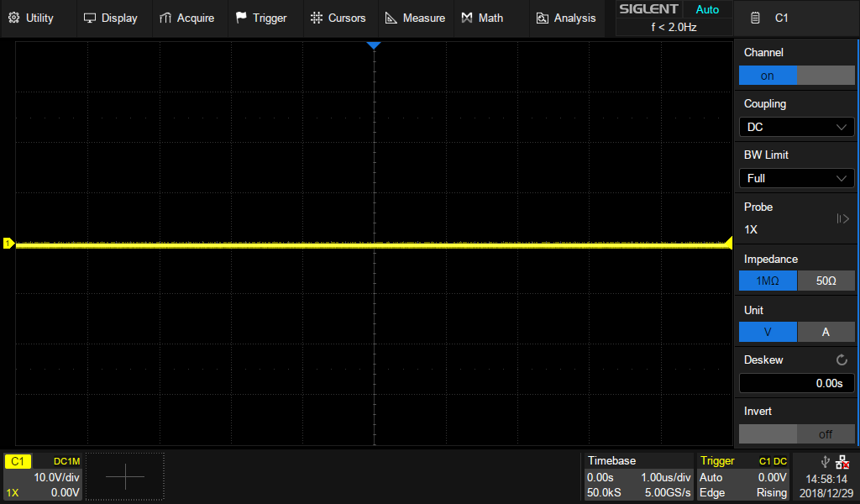
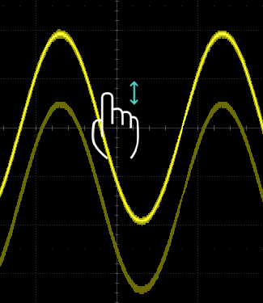
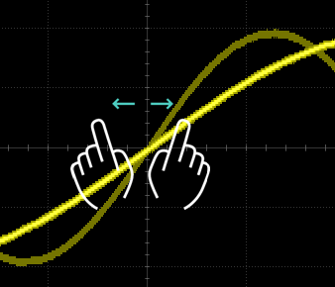
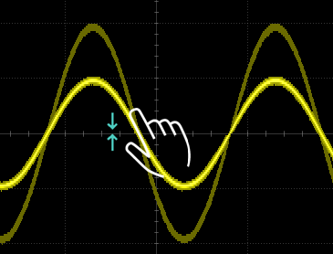
10.1 inch Touch Screen and Advanced UI
Save time with the intuitive and easy-to-use UI first introduced with the flagship SDS5000X
10.1’’ Touch Screen
1024 * 600
Multi-gesture control
Pop-up keyboard and numeric pad
Quickly input file names and parameter settings
Multi -Touch

Slide 10
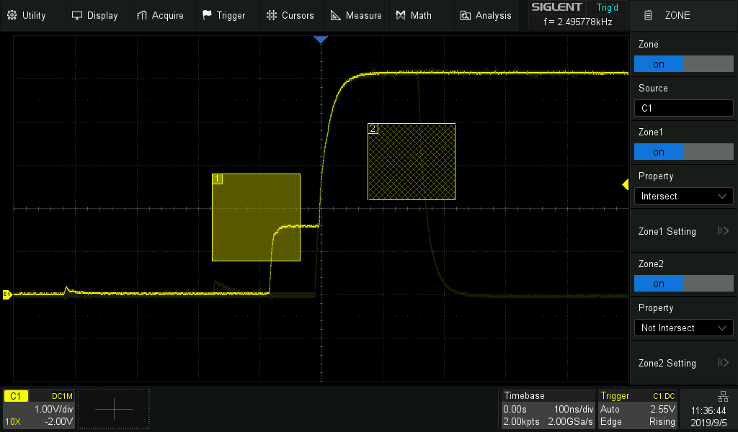
Zone Trigger
Quickly define trigger zones and isolate faults using the touch screen
Traditional trigger types can take time to configure for complex trigger conditions
With Zone Triggering, simply draw a zone and select Intersect or Not Intersect
With traditional trigger type, this signal requires more than 20 steps to trigger it

Slide 11
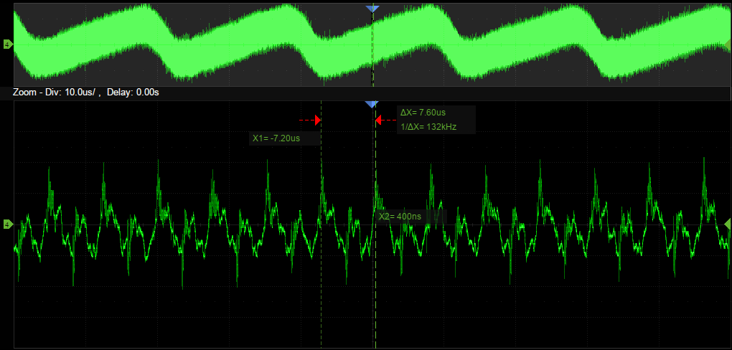
Longer Memory
Depth
Capture longer waveforms without compromising the sample rate
Utilizing a hardware-based Zoom technique and record length up to 200 Mpts, users can select a slower timebase without compromising the sample rate and then quickly zoom in to focus on the area of interest.
Much longer memory depth than competitive products
Up to 10 ms/div timebase at the sampling rate of 2 GSa/s
SDS2000X Plus 200 Mpts
Keysight MSO/DSOX2000A 1 Mpts
Tektronix MSO/DPO2000B 1 Mpts

Slide 12
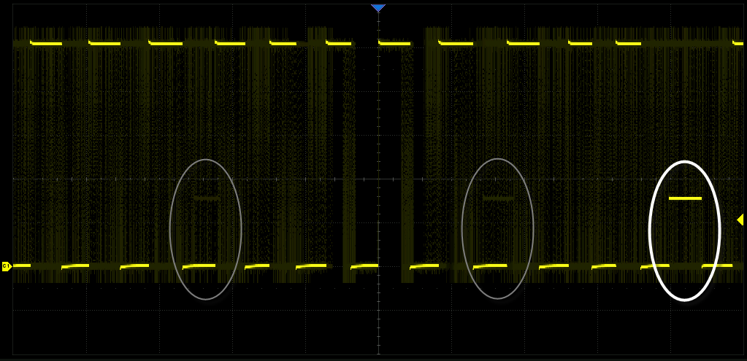
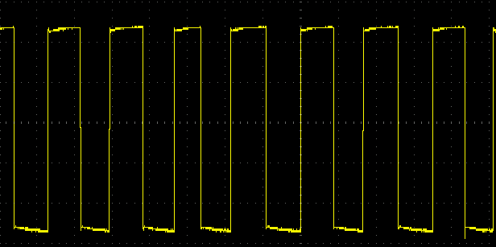
Higher Update Rate
Capture low-probability events faster
SDS2000X Plus with high sampling rate, with Persist display on.
With a waveform update rate of up to 120,000 wfm/s, the oscilloscope can easily capture low-probability events. In Sequence mode the waveform capture rate can reach 500,000 wfm/s.
Much longer memory depth than competitive products
Normal DSO display the same signal, no runt signal observed.

Slide 13
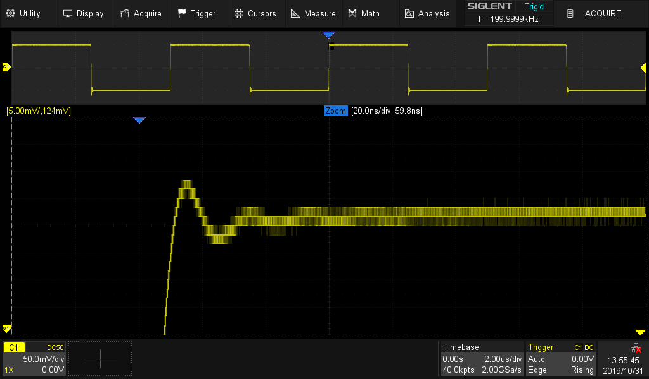
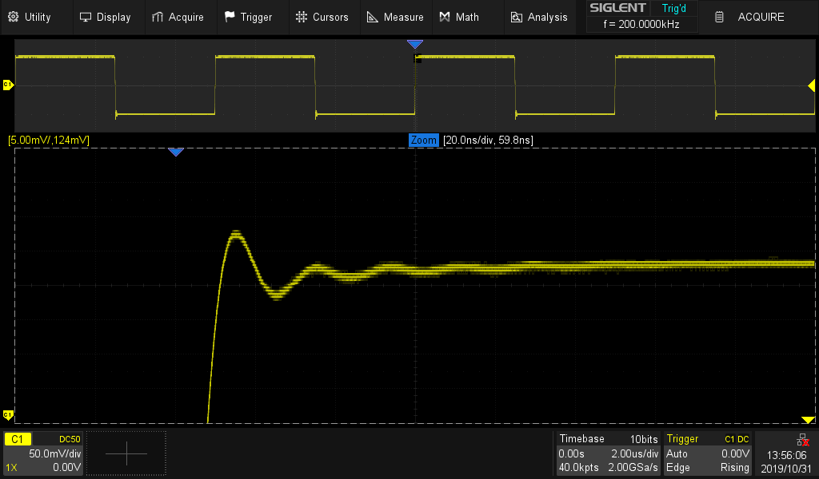
Enhanced Resolution Mode
Better accuracy
8-bit with Vertical and Horizontal Zoom
10-bit mode: More details and less noise
Digital oversampling increases resolution
Vertical and Horizontal Zoom
500µV / div vertical scale setting
Tradeoffs: ERES is bandwidth limited to 100 MHz and Memory depth decreased by factor of 2
8-bit
10-bit mode with Vertical and Horizontal Zoom
10-bit

Slide 14
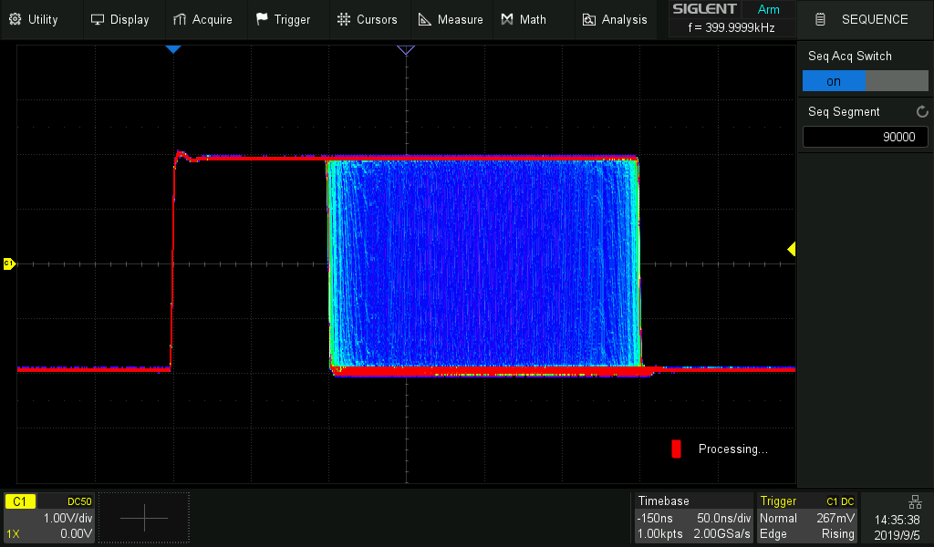
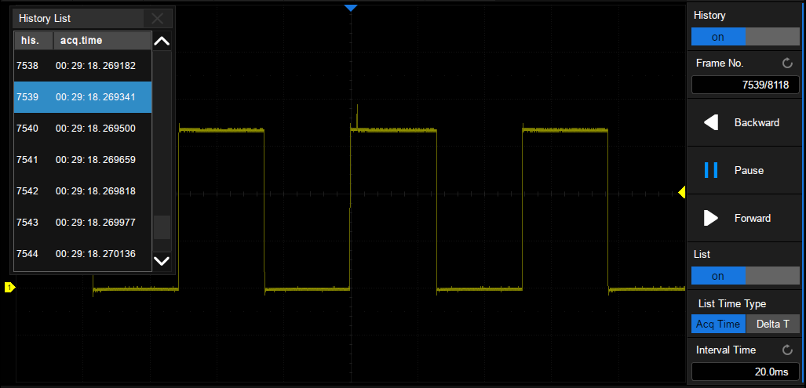
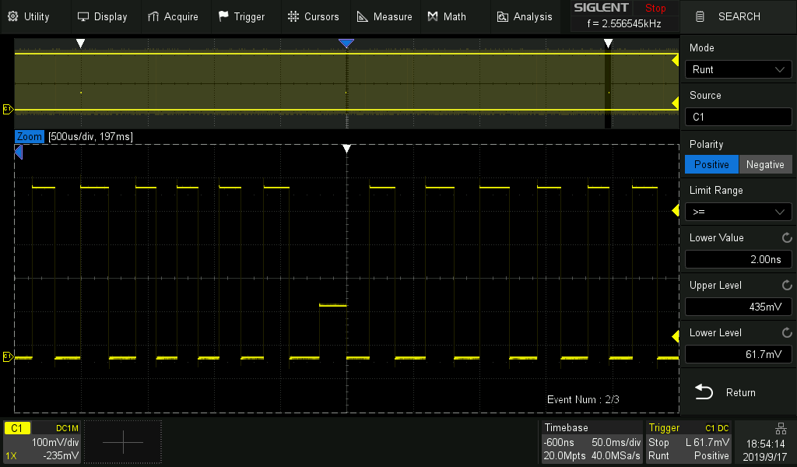
Capture rare events easily
Save memory and play back rare events at any rate
Sequence mode
History
Segmented memory
  Save memory
  Up to 90,000 segments
  Interval between segments as small as 2 µs.
Background running History,
  Serial Decode, Zoom, and cursors measurements can be used.
  Records up to 90,000 triggered waveforms.
Search and Navigate
  Easily find events within a record and history based on user specified trigger conditions.
  Useful in zoom view
Search and Navigate

Slide 15
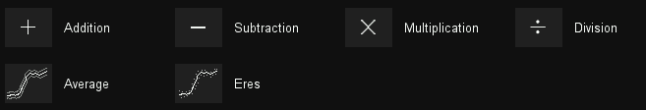


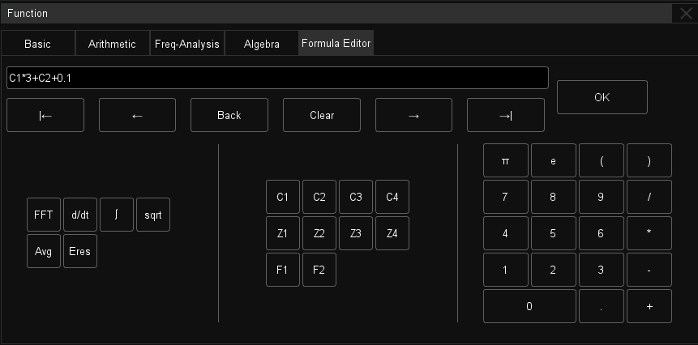
Advanced Math Functions
Calculate power, energy, and more using the powerful equation editor
Basic Operators
No differential probe? No problem. Simply use the subtract operator so simulate a differential circuit.
Multiple kinds of operators, including derivative and integral
Formula editor for advanced modifications of signals
Formula Editor

Slide 16
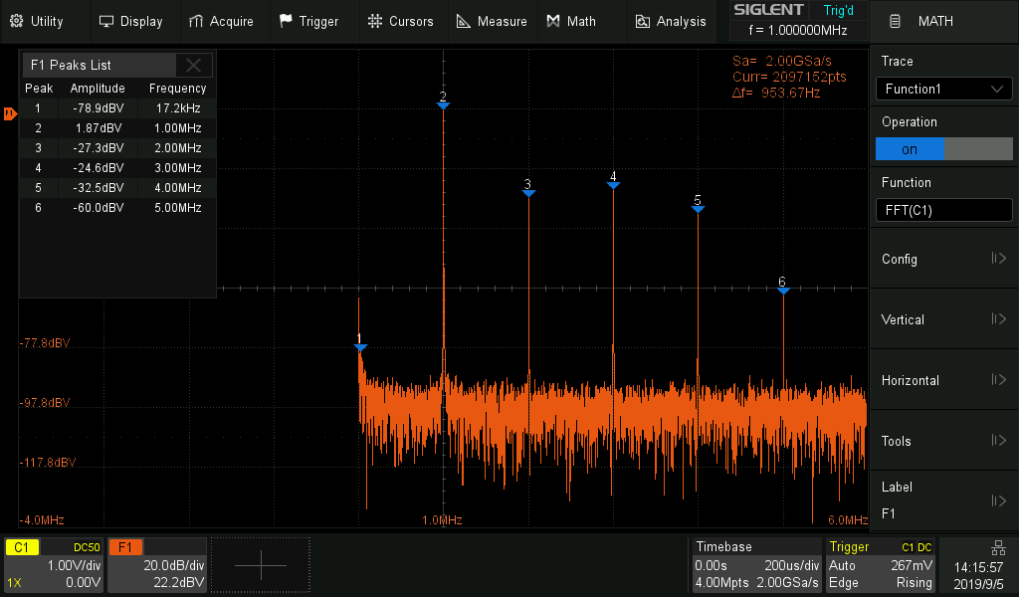
Hardware Accelerated FFT
High frequency resolution with fast refresh rate
Up to 2 M FFT points provides high frequency resolution with fast refresh rate.
A variety of window functions adapt to different spectrum measurement needs.
Three modes (Normal, Average and Max hold) can satisfy different requirements for observing the power spectrum.
Auto peak detection and markers are supported.

Slide 17
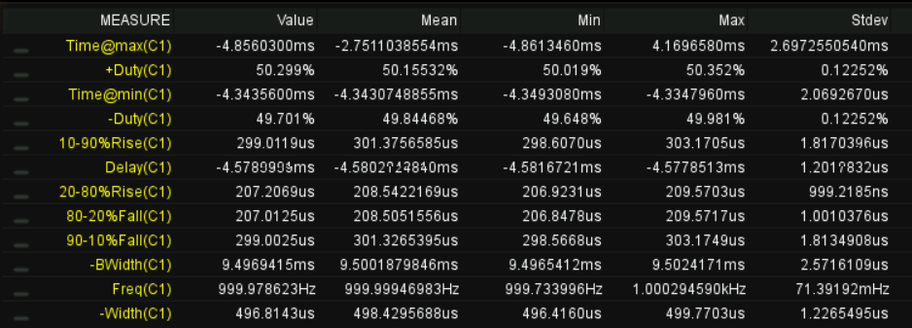
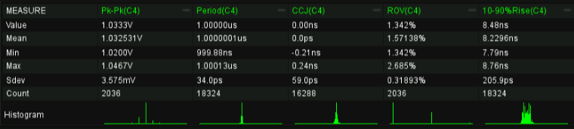
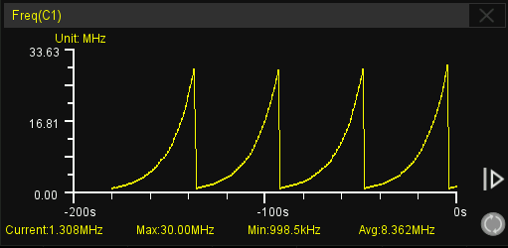
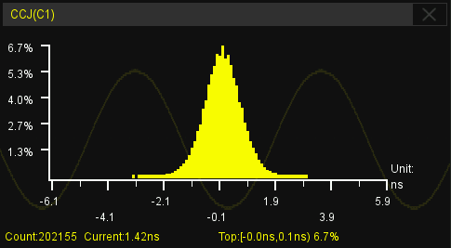
50+ types of measurements
High frequency resolution with fast refresh rate
Mode 2:
Show 12 parameters simultaneously
A total of 50+ different types of measurements.
Gate Measurement
Measurements on Math, Reference and History frames
Statistics show up to 12 parameters simultaneously
Histogram and Trend plot supported
Greatly improving the test efficiency
Mode 1:
5 parameters and Histogram
Frequency Trend of a FM signal (from 1MHz to 30MHz)
Clock Jitter Histogram
(Clearly shows jitter distribution)

Slide 18
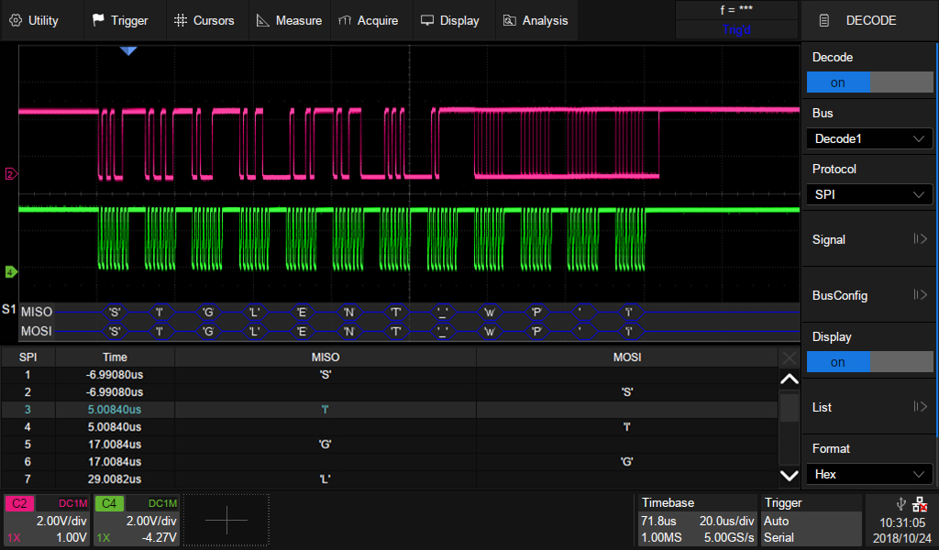
Wide range of Serial Decoders
Help to debug in various industries
Independent trigger and decoding. Increased flexibility.. Trigger and/or decode from any input source: 2/4 analog + 16 digital channels
Export decoding event list as a CSV file type for offline analysis
Return Format
Binary
Decimal
Hex
ASCII
Event List
Standard included Decoding:
I²C, SPI Embedded serial trigger and analyze
UART Computer serial trigger and analyze
CAN, LIN Automotive serial trigger and analyze
Optional Decoding:
CAN FD Automotive serial trigger and analyze
FlexRay Automotive serial trigger and analyze
I²S Audio serial trigger and analyze
MIL-STD 1553B serial trigger and analyze

Slide 19
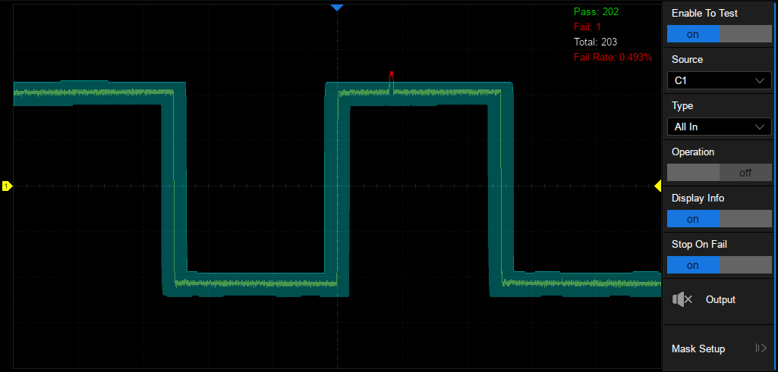
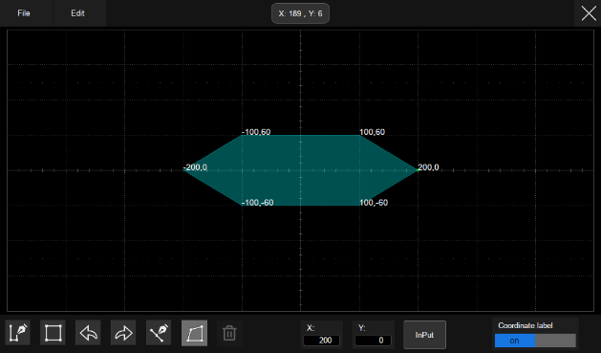
Hardware-based Mask Test
Fast Pass / Fail decisions
Perform up to 80,000 Pass/Fail decisions each second.
Easy to generate user defined test templates
Failed frames automatically stored, suitable for long-term signal monitoring or automated production line testing.
Built-in Mask Editor application helps to create custom masks.

Slide 20
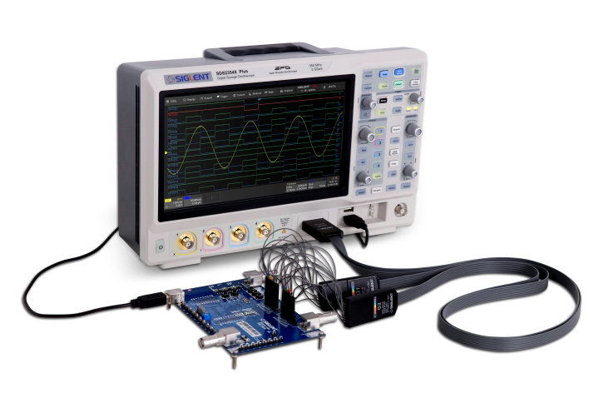
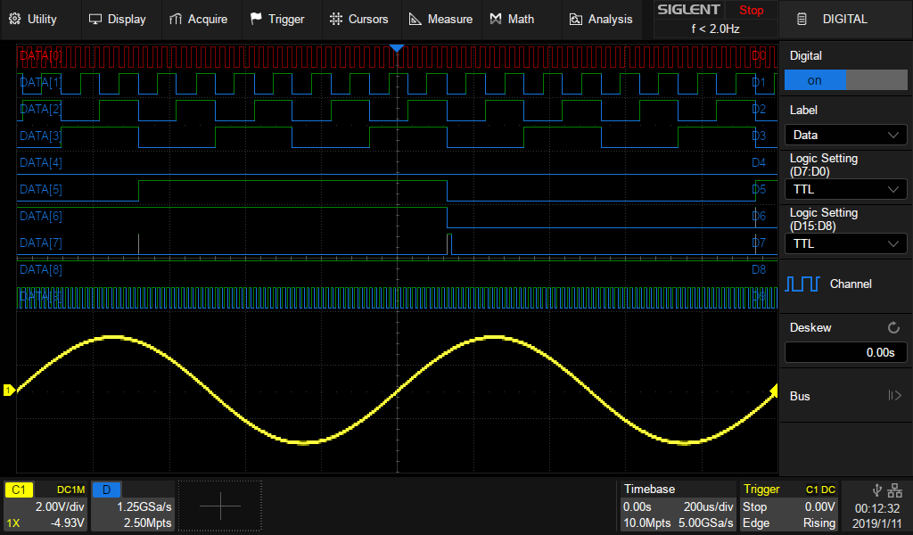
16 digital channels
Mixed signal oscilloscope, solution for both digital and analog problems
View digital and analog channels on one timebase
Full trigger and decoding on all analog and digital channels
16 channels; maximum waveform capture rate up to 1.25GSa/s; record length up to 62.5 Mpts
User defined label names, channel groups, and more
Built-in Mask Editor application helps to create custom masks.

Slide 21
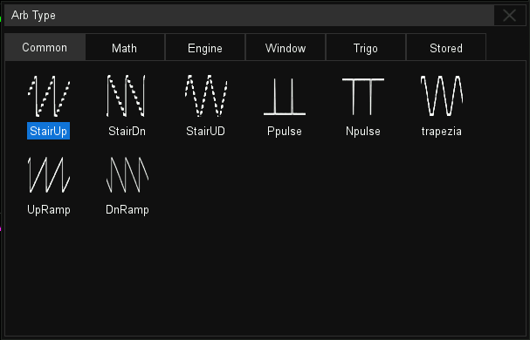
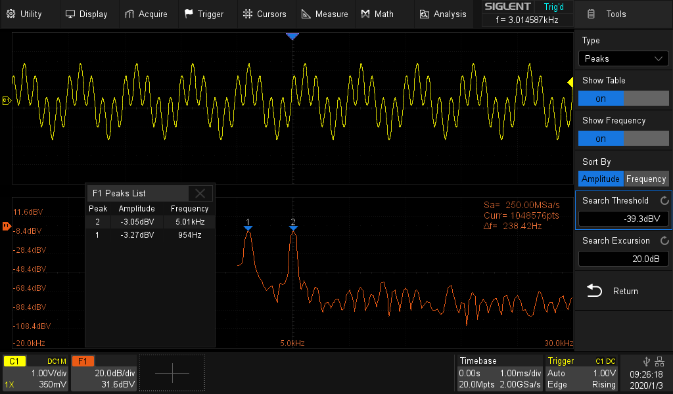
Built-in 50 MHz Waveform Generator
All-in-one Bode Plot
Convenient Bode Plot in one box. Just activate the internal function generator.
Up to 50 MHz, ±3 V output
Six basic waveforms together with multiple types of predefined waveforms
User defined arbitrary waveforms are supported
Six kinds of basic waveforms: Sine, Square, Ramp, Pulse, Nosie, DC
Arbitrary waveform types
Output a two-tone signal
Use SDS2000X Plus 2 Mpts FFT function to analyze frequency domain

Slide 22
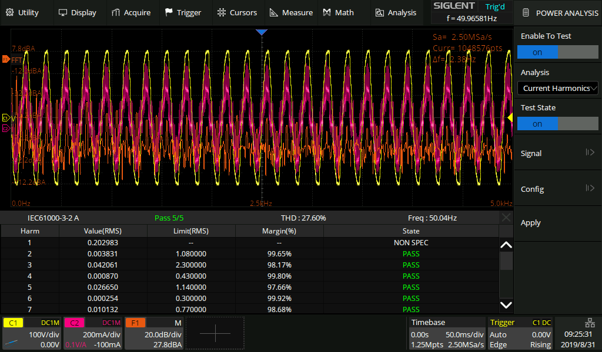
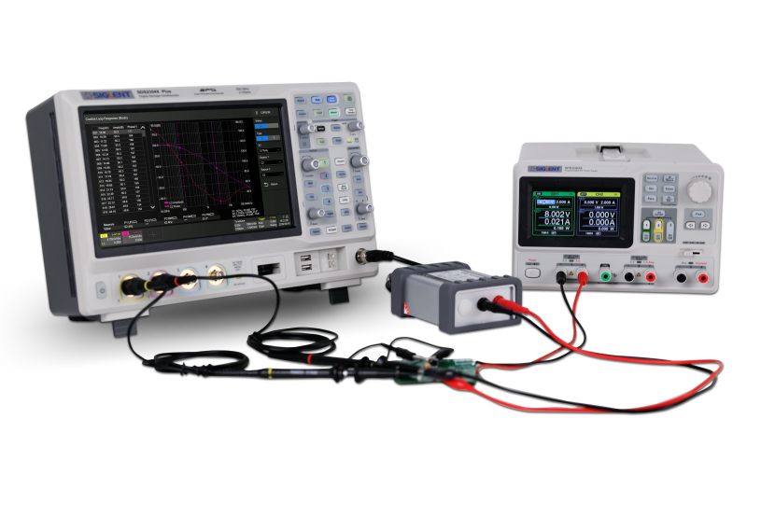
Power Analysis and Bode Plot
Powerful tools for power engineers
Power Analysis (Opt.)
  Provides a full suite of power measurements and analysis
  Improving the efficiency of measurement in switching power supplies and power device designs.
Bode Plot (Std.)
  Control the built-in waveform generator or any stand-alone SIGLENT SDG device
  Scan the amplitude and phase response over frequency
  Possible to replace expensive network analyzers in less demanding applications.
Power Analysis Function
Power Supply Control Loop Response with Bode Plot

Slide 23
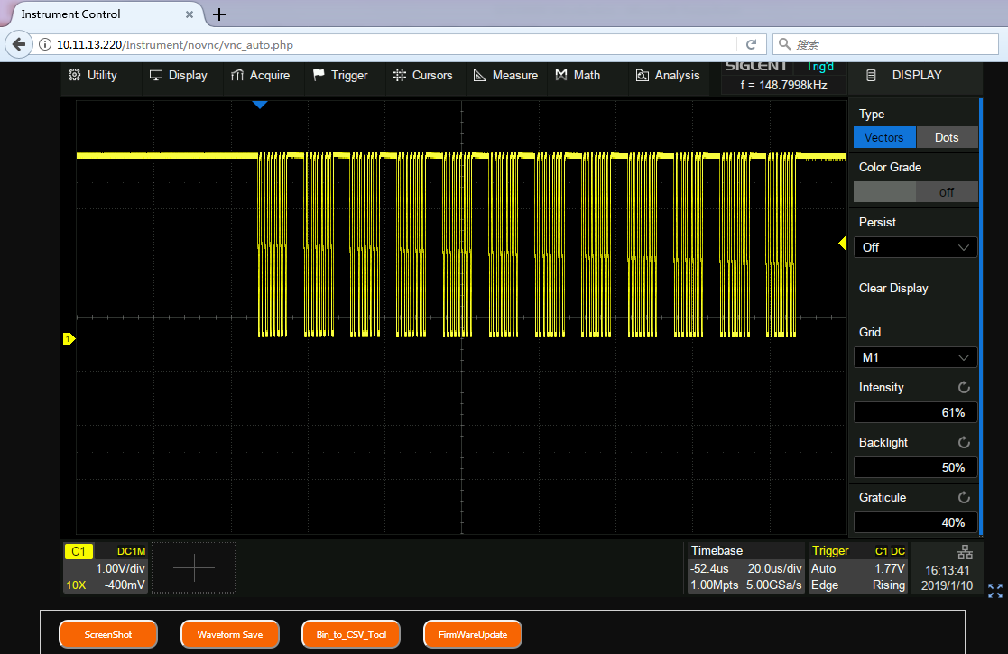
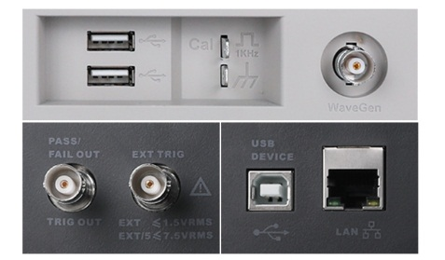
Web Control
Easy control on PC
Web Control
  Supports DHCP
  No large drivers needed
  Screen shot and save data
Complete Connectivity
  2 x USB Host, 1 x USB Device (USBTMC)
  1 x LAN (VXI-11/Telnet/Socket)
  1 x Auxiliary Output(Pass/Fail and Trigger Out)
Web Control
Complete Connectivity

Slide 24
Competition
Specs | Siglent SDS2000X Plus | Keysight MSO/DSOX2000A | Tektronix MSO/DPO2000B | Rigol MSO5000 | R&S RTB2000
Channels | 2/4+EXT | 2/4+EXT | 2/4+EXT | 2/4 | 2/4 +EXT
Bandwidth | (500 MHz), 350MHz, 200MHz, 100MHz | 200 MHz, 100 MHz, 70 MHz | 200 MHz, 100 MHz, 70 MHz | 350 MHz, 200 MHz, 100 MHz, 70 MHz | 300 MHz, 200 MHz, 100 MHz, 70 MHz
Sampling Rate | 2 GSa/s (for each channel pair) | 2 GSa/s (for each channel pair) | 1 GSa/s (per Channel) | 8 GSa/s (total) | 2.5 GSa/s (for each channel pair)
Resolution | 8 bit 10-bit mode | 8 bit | 8 bit | 8 bit | 10 bit
Memory Depth | 200 Mpts (for each channel pair) | 1 Mpts (for each channel pair) | 1 Mpts (per Channel) | 200 Mpts (for 4 channels) | 20 Mpts (for each channel pair)
Waveform Capture Rate | Normal: up to 120,000 wfm/s Sequence mode: up to 500,000 wfm/s | Up to 200,000 wfm/s | Up to 5,000 wfm/s | Up to 500,000 wfm/s | Up to 50,000 wfm/s
Vertical Zoom | Yes | No | No | No | No
Zone Trigger | Yes | No | No | Yes | No
Measurement Histogram and Trend Plot | Yes | No | No | Histogram | Histogram
Formula Math | Yes | No | No | Yes | Yes
FFT | Length: 2 Mpts | Length: 64 kpts | Length: 5 kpts | Length: 1Mpts | Length: 128 kpts
Sequence | 90,000 frames | 250 frames | No | 450,000 frames | 13,107 frames
History | 90,000 frames | N/A | No | 450,000 frames | 13,107 frames
Navigator | Yes | Yes | Yes | Yes | Support Search
Mask Editor | Yes | No | No | No | N/A

Slide 25
Competition
Specs | Siglent SDS2000X Plus | Keysight MSO/DSOX2000A | Tektronix MSO/DPO2000B | Rigol MSO5000 | R&S RTB2000
Bode Plot | Yes | No | No | No | Yes
Power Analysis | Yes | No | No | Yes | No
Counter | Yes | No | No | Yes | N/A
Serial Protocol Decode | Standard: I2C、SPI、UART、CAN、LIN Optional: CAN FD、FlexRay、I2S、MIL-STD-1553B | Optional: I2C、SPI、UART、CAN、LIN | Optional: I2C、SPI、UART、CAN、LIN | Optional: RS232/UART, I2C, SPI, CAN, LIN, I2S, FlexRay, MIL-STD-1553 | Optional: I2C/SPI, UART/RS-232/RS-422/RS-485, CAN/LIN
Time Base Accuracy | ±1 ppm initial | 25 ppm ± 5 ppm per year (aging) | ±25 ppm | ±10 ppm, ±10 ppm/year | ±2.5 ppm
Logic Analyzer | 16-bit，500 MSa/s SPL2016 probe | 8-bit, 1 GSa/s | 16-bit | 1GSa/s PLA2216 probe | 1.25 GSa/s R&S®RTB-B1
AWG | 50 MHz, built-in | 20 MHz, built-in | No | 25MHz, built-in, 2CH | 25MHz, built-in
Interface | USB Host x2, USB Device, LAN, Pass/Fail, Trigger Out | Standard USB 2.0 (LAN/ video optional) (GPIB optional) | USB Host, USB Device, LAN, Video out port | USB Host*1, USB Device*1, LAN, AUX OUT(TRIG OUT, PASS/FAIL), HDMI | AUX OUT(trigger out, reference frequency, pass/fail, AWG)，Pattern Source, USB2.0 Host*1, USB Device*1, LAN
Display | 10.1", 1024*600, capacitive touch screen | 8", 800*480, color TFT screen | 7"，480*234 | 9'', 1024*600, capacitive touch screen | 10.1", 1280*800, capacitive touch screen

Slide 26
Thank You
The Best Value in Electronic Test & Measurement
Headquarters
NA
Europe
SIGLENT TECHNOLOGIES CO., LTD.
Add: Blog No.4 & No.5, Antongda Industrial Zone, 3rd Liuxian Road,
Bao’an District, Shenzhen, 518101, China.
Tel:+ 86 755 3688 7876
Fax:+ 86 755 3359 1582
sales@siglent.com
www.siglent.com/ens
SIGLENT Technologies NA, Inc.
Add: 6557 Cochran Rd Solon, Ohio 44139
Tel: 440-398-5800
Toll Free:877-515-5551
Fax: 440-399-1211
info@siglent.com
www.siglentna.com
SIGLENT TECHNOLOGIES GERMANY GmbH
Add: Liebigstrasse 2-20, Gebaeude 14, 22113 Hamburg Germany
Tel: +49(0)40-819-95946
Mobile: +49 151 40716756
Fax: +49(0)40-819-95947
info-eu@siglent.com
www.siglenteu.com

