Slide 1

SDS1000X HD Oscilloscope

Slide 2
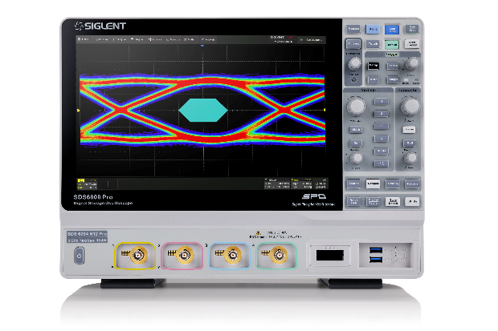
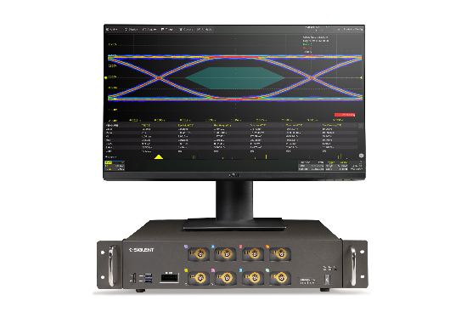
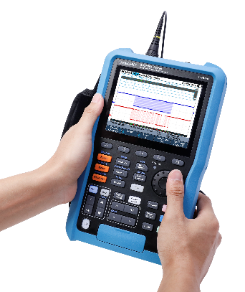
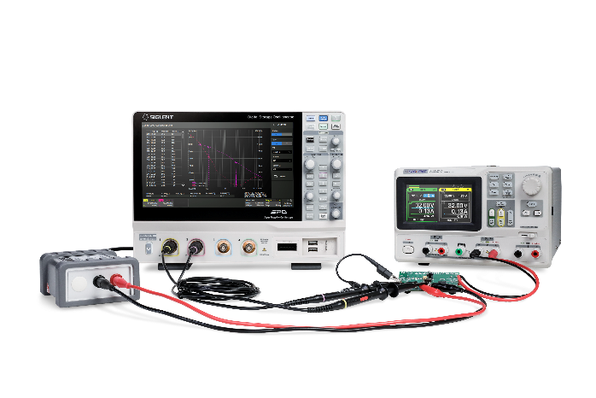
Various oscilloscope types
Satisfy different needs !
1
High bandwidth oscilloscope
Meet more test scenarios，such ac eye diagram, jitter analysis
2
Compact oscilloscope
Save space and can be used for machine diagnosis and automatic test
3
Hand-held oscilloscope
Portable design, which can be used for field testing, research and development, production and maintenance
4
High precision oscilloscope
An analytical tool for power supply design, automotive electronic systems and embedded systems

Slide 3
Basic Information
Features & Benefits
Catalogue
Market Applications
VS
Competition Analysis

Slide 4
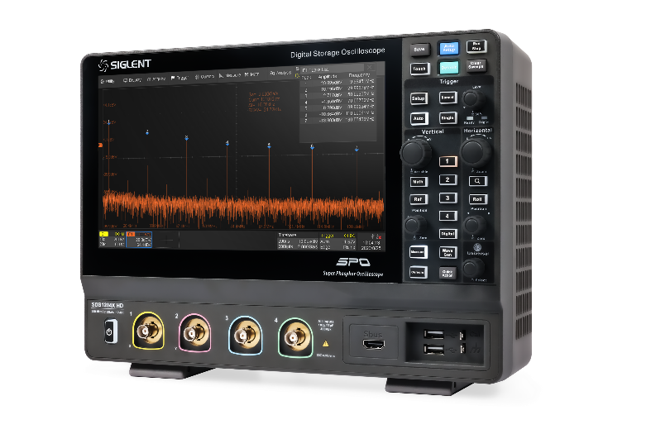
Specifications
SDS1000X HD | SDS1000X HD
Key Specifications |  | Other Specifications
channels | 2/4 | Vertical scale (probe 1X) | 1 MΩ: 0.5 mV/div – 10 V/div 50 Ω: 0.5 mV/div – 1 V/div
bandwidth | 100/200MHz | dynamic range | ≥ 35 dBc
Vertical resolution | 12-bit | Peak detect | 2 ns
Sample rate | 2 GSa/s (single channel) 1 GSa/s (half channels) 500 MSa/s (all channels) | Skew (CH1~CH4) | < 100 ps
Memory depth | 100 Mpts /ch | Display | 10.1’’ TFT LCD with capacitive touch screen
Waveform capture rate | Normal mode：up to 120,000 wfm/s Sequence mode：up to 500,000 wfm/s | weight | Net Weight 4.1 kg, Gross Weight 5.6 kg
Noise floor | 70 μVrms （200MHz) | Dimensions | L× H× W = 317.2 mm × 236.0 mm × 149.0 mm (including knobs and supporting legs)

Slide 5
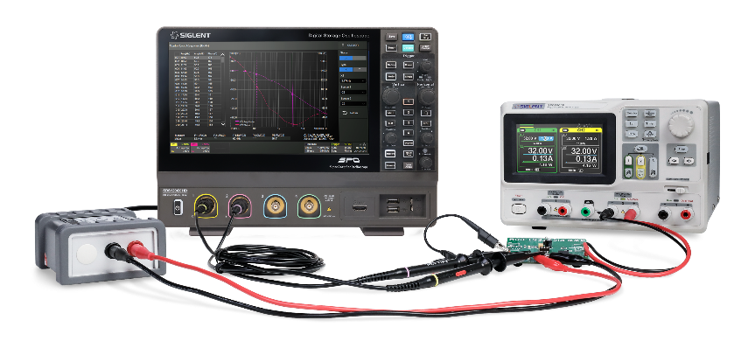
Functions
SDS1000X HD
Trigger and decoding |  |  | Standard functions
Trigger type | Edge, Slope, Pulse width, Window, Runt, Interval, Dropout, Pattern, Video, Qualified, Nth edge, Delay, Setup/Hold time, I2C, SPI, RS232/UART, CAN, LIN |  | Search and navigate | Search mode：edge, slope, pulse, interval, runt Navigate type：search event, time, history frame
Serial bus decode | Standard：I2C, SPI, UART, CAN, LIN, CAN FD, FlexRay |  | History | Maximum 80,000 frames
Measurement and Math |  |  | Counter | 7 digits
measurement | Measurement Parameters （Vertical + Horizontal + other） | 66 (19+17+30) | Bode Plot | Amplitude frequency characteristic, phase frequency characteristic
 | Number of simultaneous measurements | 12(M2 mode) /5(M1 mode) | Mask Test | 80,000 Pass / Fail decisions each second
 | Statistics | Current, Mean, Min, Max, Stdev, Count, Histogram, Trend, Track | Optional functions
Math | Trace | F1, F2, F3, F4 | Digital channel (optional) | 16 digital channels
 | Operation | FFT, +, -, x, ÷, ∫dt, d/dt, √, Identity, Negation, |x|, Sign, ex, 10x, ln, lg, Interpolation, Max hold, Min hold, ERES, Average, Formula Editor | Power Analysis (optional) | Power quality, Current Harmonics, Inrush current, Switching loss, Slew rate, Modulation, Output ripple, Turn on/turn off, Transient response, PSRR, Efficiency, SOA
 | FFT | 2 Mpts | Waveform generator (optional) | Sine, Square, Ramp, Pulse, DC, Noise, 45 Arbitrary

Slide 6
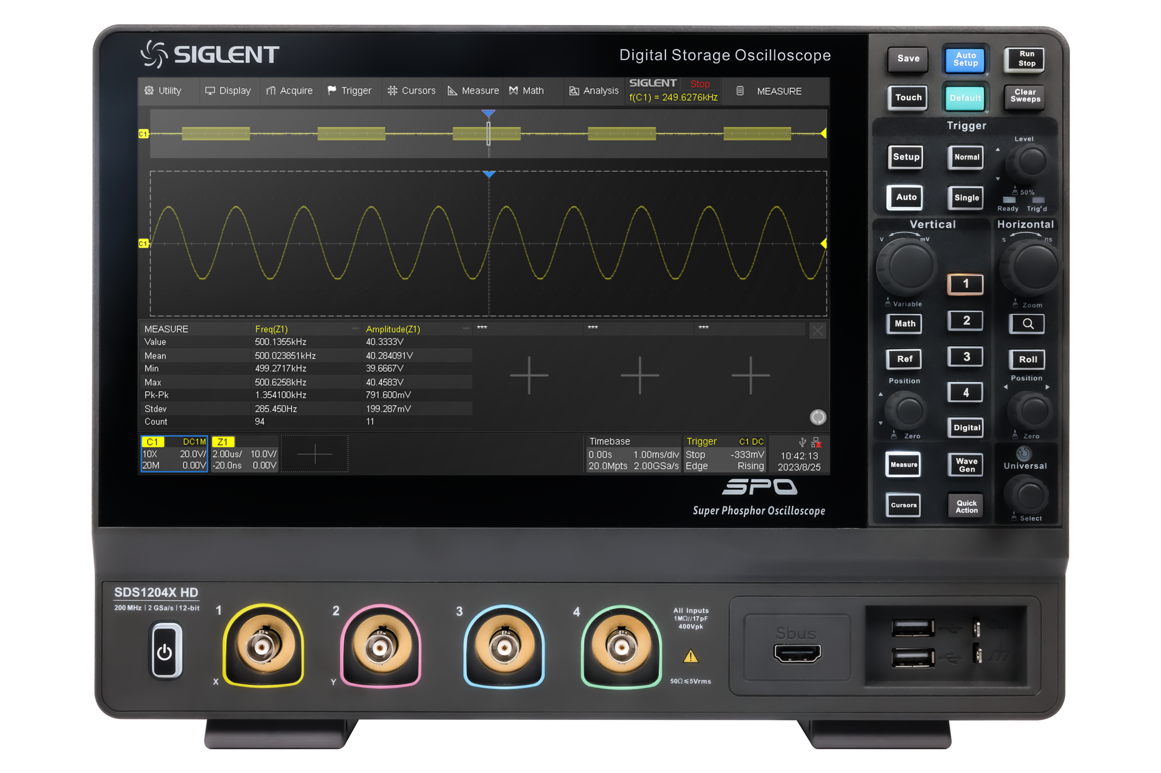
Front
Panel
Touch Screen Display
Knobs & Buttons
Digital Input Connector
Analog Input Connectors
USB 2.0 Host Ports
Probe Compensation
Power Switch
Ground Terminal
Supporting Legs

Slide 7
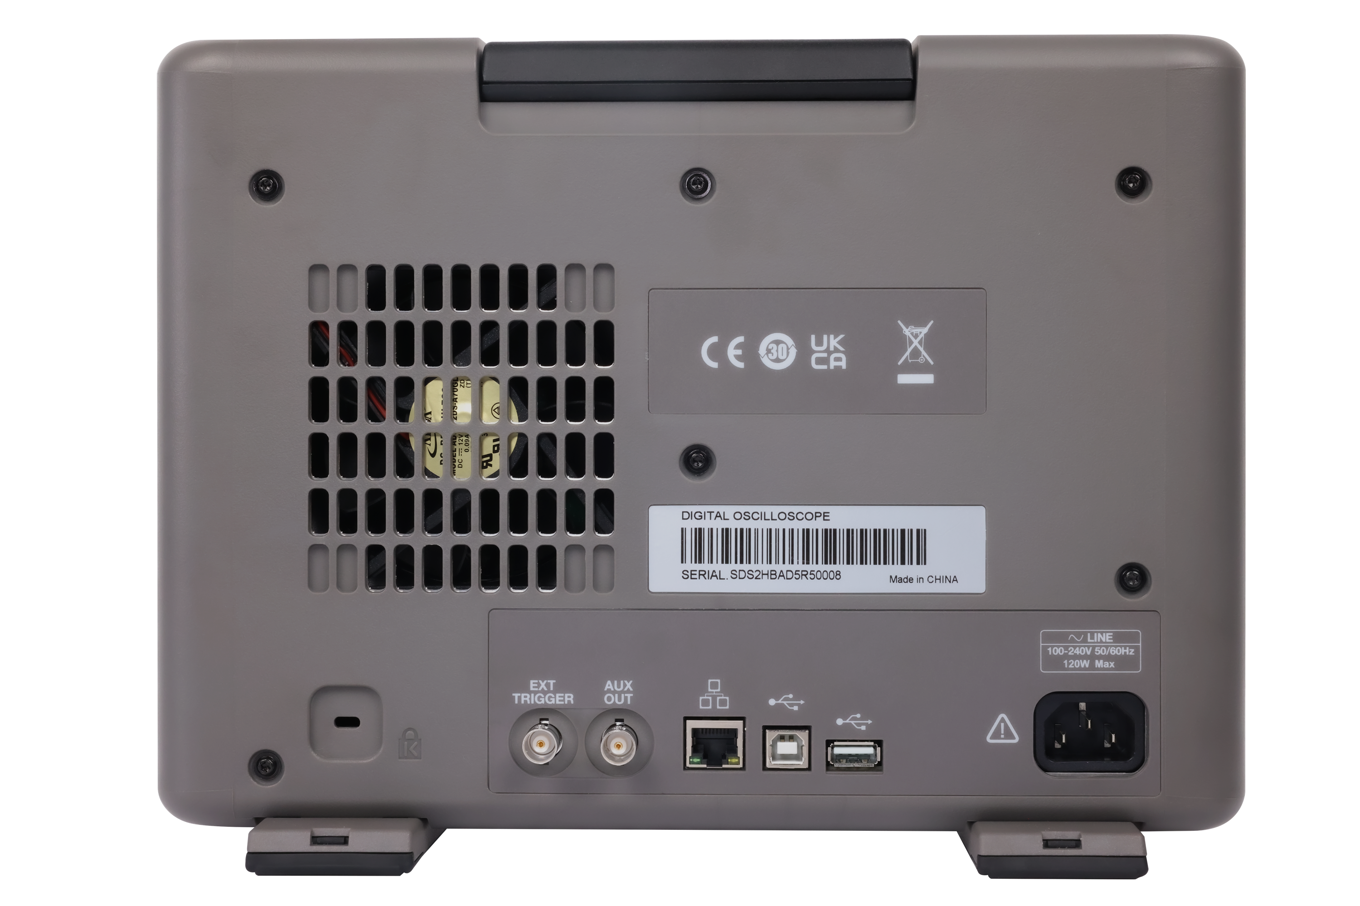
Rear
Panel
Handle
USB Host Port
AC Power Input
USB 2.0 Device Port
Ext Trigger Input
100M LAN Port
Auxiliary Out

Slide 8
Basic Information
Features & Benefits
Catalogue
Market Applications
VS
Competition Analysis

Slide 9
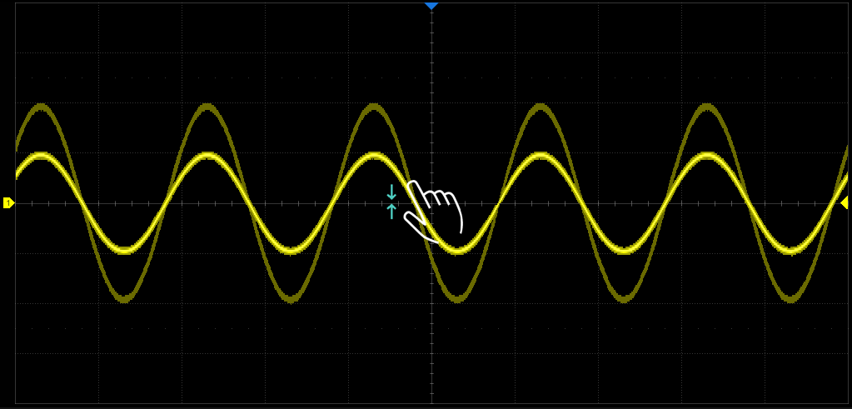

Capacitive Touch Screen
10.1 ‘’
Waveforms can be quickly adjusted
Functions can be easily activated
The operation efficiency can be improved

Slide 10
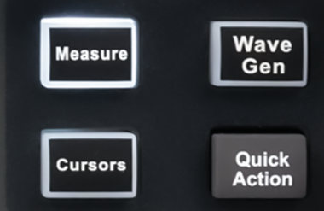
Preset Shortcut Keys
Analysis
Search, Navigate, History, Decode, Mask Test, Bode Plot, Power Analysis, Counter
Edge Trigger
Cycle Source, Cycle Slope, Cycle Coupling, Force Trigger
Display
Type, Color Grade, Persistence, Axis label
A variety of shortcut functions can be set
Satisfy the user's usage habits
Other
Save/Recall, LAN Config

Slide 11
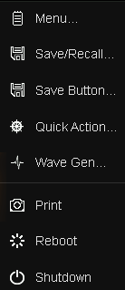
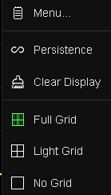
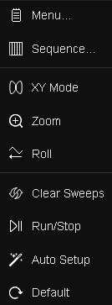
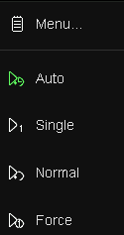
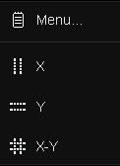
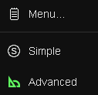
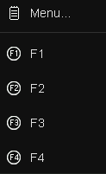
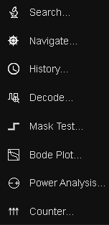
Intuitive Menu Structure
Clear functional layout
Simple and easy to operate

Slide 12
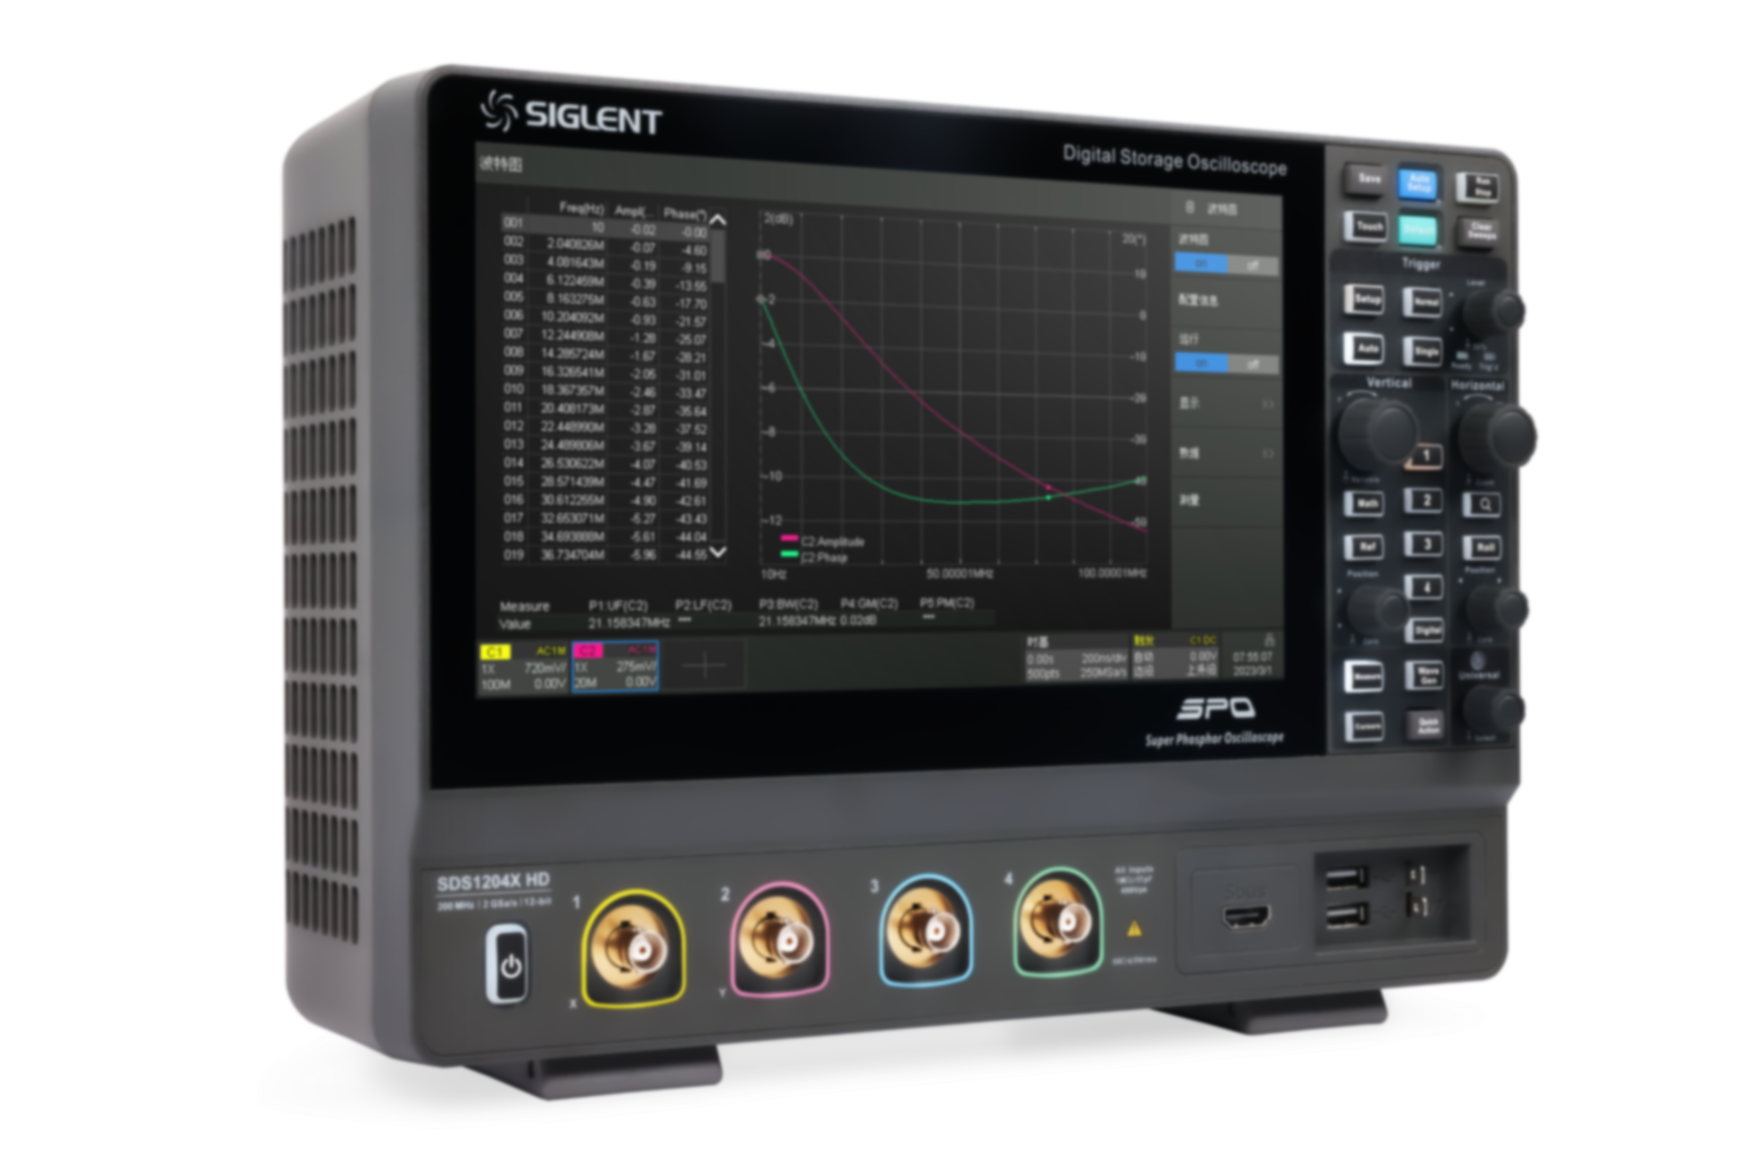
Appropriate Bandwidth
100 MHz
200 MHz
√
SDS1102X HD
√
SDS1202X HD
√
SDS1104X HD
√
SDS1204X HD
Power measurement
Embedded design
Automotive electronic test
Education and scientific research
Power supply design and analysis
High precision sensor measurement

Slide 13
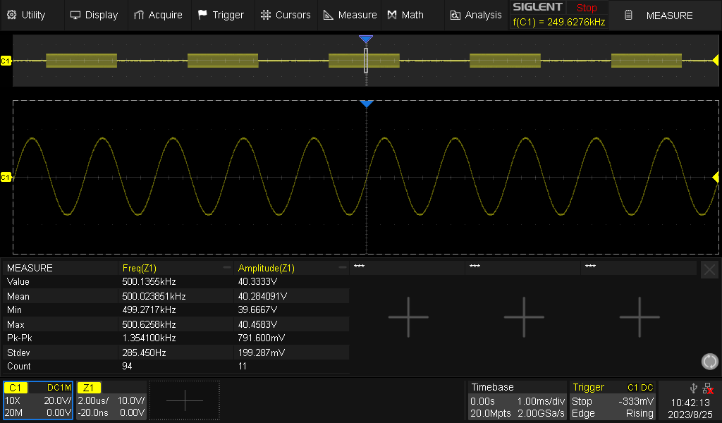
Ample Sampling Rate
2GSa/s sampling rate for the whole series
More realistic waveform restoration
More accurate measurement parameters

Slide 14
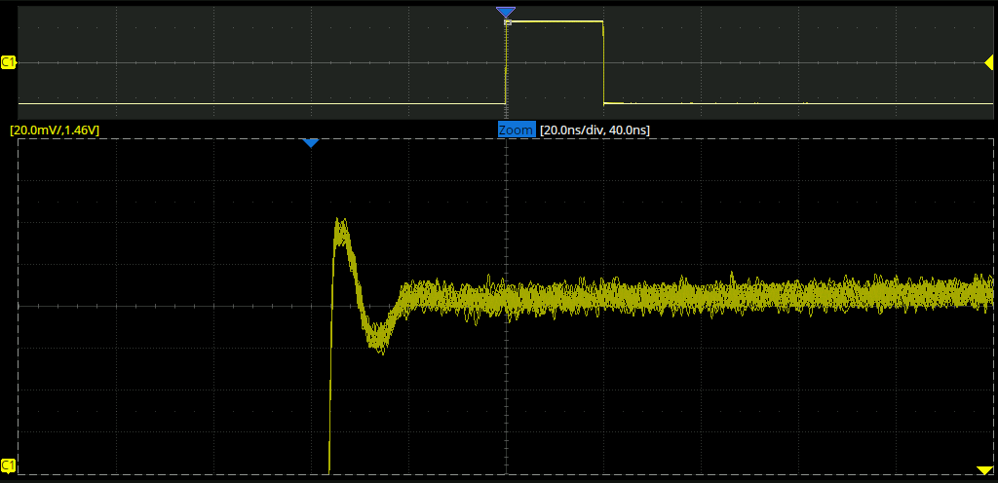
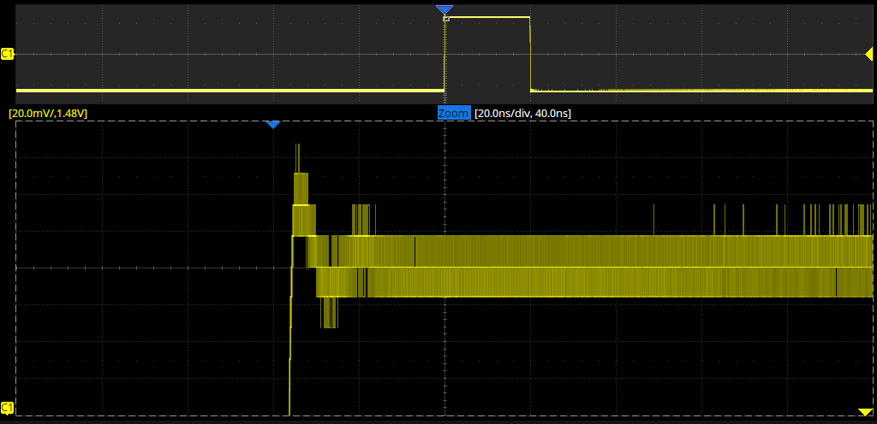
12-bit High Resolution
More waveform details
The waveform is displayed more clearly
Accuracy is 16 times that of the traditional 8-bit oscilloscope
12-bit
Measurement of small signal
Characteristic analysis of power supply
Inquiring and locating faults
8-bit

Slide 15
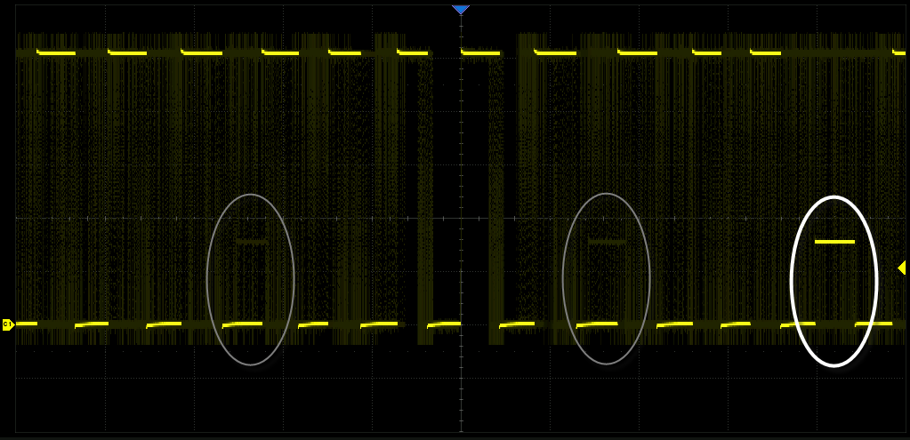
Waveform Capture Rate
Normal mode: 120, 000 wfm/s
Sequence mode: 500, 000 wfm/s
Easily capture low probability abnormal events

Slide 16
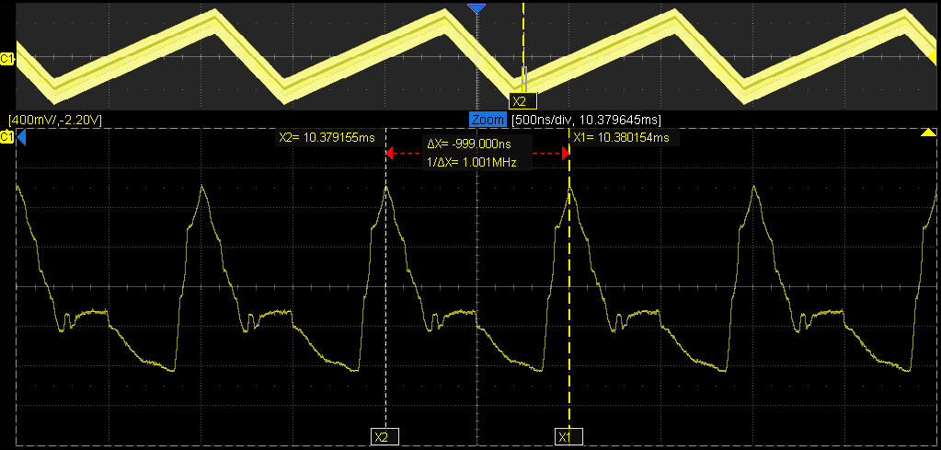
Memory Depth
100 Mpts/ch
Zoom (vertical+horizontal)
Long time observation
Give consideration to the whole and details

Slide 17
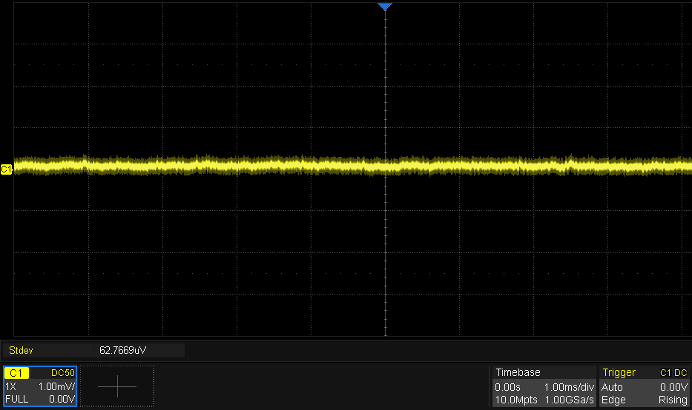
Noise Floor
Conducive to small signal measurement
The measurement result is more accurate
Power integrity measurement results are as low as millivolts
62 μVrms

Slide 18
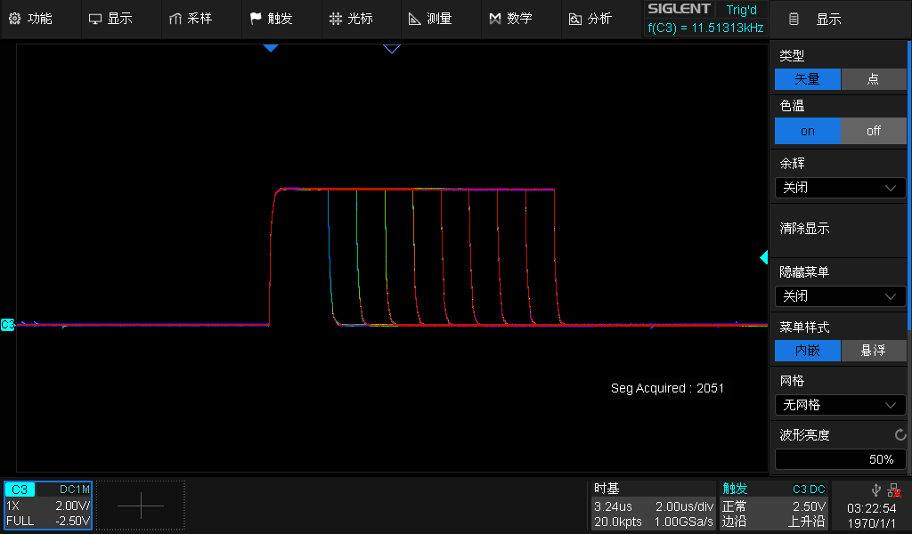
Color Temperature Display Mode
Easily display the probability of waveform occurrence
  The higher the frequency, the warmer the color
  The lower the frequency, the colder the color

Slide 19
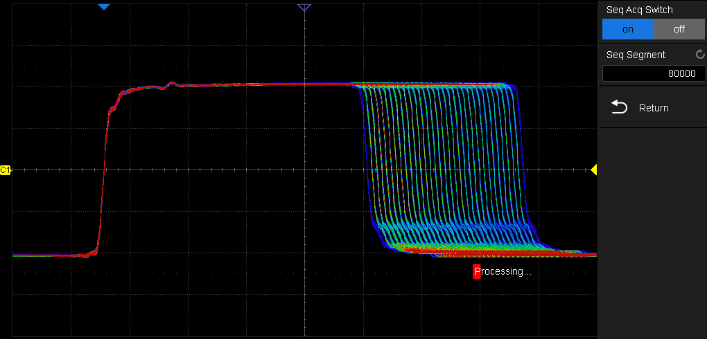
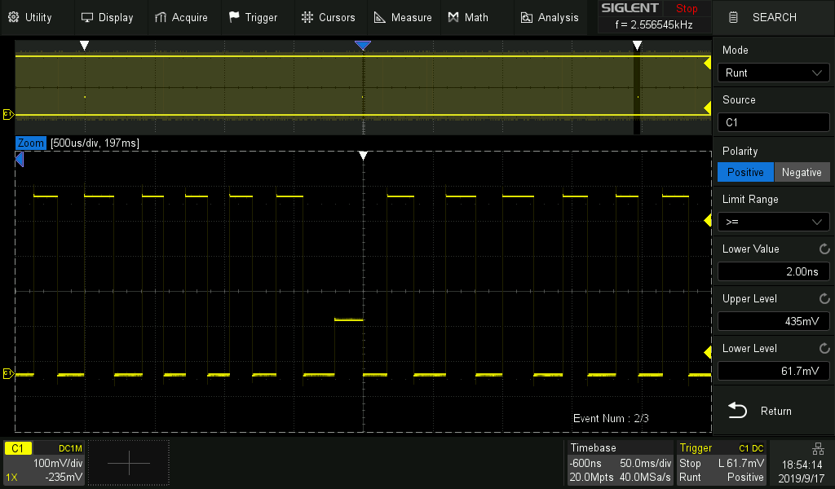
Sequence Mode & History Mode
Divide the memory length into multiple segments (up to 80,000)
The interval between segments can be as small as 2μs
All waveforms that satisfy the trigger conditions are mapped to the display
List displays the frame index and time label for each frame
All of the segments can be played back using the History Mode

Slide 20
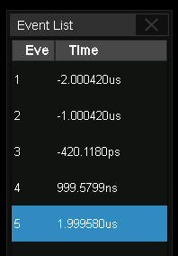
Search and Navigate
Search mode:
Edge, Slope, Pulse, Interval, Runt
Total number of events
White triangle indicators
Event list
Navigate type: Search Event, Time, History Frame
Quickly locate the event of interest

Slide 21
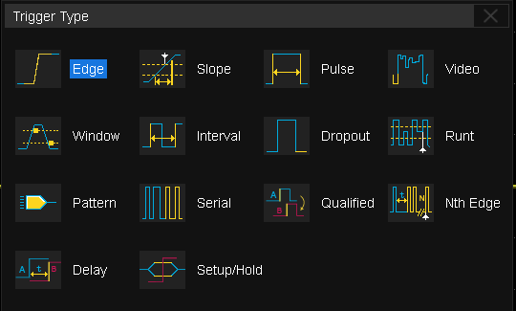
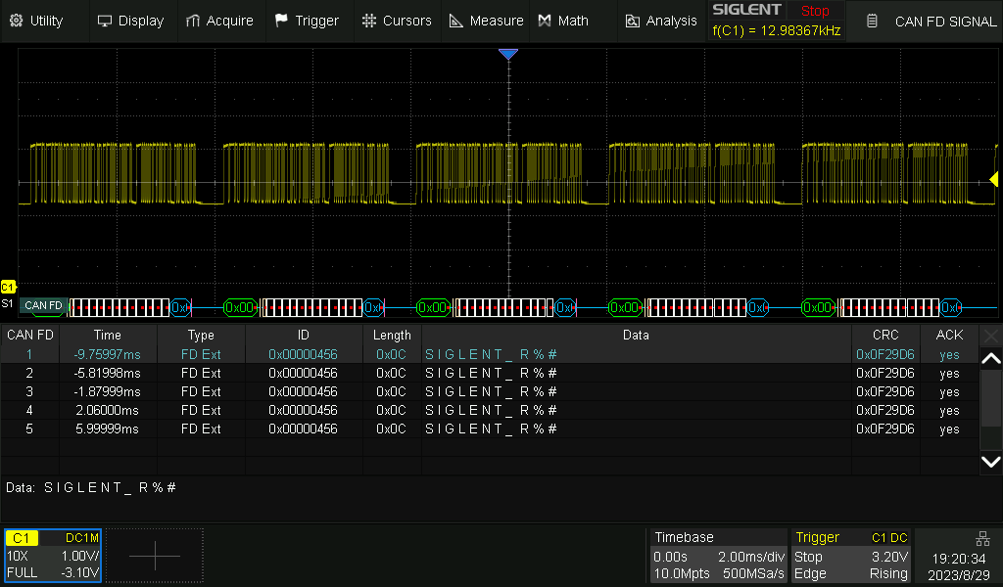
Serial Trigger and Decode
standard: IIC, SPI, UART, CAN, LIN,
CAN FD(decode only) , FlexRay(decode only)
Stabilize waveform and isolate related signal events accurately
Two buses can be decoded at the same time
Display: decode result
original waveforms
decode result of multiple frames

Slide 22
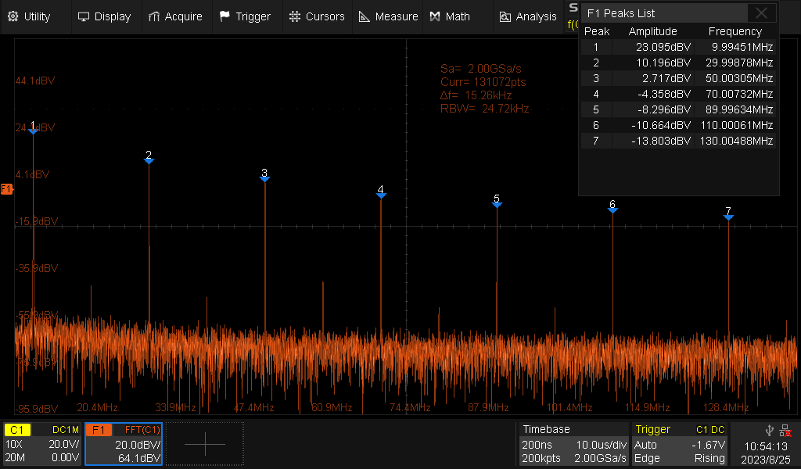
FFT
2 Mpts
3 display modes
  Split
  Full Screen
  Exclusive
Peaks and Markers
Analyze signal in frequency domain

Slide 23
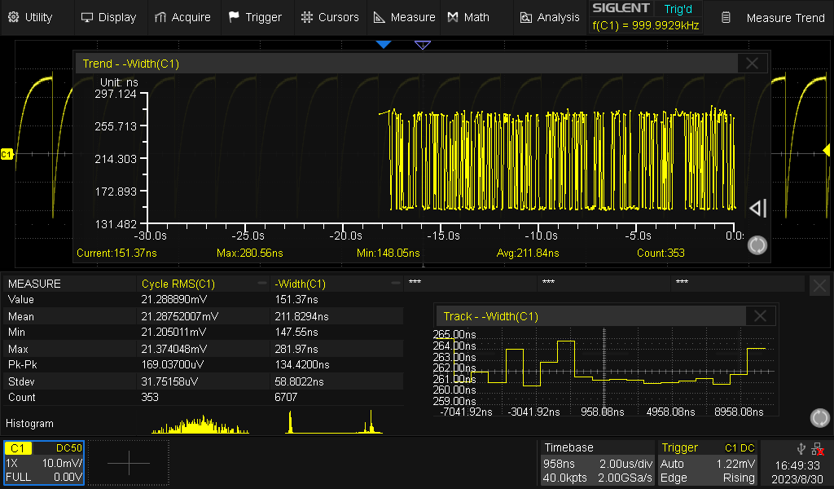
Measurement: 66 parameters
Trend /Track :the variation law of parameters with time
Histogram: probability distribution of measured parameters
Measurement sources: C1~C4, Math1~Math4, Zoom1~Zoom4, Ref A~Ref D

Slide 24
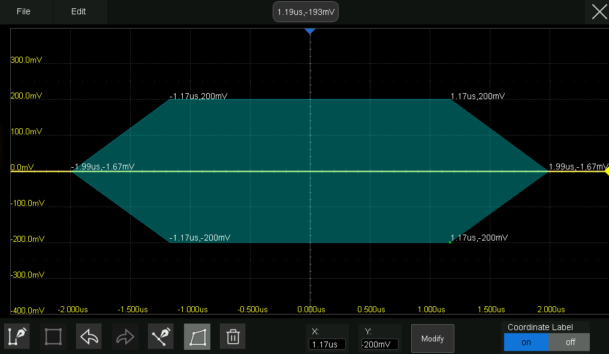

Mask Test
Mask Editor
Up to 80,000 Pass / Fail decisions each second
product quality verification
Long-term signal monitoring
Automated production line testing

Slide 25
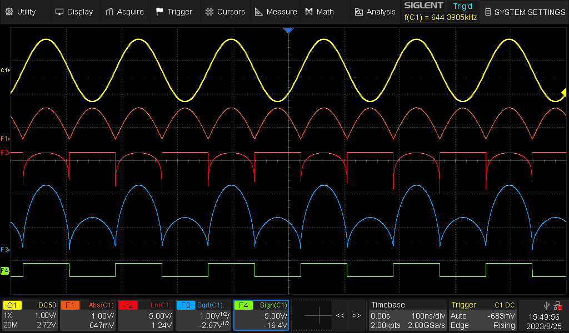
Math
Multiple operators
Formula Editor
4 math traces are available
More than 20 kinds of common mathematical operations

Slide 26
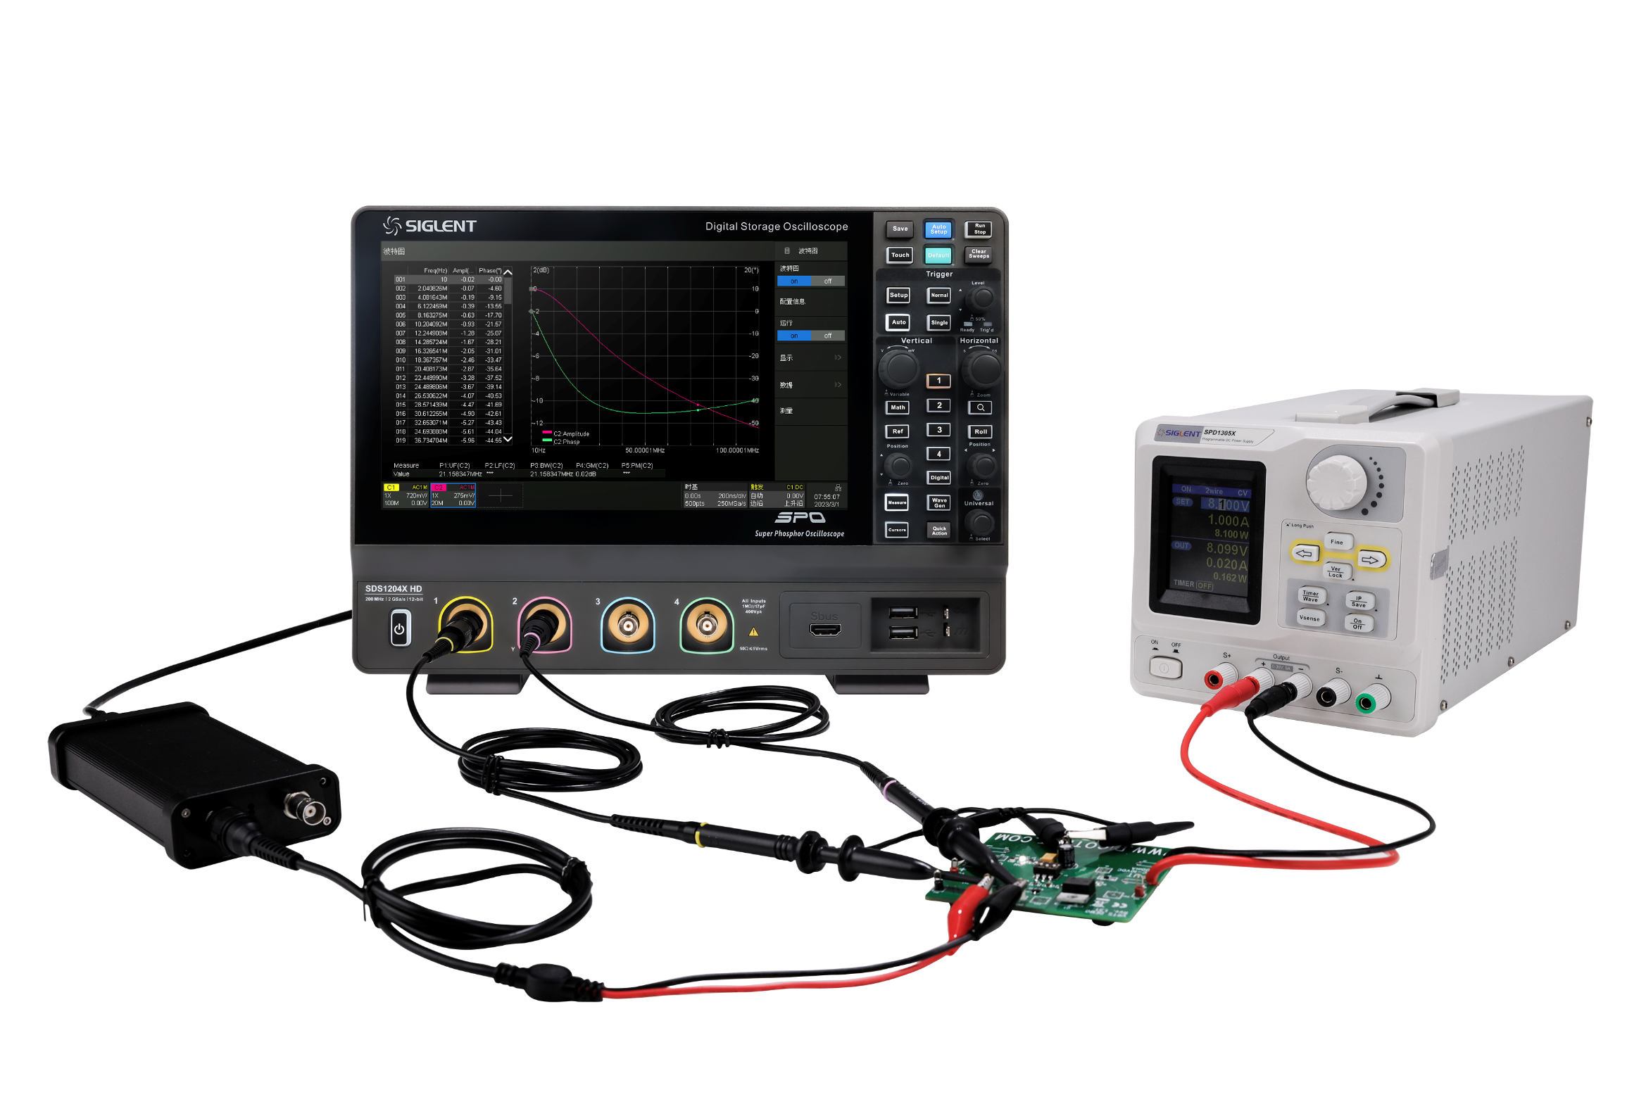
Bode Plot (Optional)
Amplitude-frequency characteristic
Phase-frequency characteristic
Measurement parameters
Bandwidth (BW)
Gain margin (GM)
Phase margin (PM)
  Upper cut-off frequency (UF)
  Lower cut-off frequency (LF)
Power supply loop response analysis

Slide 27
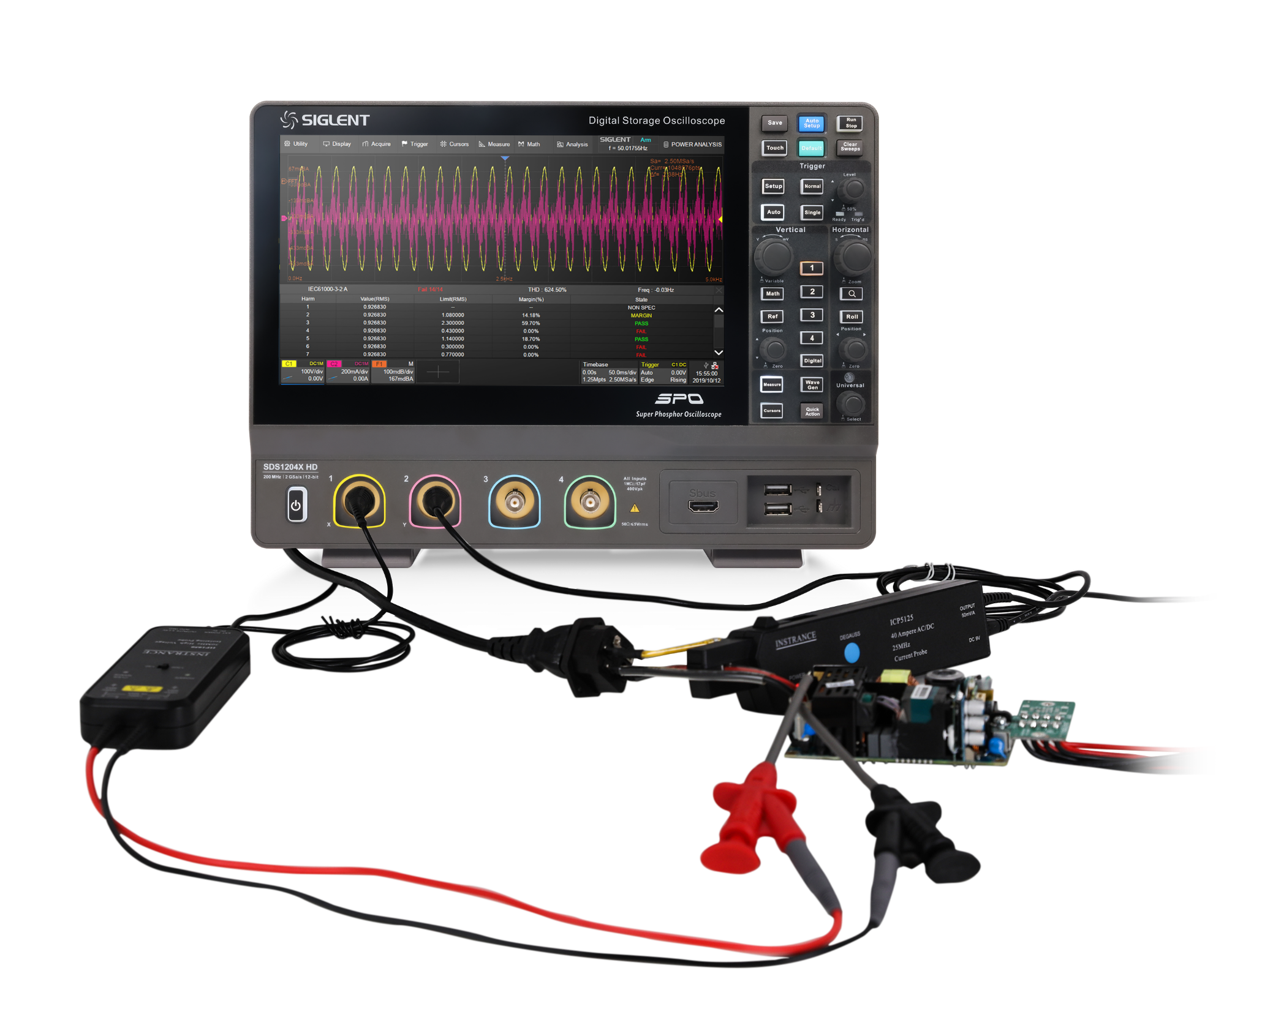
Power Analysis (Optional)
Parameter measurement of switching power devices
Analysis of modulation characteristics of power supply control loop
Harmonic analysis of line power
Power Quality
Current Harmonics
Inrush Current
Switching Loss
Slew Rate
Modulation
Turn On/Turn Off
Transient Response
PSRR
Power Efficiency
Output Ripple
SOA

Slide 28
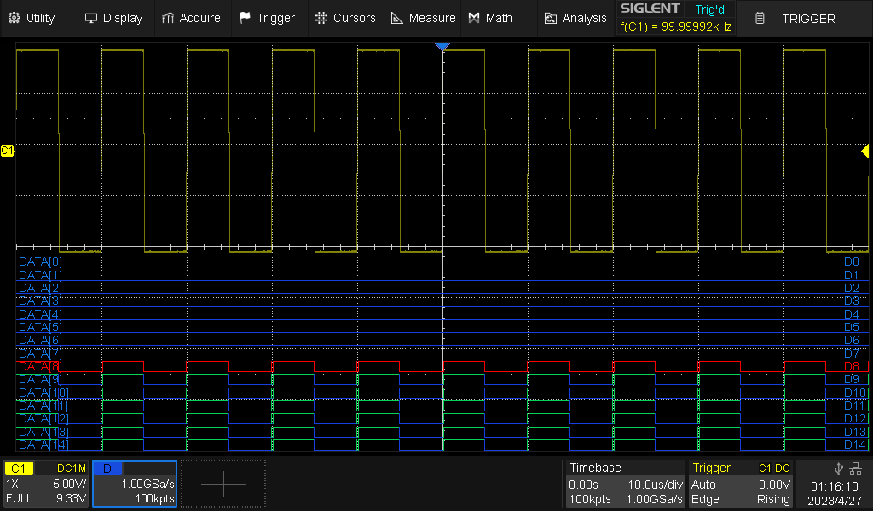
Digital Channels (Optional)
Increase 16 digital channels
Realize the function of collecting and analyzing mixed signals

Slide 29
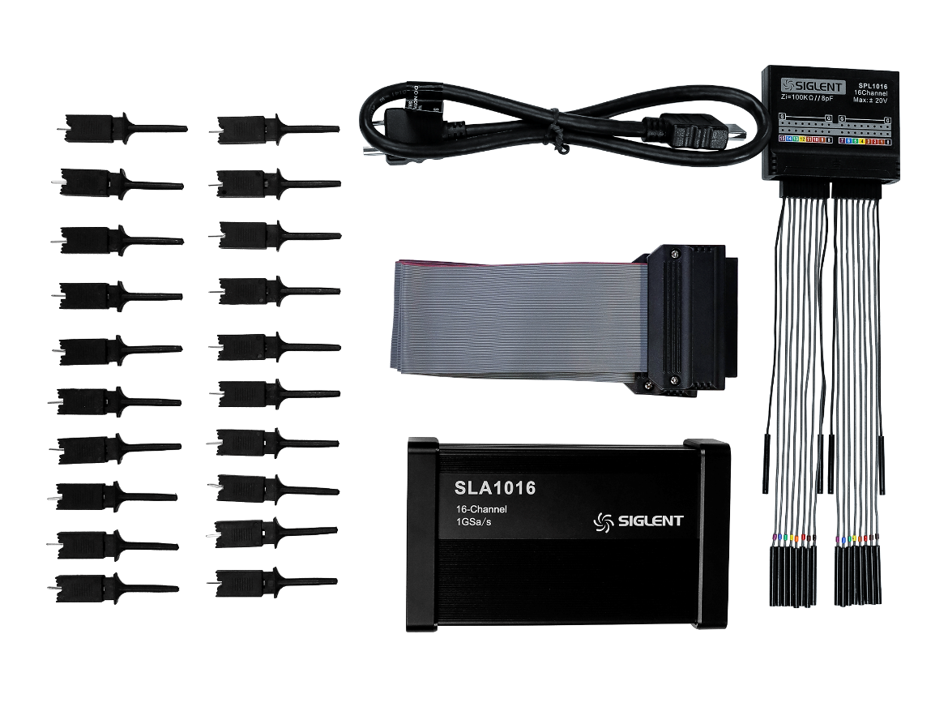
Digital channel (Optional)
16-channel logic probe SLA1016
Max. Sampling Rate | 1GSa/s
Memory Depth | 10 Mpts/ch
Min. Detectable Pulse Width | 3.3 ns
Level Group | D0~D7, D8~D15
Level Range | -10 V~10 V
Logic Type | TTL, CMOS, LVCMOS3.3, LVCMOS2.5, user-defined
Skew | D0~D15: ±1 sampling interval Digital to Analog: ± (1 sampling interval +1 ns) Digital to Analog(Triggered On Analog): ±4ns

Slide 30
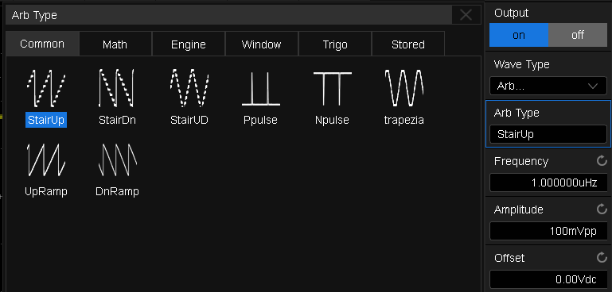
Waveform Generator (Optional)
25MHz predefined waveform output
Users can edit arbitrary waveforms using SIGLENT EasyWaveX PC software
Power loop analysis (without external isolation transformer)
Save space and budget
Suitable for teaching laboratories or design laboratories

Slide 31
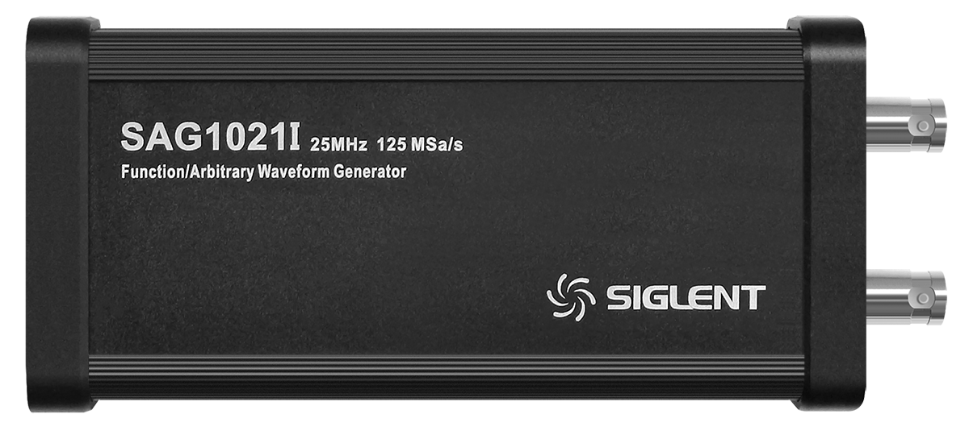
Waveform Generator (Optional)
USB arbitrary waveform generator SAG1021I
Channels | 1
Max. Output Frequency | 25 MHz
Sampling Rate | 125 MSa/s
Frequency Resolution | 1 μHz
Frequency Accuracy | ±50 ppm
Vertical Resolution | 14-bit
Amplitude Range | -1.5 V ~ +1.5 V (into 50 Ω) -3 V ~ +3 V (into High-Z)
Waveforms | Sine, Square, Ramp, Pulse, DC, Noise, 45 Arbitrary
Output Impedance | 50 Ω±2%
Protection | Over voltage protection, Current limit

Slide 32
Features & Benefits Summary
10.1-inch ultra-clear large screen: improving efficiency
Quickly adjust waveforms and activate functions and settings
Excellent noise floor: as low as 70μVrms at full bandwidth
  Suitable for small signal measurement, and the measurement result is more accurate
Intuitive menu structure: simple and easy to use
  The layout of options is clear, and similar functions are under the same column
12-bit vertical resolution: accurate
beneficial to small signal measurement
Large offset compensation range: automatically adjust to the screen centerline
The maximum offset range of 400 V can be provided, which is suitable for measuring small voltage under large DC bias
100 Msamples standard memory : both overall and detailed
It can be scaled vertically and horizontally, and can also be observed for a long time at a large sampling rate

Slide 33
Features & Benefits Summary
Preset shortcut key: satisfy personal habits
  Various shortcut key behaviors can be set independently to improve operation efficiency
Persistence and color temperature display mode: observing waveform trajectory
Master the probability of waveform occurrence and find abnormal waveform
History mode: playback at any time
Automatic real-time recording, observing abnormal events through historical waveforms, and quickly locating the source of the problem
Search and Navigate
It is beneficial to know the signal situation in a long acquisition period, and it is easy to browse different events under various search conditions
Remote web control over LAN: getting rid of space constraints
Support remote access and operation of oscilloscope directly through webpage, and monitor oscilloscope waveform anytime and anywhere
Trigger and decode: stabilize the waveform and complete debugging
Ensure the reliability of subsequent measurement, display the decoding results in various forms, and speed up the development efficiency

Slide 34
Features & Benefits Summary
Automatic measurement: 66 parameters
Measuring multiple channels at the same time, the statistical function can observe the average value and standard deviation, and can quickly evaluate the signal characteristics
FFT function: Easily analyze signal spectrum
Display spectrum in real time, can mark peaks and harmonics, and display amplitude values
Mask test: a powerful tool for quality inspection
Used for signal quality evaluation, it can monitor the failure rate of waveform for a long time, saving time and cost
Math: multi-channel parallel to improve efficiency
Four Math traces are provided. In addition to basic math operations, advanced operations such as FFT, exponents and formula editors are also provided
Digital channels: mixed signal analysis
It can realize the collection function of 16 digital channels, and combine digital channels with analog channels to realize the collection and analysis function of mixed signals
25 MHz arbitrary waveform generator: supports multiple waveforms
Arbitrary waveform can be edited by EasyWave PC software, which is suitable for teaching and R&D

Slide 35
Basic Information
Features & Benefits
Catalogue
Market Applications
VS
Competition Analysis

Slide 36
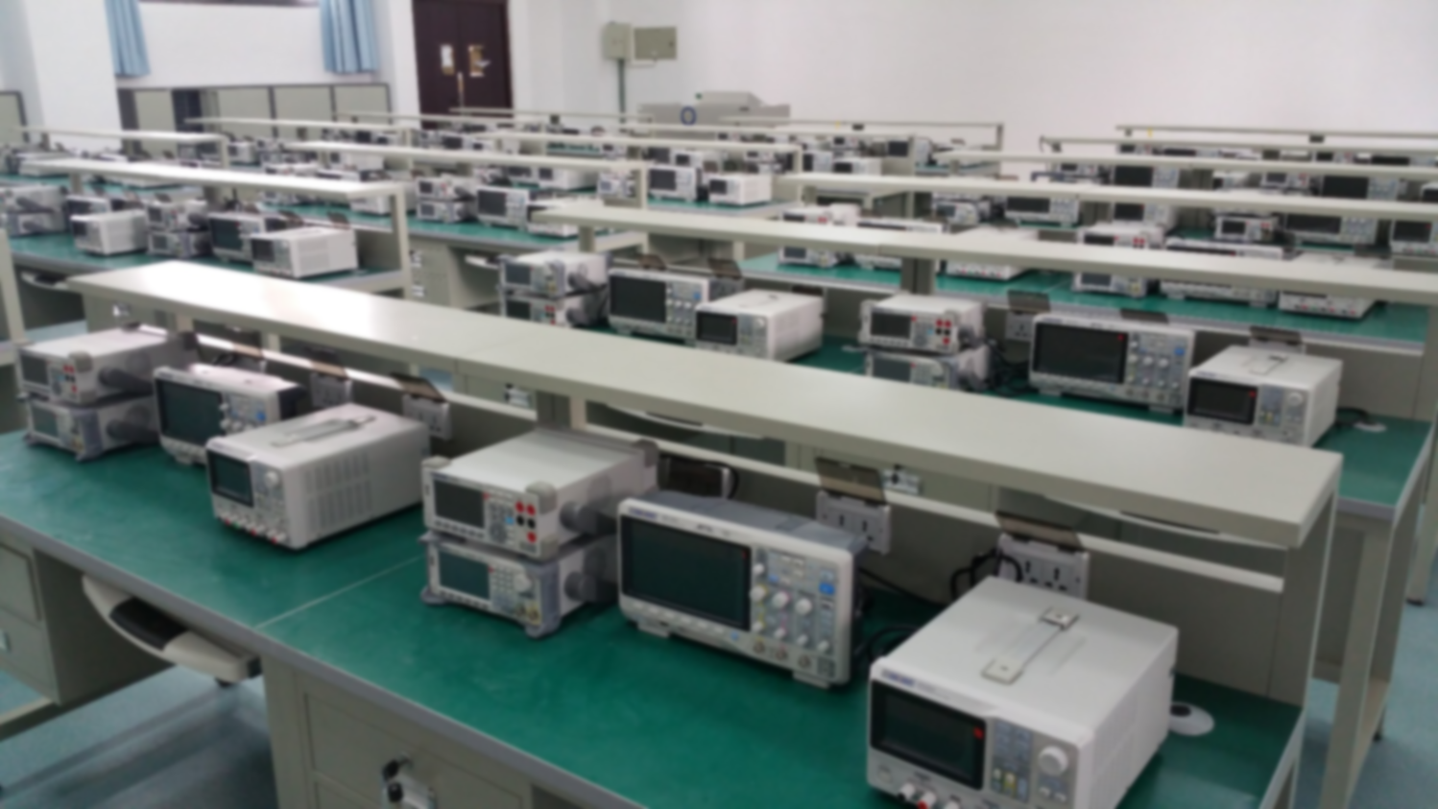
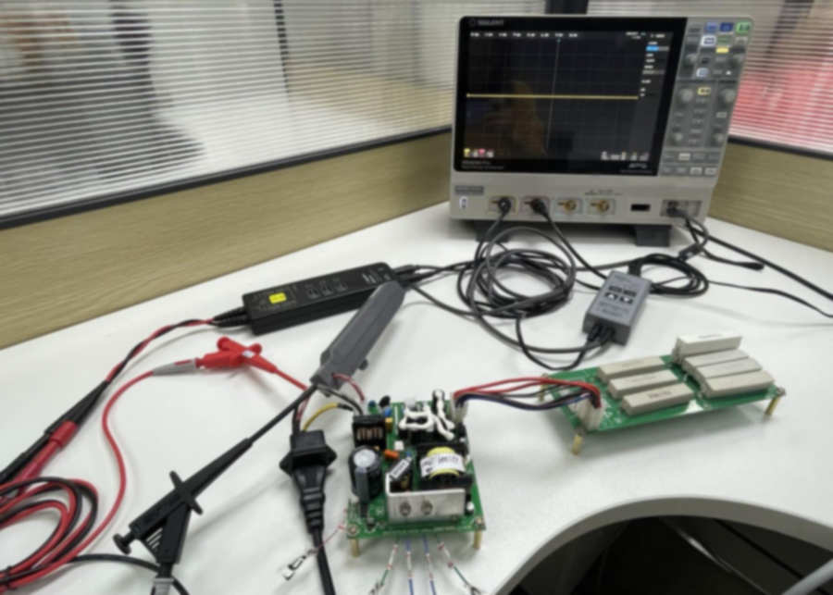
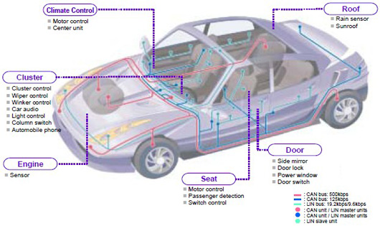
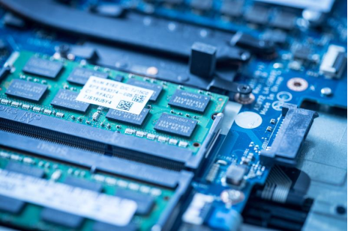
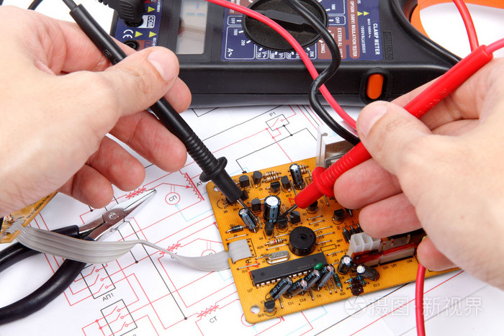
Teaching laboratory
Power supply analysis
Automotive electronic test
Embedded design
Electrical maintenance

Slide 37
Basic Information
Features & Benefits
Catalogue
Market Applications
VS
Competition Analysis

Slide 38
 | SDS1000X HD |  | DHO1000 | DHO1000
Main Specifications
channels | 2/4 |  | 2/4 | 2/4
bandwidth | 100/200MHz |  | 70/100/200MHz | 70/100/200MHz
Vertical resolution | 12-bit |  | 12-bit | 12-bit
Sample rate | 2GSa/s (single channel) 1GSa/s (half channels) 500MSa/s (all channels) |  | 2GSa/s (single channel) 1GSa/s (half channels) 500MSa/s (all channels) | Single channel mode: 2GSa/s dual channel mode: 1GSa/s other modes: 500msa/s.
Memory depth | 100 Mpts (standard) |  | 50Mpts (standard) 100Mpts (optional) | 50Mpts (standard) 100Mpts (optional)
Waveform capture rate | Normal mode：120,000 wfm/s Sequence mode：500,000 wfm/s |  | Vector mode: 50,000 wfms/s UltraAcquire mode: 1,500,000 wfms/s | Vector mode: 50,000 wfms/s condensed time acquisition mode: 1,500,000 wfms/s
Noise floor | 70 μVrms（200MHz) |  | NA | NA
Other Specifications
Vertical scale (probe 1X) | 1 MΩ: 0.5 mV/div – 10 V/div 50 Ω: 0.5 mV/div – 1 V/div |  |  | 1 MΩ:500 μV/div~10 V/div
Peak detect | 2 ns |  |  | 2 ns
Skew (CH1~CH4) | < 100 ps |  |  | ≤2 ns
Time base accuracy | ± 25ppm |  |  | ±5 ppm ± 1 ppm/year
DC gain accuracy | 0.5 mV/div ~ 4.95 mV/div: ± 1.5 %; 5 mV/div ~ 10 V/div: ± 0.5 % |  |  | ± 2%
Offset range (probe 1X) | 1 MΩ: 0.5 mV/div ~ 5 mV/div: ±1.6 V; 5.1 mV/div ~ 10 mV/div: ±4 V; 10.2 mV/div ~ 20 mV/div:±8 V; 20.5 mV/div ~ 100 mV/div: ± 8 V； 102 mV/div ~ 200 mV/div: ±80 V; 205 mV/div ~ 1 V/div: ± 80 V; 1.02 V/div ~ 10 V/div: ±400 V | 50 Ω: 0.5 mV/div ~ 5 mV/div: ±1.6V; 5.1 mV/div ~ 10 mV/div: ±4 V; 10.2 mV/div ~ 20 mV/div:±8 V; 20.5 mV/div ~ 10 0mV/div: ± 8 V | 50 Ω: 0.5 mV/div ~ 5 mV/div: ±1.6V; 5.1 mV/div ~ 10 mV/div: ±4 V; 10.2 mV/div ~ 20 mV/div:±8 V; 20.5 mV/div ~ 10 0mV/div: ± 8 V | 1MΩ： ≤65 mV/div：± 1 V； 65 mV/div~ 270 mV/div：± 10 V ； 270 mV/div~2.75 V/div：± 20 V； 2.75 V/div~10 V/div：± 100 V
CH to CH Isolation (@50Ω) | DC～Max BW： >40dB |  |  | ≥100:1
I/O | 3*USB Host, USB Device, LAN, Pass/Fail, Trigger Out, SBUS |  |  | 2*USB Host, USB Device , LAN, Pass/Fail, Trigger Out, 10 MHz IN/OUT, AUX OUT, EXT TRIG, HDMI
Display | 10.1 inches |  |  | 10.1 inches

Slide 39
 |  | SDS1000X HD | DHO1000
Common functions
Search and navigate | Search mode | Edge, Slope, Pulse, Interval, Runt | Edge, pulse width
 | Navigate type | Search Event, Time, History Frame | Search Event, Time, History Frame
History |  | Up to 80,000 frames | Up to 500,000 frames
Digital Voltmeter |  | not support | 4
Counter |  | 7 digits | 3~6 digits
Important functions
Trigger type |  | Edge, Slope, Pulse width, Window, Runt, Interval, Dropout, Pattern, Video, Qualified, Nth edge, Delay, Setup/Hold time, I2C, SPI, RS232/UART, CAN, LIN | Edge, pulse width, slope, video, pattern, duration, timeout, under-amplitude pulse, over-amplitude, delay, setup and hold, nth edge, I2C, SPI, RS232/UART, CAN, LIN.
Serial decoding | Number of simultaneous decoding | 2 | 4
 | standard configuration | I2C, SPI, RS232/UART, CAN, LIN, CAN FD, FlexRay | Parallel, RS232/UART, I2C, SPI, LIN, CAN
Waveform measurement | Measurement type (vertical+horizontal+other) | 66（19+17+30） | 41（17+16+8）
 | No. of Measurements at the same time | 5(M1 mode) /12(M2 mode) | 14
 | statistics | Current, Mean, Min, Max, Stdev, Count, Histogram, Trend, Track | Current, Mean, Min, Max, Stdev, Count
Math | Trace | 4 | 4
 | Operation | FFT, +, -, x, ÷, ∫dt, d/dt, √, Identity, Negation, |x|, Sign, ex, 10x, ln, lg, Interpolation, Max hold, Min hold, ERES, Average, Formula Editor | A+B, A-B, A×B, A/B, FFT, A&&B, A||B, A^B, !A, Intg, Diff, Lg, Ln, Exp, Sqrt, Abs, AX+B, Low Pass, High Pass, Band Pass, Band Stop, and Trend
 | FFT | 2Mpts | 1Mpts
Mask Test |  | support | support
Bode Plot |  | standard | not support
Power Analysis (Option) |  | Power quality, Current Harmonics, Inrush current, Switching loss, Slew rate, Modulation, Output ripple, Turn on/turn off, Transient response, PSRR, Efficiency, SOA | Power quality, output ripple
Digital channel(optional) |  | support | not support
Waveform generator(optional) |  | Sine, Square, Ramp, Pulse, DC, Noise, 45 Arbitrary | not support

Slide 40

Thank You
Industry leader in the field of general electronic test and measurement instruments
Contact information
Company address
www.siglent.com
Service Tel: 400-878-0807
Tel: 0755-36887876
Building 4-5, Antongda Industrial Park, Zone 68, Baoan District, Shenzhen City

