Slide 1


Slide 2
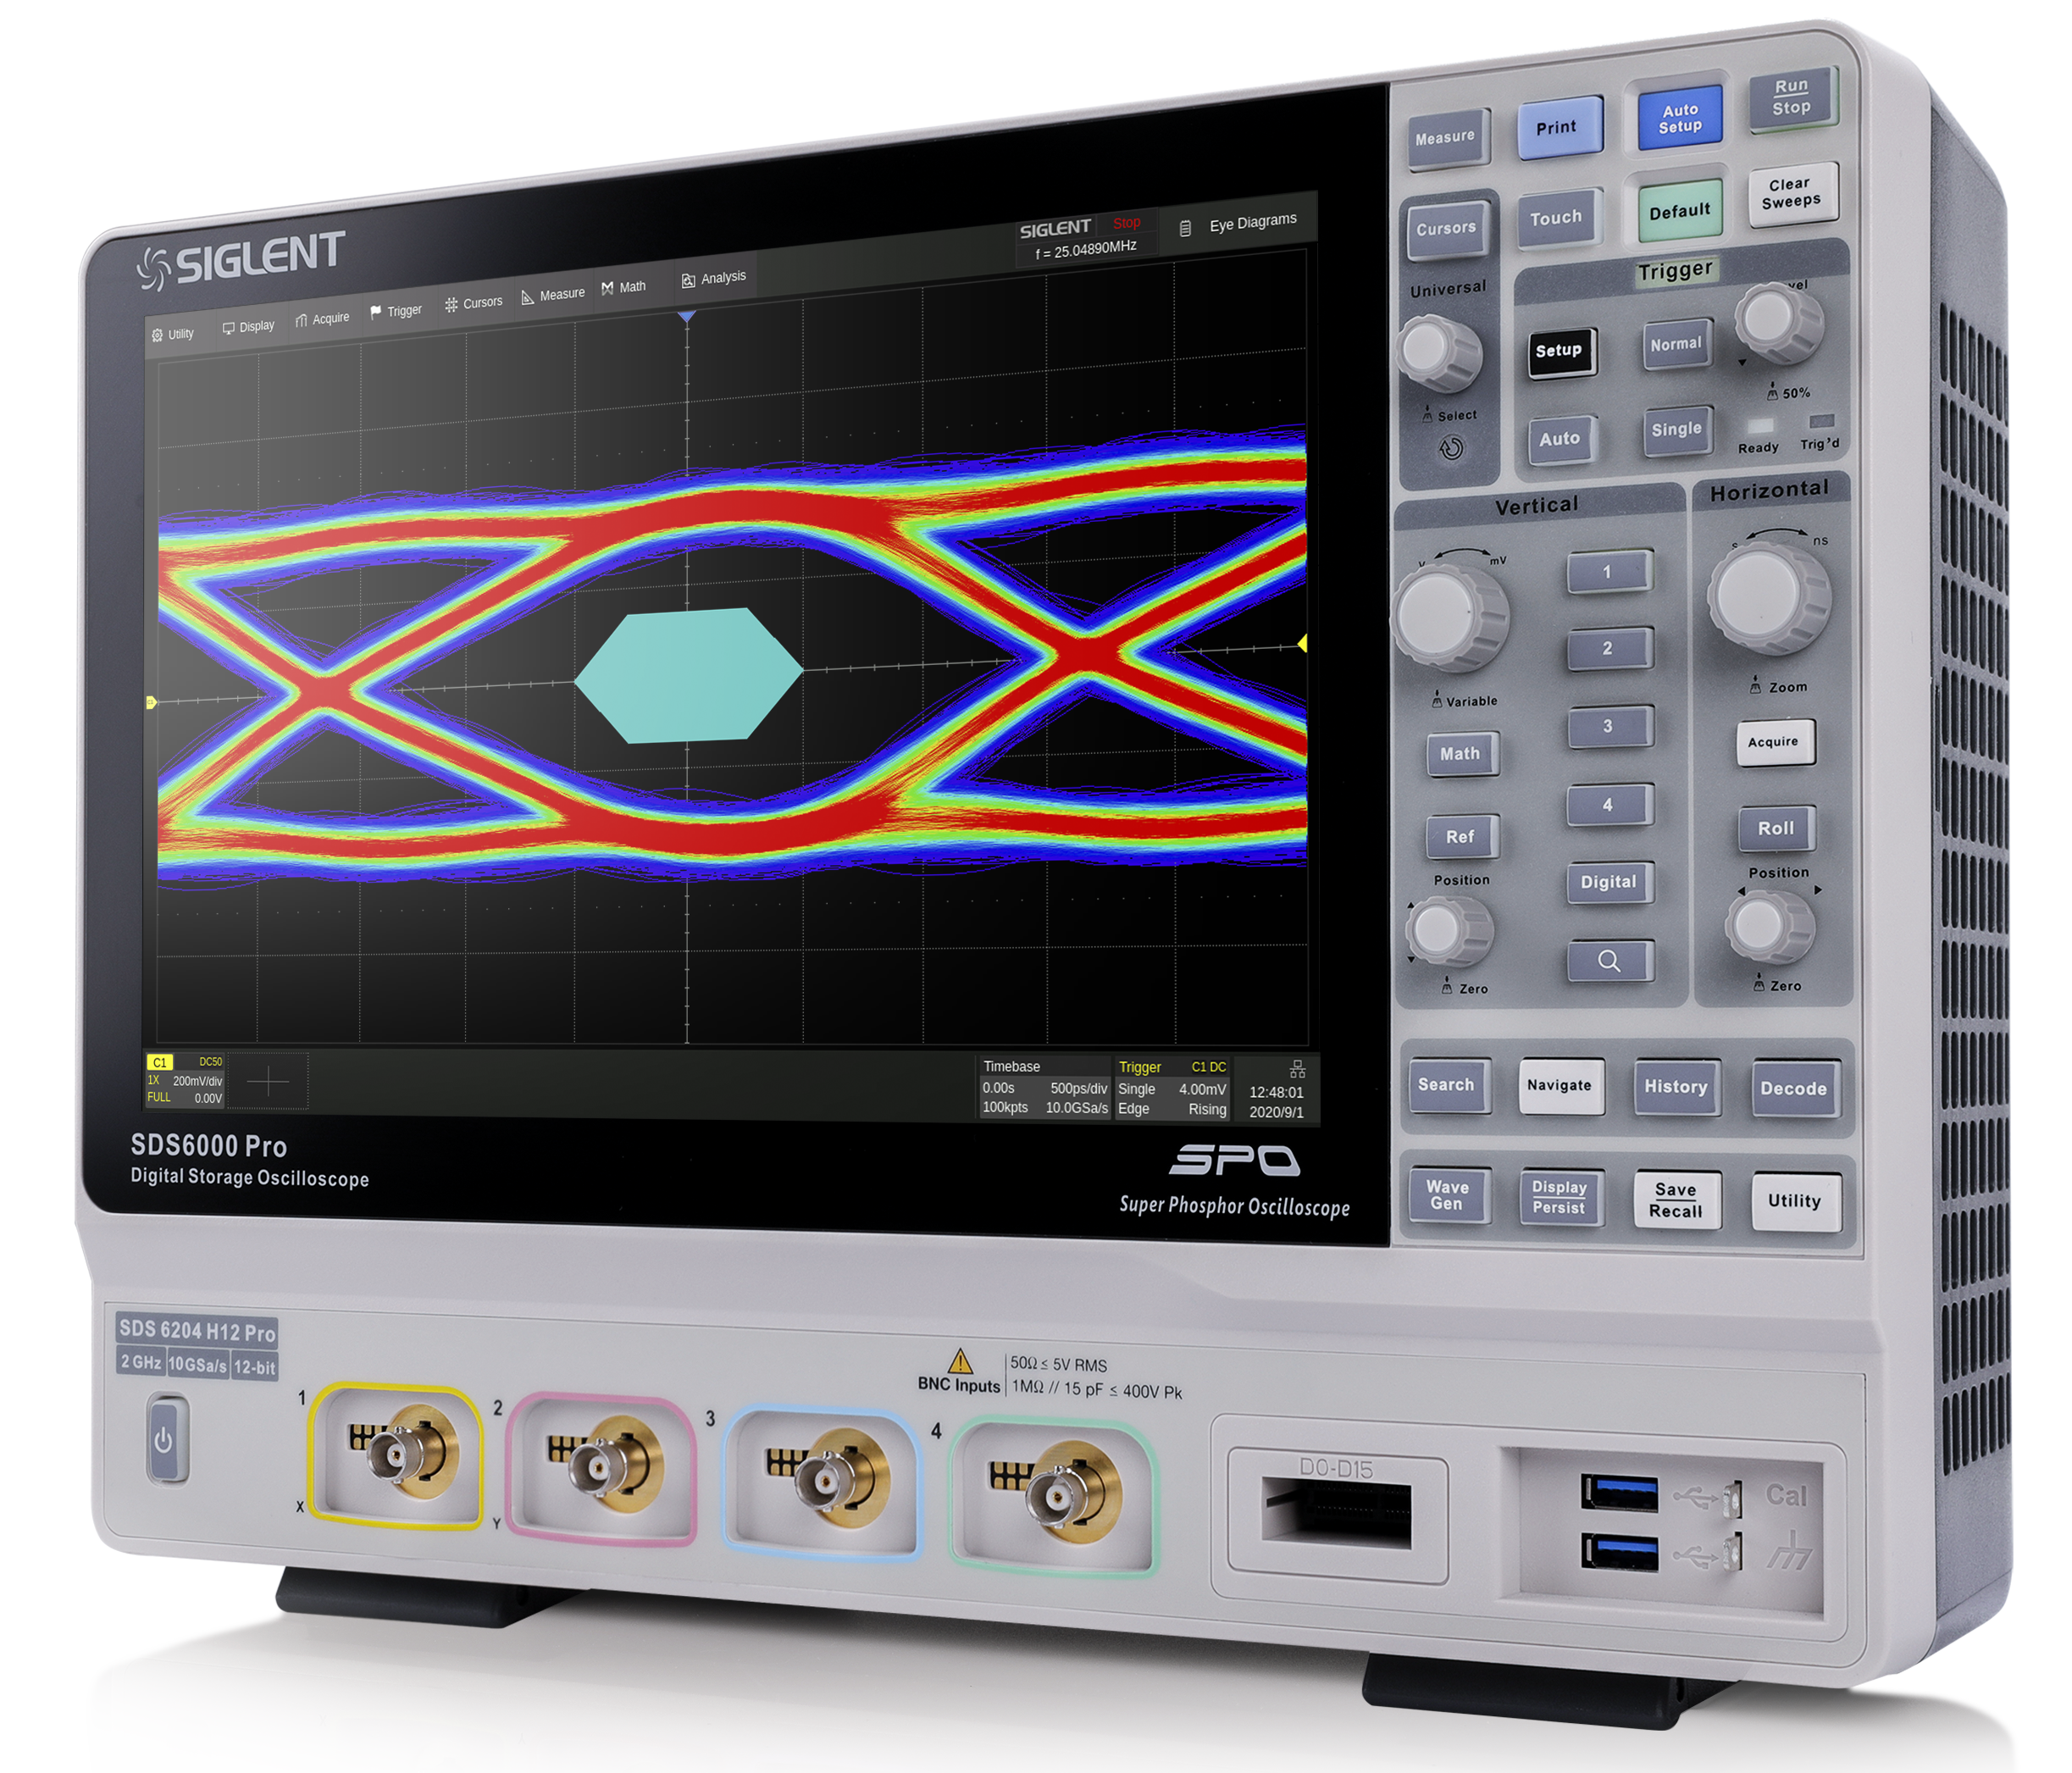
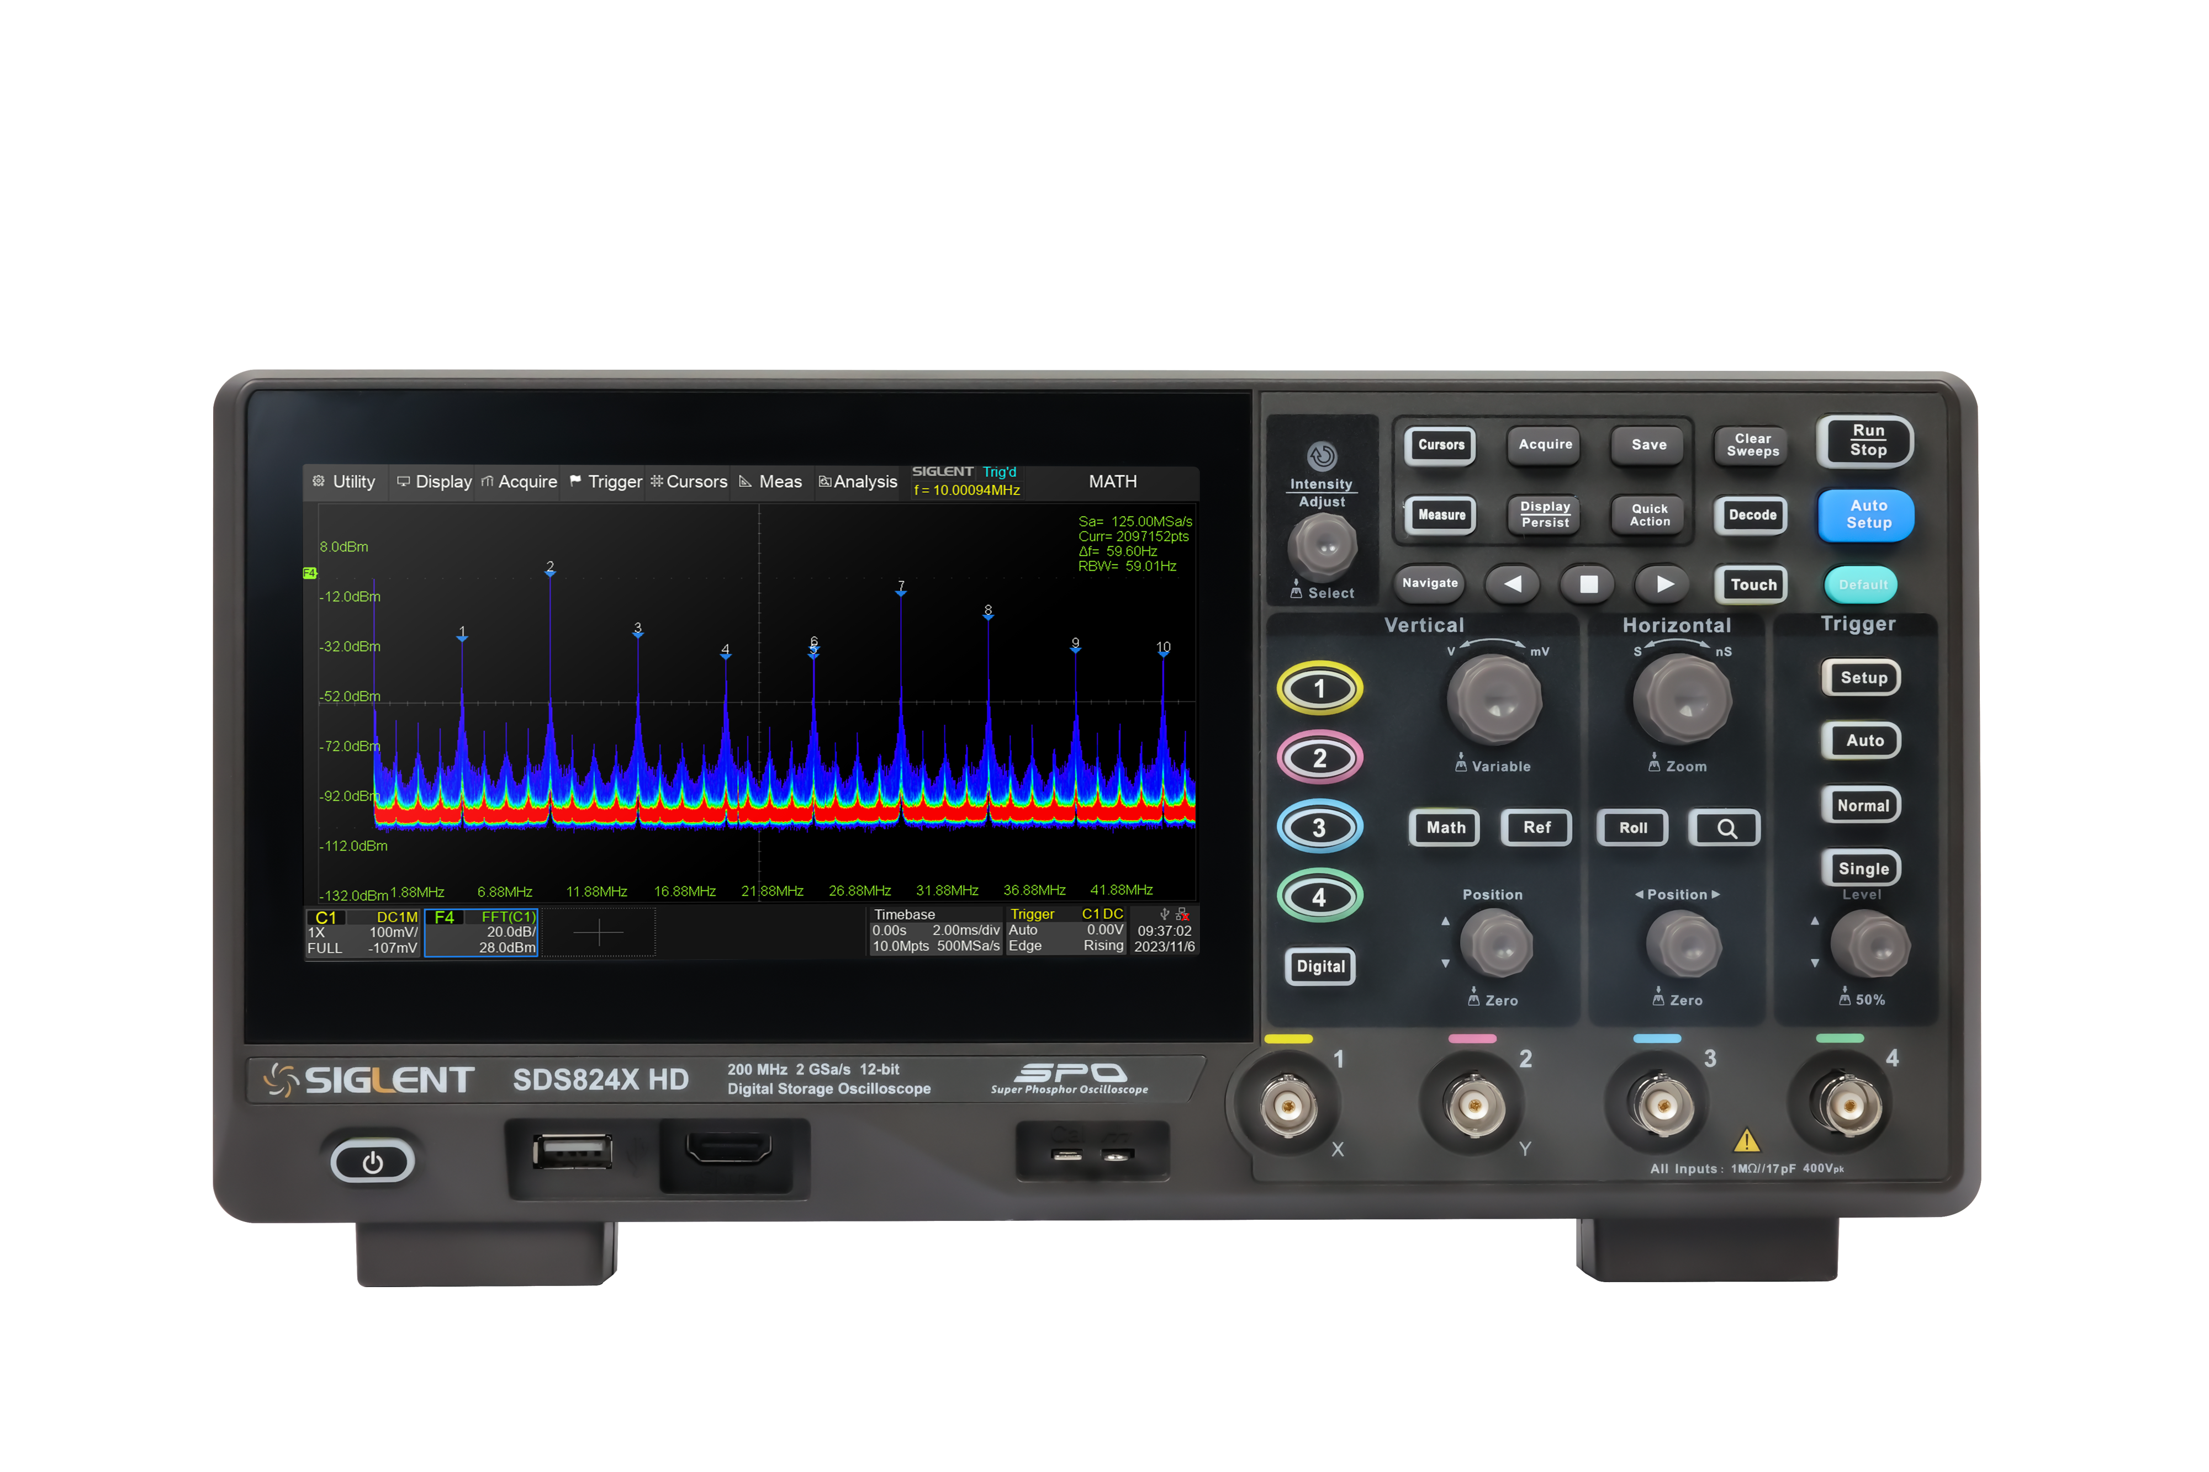
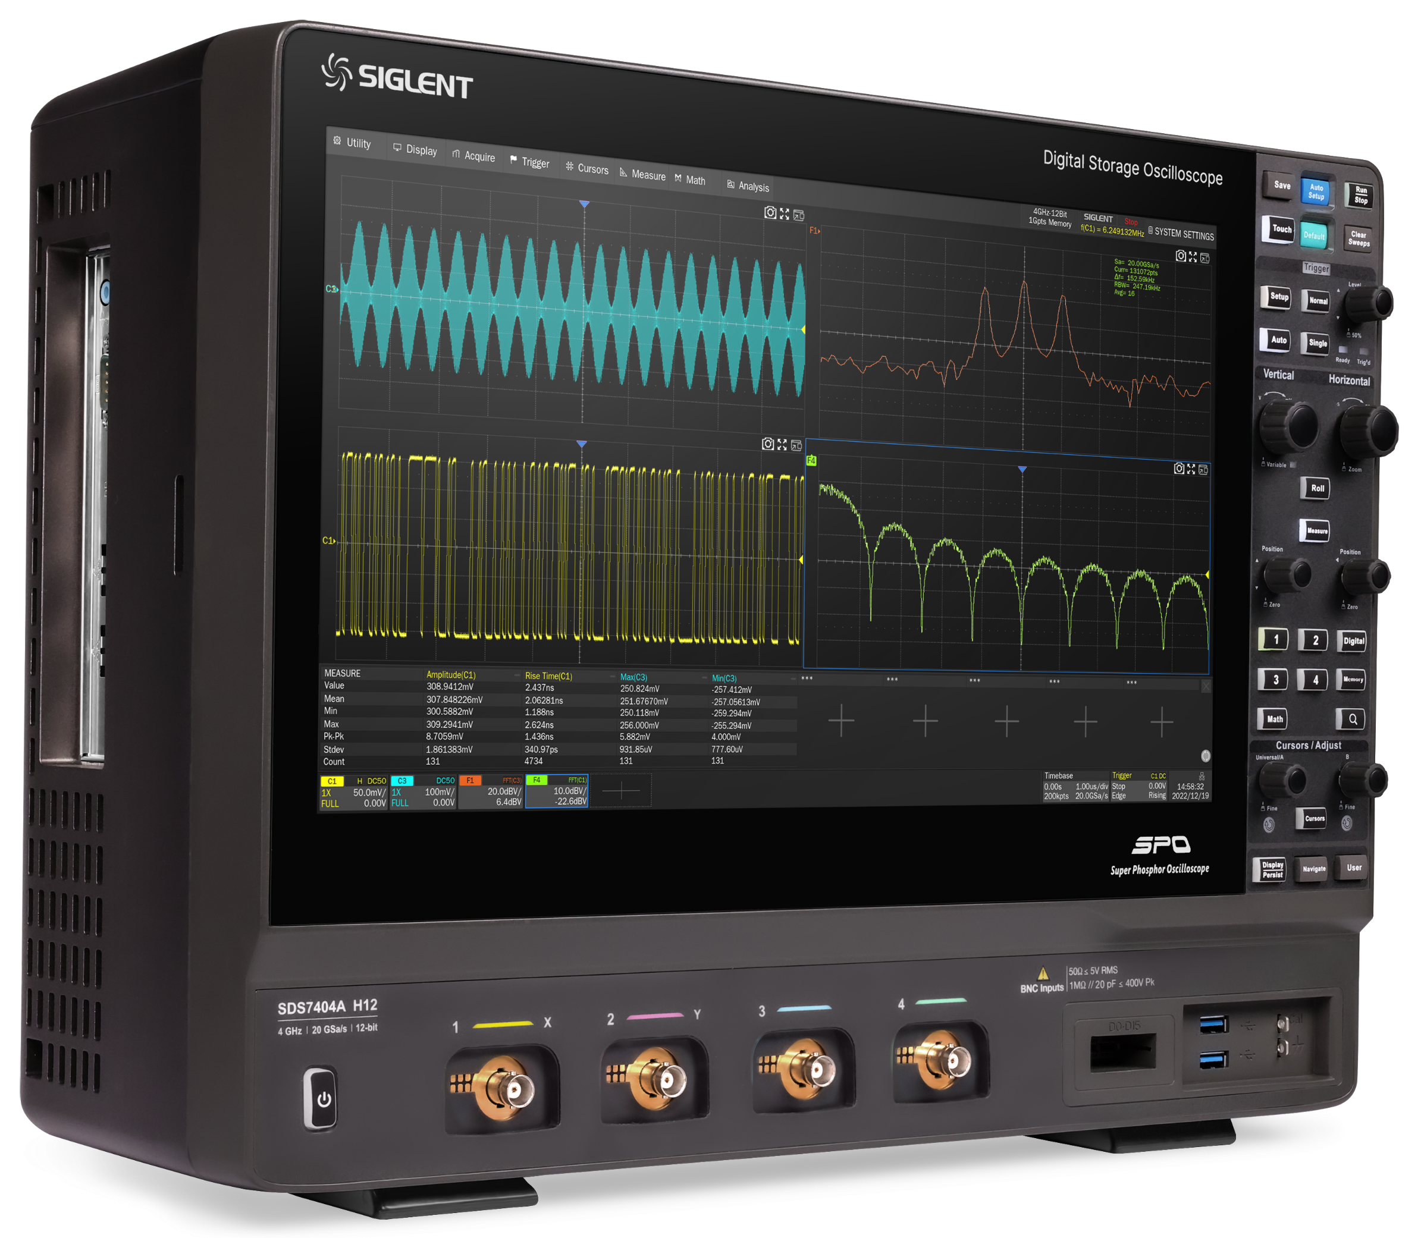
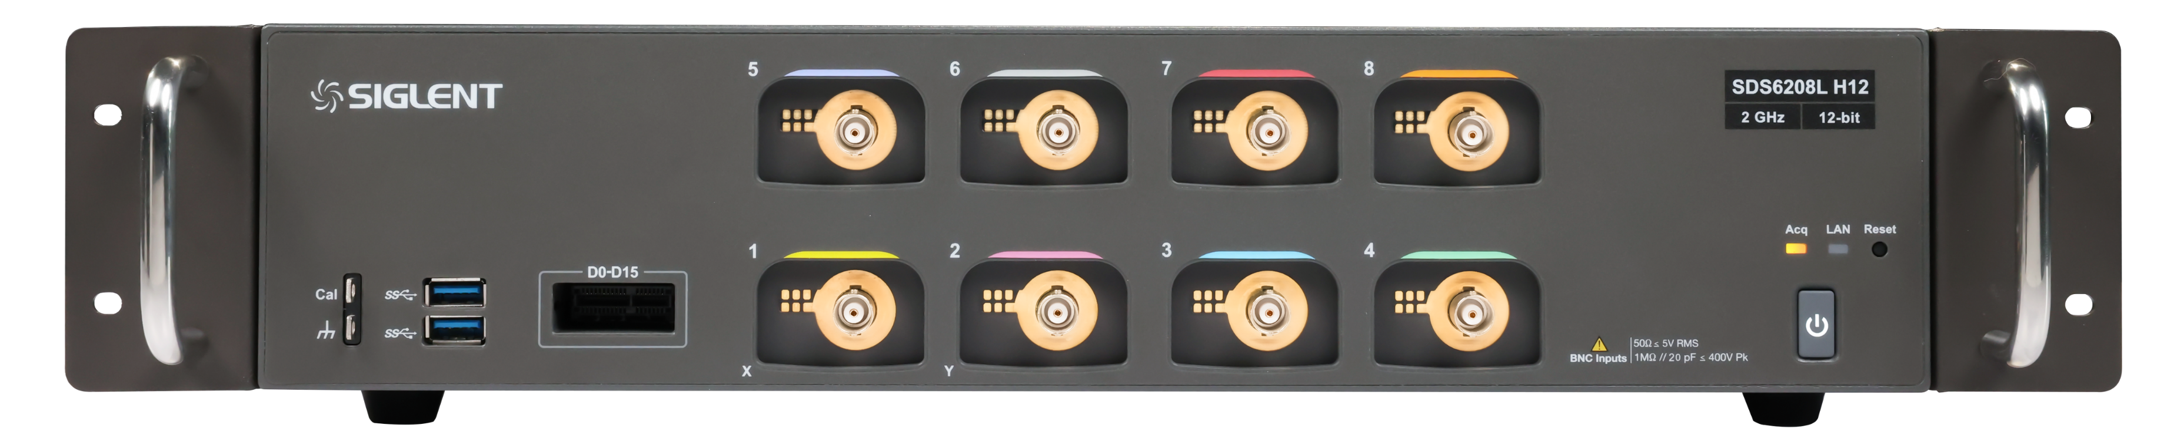
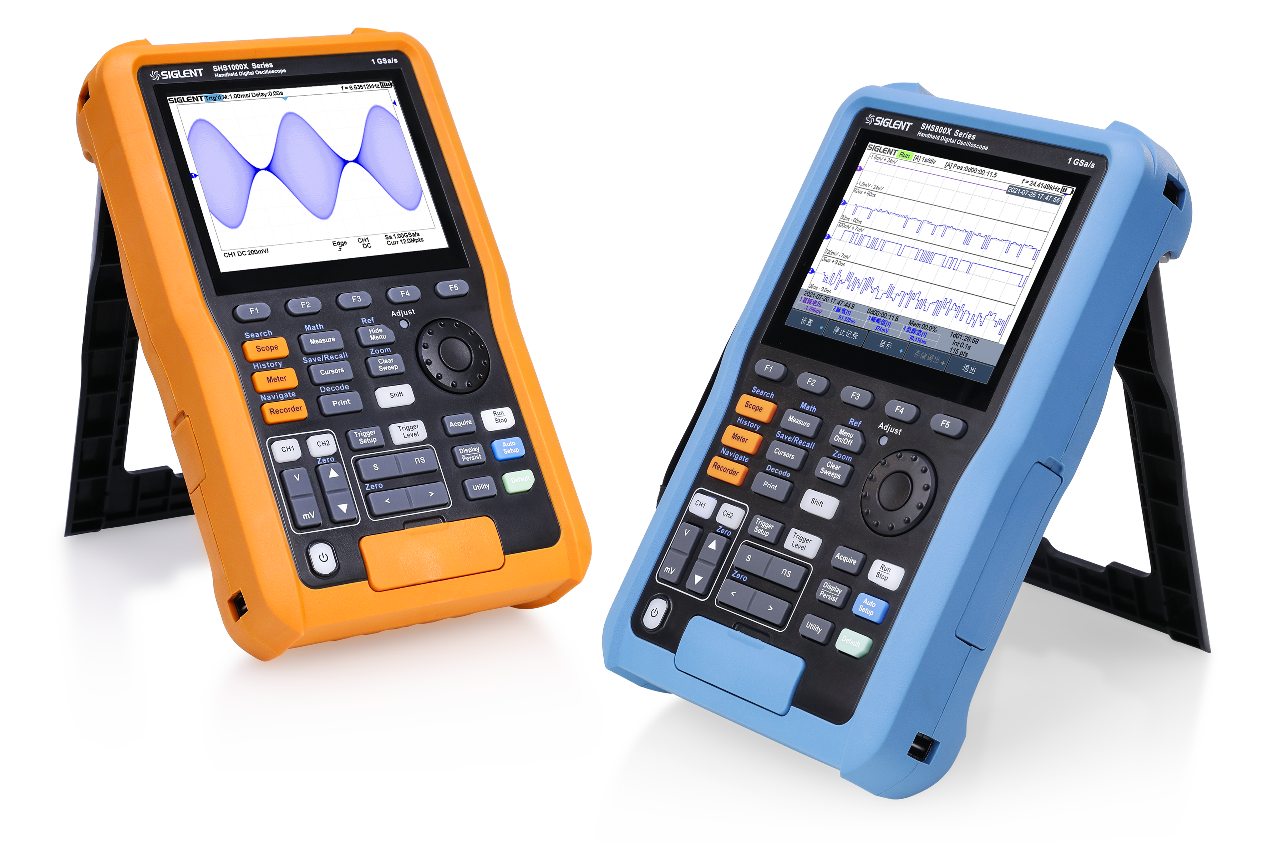
SIGLENT
Digital Oscilloscopes
High-resolution, high-bandwidth oscilloscopes
High-resolution oscilloscopes
Compact Oscilloscopes
Handheld Oscilloscopes

Slide 3
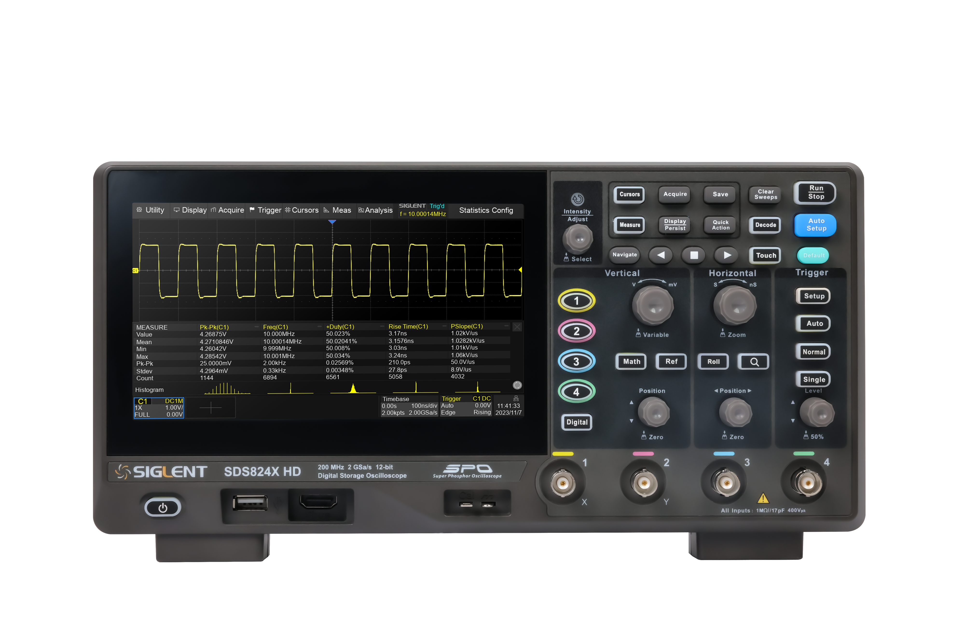
Basic Introduction
Function Characteristics
CONTENTS
Product Comparisons
Applications

Slide 4
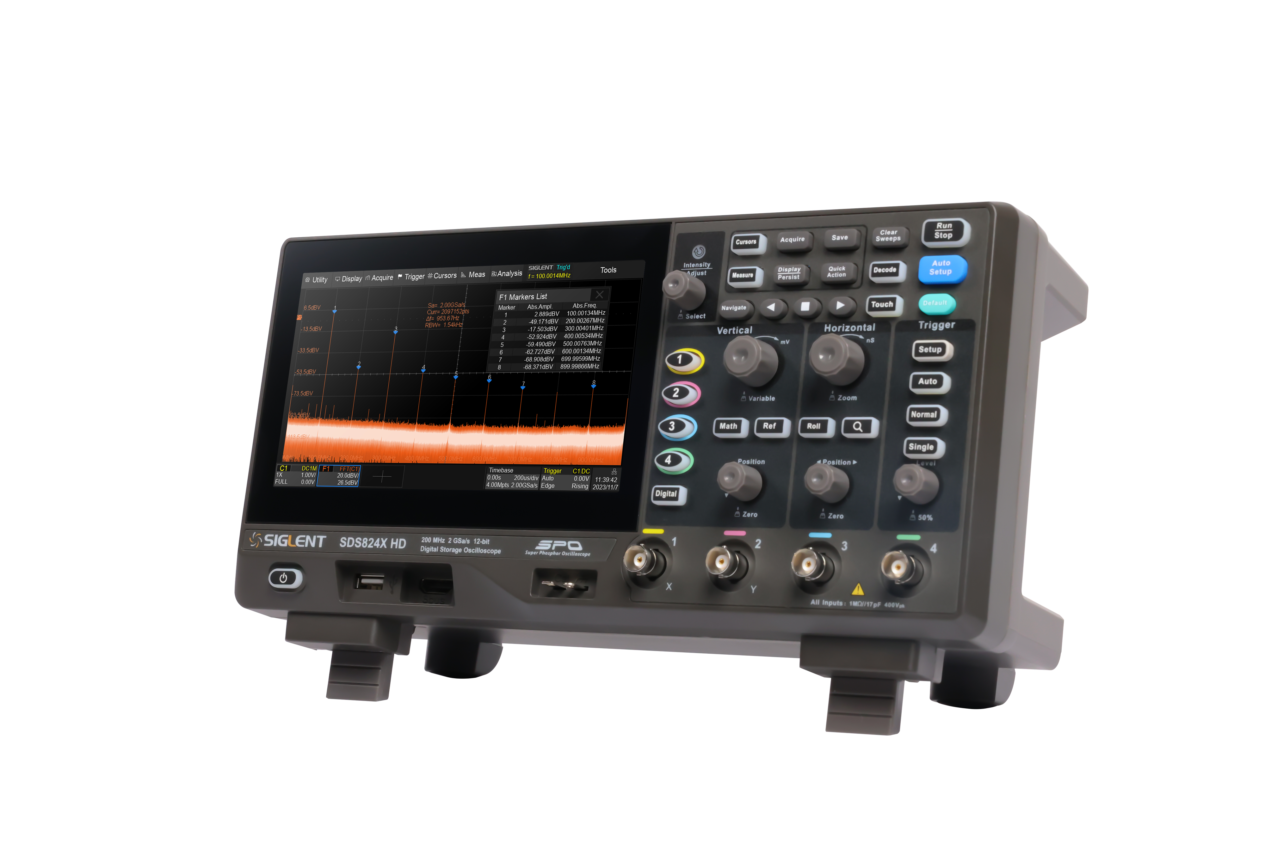
Main parameters
 | SDS804X HD SDS802X HD | SDS814X HD SDS812X HD | SDS824X HD SDS822X HD
Channels | 4（4-Channel Series） 2（2-Channel Series）
Bandwith | 70 MHz | 100 MHz | 200 MHz
Sample rate(Max.) | 2 GSa/s（single-channel）；1 GSa/s （(dual-channel)）；500 MSa/s （4 channels）
Memory depth(Max.) | 100 Mpts（single-channel）；50 Mpts（(dual-channel）；25 Mpts（4 channels）
Waveform capture rate(Max.) | Nomore mode：120,000 wfm/s；500,000 wfm/s in sequence mode
Vertical resolution | 12-bit
Serial trigger and decoder | standard：I²C、SPI、UART、CAN、LIN
Measurement | 50+ parameters; statistics, histogram, trend and track supported
Data analysis | Search, Navigate, History, Mask Test, Counter, Bode plot and Power Analysis(Optional)
Math | 4 traces 2 Mpts FFT, +, -, x, ÷, ∫dt, d/dt, √, Identity, Negation, Absolute, Sign, ex , 10x , ln, lg, Interpolation, MaxHold, MinHold, ERES, Average, Filter. Supports formula editor
I/O | 2x USB 2.0 Host, USB 2.0 Device，10M/100M LAN，AUX out（TRIG OUT，PASS/FAIL）SBUS(Logic Analyzer)
Display | 7 ” HD capacitive touch screen(1024*600)
Mechanical dimensions | Weight: 2.6 kg Width × Height × Depth = 312 mm × 151 mm × 132.6 mm

Slide 5
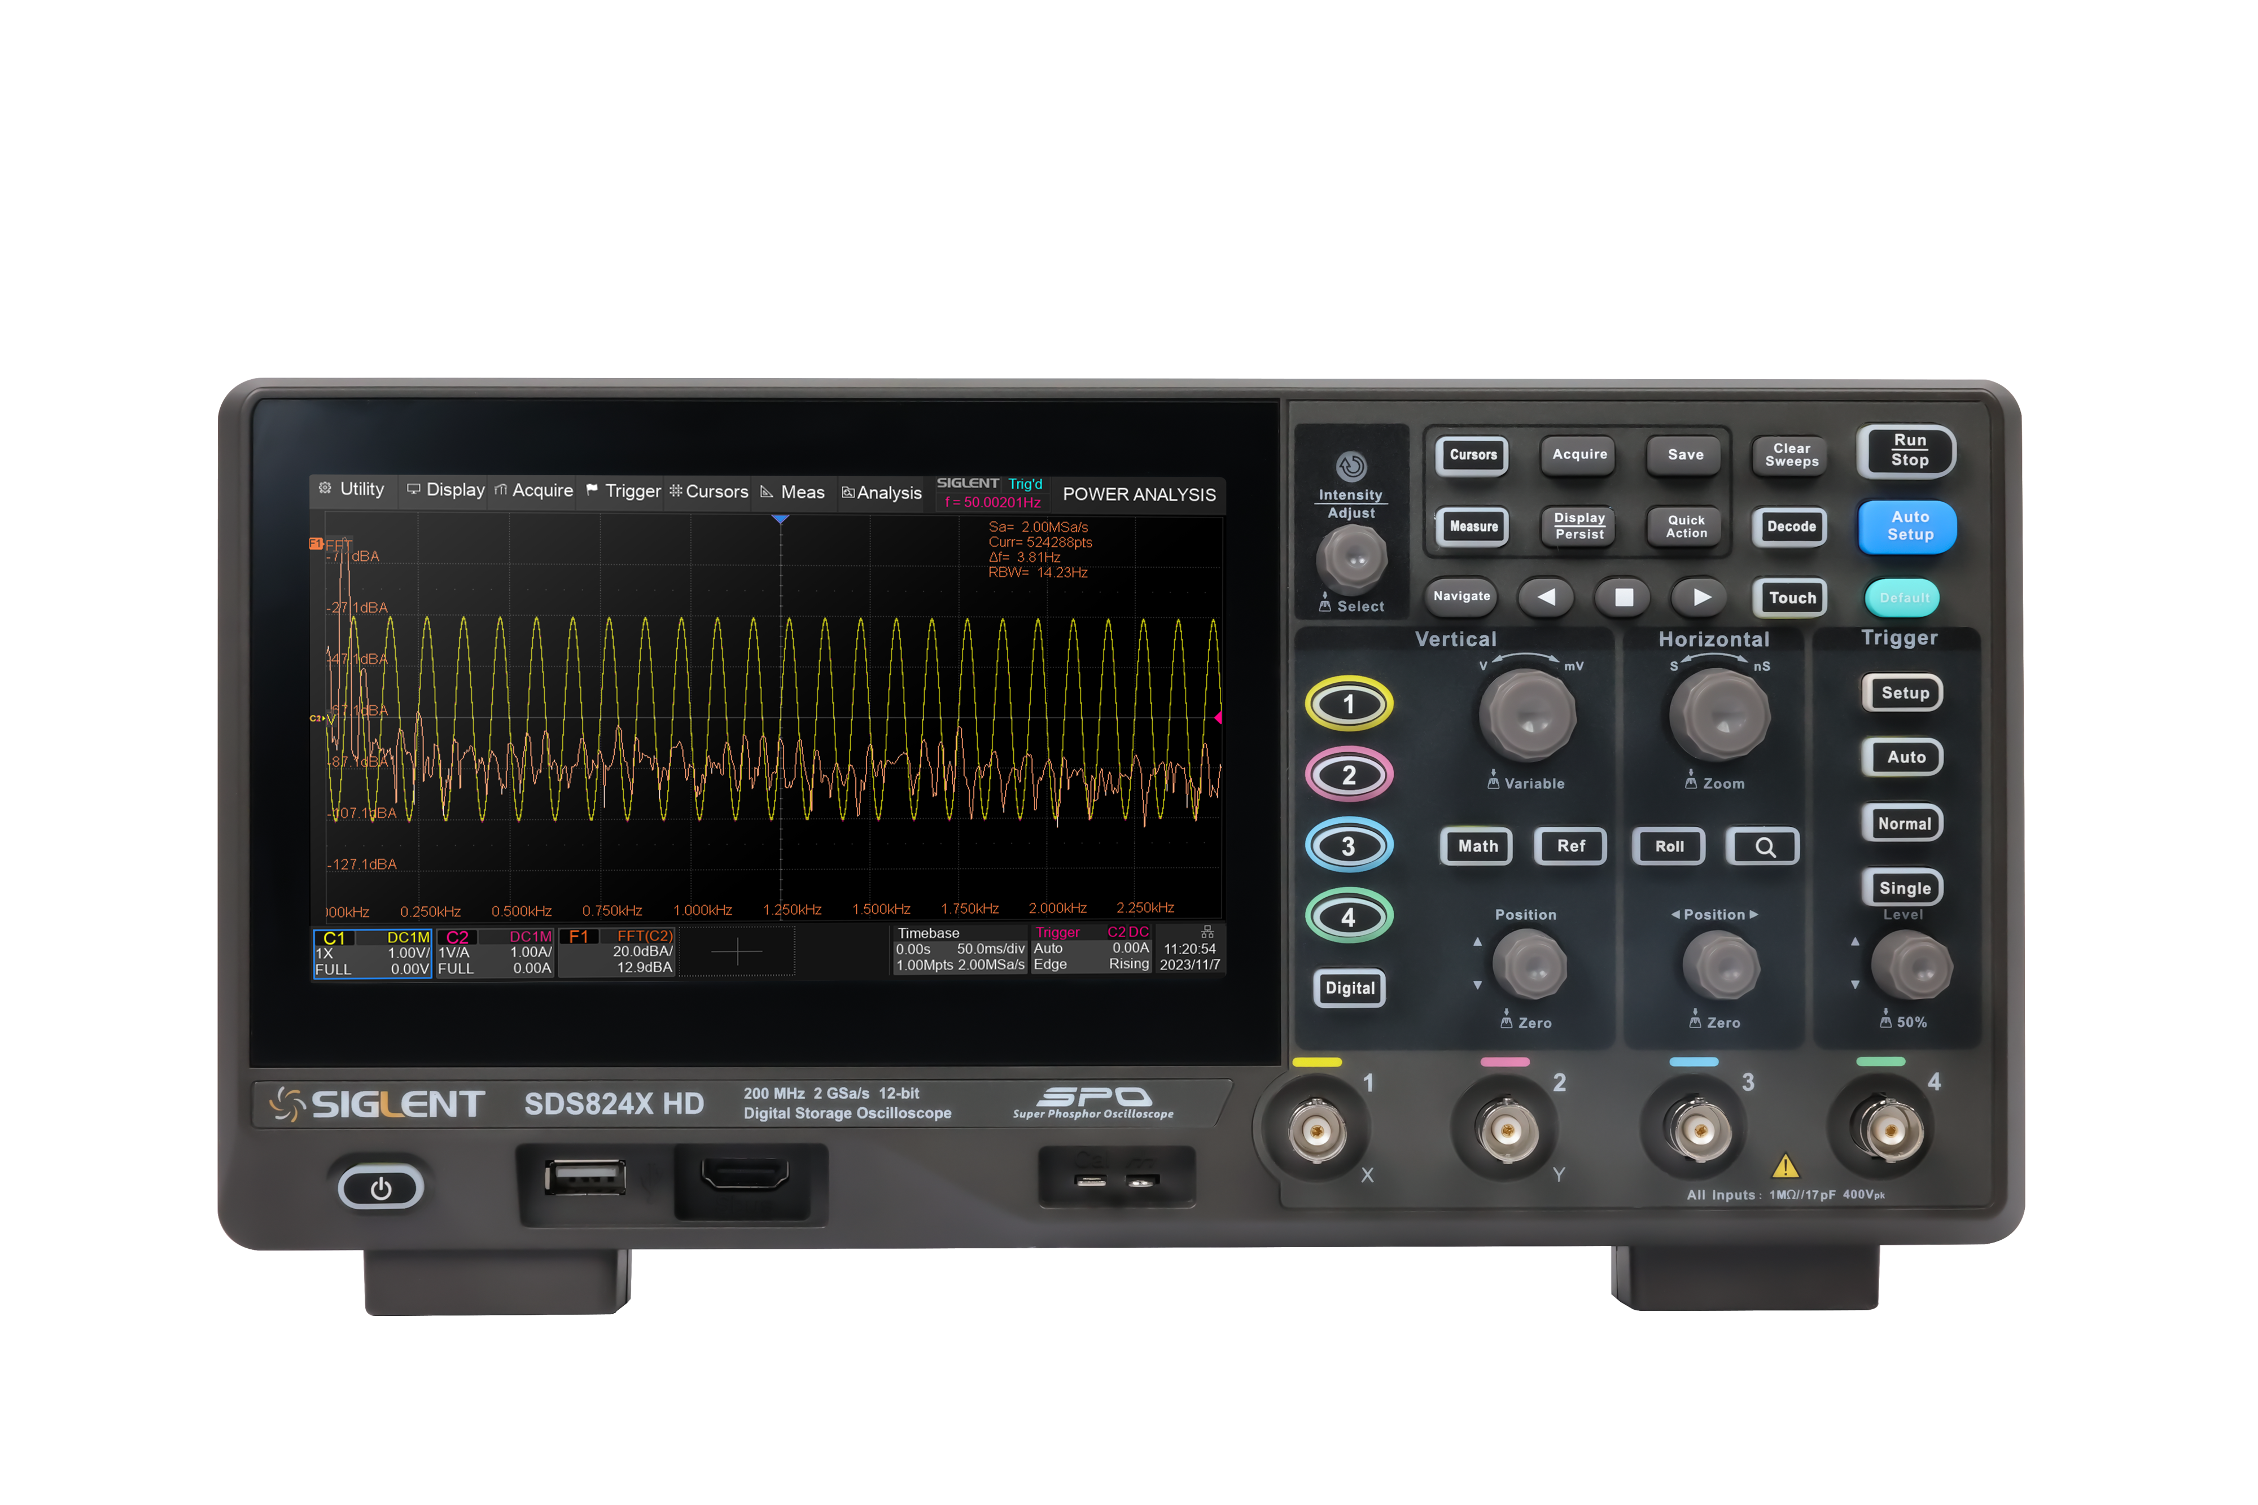
Key Features
12-bit vertical resolution
Measure small signals accurately
Excellent noise floor
Full bandwidth noise down to 70μVrms
200M Memory depth
Long-term observation at
large sampling rates
Persistence and Intensity grading
Find out the probability of the waveform appearance and detect abnormalities
Trigger and Decode
Multi-format display of decoding results
History
Automatic live recording to quickly locate problems
Remote control
free built-in web server

Slide 6
Key Features
FFT
Real-time display the spectrum, marking of peaks and harmonics, and showing the amplitude value.
Automatic measurement
Measurement of multiple channels at once for 66 parameters
Mask test
Used for signal quality assessment, able to monitor the failure rate of waveforms over time, saving time and money
USB-AWG
SAG1021I can output arbitrary waveforms edited by EasyWave software, which is suitable for teaching and R&D, and saves space.
Logical channel
16 digital channels acquisition function combine digital channels with analog channels to realize mixed signal acquisition and analysis function.
Math
Provide 4 math operation channels, support FFT, exponential, formula editor and other advanced calculations
Preset
Meet personal habits and improve operational efficiency

Slide 7
Front panel
Touch-screen display area
Front Panel Keypad
Analog input channel
USB Host
Calibration signal compensation and grounding
Logic Analysis Ports

Slide 8
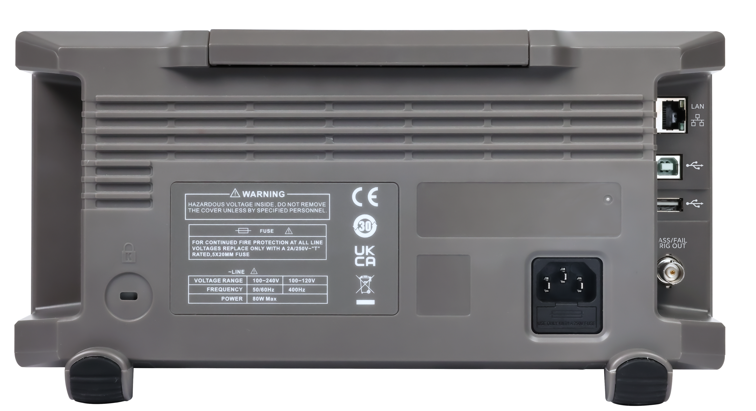
Back panel
LAN
USB Device
USB Host
Pass/Fail or Trig Out
AC power input

Slide 9
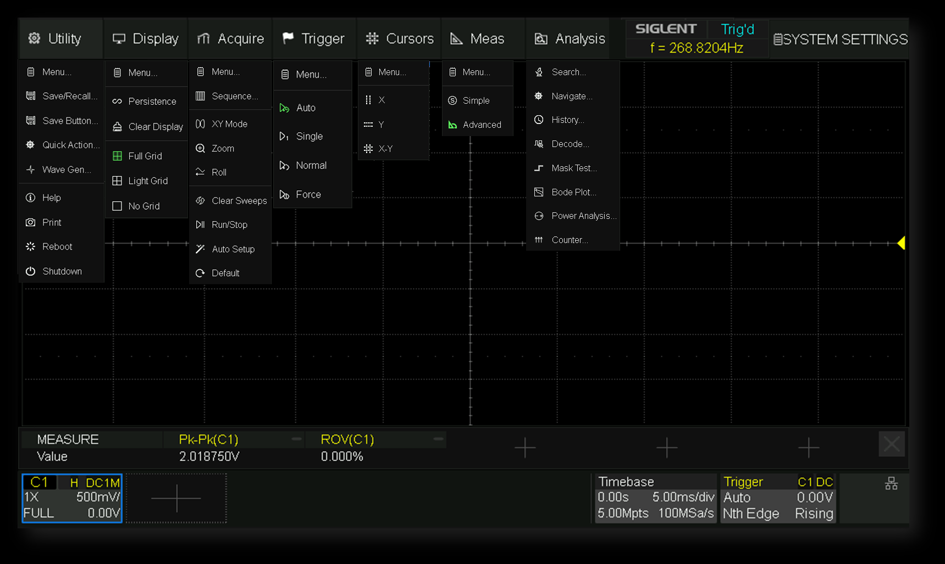
Intuitive menu panel

Slide 10
Basic Introduction
Function Characteristics
CONTENTS
Product Comparisons
Applications

Slide 11
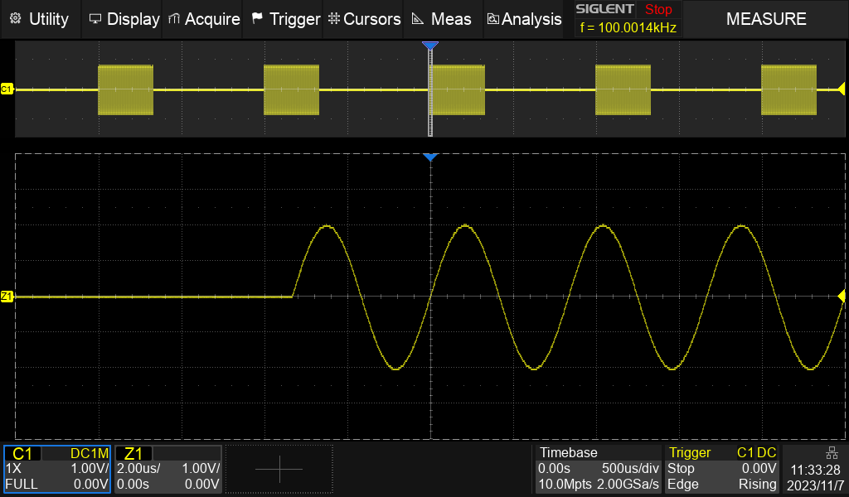

High Sample Rate
2G Sa/s Sample rate（single-channel）
1G Sa/s Sample rate （dual-channel）
500M Sa/s Sample rate（4 channels）
Realistically reconstructed waveforms
Precisely Measured Parameters

Slide 12
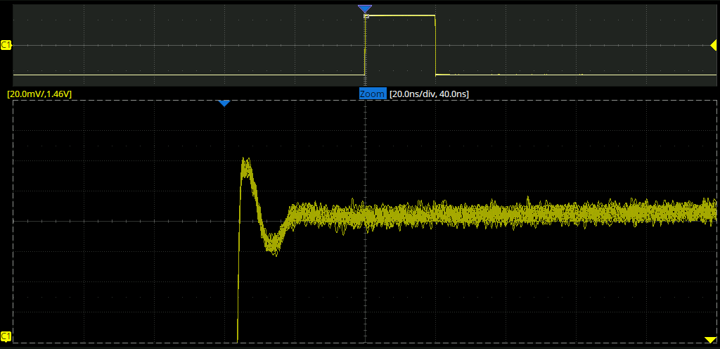
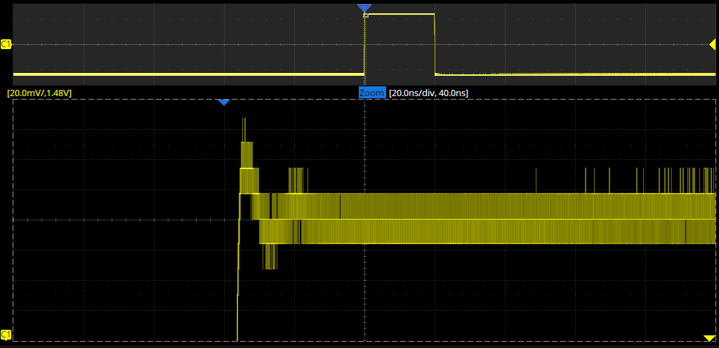
Vertical resolution
12-bit vertical resolution
16 times more accurate than 8-bit oscilloscopes
3-bit software enhanced resolution
Clean and clear presentation of waveforms
Enables observation of details of complex signals
12-bit
8-bit

Slide 13
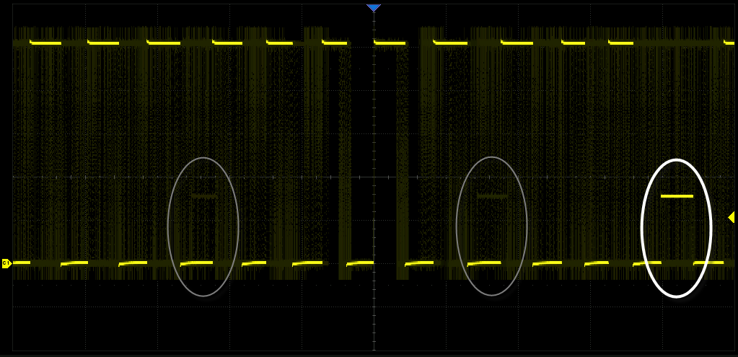
Waveform update rate
Normal mode：120,000 wfm/s .max
Sequence mode：500,000 wfm/s .max
Fast capture of high-speed transients
Waveform details at a glance
Notes:
普源的凝时模式有限制：光标、解码、搜索、延迟扫描、通过/失败测试、波形录制、参考波形、滚动模式、慢扫描模式、XY 任一功能开启时，凝时获取模式不可用

Slide 14
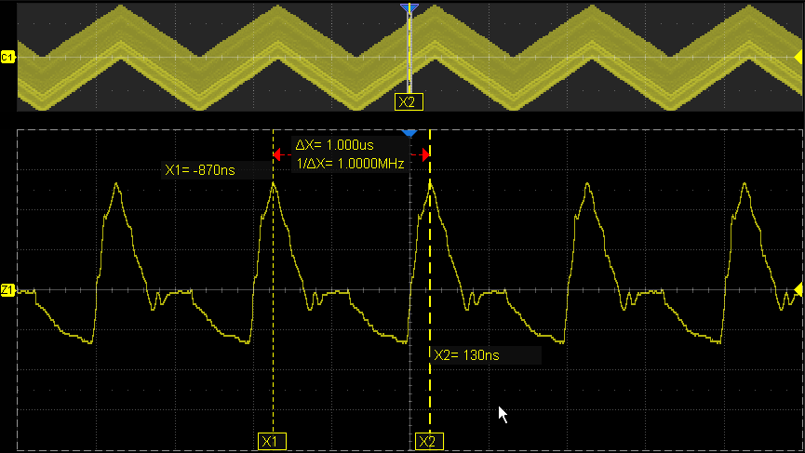
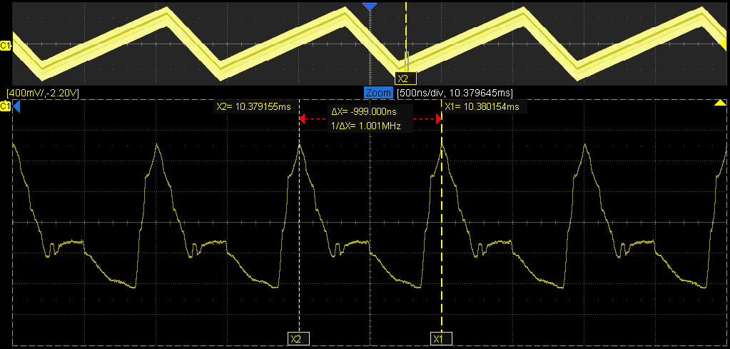
Memory depth
100 Mpts（single-channel）.max
50 Mpts（dual-channel） .max
25 Mpts（4 channels） .max
Zoom mode（vertical + horizontal）
Long-term data recording
Long storage depth ensures that
waveform details are captured

Slide 15
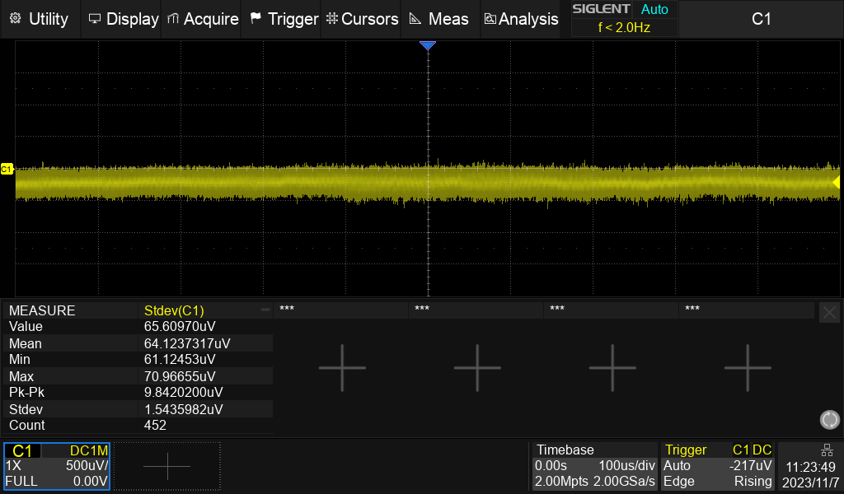
Noise floor
70 μVrms
Pure signal
More accurate measurement
Power analysis at Millivolt level

Slide 16
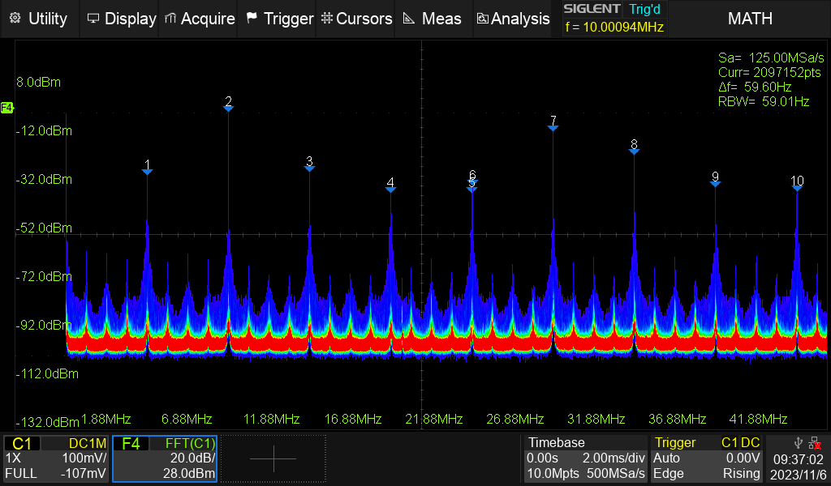
256-level Intensity Grading
Display the probability of waveform occurrence
The higher the probability, the warmer the color
The smaller the probability, the colder the color

Slide 17
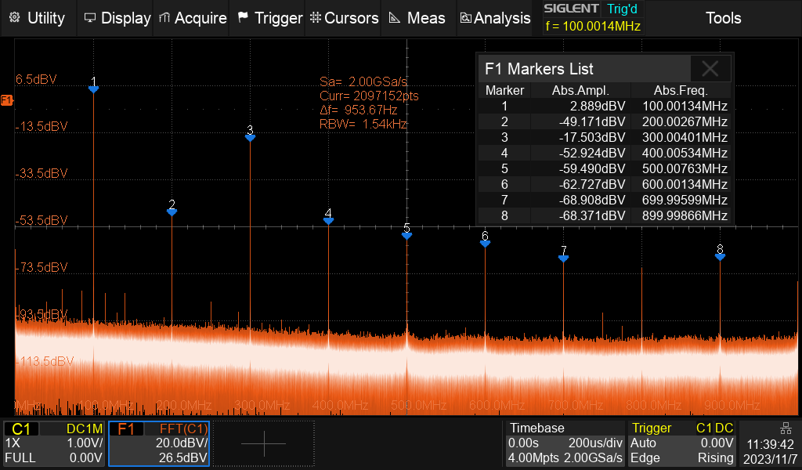
Hardware-accelerated digital FFT
2M points
Full/Split Screen Display
Support for multiple window functions
Peak detection detects spurious frequencies
Lists for peak markers
Supports normal, average, and maximum hold modes

Slide 18
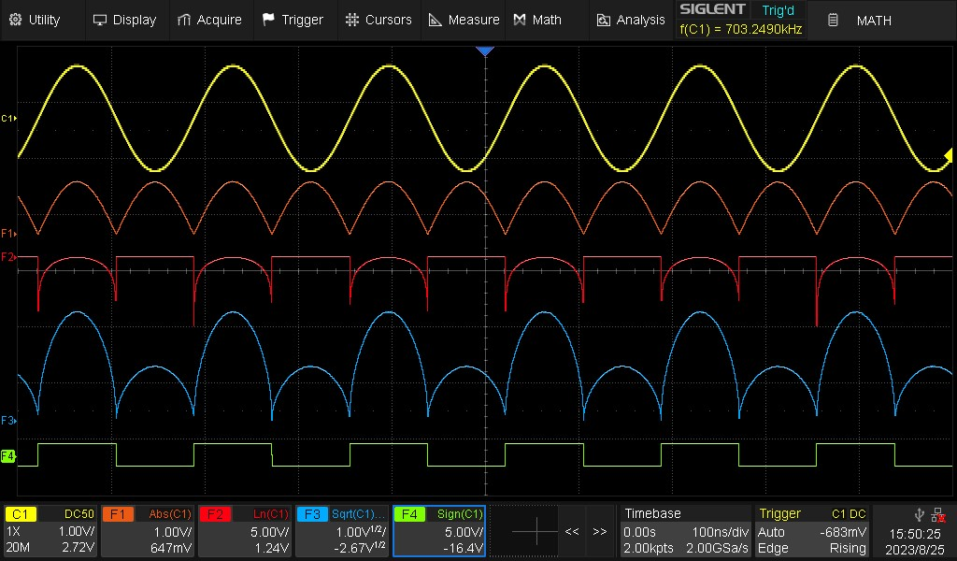
MATH
4 independent Math channels
digital filter
Formula Editor for Complex Nested Operations
Supports time-domain operations such as +, -, x, ÷, ∫dt, d/dt, √, Identity, Negation, |x|, Sign, ex , 10x , ln, lg, Interpolation, Max hold, Min hold, ERES, Average

Slide 19
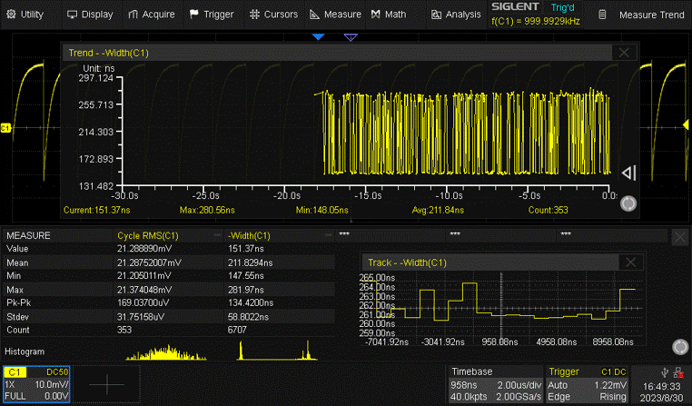
Multiple measurement parameters
66 measurement parameters
Measurement types：Horizontal, Vertical, Miscellaneous Parameters, Delay Parameters
Source: CH1~CH4, D0~D15, F1~F4, Z1~Z4,Ref, History
Statistics: Current, Mean, Min, Max, Stdev, Count, Histogram, Trend, Track

Slide 20
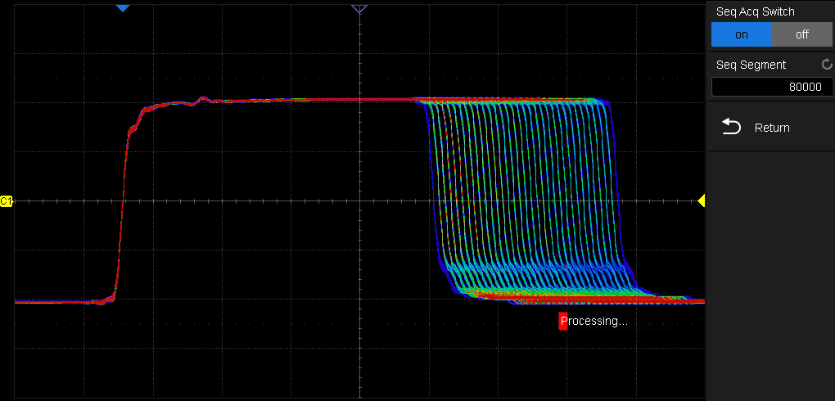
Sequence and history
Storage depth is divided into 80,000 segments
2 μs trigger interval
Single- frame/rolling display historical waveformes
More probability of capturing anomalous signals

Slide 21
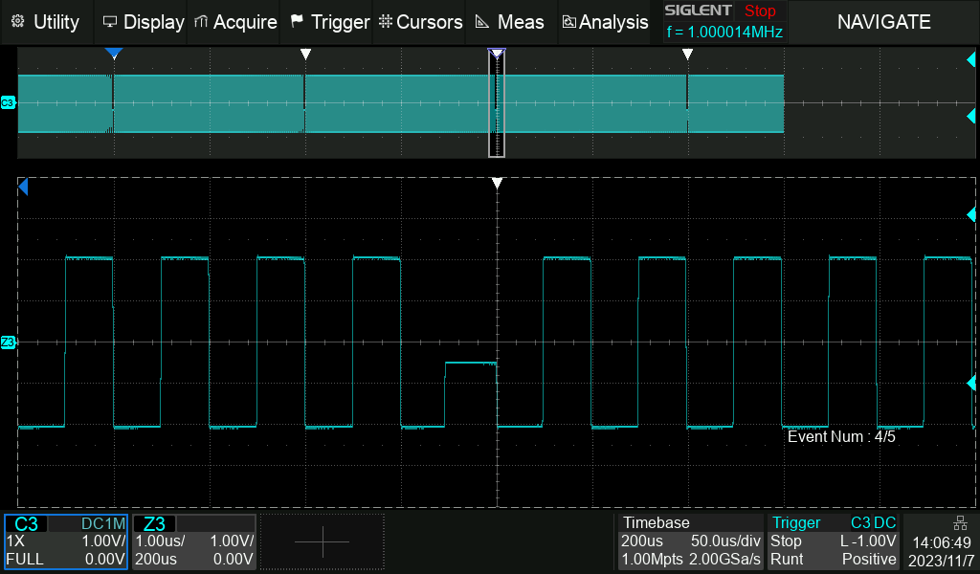
Search and Navigate
white triangle symbol
Quickly locate events of interest
Search mode：edge, slope, pulse, interval, runt
Navigate type：search event, time, History frame

Slide 22
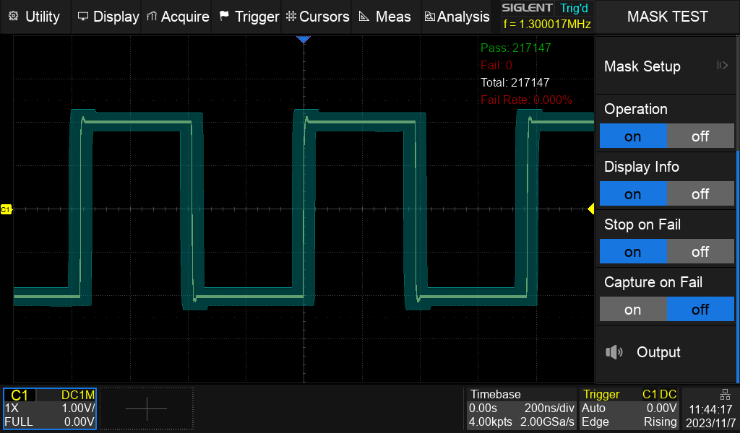
Mask test
80000 tests per second
Customizable template creation
Automatically determines whether the measured signal is qualified or not
Suitable for automated measurements
Widely used in signal quality assessment, reliability verification

Slide 23
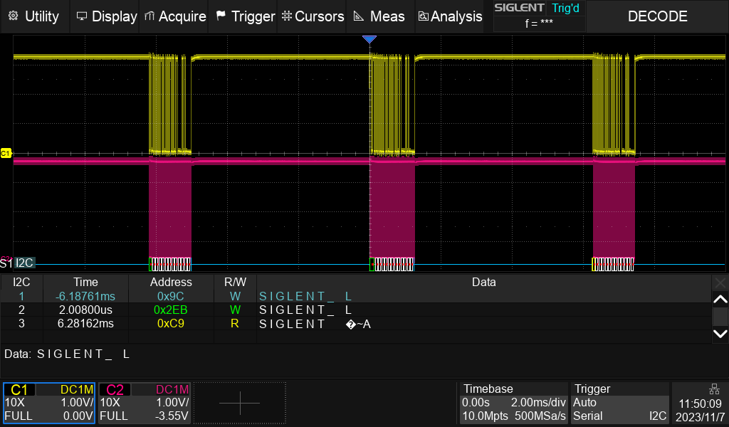
Trigger and decode
Simultaneous decoding of 2 parallel buses
5 bus triggers and decodes are standard ： IIC、SPI、UART、 CAN、 LIN
Trigger Configure can be copied from the bus.
Display：waveform and decoding results and timestamps for each frame
decoding results in hex, decimal, binary, or ASCII
Widely used in embedded design, automotive electronics, and other fields

Slide 24
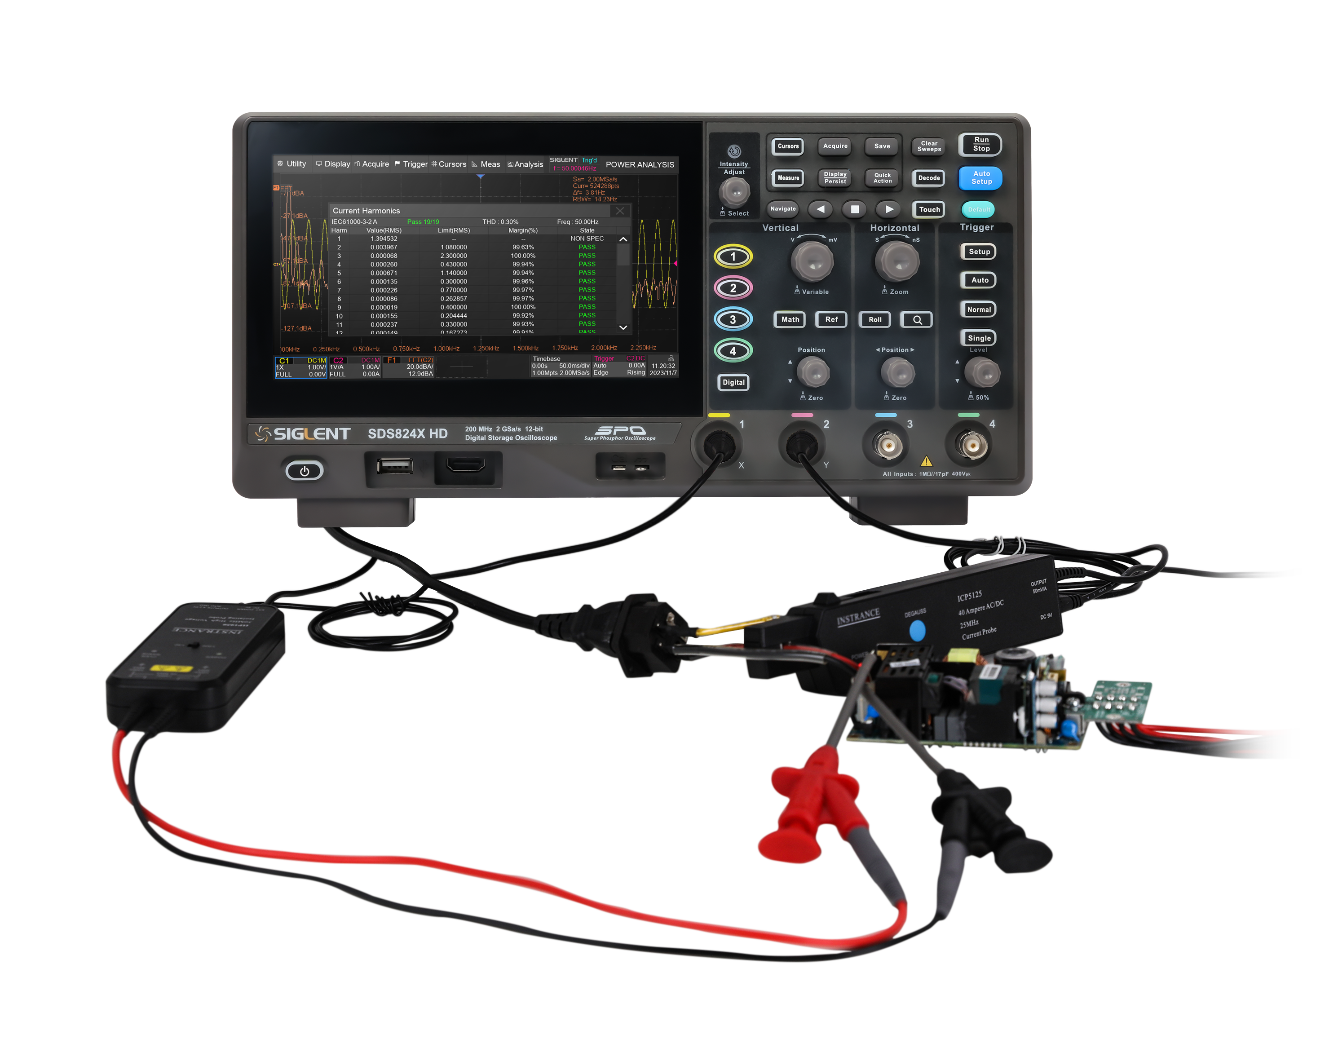
Power analysis（optional）
Line power harmonic analysis
Switching power device parameter measurement
Characterization of power control loop modulation
With Siglent's voltage probes (e.g. DPB5000 series) and current probes (CP6000 series), you can quickly and accurately analyze 12 parameters, such as power quality, current harmonics, inrush current, transient response, and MSO tube safe operating area (SOA), etc.

Slide 25
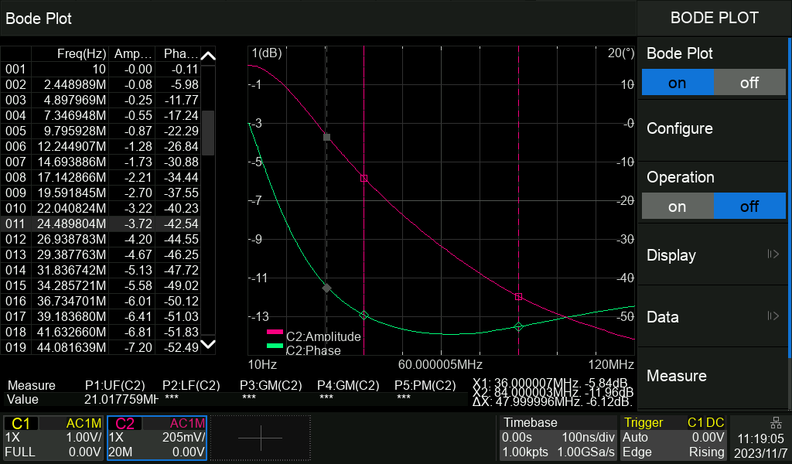
Bode plot
Power loop response analysis
Amplitude-frequency characteristics and phase-frequency characteristics
Measurement types : Upper cutoff frequency, Lower cutoff frequency, Bandwidth, Gain margin, Phase margin

Slide 26
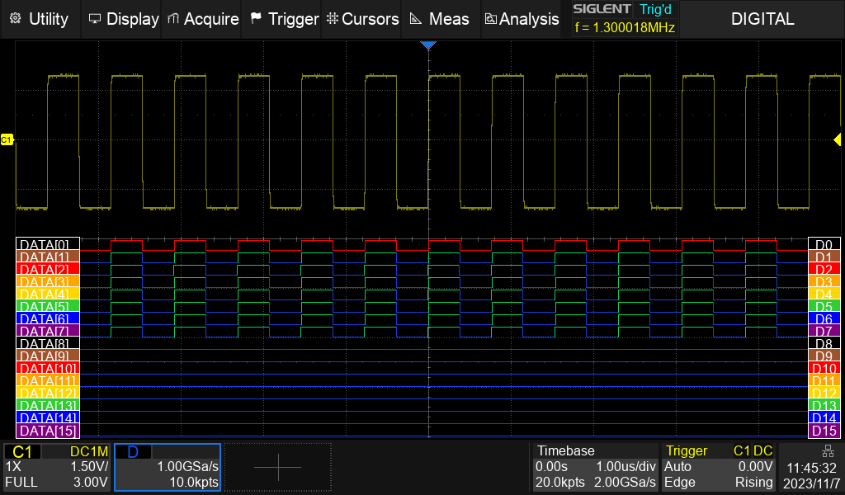
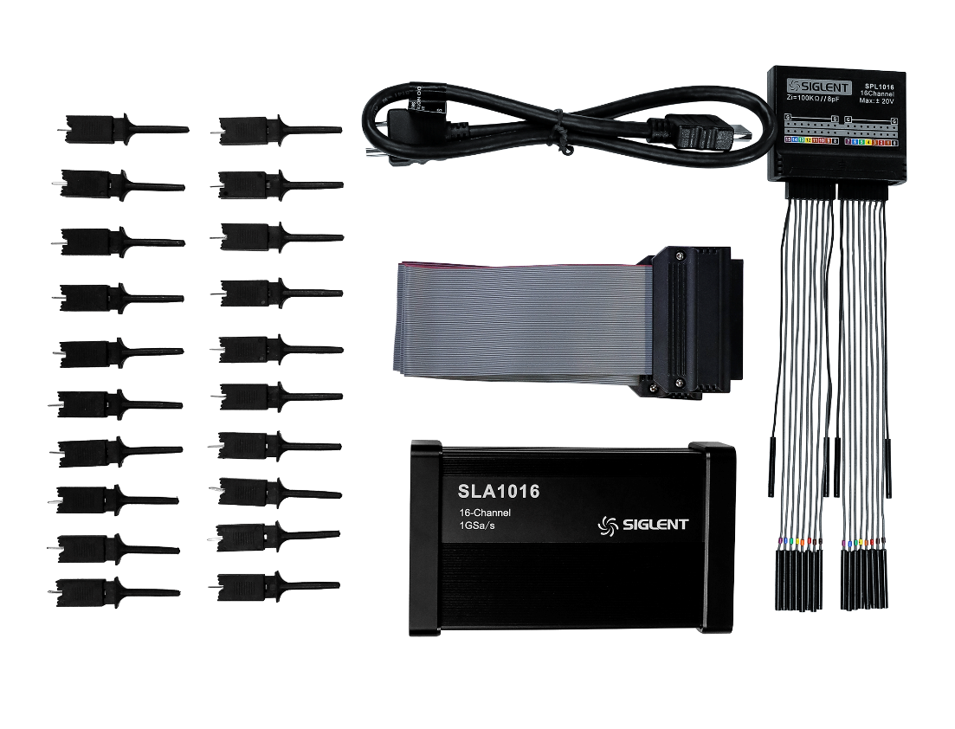
Digital channels（optional）
mixed-signal acquisition and analysis functions
Simultaneous acquisition of two different digital logic level signals
Add 16 digital channels to your instrument with the 16 logic analyzer probes
Solutions to Analog-Digital Mixed-Signal Design and Analysis Problems

Slide 27
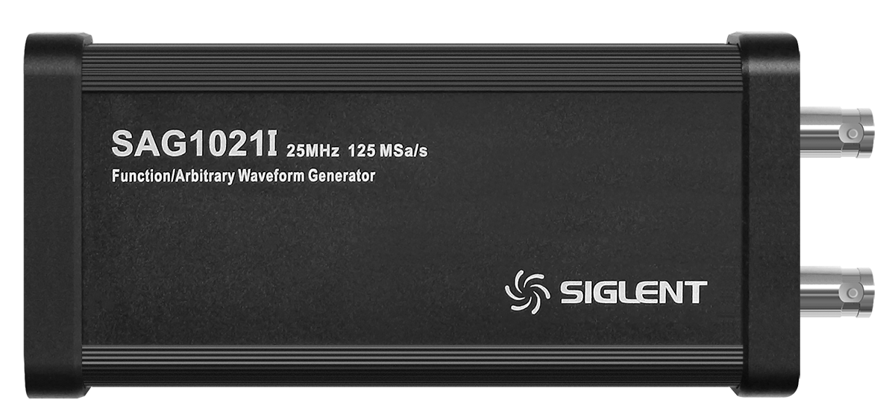
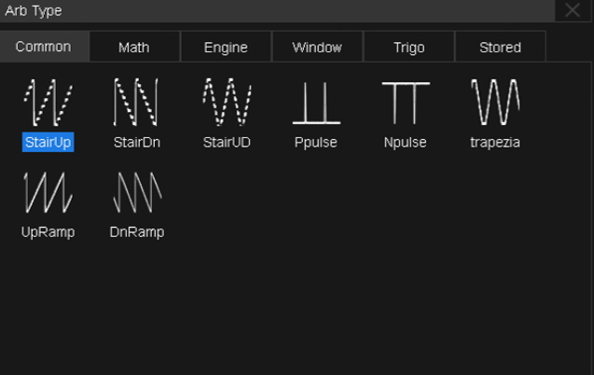
Waveform Generator （optional）
USB Arbitrary Waveform Generator SAG1021I | USB任意波形发生器SAG1021I
Output channel | 1
Max. output frequency | 25 MHz
Sample rate | 125 MSa/s
Frequency resolution | 1 μHz
Frequency accuracy | ±50 ppm
Vertical resolution | 14-bit
Amplitude | -1.5 V ～ +1.5 V ( 50 Ω) -3 V ～ +3 V ( HiZ)
Waveform | Sine, Square, Pulse, Ramp, Gaussian Noise. 45 built-in arbitrary waveforms (include DC)
Output impedance | 50 Ω±2%
Protection | Over-voltage protection, over-current protection
Host computer | EasyWave edit arbitrary waveforms
Power Loop Analysis | Support and no external isolation transformer required

Slide 28
Basic Introduction
Function Characteristics
CONTENTS
Product Comparisons
Applications

Slide 29
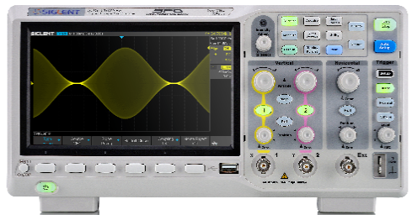
 | SIGLENT SDSS800X HD |  |  | SIGLENT SDS1000X-E
Model | SDS802X HD(70MHz、2CH) SDS812X HD(100MHz、2CH) SDS822X HD(200MHz、2CH) SDS804X HD(70MHz、4CH) SDS814X HD(100MHz、4CH) SDS824X HD(200MHz、4CH) (no EXT) | ✔ |  | SDS1202X-E(200MHz、2CH) SDS1104X-E(100MHz、4CH) SDS1204X-E(200MHz、4CH) (2CH-EXT) | ×
Sample rate(Max.) | 2 GSa/s（single-channel） 1 GSa/s（dual-channel） 500 MSa/s（full channels） | ✔ |  | 1 GSa/s（single channel） 500 MSa/s（full channels） | ×
Memory depth(Max.) | 50 Mpts（single）25 Mpts（dual）10 Mpts（four） 802/804/812/814 100 Mpts(single）50 Mpts（dual）25 Mpts（four） 822/824 | ✔ |  | 14 Mpts（single channel） 7 Mpts（full channels） | ×
Waveform capture rate(Max.) | 80,000/120,000 wfms/s ( Normal） 500,000 wfms/s （Sequence ） | ✔ |  | 400,000 wfms/s （Sequence ） | ×
Vertical resolution | 12-bit | ✔ |  | 8-bit | ×
ERES | 3bit | ✔ |  | 3bit | ✔
History mode | 80000 frames | ✔ |  | 80000 frames | ✔
Digital voltmeter | unsupport | × |  | unsupport | ×
Counter | support | ✔ |  | unsupport | ×
Bar | unsupport | × |  | unsupport | ×
Trend and Track | support | ✔ |  | unsupport | ×
Math customize | support | ✔ |  | unsupport | ×
Zoom (vertical & horizontal） | support | ✔ |  | support | ✔
Decoder type | I2C、SPI、RS232/UART、CAN、LIN | ✔ |  | IIC、SPI、UART、CAN、LIN | ✔
Mask Test | support | ✔ |  | support（4CH） | ✔
Bode plot | support | ✔ |  | support（4CH） | ✔
Power Analysis | support（optional） | ✔ |  | unsupport | ×
Digital channel | support（optional） | ✔ |  | support（optional，4CH） | ✔
USB waveform generator | support（optional） | ✔ |  | support（optional，4CH） | ✔
I/O | USB2.0 Host, USB2.0 Device, LAN , TRIG OUT, PASS/FAIL OUT, SBUS | ✔ |  | USB Host, USB Device, LAN, Pass/Fail, Trigger Out, SBUS | ✔
Display&weight | 7’’ TFT-LCD with capacitive touch screen； 2.6 kg | ✔ |  | 7’’ TFT-LCD ； 2.6 kg | ✔

Slide 30
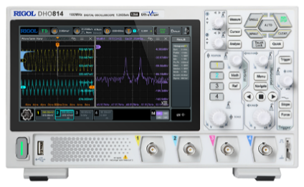
 | SIGLENT SDS800X HD |  |  | RIGOL DHO800
Model | SDS802X HD(70MHz、2CH) SDS812X HD(100MHz、2CH) SDS822X HD(200MHz、2CH) SDS804X HD(70MHz、4CH) SDS814X HD(100MHz、4CH) SDS824X HD(200MHz、4CH) (no EXT) | ✔ |  | DHO802（70MHz、2CH） DHO804（70MHz、4CH） DHO812（100MHz、2CH） DHO814（100MHz、4CH） | ×
Sample rate(Max.) | 2 GSa/s（single-channel） 1 GSa/s（dual-channel） 500 MSa/s（four channels） | ✔ |  | 1.25 GSa/s（single-channel） 625 MSa/s（dual-channel） 312.5 MSa/s（four channels） | ×
Memory depth(Max.) | 50 Mpts（single）25 Mpts（dual）10 Mpts（four） 802/804/812/814 100 Mpts(single）50 Mpts（dual）25 Mpts（four） 822/824 | ✔ |  | 25 Mpts（single） 10 Mpts（dual） 1 Mpts（four channels） | ×
Waveform capture rate(Max.) | 80,000/120,000 wfms/s ( Normal） 500,000 wfms/s （Sequence ） | ○ |  | 30,000 wfms/s（Vector mode） 1,000,000 wfms/s（UltraAcquire mode） | ○
Vertical resolution | 12-bit | ✔ |  | 12-bit | ✔
ERES | 3bit | ✔ |  | N/A | ✔
History mode | 80000 frames | × |  | 500000 frames | ✔
Digital voltmeter | unsupport | × |  | 3bit | ✔
Bar | unsupport | × |  | support | ✔
Trend and Track | support | ✔ |  | unsupport | ×
Math customize | support | ✔ |  | unsupport | ×
Zoom (vertical & horizontal） | support | ✔ |  | unsupport | ×
Decoder type | I2C、SPI、RS232/UART、CAN、LIN | ✔ |  | parallel signal、RS232/UART、I2C、SPI | ×
Mask Test | support | ✔ |  | support | ✔
Bode plot | support | ✔ |  | unsupport | ×
Power Analysis | support（optional） | ✔ |  | unsupport | ×
Digital channel | support（optional） | ✔ |  | N/A | ×
USB waveform generator | support（optional） | ✔ |  | N/A | ×
I/O | USB2.0 Host, USB2.0 Device, LAN , TRIG OUT, PASS/FAIL OUT, SBUS | × |  | USB2.0 Host, USB2.0 Device, LAN , AUX OUT, EXT , HDMI, Type-C | ✔
Display | 7’’ TFT-LCD with capacitive touch screen | ✔ |  | 7’’ TFT-LCD with capacitive touch screen | ✔
weight | 2.6 kg | × |  | 1.78 kg | ✔

Slide 31
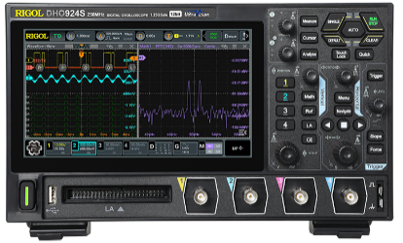
 | SIGLENT SDS800X HD |  |  | RIGOL DHO900
Model | SDS802X HD(70MHz、2CH) SDS812X HD(100MHz、2CH) SDS822X HD(200MHz、2CH) SDS804X HD(70MHz、4CH) SDS814X HD(100MHz、4CH) SDS824X HD(200MHz、4CH) (no EXT) | × |  | DHO914 （125MHz、4CH） DHO924 （250MHz、4CH） DHO914S（125MHz、4CH） DHO924S（250MHz、4CH） | ✔
Sample rate(Max.) | 2 GSa/s（single-channel） 1 GSa/s（dual-channel） 500 MSa/s（four channels） | ✔ |  | 1.25 GSa/s（single-channel） 625 MSa/s（dual-channel） 312.5 MSa/s（four channels） | ×
Memory depth(Max.) | 50 Mpts（single）25 Mpts（dual）10 Mpts（four） 802/804/812/814 100 Mpts(single）50 Mpts（dual）25 Mpts（four） 822/824 | ✔ |  | 50 Mpts（single） 25 Mpts（dual） 10 Mpts（four） | ×
Waveform capture rate(Max.) | 80,000/120,000 wfms/s ( Normal） 500,000 wfms/s （Sequence ） | ○ |  | 30,000 wfms/s（vector mode） 1,000,000 wfms/s（UltraAccqire mode） | ○
Vertical resolution | 12-bit | ✔ |  | 12-bit | ✔
ERES | 3bit | ✔ |  | unsupport | ×
History mode | 80000 frames | × |  | 500000 frames | ✔
Digital voltmeter | unsupport | × |  | 3-bit | ✔
Bar | unsupport | × |  | support | ✔
Trend and Track | support | ✔ |  | unsupport | ×
Math customize | support | ✔ |  | unsupport | ×
Zoom (vertical & horizontal） | support | ✔ |  | unsupport | ×
Decoder type | I2C、SPI、RS232/UART、CAN、LIN | ✔ |  | parallel signal、RS232/UART、I2C、SPI、LIN、CAN | ×
Mask Test | support | ✔ |  | unsupport | ✔
Bode plot | support | ✔ |  | S-series supports | ×
Power Analysis | support（optional） | ✔ |  | unsupport | ×
Digital channel | support（optional） | ✔ |  | support（optional） | ✔
USB waveform generator | support（optional） | × |  | inside（S-series standard） | ✔
I/O | USB2.0 Host, USB2.0 Device, LAN , TRIG OUT, PASS/FAIL OUT, SBUS | × |  | USB2.0 Host, USB2.0 Device，LAN , AUX OUT, AFG OUT, HDMI, Type-C | ✔
Display | 7’’ TFT-LCD with capacitive touch screen | ✔ |  | 7’’ TFT-LCD with capacitive touch screen | ✔
weight | 2.6 kg | × |  | 1.78 kg | ✔

Slide 32
Basic Introduction
Function Characteristics
CONTENTS
Product Comparisons
Applications

Slide 33
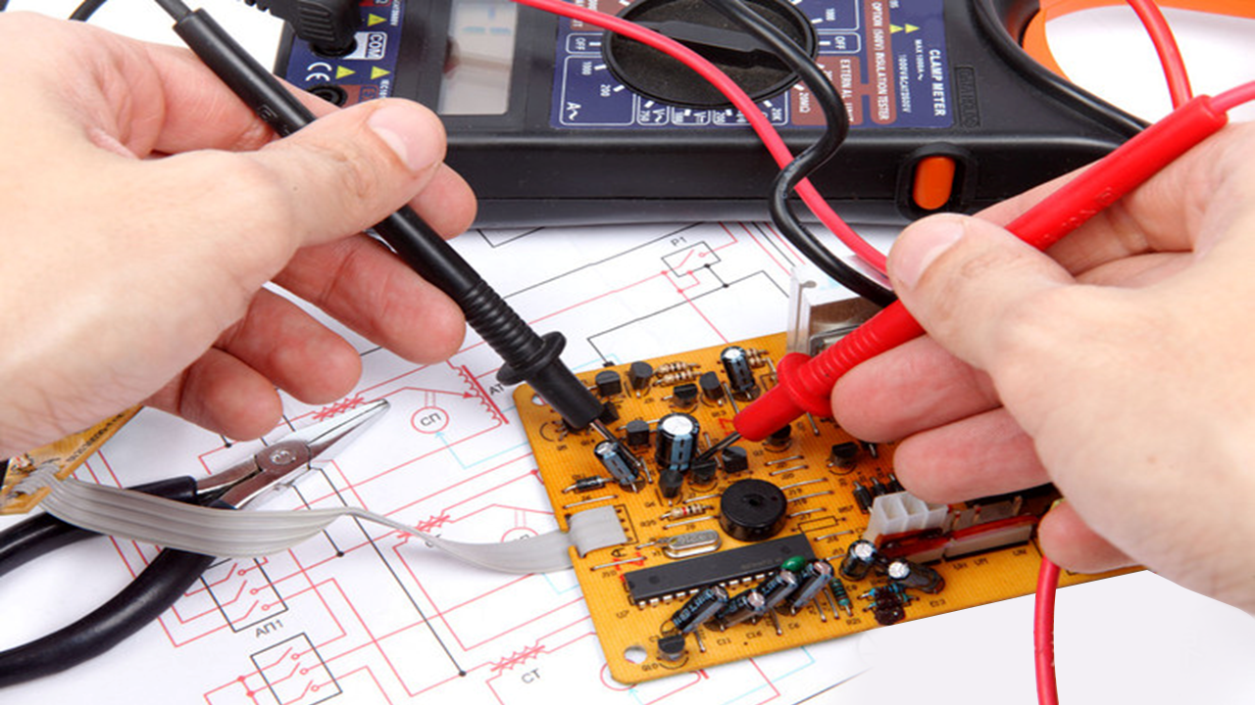
Appliance Repair
Detecting signal interruptions
Troubleshooting Companion Circuit
Measuring voltage waveforms at certain critical points
Measuring higher amplitude voltage waveforms such as backward pulses
Long-term measurements to detect accidental breakdowns
Inspection and repair TVs, computers, induction cookers, audio equipment, etc.
……

Slide 34
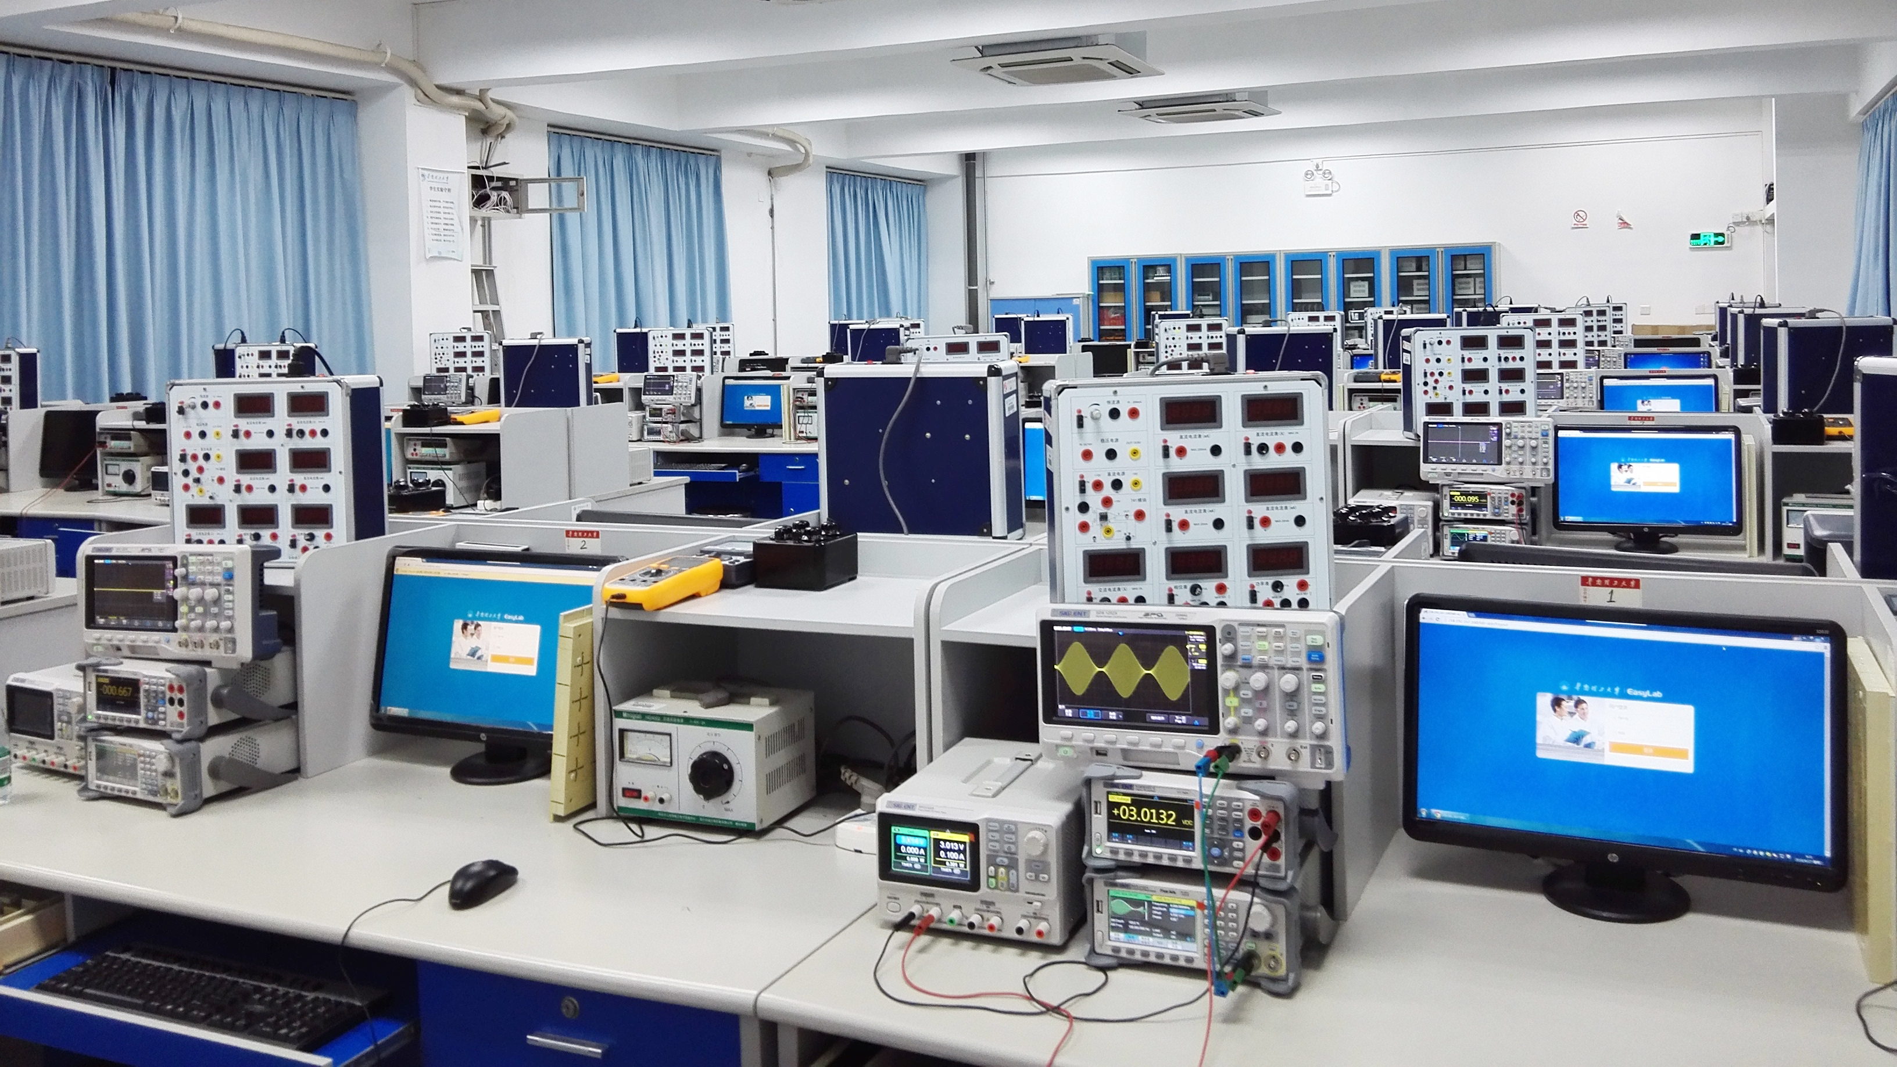
Education and Research
Used in university laboratories
Introduce students to oscilloscopes
For participation in electronic design and other competitions
Examining rectifier filter circuits
Study of the effects of capacitance and inductance on alternating current
Observe the transformation process of special signals
……

Slide 35
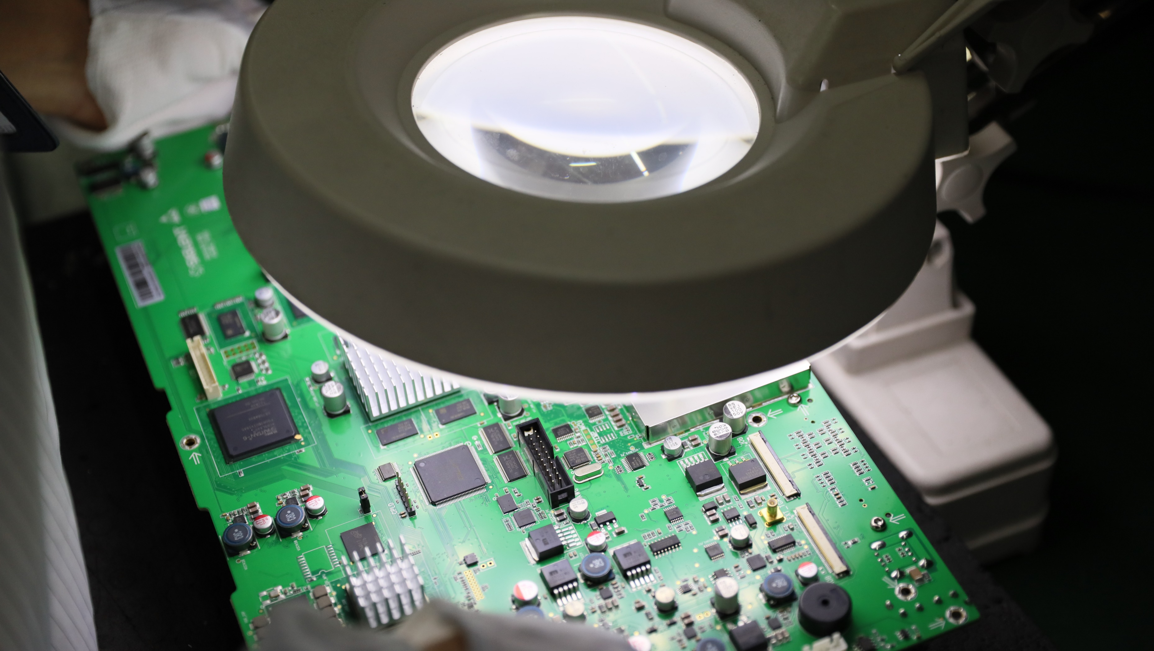
Embedded Design
Detection of tiny signals due to interference
Serial bus protocol analysis
Debugging Communication Errors

Slide 36
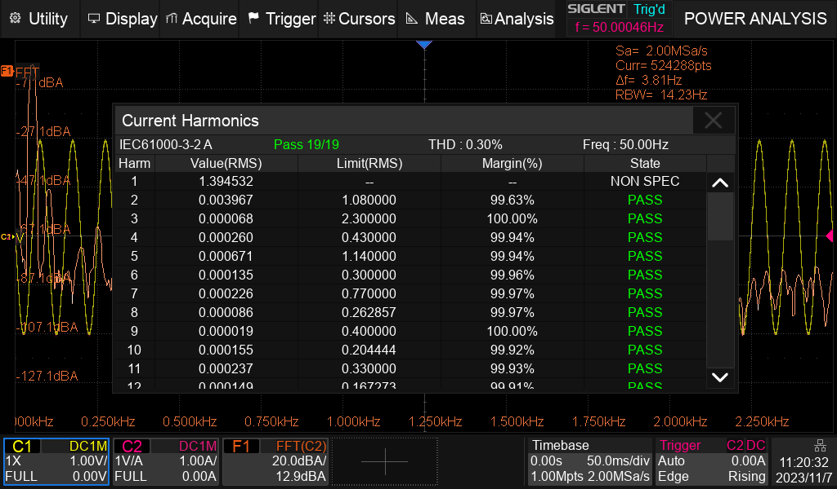
Power analyze
Power quality
Current Harmonics
Inrush current
Switching loss
Slew rate
Modulation
Output ripple
Turn on/turn off
Transient response
PSRR
Efficiency
SOA

Slide 37

汽车电子测试
Automotive Electronics Test
Circuit fault analysis
Measuring sensor signals
Measuring device signals
Measuring communication signals
Detecting cylinder operating conditions
……

Slide 38
Ordering Info
Model | Description
SDS824X HD | 4 channels，200 MHz bandwidth，2 GSa/s sample rate
SDS814X HD | 4 channels，100 MHz bandwidth，2 GSa/s sample rate
SDS804X HD | 4 channels，70 MHz bandwidth，2 GSa/s sample rate
SDS822X HD | 2 channels，200 MHz bandwidth，2 GSa/s sample rate
SDS812X HD | 2 channels，100 MHz bandwidth，2 GSa/s sample rate
SDS802X HD | 2 channels，70 MHz bandwidth，2 GSa/s sample rate
Standard accessories | quantity
USB cable | 1
Quick start | 1
Passive Probe | 1/channel
Calibration certificate | 1
power cable | 1
Optional accessories | Specification
Waveform generator（software） | SDS800XHD-FG
USB waveform generator | SAG1021I
16 digital channels（software） | SDS800XHD-16LA
16-channel logic probe | SLA1016
Power Analysis（software） | SDS800XHD-PA
Power Analyses deskew fixture | DF2001A

Slide 39

Thank You
Industry leader in the field of general electronic test and measurement instruments
Contact information
Company address
www.siglent.com
Service Tel：400-878-0807
Tel：0755-36887876
Building 4-5, Antongda industrial Park, Zone 68, BaoanDistrict, Shenzhen City

