Slide 1


Slide 2
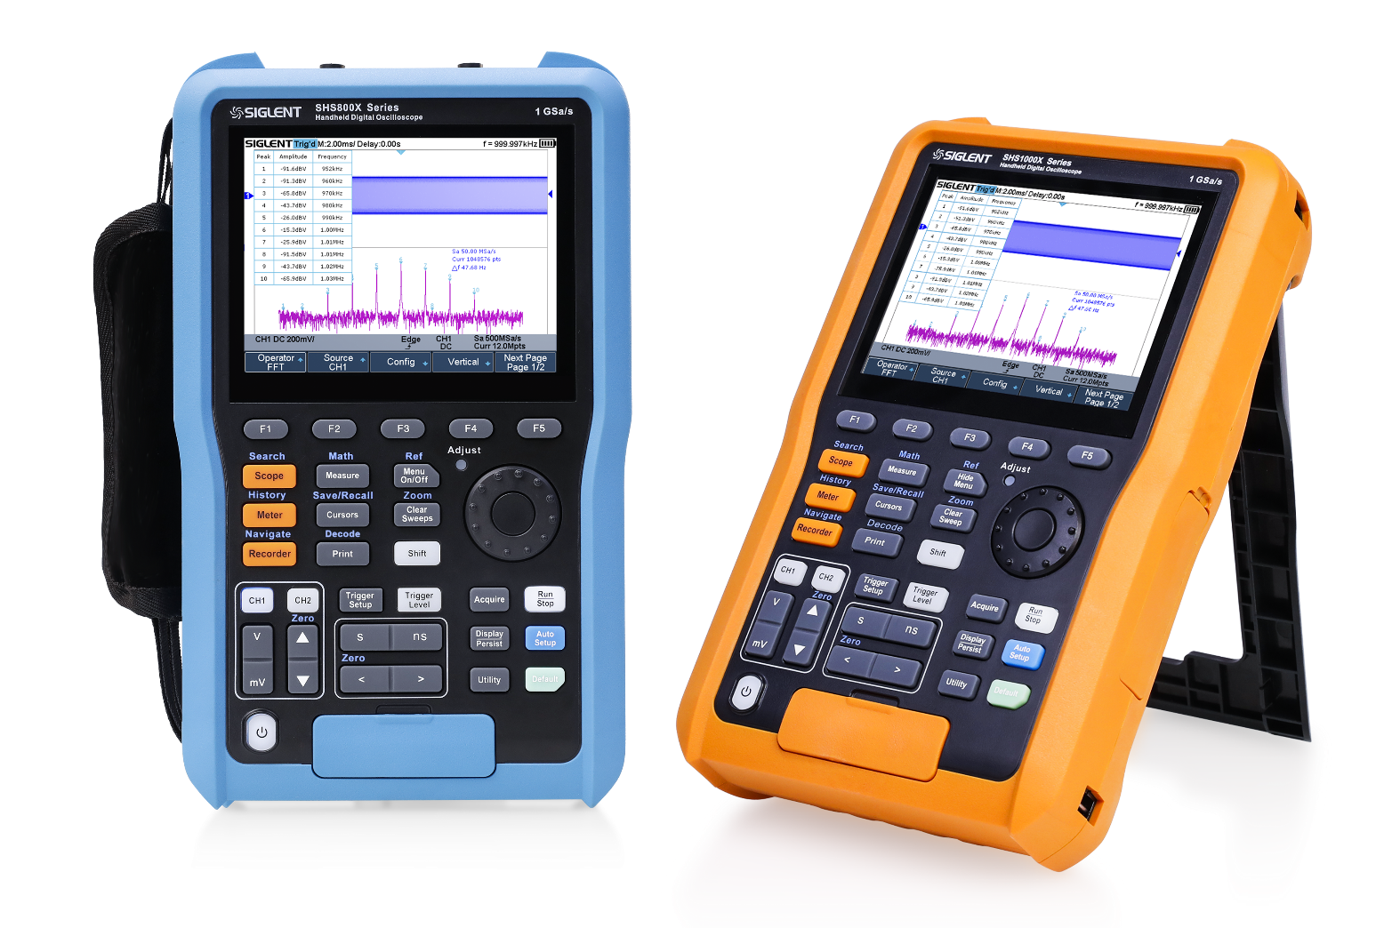
SHS800X/SHS1000X Handheld Oscilloscope
SHS1000X
SHS1102X - 100 MHz
SHS1202X - 200 MHz
SHS800X
SHS810X- 100 MHz
SHS820X - 200 MHz
SHS800X
SHS1000X

Slide 3
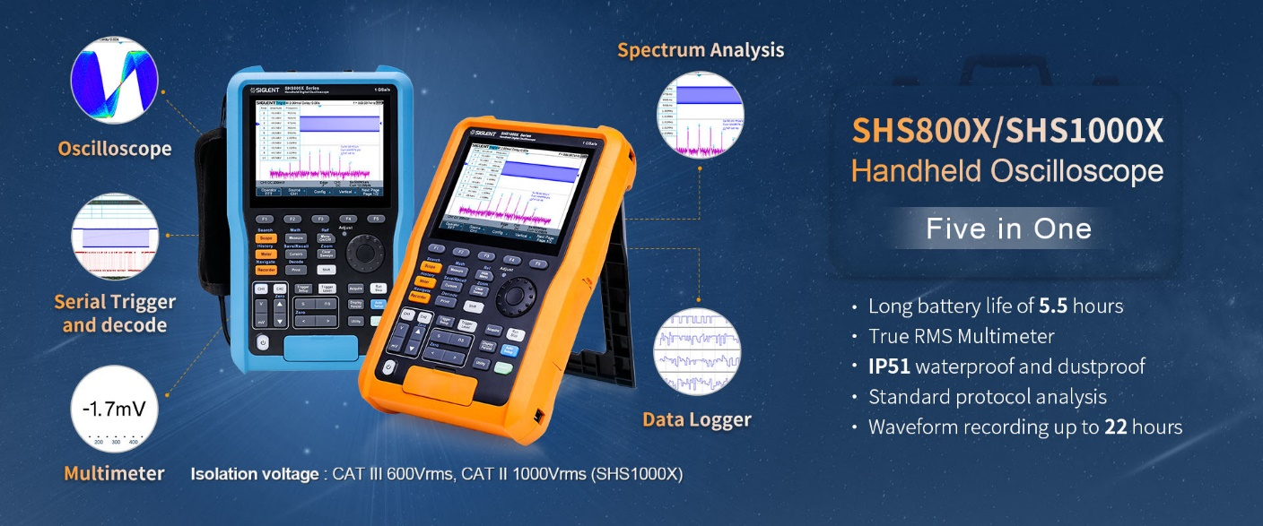

Slide 4
Basic Parameters
Features
Content
Comparative analysis
Notes:
目录字体放大

Slide 5
PART ONE
01
Basic Parameters
The Best Value In Electronic Test & Measurement

Slide 6
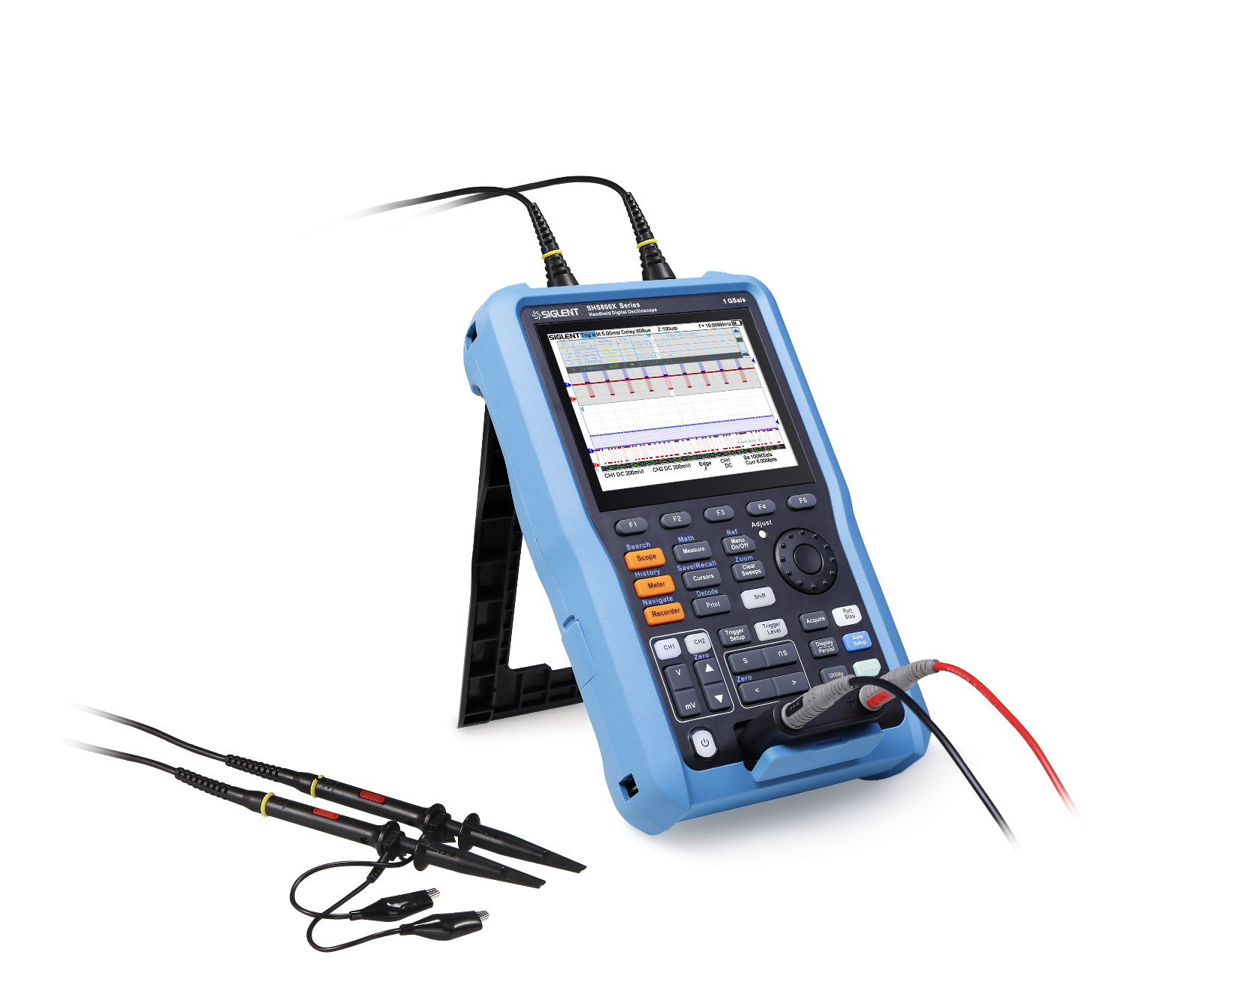
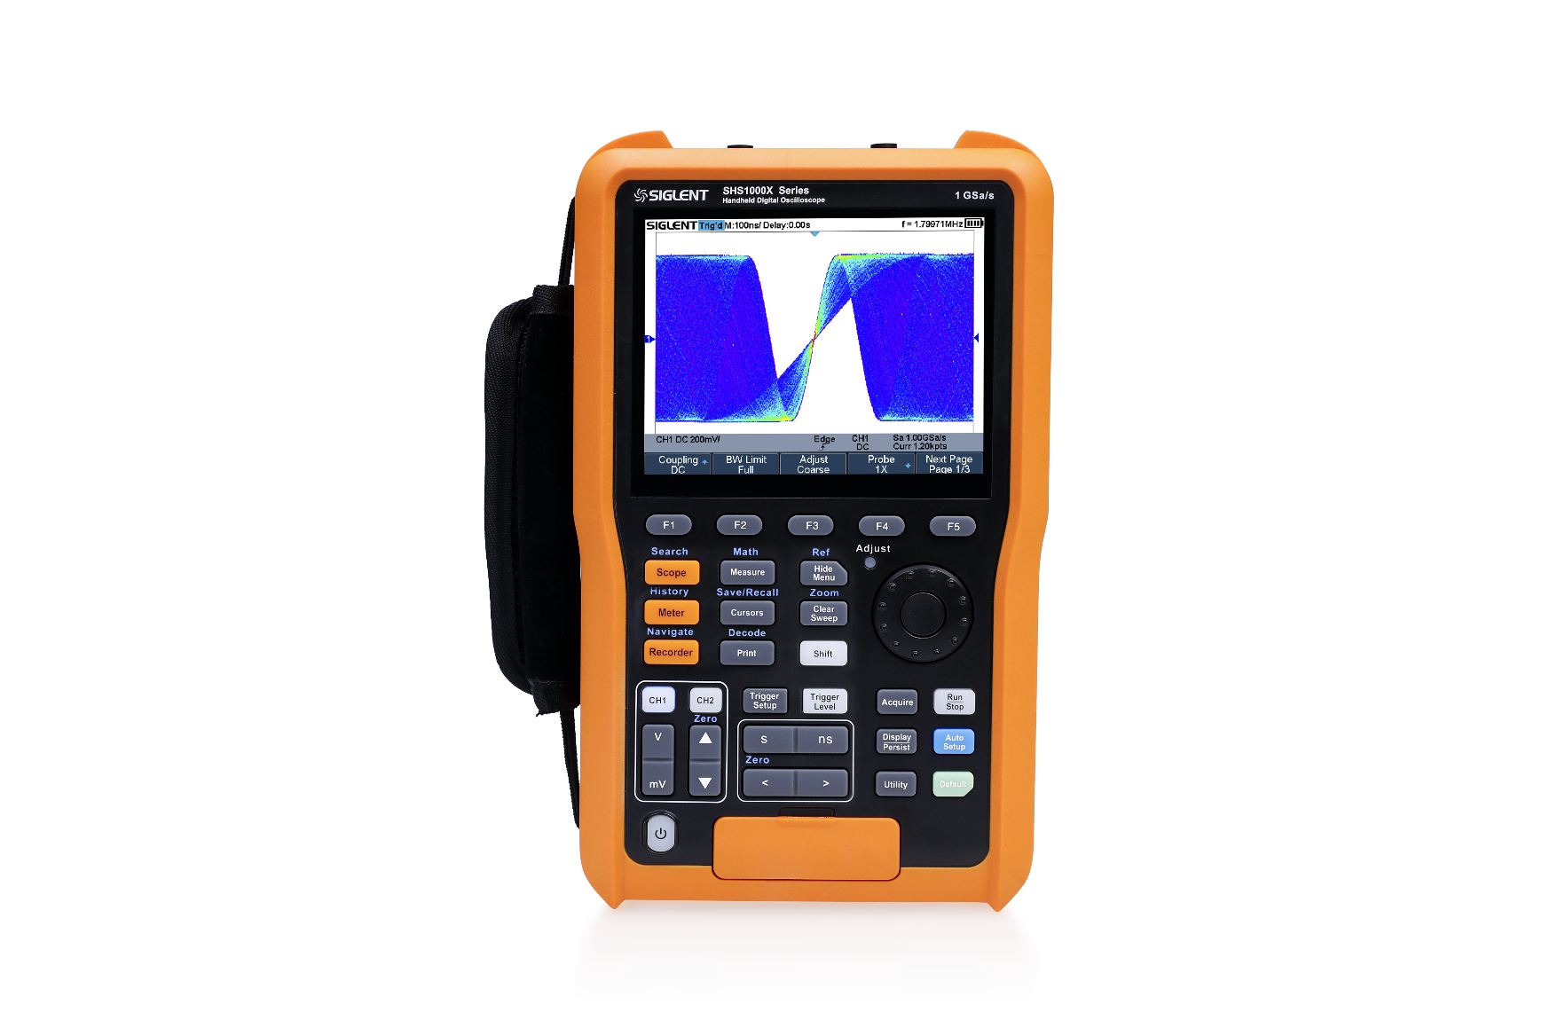
SHS800X/SHS1000X Handheld Oscilloscope

Slide 7
SHS800X Parameters
 |  | SHS810X | SHS820X
Oscilloscope | Bandwidth | 100 MHz | 200 MHz
 | Sample Rate | 1 GSa/s
 | Channels | 2 CH
 | Memory Depth | 12 Mpts
 | Waveform capture rate | 100,000 wfm/s，400,000 wfm/s (sequence mode)
 | Trigger type | Edge, Slope, Pulse Width, Window, Runt, Interval, Dropout, Pattern, Video
 | Serial Trigger and decoder | IIC, SPI, UART, CAN, LIN
 | Max input Voltage | CATII 300Vrms Between BNC Signal and Protecting Earth CATII 30Vrms Between BNC GND and Protecting Earth CATII 300Vrms Between BNC Signal and BNC GND
 | Probe | PP510 | PP215
Recorder | Sample Logger | The Max sample rate is 25 kSa/s, the Min sample rate is 1 Sa/s
 | Measurement Logger | The Max interval is 10 minutes, the Min interval is 0.1second. The Max items of logging is 4
Multimeter | Max input Voltage | CAT III 300Vrms, CAT II 600Vrms
 | Measurement type | DCV, ACV, DC, AC, Resistance, Capacitance, Diode, Continuity
 | Features | measurement value recorder, hardware based True RMS AC Voltage/Current measurement multimeter

Slide 8
SHS1000X Parameters
 |  | SHS1102X | SHS1202X
Oscilloscope | Bandwidth | 100 MHz | 200 MHz
 | Sample Rate | 1 GSa/s
 | Channels | 2 CH
 | Memory Depth | 12 Mpts
 | Waveform capture rate | 100,000 wfm/s，400,000 wfm/s (sequence mode)
 | Trigger type | Edge, Slope, Pulse Width, Window, Runt, Interval, Dropout, Pattern, Video
 | Serial Trigger and decoder | IIC, SPI, UART, CAN, LIN
 | Max input Voltage | CAT III 600Vrms, CAT II 1000Vrms Between BNC Signal and Protecting Earth CAT III 600Vrms, CAT II 1000Vrms Between BNC GND and Protecting Earth CAT III 300Vrms Between BNC Signal and BNC GND
 | Probe | PB925
Recorder | Sample Logger | The Max sample rate is 25 kSa/s, the Min sample rate is 1 Sa/s
 | Measurement Logger | The Max interval is 10 minutes, the Min interval is 0.1second. The Max items of logging is 4
Multi-meter | Max input Voltage | CAT III 600Vrms, CAT II 1000Vrms
 | Measurement type | DCV, ACV, DC, AC, Resistance, Capacitance, Diode, Continuity
 | Features | Measurement value recorder, hardware based True RMS AC Voltage/Current measurement

Slide 9
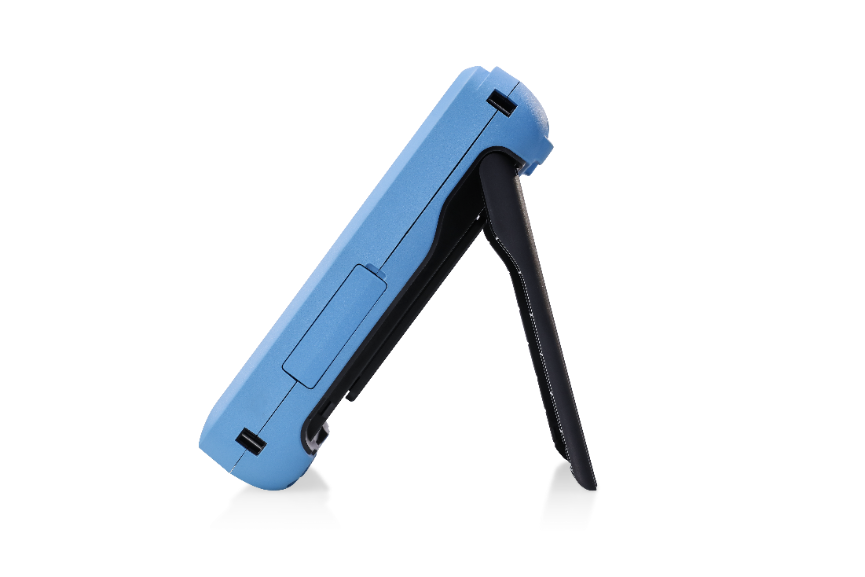
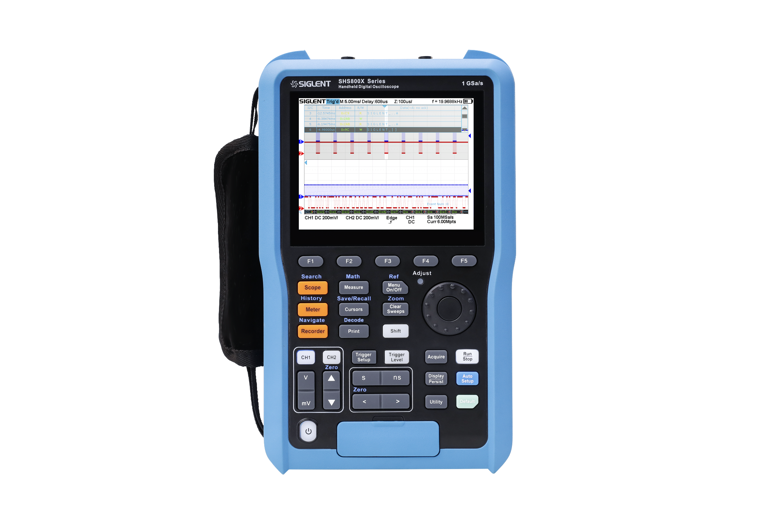
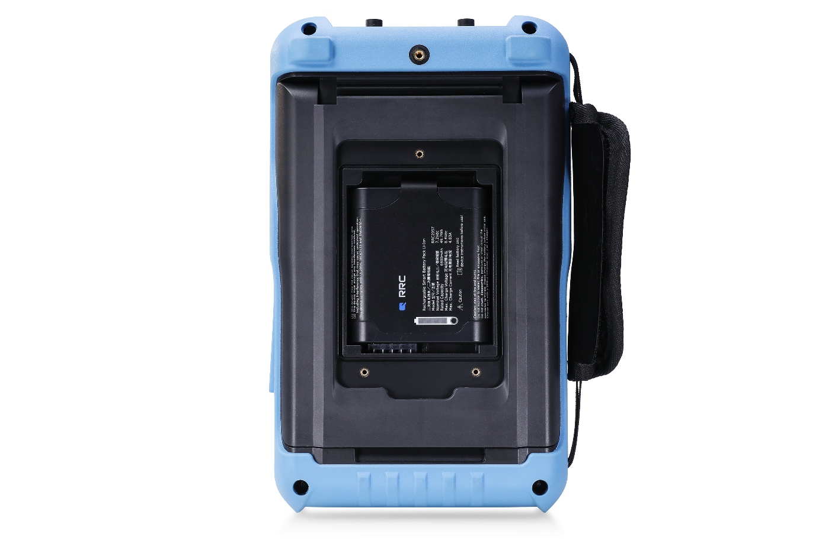
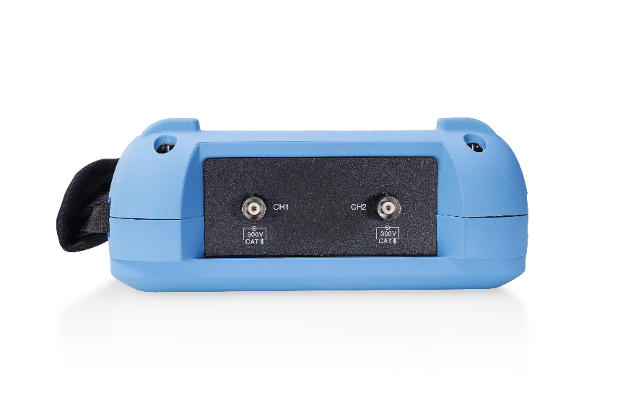
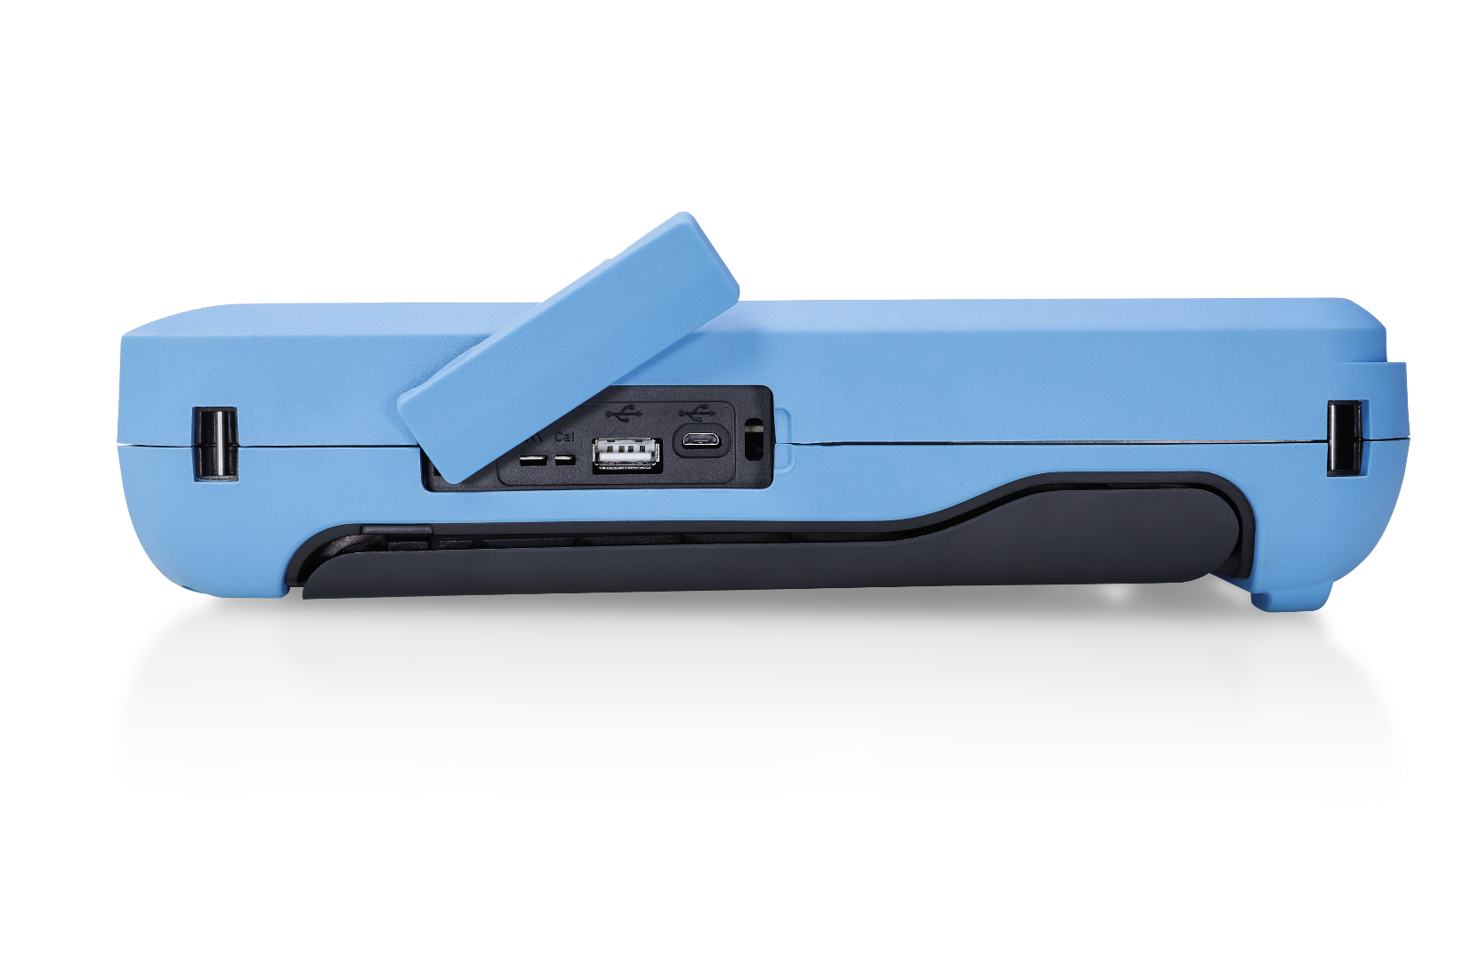
Panel

Slide 10
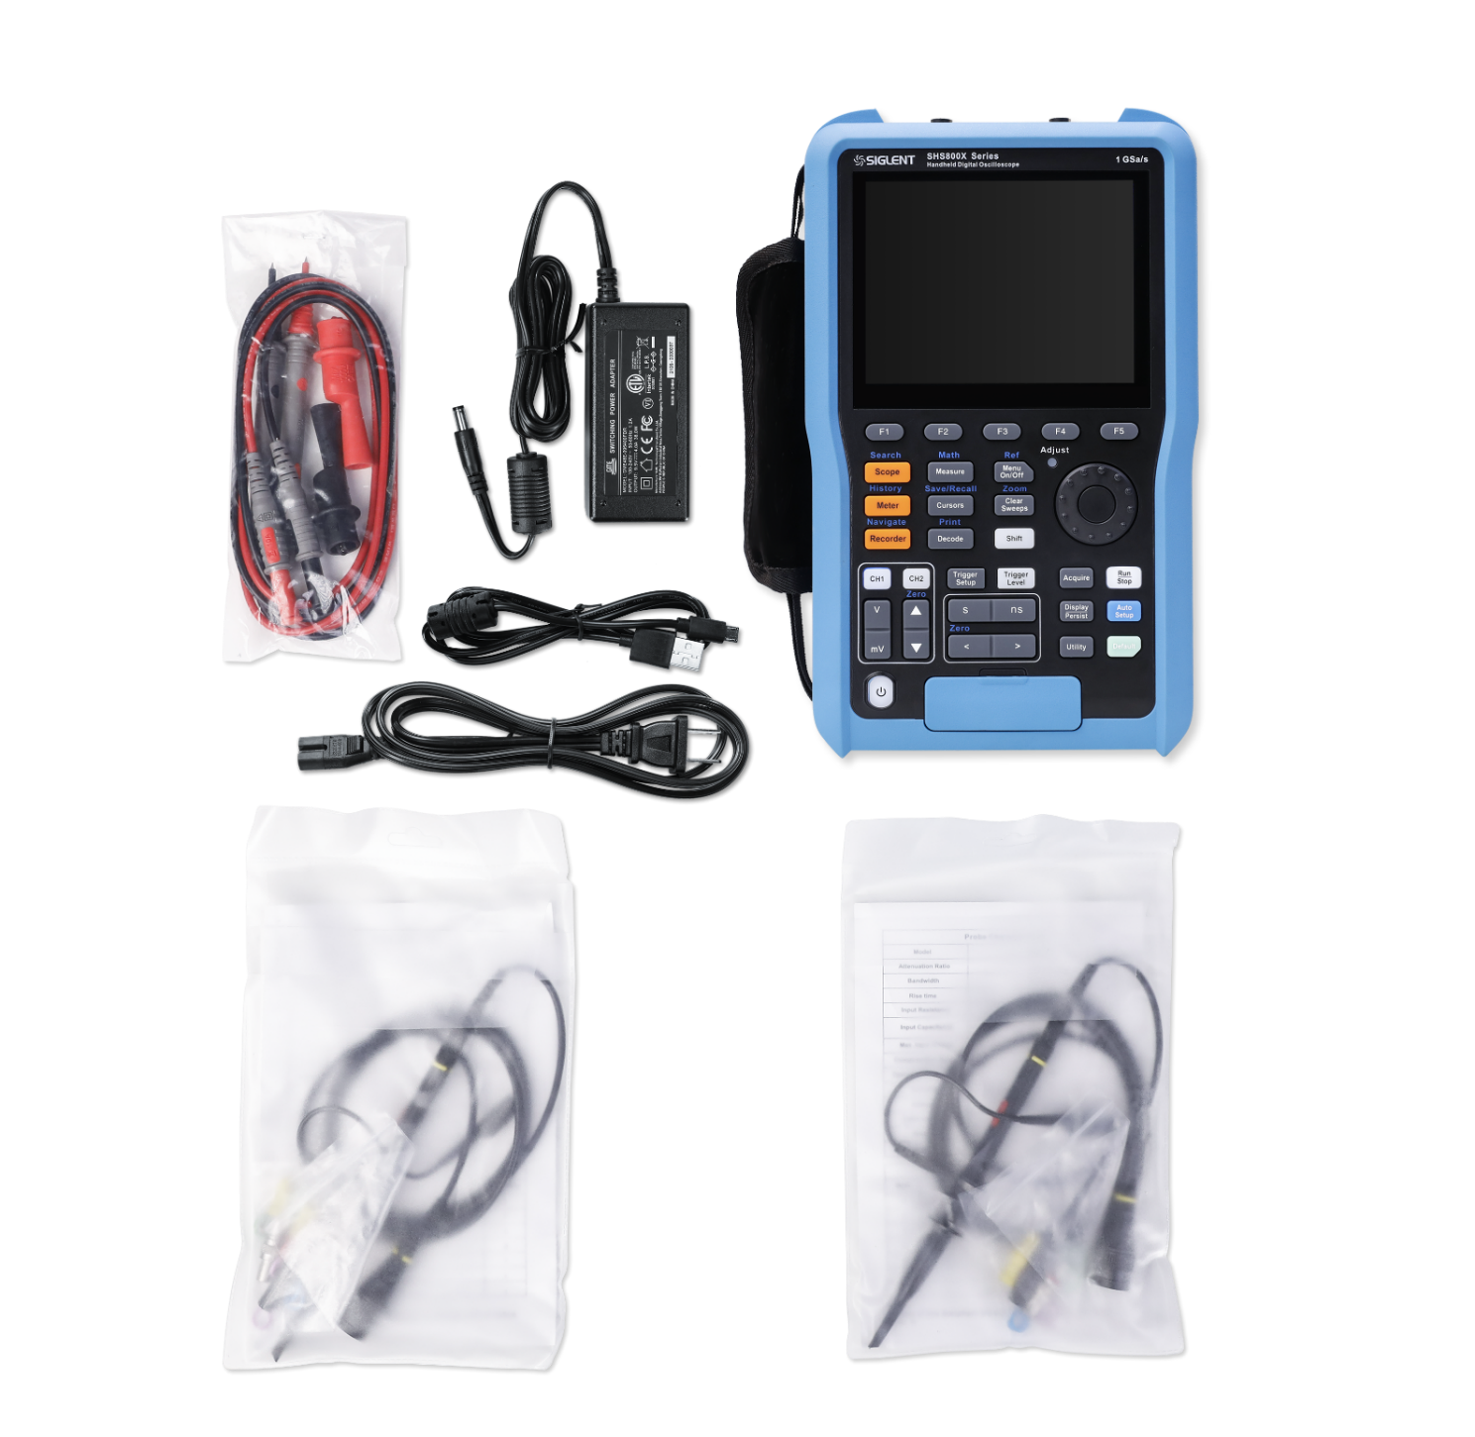
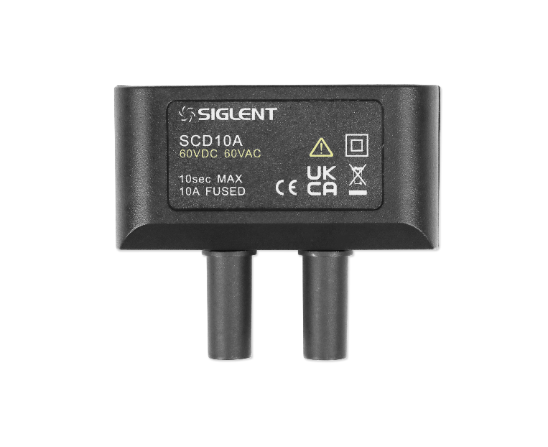
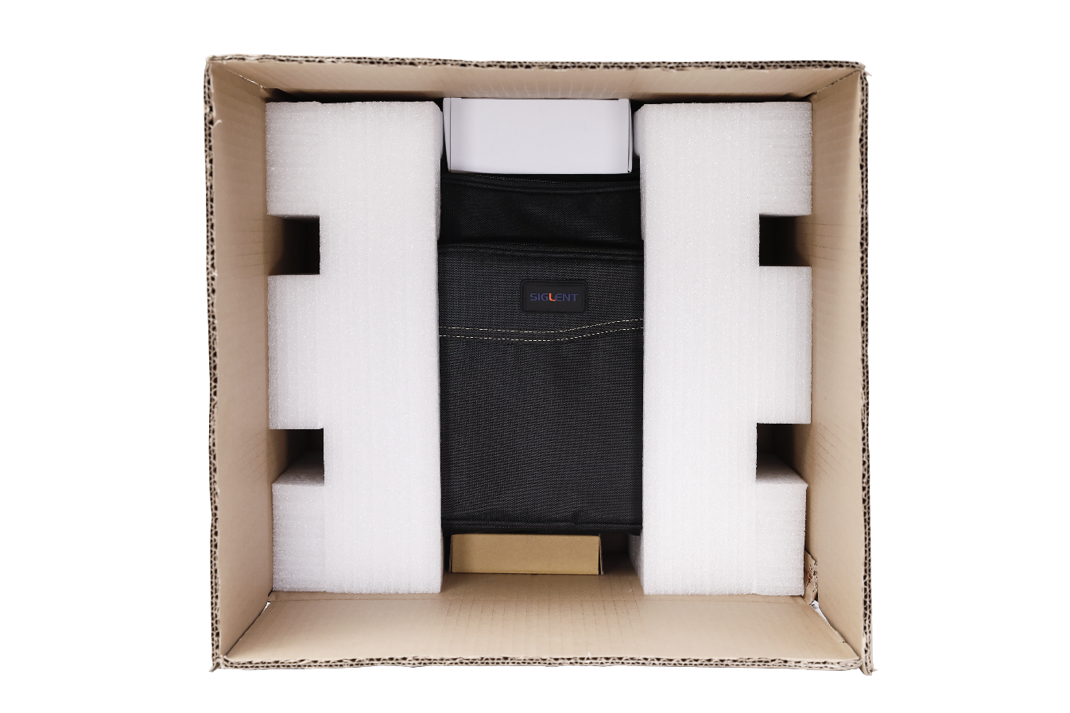
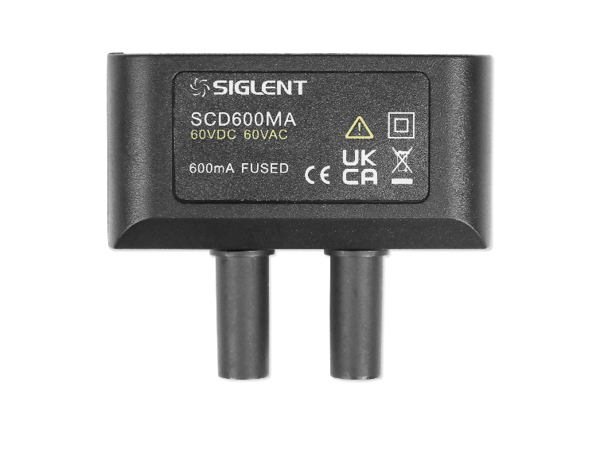
Packing List

Slide 11
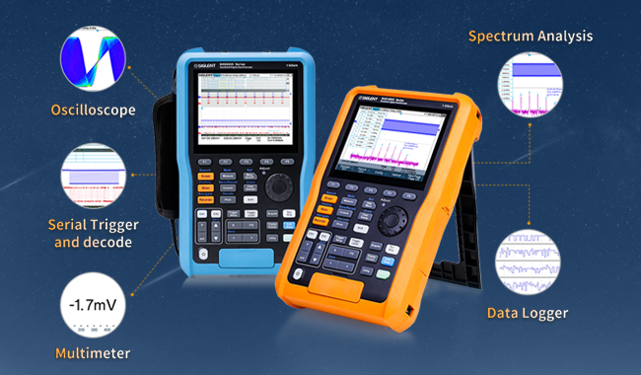


Five in one
2 CH Oscilloscope
True RMS Multi-meter
Recorder
Sample Logger
Measurement Logger
Serial Trigger and decode
FFT spectrum analysis

Slide 12
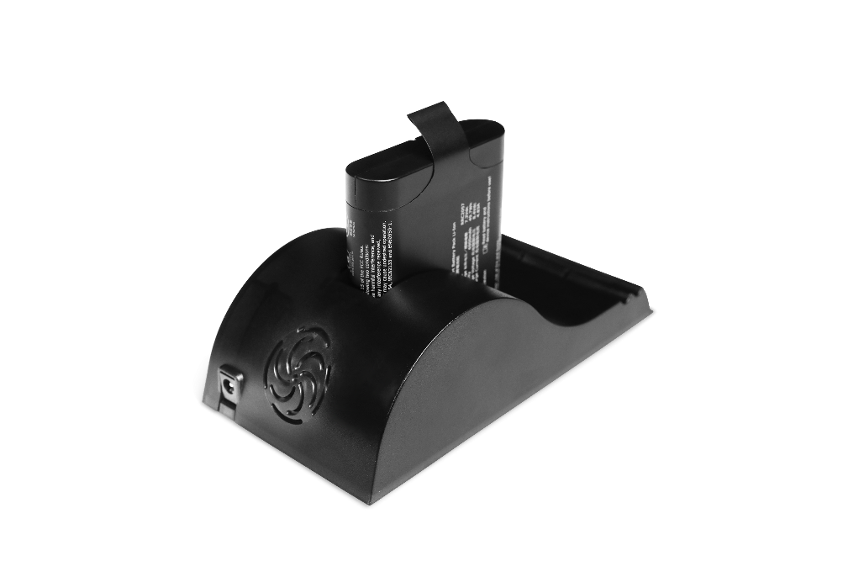
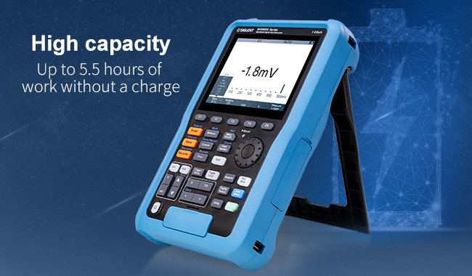
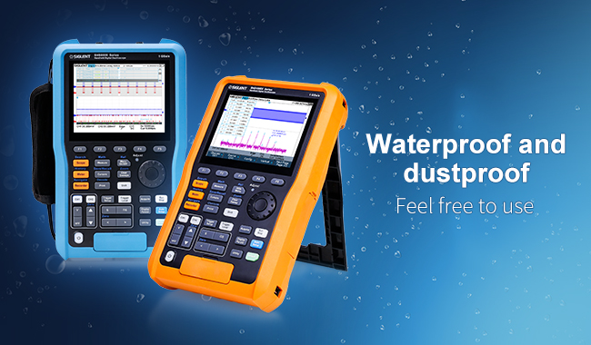
Higher protection level, longer battery life
Dust and waterproof certified to IP51, proving it is capable of testing in a variety of harsh environments
Rechargeable 6900 mA high-capacity lithium battery
UL certified
Up to 5.5 hours of work without a charge, greatly improving safety and battery life
he battery can be charged in the cabin or removed and charged with an external charger.
The included carrying case has ample room for the instrument, probes and other accessories. Perfect for field work and carrying on business trips.

Slide 13
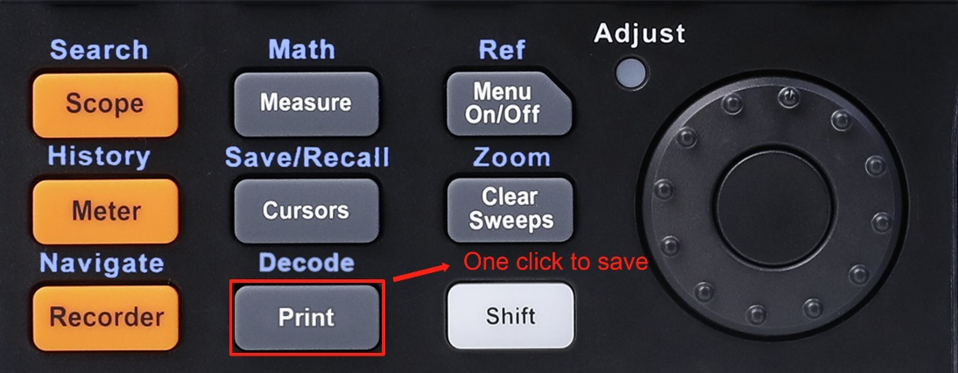
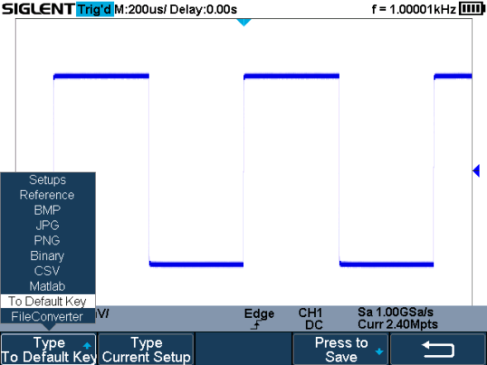
Quick data storage
Save data or waveform pictures with one click
The customizable Default button quickly saves the settings of the oscilloscope. Easily recall the settings when by pressing the Default button. There is no need to spend time debugging instrument every time during field testing.

Slide 14
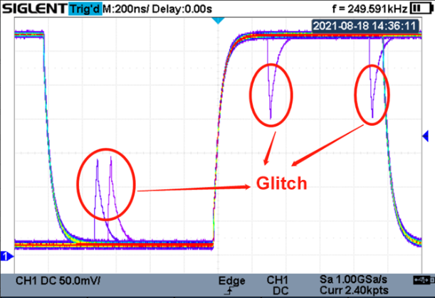
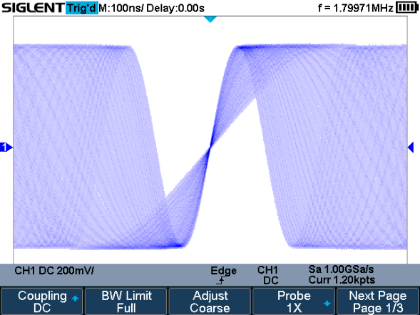
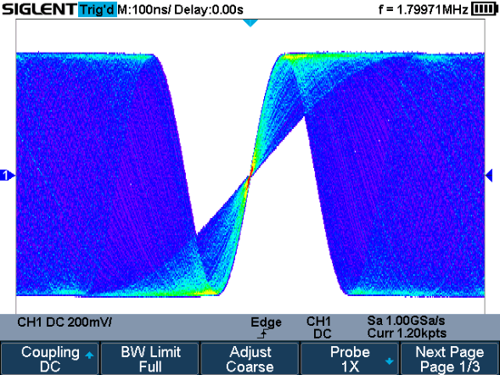
New platform – based on SPO technology
SPO technology
Waveform capture rates up to 100,000 wfm/s (normal mode) and 400,000 wfm/s (sequence mode)
Easily capture unusual or low-probability events.
Digital trigger system, more stable trigger
Supports 256-level intensity grading and color temperature display modes

Slide 15
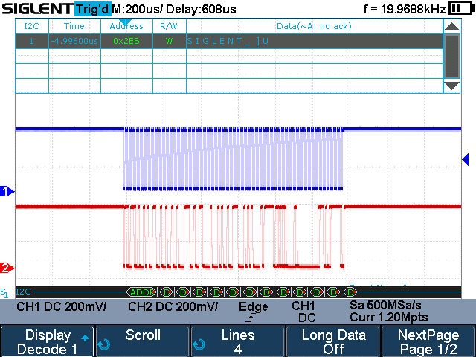
Standard Serial trigger and decode
Standard Serial trigger and decode: IIC, SPI, UART, CAN, LIN, widely used in automotive and embedded industries

Slide 16
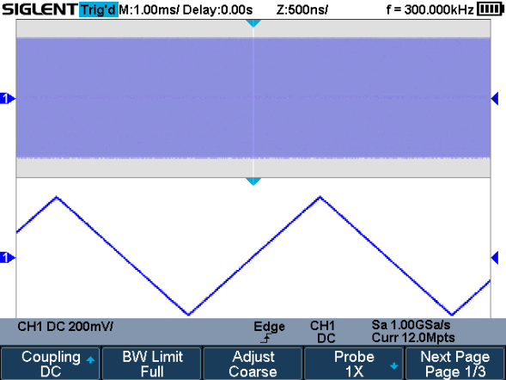
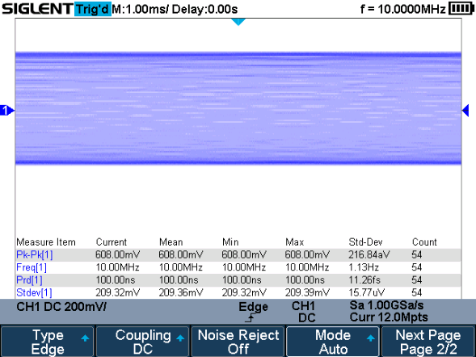
Deep Memory
12 Mpt storage depth enable users to oversample to capture for longer periods at higher resolution and use the zoom feature to see more details within each signal.
12 Mpt full storage point measurement to improve measurement accuracy. Math co-processor reduces measurement time and increases ease of use.

Slide 17
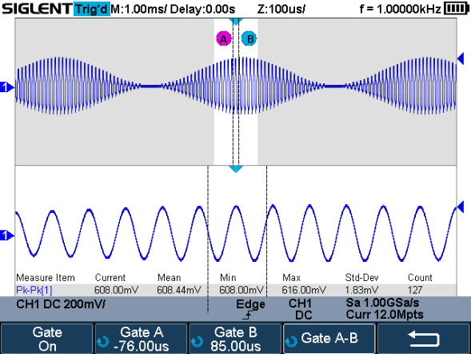
Gate and Zoom
Gate and Zoom measurements allow users to select any waveform for measurement and data statistics. It is beneficial to eliminate invalid and redundant data and ensure the validity and flexibility of measurement.

Slide 18
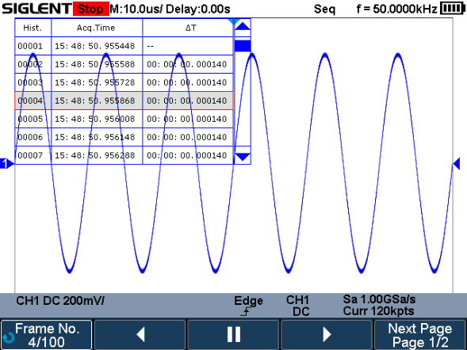
History and Sequence
Sequential mode ignores long time intervals that are not of interest and stores only the waveform frames of interest. The dead time is greatly reduced and storage space is saved.
With the history mode that is resident in the background, you can easily observe the time point of each captured waveform for easy analysis.

Slide 19
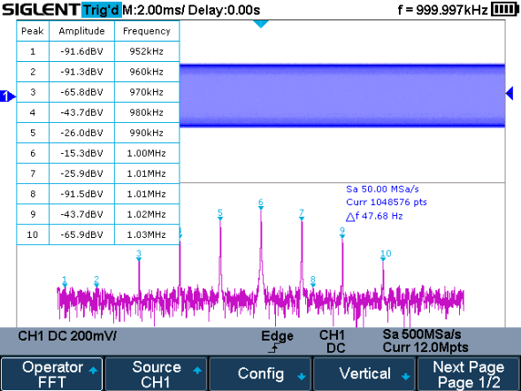
Powerful 1 Mpts FFT operation capability
SHSX scopes not only provide time domain analysis capabilities, but also include frequency domain analysis capabilities
Up to 1M point FFT, greatly improving the frequency resolution. When analyzing harmonics, the unique Peaks, Markers marking function can also directly display the amplitude of the corresponding frequency point.

Slide 20
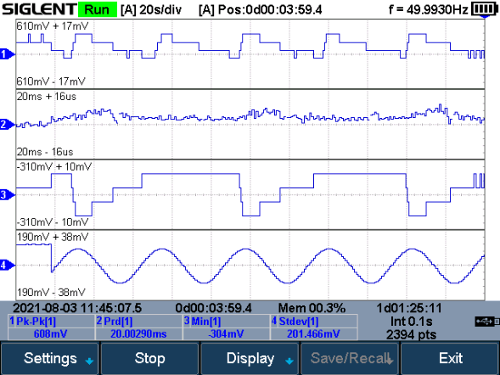
Hardware-based True RMS multimeter
Integrated 6000 count (~ 3.5 digit) digital multimeter
Hardware-Based True RMS Measurement
Features up to 4-channel measurement value trend graphing that can store 3.5 M measurement points

Slide 21
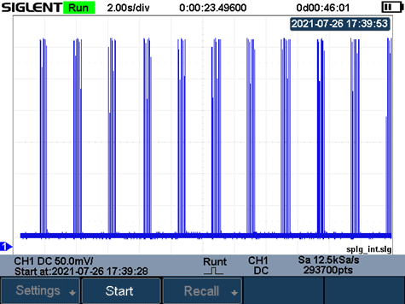
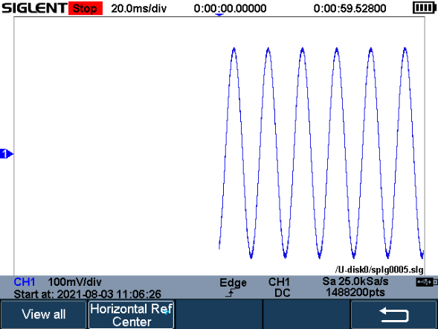
Record waveforms for up to 22 hours
Sampling rate 1 Sa/s ~ 25 kSa/s
Internally store up to 50 MB, externally store up to 2 GB
Waveform recorder function continuously records waveforms for up to 22 hours at a sampling rate of 25 kSa/s.

Slide 22
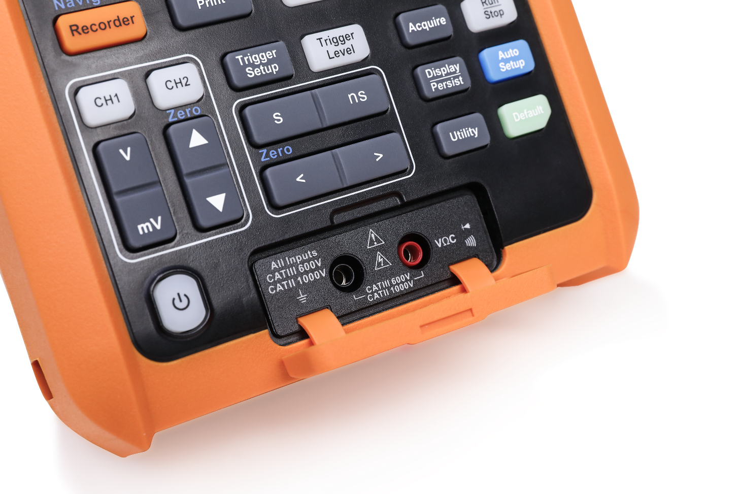
Full Isolation- only SHS1000X
The SHS1000X series features full isolation between the two oscilloscope channels, one multi-meter channel, power adapter and the USB host/device port.
The max voltage input to the analog scope inputs is CATIII 600Vrms, CATII 1000Vrms.
The max input for the multi-meter is CATIII 600Vrms, CATII 1000Vrms.

Slide 23
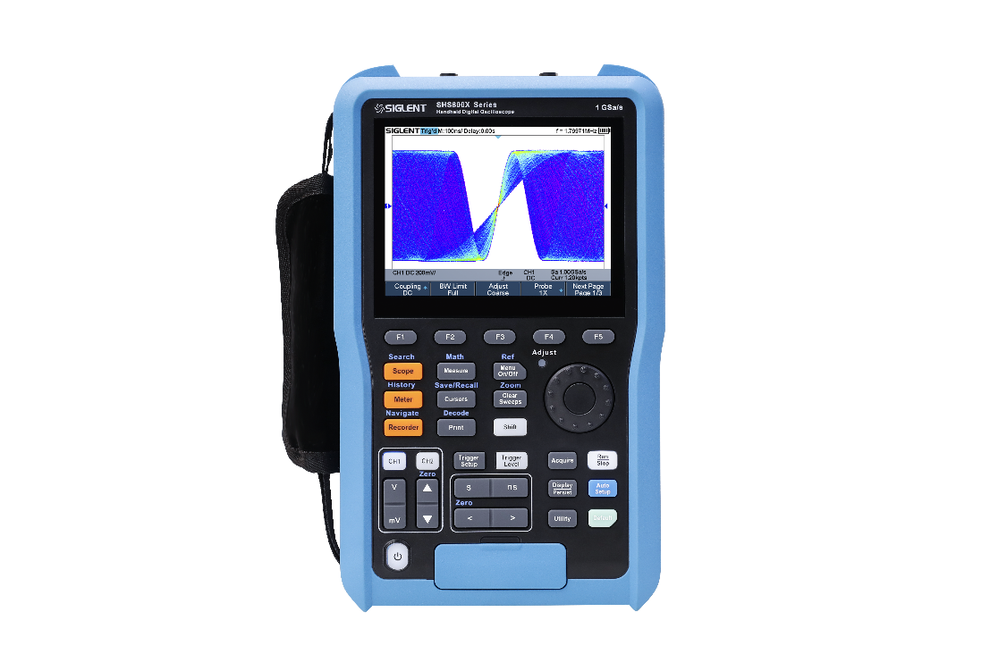
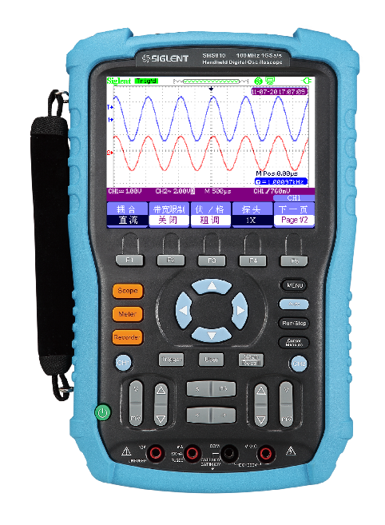
Model | Siglent SHS800X |  | Siglent SHS800
Bandwidth | 200/100 MHz | √ | 200/150/100/60 MHz | √
Bandwidth Limit | 20 MHz | √ | 20 MHz | √
Scope Channel | 2 | √ | 2 | √
CH to CH isolation | DC-Max BW: >40 dB | √ | >35 dB | X
Sampling rate | 1 Gsa/s | √ | 1 Gsa/s; 500MSa/s | √
Memory Depth | 12 Mpts in total | √ | 2 Mpts/1 Mpts/32 kpts/16 kpts | X
Wavefrom Capture Rate | 100,000 wfm/s (normal mode), 400,000 wfm/s (sequence mode) | √ | - | X
ERES | Enhance bits:0.5, 1.5, 2, 2.5, 3 | √ | - | X
Vertical Scale | 2mV/div–100 V/div | √ | 2mV/div ～ 100V/div | √
DC Gain Accuracy | ≤±2%: ≥10 mV/div ≤±3%: <10 mV/div | √ | 5mv/div-100v/div: ≤ ±3%; 2mv/div: ≤ ±4% | X
Timebase Scale | 1.0 ns/div-100 s/div | √ | 2.5ns/div ～ 50s/div; 5.0ns/div ～ 50s/div | X
Trigger Types | Edge, Slope, Pulse Width, Window, Runt, Interval, Dropout, Pattern, Video | √ | Edge, Pulse Width, Video, Slope, Alternative | X
Serial Trigger and decoder | IIC, SPI, UART, CAN, LIN | √ | - | X
Measurement Statistics | Current, Mean, Min, Max, Stdev, Count | √ | - | X
DMM Counts | 6,000 counts | √ | 6,000 counts | √
True RMS | Hardware implemented | √ | Support
Sample/Waveform Recorder | Up to 22 hours at 25 kSa/s, internal 50 MB, external 2 GB | √ | 800k points | X
Measurement Logger | 3.5 Mpts, 4 channels | √ | 1.2 Mpts, 1 channel | X
Data Transfer | PC | √ | PC | √
Other functions | Sequence, Search, Intensity and color temperature diaplay, History, 1 Mpts FFT | √ | - | X
IP Rating | IP51 | √ | - | X
Battery | 6900 mA 5.5 hours | √ | 5000 mA, 7.4 VDC, 5 hours | X
Interface | USB Host(Isolation), USB Device | √ | USB Device,USB Host | √
Size | 276*168*68 mm | √ | 259.5*163.2*53.3 mm | √
Weight | 1.75 kg | X | 1.5 kg | √
Display | 5.6'' 640*480 LCD Screen | √ | 5.7'' LCD | √

Slide 24
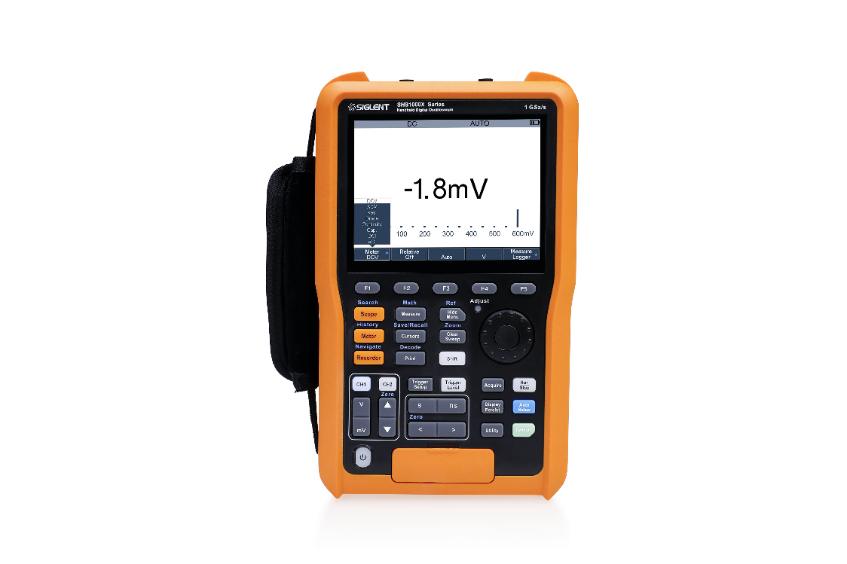
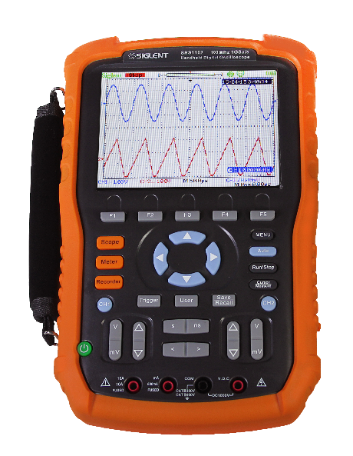
Model | Siglent SHS1000X |  | Siglent SHS1000
Bandwidth | 200/100 MHz | √ | 100/60 MHz | X
Bandwidth Limit | 20 MHz | √ | 20 MHz | √
Scope Channel | 2 | √ | 2 | √
CH to CH isolation | DC-Max BW: >40 dB | √ | >35 dB | X
Max. Floating Voltage | CATIII 600 Vrms, CATII 1000 Vrms | √ | CATIII 600 Vrms, CATII 1000 Vrms | √
Sampling rate | 1 Gsa/s | √ | 1 Gsa/s | √
Memory Depth | 12 Mpts in total | √ | 2 Mpts | X
Wavefrom Capture Rate | 100,000 wfm/s (normal mode), 400,000 wfm/s (sequence mode) | √ | - | X
ERES | Enhance bits:0.5, 1.5, 2, 2.5, 3 | √ | - | X
Vertical Scale | 5 mV/div–100 V/div | √ | 5 mV/div – 100 V/div | √
DC Gain Accuracy | ≤±2%: ≥10 mV/div ≤±3%: <10 mV/div | √ | 5 mv/div-100 v/div: ≤ ±3% | X
Timebase Scale | 1.0 ns/div-100 s/div | √ | 2.5ns/div ～ 50s/div | X
Trigger Types | Edge, Slope, Pulse Width, Window, Runt, Interval, Dropout, Pattern, Video | √ | Edge, Pulse Width, Video, Slope, Alternative | X
Serial Trigger and decoder | IIC, SPI, UART, CAN, LIN | √ | - | X
Measurement Statistics | Current, Mean, Min, Max, Stdev, Count | √ | - | X
DMM Counts | 6,000 counts | √ | 6,000 counts | √
True RMS | Hardware implemented | √ | Support | √
Sample/Waveform Recorder | Up to 22 hours at 25 kSa/s, internal 50 MB, external 2 GB | √ | 800k points | X
Measurement Logger | 3.5 Mpts, 4 channels | √ | 1.2 Mpts, 1 channel | X
Data Transfer | PC | √ | PC | √
Other functions | Sequence, Search, Intensity and color temperature diaplay, History, 1 Mpts FFT | √ | - | X
IP Rating | IP51 | √ | - | X
Battery | 6900mA，4 hours | √ | 5000 mAh, 4 hours | √
Interface | USB Host(Isolation), USB Device | √ | USB Device,USB Host | √
Size | 276*168*68 mm | √ | 259.5*163.2*53.3 mm | √
Weight | 1.75 kg | X | 1.5 kg | √
Display | 5.6'' 640*480 LCD Screen | X | 5.7'' LCD | √

Slide 25
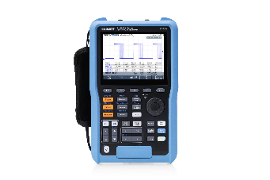

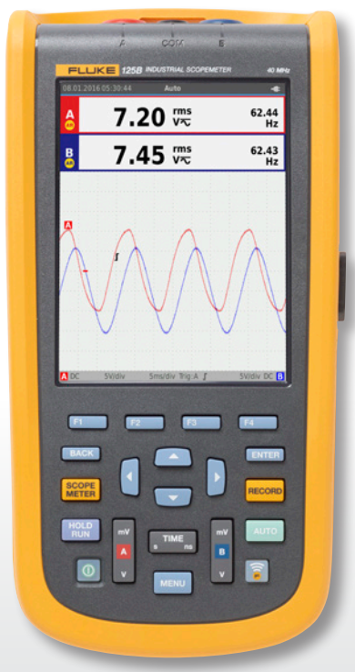
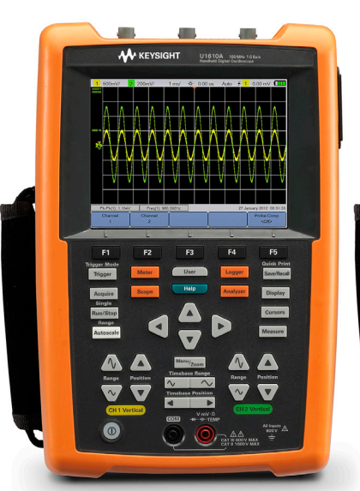
Model | Siglent SHS800X | Siglent SHS1000X | Keysight U1600A | Fluke 120B
Bandwidth | 200/100 MHz | 200/100 MHz | 200/100 MHz | 40/20 MHz
Bandwidth Limit | 20 MHz | 20 MHz | 10 kHz and 20 MHz (selectable) | -
Scope Channel | 2 | 2 | 2 | 2
Max Floating Voltage | - | CATIII 600 Vrms, CATII 1000 Vrms | CAT III 300 V | 600 Vrms CAT IV
CH to CH isolation | DC-Max BW: >40 dB | DC-Max BW: >40 dB | - | -
Sampling rate | 1 Gsa/s | 1 Gsa/s | 2 /1 Gsa/s | 40 MSa/s
Memory Depth | 12 Mpts in total | 12 Mpts in total | 2 Mpts/ 120 kpts | -
Wavefrom Capture Rate | 100,000 wfm/s (normal mode), 400,000 wfm/s (sequence mode) | 100,000 wfm/s (normal mode), 400,000 wfm/s (sequence mode) | - | -
ERES | Enhance bits:0.5, 1.5, 2, 2.5, 3 | Enhance bits:0.5, 1.5, 2, 2.5, 3 | - | -
Vertical Scale | 2 mV/div–100 V/div | 5 mV/div–100 V/div | 2 mV/div–50 V/div | 5 mV to 200 V/div
DC Gain Accuracy | ≤±2%: ≥10 mV/div ≤±3%: <10 mV/div | ≤±2%: ≥10 mV/div ≤±3%: <10 mV/div | ± 4% of full scale | -
Timebase Scale | 1.0 ns/div-100 s/div | 1.0 ns/div-100 s/div | U1620A : 2 ns/div to 50 s/div U1610A : 5 ns/div to 50 s/div | 1 μs to 5 s/div
Trigger Types | Edge, Slope, Pulse Width, Window, Runt, Interval, Dropout, Pattern, Video | Edge, Slope, Pulse Width, Window, Runt, Interval, Dropout, Pattern, Video | Edge, Glitch, TV, Nth Edge, CAN, LIN | Edge
Serial Trigger and decoder | IIC, SPI, UART, CAN, LIN | IIC, SPI, UART, CAN, LIN | No | No
Measurement Statistics | Current, Mean, Min, Max, Stdev, Count | Current, Mean, Min, Max, Stdev, Count | - | -
FFT points | 1 Mpts | 1 Mpts | 1024 pts | -
DMM Counts | 6,000 counts | 6,000 counts | 10,000 counts | dual input 5000 counts
IP Rating | IP51 | IP51 | IP41 | IP51
Battery | 6900mA 5.5 hours | 6900mA 4 hours | 10.8 V 3 hours | 7 hours with 50 % backlight brightness
Price | Starting from $979 | Starting from $1899 | Starting from $6619 | Starting from $1799

Slide 26
Thank You
The Best Value in Electronic Test & Measurement
Headquarters
NA
Europe
SIGLENT TECHNOLOGIES CO., LTD.
Add: Blog No.4 & No.5, Antongda Industrial Zone, 3rd Liuxian Road, Bao’an District, Shenzhen, 518101, China
Tel:+ 86 755 3688 7876
Fax:+ 86 755 3359 1582
sales@siglent.com
int.siglent.com
SIGLENT Technologies NA, Inc.
Add: 6557 Cochran Rd Solon, Ohio 44139 Tel: 440-398-5800 Toll Free:877-515-5551 Fax: 440-399-1211
info@siglent.com www.siglentna.com
SIGLENT TECHNOLOGIES GERMANY GmbH
Add: Staetzlinger Str. 70 86165 Augsburg, Germany Tel: +49(0)-821-666 0 111 0 Fax: +49(0)-821-666 0 111 22 info-eu@siglent.com www.siglenteu.com

