Slide 1


Slide 2
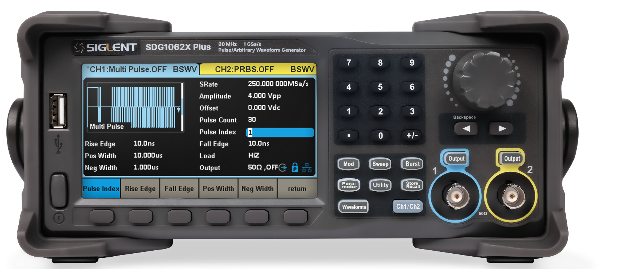

SDG1000X Plus 25/30/60 MHz
Function/Arbitrary Waveform Generator
Contents
Basic info
Features and Benefits
Applications
Competition Analysis

Slide 3
SDG1000X Plus main parameters
Model | SDG1062X Plus | SDG1032X Plus | SDG1022X Plus
Max output frequency | 60 MHz | 30 MHz | 25 MHz
Channels | 2
Sampling rate | 1 GSa/s (4X Interpolation)
Vertical resolution | 16 bits
Arbitrary waveform length | 8 Mpts/CH
Max. amplitude | ±10 V
Display | 4.3” display, 480 x 272 x RGB
Interface | Standard: USB Host, USB Device, LAN Optional: GPIB (USB-GPIB adaptor)

Slide 4

User friendly interface
Knob
USB Host
Mode function keys
CH1/CH2 output
Menu softkeys

Slide 5
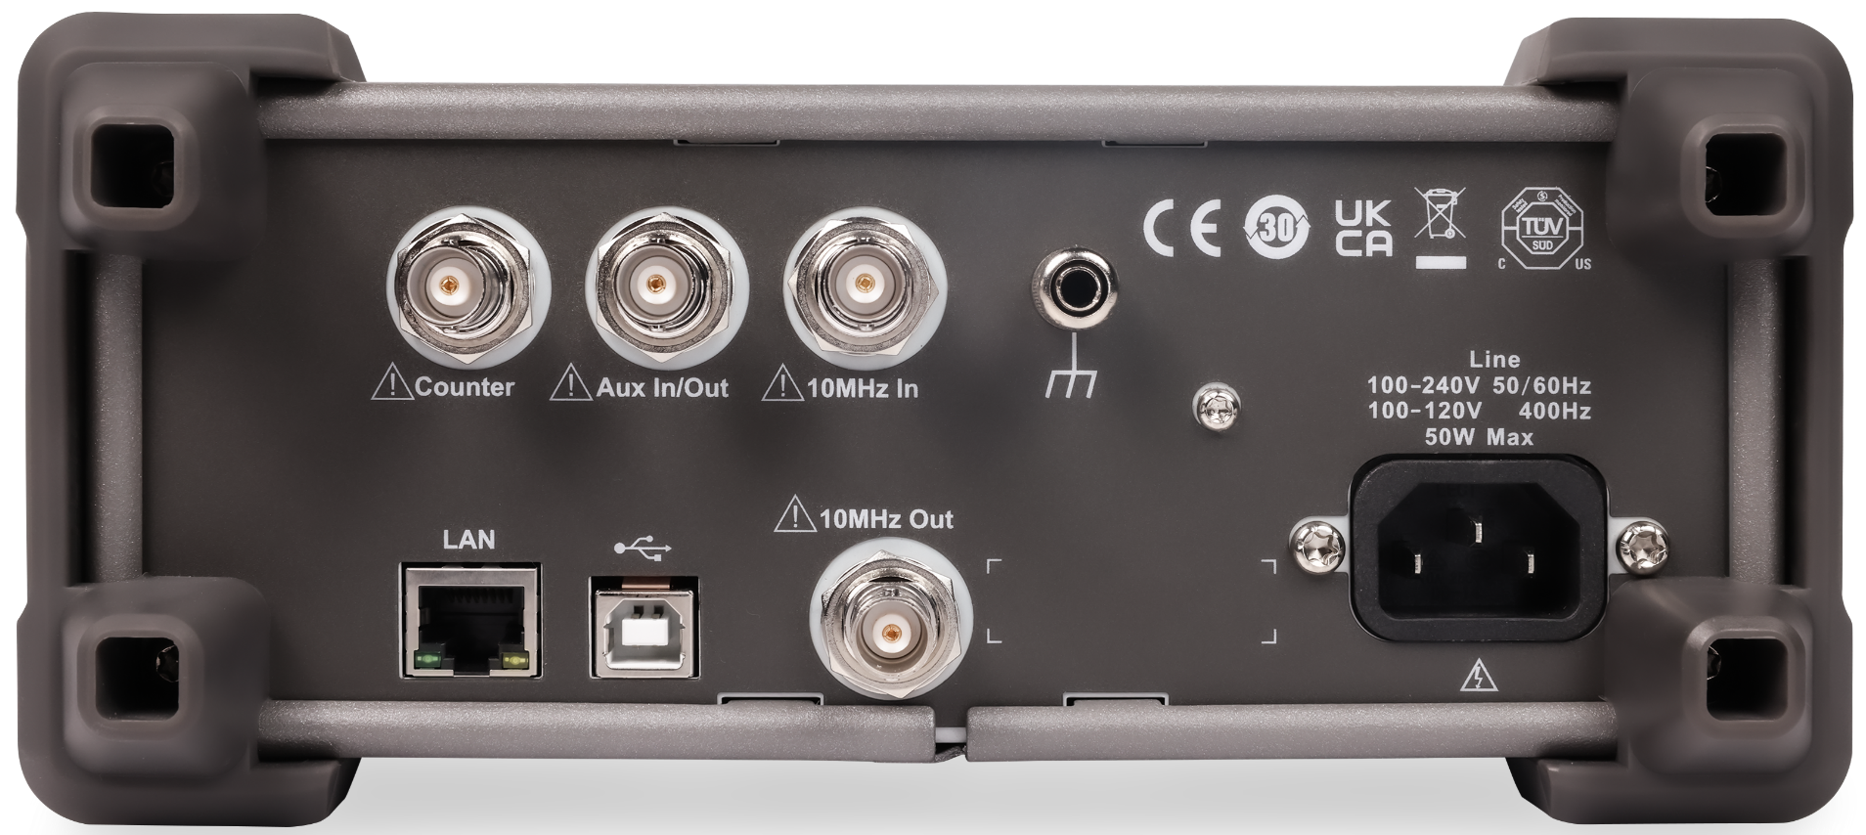
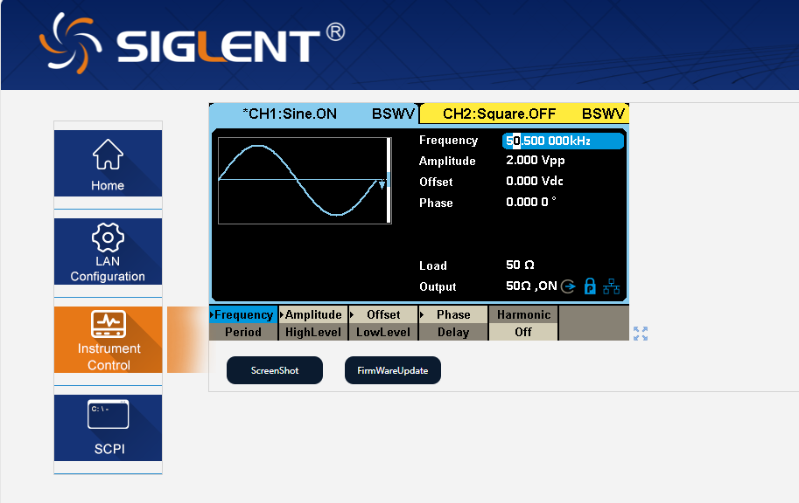
Abundant interfaces
USB Host
USB Device
Aux In/Out
10MHz In/Out
Ground terminal
LAN

Slide 6
SDG1000X Plus 25/30/60 MHz
Function/Arbitrary Waveform Generator
Contents
Basic Info
Features and Benefits
Applications
Competition Analysis

Slide 7
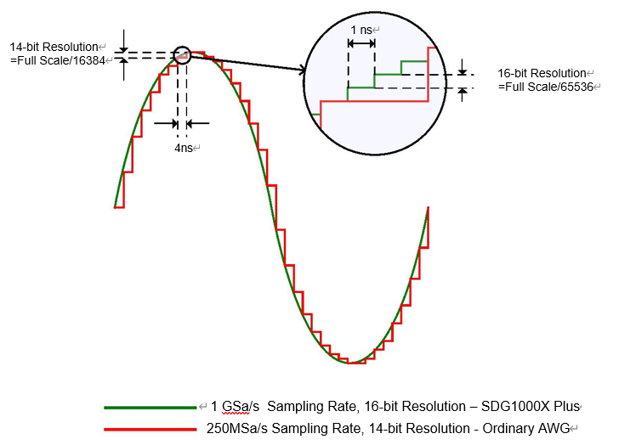
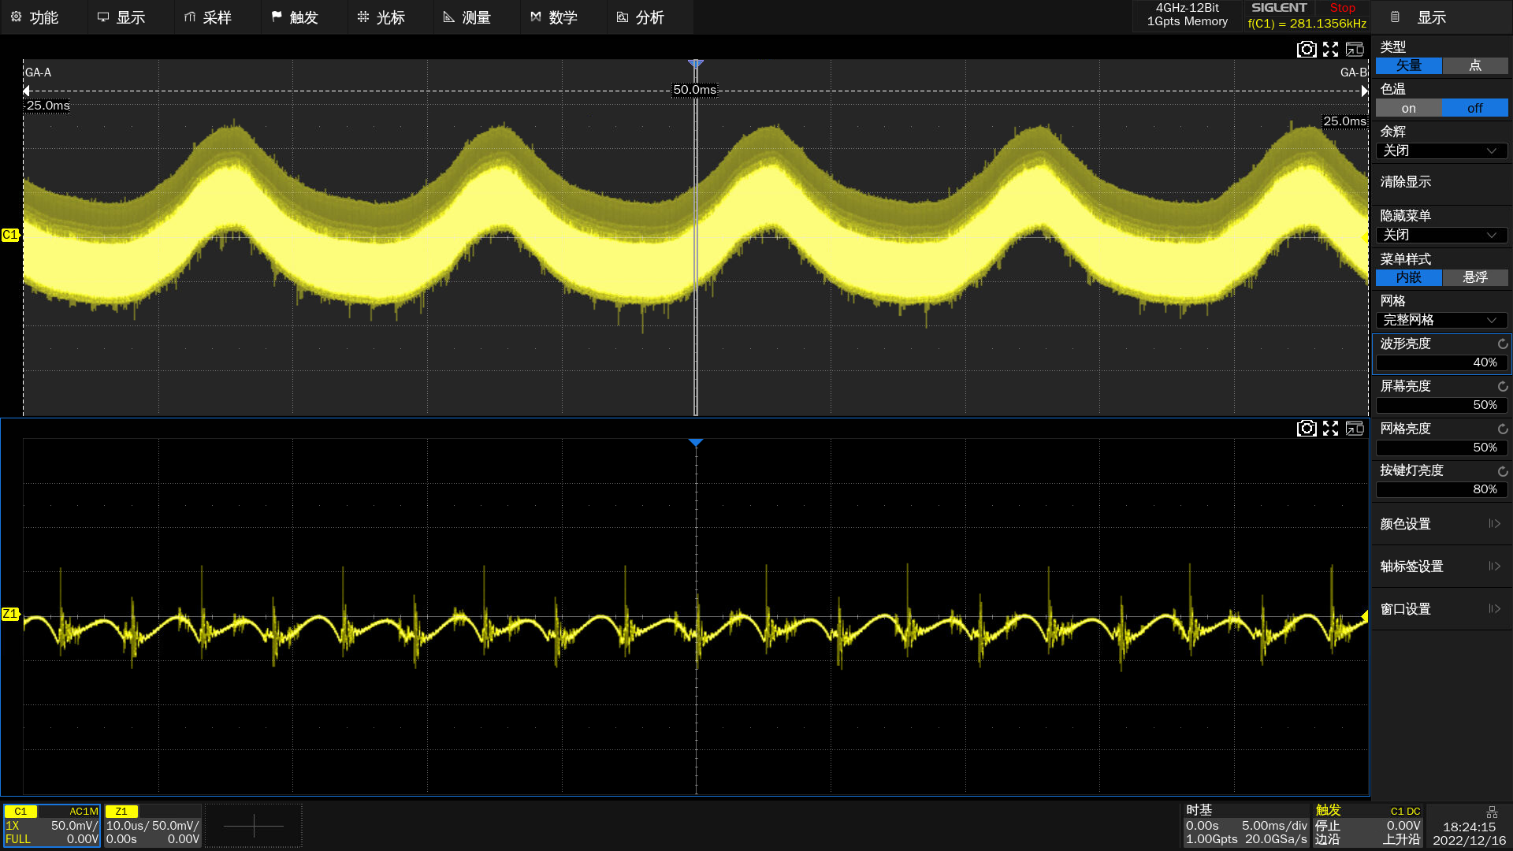
High-performance Sampling System
1 GSa/s (4X Interpolation) Sampling rate
16 bits Vertical resolution
High-performance Sampling System reliably reproduces your design signals and ensures signal integrity.

Slide 8
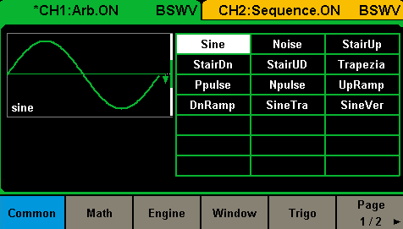
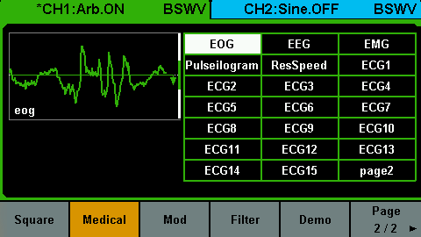
Arbitrary waveform
Arbitrary waveform length: 8 Mpts/CH
Arbitrary wave generation: User-defined(8Mpts) or Built-in(16kpts)
Built-in waveform types: Common, Math, Engine, Window, Trigo, Square, Medical, Mod, Filter, Demo.
A waveform length of 8Mpts not only accurately simulates complex modulated signals and long pulse trains, ensuring the authenticity of communication system testing, but also meets the timing and amplitude control requirements for high-speed, high-precision chip testing. Additionally, it is helpful to simulate complex bioelectric signals in the biomedical field, enabling researchers to conduct more in-depth research.

Slide 9
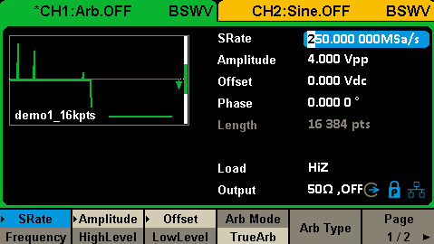
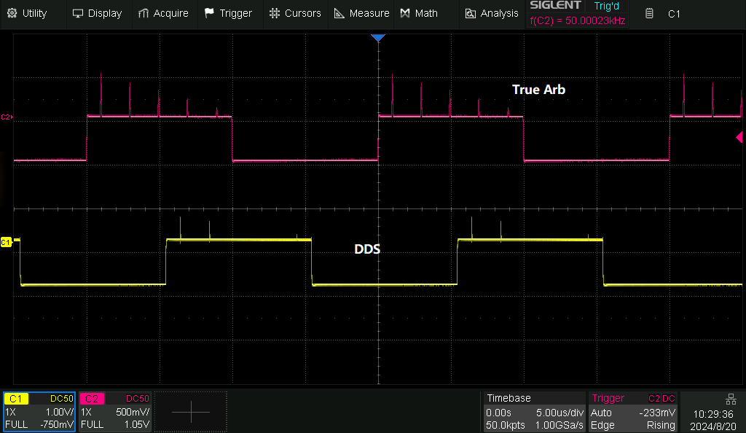
TrueArb Technology
In the traditional DDS mode, SDG uses a fixed clock to generate the signal. This technology may cause the generated signal to miss details (such as burrs) by increasing or decreasing signal points to match the clock rate, which cannot meet the requirements of accurate design.
With distortion
With jitter
Sample rate is not adjustable
With SIGLENT's TureArb mode, SDG uses a variable clock, which integrates the advantages of DDS and ensures the accurate output of signals point by point, with no details missing. This mode also supports adjusting the sampling rate and flexibly controlling the amount of signal data. At the same time, high sampling rate can effectively reduce distortion and error.
Without distortion
< 200ps Jitter
1uSa/s~250MSa/s Sample rate
DDS and TureArb output

Slide 10
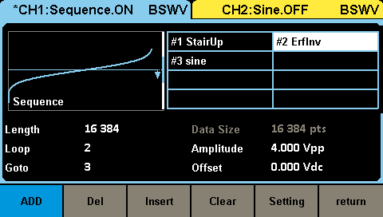
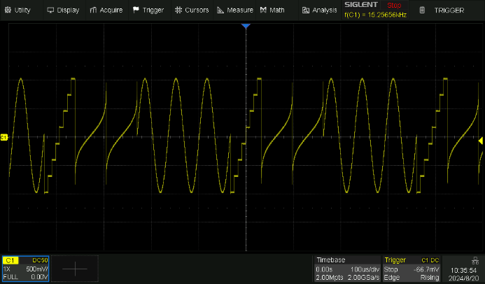
Create Sequences
8Mpts Sequence wave length
Up to 128 Sequences
Sequences generation: User-defined or Built-in(same as Arb mode)
Sequence Output can simulate abnormal signals during system operation

Slide 11
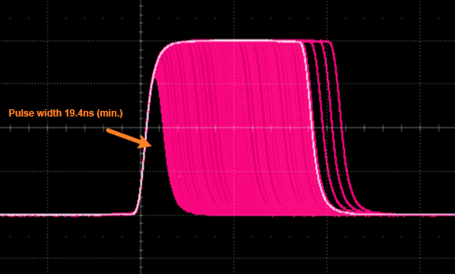
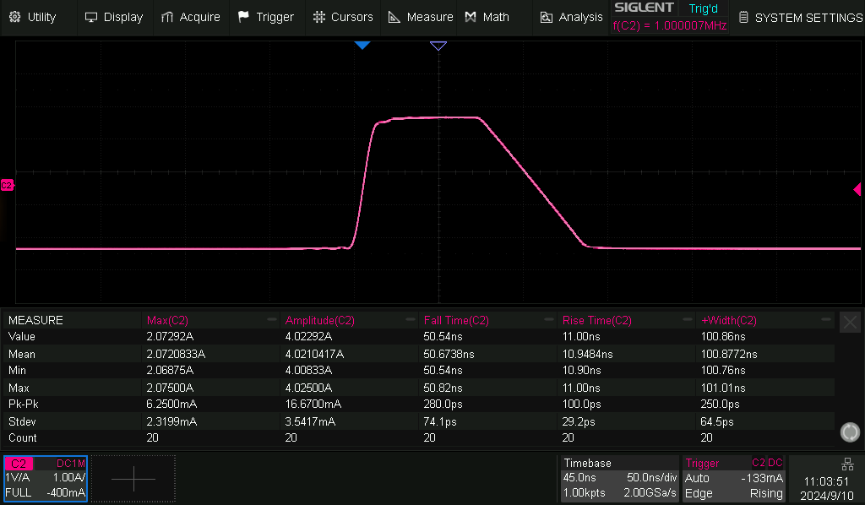
High-speed Pulse
Pulse width: 19.4ns(Min.)
Rise/fall time: 10ns(Min.) at any frequency
Set Resolution: 0.1ns
Rise time: 10ns
Fall time: 50ns
Positive pulse width: 100ns

Slide 12
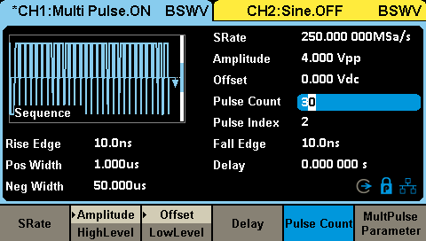
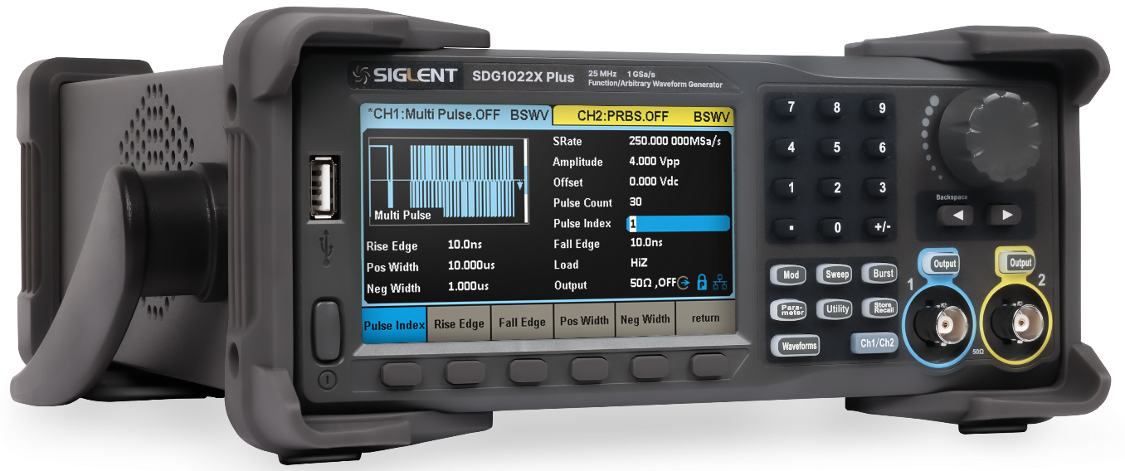
Multi Pulse
30 Pulses(Max.), each pulse can be set independently
Rise/Fall Edge: 10ns (Min.)
Pos/Neg Width: 10ns (Min.)

Slide 13
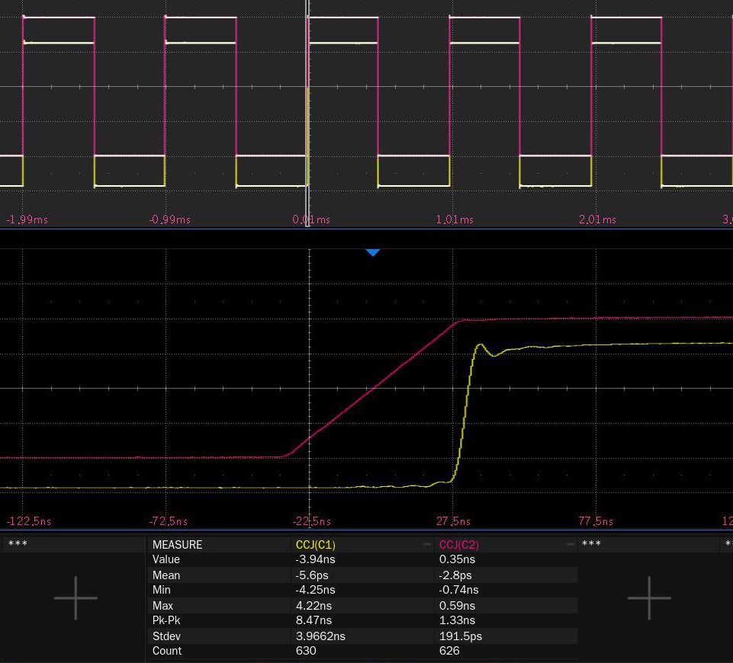
EasyPulse Technology
In the traditional DDS mode, when SDG generates a square wave/pulse waveform, if the sampling rate is not an integer multiple of the output frequency, extra jitter will be generated.
· High Jitter
SIGLENT’s EasyPulse technology overcomes the weaknesses of the DDS mode to produce a low-jitter square/pulse waveform.
Low Jitter
CCJ
SDG1062X Plus: <200ps
DDS: 3.9ns

Slide 14

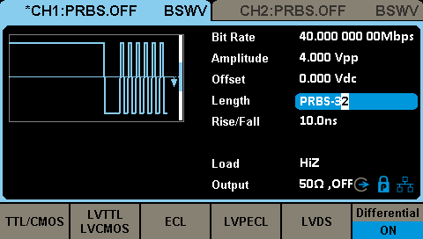
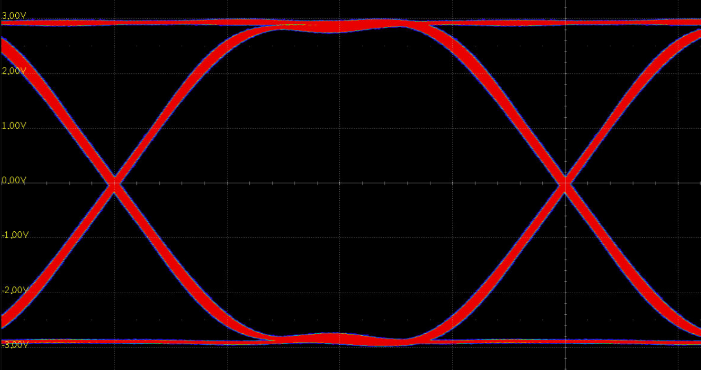
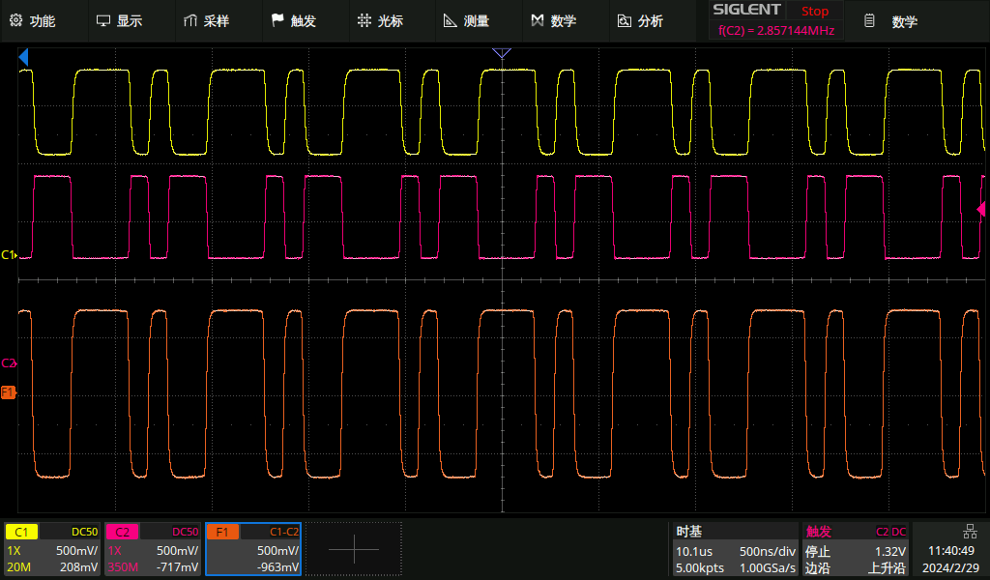
PRBS
Bit Rate: 1 μbps ~ 40 Mbps
Rise/Fall Time: 10ns ~ 1 μs
Verification of BER in High-Speed Serial Communication Systems.
SDG can output differential signals with high common-mode rejection ratio with one key without complicated setup.

Slide 15
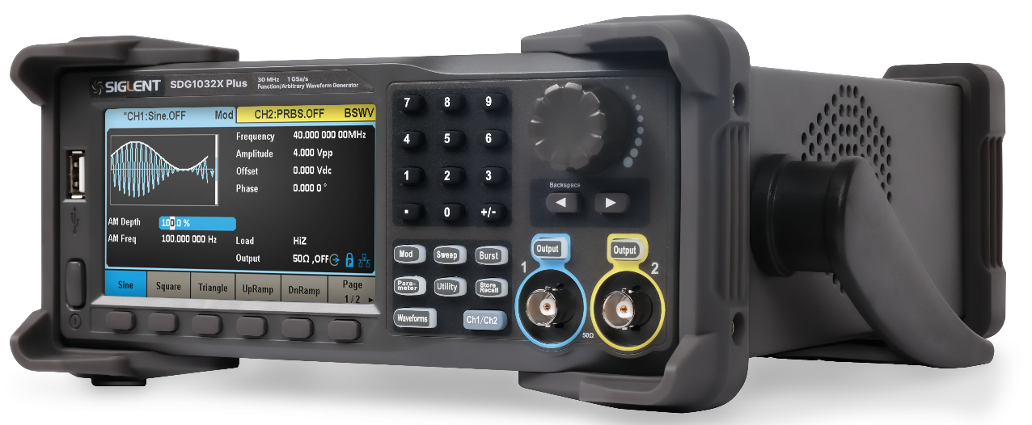
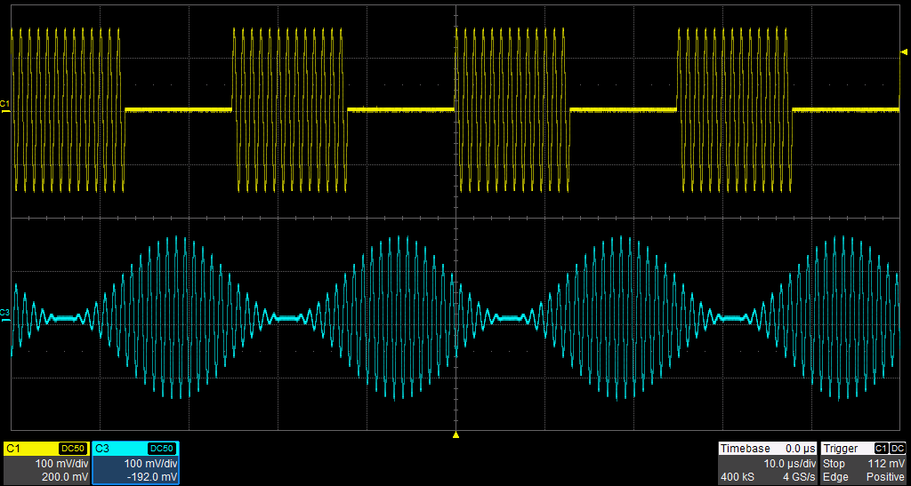
Modulation functions
AM/DSB-AM/ FM/ PM/ ASK/ FSK/ PSK/ PWM
Modulation Frequency: 1MHz (Max.)
Source: Internal/External

Slide 16
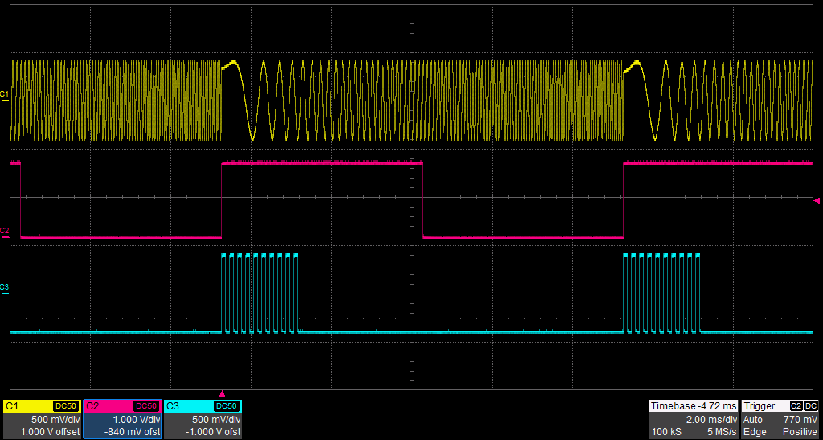
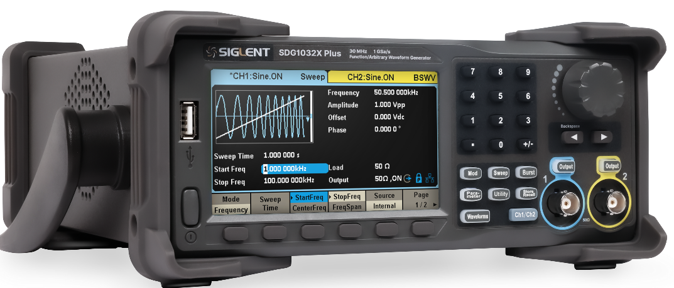
Sweep & Burst
Sweep mode: Frequency, Amplitude
Sweep type: Linear, Log
Burst: N Cycle/Gated
Burst Source: Internal/External/Manual

Slide 17
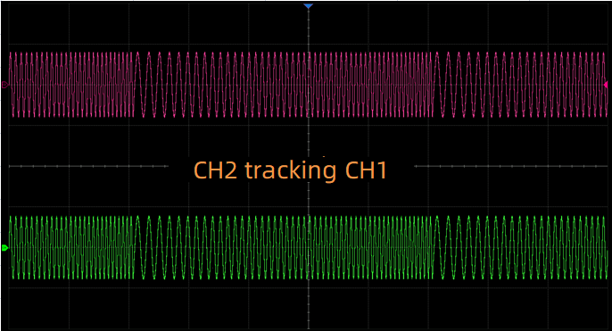
Multiple Outputs
Channel tracking: make CH2 output the same as CH1, can set phase deviation
Channel coupling: make CH1 and CH2 outputs coupled to each other in frequency/amplitude/phase
Channel Copy: Quickly copy channel settings to another channel.
Whether channel track, couple or copy, you can quickly transfer parameters from one channel to another, thus greatly simplifying setup and waveform creation steps.

Slide 18
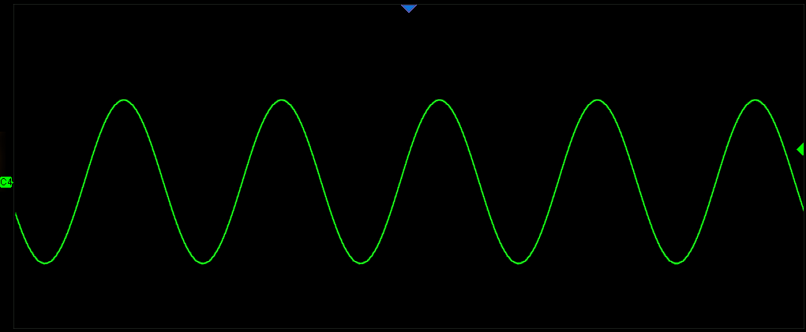
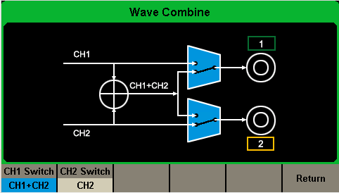
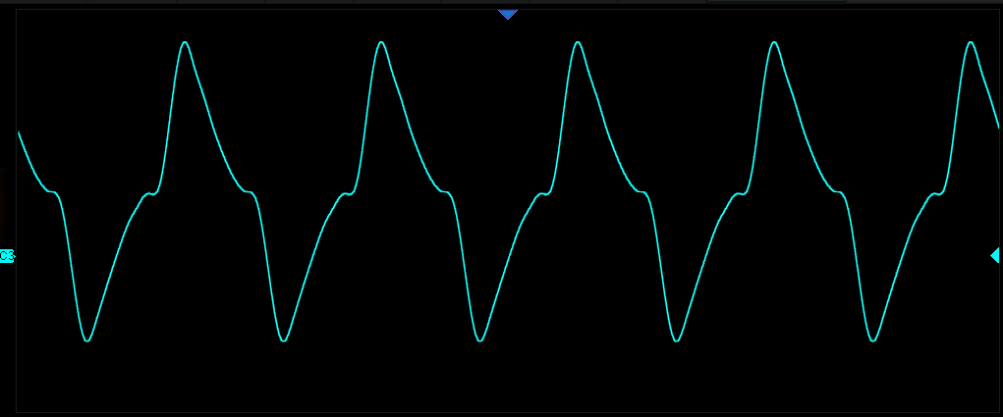
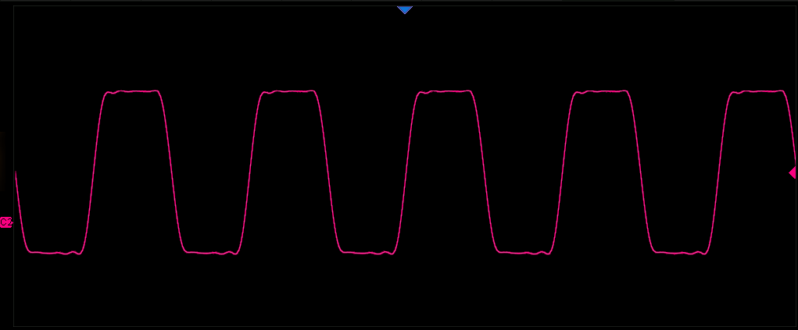


Wave Combine
SDG can combine the waveforms of CH1 and CH2, and output them through CH1 or CH2. You can easily combine basic wave, random noise, modulation signal, scan signal, pulse, Easypulse and TrueArb wave.
Generate complex signals
Simulate differential signal

Slide 19
SDG1000X Plus 25/30/60 MHz
Function/Arbitrary Waveform Generator
Contents
Basic info
Features and Benefits
Applications
Competition Analysis

Slide 20
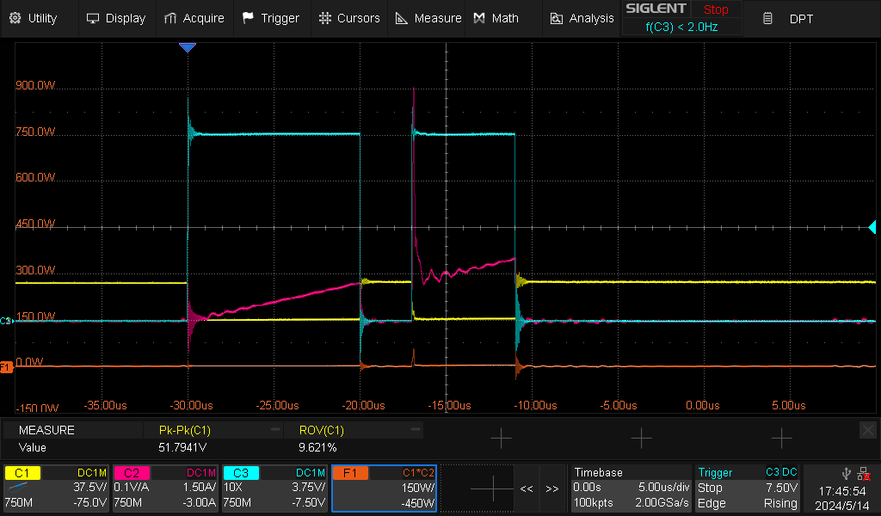
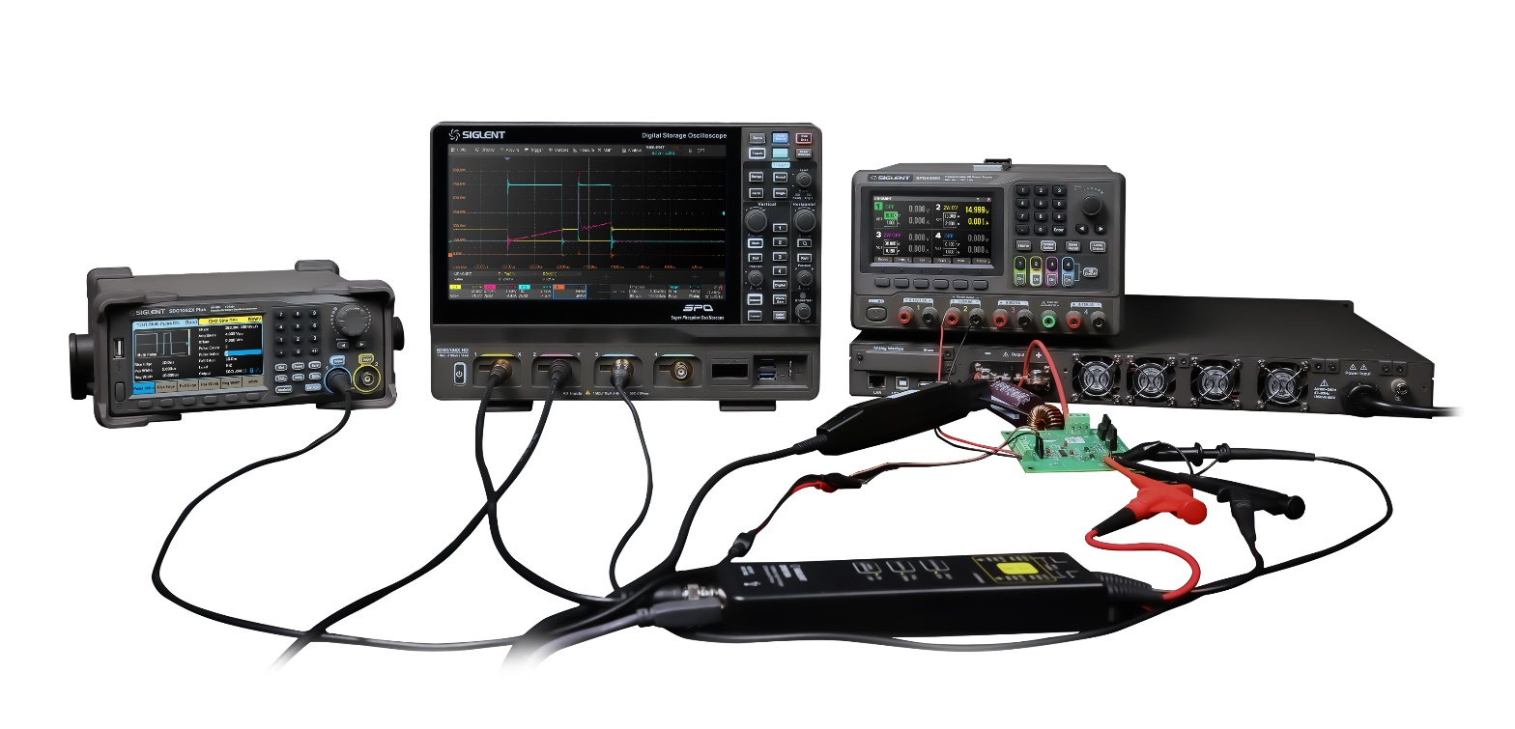
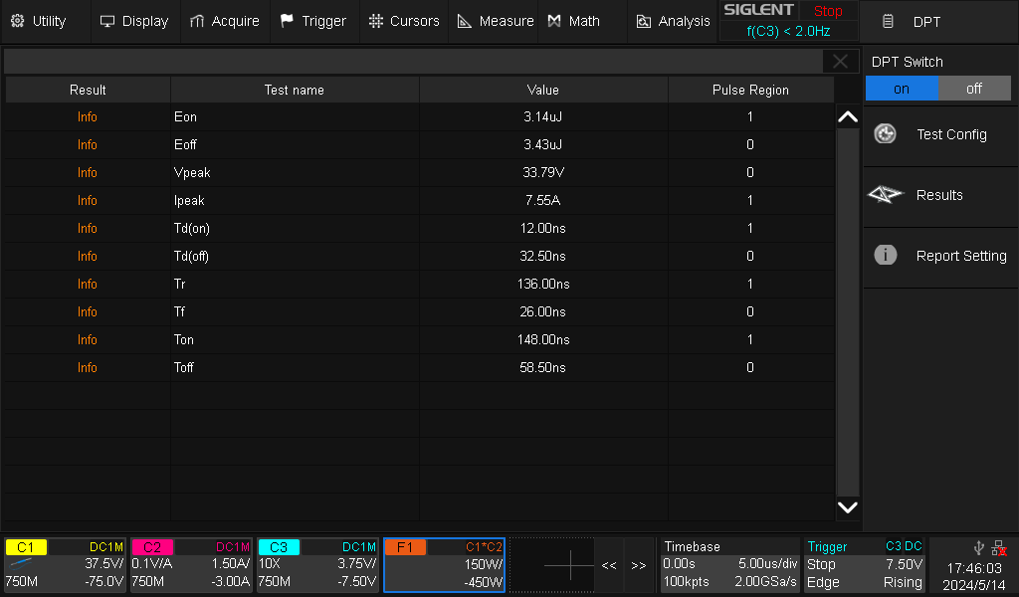
Dual-pulse Test
Measure the switch parameters and dynamic characteristics of power semiconductor devices.
Generate gate drive signals for Dual-pulse test.
SIGLENT’s first SDG supporting Dual-pulse test.

Slide 21
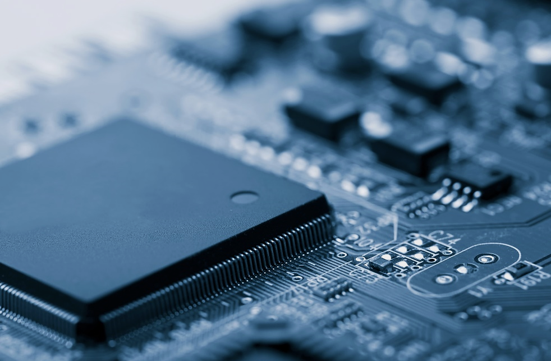

Other Applications
Embedded and semiconductor fields
Logic device - Timing Margin Test
CCD Sensor - Delay Margin Test
PLL Circuits, Amplifiers
Test Audio DAC, Power Supply Immunity
Automotive Electronics
Simulate automobile sensor signal
Test engine control unit
Test Power MOSFET Circuit
Analyze the switch waveform of IGBT circuit

Slide 22
SDG1000X Plus 25/30/60 MHz
Function/Arbitrary Waveform Generator
Contents
Basic info
Features and Benefits
Applications
Competition Analysis

Slide 23
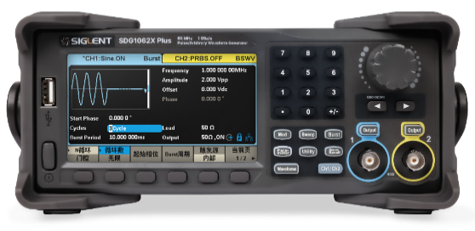
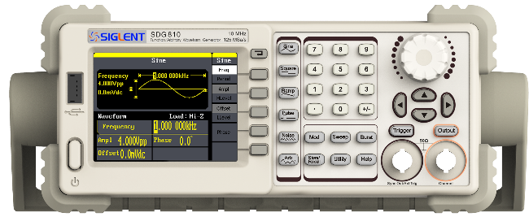
SDG1000X Plus VS SDG800
Frequency | 25/30/60 MHz
Sample rate | 1 GSa/s
Resolution | 16-bit
Arb length | 8 Mpts
Functions | Sine, Pulse, Square, Ramp, Noise, DC, Harmonic, Arb. AM, DSB-AM, FM,PM,ASK,FSK, PSK, PWM, Sweep, Burst, PRBS, Sequence, Multi-pulse
Frequency | 5/10/30 MHz
Sample rate | 125 MSa/s
Resolution | 14-bit
Arb length | 16 kpts
Functions | Sine, Pulse,Square, Ramp, Noise,DC. AM, DSB-AM, FM, PM, ASK, FSK, PWM, Sweep, Burst.
SDG1022X Plus(25MHz 2CH): $369
SDG1032X Plus(30MHz 2CH): $429
SDG1062X Plus(60MHz 2CH): $539
SDG810(10MHz 1CH): $239
SDG830(30MHz 1CH): $269

Slide 24
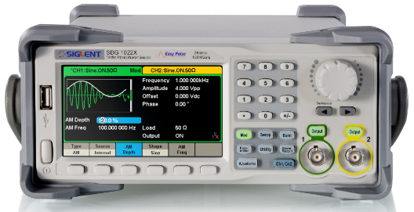
SDG1000X Plus VS SDG1000X
Frequency | 25/30/60 MHz
Sample rate | 1 GSa/s
Resolution | 16-bit
Arb length | 8 Mpts
Functions | Sine, Pulse, Square, Ramp, Noise, DC, Harmonic, Arb. AM, DSB-AM, FM,PM,ASK,FSK, PSK, PWM, Sweep, Burst, PRBS, Sequence, Multi-pulse
Frequency | 30/60 MHz
Sample rate | 150 MSa/s
Resolution | 14-bit
Arb length | 8 Mpts
Functions | Sine, Pulse,Square, Ramp, Noise,DC. AM, DSB-AM, FM, PM, ASK, FSK, PSK, PWM, Sweep, Burst.
SDG1022X Plus(25MHz 2CH): $369
SDG1032X Plus(30MHz 2CH): $429
SDG1062X Plus(60MHz 2CH): $539
SDG1032X(30MHz 2CH): $359
SDG1062X(60MHz 2CH): $459

Slide 25
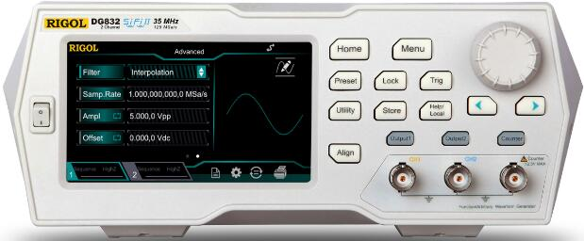
SDG1000X Plus VS RIGOL DG800
Frequency | 25/30/60 MHz
Sample rate | 1 GSa/s
Resolution | 16-bit
Arb length | 8 Mpts
Functions | Sine, Pulse, Square, Ramp, Noise, DC, Harmonic, Arb. AM, DSB-AM, FM,PM,ASK,FSK, PSK, PWM, Sweep, Burst, PRBS, Sequence, Multi-pulse
Frequency | 10/25/35MHz
Sample rate | 125 MSa/s
Resolution | 16-bit
Arb length | 2 Mpts (opt. 8Mpts)
Functions | Sine, Pulse,Square, Ramp, Noise,DC, Harmonic, Arb, Dual-tone. AM, FM, PM, ASK, FSK, PSK, PWM, Sweep, Burst, PRBS,Sequence,RS232
SDG1022X Plus(25MHz 2CH): $369
SDG1032X Plus(30MHz 2CH): $429
SDG1062X Plus(60MHz 2CH): $539
DG812(10MHz 2CH): $359
DG822(25MHz 2CH): $389
DG832(35MHz 2CH): $479
DG811(10MHz 1CH): $329
DG821(25MHz 1CH): $369
DG831(35MHz 1CH): $449
8M Arb length: $69
2CH upgrade: $99

Slide 26
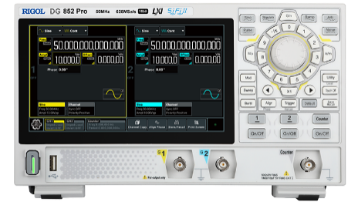
SDG1000X Plus VS RIGOL DG800 Pro
Frequency | 25/30/60 MHz
Sample rate | 1 GSa/s
Resolution | 16-bit
Arb length | 8 Mpts
Functions | Sine, Pulse, Square, Ramp, Noise, DC, Harmonic, Arb. AM, DSB-AM, FM,PM,ASK,FSK, PSK, PWM, Sweep, Burst, PRBS, Sequence, Multi-pulse
Frequency | 25/50MHz
Sample rate | 125 MSa/s
Resolution | 16-bit
Arb length | 2 Mpts (opt. 8Mpts)
Functions | Sine, Pulse,Square, Ramp, Noise,DC, Harmonic, Arb, Dual-tone. AM, FM, PM, ASK, FSK, PSK, PWM, Sweep, Burst, PRBS,Sequence,RS232
SDG1022X Plus(25MHz 2CH): $369
SDG1032X Plus(30MHz 2CH): $429
SDG1062X Plus(60MHz 2CH): $539
DG822 Pro(25MHz 2CH): $439
DG852 Pro(50MHz 2CH): $499
DG821 Pro(25MHz 1CH): $399
8M Arb length: $69
2CH upgrade: $99

Slide 27
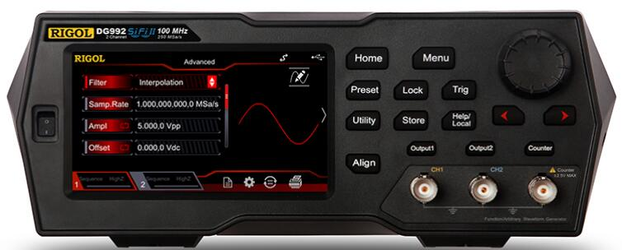
SDG1000X Plus VS RIGOL DG900
Frequency | 25/30/60 MHz
Sample rate | 1 GSa/s
Resolution | 16-bit
Arb length | 8 Mpts
Functions | Sine, Pulse, Square, Ramp, Noise, DC, Harmonic, Arb. AM, DSB-AM, FM,PM,ASK,FSK, PSK, PWM, Sweep, Burst, PRBS, Sequence, Multi-pulse
Frequency | 50/70/100 MHz
Sample rate | 250 MSa/s
Resolution | 16-bit
Arb length | 16 Mpts
Functions | Sine, Pulse,Square, Ramp, Noise,DC, Harmonic, Arb, Dual-tone. AM, FM, PM, ASK, FSK, PSK, PWM, Sweep, Burst, PRBS,Sequence,RS232
SDG1022X Plus(25MHz 2CH): $369
SDG1032X Plus(30MHz 2CH): $429
SDG1062X Plus(60MHz 2CH): $539
DG952(50MHz 2CH): $719
DG972(70MHz 2CH): $959
DG992(100MHz 2CH): $1199

Slide 28
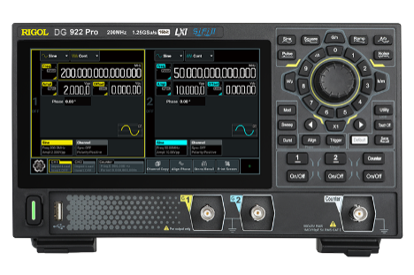
SDG1000X Plus VS RIGOL DG900 Pro
Frequency | 25/30/60 MHz
Sample rate | 1 GSa/s
Resolution | 16-bit
Arb length | 8 Mpts
Functions | Sine, Pulse, Square, Ramp, Noise, DC, Harmonic, Arb. AM, DSB-AM, FM,PM,ASK,FSK, PSK, PWM, Sweep, Burst, PRBS, Sequence, Multi-pulse
Frequency | 70/100/200 MHz
Sample rate | 1.25 GSa/s
Resolution | 16-bit
Arb length | 16 Mpts (opt. 32Mpts)
Functions | Sine, Pulse,Square, Ramp, Noise,Harmonic, Arb. AM, FM, PM, ASK, FSK, PSK, PWM, Sweep, Burst, SUM, Sequence
SDG1022X Plus(25MHz 2CH): $369
SDG1032X Plus(30MHz 2CH): $429
SDG1062X Plus(60MHz 2CH): $539
DG902 Pro(70MHz 2CH): $699
DG912 Pro(150MHz 2CH): $899
DG922 Pro(200MHz 2CH): $1199
32M Arb length: $289

Slide 29
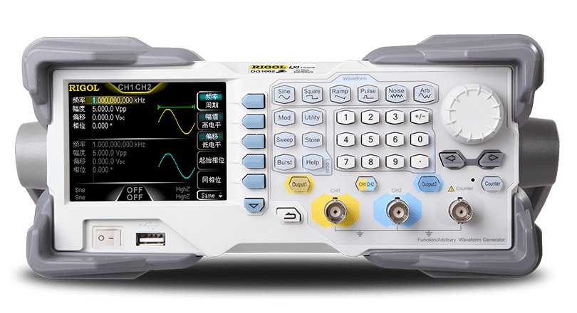
SDG1000X Plus VS RIGOL DG1000Z
Frequency | 25/30/60 MHz
Sample rate | 1 GSa/s
Resolution | 16-bit
Arb length | 8 Mpts
Functions | Sine, Pulse, Square, Ramp, Noise, DC, Harmonic, Arb. AM, DSB-AM, FM,PM,ASK,FSK, PSK, PWM, Sweep, Burst, PRBS, Sequence, Multi-pulse
Frequency | 25/30/60 MHz
Sample rate | 200 MSa/s
Resolution | 14-bit
Arb length | 2 Mpts /8 Mpts /8 Mpts (opt. 16Mpts)
Functions | Sine, Pulse,Square, Ramp, Noise,DC. Harmonic, Arb. AM, FM, PM, ASK, FSK, PSK, PWM, Sweep, Burst.
SDG1022X Plus(25MHz 2CH): $369
SDG1032X Plus(30MHz 2CH): $429
SDG1062X Plus(60MHz 2CH): $539
DG1022Z(25MHz 2CH): $359
DG1032Z(30MHz 2CH): $524
DG1062Z(60MHz 2CH): $903
16Mpts Arb length: $180

Slide 30
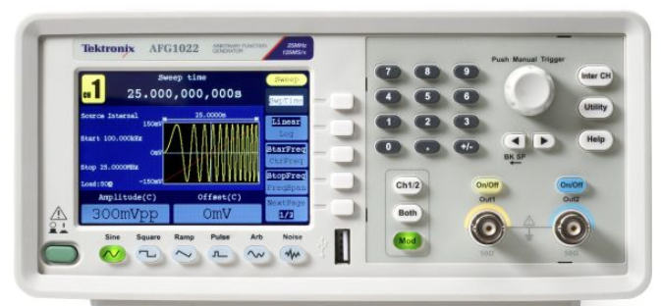
SDG1000X Plus VS AFG1000
Frequency | 25/30/60 MHz
Sample rate | 1 GSa/s
Resolution | 16-bit
Arb length | 8 Mpts
Functions | Sine, Pulse, Square, Ramp, Noise, DC, Harmonic, Arb. AM, DSB-AM, FM,PM,ASK,FSK, PSK, PWM, Sweep, Burst, PRBS, Sequence, Multi-pulse
Frequency | 25/60 MHz
Sample rate | 125/300 MSa/s
Resolution | 14-bit
Arb length | 8 kpts/1 Mpts
Functions | Sine, Pulse,Square, Ramp, Noise,DC. AM, FM, PM, ASK, FSK, PSK, Sweep, Burst.
SDG1022X Plus(25MHz 2CH): $369
SDG1032X Plus(30MHz 2CH): $429
SDG1062X Plus(60MHz 2CH): $539
AFG1022(25MHz 2CH): $1,148
AFG1062(60MHz 2CH): $1,574

Slide 31




Thank You
Every Bench. Every Engineer. Every Day.
Headquarters
NA
Europe
SIGLENT TECHNOLOGIES CO., LTD.
Add: Blog No.4 & No.5, Antongda Industrial Zone, 3rd Liuxian Road, Bao’an District, Shenzhen, 518101, China
Tel:+ 86 755 3688 7876
Fax:+ 86 755 3359 1582
sales@siglent.com
int.siglent.com
SIGLENT Technologies NA, Inc.
Add: 6557 Cochran Rd Solon, Ohio 44139
Tel: 440-398-5800
Toll Free:877-515-5551
Fax: 440-399-1211
info@siglent.com
www.siglentna.com
SIGLENT TECHNOLOGIES GERMANY GmbH
Add: Staetzlinger Str. 70 86165 Augsburg, Germany
Tel: +49(0)-821-666 0 111 0
Fax: +49(0)-821-666 0 111 22
info-eu@siglent.com
www.siglenteu.com

