Slide 1

SPD4000X Series Programmable Linear DC Power Supply

Slide 2
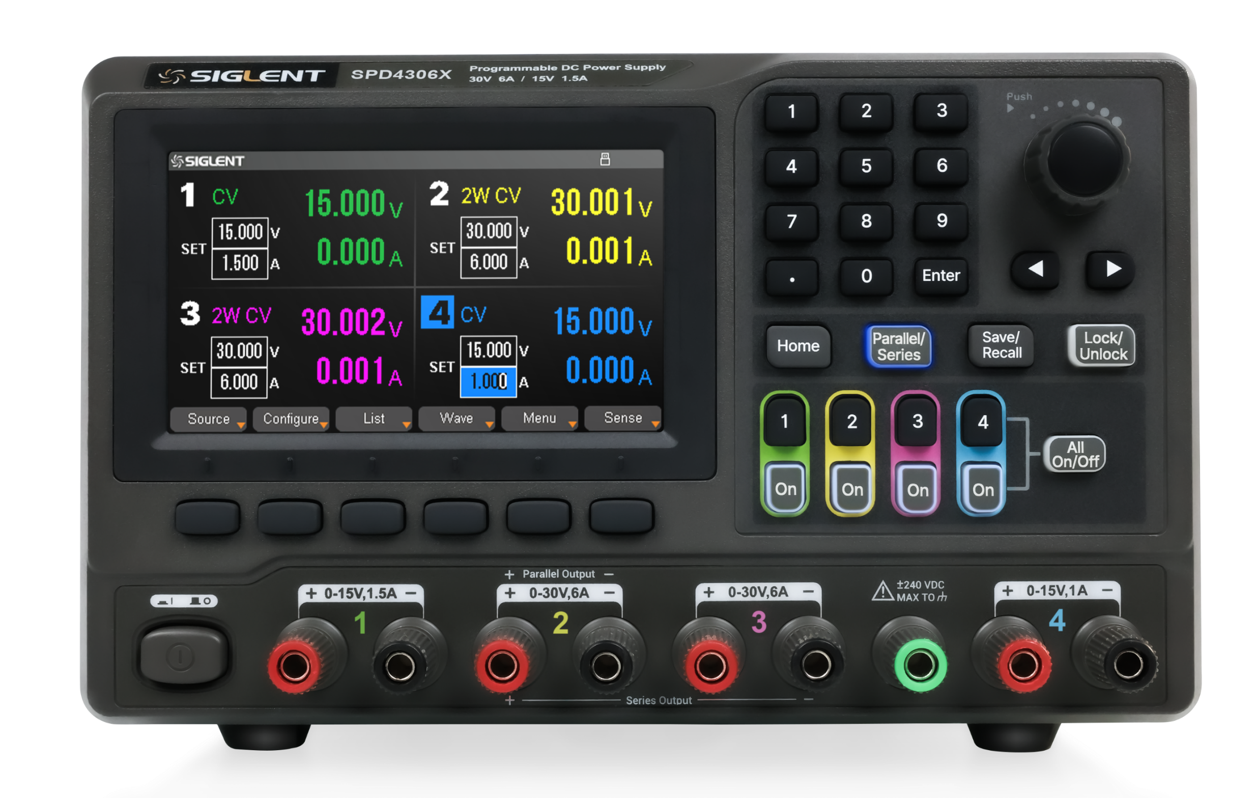
Basic Information
Features & Benefits
contents
Competition Analysis
Applications

Slide 3
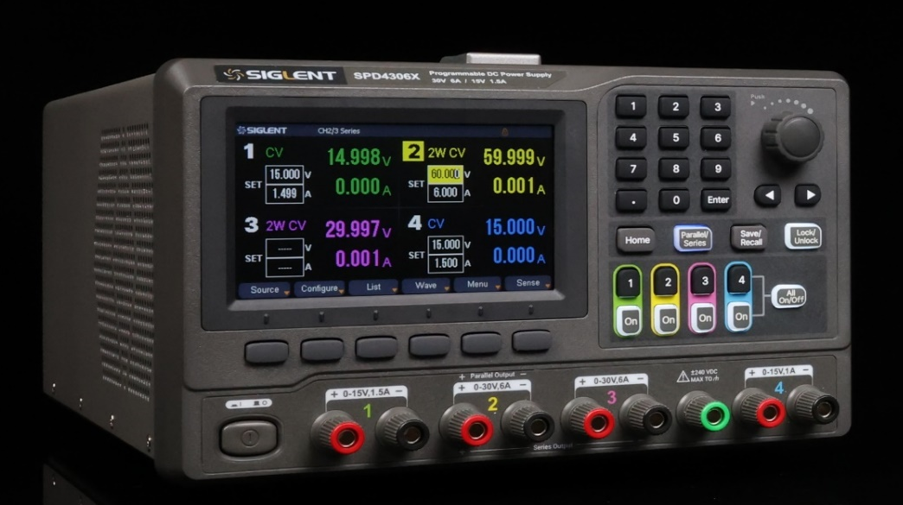
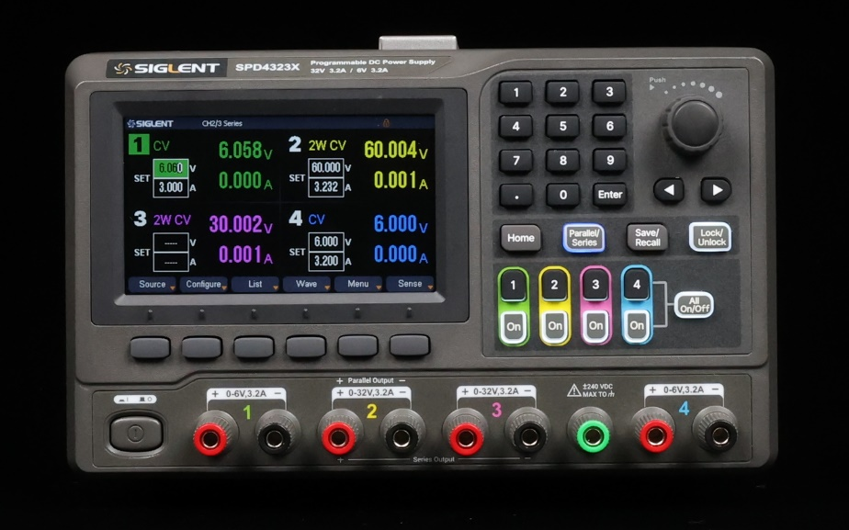

SPD4306X
SPD4121X
SPD4323X
15V/1.5A | 30V/6A | 30V/6A | 15V/1A
CH2&CH3 series : 60V / 6A
CH2&CH3 parallel : 30V / 12A
Total rated output power: 400W
15V/1.5A | 12V/10A | 12V/10A | 15V/1.5A
CH2&CH3 series : 24V / 10A
CH2&CH3 parallel : 12V / 20A
Total rated output power: 285W
6V/3.2A | 32V/3.2A | 32V/3.2A | 6V/3.2A
CH2&CH3 series: 60V / 3.2A
CH2&CH3 parallel : 32V / 6.4A
Total rated output power: 240W
Notes:
型号名称组成
中间两位表示最大额定电压 最后一位表示最大额定电流（3.2A用3表示,1.5A用1表示,10A也用1表示）

Slide 4
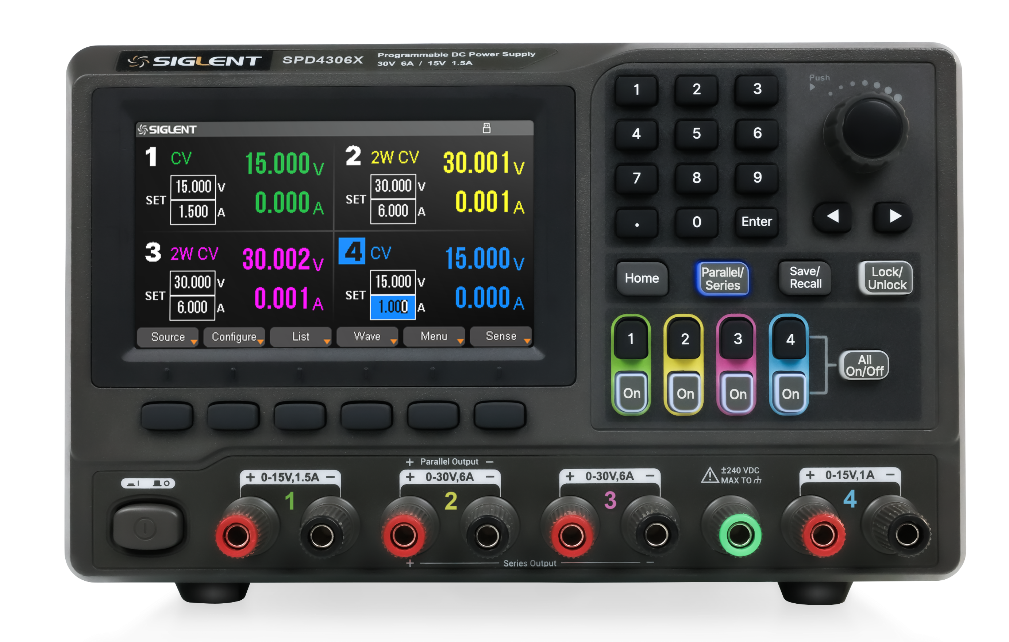
Numeric keypad
Scroll select
Right/left direction button
Display area
Shortcut function buttons
Channel control buttons
Menu buttons
Power switch
Output terminals
Ground terminal
Output terminals
Notes:
增加了数字键盘和6个功能键
通道关闭状态字体灰色
Save/Recall 存储/调用内部存储或外部U盘,长按3秒以上进行截图
Lock/Unlock 键盘锁/解锁,远程控制下自动上锁,长按解锁。

Slide 5
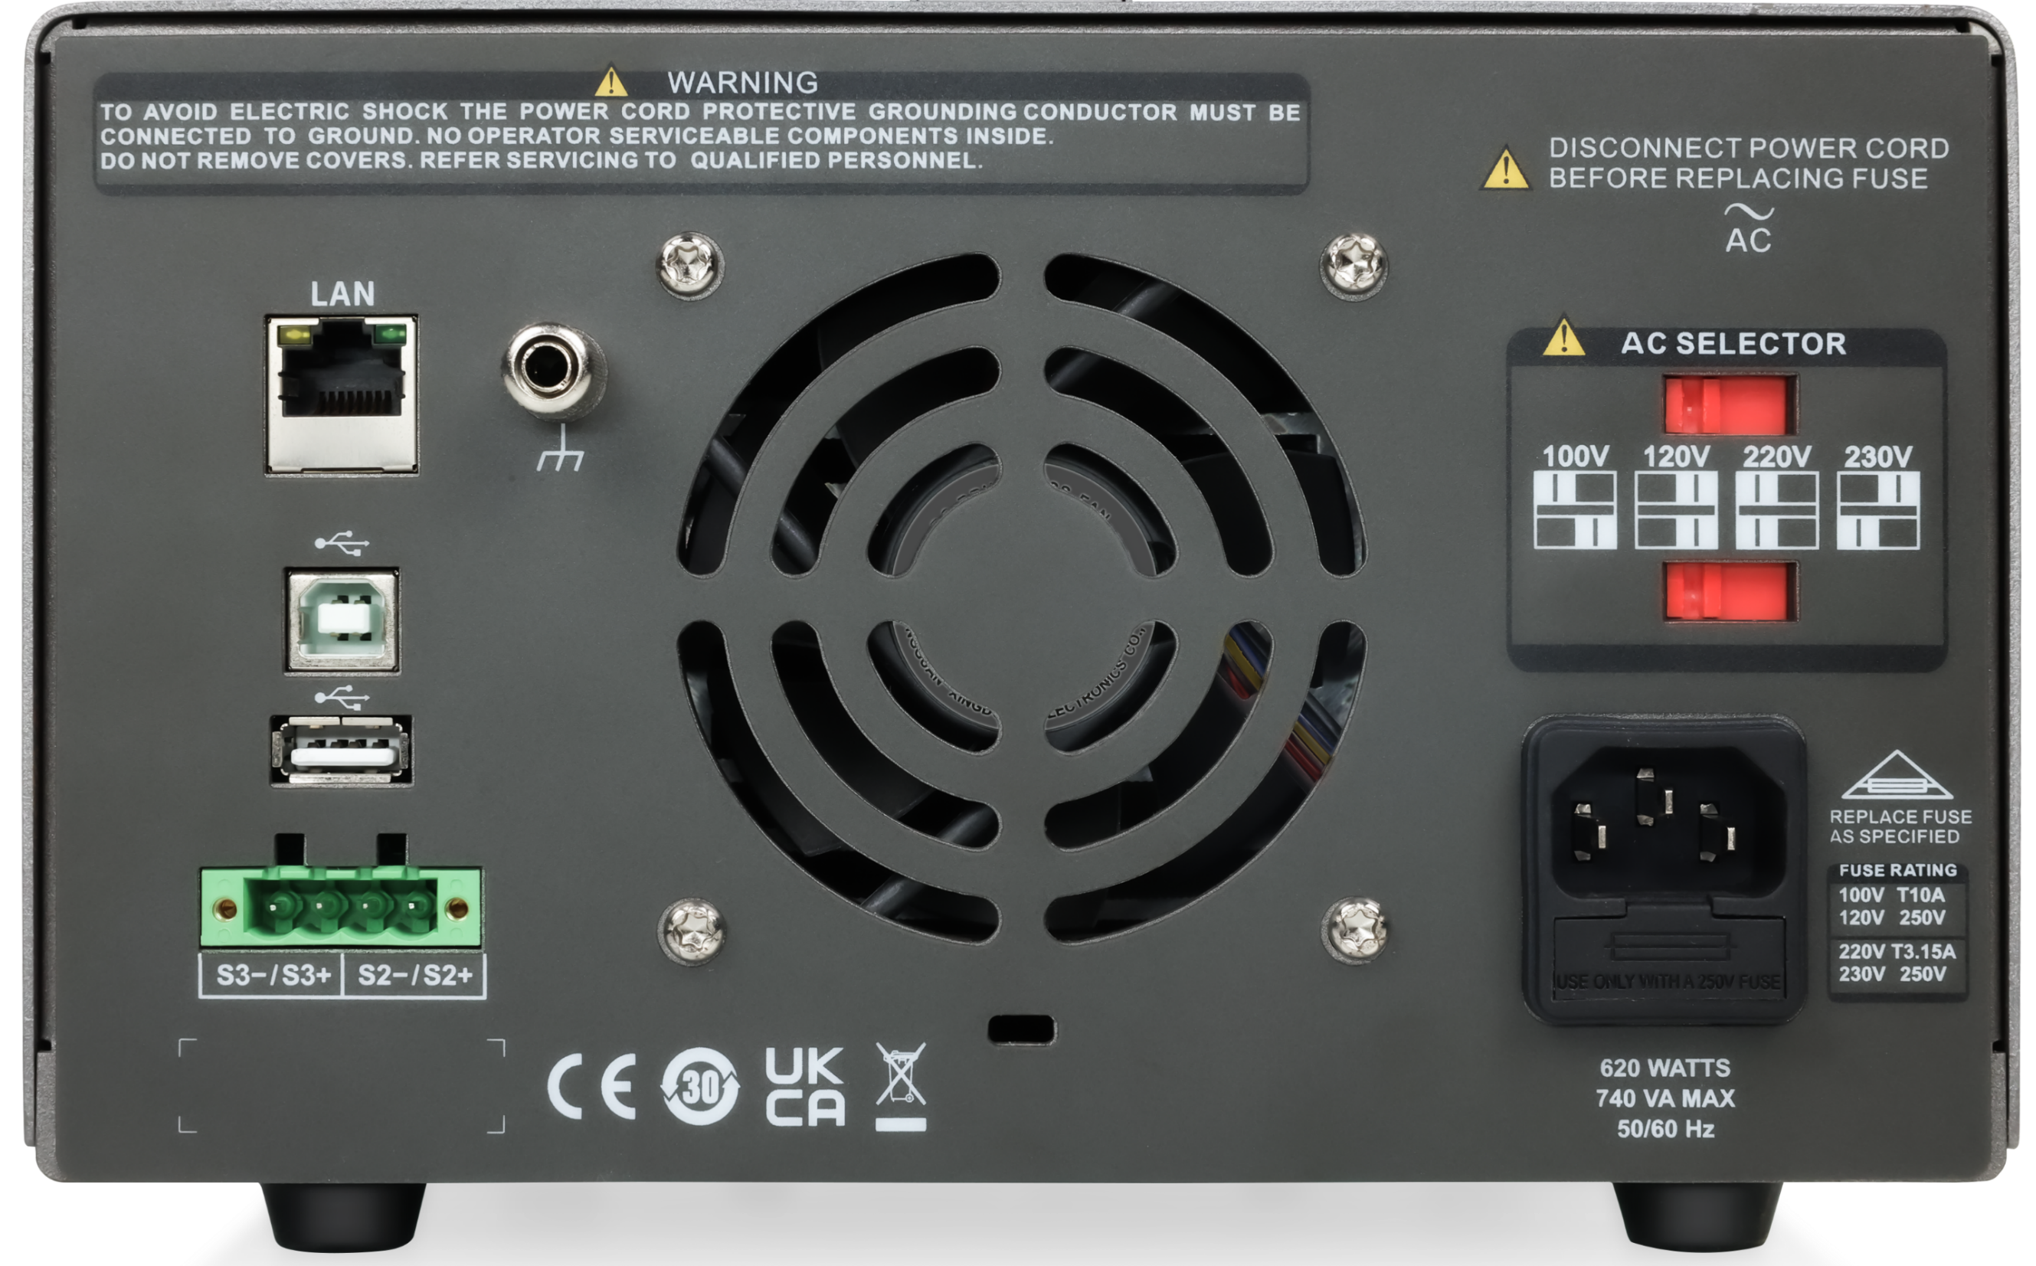
Ground port
Lan port
DIP switch of the AC power
USB ports
CH2/3 sense port
AC power socket
Certification mark
Device lock
Notes:
Sense功能,四线电压补偿
增加了USB Host

Slide 6
Basic Information
Features & Benefits
contents
Competition Analysis
Applications

Slide 7
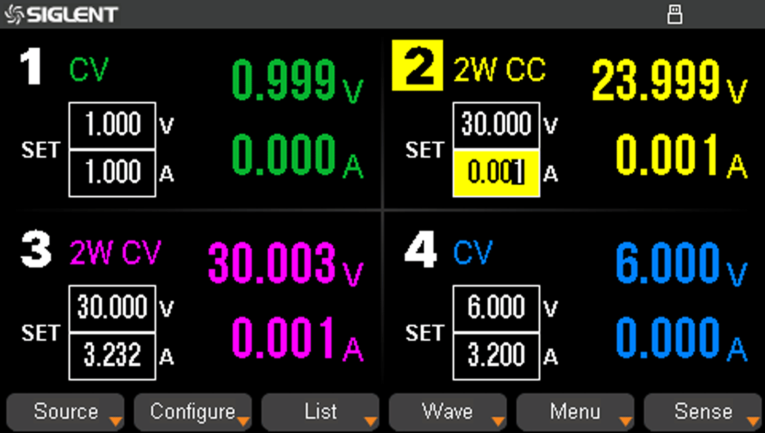
High Resolution
5-digit voltage and current display
Setting accuracy : 1mV/1mA
Read back accuracy: 1mV/1mA

Slide 8
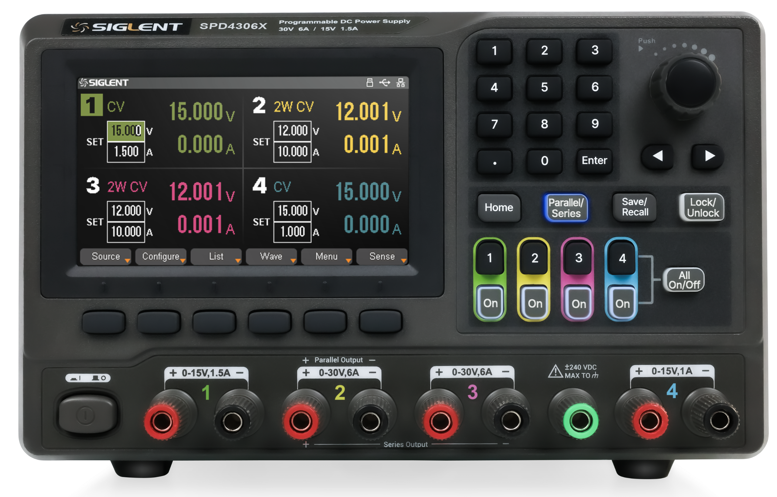
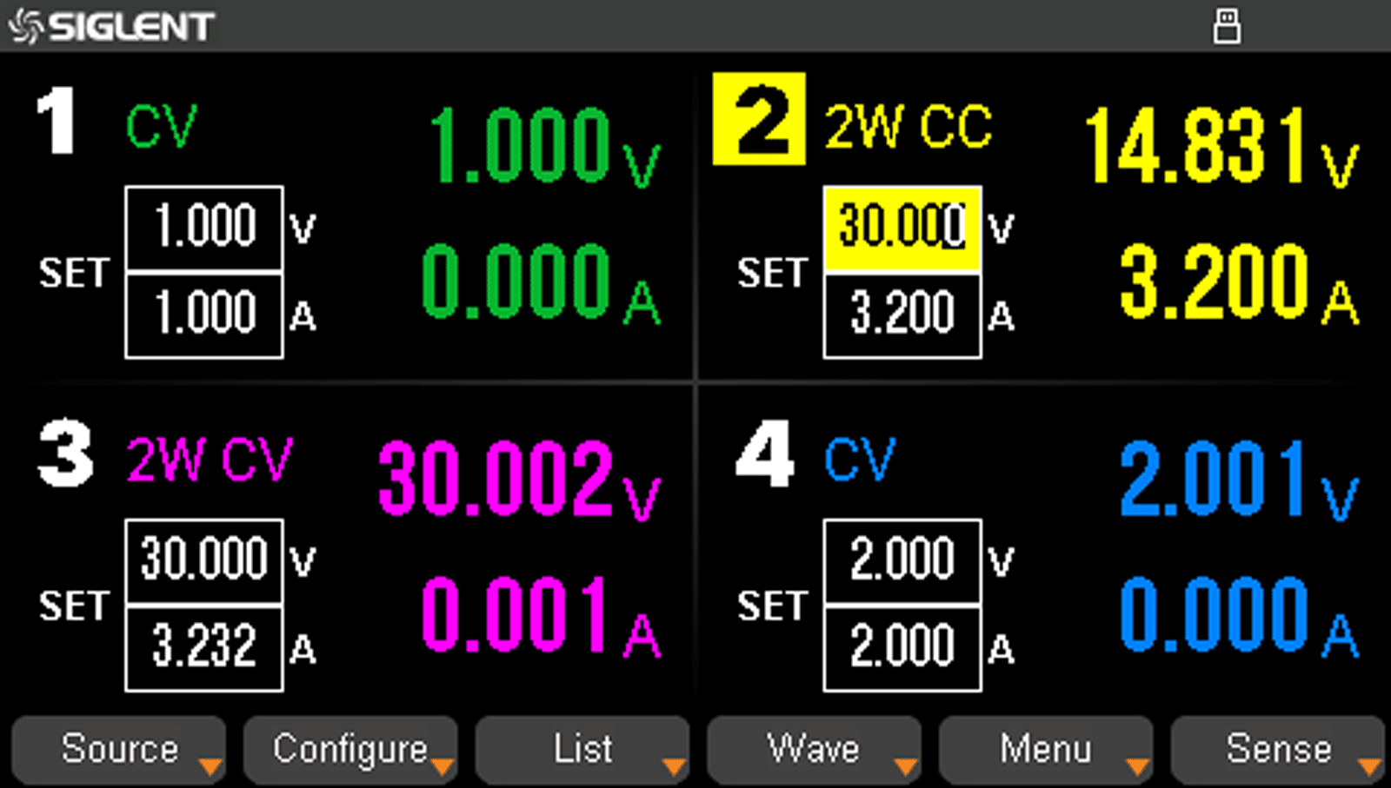
Series/Parallel/Independent Mode
Four channels can be output independently
Turned on or off independently or all together
CH2/3 can be switched in series and parallel with one key
Better power output capability

Slide 9
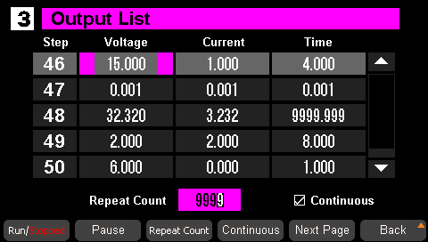
List Operation
Supports 50-step sequence editing, 8 groups of built-in list files
Each list can be individually set for voltage, current, time, etc.
Import list sequence files via USB for multi-step runs

Slide 10
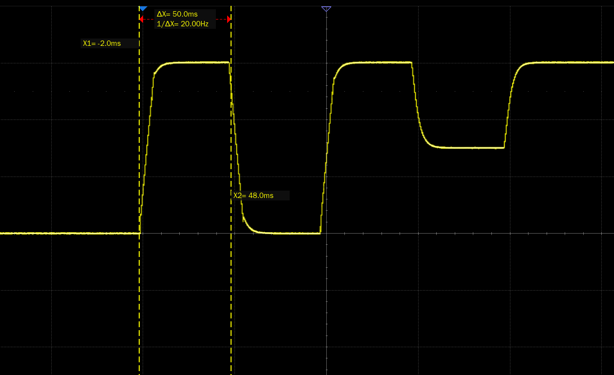
List Operation
Time accuracy: <50 ms
List setting resolution : 1 ms
Meet the user's fine requirements for pulse voltage testing
Able to change the voltage in a very short period of time, realistically simulating the working condition of the power supply system
Notes:
List时间精度=脉冲周期≠上升时间。
上升时间是电压上升过程中10%到90%的时间,脉冲周期是刚上升到刚结束（刚结束就是刚下降）的时间50ms。
要实现更短的脉冲输出,理所当然上升/下降时间也更快。
List时间精度,是每一步的开始到每一步的结束,我们设定的时间和实际时间的误差。从示波器来看,误差几乎为0。它每一步的时间（刚变化到下一步刚变化）,一般允许在1ms~99ms,但我们笼统一些,说是<50ms。 List时间精度很难通过示波器表现,示波器只表现了LIST功能展示界面,我们恰好设置了50ms而已。

Slide 11
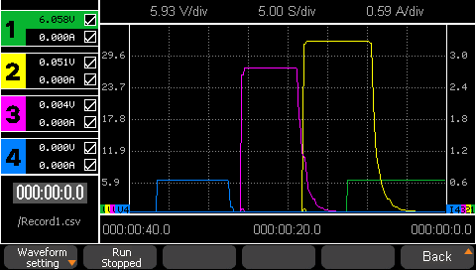
Real Time Waveform Display
Display voltage and current waveform operation graph
Clear display of four-channel output status using multiple colors

Slide 12
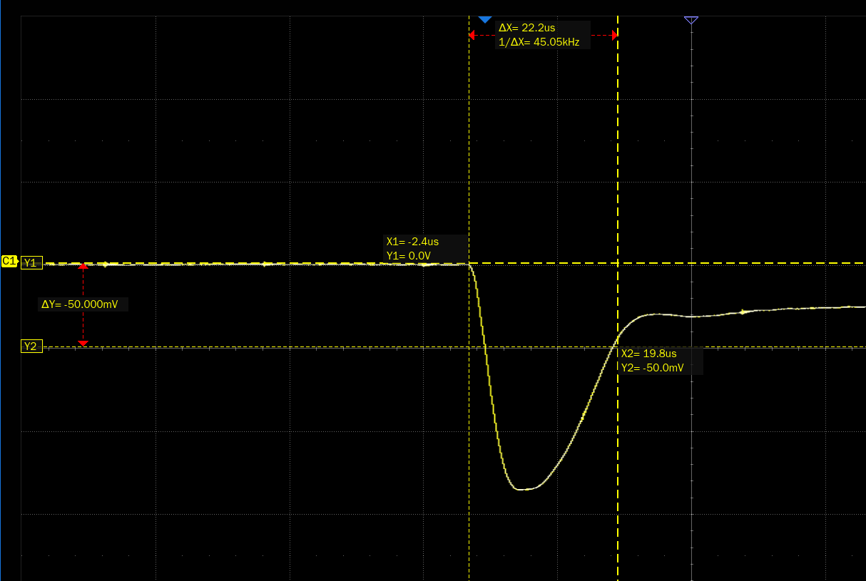
Fast Output Response Time
Output response: the instantaneous change of power supply output voltage when the load current suddenly increases
Output Response Time: the time it takes for the supply voltage to return to the set range when there is a sudden change in load current
Output response time: < 50us

Slide 13
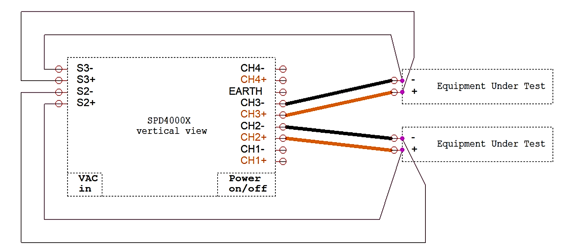
Remote Voltage Compensation Sense Function
4W sense mode can automatically compensate for the voltage drop of the positive and negative output lines, ensuring that the voltage of the remote device to be tested is equal to the set voltage of the power supply.
Only CH2 and CH3 can activate 4W sense mode
Not supported in series or parallel mode
Need to use the voltage sense connector
When CH2 activates 4W sense mode, it is necessary to connect the positive and negative voltage sense wires after the front panel of the machine has correctly connected the output positive and negative wires. One end of the positive voltage sense line and the negative voltage sense line are respectively connected to S2+ and S2- on the rear panel of the power supply, and the other end is correspondingly connected to the positive and negative terminals of the remote device to be tested. Similarly, CH3 also need to connect S3+ and S3-. A single equipment under test needs to connect a total of four wires.
Notes:
SENSE模式可以补偿导线本身电阻。在普通模式下,电压通过导线直接加到负载上,从而保持负载电压的稳定。由于电流会在导线上产生压降,实际负载电压=电源输出电压—压降。Vload＝Vout－Vcable；而Vcable＝Iload×Rcable,在一些输出为低电压、大电流的场合,电源压降已不能忽略。如电源输出设为3.3V/1A,假设输出线的电阻值是0.3Ω,就会在导线上形成0.3V的压降,那么实际到达的电压变为3.0V,这会导致被供电的系统因电压偏低,无法正常工作,从而影响到整个测试结果。
四线制可测量远端输出电压。被测端距离较近时,无需SENSE端即可进行准确测量。但当被测端距离较远时,必须使用四线制测量,将正输出端Vout+与Vs+端同时连接至负载输入正极,将负输出端Vout-与Vs-端同时连接至负载输入负极,通过正极输出远端补偿电阻Rcable+和负极输出远端补偿电阻Rcable-补偿线损造成的压降。在高精度的测试或者线缆很长的场合,就需要Sense端发挥作用,典型的Sense补偿范围是0.6V至几V。
4000系列 需自制电压感测线,要求有金属导电的尾端,尾端的长度建议 1cm。尾端放置到电压感测连接器对应位置,用螺丝刀旋紧对应上方螺丝,固定接线。接好线后,把电压感测器插入机器后面板,用螺丝刀旋紧两侧螺丝,固定连接器。
如果电缆上的电压降超过Sense的补偿范围,也有简单办法解决。
1、可以通过减少电缆的长度 。
2、增加输出电缆导体的尺寸来弥补。
3、屏蔽双绞线来获得最佳的补偿效果,可以减少负载线路阻抗的影响。
4、为了减小由于负载线电感和电容引起的波动,将负载端子并联一个电解电容。

Slide 14
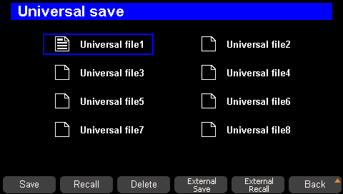
Save/Recall Settings Parameters
8 sets of built-in list
Supports saving of output voltage/current values
Supports saving of independent/serial/parallel output settings
Supports local storage and external USB flash drive storage
Recall of saved files for restoration of settings
Long press the Save/Recall key to take a screenshot

Slide 15
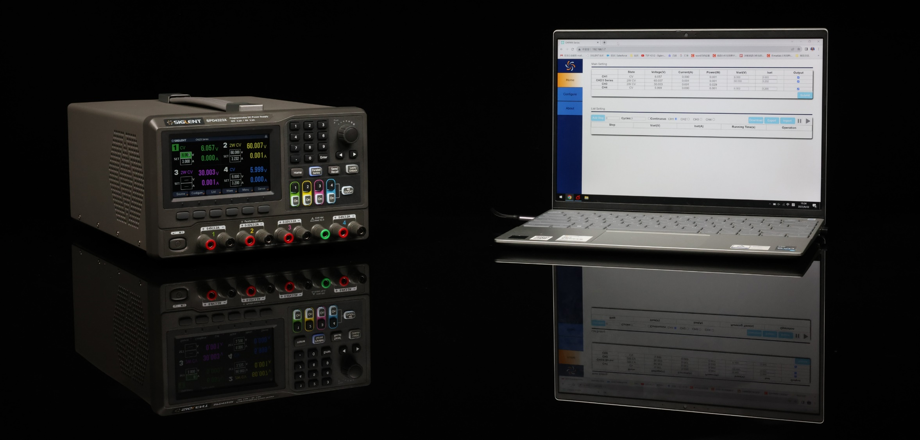
Multiple Interfaces
Built-in USB, LAN standard communication interface
Optional USB-GPIB Adapter Module
Embedded Web Server for remote control of the power supply directly through the LAN and web page
Remote programming via USB, LAN interface based on SCPI command set

Slide 16
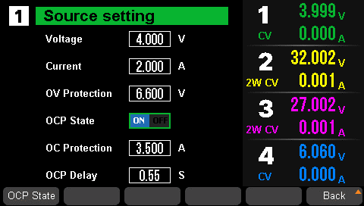
Protection Function
The power supply will monitor the voltage and current in the circuit in real time and automatically suspend the output to protect the circuit when the current or voltage value exceeds the set value.
Output overvoltage protection (OVP)
Output overcurrent protection (OCP)
Real-time monitoring of output status

Slide 17
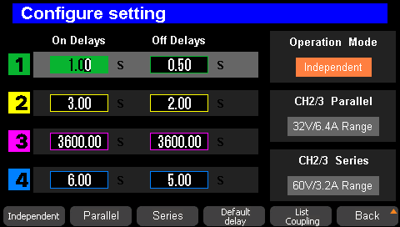
Output Delay Function
On/Off Delays
Avoid high current at the moment of turning on the output
Ideal for applications that require particularly precise power-up sequence times
Notes:
可精确延时的输出延时电路,在输入源启动的瞬间,先暂时关断电源DC-DC转换模块一段时间,等输入源输出稳定以后再打开电源DC-DC转换模块开始工作,通过这种方式来解决电源DC-DC转换模块输入瞬间会产生大电流的问题。

Slide 18
Basic Information
Features & Benefits
contents
Competition Analysis
Market Applications

Slide 19
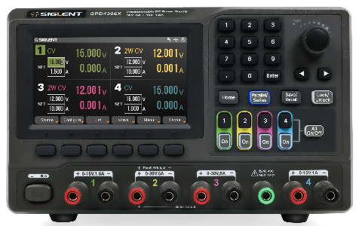
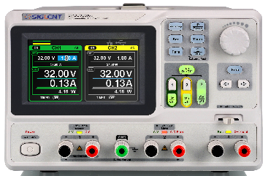
 |  | SPD4000X Series |  |  | SPD3000X Series
Output channel |  | 4 |  |  | 3
programming Resolution |  | 1mV/1mA |  |  | 10mV/10mA | 1mV/1mA
Rated output | CH1 | 6V/3.2A | 15V/1.5A | 15V/1.5A | 32V/3.2A
 | CH2 | 32V/3.2A | 12V/10A | 30V/6A | 32V/3.2A
 | CH3 | 32V/3.2A | 12V/10A | 30V/6A | 2.5/3.3/5V 3.2A
 | CH4 | 6V/3.2A | 15V/1.5A | 15V/1A
Series |  | 60V/3.2A | 24V/10A | 60V/6A | 60V/3.2A
Parallel |  | 32V/6.4A | 12V/20A | 30A/12A | 32V/6.4A
Output power |  | 240W | 285W | 400W | 220W
programming/ readback accuracy | Voltage | ±（0.03% of reading +10）mV |  |  | ±（0.5% of reading+2digits） | ±（0.03% of reading+10mV）
 | Current | ±（0.3% of reading +10）mA |  |  | ±（0.5% of reading+2digits） | ±（0.3% of reading+10mA）
C.V Mode | Line regulation | ≤0.01%+2mV |  |  | ≤0.01% +3mV
 | Load regulation
 | Ripple and noise | ≤350uVrms |  |  | ≤350uVrms
C.C Mode | Line regulation | ≤0.1%+3mA |  |  | ≤0.2%+3mA
 | Load regulation
 | Ripple and noise | ≤2mArms |  |  | ≤3mArms
Series | Line regulation | ≤0.01%+5mV |  |  | ≤0.01% +5mV
 | Load regulation | <100mV | <200mV | <150mV | ≤300mV
Parallel | Line regulation | 0.01% +5mV |  |  | ≤0.01%+3mV
 | Load regulation | 0.01% +50mV |  |  | ≤0.01%+3mV
Protection Function |  | OCP、OVP |  |  | OCP
Sense Function |  | ✔ |  |  | ×
List Function |  | Support List coupling function. In addition to setting up a single channel, you can also perform inter-channel coupling to meet the stable and controllable power-up sequence |  |  | Only support setting the voltage/current/time of CH1 or CH2
Save/Recall |  | 8 groups |  |  | 5 groups
Interface Capability |  | USB Device, USB Host, LAN, GPIB |  |  | LAN、USB Device
Web Control |  | Web Server |  |  | EasyPower

Slide 20

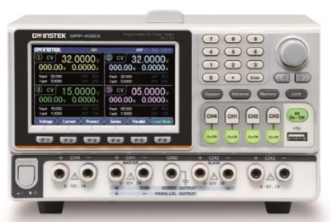
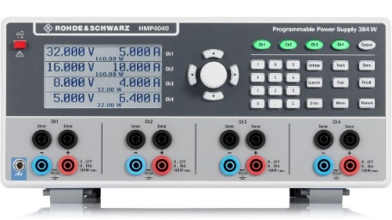
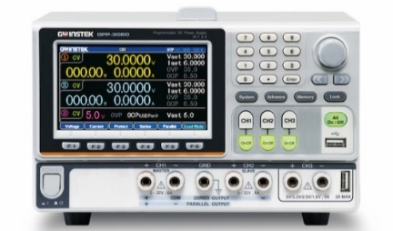
 | SPD4000X | GW GPP-4323 | R&S HMP4040 | GW GPP-3060
Output channel | 4 | 4 | 4 | 3
Output Voltage / Current CH1 |CH2 |CH3 |CH4 | 6V/3.2A |32V/3.2A |32V/3.2A |6V/3.2A SPD4323X 15V/1.5A |12V/10A |12V/10A |15V/1.5A SPD4121X 15V/1.5A |30V/6A |30V/6A |15V/1A SPD4306X | 32V/3A | 32V/3A | 5V/1A | 15V/1A | 32V/10A | 30V/6A | 30V/6A | 1.8/2.5/3.3/5V , 5A
Output power | 240W/285W/400W | 217W | 384W | 385W
programming Resolution | 1mV/1mA | 1mV/0.1mA | 1mV/0.2mA(<1A) 1mV/1mA(>1A) | 1mV/0.1mA
Readback Resolution | 1mV/1mA | 0.1mV/0.1mA | 1mV/0.2mA(<1A) 1mV/1mA(>1A) | 0.1mV/0.1mA
Series | 60V/3.2A SPD4323X 24V/10A SPD4121X 60V/6A SPD4306X | 64V/3A | 128V | 60V/6A
Parallel | 32V/6.4A SPD4323X 12V/20A SPD4121X 30V/12A SPD4306X | 32V/6A | 40A | 30V/12A
List time accuracy | <50ms | N/A | N/A | N/A
Protection Function | OVP/OCP | OVP/OCP/OTP/OPP | OCP/OVP/OTP | OVP/OCP/OTP/OPP/PRP
Load mode | unsupported | supported | unsupported | supported
Sense function | supported | unsupported | supported | supported
Real-time waveform display | supported | supported | unsupported | supported
List Operation | supported | supported | supported | supported
Built-in waveforms | unsupported | supported | unsupported | supported
Save/Recall | supported | supported | supported | supported
Web Control | supported | supported(Software control) | supported(Software control) | supported(Software control)
Safety sockets | unsupported | unsupported | supported | unsupported
Timer display | supported | supported | supported | supported
Interface Capability | USB、LAN、GPIB(option) | USB-Host、USB-Device、Ext I/O、RS232、LAN(option)、GPIB(option) | option: USB、LAN、RS‑232、GPIB | USB-Host、USB-Device、Ext I/O、RS232、LAN(option)、GPIB(option)
Channel isolation | Fully isolated | N/A | Fully isolated | N/A
Displayed | 4.3-inch TFT-LCD display | 4.3-inch TFT-LCD display | LCD | 4.3-inch TFT-LCD display
Dimension & Weight | 221(W)x133(H)x360(D)mm,8~12kg | 213(W)x145(H)x312(D)mm,7.5kg | 285(W)×136 (H)×405(D),12.8kg | 213(W)x145(H)x362(D)mm,10kg

Slide 21
Basic Information
Features & Benefits
contents
Competition Analysis
Applications

Slide 22
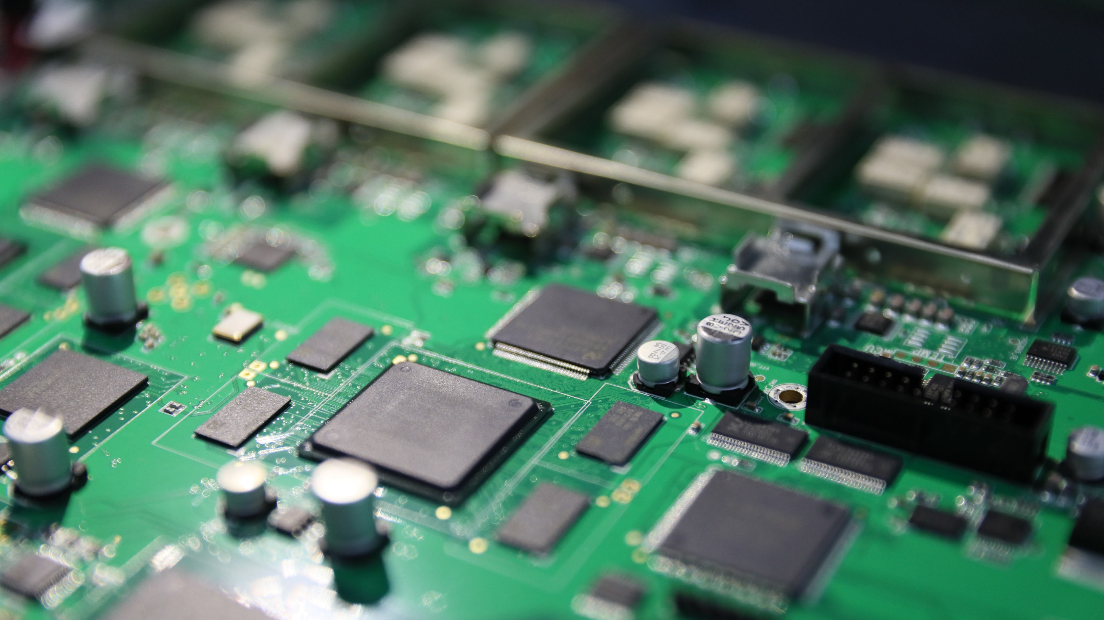
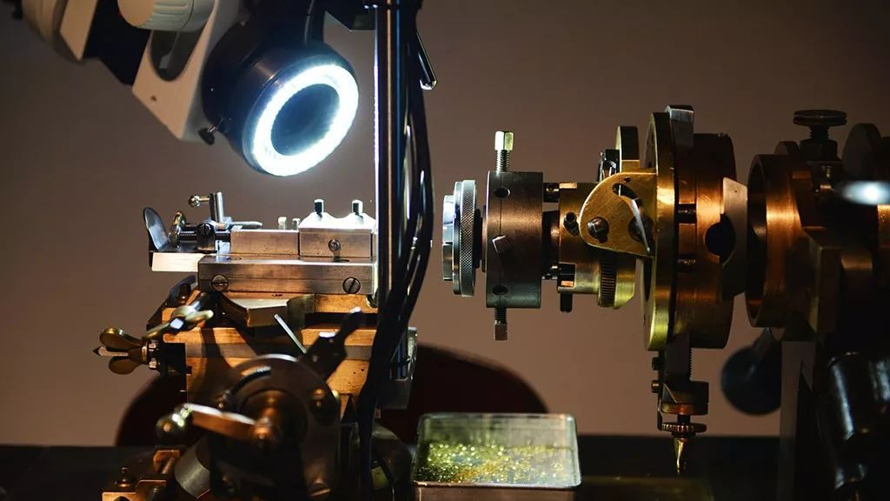
Manufacturing Industry
Accurate Supply of Voltage and Current
Security Test
Test of Motor Locked Rotor
Simulation of Wind Turbine Test
Automotive Low-Voltage Electronics Test
Headlight Dimming Motor Test
……

Slide 23
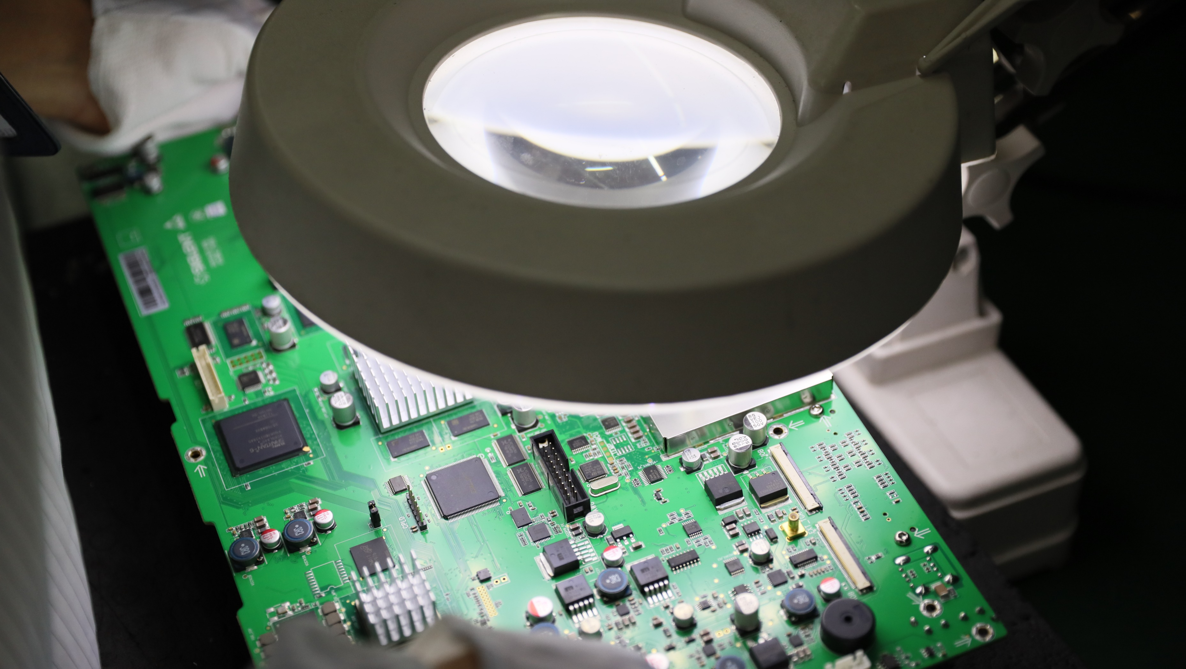
Electronics Laboratory
Testing of Precision Components
Output Voltage Adjustment Rate Test
Input Power and Efficiency Test
Ripple and Noise Test
Protection Function Test
……

Slide 24

New Energy Industry
Voltage Pulse Test
Remote Control Test
Conversion Efficiency Test
……

Slide 25

Wireless Communications
Amplifier Test
Connectivity Test
Troubleshooting and Equipment Test
Protection Features Reduce Damage to Equipment
……

Slide 26
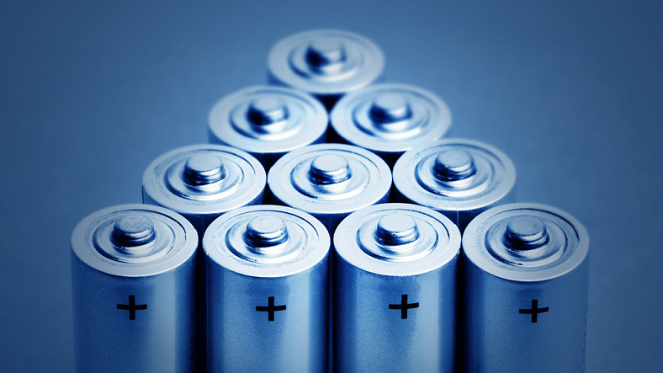
Consumer Electronics
Charge Test
Capacity Test
Aging Test
Fusing Test
Aging Test
Stability Test
……

Slide 27
Ordering Information
Models | Description
SPD4323X | 4 channels programmable linear DC power supply, 32V/3.2A, 240W
SPD4121X | 4 channels programmable linear DC power supply, 12V/10A, 285W
SPD4306X | 4 channels programmable linear DC power supply, 30V/6A, 400W
Standard Accessories
USB cable | 1
QuickStart | 1
Calibration certificate | 1
Power cord | 1
3A output test cord | 4

Slide 28

Thank You
Industry leader in the field of general electronic test and measurement instruments
Contact information
Company address
www.siglent.com
Service Tel: 400-878-0807
Tel: 0755-36887876
Building 4-5, Antongda Industrial Park, Zone 68, Baoan District, Shenzhen City

