Slide 1


Slide 2
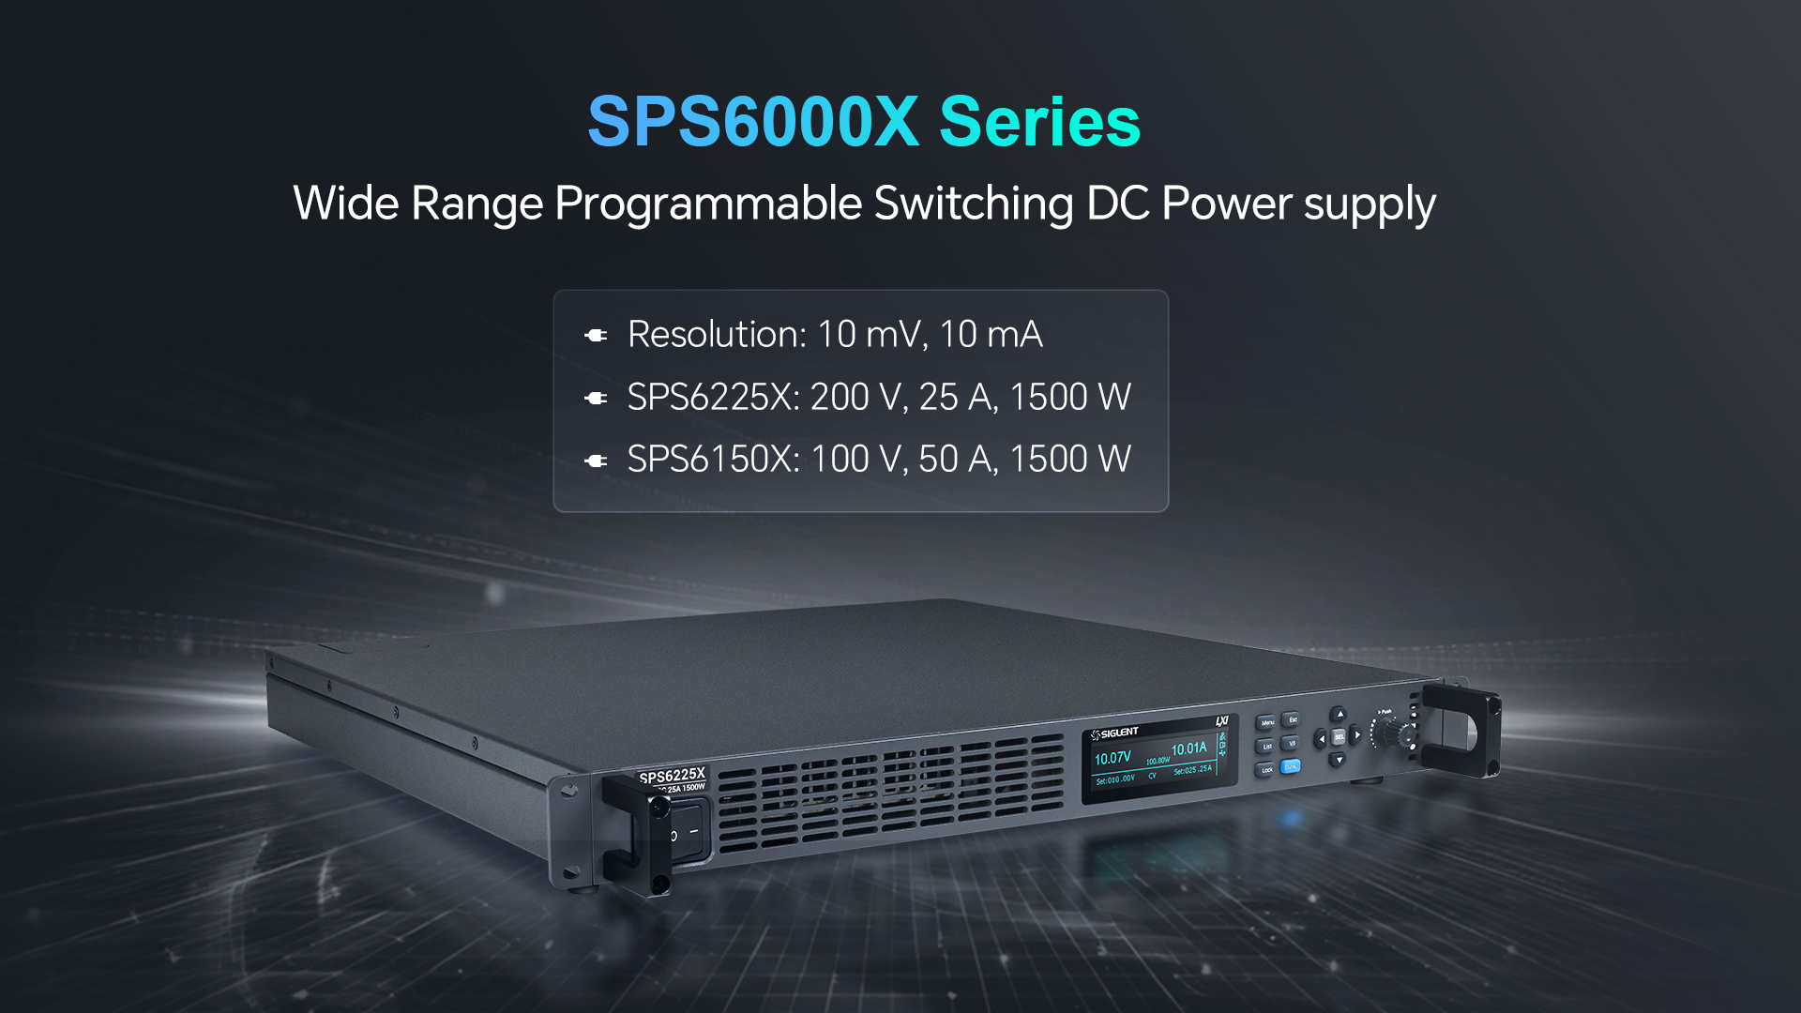

Slide 3
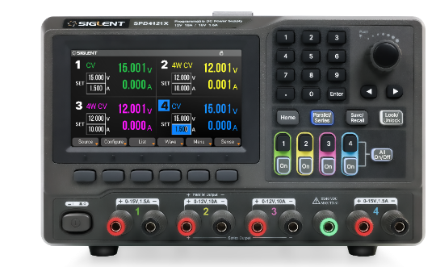
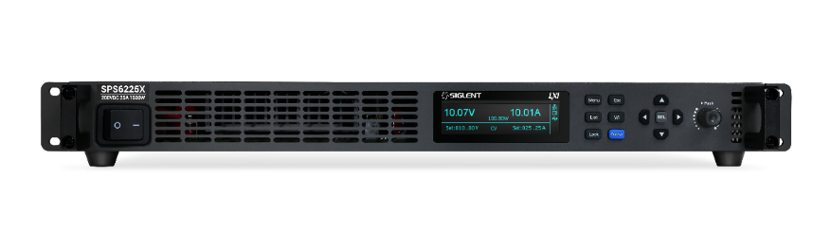


Comparisons
Switching DC Power Supply
The working involves the following stages:
AC → Rectifier → Chopper → High-Frequency Transformer → Rectifier and Filter → Voltage Regulator
Advantages:
High output power, High efficiency, Low heat dissipation, Compact transformer size, Broad input voltage range
Disadvantage: Relatively high ripple
Applications:
Ideal for high-power and high-current scenarios, including: Automotive industry, Telecommunications, Electric power systems, Renewable energy sectors
Linear DC Power Supply
The working involves the following stages:
AC → Step-Down Transformer → Rectifier → Voltage Stabilization
Advantages:
Low ripple voltage, Minimal electromagnetic interference (EMI)
Disadvantage:
High heat dissipation, Low efficiency, Bulky transformer size, Limited input voltage range
Applications:
Use in low-power applications like IoT devices and instrumentation systems.

Slide 4
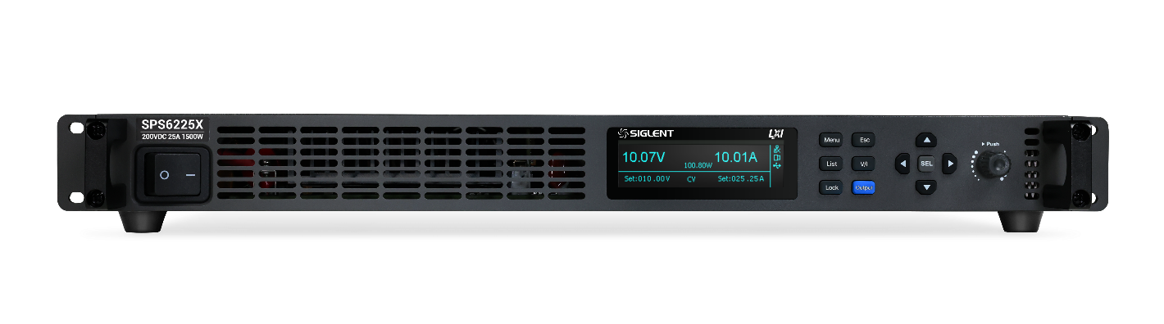
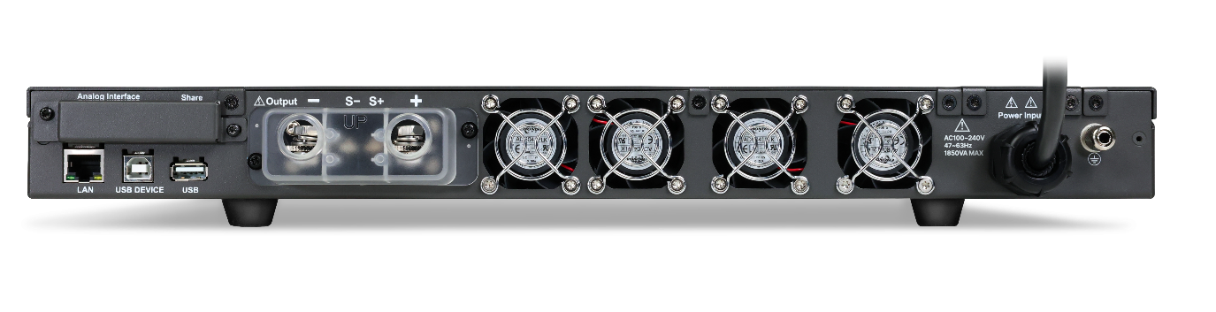
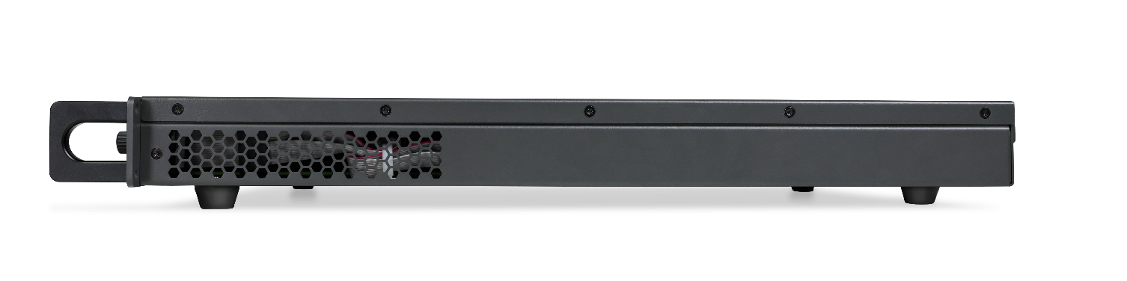
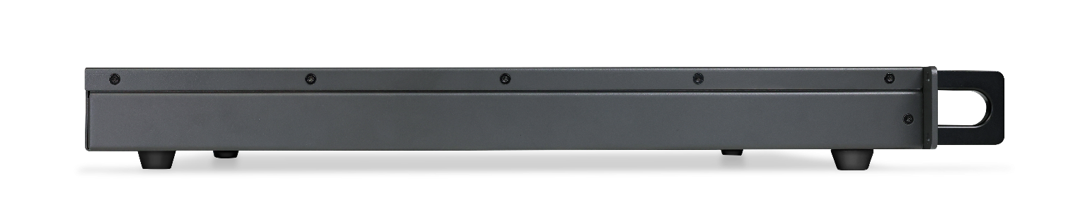
Appearance
Front panel: 3.12-inch OLED high-brightness display
Rear panel: LAN, USB, External analog control port
Machine height 1U (44 mm)

Slide 5

Wider Voltage and Current Output Range
Compared to traditional rectangular output ranges, the SPS6000X series power supplies provide a significantly broader range of voltage and current outputs.
SPS6225X
SPS6150X
Total Rated Output Power 1500W
Notes:
Conventional rectangular-output power supplies can only deliver maximum power at the highest voltage and current combination. In contrast, wide-range output power supplies can deliver full power along the curve between these two points. This allows the SPS6000X series to cover a much wider variety of voltage and current combinations under the same power output conditions, greatly enhancing the utilization efficiency of the power supply.

Slide 6
Intuitive List Operation Function
The list operation function of the SPS6000X supports both manual configuration and web control, allowing up to 50 steps of editing. Additionally, it enables adjustment of the rise and fall slopes for output voltage and current.
Notes:
By configuring the rise and fall times of voltage and current, users can verify the performance of the DUT during transitions. Additionally, slope adjustment mitigates sudden voltage changes, effectively preventing inrush current from damaging the DUT. This feature is particularly suitable for testing high-current-absorbing devices, such as capacitors.

Slide 7
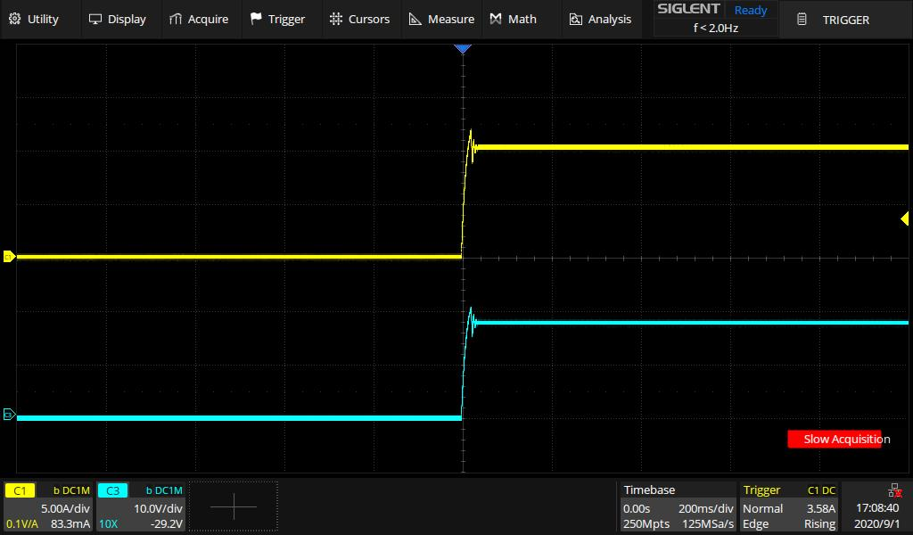
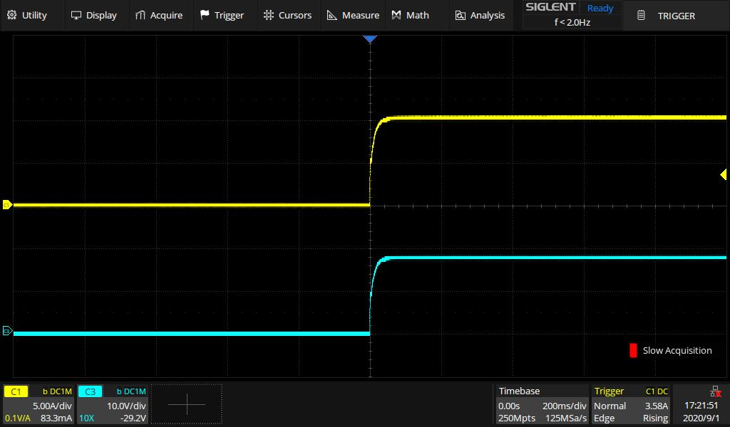
CV/CC Priority Mode
In CC priority mode, the power supply initially operates in constant current (CC) mode when output is on, effectively limiting inrush current and overshoot voltage.
In CV priority mode, the output voltage quickly reaches the set value. This is particularly useful in certain applications, such as LED testing. When the power supply starts outputting, the voltage reaches the LED's forward conduction voltage (Vf), which can otherwise lead to inrush current and overshoot voltage.
CV Priority
CC Priority

Slide 8
External Analog Control
Enables output regulation through an external voltage signal, supporting Voltage-Controlled Voltage and Voltage-Controlled Current modes.
By applying a 0-10V adjustable voltage signal to the control terminal, linear control of the output from 0 to full scale can be achieved.
Voltage-Controlled Voltage
Voltage-Controlled Current

Slide 9
Voltage, Current Monitor Output
Provides a 0-10V analog signal via monitoring output terminals to reflect real-time changes in output voltage and current. An external voltmeter or oscilloscope can be connected to monitor the output status.

Slide 10
Built-in Discharge Circuit
Built-in Discharge Circuit: The discharge circuit, connected in parallel with the output terminals, functions as an equivalent parallel resistor to enhance safety.
When the power supply is turned off or the load is disconnected, the circuit discharges the energy stored in the output filter capacitors. Without this circuit, the capacitors could remain charged, posing potential safety hazards. Additionally, the bleeder circuit helps to control and fine-tune the voltage descent slope.

Slide 11


Multiple Policy Protection Patterns
Supports Over current Protection (OCP), Over voltage Protection (OVP), Over temperature Protection (OTP), and Limited Power Protection (LPP).
When entering protection mode, the power supply automatically shuts down its output. The protection state can be exited by pressing and holding the ESC key for 2 seconds.
In Limited Power Protection (LPP) mode, the system restricts the output power, with a maximum output of approximately 102% of the rated power.

Slide 12
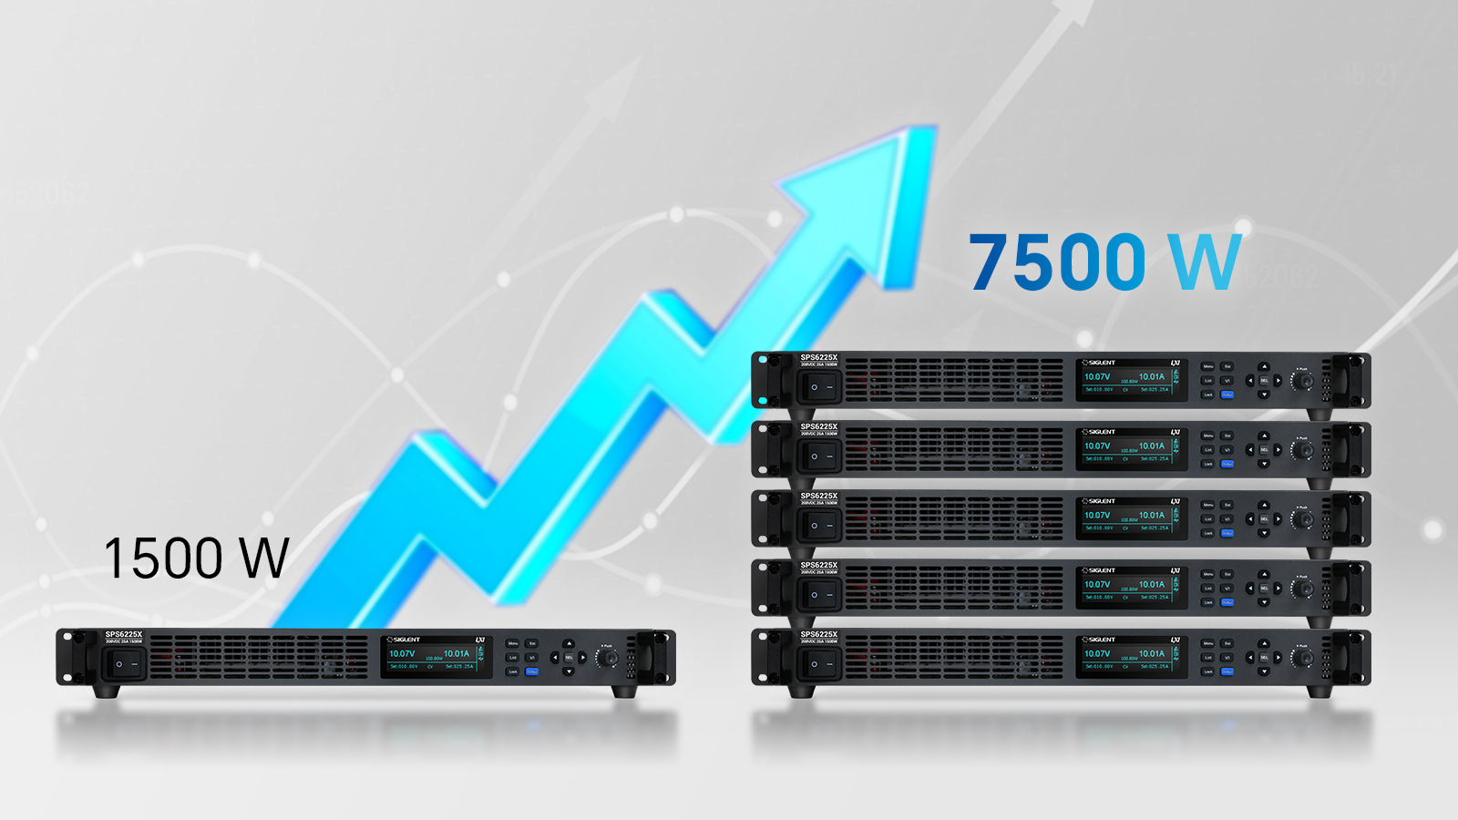
Parallel Function
Supports parallel connection of up to 5 units of the same model. Each unit provides 1500W of output power, enabling total output power expansion up to 7500W.

Slide 13
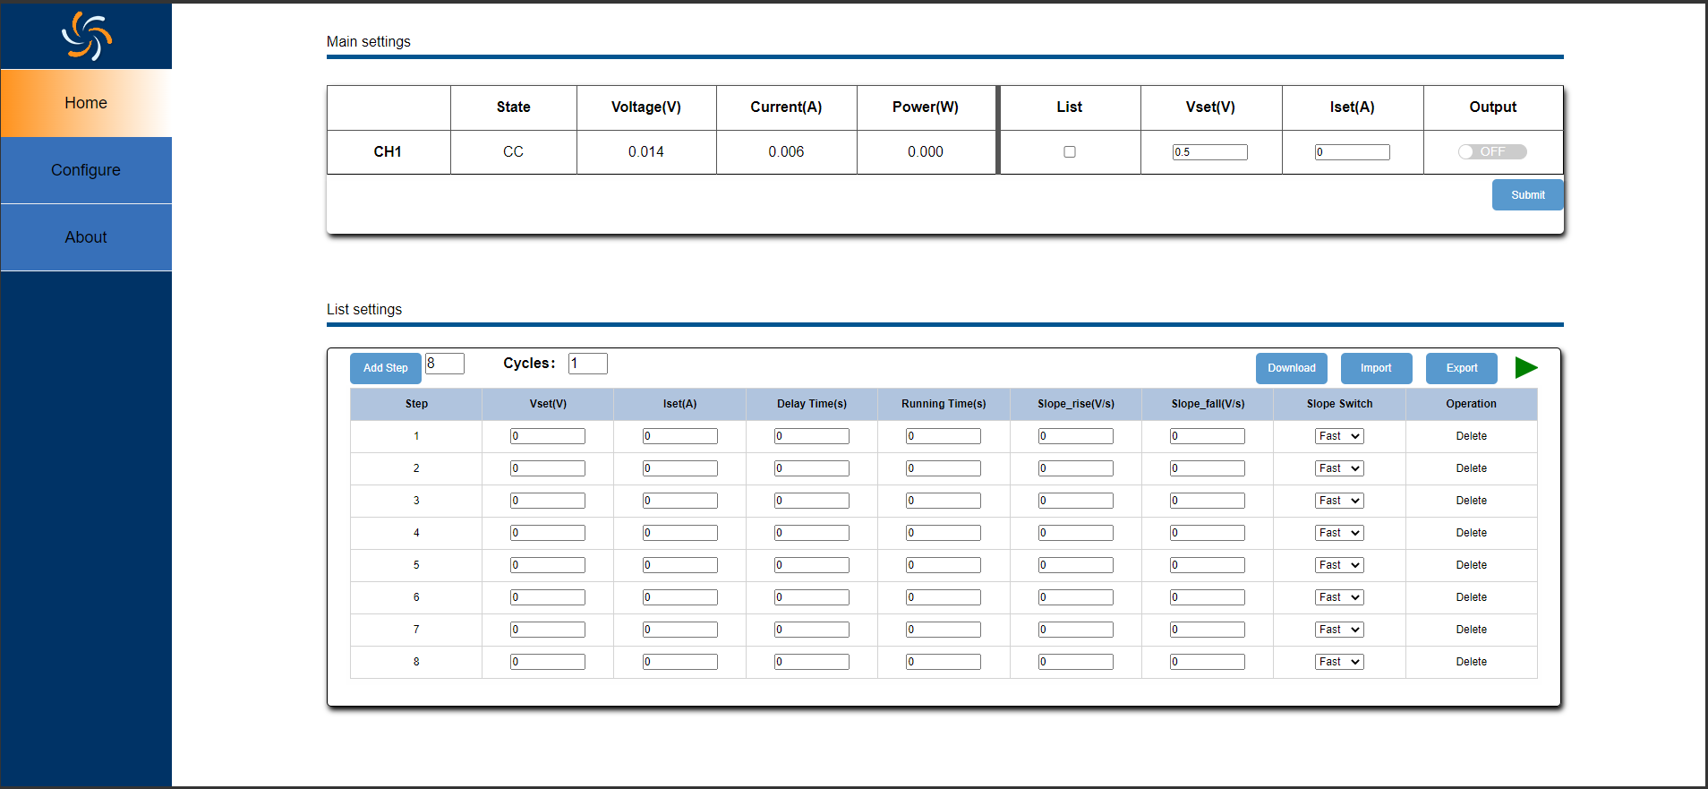
Web Remote Control
Simplifies parameter configuration with an intuitive and user-friendly interface, while also enabling convenient data and file storage.

Slide 14
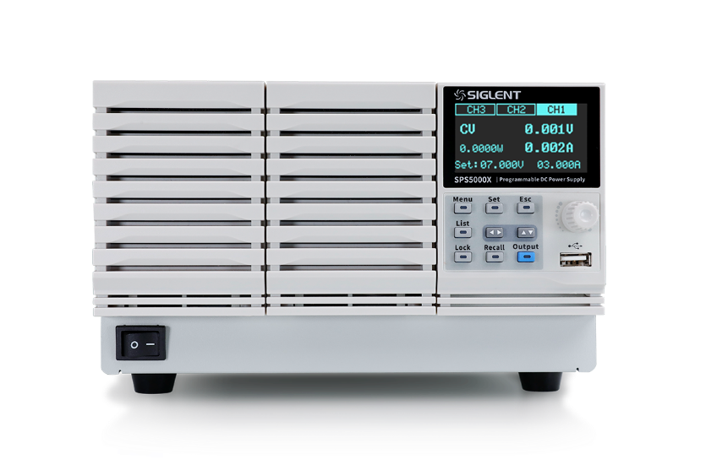
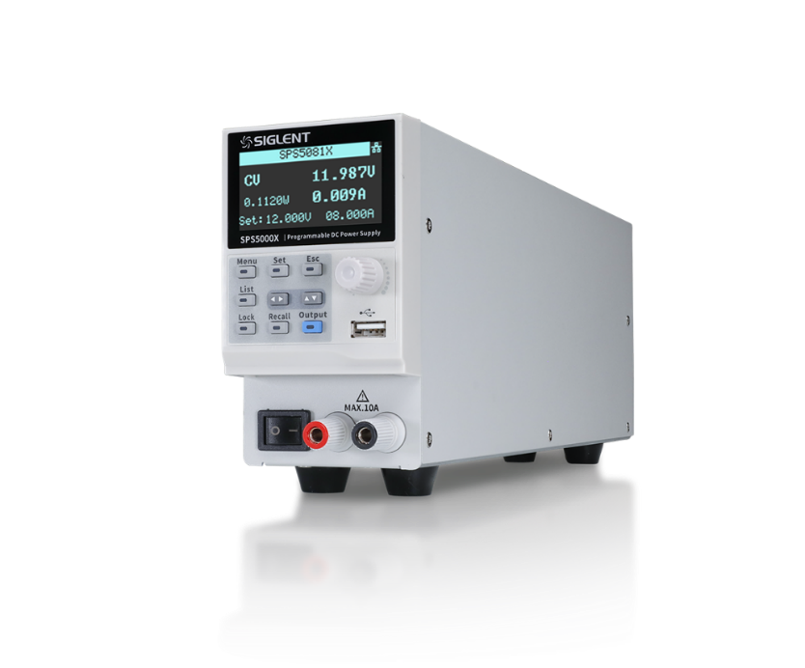
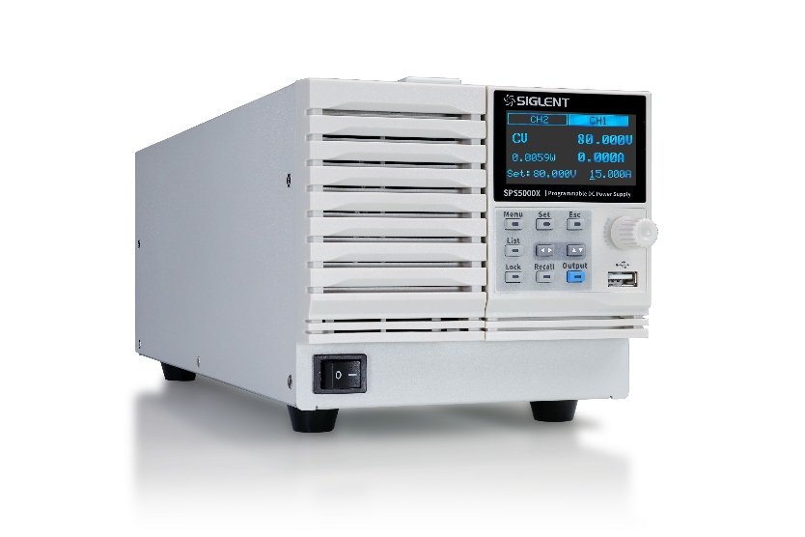
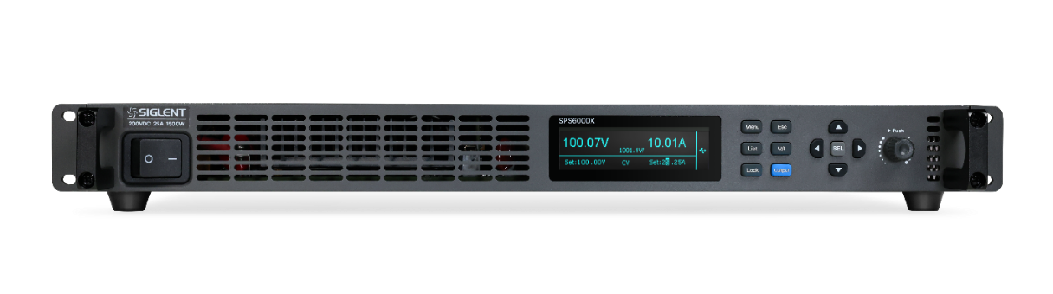
Siglent’s Switching DC Power Supplies
Module | SPS5041X | SPS5042X | SPS5043X | SPS5044X | SPS5045X
Channel | 1 |  |  | 2 | 3 | CH
Output Voltage | 40 |  |  |  |  | V
Output Current | 30 | 60 | 90 | 30 |  | A
Output Power | 360 | 720 | 1080 | 360*2 | 360*3 | W
Module | SPS5081X | SPS5082X | SPS5083X | SPS5084X | SPS5085X
Channel | 1 |  |  | 2 | 3 | CH
Output Voltage | 80 |  |  |  |  | V
Output Current | 15 | 30 | 45 | 15 |  | A
Output Power | 360 | 720 | 1080 | 360*2 | 360*3 | W
Module | SPS5161X | SPS5162X | SPS5163X | SPS5164X | SPS5165X
Channel | 1 |  |  | 2 | 3 | CH
Output Voltage | 160 |  |  |  |  | V
Output Current | 7.5 | 15 | 22.5 | 7.5 |  | A
Output Power | 360 | 720 | 1080 | 360*2 | 360*3 | W
Module | SPS6225X | SPS6150X
Channel | 1 |  | CH
Output Voltage | 200 | 100 | V
Output Current | 25 | 50 | A
Output Power | 1500 |  | W

Slide 15




Thank You
Every Bench. Every Engineer. Every Day.
Headquarters
NA
Europe
SIGLENT TECHNOLOGIES CO., LTD.
Add: Blog No.4 & No.5, Antongda Industrial Zone, 3rd Liuxian Road, Bao’an District, Shenzhen, 518101, China
Tel:+ 86 755 3688 7876
Fax:+ 86 755 3359 1582
sales@siglent.com
int.siglent.com
SIGLENT Technologies NA, Inc.
Add: 6557 Cochran Rd Solon, Ohio 44139 Tel: 440-398-5800 Toll Free:877-515-5551 Fax: 440-399-1211
info@siglent.com www.siglentna.com
SIGLENT TECHNOLOGIES GERMANY GmbH
Add: Staetzlinger Str. 70 86165 Augsburg, Germany Tel: +49(0)-821-666 0 111 0 Fax: +49(0)-821-666 0 111 22 info-eu@siglent.com www.siglenteu.com

