Slide 1


Slide 2
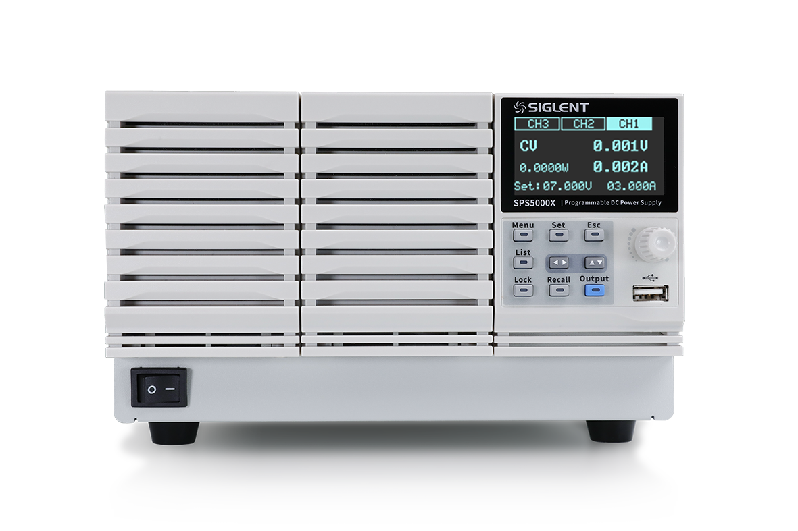
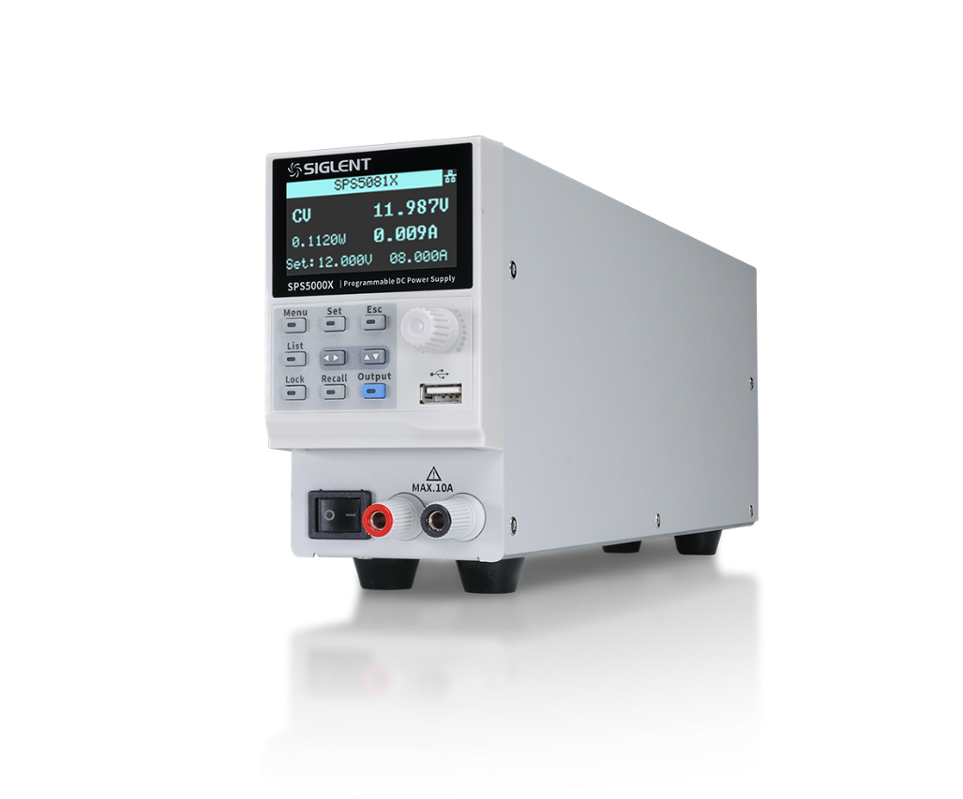
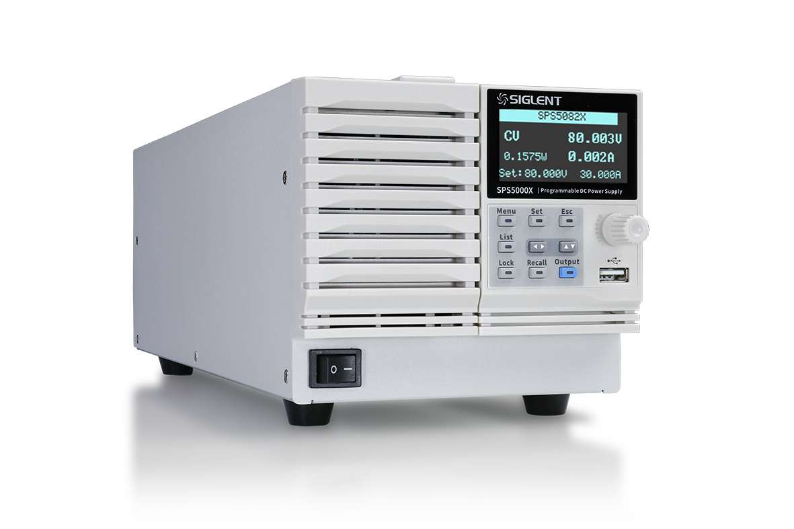
SPS5000X Series wide range
programmable Switching DC Power Supply

Slide 3
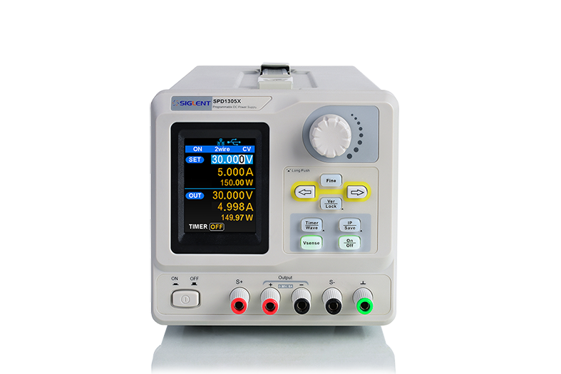
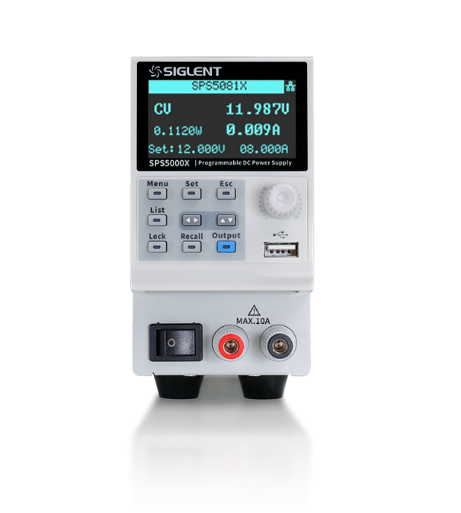


SMPS VS. Linear DC power supplies
Applications
SMPS: High power and current, such as automotive, communications, Power/Renewable energy
Linear PSU: Low power consumption devices, such as IoT devices
Working theory
SMPS: AC->Rectify>Chopping->High frequency transformer>Rectify and filter->Stabilization
Linear PSU: AC->Power frequency transformer->Rectify->Stabilization
Features
SMPS:
Pros: High output power, high efficiency, low heat, small transformer, wide input voltage range
Cons: Large ripple
Linear PSU:
Pros: Small ripple, low EM interference
Cons: High heat, low efficiency, large transformer, narrow input voltage range

Slide 4
Contents
SMPS terminology explanation
SPS5000X features and benefits
SPS5000X competition
Applications

Slide 5
Terminology
Power ratio = Vmax*Imax/Pmax, take SPS5081X as example, 80 V * 15 A / 360 W= 3.33
Efficiency = Output power/ Input power
Power Factor = Working power/Apparent power(Input voltage RMS*Input current RMS)
Line Regulation(Power Regulation): With constant load, the output voltage change corresponding to the input voltage change.
Load Regulation: With constant input voltage, the output voltage change corresponding to the load change from no load to full load.
Efficiency of SPS5000X
100 VAC input | > 77%
200 VAC input | > 79%
Power Factor
100 VAC | 0.99
200 VAC | 0.98
40V model in CV. Mode
Line Regulation | 18 mV （Constant load, 90 ~ 132 VAC or 170 ~ 265VAC）
Load Regulation | 20 mV （From no load to full load，constant input voltage）

Slide 6
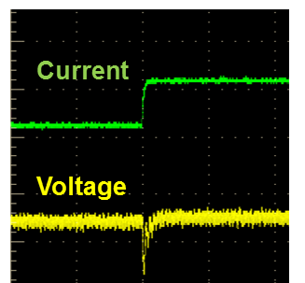
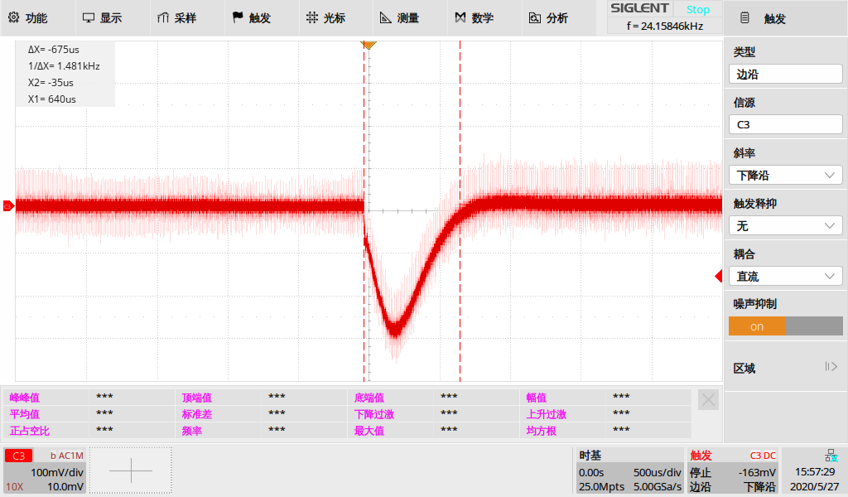
Terminology
Transient Response Time
In CV mode, when load(current) have a step change. The output voltage will have a quick jump and then get back to original setting.
SPS5000X defines it as the time needed from the beginning of jump to 99.9% + 10mV original setting level.
For example, measure SPS5081X transient response time at Vset=60V. Set electronic load current step from 3A to 6A, and set scope as AC coupling. The recovery time is less than 700us.

Slide 7
SPS5000X Features and Benefits
Wide voltage and current output range
Intuitive List Operation Function
Web Server
Adjustable Output Resistance
External Analog Control
Voltage, Current Monitor
Output ON/OFF delay
Multiple channels model
Series and Parallel
CV/CC Priority Mode
Built-in discharge circuit
Protection functions
Panels and interfaces

Slide 8
Wide voltage and current output range
In constant output power mode, the voltage and current range is switched automatically, compared to the traditional rectangular output range of most supplies, the SPS5000X provides a wider voltage and current output range, which greatly increases the utilization of the power supply.
80V/15A, 40V/30A Output Operating Area
160V/7.5A Output Operating Area

Slide 9
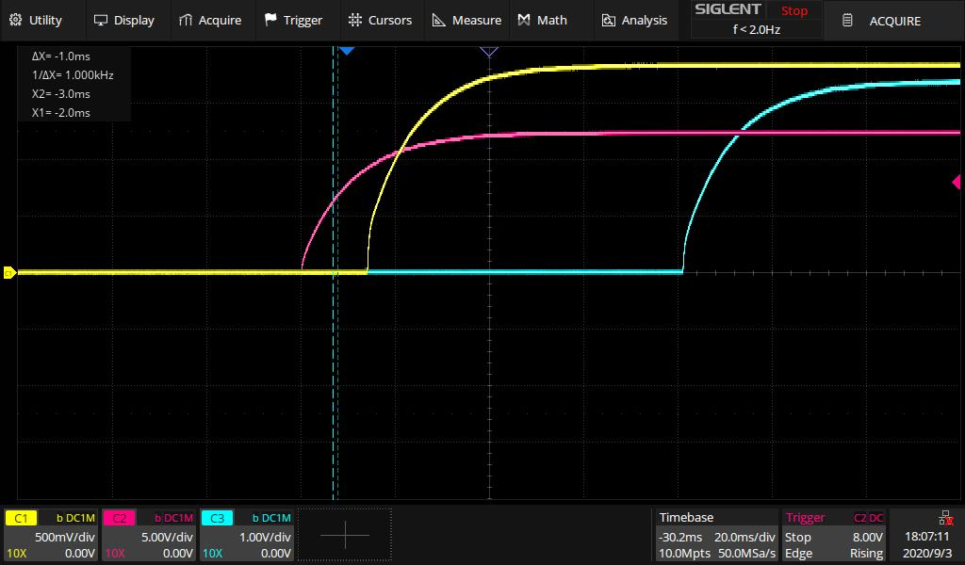
Intuitive List Operation Function
Set on front panel or via Web Server
Up to 50 steps
Editable output delay, duration, and slew rate
SPS5085X 3 CH list mode

Slide 10
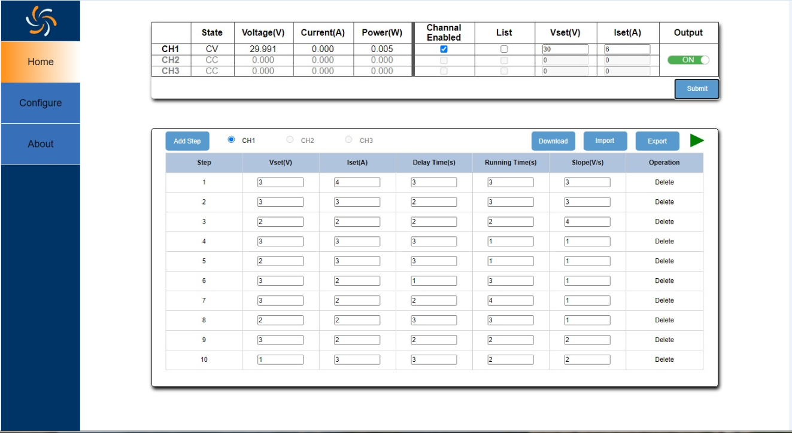
Web Server
Easily set parameters and convenient data and file save operations.

Slide 11
Adjustable Output Resistance
Software defined output resistance. It’s like an internal resistance in series with the output pole.
It is equivalent to lead-acid or lithium battery which exhibit an internal resistance.
The longer the battery is used, the higher the internal resistance. With this function, the SPS can imitate the ageing process of batteries.
When battery output current is big, there will be apparent voltage drop on internal resistance, this function can imitate battery internal resistance.

Slide 12
External Analog Control
4 kinds of operating modes: Voltage-controlled voltage, voltage-controlled current, resistance-controlled voltage and resistance-controlled current
In external voltage control mode, use 0~10V adjustable voltage to adjust output from 0V to full range. While in external resistance control mode, use 0~10k resistor.
External voltage programming voltage output
External resistance programming voltage output

Slide 13
Voltage, Current Monitor Output
Monitoring terminal output a 0-10 V analog signal represent the output current or voltage from 0 to full range.
Connect to a DMM or oscilloscope to display the changes.
Notes:
与外部模拟控制过程相反。

Slide 14
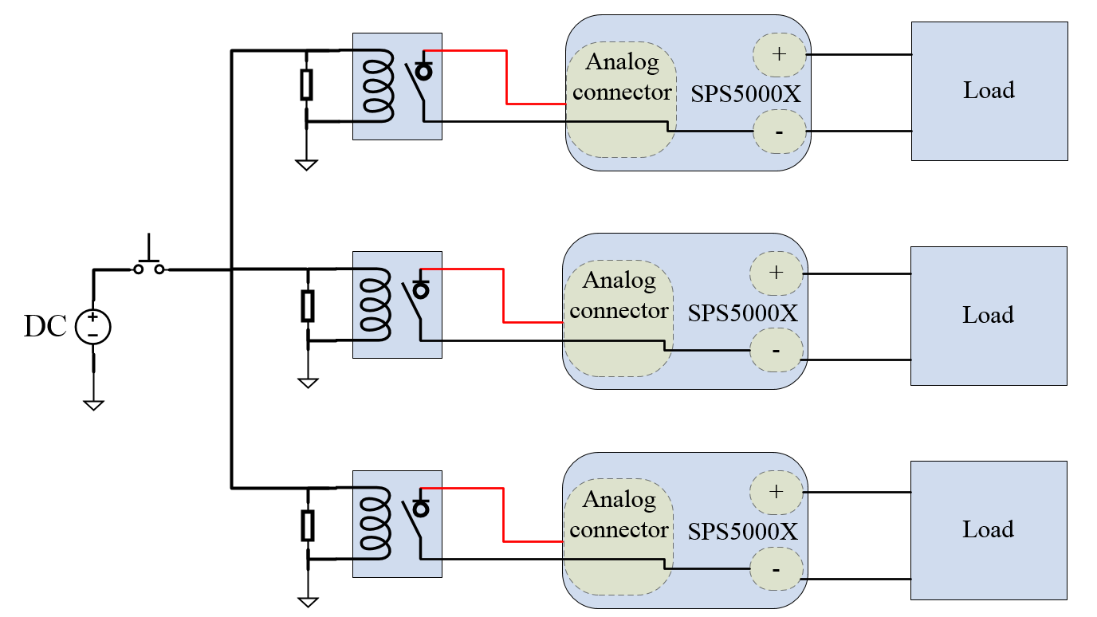
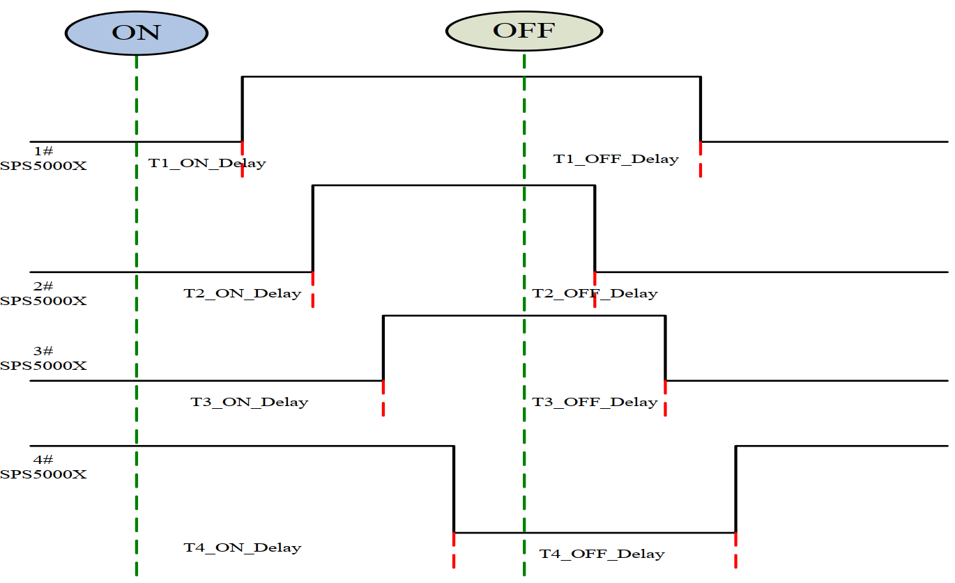
Output ON/OFF delay
Remote control Output ON/OFF, simply connect a control signal to SPS5000X ON/OFF interface.
Output ON/OFF delay
Control multiple unit power up/down sequences
For example, connect a DC power supply to multiple SPS5000X ON/OFF interface via relays. And then set different ON/OFF delay on units. This way is faster than remote communication control.

Slide 15
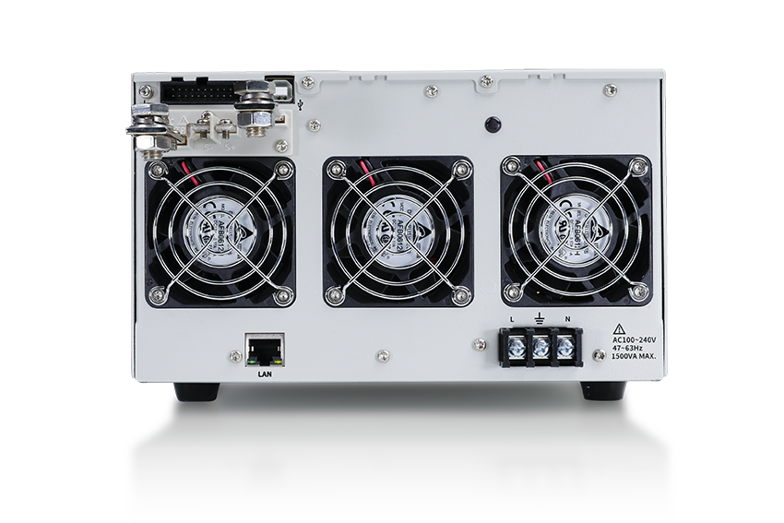
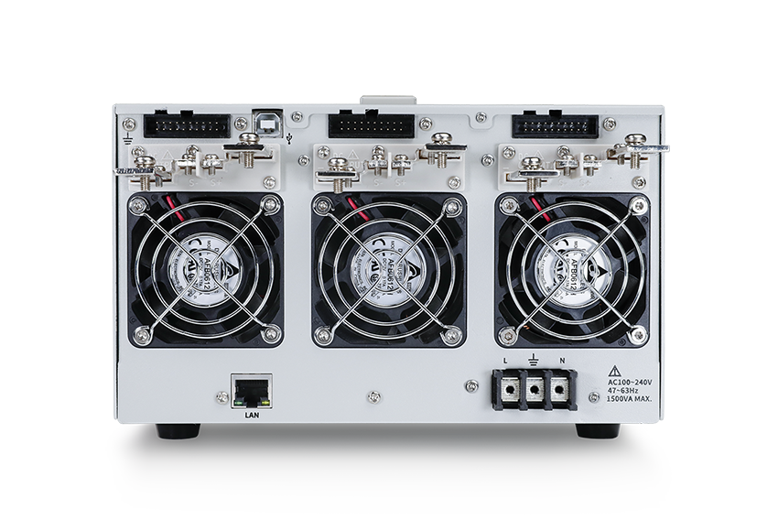
Multiple channels model
40V/50V/80V/160V，180W/360W/720W/1080W, 16 models in total
Single/Two/Three output channels (Series/Parallel between channels)
With 3 CH model, simply set different ON/OFF delay on one unit.
Model | SPS5041X | SPS5042X | SPS5043X | SPS5044X | SPS5045X | Unit
Output Channel | 1 |  |  | 2 | 3 | CH
Rated output voltage | 40 |  |  |  |  | V
Rated output current | 30 | 60 | 90 | 30 |  | A
Total rated output power | 360 | 720 | 1080 | 360*2 | 360*3 | W
Model | SPS5081X | SPS5082X | SPS5083X | SPS5084X | SPS5085X | Unit
Output Channel | 1 |  |  | 2 | 3 | CH
Rated output voltage | 80 |  |  |  |  | V
Rated output current | 15 | 30 | 45 | 15 |  | A
Total rated output power | 360 | 720 | 1080 | 360*2 | 360*3 | W
Model | SPS5161X | SPS5162X | SPS5163X | SPS5164X | SPS5165X | Unit
Output Channel | 1 |  |  | 2 | 3 | CH
Rated output voltage | 160 |  |  |  |  | V
Rated output current | 7.5 | 15 | 22.5 | 7.5 |  | A
Total rated output power | 360 | 720 | 1080 | 360*2 | 360*3 | W
SPS5083X 3 modules Single Channel
SPS5085X 3 modules Three Channels

Slide 16
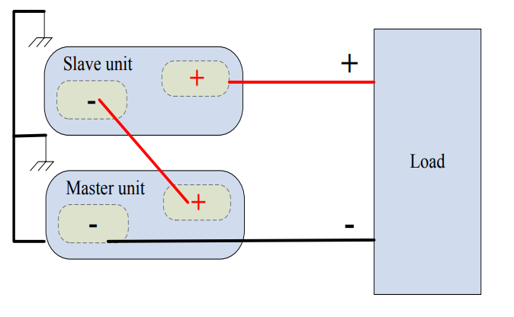
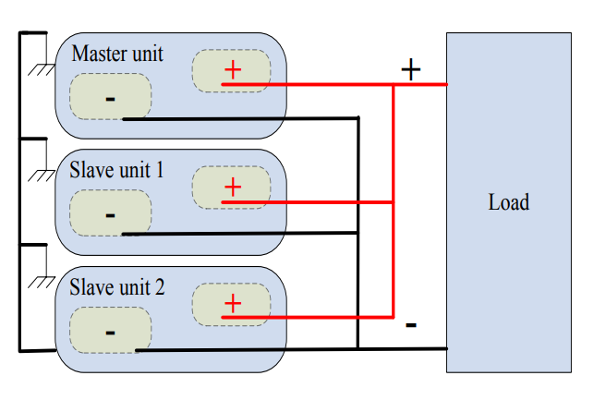
Series and Parallel
Max 2 units in series, 3 units in parallel(single channel model)
For example, two SPS5081X in parallel can expand single unit 80V/15A/360W to 80V/30A/720W.
Two units in series
Three units in parallel

Slide 17
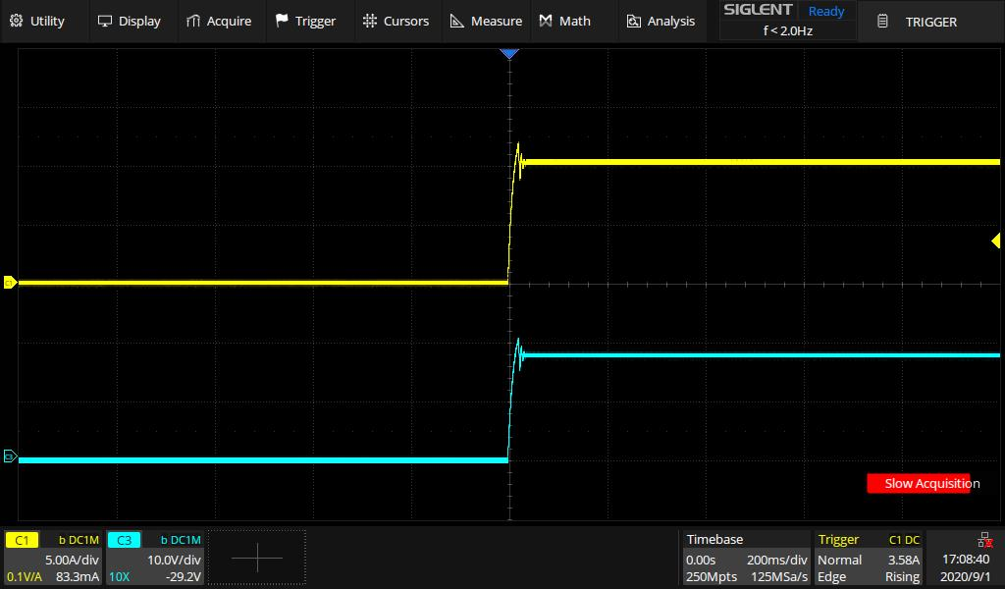
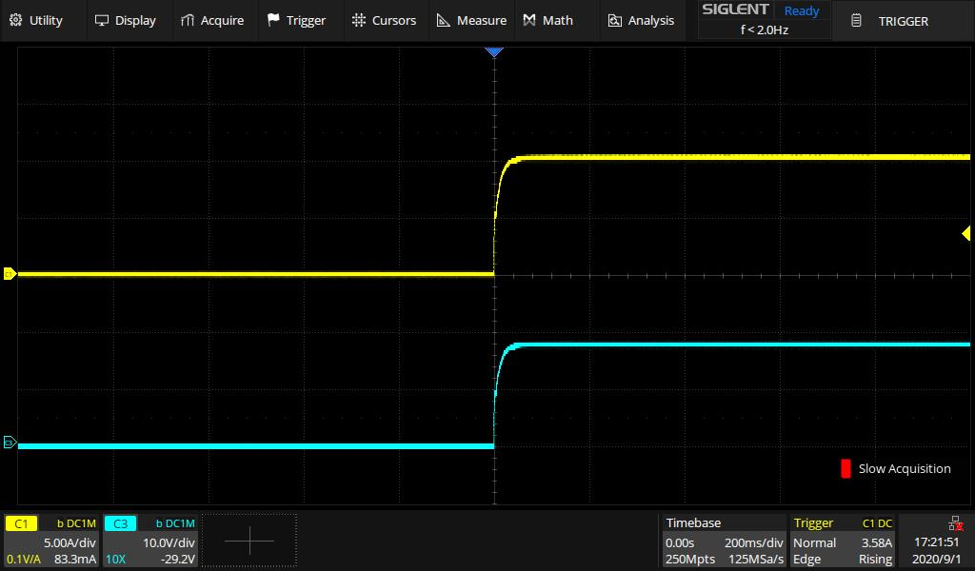
CV/CC Priority Mode
CC priority mode limits the inrush current spike and overshoot voltage effectively when the power output is turned on. But in this mode, power supply has a slower edge.
In CV priority mode, the output voltage reaches the set voltage value quickly.
NOTE: In some applications, like LED testing, CV priority can have more surge current and overshoot voltage. CC mode can protect DUT from damage.
CV Priority Mode
CC Priority Mode

Slide 18


Built-in discharge circuit
Parallel with the output terminal, equivalent to a parallel resistance.
Safety - When the output is off, it will discharge the power in the output filter capacitor.
It can also be used to adjust the slew rate for decreasing voltages.
With discharging-circuit on,
the voltage drops down to 0V immediately when output is off
Discharging-circuit off,
there is still high voltage on the terminal when output is off

Slide 19


Protection functions
OCP, OVP, OTP, LPP (Limit Power Protection)
When protection mode is activated, the output will be turned off. Press Esc button and hold 2 seconds to exit protection mode.
In LPP mode, the maximum output power is about 105% of the rated power.
For example: The SPS5081X is an 80V, 15A, 360W model. If we set the output level = 80 V, load to 5 A in CC mode, the required power is 400 W. This is higher than the supplies limit of 360 W.
So the unit will limit the power to 360 W * 105% ≈ 375 W.

Slide 20
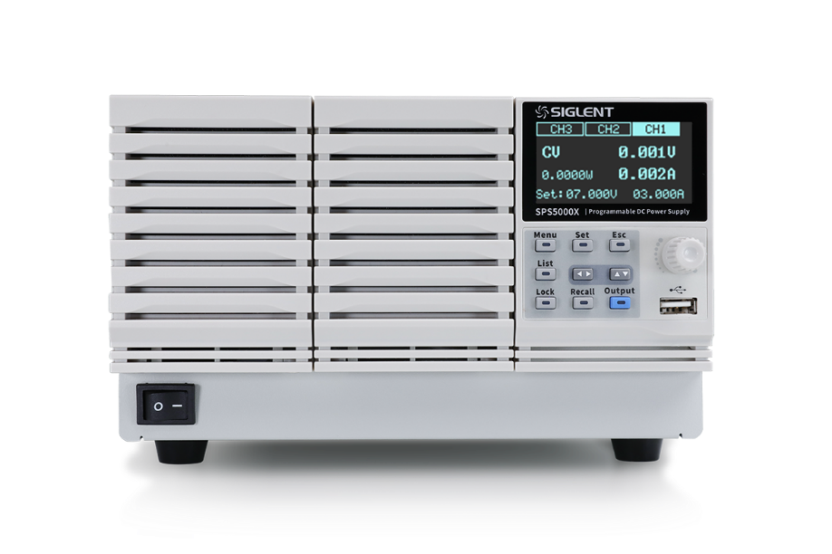

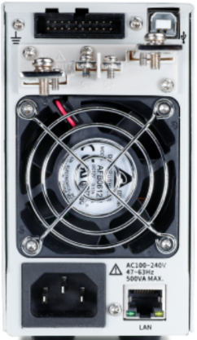
Panels and interfaces
Front Panel: Single modules have both front and rear panel output. 170 degree viewing angle display.
Rear Panel: 1/2/3 output channels; LAN, USB, analog control interface
Height 3U, Width 1/2, 1/3, 1/6 rack mount size

Slide 21
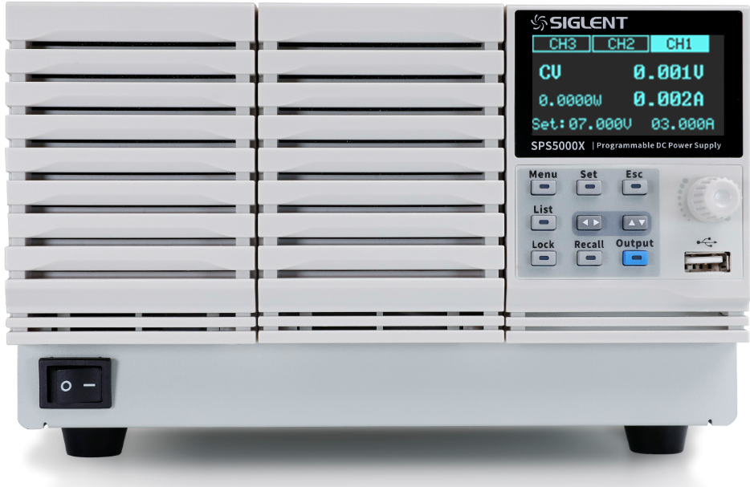
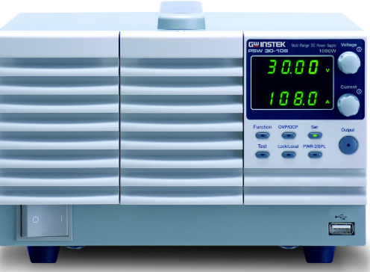
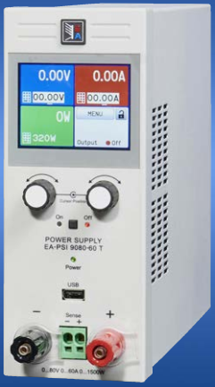
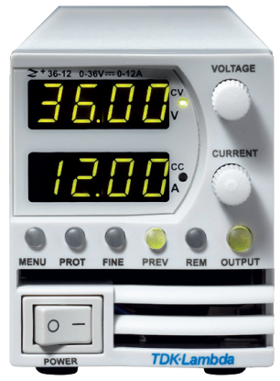
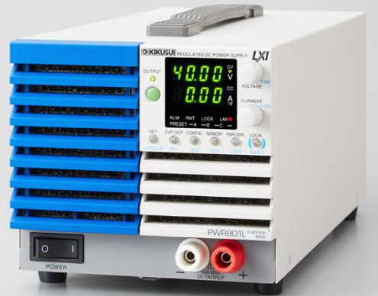
SPS5000X competition
Brands | SIGLENT SPS5000X | GW-instek PSW | EA PSI 9000 T | TDK Lambda Z+ | Kikusui PWR-01
Output Channel | 1/2/3 | 1 | 1 | 1 | 1
Voltage/Current Power ratings | 40V/30A 360W 40V/30A 360WX2 (2 channels) 40V/30A 360WX3 (3 channels) 40V/60A 720W 40V/90A 1080W 50V/10A 180W 80V/15A 360W 80V/15A 360WX2 (2 channels) 80V/15A 360WX3 (3 channels) 80V/30A 720W 80V/45A 1080W 160V/7.5A 360W 160V/7.5A 360WX2 (2 channels) 160V/7.5A 360WX3 (3 channels) 160V/15A 720W 160V/22.5A 1080W | 30V/36A 360W 30V/72A 720W 30V/108A 1080W 80V/13.5A 360W 80V/27A 720W 80V/40.5A 1080W 160V/7.2A 360W 160V/14.4A 720W 160V/21.6A 1080W 250V/4.5A 360W 250V/9A 720W 250V/13.5A 1080W 800V/1.44A 360W 800V/2.88A 720W 800V/4.32A 1080W | 40V/20A 320W 40V/40A 640W 40V/40A 1000W 40V/60A 1500W 80V/10A 320W 80V/20A 640W 80V/40A 1000W 80V/60A 1500W 200V/4A 320W 200V/10A 640W 200V/15A 1000W 200V/25A 1500W 500V/6A 1000W 500V/10A 1500W | 10V/20A 200W 10V/40A 400W 10V/60A 600W 10V/72A 720W 20V/10A 200W 20V/20A 400W 20V/30A 600W 20V/40A 800W 36V/6A 216W 36V/12A 432W 36V/18A 648W 36V/24A 864W 60V/3.5A 210W 60V/7A 420W 60V/10A 600W 60V/14A 840W 100V/2A 200W 100V/4A 400W 100V/6A 600W 100V/8A 800W | 40V/40A 400W 40V/80A 800W 40V/120A 1200W 40V/200A 2000W 80V/20A 400W 80V/40A 800W 80V/60A 1200W 80V/100A 2000W 240V/5A 400W 240V/10A 800W 240V/15A 1200W 240V/25A 2000W 650V/1.85A 400W 650V/3.7A 800W 650V/5.55A 1200W 650V/9.25A 2000W

Slide 22
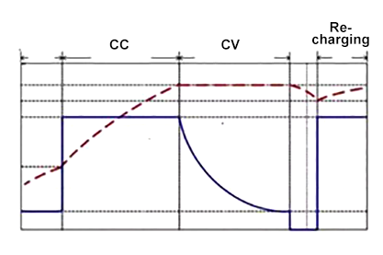
Applications
Automotive: Speaker test requires 1000 times 1s startup, 4s power down cycle to test its sound quality changes.
Automotive: Entertainment and Navigation Systems have a defined power on sequence (Monitor, Main unit, Amplifier..)
Battery test: Batteries are different and characters may vary from environments. In battery charging test shown below, there are several kinds of charging states, constant low current, constant big current, constant voltage mode. It also requires the PSU have OVP, OCP function to avoid battery damage.
Battery charging process

Slide 23
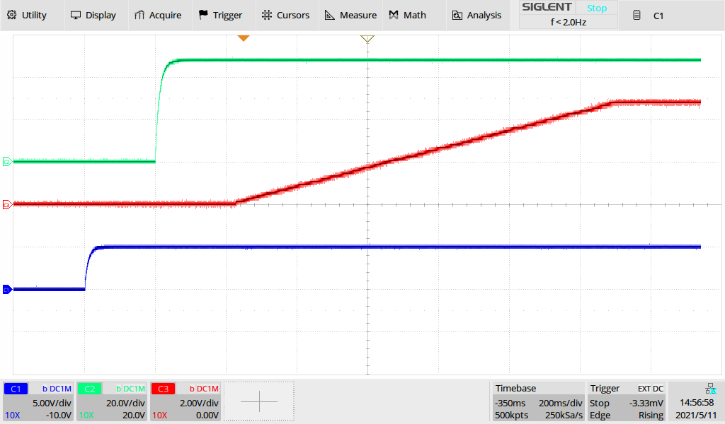
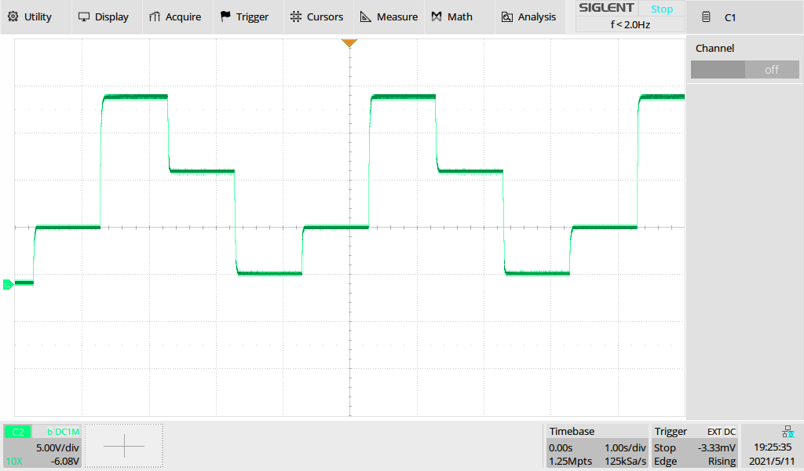
Applications
Consumer Electronics: Single board test requires multi-channel power supply.
Battery simulation: Variable internal resistance. List function with remote control ability simulate different state of batteries.
...
ON/OFF Delay to simulate different power-on/off sequence
List function for automated test

Slide 24
Thank You
The Best Value in Electronic Test & Measurement
Headquarters
NA
Europe
SIGLENT TECHNOLOGIES CO., LTD.
Add: Blog No.4 & No.5, Antongda Industrial Zone, 3rd Liuxian Road,
Bao’an District, Shenzhen, 518101, China.
Tel:+ 86 755 3688 7876
Fax:+ 86 755 3359 1582
sales@siglent.com
www.siglent.com/ens
SIGLENT Technologies NA, Inc.
Add: 6557 Cochran Rd Solon, Ohio 44139 Tel: 440-398-5800 Toll Free:877-515-5551 Fax: 440-399-1211
info@siglent.com www.siglentna.com
SIGLENT TECHNOLOGIES GERMANY GmbH
Add: Liebigstrasse 2-20, Gebaeude 14, 22113 Hamburg Germany Tel: +49(0)40-819-95946
Mobile: +49 151 40716756 Fax: +49(0)40-819-95947 info-eu@siglent.com www.siglenteu.com

