Slide 1
SDM4000A
Digital Multimeter
EVERY BENCH. EVERY ENGINEER. EVERY DAY.
www.siglent.com

Slide 2
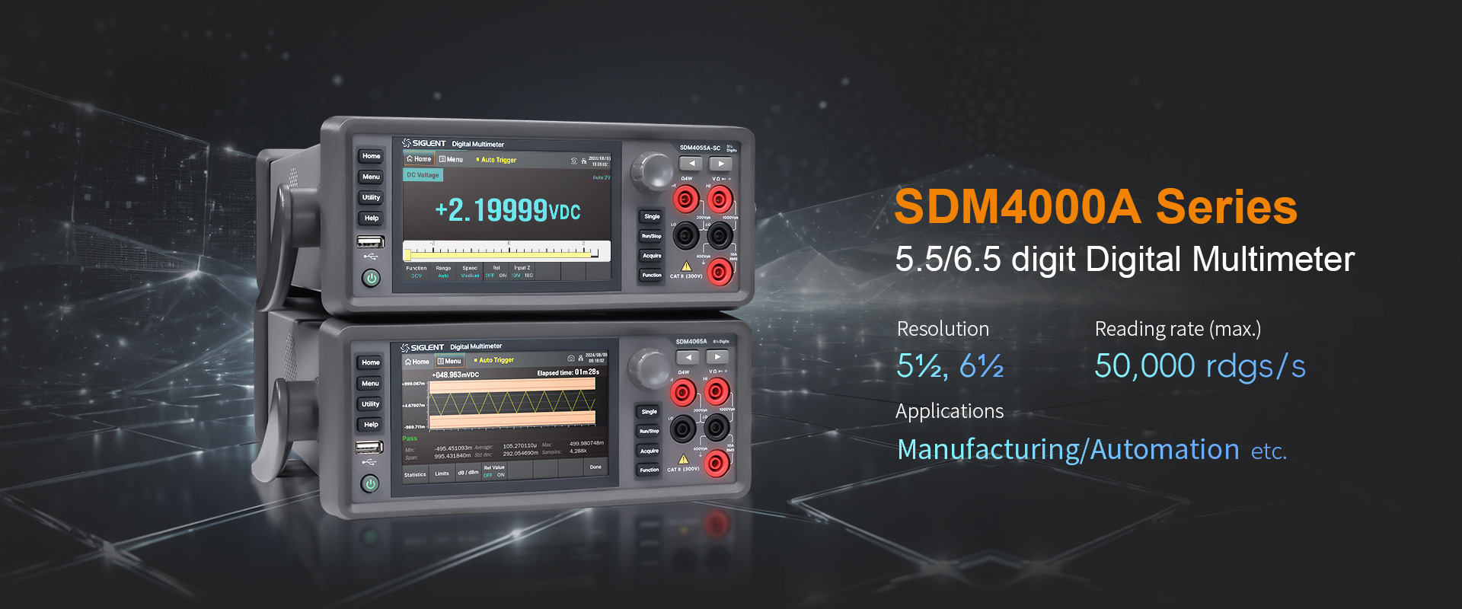

Slide 3
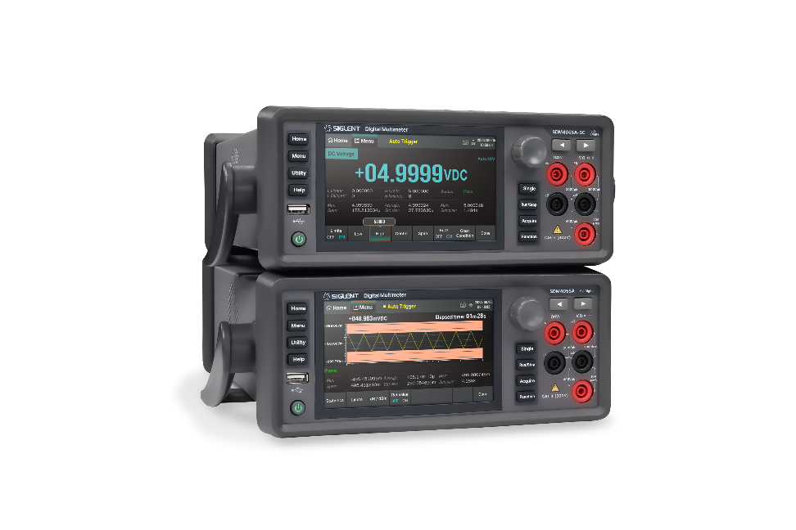
01
02
03
04
Basic Info
Features
Applications
Comparison

Slide 4

01
BASIC INFO

Slide 5
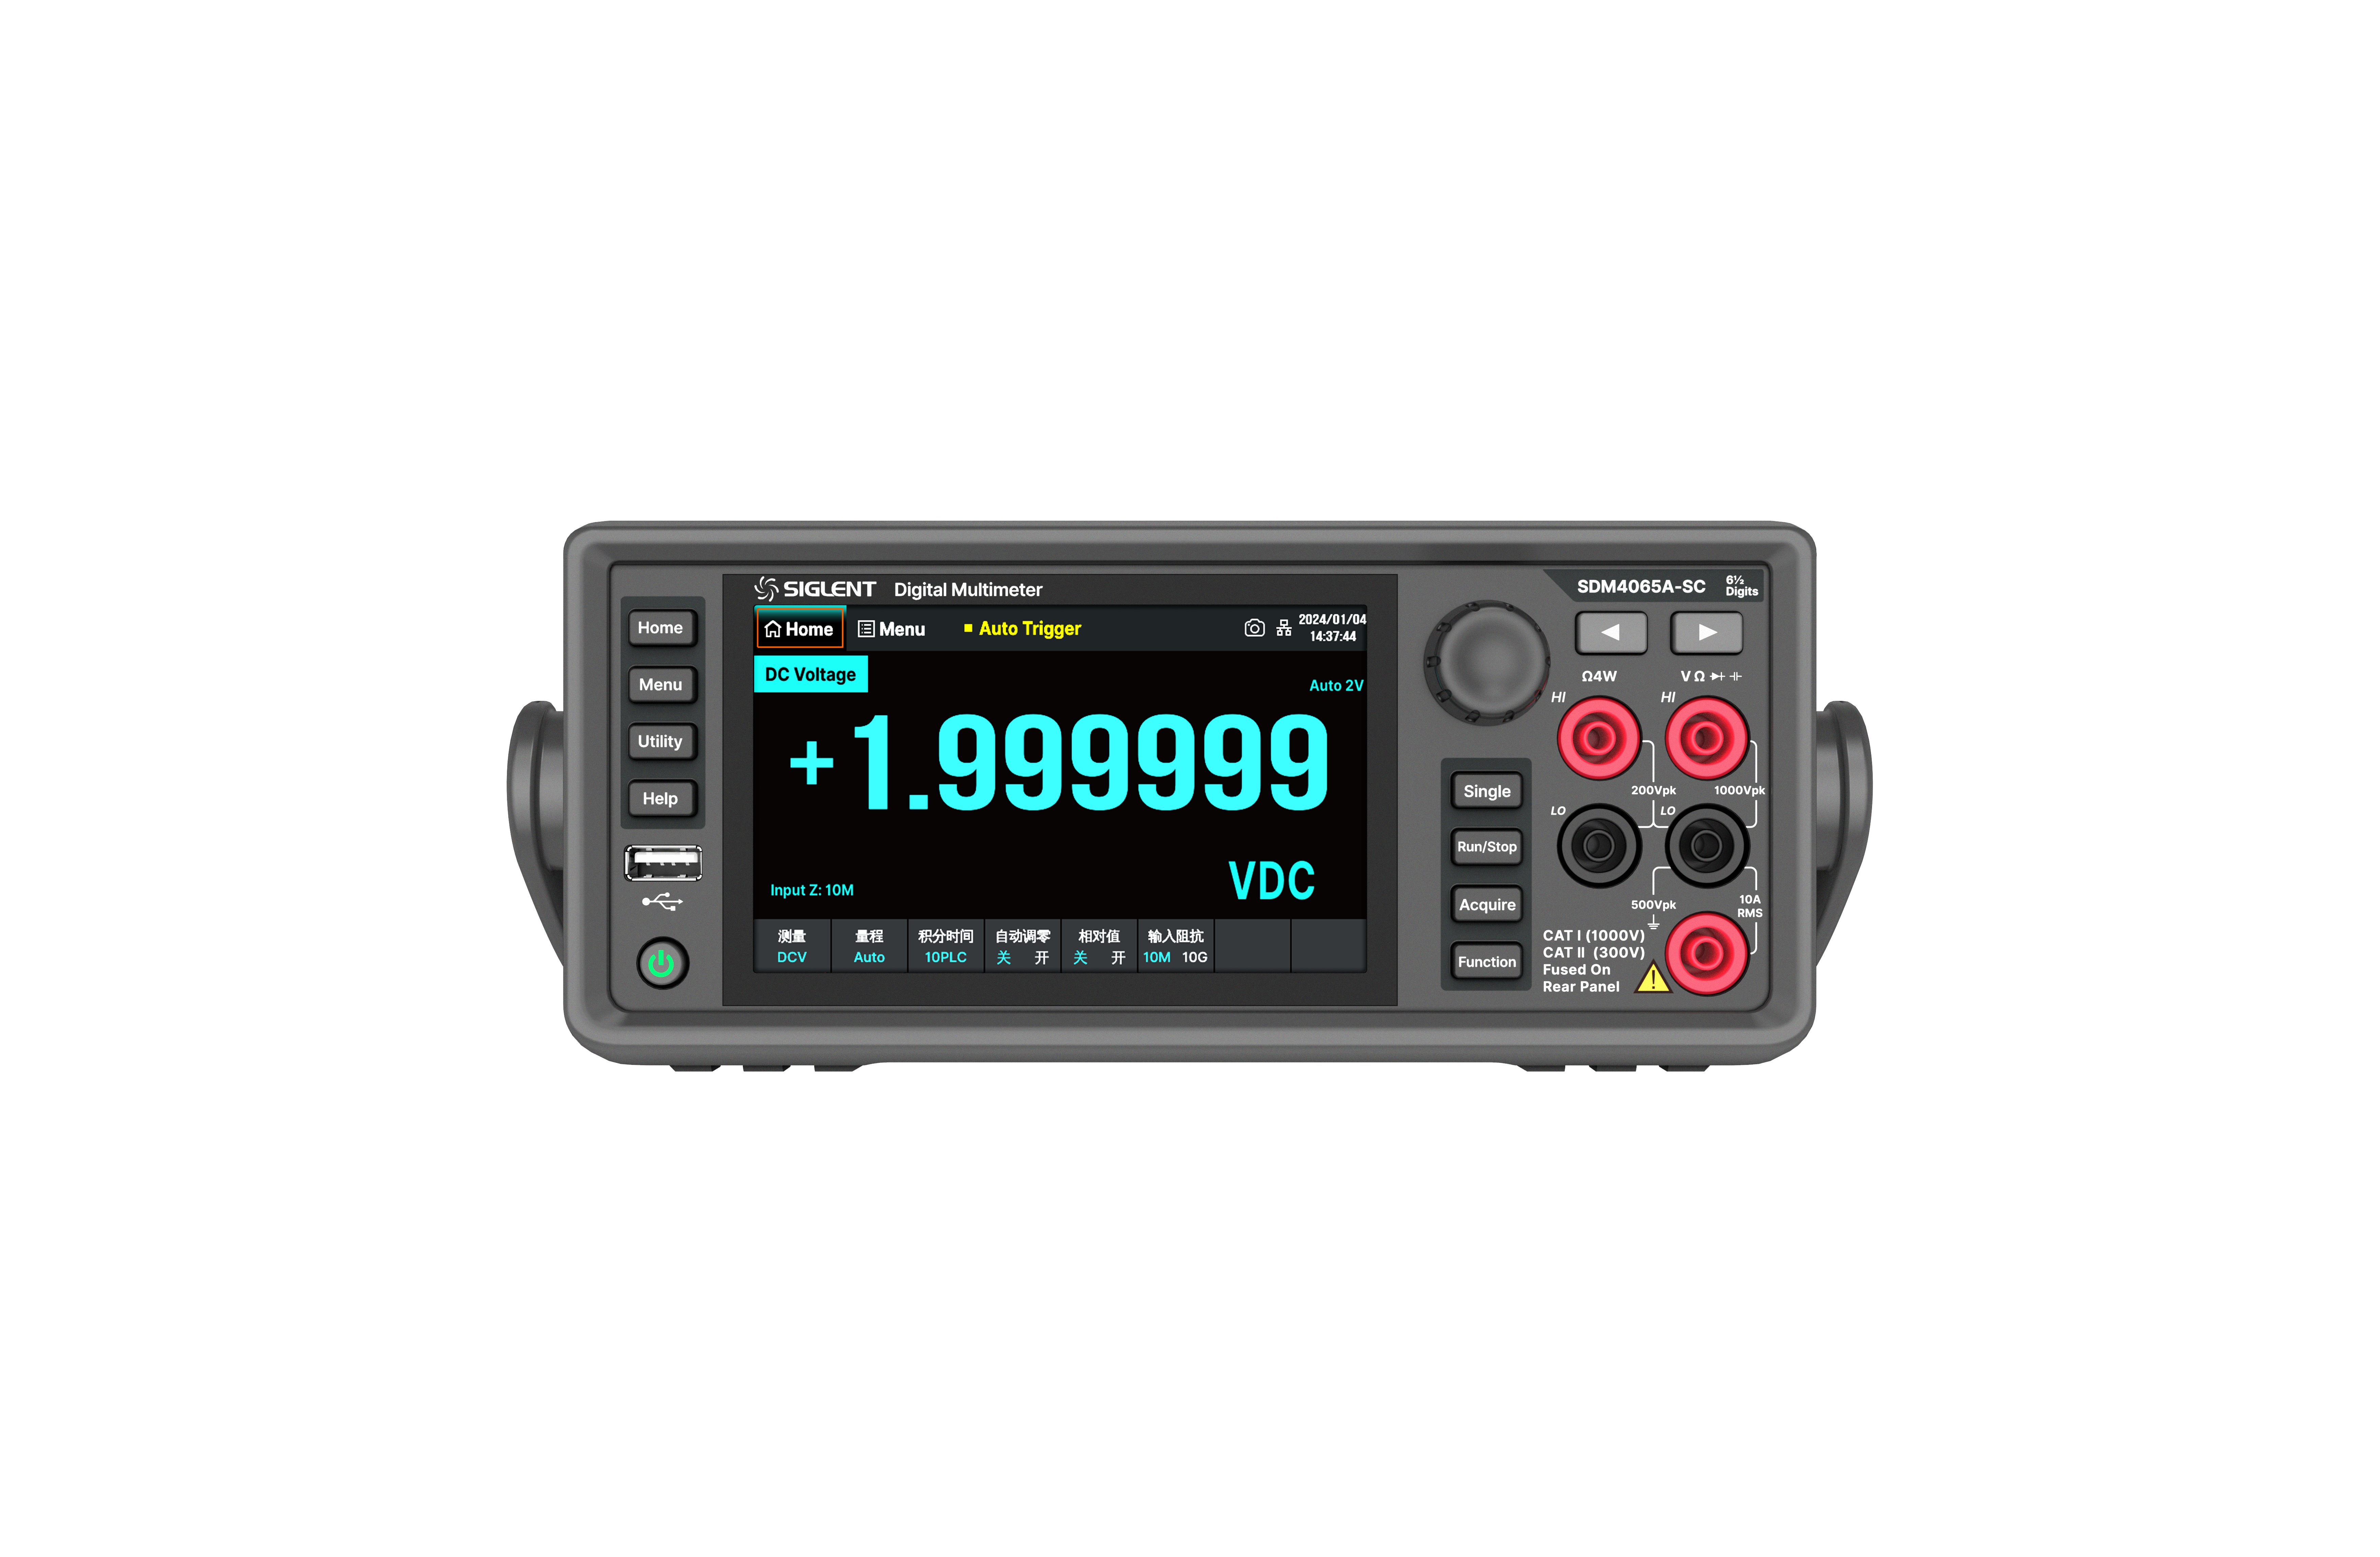

Front Panel
5 inches TFT-LCD (800 * 480)
Touch Screen
Knob and Navigation
Menu
Selection Keys
Trigger Modes
Single, Auto / Stop
USB Host
Store / Recall Data
System Upgrade
Sample / Trigger
VMC Output
Save / Recall Settings
Power Key
Supports
Auto-Power-On
Measurement Function Key
Signal Input
Terminals

Slide 6
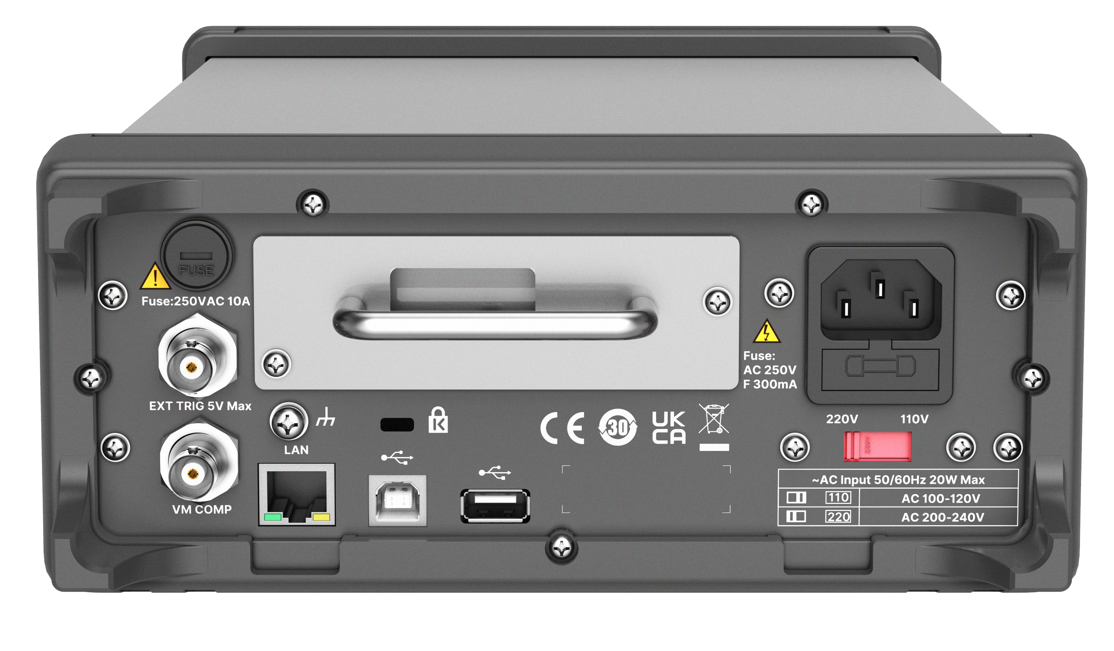
Rear Panel
16-Channel Inspection Card (option)
Current Input Fuse
Power Socket
Ext Trigger
Power Fuse
AC Voltage Selector
VMC Output
USB Host
LAN
Remote Control
Support VXI-11 Protocol
USB Device
Upper Computer Control
Support USB-TMC Protocol

Slide 7
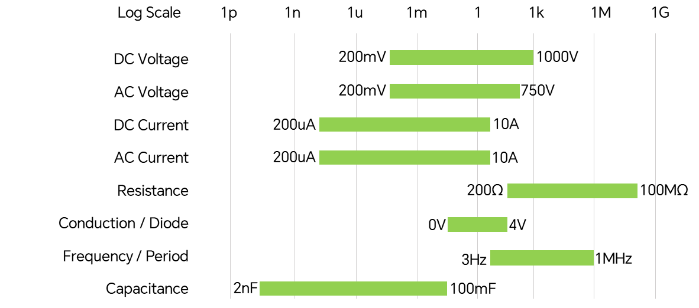
Key Specifications
Measurement Types & Ranges
 | SDM4065A | SDM4065A-SC
Resolution Bits | 6½
DCV Basic Accuracy | 35 ppm
Max Reading Rate | 50,000 readings/s
Memory | Maximum 2 Million Readings
Scan Card | NO | YES
Minimum resolution | 100nV, 0.1nA, 100μΩ, 2pF
IO | USB Host, USB Device, LAN, GPIB (option)
Interfaces | External Trigger、VMC Output
Display | 5-inch TFT Touchscreen
6^{½}

Slide 8
Key Specifications
Measurement Types & Ranges
 | SDM4055A | SDM4055A-SC
Resolution Bits | 5½
DCV Basic Accuracy | 150 ppm
Max Reading Rate | 4,800 readings/s
Memory | 512MB RAM、256MB Nand-Flash
Scan Card | NO | YES
Minimum resolution | 100nV, 0.1nA,10nA,100μΩ
IO | USB Host, USB Device, LAN, GPIB (option)
Interfaces | External Trigger、VMC Output
Display | 5-inch TFT Touchscreen
5^{½}

Slide 9
02
FEATURES

Slide 10
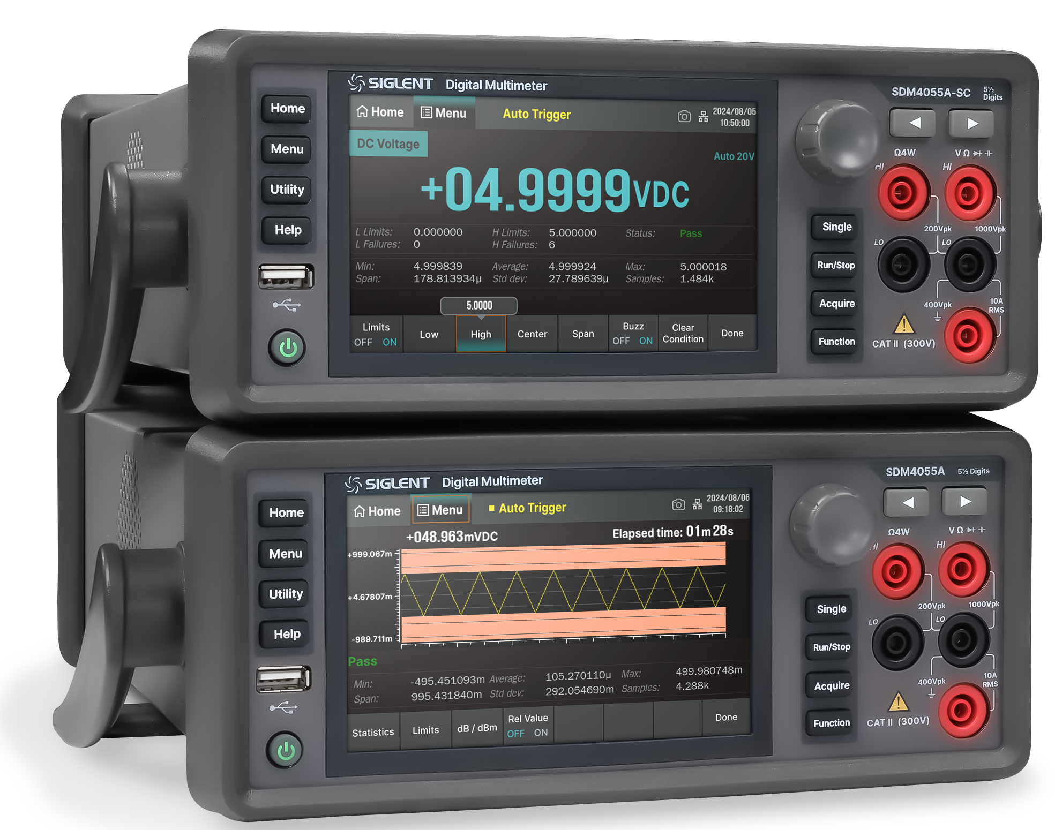
Bench Multimeter
A bench multimeter is a high-accuracy measurement instrument equipped with multifunctional measurement capabilities and a large display. It supports wider measurement ranges and stricter precision requirements while offering advanced data processing and data logging, ensuring measurement stability during extended operation.
VS Oscilloscope
· The multimeter has higher accuracy and resolution.
· The multimeter can measure a lower signal frequency range.
· The number of ADC bits is much higher than that of the oscilloscope, while the sampling rate is lower than that of the oscilloscope.
VS Handheld multimeters
· The Bench multimeter has higher accuracy and resolution.
· The Bench multimeter has faster sampling rates.
· The Bench multimeter support remote control.

Slide 11
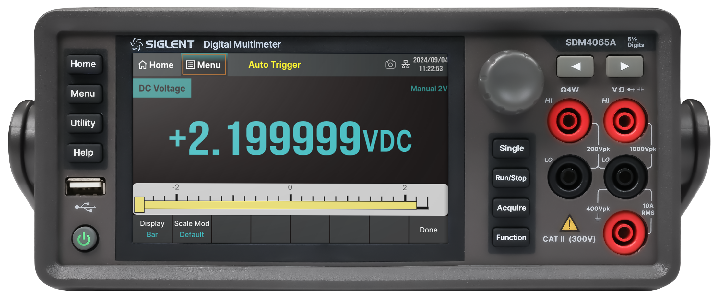
Excellent measurement accuracy
Real 5½-digit and 6½-digit readings resolution
Full-scale display range: 0 to ±219,999 0 to ±2,199,999
Explanation of Counts
Counts represent effective resolution, and the count value provides a more precise specification than digit designation.
Example
The 6½-digit SDM4000A has 2,200,000 counts.
In the 2V range (with overrange capability), it measures up to 2.199999V, where 1 count = 0.000001V (effective resolution: 1 µV, calculated as 2V / 2,200,000 counts).
A 6½-digit model with 1,100,000 counts in the same 0–2V range achieves a resolution of 2 µV.
Key Insight
Counts define how finely a full scale is divided. Even with the same 6½-digit specification, different counts yield distinct minimum resolutions. Therefore, counts are a more accurate metric than digits for comparing multimeter precision.

Slide 12
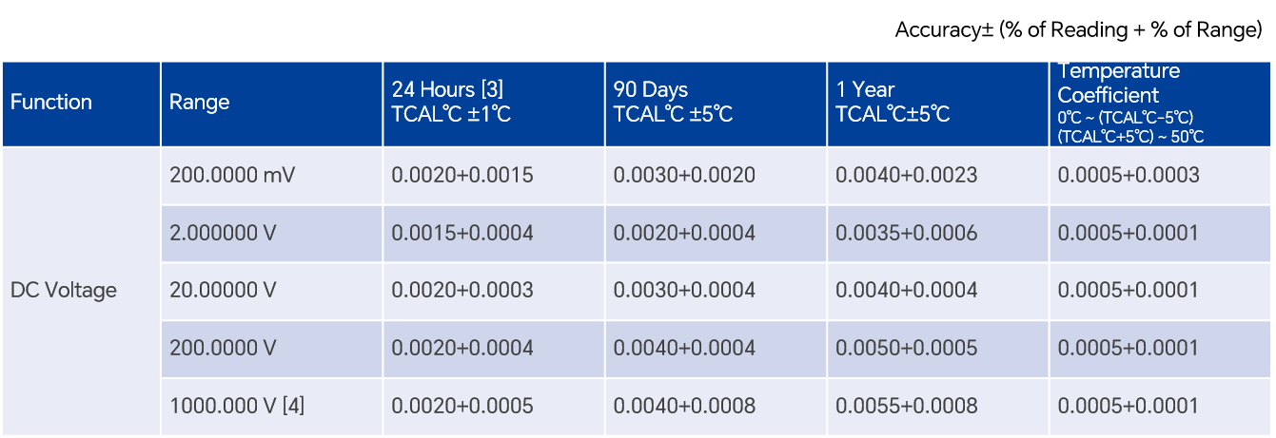
DCV Basic Accuracy
Accuracy indicates how closely a multimeter’s measured value aligns with the true value, reflecting the magnitude of measurement error.
A smaller accuracy value signifies better performance and closer proximity to the true value.
Accuracy of Digital Multimeters
Accuracy is expressed as: Accuracy = ±(% of Reading + % of Range)
Example
Using the SDM4000A (1-year accuracy, 20V range) to measure a 10V DC signal:
Accuracy Calculation: 0.0040% of reading+0.0004% of range =10×(0.0040/100)+20×(0.0004/100)=±0.00048V
Measured Value: 10V
Accuracy: ±0.00048V
Resolution: 0.00001V
Actual Reading Range: 9.99952V to 10.00048V
Resolution of SDM4000A (35 ppm)
Resolution refers to the smallest quantifiable unit of measurement, representing the minimal detectable signal change.
Resolution varies across ranges and measurement parameters, typically expressed as % of range or ppm (parts per million, 10⁻⁶).
Key Notes
Some multimeters use ppm instead of % of reading or % of range.
To convert ppm to absolute error:
Example1: 10 ppm error at 1V → 1×10×10⁻⁶=0.00001V.
Example2: 5 ppm error at 10V → 10×5×10⁻⁶=50µV.

Slide 13
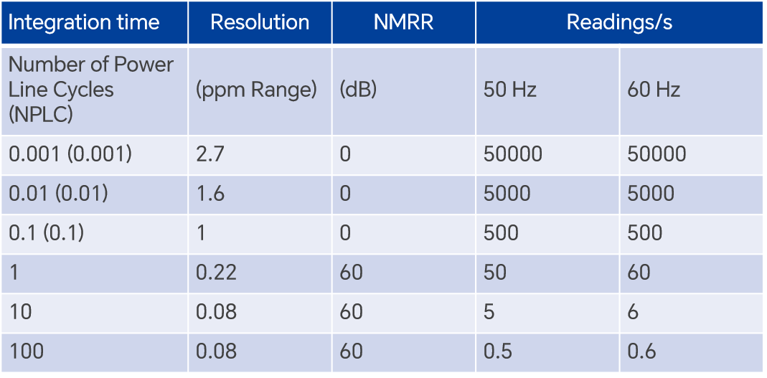
Performance and Measurement Speed
Explanation of NPLC
NPLC (Number of Power Line Cycles), also known as Aperture Time, determines the integration time for noise reduction.
Power Line Noise Mitigation:
When measuring small signals, power line noise (50 Hz in China, 60 Hz in the U.S.) can interfere with accuracy. Adjusting NPLC helps eliminate this error.
SDM4000A acquisition state:
Integration Time by NPLC:
NPLC=1: 1 power line cycle → NPLC=1 → 1/50Hz=0.02s
NPLC=10: 10 cycles → 0.2s.
NPLC=50: 50 cycles → 1s.
Key Trade-offs:
Increasing NPLC enhances precision by allowing more time for noise averaging but slows down measurements.
Higher NPLC:
Longer integration time → Reduced noise → Higher accuracy.
Slower measurement speed.
NPLC = 100, 10, 1, 0.1, 0.01, 0.001
Maximum Reading Rate: 50,000 readings/s
Minimum Sampling Interval: 20 µs
High Speed: NPLC=0.001 | Low Speed: NPLC=1
Fast Speed: NPLC=0.01 | High Precision: NPLC=10
Medium Speed: NPLC=0.1 | Ultra-High Precision: NPLC=100

Slide 14
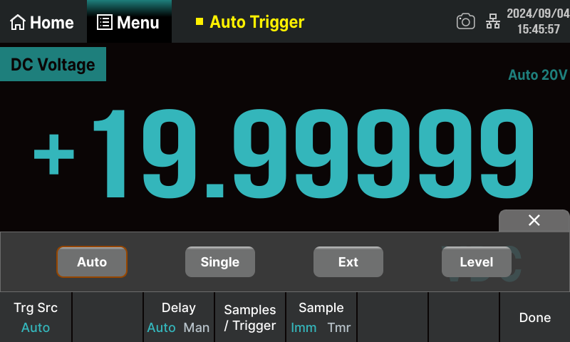
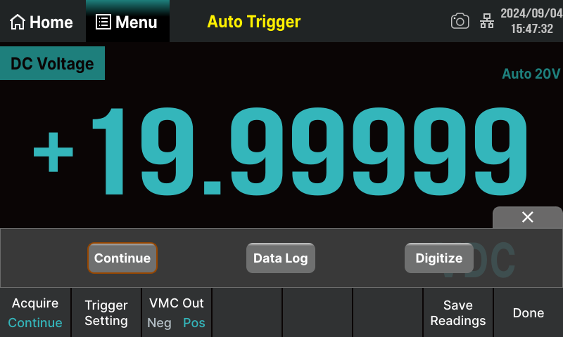
Trigger and Sample
Trigger
Trigger Modes: Auto Trigger, Single Trigger, External Trigger, Level Trigger
SDM4000A can capture one or a specified number of readings upon receiving a trigger signal. Users can configure the delay time between trigger activation and data acquisition.
Sample
Supported Sampling Modes
Continuous Sampling
Recorder Function
Digitizer Function

Slide 15
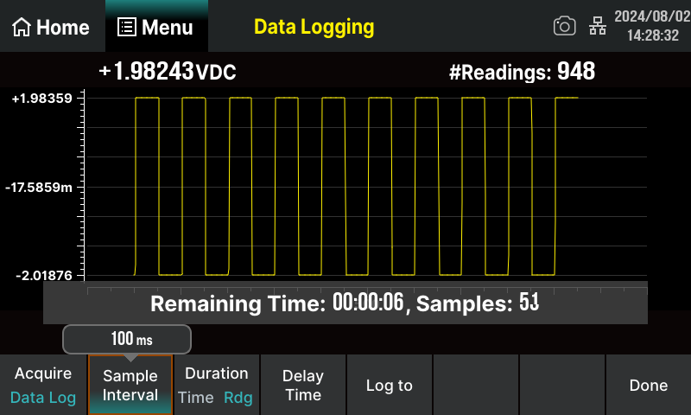
Data Logging Function
Purpose: Ideal for long-term data logging applications.
Key Specifications:
Recording Interval: 0.1 s to 3600 s
Maximum Internal Memory: 2M points
Maximum File Storage: 360M points
Maximum Duration: 100 hours
Measurable Parameters: DCV, DCI, ACV, ACI, Ω, frequency, period, temperature.

Slide 16
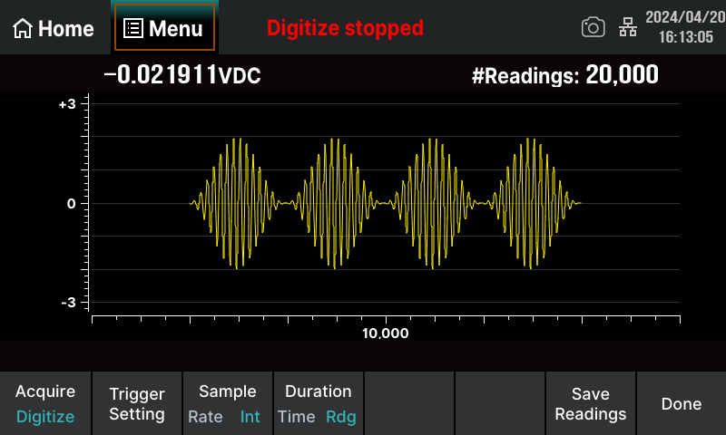
Digitizer Function
Advantages:
Outperforms oscilloscopes and spectrum analyzers in low-frequency, high-precision sampling.
Ideal for applications such as precision digital sampling and audio signal digitization.
Key Specifications:
Maximum Sampling Rate: 50 kSa/s
Single Capture Capacity: 2M points
Bandwidth: 10 kHz

Slide 17
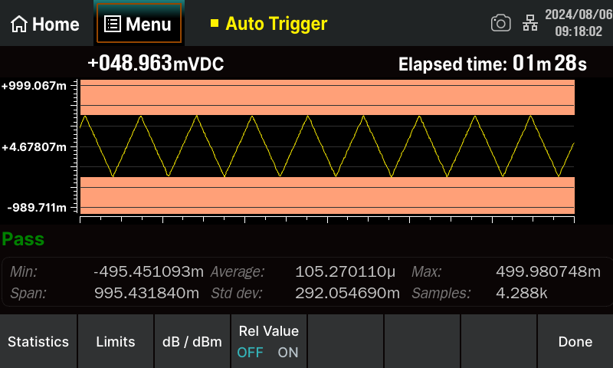
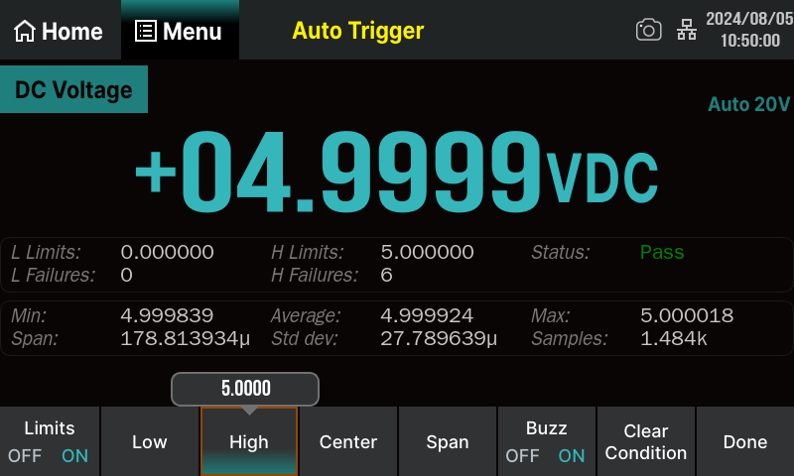
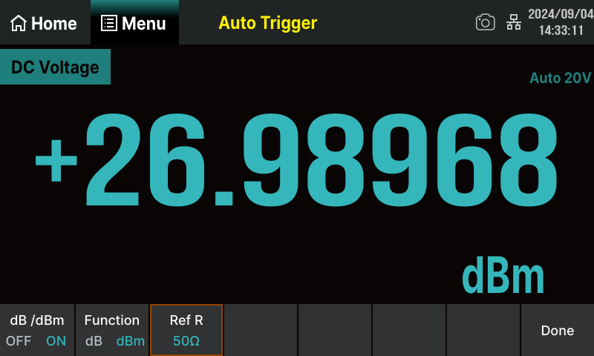
Math Function
Statistics: Calculates Max, Min, Average, Peak-to-Peak, Standard Deviation, Sample Count. | dBm Calculation: Computes power (0 dBm = 1 mW) across a reference resistor.
Limit Testing: Performs Pass/Fail tests based on user-defined upper/lower thresholds. | dB Calculation: Measures relative values in decibels against a reference.
 | Relative Value Calculation: Displays the difference between actual measurements and a stored reference value.

Slide 18
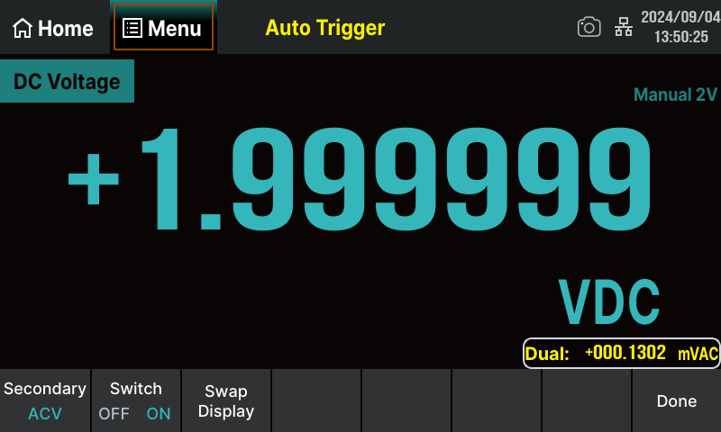
Dual Display
Function: Simultaneously displays two characteristics of the same input signal.
Advantage: Eliminates the need for additional instruments, facilitating efficient multi-parameter monitoring.
Enhanced Capability: Streamlines intricate testing and measurement workflows.

Slide 19
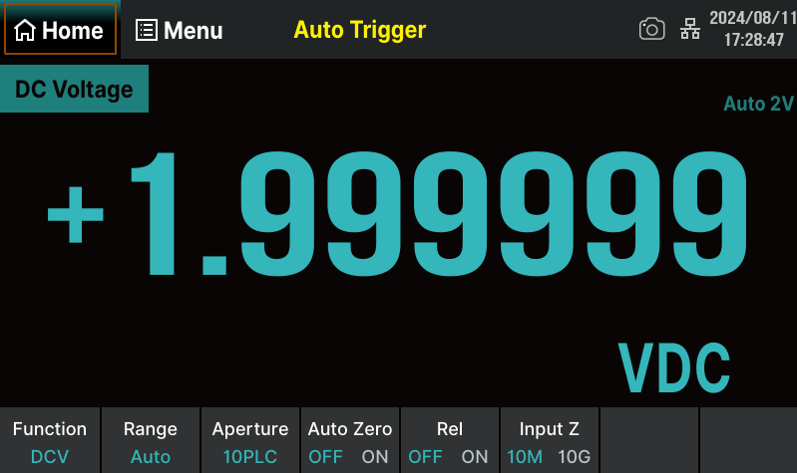
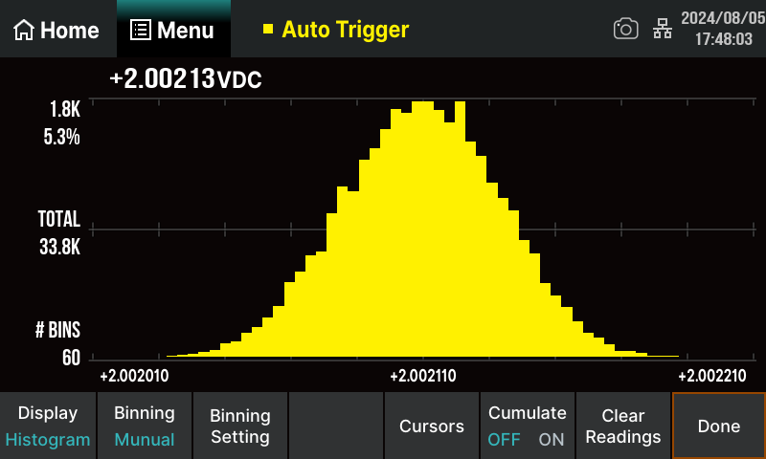
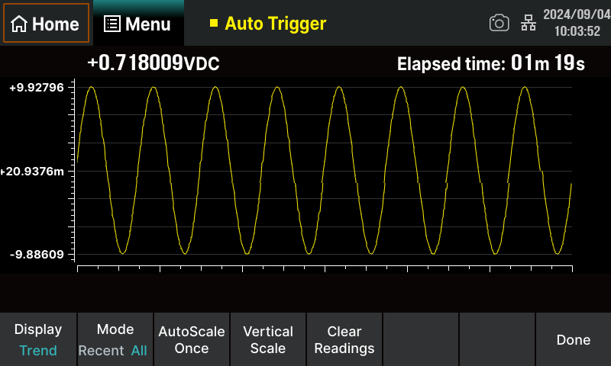
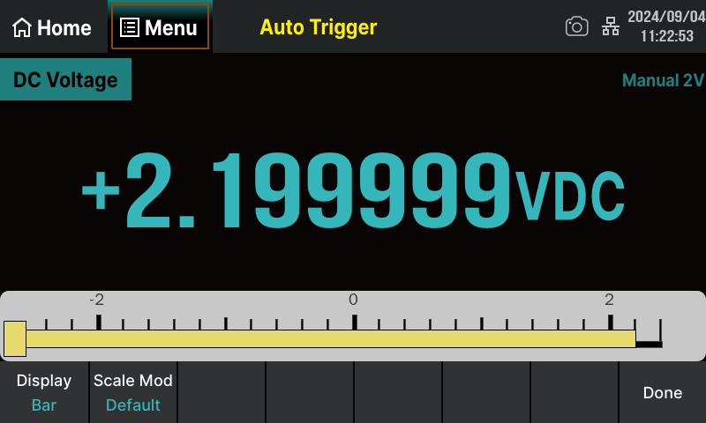
Display Modes
Real-Time Visualization: Observe measurement data changes intuitively.
Histogram: Displays measurement data in a distribution format.
Trend Chart: Shows data trends over time in continuous measurement mode.
Bar Graph: Supports horizontal scaling modes: Default, Manual, or Limit-based.
Numerical Display: Observe measurement data changes intuitively.
Histogram: Displays measurement data in a distribution format.
Trend Chart: Shows data trends over time in continuous measurement mode.
Bar Meter: Supports horizontal scaling modes: Default, Manual, or Limit-based.
Digital Display
Histogram
Trend Chart
Bar Meter

Slide 20
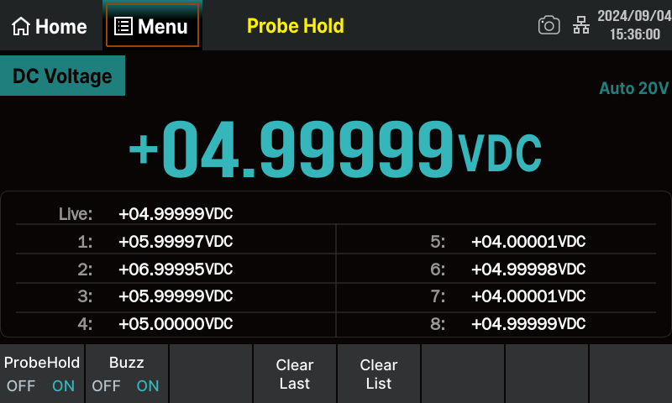
Probe Hold
Stability Alert: Triggers a buzzer when stable readings are detected, automatically displays the value on the front-panel display
Features:
Retains the latest 8 readings on-screen.
Supports multiple measurement types (e.g., DCV, ACV, resistance).
Allows users to review historical data or clear displayed readings at any time.

Slide 21
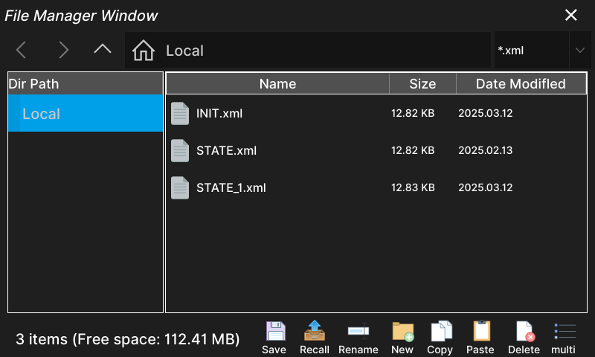
Storage/Recall
Store/Restore Settings: Supports saving and restoring instrument parameter files and data files in/from internal storage and external USB storage devices.
Timestamp Support: Adds timestamps to recorded readings.
Internal Storage: Up to 2M points of internal memory.
Memory Capacity: 2Gb NAND Flash storage.
File Formats:
Measurement data saved as CSV files.
Scan card configurations saved as XML files.
File Management: Users can create folders, save screenshots, and perform operations like copying, renaming, and deleting files.

Slide 22
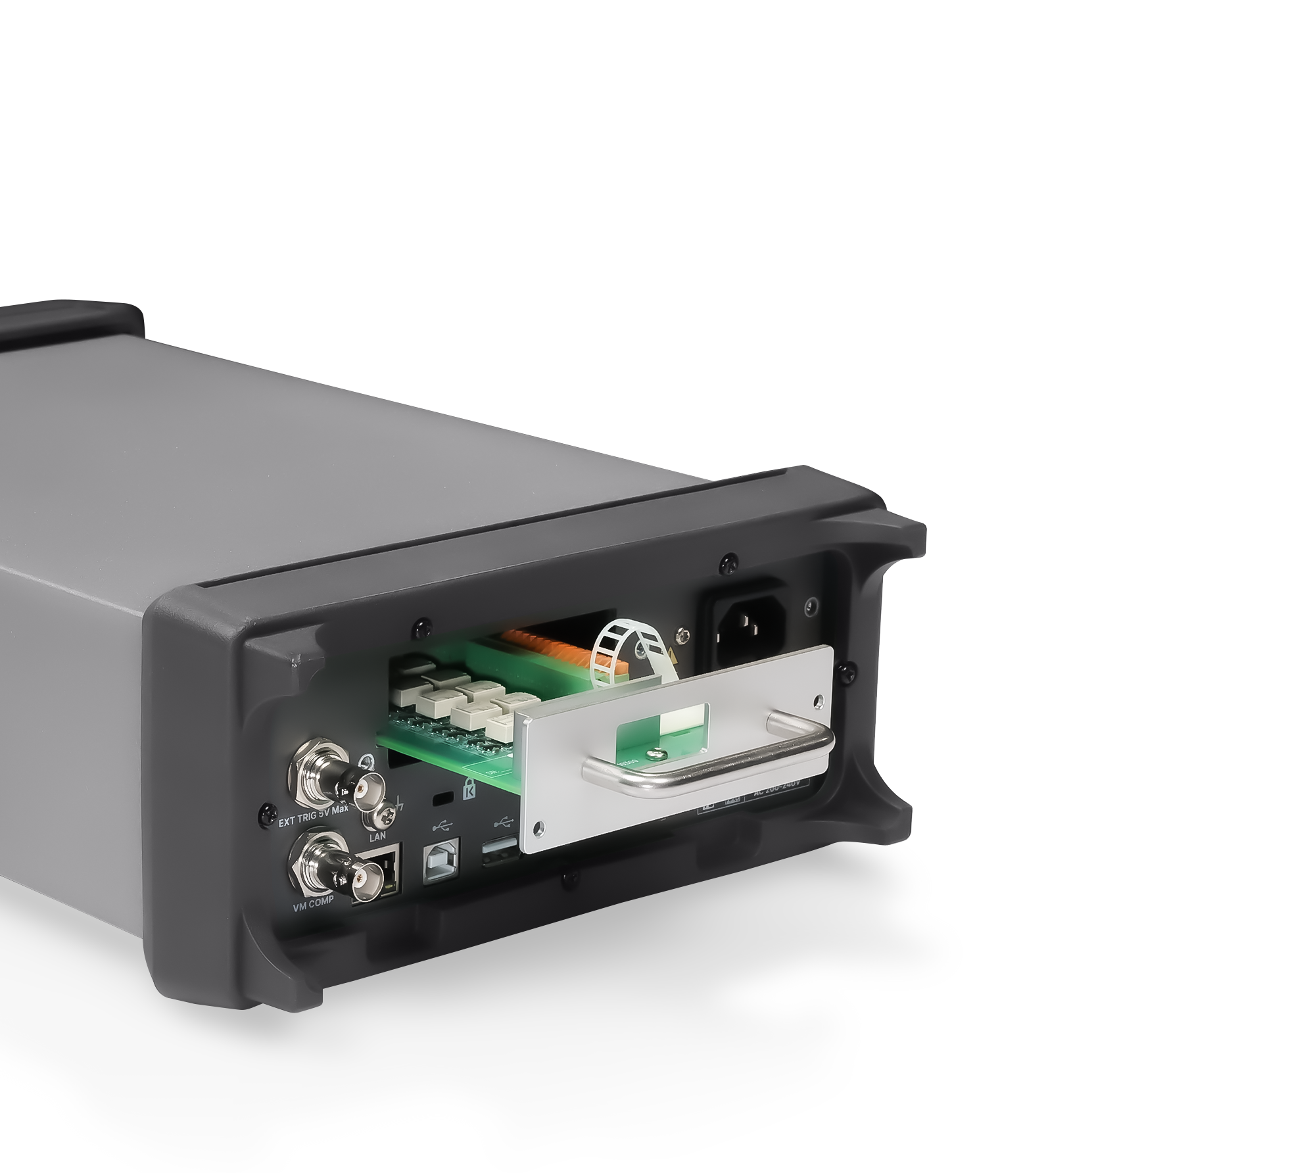
Scan Card
Scan Card
SDM4000A-SC Option:
The SDM4000A - SC Option is equipped with the 16 - channel SC1016 Scan Card, which consists of 12 multi - function channels and 4 current channels. The multi - function channels offer a wide range of measurement capabilities, such as voltage, resistance, etc. This combination of channels provides a high degree of flexibility for different test requirements.
This option combines high - precision measurement capabilities with flexible signal routing, offering comprehensive test solutions. It enables automated measurements across multiple test points or devices, significantly improving testing efficiency and accuracy. With the support of PC software, users can conveniently manage the instrument and the scan card, further enhancing the automation level of the testing process. This means that complex test sequences can be easily programmed and executed, allowing for seamless integration into various test environments.

Slide 23
03
APPLICATIONS

Slide 24
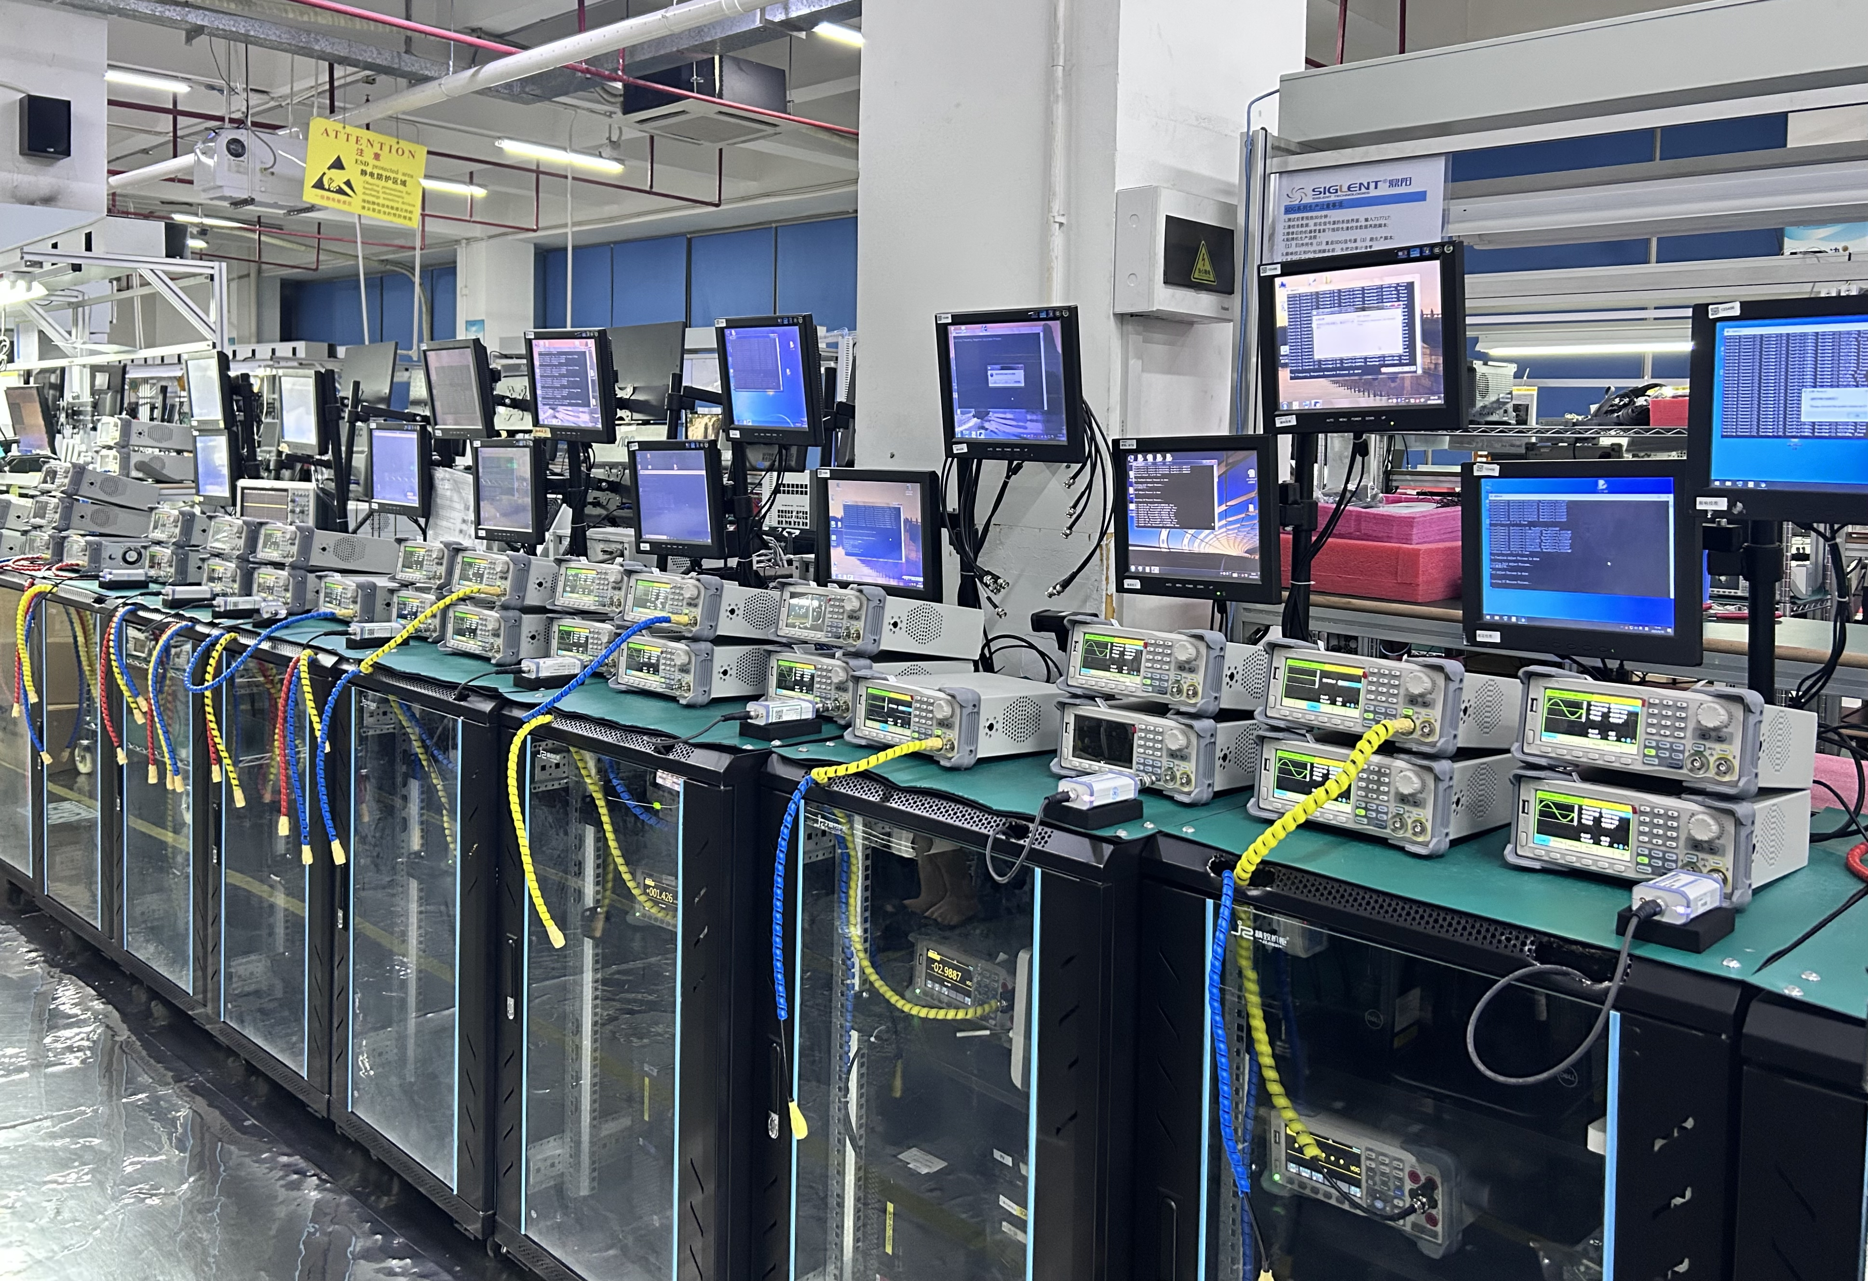
APPLICATIONS
Electronics Manufacturing
Component testing: Circuit boards, power adapters, integrated circuits (ICs), capacitors, diodes, transistors, and passive components.
Power Engineering
Parameter measurement & monitoring: Voltage, current, power factor, resistance in electrical systems and circuits.
Automation Control
System testing & debugging: Automation control systems, sensors, actuators, PLCs, variable frequency drives (VFDs), and temperature sensors (e.g., RTD, thermocouple).

Slide 25

APPLICATIONS
Communication and Network Engineering
Testing: Voltage, current, impedance, and frequency of communication devices (e.g., routers, switches, fiber optic transceivers).
Solar and Renewable Energy
Performance testing: Solar panels, wind turbines, and related power conversion systems.
Automotive Electronics and Aerospace
Diagnostics: Electronic circuit faults, battery voltage and current, sensors (e.g., pressure, temperature), and electromechanical actuators.

Slide 26
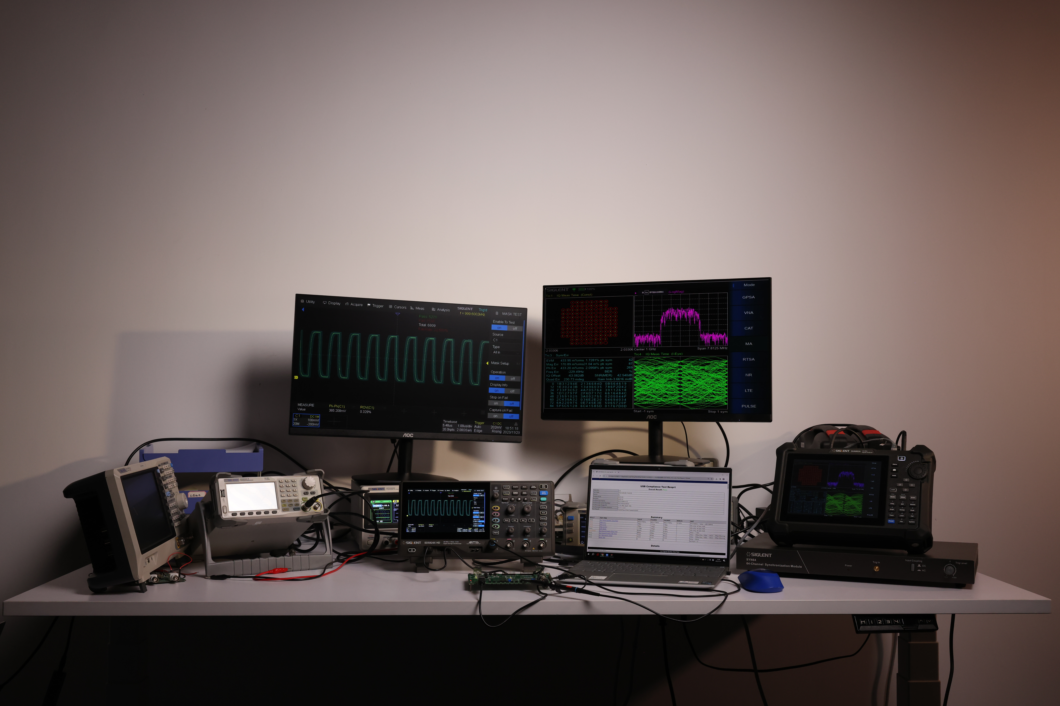
APPLICATIONS
Laboratory and Scientific Research
Performing measurements and analysis in electronics, optics, and materials science to support scientific research projects.
Education and Training
Training students in electrical circuit fundamentals, standard measurement techniques, and operation of laboratory instruments.

Slide 27
04
COMPARISON

Slide 28
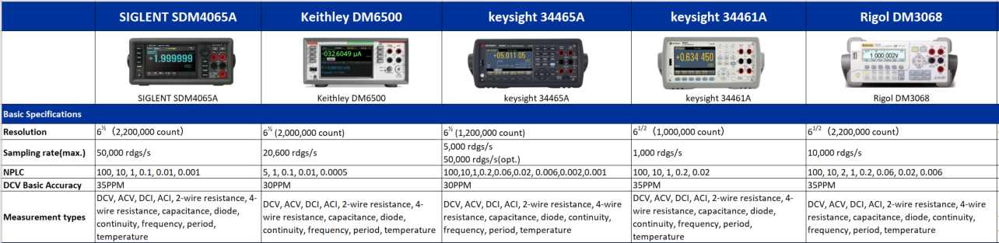
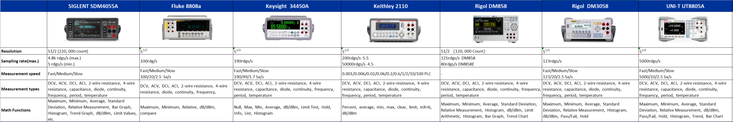

Slide 29
Ordering Information
Product Model | Description
SDM4065A | 6.5 Digits High Precision Multimeter
SDM4065A-SC | 6.5 Digits High Precision Multimeter with 16 Channel Scanner Cards
SDM4055A | 5.5 Digits High Precision Multimeter
SDM4055A-SC | 5.5 Digits High Precision Multimeter with 16 Channel Scanner Cards
Standard Configurations | Quantity
Power Cord | 1
Test Leads | 2
Alligator Clips | 2
USB Cable | 1
Quick Start | 1
Warranty Card | 1
Optional Configurations | Model
USB-GPIB Adapter | USB-GPIB
30A Diverter | SCD30A

Slide 30
Multimeter Usage Tips
——Unstable Readings (Random Fluctuations) Before Measurement Begins
Electricity generates magnetism, and magnetism generates electricity. In our electrified living environments, electromagnetic waves are ubiquitous. Digital multimeters exhibit extremely high input impedance, reaching MΩ or GΩ.
When sensing charges from ambient electromagnetic waves, according to U = IR, even a small charge (I) across a very large resistance (R) can generate a weak voltage. Thus, in low AC or DC voltage ranges, induced currents may cause voltage fluctuations. This phenomenon is entirely normal.
Properly connect the probes, short-circuit the probe tips, and zero the data before measurement. This eliminates interference, ensuring stable readings during normal operation.

Slide 31
EVERY BENCH. EVERY ENGINEER. EVERY DAY.

