Slide 1

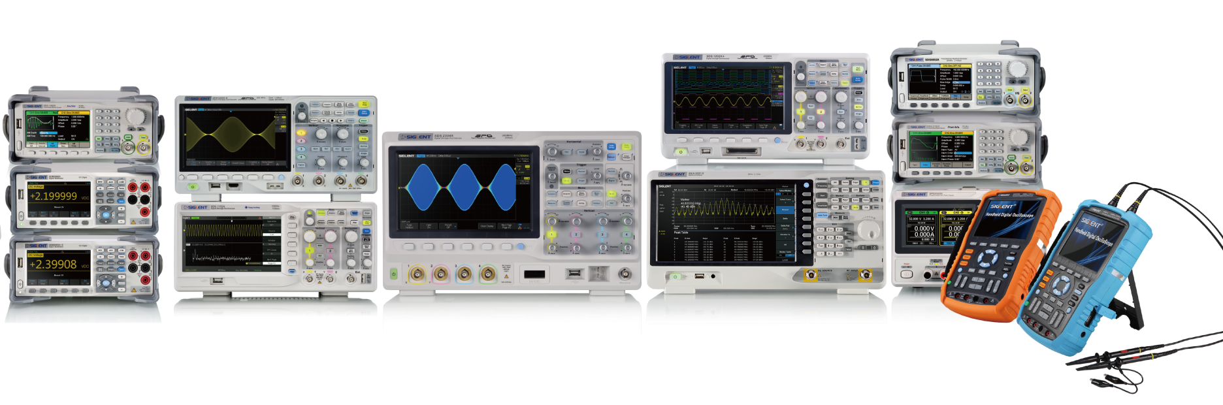
The Best Value in Electronic Test & Measurement

Slide 2

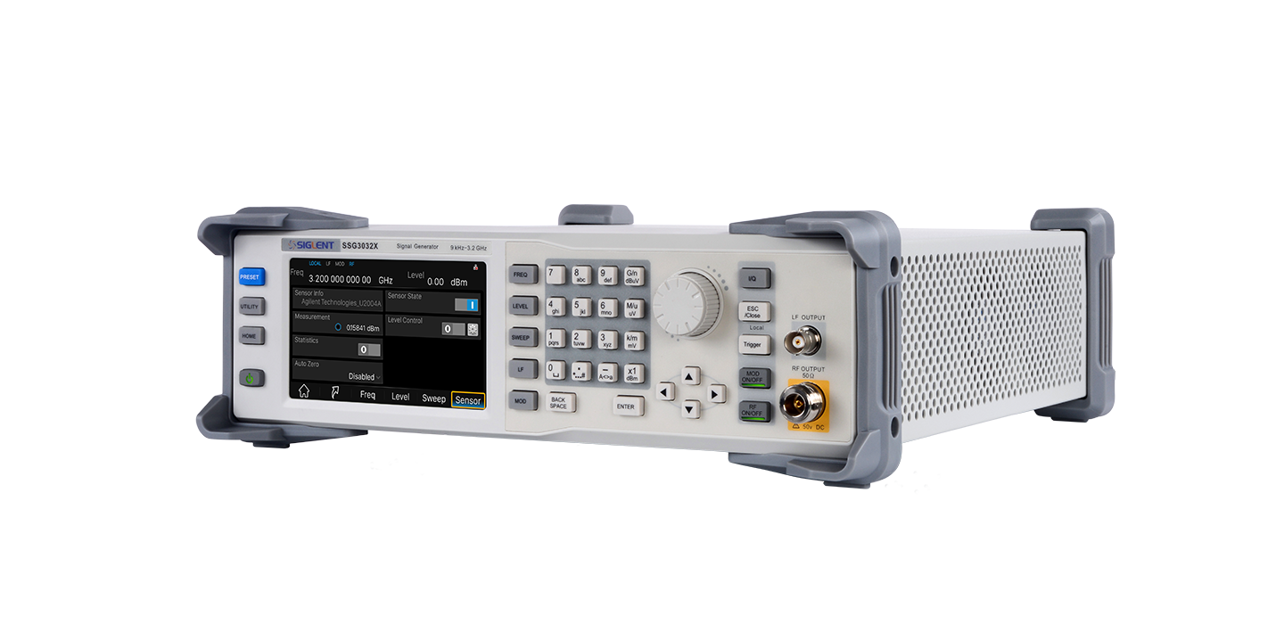
SSG3000X Series
RF Signal Generators

Slide 3
Overview
Key Features
Contents
Panel Introduction
Product Comparison

Slide 4

Section 1
Overview

Slide 5
Overview
Frequency range from 9 kHz to 2.1 / 3.2 GHz
0.01 Hz minimum frequency setpoint resolution
Level output from to -110 dBm to +13 dBm
Maximum level up to 20 dBm (Typical)
Minimum amplitude resolution as low as 0.01 dB
Internal modulation includes AM/FM/PM, external modulation as well
Pulse modulation, on/off ratio ≥ 70 dBc
Pulse train generator (Option) , user-definable pulse sequence
Power meter measurement kit, easy to measure power and control the output
Communication interfaces: USB Host, USB Device (USBTMC), GPIB (option)
Web browser remote control
5-inch capacitive touch screen, USB mouse/keyboard support
Notes:
输出频率分辨率可达0.01Hz
输出范围可从+13dBm~-115dBm
最大输出功率可达20dBm(典型值)
幅度最小分辨率可达0.01dB

Slide 6
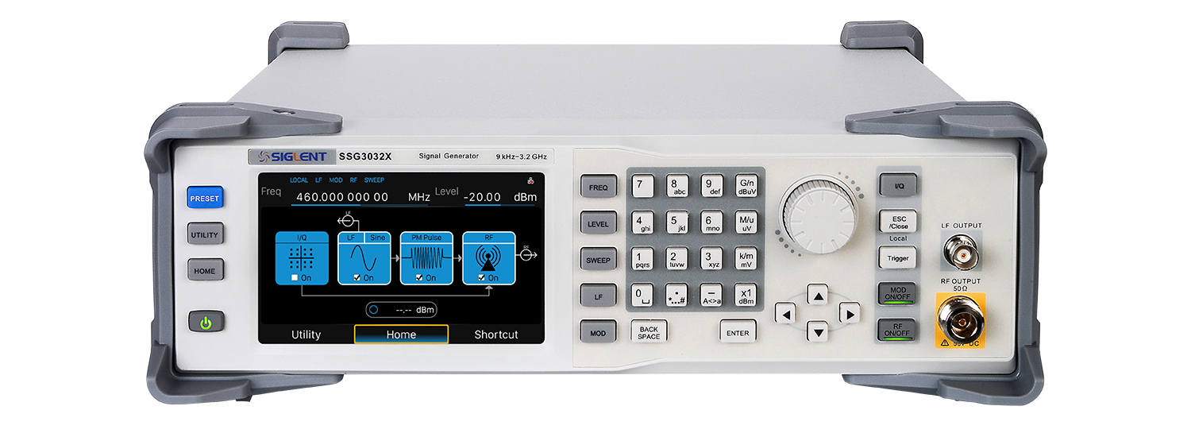
Overview
Internal/External Modulation
AM
Internal/External Modulation
FM/PM
PULSE
PULSE
I/Q
Digital Modulation
Internal and external modulation customization
Pulse train generator
Sine、Square、 DC、triangle, saw-tooth
CW
9 kHz -- 3.2 GHz
+13 dBm-- -110 dBm
LF
SENSOR
Frequency sweep, amplitude sweep,
Frequency + amplitude sweep
SWEEP
USB power meter corrects flatness to keep power constant
Notes:
输出频率分辨率可达0.01Hz
输出范围可从+13dBm~-115dBm
最大输出功率可达20dBm(典型值)
幅度最小分辨率可达0.01dB

Slide 7
Section 2
Key Features

Slide 8
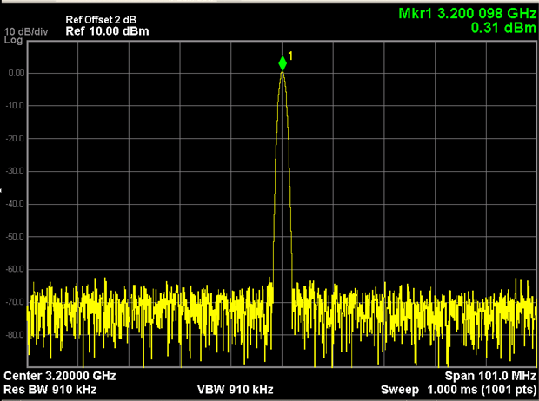
Key Features
Maximum frequency up-to 3.2 GHz
Notes:
输出频率分辨率可达0.01Hz
输出范围可从+13dBm~-115dBm
最大输出功率可达20dBm(典型值)
幅度最小分辨率可达0.01dB

Slide 9
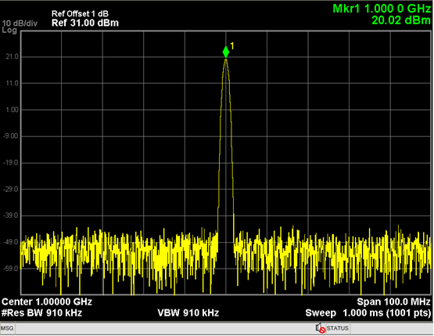
Key Features
Maximum level up to 20 dBm
Notes:
输出频率分辨率可达0.01Hz
输出范围可从+13dBm~-115dBm
最大输出功率可达20dBm(典型值)
幅度最小分辨率可达0.01dB

Slide 10
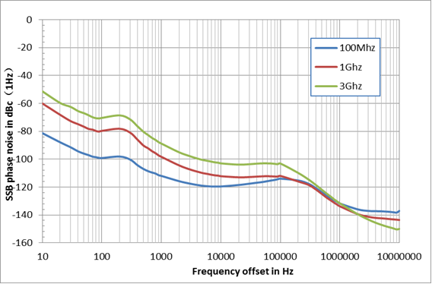
Key Features
High purity signal output
Phase noise ＜ -110 dBc/Hz @ 1 GHz , 20 kHz offset (Typical)
Notes:
输出频率分辨率可达0.01Hz
输出范围可从+13dBm~-115dBm
最大输出功率可达20dBm(典型值)
幅度最小分辨率可达0.01dB

Slide 11
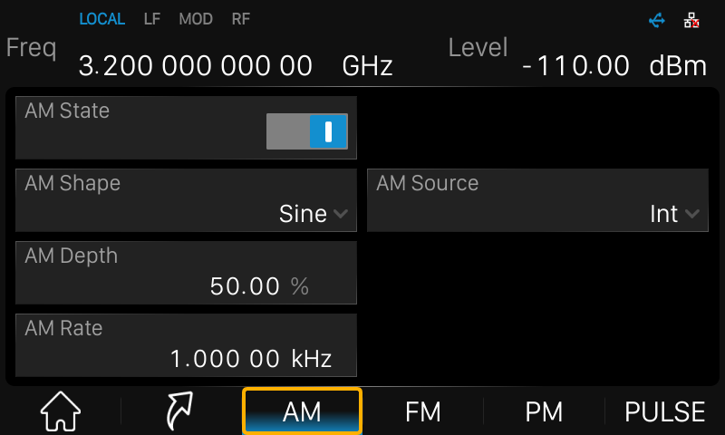
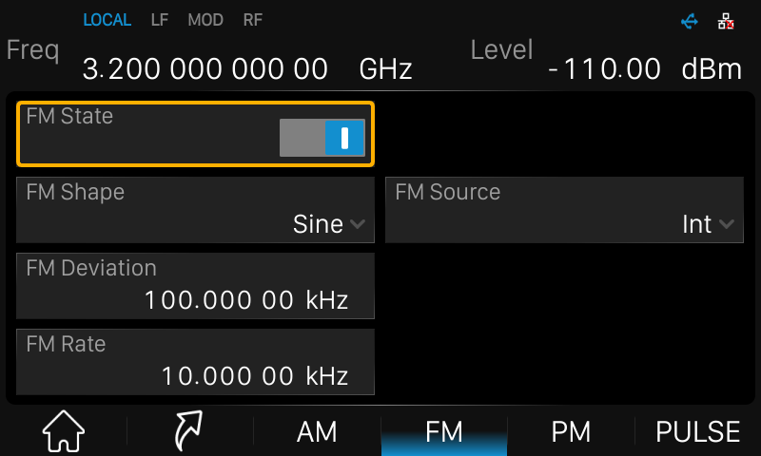
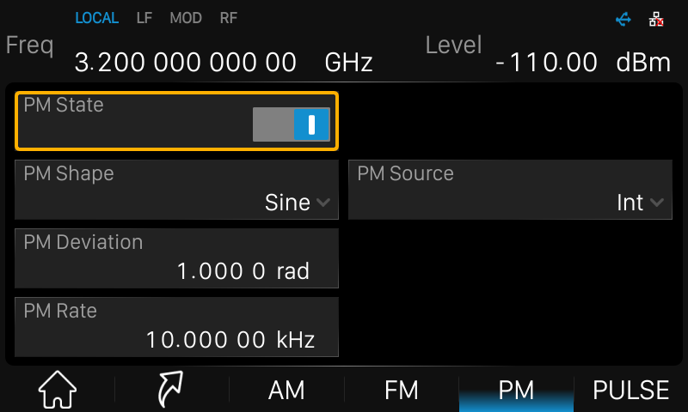
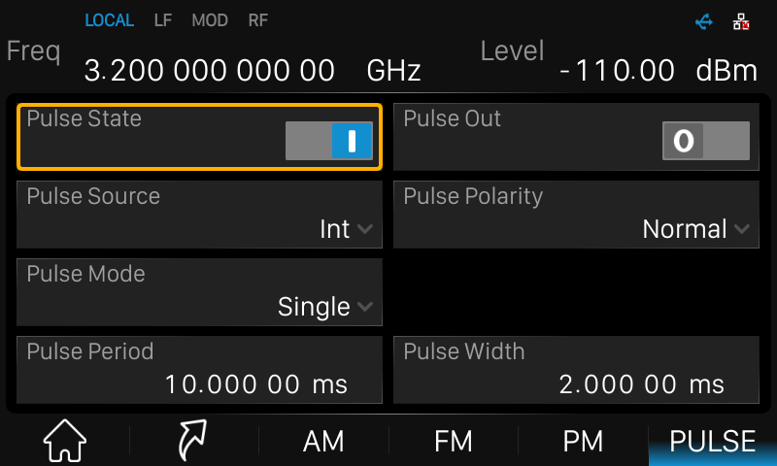
Key Features
FM/AM/PM/Pulse Modulation
Notes:
输出频率分辨率可达0.01Hz
输出范围可从+13dBm~-115dBm
最大输出功率可达20dBm(典型值)
幅度最小分辨率可达0.01dB

Slide 12
Key Features
Analog & Pulse Modulation
Internal Analog Modulation Source
AM Modulation
LF Output
FM Modulation
External Modulation Signal Input
ΦM Modulation
RF output
Pulse Generator
Pulse In/Out
Pulse Modulation
Pulse Train Generator
Notes:
输出频率分辨率可达0.01Hz
输出范围可从+13dBm~-115dBm
最大输出功率可达20dBm(典型值)
幅度最小分辨率可达0.01dB

Slide 13
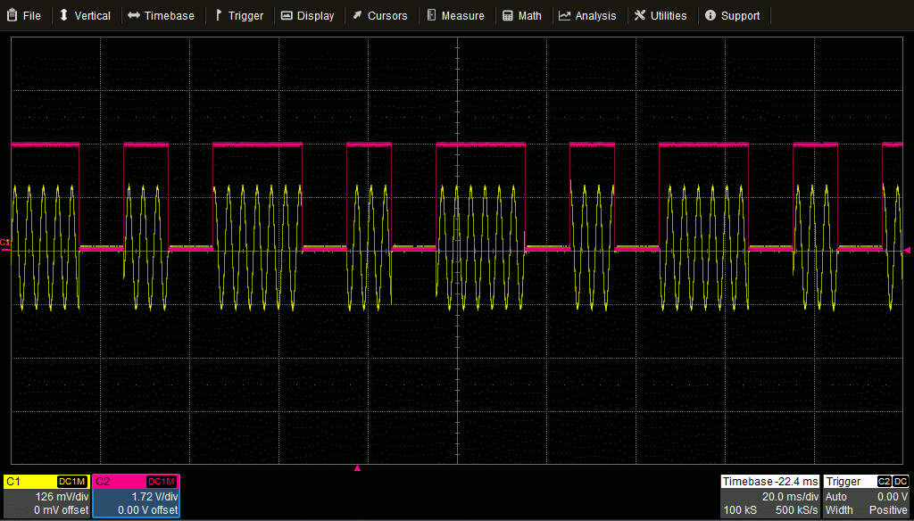
Key Features
Double Pulse Modulation
Notes:
输出频率分辨率可达0.01Hz
输出范围可从+13dBm~-115dBm
最大输出功率可达20dBm(典型值)
幅度最小分辨率可达0.01dB

Slide 14
Key Features
Pulse Train Modulation
Maximum up-to 2047 pulses
Notes:
输出频率分辨率可达0.01Hz
输出范围可从+13dBm~-115dBm
最大输出功率可达20dBm(典型值)
幅度最小分辨率可达0.01dB

Slide 15

Key Features
Digital Modulation
I / Q Baseband Generator
Digital Source Editor
Digital Modulation
Pulse Shaping Filter
I/Q Modulation
SDG6000X
External IQ Baseband Generator
Easy IQ
SSG3000X
I/Q Modulation
RF Output
Notes:
输出频率分辨率可达0.01Hz
输出范围可从+13dBm~-115dBm
最大输出功率可达20dBm(典型值)
幅度最小分辨率可达0.01dB

Slide 16
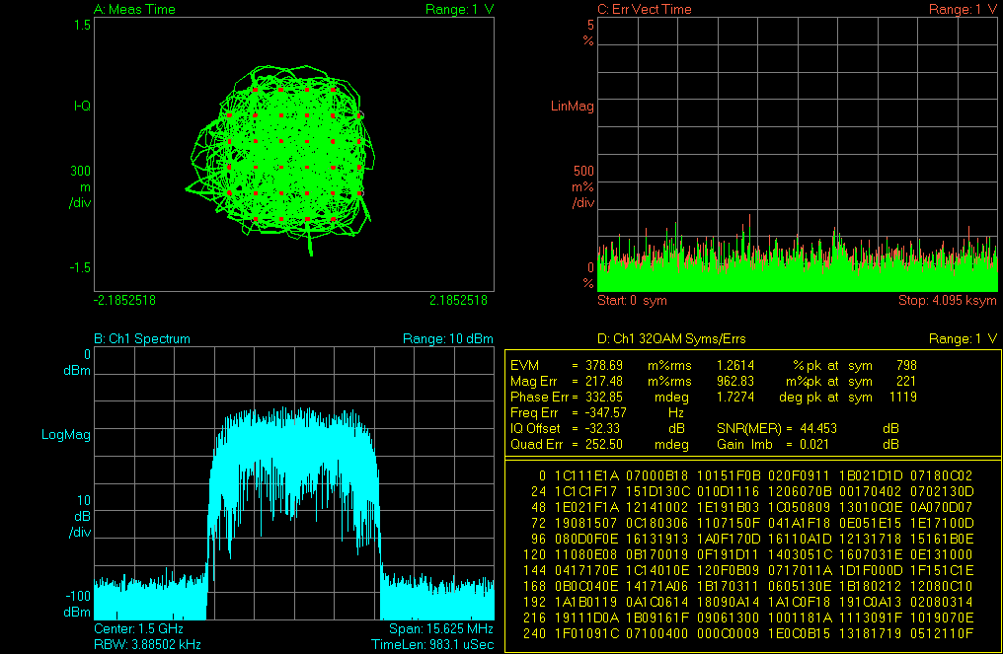
Key Features
I/Q modulation signal output
Using a SIGLENT SDG6000X function generator, I/Q modulation can be realized by using the SSG3000X external modulation function
Notes:
输出频率分辨率可达0.01Hz
输出范围可从+13dBm~-115dBm
最大输出功率可达20dBm(典型值)
幅度最小分辨率可达0.01dB

Slide 17
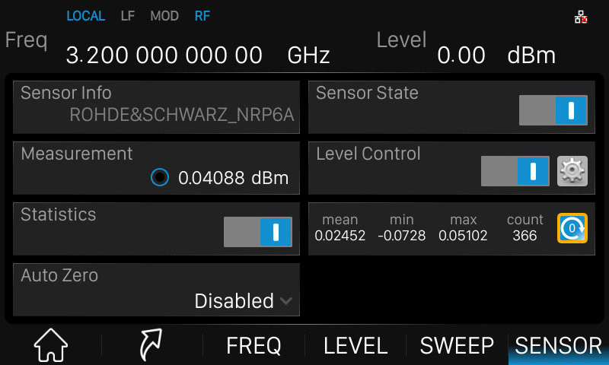
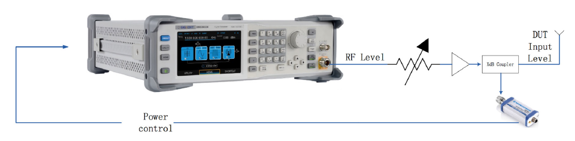
Key Features
USB-power meter reading display
Notes:
输出频率分辨率可达0.01Hz
输出范围可从+13dBm~-115dBm
最大输出功率可达20dBm(典型值)
幅度最小分辨率可达0.01dB

Slide 18
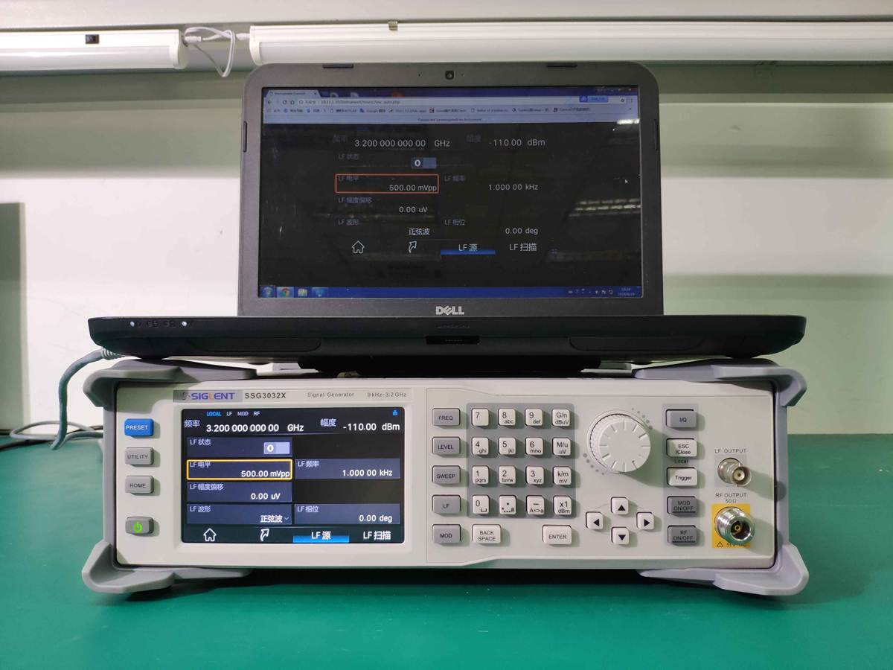
Key Features
Web page control
Directly control the SSG3000X by browser interface. No driver or additional software required
Notes:
输出频率分辨率可达0.01Hz
输出范围可从+13dBm~-115dBm
最大输出功率可达20dBm(典型值)
幅度最小分辨率可达0.01dB

Slide 19
Section 3
Panel Introduction
Front Panel
Rear Panel

Slide 20
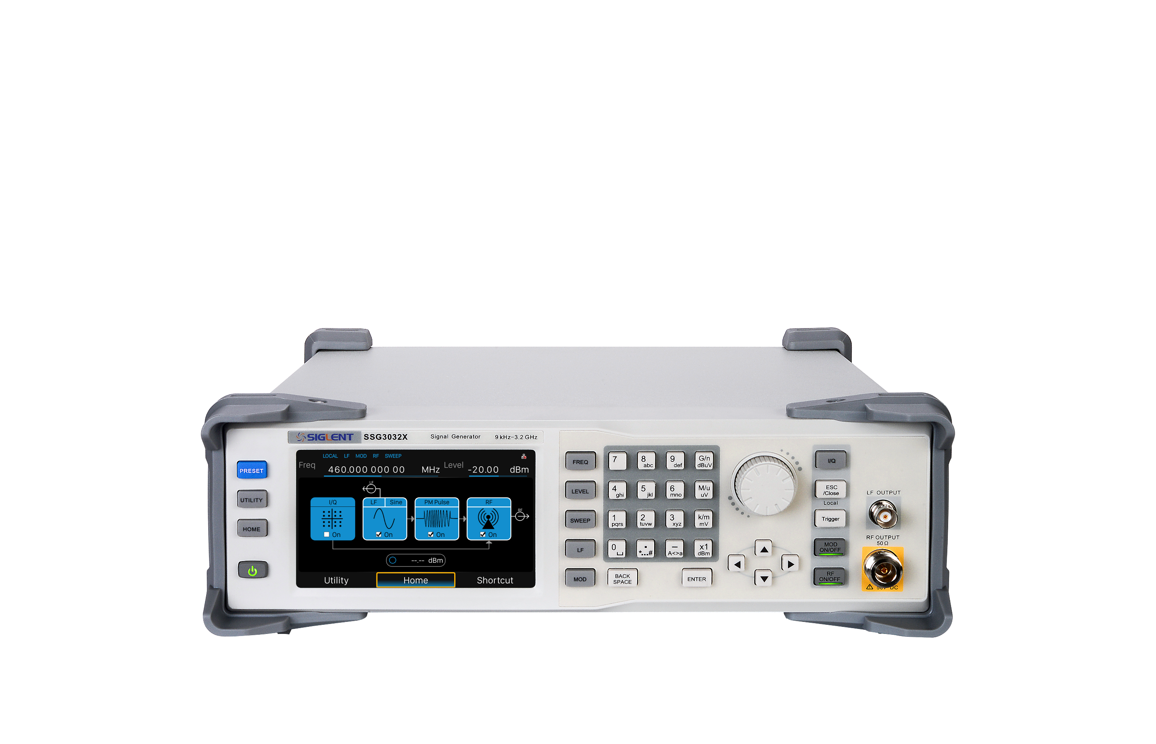
Front Panel
Function keys
Knob
LF output
RF output
Main On/Off
Display
Number keypad
Arrow keys
Function
On/Off

Slide 21
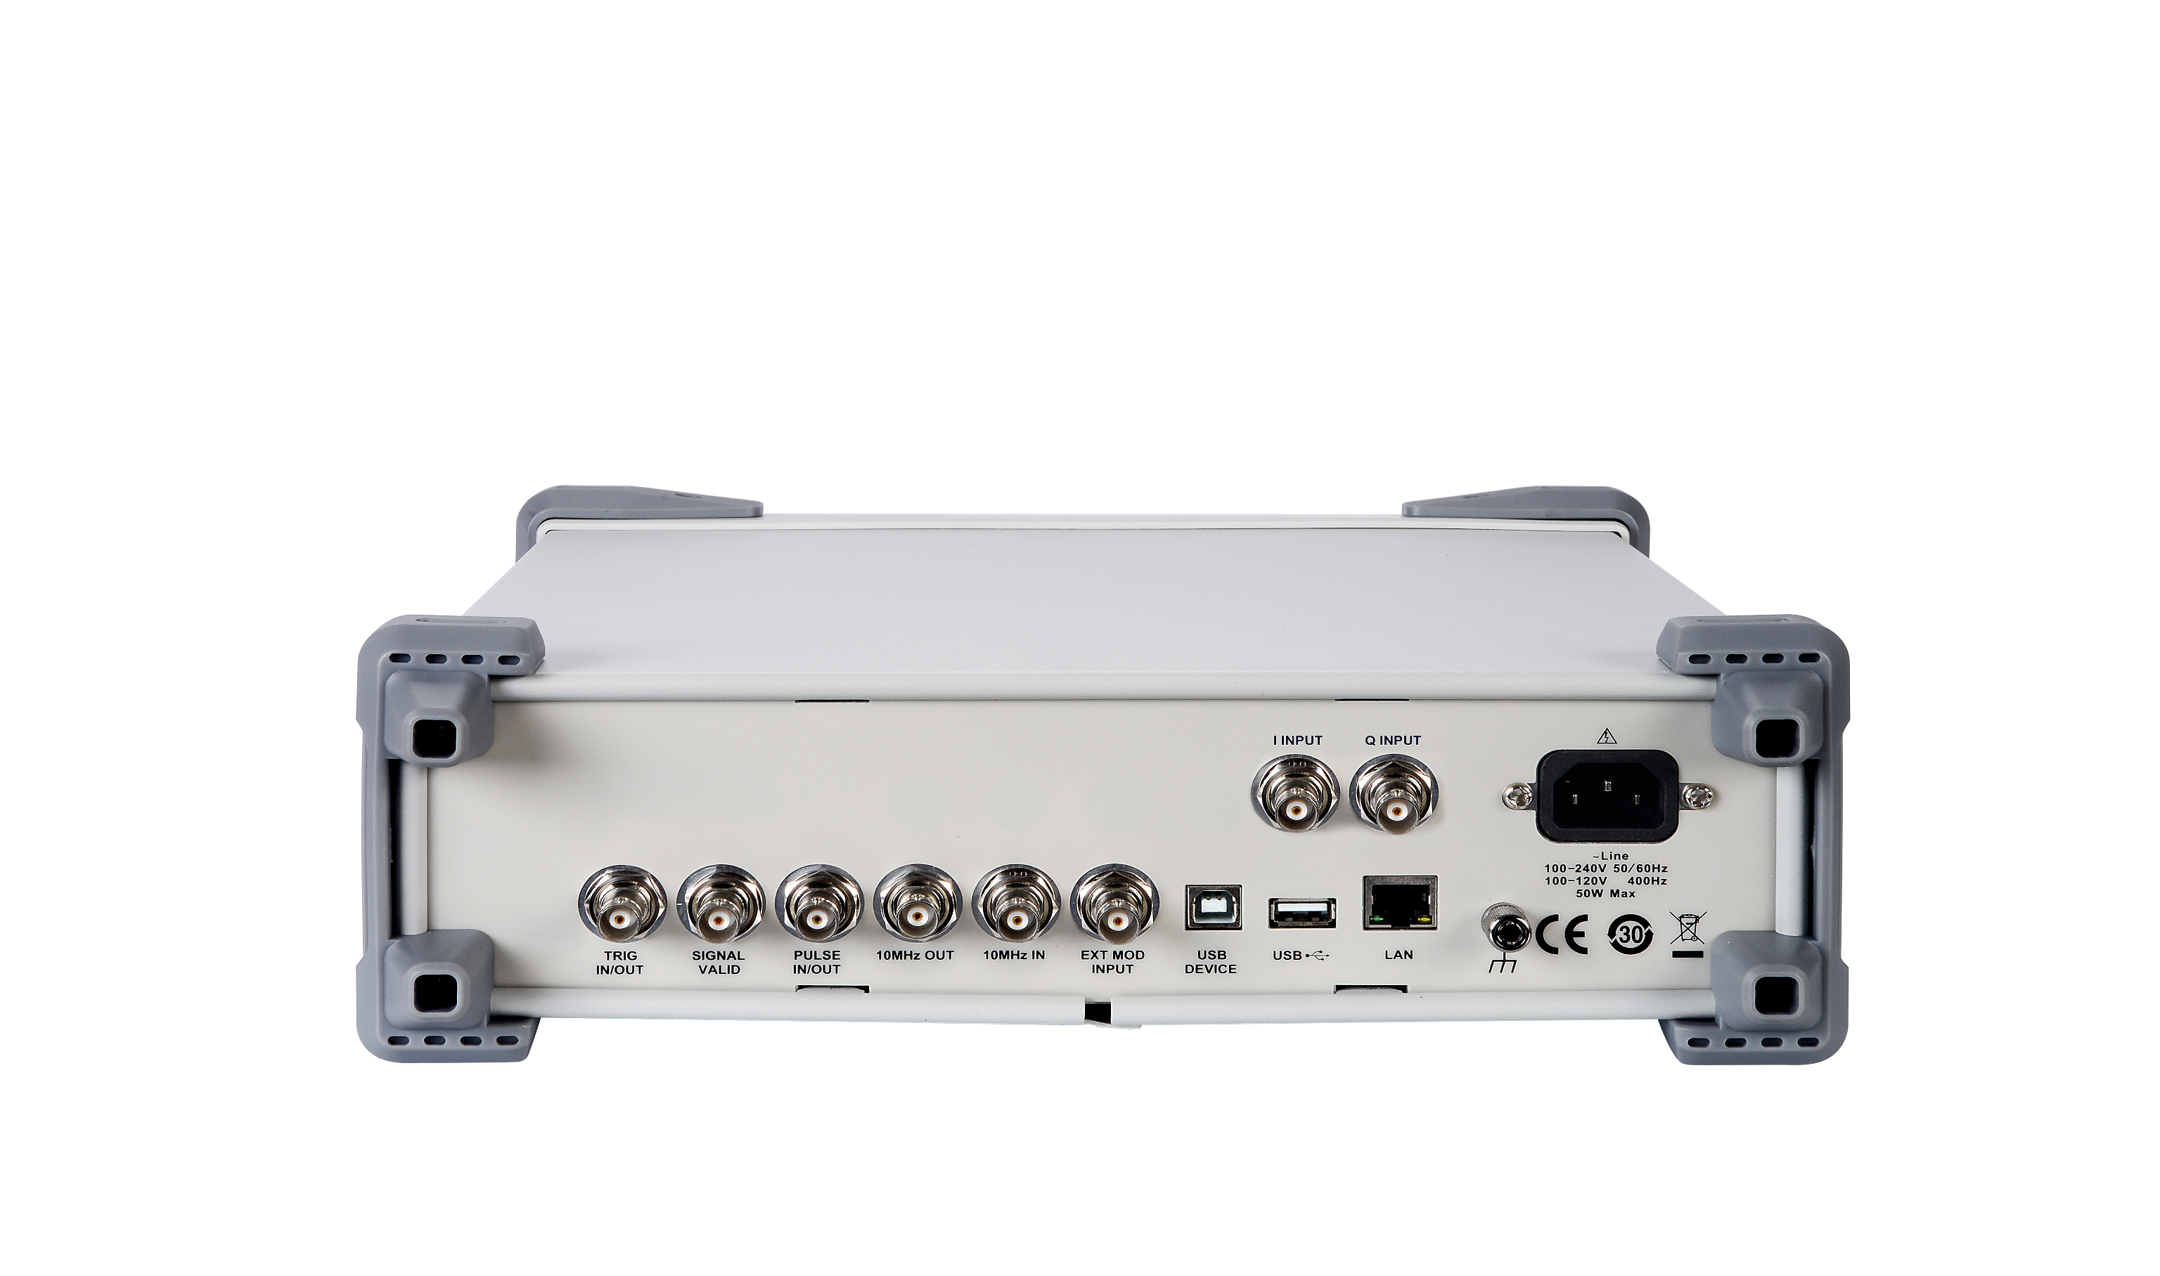
Rear Panel
Pulse In/Out
USB Device
I Input
Q Input
Trig In/Out
10 MHz In
Signal
Valid
Out
10 MHz Clock Out
EXT MOD INPUT
USB Interface
LAN Interface
Power Interface

Slide 22
Section 4
Competitive
Comparison

Slide 23
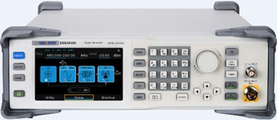
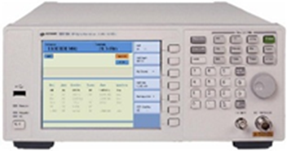
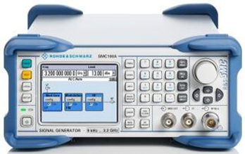
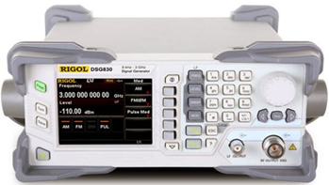
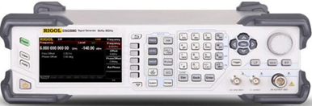
Comparison
Para/Model | SIGLENT SSG3000X | Keysight N9310A | R&S SMC100A | Rigol DSG3030 | Rigol DSG800
Appearance
Frequency Range | 9 kHz – 3.2 GHz | 9 kHz – 3.0 GHz | 9 kHz – 3.2 GHz | 9 kHz – 3.0 GHz | 9 kHz – 3.0 GHz
Frequency Resolution | 0.01 Hz | 0.1 Hz | 0.001 Hz | 0.01 Hz | 0.01 Hz
Temperature stability | 1 ppm | 1 ppm | 2 ppm | 0.5 ppm | 2 ppm
Amplitude Dynamic Range | -110 dBm - +13 dBm | -127 dBm - +13 dBm | -120 dBm - +13 dBm | -130 dBm - +13 dBm | -110 dBm - +13 dBm
Maximum output power | 20 dBm | 20 dBm | 17 dBm | 25 dBm | 20 dBm
Full amplitude accuracy | < 0.7 dB | < 1 dB | < 0.9 dB | < 0.7 dB | < 0.7 dB
Phase Noise@1GHz （20Khz offset） | -110 dBc/Hz | -95 dBc/Hz | -111 dBc/Hz | -110 dBc/Hz | -105 dBc/Hz
Frequency switch switching time | < 10 ms | < 10 ms | < 7 ms | < 10 ms | < 10 ms
harmonic (1MHz<f<3.2GHz) | < -30 dBc | < -30 dBc | < -30 dBc | < -30 dBc | < -30 dBc
Non-harmonic | < -65 dBc | < -50 dBc | < -54 dBc | < -64 dBc | < -64 dBc
AM/FM/PM Modulation | Supported | Supported | Supported | Supported | Supported

Slide 24
Comparison
Para/Model | SIGLENT SSG3000X | Keysight N9310A | R&S SMC100A | Rigol DSG3030 | Rigol DSG800
Appearance
Pulse Modulation | Standard | Standard | Standard | Standard | Option
Pulse on/off ratio | >70 dB | >40 dB | >80 dB | >80 dB | >70 dB
Pulse Generator | Standard | Not support | Standard | Standard | Option
Pulse Burst | Supported | Not Supported | Not Supported | Supported | Supported
Power meter measurement and control | Standard | Not Supported | Standard | Standard | Not Supported
IQ Modulation | Supported | Supported | Supported | Supported | Supported
Memory | 256 MB | 16 MB | ---- | 1 GB | 96 MB
Web server | Supported | Not Supported | Not Supported | Not Supported | Not Supported
Interface | USB Host/Device, LAN, GPIB(Option) | USB Host, USB Device | USB Host, USB Device, LAN | USB Host/Device, LAN, GPIB | USB Host/Device, LAN
Mouse and keyboard | Supported | Not Supported | Supported | Not Supported | Not Supported
Touch screen | Capacitive touch screen | Not Supported | Not Supported | Not Supported | Not Supported
Display | 5 inch TFT-LCD（800*480） | LCD 640*480 | LCD display | 4.3 inch TFT-LCD（480*272） | 3.5 inch TFT-LCD（320*240）

Slide 25


Thank You
SIGLENT—The Best Value in Electronic Test & Measurement
Contact Info
Company Address
www.siglent.com/ens
Email：sales@siglent.com
Tel：+86-755-36887876
Bldg No.4 & No.5，
Antongda Industrial Zone
3rd Liuxian Road, Bao’an District, Shenzhen, China

