Slide 1


Slide 2
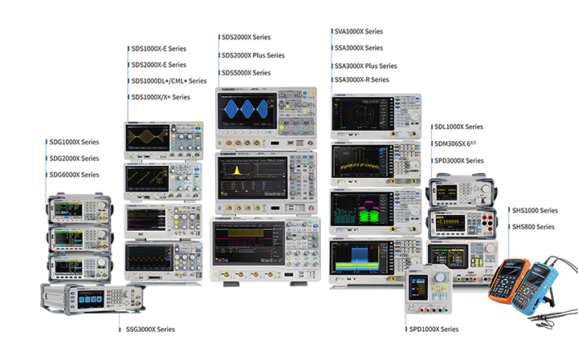
New Product Introduction
Public May 15th, 2020

Slide 3
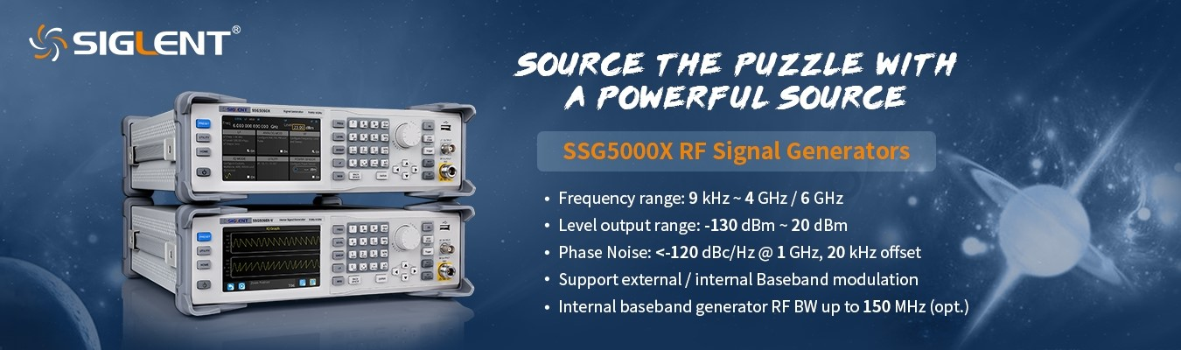


To Solve the RF design puzzle, you need the right piece
Market Overview
The SSG5000X Series at a Glance
Specs and Datasheet explanation
Features
Applications
Competition Analysis
Content

Slide 4
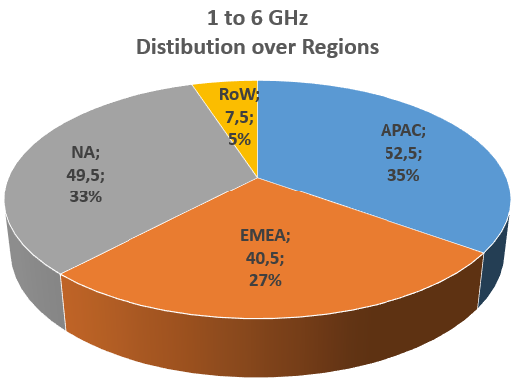
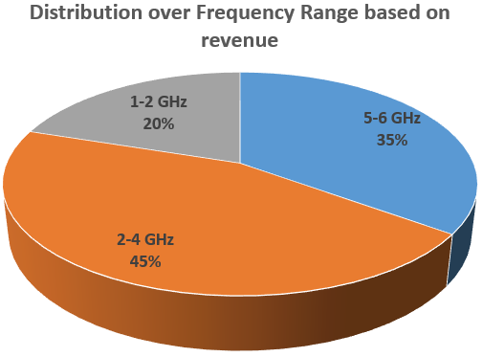
Market Overview – RF-Generator
The worldwide RF & µW Signal generator Market size (Benchtop; 1 GHz to 6 GHz; >6 GHz)
is estimated to be USD 300M in 2020
The Market is expected to show a CAGR of 2-3% till 2023
Roughly 50% of the total market (USD ~150 M) are at 1 GHz – 6 GHz
Source from Technavio and Markets&Markets
Various other Sources

Slide 5
Market Overview – RF-Generator
The worldwide RF & µW Signal generator Market size (Benchtop; 1 GHz to 6 GHz; >6 GHz)
is estimated to be USD 300M in 2020
Market growth factors:
Three phases of 5G implementation push
Digitalization (Connectivity part)
Growing Telecommunications, Aerospace & Defense,
Mechanical, Electronics…
Growing number of manufacturing units.
New manufacturing sites will require new test equipment.
Source from Technavio and Markets&Markets
Various other Sources

Slide 6
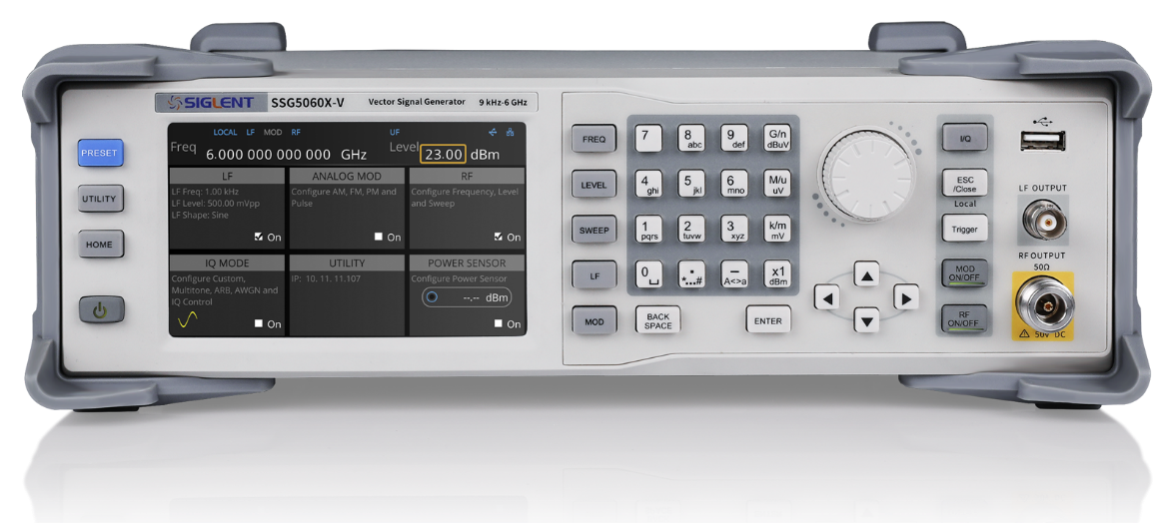
The SSG5000X Series at a Glance
5 inch touch screen,
External mouse & keyboard supported
Models | SSG5040X | SSG5060X | SSG5040X-V | SSG5060X-V
Frequency Range | 9 kHz - 4 GHz (CW Mode) | 9 kHz - 6 GHz (CW Mode) | 9 kHz - 4 GHz (CW Mode) 10 MHz - 4 GHz (IQ Mode) | 9 kHz - 6 GHz (CW Mode) 10 MHz - 6 GHz (IQ Mode)
Level setting range | -140 dBm~+26 dBm (1 MHz≤f≤4 GHz)
Level Accuracy | < 0.7 dB (typ)
Phase Noise | -120 dBc/ Hz @ 1 GHz, 20 kHz offset (typ.)

Slide 7
Specs and Datasheet explanation
Frequency Range: When choosing a Signal Generator, it is necessary to consider all the tests. Not only the DUT operating
frequency range. For example, when testing a radio receiver, it is necessary to test its susceptibility to out of band signals.
Frequency Accuracy
Is affected by stability of the reference oscillator and the amount of time since last calibration
High Accuracy Frequency Reference Option: 10M_OCXO_L
Frequency accuracy = Output Frequency * Aging rate per year * Time since last calibration
For example, SSG5060X one year after calibration, Accuracy = 6 GHz * 0.5ppm/first year * 1(year) = 3 kHz
 | SSG5040X | SSG5060X | SSG5040X-V |  | SSG5060X-V
Frequency Range | 9 kHz - 4 GHz (CW Mode) | 9 kHz - 6 GHz (CW Mode) | 9 kHz - 4 GHz (CW Mode) 10 MHz - 4 GHz (IQ Mode) |  | 9 kHz - 6 GHz (CW Mode) 10 MHz - 6 GHz (IQ Mode)
Frequency Resolution | 0.001 Hz
 | Frequency Accuracy
Reference frequency | 10.000000 MHz |  |  | Option 10M_OCXO_L
Initial calibration accuracy | ＜0.2 ppm |  |  | ±100 ppb
Temperature stability | ＜1 ppm/year, 0℃ ~50℃ |  |  | ±1 ppb, 0℃ ~50℃
Frequency aging rate | ＜0.5 ppm/first year, 3.0 ppm/20 years |  |  | 50 ppb/1 year

Slide 8
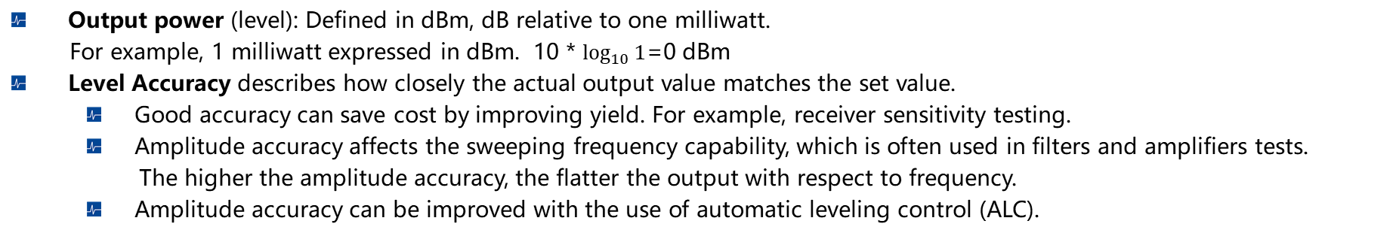
Specs and Datasheet explanation
Output power (level): Defined in dBm, dB relative to one milliwatt.
For example, 1 milliwatt expressed in dBm. 10 * $\log_{10}{1}$=0 dBm
Level Accuracy describes how closely the actual output value matches the set value.
Good accuracy can save cost by improving yield. For example, receiver sensitivity testing.
Amplitude accuracy affects the sweeping frequency capability, which is often used in filters and amplifiers tests.
The higher the amplitude accuracy, the flatter the output with respect to frequency.
Amplitude accuracy can be improved with the use of automatic leveling control (ALC).
 | SSG5040X |  | SSG5060X |  | SSG5040X-V |  | SSG5060X-V
Level setting range | -140 dBm~+26 dBm (1 MHz≤f≤4 GHz)
Level of performance range | -130 dBm~+20 dBm (1 MHz≤f≤4 GHz)
Level error, when ALC State is on | Frequency Range | Range of Output Power
 |  | +20 dBm to -40 dBm |  | -40 dBm to -90 dBm |  | -90 dBm to -110dBm |  | -110 dBm to -130 dBm
 | 9 kHz ≤ f ＜100 kHz | ≤0.9 dB ≤0.7 dB (typ.) |  | ≤0.9 dB ≤0.7 dB (typ.) |  | ≤1.1 dB
 | 100 kHz ≤ f ≤ 4 GHz | ≤0.7 dB ≤0.5 dB (typ.) |  | ≤0.7 dB ≤0.5 dB (typ.) |  | ≤1.1 dB ≤0.7 dB (typ.) |  | ≤1.1 dB (typ.)
 | 4 GHz＜ f ≤ 6 GHz | ≤0.7 dB ≤0.5 dB (typ.) |  | ≤0.7 dB ≤0.5 dB (typ.) |  | ≤1.1 dB ≤0.7 dB (typ.) |  | ≤1.2 dB (typ.)
Level error, when ALC off (S&H) | Additional Level Error <0.2 dB

Slide 9
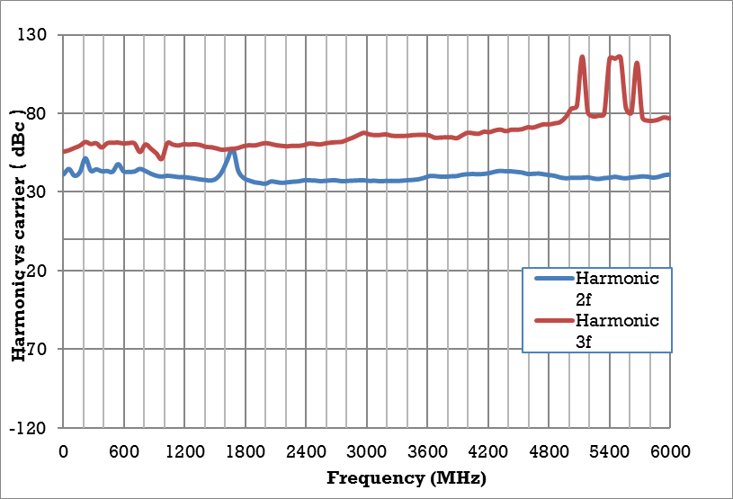
Specs and Datasheet explanation
Spectral Purity
Harmonics and Spurious Signals: They are normally quoted in terms of decibels relative to the carrier.
Harmonics are integer multiples of the carrier frequency. Spurs are non-integer multiples of the carrier frequency.
High dynamic range generators are needed when measuring spurs and harmonics, or the ones detected may come from the generator and not the DUT.
Measured harmonics versus carrier frequency at level ≤ +13 dBm

Slide 10
Specs and Datasheet explanation
Distortion:
Harmonic Distortion: Often caused by non-linear semiconductors, the frequency is integer multiples of a sine wave.
Intermodulation Distortion (IMD): Occurs when mixing two or more signals at different frequencies. Its frequency is the sum and difference of integer multiples of the input frequencies. For example, input F1 and F2, it could be 2*F1 – F2 or 2*F2 –F1.
When it matters: Power amplifier tests require low distortion generators as do ACPR tests on receivers.
3GPP2 cdma 2000 distortion performance
Offset | Configuration | Frequency | Power level ≤ 4 dBm
885 kHz to 1.98 MHz | 9 channel forward link | 800 to 900 MHz | -64 dBc(typ.)
＞1.98 to 4.0 MHz |  |  | -82 dBc(typ.)
＞4.0 to 10 MHz |  |  | -82 dBc(typ.)

Slide 11
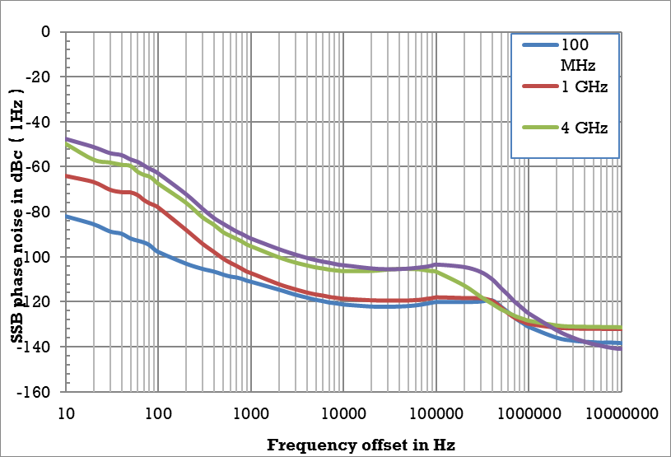
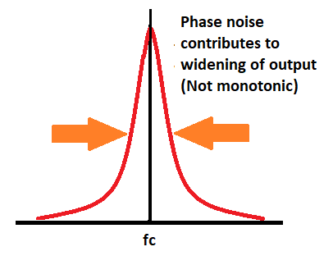
Specs and Datasheet explanation
Phase Noise: When measuring the noise of a system, the phase noise of the signal generator may affect the measurements. It is measured in terms of dBc/Hz. This is the noise measured in 1 Hz bandwidth relative to the level of the carrier. Noise is distributed over the frequency range but not only a frequency point.
When it matters? Radar applications, orthogonal frequency-division multiplexing (OFDM)
Measured phase noise

Slide 12
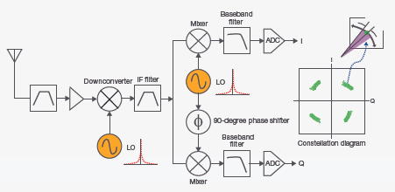
Specs and Datasheet explanation
Phase Noise:
When it matters? Digital modulation
Source: Keysight White Paper

Slide 13
Specs and Datasheet explanation
Speed
Time is money, faster generators shorten the test time thus save manufacture costs.
How fast does a generator change from one frequency/ amplitude/ waveform to another?
Main Factors: Type of change, source of commands (SCPI, List/Step Sweep mode)
When it matters: Tests which require fast change of frequency/amplitude/waveforms. For example, receiver sensitivity measurements and bit-error-rate (BER) measurements, verify amplifier functionality over variable waveforms,
amplifier gain compression tests require various power levels.
SSG5000X Frequency and Level Setting Time
Frequency Setting Time | <5 ms (typ.), ALC ON
 | <10 ms (typ.), ALC OFF (S&H)
Frequency Sweep Dwell Time | 10 ms~100 s
Level Setting Time | ALC state ON ＜5 ms
 | ALC state S&H ＜10 ms

Slide 14
Intermediate Summary
All discussed Parameters are common to the CW-Version and the Vector Signal Version of the SSG5000X Series.
The comparison to SSG3000X shows that the SSG5000X is superior
SSG5000X
SSG5000X-V
Applications / Use Cases
New Features and extended Functions
Applications / Use Cases

Slide 15
Contents
Application Areas for SSG5000X

Slide 16

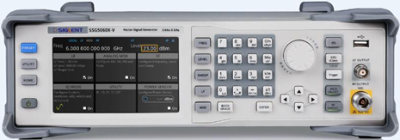
Applications for CW-Source
Stable Reference Source (e.g. Local Oscillator, Cal.Source, Reference Signal)
Interference Source for electro-magnetic susceptibility (EMS) measurements
Digital Input Data
PSK Modulator
00101101001011…
LO
EUT
RF Amp

Slide 17
Applications for CW-Source
Receiver Testing (Interference Source for Blocking, Two-Tone tests)
Universal Instrument for testing (Linearity e.g. with two-tone signal for Intermodulation Performance, Component testing)
Radar-Testing (Pulse Modulated Signals)
Military applications
Avionic applications (VOR/ILS )
Signal Source with standardized Signal e.g. LTE
Wanted Signal
In-Band Blocking
Out-of-Band Blocking
Intermodulation
e.g. LTE Receiver like Base Station or Mobile
Modulated Interferer
Signal Source with standardized Signal e.g. LTE
Σ
CW Interferer

Slide 18
Contents
New Features and extended Functions for SSG5000X-V
V stands for Vector Signal Source

Slide 19
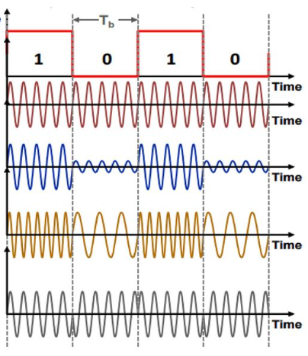
What is a Vector Signal Source?
Basic Intro / Re-Cap Digital Modulation
The Information Signal is a digital bit sequence
The modulation approach for Amplitude, Frequency and Phase is the same like at analog modulations.
Analog – Infinite available “states”
Digital - two states are available, 0 and 1.
The Carrier Signal property changes between two values (Keying)
➔ digital AM ➔ ASK (Amplitude Shift Keying); Same for FM / PM ➔ FSK and PSK

Slide 20



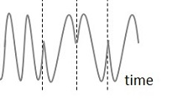
Digital Modulation @ Constellation Diagram
Binary Phase Shift Keying (BPSK) – 2 phases: 0 degrees = 0, 180 degrees = 1
90°
180°
0°
Binary 1
Binary 0
270°

Slide 21
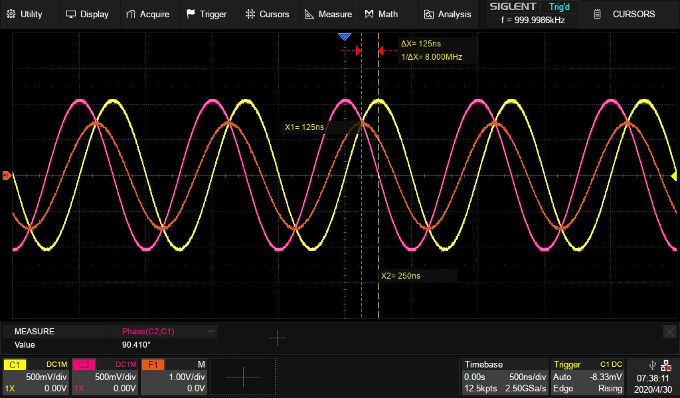
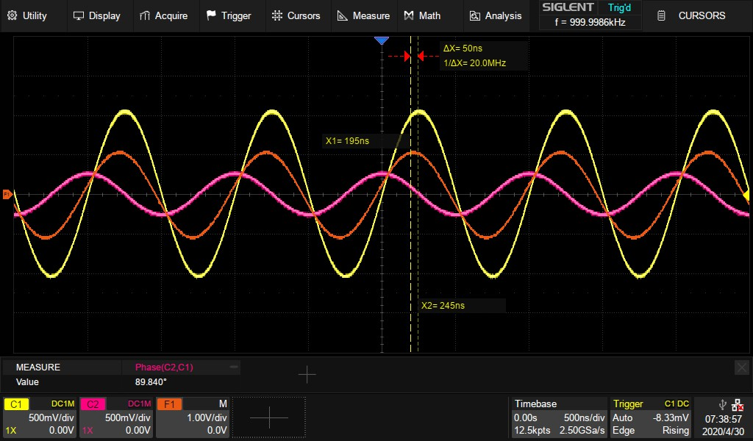
Vector Signal Modulation
Both pictures show the Sine / Cosine wave and Sum of both (orange) -> What is the difference between the two pictures?
The Amplitude of the Cosine wave is lower.
Which effect does the different Amplitudes of the Sine and Cosine have on the Sum-Signal (orange)?
The Sum-Signal move towards the Sine Wave ➔This means:
BY CHANGING THE AMPLITUDE OF ONE OF THE BASE SIGNALS THE PHASE CAN BE MANIPULATED!

Slide 22
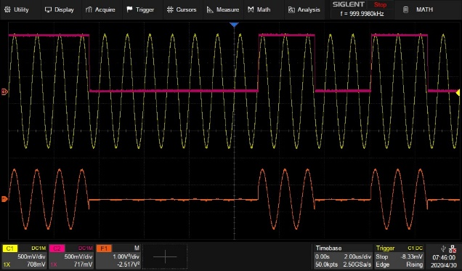
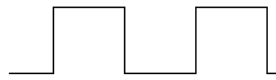
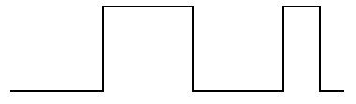
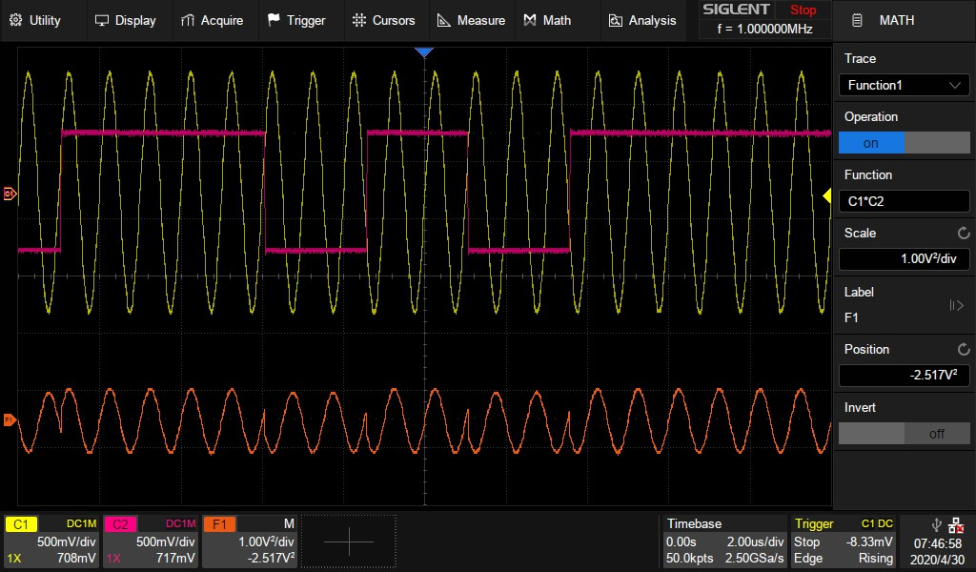
Quadrature Amplitude Modulation - QAM
If we now apply ASK to the Sine wave and to the Cosine wave we are able to address 4 points, but only in the 1st Quadrant
1 V
Mixer
0 V
0110011
10
Cosine
11
90° Phase Shift
Q
Digital Input Data
Mapping
Σ
φ
00101101001011…
00
I
01
LO
Sinewave
0011001
1 V
0 V
Mixer

Slide 23
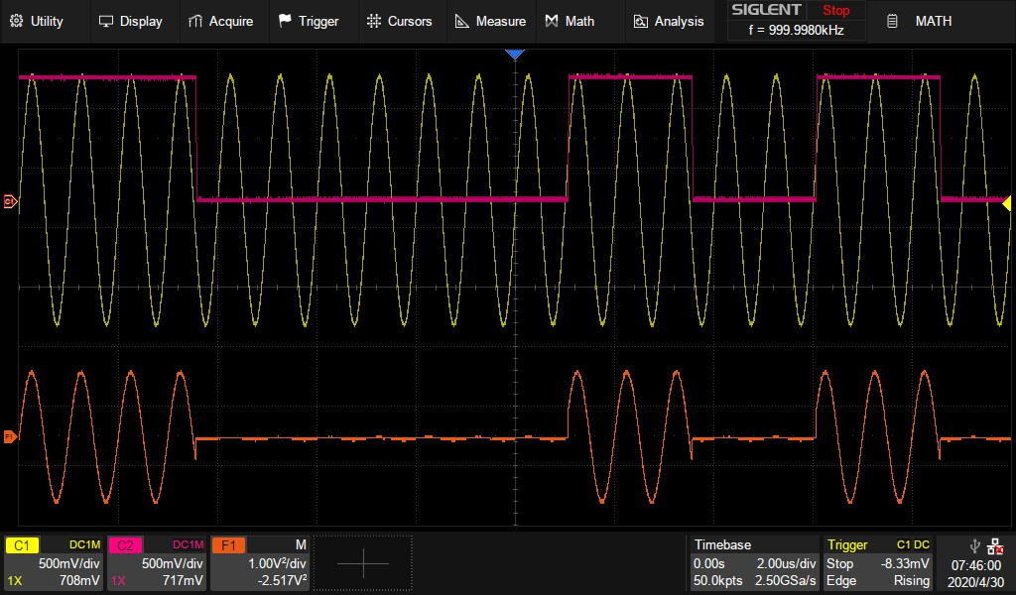
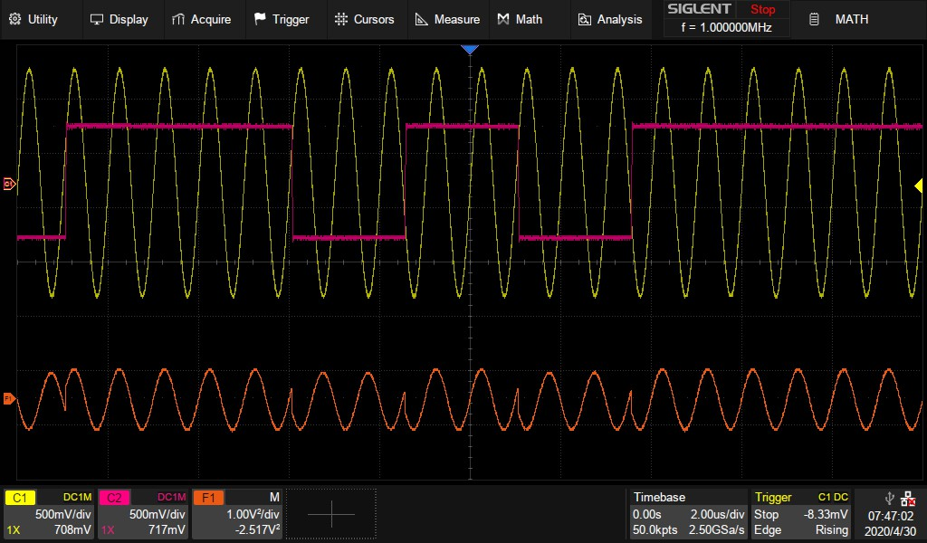
Quadrature Amplitude Modulation
ASK Modulation
Uni-Polar Data Signal
Bit Value 0 = 0V
Bit Value 1 = 1V
Bi-Polar Data Signal
Bit Value 0 = -0.5 V
Bit Value 1 = +0.5 V

Slide 24
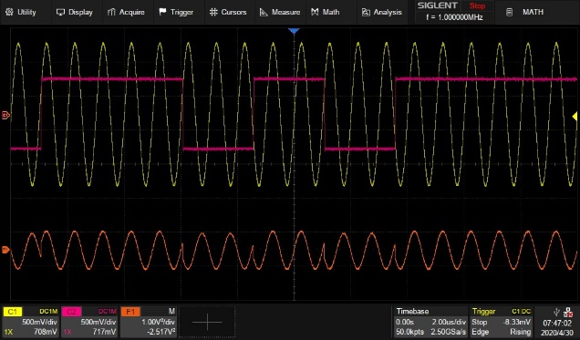
Quadrature Amplitude Modulation - QAM
If we now apply ASK to the Sine wave and to the Cosine wave we are able to address 4 points, but only in the 1st Quadrant
Bipolar NRZ Encoder
1 V
Mixer
0 V
Q
0110011
Cosine
01
11
90° Phase Shift
Digital Input Data
Mapping
Σ
φ
00101101001011…
00
I
LO
Bipolar NRZ Encoder
Sinewave
00
10
0011001
1 V
0 V
Mixer

Slide 25
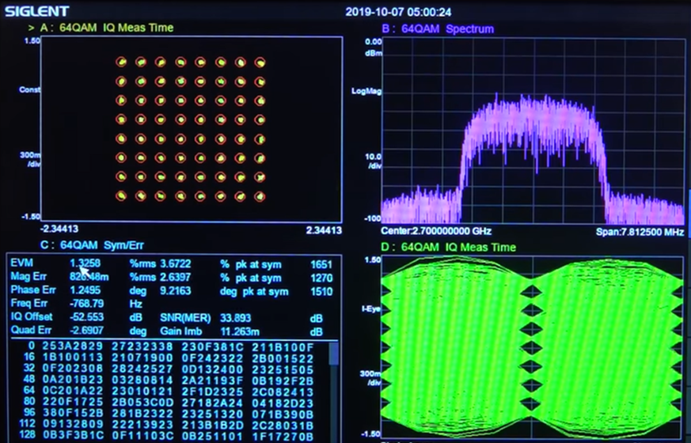
What is a Vector Signal Source?
The answer is:
A Vector Signal Source is capable to generate Complex Modulated Signals
A Vector Source utilize the IQ-Modulation Technique to generate e.g. 16, 64 QAM or higher modulated signals.

Slide 26
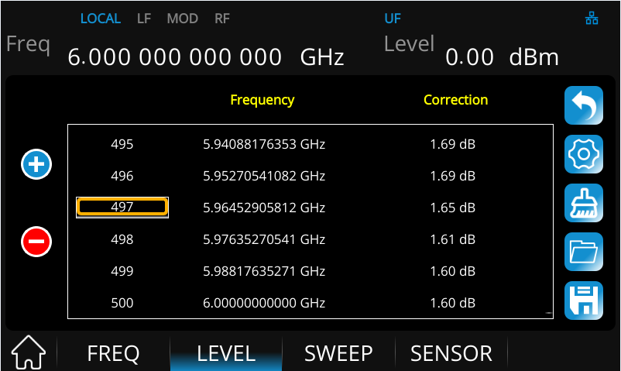
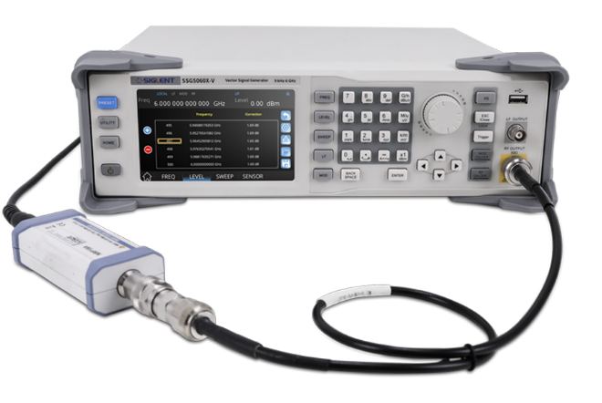
SSG5000X(-V)/3000X(-IQE) Features
Cable loss compensation
The longer the transmission line, the larger the cable loss. In order to ensure good flatness before the signal arrives at the DUT, a flatness correction is needed to compensate for the loss caused by the transmission line and switch impedance.
SSG5000X supports flatness correction with an external power sensor (not included).
Supported Power sensors currently include R&S USB-type Z series, Keysight U series.
Power Sensor Connection

Slide 27
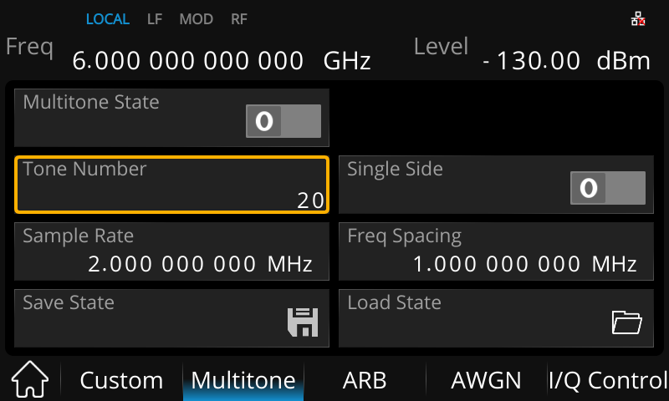
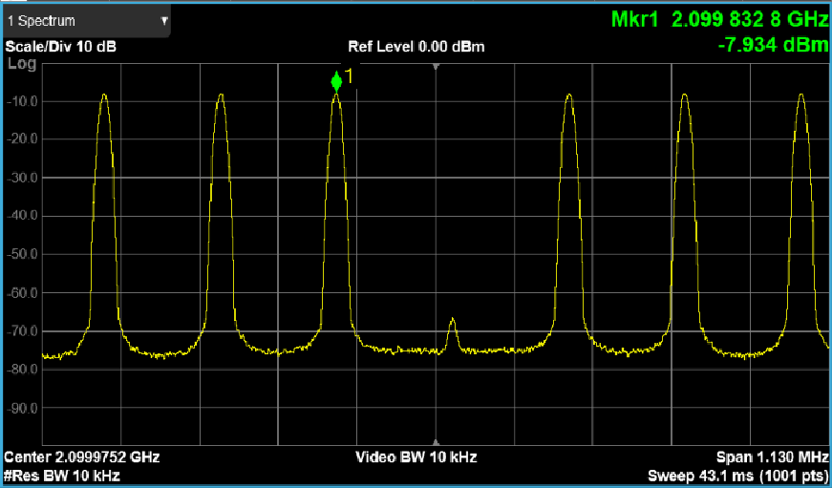
SSG5000X-V Features
Multi-tone mode
Multi-tone signal consists of several sine waves. SSG5000X supports up to 20 tones.
Audio Measurements
Amplifier and receiver non-linear distortion tests
Ground and satellite communications

Slide 28
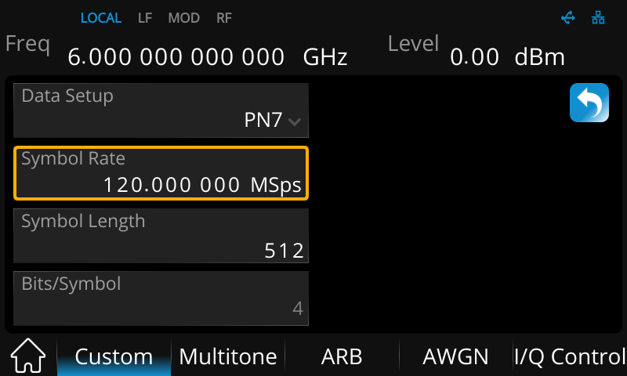
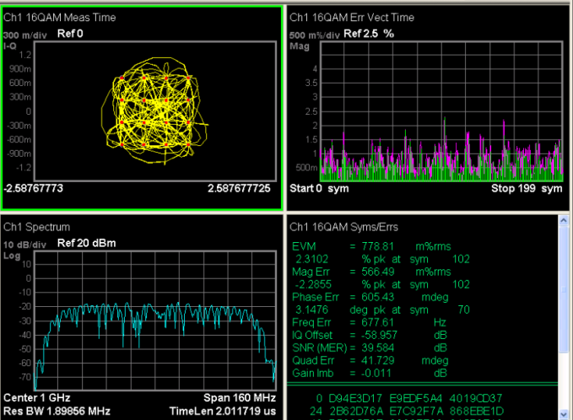
SSG5000X-V Features
CUSTOM mode
Create waveforms that meet requirements quickly.
IQ modulation is a very effective way to transmit information. SSG5000X can output common modulation signals like QAM, PSK, ASK, FSK.
The symbol rate can be set to as high as 120 Msps

Slide 29
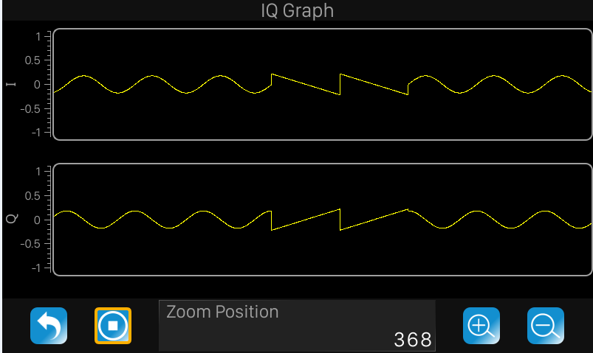
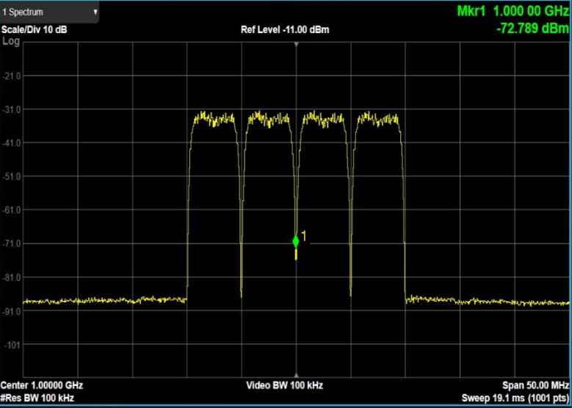
SSG5000X-V Features
Powerful ARB mode
Build and replay waveform sequences. There are two types of waveform files.
Segment: Created by pre-defined ARB formats
Sequence: Several segments strung together
Generate multi-carrier signals
Usually narrowly spaced carriers, which is spectrally efficient and resilient to interference.
Widely used with the introduction of OFDM (Orthogonal Frequency Division Multiplexing), which is used for systems such as wireless/ cellular telecommunications and networking standards such as WiMAX, Wi-Fi 802.11, LTE.
Build and Replay Waveform Sequences
Generate Multi-Carrier Signals

Slide 30
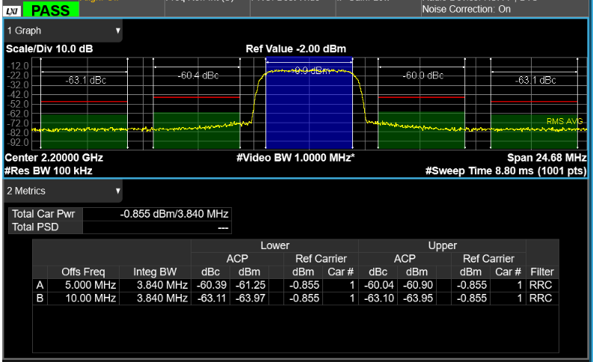
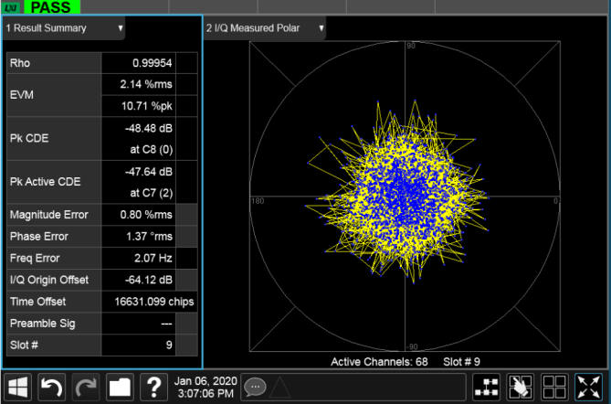
SSG5000X-V Features
Powerful ARB mode
Rapid developments in consumer electronics require a variety of communication protocols to verify wireless products.
SSG5000X series has built-in common protocol files: 5G NR, LTE, WLAN, WCDMA, GSM, BLUETOOTH.
Built-in or build-your-own..
3GPP WCDMA TM1-64DPCH ACPR
3GPP WCDMA TM1-64DPCH EVM

Slide 31
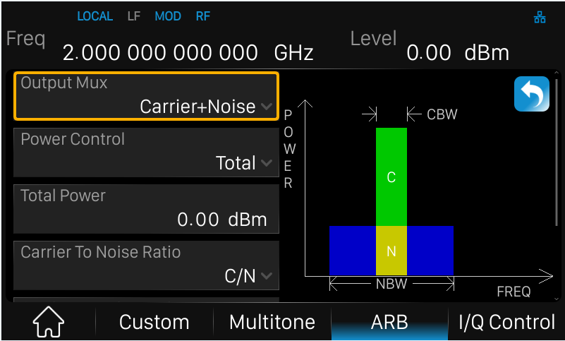
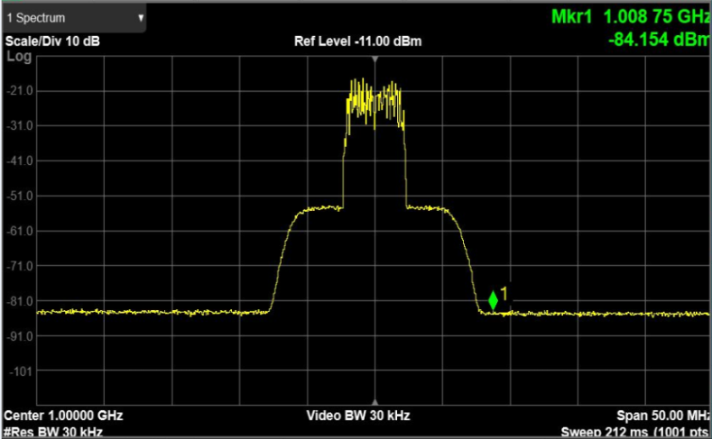
SSG5000X-V Features
Powerful ARB mode
Add Real-Time AWGN (Additive White Gaussian Noise) to signals. AWGN is a basic noise model used in information theory to mimic the effect of many random processes that occur in nature, like thermal noise.
Add AWGN to the test signal when testing receiver performance to simulate various environments.
Add real time AWGN to digital IQ signals for receiver performance tests

Slide 32
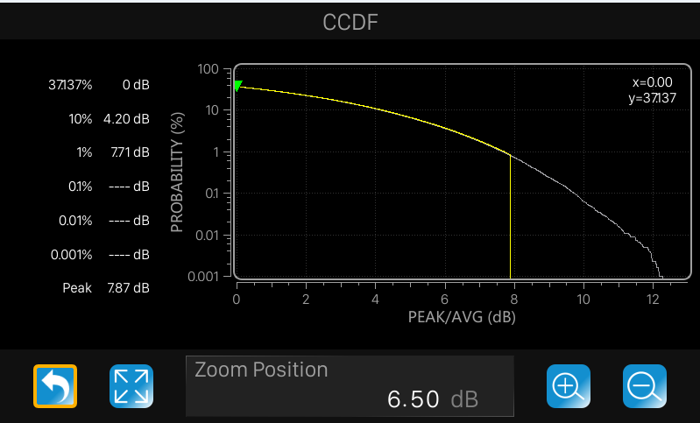
SSG5000X-V Features
Powerful ARB mode
Clip the peak power of the signal and display CCDF (Complementary Cumulative Distribution Function) curve.
The signal power exceeds the average by at least 4 dB for 10% of the time.
Y axis is the percent of time the signal is at or above the power specified by the X axis.
X axis is dB above average power

Slide 33
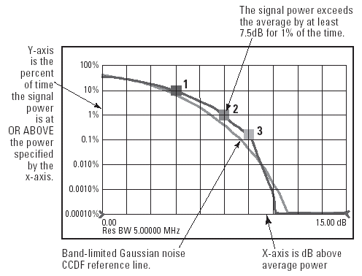
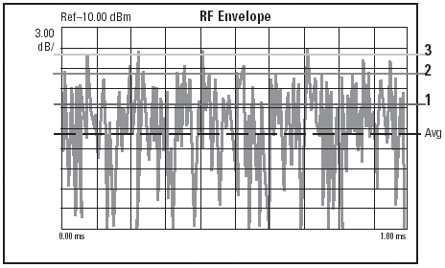
CCDF (Complementary Cumulative Distribution Function)
CCDG? WHAT?
CCDG is a graphical display which shows the statistical distribution or the probability how often certain power levels appear within a complex modulated signal

Slide 34
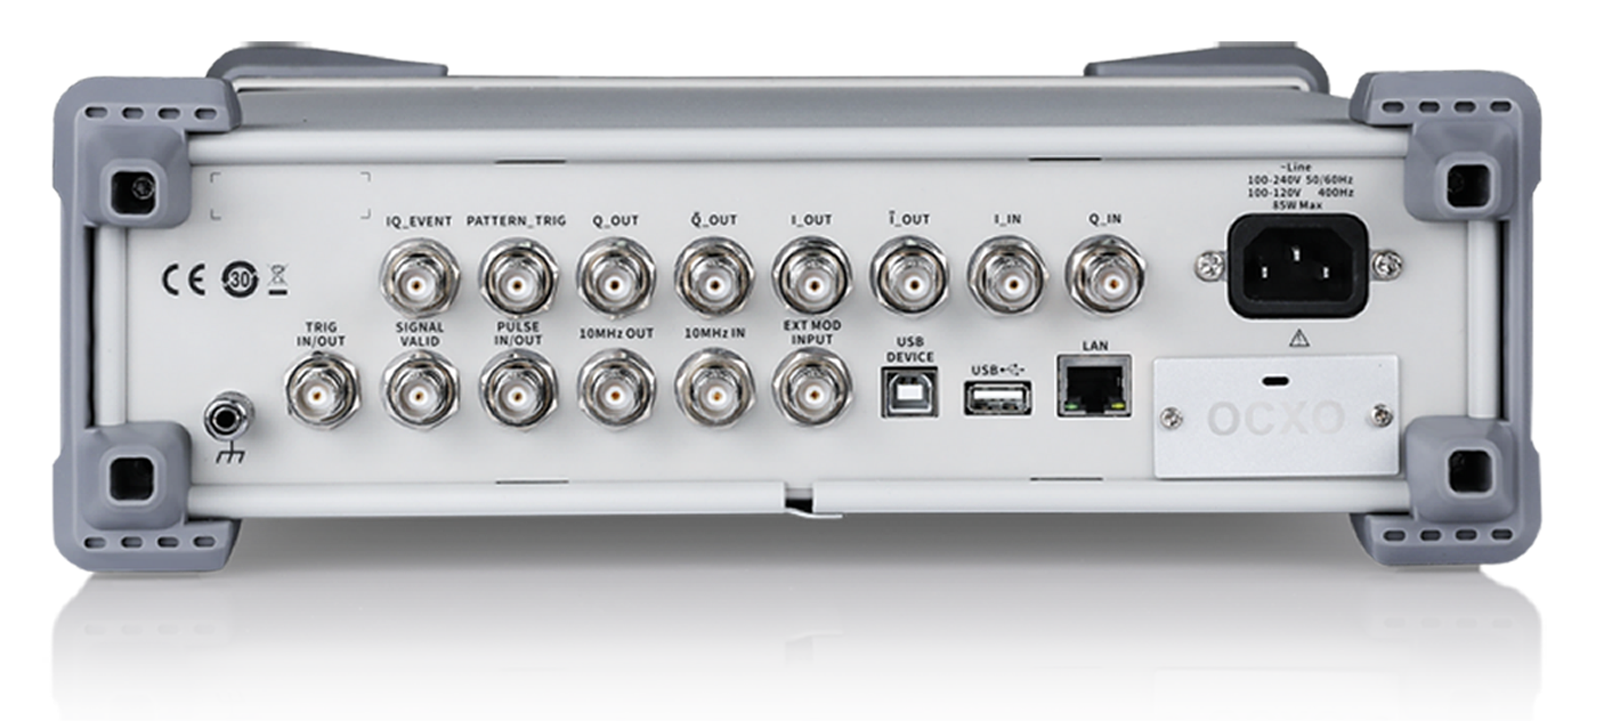
Appearance of SSG5000X-V Back
Various Control In-/Outputs
Differential I and Q Baseband Outputs
Ext I and Q Baseband Inputs
High Stability
Oven Controlled
Ref. Oscillator
USB Device
Remote Control
LAN
Web Server

Slide 35
Contents
Application Areas for SSG5000X-V

Slide 36
Applications
General overview on possibilities
Bipolar NRZ Encoder
1 V
Mixer
0 V
Q
0110011
Cosine
01
11
90° Phase Shift
Digital Input Data
Mapping
Σ
φ
00101101001011…
00
I
LO
Bipolar NRZ Encoder
Sinewave
00
10
0011001
1 V
0 V
Mixer

Slide 37
Applications
General overview on possibilities
Q
01
11
φ
00
I
Generate the various complex modulations up to 6 GHz all in one Box
00
10

Slide 38
Applications
General overview on possibilities
Bipolar NRZ Encoder
1 V
Mixer
0 V
Q
0110011
Cosine
01
11
90° Phase Shift
Digital Input Data
Mapping
Σ
φ
00101101001011…
00
I
LO
Bipolar NRZ Encoder
Sinewave
00
10
0011001
1 V
0 V
Mixer

Slide 39
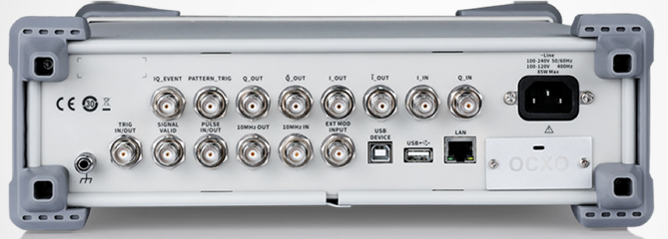
Applications
General overview on possibilities
Up-modulate external IQ Baseband signals up to 6 GHz
Bipolar NRZ Encoder
1 V
0 V
Q
0110011
01
11
Digital Input Data
Mapping
RF
φ
00101101001011…
00
I
00
10
0011001
1 V
0 V
Bipolar NRZ Encoder

Slide 40
Applications
General overview on possibilities
Bipolar NRZ Encoder
1 V
Mixer
0 V
Q
0110011
Cosine
01
11
90° Phase Shift
Digital Input Data
Mapping
Σ
φ
00101101001011…
00
I
LO
Bipolar NRZ Encoder
Sinewave
00
10
0011001
1 V
0 V
Mixer

Slide 41
Applications
General overview on possibilities
Mixer
Q
Cosine
01
11
90° Phase Shift
Σ
φ
00
I
LO
Sinewave
00
10
Generate and output differential IQ Baseband signals
Mixer

Slide 42
Applications
Receiver tests – Adjacent channel selectivity tests, Bit-error-rate (BER) measurement
Signal Source with standardized Signal e.g. LTE
Wanted Signal
e.g. LTE Receiver like Base Station or Mobile
In-Band Blocking
Out-of-Band Blocking
Intermodulation
Modulated Interferer
Signal Source with standardized Signal e.g. LTE
Σ
CW Interferer

Slide 43


Applications
Receiver tests – Performance test
Add disturbances like Noise, Fading, Clipping or Bit Errors and determine how the receiver handles the changes…
e.g. LTE Receiver like Base Station or Mobile
Add Noise to Sender Signal
e.g. LTE Receiver like Base Station or Mobile
Multi-Channel Fading
Add multi-channel signal propagation and reflections

Slide 44
Contents
Positioning / Pricing / Competitive Analysis

Slide 45
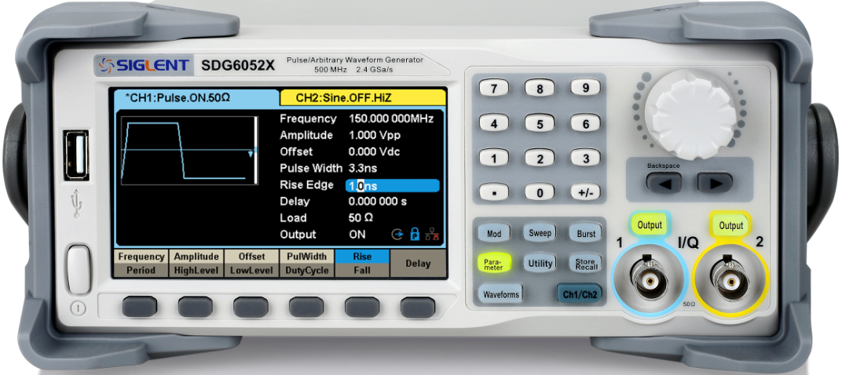
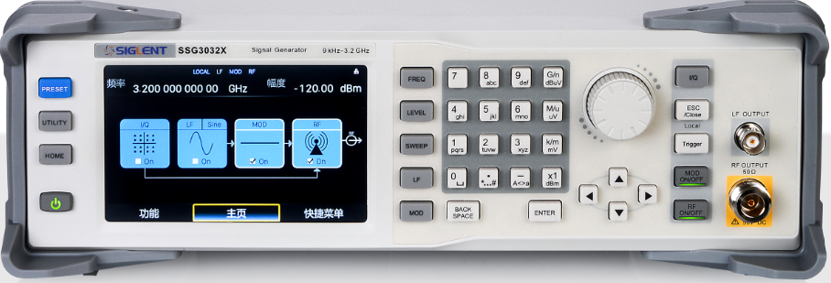
RF Signal Generator Positioning
Price / USD
15,899.-
14,099.-
10,599.-
SSG5000X-V
4 GHz / 6 GHz
8,809.-
6,539.-
+ 2168.-
8,707.-
SSG5000X
4 GHz / 6 GHz
4,929.-
+ 2,168.-
7,097.-
SSG3000X-IQE
2.1 GHz / 3.2 GHz
4,009.-
2,549.-
SSG3000X
2.1 GHz / 3.2 GHz
Functions & Performance
Basic RF-SG
VSG, together with SDG6000X-IQ
Performance RF-SG
Performance RF-VSG

Slide 46
Pricing
Model | Description | Price
SSG5040X | 9 k - 4 GHz; -140 dBm ~ +26 dBm; 0.001Hz frequency resolution, Phase noise -120 dBc/Hz @1 GHz, 20 kHz offset; 5 inch TFT touch-screen | $8,809
SSG5060X | 9 k - 6 GHz; -140 dBm ~ +26 dBm; 0.001Hz frequency resolution, Phase noise -120 dBc/Hz @1 GHz, 20 kHz offset; 5 inch TFT touch-screen | $10,599
SSG5040X-V | 9 k - 4 GHz; -140 dBm ~ +26 dBm; 0.001Hz frequency resolution, Phase noise -120 dBc/Hz @1 GHz, 20 kHz offset; 5 inch TFT touch-screen; with 75 MHz internal IQ modulation | $14,099
SSG5060X-V | 9 k - 6 GHz; -140 dBm ~ +26 dBm; 0.001Hz frequency resolution, Phase noise -120 dBc/Hz @1 GHz, 20 kHz offset; 5 inch TFT touch-screen; with 75 MHz internal IQ modulation | $15,899
SSG5000X-PT | Pulse train generator (SW) | $879
SSG5000XV_B150 | Upgrade IQ bandwidth to 150 MHz (SW) | $3,999
SSG5000X_F60 | Upgrade RF frequency to 6 GHz (SW) | $5,589
10M_OCXO_L | High accuracy clock source | $1,199

Slide 47
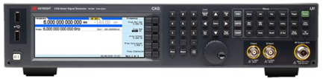
Competitive Analysis
Parameter | SIGLENT SSG5000X-V |  | Keysight N5171B/N5172B
Frequency Range | 9 KHz ~ 4/6 GHz | √ | 9 KHz ~ 1/3/6 GHz | √
Frequency Range (IQ Mode) | 10 MHz ~ 4/6 GHz | X | 5 MHz ~ 3/6 GHz | √
Frequency resolution | 0.001 Hz | √ | 0.001 Hz | √
Level of performance range | -130dBm ~ +20dBm | X | -144dBm ~ +26dBm | √
Total Amplitude Accuracy | < 0.7 dB | X | < 0.3 dB | √
Amplitude resolution | 0.01 dB | √ | 0.01 dB | √
Phase noise@1GHz (20KHz offset) typical | -120dBc/Hz | X | -122dBc/Hz | √
Frequency switching speed (typical) | < 10 ms | X | < 5 ms | √
Harmonics (1MHz<f<6GHz) | < -30dBc | X | < -35dBc | √
Non-harmonics | < -65dBc | √ | < -60dBc | X
Pulse on/off ratio | >70dB | X | > 80dB | √
AM/FM/PM modulation | Support | √ | Support | √
Pulse modulation | Standard | √ | Optional | X
Pulse train generator | Optional | √ | Optional | √
Power meter measurement and control | Standard | √ | Support | √
IQ modulation | QAM/FSK/ASK/PSK/Multitone | √ | QAM/FSK/ASK/PSK/MSK/ DVB-SA APSK | √
Internal I or Q bandwidth | 37.5MHz;75MHz(optional) | √ | 60MHz | √
RF(I+Q) bandwidth | 75M;150MHz(optional) | √ | 120MHz | √
Protocol file playback | 5G_NR/LTE/WLAN/WCDMA/GSM/BLUETOOTH | √ | Support | √
Max. playback capacity | 200 MSa | √ | 32 MSa; 512 MSa optional | √
Max. internal storage space | 4 GB | √ | 3 GB | X
Web server | Support | √ | Support | √
Interface | USB Host,Device,LAN,GPIB | √ | USB Host, Device, LAN, GPIB | √
Touch screen | Capacitive touch screen | √ | Touch screen | √
Display | 5 inch TFT-LCD（800*480） | √ | LCD display | √
Price | $8,809 (SSG5040X; 4GHz) | √ | $26,407 (N5172B; 3GHz) | X

Slide 48
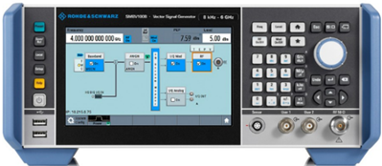
Competitive Analysis
Parameter | SIGLENT SSG5000X-V |  | R&S SMBV100B
Frequency Range | 9 KHz ~ 4/6 GHz | √ | 8 KHz ~ 3/6 GHz | √
Frequency Range (IQ Mode) | 10 MHz ~ 4/6 GHz | X | 1 MHz ~ 3/6 GHz | √
Frequency resolution | 0.001 Hz | √ | 0.001 Hz | √
Level of performance range | -130dBm ~ +20dBm | √ | -127dBm ~ +25dBm | √
Total Amplitude Accuracy | < 0.7 dB | √ | < 0.7 dB | √
Amplitude resolution | 0.01 dB | √ | 0.01 dB | √
Phase noise@1GHz (20KHz offset) typical | -120dBc/Hz | X | -132dBc/Hz | √
Frequency switching speed (typical) | < 10 ms | X | < 1 ms | √
Harmonics (1MHz<f<6GHz) | < -30dBc | √ | < -30dBc | √
Non-harmonics | < -65dBc | √ | < -64dBc | X
Pulse on/off ratio | >70dB | X | > 80dB | √
AM/FM/PM modulation | Support | √ | Support | √
Pulse modulation | Standard | √ | Optional | X
Pulse train generator | Optional | √ | Optional | √
Power meter measurement and control | Standard | √ | Optional | X
IQ modulation | QAM/FSK/ASK/PSK/Multitone | √ | Support | √
Internal I or Q bandwidth | 37.5MHz;75MHz(optional) | X | 250MHz | √
RF(I+Q) bandwidth | 75M;150MHz(optional) | X | 500MHz | √
Protocol file playback | 5G_NR/LTE/WLAN/WCDMA/GSM/BLUETOOTH | √ | Support | √
Max. playback capacity | 200 MSa | √ | 64 MSa; 2 GSa optional | √
Max. internal storage space | 4 GB | X | 64 GB | √
Web server | Support | √ | Support | √
Interface | USB Host,Device,LAN,GPIB | √ | USB Host,USB Device，LAN,GPIB | √
Touch screen | Capacitive touch screen | √ | Capacitive touch screen | √
Display | 5 inch TFT-LCD（800*480） | X | 7 inch LCD display | √
Price | € 5,299 (SSG5040X; 4GHz) | √ | € 21,750 (SMBV100B; 3GHz) | X

Slide 49
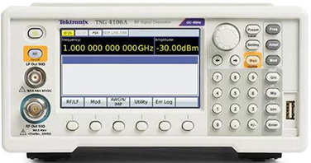
Competitive Analysis
Parameter | SIGLENT SSG5000X-V |  | Tek TSG4100A
Frequency Range | 9 KHz ~ 4/6 GHz | √ | 950KHz ~ 2/4/6 GHz | X
Frequency Range (IQ Mode) | 10 MHz ~ 4/6 GHz | X | 950KHz ~ 2/4/6 GHz | √
Frequency resolution | 0.001 Hz | X | 0.0001 Hz | √
Level of performance range | -130dBm ~ +20dBm | √ | -110dBm ~ +16.5dBm | X
Total Amplitude Accuracy | < 0.7 dB | X | < 0.6 dB | √
Amplitude resolution | 0.01 dB | √ | 0.01 dB | √
Phase noise@1GHz (20KHz offset) typical | -120dBc/Hz | √ | -113dBc/Hz | X
Frequency switching speed (typical) | < 10 ms | X | < 8 ms | √
Harmonics (1MHz<f<6GHz) | < -30dBc | X | < -35dBc | √
Non-harmonics | < -65dBc | √ | N/A | X
Pulse on/off ratio | >70dB | √ | > 70dB | √
AM/FM/PM modulation | Support | √ | Support | √
Pulse modulation | Standard | √ | Optional | X
Pulse train generator | Optional | √ | N/A | X
Power meter measurement and control function | Standard | √ | N/A | X
IQ modulation | QAM/FSK/ASK/PSK/Multitone | √ | Support | √
Internal I or Q bandwidth | 37.5MHz;75MHz(optional) | X | 100MHz | √
RF(I+Q) bandwidth | 75M;150MHz(optional) | X | 200MHz | √
Protocol file playback | 5G_NR/LTE/WLAN/WCDMA/GSM/BLUETOOTH | √ | N/A | X
Max. playback capacity | 200 MSa | √ | N/A | X
Max. internal storage space | 4 GB | √ | N/A | X
Web server | Support | √ | Not support | X
Interface | USB Host,Device,LAN,GPIB | √ | USB Host,USB Device，LAN,GPIB | √
Touch screen | Capacitive touch screen | √ | Not support | X
Display | 5 inch TFT-LCD（800*480） | √ | LCD display | √
Price | € 5,299 (SSG5040X; 4GHz) | √ | € 9,940 (TSG4104A; 4GHz) | X

Slide 50
Thank You
The Best Value in Electronic Test & Measurement
Headquarters
NA
Europe
SIGLENT TECHNOLOGIES CO., LTD.
Add: Blog No.4 & No.5, Antongda Industrial Zone, 3rd Liuxian Road,
Bao’an District, Shenzhen, 518101, China.
Tel:+ 86 755 3688 7876
Fax:+ 86 755 3359 1582
sales@siglent.com
www.siglent.com/ens
SIGLENT Technologies NA, Inc.
Add: 6557 Cochran Rd Solon, Ohio 44139 Tel: 440-398-5800 Toll Free:877-515-5551 Fax: 440-399-1211
info@siglent.com www.siglentna.com
SIGLENT TECHNOLOGIES GERMANY GmbH
Add: Liebigstrasse 2-20, Gebaeude 14, 22113 Hamburg Germany Tel: +49(0)40-819-95946
Mobile: +49 151 40716756 Fax: +49(0)40-819-95947 info-eu@siglent.com www.siglenteu.com

