Slide 1


Slide 2
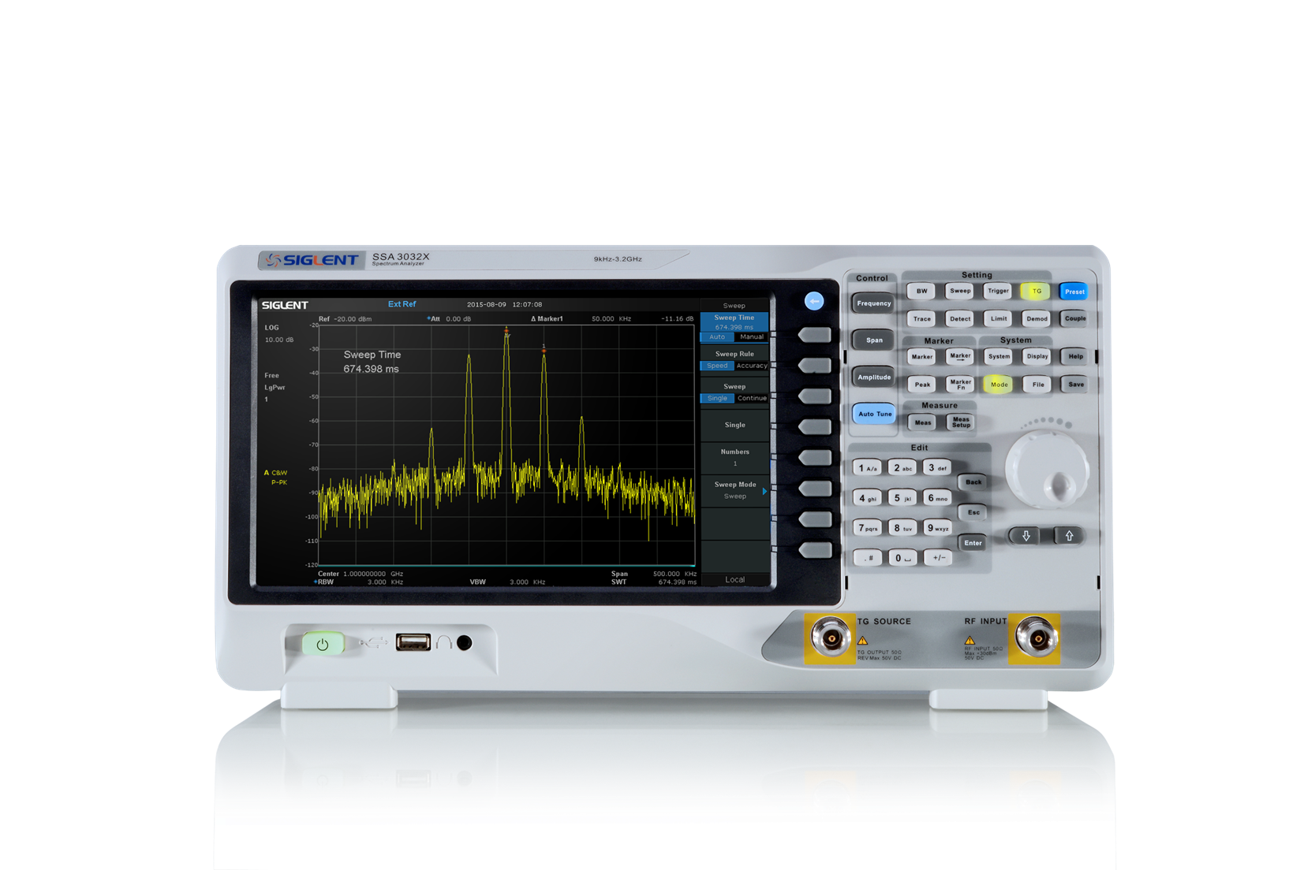
SSA3000X series Spectrum Analyzer

Slide 3
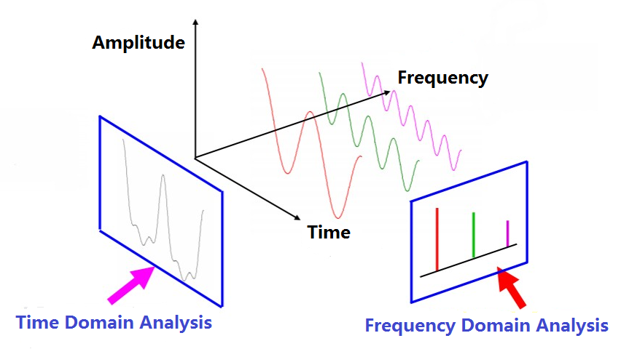
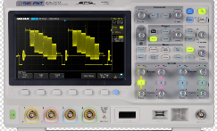
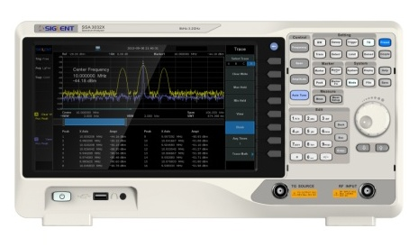


What is a spectrum analyzer?
A spectrum analyzer is a frequency-selective, peak-responding voltmeter, calibrated to display
the rms value of a sine wave.

Slide 4
Application Areas
Research
Development
Education
Production
Measuring the transmission characteristics of cables, filters and amplifiers
Maintenance

Slide 5
Brief Description
Model | SSA3021X | SSA3032X
Frequency Range | 9 kHz~3.2 GHz | 9 kHz~2.1 GHz
Resolution Bandwidth | 10 Hz~1 MHz, in 1-3-10 sequence | 10 Hz~1 MHz, in 1-3-10 sequence
Displayed Average Noise Level | -161 dBm/Hz, Normalize to 1 Hz (typ.) | -161 dBm/Hz, Normalize to 1 Hz (typ.)
Phase Noise | <-98 dBc/Hz@1 GHz, 10 kHz offset | <-98 dBc/Hz@1 GHz, 10 kHz offset
Amplitude Precision | < 0.7 dB | < 0.7 dB

Slide 6
Features of SSA3000X Series
All-Digital IF Technology
Frequency Range from 9 kHz up to 3.2 GHz
-161 dBm/Hz Displayed Average Noise Level (Typ.)
-98 dBc/Hz @10 kHz Offset Phase Noise (1 GHz, Typ.)
Total Amplitude Accuracy < 0.7 dB
10 Hz Minimum Resolution Bandwidth (RBW)
Standard Preamplifier
Up to 3.2 GHz Tracking Generator Kit (Opt.)
Reflection Measurement Kit (Opt.)
Advanced Measurement Kit (Opt.)
EMI Pre-compliance Measurements Kit (Opt.)
10.1 lnch WVGA（1024x600）Display

Slide 7

Front Panel
10.1 inch widescreen display
Keyboard operating area
USB host
Earphone connector
Tracking generator output N head
RF input N head

Slide 8
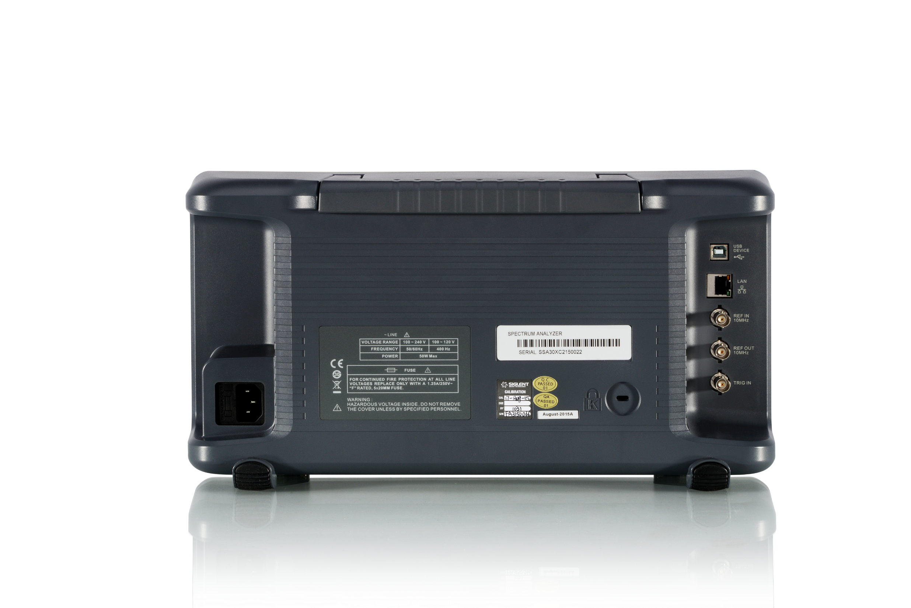
Rear panel
USB DEVICE
LAN
REF IN 10MHz
REF OUT 10MHz
TRIG IN
DC power supply input

Slide 9
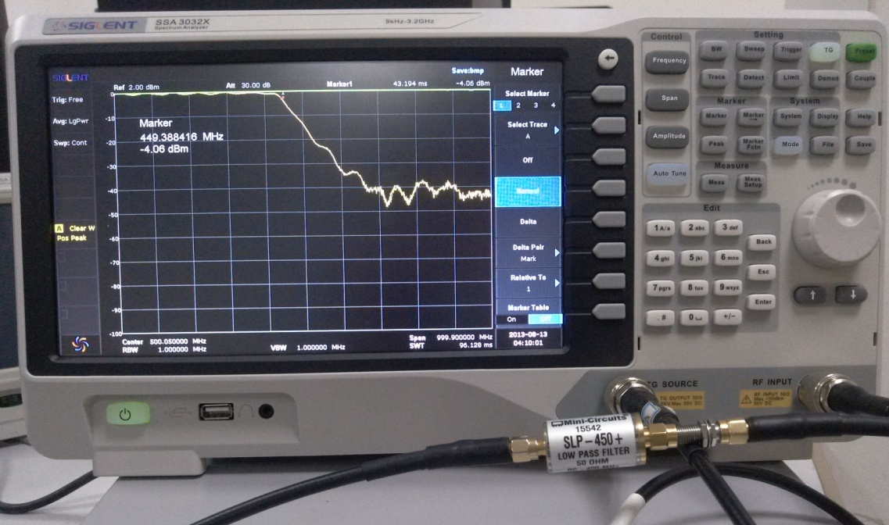
TG : Tracking generator
TG output sweeps signal from 100KHz to 2.1G/3.2GHz
Used as a radio frequency (RF) signal source at the zero span
Sweep range is the center frequency at zero span
Using TG to get amplitude-frequency response curve
Figure on the right side shows the
amplitude-frequency curve of the
filter with 450M
TG Normalized
Eliminate measurement errors caused by line loss

Slide 10
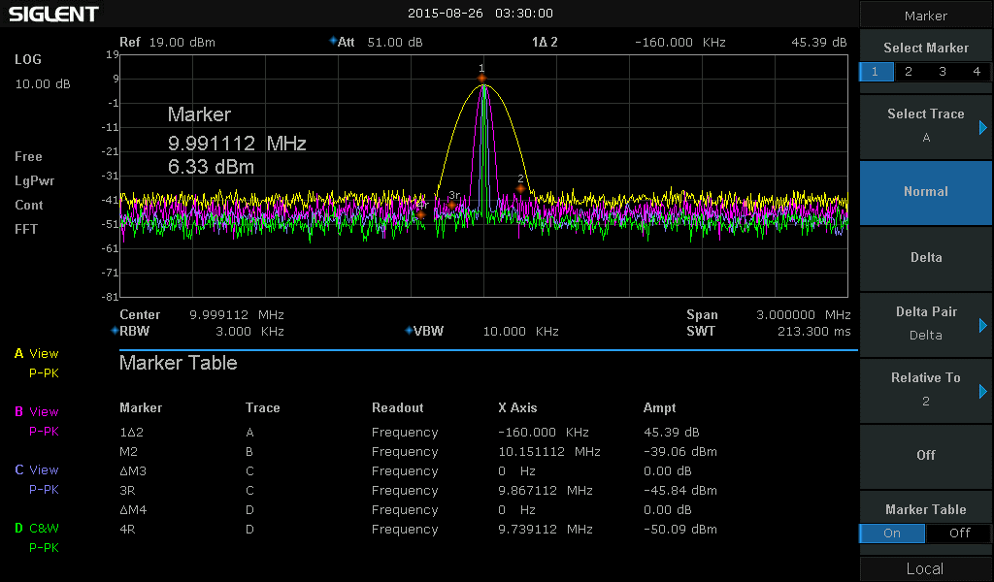
User-friendly Design
  Single-page menu：Easy to access to
  important measurement functions
The screen employs powerful cursor
– assisted measurements. Data and
waveforms can be displayed on the
screen simultaneously.
  Four traces are classified by color, which
  helps users to distinguish appropriate
  spectra changes.

Slide 11
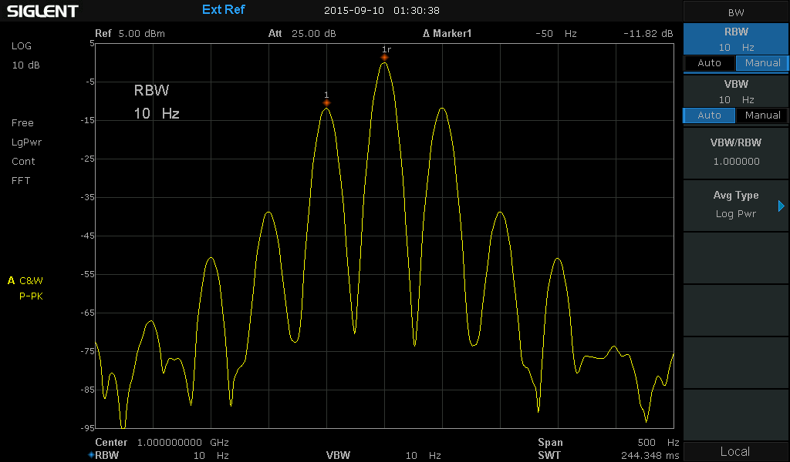
10 Hz Minimum Resolution Bandwidth (RBW)
A RBW of 10Hz makes it easy to clearly
separate the two input signals on the display.
RBW is the 3dB bandwidth of the IF filter
Gaussian, The equivalent noise bandwidth,
Shape factor, Sweep speed.

Slide 12
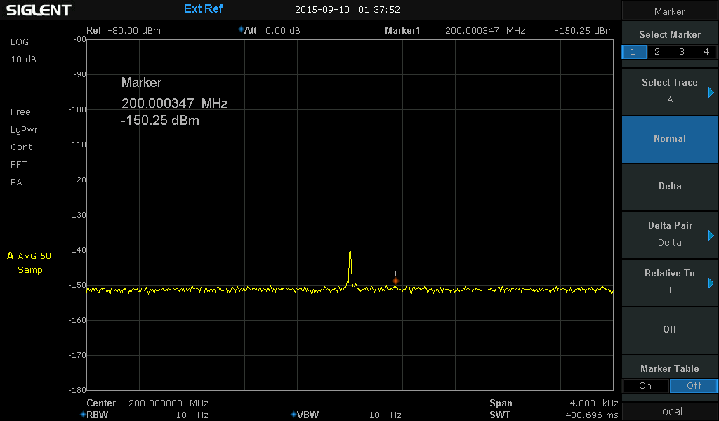
DANL= -161 dBm/Hz (Normalized to 1 hz)
  Built in high-performance RF front-end, SSA3000X series offer low background noise,
  and a standard built-in preamplifier. The overall high sensitivity improves weak signal
  monitoring.
.

Slide 13
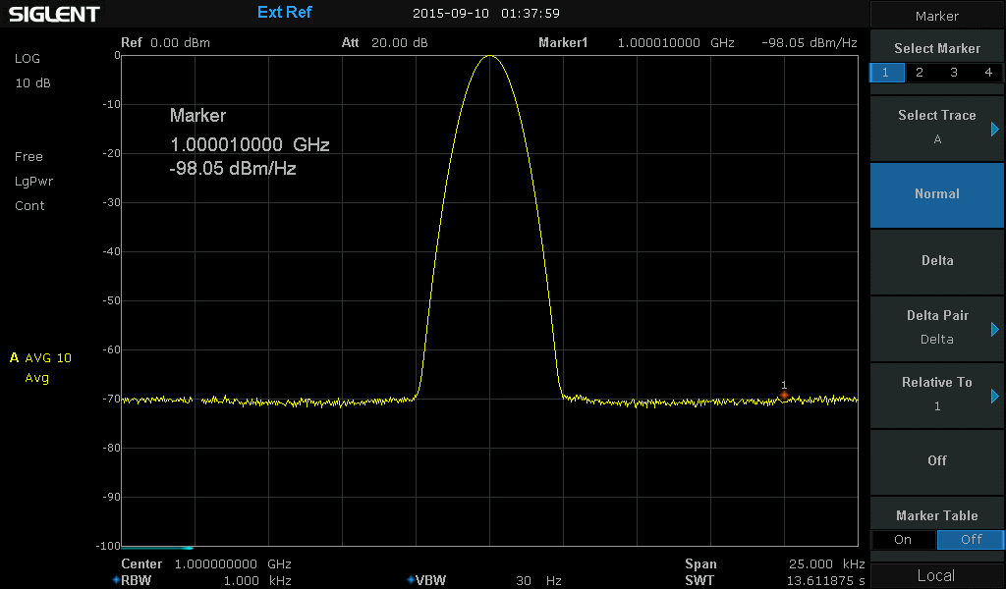
Phase noise -98 dBc/Hz @1 GHz / offset 10 kHz
Excellent phase noise performance enables users to evaluate most synthesizers
and signal generators.
.

Slide 14
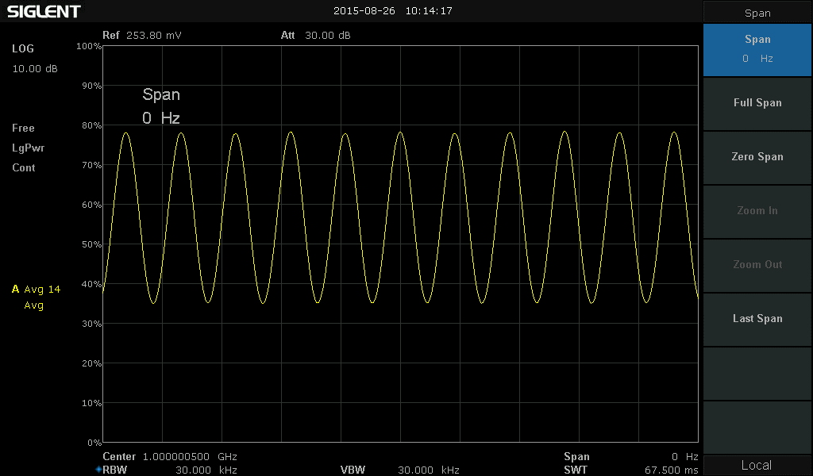
Demodulation at the zero span setting
When the spectrum analyzer is set at zero span, the detector can demodulate the
input signal enabling users to observe the modulated signals on screen over time.
The SSA3000X includes a front panel audio output jack for listening to AM and FM
demodulated signals.
.

Slide 15
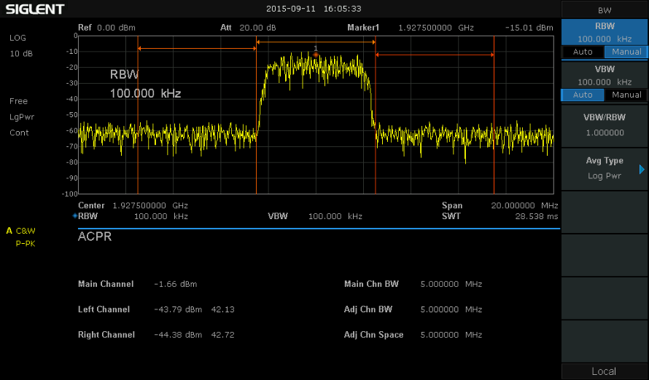
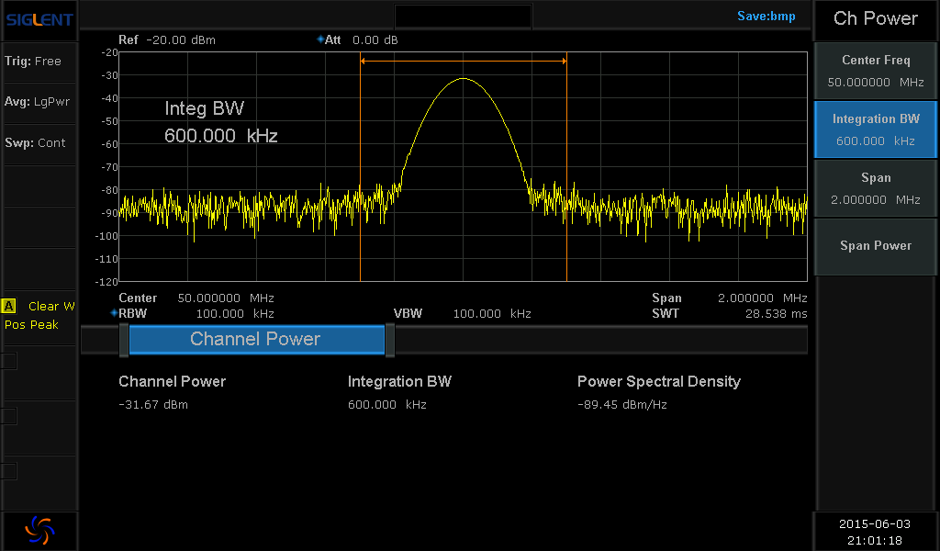
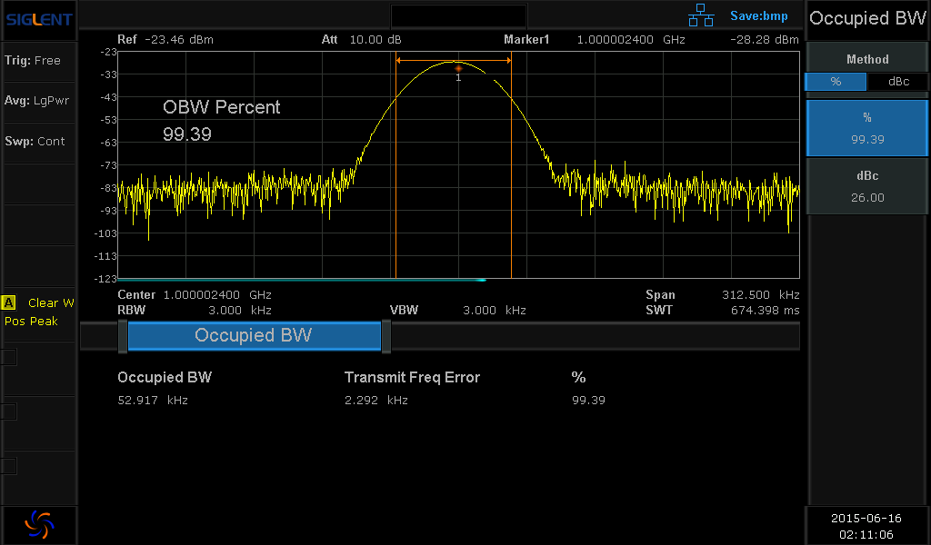
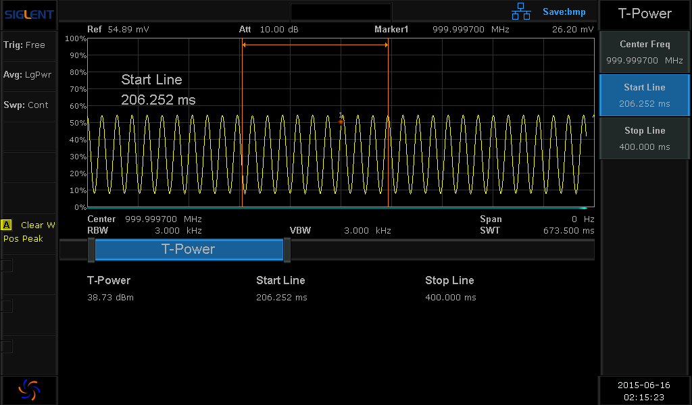
Advanced Power Measurement
ACPR
Channel Power
Occupied Bandwidth
Time-Domain Power

Slide 16
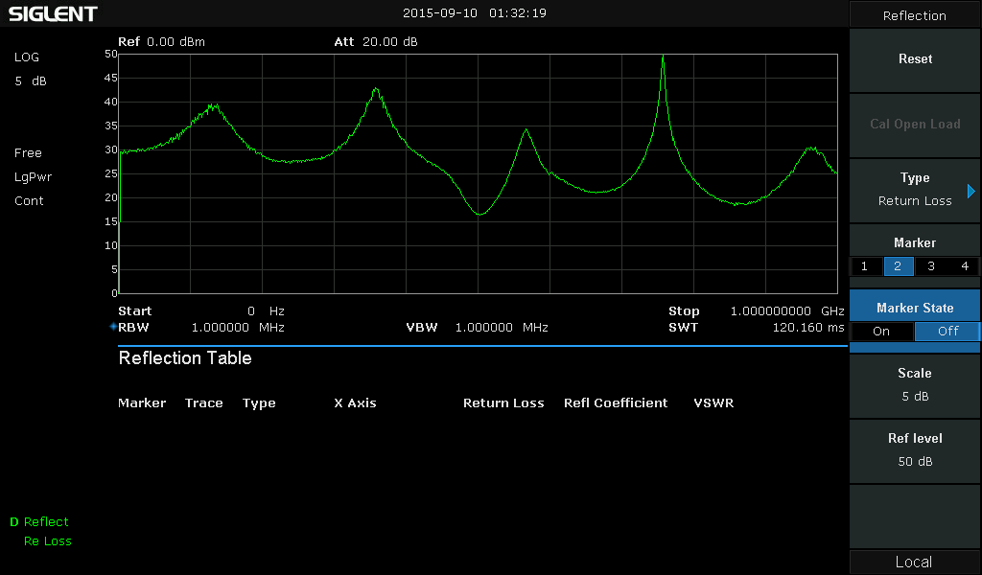
Reflection measurement
The optional reflector kit can easily measure S21, S11, and acquire characteristic curve of the Return Loss and VSWR.

Slide 17
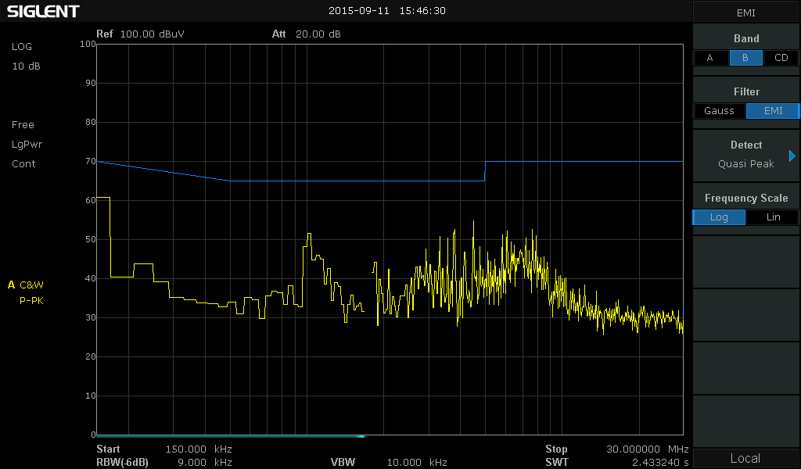
EMI Pre-compliance Measurement
EMI filter (200 Hz, 9 kHz, 120 kHz, -6 dB bandwidth)
Quasi-peak detector
Follow CISPR 16
Importing stored limit templates makes it easy to evaluate
EMI levels for pre-compliance testing.

Slide 18
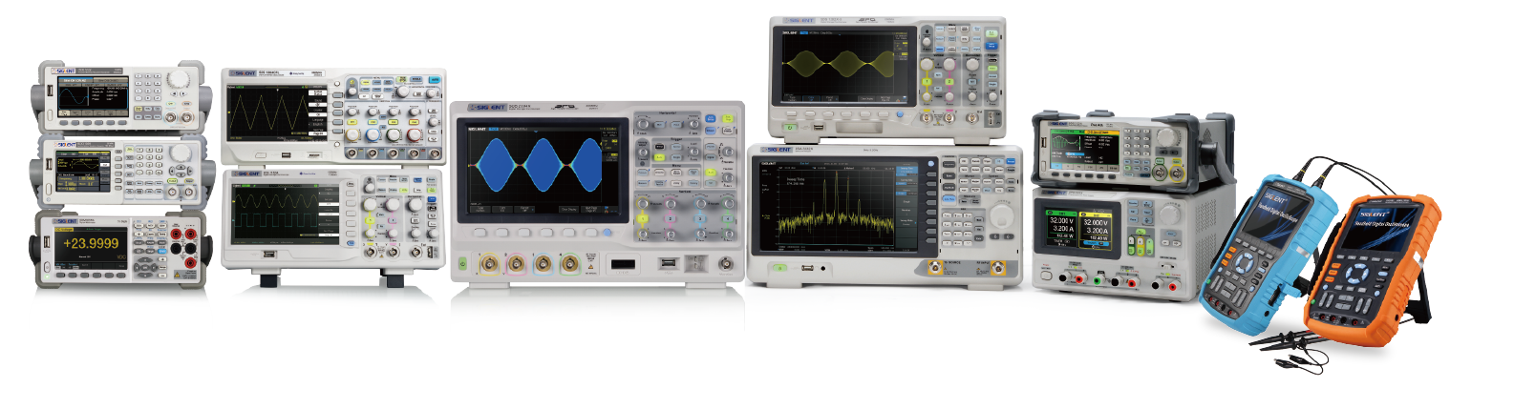
用创新的思维管理企业！！
Thank You!
To Provide Every Engineer Worldwide With Professional T&M Instruments

