Slide 1


Slide 2
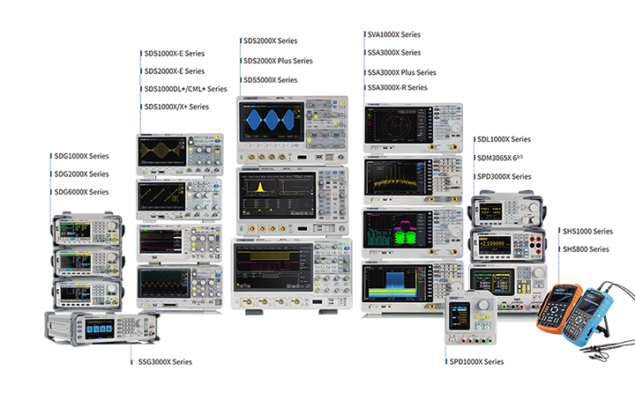
New Product Introduction
Public April 6, 2020

Slide 3

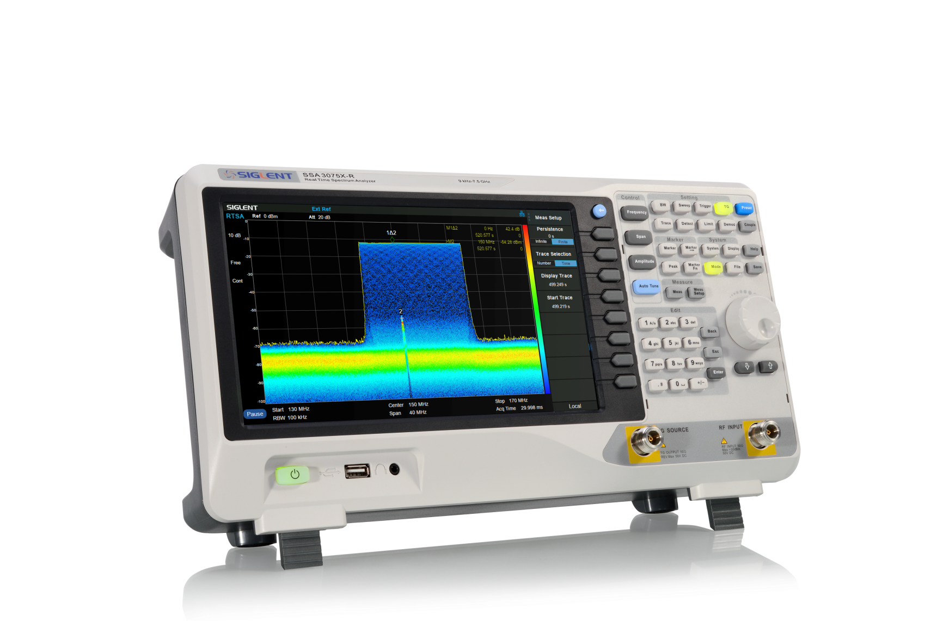

SSA3000X-R Series
Real-Time Spectrum Analyzer
+
General Purpose Spectrum Analyzer
+
EMI Measurement Mode (opt.)
+
Vector Signal Analyzer (opt.)

Slide 4
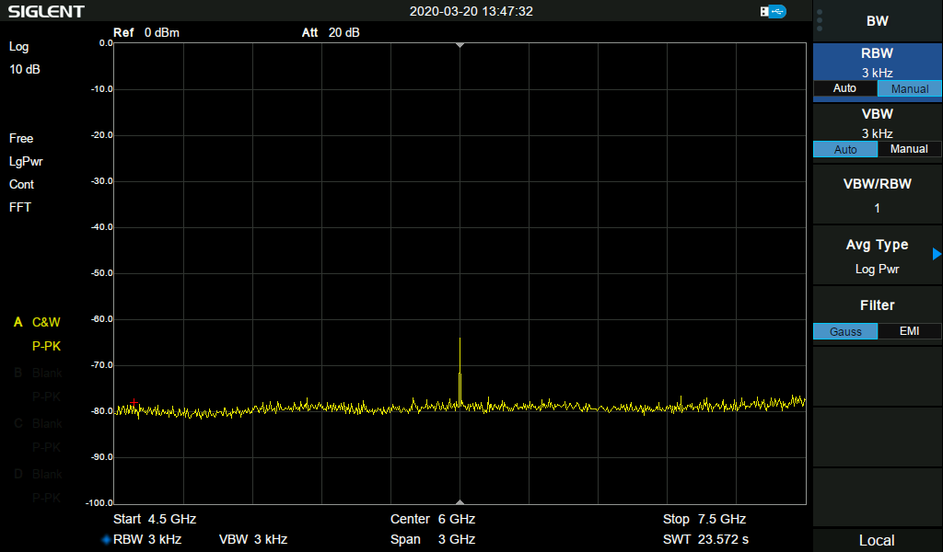



Why Real Time?
Swept SA
LO sweep from start to end frequency defined by SPAN and Center Frequency.
Calculation time is longer than FFT time.
Information may be lost if the frequency is not on sweeping point.
Used to analyze continuous signals, measure insertion loss, SWR.
Sweep time correlates to RBW.
The same sweep signal captured by SSA3000X-R SA mode

Slide 5
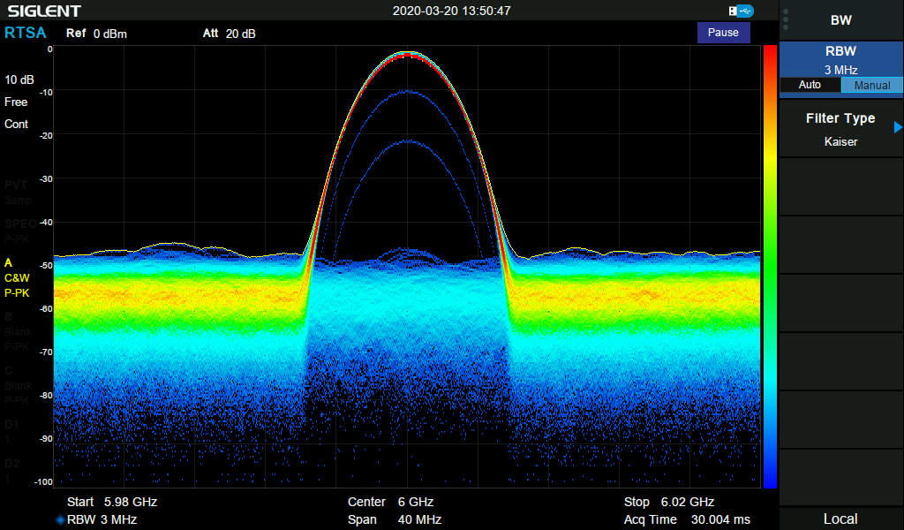
Why Real Time?
RTSA
Modern digital communication signals features various modulations, hopping frequency, complex interference environment.
In order to understand complex and elusive signals in multiple measurements. SSA3000X-R RTSA can capture and analyze transient signals in real-time.
It provides time-frequency-amplitude-probability measurements and integrates VSA & EMI option. Enable engineer analyze signal in various aspects.
RTSA acquire time is irrelevant to RBW.
The same sweep signal captured by RTSA. RTSA is designed for ‘dynamic’ signal capture and analysis.

Slide 6
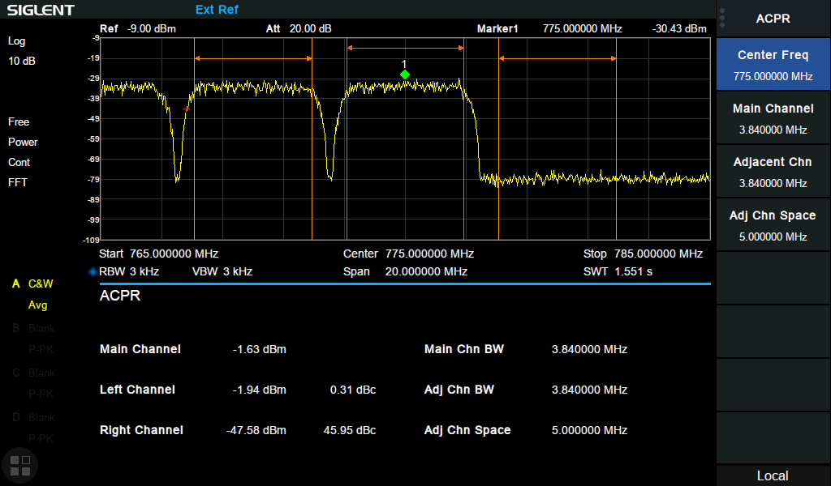
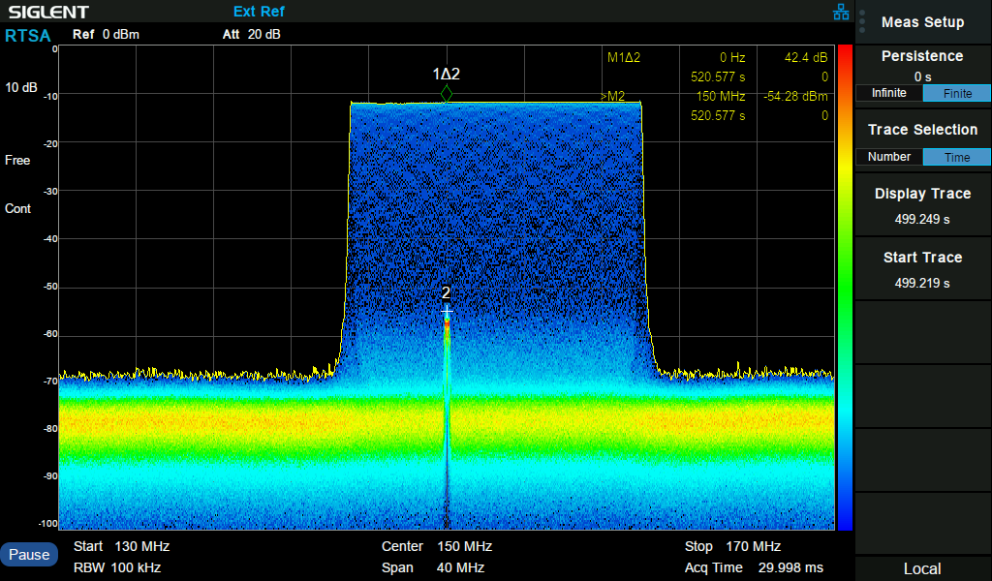
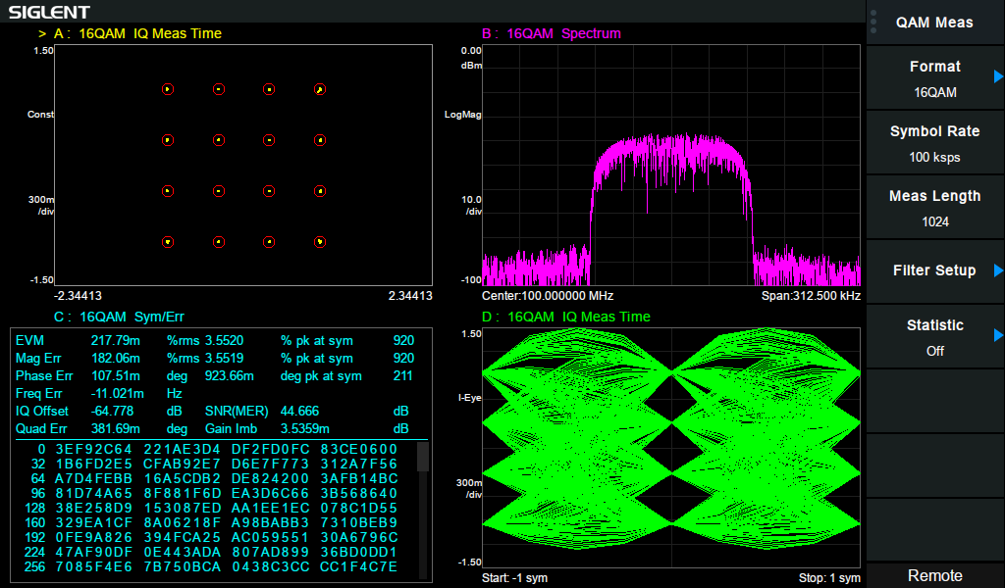
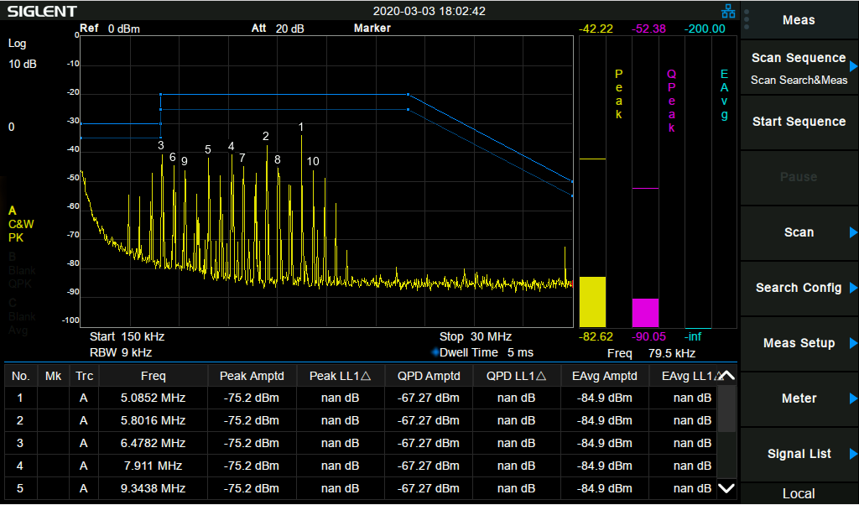
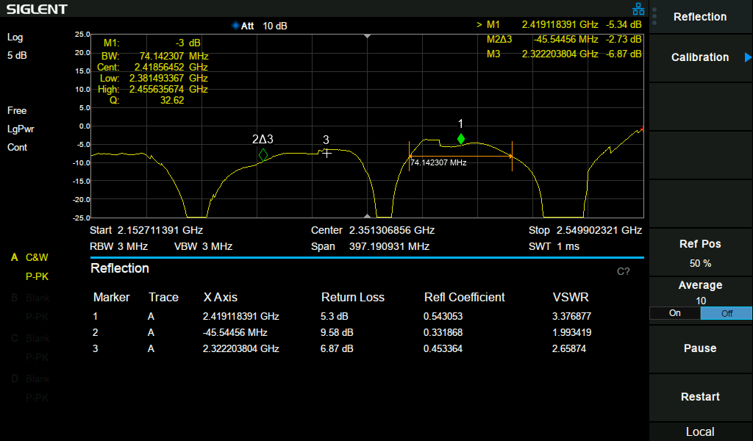
SSA3000X-R Features
Up to 40 MHz (option) real-time bandwidth
Locate the interested events in complex signal environment with Frequency Mask Trigger (FMT)
Density, Spectrogram, PvT, 3D display modes, analyze a signal in multi-views
Detect and measure accurately with signal as short as 7.2 us (100% POI)
See small signals in the presence of large signals with a dynamic range of 60 dB and FMT
Perform better EMI tests with dedicated EMI Receiver Mode
ACPR in AMK measurement kit
RTSA mode
40 MHz VSA mode
EMI Measurement Mode
Reflection Measurement

Slide 7
SSA3000X-R main specs
 | SSA3050X-R | SSA3075X-R
Frequency Range | 9 kHz ~ 5.0 GHz | 9 kHz ~ 7.5 GHz
Resolution Bandwidth | 1 Hz ~ 3 MHz | 1 Hz ~ 3 MHz
Displayed Average Noise Level | -165 dBm/Hz | -165 dBm/Hz
SSB Phase Noise | <-98 dBc/Hz | <-98 dBc/Hz
Tracking Generator | 100 kHz - 5.0 GHz | 100 kHz - 7.5 GHz
Advanced Measurement | CHP, ACPR, OBW, CNR, Harmonic, TOI, Monitor
Modulation Analysis | AM, FM, ASK, FSK, MSK, PSK, QAM
Reflection Measurement | VSWR measurement using Reflection Bridge
EMI Measurement Mode | EMI Filter and Quasi-Peak Detector, Log Scale and Limit Line
Real Time Band Width | 25 MHz, 40 MHz (Option)
100% POI | 7.20 μs
RTSA Display Modes | Density, Spectrogram, 3D, PvT
Communication Interface | LAN, USB Device, USB Host (USB-GPIB)
Remote Control Capability | SCPI / LabVIEW / IVI based on USB-TMC / VXI-11 / Socket / Telnet
Remote Controller | NI-MAX, Web Browser, Easy Spectrum software, File Explorer

Slide 8
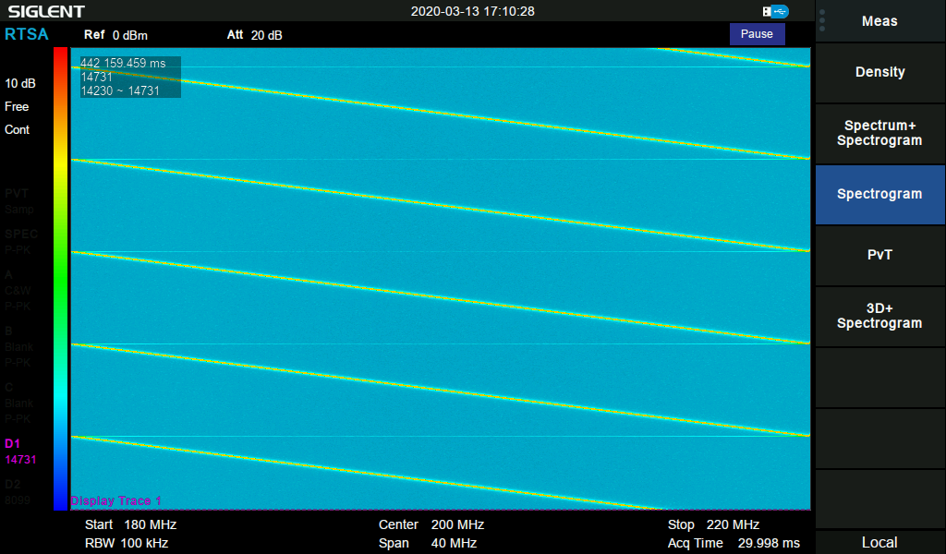
Real-Time bandwidth
Also called instantaneous bandwidth. It is the widest measurement span in which the analyzer can sustain real-time operation.
SSA3000X-R offers 25 MHz RTBW as standard, 40 MHz as an option.

Slide 9
Parameters
RTSA parameters are similar to swept SA.
 | RTSA | Swept SA
Center Frequency | Target frequency
SPAN | Frequency range to be analyzed
RBW | Change with SPAN
Sweep time | Data acquisition time; Irrelevant to RBW | The time LO sweep over the SPAN; Relevant to RBW
Detect | Pos Peak, Neg Peak, Average, Sample

Slide 10
FMT
Why need Frequency Mask Trigger?
Think of capturing and analyzing a rare event in a given frequency range. Need to capture real-time data over a very long time, but most of the time the event does not appear.
Requires a large amount of fast memory.
Extremely time consuming to analyze the bulk of stored data.
With FMT, Trigger on and acquire the event of interest
Reduces the necessary memory size.
Reduces the time to spot the event of interest in the acquired data.
FMT enables different trigger power levels on individual frequencies. Thus it enables triggering on a small signal in the presence of a big signal. This is extremely important when analyzing intermittent, interfering, pulse, hopping frequency signals.

Slide 11
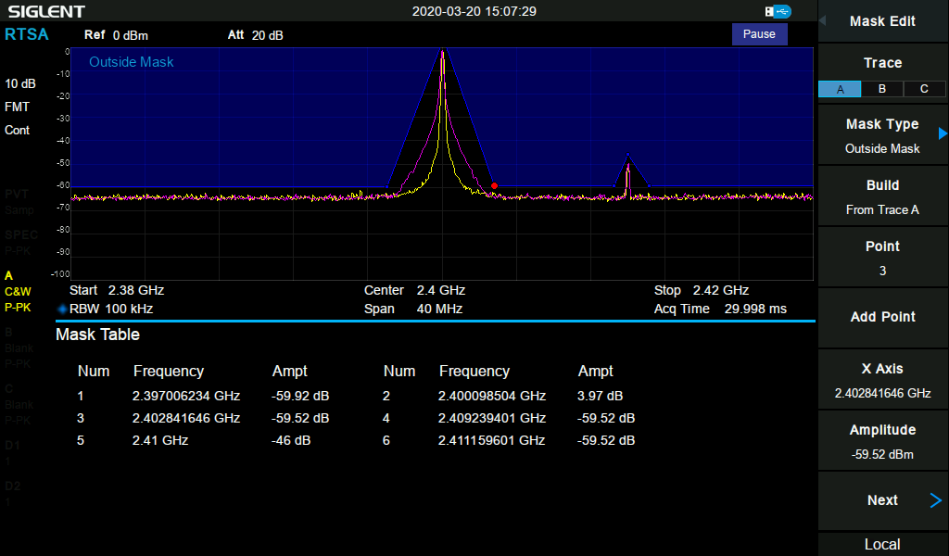
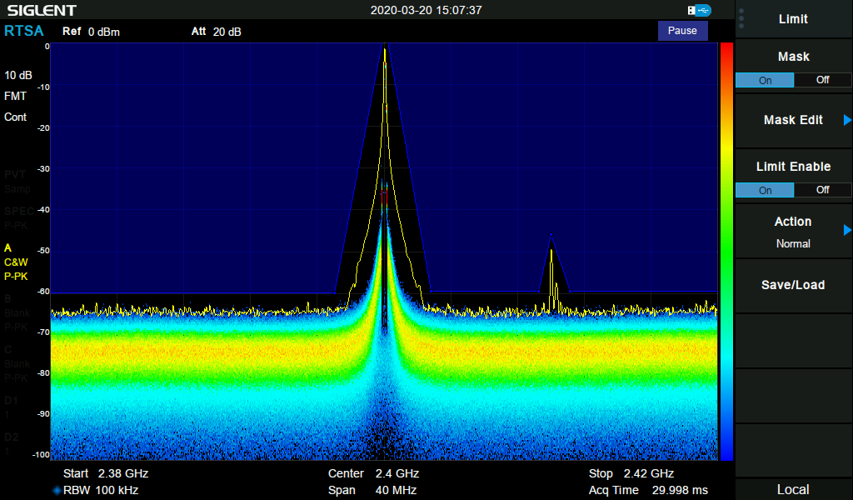
FMT
SSA3000X-R FMT is in Limit menu.
Mask Type
Greater Than
Less Than
Outside Mask
Inside Mask
Action
Normal
Beep
Stop
Mask Edit: Add a point and drag it to the appropriate location or input frequency and amplitude.
1-801 points, if any specific point
exceeds mask, it will trigger.

Slide 12
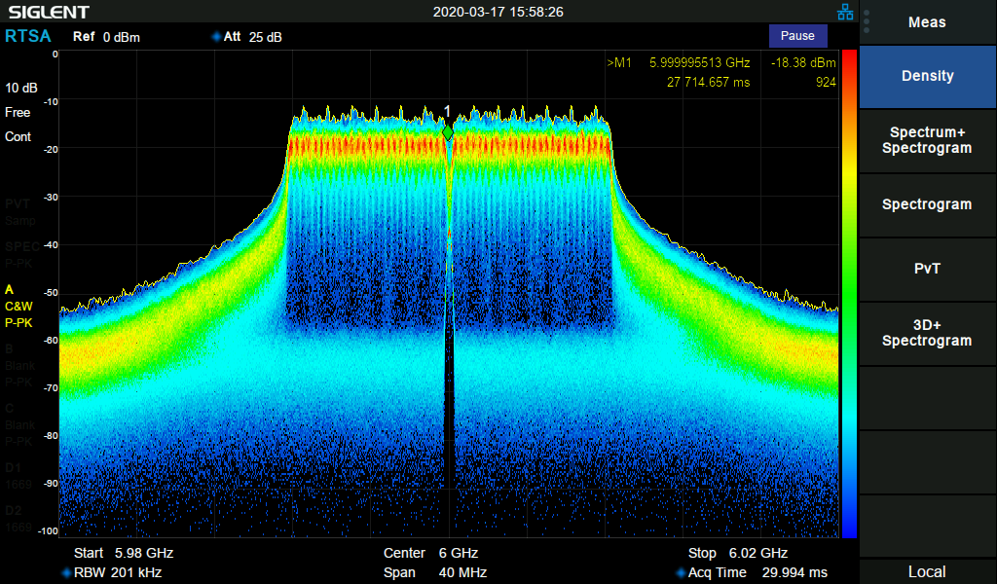
Density
Also called as Histogram Persistence/ Persistence Spectrum.
Horizontal – Frequency Vertical – Amplitude Color – Probability
Typical Applications:
Analysis of time varying signals
Analyze small signal in the presence of big signal
WLAN 802.11

Slide 13
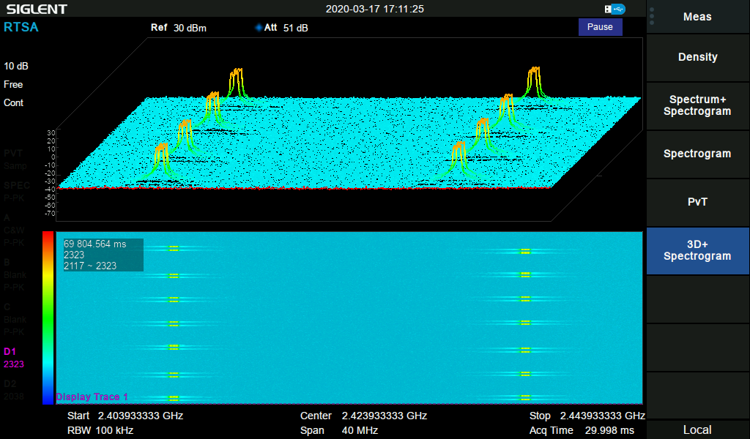
Spectrogram
How to know when a event happens and its periods? Density is not enough.
Display continuous spectra over time, use different color to represent spectra level.
Useful in analyzing time variant signals.
SSA3000X-R can save 50,000 traces in history to play back.
Typical Applications:
Transient oscillation of a VCO
Frequency hopping signals,
such as radar, EW signals
A Bluetooth transmitter sending data in Hopping mode
Horizontal – Frequency
Vertical – Time
Color – Amplitude Level

Slide 14
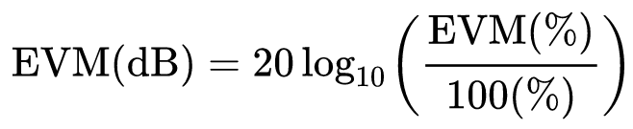
VSA option
What if the signal is modulated so that demodulation and detailed analysis is needed?
SSA3000X-R provides Vector Signal Modulation Analysis option and EVM evaluation. The analysis BW is same with real-time BW in RTSA mode.
Supported demodulation types: AM, FM, ASK, FSK, MSK, PSK, QAM
EVM
EVM (Error Vector Magnitude) can be expressed in % or dB.
EVM is used to quantify the performance of a digital radio transmitter or receiver.
Informally, EVM is a measure of how far the points are from the ideal constellation points locations.

Slide 15
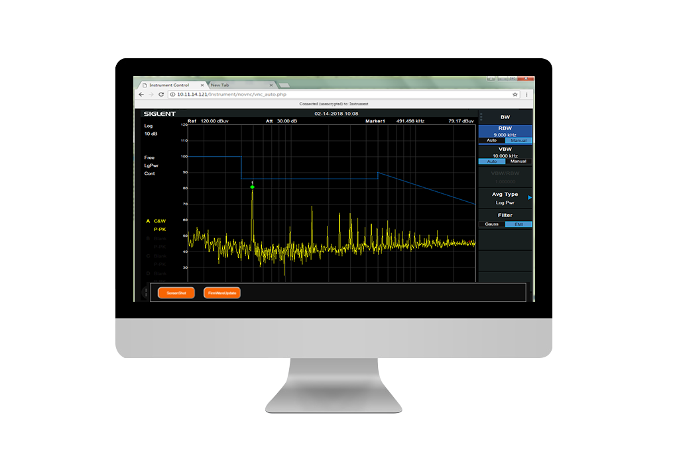
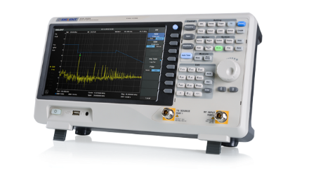
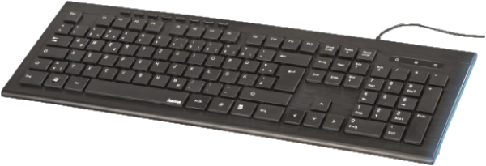
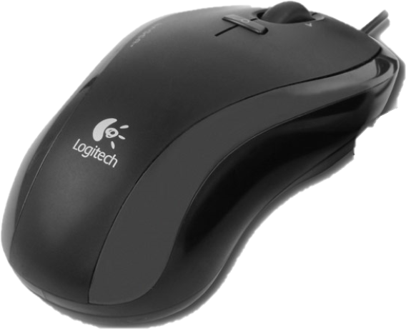
SSA3000X-R Series Usability
Utilize the same easy and intuitive User Interface as SSA3000X Plus
Touch Screen – Quick access to settings
External Keyboard & Mouse – Computer-like usage
Webserver – Easy Remote control
SSA3000X-R comes with a 10.1 inch touch screen. It supports on screen keyboard and enable to edit Labels.
Plus, external keyboard and mouse are also supported.
In addition to EasySpectrum, Telnet and Socket communication, It includes a Webserver that enables direct remote control via a PC or mobile.

Slide 16
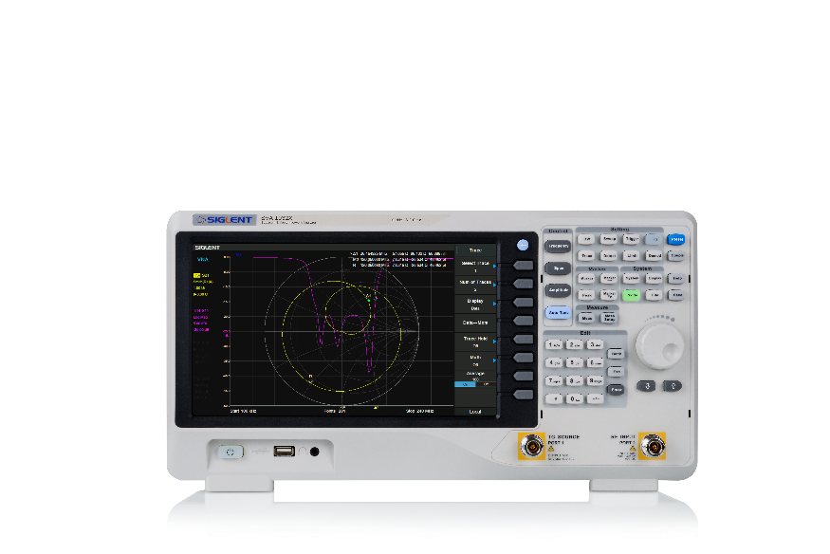
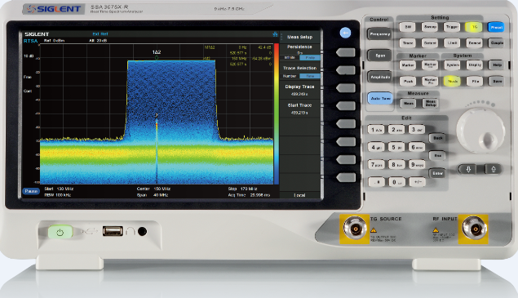
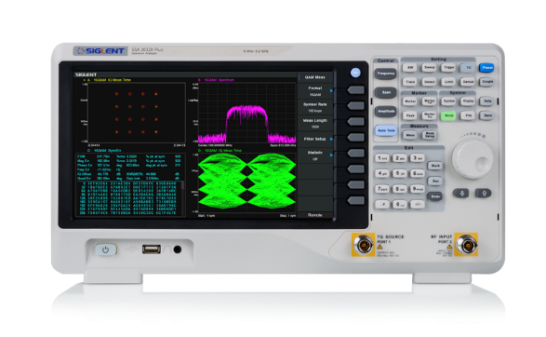
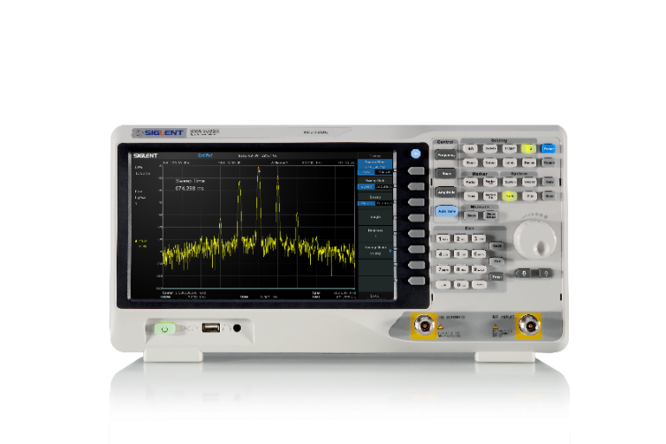
Spectrum Analyzer Portfolio Positioning
10449.-
Price/USD
8549.-
8159.-
6999.-
3409.-
2795.-
2595.-
SSA3000X-R
5 GHz / 7.5 GHz
1999.-
1595.-
SVA1000X
1.5 GHz / 3.2 GHz / 7.5 GHz
1395.-
SSA3000X plus
2.1 GHz / 3.2 GHz / 7.5 GHz
SSA3000X
2.1 GHz / 3.2 GHz
Functions & Performance
Basic SA
SA & opt. VSA
SA & VNA & opt. VSA
SA & RTSA & opt. VSA, EMI Receiver Mode

Slide 17
Applications
SA General purpose Spectrum Analysis
AM/FM demodulation
Interference and Surveillance
Insertion loss/ Reflection measurement
AMK Analyze modulated signal Parameter (CP, OBW, CNR)
Determine Signal Quality (ACPR, CNR, Harmonics, etc.)
Harmonics measurements
Amplifier performance (TOI, etc.)

Slide 18
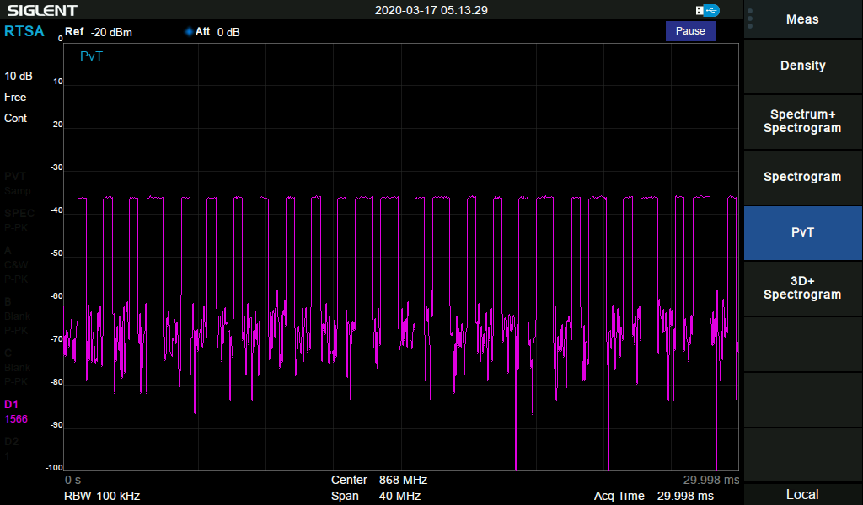

RTSA Applications
PULSE MEASUREMENTS
Any kind of pulsed signals. Gather information about the carrier frequency, rise and fall times, occupied spectrum and pulse width.
RADAR
Radar pulses must be measured within time and frequency domain to detect spurs, analyze the noise figure or the spectrum occupancy.
The transient nature of Radar signals make capturing and analysis difficult. With RTSA FMT, it enables capture radar signal in complex EW spectral environment.

Slide 19
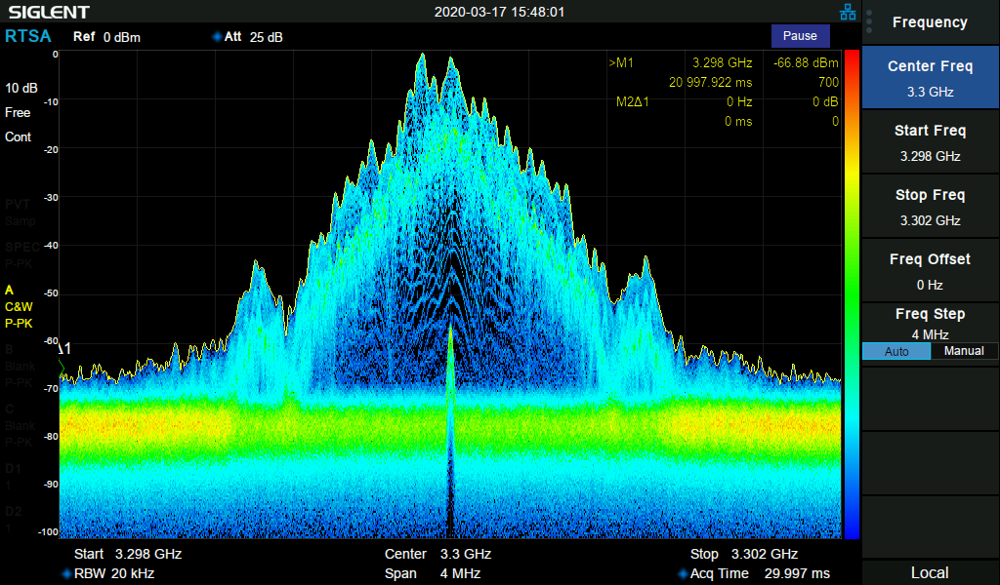
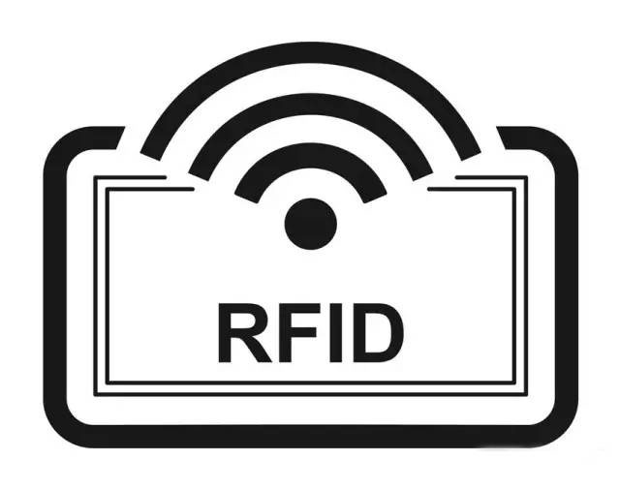


RTSA Applications
NFC/RFID/Bluetooth
Near-field-communication (NFC), radio frequency identification (RFID), tire pressure-monitoring systems (TPMS) or other communication standards can be measured and monitored. They are usually operating in bands where other applications are located too. Therefore RTSAs can be used to identify external disturbances.

Slide 20
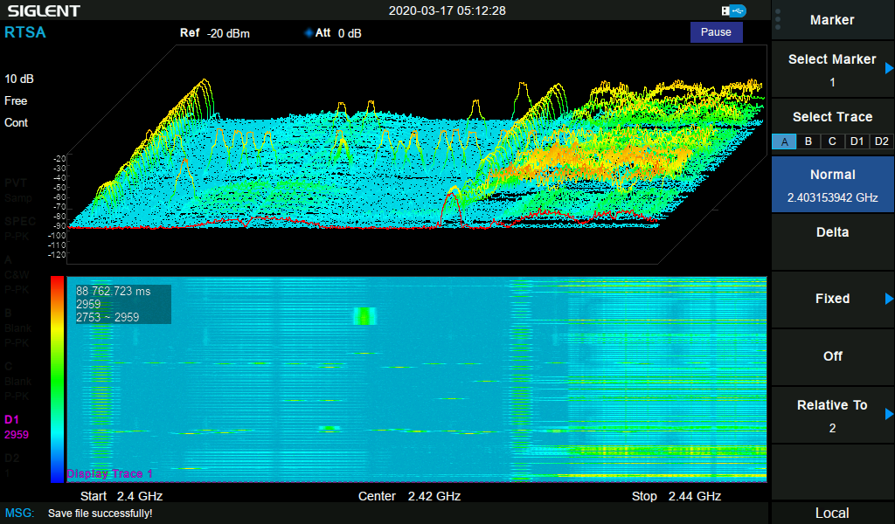
RTSA Applications
VCO/PLL ANALYSIS
Random sweeping or glitch behavior is produced by Voltage-controlled oscillators or phase-locked loop ICs that would not be detected by normal swept analyzers.
Spectrum Management
Intermittent signals are nearly impossible to capture with an swept analyzer. With frequency mask triggers you can capture nearly any intermittent signal with 100% probability. (SSA3000X-R 100% POI at 7.2us)

Slide 21
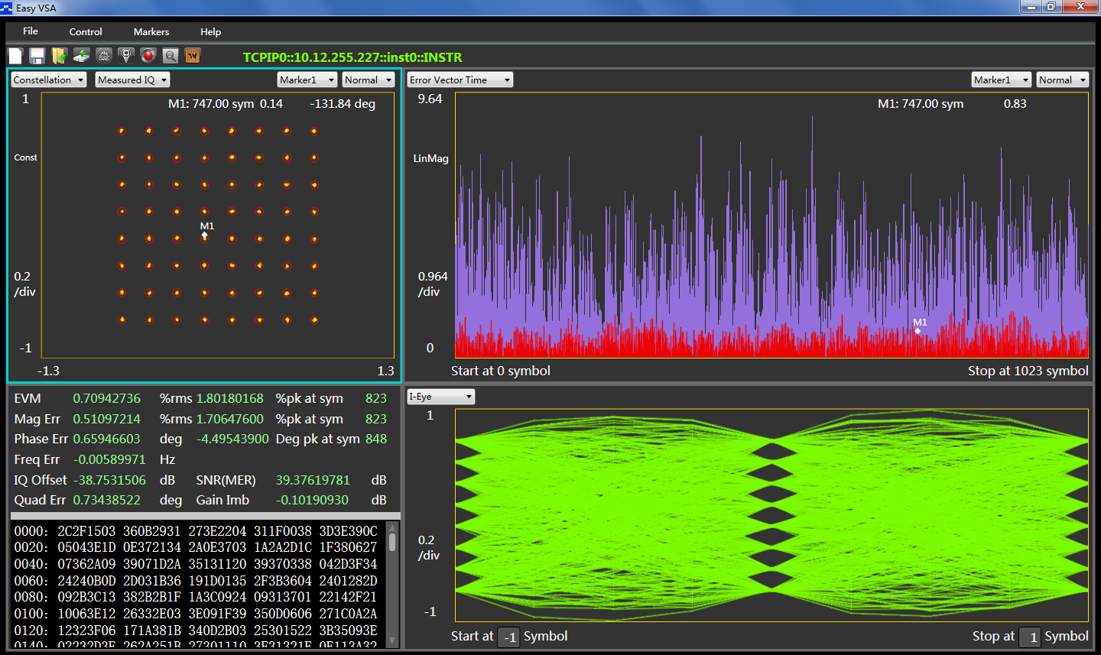
Applications
Wideband VSA
Transmission Quality Analysis (for AM,FM, PSK, MSK, FSK, QAM modulation)
SSA3000XP-DMA analysis bandwidth is only 2.5 MHz
SSA3000XR-WDMA analysis bandwidth is up to RTSA BW (25 MHz standard, 40 MHz option)
New Easy VSA software supports SSA3000X Plus, SSA3000X-R, SVA1000X
Play back in Easy VSA, Easy IQ and SSG5000X signal generator.

Slide 22
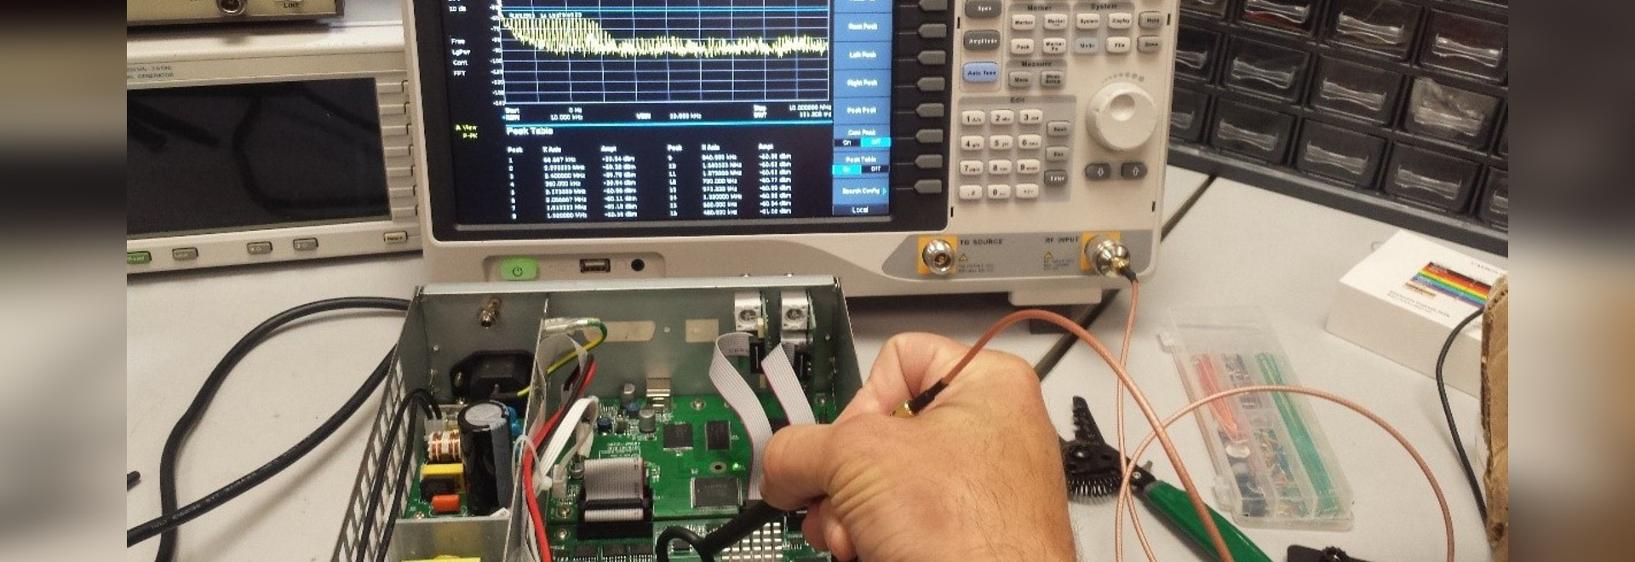
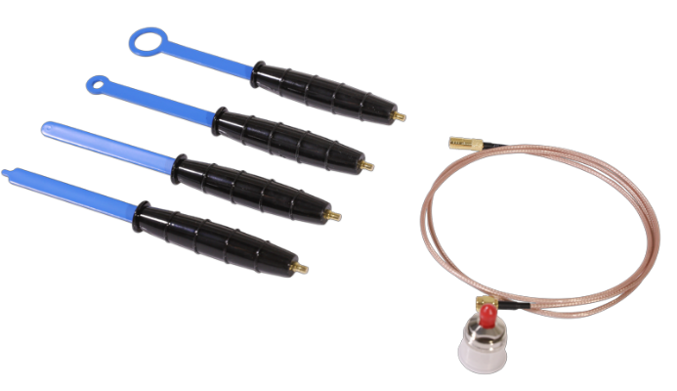
Applications
EMI
Since the devices are getting more and more complex there are much more potential disturbers. Distortion could be caused by switching between different operations modes or by only partly activated components. These can be captured and identified quickly by an RTSA.
New dedicated EMI Measurement Mode

Slide 23
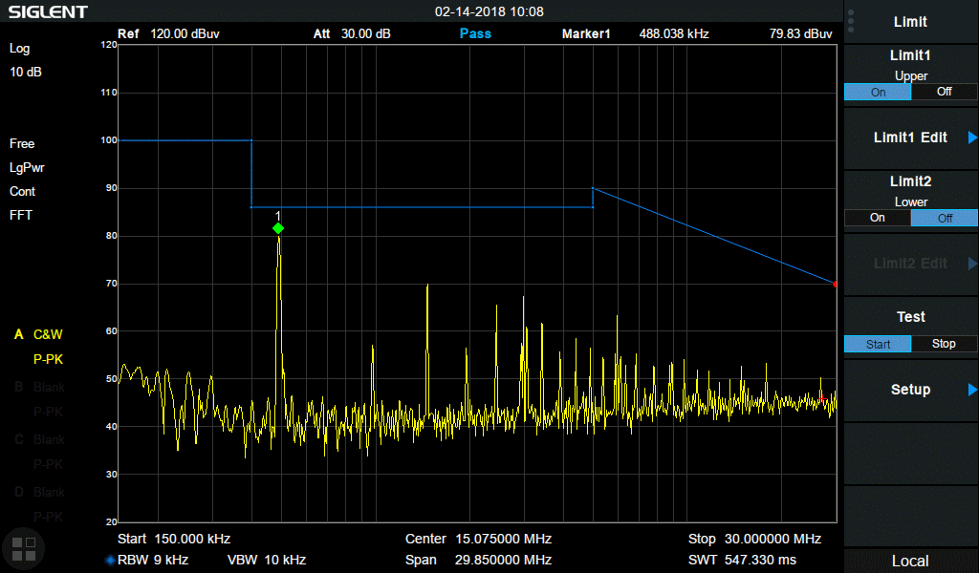
EMI option changes
EMI Measurement Mode
Built-in CISPR Band A/B/C/D presets
Peak, Quasi Peak, EMI Average Detector
Continuously monitor signal with bar meter to detect
maximum amplitude
Compare emissions with regulatory limits
EMI in SSA3000X
BW -> Filter -> EMI filter
Quasi Peak Detector
Free Easy Spectrum
Compare emissions with regulatory limits

Slide 24
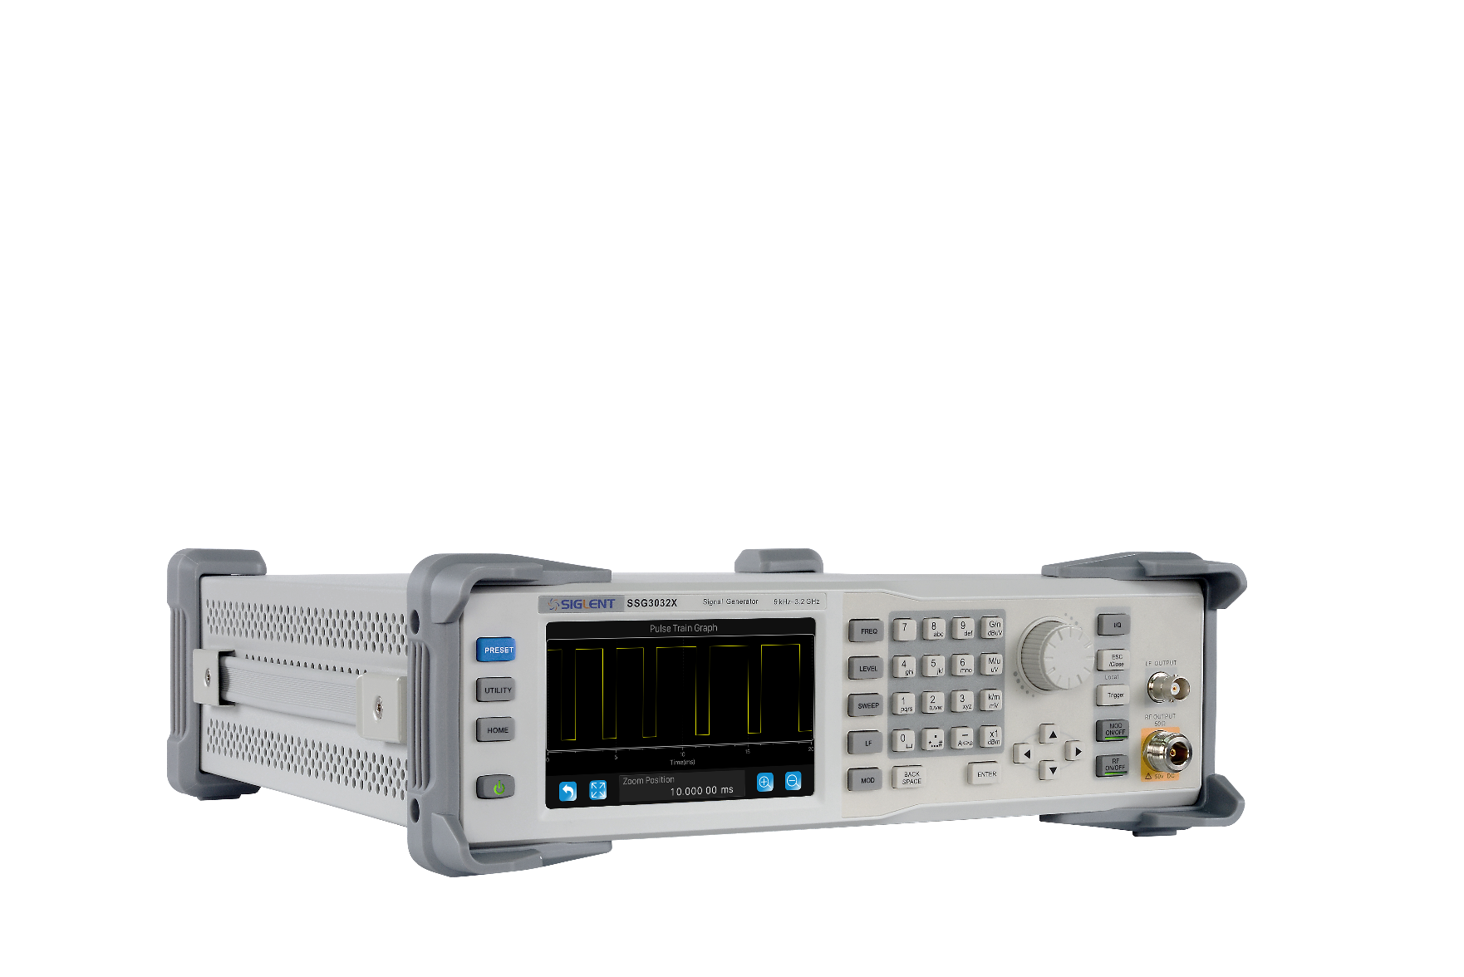
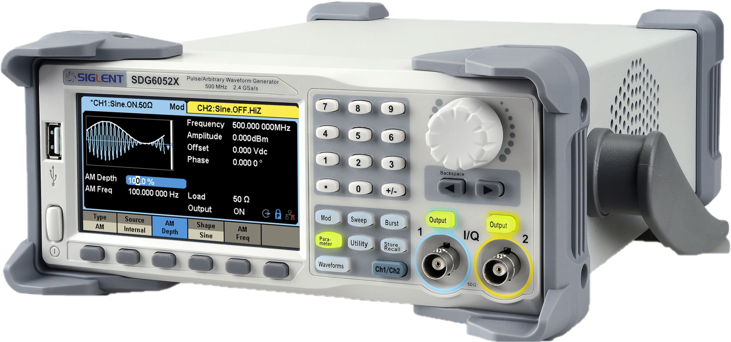
Cross - Selling
Don’t forget to cross sell other products!
If you talk to a customer, who work on RF-Designs always ask about RF-Signal Source!
We have a very competitive solution with SSG3000X or SSG3000X-IQE !
Also SDG6000X together with the IQ-Option might fit for these Customers

Slide 25
SSA3000X-R competition analysis
 | SSA3000X-R | Rigol RSA5000
Frequency Range | 9 kHz ~ 5/7.5 GHz | 9 kHz ~ 3.2/6.5 GHz
RTBW | 25 MHz; 40 MHz (Option) | 25 MHz; 40 MHz (Option)
100% POI | 7.2 us | 7.45 us
Total Amplitude Accuracy | < 0.7 dB | < 0.8 dB
Preamplifier | Standard configuration | Option
TG | 100 kHz ~ 5/7.5GHz standard | 100 kHz ~ 3.2/6.5 GHz
Web Server | Support | Not support
Price | $8,549 (5GHz) | $8999(3.2GHz)
Higher frequency range
Higher amplitude accuracy
Higher price performance ratio

Slide 26
SSA3000X-R competition analysis
 | SSA3000X-R | Keysight N9020B-RT1
Frequency Range | 9 kHz ~ 5/7.5 GHz | 10Hz ~ 3.6/8.4GHz (option 503/508)
RTBW | 25 MHz; 40 MHz (Option) | 25MHz; 160MHz (option)
100% POI | 7.2 us | 17.3 us
Total Amplitude Accuracy | < 0.7 dB | < 0.39 dB
Preamplifier | Standard configuration | Option
TG | 100 kHz ~ 5/7.5GHz standard | N/A
Web Server | Support | Support
Price | $8,549 | $81,593
Better 100% POI
Standard Preamplifier
Better price performance ratio

Slide 27
SSA3000X-R competition analysis
 | SSA3000X-R | R&S FSVR7
Frequency Range | 9 kHz ~ 5/7.5 GHz | 10 Hz ~ 7 GHz
RTBW | 25 MHz; 40 MHz (Option) | 40 MHz
100% POI | 7.2 us | 24 us
Total Amplitude Accuracy | < 0.7 dB | < 0.4 dB
Preamplifier | Standard configuration | Option
TG | 100 kHz ~ 5/7.5GHz standard | N/A
Web Server | Support | Support
Price | $8,549 | $47,754
Better 100% POI
Standard Preamplifier
Better price performance ratio

Slide 28
RTSA Structure
Structure
FFT Windows
Overlap
POI
Density

Slide 29
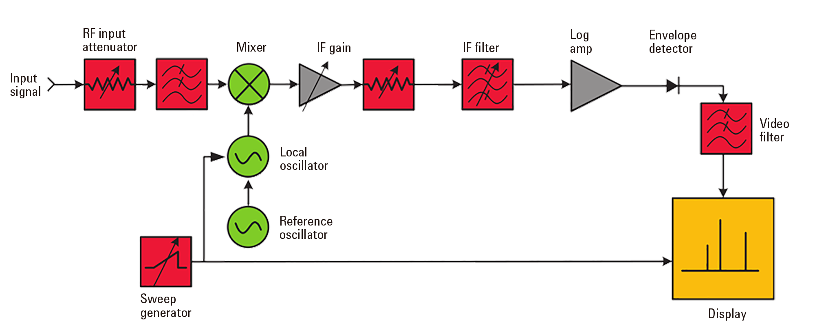
Swept SA Structure
This is old swept SA structure just to briefly explain the theory behind

Slide 30
Swept SA shortage
Traditional SA has blind time.
Set parameters like RBW and SPAN, SA will sweep from the lowest frequency to the highest.
When SPAN is wide, RBW is small– Sweep time is long.
Even with Max-Hold, agile and elusive signals is difficult to locate.

Slide 31
Swept SA shortage
In Swept FFT mode, blind time exist between two FFT sweep. Data length = FFT window length (Relate to RBW)
Left figure: Analysis BW ＜ IF BW
Right figure: Analysis BW ＞ IF BW

Slide 32
RTSA Structure
IF 40 MHz Bandwidth
ADC sampling rate is 160 MHz, FFT sampling rate is 51.2 MHz .

Slide 33
RTSA advantage
RTSA improves the probability of agile signal capture. Gap-free is the primary difference from swept SA.
Acquisition time is user defined data acquire time, from ms to 50s.
Each acquisition time contains 1 to millions of FFT frames. (Depends on SPAN and RBW)

Slide 34
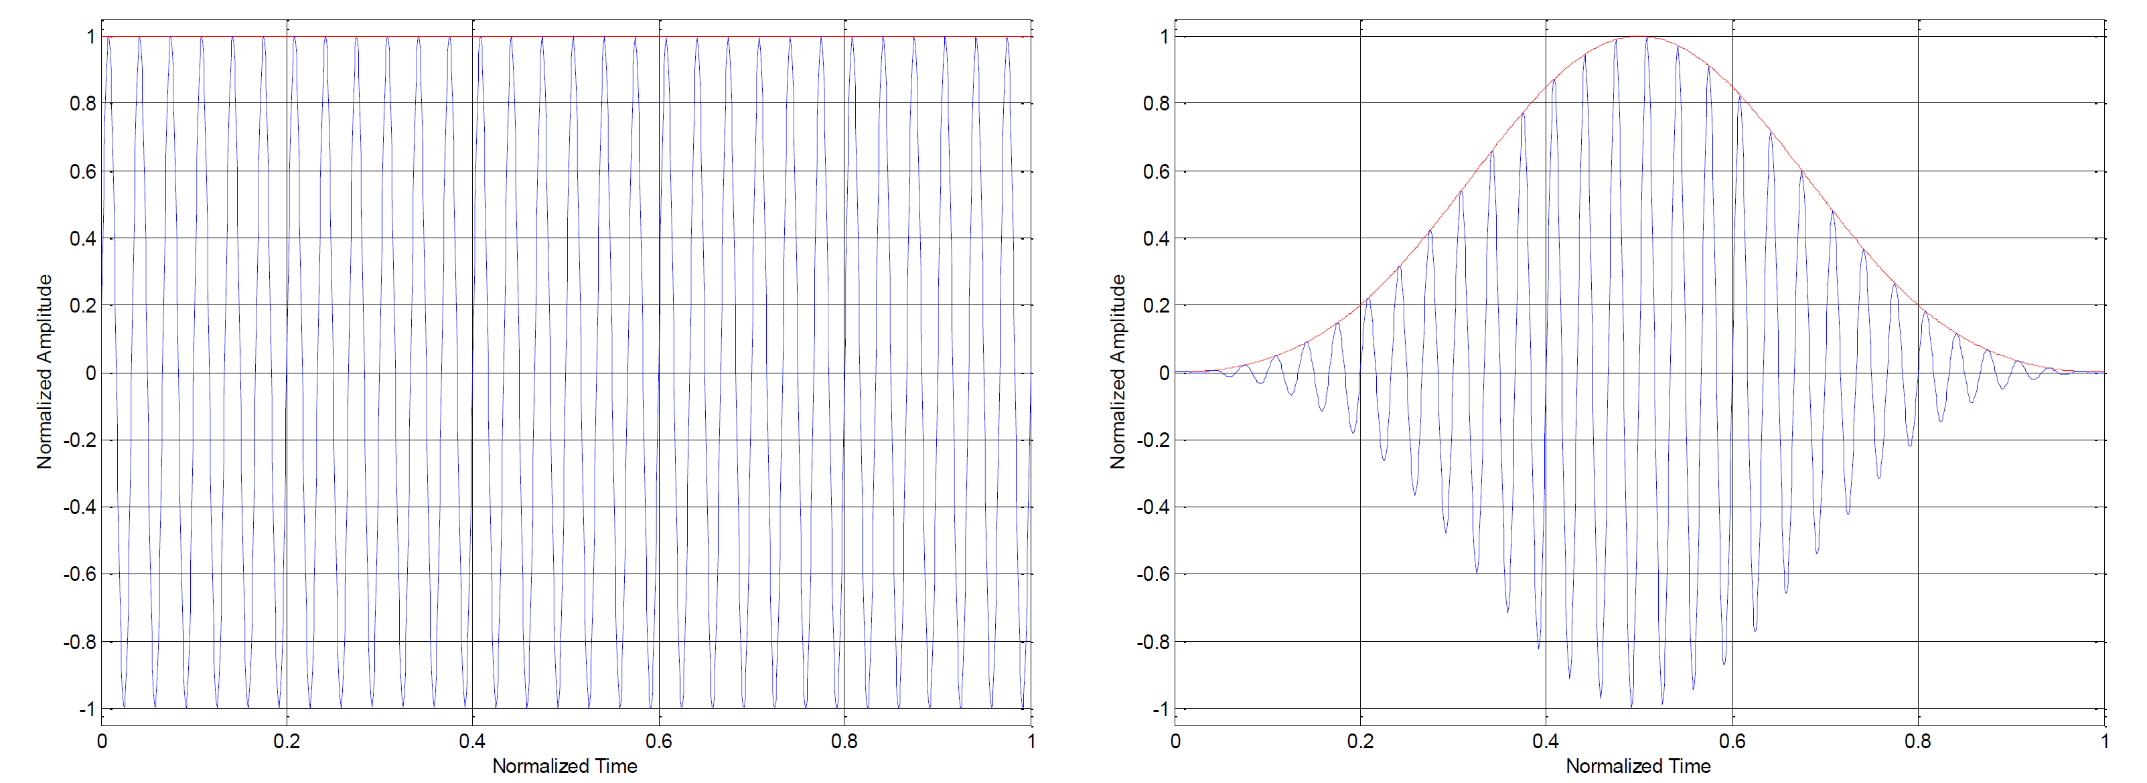
FFT Windows
If the FFT is directly applied over the gathered data the resulting frequency domain signal will exhibit phenomena like spectral leakage, scalloping loss, and processing loss.
Applying a window function to the signal in time domain prior to FFT computation significantly reduces these effects, as the window can force the signal to be periodic with exactly the window length.
The window length is usually equal to the FFT length.
Leaving the signal as it is, is an rectangular window.

Slide 35
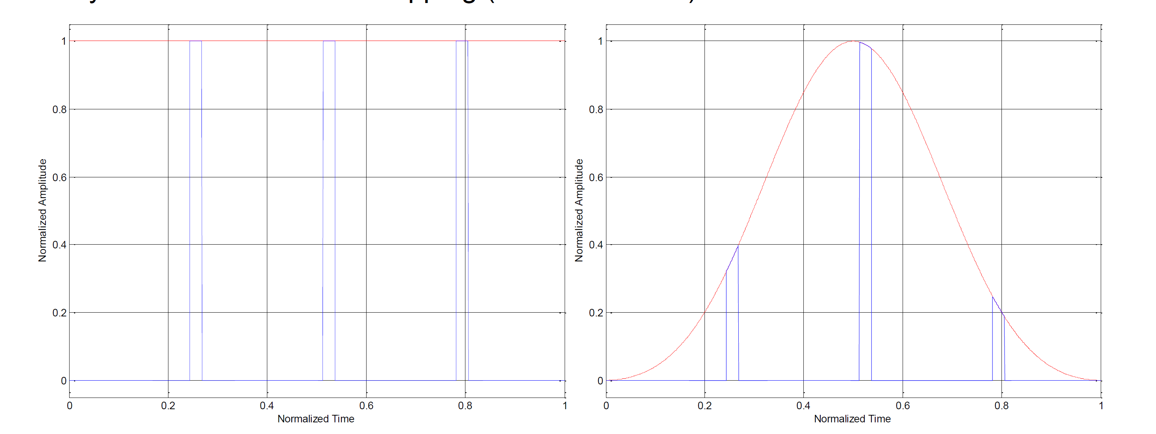
FFT Windows
Different Signals require different FFT windows.
For rare events, such as pulses, the location within the window function makes a significant difference in terms of level accuracy.
Window | Spectral Leakage | Amplitude Accuracy | Frequency Resolution
Kaiser | Good | Good | Fair
Hanning | Good | Fair | Good
Flattop | Good | Best | Poor
Gaussian | Fair | Good | Fair
Blackmann-Harris | Best | Good | Fair
Rectangular | Poor | Poor | Best
Use the right FFT window for your application
The FFT window influences the accuracy.

Slide 36
Gap free conditions
When Capture time is longer than FFT process time -> Gap free
SSA3000X-R adopts 1024 points FFT, FFT process time is approx. 6.4us.
When Capture time is less than FFT process time, it is not gap-free.
For example, in SSA3000X-R, when SPAN is 40 MHz, window length 32, capture time is about 0.6 us, much less than FFT process time 6.4 us.

Slide 37
Overlap
When Capture time is longer than FFT process time, every two FFT process has interval in between. If a event happens at the edge of FFT window, this event may be missed out.

Slide 38
Overlap
Overlap can help to solve the issue. Agile signal can ben analyzed with overlap in multi FFT frames.
A side effect of this property is that consecutive events may occur in several FFT results. The result is similar to a photograph that depicts everything that has happened within the exposure time.

Slide 39
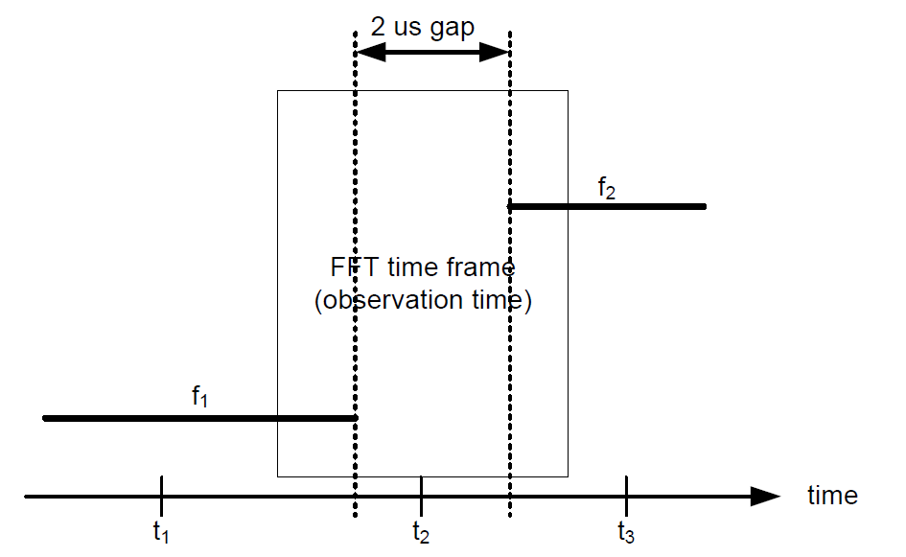
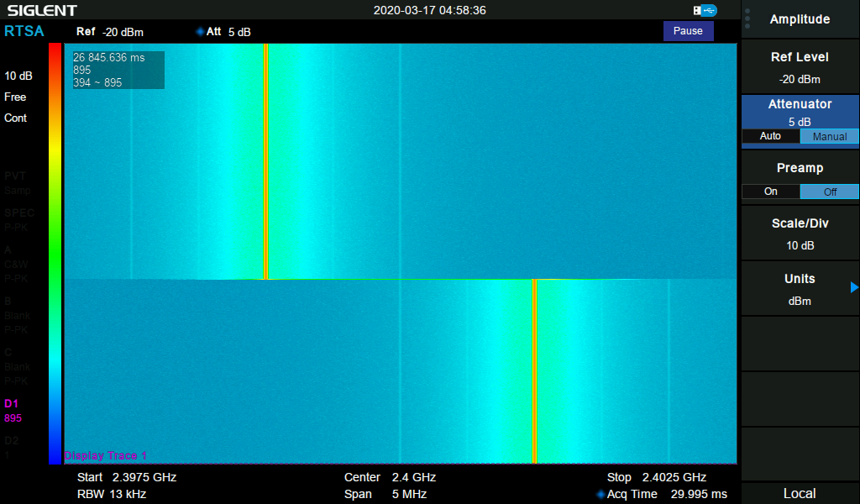
Mixing results
If there is a gap between two signals, which is smaller than the FFT, a user might expect an FFT result showing nothing but noise components. Since the FFT includes everything what is within the window, there will be mixing results. A user with knowledge about FFT processes knows what to expect:
Consecutive FFT results show the spectral component for f1 at first. During the 2 μs gap without a signal, the FFT result may show a spectral components of f1 at reduced level as well as a spectral components of f2 with a reduced level.

Slide 40
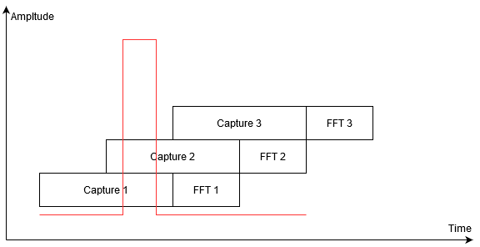
POI
Probability of Intercept
100% POI time means when signal lasts longer than this time, RTSA can 100% capture and accurately measure it.
Lwin – Window length fs – sampling rate NFFT – 1024 points in SSA3000X-R fclk – FFT clock 160 MHz
Detected but with wrong amplitude.
100% POI is granted when the Signal is measured at least 2 Capture Windows

Slide 41
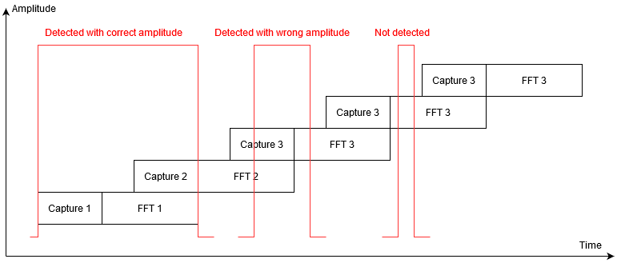
POI
Probability of Intercept
100% POI time can be reduced by reducing the FFT points. This will reduce the capturing time as low as FFT conversion.
RBW | FFT Points
1 | 1024
2 | 512
3 | 256
4 | 128
5 | 64
6 | 32
100% POI = one FFT process time + one frame data capture
The FFT will always work with 1024 points but within RBW 6 only 32 points will be captured. The left 992 points are set to 0. This ensures that the FFT is running continually and the maximum sampling speed is achieved.
No overlapping anymore. There will be blind time between two windows. Similar to blind time within Oscilloscopes.

Slide 42
Density
(Histogram Persistence)
RTSA can do thousands of FFT calculations per second. Due to noise, every waveform can not be completely overlapped.
Question: How to display thousands of frames and show the probability each frame appears?
A: Mapping frequency and amplitude, use different colors to present the hit counts.
One frame FFT
7 frames FFT with intensity display
7 frames FFT

Slide 43
Thank You
The Best Value in Electronic Test & Measurement
Headquarters
NA
Europe
SIGLENT TECHNOLOGIES CO., LTD.
Add: Blog No.4 & No.5, Antongda Industrial Zone, 3rd Liuxian Road,
Bao’an District, Shenzhen, 518101, China.
Tel:+ 86 755 3688 7876
Fax:+ 86 755 3359 1582
sales@siglent.com
www.siglent.com/ens
SIGLENT Technologies NA, Inc.
Add: 6557 Cochran Rd Solon, Ohio 44139 Tel: 440-398-5800 Toll Free:877-515-5551 Fax: 440-399-1211
info@siglent.com www.siglentna.com
SIGLENT TECHNOLOGIES GERMANY GmbH
Add: Liebigstrasse 2-20, Gebaeude 14, 22113 Hamburg Germany Tel: +49(0)40-819-95946
Mobile: +49 151 40716756 Fax: +49(0)40-819-95947 info-eu@siglent.com www.siglenteu.com

