Slide 1


Slide 2
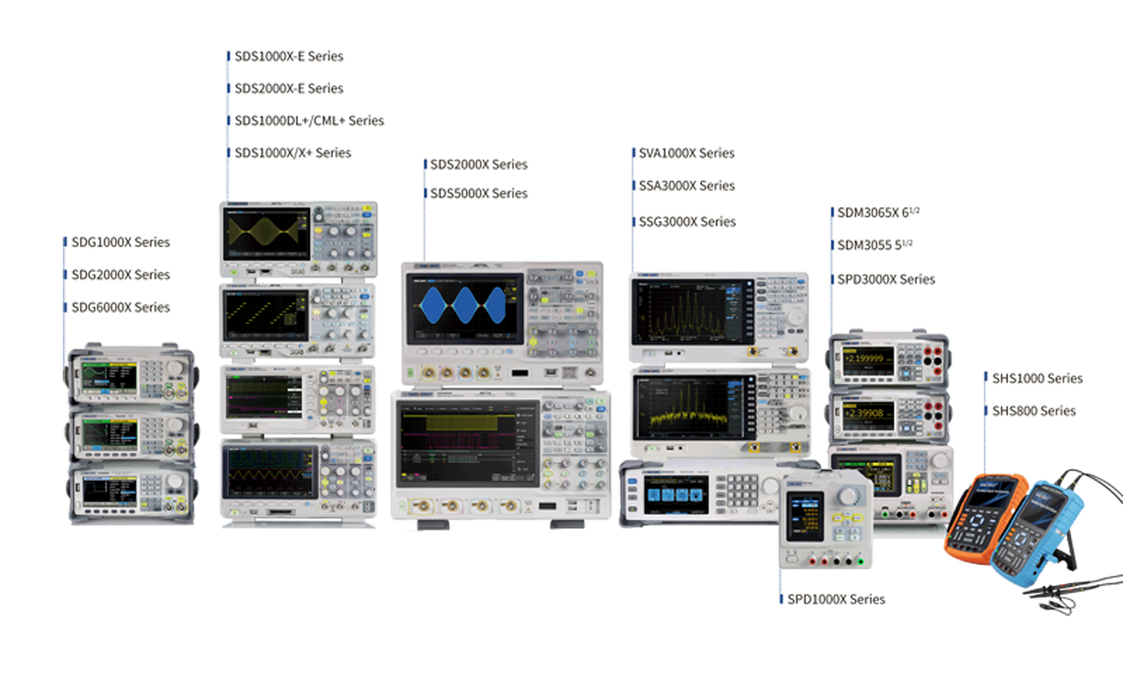
New Product Introduction
16th of September 2019

Slide 3
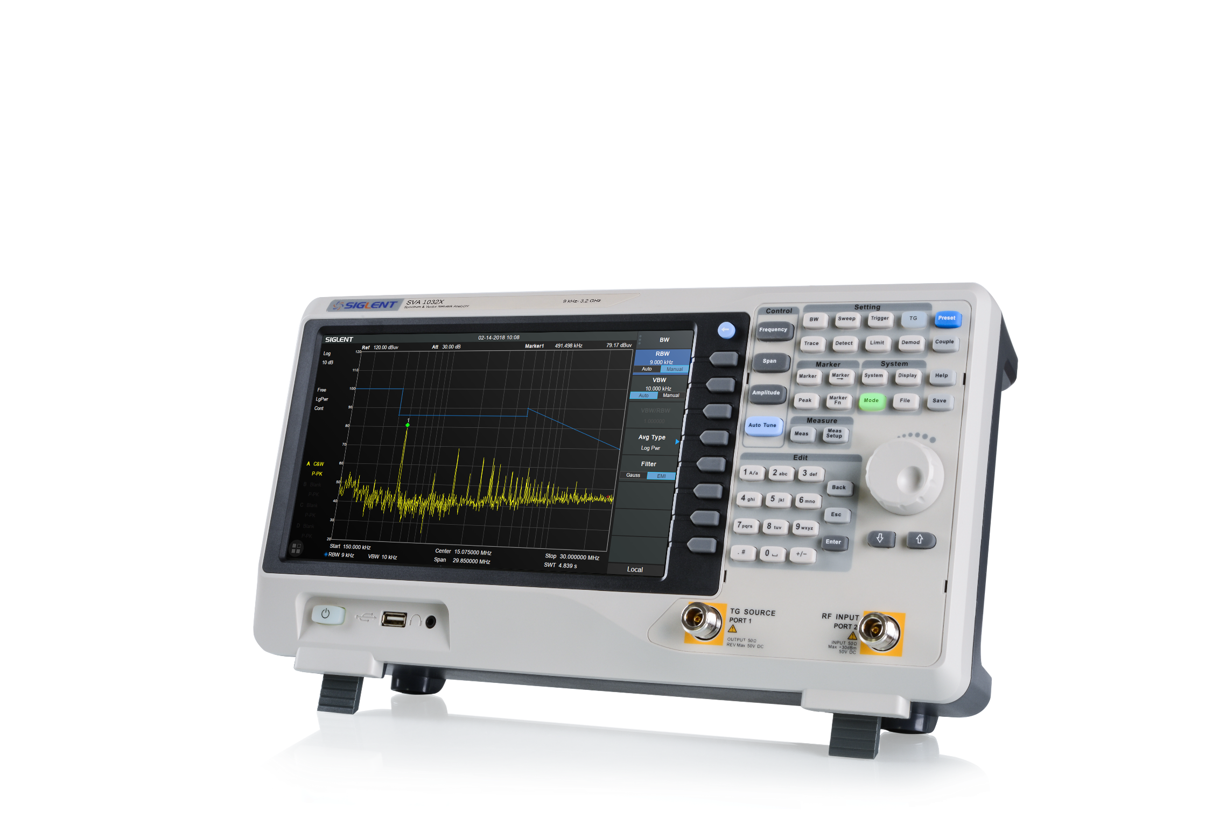

SVA1032X
Spectrum & Vector Network Analyzer

Slide 4
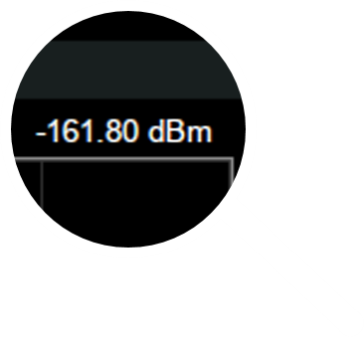
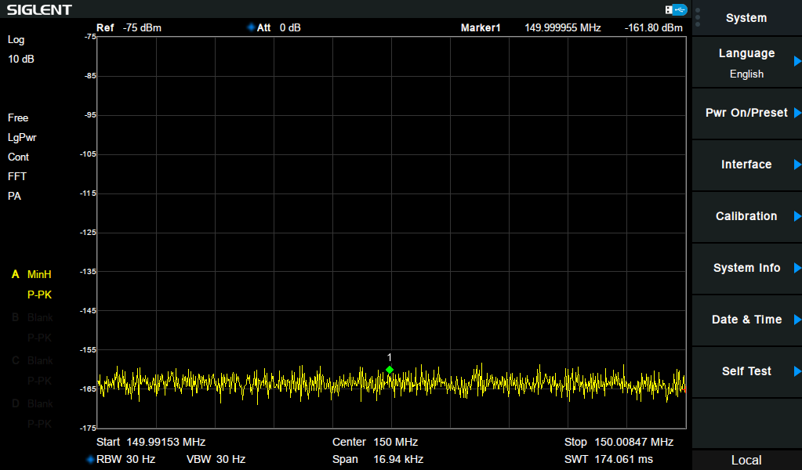
SVA1000X Series
What does the Spectrum & Network Analyzer Series deliver?
1.) Spectrum Analyzer with superb base Specifications
Model Spec. | SVA1015X | SVA1032X
Spectrum Analyzer Bandwidth | 9 kHz - 1.5 GHz | 9 kHz - 3.2 GHz
DANL | -156 dBm/Hz | -161 dBm/Hz
RBW | 1 Hz - 1 MHz
Phase Noise | < -98 dBc/Hz@1 GHz, 10 kHz offset
Total Amplitude Accuracy | <1.2 dB | <0.7 dB
Tracking Generator | Standard
Tracking Generator Bandwidth | 5 MHz - 1.5 GHz | 100 kHz - 3.2 GHz

Slide 5
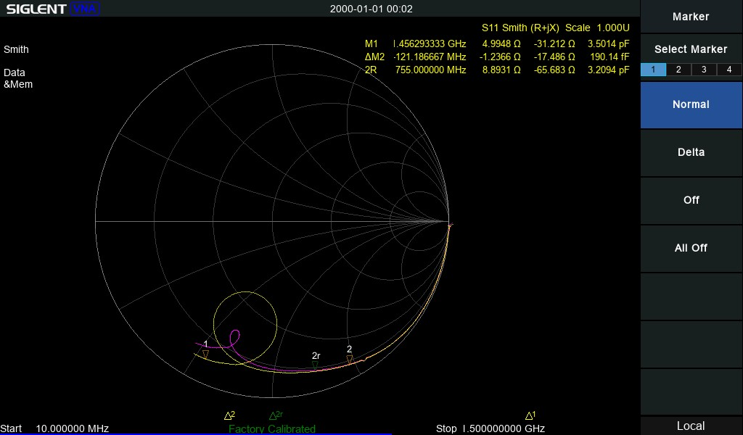
SVA1000X Series
What does the Spectrum & Network Analyzer Series deliver?
2.) Vector Network Analyzer (VNA)
Model Spec. | SVA1015X | SVA1032X
VNA Bandwidth | 10 MHz - 1.5 GHz | 100 kHz - 3.2 GHz
Measurements | S11 / S21
Stimulus Power | -5 dBm
Formats | Lin Mag, Log Mag, Phase, Group Delay, SWR Smith Chart (Lin/Log Phase, Real/Imag, R+jX, G+jB) Polar Chart (Lin/Log Phase, Real/Imag)
Sweep Points | 101 ~751, default 201
VNA is Standard!
With the 16th of September 2019 VNA is also Standard for SVA1015X!
SVA1015X new pricing: 1739.-€

Slide 6
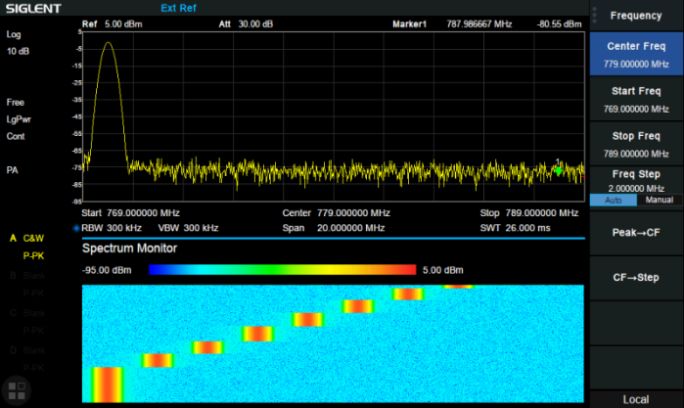
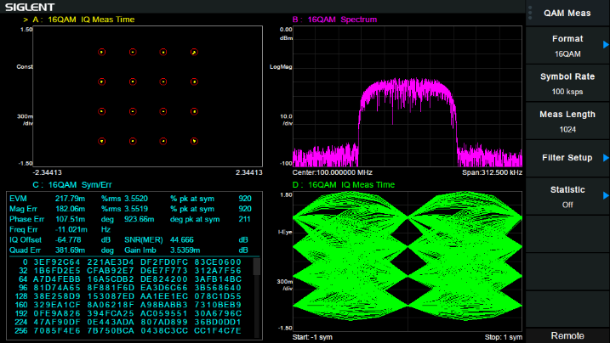
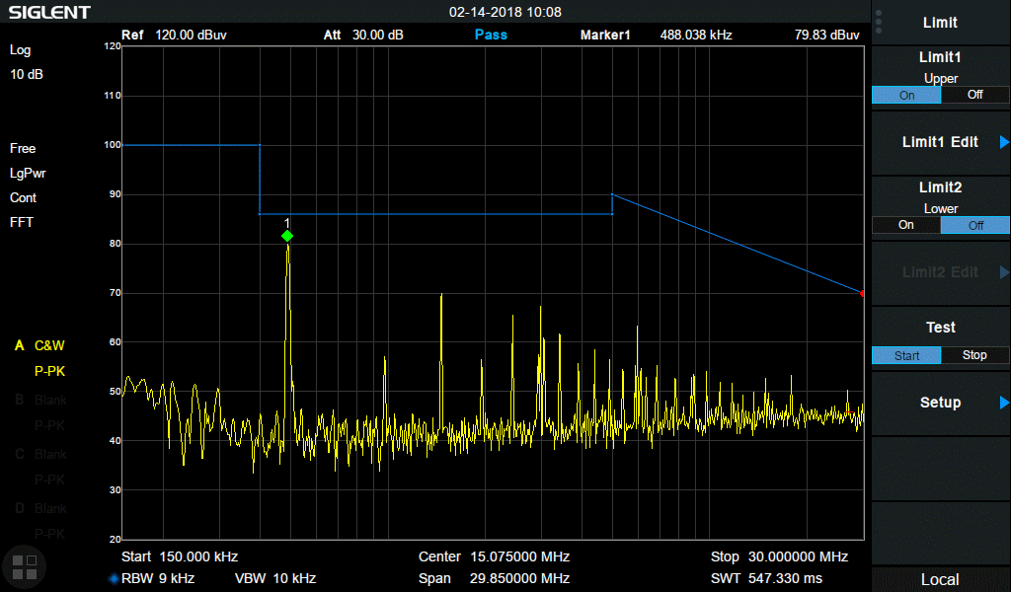
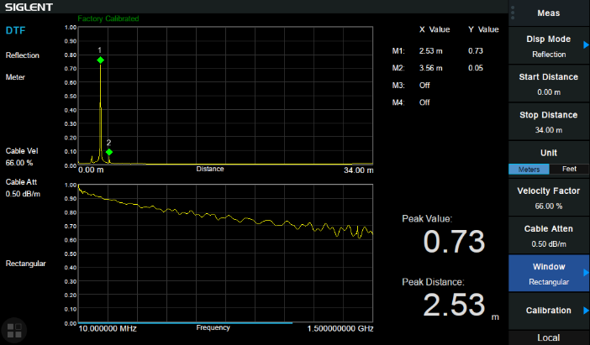
SVA1000X Series
What does the Spectrum & Network Analyzer Series deliver?
3.) Options:
Advanced Measurements (AMK)
Vector Signal Analysis (VSA)
EMC-Pre-Compliance (EMC)
Distance to Fault Measurement (DTF)

Slide 7
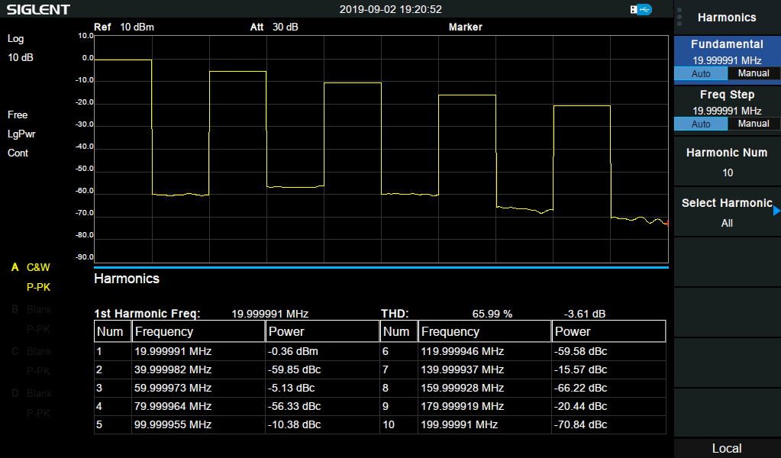
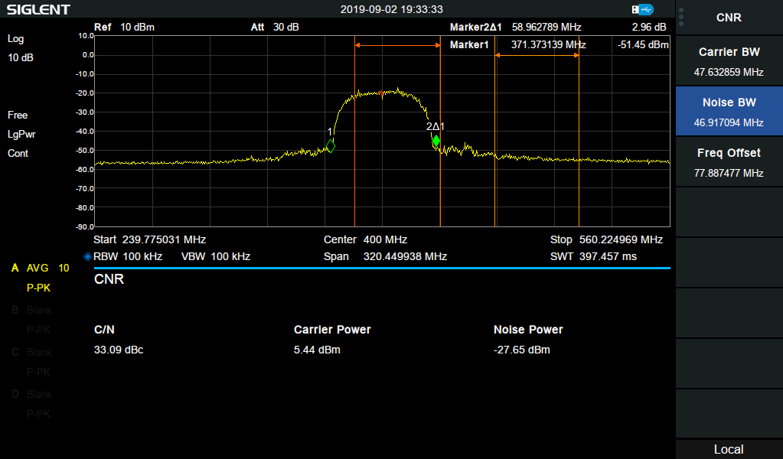
SVA1000X Series
What does the Spectrum & Network Analyzer Series deliver?
Extended Advanced Measurements (AMK) : Harmonic and CNR measurement
Harmonic Measurement:
The harmonic power and total harmonic distortion of carrier signal are measured. The maximum measurable harmonic is 10th harmonic.
CNR Measurement:
Measure the power of the carrier and noise of the specified bandwidth and their ratio. The term carrier-to-noise-ratio (CNR), instead of signal-to-noise-ratio (SNR) is preferred to express the signal quality when the signal is digitally modulated.

Slide 8

SVA1000X Series
What does the Spectrum & Network Analyzer Series deliver?
Vector Signal Analysis
Supported Modulation Types:
Analog: AM, FM
Digital: ASK, FSK, MSK, PSK, QAM
Do not mix AM, FM Demodulation with Modulation Analysis!
Demod. is Standard, VSA is Optional
Multiple Trace Data Formats selectable
Various Numerical Result Data
Time Domain View
Spectrum View
Etc.

Slide 9

SVA1000X Series
What does the Spectrum & Network Analyzer Series deliver?
EMC-Pre-Compliance
Supported EMI Filter RBW (-6 dB):
200 Hz, 9 kHz, 120 kHz, 1MHz
Detector:
Peak, Average, RMS, Quasi-Peak
– Two limit lines can be activated
– Each limit line can be either an upper or lower limit
– Limit lines have two modes: Line / Point
Line is a single line, that exist at a user-defined amplitude.
Point defined limits using line segments to built complex limits, like CISPR masks.

Slide 10
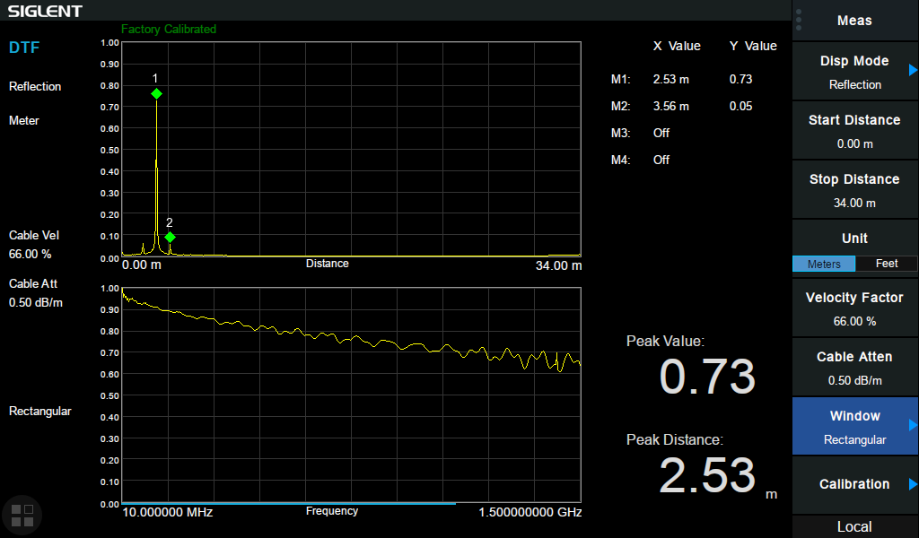
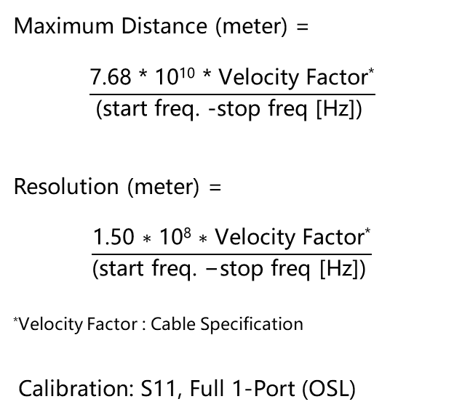
SVA1000X Series
What does the Spectrum & Network Analyzer Series deliver?
Distance-To-Fault Measurement
Maximum Distance (meter) =
$$\frac{\text{7.68 ∗ 10}\text{10}\text{ ∗ }\text{Velocity} \text{Factor}\text{∗}}{\text{(}\text{start} \text{freq}\text{. −}\text{stop} \text{freq}\text{ [}\text{Hz}\text{]) }}$$
Resolution (meter) =
$$\frac{\text{1.50}\text{ ∗ 10}\text{8}\text{ ∗ }\text{Velocity} \text{Factor}\text{∗}}{\text{(}\text{start} \text{freq}\text{. −}\text{stop} \text{freq}\text{ [}\text{Hz}\text{]) }}$$
*Velocity Factor : Cable Specification
Calibration: S11, Full 1-Port (OSL)

Slide 11
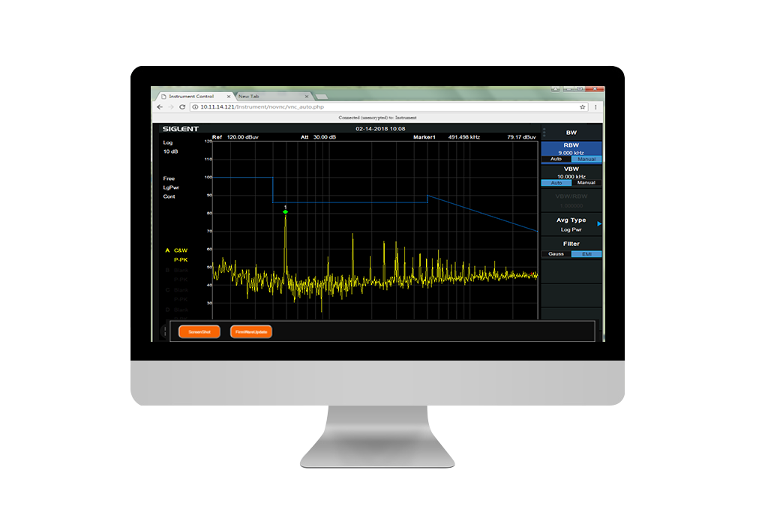
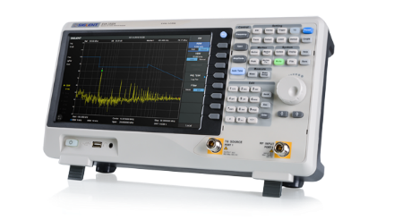
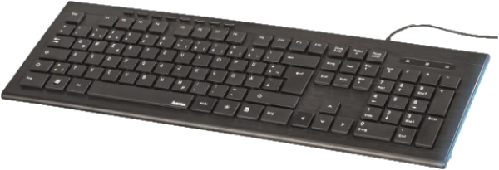
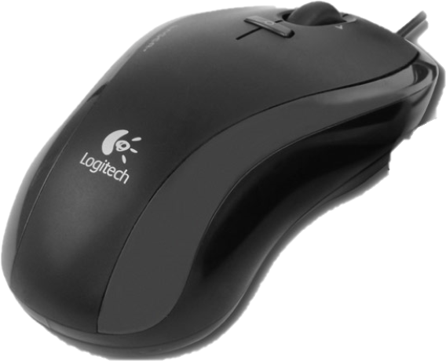
SVA1000X Series
What does the Spectrum & Network Analyzer Series deliver?
Easy Operation
Touch Screen, support external Keyboard & Mouse and offer a Webserver
SVA1000X Series comes with a 10.1 inch touch screen. It supports on screen keyboard and enable to edit Labels.
Plus, external keyboard and mouse are also supported.
In addition to EasySpectrum, Telnet and Socket communication, SVA1000X support Webserver to control the unit remotely on PC or mobile.

Slide 12
Specification at a Glance
Model Spec. | SVA1015X | SVA1032X
TG | Standard
SA Bandwidth | 9 kHz - 1.5 GHz | 9 kHz - 3.2 GHz
VNA Bandwidth | 10 MHz - 1.5 GHz | 100 kHz - 3.2 GHz
VNA Calibration Kit | F503ME, F603ME
DANL | -156 dBm/Hz | -161 dBm/Hz
RBW | 1 Hz - 1 MHz
Phase Noise | < -98 dBc/Hz@1 GHz, 10 kHz offset
Options | AMK/EMI/AMA/DMA/DTF
Advanced Measurement Kit | CHP/ACPR/TOI/OBW/Monitor/Harmonic/CNR
Analog Modulation Analyis | AM/FM
Digital Modulation Analyis | ASK/FSK/PSK/QAM
EMI | Filter BW: 200/9k /120k/1M
VNA is Standard!
With the 16th of September 2019
VNA is also Standard for SVA1015X!
SVA1015X new pricing: 1739.-€
Always offer SVA1000X with Cal.Kit!
Selling SVA1000X to a customer not owning a Cal.Kit, makes no sense!

Slide 13
Applications
SA General purpose Spectrum Analysis
AM/FM demodulation
Interference and Surveillance
AMK Analyze modulated signal Parameter (CP, OBW, CNR)
Determine Signal Quality (ACPR, CNR, Harmonics, etc)
Harmonics measurements
Amplifier performance (TOI, etc.)
Intermittent signals analysis (Monitor)
VNA Impedance matching for RF-designs
S11,S21 (reflection/transmission) measurement for RF-Components (filter, amplifier, cable, antenna)
SWR measurement of antennas
VSA Transmission Quality Analysis (for AM,FM, PSK, MSK, FSK, QAM modulation)
Transmitter Qualification
DTF Cable test
EMI EMC Pre-compliance test

Slide 14

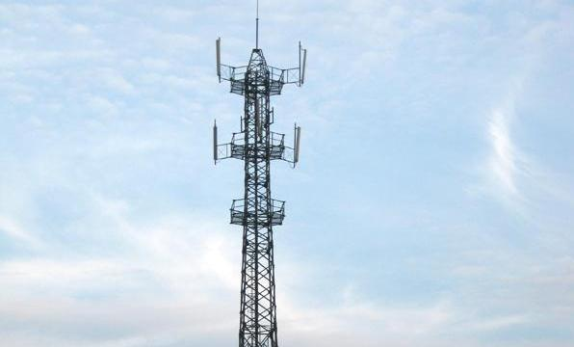


Markets / Target Customer
Enterprise
Automotive electronics
Communication
Semiconductor
Education
Engineers working on Designs, which incorporate RF-Components like Antenna, Filter, RF-Amplifier, etc.
Quality department (e.g. incoming components inspection)
RF / Telecom Institutes at Universities
…
Customer Markets:
-Medical (e.g. Patient Monitoring)
-Consumer Electronics (e.g. wearables)
-Factory Automation (IIoT)
-Home/building Automation
-Automotive (Internal & external communication)
-Broadcast
-RF-Component Manufacturers

Slide 15
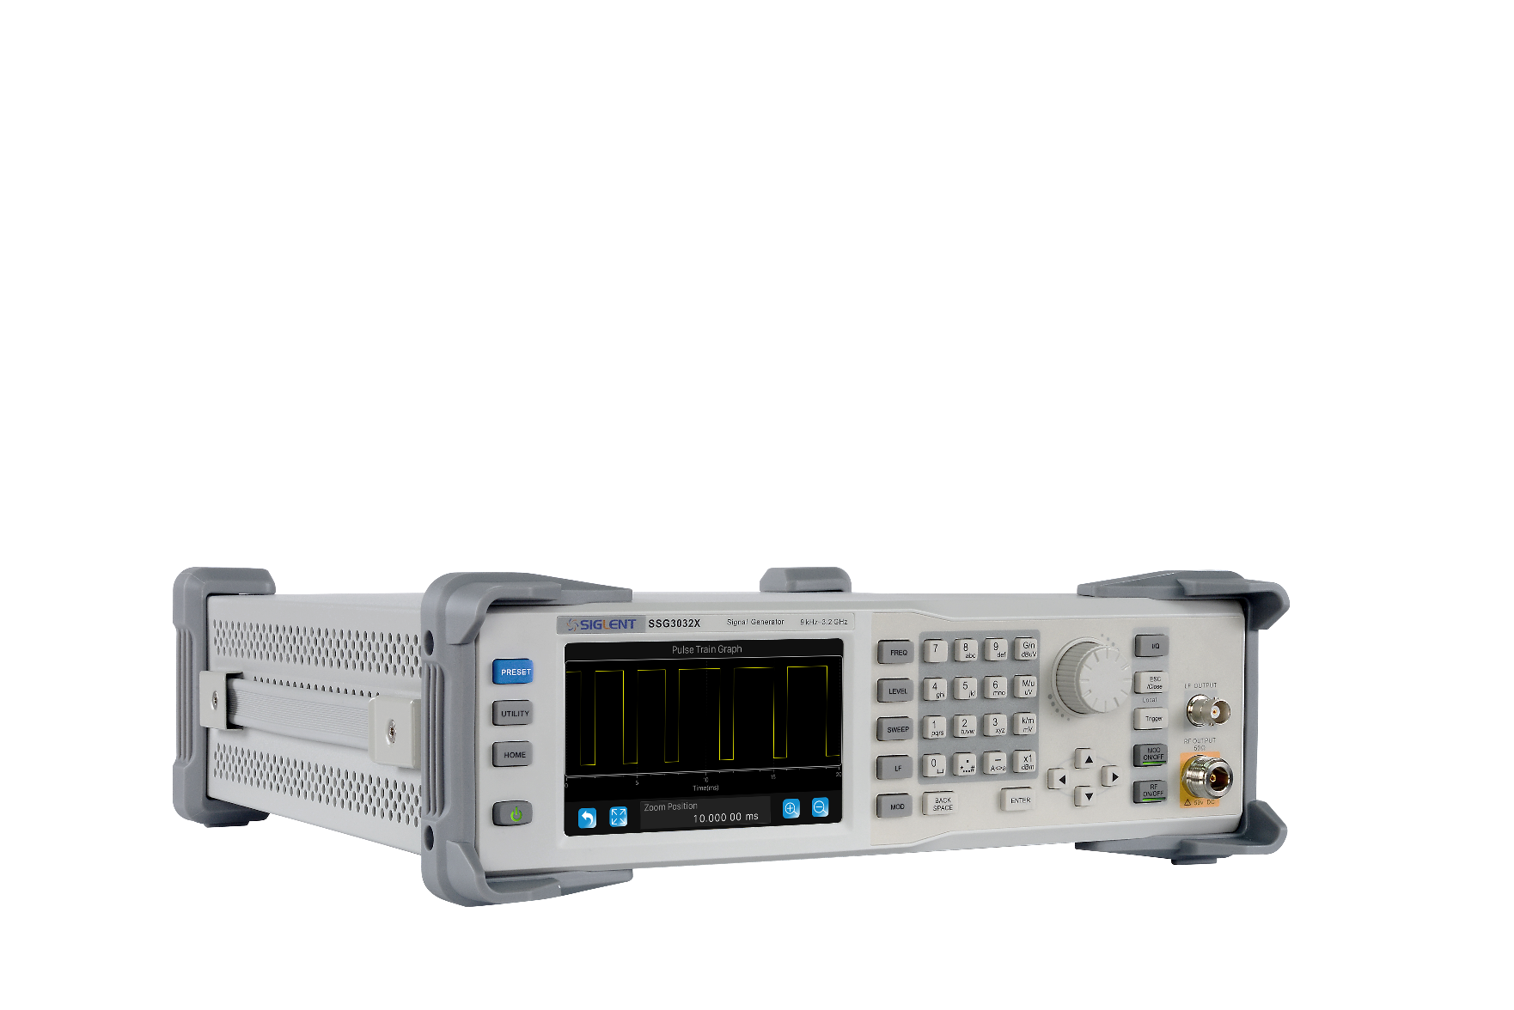
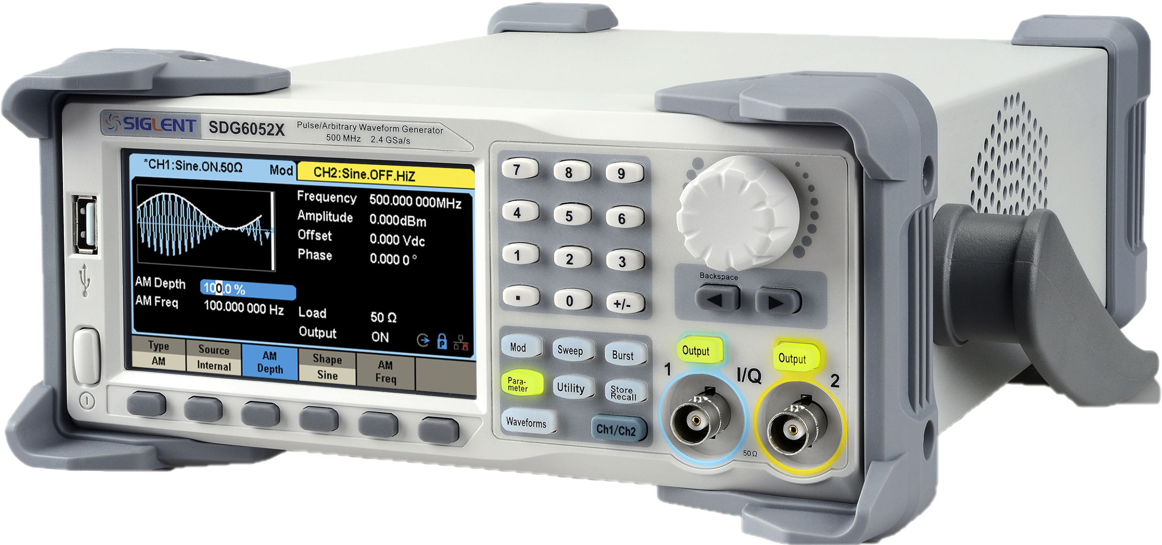
Cross - Selling
Don’t forget to cross sell other products!
If you talk to a customer, who work on RF-Designs always ask about RF-Signal Source!
We have a very competitive solution with SSG3000X or SSG3000X-IQE !
Also SDG6000X together with the IQ-Option might fit for these Customers

Slide 16
SVA1000X-Series Pricing Info
 | Description | Retailing Price [€]
SVA1015X | 9 kHz - 1.5 GHz SA, 10 MHz - 1.5 GHz VNA | 1739.-
SVA1032X | 9 kHz – 3.2 GHz SA, 100 kHz – 3.2 GHz VNA | 2969.-
SVA1000X-AMK | CHP/ACPR/TOI/OBW/Monitor/Harmonic/CNR | 364.-
SVA1000X-EMI | EMI measurement kit | 389.-
SVA1000X-AMA | Analog Modulation Analysis: AM，FM | 286.-
SVA1000X-DMA | Digital Modulation Analysis Function, including ASK, FSK, MSK, PSK, QAM | 469.-
SVA1000X-DTF | Distance To Fault | 249.-
F503ME | N type Mechanical Calibration Kit: Open(M), Short(M), Match(M,50), Through(F-F), 3.5 GHz | 339.-
SRF5030T | Near field probes | 499.-
Demo Unit Concept and Price:
We created a Demo Bundle:
SVA1032X all Options incl. + F503ME
Price: 2248.- €

Slide 17
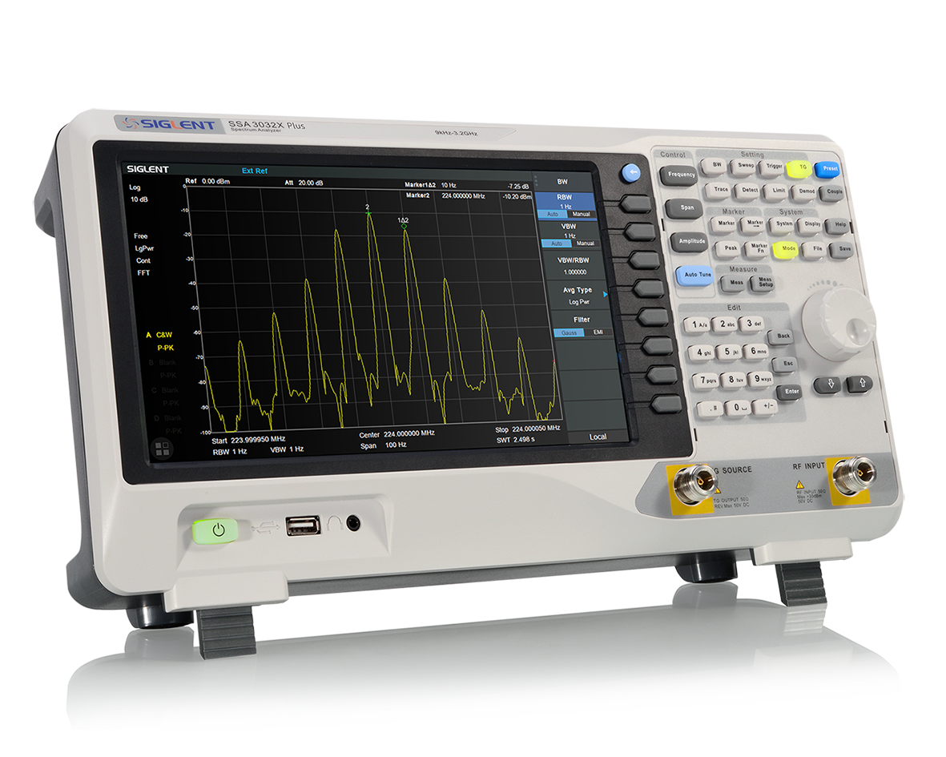
SSA3000X Plus
Spectrum Analyzer

Slide 18
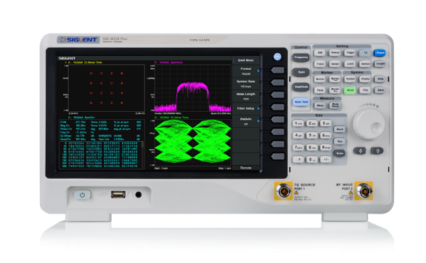
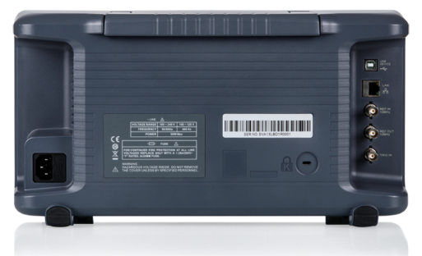
Appearance of SSA3000X plus
10.1 inch Multi-Touch screen
Commons for SVA1000X, SSA3000X, SSA3000X Plus
Same size
Same appearance
Same Interfaces
USB Host, USB Device, LAN
REF IN, REF OUT 10 MHz, TRGI IN
Differences SSA3000Xplus vs. SSA3000X
10.1” Multi Touch screen
Support external Keyboard & Mouse
Web Server

Slide 19
Technical Differences X vs. X plus
Model Spec. | SSA3000X Series |  | SSA3000X Plus Series
 | SSA3021X | SSA3032X | SSA3021X Plus | SSA3032X Plus
DANL | -151 dBm/Hz (equivalent) |  | -161 dBm/Hz
Frequency Counter resolution | 1 Hz |  | 0.01 Hz
Sweep speed | - |  | 3~100 times faster in different RBW
VSWR Bridge | 1 M~2 GHz |  | 100 k~3.2 GHz (intro later)
VSWR Measurement | Open Cal |  | Open+Short Cal
Trace Math | Log operation |  | Log and Power operation
MA | - |  | AM/FM/ASK/FSK/PSK/QAM
EMI filter | 200 Hz, 9 kHz, 120 kHz |  | 200 Hz, 9 kHz, 120 kHz, 1MHz
Control | - |  | Touch Screen, Mouse & Keyboard, Webserver
On Screen Keyboard | No |  | Support
On Screen Annotation | No |  | Support
FTP File Download | No |  | Support
Power on Line | No |  | Support

Slide 20
SSA3000X plus Series
Vector Signal Analysis
Supported Modulation Types:
Analog: AM, FM
Digital: ASK, FSK, MSK, PSK, QAM
Do not mix AM, FM Demodulation with Modulation Analysis!
Demod. is Standard, VSA is Optional
Multiple Trace Data Formats selectable
Various Numerical Result Data
Time Domain View
Spectrum View
Etc.

Slide 21
SSA3000X plus-Series Pricing Info
 | Description | Retailing Price [€]
SSA3021X plus | 9 kHz – 2.1 GHz SA, Touch Screen | 1469.-
SSA3032X plus | 9 kHz – 3.2 GHz SA, Touch Screen | 2439.-
SSA3000X plus-AMK | Advanced measurement kit ,including ACPR, CHPower, OBW, etc. | 395.-
SSA3000X plus-EMI | EMI measurement kit | 425.-
SSA3000X plus-AMA | Analog Modulation Analysis Function,including AM，FM | 286.-
SSA3000X plus-DMA | Digital Modulation Analysis Function,including ASK, FSK | 469.-
SSA3000X plus-Refl | Reflect measurement kit (SW) | 369.-
RB3x20 | RB (1 MHz~2 GHz), N (M) -N (M) adaptor (2 pcs) | 329.-
RBSSA3X20 | SSA3000X Plus-Refl(SW) & RB3X20(HW) | 469.-
SRF5030T | Near field probes | 499.-
Tracking Generator is included as Standard
Anyway we have defined a price in the price list:
SSA3000X plus-TG 169.-€

Slide 22
Spectrum Analyzer Applications
Channel power measurement, Occupied BW, ACPR (For example, W-CDMA signal measuring)
AM/FM broadcast demodulation
Intermittent signals analysis (With MAX Hold see intermittent signals, with Spectrogram see when it appears)
Interference and Surveillance :
- RF Interference
- EMC Pre-compliance test
- RF Site Survey,
- Spectrum recording
- Security surveillance
- Intruder watch
- Satellite signal monitoring
Return Loss/Reflection Coefficient measurement of antenna, cables, filters(With RBSSA external directional bridge)
…

Slide 23
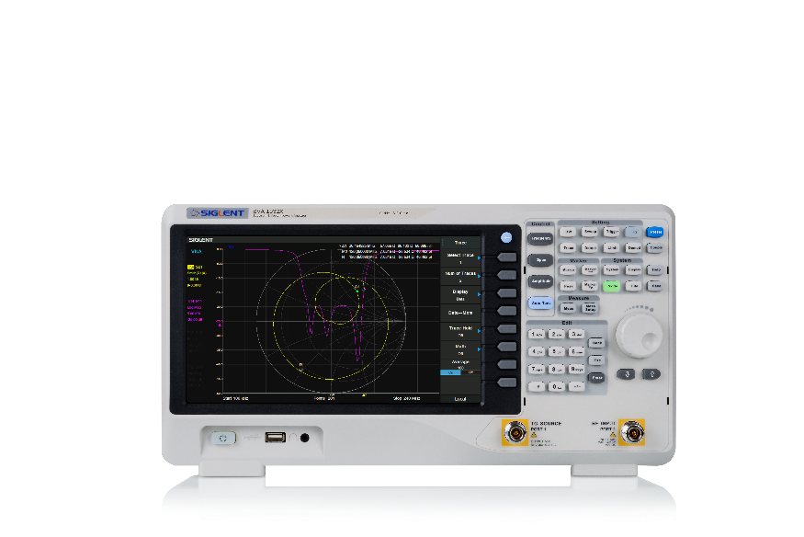
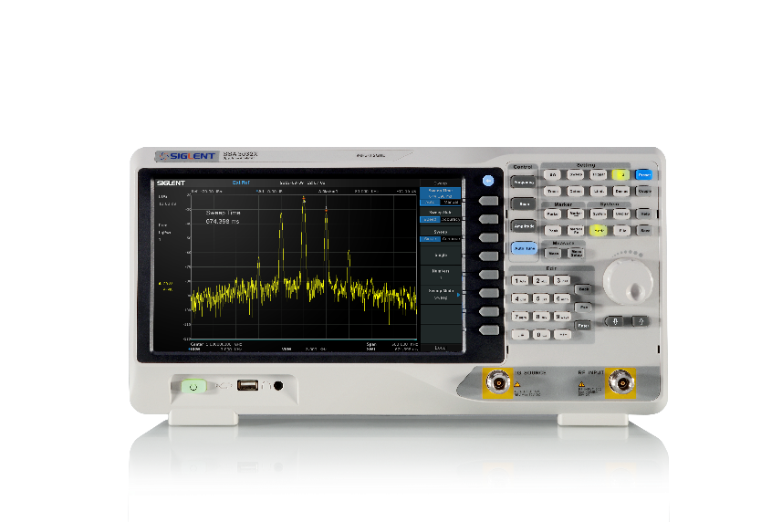
Spectrum Analyzer Portfolio Positioning
Price
2969.-
2439.-
2259.-
SVA1000X
1.5 GHz / 3.2 GHz
1739.-
1469.-
SSA3000X plus
2.1 GHz / 3.2 GHz
1299.-
SSA3000X
2.1 GHz / 3.2 GHz
Functions & Performance
Basic SA
SA & opt. VSA
SA & VNA & opt. VSA

Slide 24
SSA3kX vs. SSA3kX plus vs. SVA1kX
Model Spec. | SSA3000X Series |  | SSA3000X Plus Series |  | SVA1000X Series
 | SSA3021X | SSA3032X | SSA3021X Plus | SSA3032X Plus | SVA1015X | SVA1032X
TG | Standard |  | Standard |  | Standard
SA Bandwidth | 9 kHz - 2.1 GHz | 9 kHz - 3.2 GHz | 9 kHz - 2.1 GHz | 9 kHz - 3.2 GHz | 9 kHz - 1.5 GHz | 9 kHz - 3.2 GHz
VNA Bandwidth | - |  | - |  | 10MHz - 1.5 GHz | 100 kHz - 3.2 GHz
VNA Calibration Kit | - |  | - |  | F503ME
DANL | -151 dBm (RBW 10Hz) -161 dBm, Normalized to 1 Hz |  | -161 dBm/Hz |  | -156 dBm/Hz | -161 dBm/Hz
RBW | 10 Hz - 1 MHz (1Hz setable) |  | 1 Hz - 1 MHz |  | 1 Hz - 1 MHz
Phase Noise | < -98 dBc/Hz@1 GHz, 10 kHz offset |  | < -98 dBc/Hz@1 GHz, 10 kHz offset |  | < -98 dBc/Hz@1 GHz, 10 kHz offset
Options | AMK/EMI/Refl |  | AMK/EMI/AMA/DMA |  | AMK/EMI/AMA/DMA/DTF
AMK | CHP/ACPR/TOI/OBW/Monitor |  | CHP/ACPR/TOI/OBW/Monitor/Harmonic/CNR |  | CHP/ACPR/TOI/OBW/Monitor/Harmonic/CNR
AMA | - |  | AM/FM |  | AM/FM
DMA | - |  | ASK/FSK/PSK/QAM |  | ASK/FSK/PSK/QAM
EMI filter | 200 Hz, 9 kHz, 120 kHz |  | 200 Hz, 9 kHz, 120 kHz, 1MHz |  | 200 Hz, 9 kHz, 120 kHz, 1MHz
Touch Screen | - |  | Touch Screen, Mouse & Keyboard, Webserver |  | Touch Screen, Mouse & Keyboard, Webserver

Slide 25
Thank You
The Best Value in Electronic Test & Measurement
Headquarters
NA
Europe
SIGLENT TECHNOLOGIES CO., LTD.
Add: Blog No.4 & No.5, Antongda Industrial Zone, 3rd Liuxian Road,
Bao’an District, Shenzhen, 518101, China.
Tel:+ 86 755 3688 7876
Fax:+ 86 755 3359 1582
sales@siglent.com
www.siglent.com/ens
SIGLENT Technologies NA, Inc.
Add: 6557 Cochran Rd Solon, Ohio 44139
Tel: 440-398-5800
Toll Free:877-515-5551
Fax: 440-399-1211
info@siglent.com
www.siglentna.com
SIGLENT TECHNOLOGIES GERMANY GmbH
Add: Liebigstrasse 2-20, Gebaeude 14, 22113 Hamburg Germany
Tel: +49(0)40-819-95946
Mobile: +49 151 40716756
Fax: +49(0)40-819-95947
info-eu@siglent.com
www.siglenteu.com

