Slide 1


Slide 2
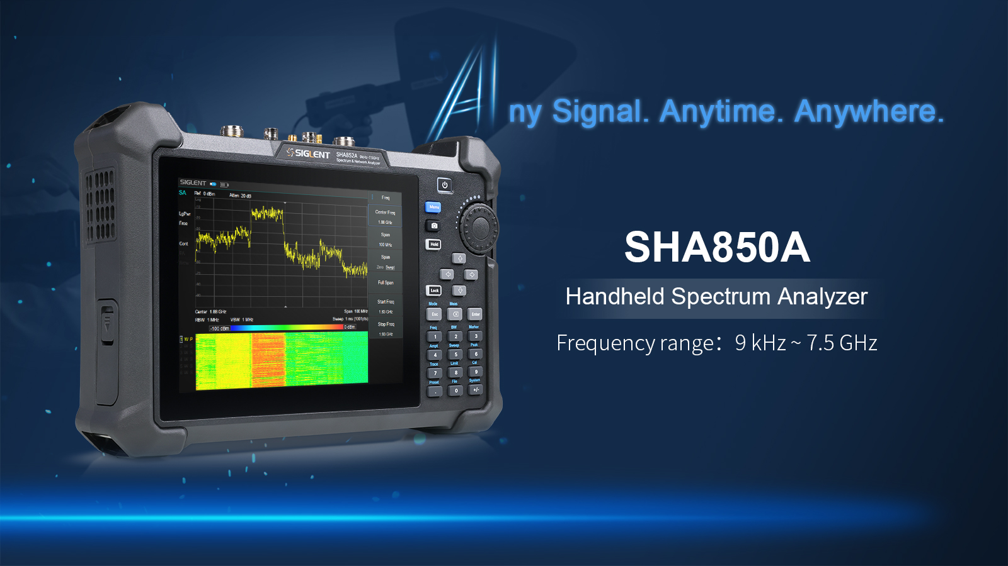

Slide 3

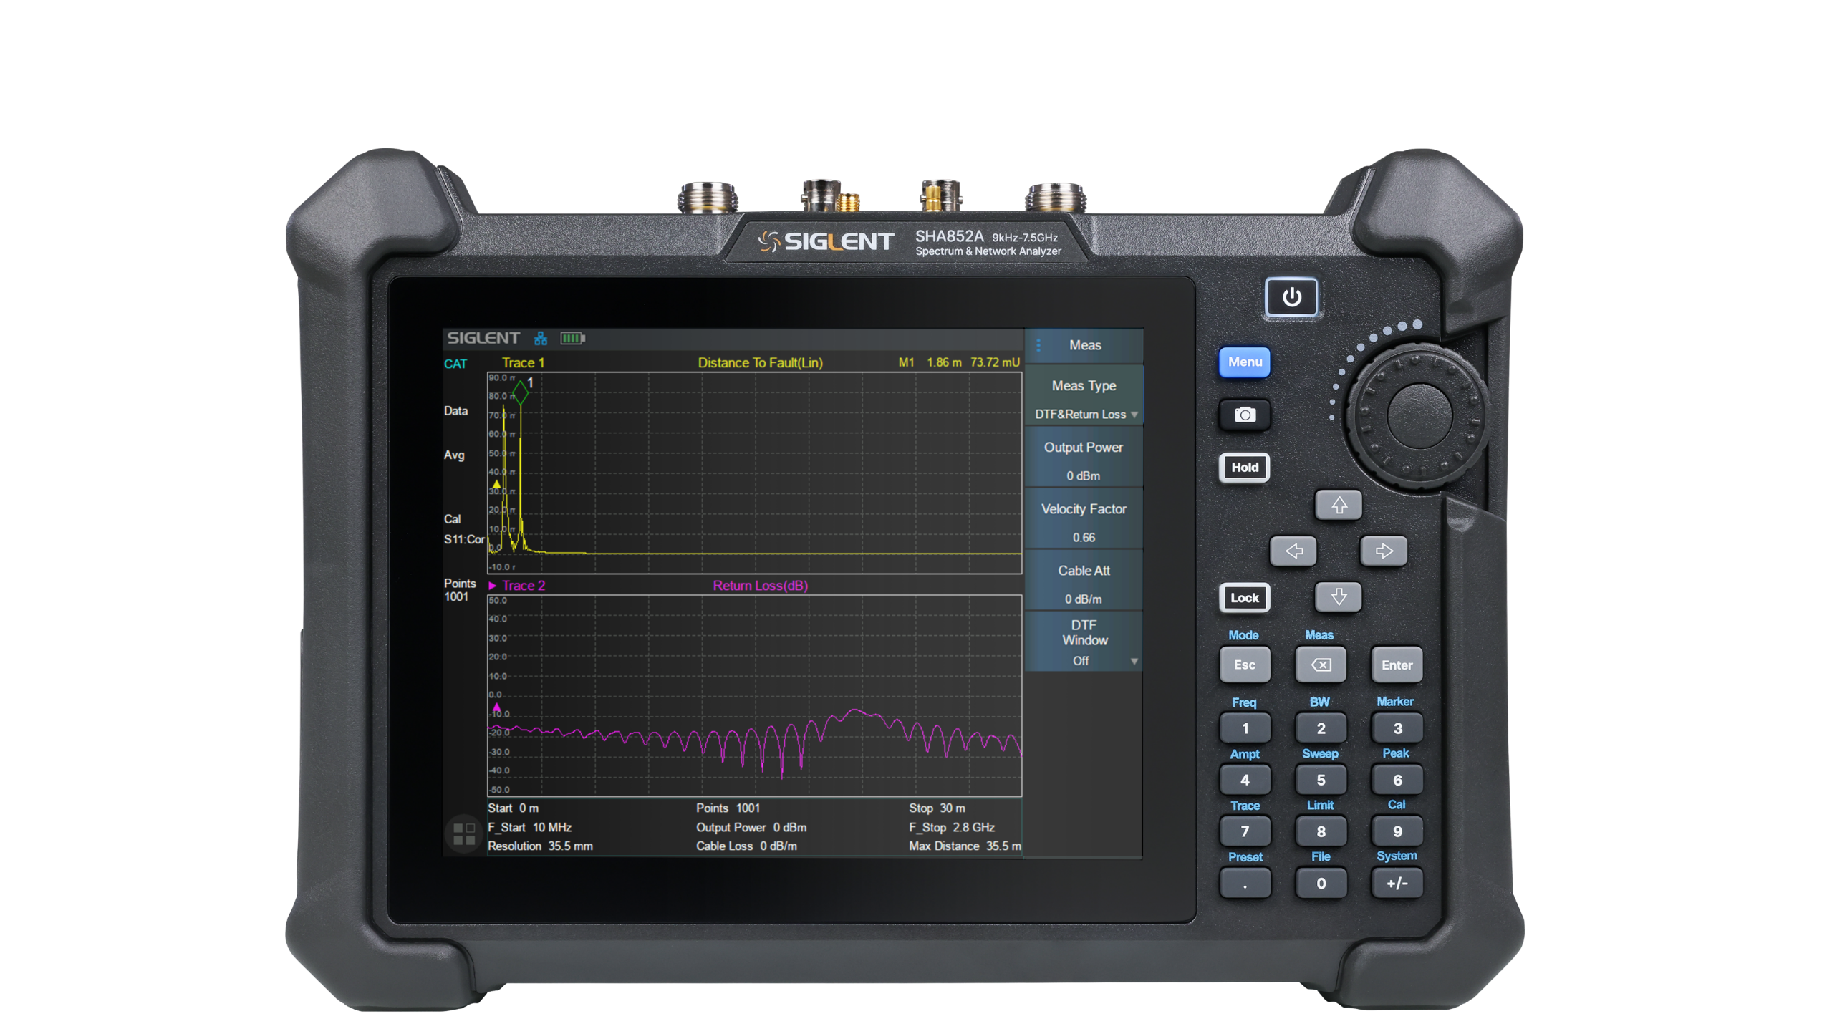
Why should you choose SHA850A?
Multifunction Handheld Spectrum Analyzer
01
Capture any signal with precision and confidence
Measurement accuracy comparable to performance benchtop instruments.
Conduct proficient testing in complex environments
Lightweight, portable, durable, specially designed for field operation.
Utilize portable analyzer functions
Cable and antenna analyzer (CAT)
Vector network analyzer (VNA)
Spectrum analyzer (SA)
Provide budget flexibility
Select the current required features and easily upgrade in the future to advance with changing measurement requirements.
02
03
04
3

Slide 4
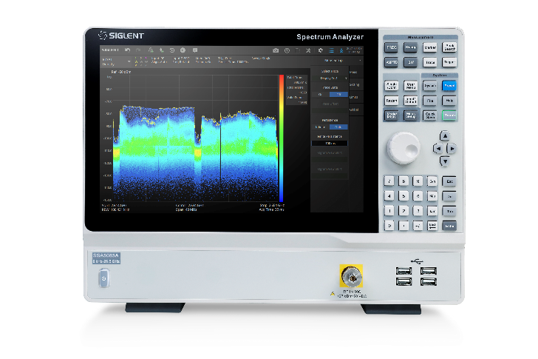

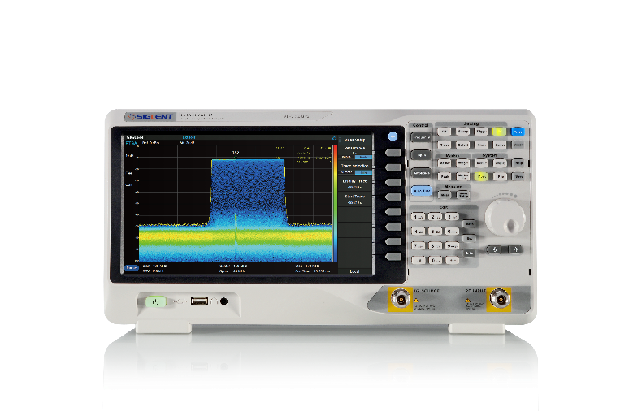
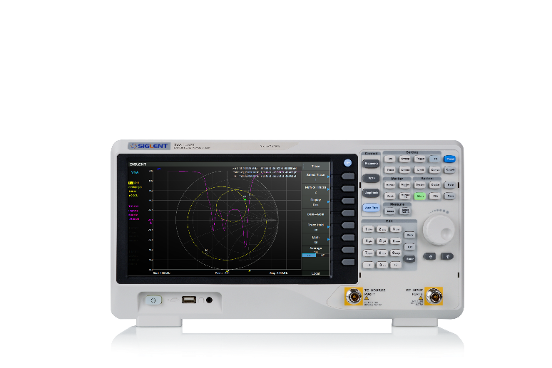
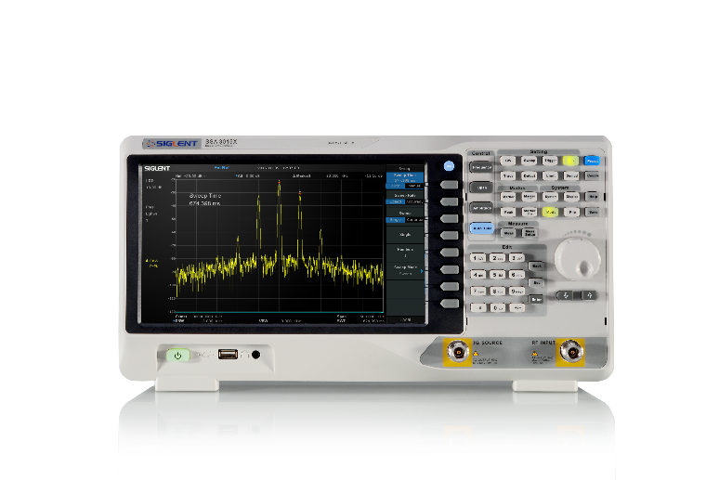
Traditional measurement technology of SIGLENT
Innovation brought by SHA850A
2022.09
SSA5000A Spectrum Analyzer
Cable and antenna analyzer
DTF and SWR measurement
Vector network analyzer
2020.04
SSA3000X-R Real-time Spectrum Analyzer
Dynamic range up to 114 dB
Spectrum analyzer
2019.09
SVA1000X Spectrum & Vector Network Analyzer
± 0.7 dB Total amplitude accuracy
2023.05
2019.09
SSA3000X Plus Spectrum Analyzer
4

Slide 5
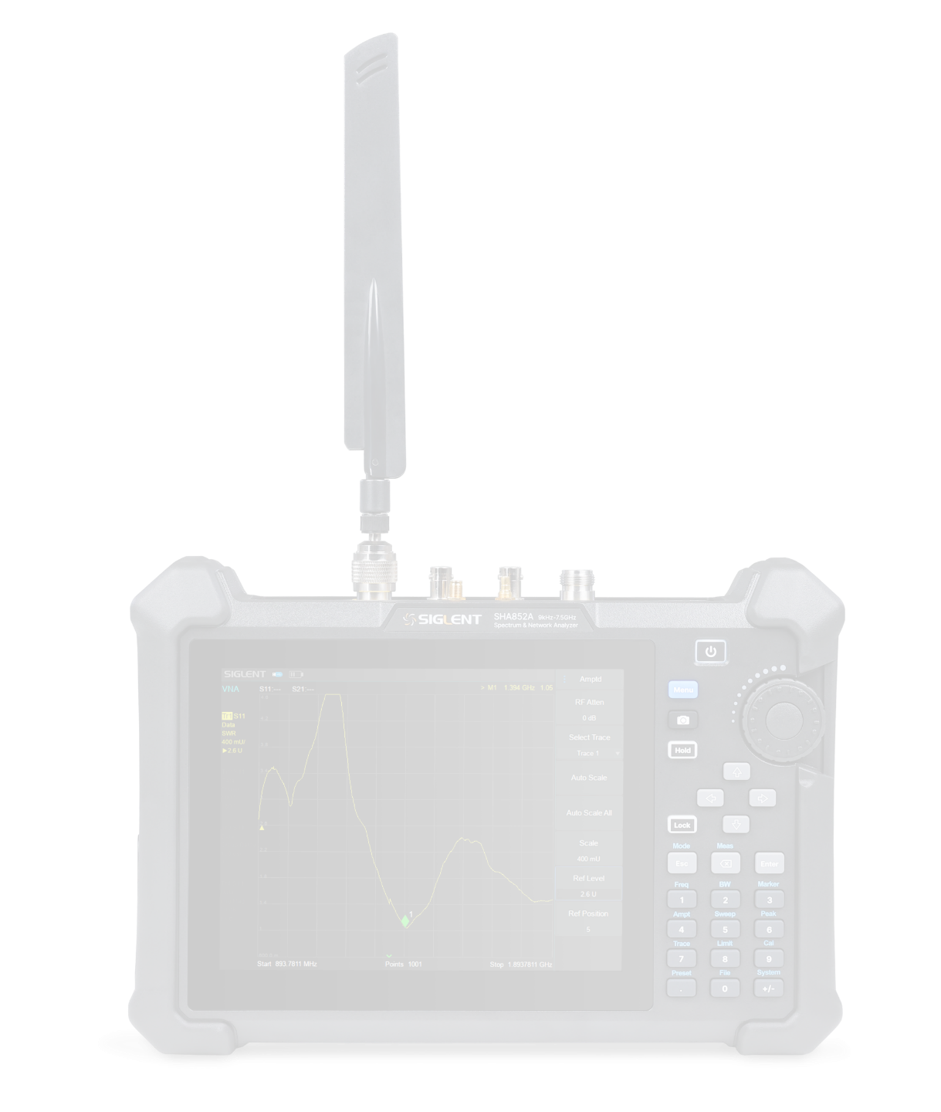
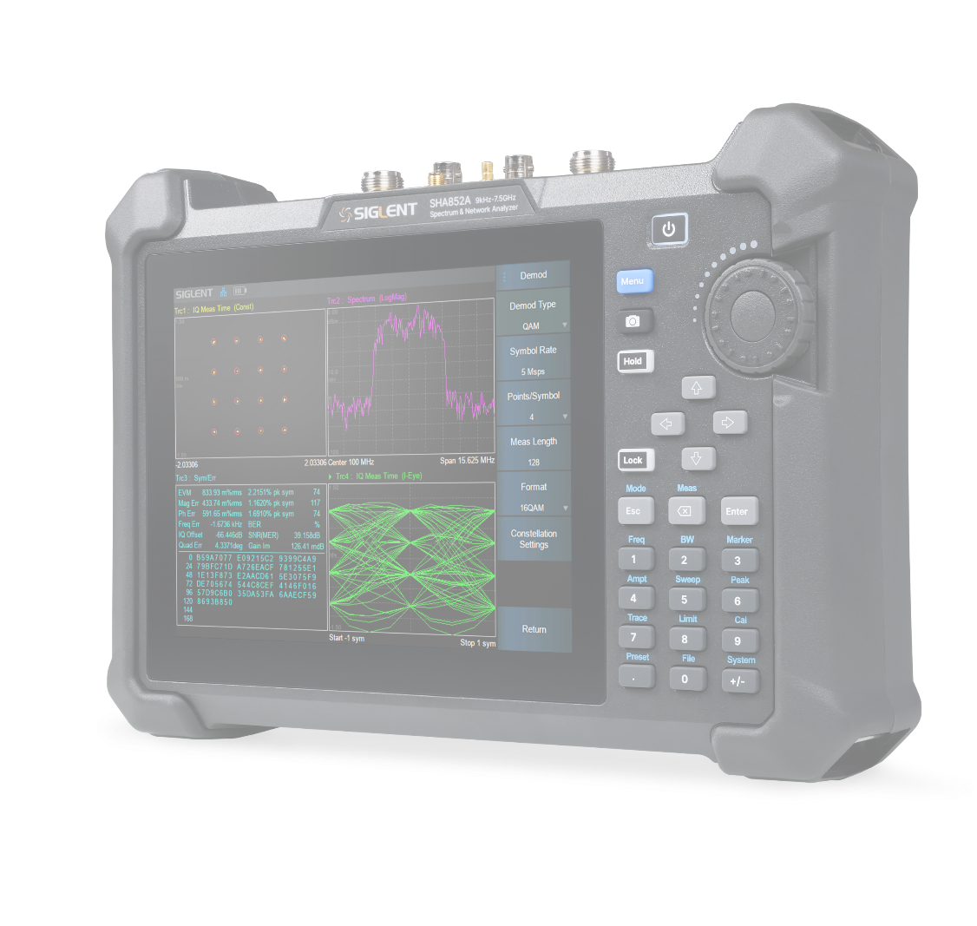
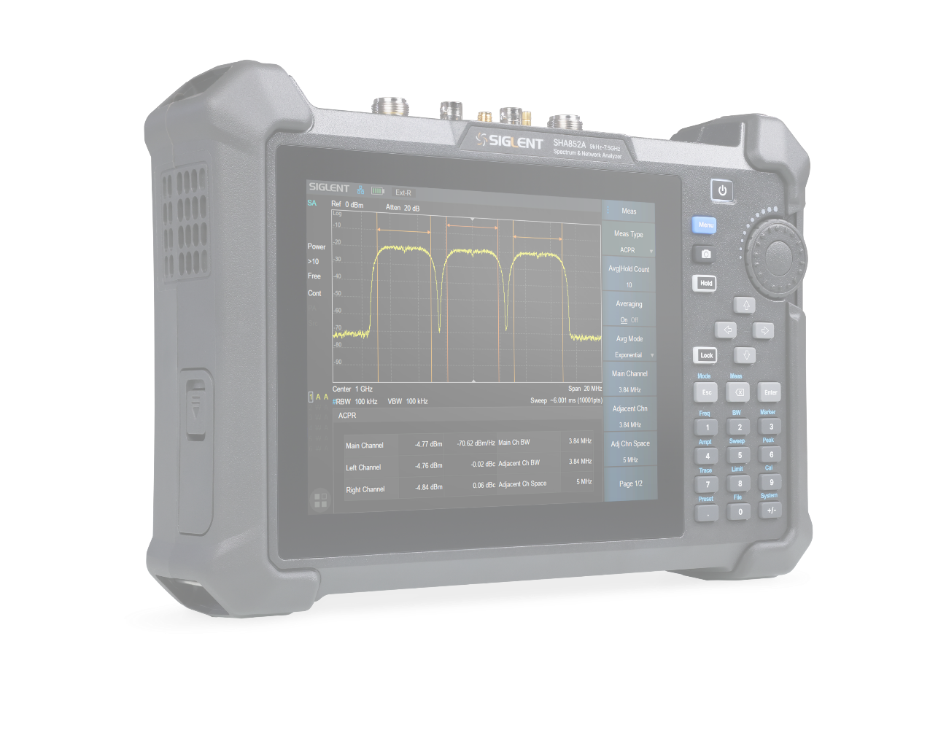
Outstanding Characteristics
Multiple Functions
Subtle Design
Wide dynamic range
Low phase noise
Independent source
Standard preamplifier
···
Spectrum Analyzer
Vector Network Analyzer
Cable and Antenna Test
Analog Modulation Analysis
Digital Modulation Analysis
···
Small size
Touch screen
Abundant communication interface
Intuitive operation interface
···
5

Slide 6
Basic Info
Features and Benefits
Contents
Market and Application
Competition Analysis

Slide 7


Specification
Model | SHA851A | SHA852A
Spectrum Analyzer | 9 kHz ~ 3.6 GHz | 9 kHz ~ 7.5 GHz
Vector Network Analyzer (SHA850-VNA) | 100 kHz ~ 3.6 GHz | 100 kHz ~ 7.5 GHz
Cable and Antenna Test | 100 kHz ~ 3.6 GHz | 100 kHz ~ 7.5 GHz
Source | 100 kHz ~ 3.6/7.5 GHz (option SHA850-SOR)
Preamplifier | 25 dB, standard
Displayed Average Noise Level | -165 dBm (typ.), Preamp on, best, 20 °C to 30 °C
SSB Phase Noise | -104 dBc/Hz (typ.) @ fc = 1 GHz, Offset 10 kHz
Dynamic Range | 114 dB
Advanced Measurement Kit | CHP, Channel Power; ACPR, Adjacent Channel Power Ratio; OBW, Occupied Bandwidth; T-Power, Time Domain Power; CNR, Carrier Noise Ratio; Harmonic measurement; TOI, Third-Order Intercept; Spectrogram(option SHA850-AMK)
Analog Modulation Analysis | AM, FM, PM (option SHA850-AMA)
Digital Modulation Analysis | ASK: 2ASK; FSK: 2FSK, 4FSK, 8FSK, 16FSK;MSK: GMSK;PSK: BPSK, QPSK, OQPSK, 8PSK; DPSK: DBPSK, DQPSK, D8PSK, π/4 -DQPSK, π/8 -D8PSK; QAM: 16, 32, 64, 128, 256(option SHA850-DMA)
Dimensions | 310 mm × 215 mm × 78.5 mm (W×H×D)
Operating time | 4h
7

Slide 8
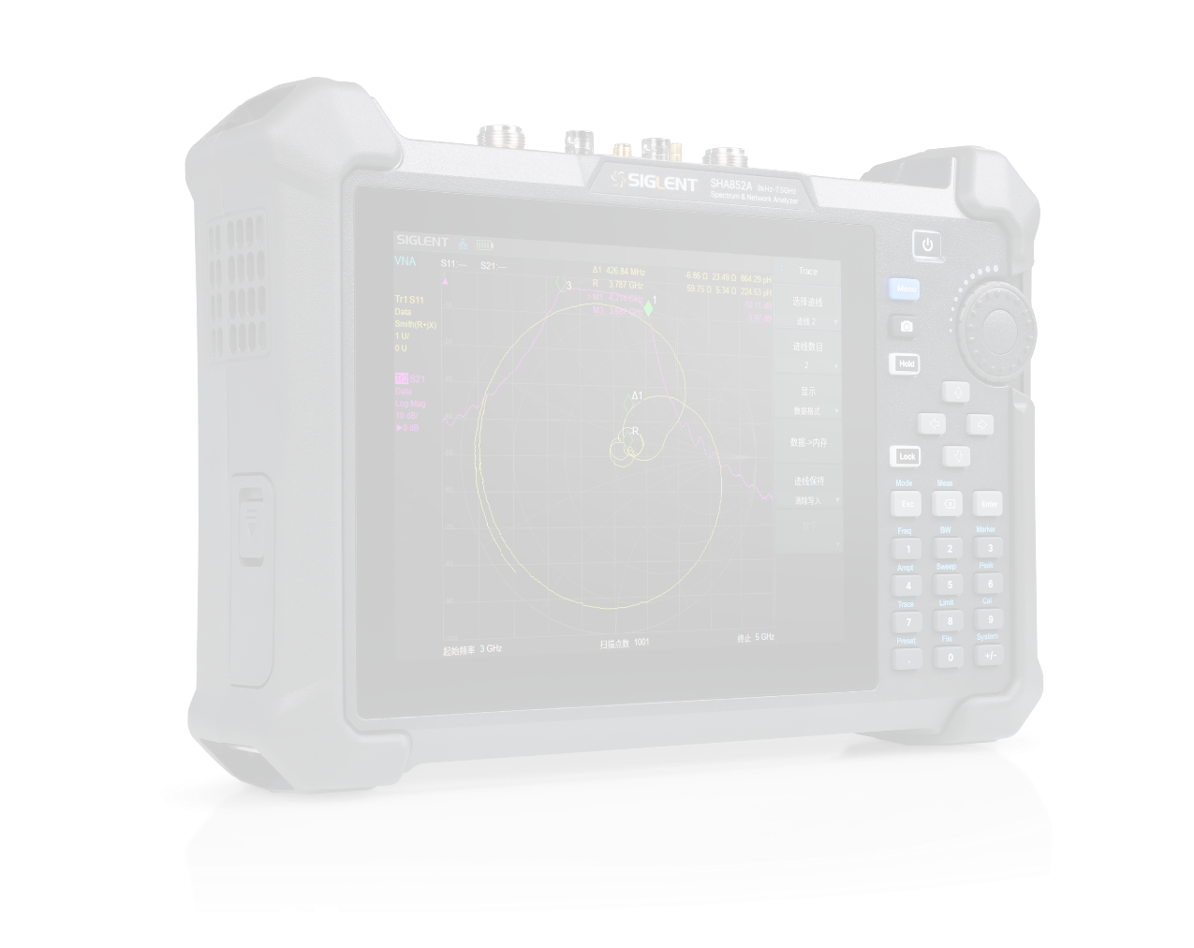
Features and Benefits
make operation more fluent.
01
02
03
8.4" touch screen
Abundant communication interfaces
Low phase noise -104 dBc/Hz
Simple UI interface
Easy to use
Support mouse and remote web page control
More connection and control modes
Provides excellent signal quality
Excellent phase performance
04
05
06
Sources
High performance RF components
VNA
Option SHA850-SOR
Transmission response of filter
Cable insertion loss
Improve accuracy and stability of the measurement results
Less trace noise
Option SHA850-VNA
Amplitude and phase parameters
8

Slide 9
High dynamic range 114 dB
It can be applied to test scenes that require high dynamic range, such as measuring the passband and out-of-band suppression performance of filters at the same time, and measuring narrow-band devices with high suppression, such as cavity filters.
Ecal
Shorten the calibration time and reduce the number of connections in the test, while providing higher measurement consistency, less human error and higher accuracy.
Advanced measurement kit
A variety of intelligent measurement functions are integrated into a portable instrument powered by battery, which can easily complete the measurement task.
GPS option
Provide geographical location labels for measurement, and geographical data such as longitude, latitude and altitude can be displayed on the screen and saved in data files.
Bias Out
Power supply for external offset connectors, probes and active devices saves time and improves measurement accuracy.
9

Slide 10

Front Panel
LCD Screen
Menu
Shortcut screenshot button
Multifunction knob
Measurement control, Pause or resume the current measurement process
Key and touch screen lock control
Reuse keys for menu selection mode and numerical input mode, which can be switched by Enter and Esc.
310.1 mm
10
Notes:
Large horizontal screen design and large buttons for easy operation and observation-you can operate with gloves on.
Multifunction knob
complete the rapid adjustment and selection of parameters.
Key and touch screen lock control
Turn off or turn on keyboard and touch functions to prevent misoperation.

Slide 11
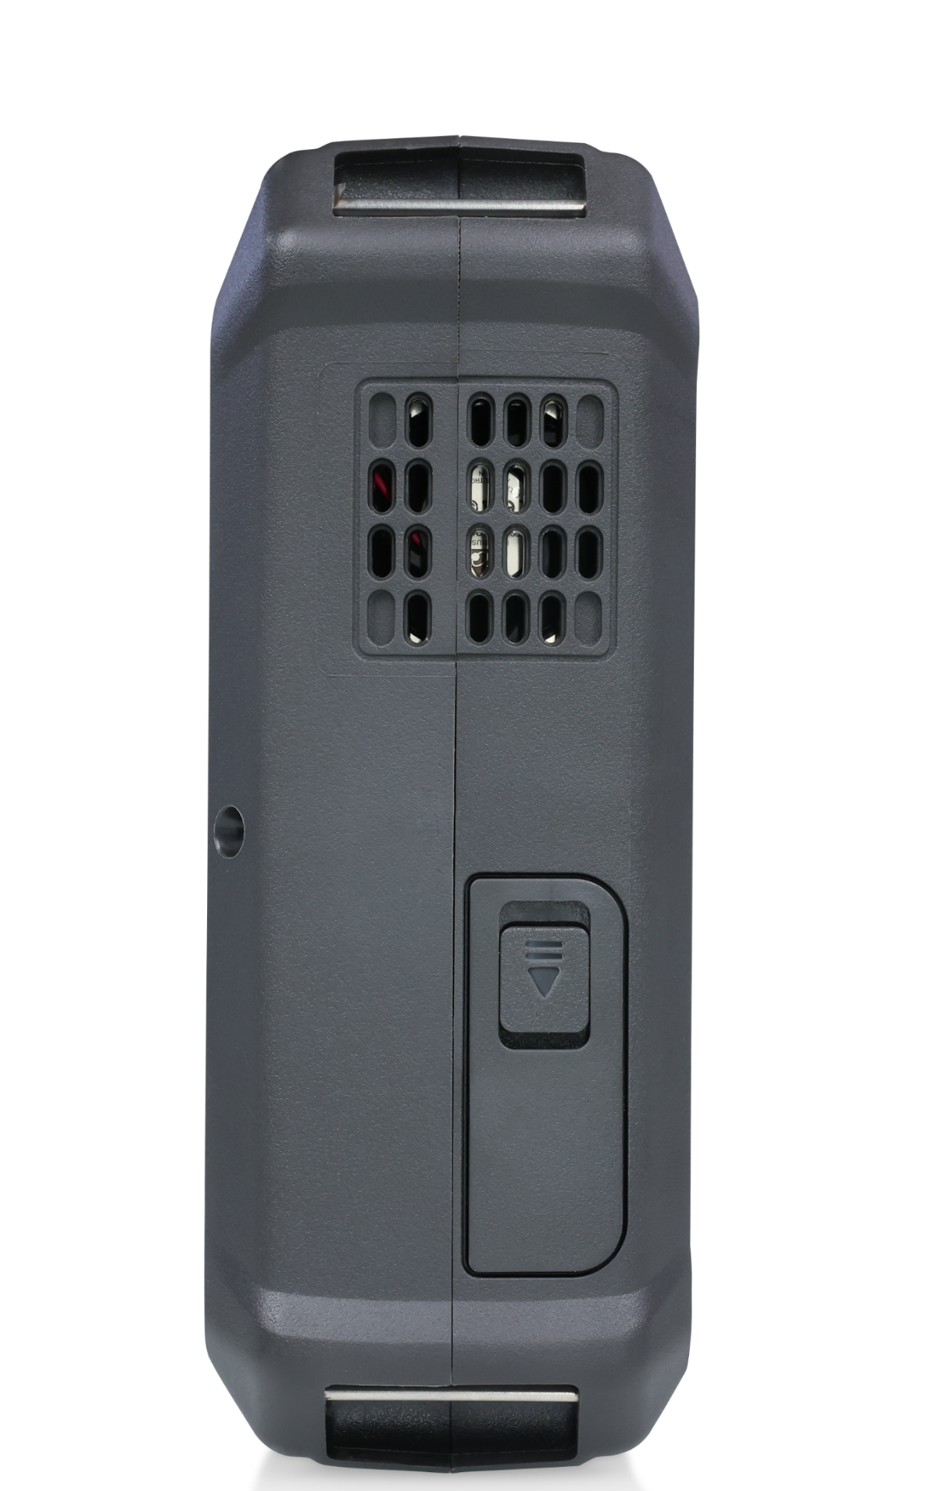
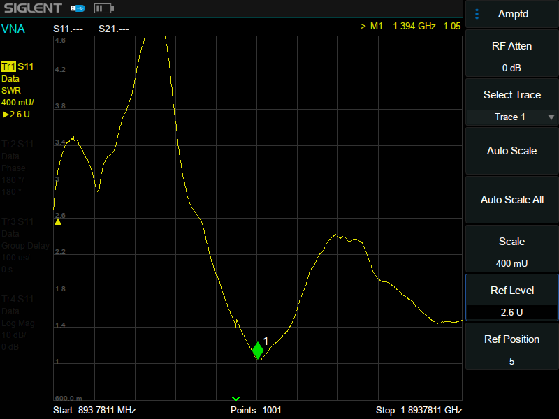
User Interface
Left
Mode/Measure
Logo
Hardware
Measurement status bar
Result display area
Scan parameter area
Menu area
Fan vent
215mm
Battery case cover
11

Slide 12
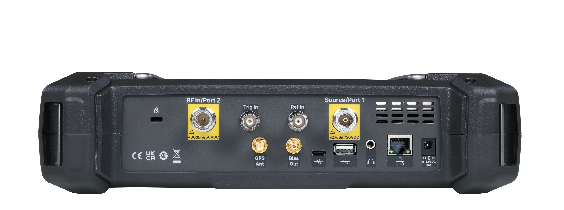
Rear Panel
K groove
RF In/Port 2
External trigger signal input
External reference signal
Independent source
LAN
78.5 mm
USB Device
USB Host
External power supply
Hand strap buckle
The connector recess can protect the RF connector well.
Built-in GPS receiver provides accurate position information, SMA female
Built-in DC power supply can supply power for external bias connectors, probes and active devices, SMB female
Audio output
3.5 mm
12

Slide 13
Basic Info
Features and Benefits
Contents
Market and Application
Competition Analysis

Slide 14
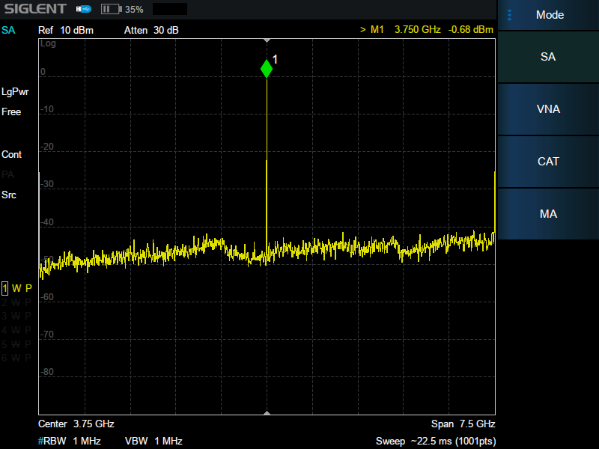
Design Features
Any signal. Anytime. Anywhere.
8.4 inch multi-touch screen
Quickly adjust waveform
Easily activate features and settings
Improve operation efficiency
Support network remote control
…
14

Slide 15
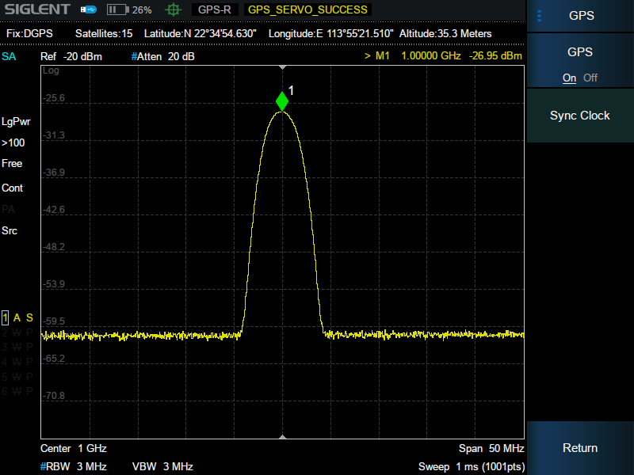
GPS
Any signal. Anytime. Anywhere.
Area for "GPS display information“
Area for "GPS satellite lock icon“
GPS display information:
Fix: Invalid / Estimated: Unknown system /
GNSS: global navigation satellite system /
DGPS: differential global positioning system
Satellite: number of Satellites
Latitude
Longitude
Altitude
*Requires GPS Antenna and GPS Receiver Option. GPS Logging Option for saving data.
15

Slide 16
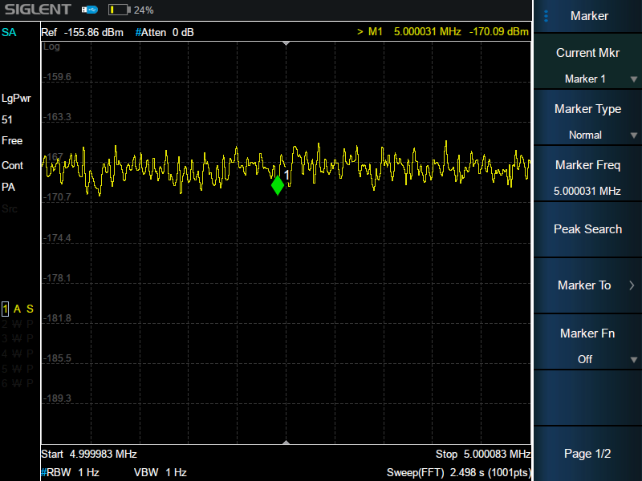
Low DANL
Any signal. Anytime. Anywhere.
-165 dBm/Hz
Low noise
High performance RF design
Provide standard built-in preamplifier
Improving weak signal monitoring with high sensitivity
16

Slide 17
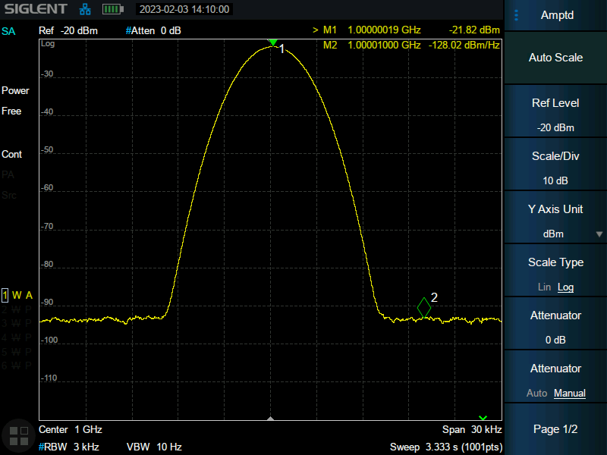
Low Phase Noise
Any signal. Anytime. Anywhere.
-104 dBc/Hz
A measurement parameter of the frequency stability of the oscillator
An important index for evaluating spectrum analyzers – SHA800A has better performance than SSA3000X-R series
17

Slide 18
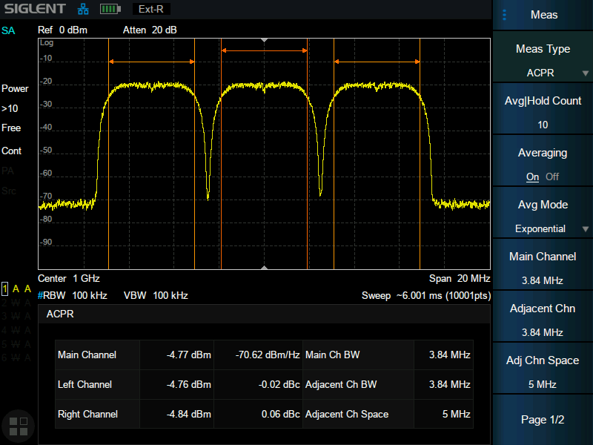
ACPR
Any signal. Anytime. Anywhere.
Common measurement characteristic for channel-based communication protocols.
It can describe the out-of-band spectrum distortion characteristics of signal caused by nonlinear distortion of power amplifier
*Requires AMK (Advanced Measurement Kit) Option
18

Slide 19
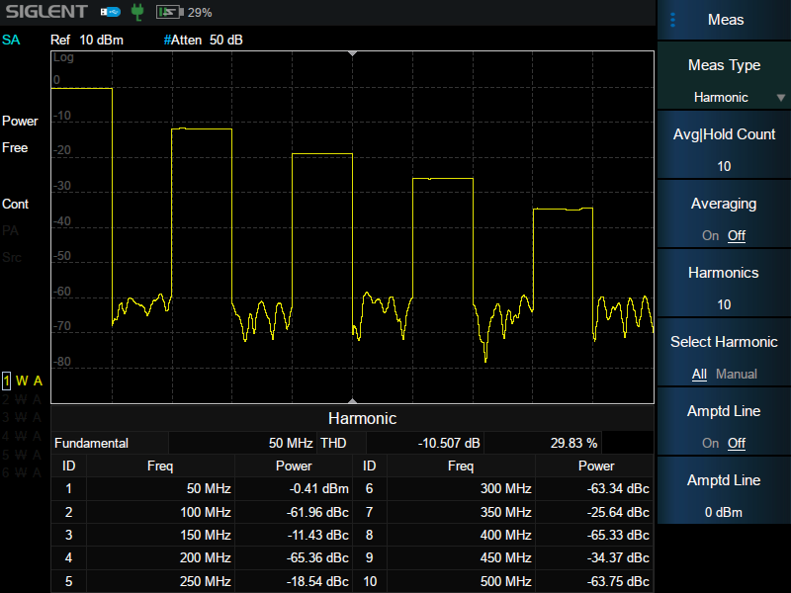
Harmonic Analysis
Any signal. Anytime. Anywhere.
Measure the harmonic power and total harmonic distortion of carrier signal
The maximum measurable harmonic is the 10th harmonic
The fundamental amplitude of the carrier signal should be greater than -50 dBm
*Requires AMK (Advanced Measurement Kit) Option
19

Slide 20
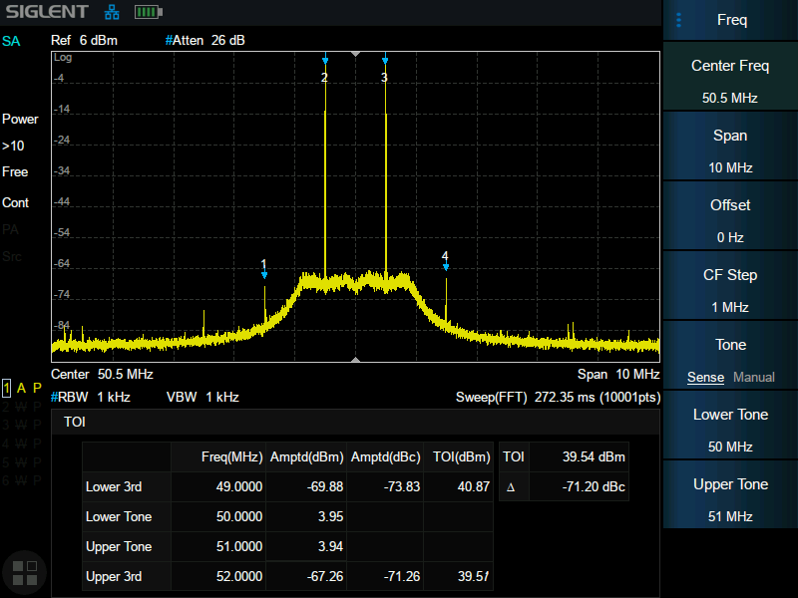
TOI
Any signal. Anytime. Anywhere.
IP3: Third-order Intercept Point
An important index to measure linearity or distortion of amplifiers, mixers, and receivers
*Requires AMK (Advanced Measurement Kit) Option
20

Slide 21
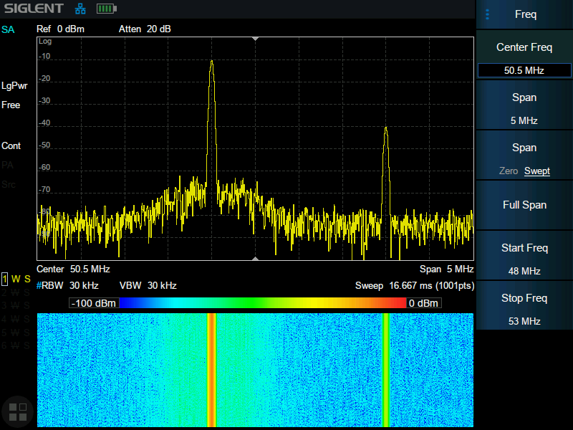
Spectrum Monitor
Any signal. Anytime. Anywhere.
Color represents spectral energy
The X axis is frequency
The Y axis is time
Also called Spectrogram or Waterfall Chart
By detecting the non-continuous and frequency hopping signals
We can observe the change of the signal over a longer period of time
*Requires AMK (Advanced Measurement Kit) Option
21

Slide 22
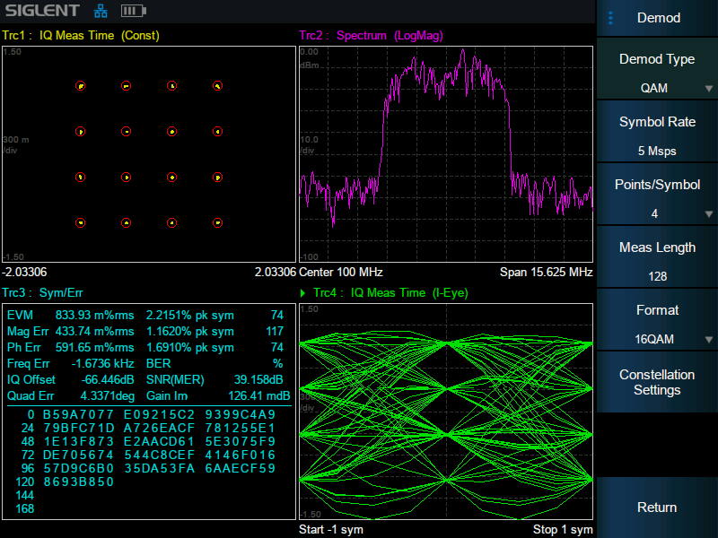
Signal Modulation Analysis
Any signal. Anytime. Anywhere.
Analog signal: AM/FM/PM (AMA Option)
Digital signal: ASK/FSK/PSK/QAM (DMA Option)
EVM (Error Vector Magnitude) Calculation
Transmission quality factors
Visualization modes include eye-diagrams and constellations
Extends troubleshooting to complex signals and systems
*Requires AMA / DMA Option
22

Slide 23
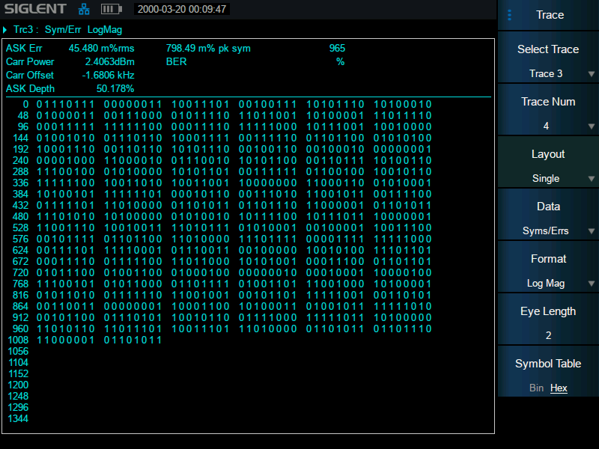
Digital Modulation Analysis
Any signal. Anytime. Anywhere.
Display in binary or hexadecimal
Compare captured data to known data to calculate BER (Bit Error Rate)
*Requires DMA Option
23

Slide 24
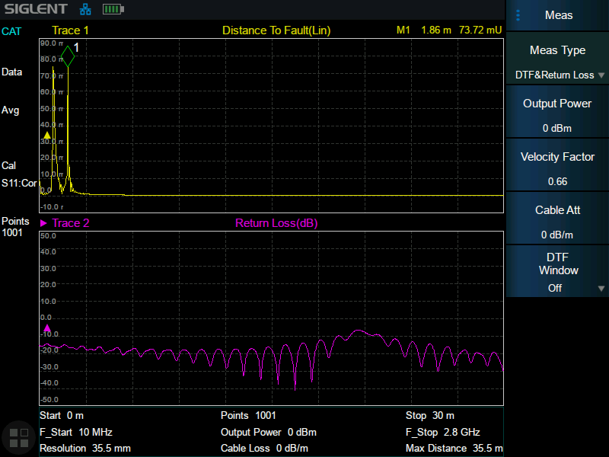
DTF
Any signal. Anytime. Anywhere.
Detecting Cable Quality
Service Maintenance
Performance Verification
Fault Analysis
*Standard in CAT mode
24

Slide 25
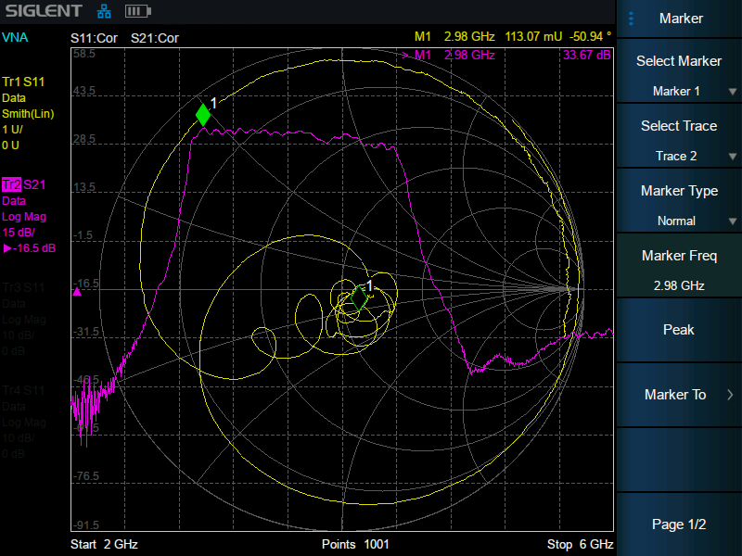
VNA
Any signal. Anytime. Anywhere.
Easily measure S11 and S21
10001 maximum measuring points
The display contents include:
Simultaneous S11 and S21 display provides simple and intuitive impedance measurements
Phase
Group Delay
Polar Chart
Smith Chart
…
*Requires VNA Option
25

Slide 26
SWR
Any signal. Anytime. Anywhere.
An index indicating the matching degree between antenna and base station
Ideal VSWR = 1. The greater the VSWR, the greater the reflection and therefore, the worse worse the match
*Available in VNA mode Option
26
Notes:
Better signal fidelity than CAT mode

Slide 27
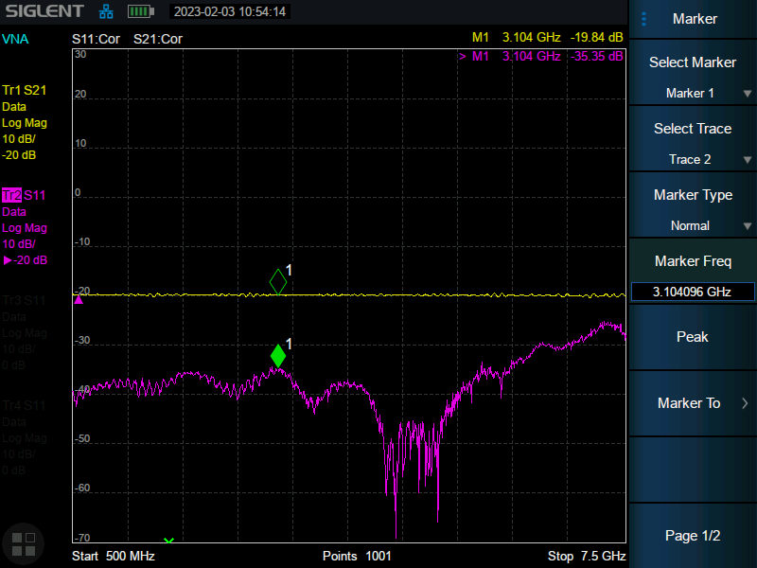
Insertion Loss/Return Loss
Any signal. Anytime. Anywhere.
Insertion loss can represent the loss of jumper cable, feeder cable, duplexer, etc.
Or the gain of tower top amplifier
Return loss (RL) is an important parameter for measuring and verifying cable and antenna systems
The measurement results can reflect the power transmission efficiency of the system
*Requires VNA Option
27
Notes:
Better signal fidelity than CAT mode

Slide 28
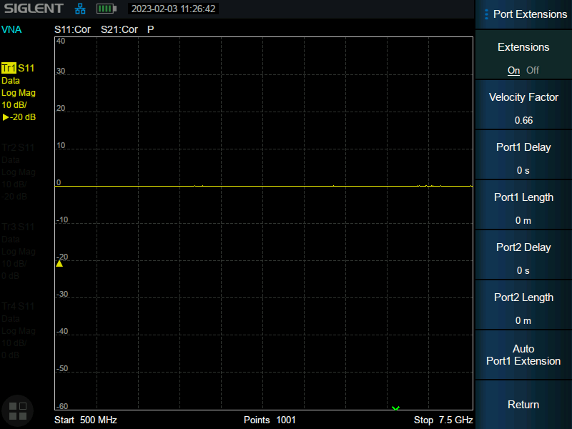
Port Extension
Any signal. Anytime. Anywhere.
Eliminates the error of test fixture
The reference plane can be extended to the specified measurement plane so that more accurate testing can be carried out
*Requires VNA Option
28

Slide 29
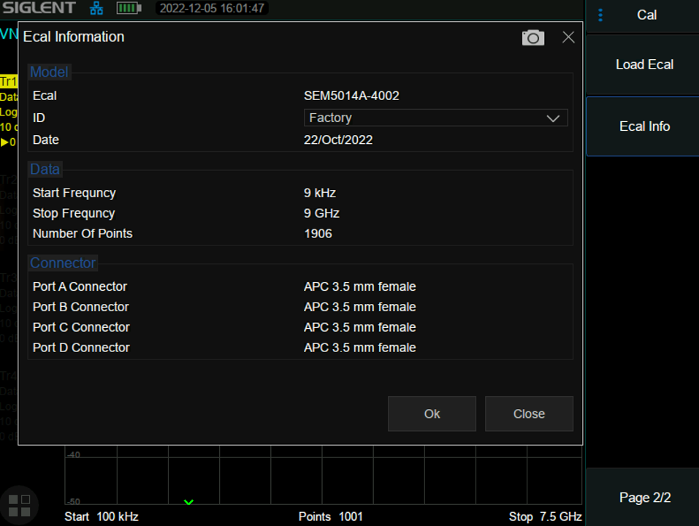
Ecal
Any signal. Anytime. Anywhere.
Supports user calibration kit
Shortens the calibration time
Reduces the number of connections
Provides higher measurement consistency
Reduces human error and improves accuracy
*Requires VNA Option
29

Slide 30
Basic Info
Features and Benefits
Contents
Market and Application
Competition Analysis

Slide 31


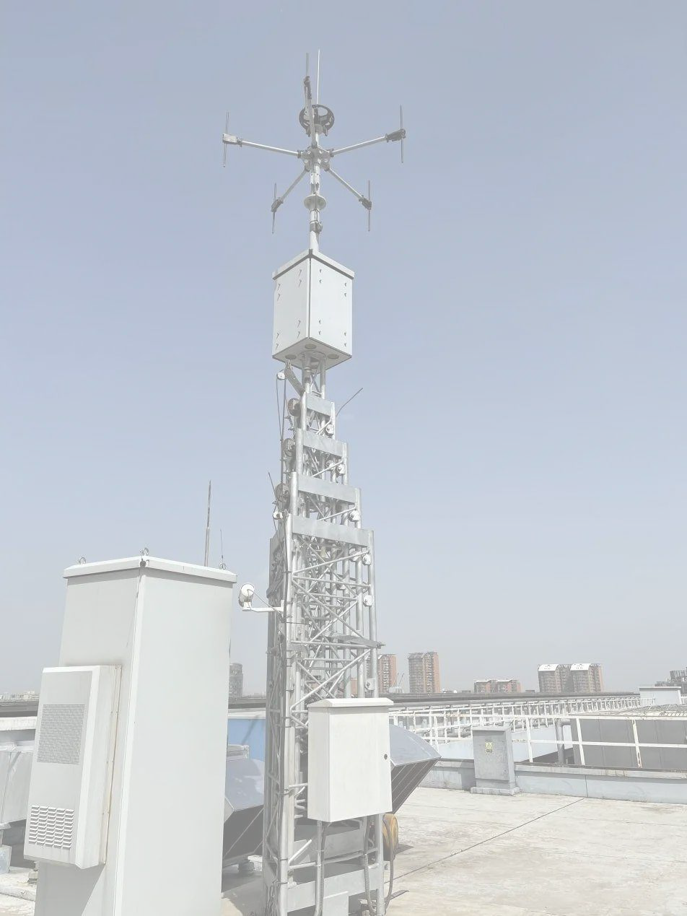

Market and Application
Any signal. Anytime. Anywhere.
Communication Engineering
Failure Analysis in the field
Site Installation & Troubleshooting
Comparative measurement of received signal power
Fast location of interference signals
Installation and maintenance of base station
Cable and antenna measurement
Wireless equipment field test
Field strength coverage measurement
Telecom drive test operation and maintenance
Characterize RF devices
Characterize electronic components including
Resistors, Capacitors, Inductors…
Filters, Cables, Mixers, Connectors…
Antennas, Amplifiers, Attenuators…
Site survey
Radio link installation
Site acceptance
Design and assembly troubleshooting
Device parameter Verification
Measure the characteristics of amplifiers, mixers, filters and other devices in the field
Test the performance, bandwidth, intermodulation distortion and many other indicators
31

Slide 32

Telecom drive test operation and maintenance
Installation and maintenance of cellular systems
Fault diagnosis and maintenance to ensure the continuity of communication.
Most microwave link equipment problems are related to cables, antennas and connectors.
If the performance of the feeder is degraded, it may lead to problems such as
Reduced coverage
Link failure
Decreased sensitivity of the receiver path
32

Slide 33

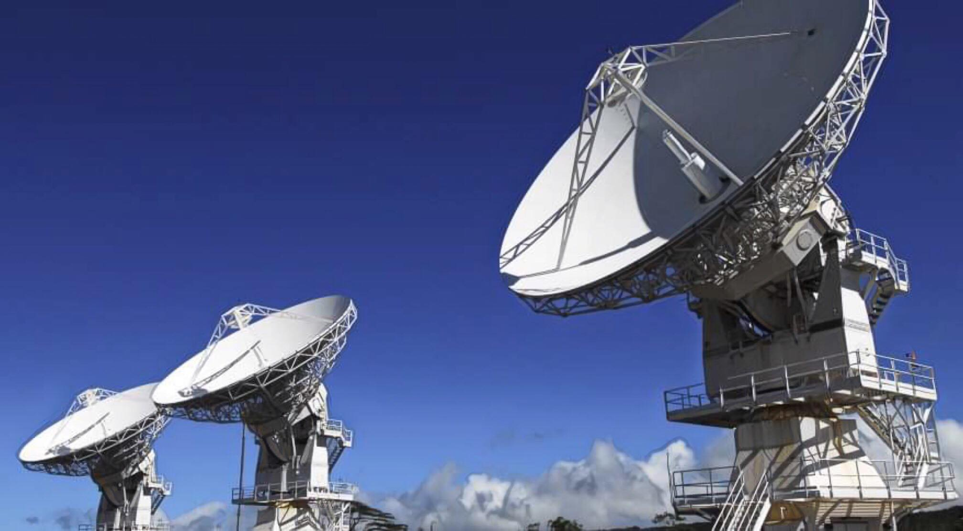
Radio Monitoring
Management
In applications such as communication and commercial microwave backhaul
Hardware installation and maintenance
Detecting the quality of wireless signals
Periodically detect unexpected signals
Signal monitoring
Example
Detecting low-level signals or neighboring small interference signals under strong signal conditions requires high dynamic range.
While the latter requires excellent phase noise performance.
33

Slide 34
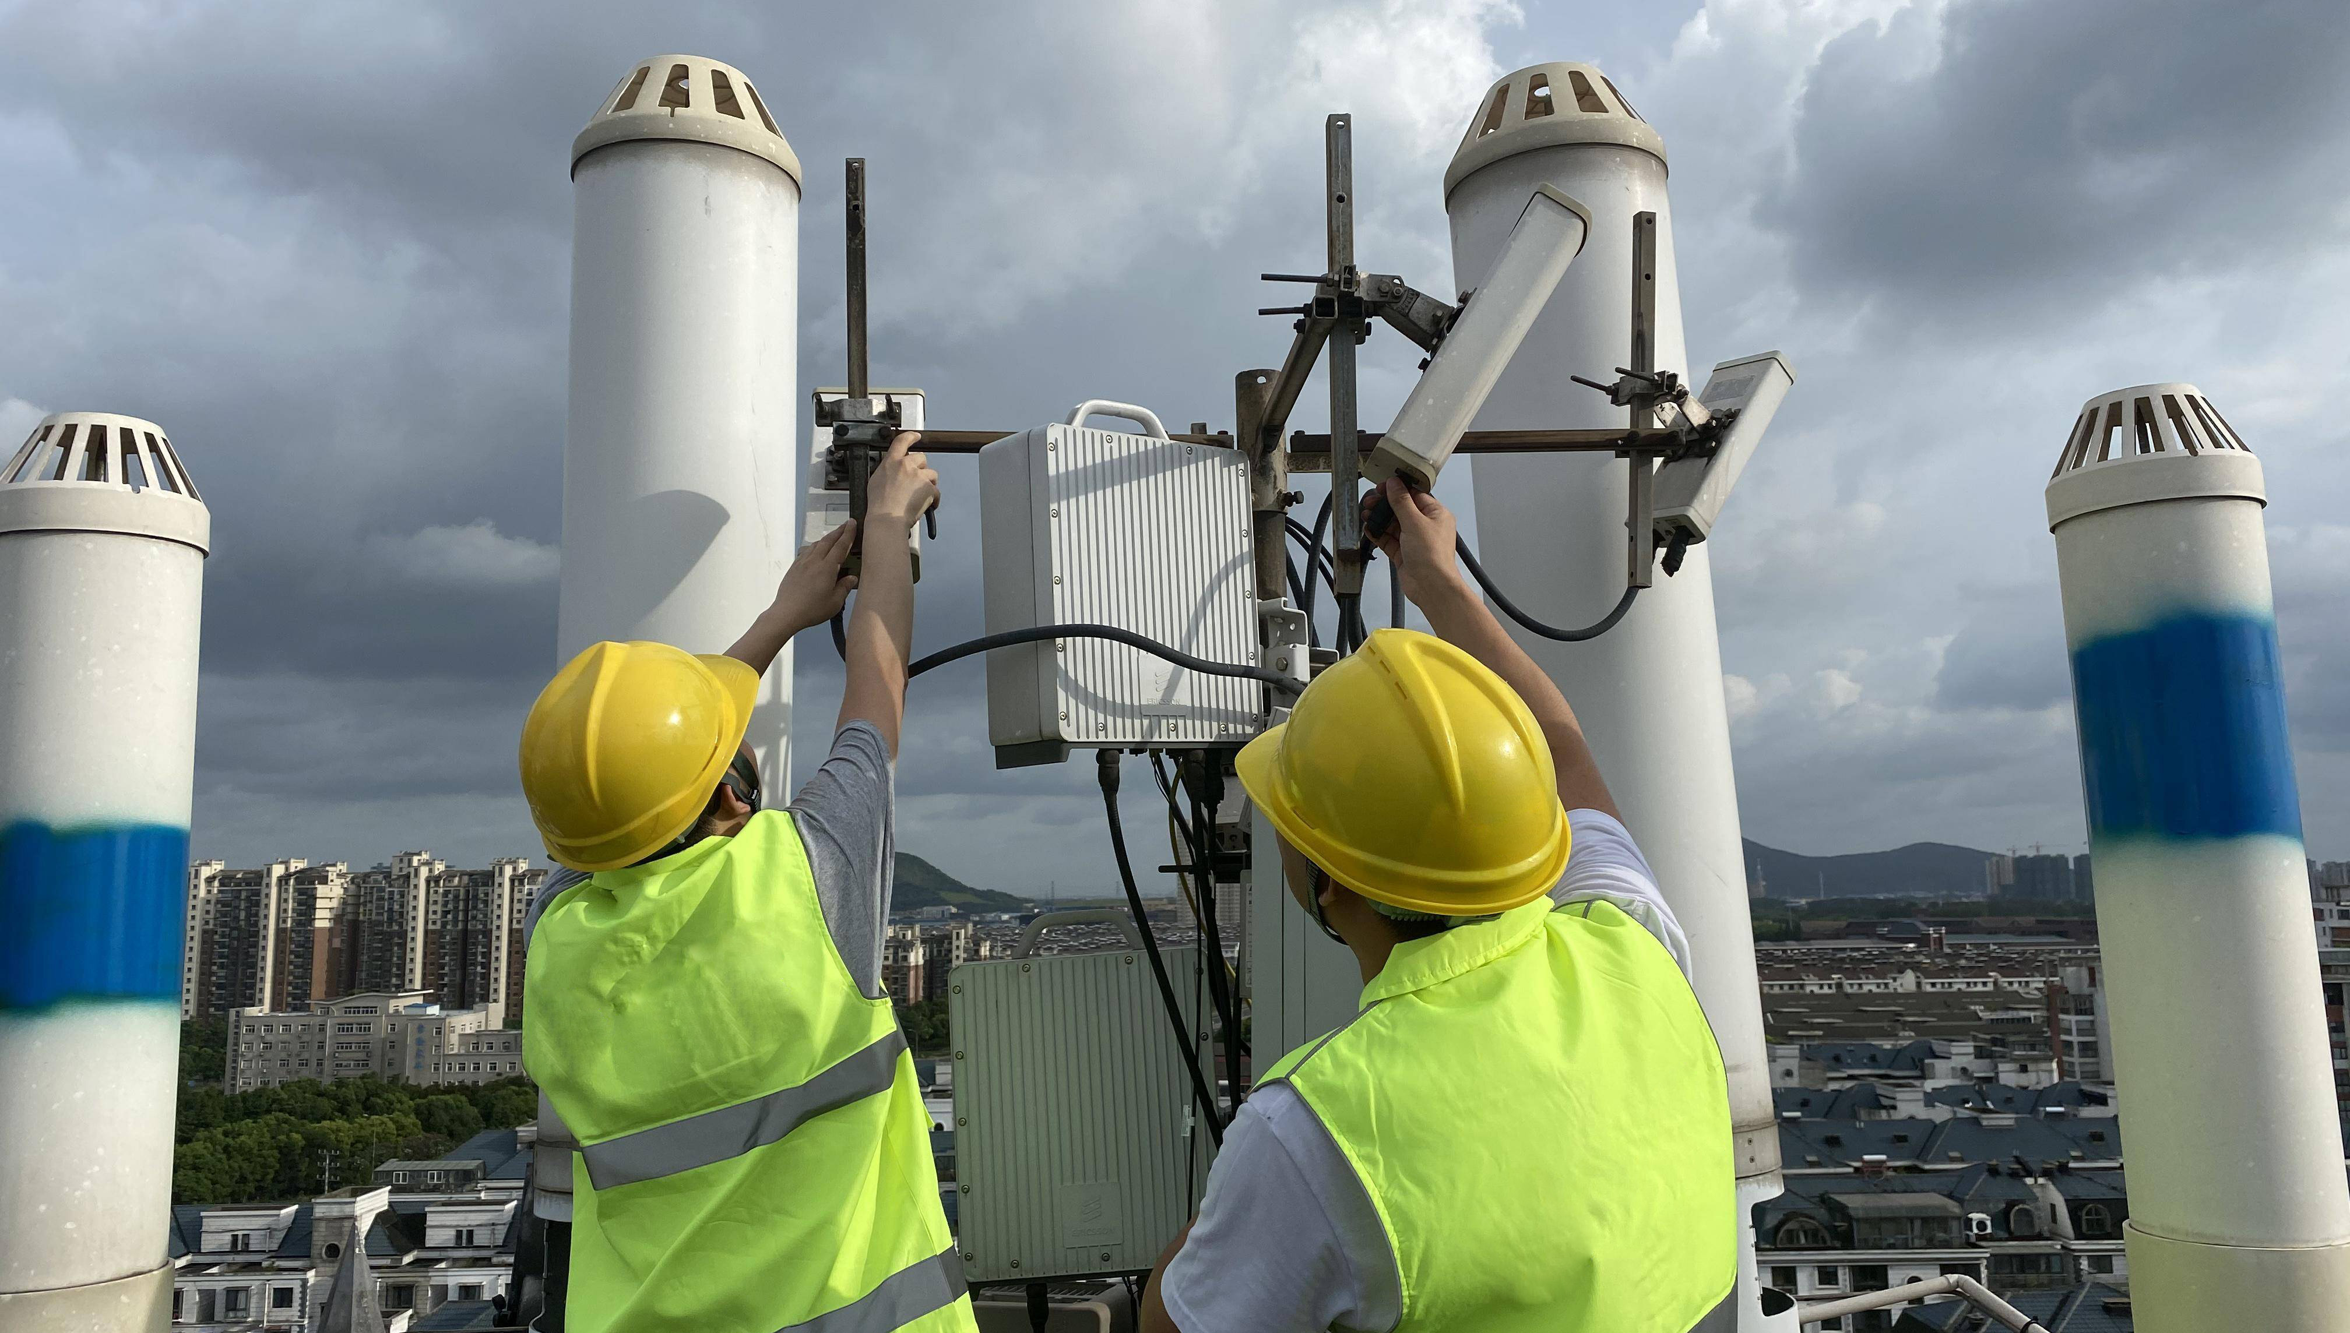

Station Installation
Verification
Verify station parameters including frequency and power
Debug cables and connections
Characterize active and passive devices including amplifiers and antennas
Conduct on-site verification and followup
34

Slide 35
Basic Info
Features and Benefits
Contents
Market and Application
Competition Analysis

Slide 36
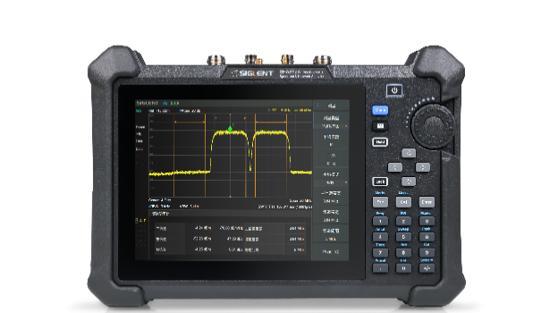
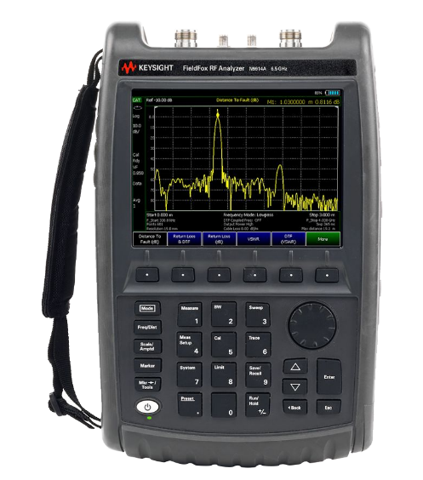
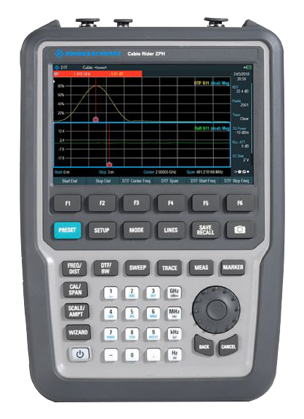
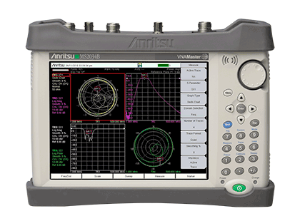
Model | SIGLENT SHA850A | KEYSIGHT N9913/4A | R&S ZPH | Anritsu MS2034/5B
Appearance
Spectrum Analyzer | 9 kHz ~ 3.6/7.5 GHz | 5 kHz ~ 4 GHz/6.5 GHz(option 233) | 5 kHz ~ 3 GHz/4 GHz(option ZPH-B4) | 9 kHz ~ 4/6 GHz
Vector Network Analyzer | 100 kHz ~ 3.6/7.5 GHz (option SHA850-VNA) | 30 kHz to 4/6.5 GHz (N9914A-V5K) (N9914A-210; N9914A-211) | 2 MHz to 3 GHz/4 GHz (option ZPH-B4) | 500 kHz ~ 4/6 GHz
Cable and Antenna Analyzer | 100 kHz ~ 3.6/7.5 GHz | 30 kHz to 4/6.5 GHz (N9914A-V5K: 5kHz start frequency) | 2 MHz to 3 GHz/4 GHz (option ZPH-B4) | 500 kHz ~ 4/6 GHz
DANL | -165 dBm/Hz | -155 dBm/Hz | -163 dBm/Hz | -162 dBm
SSB Phase Noise | fc = 1 GH, offset 10 kHz -104 dBc/Hz (typ.) | fc = 1 GH, offset 10 kHz -111 dBc/Hz(typ.) | fc = 500 MHz, offset 30 kHz -95 dBc/Hz(typ.) | fc = 1 GH, offset 10 kHz –110 dBc/Hz(typ.)
Dynamic Range (typ.) | 114 dB | 100 dB | > 90 dB | 100 dB
Analog Modulation Analysis | AM/FM/PM (option SHA850-AMA) | AM/FM (Option 355) | AM/FM (option ZPH-K7) | AM/FM/PM (Option 509)
Digital Modulation Analysis | ASK/FSK/MSK/PSK/DPSK/QAM (option SHA850-DMA) | none | none | none
Measurement range | DANL to +10 dBm, 100 kHz ~ 1 MHz DANL to +20 dBm, 1 MHz ~ 7.5 GHz | DANL to +20 dBm | DANL to +30 dBm | DANL to +26 dBm (≥ 50 MHz) DANL to 0 dBm (< 50 MHz)
Preamplifier | 25 dB (nom.), standard | +20 dB (Option 235) | option | standard
Source | 100 kHz ~ 3.6/7.5 GHz (option SHA850-SOR) | 30 kHz to 4/6.5 GHz | 100 kHz ~ 4 GHz | unspecified
Dimensions | 310.1 x 215 x 78.5 mm | 292 x 188 x 72 mm | 294 x 202 x 76 mm | 273 x 199 x 91 mm
Operating time | 4 hours | 3.5 hours | 6.5 ~ 9 hours | 3.6 hours
36

Slide 37
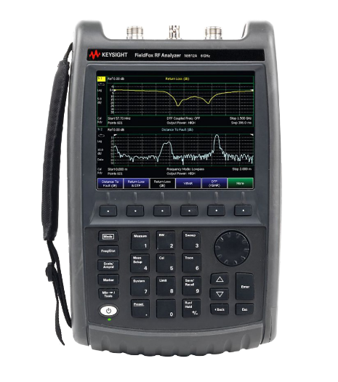
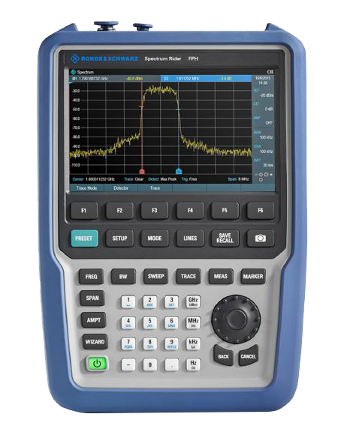
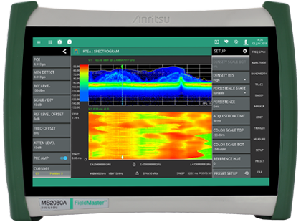
Model | SIGLENT SHA850A | KEYSIGHT N9912A | R&S FPH | Anritsu MS2080A
Appearance
Spectrum Analyzer | 9 kHz ~ 3.6/7.5 GHz | N9912AU-230: 100 kHz to 4 GHz N9912AU-231: 100 kHz to 6 GHz | 5 kHz to 2 GHz(model .02) 5 kHz to 6 GHz(model .06) | 9 kHz ~ 4 GHz (Option 704)
Vector Network Analyzer | 100 kHz ~ 3.6/7.5 GHz (option SHA850-VNA) | Option 104:2 MHz to 4 GHz Option 106:2 MHz to 6 GHz (S11 – Option 303; S21 – Option 110 and 303) | none | none
Cable and Antenna Analyzer | 100 kHz ~ 3.6/7.5 GHz | Option 104: 2 MHz to 4 GHz Option 106: 2 MHz to 6 GHz | none | 150 kHz to 4 GHz (S331P-0704) 150 kHz to 6 GHz (S331P-0706)
DANL | -165 dBm/Hz | -148 dBm/Hz | -163 dBm/Hz | -167 dBm
SSB Phase Noise | fc = 1 GH, offset 10 kHz -104 dBc/Hz (typ.) | fc = 1 GH, offset 10 kHz -88 dBc/Hz(typ.) | fc = 500 MHz, offset 30 kHz -95 dBc/Hz(typ.) | fc = 1 GH, offset 10 kHz –94 dBc/Hz(typ.)
Dynamic Range (typ.) | 114 dB | unspecified | none | >105 dB Typical
Analog Modulation Analysis | AM/FM/PM (option SHA850-AMA) | AM/FM (Option 230 or 231) | AM/FM (option FPH-K7) | AM/FM (Option 24)
Digital Modulation Analysis | ASK/FSK/MSK/PSK/DPSK/QAM (option SHA850-DMA) | none | ASK/FSK (option FPH-K7) | none
Measurement range | DANL to +10 dBm, 100 kHz ~ 1 MHz DANL to +20 dBm, 1 MHz ~ 7.5 GHz | DANL to +20 dBm | DANL to +30 dBm | DANL to +30 dBm
Preamplifier | 25 dB (nom.), standard | +22 dB (Option 235) | option | standard
Source | 100 kHz ~ 3.6/7.5 GHz (option SHA850-SOR) | N9912AU-230: 2 MHz to 4 GHz N9912AU-231: 2 MHz to 6 GHz | 100 kHz to MAX frequency | unspecified
Dimensions | 310.1 x 215 x 78.5 mm | 292 x 188 x 72 mm | 294 x 202 x 76 mm | 290 x 212 x 96 mm
Operating time | 4 hours | 4 hours (typical) | 8 h(model .02) / 7 h(model .06) | 3 h with Internal 6 h with Accessory Power Pack
37

Slide 38
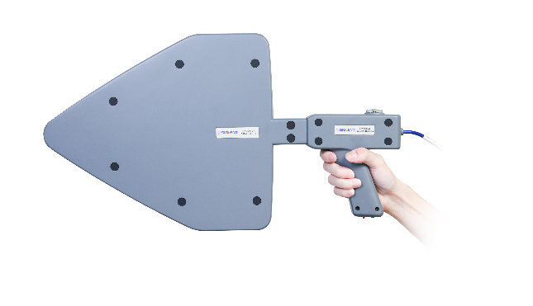
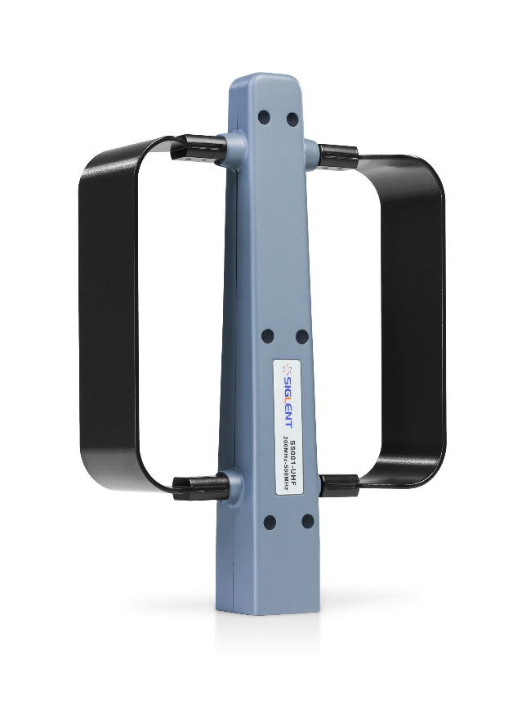
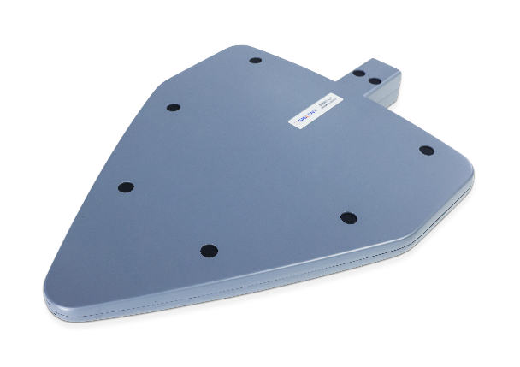
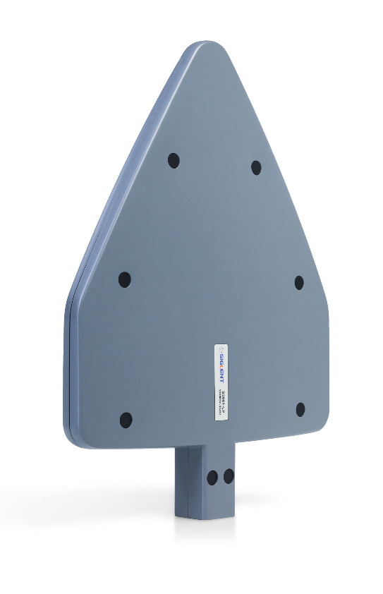
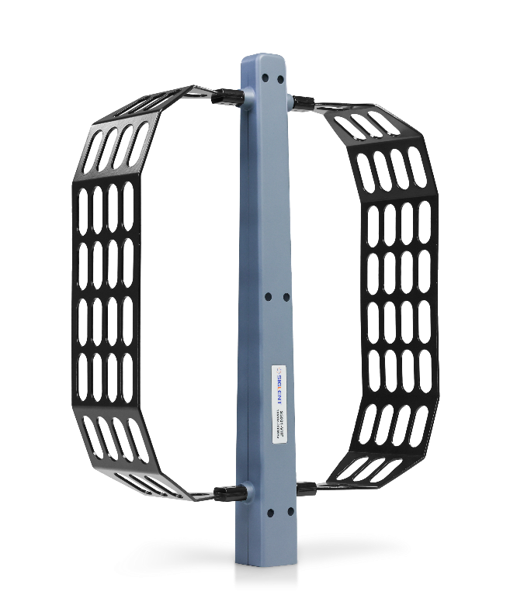
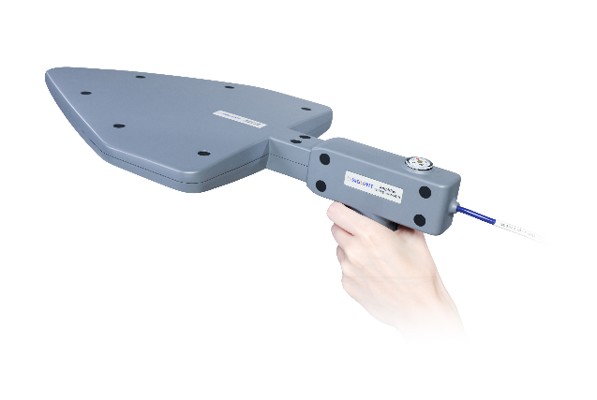
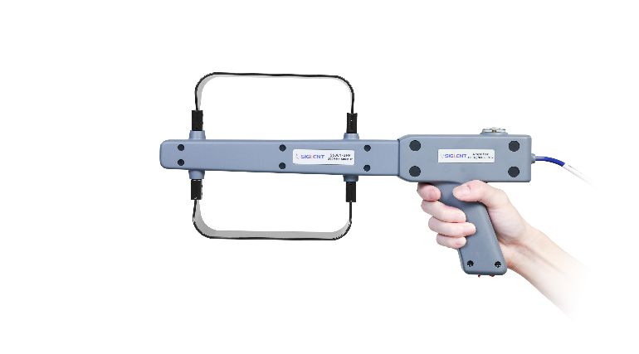
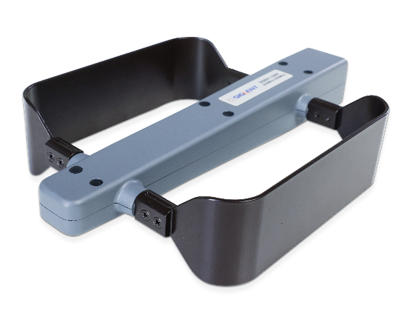
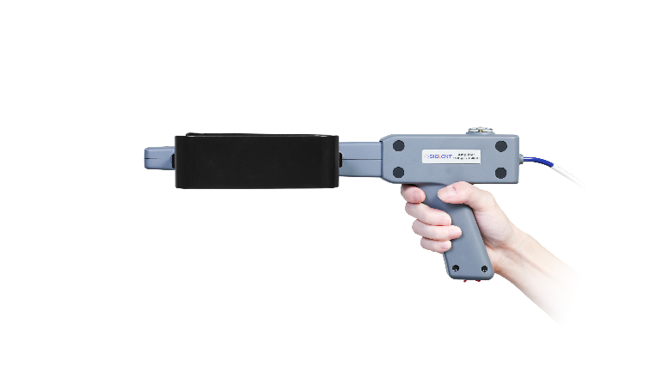
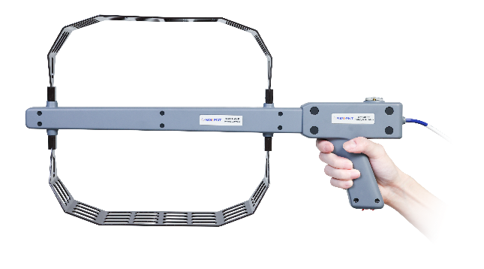
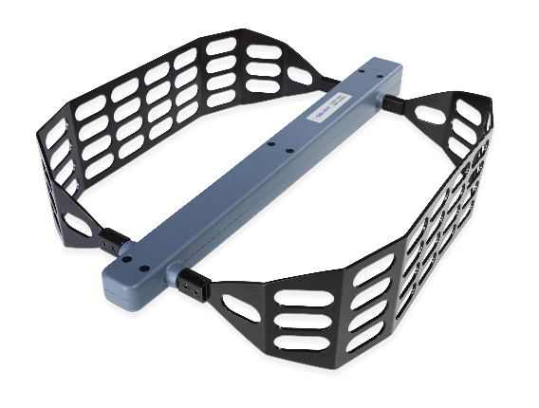
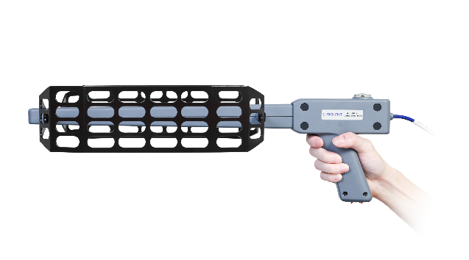
S5000 Directional Antenna Set
Model | ANT-DA13 (S5001-LP) | ANT-DA12 (S5001-UHF) | ANT-DA11 (S5001-VHF)
Frequency Range | 500MHz-8GHz | 200MHz – 500MHz | 10MHz – 200MHz
Appearance
Antenna Gain | 10dB (typ.)
SWR | ＜1:1.9 (typ.)
Direction Of Polarization | horizontal, vertical
RF Interface | 50Ω/N type, female
Handle Radio Frequency Wire | 1.5m /N type, male
Handle Amplifier Gain | 12dB @1GHz, more than 50 hours
Dimensions | 470 x 400 x 240mm
Rough Weight | 4.8kg (including packing box) | 4.8kg (including packing box) | 4.8kg (including packing box)
Net Weight | 0.45kg (including handle 0.96kg) | 0.32kg (including handle 0.83kg) | 0.50kg (including handle 1.01kg)
38

Slide 39
Pattern and application diagram
39

Slide 40




Pricing & Availability
Type | Model Name | Description | Price | Availability
Product Code | SHA851A | Spectrum & Vector Network Analyzer, 9 kHz~3.6 GHz | $4,860 | 4-6 weeks
 | SHA852A | Spectrum & Vector Network Analyzer, 9 kHz~7.5 GHz | $7,650 | 4-6 weeks
Options | SHA850-F2 | SHA851A to SHA852A | $4,022 | Stock
 | SHA850-SOR | Source | $297 | Stock
 | SHA850-VNA | Vector Network Analysis | $1,019 | Stock
 | SHA850-AMK | Advanced Measurement Kit | $400 | Stock
 | SHA850-AMA | Analog Modulation Analysis | $338 | Stock
 | SHA850-DMA | Digital Modulation Analysis | $606 | Stock
 | SHA850-BIAS | DC Bias Out | $132 | Stock
 | SHA850-GPS | GPS Receiver | $173 | Stock
 | SHA850-GPSM | GPS Logging(need GPS Receiver) | $173 | Stock
Antenna Accessories | ANT-GPS1 | GPS Antenna with male SMA connector | $20 | 4-6 weeks
 | ANT-DA1 | Contains amplifier handle and 3 antennas: 10-200 MHz, 200-500 MHz, and 500 MHz-8 GHz | $7,614 | 4-6 weeks
 | ANT-DA11 | Contains amplifier handle and 10MHz ~ 200MHz antenna | $3,080 | 4-6 weeks
 | ANT-DA12 | Contains amplifier handle and 200MHz ~ 500MHz antenna | $3,065 | 4-6 weeks
 | ANT-DA13 | Contains amplifier handle and 500MHz ~ 8GHz antenna | $3,673 | 4-6 weeks
40

Slide 41



General Accessories
Product | Description | Order Number
General Accessories | Rechargeable lithium battery | SHA800-BAT
 | AC-DC adapter | SHA800-AP
Options | Portable bag | SHA800-BG
 | GPS antenna, SMA(M), 100cm | ANT-GPS1
 | S5000 Directional Antenna Set: S5001-VHF(10 MHz~200 MHz), S5001-UHF(200 MHz~500 MHz), S5001-LP(500 MHz~8 GHz), Preamp(10 dB, 9 kHz~8 GHz) | ANT-DA1
 | Near field probe kit：300 kHz~3 GHz, H-field probes(20 mm,10 mm,5 mm), E-field probe(5 mm) | SRF5030T
 | Utility Kit: N(M)-SMA(M) cable(6 GHz), N(M)-N(M) cable(6 GHz), N(M)-BNC(F) adaptor x2, N(M)-SMA(F) adaptor x2, 10 dB 1W attenuator | UKitSSA3X
 | N(M)-BNC(M) cable, DC~2 GHz, 700 mm | N-BNC-2L
 | N(M)-SMA(M) cable, DC~6 GHz, 700 mm | N-SMA-6L
 | N(M)-N(M) cable, DC~6 GHz, 700 mm | N-N-6L
 | N(M)-N(M) cable ,DC~18 GHz，1000 mm | N-N-18L
CAT&VNA Accessories | N(M)-SMA(M) cable ,DC~18 GHz，1000 mm | N-SMA-18L
 | SMA(M)-SMA(M) cable ,DC~18 GHz，1000 mm | SMA-SMA-18L
41

Slide 42


VNA Calibration Kit Selection
Model | Max Frequency | Most Popular Calibration Kit | Alternate Cal Kit for reverse gender | Complete Kit for both genders
SHA851A | 3.6 GHz | F503ME | F503FE | F504TS
SHA852A | 7.5 GHz | F504MS | F504FS | F504TS
Calibration Kit Model | Max Frequency | Calibration Kit Connectors | Calibration Kit Gender
F503FE | 4.5 GHz | N Type (F) | Female
F503ME | 4.5 GHz | N Type (M) | Male
F603FE | 4.5 GHz | 3.5 mm | Female
F603ME | 4.5 GHz | 3.5 mm | Male
F504FS | 9 GHz | N Type (F) | Female
F504MS | 9 GHz | N Type (M) | Male
F504TS | 9 GHz | N Type (M & F) | Male & Female w/ Wrench
F604FS | 9 GHz | 3.5 mm | Female
F604MS | 9 GHz | 3.5 mm | Male
F604TS | 9 GHz | 3.5 mm | Male & Female w/ Wrench
Y504FS | 9 GHz | N Type (F) | Female
Y504MS | 9 GHz | N Type (M) | Male
F503ME
F504TS
42

Slide 43
Thank You
Every Bench. Every Engineer. Every Day.
Headquarters
NA
Europe
SIGLENT TECHNOLOGIES CO., LTD.
Add: Blog No.1 & No.4 & No.5, Antongda Industrial Zone, 3rd Liuxian Road, Bao’an District, Shenzhen, 518101, China
Tel:+ 86 755 3688 7876
Fax:+ 86 755 3359 1582
sales@siglent.com
int.siglent.com
SIGLENT Technologies NA, Inc.
Add: 6557 Cochran Rd Solon, Ohio 44139
Tel: 440-398-5800
Toll Free:877-515-5551
Fax: 440-399-1211
info@siglent.com
www.siglentna.com
SIGLENT TECHNOLOGIES GERMANY GmbH
Add: Staetzlinger Str. 70 86165 Augsburg, Germany
Tel: +49(0)-821-666 0 111 0
Fax: +49(0)-821-666 0 111 22
info-eu@siglent.com
www.siglenteu.com

