Slide 1

SDS7000A High resolution Oscilloscope

Slide 2
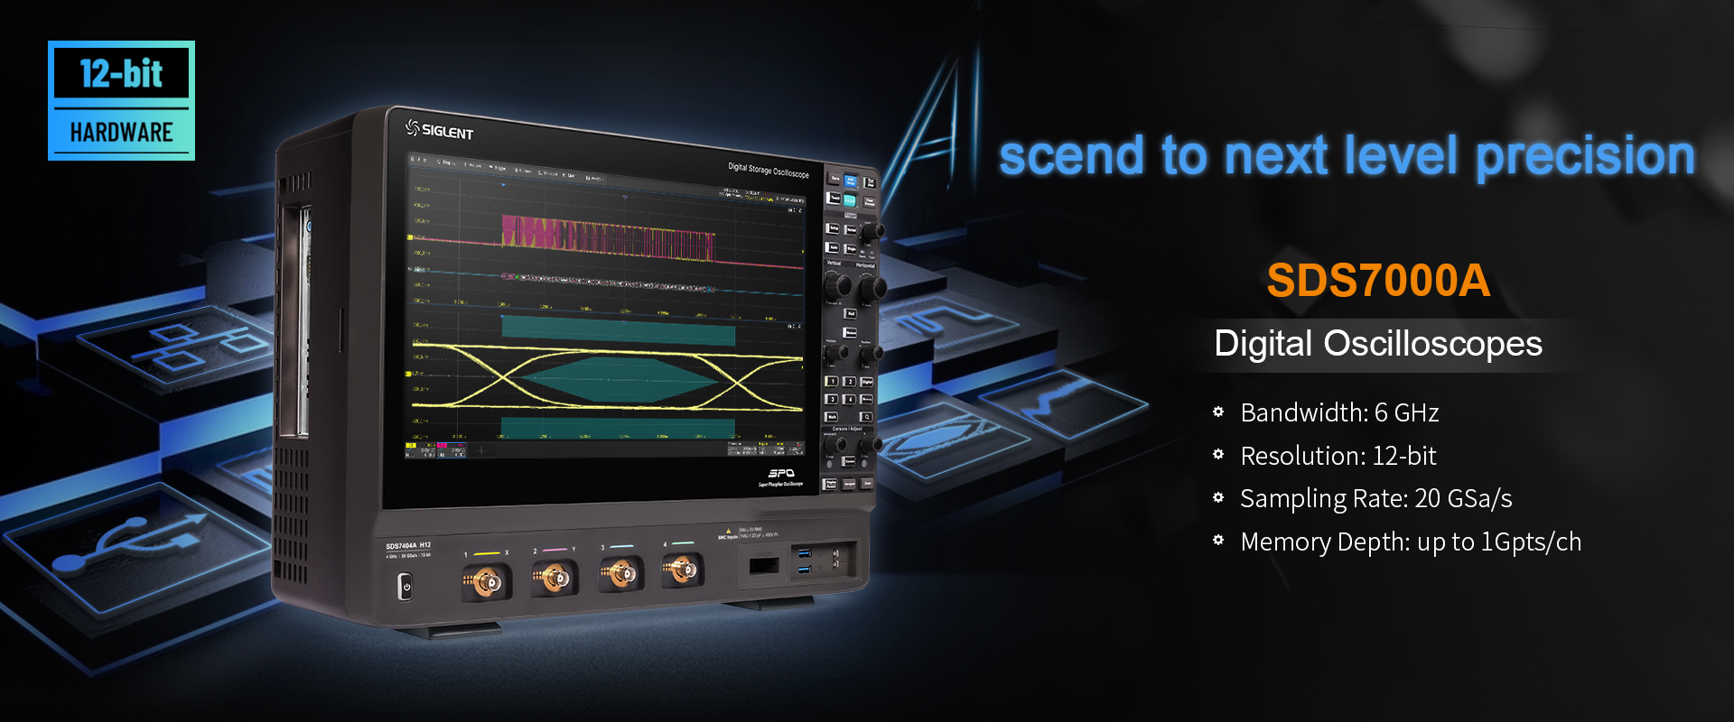

Slide 3
Basic information
Advanced Functions
Contents
Fundamental Functions
Competition Analysis

Slide 4
PART ONE
01
Brief introduction
Every Bench. Every Engineer. Every Day.

Slide 5
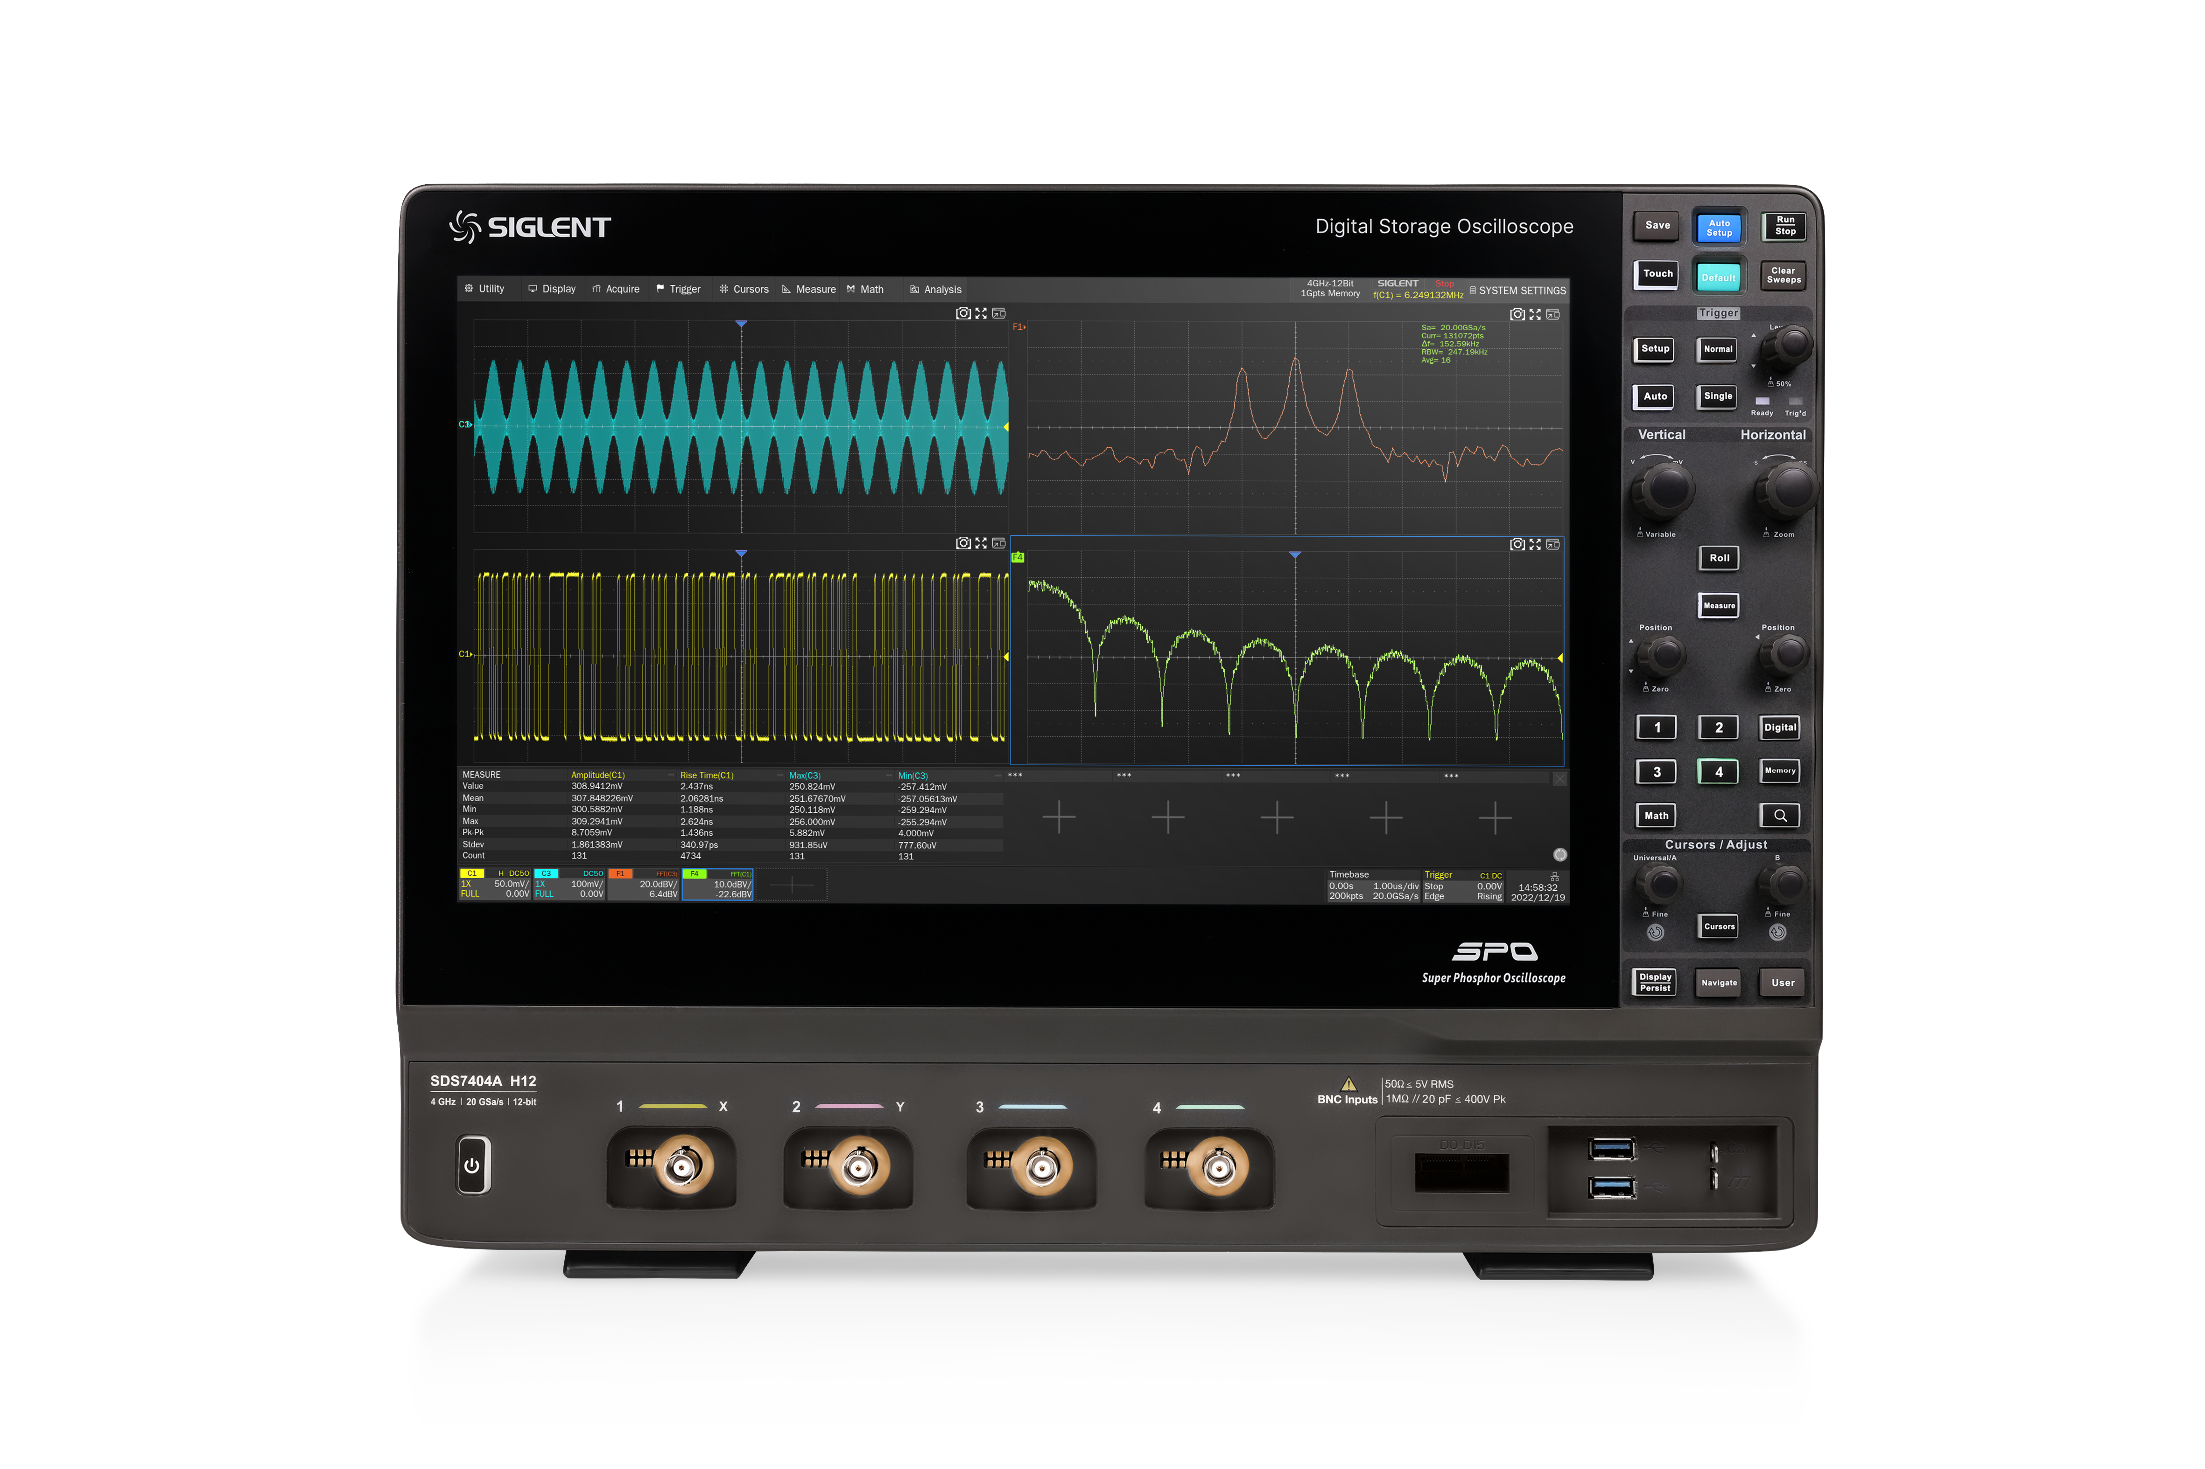
All Models
SDS7604A
SDS7404A
SDS7304A
6GHz
260 μVrms
4GHz
220 μVrms
3GHz
180 μVrms
Sequence & History: 124,000 segments
15.6 ’ display capacitive touch screen
Net Weight 10.56 kg
Sample Rate: 20 GSa/s
Waveform capture rate: 1,000,000 wfm/s
Memory depth: 500 Mpts/ch,1 Gpts/ch (optional)

Slide 6
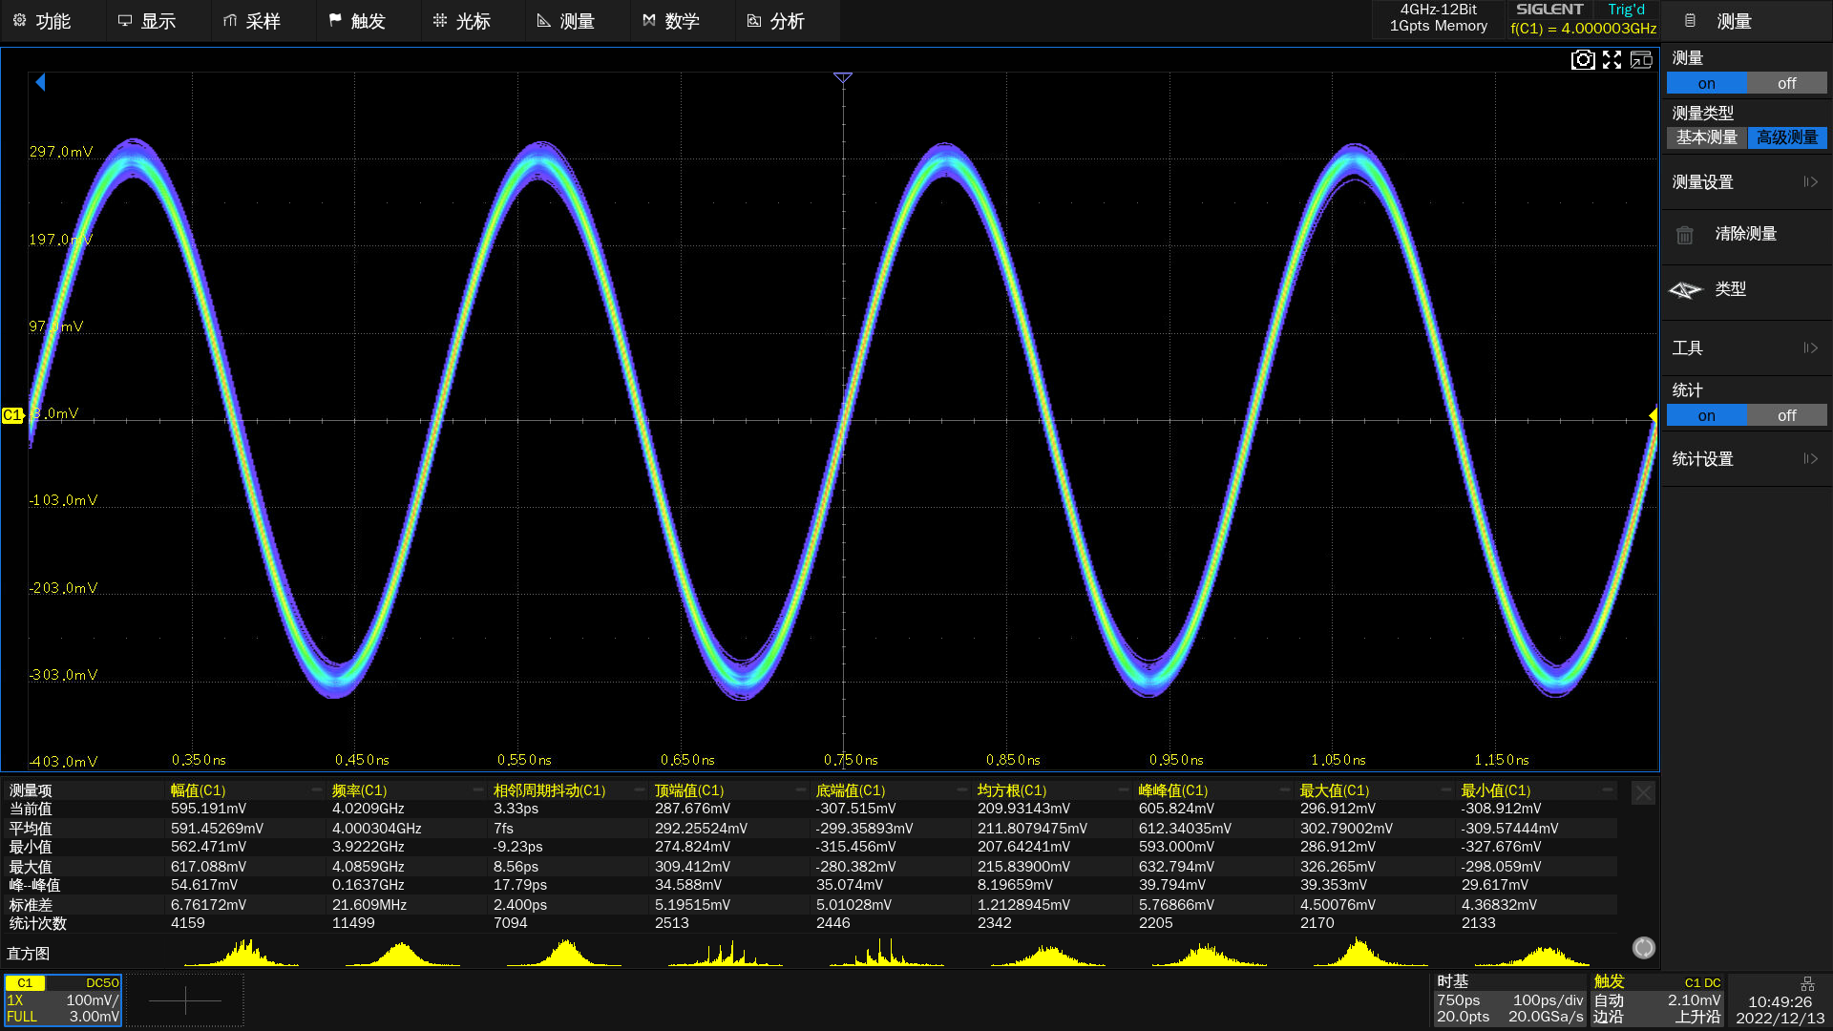
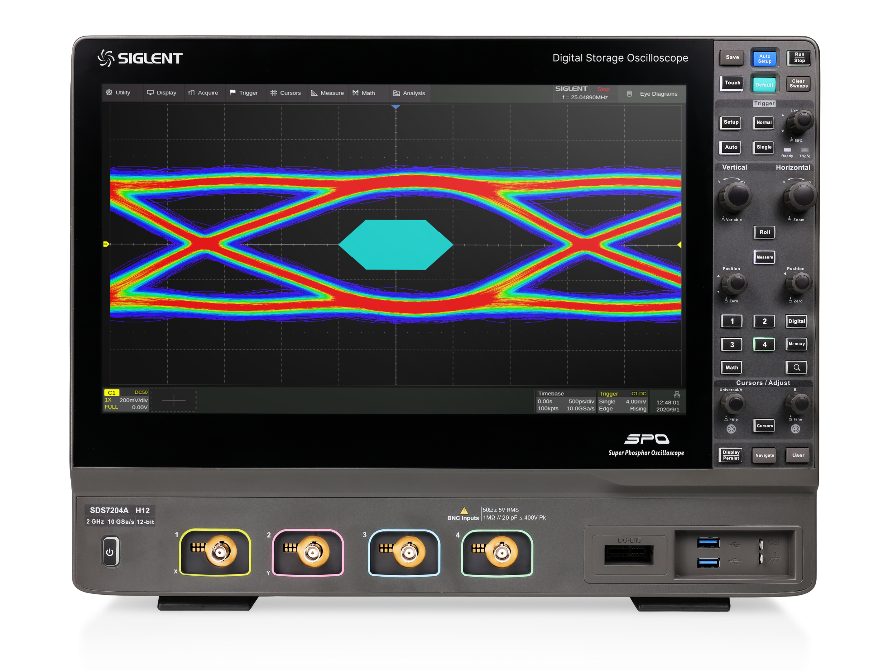

Bandwidth Upgrade
6 GHz bandwidth
Faster rise time 68 ps
More compliance tests possible
DDR3
1.5Gbps MIPI D-PHY
Broaden the range of applications.
Higher data speed can be tested
Better signal integrity results

Slide 7
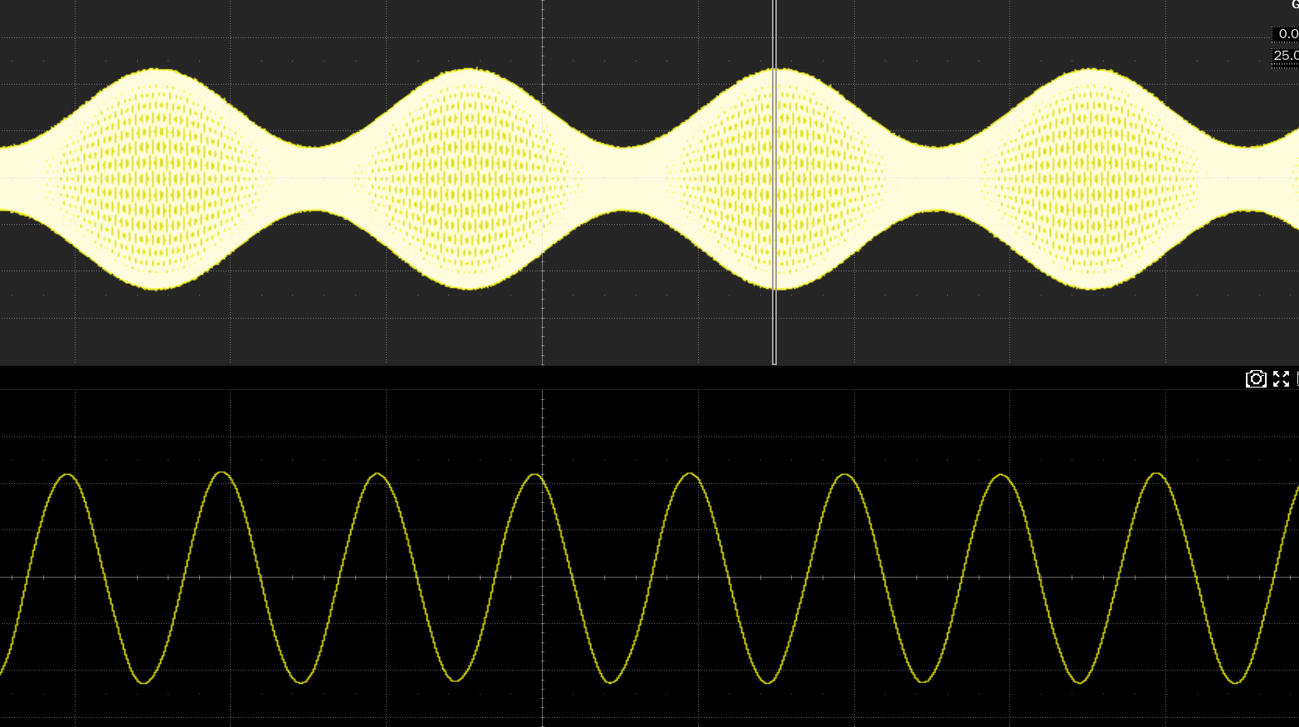
500 Mpts deep Memory Depth
Long time observation
Capture more waveforms details.
Ensure that the waveform is not distorted.
Excellent running performance
Maintain a high sample rate.
Accurate and effective analysis.
1 Gpts/ch (Optional)
Memory depth = Sample rate x Sample time

Slide 8
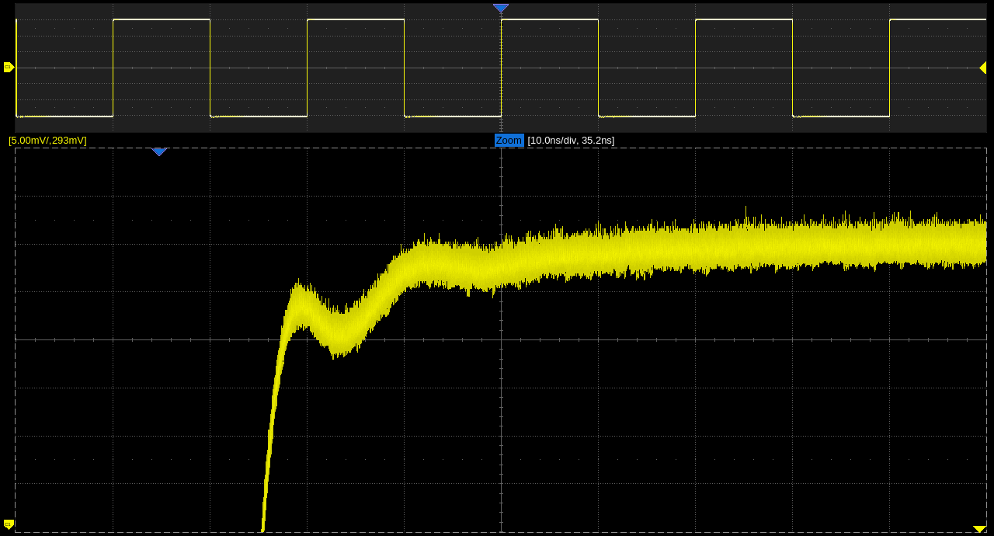
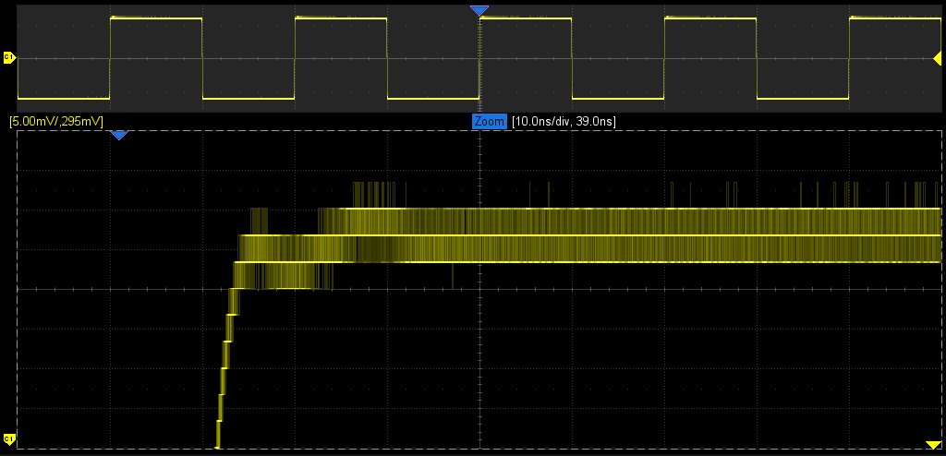
12-bit High Resolution
More than 16 times the accuracy of 8-bit oscilloscopes
Vertical resolution up to 16 bits in ERES mode.
Conducive to the detection of small signals.
Clearer and cleaner waveform display.
* 16 =
12-bit
8-bit

Slide 9
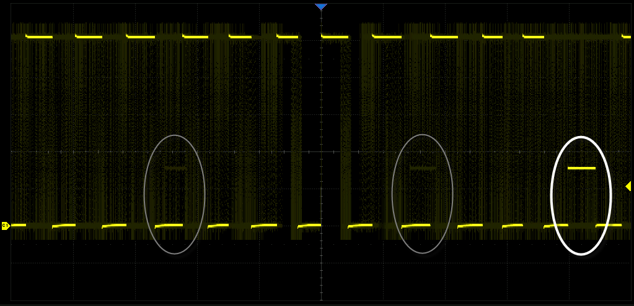
Higher Waveform Capture Rate
Up to 1 million wfm/s
Quickly capture abnormal or low probability events.

Slide 10
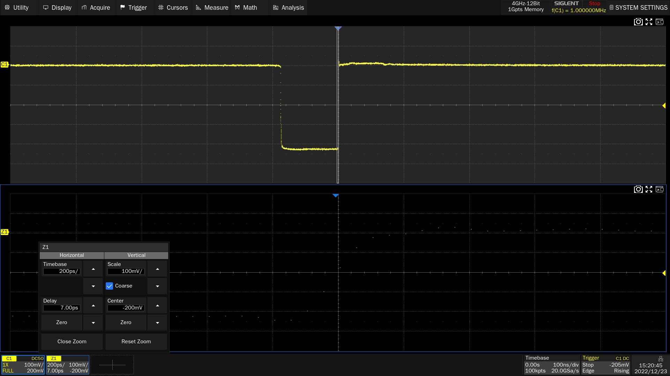
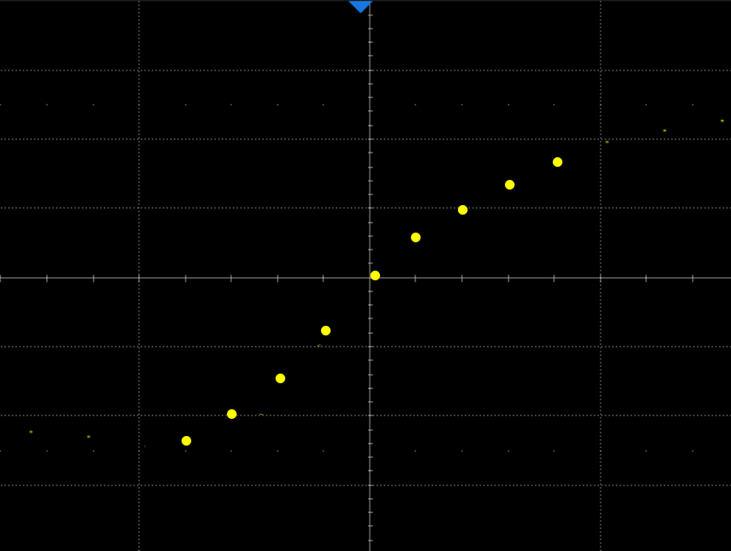
Excellent Real-time Sample Rate
Up to 20 GSa/s
Avoid spectral aliasing.
Rebuild the measured waveform precisely.

Slide 11
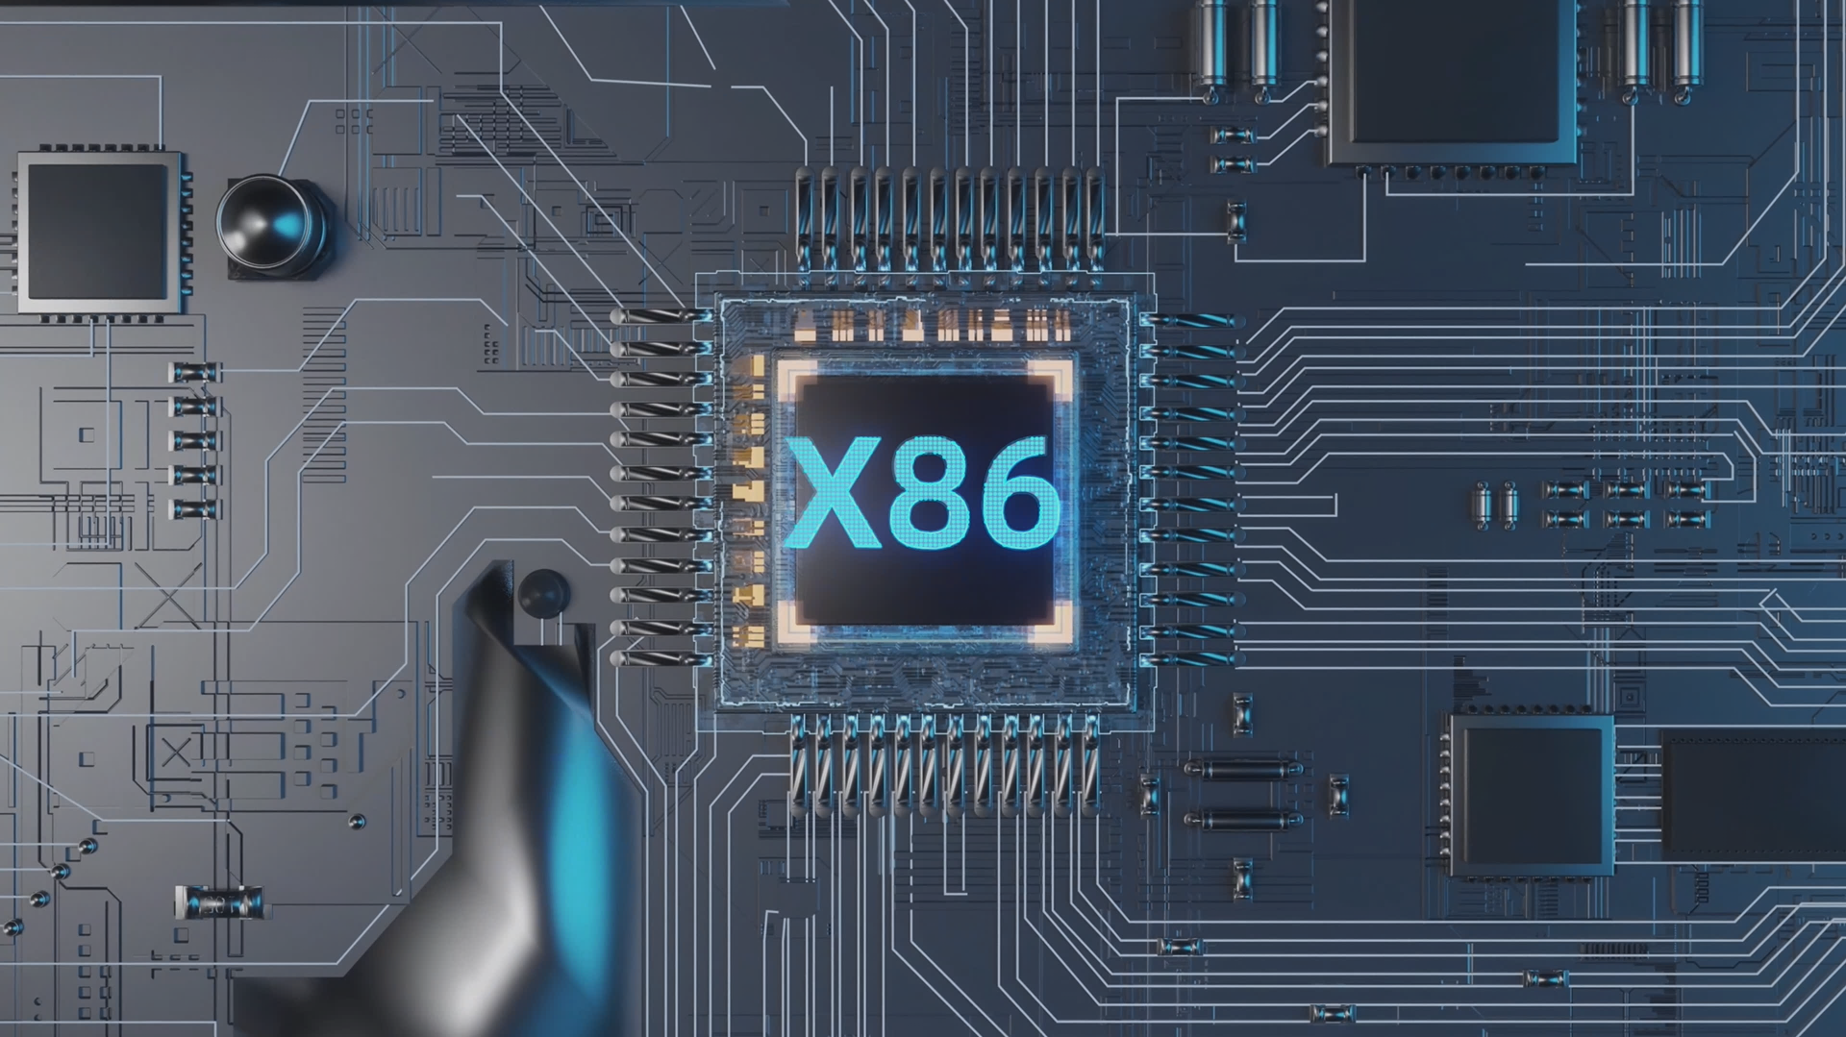
Faster Processor
Upgrade to X86 processor
32 GB DDR4, 250 GB SSD or better.
Linux operating system.
Greatly improve the system performance response speed.

Slide 12
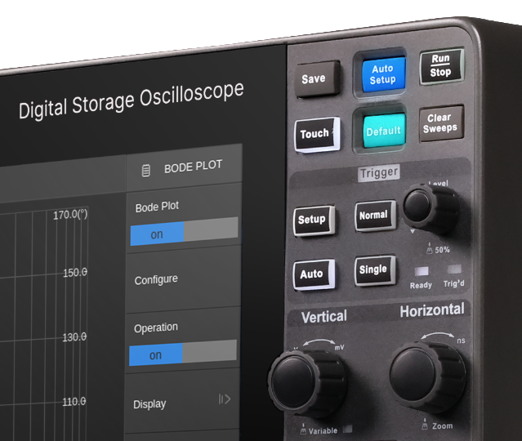
Upgrade Of Touch Control
New panel design, better touch
15.6-inch HD touch screen.
Fully consider the user's usage scenarios and habits.

Slide 13
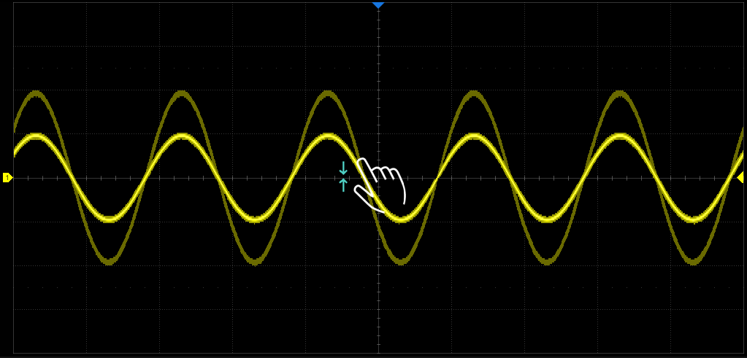
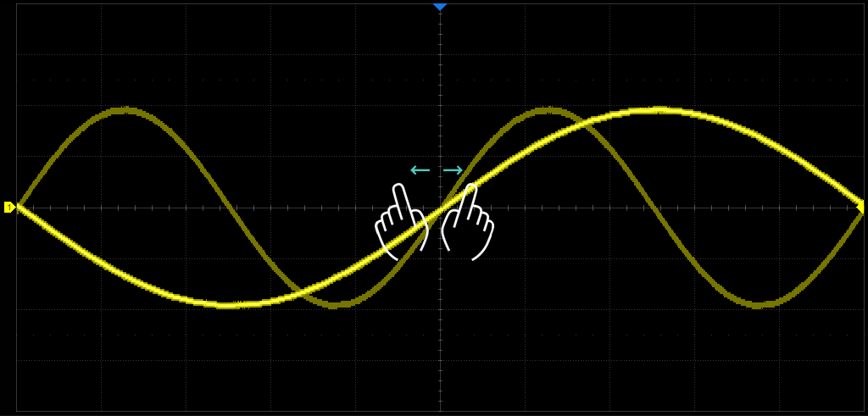
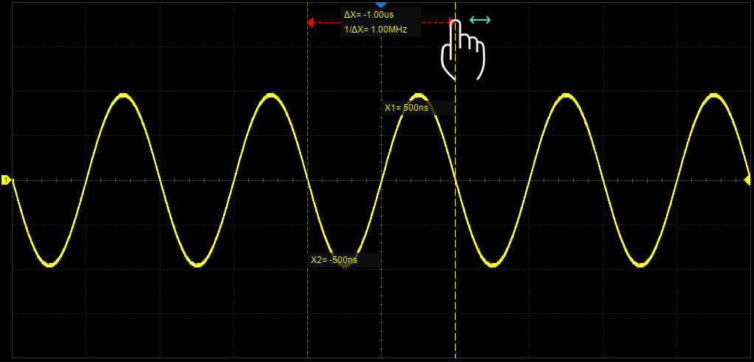
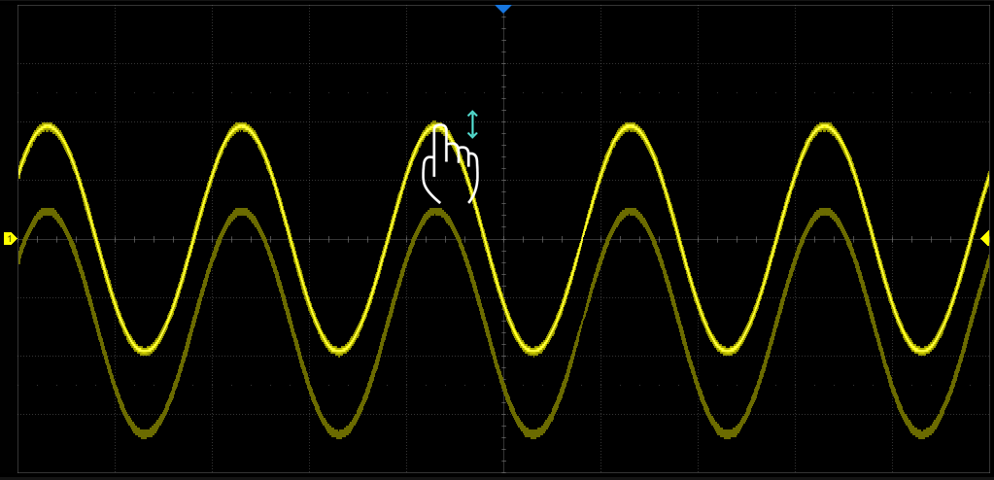
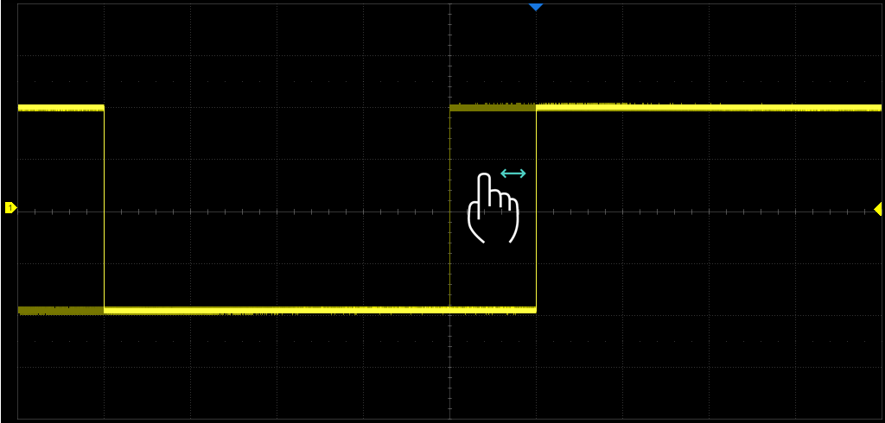
Adjust Waveform Quickly

Slide 14
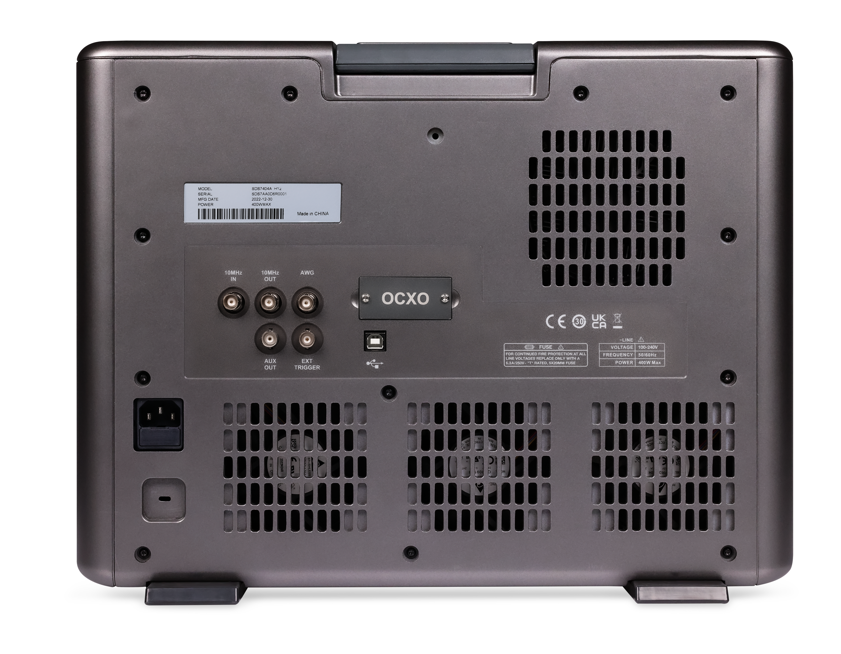
More Interfaces & Extended Functions
AWG
OCXO
10MHz OUT
10MHz IN
USB2.0 Device
AUX OUT
EXT TRIGGER

Slide 15
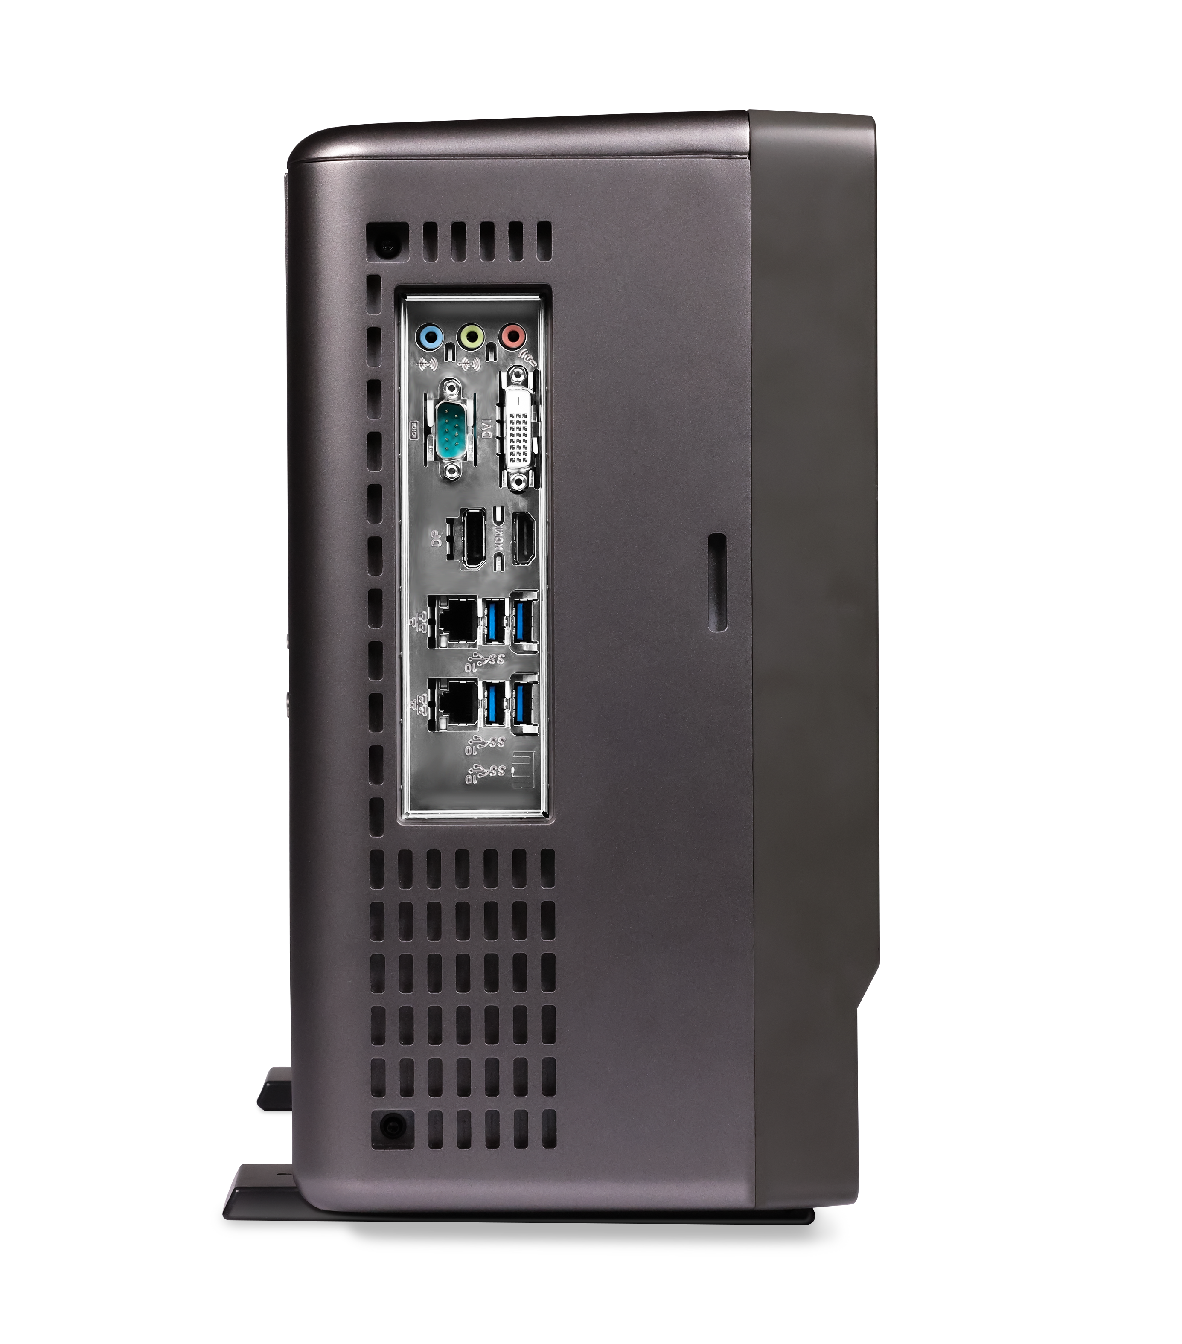
2×1000M LAN
DP 1.2
COM
Line In
Line Out
Mic In
4 × USB Host 3.1 Gen 1
HDMI 1.4
DVI-D

Slide 16
PART TWO
02
Basic Functions
Every Bench. Every Engineer. Every Day.

Slide 17
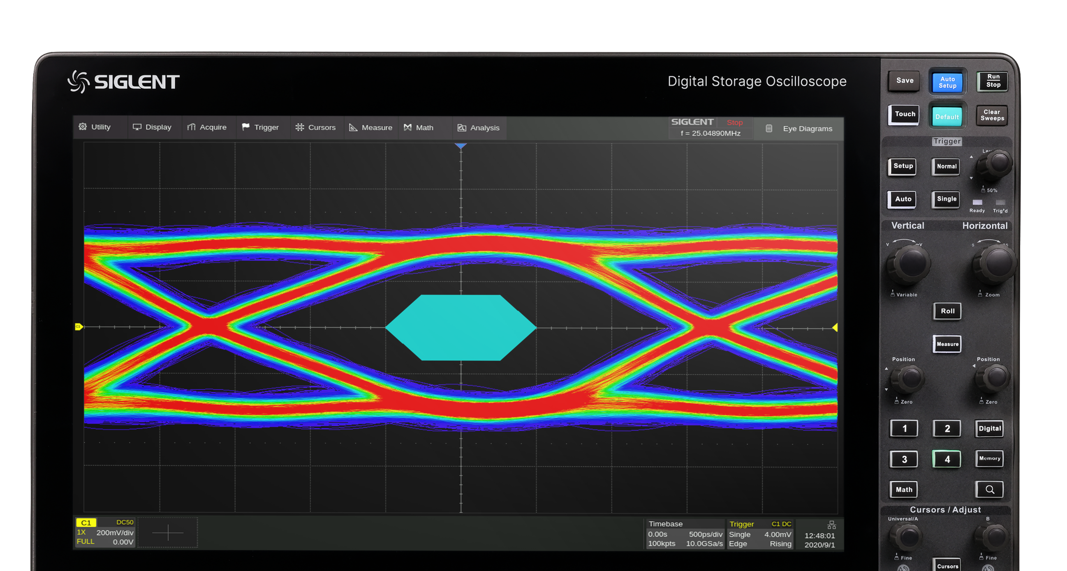
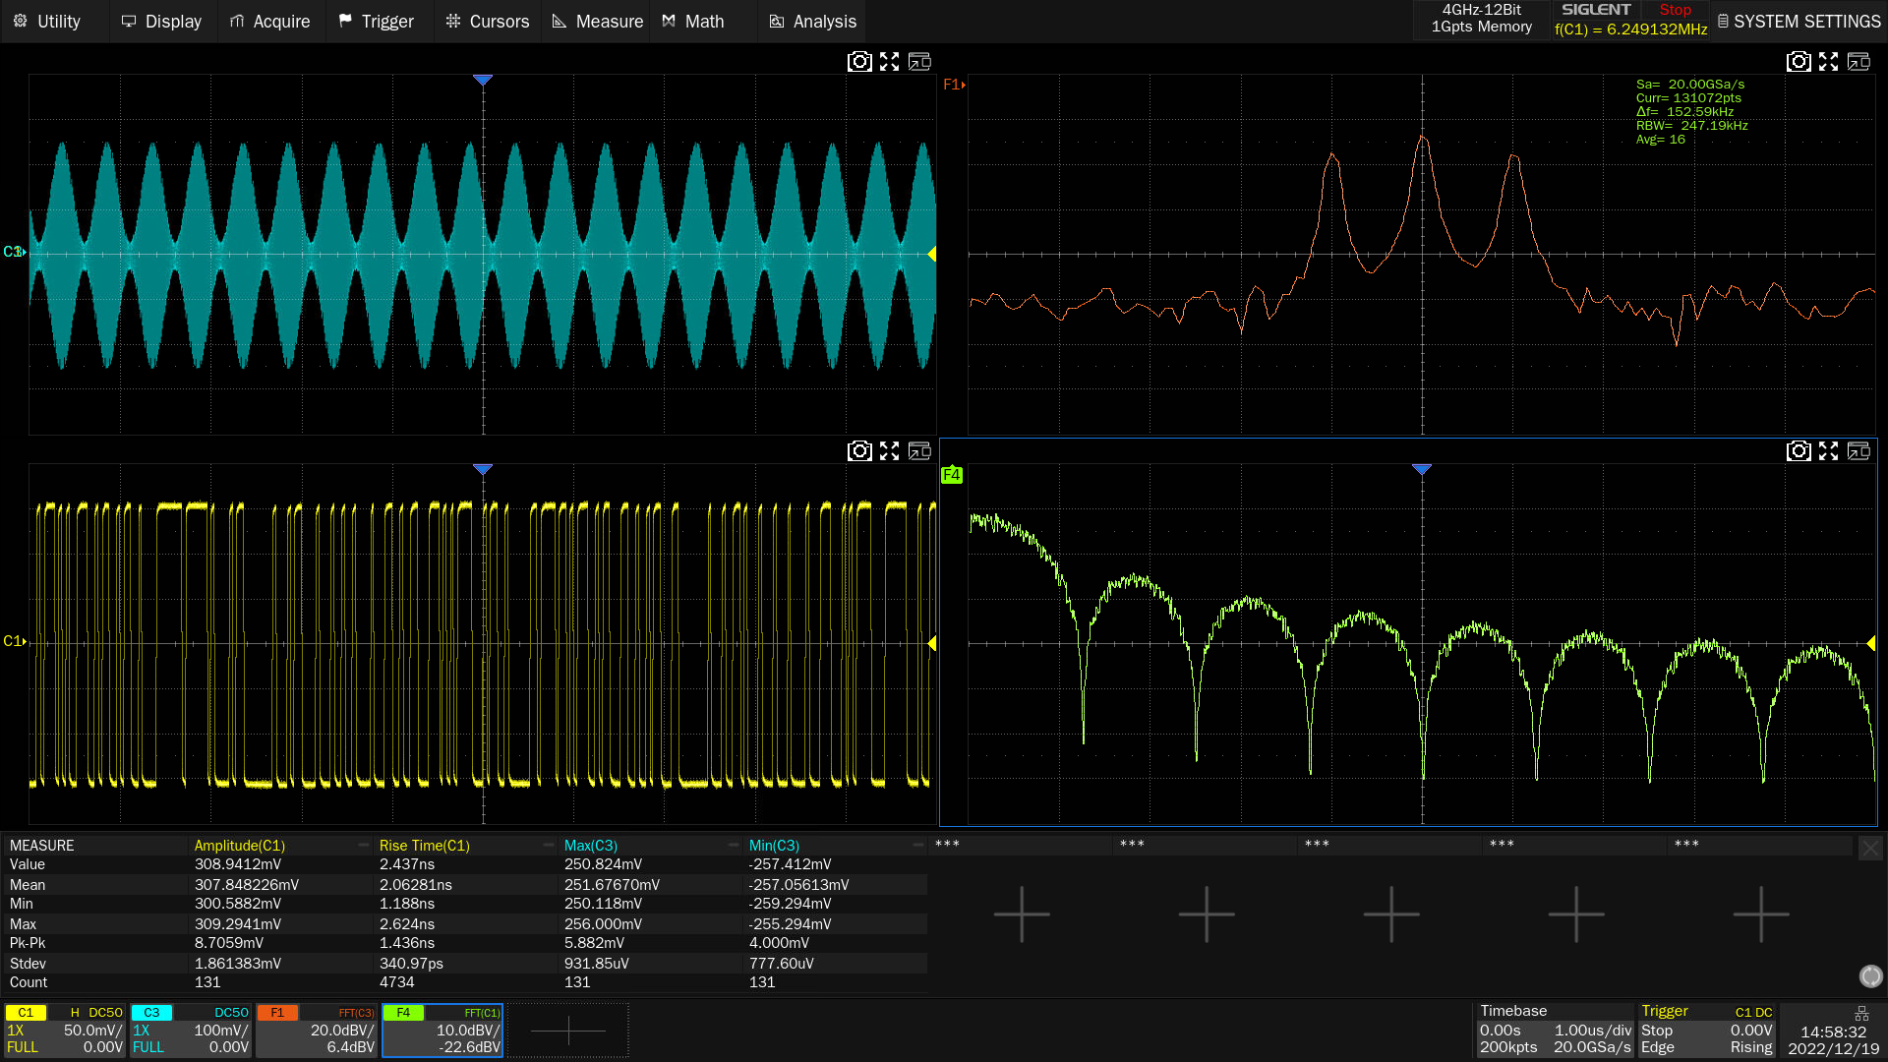
Split-screen Display
4 display windows
Waveforms are more intuitive.
15.6-inch capacitive touch HD display.

Slide 18
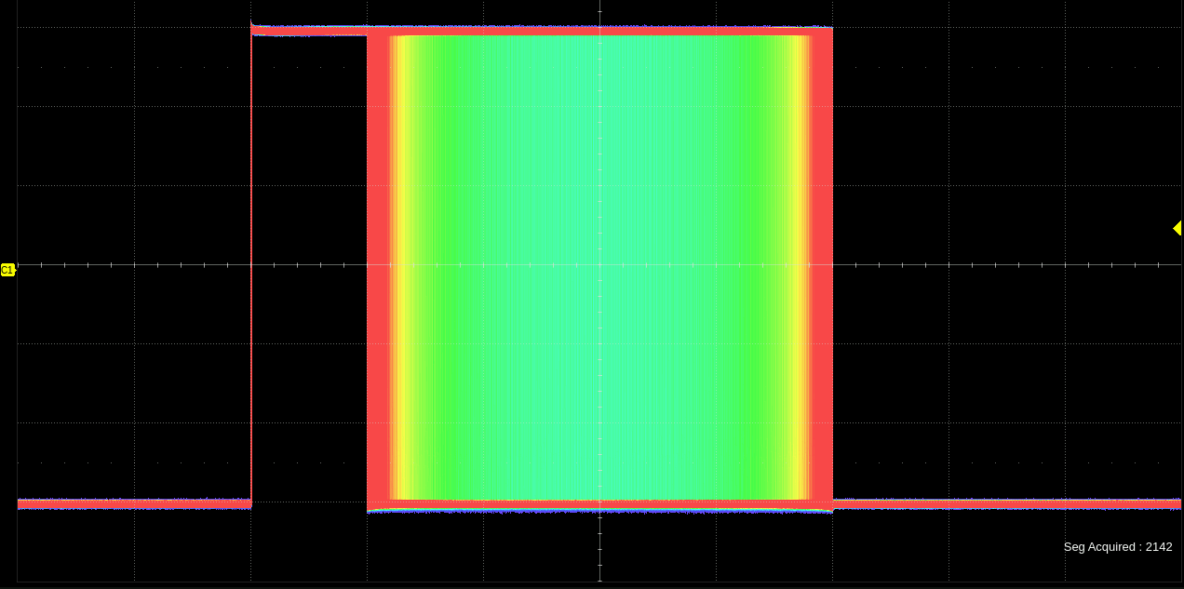
Color Temperature Display Mode
Intuitively display the probability of waveform occurrence
The higher the probability, the warmer the color.
The lower the probability, the colder the color.

Slide 19
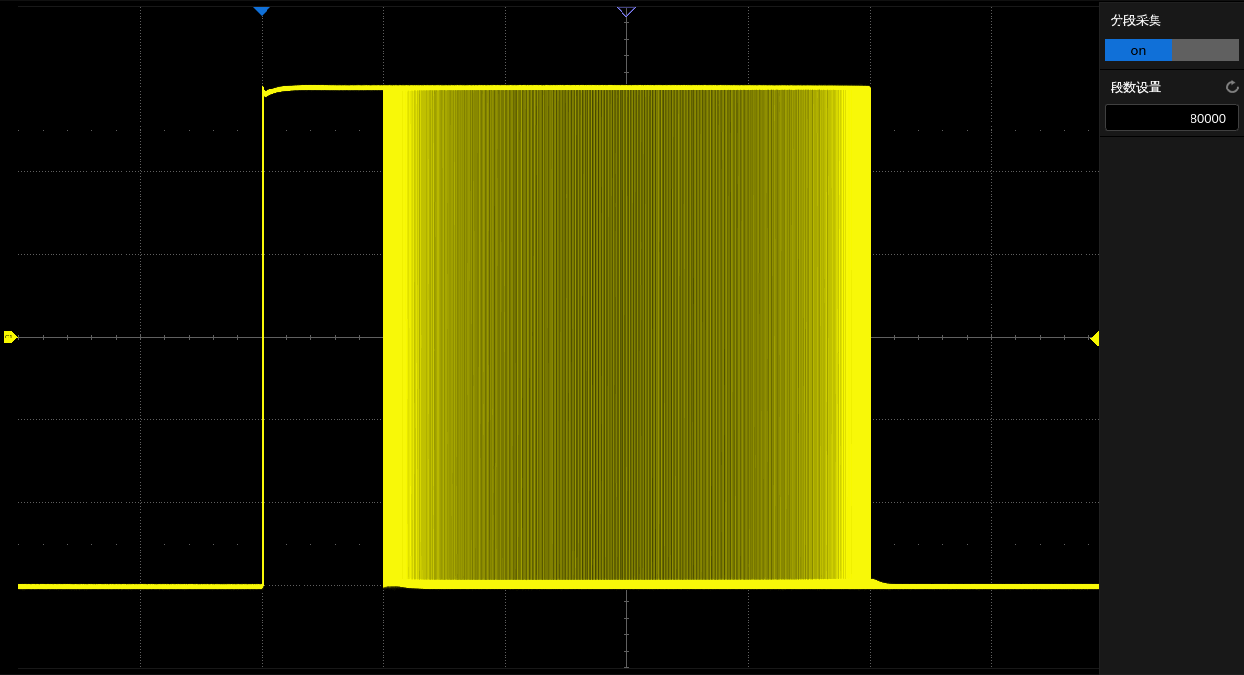
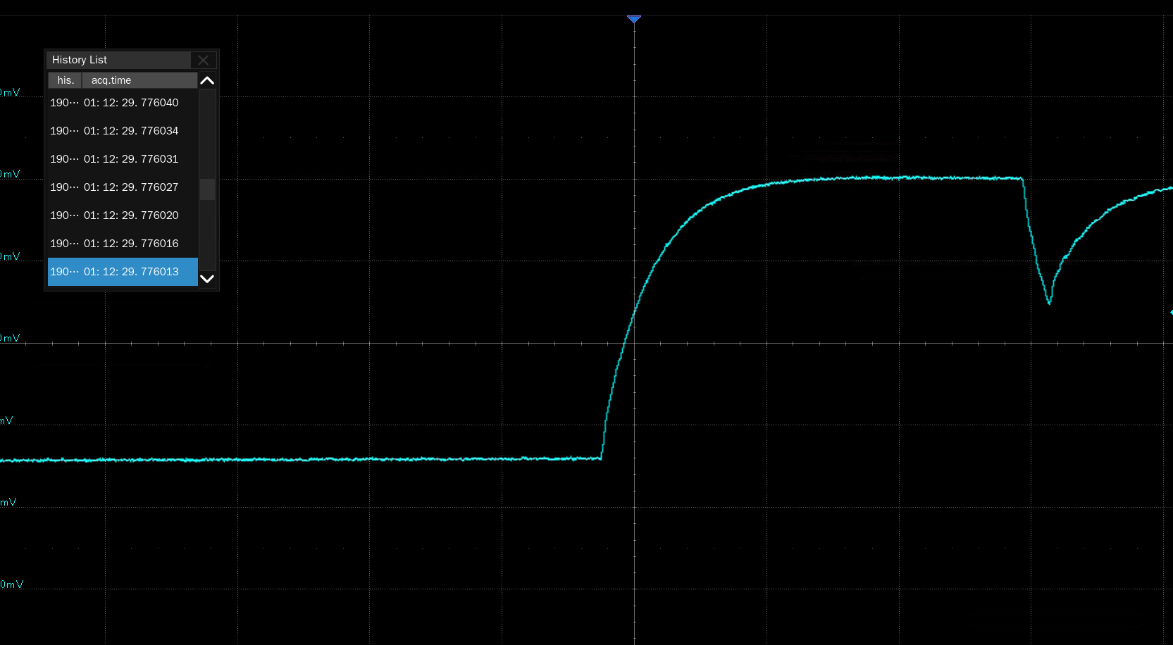
Sequence Mode & History Mode
Maximum of 124,000 frames can be recorded
The interval between segments can be as small as 0.9μs.
Playback and observe unusual events at any time.
Sequence
History

Slide 20
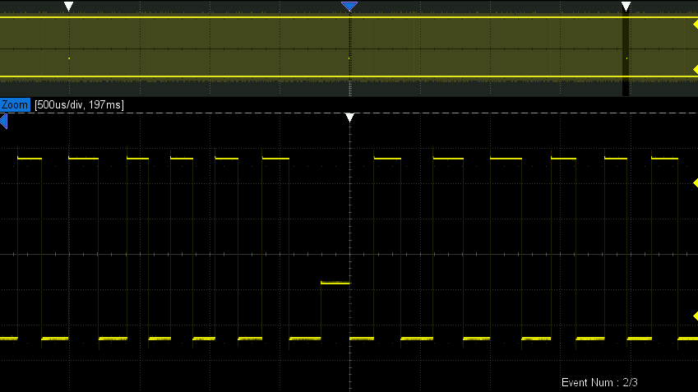
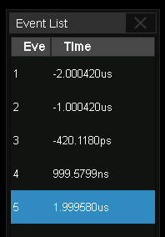
Search & Navigate
Search conditions: Edge, Slope, Pulse, Interval, Runt.
Navigate type: Search Event, Time, History Frame.

Slide 21
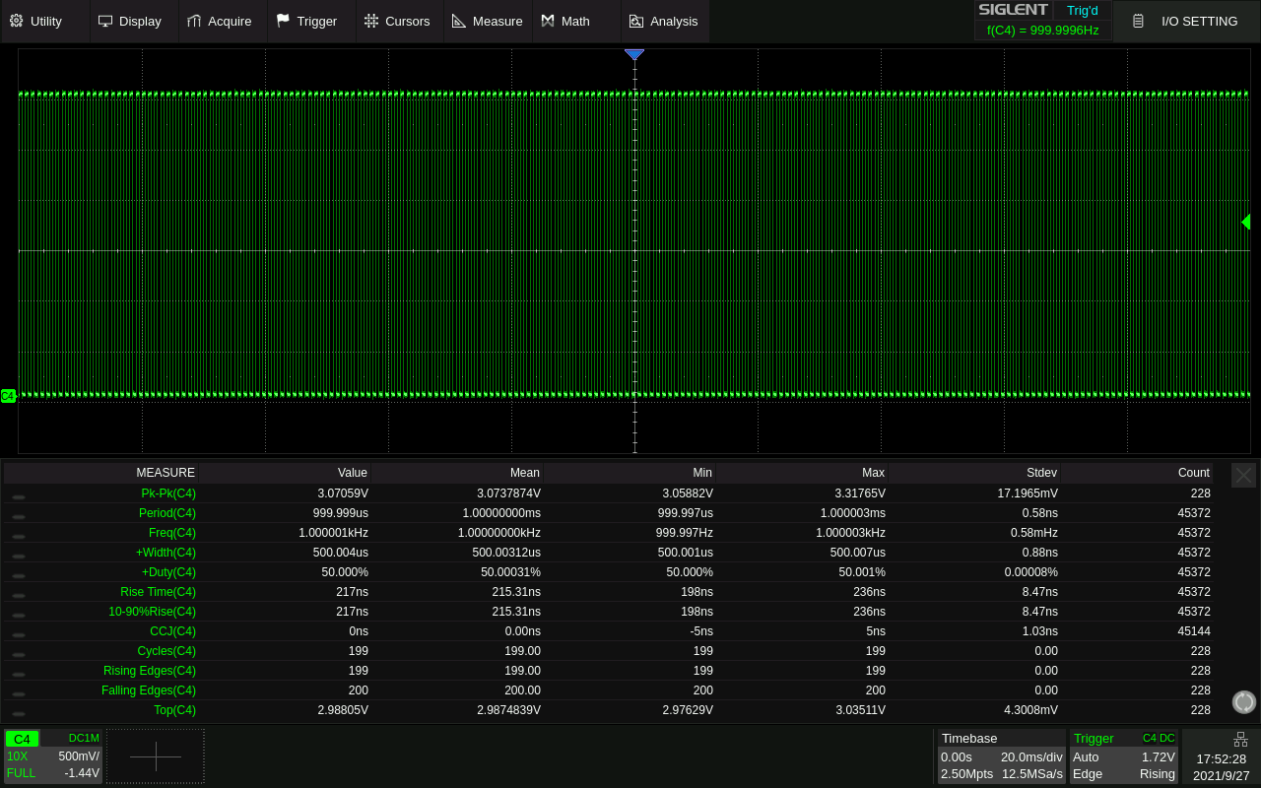
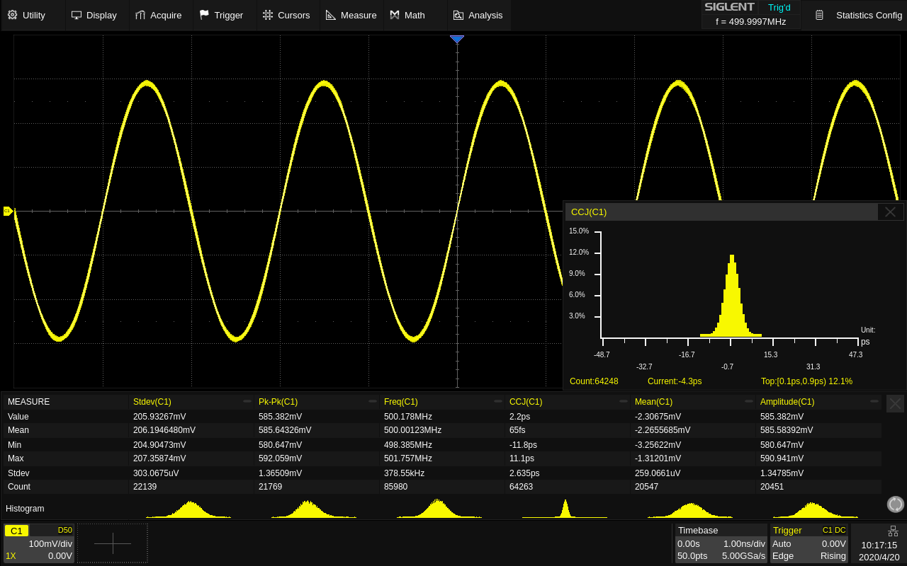
Extensive Measurement Parameters
60+ different types of measurements
4 categories: horizontal, vertical, delay and miscellaneous.
Statistics: Current, Mean, Min, Max, Stdev, Count; Trend, Track, Histogram.

Slide 22
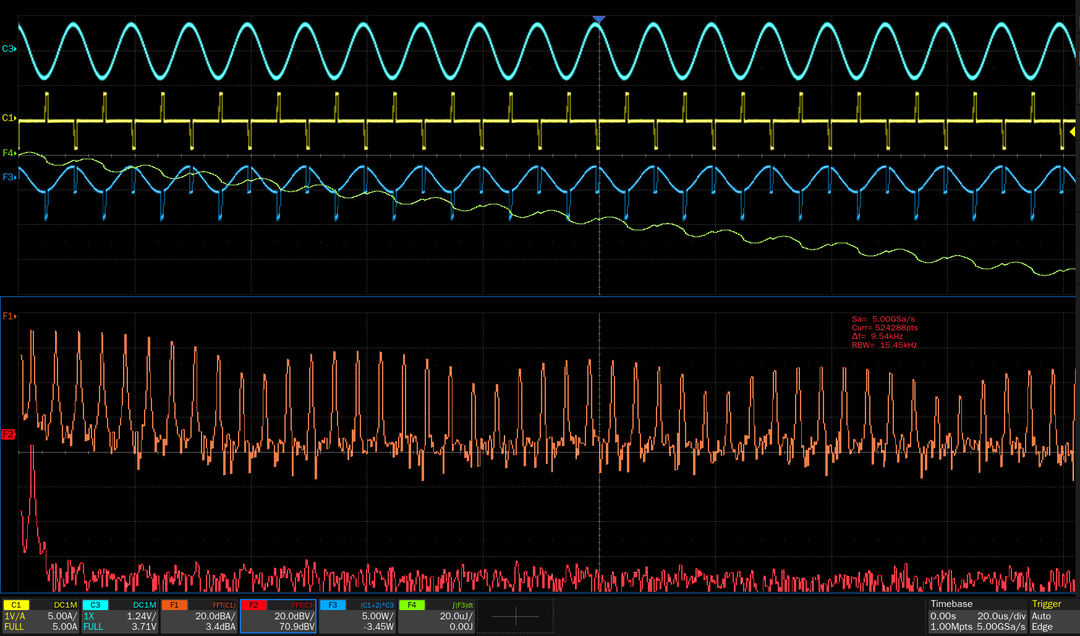
Advanced Math Function
4 math traces are available
Formula Editor

Slide 23
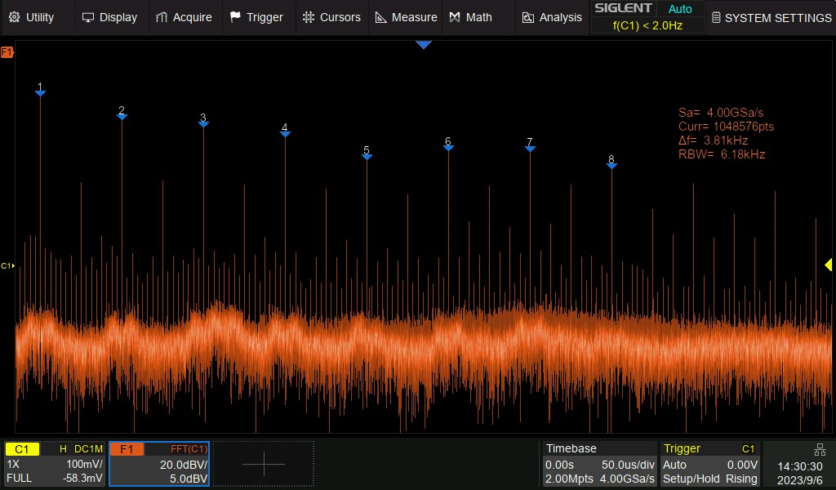
Hardware-accelerated FFT
32Mpts FFT operation
High-frequency resolution
SFDR as low as 45dBc
Fast refresh rate
Hardware-accelerated Save up to 88% of time

Slide 24
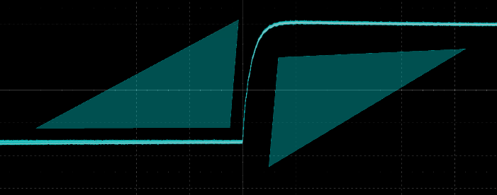
Hardware-based High Speed Mask Test Function
Built-in Mask
80,000 Pass / Fail decisions each second
Automatically take screenshots or save historical frames.
Ideal for long-term signal monitoring or automated production line testing.

Slide 25
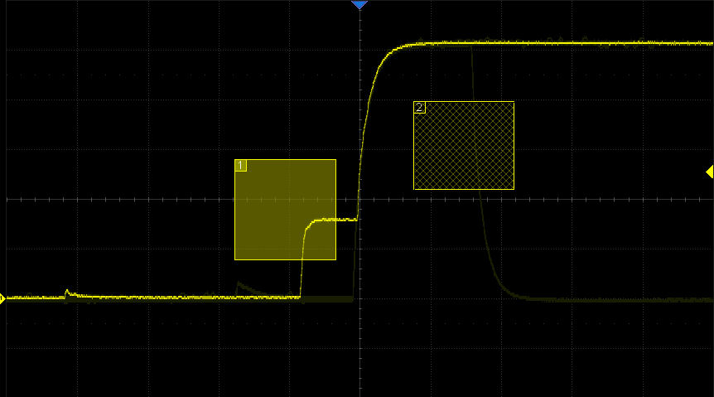
Zone Trigger
Quickly isolate the waveform of interest
Signals that are difficult to characterize.
Two user-defined areas .
Intersect or not intersect .

Slide 26
PART THREE
03
Advanced Functions
Every Bench. Every Engineer. Every Day.

Slide 27
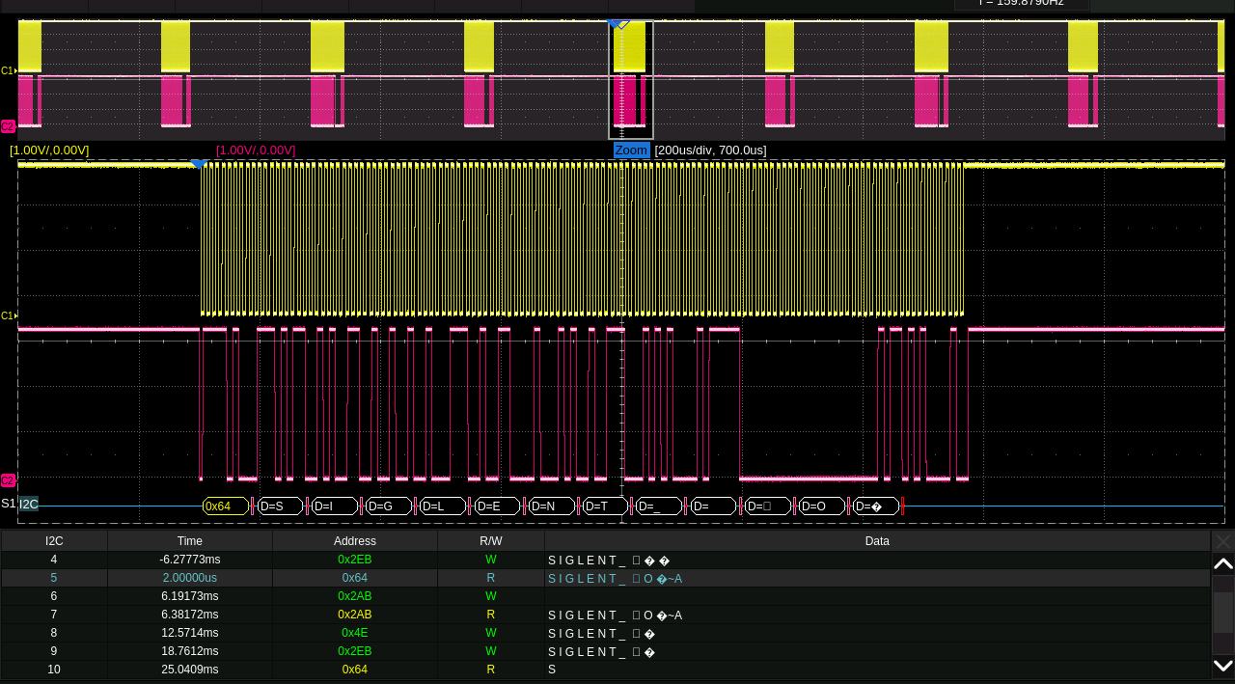
Serial Bus Decode
Standard：I²C, SPI, UART, CAN, LIN
Optional：CAN FD, FlexRay, I²S, MIL-STD-1553B, SENT, Manchester, ARINC429,
USB2.0

Slide 28
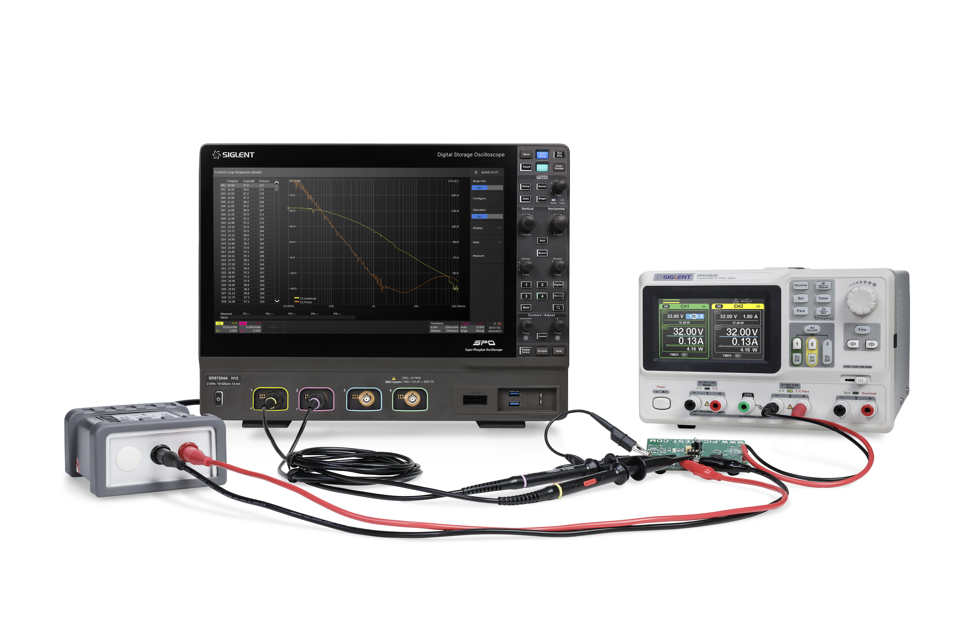
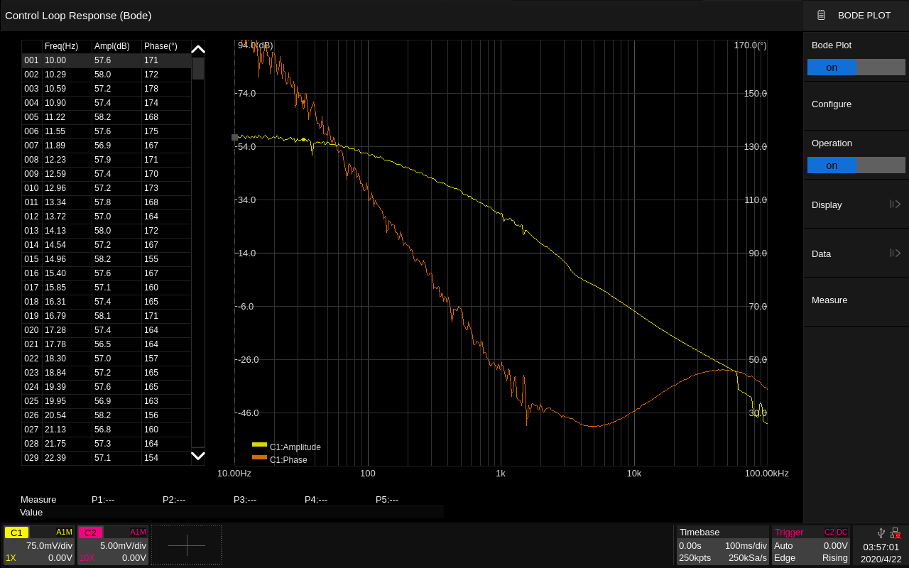
Bode Plot
Obtain gain and phase values for each frequency point
Power supply loop response analysis.
Low frequency response analysis of passive filters and amplifier circuits.

Slide 29
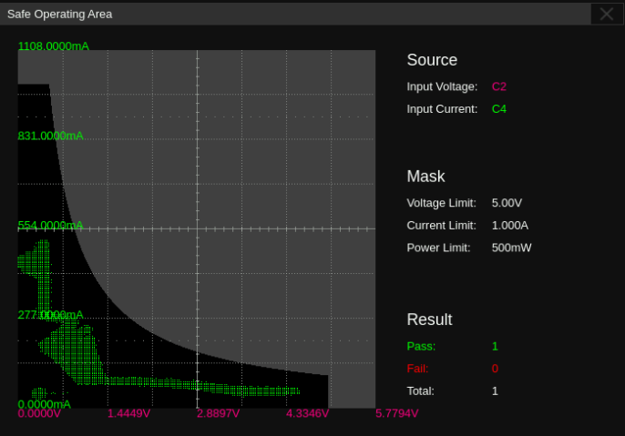
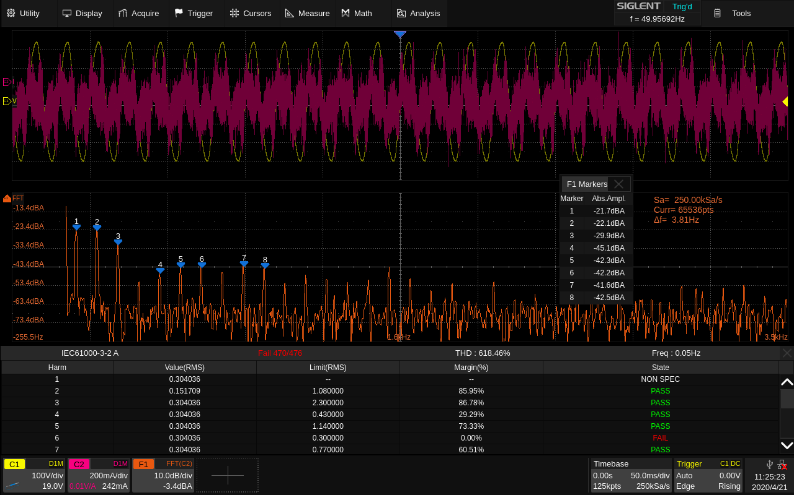
Power Analysis (Optional)
Conveniently measure 12 parameters such as power quality, harmonics, inrush current and switching loss.
Greatly improve the design efficiency of switching power supplies and power devices.

Slide 30
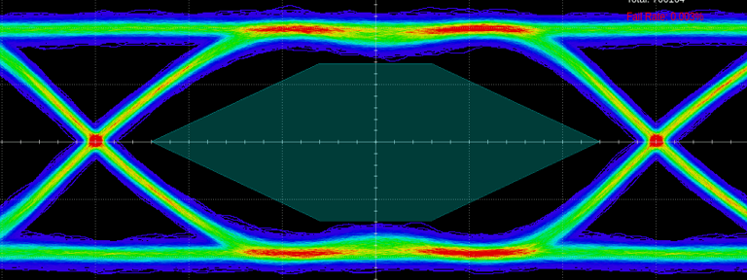
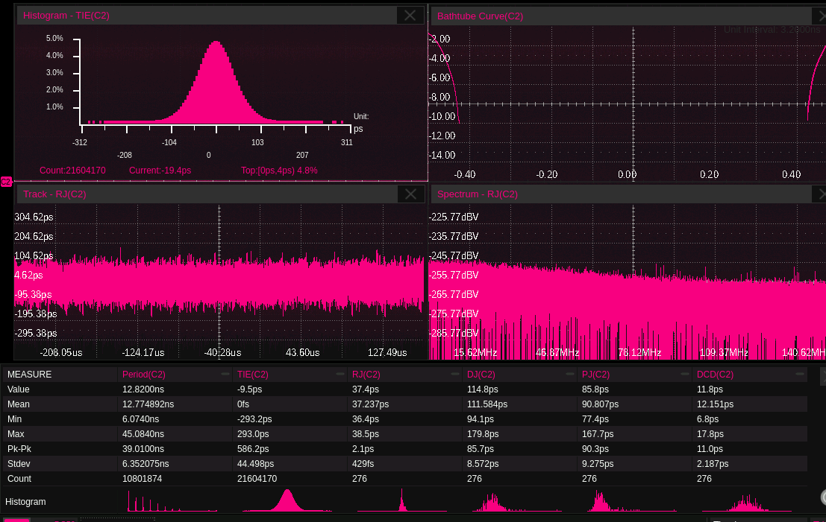
Eye/Jitter Analysis (Optional)
Automatically extract the embedded reference clock from serial data
Mask test on eye diagrams.
Measurement on multiple eye/jitter parameters.

Slide 31
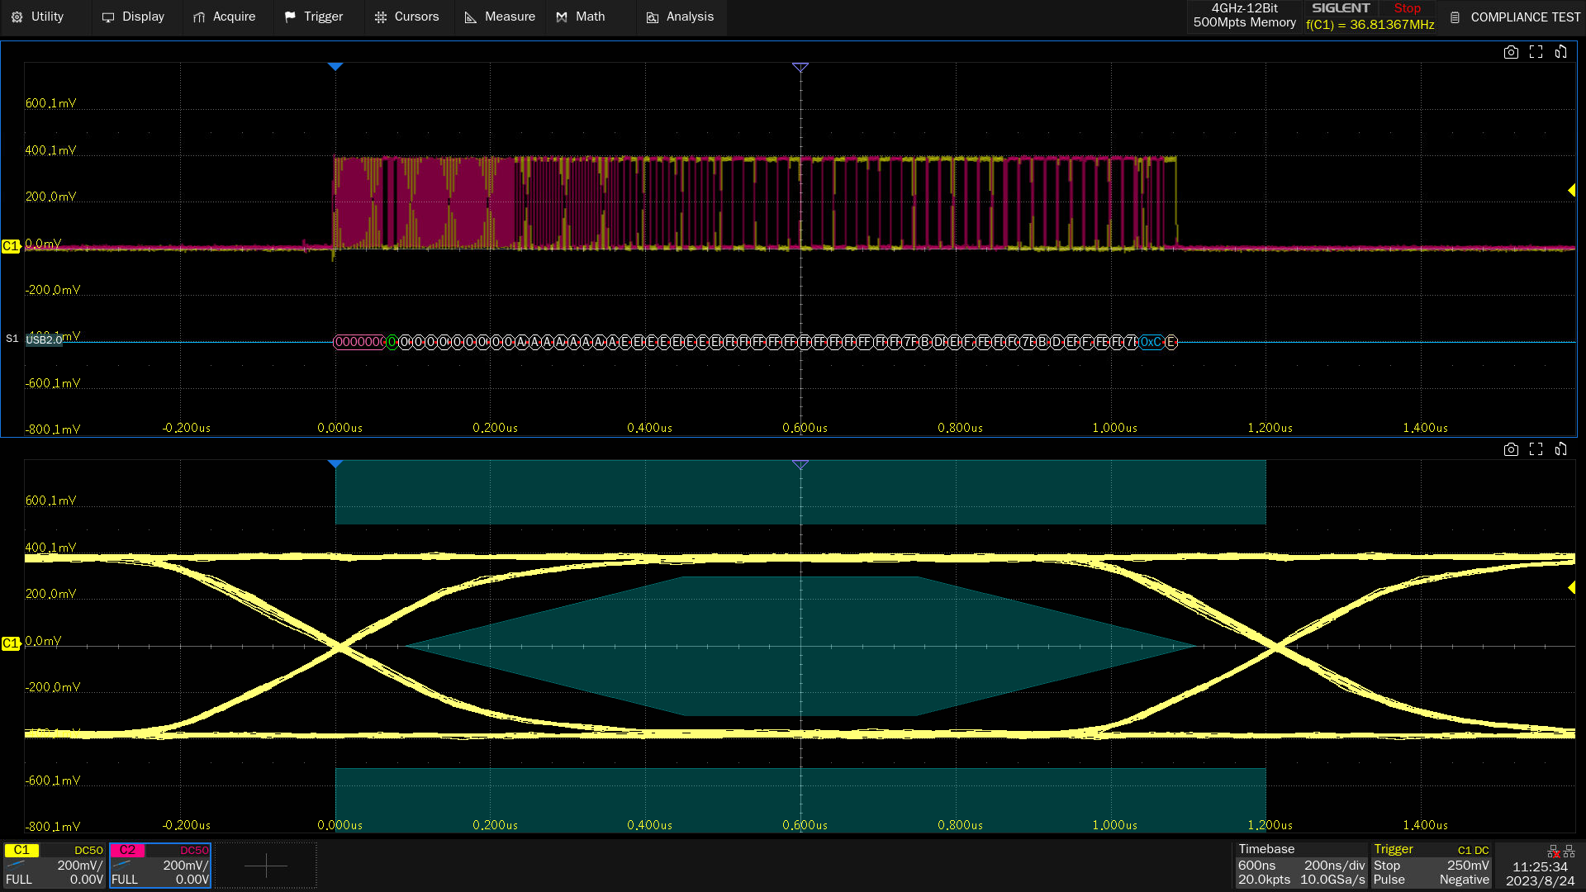
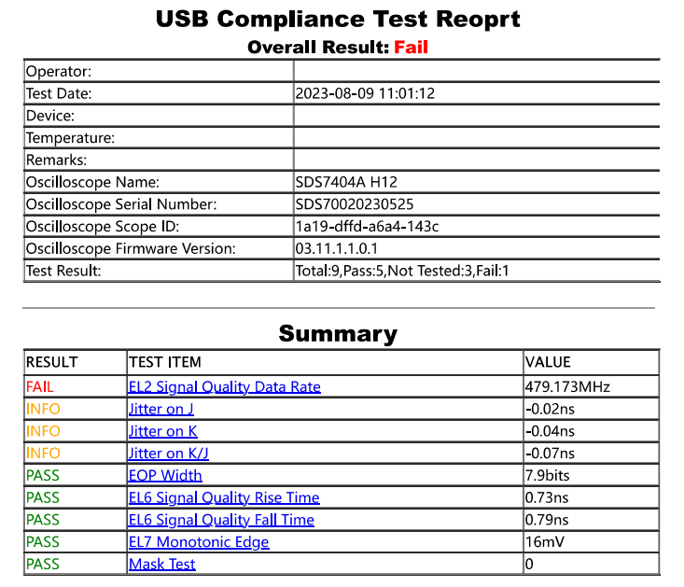
Compliance Test(Optional)
USB 2.0, 100Base-TX, 1000Base-T, 100Base-T1, 1000Base-T1，MIPI-DPHY，DDR2/DDR3
Connect the fixture according to the prompt.
Test items can be completed quickly without manual measurement.
Automatically generate reports.

Slide 32
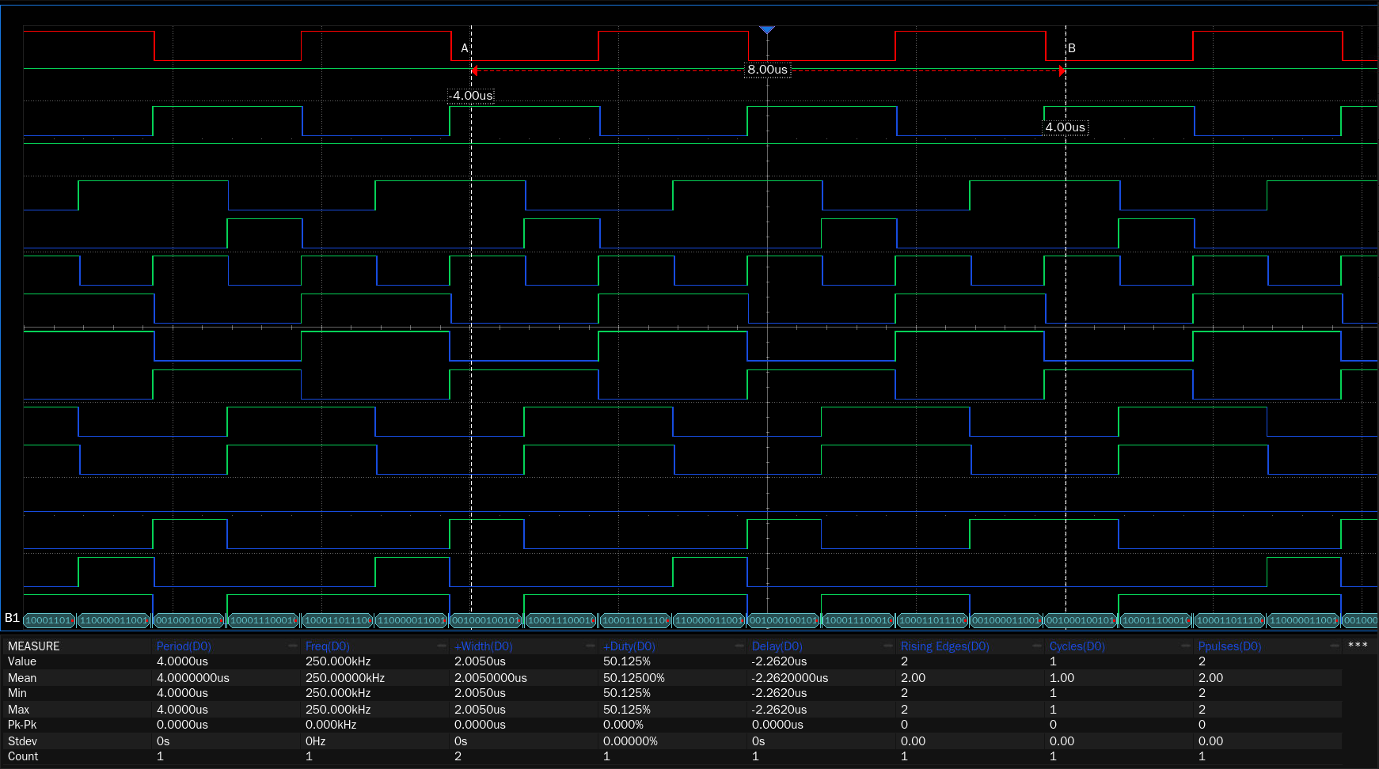
Digital Channels / MSO
Acquisition and analysis of mixed signals by 16 digital channels
Reflect the timing relationship of the measured signal.
Max. Sampling Rate: 1 GSa/s.
Memory depth: 50 Mpts/ch.

Slide 33
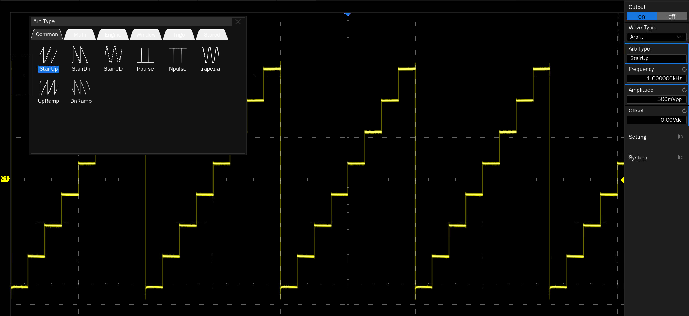
50 MHz Function/Arbitrary Waveform Generator(Optional)
Built-in
Sampling Rate: 125 MSa/s
Waveforms: Sine, Square, Ramp, Pulse, DC, Noise, 45 Arbitrary
Frequency Resolution: 1 μHz

Slide 34
PART FOUR
04
Competition Analysis
Every Bench. Every Engineer. Every Day.

Slide 35
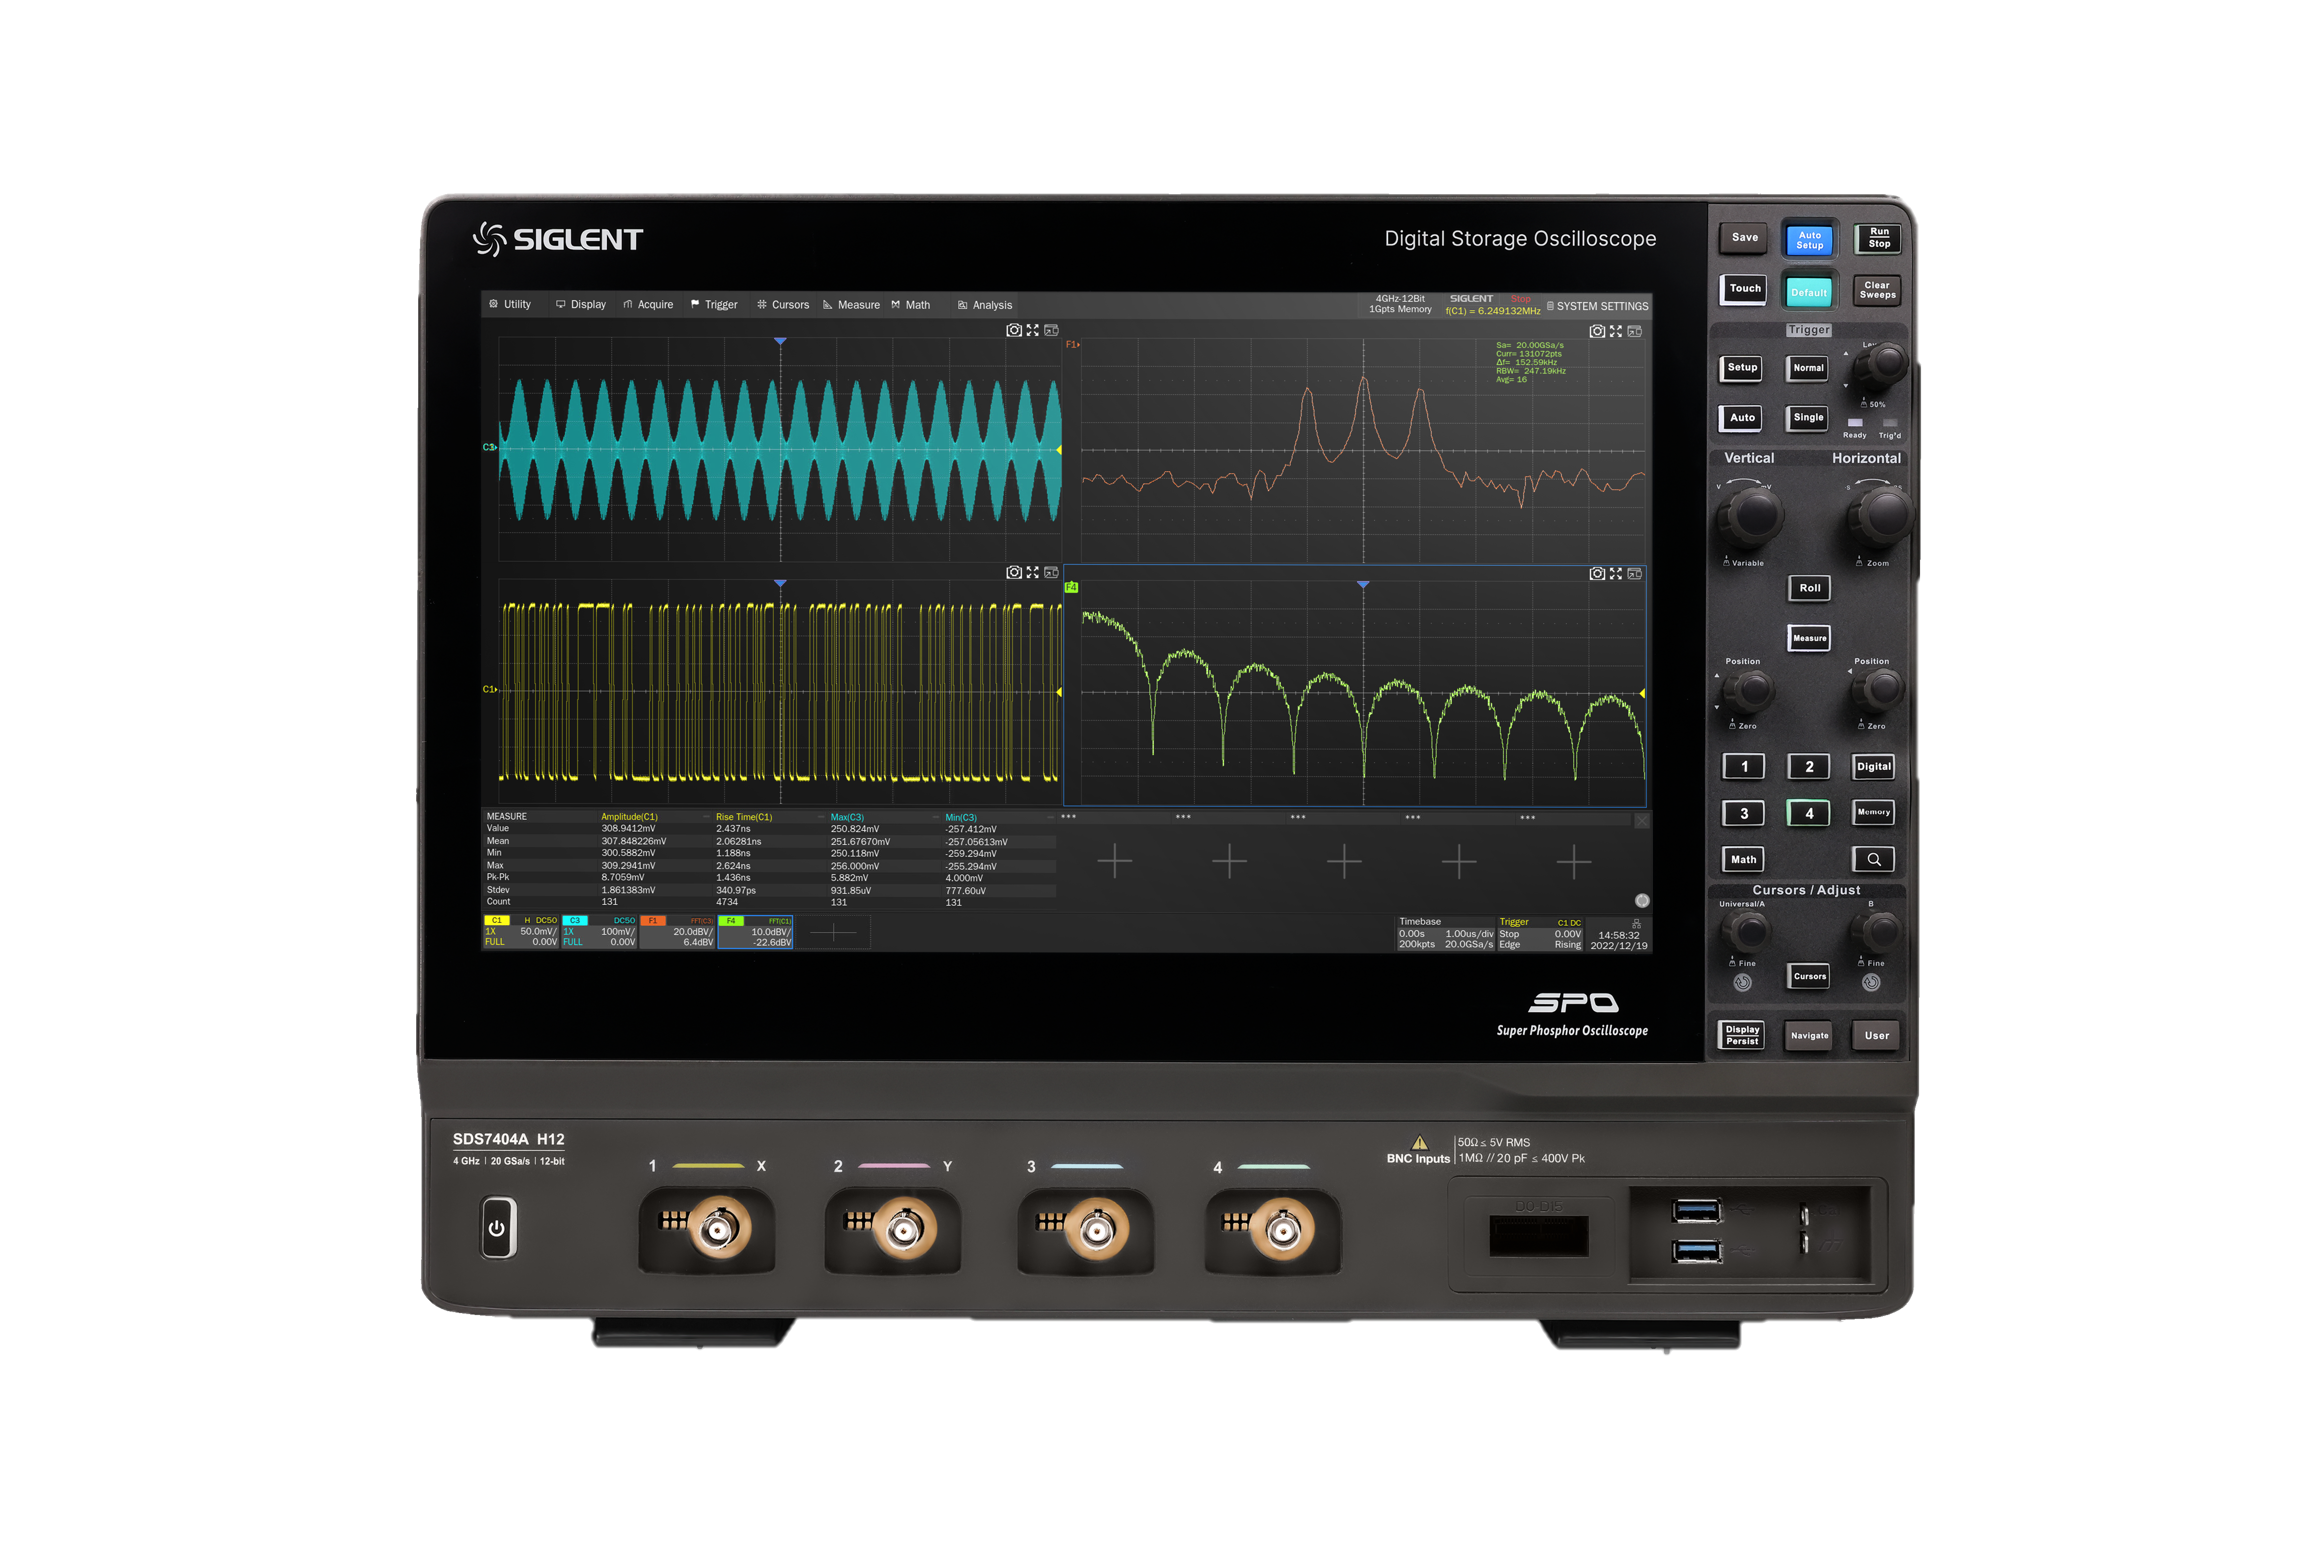
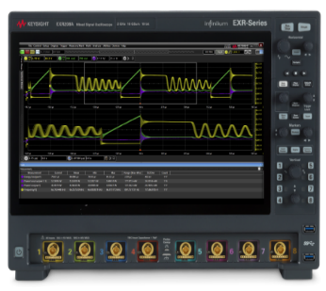
 | Siglent SDS7000A |  | Keysight Infiniium EXR
Channels | 4 | X | 4/8 | √
Bandwidth | 3/4/6GHz | X | 500MHz 1/2/2.5/4/6GHz | √
Sample rate | 20 GSa/s (interleaving mode) 10 GSa/s (non-interleaving mode) | ○ | 16 GSa/s, all analog channels | ○
Vertical resolution | 12 bits, 16 bits(ERES) | √ | 10 bits, 16 bits(ERES) | X
Memory depth | 500 Mpts/ch | √ | 100 Mpts/ch | X
Waveform capture rate | 1,000,000 wfm/s | √ | 200, 000 wfms/s | X
Noise floor | 150uVrms @ 2 GHz BW 180uVrms @ 3 GHz BW 220uVrms @ 4 GHz BW 260uVrms @ 6GHz BW | X | 81uVrms @ 1 GHz 102uVrms @ 2 GHz 112uVrms @ 2.5 GHz 149uVrms @ 4GHz | √
DC gain accuracy | 1 mV/div ~ 4.95 mV/div: ±1.5% full scale(typical) 5 mV/div ~ 10 V/div: ±0.5% full scale(typical) | √ | ± 2% full scale (±1% typical) | √
Zone trigger | standard | √ | optional | X
Mask test | standard | √ | standard | √
Power analysis | optional | √ | optional | √
Eye test | optional | X | standard | √
Jitter test | optional | √ | optional | √
Display | 15.6 inch | √ | 15.6 inch | √
Wight | 10.56 kg | X | 13.75 kg | √

Slide 36
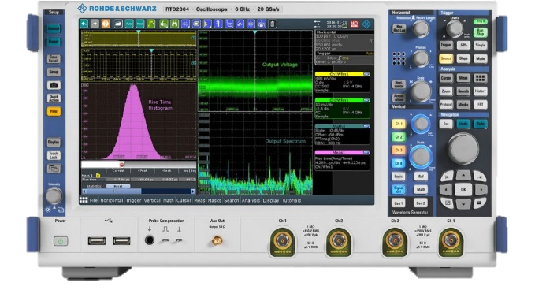
 | Siglent SDS7000A |  | R&S RTO2000
Channels | 4 | √ | 2/4 | √
Bandwidth | 3/4/6GHz | X | 600MHz 1/2/3/4/6GHz | √
Sample rate | 20 GSa/s (interleaving mode) 10 GSa/s (non-interleaving mode) | √ | max. 10 GSa/s on each channel R&S®RTO2044, R&S®RTO2064 max. 10 GSa/s (4 channels) max. 20 GSa/s (2 channels) | X
Vertical resolution | 12 bits, 16 bits(ERES) | √ | 8 bits, 16 bits(ERES) | X
Memory depth | 500 Mpts/ch | √ | 50 Mpts(4 channels) 100 Mpts(2 channels) 200 Mpts (1 channel) | X
Waveform capture rate | 1,000,000 wfm/s | √ | 1,000,000 wfm/s | √
Noise floor | 150uVrms @ 2 GHz BW 180uVrms @ 3 GHz BW 220uVrms @ 4 GHz BW 260uVrms @ 6 GHz BW | √ | 130uVrms @ 1GHz 200uVrms @ 2GHz 220uVrms @ 3GHz 260uVrms @ 4GHz | X
DC gain accuracy | 1 mV/div ~ 4.95 mV/div: ±1.5% full scale(typical) 5 mV/div ~ 10 V/div: ±0.5% full scale(typical) | √ | at 50 Ω, input sensitivity > 5 mV/div: ±1.5 % at 50 Ω, input sensitivity ≤ 5 mV/div: ±2 % at 1 MΩ: ±2 % | X
Zone trigger | standard | √ | optional | X
Mask test | standard | √ | standard | √
Power analysis | optional | √ | optional | √
Eye test | optional | X | standard | √
Jitter test | optional | √ | optional | √
Display | 15.6 inch | √ | 12.1 inch | X
Wight | 10.56 kg | X | 9.6 kg | √

Slide 37
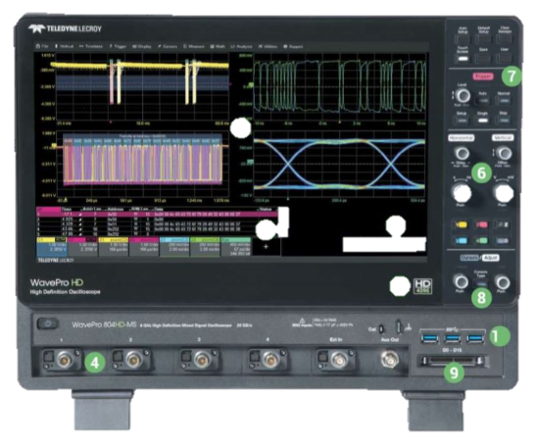
 | Siglent SDS7000A |  | LeCroy WavePro HD
Channels | 4 | √ | 4 | √
Bandwidth | 3/4/6GHz | X | 2.5/4/6/8GHz | √
Sample rate | 20 GSa/s (interleaving mode) 10 GSa/s (non-interleaving mode) | √ | 20 GSa/s (2 channels) 10 GSa/s (4 channels) | √
Vertical resolution | 12 bits, 16 bits(ERES) | √ | 12 bits, 15 bits(ERES) | X
Memory depth | 500 Mpts/ch | √ | 100 Mpts/ch | X
Waveform capture rate | 1,000,000 wfm/s | √ | unknown
Noise floor | 150uVrms @ 2 GHz BW 180uVrms @ 3 GHz BW 220uVrms @ 4 GHz BW 260uVrms @ 6 GHz BW | √ | 155uVrms @ 2.5GHz 228 uVrms @ 4GHz 285 uVrms @ 6GHz 315 uVrms @ 8GHz | √
DC gain accuracy | 1 mV/div ~ 4.95 mV/div: ±1.5% full scale(typical) 5 mV/div ~ 10 V/div: ±0.5% full scale(typical) | X | ± 0.5% full scale | √
Zone trigger | standard | √ | Not support | X
Mask test | standard | √ | standard | √
Power analysis | optional | √ | optional | √
Eye test | optional | √ | optional | √
Jitter test | optional | √ | optional | √
Display | 15.6 inch | √ | 15.6 inch | √
Wight | 10.56 kg | √ | 11.1 kg | X

Slide 38
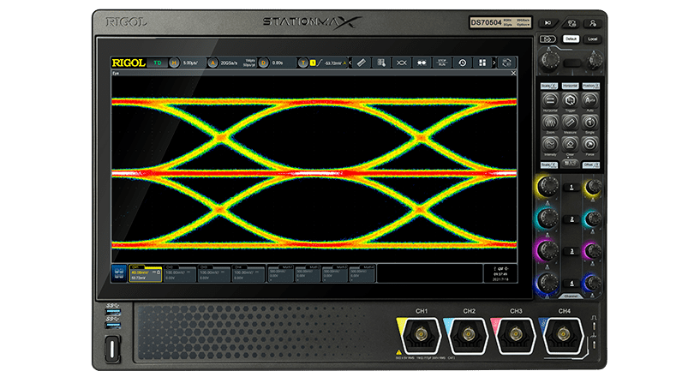
 | Siglent SDS7000A |  | Rigol DS70000
Channels | 4 | √ | 4 | √
Bandwidth | 3/4/6GHz | X | 3/5GHz | √
Sample rate | 20 GSa/s (interleaving mode) 10 GSa/s (non-interleaving mode) | √ | 20 GSa/s (interleaving mode) 10 GSa/s (non-interleaving mode) | √
Vertical resolution | 12 bits, 16 bits(ERES) | √ | 8 bits 16 bits (ERES) | X
Memory depth | 500 Mpts/ch | √ | 500 Mpts(4 channels) | X
Waveform capture rate | 1,000,000 wfm/s | √ | 1,000,000 wfms/s | √
Noise floor | 150uVrms @ 2 GHz BW 180uVrms @ 3 GHz BW 220uVrms @ 4 GHz BW 260uVrms @ 6 GHz BW | √ | 600uVrms @3GHz BW 800 uVrms @ 5GHz BW | X
DC gain accuracy | 1 mV/div ~ 4.95 mV/div: ±1.5% full scale(typical) 5 mV/div ~ 10 V/div: ±0.5% full scale(typical) | √ | ± 2% full scale | X
Zone trigger | standard | √ | not support | X
Mask test | standard | √ | standard | √
Power analysis | optional | √ | not support | X
Eye test | optional | √ | optional | √
Jitter test | optional | √ | optional | √
Display | 15.6 inch | √ | 15.6 inch | X
Wight | 10.56 kg | √ | 22.5kg | X

Slide 39
Ordering Information
Model | Description
SDS7604A H12 | 6 GHz, 20 GSa/s, 4-CH, 12-bit, standard 500 Mpts/ch memory depth, 15.6” capacitive touch screen
SDS7404A H12 | 4 GHz, 20 GSa/s, 4-CH, 12-bit, standard 500 Mpts/ch memory depth, 15.6” capacitive touch screen
SDS7304A H12 | 3 GHz, 20 GSa/s, 4-CH, 12-bit, standard 500 Mpts/ch memory depth, 15.6” capacitive touch screen
Standard Accessories | Quantity
USB cable | 1
Quick start | 1
Passive probe (SP3150A) | 1/channel
Certificate of calibration | 1
Wireless mouse | 1
Power cord | 1
Protective Cover | 1

Slide 40
Optional Accessories | Part No. | Optional Accessories | Part No.
Waveform generator (software) | SDS7000A-FG | 100Base-TX compliance test (software) | SDS7000A-CT-100BASE-T
16 digital channels (software) | SDS7000A-16LA | 1000Base-T compliance test (software) | SDS7000A-CT-1000BASE-T
16-channel logic probe | SPL2016 | 100Base-T1 compliance test (software) | SDS7000A-CT-100BASE-T1
Power Analysis (software) | SDS7000A-PA | 1000Base-T1 compliance test (software) | SDS7000A-CT-1000BASE-T1
Power Analysis deskew fixture | DF2001A | Ethernet test fixture | FX-ETH
Eye Diagram/Jitter Analysis (software) | SDS7000A-EJ | Automotive Ethernet test fixture | FX-AMETH
I²S trigger & decode (software) | SDS7000A-I2S | 1Gpts memory depth（software） | SDS7000A-1GPTS
MIL-STD-1553B trigger & decode (software) | SDS7000A-1553B | STB3 demo signal source | STB3
FlexRay trigger & decode (software) | SDS7000A-FlexRay | USB-GPIB adapter | USB-GPIB
CAN FD trigger & decode (software) | SDS7000A-CANFD | OCXO timebase (Assembled and calibrated in factory only) | 10M_OCXO_L
SENT trigger & decode (software) | SDS7000A-SENT | High-speed active probe | SAP1000, SAP2500
Manchester decode (software) | SDS7000A-Manch | High voltage probe | HPB4010
ARINC429 trigger & decode (software) | SDS7000A-ARINC | High-speed differential probe | SAP2500D, SAP5000D
USB 2.0 decode (software) | SDS7000A-USB2 | High voltage differential probe | DPB1300/DPB4080/DPB5150/ DPB5150A/DPB5700/DPB5700A
USB 2.0 compliance test (software) | SDS7000A-CT-USB2 | Current probe | CPL5100/CP4020/CP4050/CP4070/CP4070A CP6030/CP6030A/CP6150/CP6500
USB 2.0 test fixture | FX-USB2 | Transit case | CASE-S2
3 GHz to 4GHz bandwidth upgrade(software) | SDS7000A-BW3T4 | 6 GHz to 8 GHz bandwidth upgrade (software) | SDS7000A-BW6T8

Slide 41
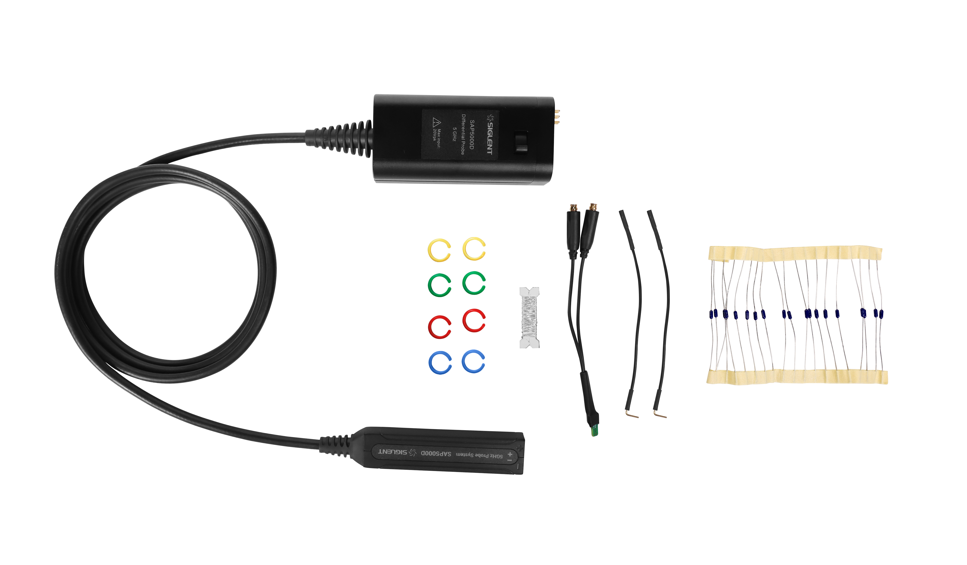
SAP5000D Active Differential Probe
Bandwidth: 5 GHz
Attenuation ratio: 10：1
Rise time: 80ps
Vertical displacement range: ±12 V
Interface: SAPBus
Cable length: 130 cm

Slide 42
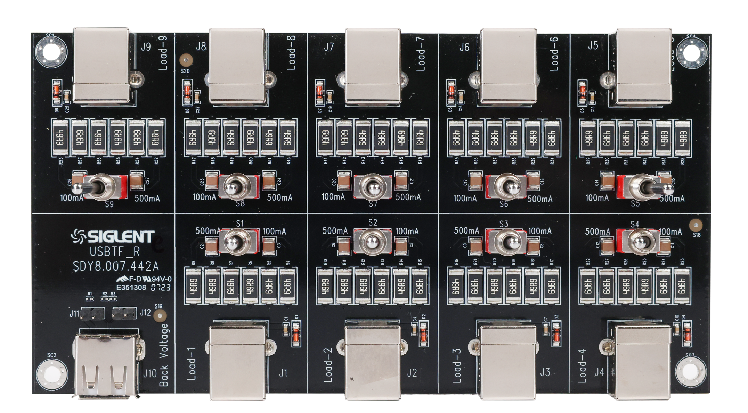

USB 2.0 Compliance Test Fixture（FX-USB2 ）
Droop
SQ Device
Controller
Droop
SQ Host
Back Voltage
USBTF_SR
USBTF_SQ
Sensitivity Recevier
Trigger
Inrush

Slide 43

100 Base-TX/1000Base-T
Compliance Test Fixture（FX-ETH ）
Probe test section
MDI common-mode output voltage test
Link partner test section
jitter test section
Disturbing test section
calibration section
SMA test section

Slide 44

100 Base-T1/1000Base-T1
Compliance Test Fixture（FX-AMETH ）
Automotive Ethernet Adapter(MateNet to SMA, Mini-50 to SMA, H-MTD to SMA)
Automotive Ethernet test fixture
Frequency converter test fixture

Slide 45
Thank You
Every Bench. Every Engineer. Every Day.
Headquarters
NA
Europe
SIGLENT TECHNOLOGIES CO., LTD.
Add: Blog No.4 & No.5, Antongda Industrial Zone, 3rd Liuxian Road, Bao’an District, Shenzhen, 518101, China
Tel:+ 86 755 3688 7876
Fax:+ 86 755 3359 1582
sales@siglent.com
int.siglent.com
SIGLENT Technologies NA, Inc.
Add: 6557 Cochran Rd Solon, Ohio 44139 Tel: 440-398-5800 Toll Free:877-515-5551 Fax: 440-399-1211
info@siglent.com www.siglentna.com
SIGLENT TECHNOLOGIES GERMANY GmbH
Add: Staetzlinger Str. 70 86165 Augsburg, Germany Tel: +49(0)-821-666 0 111 0 Fax: +49(0)-821-666 0 111 22 info-eu@siglent.com www.siglenteu.com

