Slide 1
SIGLENT
SDS7000A Digital Oscilloscope
EVERY BENCH. EVERY ENGINEER. EVERY DAY.
www.siglent.com

Slide 2
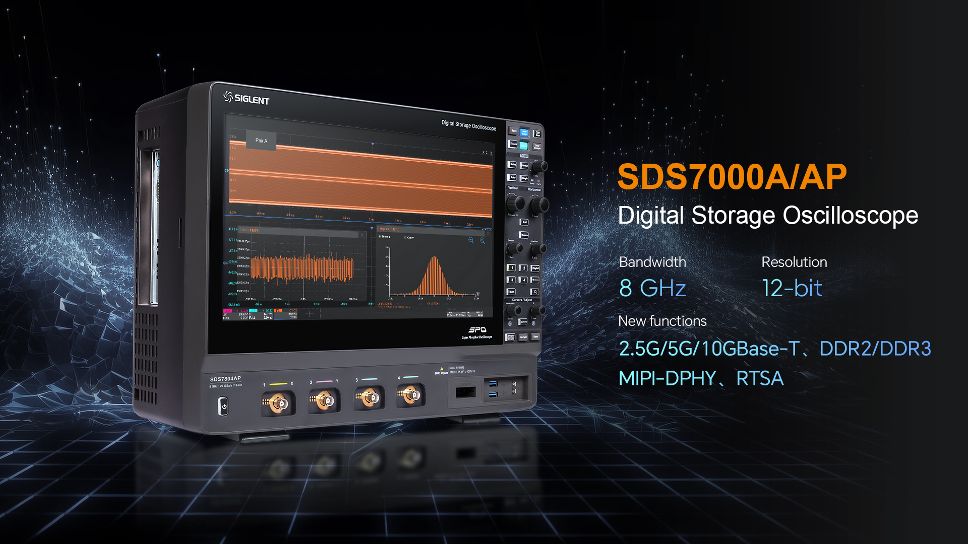

Slide 3
01
02
03
04
Basic information
Features & Benefits
Applications
Competition

Slide 4

01
Basic information

Slide 5
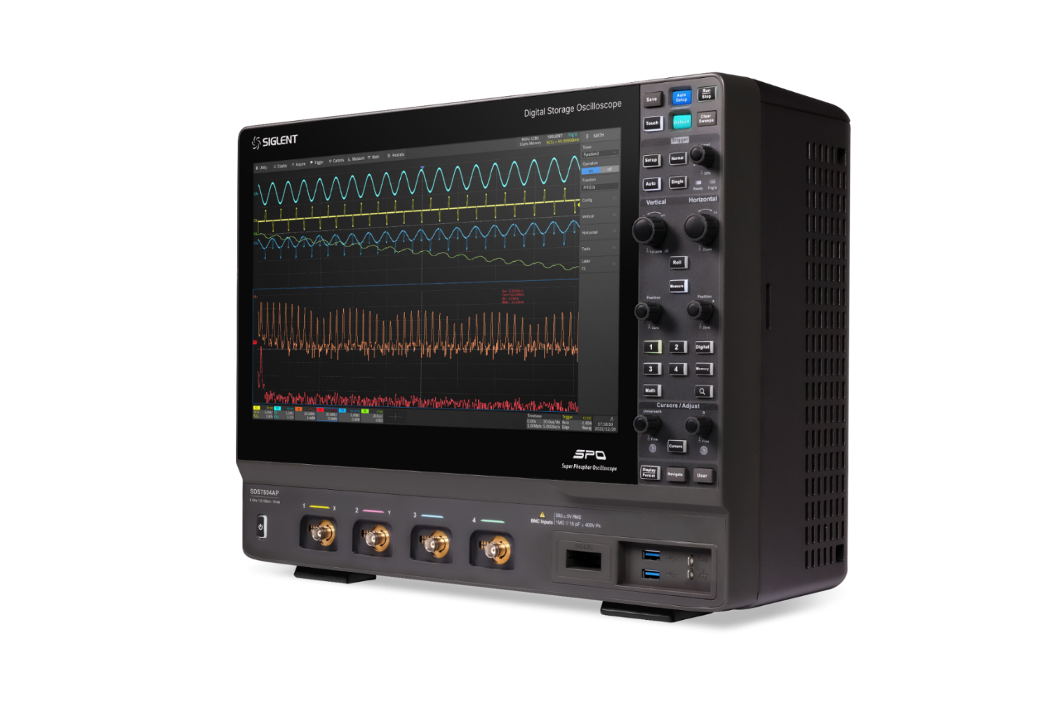
SDS7000AP
8 GHz
20 GSa/s
Analog bandwidth
Full Channel Sample Rate
2 Gpts
12 bits
Maximum storage depth
Vertical resolution
1,000,000
60+
wfm/s waveform capture rate
Automatic parameter measurement

Slide 6
 | SDS7804A H12、SDS7604A H12 SDS7404A H12、SDS7304A H12 | SDS7804AP、SDS7604AP
Channels | 4 + EXT | 4 + EXT
Bandwidth | 3/4/6/8GHz | 6/8 GHz
Resolution | 12-bit (ERES 16-bit) | 12-bit (ERES 16-bit)
Sample Rate | 20 GSa/s (2 channels) 10 GSa/s (3 or 4 channels) ‘4pcs x 10G ADC’ | 20 GSa/s @ all channels ‘8pcs x 10G ADC’
Waveform capture | 1,000,000 wfm/s (Sequence mode: 1,100,000 wfm/s ) | 1,000,000 wfm/s (Sequence mode: 1,100,000 wfm/s )
Storage depth | Standard: 500 Mpts/ch Optional: 1 Gpts/ch (1 or 2 channels) 500 Mpts/ch（4 channels） | Standard: 1 Gpts/ch (1 or 2 channels) 500 Mpts/ch (3 or 4 channels) Optional: 2 Gpts/ch (1 channel) 1 Gpts/ch (2 channels) 500 Mpts/ch (3 or 4 channels)
Serial trigger and decode | Standard: I2C, SPI, UART, CAN, LIN Optional: CAN FD, CAN XL(decode only), FlexRay, I2S, MIL-STD-1553B, SENT, Manchester(decode only), ARINC429, USB 2.0 (decode only) | N/A
Compliance Test | USB 2.0, 100Base-TX, 1000Base-T, 100/1000Base-T1, 2.5G/5G/10GBase-T, MIPI-DPHY | Option

Slide 7
SDS7000A Series Overview
Model | Bandwidth | ADC bits | Maximum sampling rate | Maximum storage depth
SDS7804AP | 8 GHz | 12 bits | 20GSa/s @All channels | 2 Gpts/ch (single-channel mode) 1 Gpts/ch (dual-channel mode) 500 Mpts/ch (quad channel mode)
SDS7604AP | 6 GHz | 12 bits | 20GSa/s @All channels | 2 Gpts/ch (single-channel mode) 1 Gpts/ch (dual-channel mode) 500 Mpts/ch (quad-channel mode)
SDS7804A | 8 GHz | 12 bits | 20 GSa/s (single/dual-channel mode) 10 GSa/s (quad-channel mode) | 1 Gpts/ch (single/dual-channel mode) 500 Mpts/ch (quad-channel mode)
SDS7604A | 6 GHz | 12 bits | 20 GSa/s (single/dual-channel mode) 10 GSa/s (quad-channel mode) | 1 Gpts/ch (single/dual-channel mode) 500 Mpts/ch (quad-channel mode)
SDS7404A | 4 GHz | 12 bits | 20 GSa/s (single/dual-channel mode) 10 GSa/s (quad-channel mode) | 1 Gpts/ch (single/dual-channel mode) 500 Mpts/ch (quad-channel mode)
SDS7304A | 3 GHz | 12 bits | 20 GSa/s (single/dual-channel mode) 10 GSa/s (quad-channel mode) | 1 Gpts/ch (single/dual-channel mode) 500 Mpts/ch (quad-channel mode)

Slide 8
 | SDS7804A H12、SDS7604A H12 SDS7404A H12、SDS7304A H12 | SDS7804AP、SDS7604AP
Spectrum Analyzer mode | Opt. (Bandwithd: 125/250/500 MHz, 1 GHz) (TOI: 4.99μs , 500 MHz SPAN) (RTSA/DDC/SigVSA) | × （supports later）
Eye/Jitter Analysis | Opt. | Opt.
Bode plot | Std. | Std.
Power Analysis | Std. | Std.
Segmented Acquisition | Std. | Std.
History Mode | Std. | Std.
Math Operations Capacity | Std. | Std.
Search & Navigation | Std. | Std.
DMM | Std. | Std.
Counter | Std. | Std.
Histogram | Std. | Std.
Digital Channels | Std. (16 Channels) | Std. (16 Channels)
AWG | Opt. (50 MHz, Builit-in) | Opt. (50 MHz, Builit-in)

Slide 9
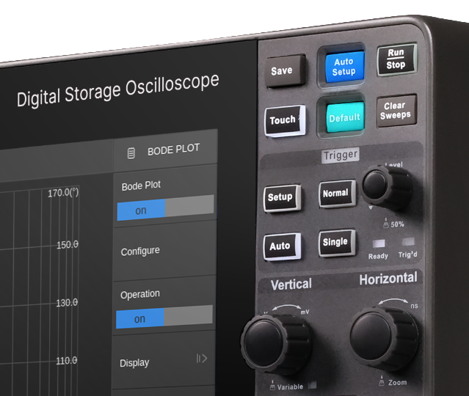
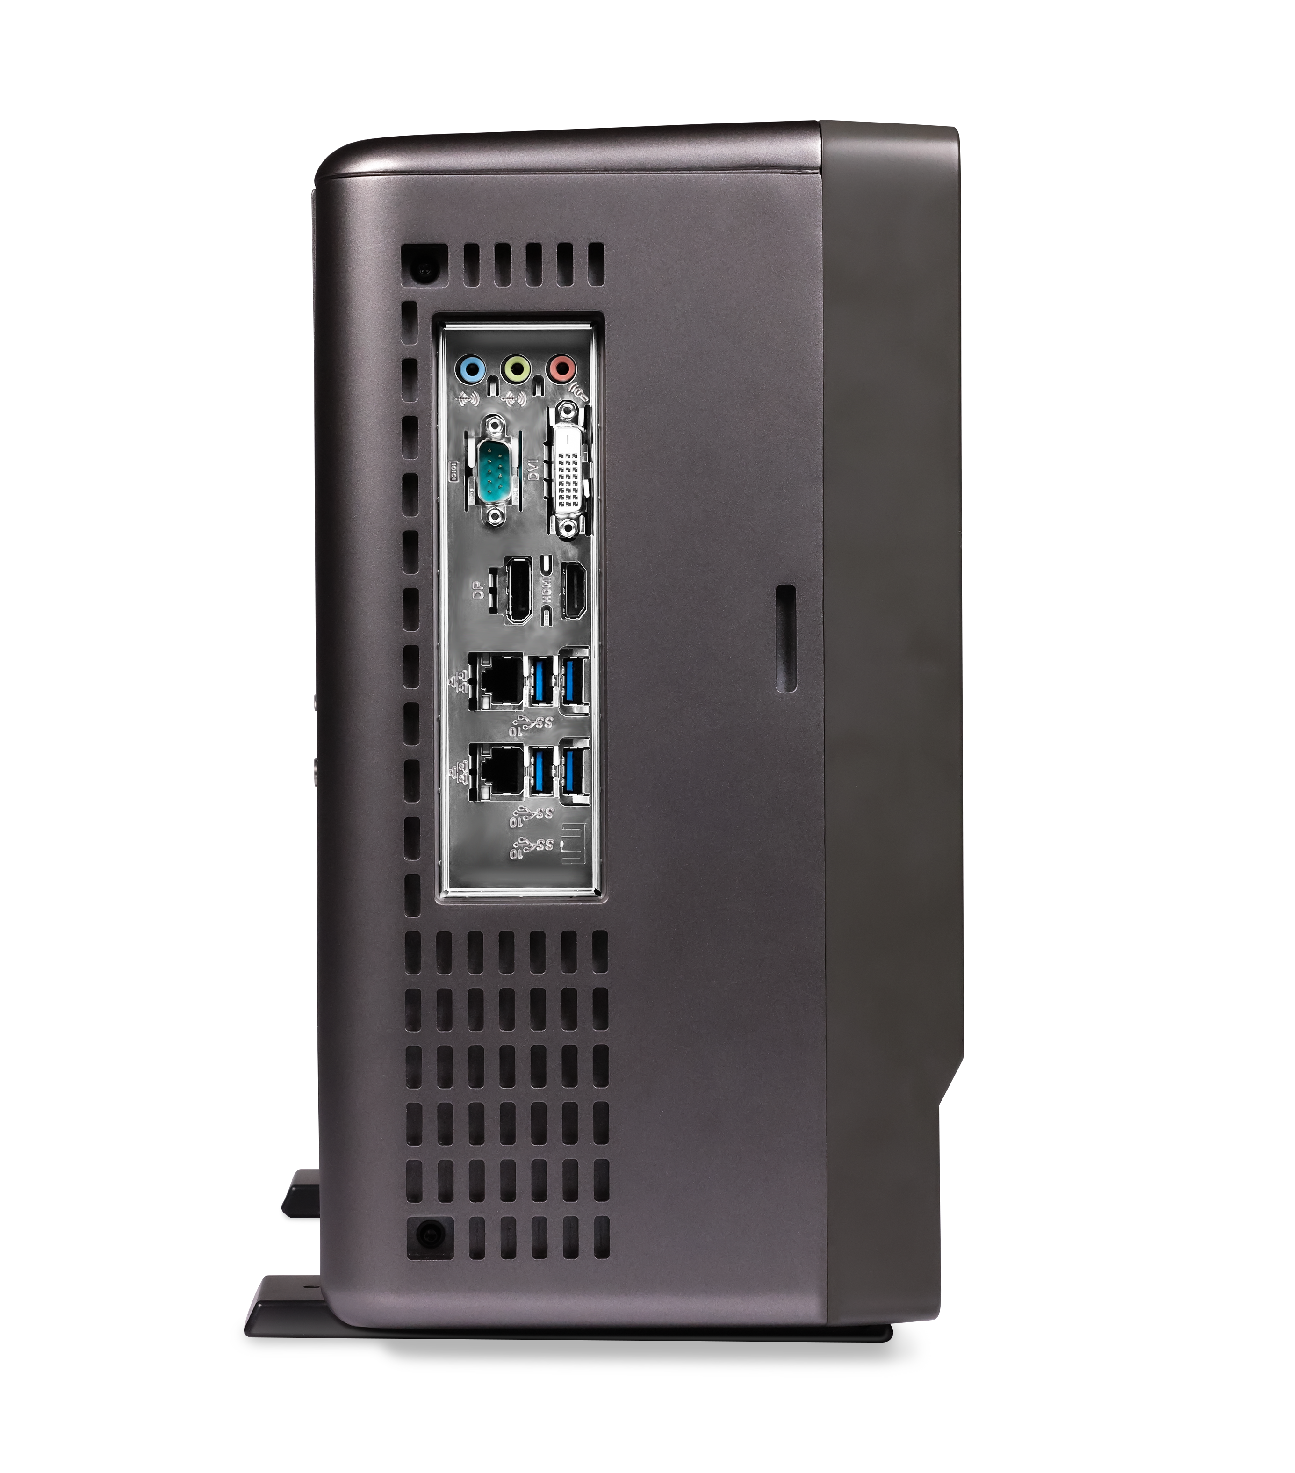

Panel & Connector Introduction
15.6-inch capacitive touch HD screen.
New panel design for better touch experience.
Full consideration of user scenarios.
DVI-D port for video output
Video outputs HDMI port
Audio input
4 x USB3.1
Audio output
Audio input
Video output DP port
COM serial port
2x 1000M LAN

Slide 10
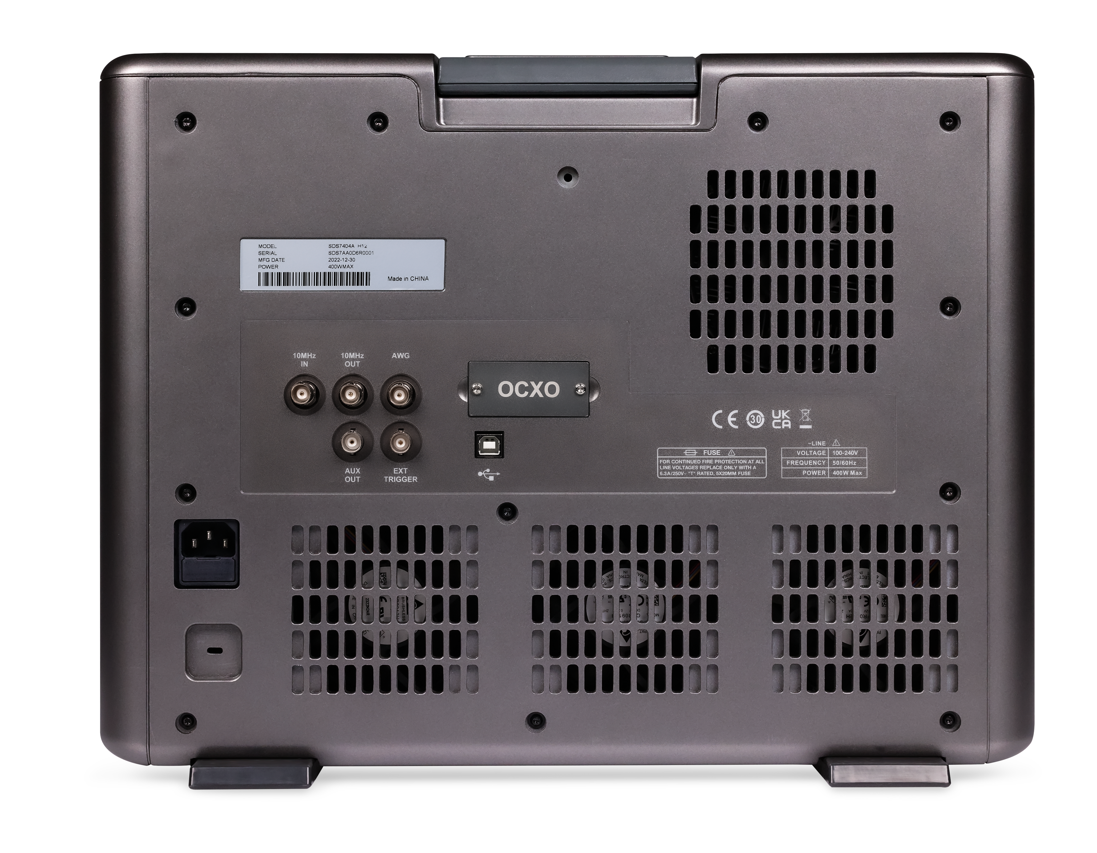
Panel & Connector Introduction
Waveform Generator Output
OCXO
Option Interface
10MHz OUT Reference Output
10MHz IN Reference Input
Auxiliary output
USB Device
External trigger input

Slide 11
02
Features & Benefits

Slide 12
12-Bit Vertical Resolution
12-Bit
The number of ADC bits of an oscilloscope is one of the most critical parameters of an oscilloscope, which represents the resolution of the oscilloscope in the vertical direction.
Conventional Oscilloscope
8-bit ADC
SDS7000A Series
12-bit ADC
Increased accuracy
256 Quantitative levels
4096 Quantitative levels
16 Times

Slide 13
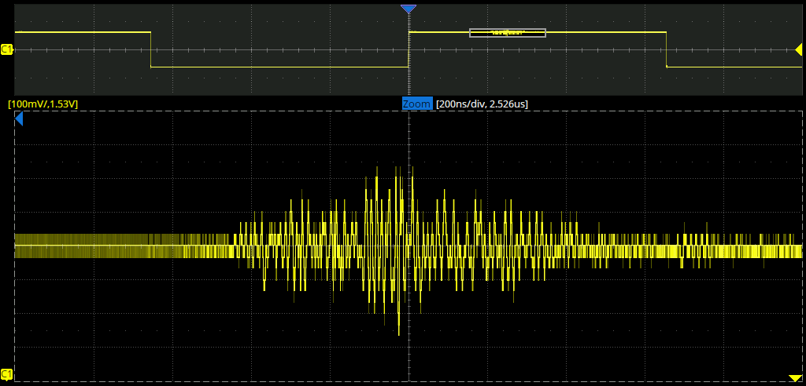
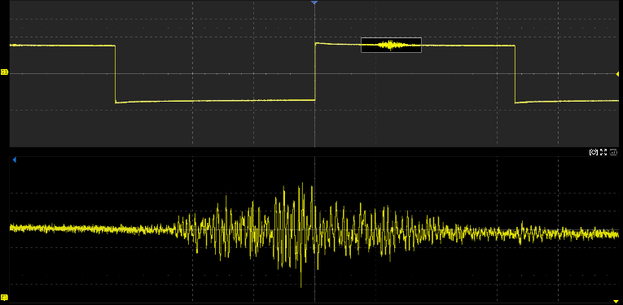
12-bit ADC delivers 16 times the small-signal measurement capability of a typical 8-bit oscilloscope
The number of ADC bits of an oscilloscope is one of the most critical parameters of an oscilloscope, which represents the resolution of the oscilloscope in the vertical direction.
ADC bit count 12bit; up to 16bit vertical resolution in ERES mode.
Hardware-implemented 1mV/div vertical stops allow detection of smaller waveform variations.
Clearer and cleaner waveform display.
Accuracy is more than 16 times higher than 8bit oscilloscope.
8-bit
12bit
12-bit

Slide 14
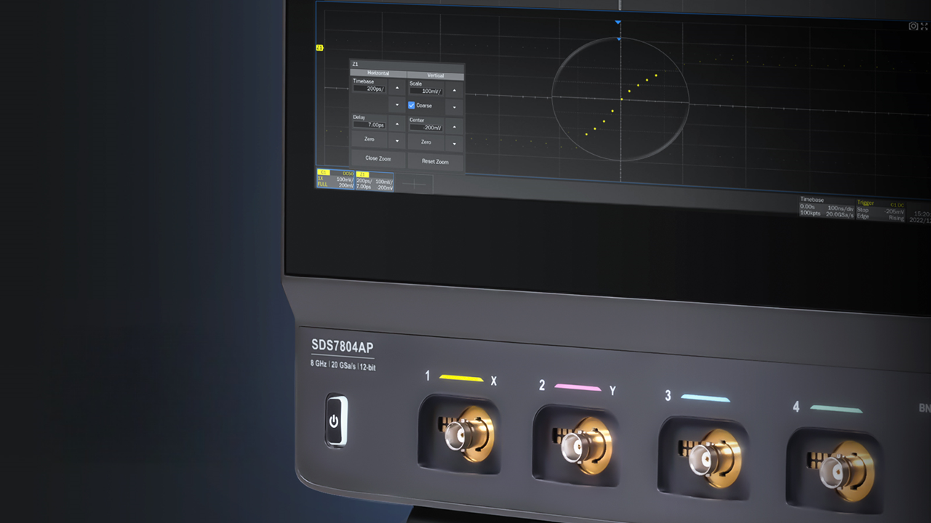
Maximum Sampling Rate of 20 GSa/s
for All channels

Slide 15
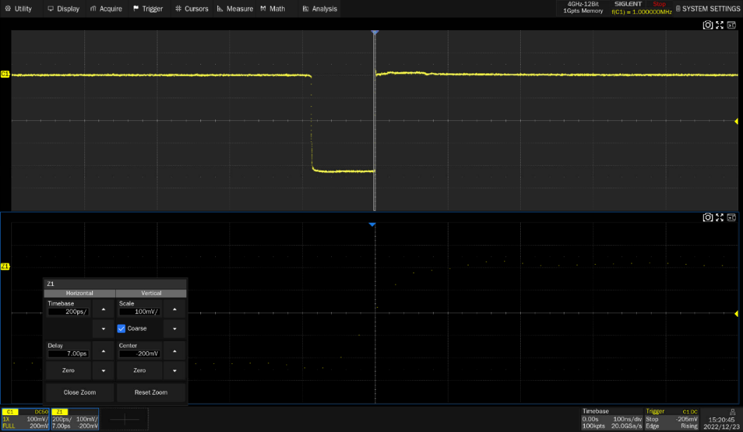
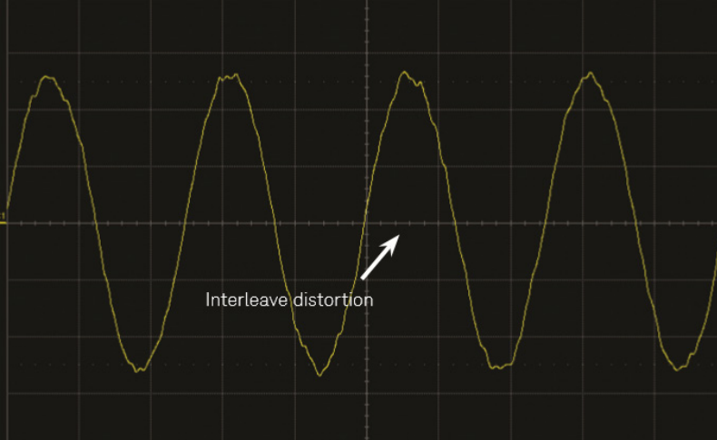
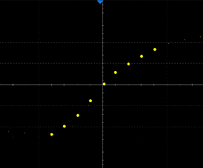
Maintaining a high sample rate at 12-bit high resolution is a huge challenge
The higher the sampling rate, the more detail of the signal waveform is displayed.
The SDS7000AP can sample at 20GSa/s for the full channel. Adopting Siglent's unique interleaved sampling technology, the two ADCs are synchronized with phase-delayed clocks, and then the same analog channel is sampled using the two ADCs, which is designed to double the maximum sampling rate.
This sampling method also places a high demand on the synchronization between ADCs. If the phase delay clocks are not synchronized between the ADCs, the sampling will be uneven and thus the reconstruction of the waveform on the screen will be distorted.
Uniform sampling points at 20 GSa/s
Two ADCs that are not fully synchronized can cause waveform reconstruction distortion

Slide 16
Why are some oscilloscopes afraid to write ENOB indicators?
ENOB (effective number of bits) is as important as the number of ADC bits, which represents the acquisition capability of the oscilloscope under ideal conditions, but in the oscilloscope, a portion of the ADC bits will be drowned in noise. Therefore, it is the ENOB, not the number of ADC bits, that determines the quality of an oscilloscope test. the ENOB takes the system error into account as well, and therefore better reflects the integrity of the test signal.
As shown in the figure is the comparison between Siglent SDS7000AP and the ENOB of mainstream foreign competitors, 12bit ADC with Siglent self-developed front-end, SDS7000AP has a strong system performance.
We'll emphasize the better specification - 12bit - more often, but the number of bits in the ADC is only a small part of the oscilloscope system. It's the ENOB of the system that is the effective number of bits when seeing the signal on the screen, making measurements and using the analysis functions.
Some companies will not show this specification in the datasheet and only provide the ADC bits.
12bits

Slide 17
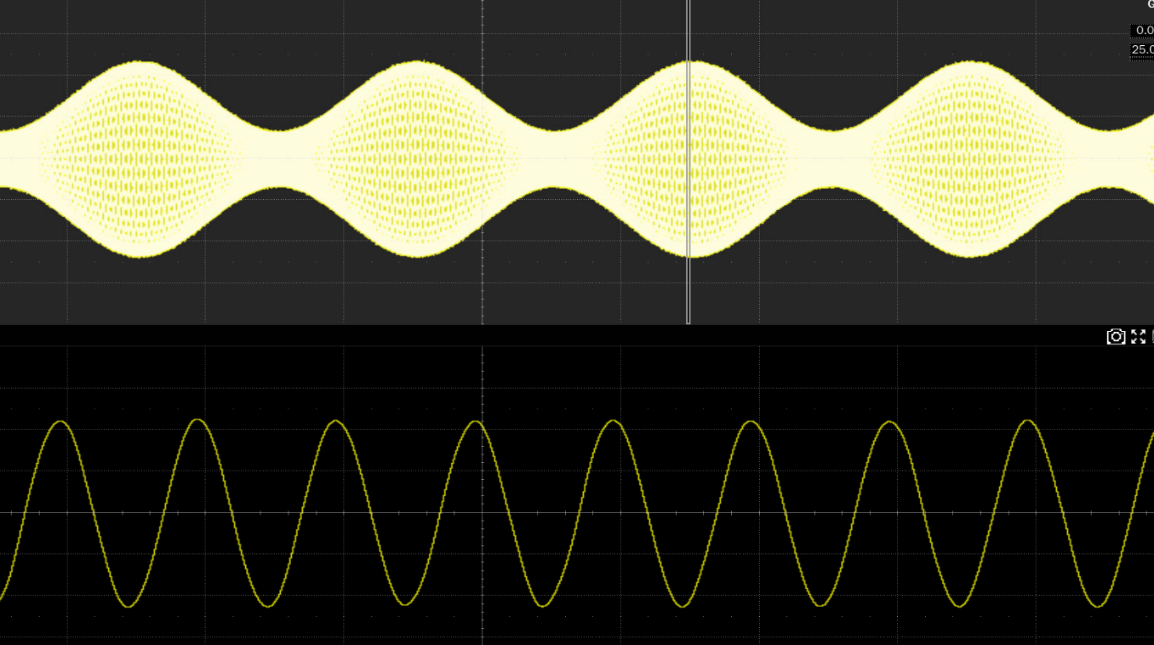
Large Memory Depth – Combines Signal Wholeness and Detail
The maximum 2 Gpts/channel deep storage ensures that the oscilloscope can capture signals for a longer period of time at a high sampling rate and then quickly zoom in on areas that need attention to achieve a balance between the whole and the details.
Memory Depth = Sample Rate x Sample Time
Ultra-long-duration
Capture multiple waveforms
Ensure zero waveform distortion
Exceptional operational performance
Maintain high sampling rates
Accurate and effective analysis
2Gpts/CH
Using an oscilloscope to capture signals over long periods of time

Slide 18

High-precision clock source to reduce the oscilloscope's own jitter impact on the measured signal jitter analysis
For oscilloscopes with high storage depths, a highly accurate local oscillator is critical.
The SDS7000A series' high-precision clock source ensures the accuracy of the time base with 100ppb accuracy after calibration.
For high-speed signal testing, jitter is a test item that cannot be avoided, and we will also include the jitter of the oscilloscope in the test.
 | Temperature Compensated Crystal Oscillator（TCXO） | Oven Controlled Crystal Oscillator（OCXO）
Initial Accuracy | ＜2 ppm | ±100 ppb
Temperature Stability | ±1 ppb，0℃~50℃ | ±1 ppb，0℃~50℃
Frequency Aging Rate | ＜0.5 ppm/first year, 3.0 ppm/20 years | 50 ppb per year
OCXO

Slide 19
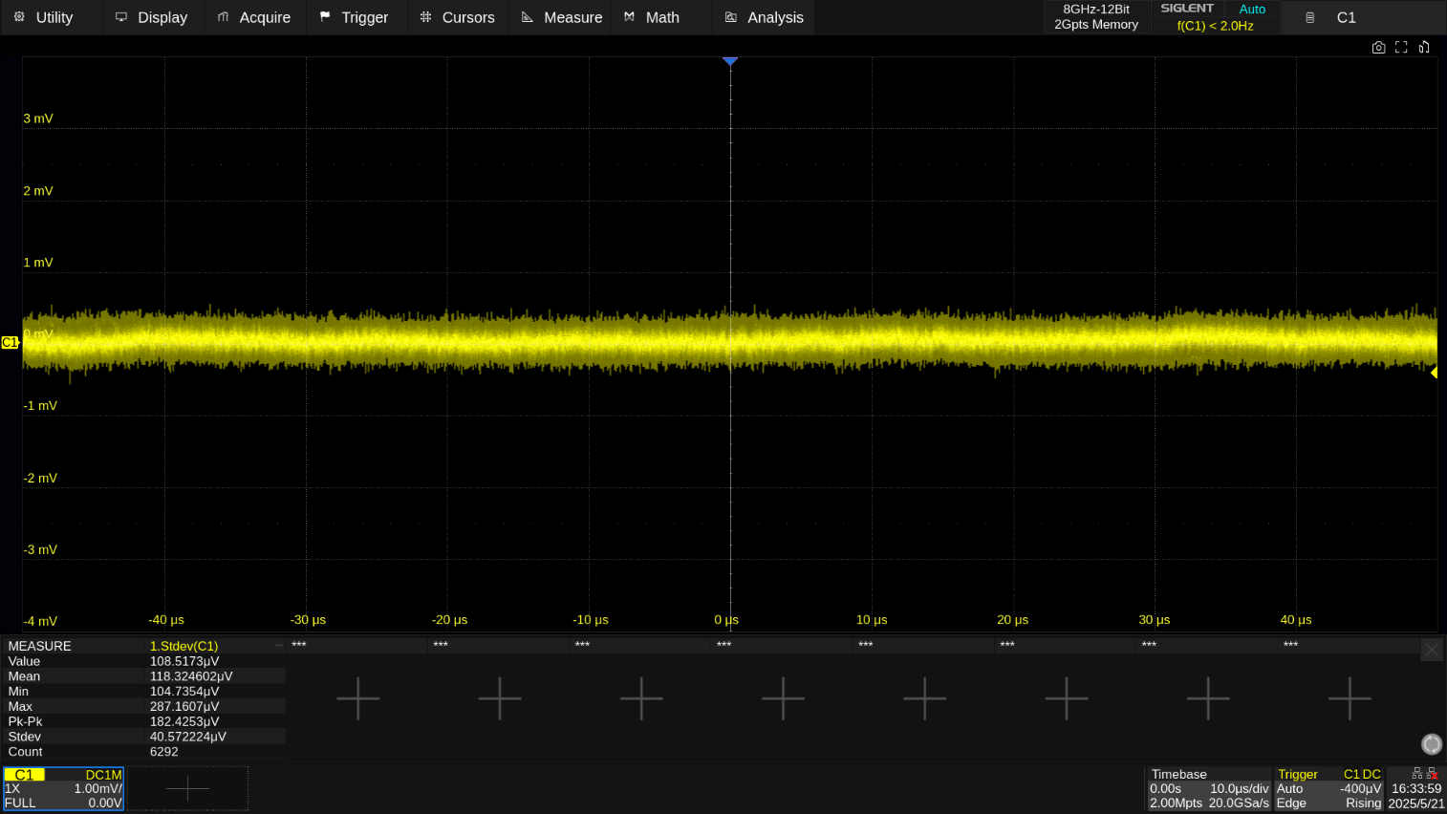
Superior noise floor, a guarantee of measurement accuracy
Based on a high quantization level 12-bit ADC and high-performance front-end circuitry, the SDS7000AP has low intrinsic noise.
Noise floor is as low as 300 μVrms at 8 GHz bandwidth.
Supports 50Ω and 1MΩ impedances with bandwidth filters for each analog path.
High-frequency noise is reduced by low-pass filtering and digital processing.
Low intrinsic noise

Slide 20
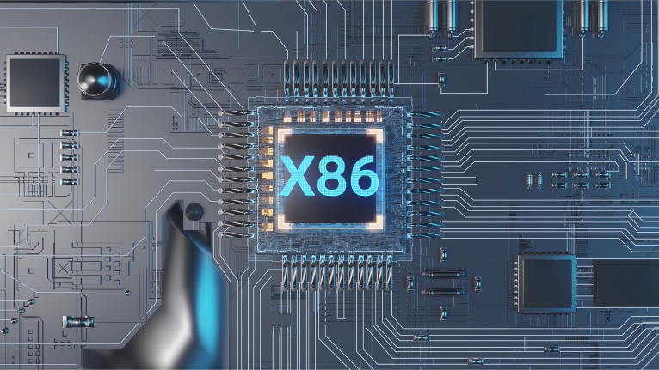
Upgraded efficiency with new processor
The processor is fully upgraded from an embedded ARM processor to an X86 processor.
The speed of system response, measurement, calculation and analysis has been dramatically increased.
250GB internal storage.
3.6GHz i3 processor 32G DDR4 RAM.
Start-up time <1min.
Linux system for more stable operation.

Slide 21
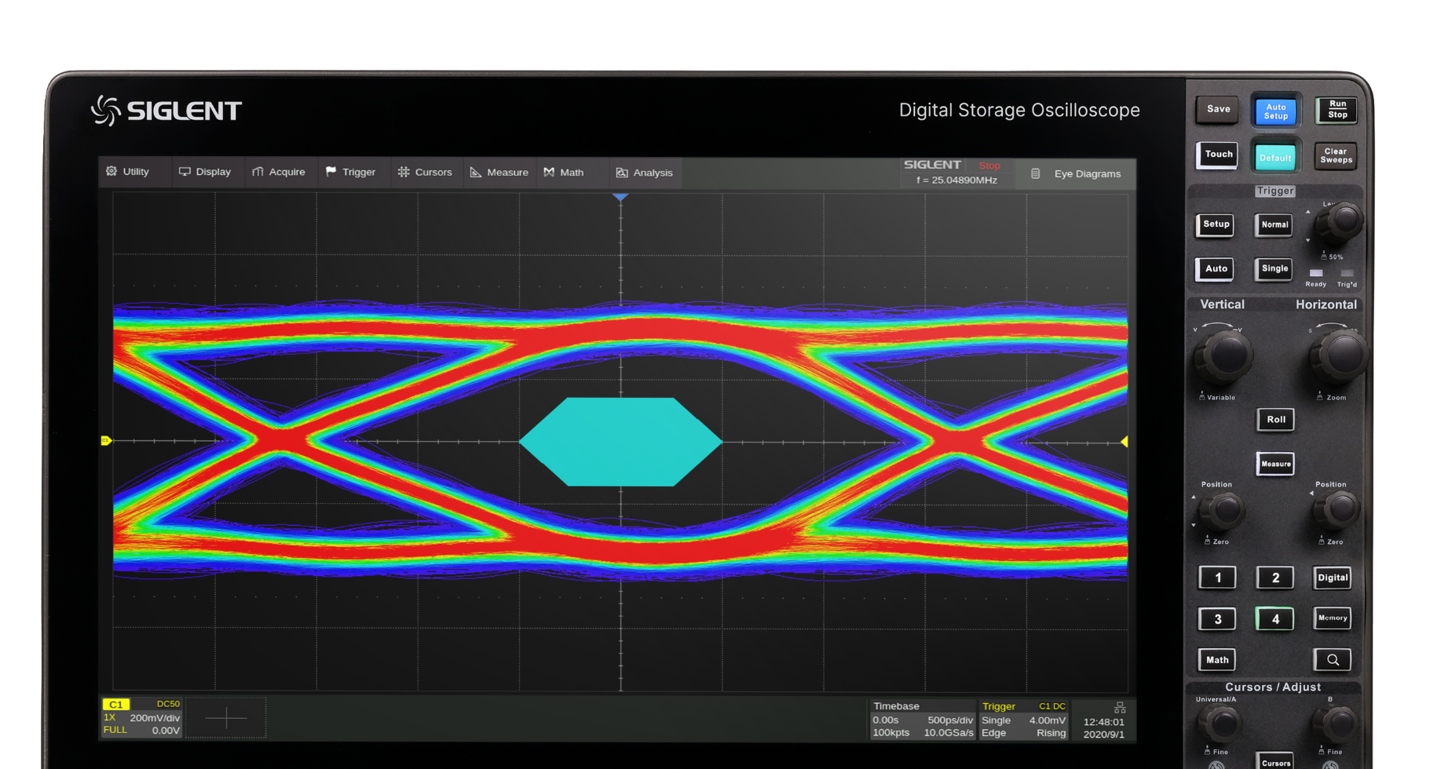
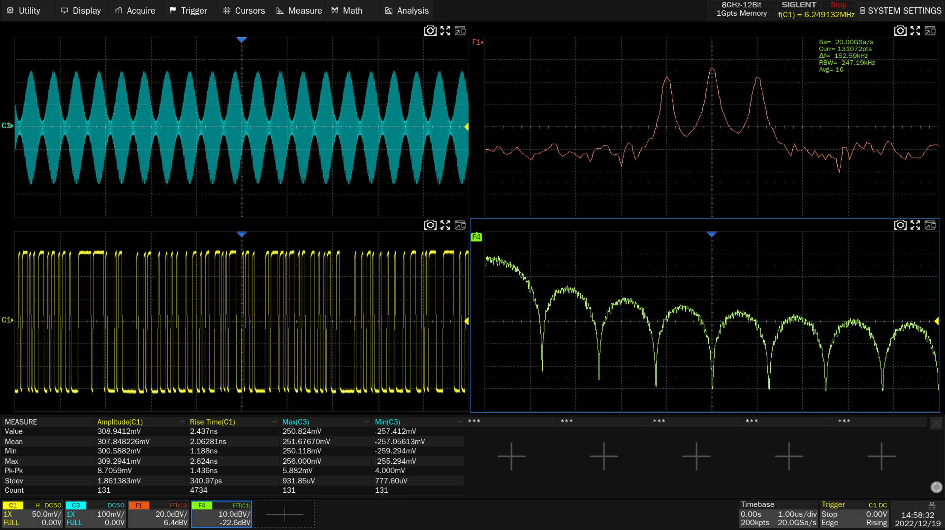
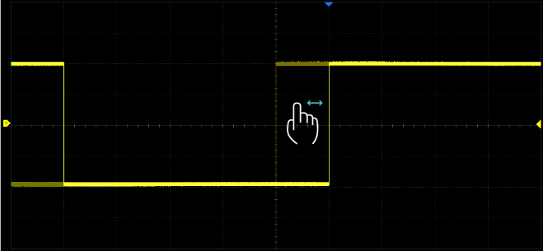
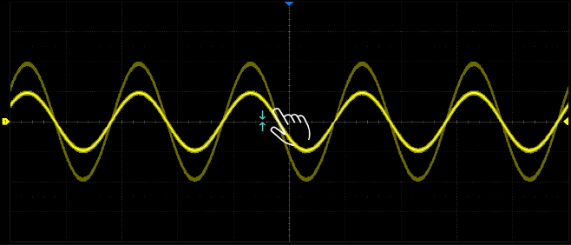
Adjust the waveform display to your liking
15.6-inch capacitive touch HD display.
Support split-screen display, multi-channel and multi-interface, flat presentation of more information, clear and reliable waveforms from the whole to the subtleties, and improved testing efficiency.
Defining various gestures specifically for oscilloscope operation greatly improves the efficiency of instrument control.

Slide 22
03
Applications

Slide 23
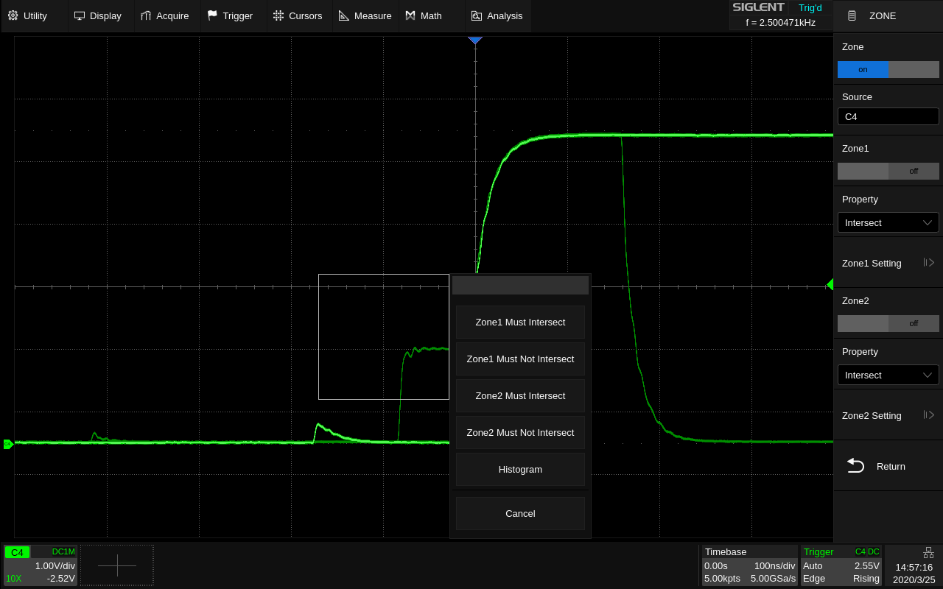
Window Trigger
Using Window triggering simplifies the operation of advanced triggering by quickly isolating the waveform of interest.
Supports up to two regions.

Slide 24
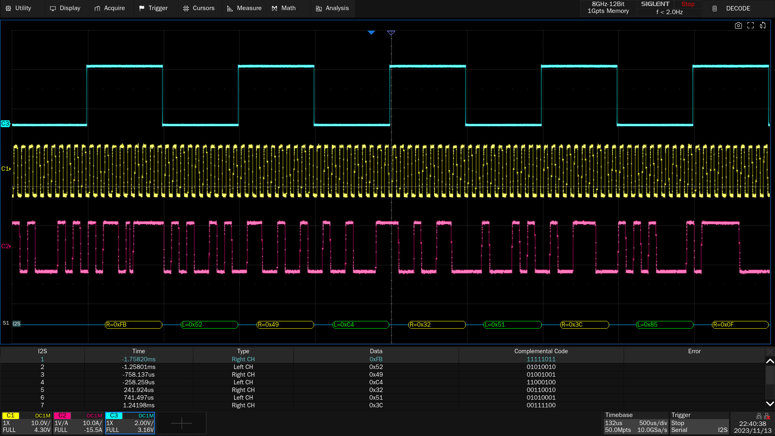
Serial Bus Decoding
Standard: I2C, SPI, UART, CAN, LIN
Optional: CAN FD, CAN XL, I2S, FlexRay, MIL-STD-1553B, SENT, ARINC 429, Manchester, USB2.0

Slide 25
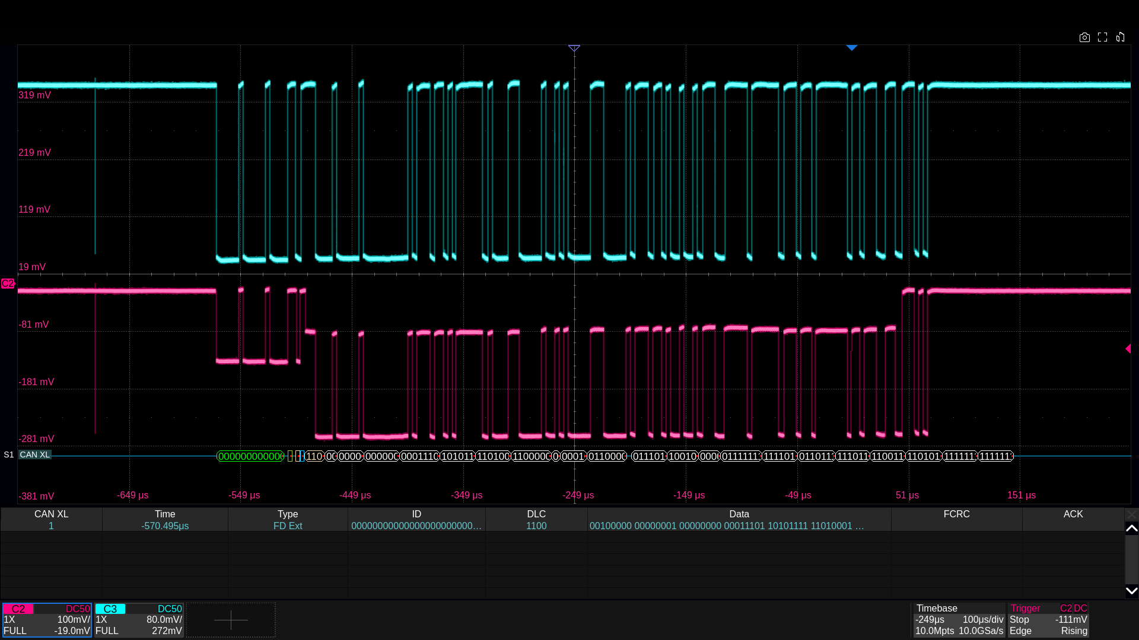
Enhanced CAN XL Decoding Support
SDS7000A Series Oscilloscopes Fully Support CAN XL Decoding.
Combined with existing CAN/CAN FD decoding capabilities, full scene coverage of CAN protocols (10 kbps to 20 Mbps) is realized.
Equipped with 16 channels (4 analog channels C1-C4 and 12 digital channels D0-D15), it supports synchronous parsing and can accurately capture data conflicts, signal reflections and other anomalies.
Notes:
With the development of automotive electronics to high bandwidth and low latency, CAN XL, the upgraded protocol of CAN bus, is gradually replacing the traditional CAN/ CAN FD, which is mainly used to meet the needs of high-speed data transmission and large frame length communication in automotive electronics, industrial automation, etc. CAN XL decoding function is to parse the raw signals transmitted in the CAN XL bus to obtain the frame structure, ID, data content, Error messages, etc., to help engineers quickly analyze the bus communication status.

Slide 26
CAN XL Applications
Automobile manufacturers: When developing smart cars and self-driving vehicles, they need to debug the in-vehicle CAN XL network.
Automotive component suppliers: Testing the communication stability of CAN XL interfaces when producing ECUs, in-vehicle radars, cameras, etc.
Semiconductor manufacturers: When designing CAN XL controller chips and transceiver chips, verify the protocol processing capability and physical layer performance of the chips.
Industrial equipment manufacturers: In robot control and intelligent manufacturing lines, CAN XL is used to transmit large amounts of sensor data or control commands that need to be decoded for functional debugging.

Slide 27
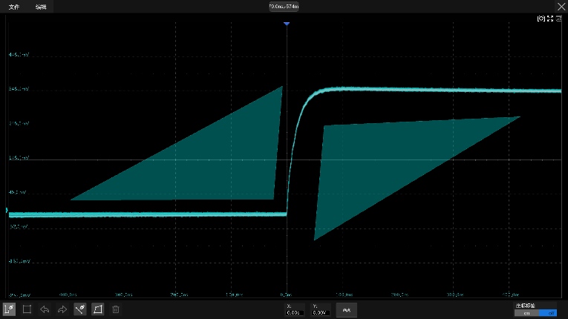
Hardware-implemented template tests
Hardware-based template test function at rates up to 80,000 fps.
Template tests are supported under eye chart and jitter tests.
Automatically generates templates based on user-defined vertical and horizontal tolerances, and compares whether the signal under test touches the template or not.
You can preset the acquisition stop and buzzer alarm when the test fails, and automatically take a screenshot of the failed frame or save it in the history frame.
Suitable for long-term unattended monitoring of abnormal signals.

Slide 28
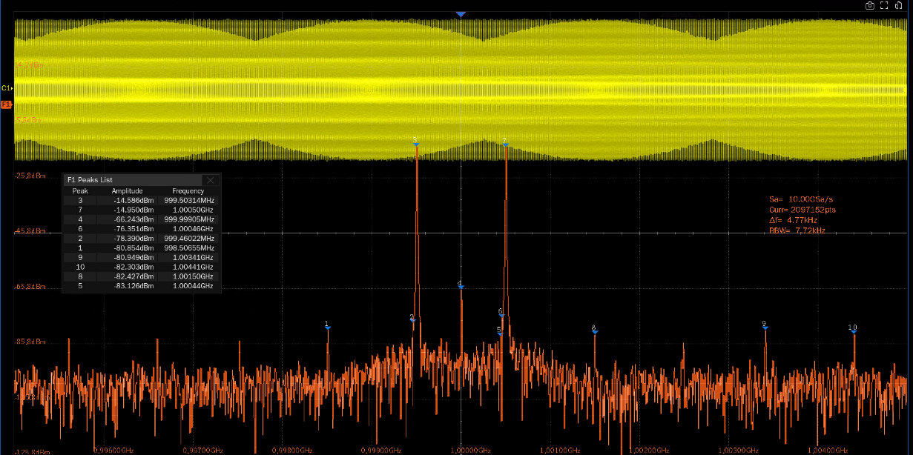
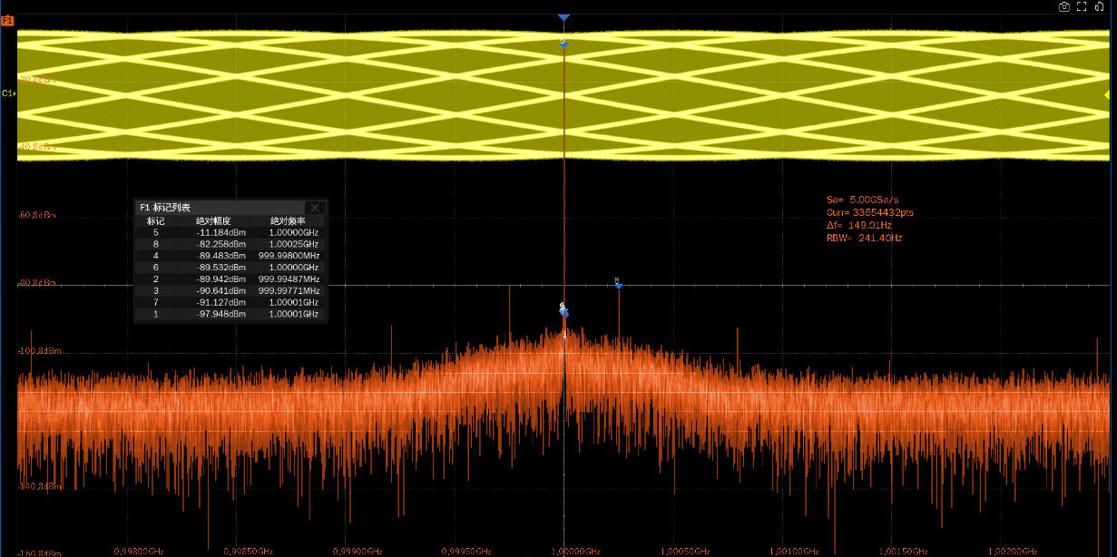
Hardware-accelerated FFT
The SDS7000A oscilloscope comes standard with spectrum analysis, 12-bit ADC and SFDR as low as 45dBc, ensuring lower noise floor with the oscilloscope's FFT function.
Siglent's hardware-accelerated FFT algorithm offers up to 88% time savings, supports up to 32M operation points, and provides superior frequency resolution while still maintaining a high spectral refresh rate.
Spectrum analysis using an oscilloscope enables a wider analysis bandwidth than a spectrum analyzer, and the SDS7000A supports tests up to 10 GHz. It can be used with an external inverter to accomplish broadband tests that cannot be performed with a spectrum analyzer.
Spectrum analysis using an oscilloscope

Slide 29

Eye Chart & Jitter Test
Typically used for high-speed signal testing
Jitter test detects signal timing offsets and helps identify potential problems
Visualization of signal quality to determine transmission reliability
Ensure accurate data transmission to improve product quality and stability

Slide 30
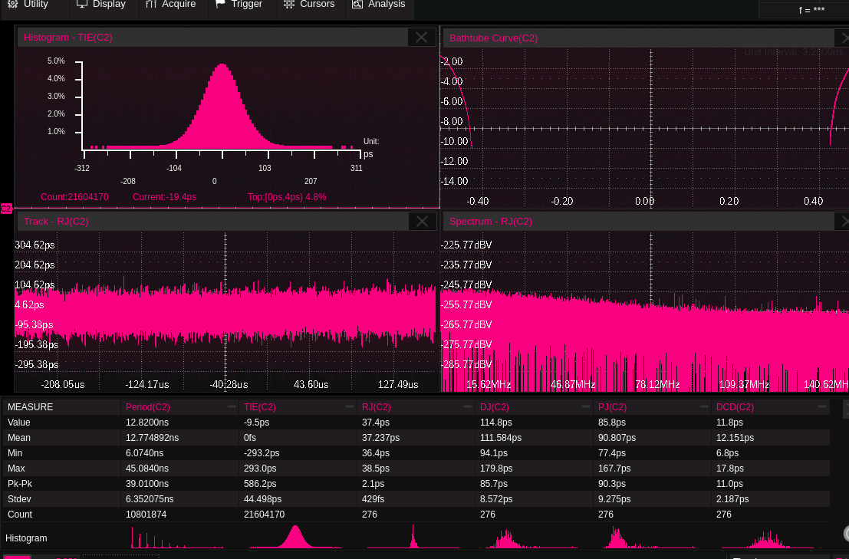
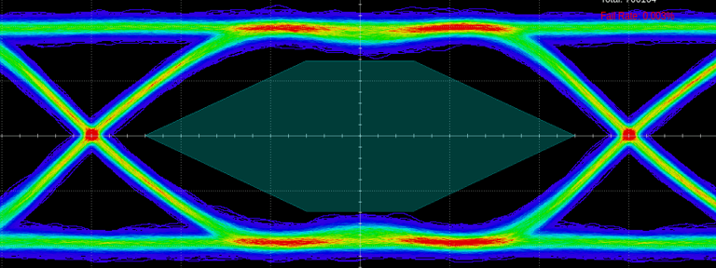
Eye chart & Jitter analysis
Supports clock recovery by constant frequency or phase-locked loop, and supports clock recovery of embedded clock signals such as USB, Ethernet, and MIPI.
The color temperature display identifies anomalous signals with a small probability of occurrence.
Automatically test eye chart and jitter related parameters, support template test.
Jitter test supports advanced statistical analysis, noise analysis for high-speed digital interfaces.
Jitter analysis
Eye chart

Slide 31
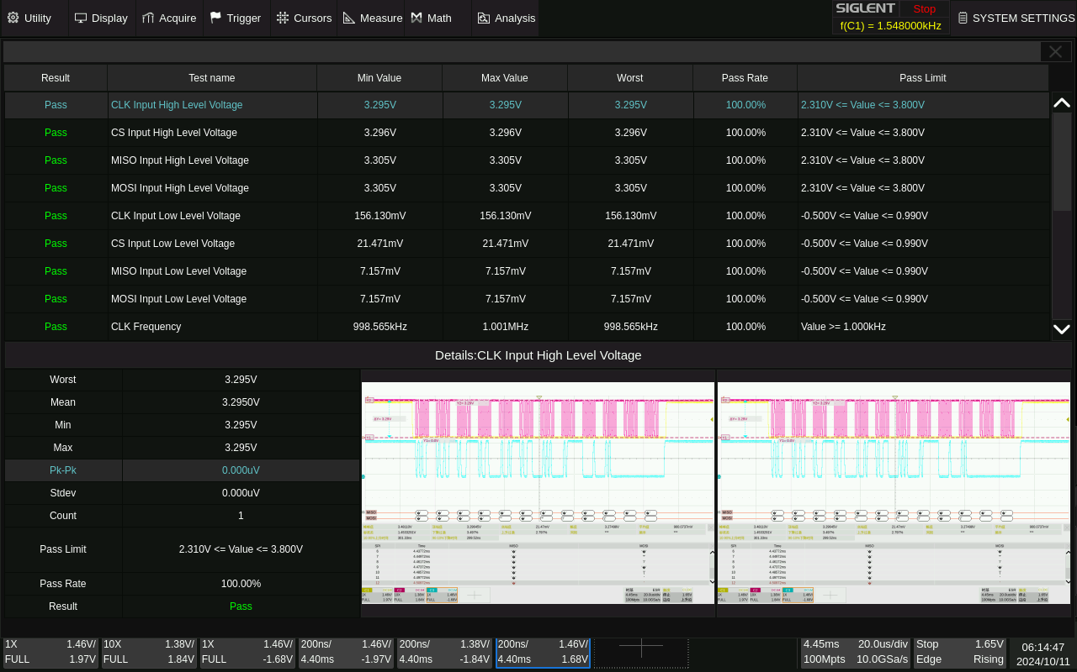
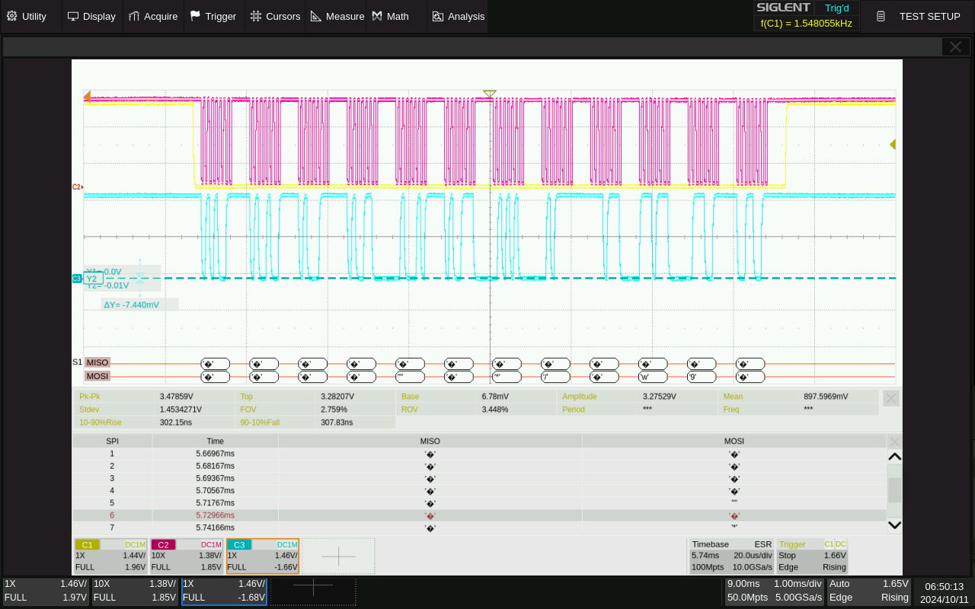
Serial Bus Analysis
Serial bus analysis can quickly and easily identify signal integrity issues and verify the performance of serial interface designs.
Bootstrap UI, wizard guide to complete configuration and testing.
One-touch testing of signal status.
Serial bus analysis test items
Screenshots of the testing process

Slide 32
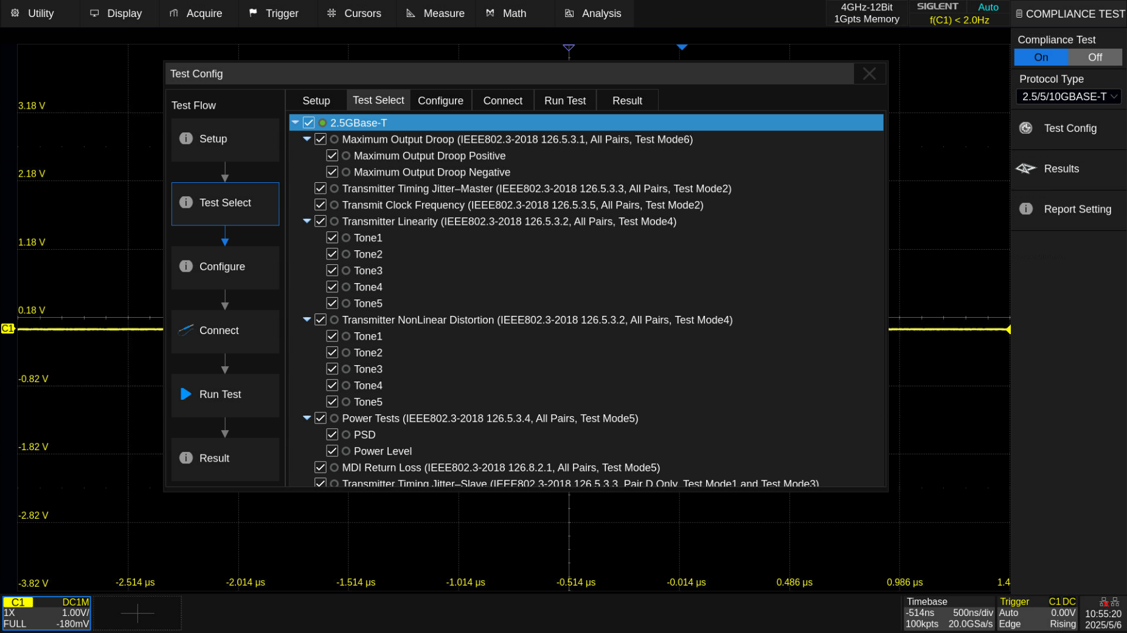
2.5G/5G/10GBase-T Test Items
Maximum Output Droop
Transmitter Timing Jitter-Master
Transmit Clock Frequency
Transmitter Linearity
Transmiter NonLinear Distortion (2.5GBase-T only)
Power Tests
MDl Return Loss
Transmitter Timing Jitter-Slave

Slide 33
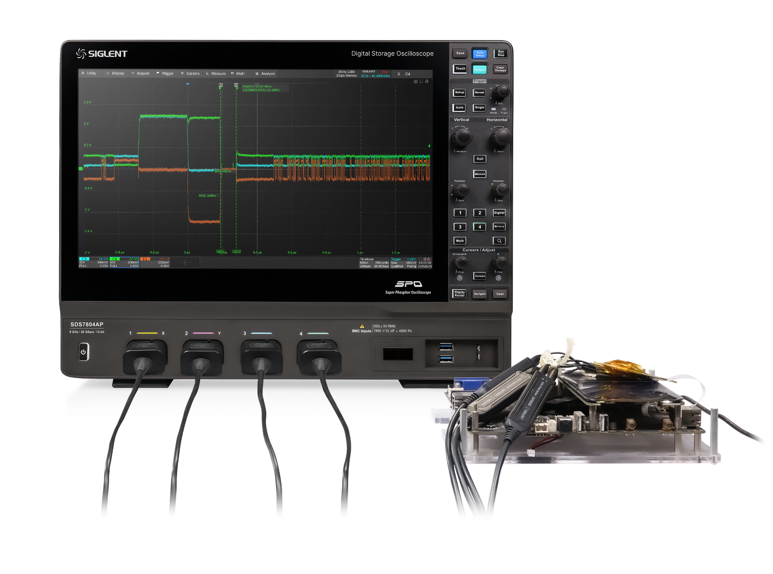
MIPI-DPHY Compliance Testing
The SDS7000A series supports MIPI-DPHY compliance analysis based on the CTS 1.0 specification.
The oscilloscope captures HS-TX and LP-TX signaling on both data and clock lanes using its 12-bit ADC and ≥4 GHz bandwidth, combined with 5 GHz active differential probes.

Slide 34
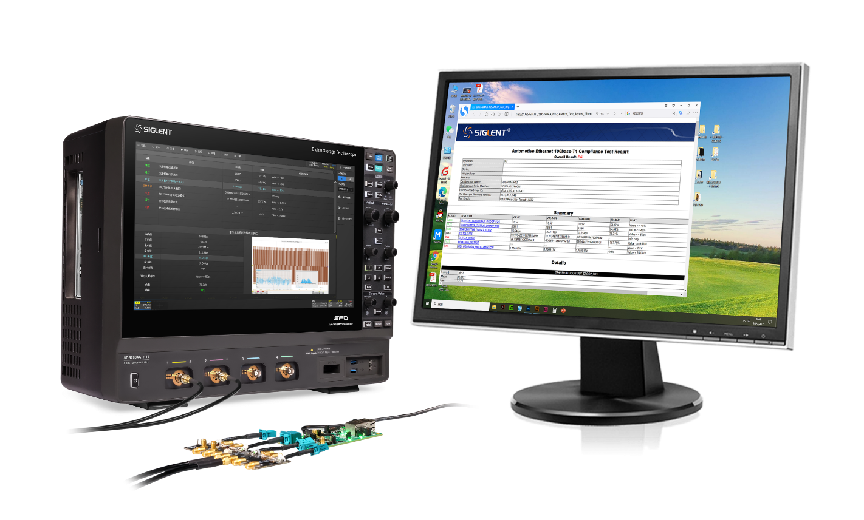
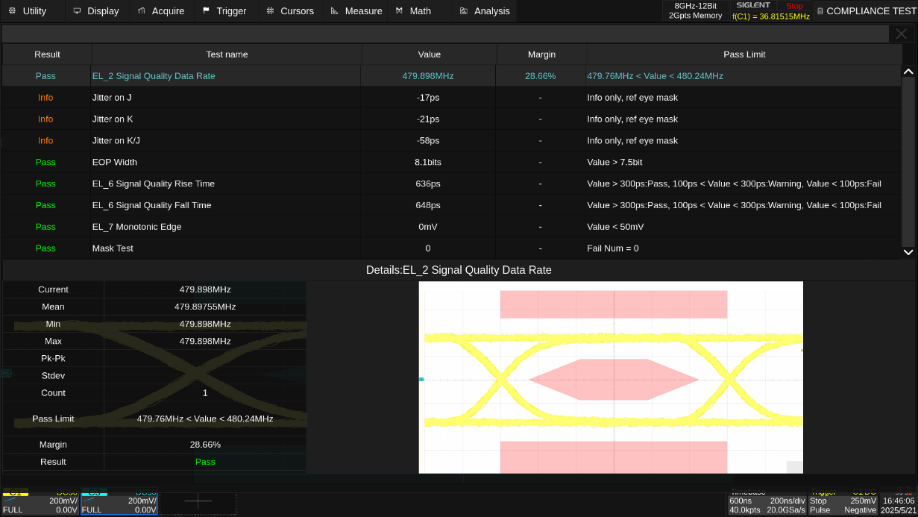
Enriched protocol conformance testing
Supports protocol conformance testing for USB2.0, 100Base-TX, 1000Base-T, 2.5G/5 G/10GBase-T, 100Base-T1, 1000Base-T1, MIPI-DPHY, DDR2/DDR3
Provide specialized test fixtures.
Automatic report generation.

Slide 35
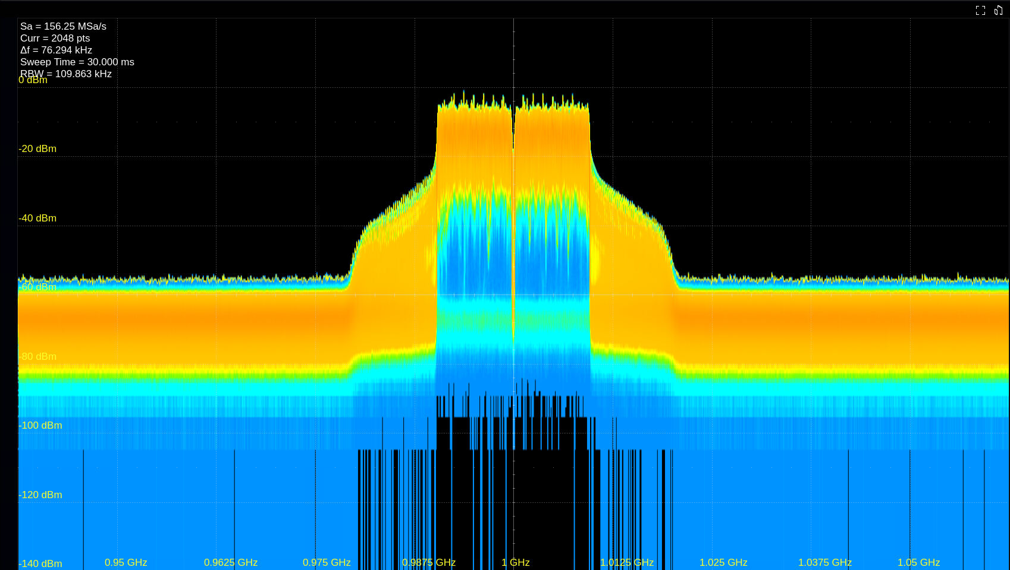
Real-Time Spectrum Analysis
Support maximum 1GHz SPAN real-time spectrum analysis, DDC processing based on 20GSa/s sampling data, DDC output maximum sampling rate of 1.25GSa/s.
With density map, spectrum monitoring, 3D map, 3D map + spectrum monitoring, density map + spectrum monitoring display mode, can realize high precision measurement in frequency domain.
Realize the function of Real-time spectrum analysis on the oscilloscope, seamlessly detect and analyze the input signal in the frequency domain, so that the oscilloscope has the professional analysis capability in both time and frequency domains at the same time.
With the RTSA option turned on, the real-time analysis bandwidth range is unlimited, and SIGVSA performance is supported.
Real-time Analysis Bandwidth
( 125 MHz，250 MHz， 500 MHz， 1 GHz )
Value of 100% TOI 4.99 μs (500 MHz SPAN)

Slide 36
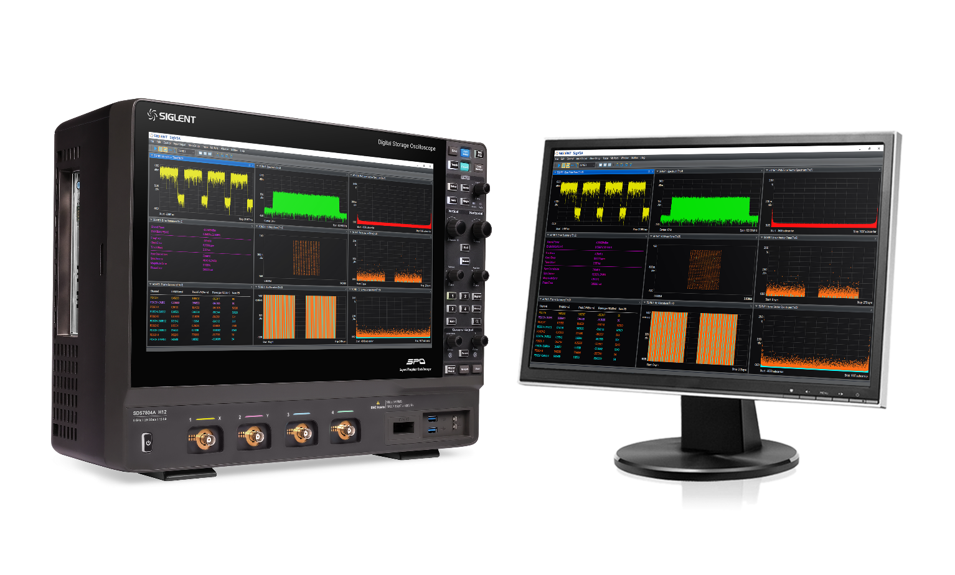
Integrated Vector Signal Analysis (SigVSA)
The SDS7000A features SigVSA vector signal analysis software, allowing direct signal analysis from DDC output without external equipment.
Supported signal types: 4G LTE, 5G NR, IEEE802.11b/a/g/n/ac/ax/be and 4096QAM, etc.
The real-time captured waveforms can be acquired directly from the oscilloscope for analysis, or the saved waveform data files can be analyzed offline.

Slide 37
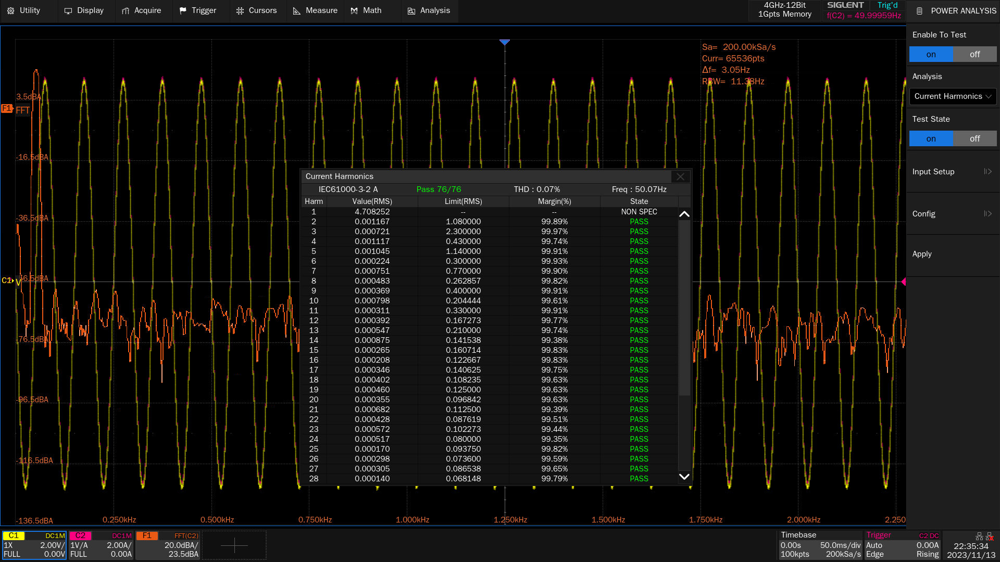
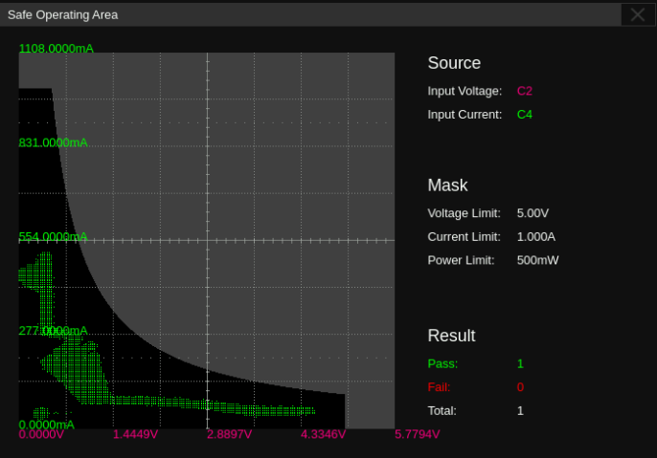
Power Analysis
Analyze the efficiency and reliability of switching power supplies.
Wide selection of voltage and current probes.
Quickly measure and analyze power quality, current harmonics, inrush current, switching losses, output ripple, etc.
Clear guidelines for easy device connections.
Current Harmonic Test
Safe work zone testing

Slide 38
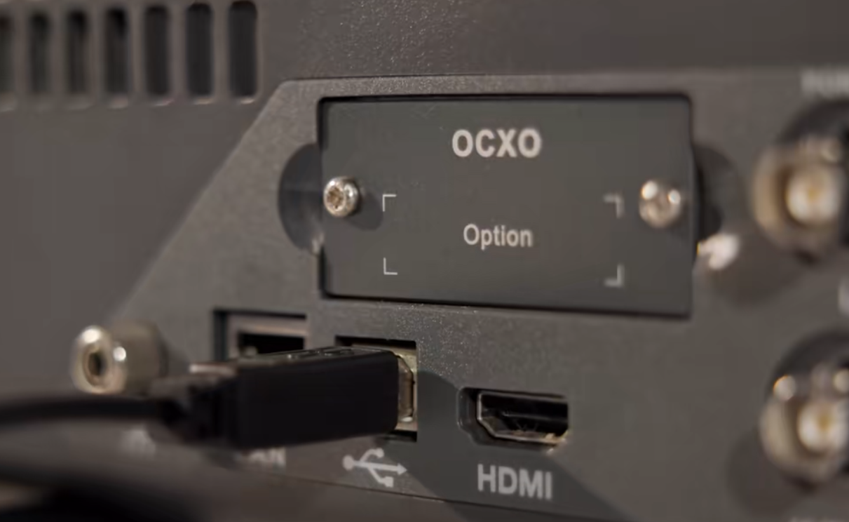
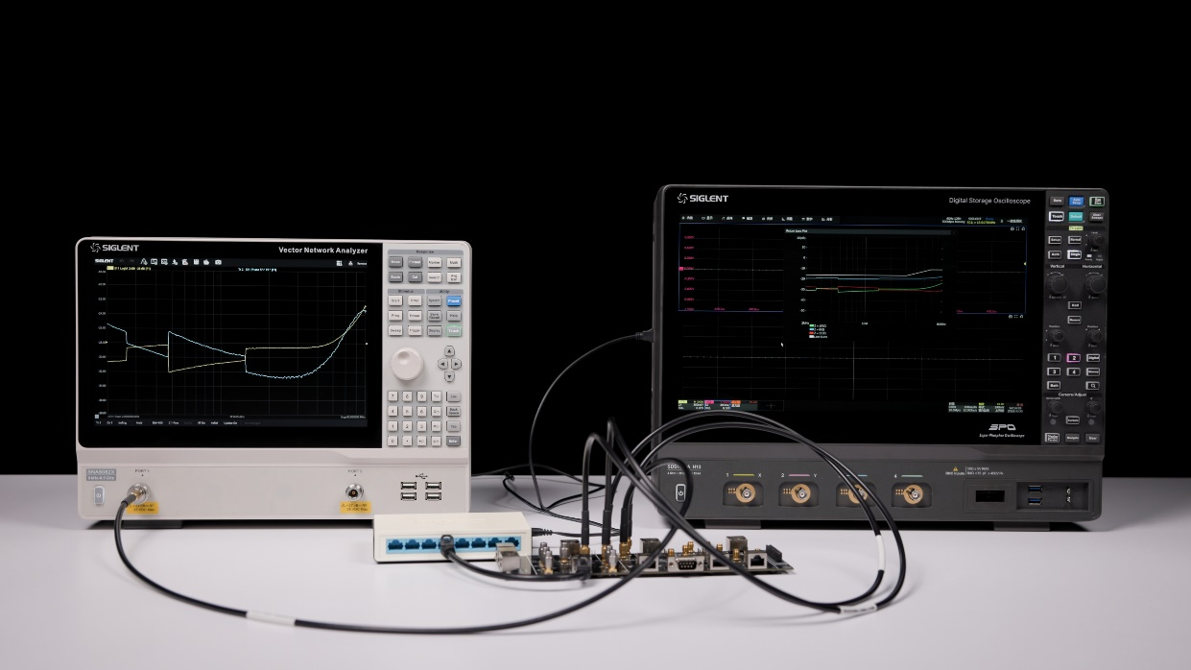
System solution testing
Convenient programmable control gives the SDS7000A more application scenarios.
It is possible to control other SIGLENT devices for testing.
Facilitates compliance testing of interfaces, wiring harnesses, etc.
Remote control of the oscilloscope via USB or LAN port
Co-testing with Oscilloscopes and Vector Network Analyzers

Slide 39
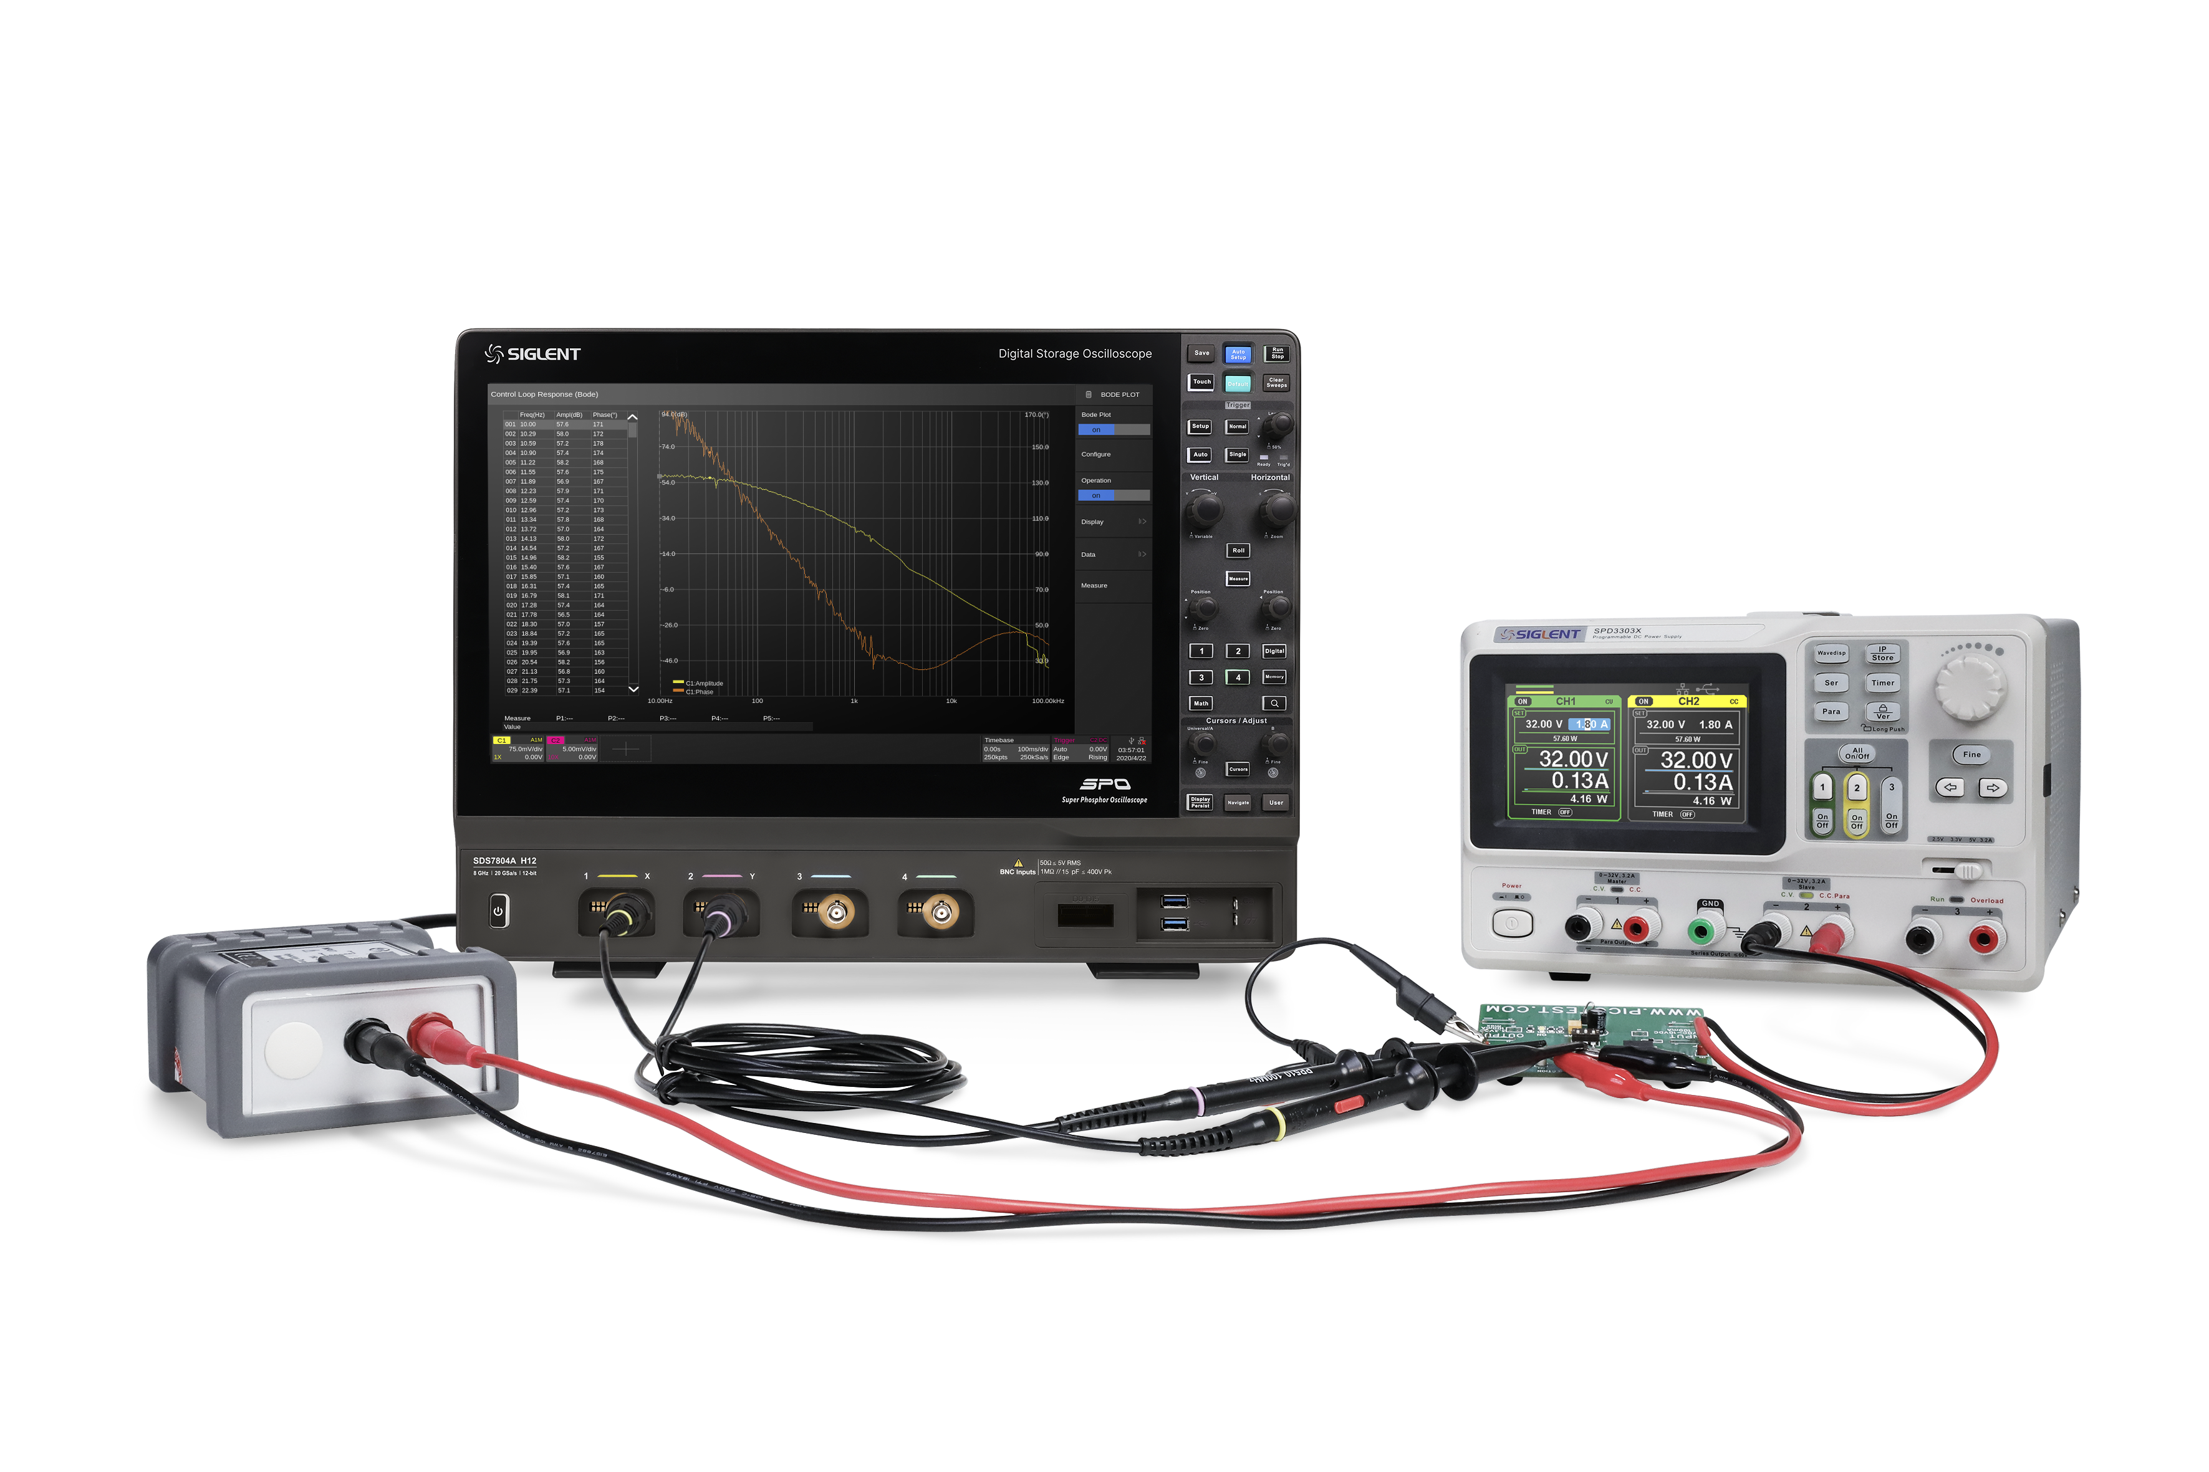
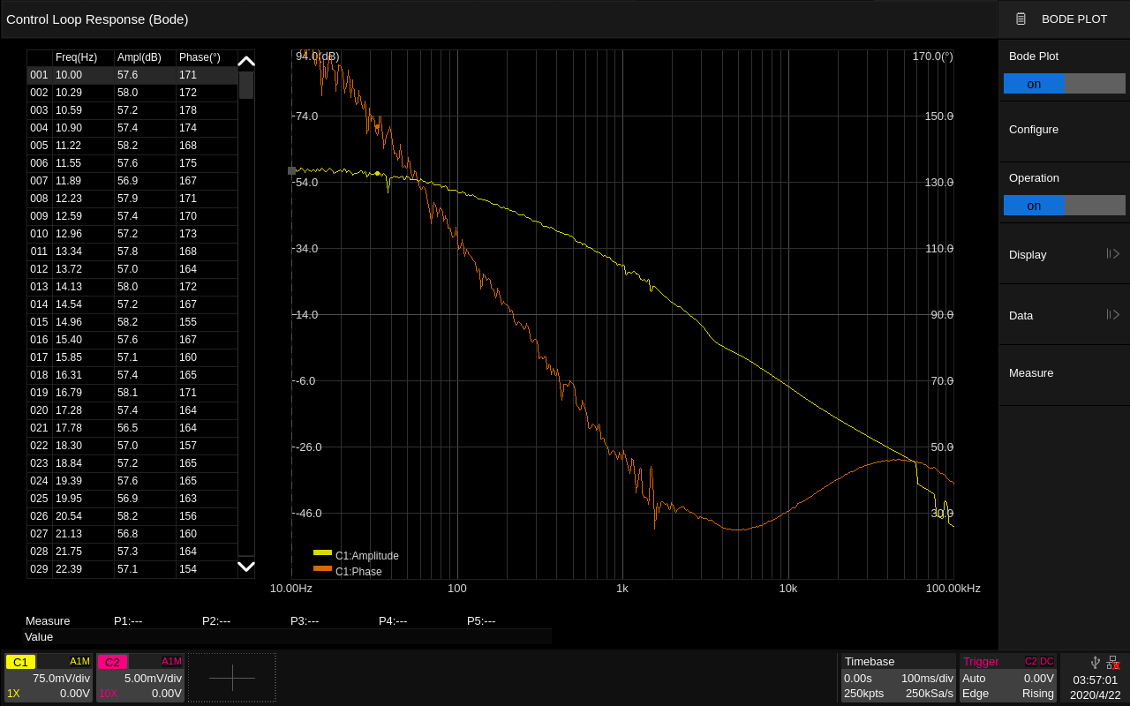
Bode Plot
Perform filter testing
Built-in waveform generator
Measurement of power control loop response
Scanning the amplitude and phase frequency response of a DUT
Bode Plot Test Environment
Bode Plot Test Results

Slide 40
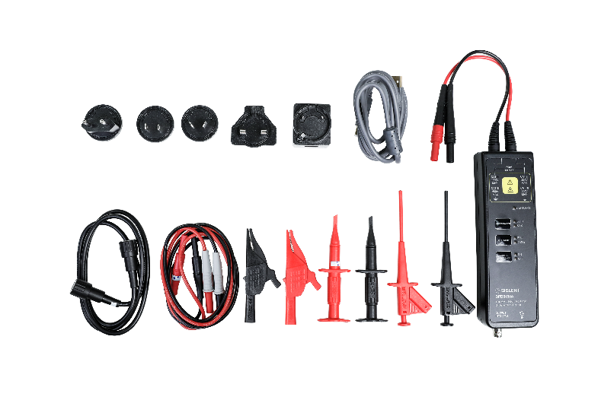
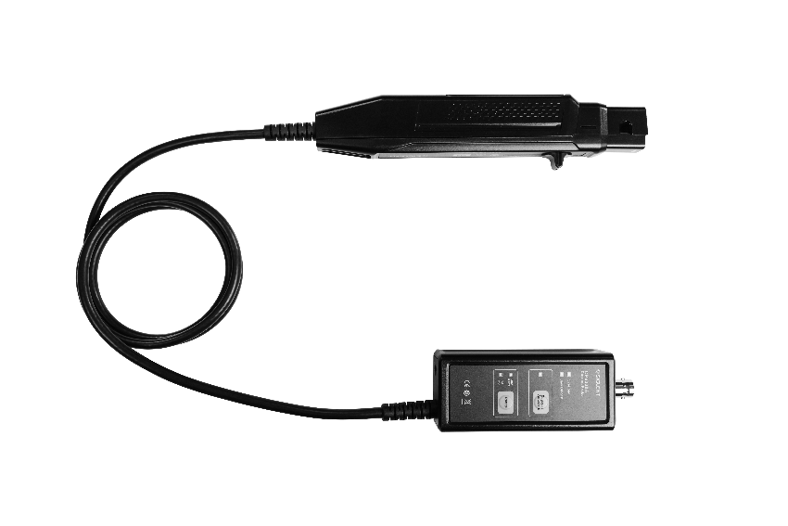
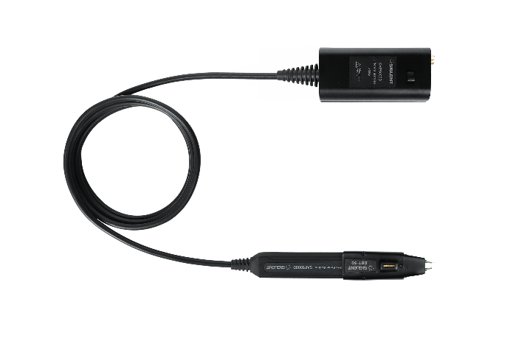
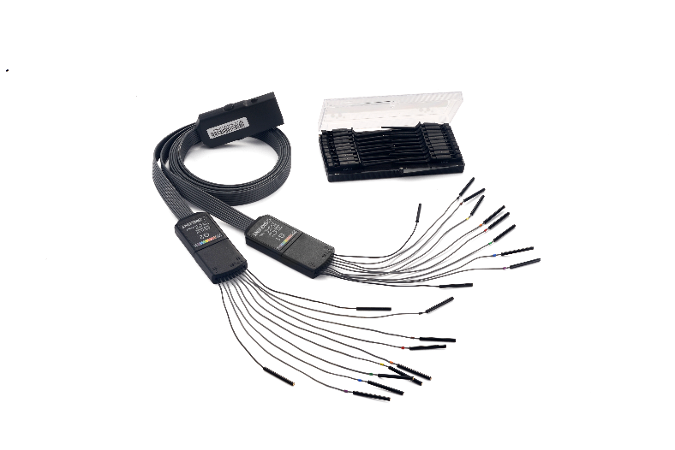
Wide range of probes
A wide range of passive probes, single-ended active probes, differential active probes, current probes, high-voltage differential probes, high-voltage probes, and logic probes are available to fit a variety of test scenarios to meet various test needs.
High Voltage Differential Probes
Current Probes
Active Differential/Single-Ended Probes
SPL2016 Logic Probe

Slide 41
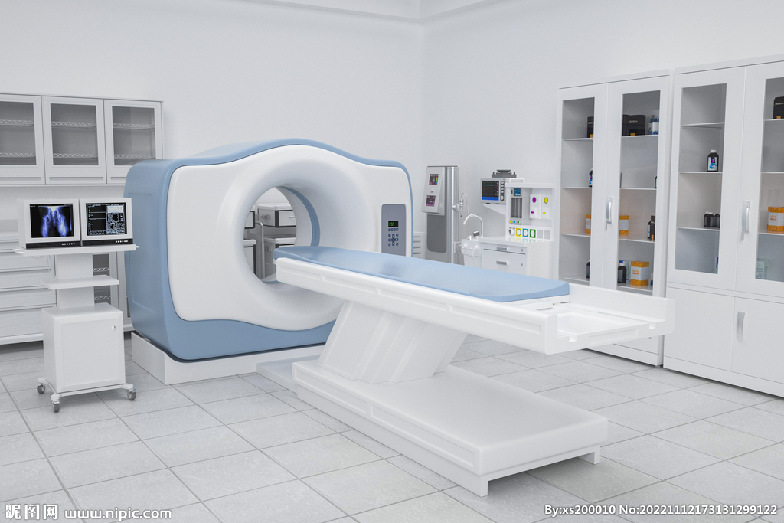
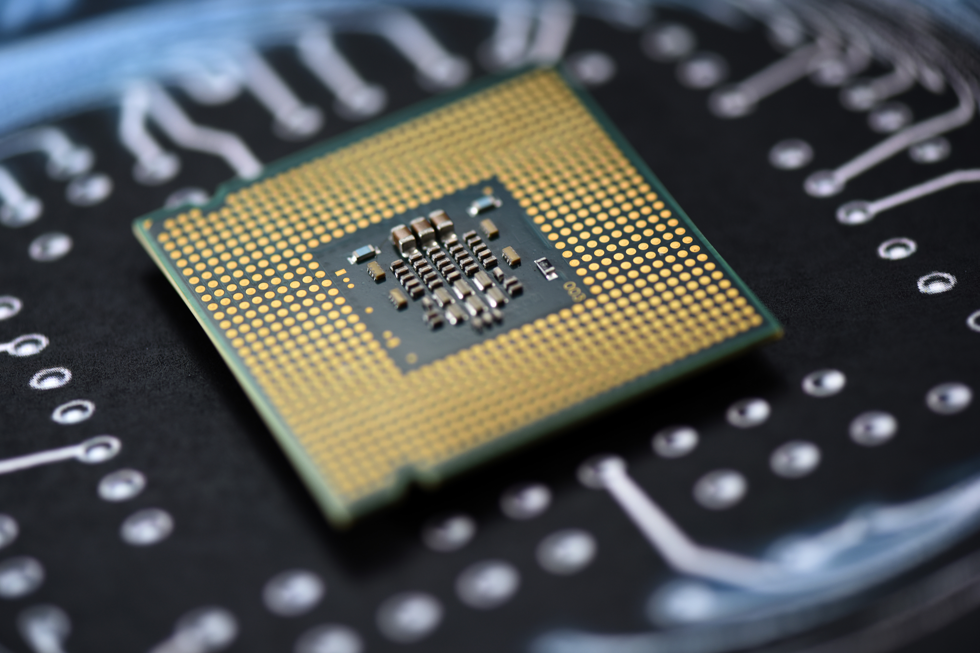

Areas of application
Medical
EEG signal analysis
Physiological Signal Analysis
Test EKG, ECG, EEG, EMG and other signals
Industrial Automation
Monitoring of equipment operating status
Measurement of high-precision sensors and drives
Communications
3G, 4G, 5G, TV broadcast signals...
Baseband IQ signal debugging

Slide 42


Areas of application
New Energy
Photovoltaic cell performance testing, PV inverter testing
Grid-connected energy storage testing
High-Speed Data Transmission
Serial Bus Testing
Interface Conformance Testing
Interference Source Localization
Signal Commissioning
Antennas & Base Stations
Base station maintenance test
Echo/transmit signal testing
Signal Analysis and Optimization

Slide 43
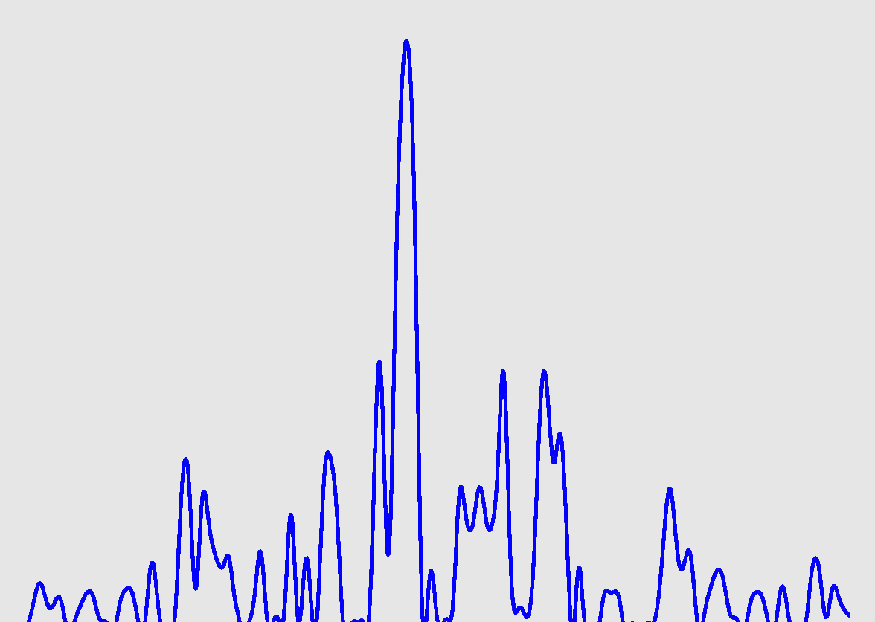
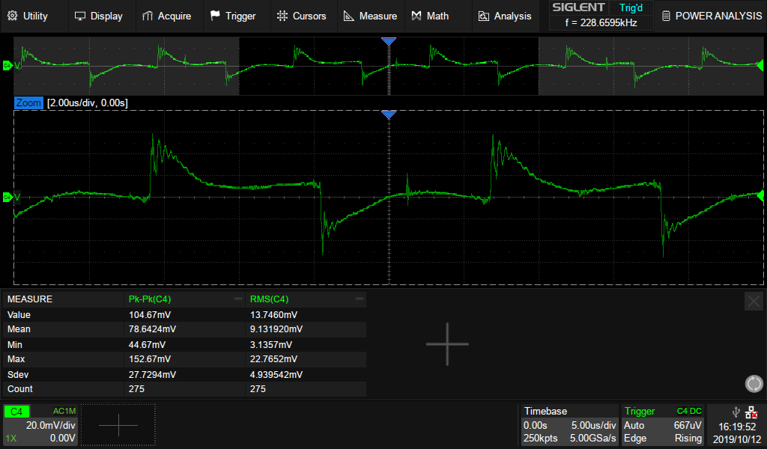
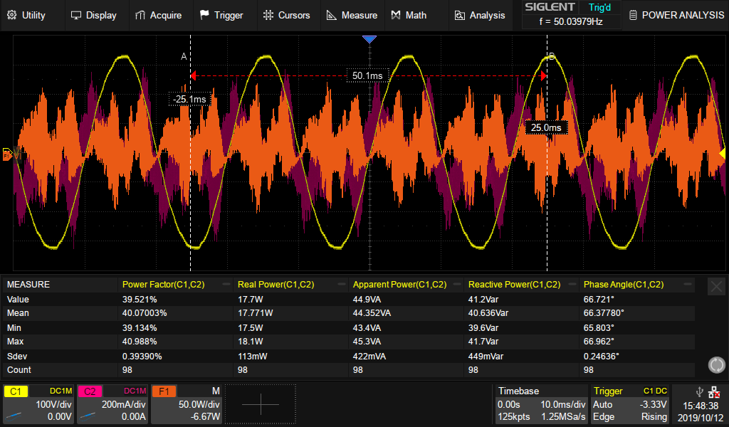
Areas of application
Optical Communication
Optical power, optical pulse test
Eye Chart Analysis
Optical transmitter/receiver testing
Power Supply Testing
Ripple testing, conversion efficiency, signal quality analysis, design verification
Power Measurement
Measurement of power consumption and efficiency of components or parts, sensitivity of receivers and gain of amplifiers...

Slide 44
04
Competition

Slide 45
 | SDS7000A | KEYSIGHT Infiniium EXR | Keysight 6000X
Channels | 4 | 4/8 | 2/4
Bandwidth | 3/4/6/8GHz | 500MHz 1/2/2.5/4/6GHz | 1/2.5/4/6GHz
Resolution | 12 bits | 10 bits | 8 bits
Max Sample Rate | 20 GSa/s (all channels) | 16 GSa/s (all channels) | 10 GSa/s (all channels)
Max Memory Depth | 500 Mpts/ch (all channels) | 400 Mpts/ch (all channels) | 4 Mpts/ch (all channels)
Waveform capture | 1,000,000 wfm/s | 200,000 wfms/s | 450,000 wfms/s
Eye and jitter analysis | Option | Option | Option
RTSA | Option | N/A | N/A
VSA | Standard (buy RTSA) | Option | Option
Serial trigger and decode | Standard: I2C, SPI, UART, CAN, LIN Option: CAN FD, CAN XL(decode only), FlexRay, I2S, MIL-STD-1553B, SENT, Manchester (decode only), ARINC429, USB 2.0 (decode only) | Option: I2C, SPI, Quad SPI, eSPI, Quad eSPI, RS232, UART, JTAG, I2S, SVID, Manchester, USB 2.0, 10/100 Mb/s Ethernet, USB-PD, PCIe Gen 1 (decode), CAN, LIN, CAN-FD, SENT, FlexRay, CAN XL, RFFE, I3C, SPMI, C-PHY/D-PHY based CSI & DSI (Up to 2.5 Gbps) , CSI 3, DigRFv4, LLI, UniPro, UFS, SSIC, ARINC 429, MIL-STD 1553, SpaceWire, 100BASE-T1 Automotive Ethernet, USB 2.0, USB-PD, eUSB2, USB4 LS(decode) | Option: I2C, SPI, UART/RS232, CAN/CAN dbc/CAN FD/LIN/LIN symbolic, SENT, FlexRay, I2S, MIL-STD1553, CXPI, ARINC429, USB 2.0, Manchester/NRZ, USB PD
Data analysis | Option: USB 2.0, 100Base-TX, 1000Base-T, 2.5G/5G/10GBase-T, 100Base-T1, 1000Base-T1, MIPI-DPHY, DDR2/DDR3 | Option: USB 2.0 Transmitter, 10M/100M/1GBASE-T and Energy Efficient Ethernet, 10G, MG Base-T, N-Base-T, 10/100/1000BASE-T1, MIPI C-PHY, up to 1.5 Gbps, MIPI D-PHY, DDR3 and LPDDR3 Compliance Test Software | USB 2.0
Price | - | https://www.keysight.com 5/13/2025 $27,306 @ 500MHz, 4channels $34,512 @ 1GHz, 4channels $42,348 @ 2GHz, 4channels $45,213 @ 2.5GHz, 4channels $57,501 @ 4GHz, 4channels $79,926 @ 6GHz, 4channels | https://www.keysight.com 5/13/2025 $28,450 @ 1GHz, 4channels, DSO $34,768 @ 2.5GHz, 4channels, DSO $45,773 @ 4GHz, 4channels, DSO $57,988 @ 6GHz, 4channels, DSO

Slide 46
 | SDS7000A | R&S RTO6 | R&S RTO2000
Channels | 4 | 4 | 2/4
Bandwidth | 3/4/6/8GHz | 600MHz 1/2/3/4/6GHz | 600MHz 1/2/3/4/6GHz
Resolution | 12 bits | 8 bits | 8 bits
Max Sample Rate | 20 GSa/s (all channels) | 10 GSa/s (all channels) | 10 GSa/s (all channels)
Max Memory Depth | 500 Mpts/ch (all channels) | 400 Mpts/ch (all channels) | 2 Gpts/ch (all channels)
Waveform capture | 1,000,000 wfm/s | 1,000,000 wfms/s | 1,000,000 wfms/s
Eye and jitter analysis | Option | Standard, Advanced jitter analysis Option | Option
RTSA | Option | Option | Option
VSA | Standard (buy RTSA) | Option | Option
Serial trigger and decode | Standard: I2C, SPI, UART, CAN, LIN Option: CAN FD, CAN XL(decode only), FlexRay, I2S, MIL-STD-1553B, SENT, Manchester (decode only), ARINC429, USB 2.0 (decode only) | Option: I2C, SPI, UART/RS-232/RS-422/RS-485, CAN, LIN, I2S, MIL-STD-1553, ARINC 429, FlexRay™, CAN-FD, MIPI RFFE, USB 2.0/HSIC, MDIO, 8b10b, Ethernet Manchester, NRZ, SENT, MIPI D-PHY, SpaceWire, MIPI M-PHY/UniPro, CXPI, USB 3.1 Gen1, USB-SSIC, PCIe 1.1/2.0, USB PD, Automotive Ethernet 100BASE-T1/1000BASE-T1 | Option: I2C, SPI, UART/RS-232/RS-422/RS-485, CAN, LIN, I2S, MIL-STD-1553, ARINC 429, FlexRay, CAN-FD, Ethernet (10BASE-T/100BASE-TX) , SENT, MIPI RFFE, MIPI D-PHY, MIPI M-PHY, Manchester, NRZ, 8b10b, MDIO, Ethernet (100/1000BASE-T1) , USB 1.0/1.1/2.0/HSIC, USB 3.1 Gen 1, USB power delivery, USB 3.1 SSIC, SpaceWire, PCI Express 1.1/2.0, CXPI
Data analysis | Option: USB 2.0, 100Base-TX, 1000Base-T, 2.5G/5G/10GBase-T, 100Base-T1, 1000Base-T1, MIPI-DPHY, DDR2/DDR3 | Option: USB 2.0, 10M/100M/1G-BASE-T/EE Ethernet, 2.5/5/10G-BASE-T Ethernet, 100BASE-T1 Ethernet, MIPI D-PHY, MIPI D-PHY 2.5, PCIe 1.1/2.0 (up to 2.5 GT/s), 1000BASE-T1 Ethernet, MGBASE-T1, 10BASE-T1 Ethernet, DDR3/DDR3L/LPDDR3, eMMC | Option: USB 2.0, 10/100/1000BASE-T/EEE Ethernet, 2.5/5/10GBASE-T Ethernet, 10/100/1000/MG/BASE-T1 Ethernet, MIPI D-PHY, MIPI D-PHY 2.5, PCI Express 1.1/2.0, DDR3/DDR3L/LPDDR3, Emmc
Price | - | https: //www.newark.com $31, 605 @ 1GHz $36, 145 @ 2GHz $40, 050 @ 3GHz $51, 320 @ 4GHz $71, 875 @ 6GHz | https: //www.newark.com $32, 190 @ 1GHz, 4channels $41, 070 @ 3GHz, 4channels $72, 705 @ 6GHz, 4channels

Slide 47
 | SDS7000A | Tek 6 Series B | Rigol DS70000
Channels | 4 | 4/6/8 | 4
Bandwidth | 3/4/6/8GHz | 1/2.5/4/6/8/10GHz | 3/5GHz
Resolution | 12 bits | 12 bits | 8 bits
Max Sample Rate | 20 GSa/s (all channels) | 25 GSa/s (all channels) | 10 GSa/s (all channels)
Max Memory Depth | 500 Mpts/ch (all channels) | 1 Gpts/ch (all channels) | 1 Gpts (all channels)
Waveform capture | 1,000,000 wfm/s | 500,000 wfms/s | 1,000,000 wfms/s
Eye and jitter analysis | Option | Option | Option
RTSA | Option | Option | Option
VSA | Standard (buy RTSA) | Option | Option
Serial trigger and decode | Standard: I2C, SPI, UART, CAN, LIN Option: CAN FD, CAN XL(decode only), FlexRay, I2S, MIL-STD-1553B, SENT, Manchester (decode only), ARINC429, USB 2.0 (decode only) | Option: I2C, SPI, eSPI, I3C, RS-232/422/485/UART, SPMI, SMBus, CAN, CAN FD, LIN, FlexRay, SENT, PSI5, CXPI, Automotive Ethernet, MIPI C-PHY, MIPI D-PHY, USB 2.0, eUSB2, Ethernet, EtherCAT, Audio, MIL-STD-1553, ARINC 429, Spacewire, 8B/10B, NRZ, Manchester, SVID, 1-Wire, MDIO, NFC | Option: RS232/UART, I2C, SPI, CAN, LIN, 12S, FlexRay, MIL-STD-1553, MIPI-RFFE and USB2.0 serial bus
Data analysis | Option: USB 2.0, 100Base-TX, 1000Base-T, 2.5G/5G/10GBase-T, 100Base-T1, 1000Base-T1, MIPI-DPHY, DDR2/DDR3 | Option: Ethernet, USB 2.0, Automotive Ethernet, Multi-gigabit Automotive Ethernet, Industrial Ethernet, MIPI D-PHY 1.2, MIPI D-PHY 2.1, MIPI C-PHY 2.0 | Option: USB2.0, 1000 Base-T/100 Base-T, 100M/1000M Automotive Ethernet
Price | - | https://www.newark.com 5/13/2025 $43,300 @ 1GHz, 4channels $54,900 @ 2.5GHz, 4channels $71,400 @ 4GHz, 4channels $99,800 @ 6GHz, 4channels $129,000 @ 8GHz, 4channels $169,000 @10GHz, 4channels | N/A

Slide 48
SDS7000A Full Series Ordering Information
Product Model | Product Description
SDS7804AP | 8 GHz bandwidth @ full channel, 20 GSa/s sample rate @ full channel, 12-bit, 500 Mpts memory depth standard, 4 channels
SDS7604AP | 6 GHz bandwidth @ full channel, 20 GSa/s sample rate @ full channel, 12-bit, 500 Mpts storage depth standard, 4 channels
SDS7804A H12 | 8 GHz bandwidth, 20 GSa/s sample rate, 12-bit, 500 Mpts memory depth standard, 4 channels
SDS7604A H12 | 6 GHz bandwidth, 20 GSa/s sample rate, 12-bit, 500 Mpts memory depth standard, 4 channels
SDS7404A H12 | 4 GHz bandwidth, 20 GSa/s sample rate, 12-bit, 500 Mpts memory depth as standard, 4 channels
SDS7304A H12 | 3 GHz bandwidth, 20 GSa/s sample rate, 12-bit, 500 Mpts memory depth standard, 4 channels

Slide 49
SDS7000A Option Information
Option | Description
SDS7000A-FG | AWG Option (Software)
SDS7000A-PA | Power Analysis Option (Software)
SDS7000A-EJ | Eye Charts and Jitter Analysis Option (Software)
SDS7000A-I2S | I2S Trigger/Decode Option (Software)
SDS7000A-1553B | MIL-STD-1553B Trigger/Decode Option (Software)
SDS7000A-FlexRay | FlexRay Trigger/Decode Option (Software)
SDS7000A-CAN FD | CAN FD Trigger/Decode Option (Software)
SDS7000A-CAN XL | CAN XL Decode Option (Software)
SDS7000A-SENT | SENT Trigger/Decode Option (Software)
SDS7000A-Manch | Manchester Decode Option (Software)
SDS7000A-USB2 | USB2.0 Decode Option (Software)
SDS7000A-ARINC | ARINC429 Trigger/Decode Option (Software)
SDS7000A-CT-USB2 | USB2.0 Conformance Test Option (Software)
SDS7000A-CT-100BASE-T | 100 M Ethernet Conformance Analysis Option (software)
SDS7000A-CT-1000BASE-T1 | 1000 M Ethernet Conformance Analysis Option (software)
SDS7000A-CT-2.5/5/10GBASE-T | 2.5/5/10GBASE-T Ethernet Conformance Analysis Option (software)
SDS7000A-CT-100BASE-T1 | 100 M Vehicular Ethernet Conformance Analysis Option (software)
SDS7000A-CT-1000BASE-T1 | 1000 M Vehicular Ethernet Conformance Analysis Option (software)
SDS7000A-CT-DP | MIPI-DPHY Consistency Analysis Option (Software)
SDS7000A-CT-DDR | DDR2/DDR3 Consistency Analysis Option (Software)
SDS7000A-RFA | RTSA/DDC/Signal Analysis Option (Software, A models only)
SDS7000A-1GPTS | 1 Gpts Storage Depth Upgrade Option (Software, A models only)
SDS7000AP-2GPTS | 2 Gpts Storage Depth Upgrade Option (Software, AP models only)
SDS7000A-BW2T3 | 2 GHz to 3 GHz Bandwidth Upgrade Option (Software)
SDS7000A-BW2T4 | 2 GHz to 4 GHz Bandwidth Upgrade Option (Software)
SDS7000A-BW3T4 | 3 GHz to 4 GHz Bandwidth Upgrade Option (Software)
SDS7000A-BW6T8 | 6 GHz to 8 GHz Bandwidth Upgrade Option (Software for A models only)
SDS7000AP-BW6T8 | 6 GHz to 8 GHz Bandwidth Upgrade Option (Software for AP models only)
10M_OCXO_L | High Precision OCXO Reference Source (Factory installed)
Notes:
Note: SDS7000 family oscilloscopes include 3 distinct hardware platforms: 3-4 GHz SDS7000A, 6-8 GHz SDS7000A, and SDS7000AP. It is not possible to upgrade between platforms. Bandwidth upgrades are available within the same platform only.

Slide 50
EVERY BENCH. EVERY ENGINEER. EVERY DAY.

