Slide 1


Slide 2
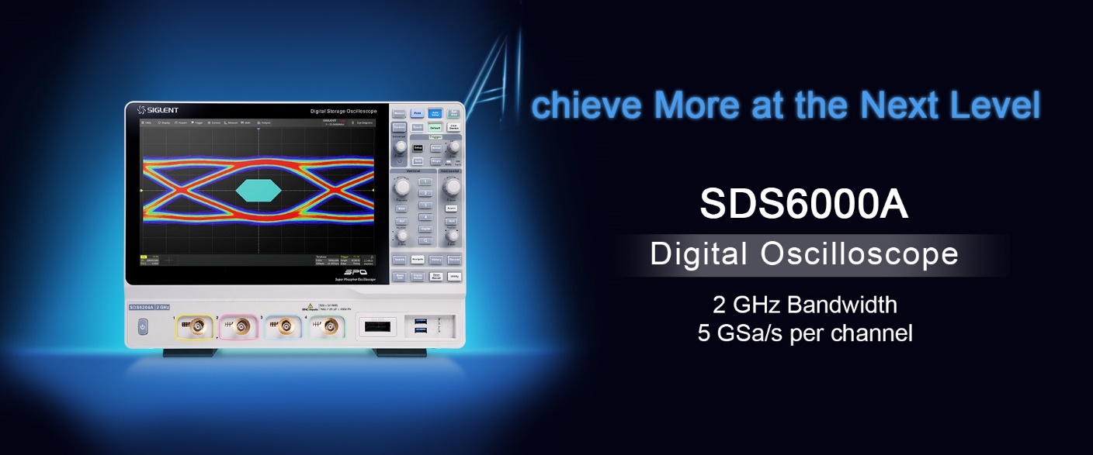
Notes:
banner

Slide 3
SDS6000A Series Digital Oscilloscope

Slide 4
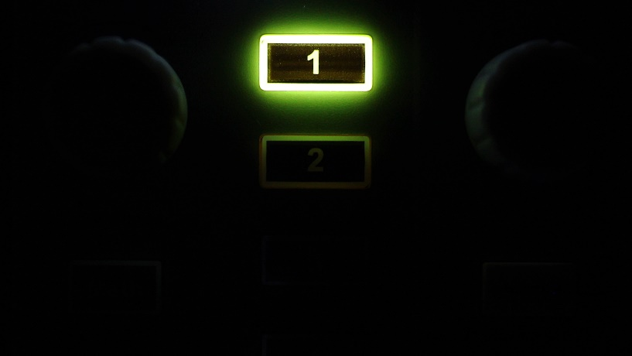
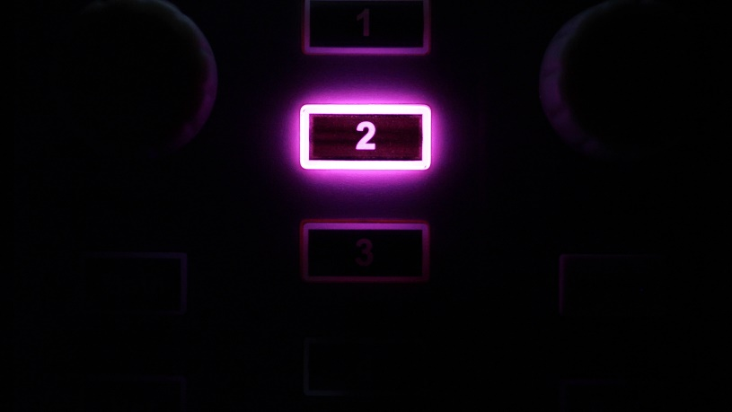
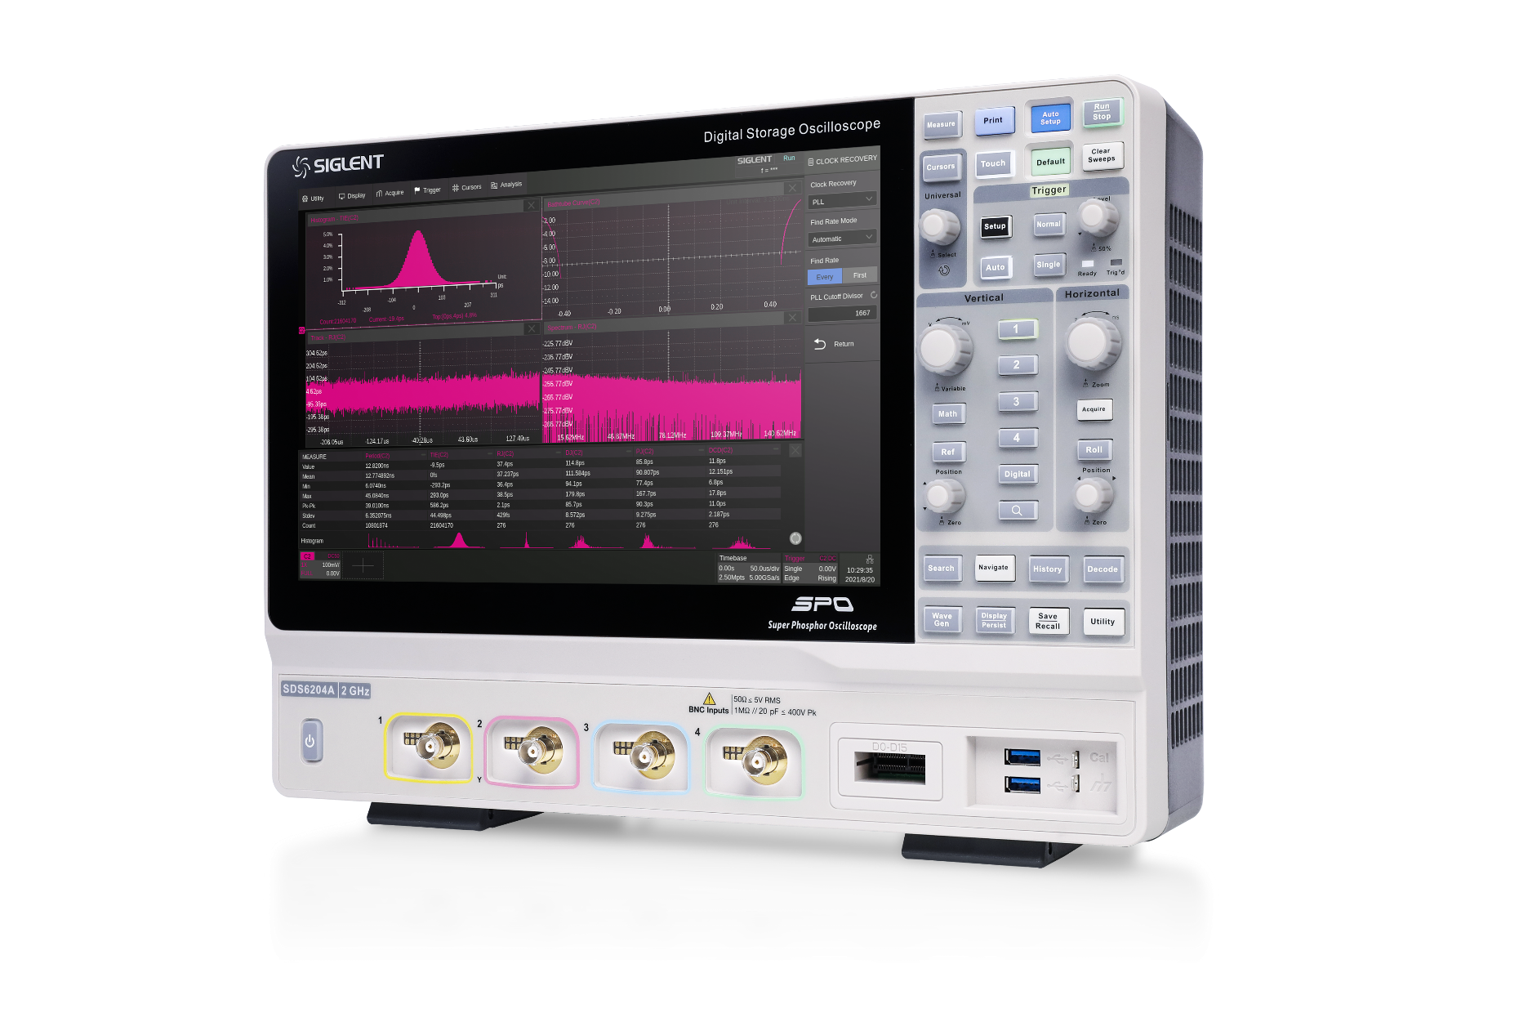
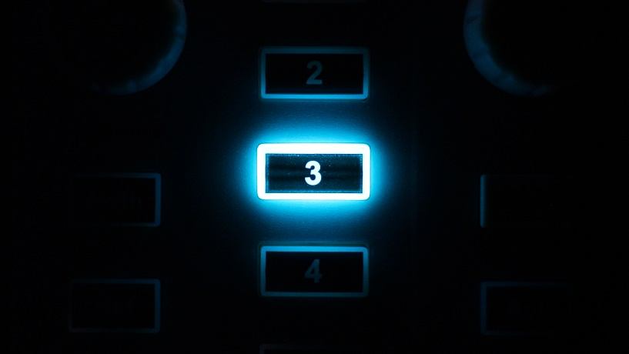
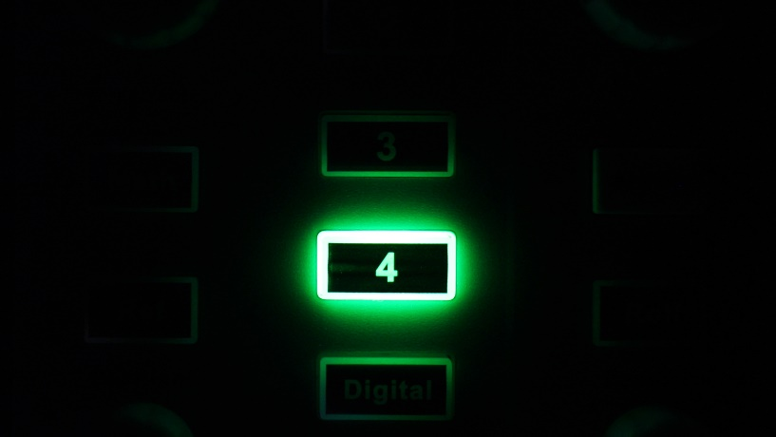
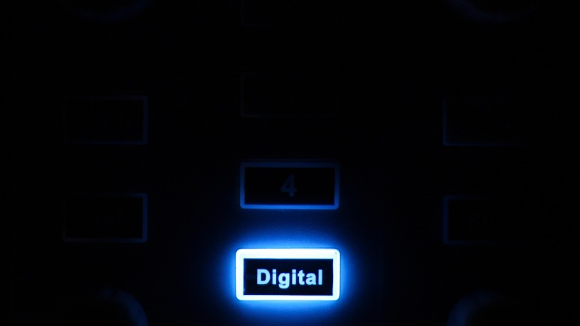


An upgraded touching feeling
New foot support design, more steady
New button and knob design, better touch feeling and response
New LED lights design, bright intensity can be adjusted

Slide 5
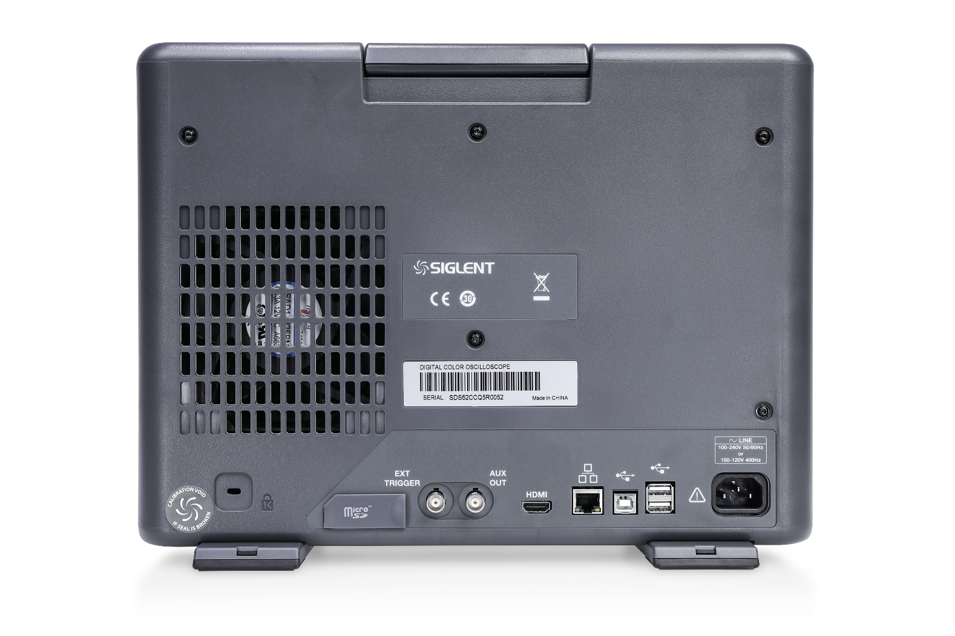
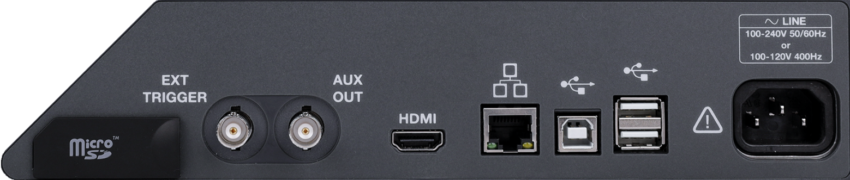
More storage and connection choices
Add Micro SD card, HDMI
2*USB3.0, 2*USB2.0 for fast storage, external keyboard and mouse
Remote web control
Notes:
Each SDS6000A unit come with a wireless mouse

Slide 6
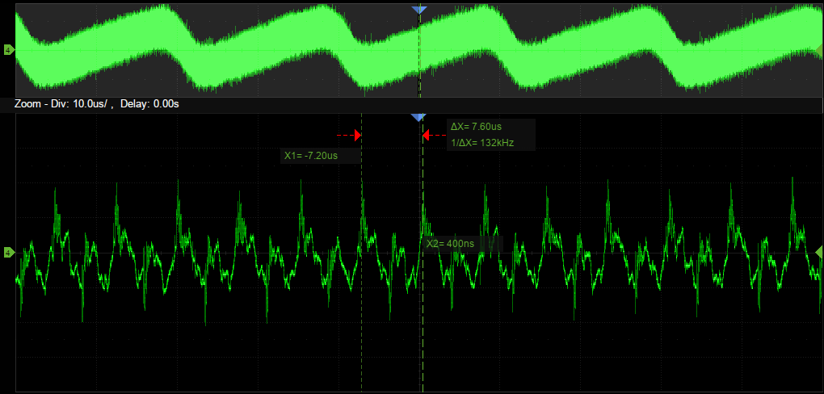
More details on a 12.1’’ big touch screen
Display resolution 1280*800 pixels
Backlight intensity adjustable
Hardware based vertical and horizontal zoom with 500Mpts deep memory, display signal details clearly on a big screen

Slide 7
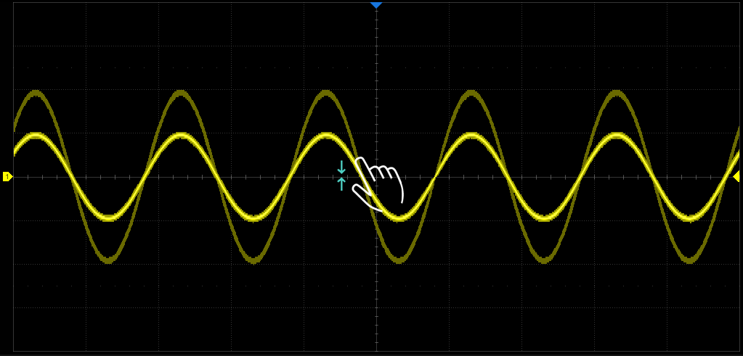
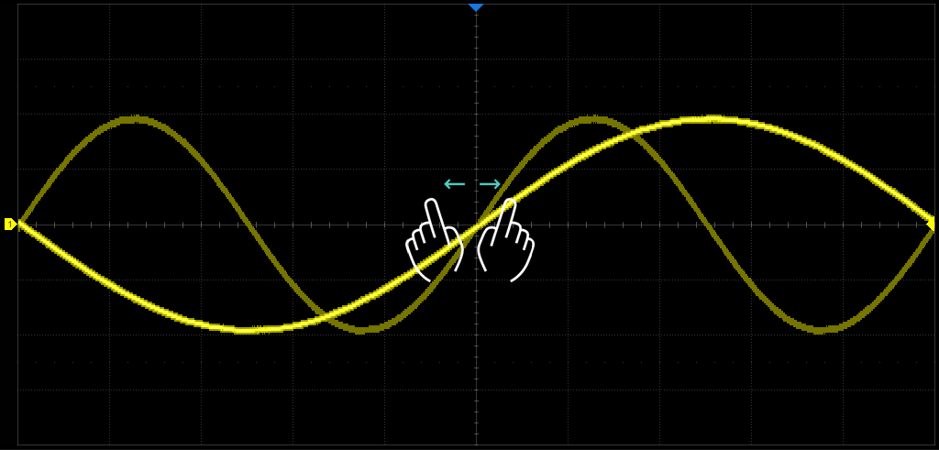
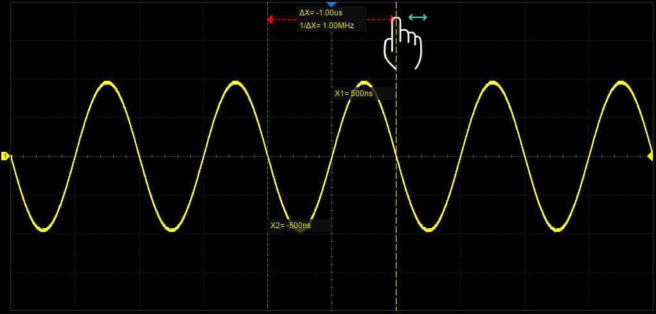
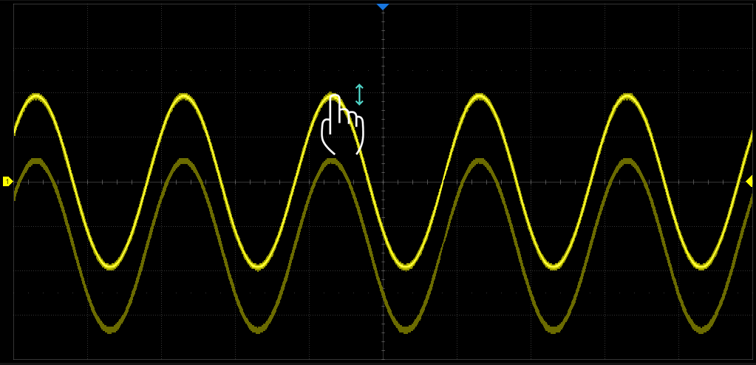
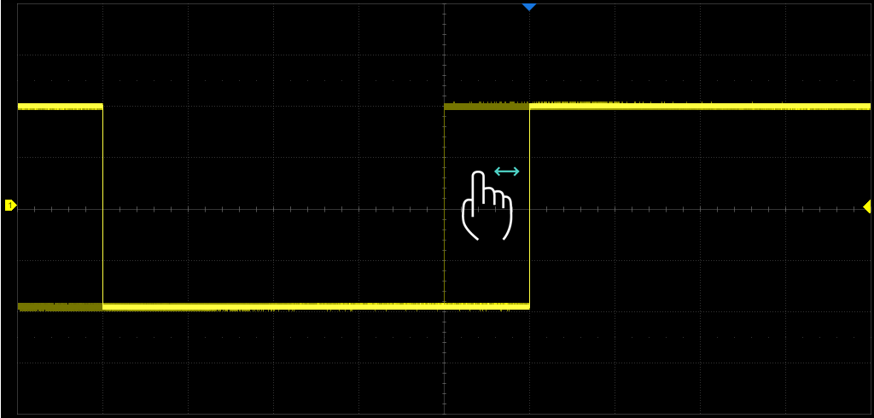
Multi-gesture control
Capacitive touch screen support multi-gesture control, adjust waveform settings quickly
Notes:
Very useful in FFT horizontal and vertical adjustment

Slide 8

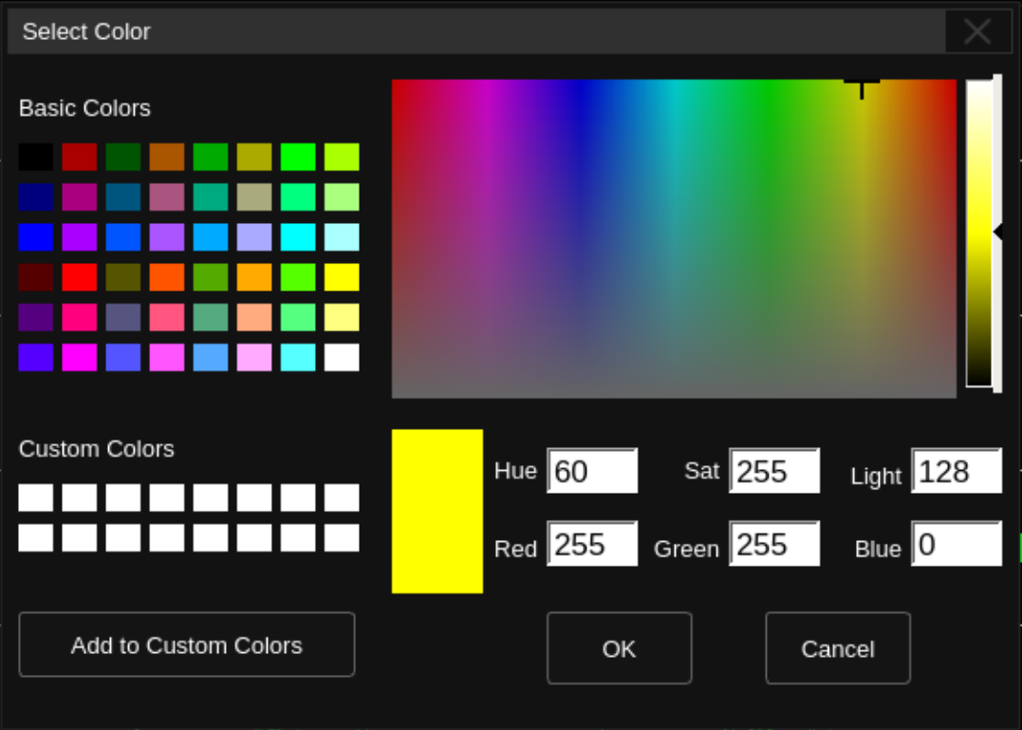
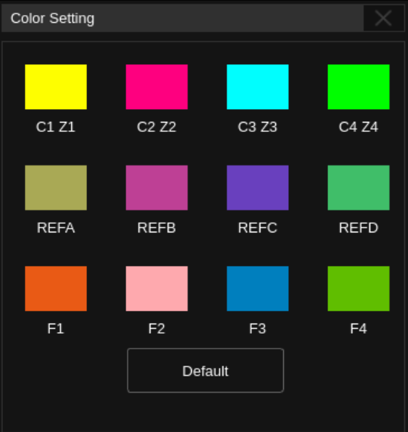
Customizable trace settings
Adjustable channel trace colors
Channels can be hidden but still available for MATH calculations

Slide 9
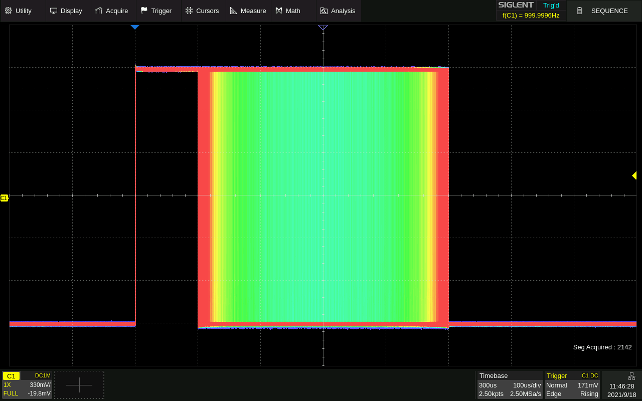
Well-implemented color display
Color temperature display easily show events probability.

Slide 10
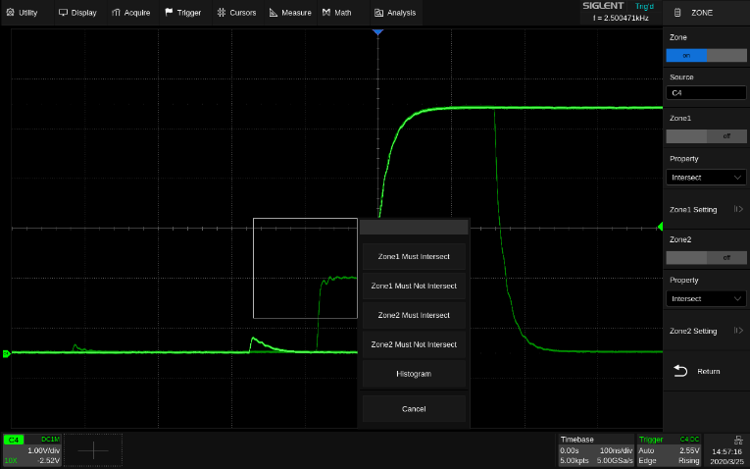
More waveform update rate
170,000 wfm/s waveform update rate capture unusual or low-probability events quickly
With Trigger Zone, easily trigger on whatever you can see

Slide 11
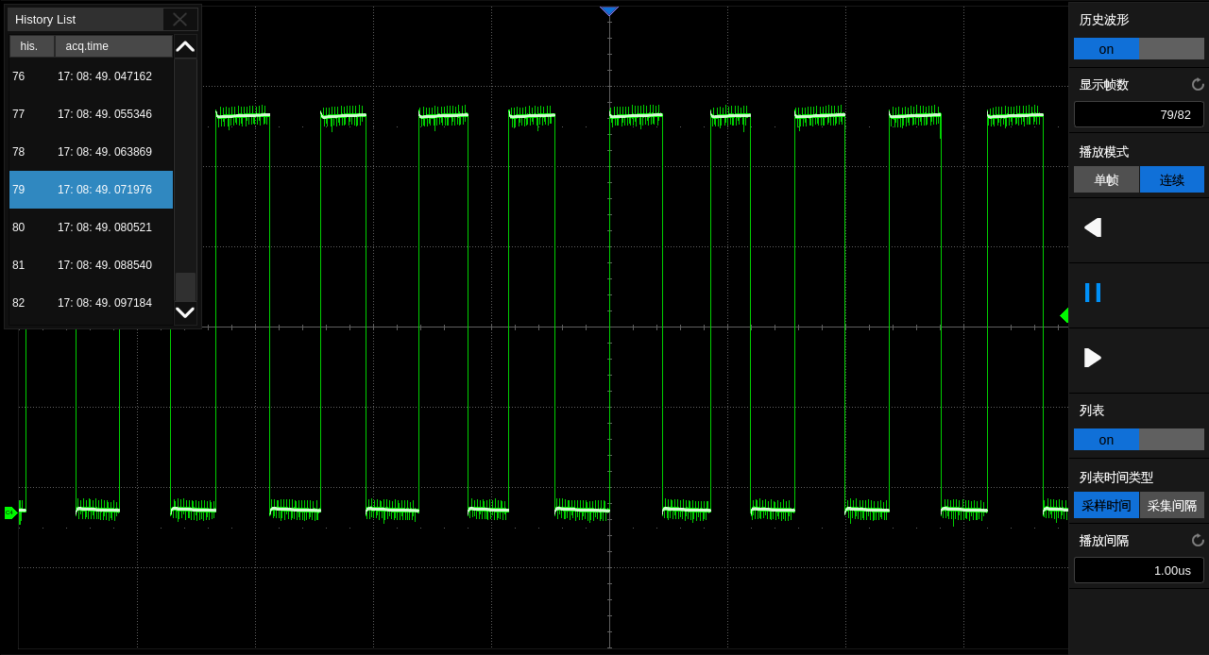
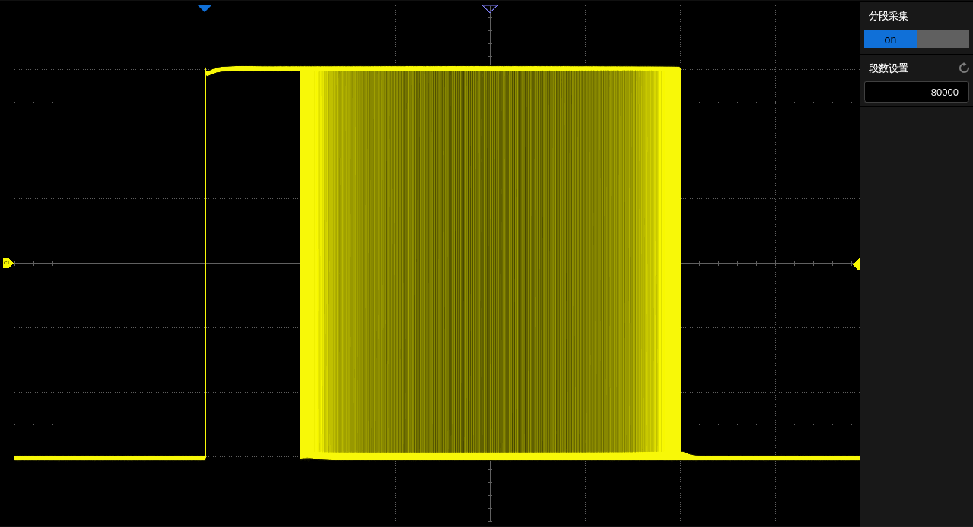
Sequence and History
With segmented memory, the waveform capture rate can reach 750,000 wfm/s. Dead time is as small as 1.3 us.
With always in background History function, up to 80,000 frames of waveforms can be recorded and played back to observe events of interest.

Slide 12
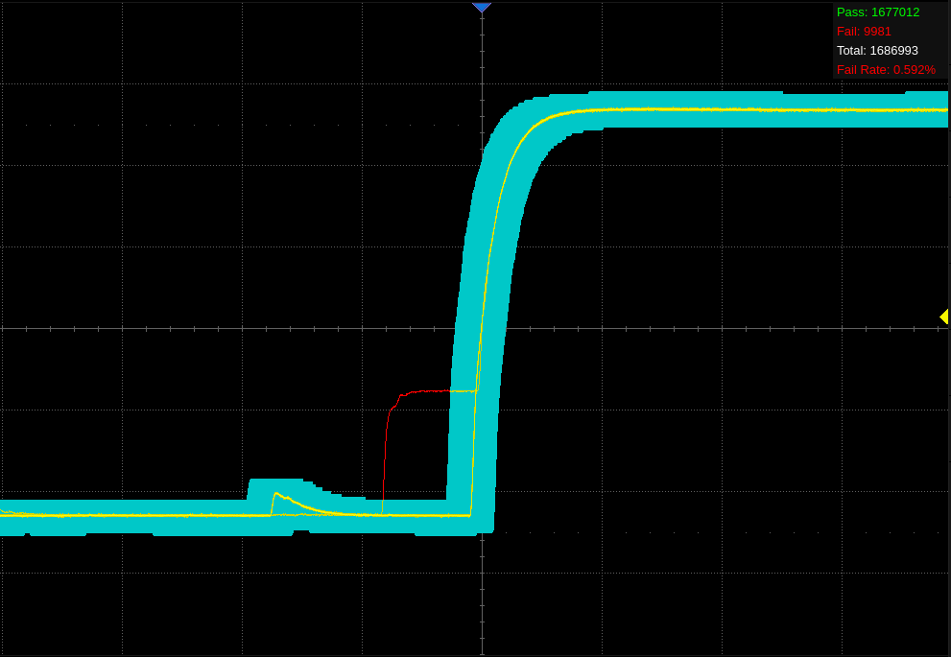
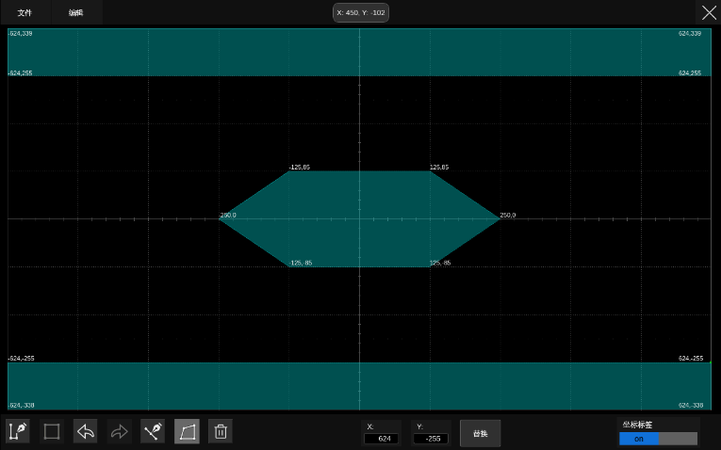
Hardware based Mask Test
The failed frames of Mask Test can also be stored as history.
Up to 18,000 Pass/Fail decisions each second.
Built-in Mask Editor application helps to create custom masks
Suitable for long-term signal monitoring or automated production line testing

Slide 13
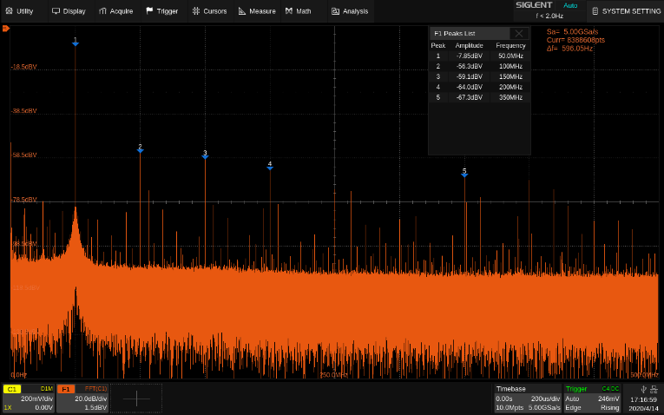
Hardware accelerated FFT
Up to 8Mpts FFT provides high frequency resolution with a fast fresh rate
Auto peak detection and markers are supported

Slide 14
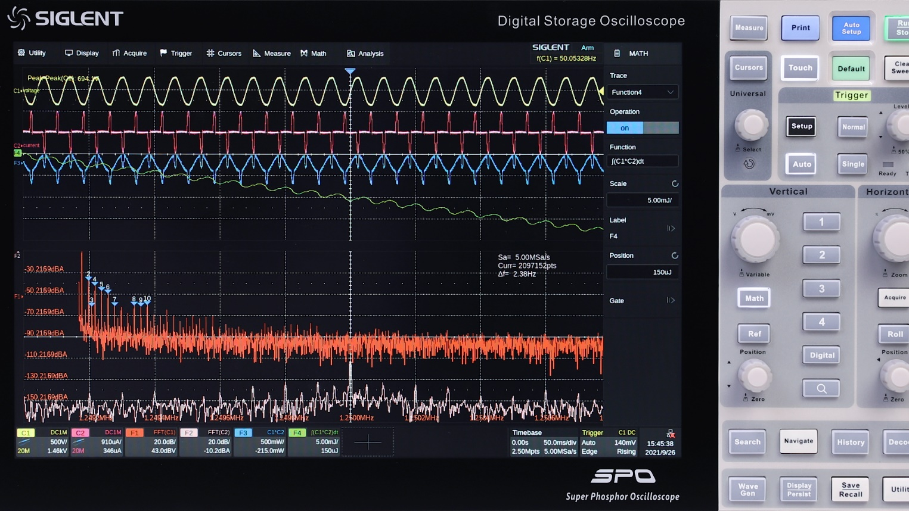
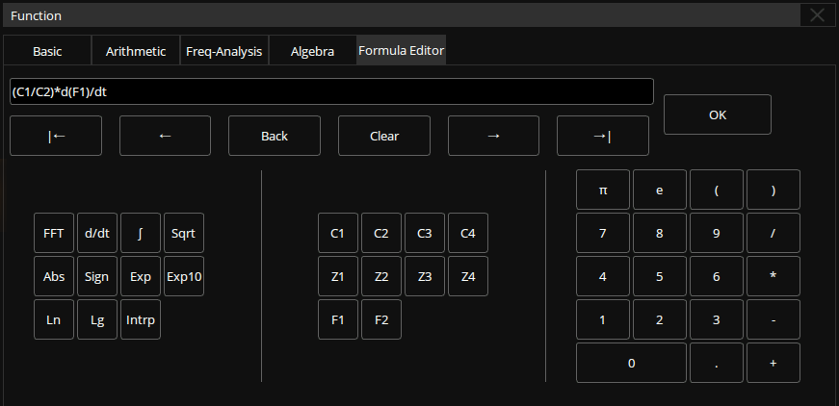
More powerful MATH processor
Maximum 4 math traces can meet most of today’s calculation requests
Formula Editor is available for more complex calculations

Slide 15
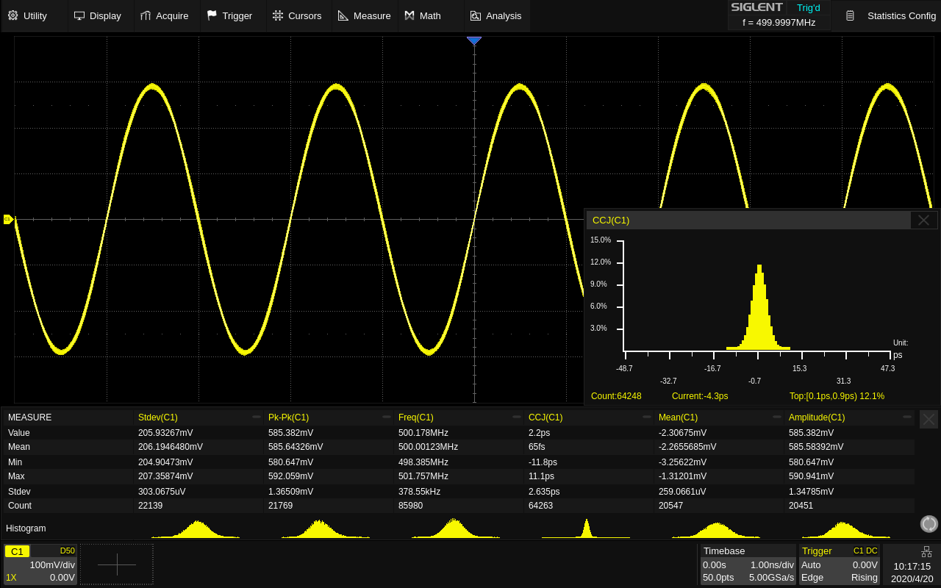
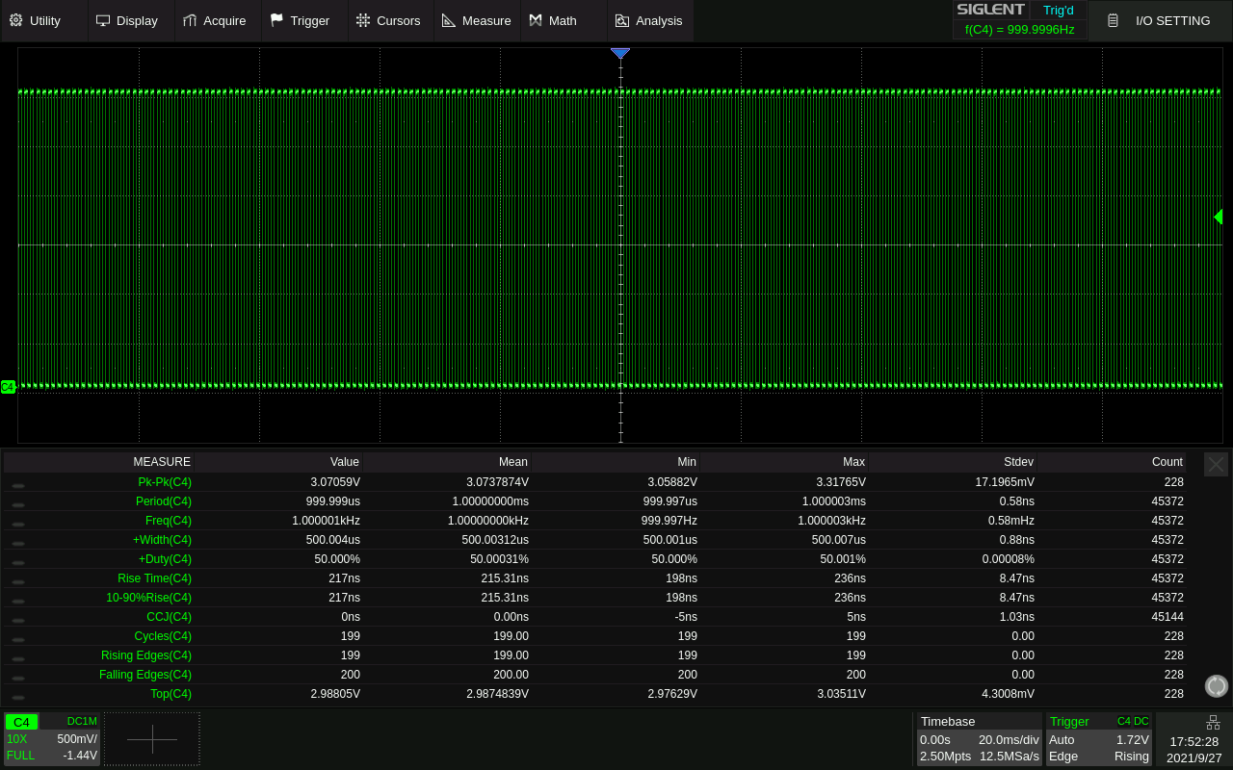
More measurement capability
Up to 12 parameters statistics can be showed simultaneously in M2 display mode
Histogram show the probability distribution of a parameter
Trend and Track show the parameter value vs. time
Notes:
Trend: Plot with one measurement value per second.
Track: Plot with all the measurement values in a frame.

Slide 16
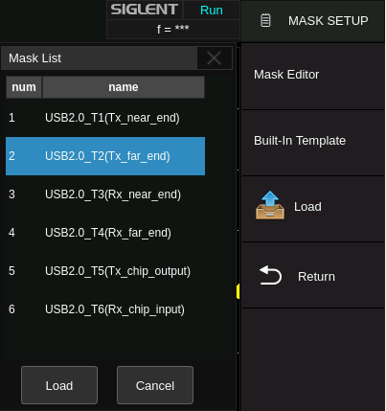
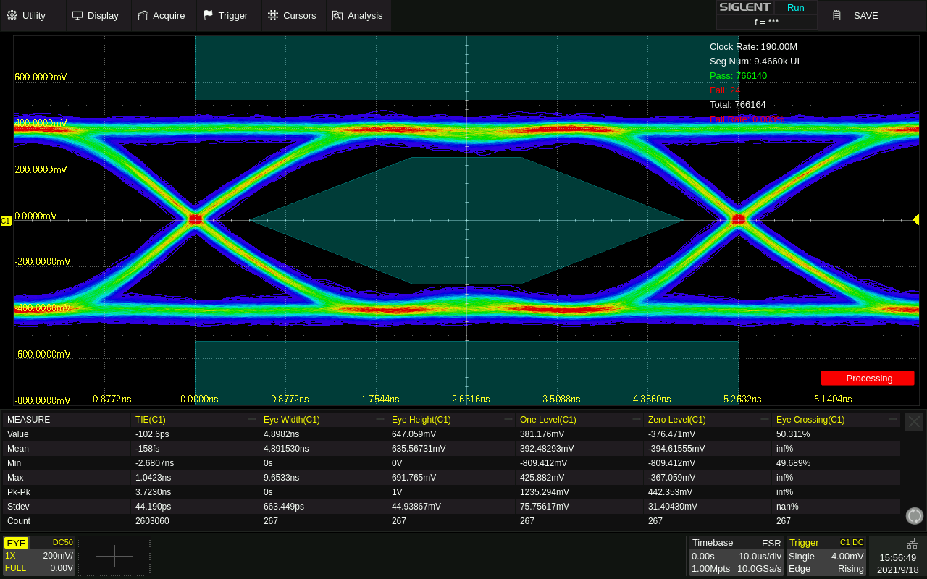
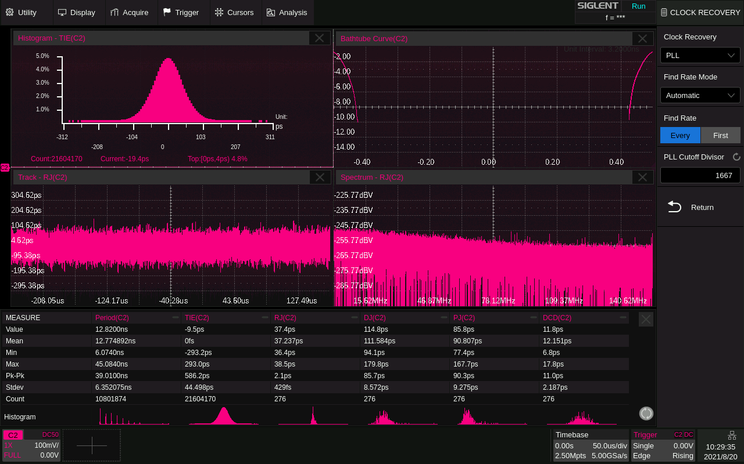
More analysis tools – Eye/Jitter Analysis
Automatically extract the embedded reference clock from serial data and create the eye diagram
Measurement on multiple eye/jitter parameters are provided
Mask test on the eye diagram is supported

Slide 17
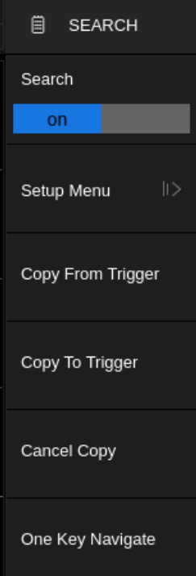
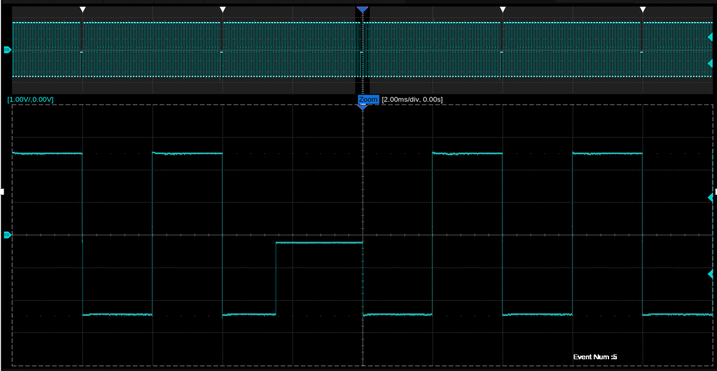
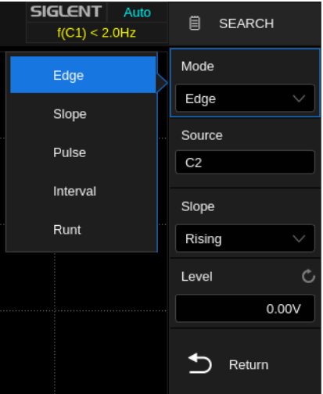
Search and Navigate
Several kinds of search conditions
One key to navigate

Slide 18
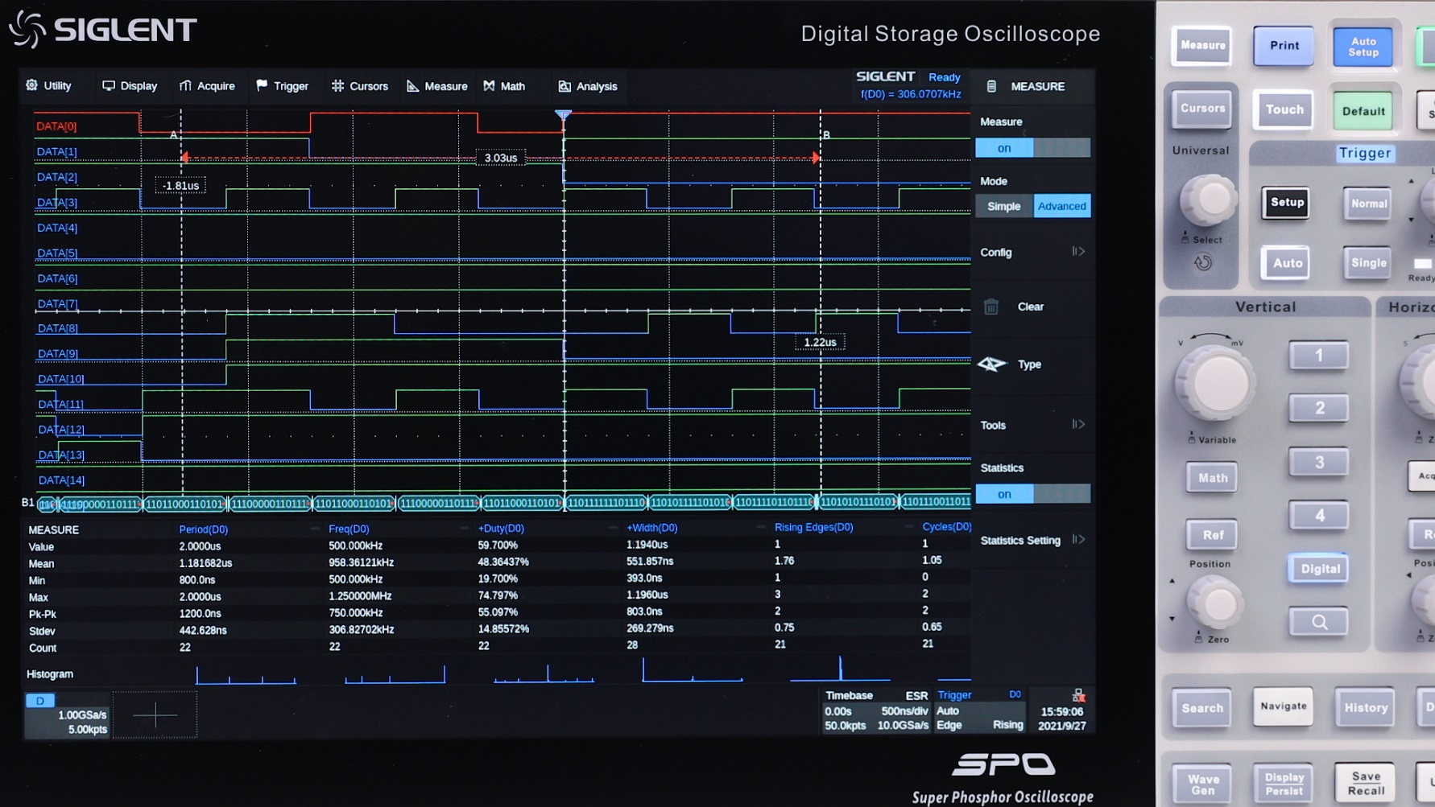
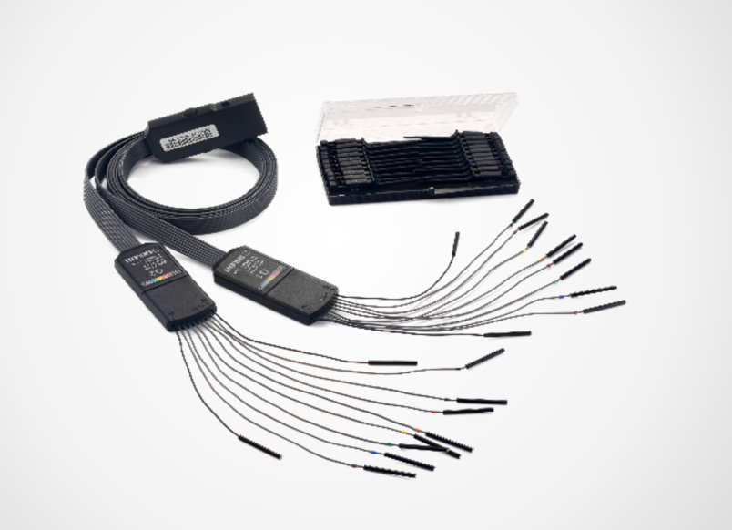
Digital Channels
16 digital channels can be used as source of MATH, Measurement

Slide 19
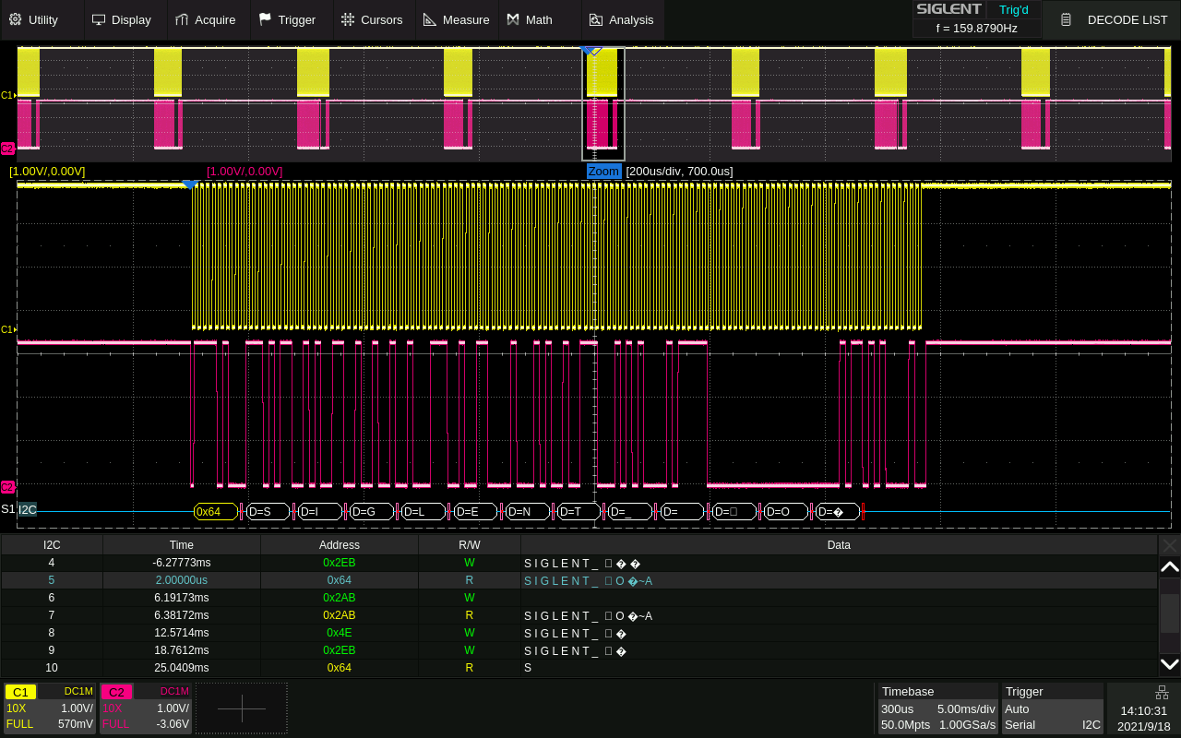
Serial bus decode
Standard: I2C, SPI, UART, CAN, LIN
Optional: CAN FD, FlexRay, I2S, MIL-STD-1553B, SENT and Manchester
Two buses can be decoded simultaneously

Slide 20
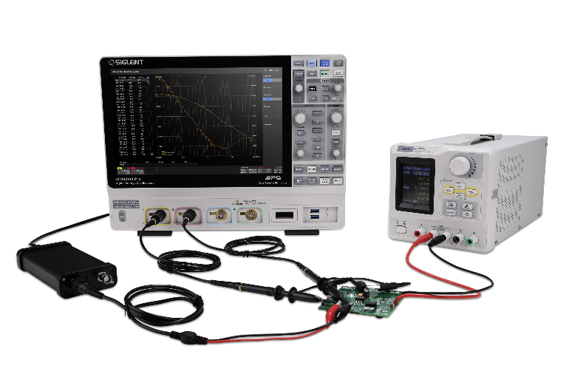
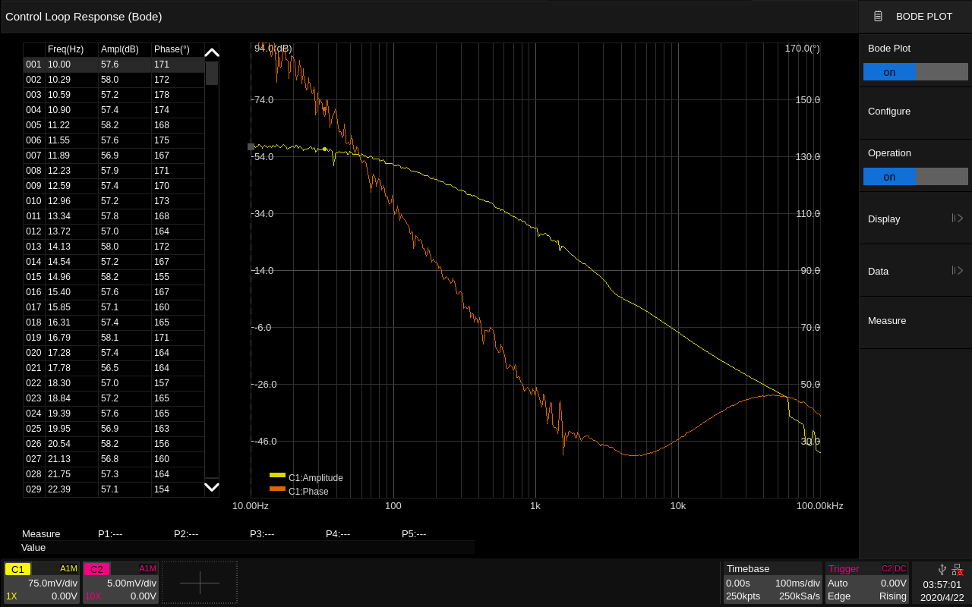
Standard bode plot
Work with isolated USB AWG module SAG1021I or a stand-alone SIGLENT SDG generator
Scan amplitude and phase frequency response of the DUT
Filter test, power supply control loop response measurement

Slide 21
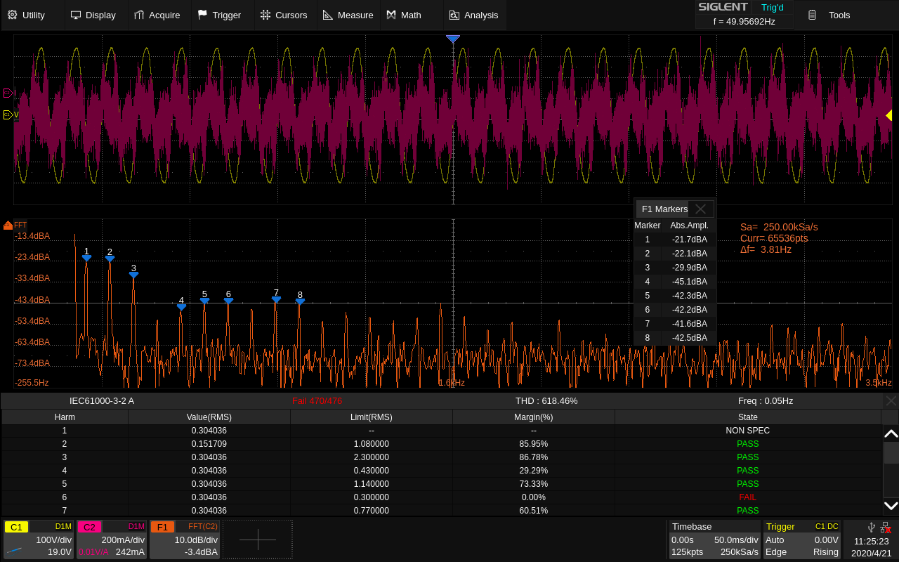
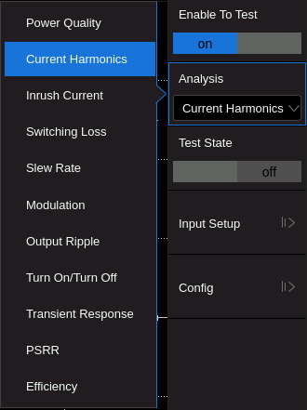
Power analysis
Greatly improve the measurement efficiency in switching power supplies and power devices design
Abundant voltage and current probes choices

Slide 22
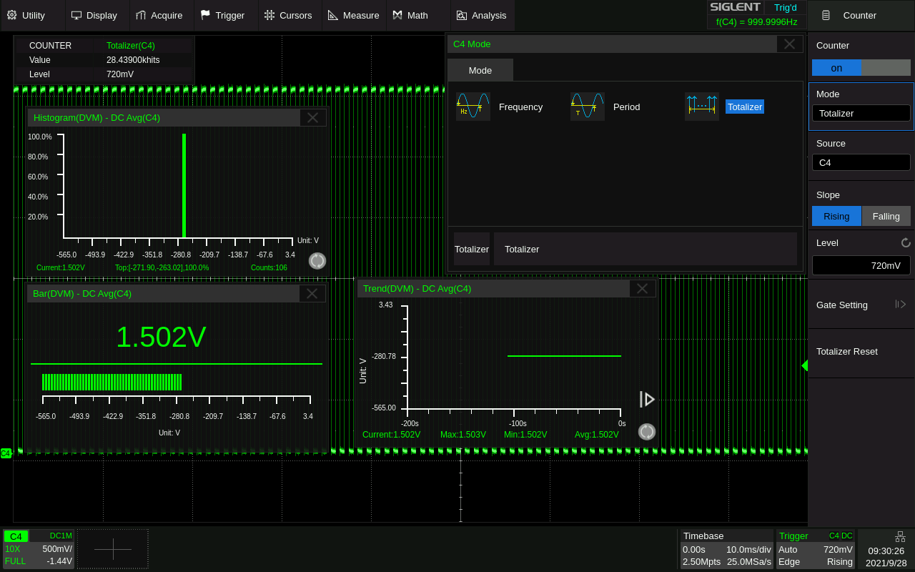
Other tools
DVM
Source: CH1~CH4
Mode: DC mean, DC RMS, AC RMS, Peak-peak, Amplitude
Plot: Bar, Histogram, Trend
Counter
Source: CH1~CH4
Frequency resolution: 7 digits
Totalizer: Counter on edges, supports Gate and Trigger

Slide 23
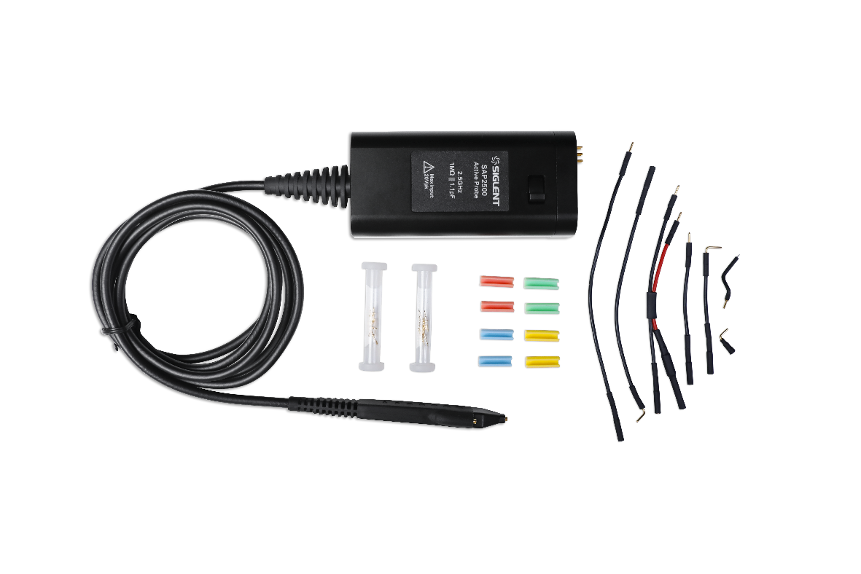
Newly designed probes
SAP2500 active probe, SAP2500D active differential probe

Slide 24
What’s more on SDS6000A?
 | SDS5000X | SDS6000A
Bandwidth | Up to 1 GHz | Up to 2 GHz
Sample rate | 5 GSa/s (Interleaved mode) | 5 GSa/s each channel
Memory depth | 250 Mpts (Interleaved mode) | 500 Mpts/ch(single-channel) 250 Mpts/ch (dual-channel) 125 Mpts/ch (3 or 4 channels)
Waveform capture rate | 110,000 wfm/s (Normal mode); 480,000 wfm/s(Sequence mode) | 170,000 wfm/s (Normal mode); 750,000 wfm/s(Sequence mode)
DC gain accuracy | ≤ 3.0% | ±1.5%
SFDR | ≥ 32 dBc | ≥ 45dBc
CH to CH Isolation (@50Ω) | DC ~ 100 MHz >40 dB; 100 MHz ~ BW: ≥34 dB | 70 dB up to 200 MHz 60 dB up to 500 MHz 50 dB up to 1 GHz 40 dB up to 2 GHz
Math functions | 2 traces | 4 traces
FFT | 2 Mpts | 8 Mpts
Eye diagram | No | Support
Jitter Analysis | No | Support
I/O | VGA | HDMI, micro SD card
Screen | 10.1’’ touch screen, 1024*600 | 12.1’’ touch screen, 1280*800

Slide 25
SDS6000A Competition Analysis

Slide 26
Brands | SIGLENT SDS6000A |  | KEYSIGHT 4000X Series
Bandwidth | 500MHz/ 1GHz/ 2GHz | √ | 200/350/500MHz/1GHz/1.5GHz | √
HiRes/ERES | HiRes up to 16-bit | √ | 12-bit (High Res) | X
Real-Time sample rate | 5GSa/s(10GSa/s ESR) @ each channel | √ | 5GSa/s(Interleaved) 2.5GSa/s(non-interleaved) | X
Memory depth | 500 Mpts/ch(single-channel) 250 Mpts/ch (dual-channel) 125 Mpts/ch (3 or 4 channels) | √ | 4Mpts/ch(Interleaved) 2Mpts/ch(non-interleaved) | X
Vertical scale | 500 uV/div ～10 V/div | √ | 1 mV/div ～5 V/div | X
Time scale | SDS6054A, 0.5 ns/div – 1000s/div; SDS6104A, 0.2 ns/div – 1000s/div; SDS6204A, 0.1 ns/div – 1000s/div | √ | 4052A,4054A: 1 ns/div to 50 s/div 4104A,4154A: 500 ps/div to 50 s/div | X
Time base Accuracy | ±2 ppm initial (0~50℃)； ±0.5 ppm 1st year aging； ±3 ppm 20-year aging | √ | ± 10 ppm | X
DC gain accuracy | ±1.5% | √ | 2% full scale | X
SFDR | ≥ 45dBc | √ | - | X
CH to CH Isolation (@50Ω) | 70 dB up to 200 MHz 60 dB up to 500 MHz 50 dB up to 1 GHz 40 dB up to 2 GHz | √ | 200 MHz~1 GHz: ≥ 40 dB from DC to maximum specified bandwidth of each model; 1.5 GHz: ≥ 40 dB from DC to 1 GHz, ≥ 35 dB from 1 to 1.5 GHz | X
FFT | 8 Mpts | √ | 64 kpt | X
Sequence | Up to 80,000 segments, interval between triggers = 1.3 μs min. | √ | 1000 segments | X
History | Up to 80,000 frames | √ | No | X
Automatic Measurements parameters | 50+ parameters | √ | 36 | X
Mask test | Up to 18,000 frames/s | √ | Option | X
Waveform Histogram | Horizontal, Vertical, Both | √ | No | X
Digital multimeter | 4 digits, CH1~CH4; Bar, Histogram, Trend | √ | 3-digit | X
Bode plot | Vari-Level, 10 Hz~120 MHz | √ | Support | √
Counter | 7 digits, totalizer(Counter on edges, supports Gate and Trigger) | √ | 5-digit frequency or period counter (8 digits with external 10 MHz clock reference) | X
I/O | USB 3.0 Host x2,USB 2.0 Host x2,USB 2.0 Device,LAN,micro SD card, HDMI, External trigger,Auxiliary output (TRIG OUT,PASS/FAIL) | √ | USB Host& Device, LAN, AUX (Pass/Fail, Trigger Out), video (GPIB option) | X
Screen | 12.1 capacitive touch screen, 1280*800 | √ | 12.1 capacitive touch screen 800*600 | X
Starting price(500MHz) | $9,880 | √ | $16,465 | X

Slide 27
Thank You
The Best Value in Electronic Test & Measurement
Headquarters
NA
Europe
SIGLENT TECHNOLOGIES CO., LTD.
Add: Blog No.4 & No.5, Antongda Industrial Zone, 3rd Liuxian Road,
Bao’an District, Shenzhen, 518101, China.
Tel:+ 86 755 3688 7876
Fax:+ 86 755 3359 1582
sales@siglent.com
www.siglent.com/ens
SIGLENT Technologies NA, Inc.
Add: 6557 Cochran Rd Solon, Ohio 44139 Tel: 440-398-5800 Toll Free:877-515-5551 Fax: 440-399-1211
info@siglent.com www.siglentna.com
SIGLENT TECHNOLOGIES GERMANY GmbH
Add: Liebigstrasse 2-20, Gebaeude 14, 22113 Hamburg Germany Tel: +49(0)40-819-95946
Mobile: +49 151 40716756 Fax: +49(0)40-819-95947 info-eu@siglent.com www.siglenteu.com

