Slide 1

Notes:
Slogan change

Slide 2
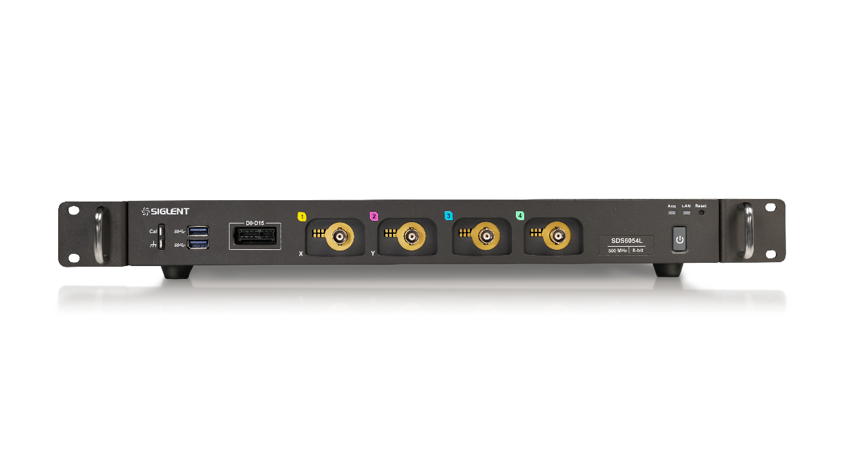
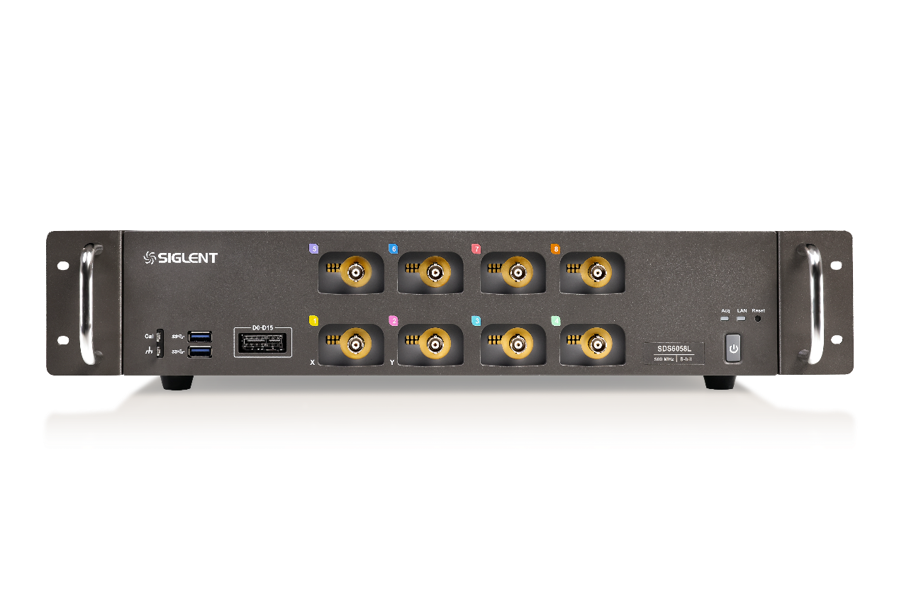
SDS6000L Low Profile Digital Oscilloscope
1U
4/8+EXT Channels
Up to 2 GHz bandwidth
12-bit resolution (ERES mode）
10 GSa/s/CH (ESR) sample rate
Up to 500 Mpts/CH (Single-Channel）
Up to 750,000 wfm/s (Sequence mode)
2U
Notes:
Up to 12-bit in ERES mode, equivalent to 16-bit Hi-Res mode
ESR: Enhanced Sample Rate provides better measurement accuracy by using 2x interpolation

Slide 3
Bench VS. Low Profile
Low profile oscilloscopes
Content
Brief Introduction of SDS6000L
Comparison
Notes:
目录字体放大

Slide 4
PART ONE
01
Bench VS. Low Profile
What are these differences between low profile oscilloscopes and traditional bench oscilloscopes?

Slide 5
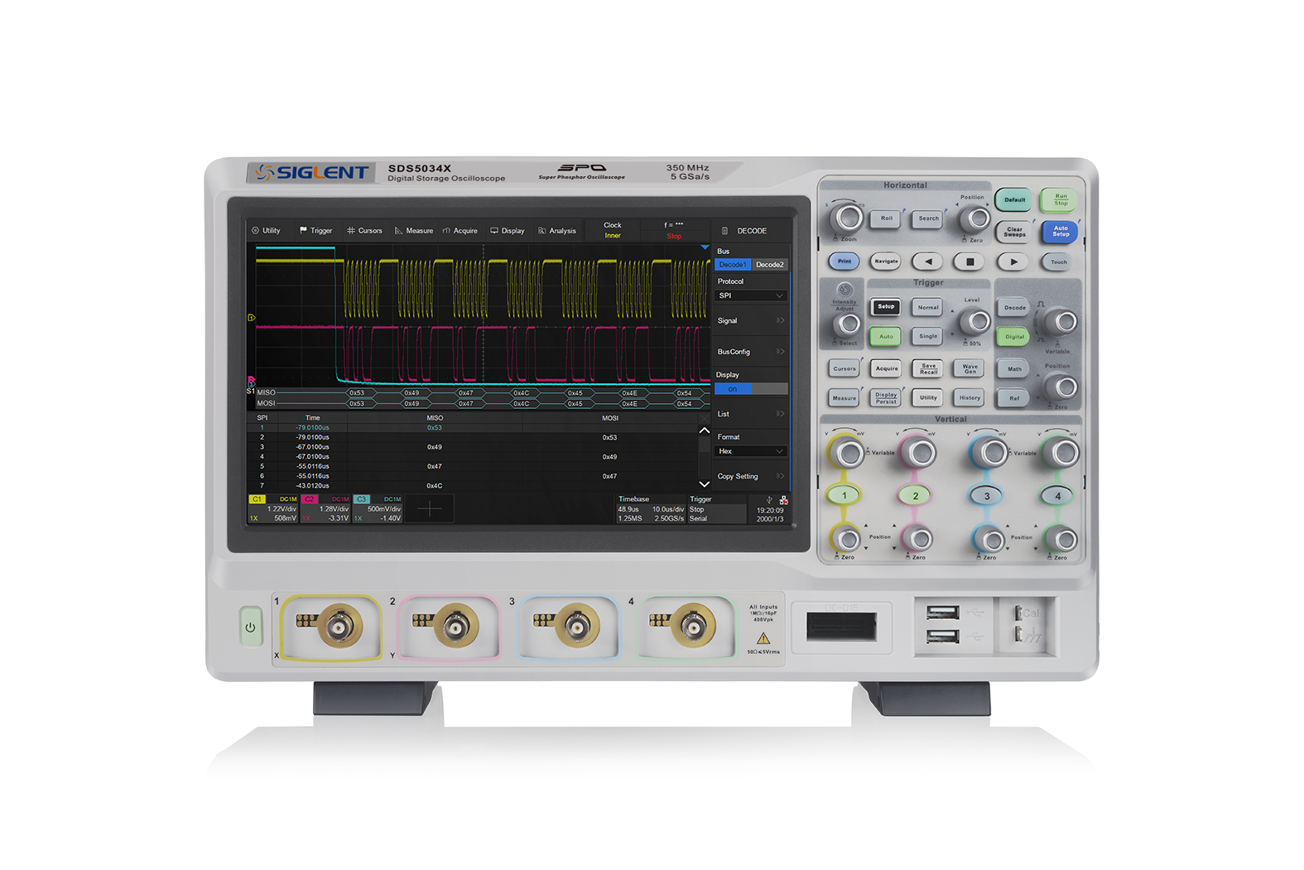
Bench
Large-size desktop models
daily testing requirements
Notes:
目录字体放大

Slide 6
Low Profile
Low profile and small size
More channels. No limitations.
Stack-Up your bench…
Notes:
目录字体放大

Slide 7
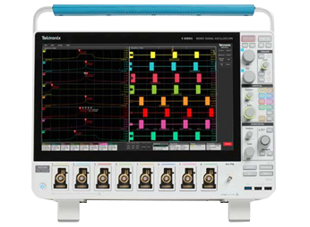
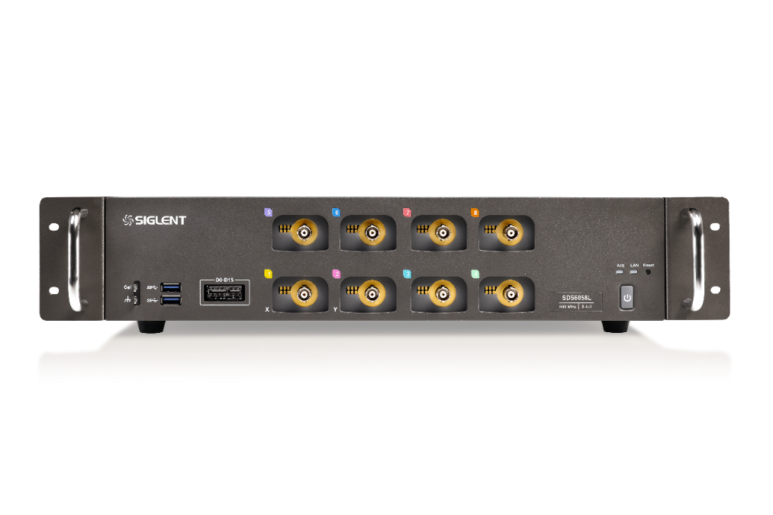
What’re these differences?
“Traditional Bench”
“Low Profile”
7U
1U/2U
8 channels
(Max.)
512 channels (Max.)
Traditional operation
Designed for expansion、Remote control
Compared to low profile oscilloscopes, traditional bench oscilloscopes have a single large size, limited number of channels, can not be integrated control and other limitations…
Notes:
目录字体放大

Slide 8
PART TWO
02
Low Profile Oscilloscope
Stack-Up Your Bench

Slide 9
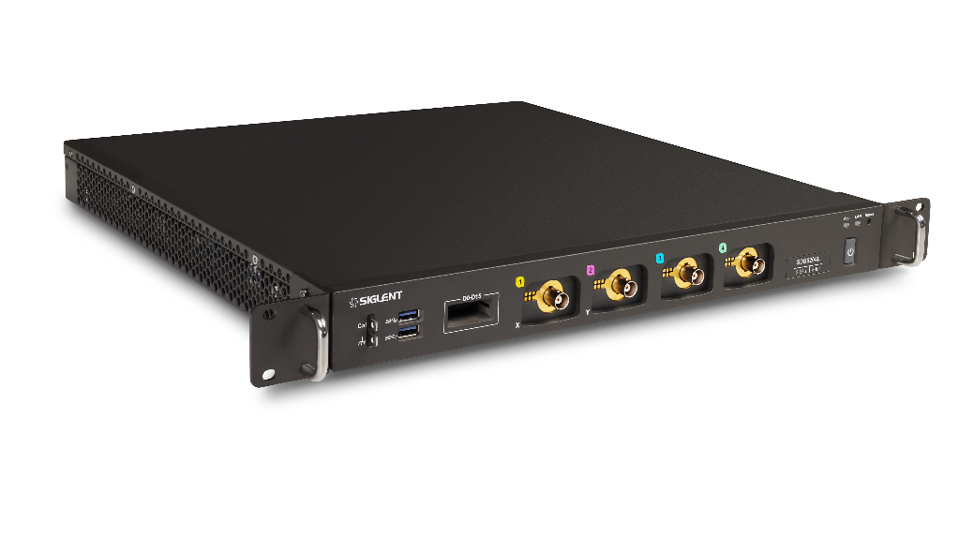
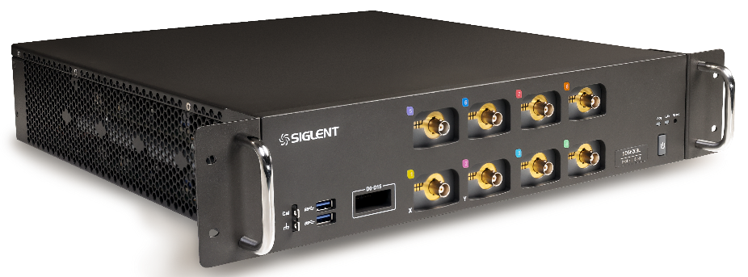


Low profile Oscilloscope
Stack-Up Your Bench
SDS6000L 1U for 4-channal; 2U for 8-channel
More channels. No limitations.
Remote access / control
43mm
86mm
414mm
414mm
395mm
395mm
Notes:
目录字体放大

Slide 10
Low profile Oscilloscope
Stack-Up Your Bench
More channels. No limitations.
SDS6000L Flexible Multi-channel High-speed Acquisition System
Remote access / control
Up to 512 2GHz analog channels
Up to 1024 digital channel
Notes:
目录字体放大

Slide 11
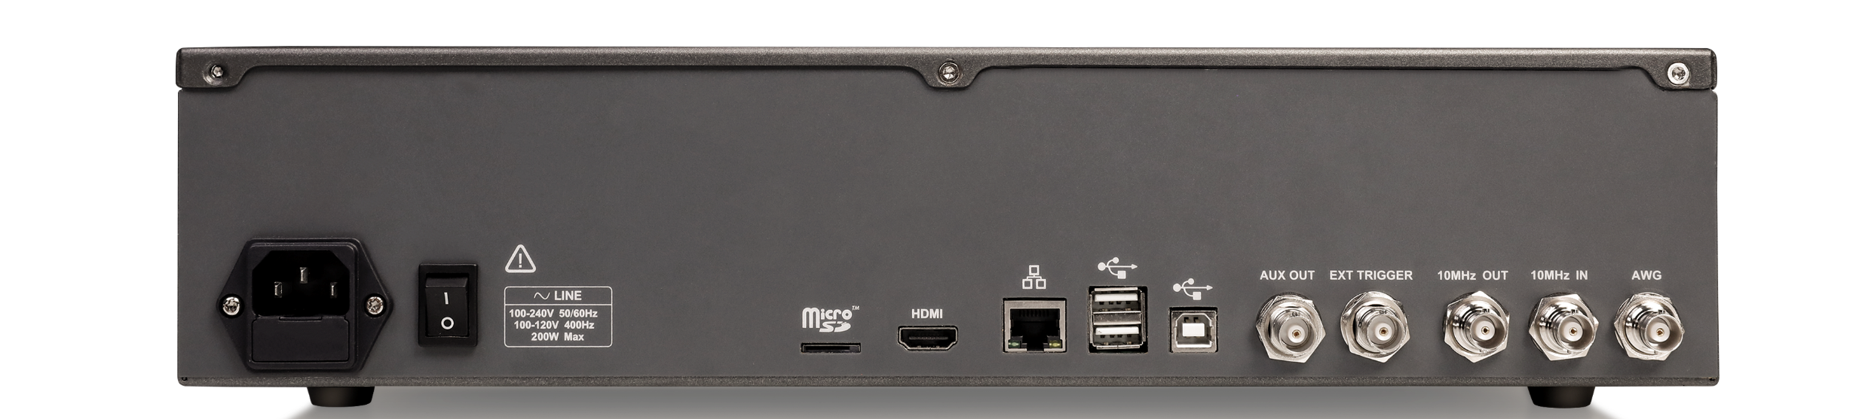
Low profile Oscilloscope
Stack-Up Your Bench
More channels. No limitations.
Remote access / control
Webserver for Web and VNC remote control; SCPI support for automated test environments
Notes:
目录字体放大

Slide 12


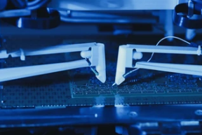
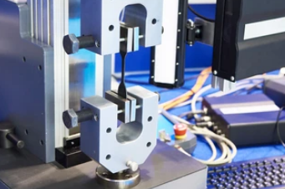

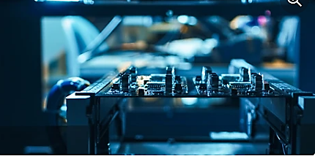
Applications of Low profile Oscilloscope
The SDS6000L is ideal for Mid-market applications that require high analog channel count .
• Manufacturing test engineering
• System Level debug – Siemens, Cisco, Nokia, Juniper, Ciena, Auto
• Pure science - Energy, Power Designer
• Software automation engineer
• Power electronic designer
• System integration engineer
• PCB manufacturing
…for this, SDS6000L provides the perfect solution.
Notes:
目录字体放大

Slide 13
PART THREE
03
Brief Introduction
Performance parameters and specific advantages of SDS6000L

Slide 14
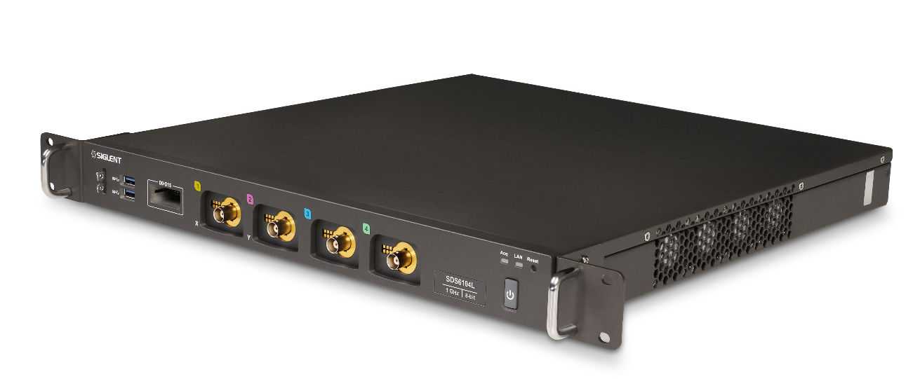

SDS6000L Low profile Digital Oscilloscope
Main Parameters
4/8+EXT channels
500 MHz, 1 GHz, 2 GHz models
8-bit resolution (up to 12-bit in ERES mode)
10GSa/s/CH (ESR)
1U for 4-channel; 2U for 8-channel
Design Features
Up to 512 channels with flexible networking
  Memory length up to 500 Mpts(single channel)
Segmented acquisition (Sequence) mode, up to 750,000 wfm/s
Low background noise, supports 0.5 mV/div to 10 V/div vertical scales
1.5% DC gain accuracy

Slide 15
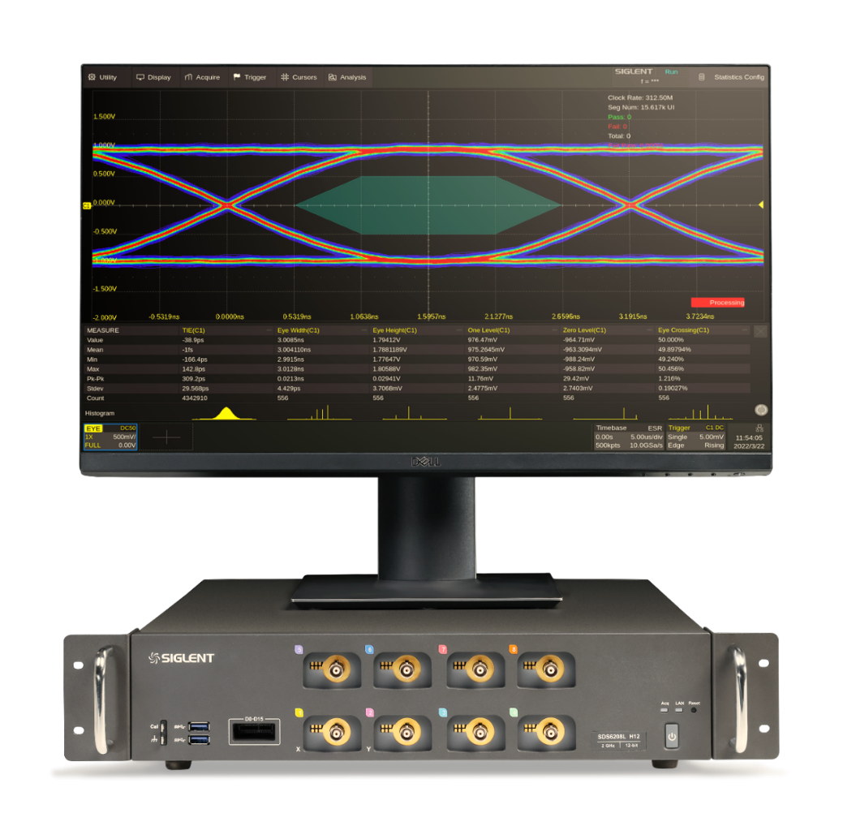

SDS6000L Low profile Digital Oscilloscope
Multiple Functions
Automatic measurements on 50+ different types and 12 parameters
4 Math traces
History, Search, Navigate and Histogram modes
Built-in Digital Voltmeter and 7 digits Frequency resolution
Serial bus triggering and decoder
Hardware-based Mask Test
Optional
Jitter Analysis
Eye Diagram
Power analysis
Waveform Generator(25 MHz )
MSO function(16-channel)

Slide 16
Main Parameters
Design Features
Multiple Functions
Optional
SDS6000L Main Specs
Model | Channel | Bandwidth | Resolution | Sampling Rate | Memory Depth | Dimensions
SDS6208L | 8+EXT | 2 GHz | 8-bit (up to 12-bit in ERES mode) | 10GSa/s/CH (ESR) | 500 Mpts/ch （Single-Channel） 250 Mpts/ch (Dual-Channel) 125 Mpts/ch (Four-Channel) | 1U for 4-channel 2U for 8 channel
SDS6204L | 4+EXT
SDS6108L | 8+EXT | 1 GHz |  | 2 GSa/s | 200 Mpts
SDS6104L | 4+EXT
SDS6058L | 8+EXT | 500 MHz
SDS6054L | 4+EXT | 350 MHz |  | 2 GSa/s | 200 Mpts

Slide 17
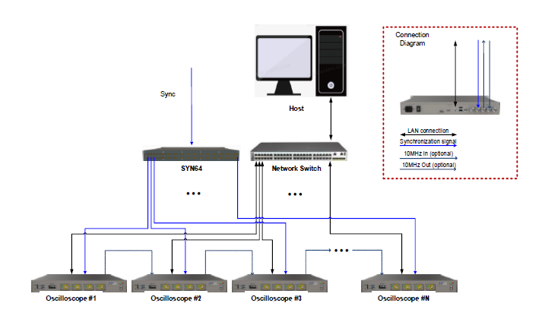
Main Parameters
Design Features
Multiple Functions
Optional
Flexible networking for a wide range of applications
Multi-channel acquisition system
Multiple units are combined to create a high-speed acquisition system with up to 512 channels
The host can access each unit over 1000M LAN
Sample clocks are synchronized between all units by cascading the 10 MHz In and 10 MHz Out clocks in a daisy chain
(Standard sizes: 4-channel models–1U, 8-channel models–2U)

Slide 18
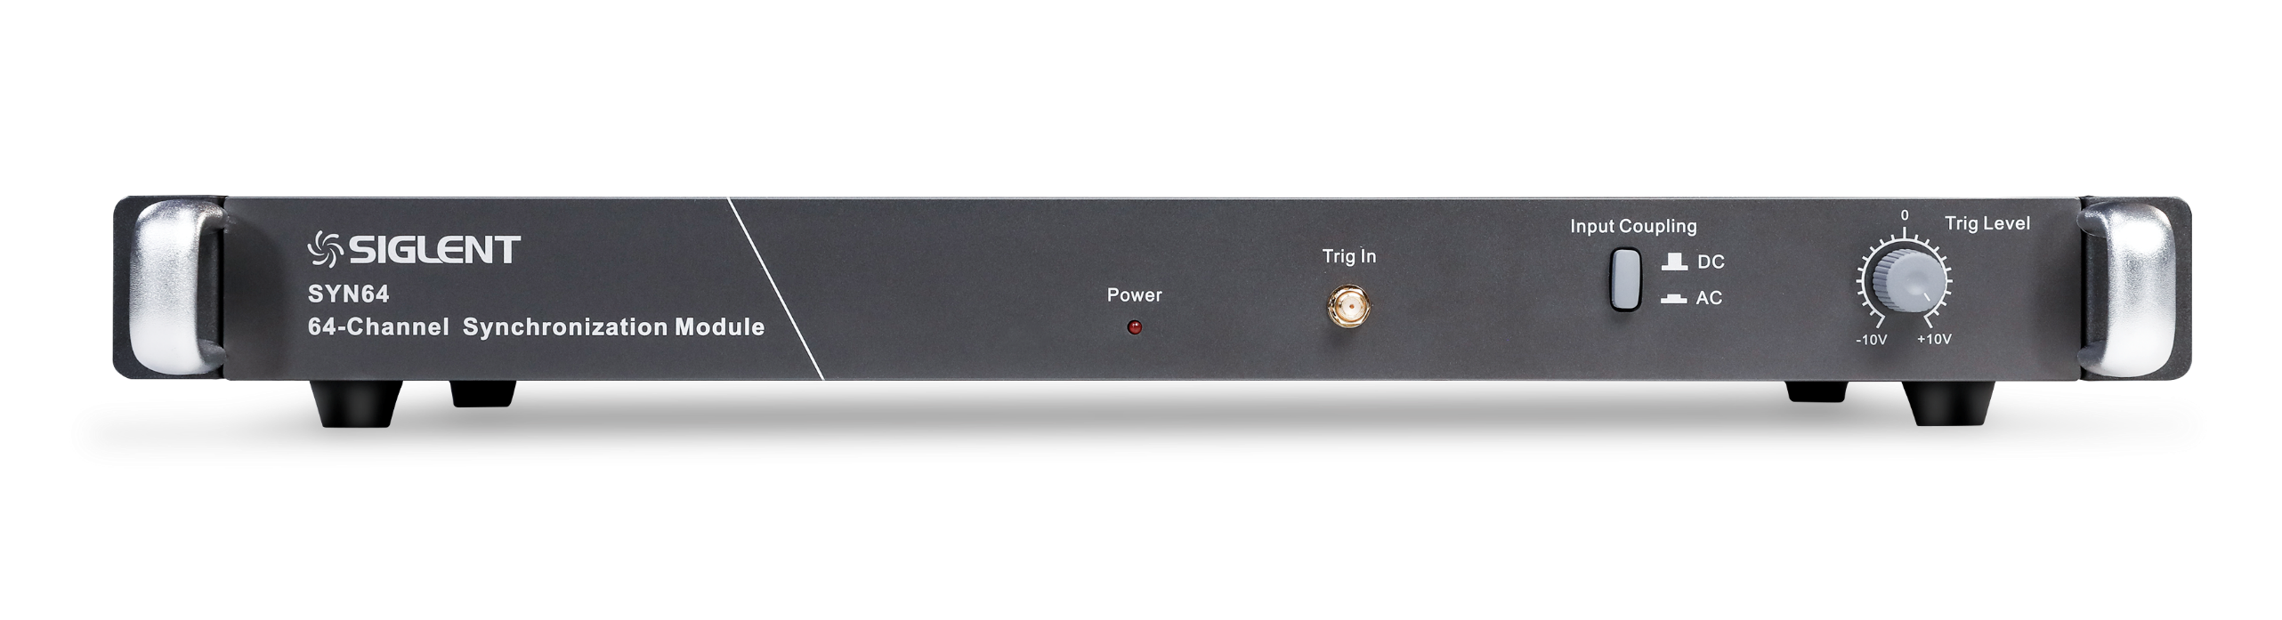
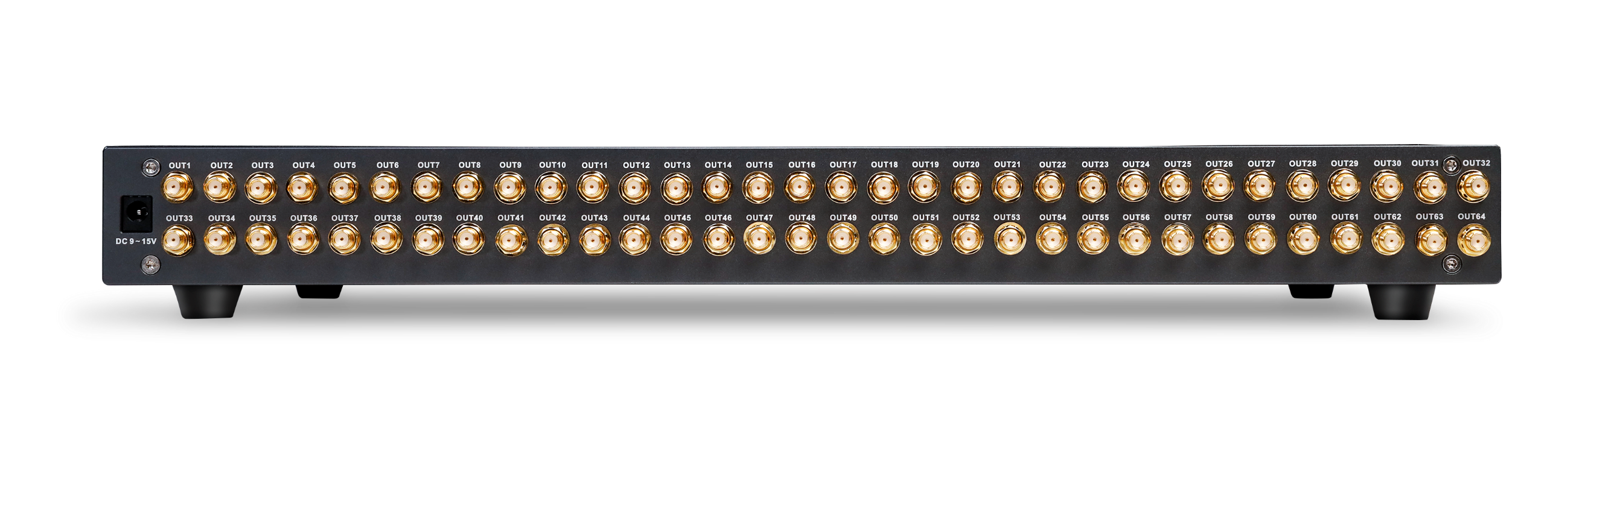
Main Parameters
Design Features
Multiple Functions
Optional
SYN64 synchronous module
Input of Calibration signal or Trigger signal
64 output channels connected to SDS6000L EXT TRIGGER port

Slide 19
Main Parameters
Design Features
Multiple Functions
Optional
High-fidelity data capture for a more complete signal
Deep Record Length
Memory length up to 500 Mpts/ch
Quickly zoom in to focus on the area of interest without compromising the sample rate
High Waveform Update Rate
The waveform capture rate can reach 750,000 wfm/s in Sequence mode
Oscilloscope can easily capture unusual or low-probability events

Slide 20
Main Parameters
Design Features
Multiple Functions
Optional
Zone Trigger
Quickly define trigger zones and isolate faults
Traditional trigger types can take time to configure for complex trigger conditions
With Zone Triggering, simply draw a zone and select Intersect or Not Intersect

Slide 21
Main Parameters
Design Features
Multiple Functions
Optional
Advanced Math Functions
Calculate power, energy, and more using the powerful equation editor
No differential probe?
No problem. Simply use the subtract
operator so simulate a differential circuit
Multiple kinds of operators, including derivative and integral
Formula editor for advanced modifications of signals

Slide 22
Main Parameters
Design Features
Multiple Functions
Optional
Hardware Accelerated FFT
High frequency resolution with fast refresh rate
Up to 8 M FFT points provides high frequency resolution with fast refresh rate.
A variety of window functions adapt to different spectrum measurement needs.
Three modes (Normal, Average and Max hold) can satisfy different requirements for observing the power spectrum.
Auto peak detection and markers are supported.

Slide 23
Main Parameters
Design Features
Multiple Functions
Optional
Automatic measurements
Automatic measurements on 50+ different types and 12 parameters
Measurement function
Measurement types include horizontal, vertical, inter-channel delay and mixed measurement types with over 50 parameters
Statistics function
Parameter statistics function can display five kinds of measured values of any parameter
12 different parameters can be measured and counted at the same time

Slide 24
Main Parameters
Design Features
Multiple Functions
Optional
Powerful debugging tools
Segmented memory
  Save memory
  Up to 80,000 segments
  Interval between segments as small as 1.3 µs
Background running History
  Serial Decode, Zoom, and cursors measurements can be used
  Records up to 80,000 triggered waveforms
Search and Navigate
  Easily find events within a record and history based on user specified trigger conditions
  Useful in zoom view
Sequence mode
History
Search and Navigate

Slide 25
Main Parameters
Design Features
Multiple Functions
Optional
Wide range of Serial Decoders
Help to debug in various industries
Display the decoded characters through the events list.
Bus protocol information can be quickly and intuitively displayed in tabular form.
I2C, SPI, UART,CAN, LIN, CAN FD, FlexRay, I2S, MIL-STD-1553B, SENT, and Manchester are supported.
Event List

Slide 26
Main Parameters
Design Features
Multiple Functions
Optional
Hardware-based Mask Test
Performing up to 18,000 Pass / Fail decisions each second
Hardware-based High Speed Mask Test Function
Suitable for long-term signal monitoring or automated production line testing
Built-in Mask Editor
This application helps to create custom masks.

Slide 27
Main Parameters
Design Features
Multiple Functions
Optional
Jitter Analysis & Eye Diagram
Eye diagram and jitter analysis of digital signals, automatic clock extraction from serial data for reconstructing eye diagram and jitter calculation
Support for automatic measurement of various eye diagram and jitter parameters
Support for mask testing of eye diagram
Jitter Analysis
Eye Diagram

Slide 28
Main Parameters
Design Features
Multiple Functions
Optional
Power Analysis
Powerful tools for power engineers
Provides a full suite of power measurements and analysis
Improving the efficiency of measurement in switching power supplies and power device designs

Slide 29
Main Parameters
Design Features
Multiple Functions
Optional
Waveform Generator(25 MHz )
Built-in 25 MHz function/arbitrary waveform generator function
Dozens of commonly used built-in waveforms are integrated, and waveforms can also be imported externally
Users can directly restore waveforms captured by the oscilloscope through the waveform generator

Slide 30
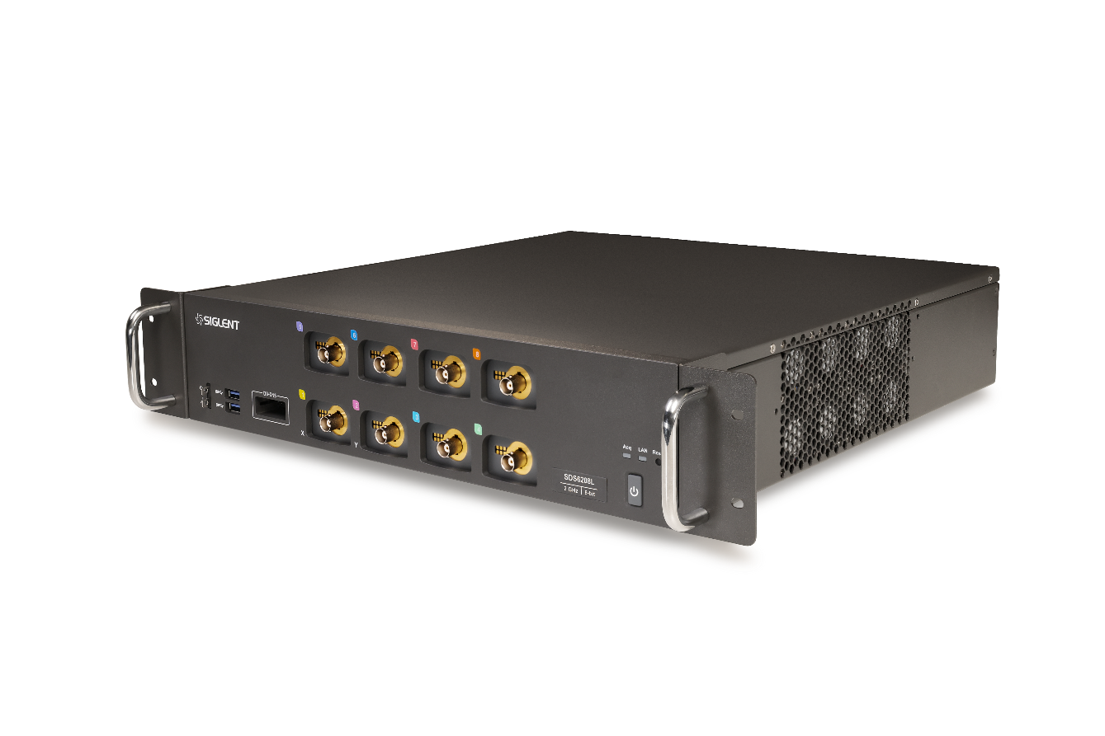
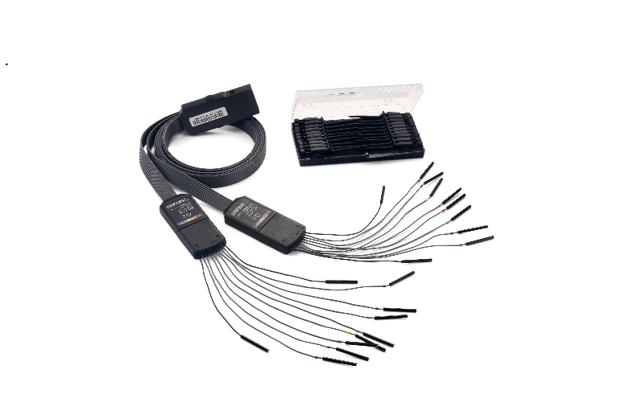
Main Parameters
Design Features
Multiple Functions
Optional
MSO Function
Mixed signal oscilloscope, solution for both digital and analog problems
View digital and analog channels on one timebase
Full trigger and decoding on all analog and digital channels
16 channels; maximum waveform capture rate up to 1 GSa/s; record length up to 50 Mpts
User defined label names, channel groups, and more

Slide 31
PART FOUR
04
Comparison
Comparison of similar products

Slide 32
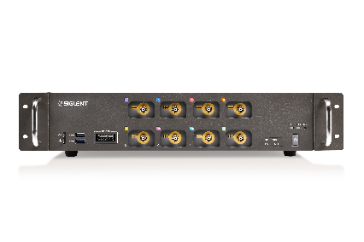
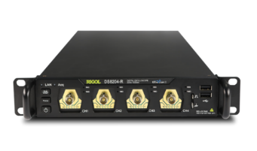
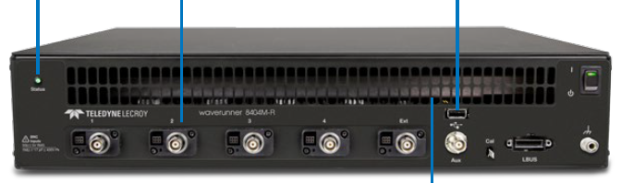
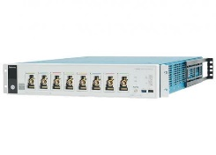
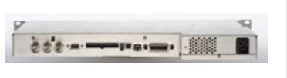
Model | SDS6000L | Rigol DS8000-R | LeCroy WaveRunner 8000-R | Tek5 Low-profile-MSO | Keysight DSO6000L
 |  |  | (Discontinued) |  | (Discontinued)
Analog Channel | 4/8+EXT | 4+EXT | 4+EXT | 8 | 4
Bandwidth | 500 MHz, 1 GHz，2 GHz | 350 MHz, 1 GHz, 2 GHz | 1 GHz, 2.5 GHz, 4 GHz | 1 GHz | 100 MHz,500 MHz,1 GHz
Sample Rate | 10GSa/s/CH (ESR) | 10 GSa/s(Single-Channel) 5G Sa/s(Dual-Channel) 2.5 GSa/s(All-Channel) | 10 GSa/s, 20 Gsa/s; 20 GSa/s, 40GSa/sin interleaved mode | 6.25 GSa/s | 2 GSa/s(100 MHz model) 4 GSa/s half channel, 2 GSa/s each channel(500 MHz,1 GHz model)
Resolution | 8-bit | 8-bit | 8-bit | 12-bit | 8-bit
Memory Depth | 500 Mpts/ch (Single-Channel) 250 Mpts/ch (Dual-Channel) 125 Mpts/ch (3 or 4 channels) | 500 Mpts(Single-Channel) 250 Mpts(Dual-Channel) 125 Mpts(All-Channel) | 16 Mpts, 64 Mpts; 32 Mpts, 128 Mpts(in interleaved mode) | Standard:125 Mpts Optional:250 Mpts, 500 Mpts | 2 channels/4 channels 8 Mpts/4 Mpts
Waveform Update Rate | Normal mode: up to 170,000 wfm/s Sequence mode: up to 750,000 wfm/s | 600,000 wfm/s | 1000,000 trigger rate, sequence mode | >500,000 wfm/s | -
Background Noise | - | - | - | - | -
DC Gain Accuracy | ± 1.5% | ±2% full scale | ±1% full scale, at offset = 0 | 50 Ω: ±2.0%(±2.0% at 2 mV/div, ±4% at 1 mV/div, typical) ±1.0% of full scale, (±1.0% of full scale at 2 mV/div, ± 2% at 1 mV/div, typical) | -
Sequence | Up to 80,000 segments | - | 1000 segment, Re-arm time = As fast as 1 μs | Standard | -
History | Up to 80,000 | Up to 450,000 | - | Standard | -
Trigger | Edge, Slope, Pulse width, Window, Runt, Interval, Dropout, Pattern, Video, Qualified, Nth edge, Setup/hold, Delay, Serial，Zone | edge, pulse width, slew rate, video, runt, timeout, pattern, setup/hold, delay, Nth edge, protocol, zone,duration,window | edge, window, video, state or edge qualified, qualifided first, pattern, dropout, pulse width, glitch, slew rate, interval, runt, timeout, exclusion, mesurement trigger, cascade, protocol, zone, | Edge, Pulse Width, Runt, Timeout, Window, Logic, Setup & Hold, Rise/Fall Time, Parallel Bus, Sequence, Visual Trigger, Video (Optional), RF vs. Time (Optional) | Edge, pulse width, pattern, TV, duration, sequence, CAN, LIN, USB, I2 C, SPI, Nth edge burst
Measurement | 50+ different types of measurements; and mean value of up to 12 parameters simultaneously | 41 auto measurements; and up to 10 measurements can be displayed at a time. | Standard | 36 measurements | -
Math | 4 traces; 8 Mpts FFT, +, -, x, ÷, ∫dt, d/dt, √, Identity, Negation, Absolute, Sign, ex, 10x, ln, lg, Interpolation, MaxHold, MinHold, ERES, Average, Formula Editor | Displays 4 functions at the same time; A+B, A-B, A×B, A/B, FFT, A&&B, A||B, A^B, !A, Intg, Diff, Sqrt, Lg, Ln, Exp, Abs, AX+B; Filter: High pass filter, low pass filter, band pass, band stop | Standard Optional: Digital Filtering Package | Add, subtract, multiply, divide;Define extensive algebraic expressions;Invert, Integrate, Differentiate, Square Root, Exponential, Log 10, Log e, Abs, Ceiling, Floor, Min, Max,Degrees,Radians, Sin, Cos, Tan, ASin, ACos, and Atan;Boolean result of comparison >, <, ≥, ≤, =, and ≠;AND, OR, NAND, NOR, XOR, and EQV;Loading of user-definable filters. | f (g(t)) g(t): { 1, 2, 3, 4, 1-2, 1+2, 1x2, 3-4, 3+4, 3x4} f(t): { 1-2, 1+2, 1x2, 3-4, 3+4, 3x4, FFT(g(t)), differentiate d/dt g(t), integrate ∫ g(t) dt, square root √g(t) } Where 1,2,3,4 represent analog input channels 1, 2, 3, and 4 Note: Channels 3 and 4 only available on DSO6xx4L models

Slide 33
Model | SDS6000L | Rigol DS8000-R | LeCroy WaveRunner 8000-R | Tek5 Low-profile-MSO | Keysight DSO6000L
Serial Decoder | Standard: I2C, SPI, UART, CAN, LIN Optional: CAN FD, FlexRay, I2S, MIL-STD-1553B, SENT, Manchester (Decoder only) | Standard: Parallel Option: I2C, SPI, RS232/UART, I2S, CAN, LIN, FlexRay, MIL-STD1553 | Optional I2C/SPI, UART, CAN/CAN-FD, LIN, SENT, I2S, AudioBus, MIL-STD1553, ARINC429, DigRF, MIPI D-PHY, M-PHY, FibreChannel, PCIe GEN1, SAS, SATE, SpaceWire, USB 2.0, Manchester/NRZ, 8B10B | Optional: I2C, SPI, eSPI, I3C, RS-232/422/485/UART, SPMI, SMBus, CAN, CAN FD, LIN, FlexRay, SENT, PSI5, CXPI, Automotive Ethernet,MIPI C-PHY,MIPI D-PHY, USB 2.0, eUSB2, Ethernet, EtherCAT, Audio, MIL-STD-1553, ARINC`429, Spacewire, 8B/10B,NRZ, Manchester, SVID, SDLC, 1-Wire, MDIO | CAN, LIN, USB, I2 C, SPI,
Search | Standard | Standard | WaveScan | Standard | -
Navigate | Standard | Standard | WaveScan | - | -
FRA | Standard | - | - | Standard | -
Histogram | Standard | Standard | - | Standard | -
Digital Voltmeter | Standard | 3 digits | - | 4-digit | -
Frequency resolution | 7 digits | 6 digits | - | 8-digit | 5-digit
Jitter Analysis | Optional | Optional | Optional: SDAII | Optional | -
Eye Diagram | Optional | Optional | Optional: SDAII, Eye Doctor II, Cable De-embedding, Serial data mask | Optional | -
Power Analysis | Optional | Built UPA (Optional) + PC | Optional | Optional | -
MSO | Optional 16-channel; maximum sample rate up to 1 GSa/s; record length up to 50 Mpts | - | 16-ch (MSO model) 1.25 GSa/s 128 Mpts all pods | 64-channel (Max.) | Optional 16 logic timing channels; 2 GSa/s one pod, 1 GSa/s each pod; 8 Mpts one pod , 4 Mpts both pod
Waveform Generator | Optional 25 MHz | Optional 25 MHz | - | Optional 50 MHz | -
I/O | USB 3.0 Host x2，USB 2.0 Host x2，USB 2.0 Device，1000M LAN , HDMI, External trigger，Auxiliary output（TRIG OUT，PASS/FAIL）, 10MHz In, 10MHz Out, SD Card | USB Host&Device, LAN(LXI), HDMI, TRIG OUT, 10MHz In, 10MHz Out Optional： 10GE SFP+, USB-GPIB | USB 2.0 X2, USB 3.1 Gen 1 X2, Easily accessible USB2.0; USBTMC, DP, VGA,10/100/1000Base-T X2,Removable SSD | USB Host (6 ports), USB 3.0 Device (1 port), LAN (10/100/1000 Base-T Ethernet), Display Port, DVI-D, VGA | USB 2.0 high speed, 10/100-BaseT LAN, IEEE488.2 GPIB, XGA video output
Time base Accuracy | ±2 ppm initial (0~50℃)；±0.5 ppm 1st year aging；±3 ppm 20-year aging | ±1 ppm ± 2ppm/year aging | ±1.5 ppm ± 0.5ppm/year aging | ±2.5ppm over any ≥1 ms time interval; ±1.5 ppm /year aging | -
Operating Temperature | 0~50℃, operating | -40~50℃, operating | 5~40℃, operating | 0~50 °C (32 °F to 122 °F), operating | -10~50°C, operating
Dimensions | 1U for 4-channal; 2U for 8-channel | WxHxD = 214mm x43mmx478mm 1U | WxHxD = 445mm x86.5mmx445mm 2U | 3.44 in (87.3 mm) H x 17.01 in (432 mm) W x 24.74 in (621.5 mm) D 2U | 43.5 cm W x 27 cm D x 4.2 cm H 1u

Slide 34
Thank You
Every Bench. Every Engineer. Every Day.
Headquarters
NA
Europe
SIGLENT TECHNOLOGIES CO., LTD.
Add: Blog No.4 & No.5, Antongda Industrial Zone, 3rd Liuxian Road, Bao’an District, Shenzhen, 518101, China
Tel:+ 86 755 3688 7876
Fax:+ 86 755 3359 1582
sales@siglent.com
int.siglent.com
SIGLENT Technologies NA, Inc.
Add: 6557 Cochran Rd Solon, Ohio 44139
Tel: 440-398-5800
Toll Free:877-515-5551
Fax: 440-399-1211
info@siglent.com
www.siglentna.com
SIGLENT TECHNOLOGIES GERMANY GmbH
Add: Staetzlinger Str. 70 86165 Augsburg, Germany
Tel: +49(0)-821-666 0 111 0
Fax: +49(0)-821-666 0 111 22
info-eu@siglent.com
www.siglenteu.com

