Slide 1
SIGLENT TECHNOLOGIES
EVERY BENCH. EVERY ENGINEER. EVERY DAY.
www.siglent.com

Slide 2
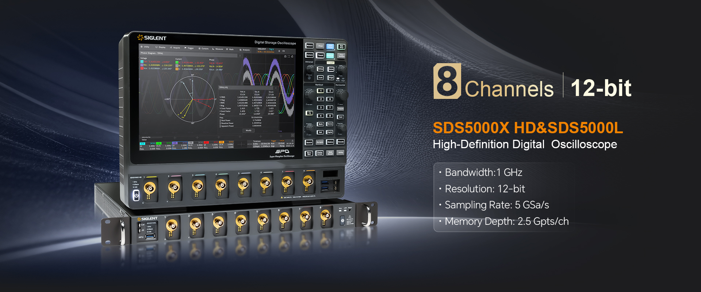
banner

Slide 3
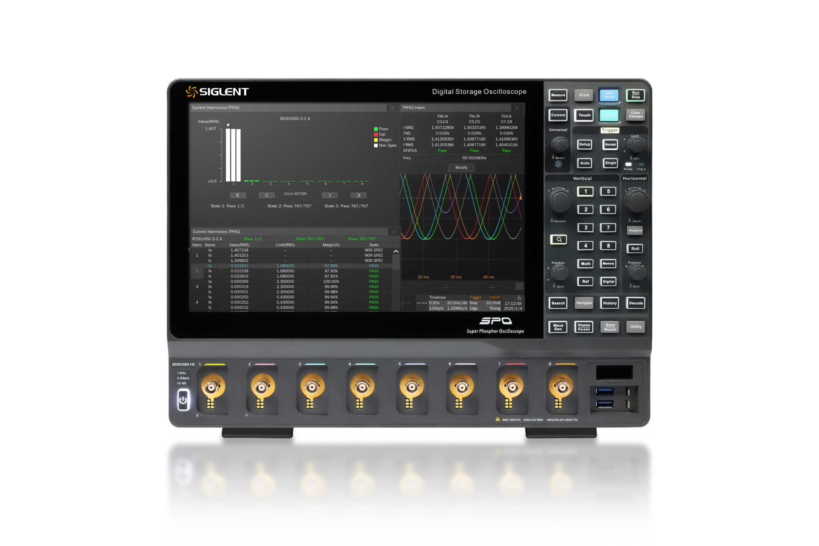
Eight-channel High-resolution Digital Oscilloscope
SDS5000X HD Series
SDS5108X HD 1GHz
SDS5058X HD 500MHz
SDS5038X HD 350GHz
SDS5106X HD 1GHz
SDS5056X HD 500MHz
SDS5036X HD 350MHz
SDS5104X HD 1GHz
SDS5054X HD 500MHz
SDS5034X HD 350MHz

Slide 4
01
02
03
04
05
Basic Introduction
Characteristics & Superiority
Application Solutions
Competitive Product Comparison
Ordering Information

Slide 5

01
Basic Introduction

Slide 6
Overview of the SDS5000X HD series
Models | Bandwidth | Max. Sampling Rate | Analog channels | Memory Depth(Max.)
SDS5108X HD | 1GHz | 5 GSa/s (quarter channel/half channel mode) 2.5 GSa/s (full channel mode) | 8 | 2.5 Gpts/ch (quarter channel mode) 1 Gpts/ch (half channel mode) 500 Mpts/ch (full channel mode)
SDS5106X HD | 1GHz | 5 GSa/s (quarter channel/half channel mode) 2.5 GSa/s (full channel mode) | 6 | 2.5 Gpts/ch (quarter channel mode) 1 Gpts/ch (half channel mode) 500 Mpts/ch (full channel mode)
SDS5104X HD | 1GHz | 5 GSa/s (quarter channel/half channel mode) 2.5 GSa/s (full channel mode) | 4 | 2.5 Gpts/ch (quarter channel mode) 1 Gpts/ch (half channel mode) 500 Mpts/ch (full channel mode)
SDS5058X HD | 500MHz | 5 GSa/s (quarter channel/half channel mode) 2.5 GSa/s (full channel mode) | 8 | 2.5 Gpts/ch (quarter channel mode) 1 Gpts/ch (half channel mode) 500 Mpts/ch (full channel mode)
SDS5056X HD | 500MHz | 5 GSa/s (quarter channel/half channel mode) 2.5 GSa/s (full channel mode) | 6 | 2.5 Gpts/ch (quarter channel mode) 1 Gpts/ch (half channel mode) 500 Mpts/ch (full channel mode)
SDS5054X HD | 500MHz | 5 GSa/s (quarter channel/half channel mode) 2.5 GSa/s (full channel mode) | 4 | 2.5 Gpts/ch (quarter channel mode) 1 Gpts/ch (half channel mode) 500 Mpts/ch (full channel mode)
SDS5038X HD | 350MHz | 5 GSa/s (quarter channel/half channel mode) 2.5 GSa/s (full channel mode) | 8 | 2.5 Gpts/ch (quarter channel mode) 1 Gpts/ch (half channel mode) 500 Mpts/ch (full channel mode)
SDS5036X HD | 350MHz | 5 GSa/s (quarter channel/half channel mode) 2.5 GSa/s (full channel mode) | 6 | 2.5 Gpts/ch (quarter channel mode) 1 Gpts/ch (half channel mode) 500 Mpts/ch (full channel mode)
SDS5034X HD | 350MHz | 5 GSa/s (quarter channel/half channel mode) 2.5 GSa/s (full channel mode) | 4 | 2.5 Gpts/ch (quarter channel mode) 1 Gpts/ch (half channel mode) 500 Mpts/ch (full channel mode)

Slide 7
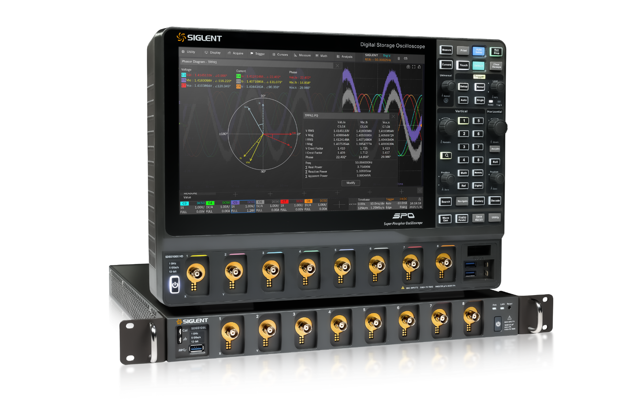
SDS5000X HD
SDS5000L
1 GHz
Analog Bandwidth
5 GHz
Full-channel
sampling rate
2.5 Gpts
Memory Depth(Max.)
12bit
Vertical Resolution
650,000 frames/s waveform capture rate
60+ parameters are automatically measured

Slide 8
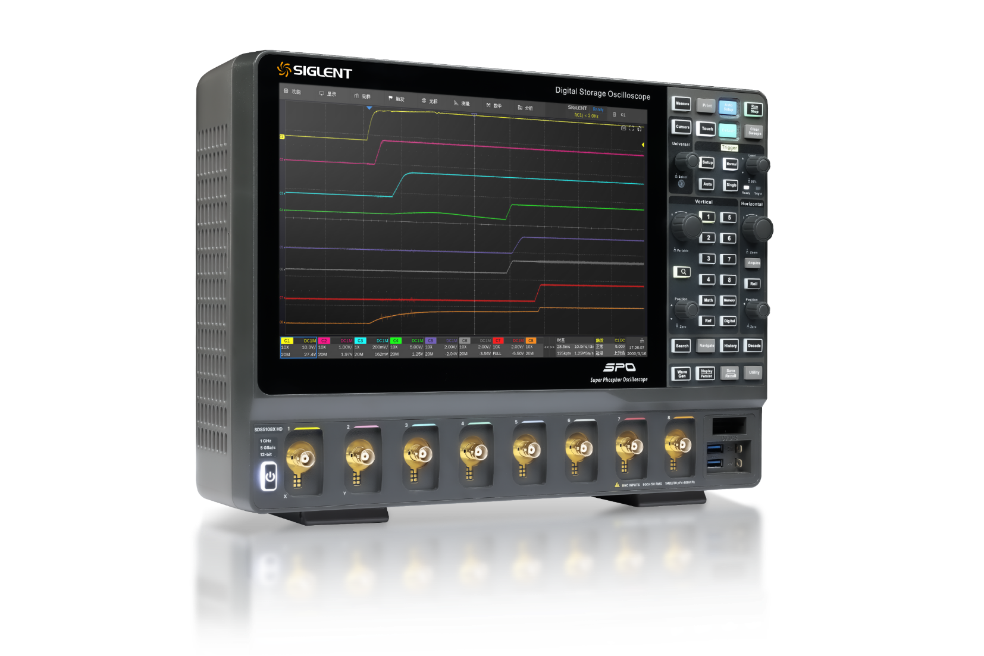
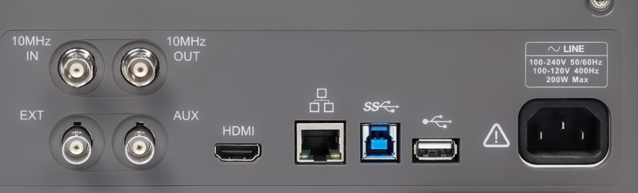


Panel Introduction
The 12.1-inch capacitive touch high-definition screen provides clearer eight-channel waveform observation.
Compact eight-channel design.
Rich interfaces, USB 3.0 Host x2, USB 2.0 Host x1, USB 3.0 Device, 10M/100M/1000M LAN, external trigger input, auxiliary output (TRIG OUT, PASS/FAIL), 10MHz In, 10MHz Out, HDMI output.
10MHz In
10MHz Out
Digital Channels
(Standard Configuration)
External Trigger Input
USB Host
USB
Device & Host
Auxiliary Output
HDMI port on the video output
1000M LAN

Slide 9
02
Characteristics & Superiority

Slide 10
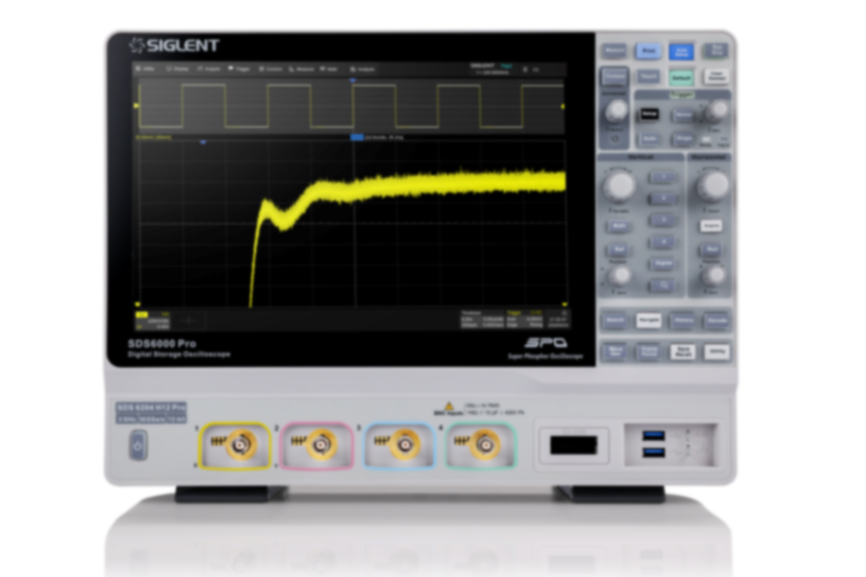
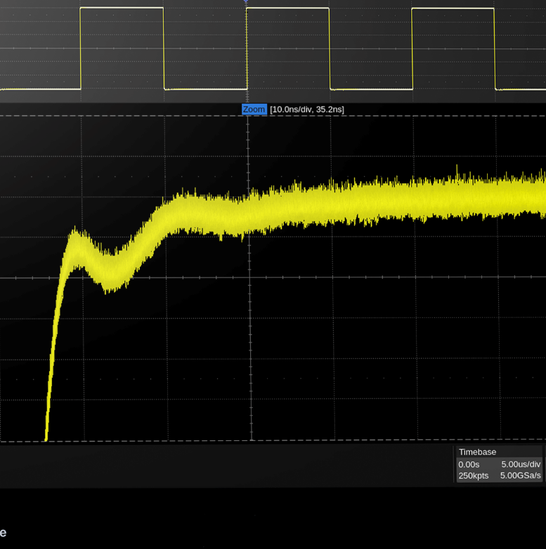
12-bit Vertical Resolution
The number of ADC bits of an oscilloscope is one of the most critical parameters of an oscilloscope, which represents the resolution of the oscilloscope in the vertical direction.
ADC bits 12bit; Up to 16-bit vertical resolution in ERES mode.
The hardware-implemented 1mV/div vertical position allows for the detection of smaller waveform changes.
Clearer and cleaner waveform display.
The accuracy is more than 16 times higher than that of 8-bit oscilloscopes.
12bit

Slide 11
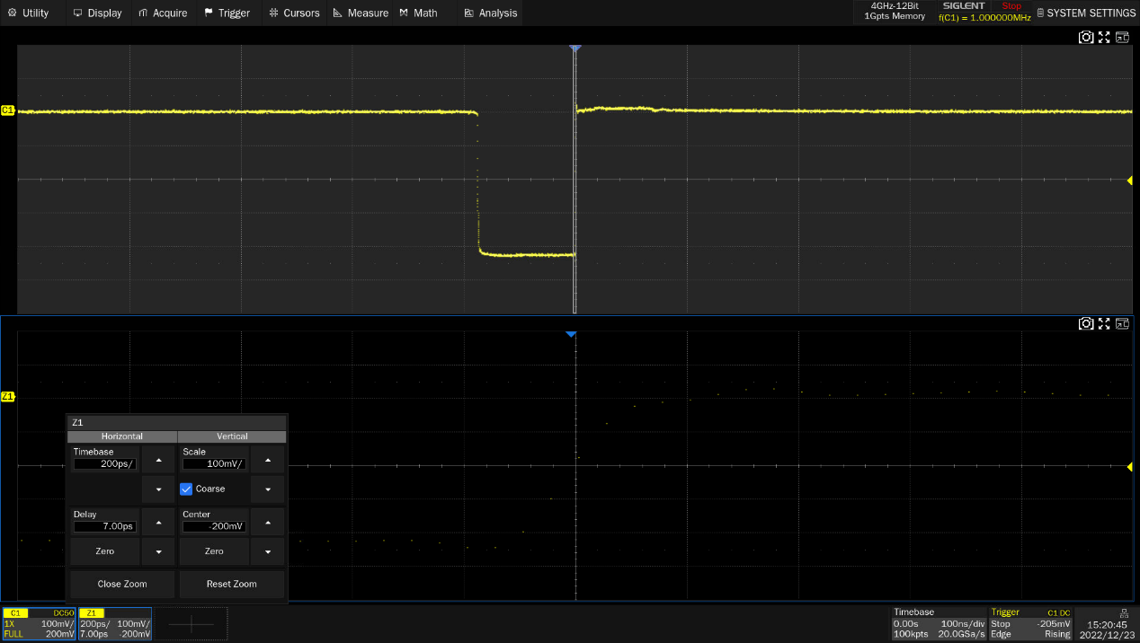
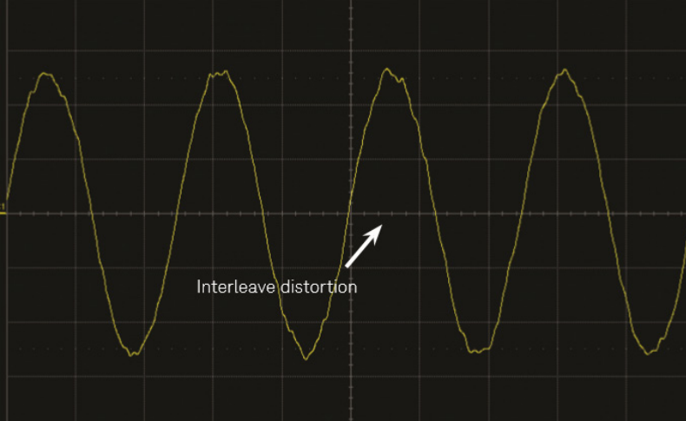
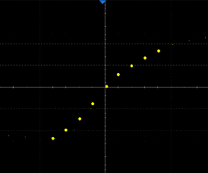
Higher Sampling Rates
The higher the sample rate, the more detail you see about the signal.
SDS5000X HD can be sampled at 5GSa/s. Using Siglent's unique interleaved sampling technology, the two ADCs are synchronized with the phase delay clock, and then the two ADCs are used to sample the same analog channel, which doubles the maximum sampling rate when using half or less channels at the same time.
This sampling method also places high demands on synchronization between ADCs. If the phase delay clocks between the ADCs are not synchronized, the sampling will be uneven, and the reconstruction of the waveform on the screen will be distorted.
Uniform sampling points at 5GSa/s
Two ADCs that are not perfectly synchronized can result in distorted waveform reconstruction

Slide 12
High ENOB
ENOB (effective number of bits) is just as important as the number of digits in ADC. The number of bits of the ADC represents the acquisition capability of the oscilloscope in an ideal state, but in the oscilloscope, a portion of the ADC bits are drowned in noise. Therefore, it is the ENOB, not the ADC bits, that determines the quality of the oscilloscope test. ENOB takes into account the error of the system and therefore better reflects the integrity of the test signal.
Brands | SDS5000X HD | Tektronix 5 Series MSO | R&S MXO5 Oscilloscope | Keysight EXR | Keysight MXR | Rigol MHO/DHO5000 | WaveRunner 8000HD
ENOB | 1GHz-8.2-bit 500MHz-8.4-bit 350MHz-8.6-bit | 1 GHz 7.6 500 MHz 7.9 350 MHz 8.2 250 MHz 8.1 20 MHz 8.9 | 10 MHz 10.0 20 MHz 9.6 100 MHz 8.7 200 MHz 8.3 300 MHz 8.0 500 MHz 7.7 1 GHz 7.0 | 20 MHz 9.0 200 MHz 8.5 250 MHz 8.4 350 MHz 8.3 500 MHz 8.2 1 GHz 8.0 2 GHz 7.6 | 20 MHz 9.0 200 MHz 8.5 250 MHz 8.4 350 MHz 8.3 500 MHz 8.2 1 GHz 8.0 2 GHz 7.6 | 1 GHz 7.7 500 MHz 7.7 250 MHz 8 | 2GHz-8.4-bit 1GHz-8.6-bit 500MHz-8.8-bit 350MHz-8.9-bit
12bit
The comparison between Siglent SDS5000X HD and ENOB of foreign mainstream competitors is shown in the table, equipped with a 12-bit ADC, and SDS5000X HD has strong system performance.
We'll put more emphasis on the better spec – 12bit, but the number of bits in the ADC is only a fraction of that in an oscilloscope system. The ENOB of the system is the number of effective bits when the signal is seen on the screen, the measurement is made, and the analysis function is used.
Some competitors do not display this specification in the datasheet, but only provide the number of ADC digits.

Slide 13
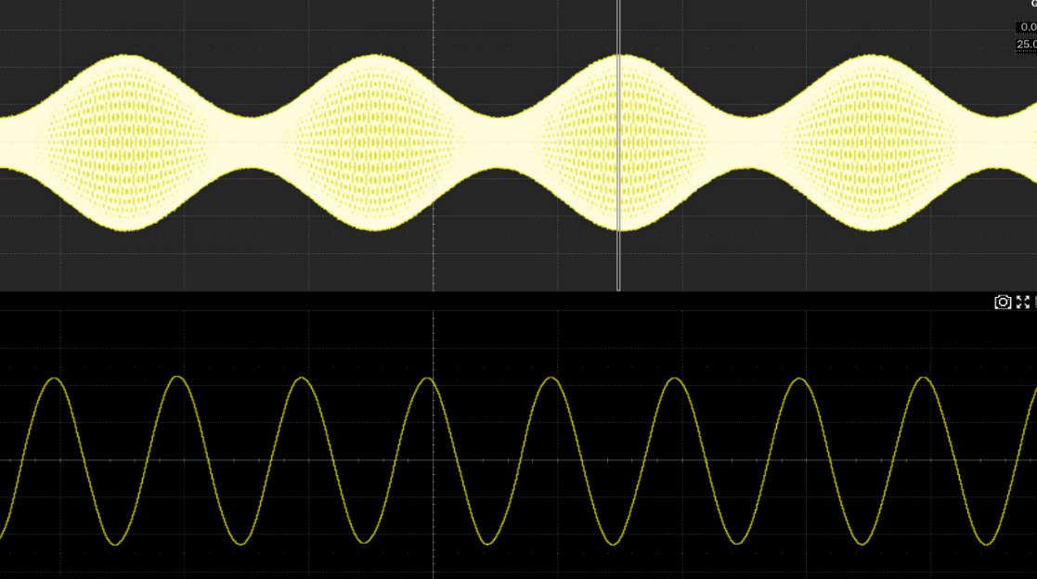
Large Memory Depth
The deep memory of up to 2.5Gpts/channel ensures that the oscilloscope can capture signals for longer periods of time at high sampling rates, and then quickly zoom in on areas that need attention, achieving both overall and detailed considerations.
Memory Depth = Sample Rate x Sample Time
Ultra-long observation time
Capture multiple waveforms
Ensure that the waveform is not distorted
Excellent runnability
Maintain high sampling rates
Accurate and efficient analysis
2Gpts/CH
Use an oscilloscope to capture signals over long periods of time

Slide 14
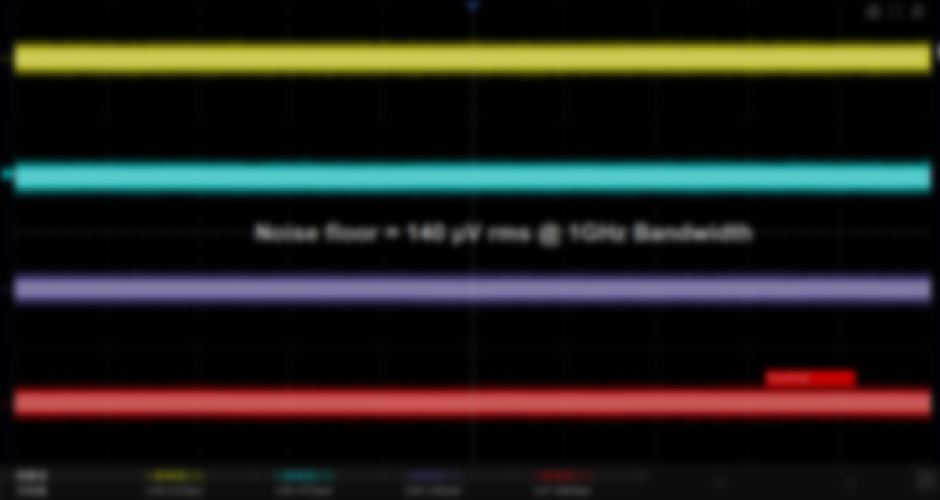
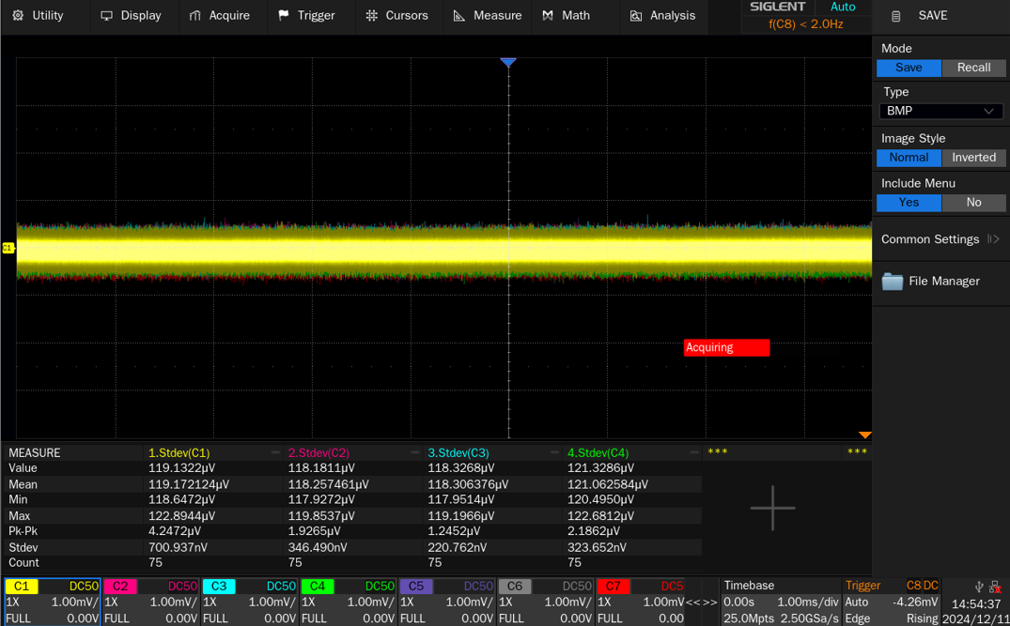
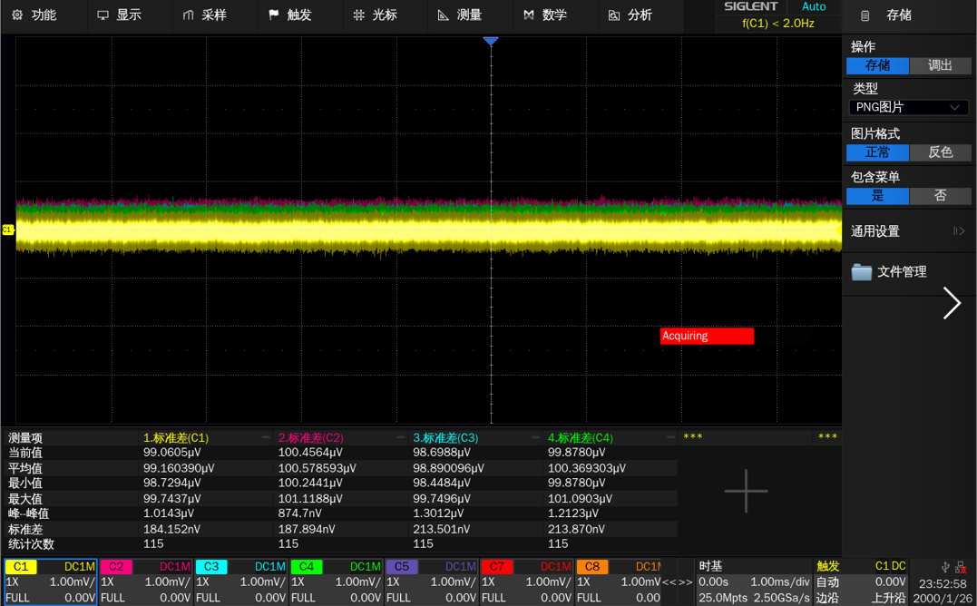
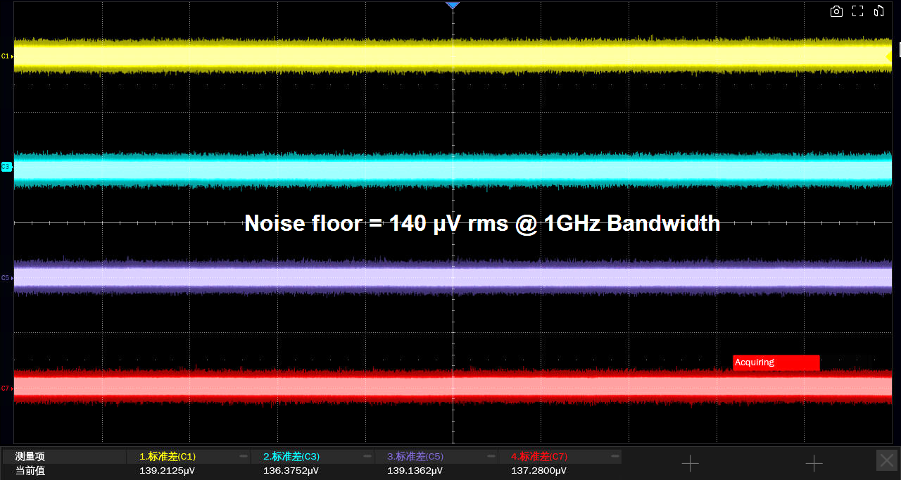
Excellent Noise Floor
Based on a high-quantization series 12-bit ADC and high-performance front-end circuitry, SDS5000X HD has a low noise floor.
The noise floor is as low as 140 μVrms at 1 GHz.
50Ω and 1MΩ impedances are supported, and each analog path has a bandwidth filter.
High-frequency noise is reduced through low-pass filtering and digital processing.
500 MHz bandwidth models:
350 MHz bandwidth models:

Slide 15
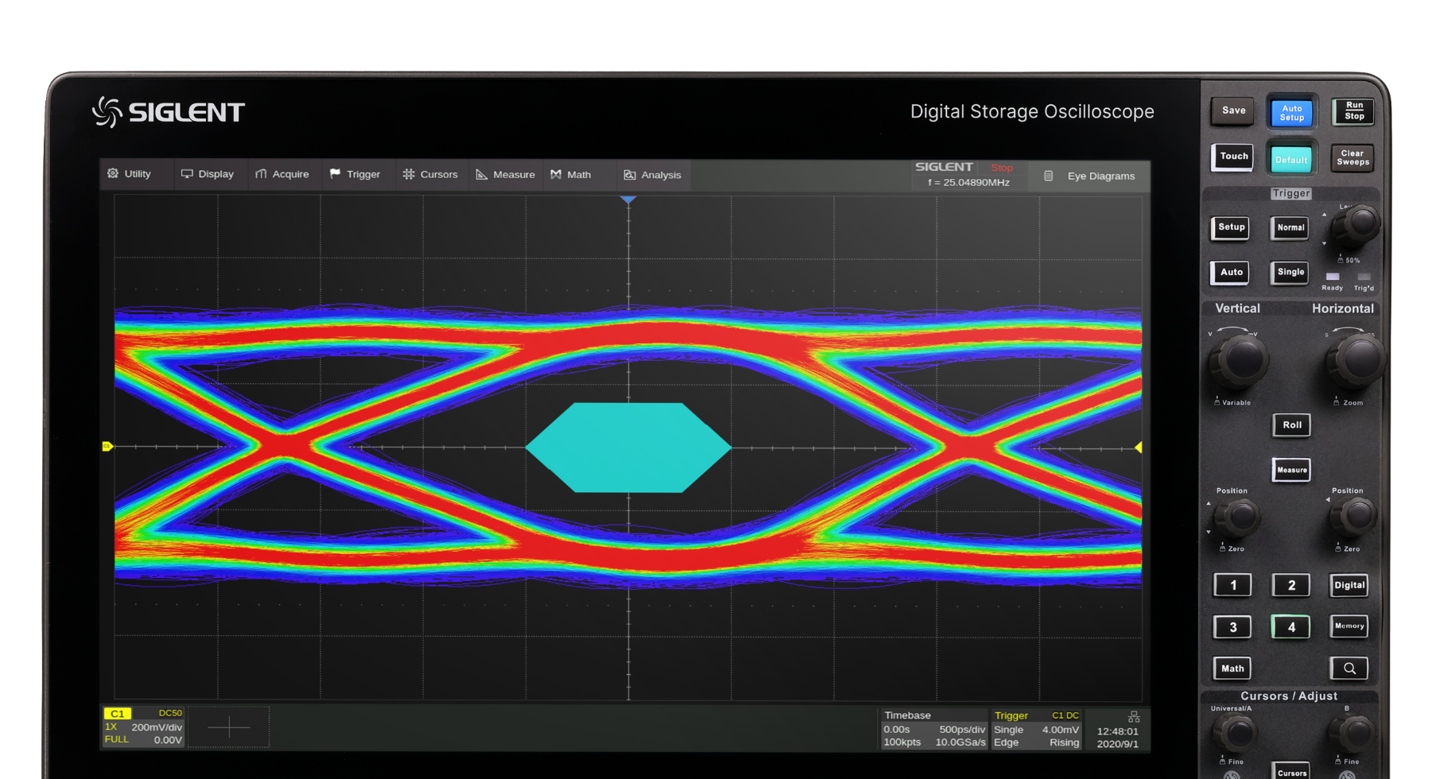
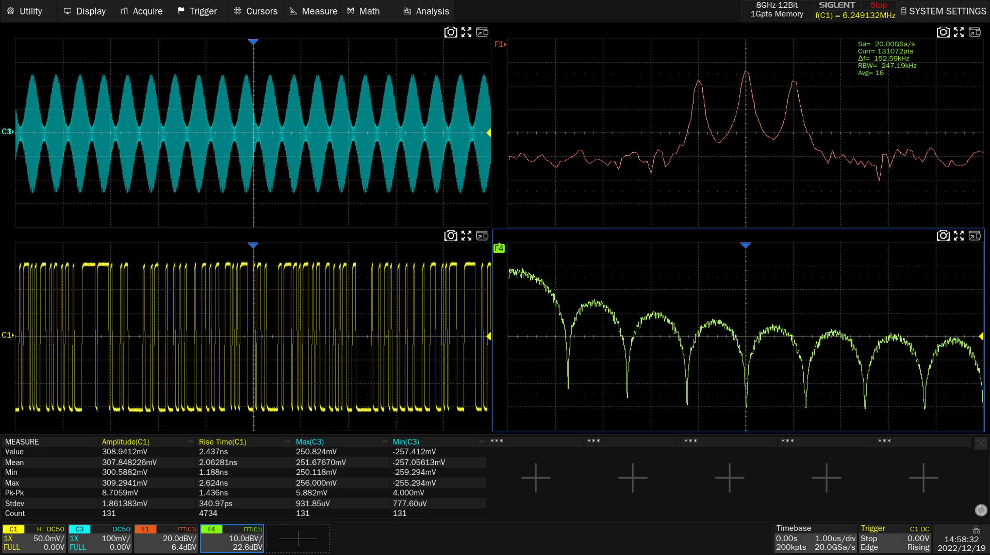
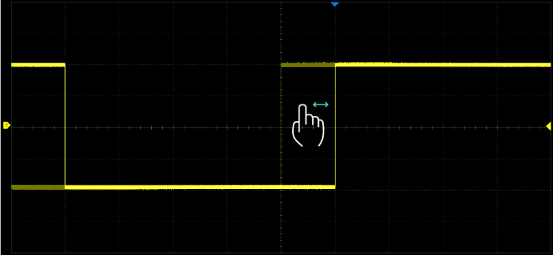
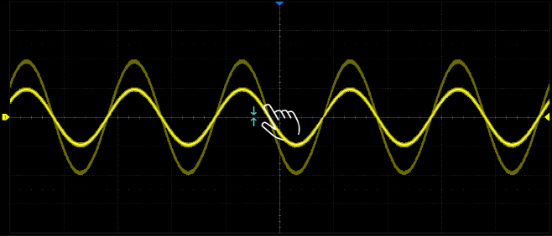
Customized Interface
12.1-inch capacitive touch HD display.
It supports split-screen display, multi-channel and multi-interface, flattening to present more information, and the waveform is clear and reliable from the whole to the subtleties, improving test efficiency.
A variety of gestures are defined specifically for oscilloscope operation, which greatly improves the efficiency of instrument operation. Built-in WebServer allows you to remotely access and operate the oscilloscope directly from the web page。
Notes:
Use gestures for waveform control
Multi-channel and multi-interface display

Slide 16
03
Application Solutions

Slide 17
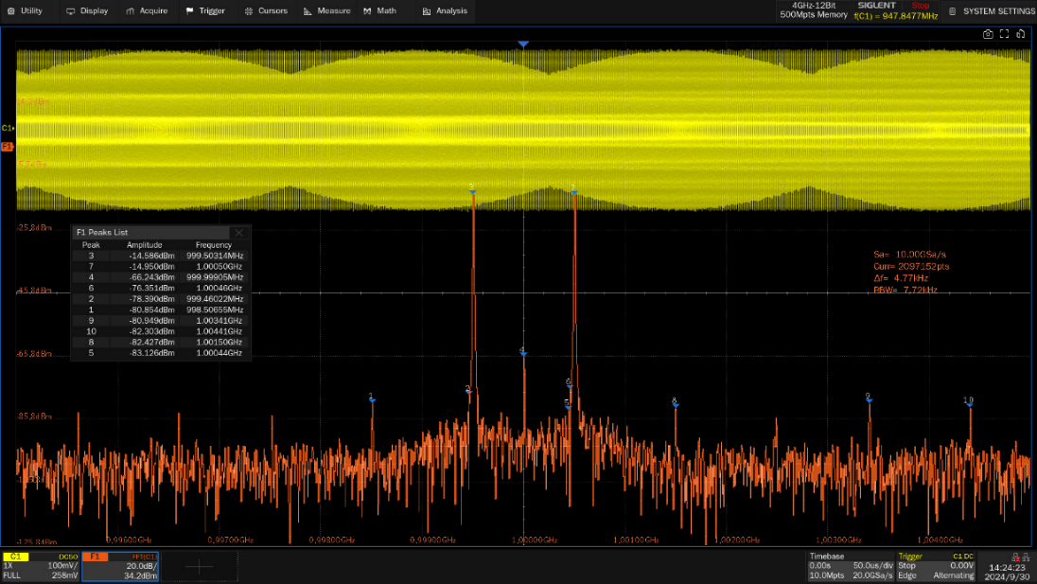
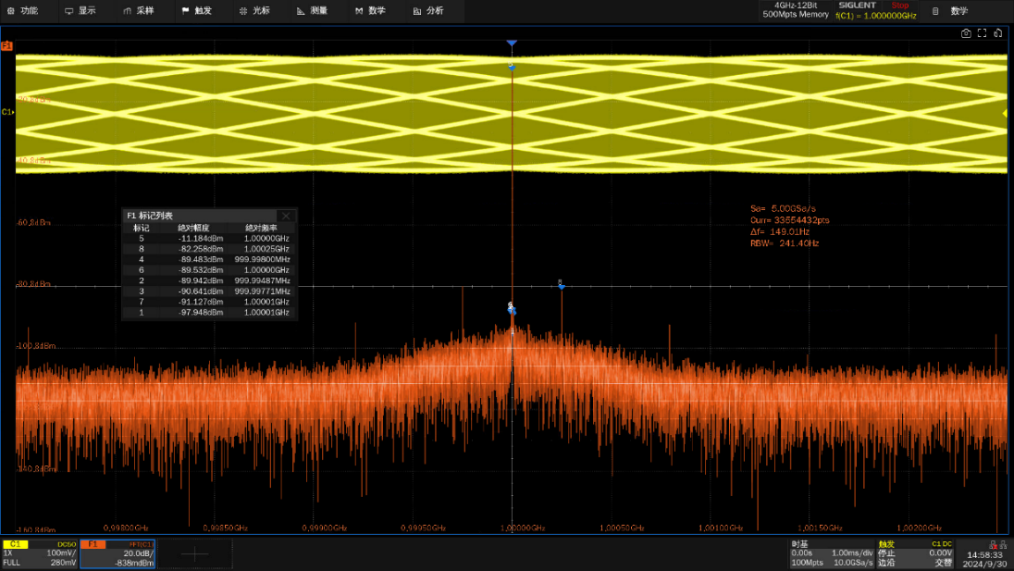
Hardware-accelerated FFT
SDS5000X HD oscilloscope come standard with spectrum analysis, a 12-bit ADC, and SFDR down to 45dBc, ensuring a low noise floor with the oscilloscope's FFT function.
Siglent's hardware-accelerated FFT algorithm can save up to 88% of the time and support up to 32M operation points, providing superior frequency resolution while still maintaining a high spectral refresh rate.
Support a variety of window functions, support normal, average, maximum value hold and other modes, support automatic marking of peak points.
Use an oscilloscope for spectrum analysis
Notes:
Save 88% of time, the algorithm used is calc, 8M points.
[f,amp,phase] = calcFFT(X,sf,plotYN) takes one or more signals, X (each column a separate signal), and computes the single-sided phase and frequency spectrogram. It also returns the frequency axis, f, based on the sampling frequency input, sf. plotYN toggles whether or not to plot the phase and frequency spectrograms for each signal.
The effect of acceleration is different under different window functions, but it is about 80%.

Slide 18
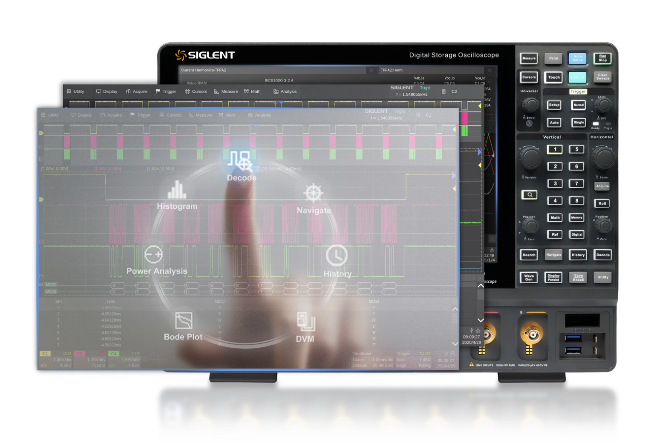
Serial Bus Decoding
Standard: I2C, SPI, UART, CAN, LIN
Optional: CAN FD, FlexRay, I2S, MIL-STD-1553B, SENT, Manchester, ARINC429, USB2.0
Through the event list display and decoding, the protocol information of the bus can be displayed in a tabular form quickly and intuitively.

Slide 19
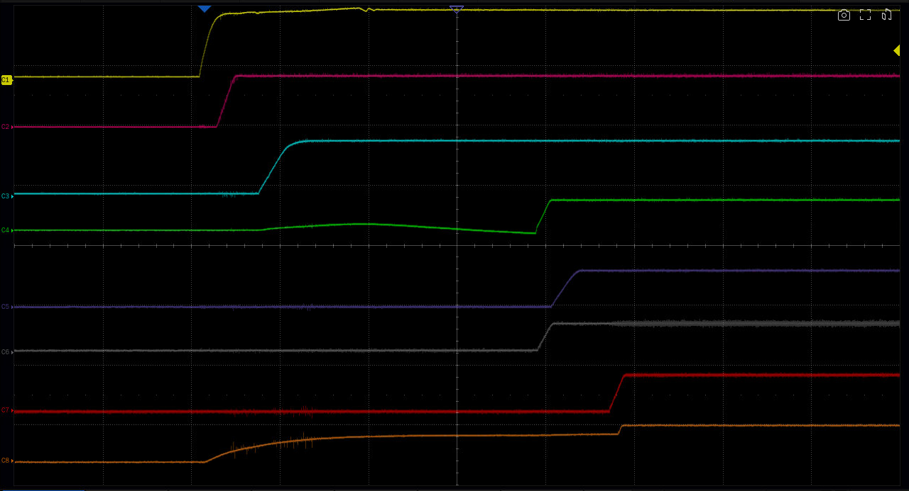
Power-on Timing Analysis
Through the power-on timing test, ensure that the signals of each module appear in the correct timing, avoid signal collisions and interference, and ensure the normal operation of the system.
Capture the power-up process of all relevant signals at once, saving measurement time and increasing work efficiency.

Slide 20
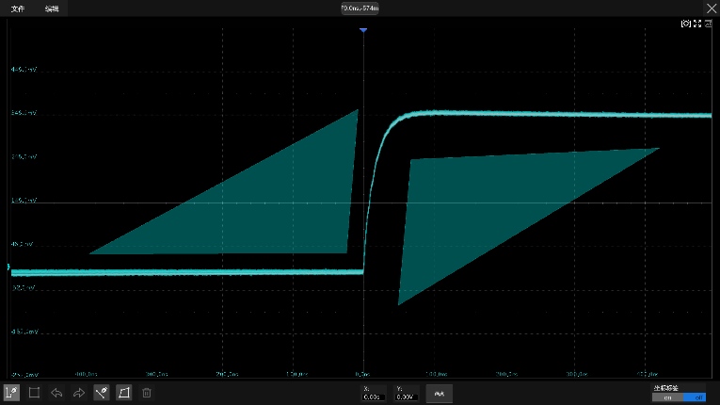
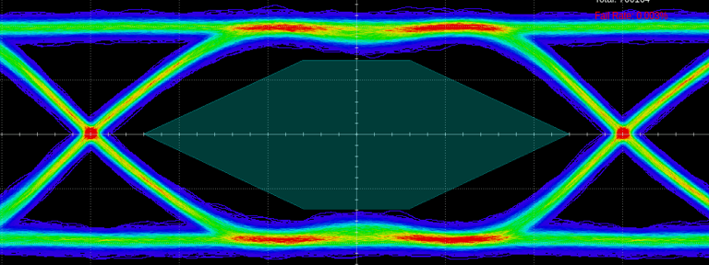
Mask Testing for Hardware Implementations
Hardware-based mask testing at up to 80,000 frames per second.
Mask testing is supported under eye diagram and jitter tests.
Masks are automatically generated based on user-defined vertical and horizontal tolerances to compare whether the signal under test touches the Mask.
It can pre-set the acquisition stop and buzzer alarm when the test fails, and automatically take a screenshot of the failure frame or save it in the history frame.
It is suitable for long-term unattended monitoring of abnormal signals.

Slide 21
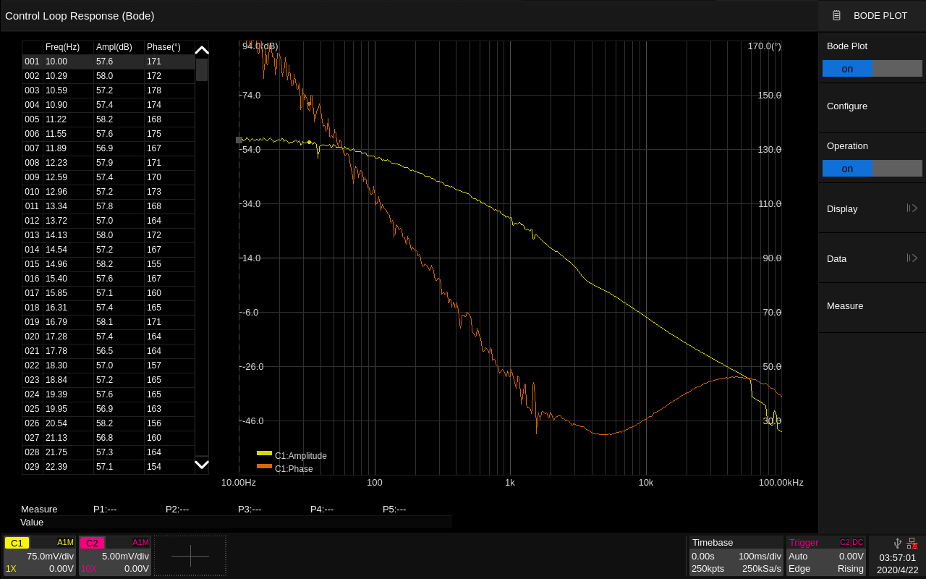
Bode Plot
Filter test .
Built-in waveform generator.
Measure the response of the power control loop.
Sweep the amplitude and phase frequency response of the DUT.

Slide 22
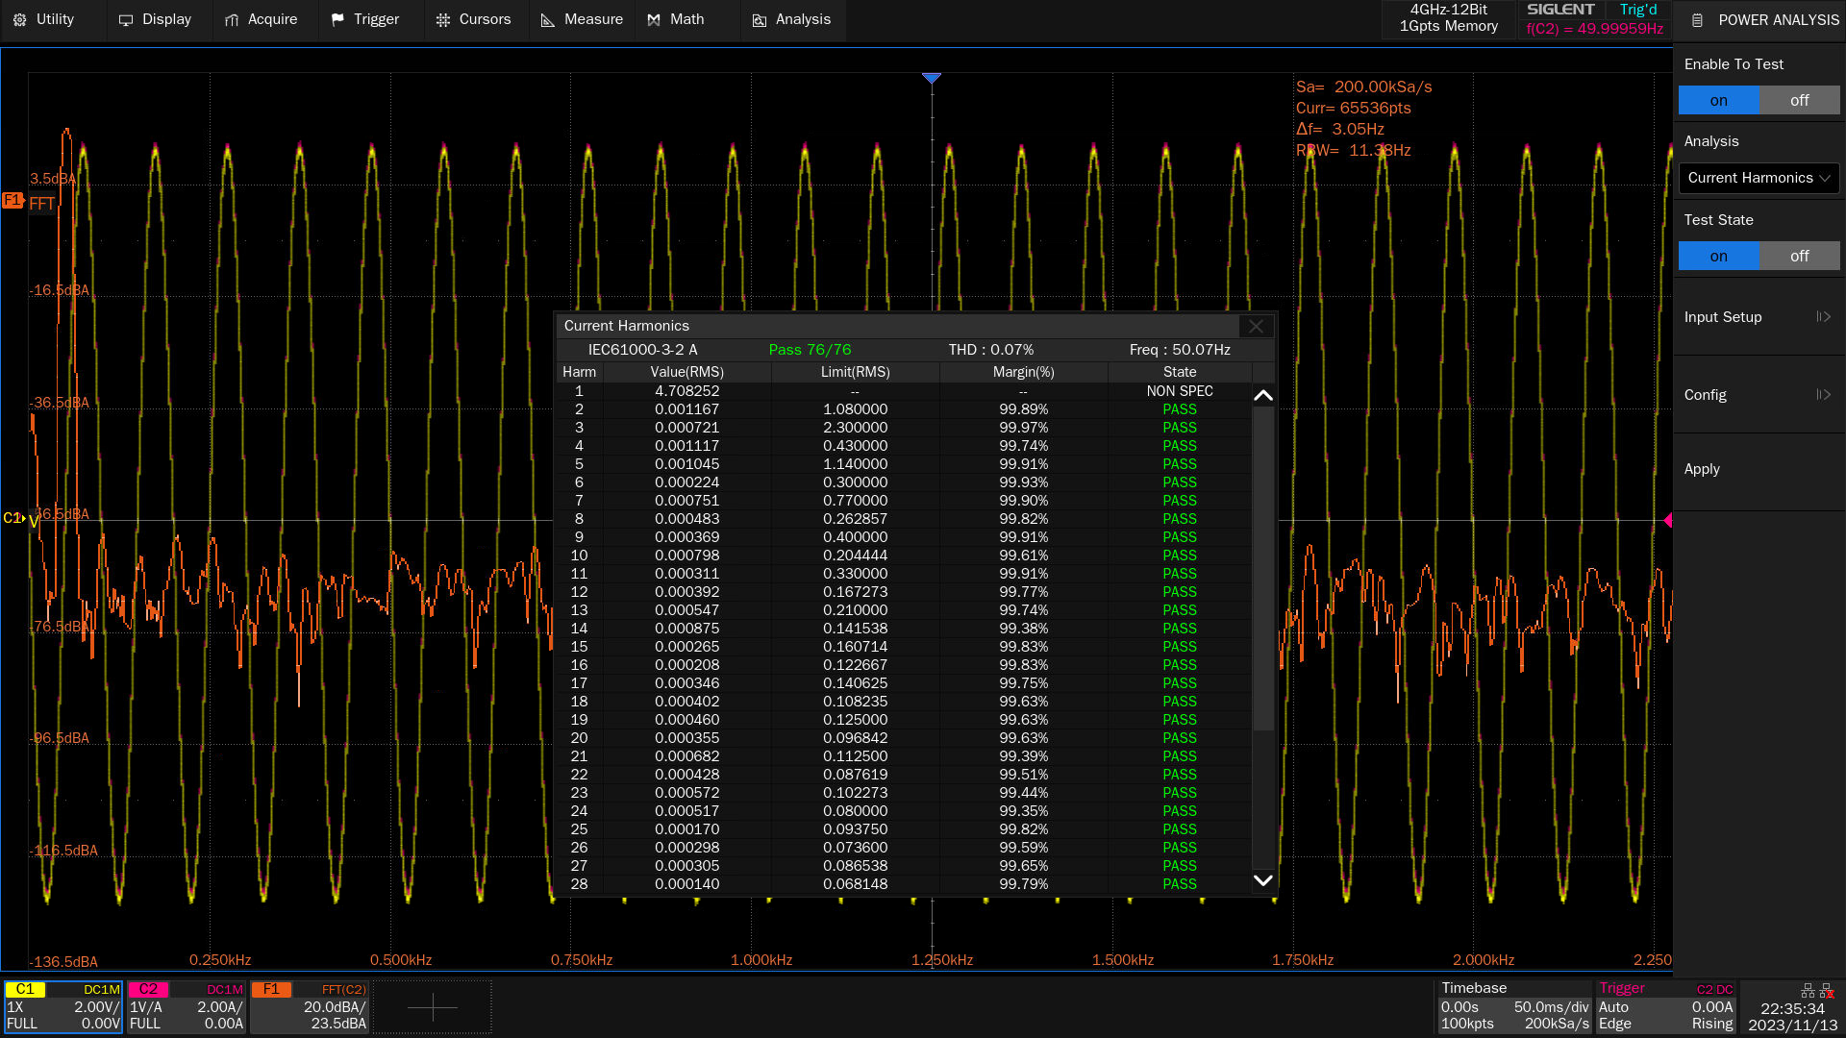
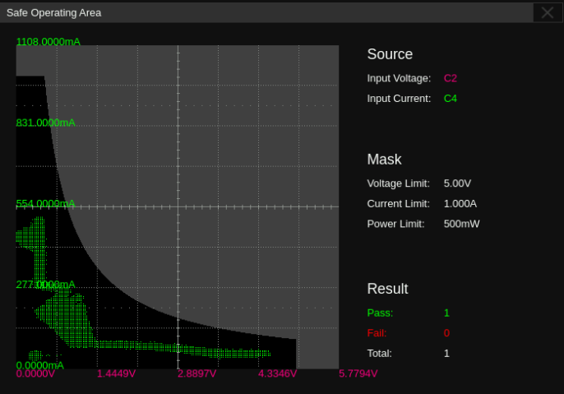
Power Analysis
Analyze the efficiency and reliability of switching power supplies.
Extensive selection of voltage and current probes.
Quickly measure and analyze power quality, current harmonics, inrush currents, switching losses, output ripple, and more
Jitter testing supports advanced statistical analysis and noise analysis of high-speed digital interfaces.
Clear guidance for easy device connection.
Current harmonic test
Safe work area testing

Slide 23
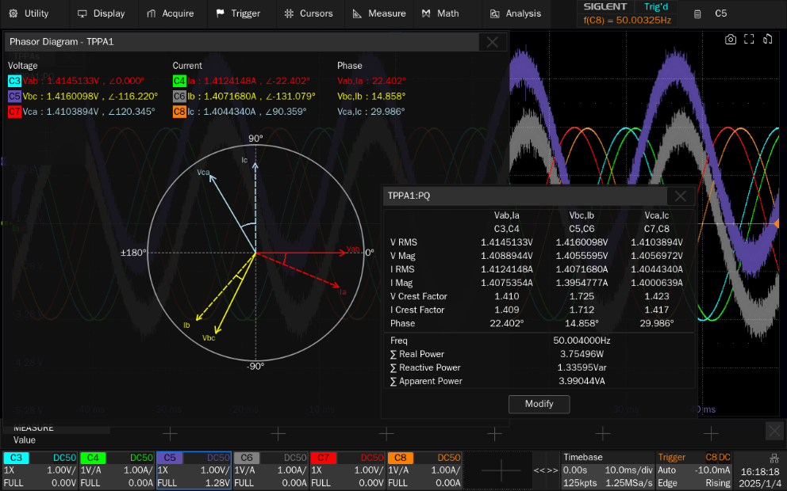
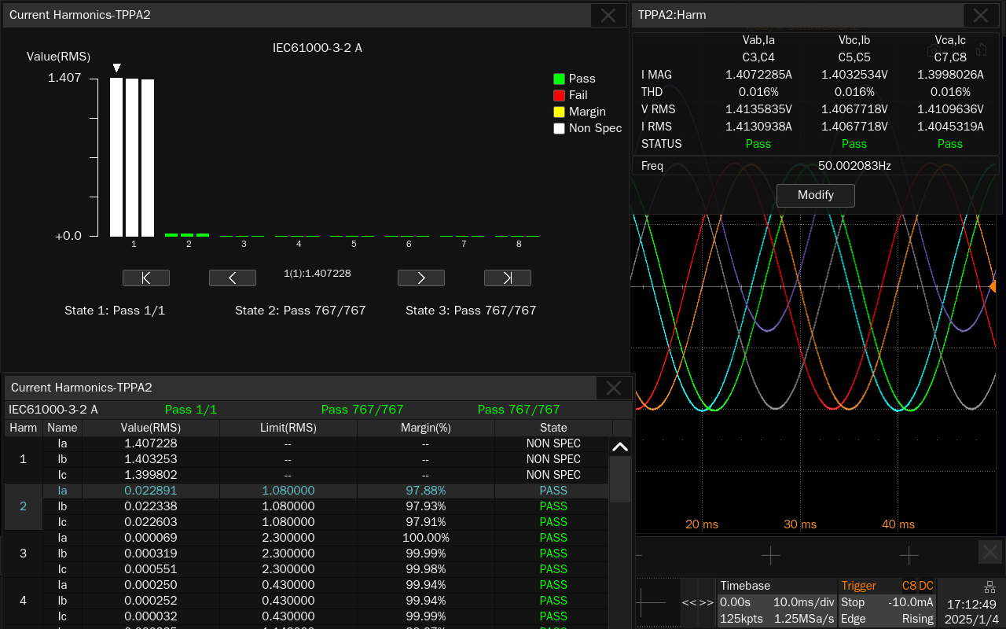
Three-phase Power Analysis
Analyze the efficiency and reliability of switching power supplies.
Extensive selection of voltage and current probes.
Quickly measure and analyze power quality, current harmonics, inrush currents, switching losses, output ripple, and more.
Jitter testing supports advanced statistical analysis and noise analysis of high-speed digital interfaces.
Clear guidance for easy device connection.
Power quality analysis
Harmonic analysis

Slide 24
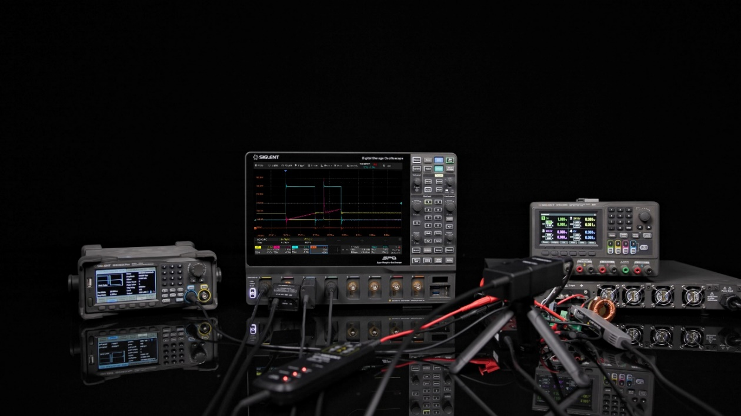
Wide Bandgap Semiconductor Testing
The automated testing software tests the double pulse parameters.
Optically isolated probe with high common-mode rejection ratio for testing SiC, GaN, and other devices.
Automatically test parameters such as turn-on delay time, current rise time, turn-on loss, turn-off delay time, voltage rise time, and turn-off loss.
The 8-channel allows for simultaneous testing of more parameters of interest.
Double-pulse testing with SDS5000X HD and optically isolated probes

Slide 25
04
Competitive Product Comparison

Slide 26
VS Tektronix 5 Series MSO
 | Siglent SDS5000X HD | Tektronix 5 Series MSO
Analog Channels | 8/6/4 + EXT | 8/6/4 + EXT
Bandwidth | 350MHz/500MHz/1GHz | 350 MHz/ 500 MHz/ 1 GHz/ 2 GHz
Real-time Sampling Rate | 5 GSa/s (quarter channel/half channel mode) 2.5 GSa/s (full channel mode) | 6.25 GS/s on all analog/digital channels(160 ps resolution) 12.5 GS/s ~ 500 GS/s（interpolated）
Memory Depth | 2.5 Gpts/ch(quarter channel mode) 1 Gpts/ch (half channel mode) 500 Mpts/ch (full channel mode) | Standard：62.5Mpts Optional：125M/250M/500Mpts
Waveform Capture Rate | Normal mode：rates up to 160,000 wfm/s Sequence mode：rates up to 650,000 wfm/s | >500,000 wfms/s
Noise Floor | (rms, @50Ω,typical,1 mV/div) 1GHz-140 μV 500MHz-120μV 350MHz-100μV | 1GHz-254 μV 500MHz-198μV 350MHz-141μV
Mask Tesk | Standard | Optional
Bode Plot | Standard | Optional
Three-phase Power Analysis | Optional | Optional，Inverter Motor Drive Analysis

Slide 27
VS R&S MXO5 Oscilloscope
 | Siglent SDS5000X HD | R&S MXO5 Oscilloscope
Analog Channels | 8/6/4 + EXT | 4 or 8
Real-time Sampling Rate | 5 GSa/s (quarter channel/half channel mode) 2.5 GSa/s (full channel mode) | max. 5 Gsample/s on 4 channels max. 2.5 Gsample/s on 8 channels
Storage Depth | 2.5 Gpts/ch(quarter channel moide) 1 Gpts/ch (half channel mode) 500 Mpts/ch (full channel mode) | Optional： with 8 active channels: • max. 500 Mpoints (single capture) • max. 250 Mpoints (run continuous) with 4 active channels: • max. 500 Mpoints (single capture and run continuous) Optional： with 4 active channels: • max. 1 Gpoints (single capture) with 2 active channels: • max. 1 Gpoints (run continuous)
Waveform Capture Rate | Normal mode：rates up to 160,000 wfm/s Sequence mode：rates up to 650,000 wfm/s | > 4 500 000 waveforms/s
ENOB (typical) | 1GHz-8.2-bit 500MHz-8.4-bit 350MHz-8.6-bit | 200 MHz 8.3 300 MHz 8.0 500 MHz 7.7 1 GHz 7.0
DC Gain Accuracy | 0.5 mV/div ~ 4.95 mV/div: ±1.5 % FS; 5 mV/div ~ 10 V/div: ±0.5 % FS typical，±1.0 % FS max; | input sensitivity > 5 mV/div ±1 % full scale ≤ 5 mV/div to ≥ 1 mV/div ±1.5 % full scale 500 µV/div ±2.5 % full scale
Bode Plot | Standard | N/A
Power Analysis | Optional | MXO5-K31

Slide 28
VS Keysight EXR
 | Siglent SDS5000X HD | Keysight EXR Series
Analog Channels | 8/6/4 + EXT | 4 or 8
Real-time Sampling Rate | 5 GSa/s (quarter channel/half channel mode) 2.5 GSa/s (full channel mode) | real time：16 GSa/s, all analog channels
Memory Depth | 2.5 Gpts/ch(quarter channel mode) 1 Gpts/ch (half channel mode) 500 Mpts/ch (full channel mode) | Standard：100 Mpts/channel, all channels Optional：400 Mpts/channel, all channels (400 Mpts/ch option) 1.6 Gpts shared between channels 1-4, 5-8 (1.6 Gpts Combined Flexible Memory option)
Vertical Resolution | 12-bit | 10 bit
ENOB (typical) | 1GHz-8.2-bit 500MHz-8.4-bit 350MHz-8.6-bit | 350 MHz 8.3 500 MHz 8.2 1 GHz 8.0 2 GHz 7.6
DC Gain Accuracy | 0.5 mV/div ~ 4.95 mV/div: ±1.5 % FS; 5 mV/div ~ 10 V/div: ±0.5 % FS typical，±1.0 % FS max; | ± 2% full scale (±1% typical)
Bode Plot | Standard | D9010PWRA
Power Analysis | Optional | D9010POWA
Three-phase Power Analysis | Optional | N/A

Slide 29
VS Keysight MXR
 | Siglent SDS5000X HD | Keysight MXR Series
Analog Channels | 8/6/4 + EXT | 4 or 8
Real-time Sampling Rate | 5 GSa/s (quarter channel/half channel mode) 2.5 GSa/s (full channel mode) | real time：16 GSa/s, all analog channels
Memory Depth | 2.5 Gpts/ch(quarter channel mode) 1 Gpts/ch (half channel mode) 500 Mpts/ch (full channel mode) | Standard：200 Mpts/channel, all channels Optional：400 Mpts/channel, all channels (400 Mpts/ch option) 1.6 Gpts shared between channels 1-4, 5-8 (1.6 Gpts Combined Flexible Memory option)
Vertical Resolution | 12-bit | 10 bit
ENOB (typical) | 1GHz-8.2-bit 500MHz-8.4-bit 350MHz-8.6-bit | 350 MHz 8.3 500 MHz 8.2 1 GHz 8.0 2 GHz 7.6
DC Gain Accuracy | 0.5 mV/div ~ 4.95 mV/div: ±1.5 % FS; 5 mV/div ~ 10 V/div: ±0.5 % FS typical，±1.0 % FS max; | ± 2% full scale (±1% typical)
Bode Plot | Standard | D9010PWRA
Power Analysis | Optional | D9010POWA
Three-phase Power Analysis | Optional | N/A

Slide 30
VS Rigol MHO/DHO5000
 | Siglent SDS5000X HD | Rigol MHO/DHO5000
Analog Channels | 8/6/4 + EXT | 8/6/4 + EXT
Bandwidth | 350MHz/500MHz/1GHz | 500MHz/1GHz
Real-time Sampling Rate | 5 GSa/s (quarter channel/half channel mode) 2.5 GSa/s (full channel mode) | 8-channel model: 4 GSa/s (single & half channel), 2 GSa/s (full channel) 4-channel model: 4 GSa/s (single channel & half channel & full channel)
Memory Depth | 2.5 Gpts/ch(quarter channel mode) 1 Gpts/ch (half channel mode) 500 Mpts/ch (full channel mode) | 500 Mpts (single & half channel), 250 Mpts (full channel)
ENOB (typical) | 1GHz-8.2-bit 500MHz-8.4-bit 350MHz-8.6-bit | 1 GHz bandwidth 7.7 500 MHz bandwidth 7.7 250 MHz bandwidth 8
DC Gain Accuracy | 0.5 mV/div ~ 4.95 mV/div: ±1.5 % FS; 5 mV/div ~ 10 V/div: ±0.5 % FS typical，±1.0 % FS max; | ±2% ( <5mV )；±1% ( ≥5mV )
DC Gain Accuracy | 0.5 mV/div ~ 4.95 mV/div: ±1.5 % FS; 5 mV/div ~ 10 V/div: ±0.5 % FS typical，±1.0 % FS max; | ± 2% full scale (±1% typical)
Bode Plot | Standard | D9010PWRA
Power Analysis | Optional | D9010POWA
Three-phase Power Analysis | Optional | N/A

Slide 31
05
Ordering Information

Slide 32
Ordering Information
Model | Description
SDS5108X HD | 8 analog channels，1GHz bandwidth，5GSa/s sample rate，12-bit，2.5 Gpts memory depth，12.1-inch capacitive touch HD display
SDS5058X HD | 8 analog channels，500 MHz bandwidth，5GSa/s sample rate，12-bit，2.5 Gpts memory depth，12.1-inch capacitive touch HD display
SDS5038X HD | 8 analog channels，350 MHz bandwidth，5GSa/s sample rate，12-bit，2.5 Gpts memory depth，12.1-inch capacitive touch HD display
SDS5106X HD | 6 analog channels，1GHz bandwidth，5GSa/s sample rate，12-bit，2.5 Gpts memory depth，12.1-inch capacitive touch HD display
SDS5056X HD | 6 analog channels，500 MHz bandwidth，5GSa/s sample rate，12-bit，2.5 Gpts memory depth，12.1-inch capacitive touch HD display
SDS5036X HD | 6 analog channels，350 MHz bandwidth，5GSa/s sample rate，12-bit，2.5 Gpts memory depth，12.1-inch capacitive touch HD display
SDS5104X HD | 4 analog channels，1GHz bandwidth，5GSa/s sample rate，12-bit，2.5 Gpts memory depth，12.1-inch capacitive touch HD display
SDS5054X HD | 4 analog channels，500 MHz bandwidth，5GSa/s sample rate，12-bit，2.5 Gpts memory depth，12.1-inch capacitive touch HD display
SDS5034X HD | 4 analog channels，350 MHz bandwidth，5GSa/s sample rate，12-bit，2.5 Gpts memory depth，12.1-inch capacitive touch HD display

Slide 33
EVERY BENCH. EVERY ENGINEER. EVERY DAY.

