Slide 1
SIGLENT TECHNOLOGIES
EVERY BENCH. EVERY ENGINEER. EVERY DAY.
www.siglent.com

Slide 2
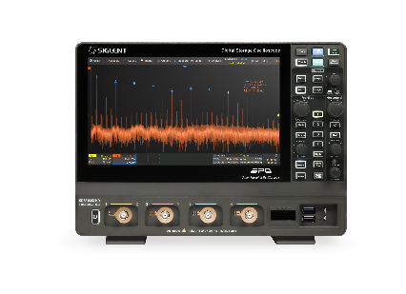
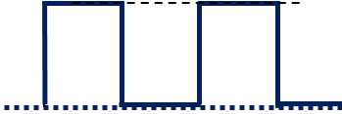
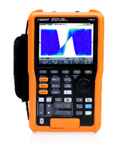
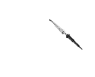
Why do customers need opt. Isolated Probes despite we have already solutions?
➔ Floating Measurements require special tools
Supply Voltage 600 V
615 V
Ground-free, floating Measurements
HV Differential Probes
15 V
600 V
Isolated Channel Oscilloscope

Slide 3

New Semiconductors change the Requirements
Wide BandGap (WBG) Semiconductors (SiC / GaN) are key to improve efficiency of Power Electronics
WBG Semiconductors help to satisfy the market requirements.

Slide 4
WBG Semiconductors:
Effects on Measurements and Equipment
Silicon-based vs. WBG-Semiconductors
Faster Rise/Fall times
Faster Switching Speed
Higher DI/Dt
Higher DV/Dt
Which T&M requirements are affected?
Bandwidth for Voltage and Current measurements
EMC
Dynamic Range
Common Mode Rejection Ratio (CMRR @ higher Frequencies)
Probing
Differential Voltage
10kV
3.3kV
IGBT
SiC
700V
Silicon
GaN
100ns
10ns
1ns
<1ns
Rise Time

Slide 5
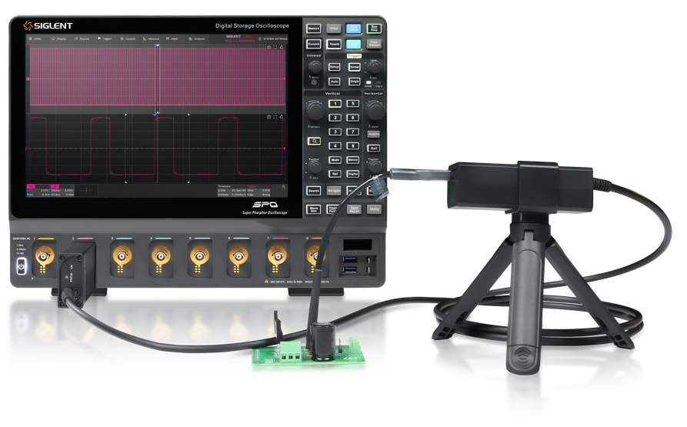
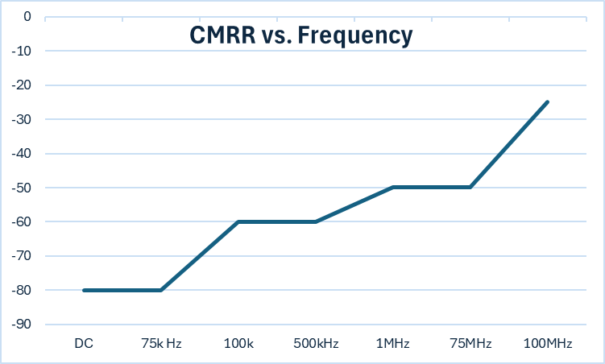
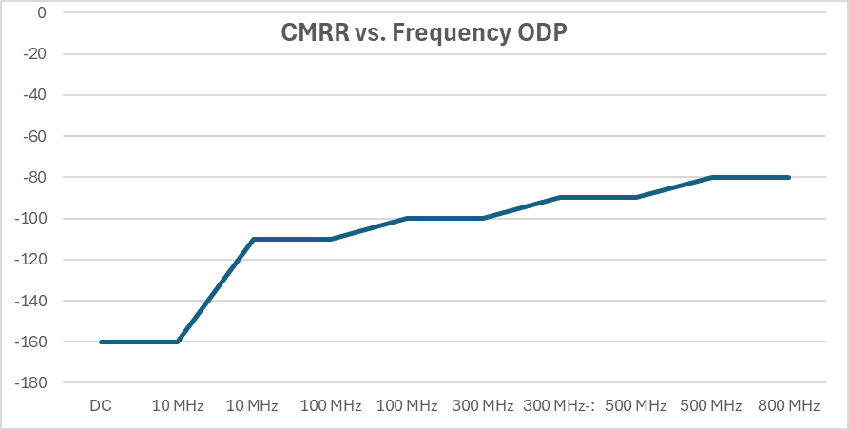
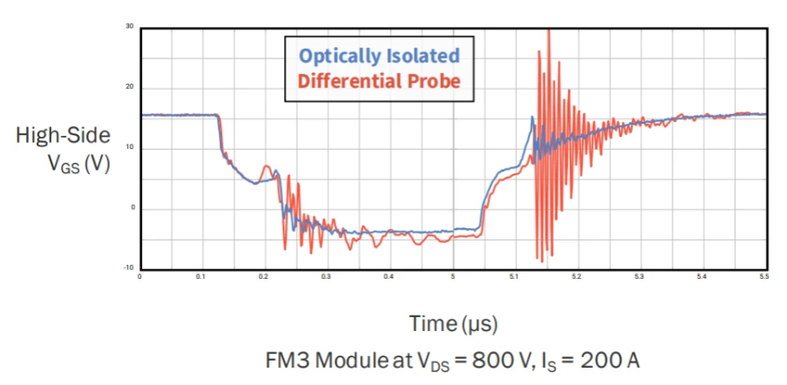
Comparison Classic vs. Opt.Iso.Probe
Faster Rise time need Higher Bandwidth Scope & Probes
Current Siglent Solutions: limited to 200 MHz
Classical HV-diff. Probe
Opt. Iso. HV-diff. Probe
Differential Amplifier
Common Mode Error @100MHz with HV-Diff. Probe
CMMR = 25 dB ~ 18:1
600V / 18 = 33,3V
+
V_{diff} 15 V
-
V_{CM} 600 V
Source: Wolfspeed App.Note, Dynamic Characterization and Measurement Methods

Slide 6
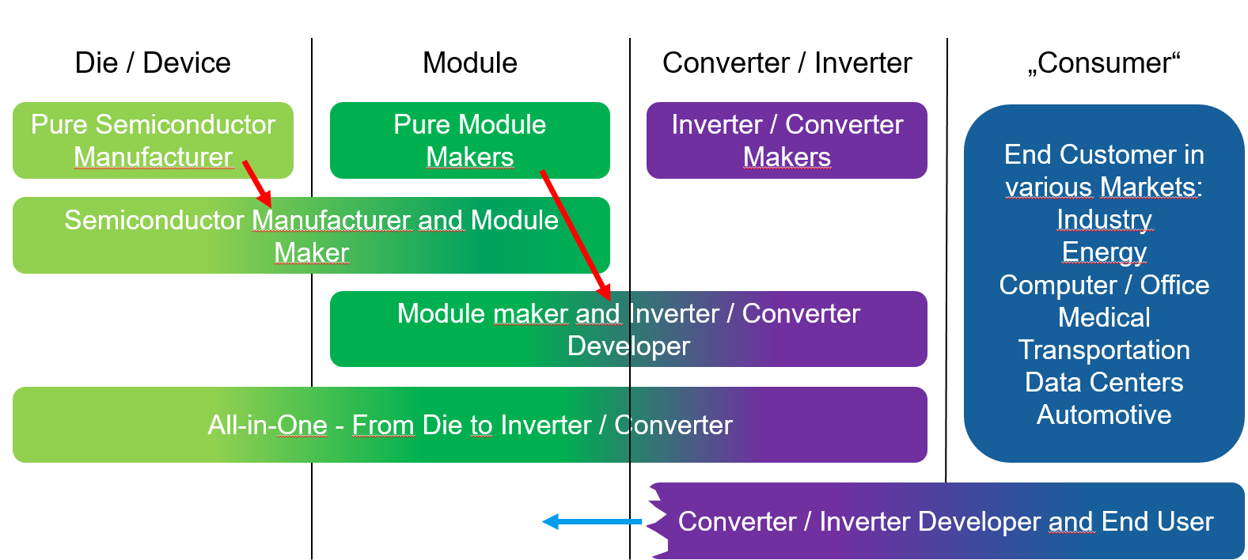
Whom should we address with the Siglent Solution?
Fokus Area
Notes:
Semiconductor Manufactureres mostly have solutions. Same is valid #
End customers mainly buy ready to use devices and maximum do verification tests.

Slide 7
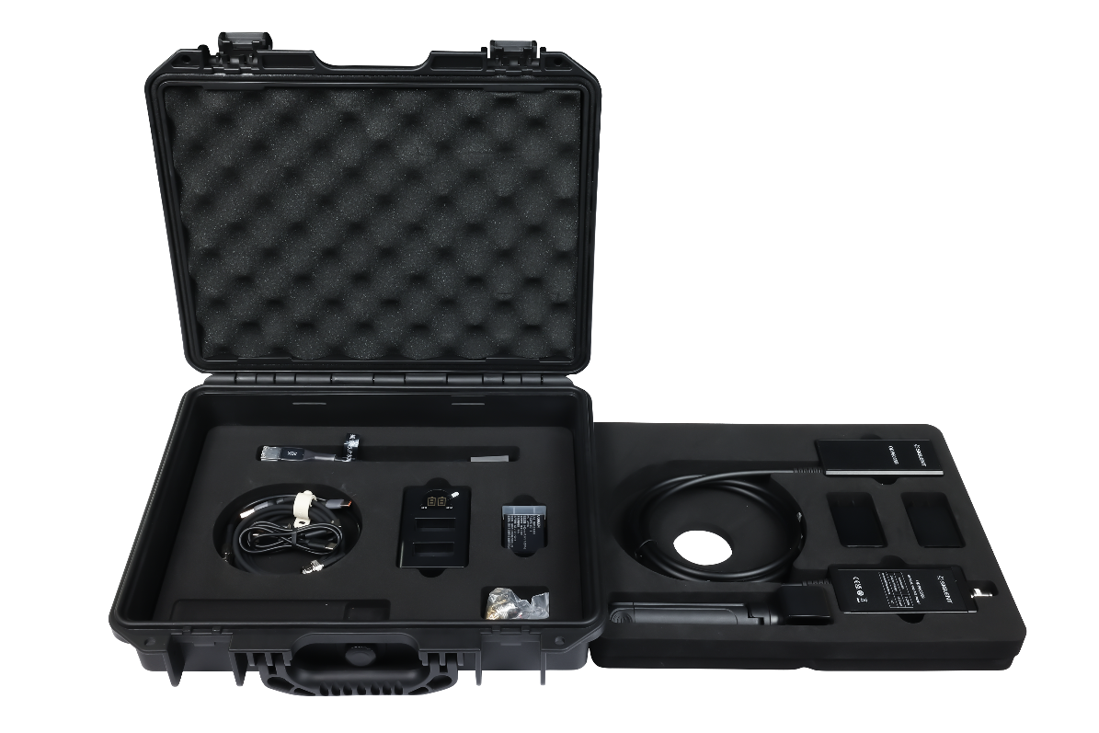
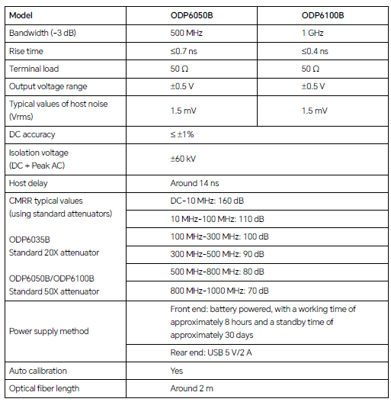
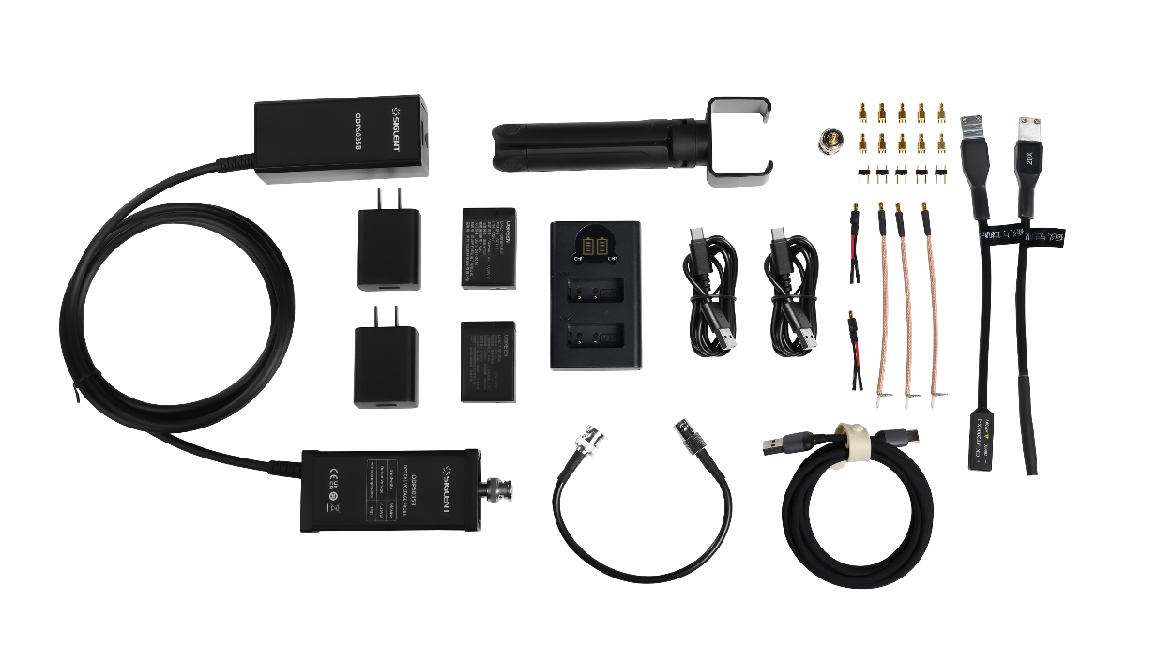
ODP6000A

Slide 8
Ordering Information
Model | Description | List Price
ODP6050B | Optical isolated probe: 500 MHz, 50X, Max. Differential Test Voltage (DC + Peak AC) +/-25 V, Isolated Voltage +/-60 kV, DC 5 V adapter or 7.4 V battery Power supply, Standard attenuators 50X/1000X/2000X/5000X | € 4.500
ODP6100B | Optical isolated probe: 1 GHz, 50X, Max. Differential Test Voltage (DC + Peak AC) +/-25 V, Isolated Voltage +/-60 kV, DC 5 V adapter or 7.4 V battery Power supply, Standard attenuators 50X/1000X/2000X/5000X | € 8.530
CK-AT5X-2 | Connector Type SSMB, Attenuation Ratio 5:1，Measurement Range ±2.5 Vpk, Input Impedance 1 MΩ||28 pF | € 173
CK-AT10X-2 | Connector Type SSMB, Attenuation Ratio 10:1，Measurement Range ±5 Vpk, Input Impedance 1 MΩ||6 pF | € 173
CK-AT20X-2 | Connector Type SSMB, Attenuation Ratio 20:1，Measurement Range ±10 Vpk, Input Impedance 5 MΩ||6 pF | € 173
CK-AT50X-2 | Connector Type SSMB, Attenuation Ratio 50:1，Measurement Range ±25 Vpk, Input Impedance 10 MΩ||4 pF | € 173
CK-AT100X-2 | Connector Type SSMB, Attenuation Ratio 100:1，Measurement Range ±50 Vpk, Input Impedance 10 MΩ||2 pF | € 173
CK-AT200X-2 | Connector Type SSMB, Attenuation Ratio 200:1，Measurement Range ±100 Vpk, Input Impedance 10 MΩ||2 pF | € 173
CK-AT500X-2 | Connector Type 2.54 mm socket, Attenuation Ratio 500:1, Measurement Range ±250 Vpk, Input Impedance 10 MΩ||2 pF | € 288
CK-AT5X-2 | Connector Type SSMB, Attenuation Ratio 5:1，Measurement Range ±2.5 Vpk, Input Impedance 1 MΩ||28 pF | € 173

Slide 9
EVERY BENCH. EVERY ENGINEER. EVERY DAY.

