Slide 1


Slide 2
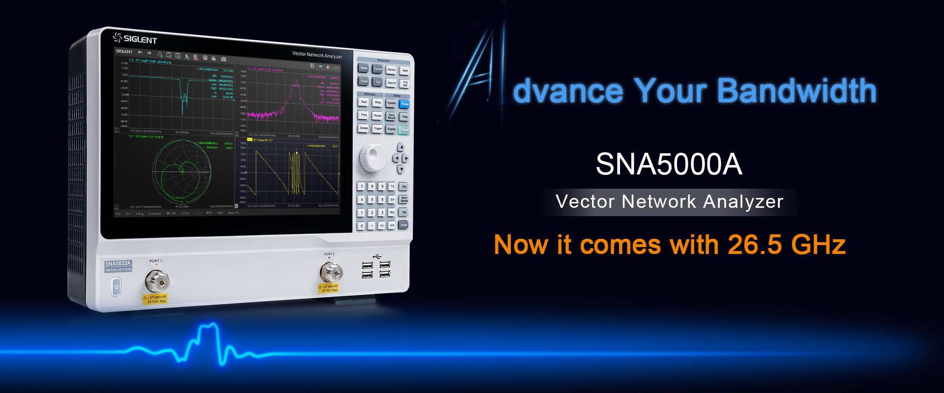

Slide 3
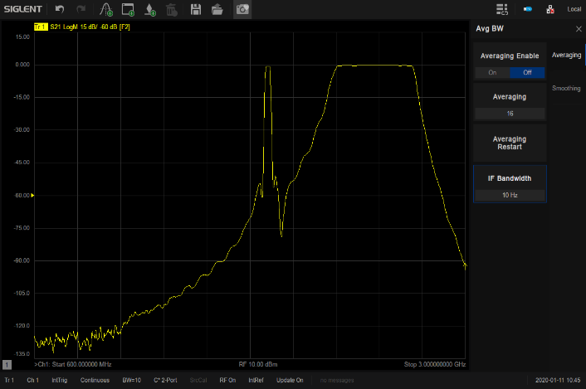
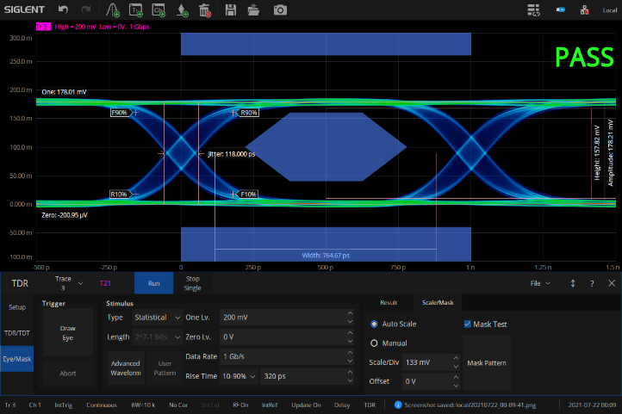
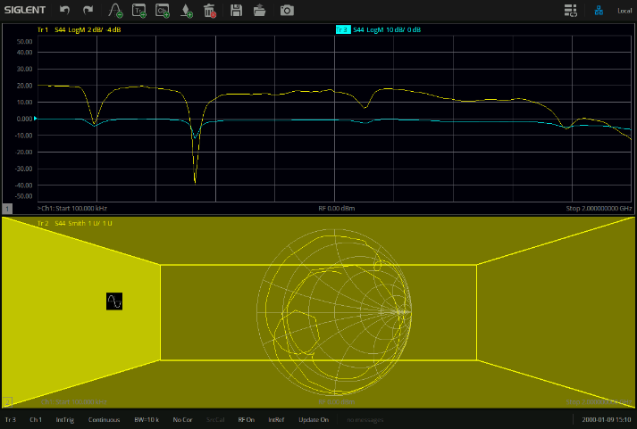


SNA5000A Highlights
Excellent RF performance
Abundant features
Modern design
Wide dynamic range
Wide range of output level
Low trace noise
Up to 26.5 GHz bandwidth
Advanced time domain analysis
Mixer measurement
Spectrum analysis
Fixture tests
Frequency offset mode
…
Intuitive user interface
Light weight and small size
Various quick operations

Slide 4
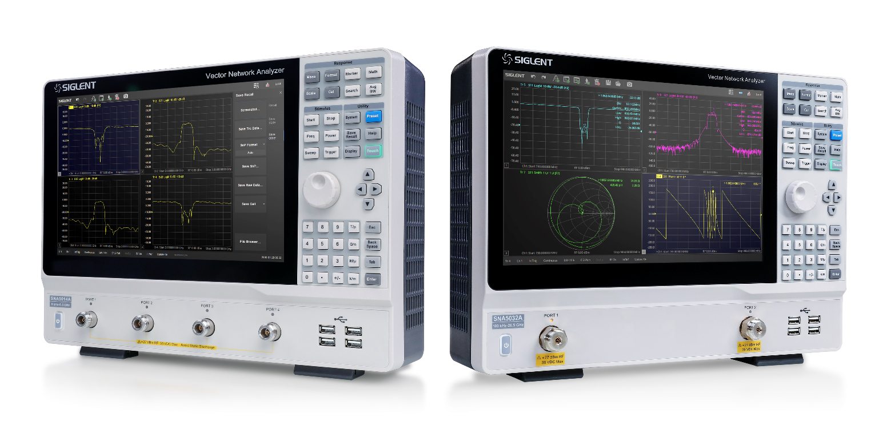
SNA5000A 2/4 ports, 4.5/8.5/13.5/26.5 GHz
Vector Network Analyzer
Contents
SNA5000A basic info
Features and Benefits
Calibration
Test Examples
Competition Analysis
Future Proof

Slide 5
SNA5000A main parameters
Model | SNA5002A SNA5004A | SNA5012A SNA5014A | SNA5022A | SNA5032A
Frequency range | 9 kHz ~ 4.5 GHz | 9 kHz ~ 8.5 GHz | 100kHz-13.5 GHz | 100kHz-26.5 GHz
Ports | 2/4 | 2/4 | 2 | 2
Frequency resolution | 1 Hz
Level resolution | 0.05 dB
Range of IFBW | 10 Hz ~ 3 MHz
Setting range of output level | -55 dBm ~ +10 dBm
Dynamic range | 125 dB
Bias-Tees | Standard
Interface | LAN，USB Device, USB Host(USB-GPIB)
Remote control | SCPI/Labview/IVI based on USB-TMC/VXI-11/Socket/Telnet/WebServer
Display | 12.1-inch touch screen
Video output | HDMI
Types of calibration | Response calibration, Enhanced Response calibration, Full-one port calibration, Full-two port calibration, Full-three port calibration, Full-four port calibration, TRL calibration
Types of measurement | Scattering-parameter measurement, differential-parameter measurement, receiver measurement, time-domain parameter analysis, limit test, ripple test, impedance conversion, fixture simulation, adapter removal / insertion, enhanced time-domain parameter analysis(TDR), spectrum analysis, frequency offset, scalar mixer measurement

Slide 6
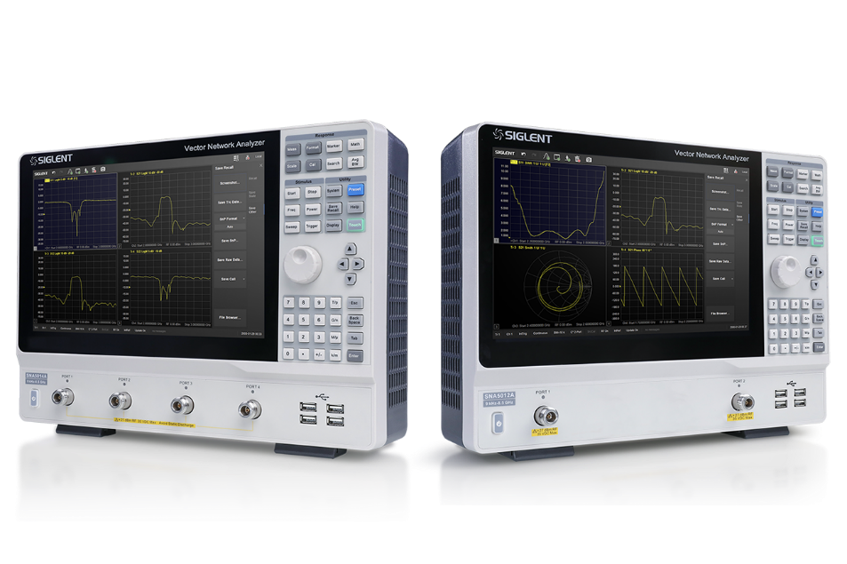
SNA5000A 2/4 ports, 4.5/8.5/13.5/26.5 GHz
Vector Network Analyzer
Contents
SNA5000A basic info
Features and Benefits
Calibration
Test Examples
Competition Analysis
Future Proof

Slide 7
SNA5000A Features and benefits
Hardware
Features | Benefits
Small size and light weight | Desk space saver and extremely portable
Big touch screen and shortcuts | Focus on measurement, save test time
Two internal sources | Faster mixer measurements
Integrated, synthesized sources | Providing excellent frequency resolution and stability
Standard Bias-tee connections | Convenient amplifier measurements
Up to 8 receivers with identical architecture (reference and measurement receivers) | Multipath DUTs, antenna arrays

Slide 8
SNA5000A Features and benefits
Functions
Features | Benefits
Versatile display and MATH function | Indicate multiple info like phase, S parameters, group delay and impedance at the same time
Data hold and limit test | Intuitive display of components verification
Spectrum analysis option | Spurious research or power measurements without reconnecting the DUT to a SA
Frequency offset mode | Realize the measurement of nonlinear characteristics of the device
Wide range of output level | Characterize most DUTs without need of external amplifiers or attenuators

Slide 9
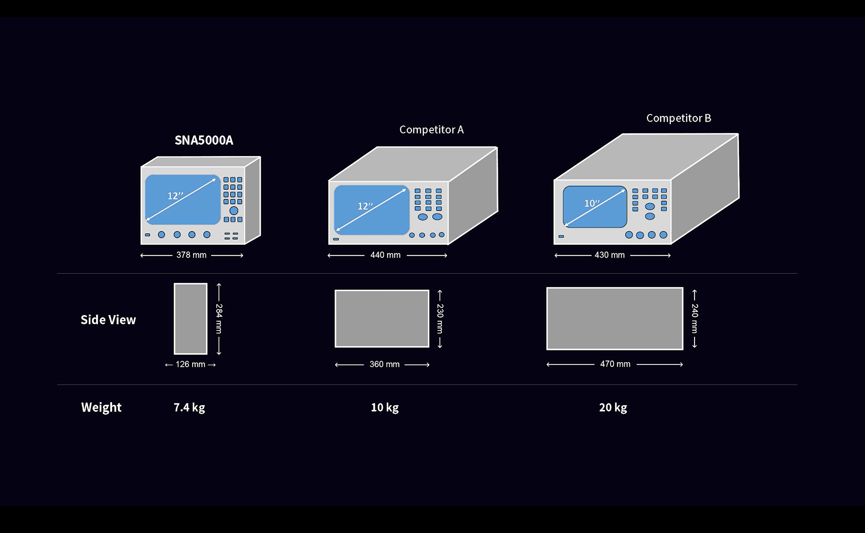

Compact shape
$L×W×D=$378 $×$284 $×$126 mm
2-port: 5.5 kg
4-port or SNA5032A/SNA5022A :7.4 kg

Slide 10
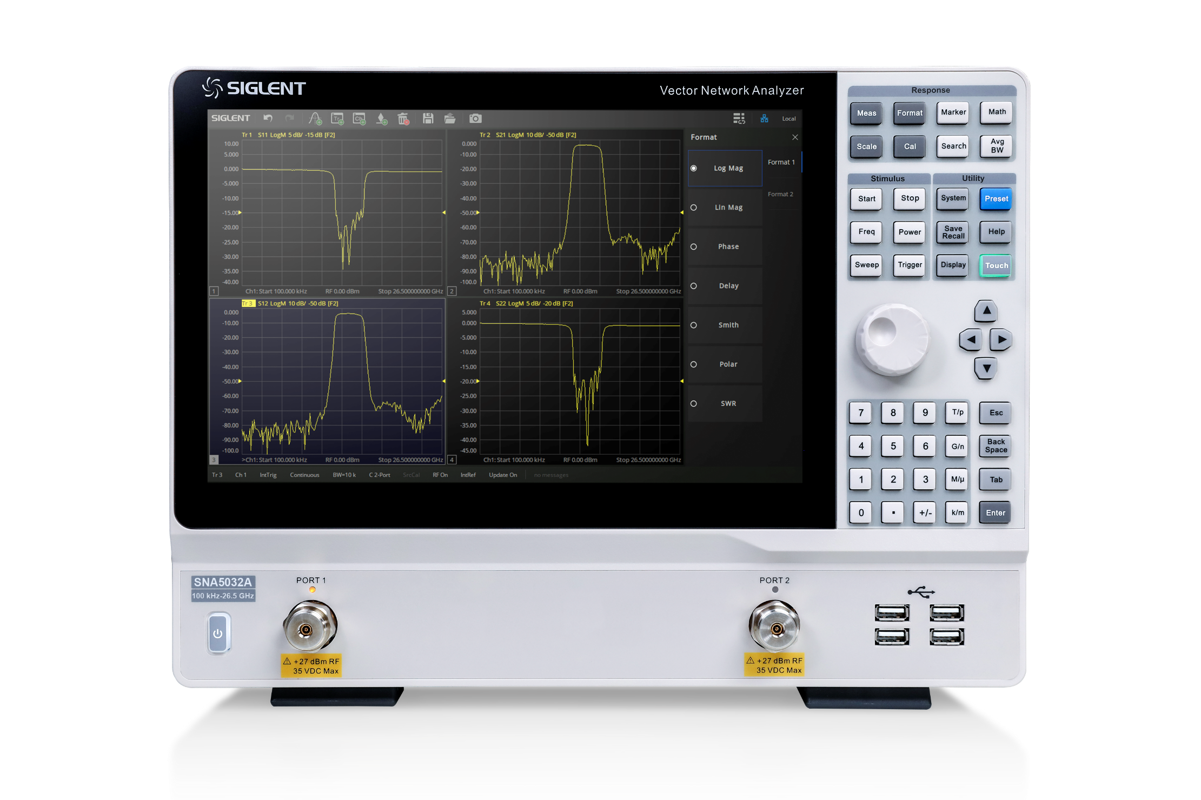
User Friendly Interface
Useful short cuts operations: Undo, Redo, Add Trace, Add Trace+Window, Add Channel+Window, Add Marker, Delete, Save, Open, Screenshot
Response
Utility
Stimulus
12.1 inch Big Touch Screen
Navigation
Up to 256 Channels, and 256 traces
Knob
Numeric
4 USB host ports
Type-N, female, 50Ω (SNA5002A/SNA5012A/SNA5004A/SNA5014A)
3.5mm NMD（male），50Ω (SNA5032A/SNA5022A)

Slide 11
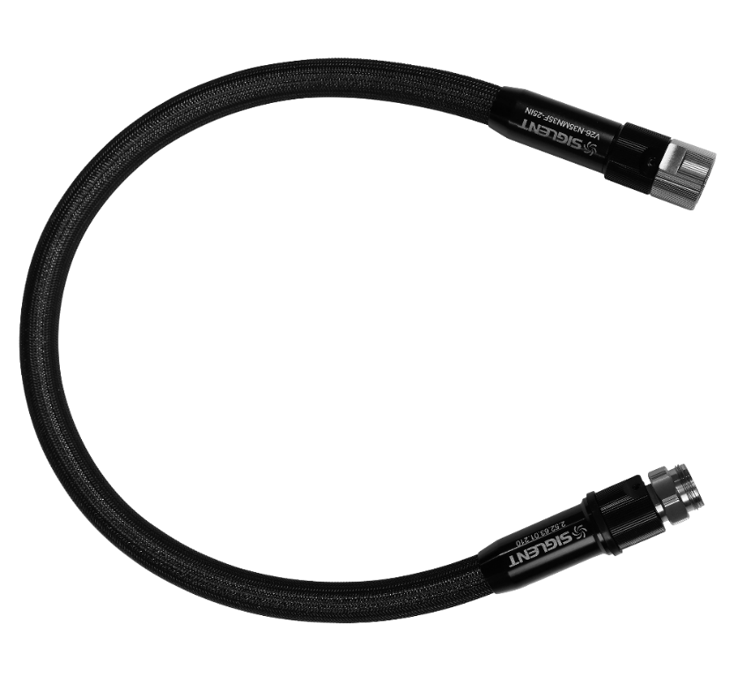
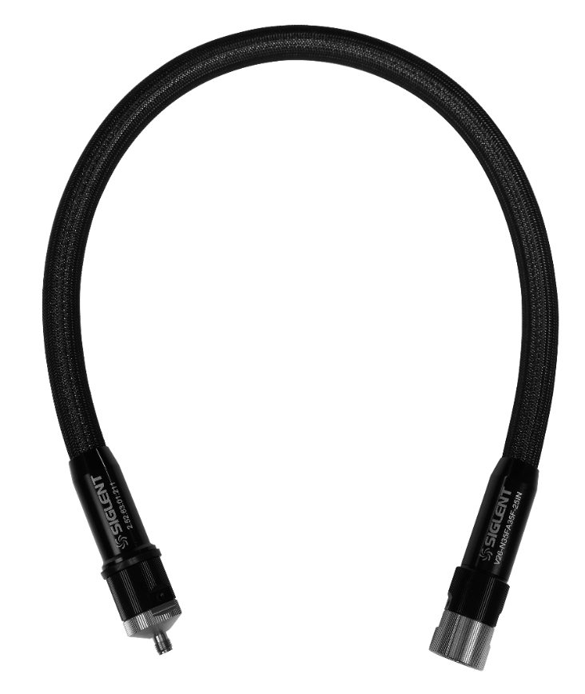
New high stability cables
V26-N35MN35F-25IN: NMD 3.5 mm male - NMD 3.5 mm female; 26.5 GHz; length 25''/635mm
V26-N35FA35F-25IN: NMD 3.5 mm female - APC 3.5 mm female; 26.5 GHz; length 25''/635mm
Mechanical phase stability: ±2.7°
Mechanical amplitude stability: ±0.08 dB

Slide 12
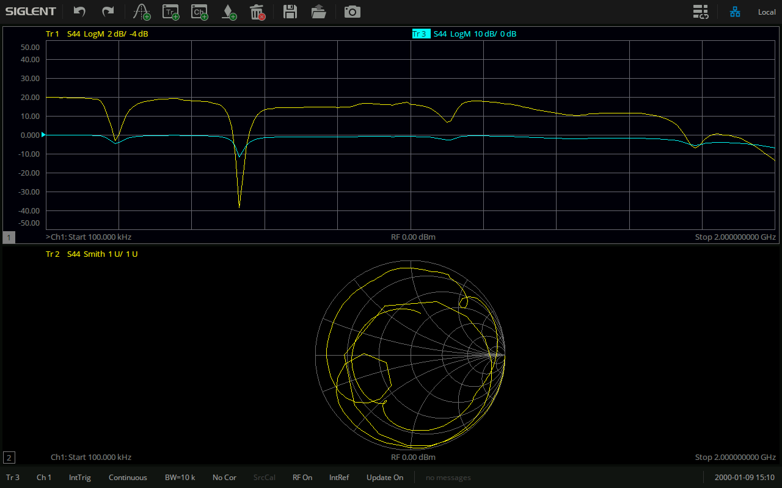
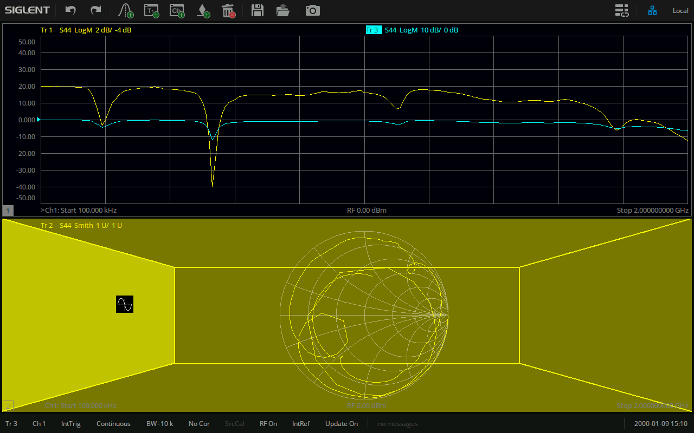
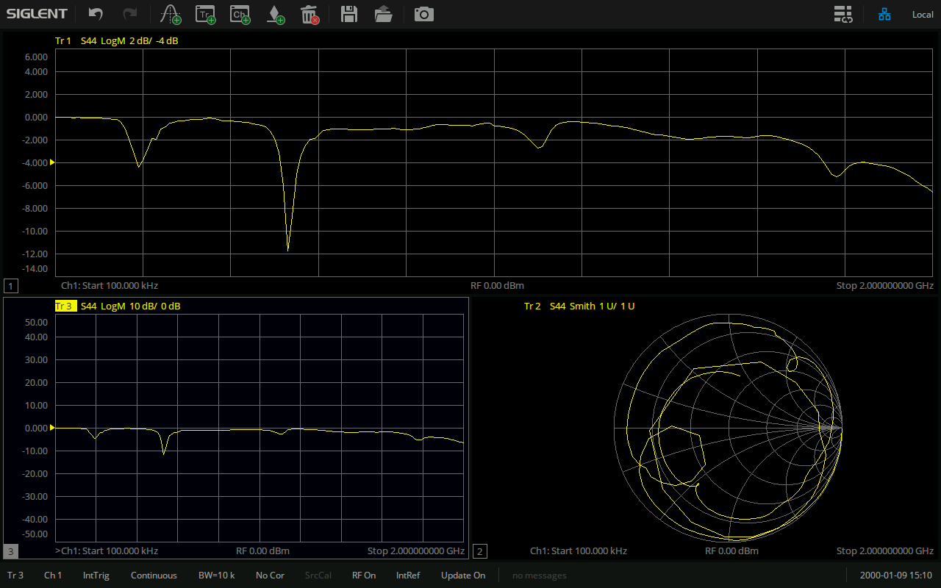
User Friendly Interface
Simply drag a trace to create a new channel around existing one

Slide 13
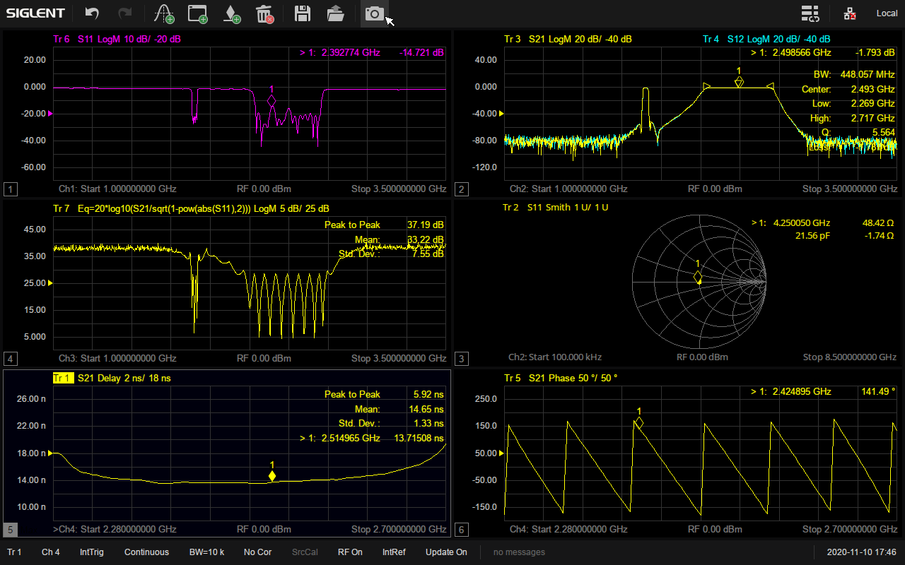
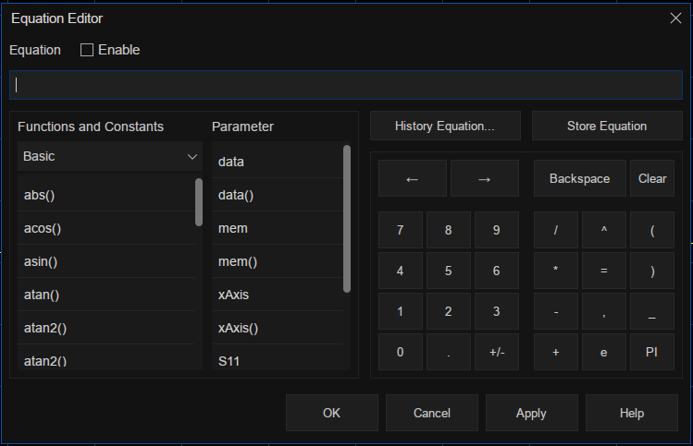

Versatile Display and MATH functions
Multi-window display in case too many traces in a channel(up to 256 traces）
Equation Editor
Multi-format display help to learn about a DUT in various angles
Log Mag, Lin Mag, Phase, Delay, Smith, Polar, SWR
Trace statistics

Slide 14
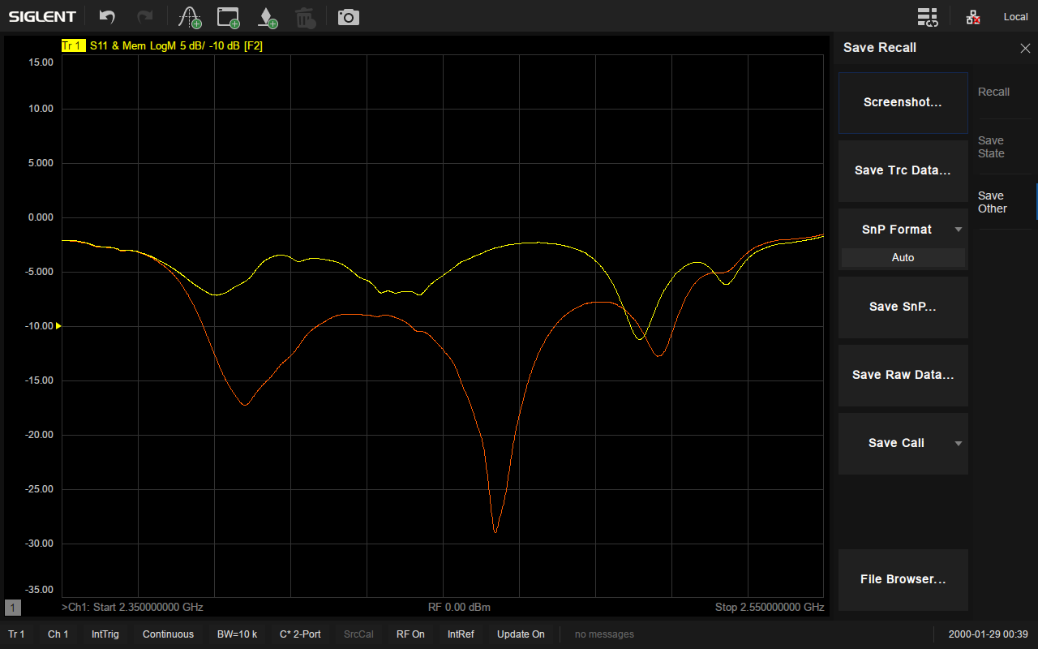
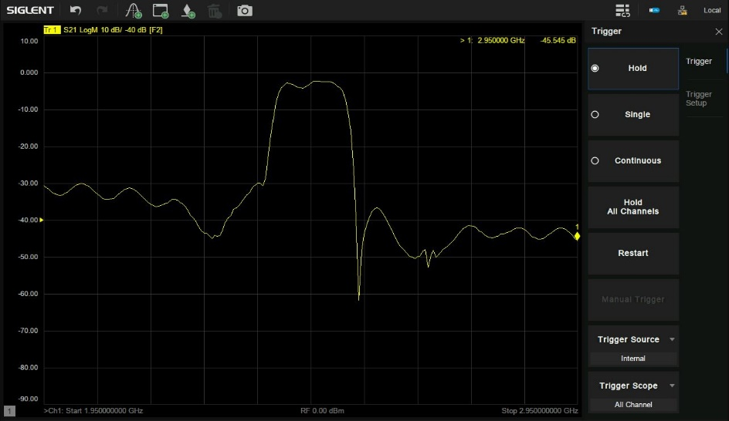
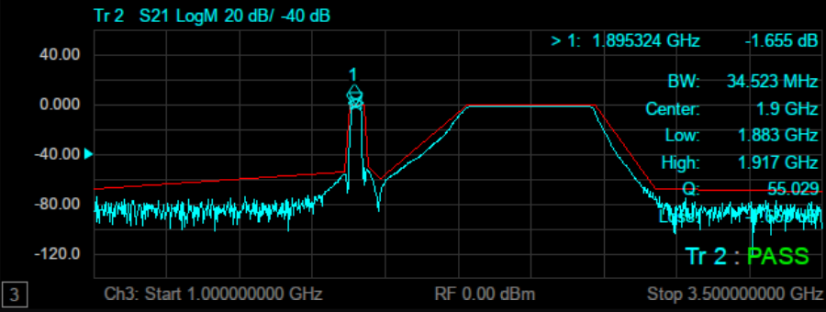
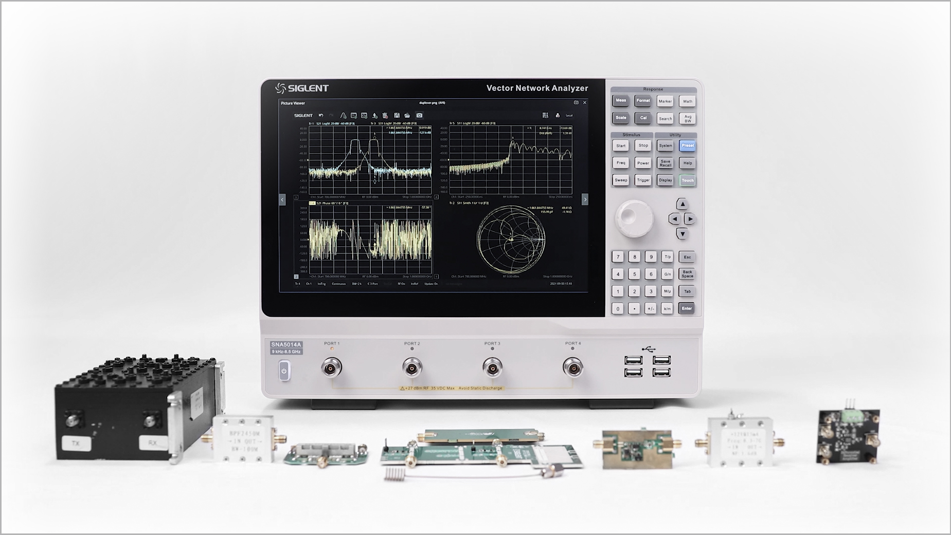
Data hold and limit test
Display and compare memory with current data
Limit test
Display data hold
Useful in products verification

Slide 15
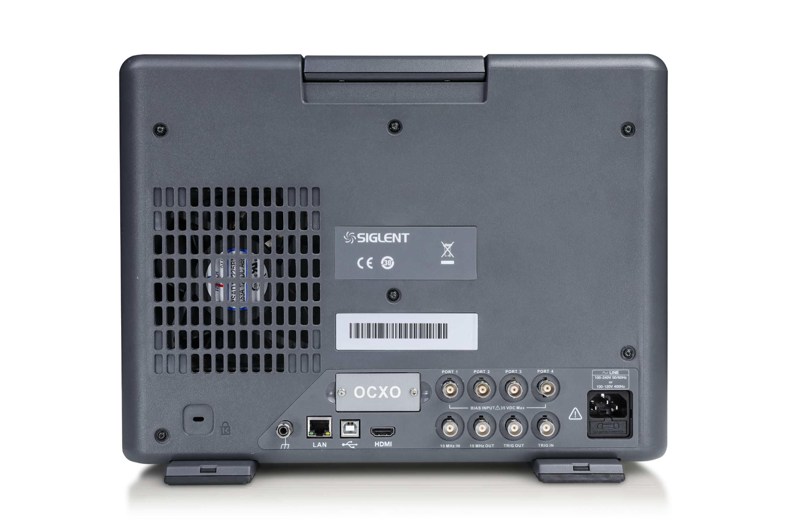
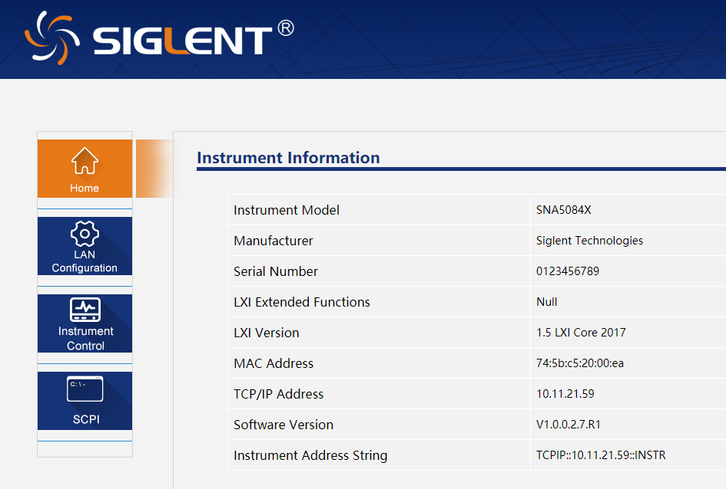
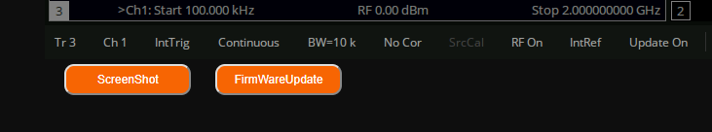
Abundant Interfaces
4 USB Host ports on the front panel
LAN, USB Device, HDMI in the back panel
Standard Bias Tee, with BIAS INPUT ports
10 MHz IN, 10 MHz OUT, TRIG OUT, TRIG IN
Option SNA5000-HPR high performance reference
clock can be added later in field
Web Server makes remote control more than easy

Slide 16
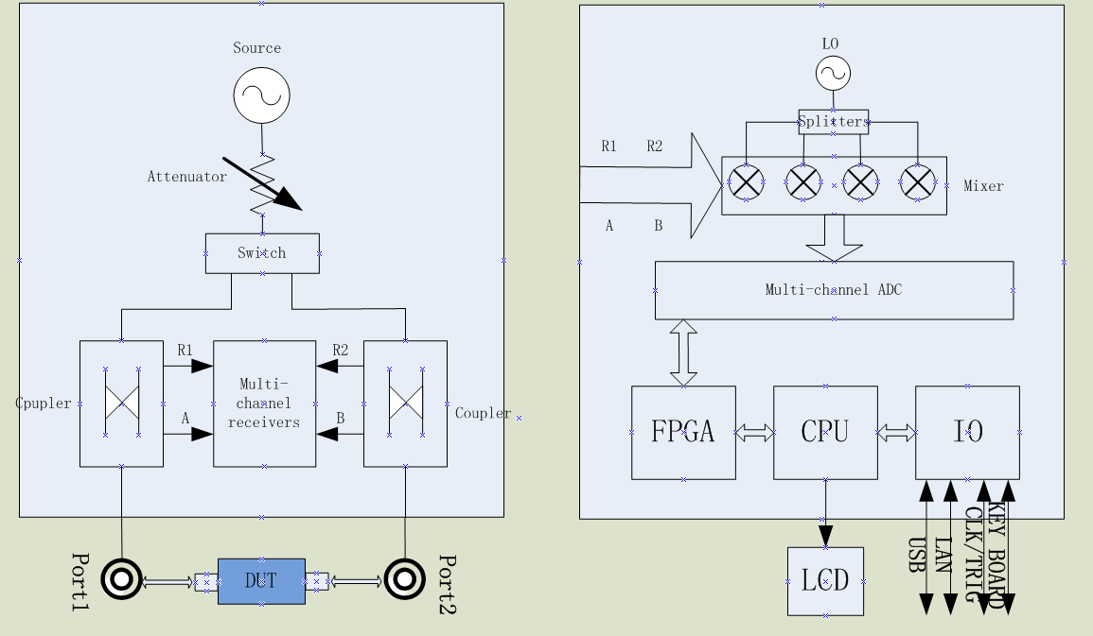
SNA5000A Structure
VNA is a complex test system which consists of Source, Power Divider, Directional coupler, Receivers, Detector, Processor, Display etc.
It tests parameters of components, electronic circuits and systems like linear / non-linear parameters, frequency variation parameters, S parameters.
SNA5000A 2 port models have 1 source, 4 independent receivers, 4 port models have 2 sources, 8 independent receivers.
Notes:
Here is a generalized block diagram of a network analyzer, showing the major signal-processing sections. In order to measure the incident, reflected and transmitted signal, four sections are required:
Source for stimulus
Signal-separation devices
Receivers that downconvert and detect the signals
Processor/display for calculating and reviewing the results
The signal source supplies the stimulus for our stimulus-response test system. We can either sweep the frequency of the source or sweep its power level. Traditionally, network analyzers used a separate source. These sources were either based on open-loop voltage-controlled oscillators (VCOs) which were cheaper, or more expensive synthesized sweepers which provided higher performance, especially for measuring narrowband devices. Excessive phase noise on open-loop VCOs degrades measurement accuracy considerably when measuring narrowband components over small frequency spans. Siglent VNA have integrated, synthesized sources, providing excellent frequency resolution and stability.

Slide 17
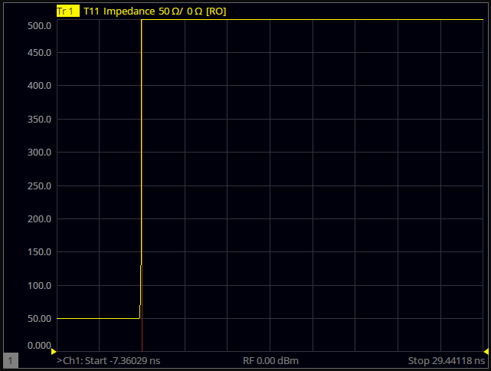
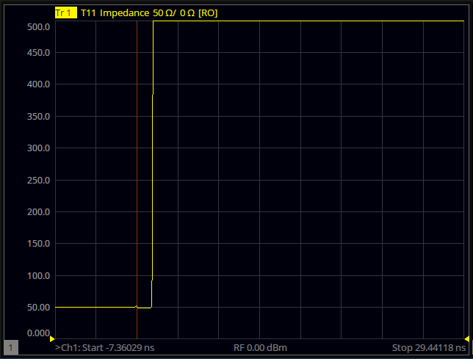
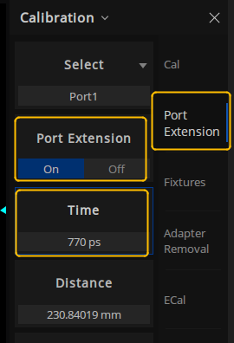
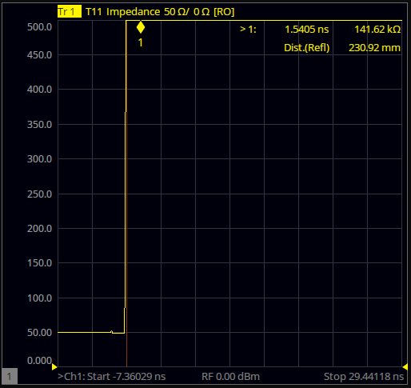
Fixture tests and Adapter remove/ insert
Port Extensions: a useful way to eliminate fixture errors. Electrically move the measurement reference plane after calibration.
S parameters calibration is often performed between RF cable and fixture port plane. DUT is inside fixture, and connected to fixture via microstrip line, which results in errors. Because the actual measurement plane is not the same as calibration plane
It can be eliminated by simply entering microstrip line Length, Velocity Factor, Loss parameters.
Automatic Port Extension
Cable with calibration
Add fixture,
With Port Extension ON
Notes:
Add fixture, the calibration plane is not the same as measurement plane(redline & yellow line difference)

Slide 18
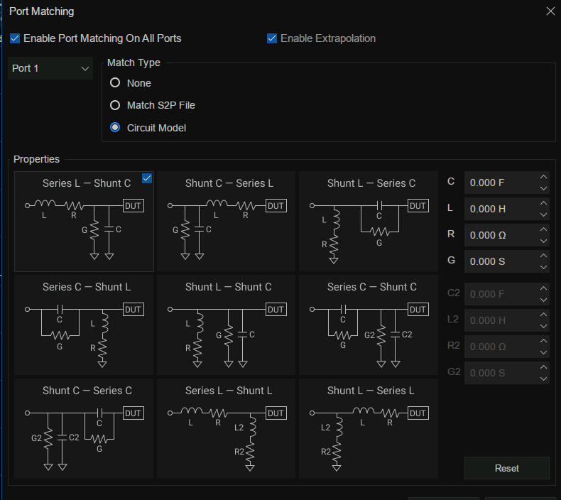
Fixture tests and Adapter remove/ insert
Port Match
Match S2P file
9 kinds of circuit models made with L, R, G, C
VNA
DUT
CAL Ref Plane
Port Match
VNA
Matching
Network A
DUT
Matching
Network B
CAL Ref Plane

Slide 19
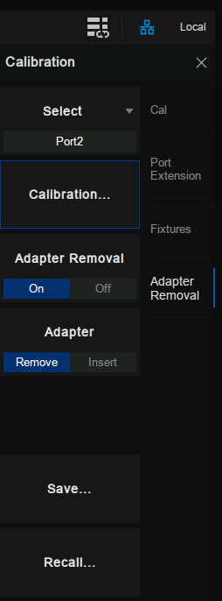
Fixture tests and Adapter remove/ insert
Adapter Remove / Insert
Calibration Plane
Calibration Plane
Port 1
Open
Open
Port 1
Short
Short
Load
Load
Adapter
Removal
Adapter
Insert
Perform calibration with adapter
Remove adapter and measure Open, Short, Load values to determine adapter’s characteristics
Remove the adapter characteristics from the error coefficients in a de-embedding fashion
Perform calibration without adapter
Insert adapter and measure Open, Short, Load values to determine adapter’s characteristics
Insert the adapter characteristics from the error coefficients in a embedding fashion

Slide 20
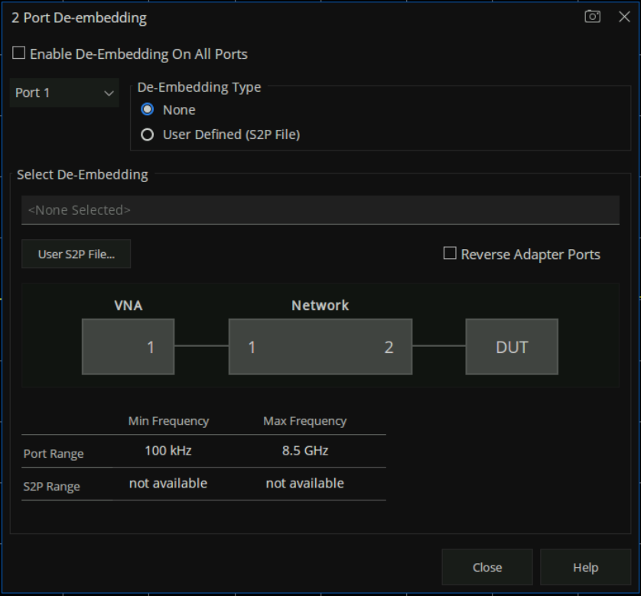
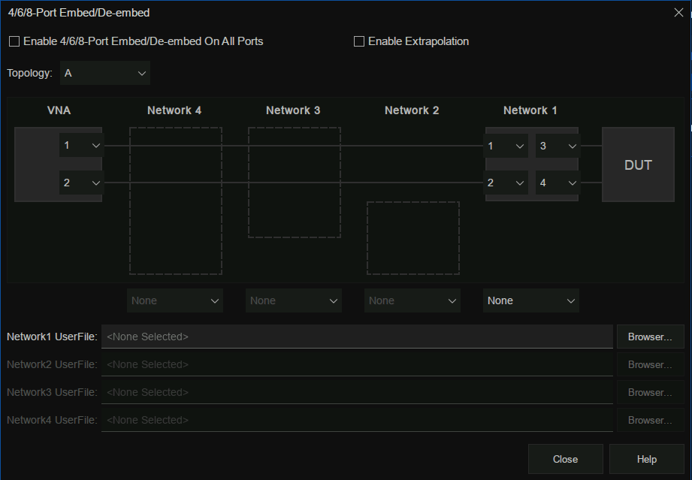
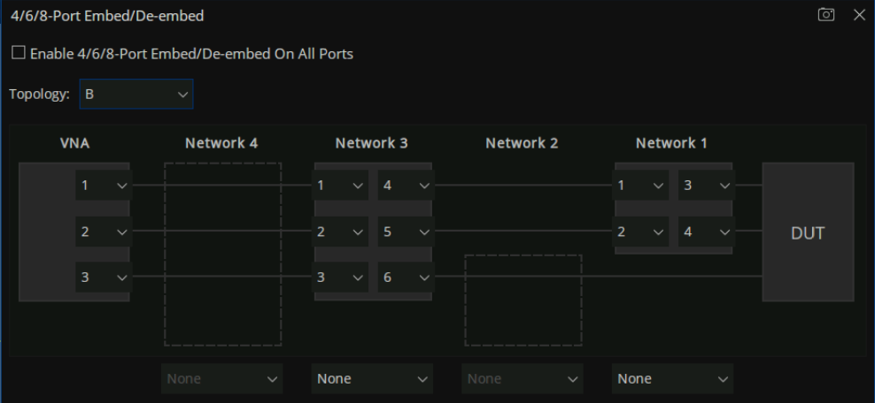
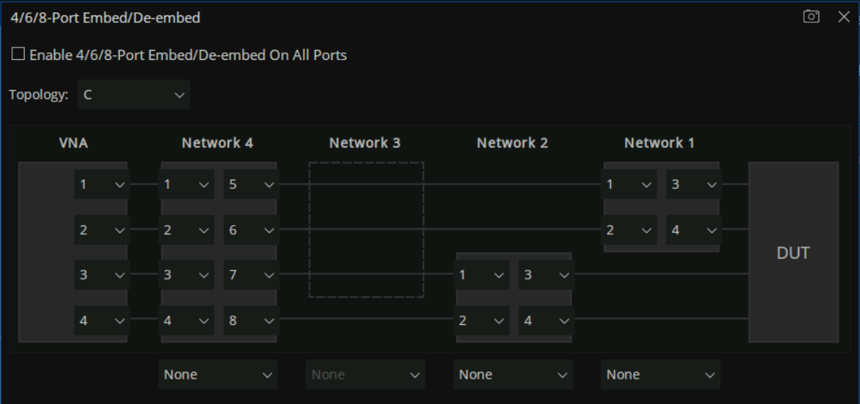
Fixture tests and Adapter remove/ insert
2-Port and N-Port De-Embedding
De-Embedding can remove the characteristics of the cable, test fixtures, etc.
N-Port De-Embedding has 3 kinds of topology.

Slide 21
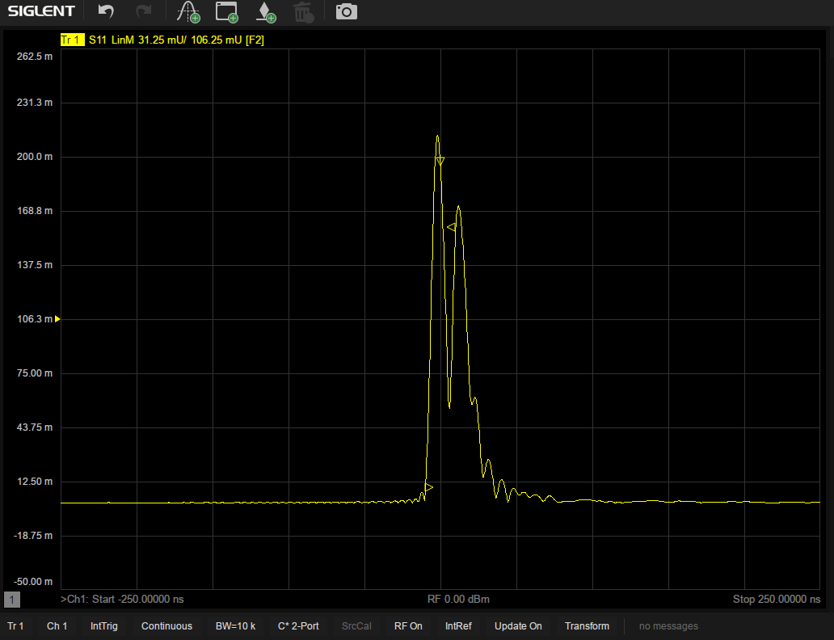
Time Domain analysis (Option SNA5000-TDA)
Get time domain info via inverse Fourier transform
Enable VNA analyze DUT in both frequency and time domain
Time Gating
Possibly the most useful function in VNA time domain transform functions
Exclude some time domain responses, only keep what is interested in
Window

Slide 22
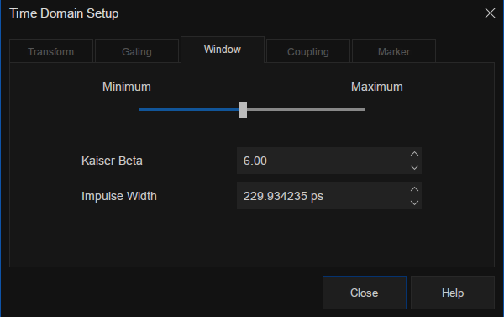
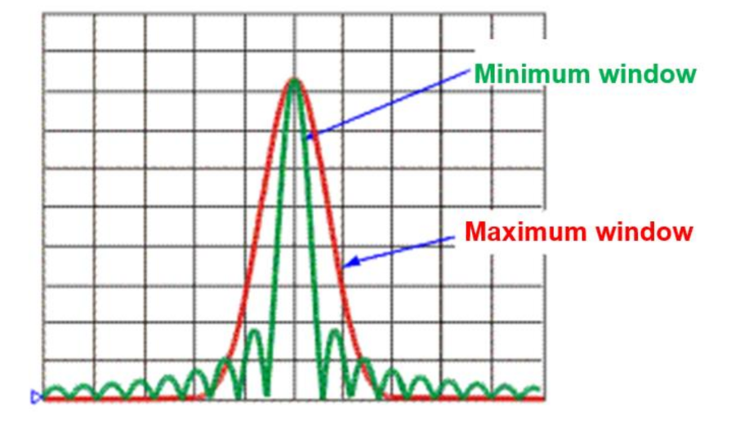
Window (Option SNA5000-TDA)
Reduce the overshoot and ringing in the process of frequency domain and time domain conversion
The size of the window should be balanced between response resolution and dynamic range.
Set the minimum window can get the best response resolution
Set the maximum window can get the maximum dynamic range
Three methods of setting window size
Minimum-maximum
Kaiser Beta
Impulse width

Slide 23
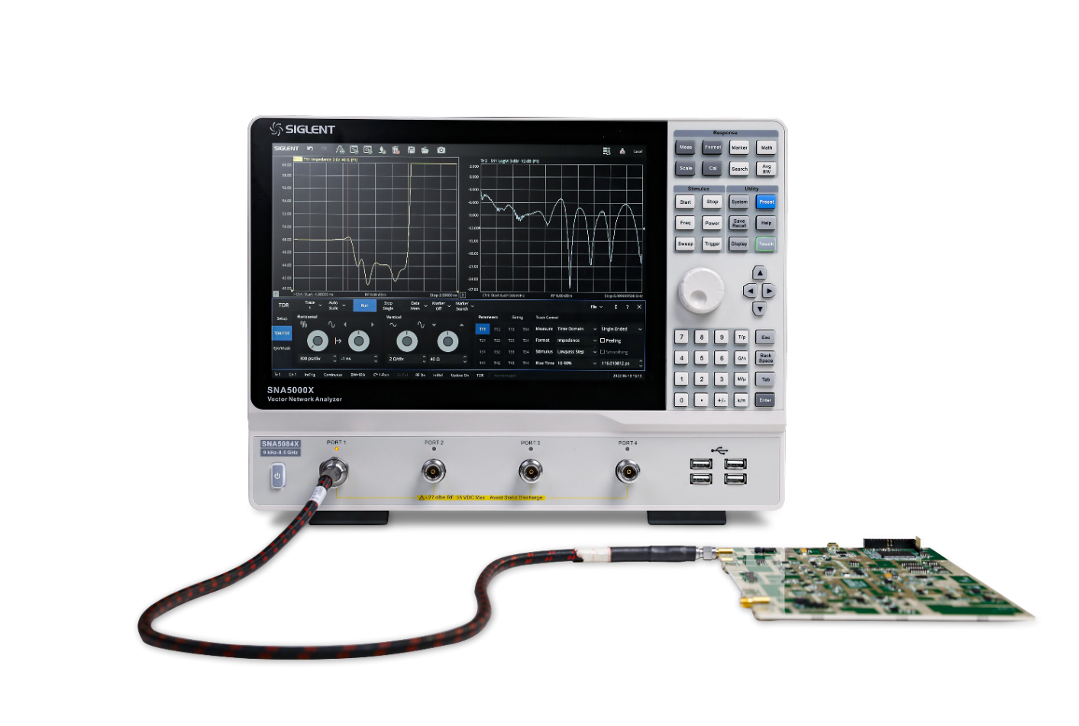
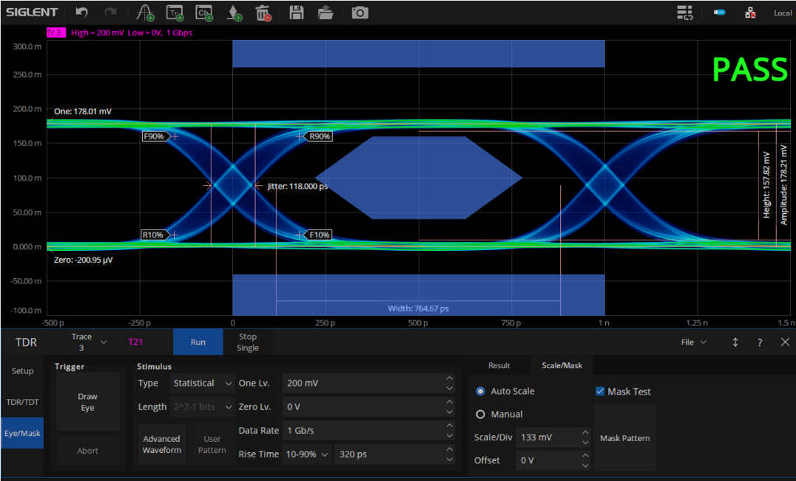
Enhanced Time-Domain analysis
(Option SNA5000-TDR)
VNA TDR use frequency domain information to calculate the inverse Fourier transform for time domain results.
TDR/TDT (Time Domain Reflection / Transmission)
Eye/Mask
Advantages over traditional Time Domain Reflector
Utilizing a narrowband receiver, has higher SNR and superior dynamic range.
TDR/TDT
Eye/Mask

Slide 24
Enhanced Time-Domain analysis
(Option SNA5000-TDR)
Advantages
Intuitively display impedance discontinuous position and characteristics. It can indicate the impedance of every point along the transmission line, helps to locate fault points.
With time domain gating, easily eliminate influences of some kinds of mismatch. It helps to analyze the influences of malfunctions to DUT characteristics.
Without the need of an external generator, but generate eye diagram with internal virtual pattern generator. It provides a genuine signal integration analysis tool.
Eye function provides high performance waveform simulation function. Without need to change external connections, it can easily improve signal transmission quality at the transmit end with application of pre-emphasis/de-emphasis technology, receive end the equalization technique.
Eye function provides jitter injection function to simulate signals with jitter and to see what effects can it bring to signal transmission.
Notes:
Utilizing a narrowband receiver (an architecture with down-conversion and filtering to result in an intermediate frequency or IF),
The VNA allows for greatly reduced system noise levels. This translates into enhanced signal-to-noise ratio and therefore superior dynamic range to a TDR.
This is significant in applications where low levels of crosstalk need to be measured in the gigabit per second range and higher.

Slide 25
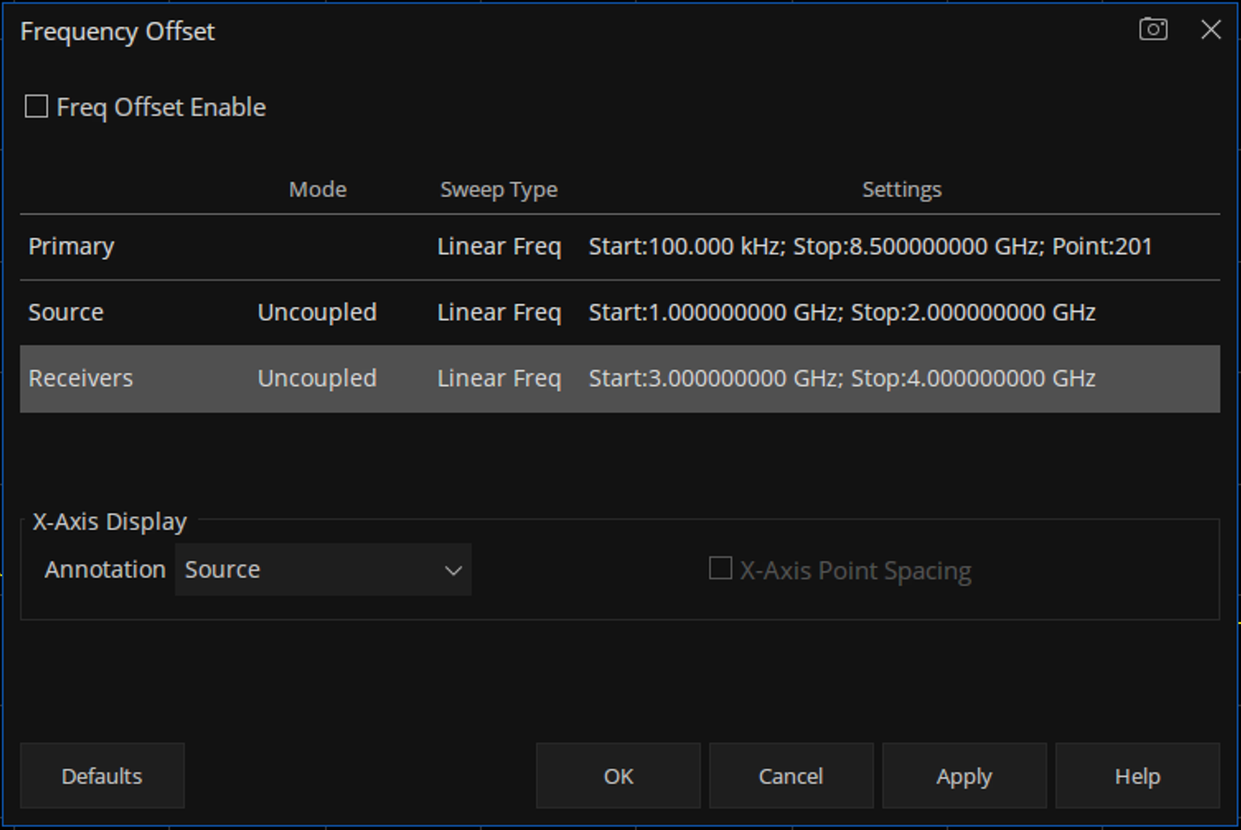
Frequency Offset Mode
Advantages
Enable the SNA internal RF signal source and SNA port receiver to operate at different frequencies.
Realize the measurement of nonlinear characteristics of the device.
Enable phase consistency measurements of complex inverter components
Features such as one-time display of multiple groups of data under multiple channels

Slide 26
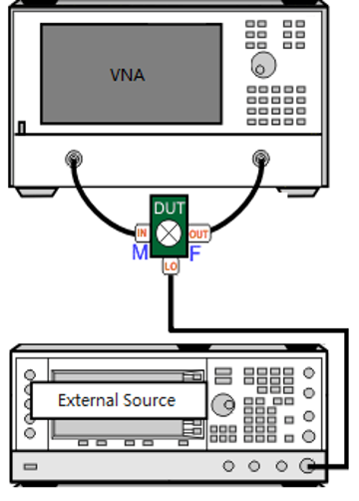
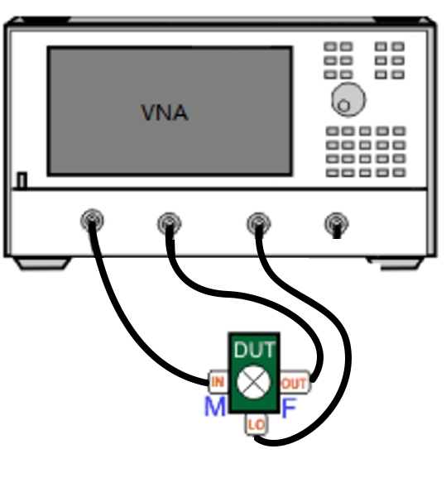
Scalar Mixer Measurements (Option SNA5000- SMM)
FW version (> V1.0.0.2.10.R9)
Measurement Setup
All of Siglent SSG signal generators are supported
4 port models do not need external source
Notes:
Conversion loss, the 1 dB compensation point, isolation between ports and port VSWR

Slide 27
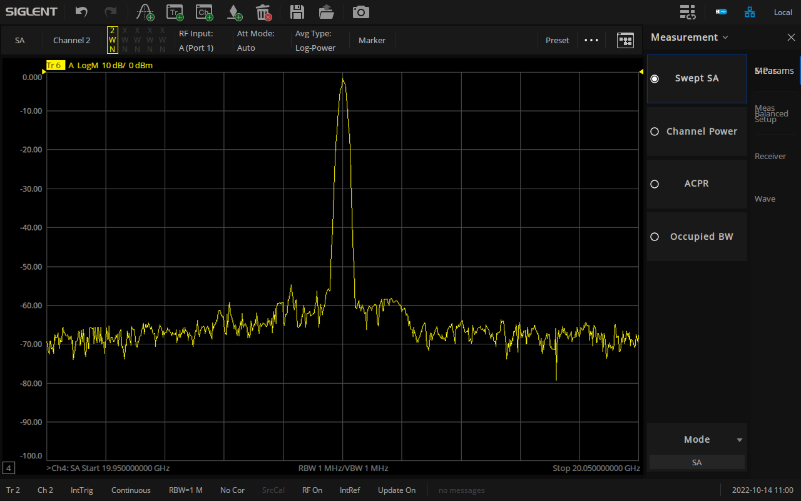
Spectrum Analysis function (Option SNA5000-SA)
Adjust the local oscillator signal and mirror suppression algorithm processing to obtain the signal spectrum
Spurious research or power measurements without reconnecting the DUT to a SA
For 4 port models, four SA windows can be opened at the same time to observe 4 different frequencies.
Display the SA setting dialog box, SA parameter reset, SA processing flow chart
Active Entry
Indicate the main working state of state, the port of RF input , Attenuation mode , Average Type, Current Marker operation.
SA Measurement items.
Indicate and control the main sweep parameters, such as frequency, resolution.
Status bar.

Slide 28
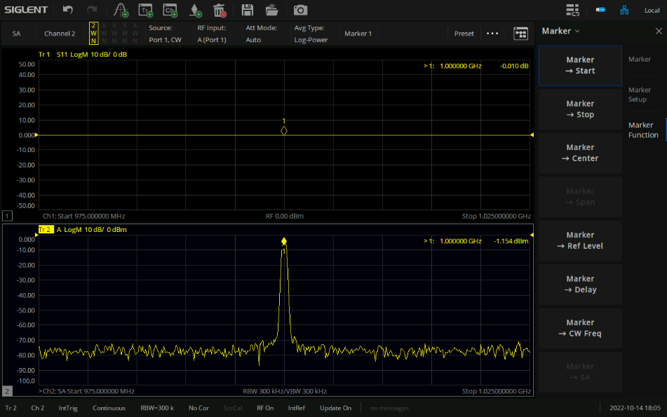
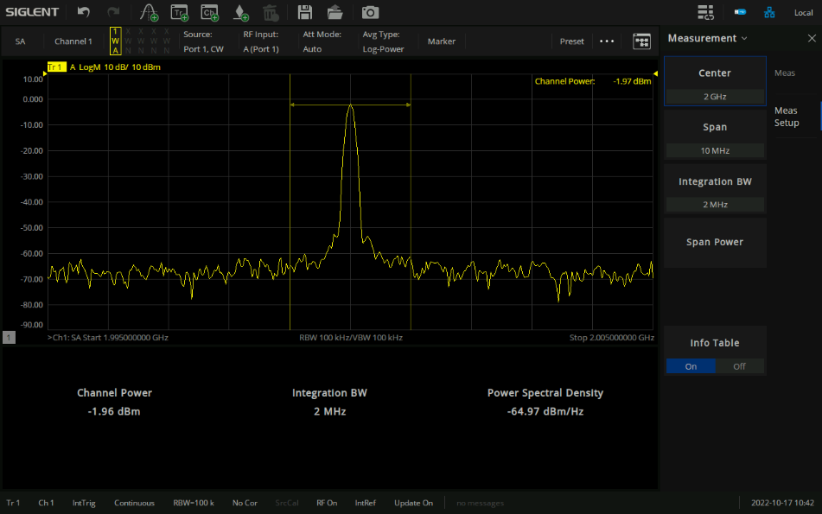
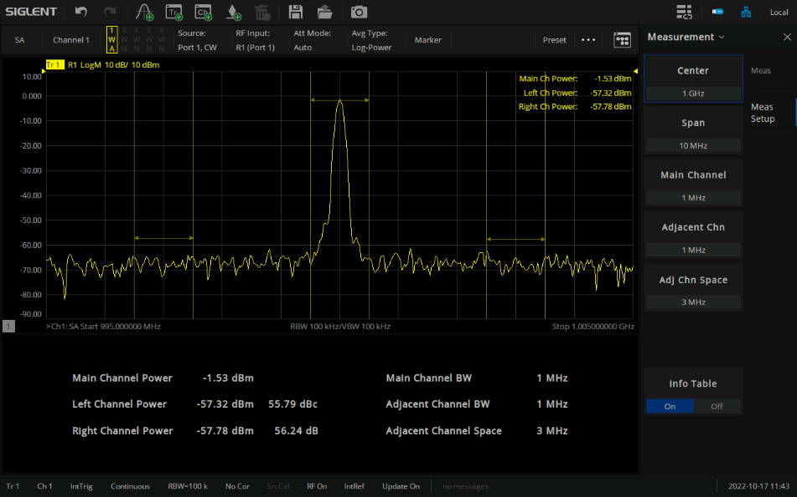
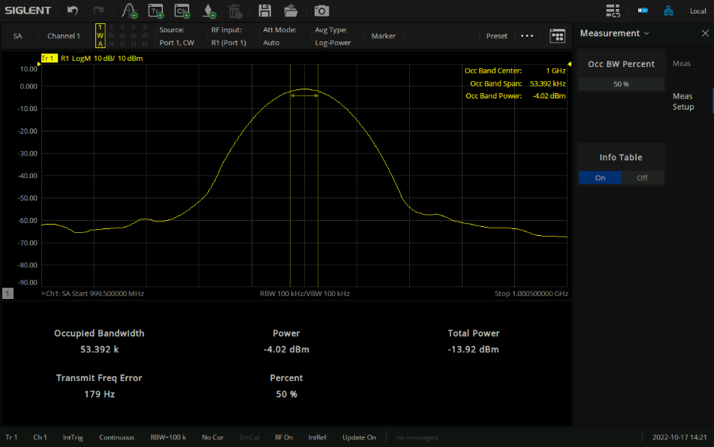
Spectrum Analysis Measurement (Option SNA5000-SA)
Marker-> SA
Channel Power
ACPR
Occupied BW

Slide 29
SNA5000A 2/4 ports, 4.5/8.5/13.5/26.5 GHz
Vector Network Analyzer
Contents
SNA5000A basic info
Features and Benefits
Calibration
Test Examples
Competition Analysis
Future Proof

Slide 30
Measurement error modeling
Systematic errors
Imperfections in the analyzer and test setup
Time invariant
Eliminated via calibration
Random errors
Unpredictable
Like instrument noise, switch and connector repeatability
Can not be eliminated via calibration
Drift errors
System performance changing after calibration
Temperature variation
Eliminated by Re-calibration
Calibration
Re-Calibration
Notes:
How to reduce random errors? using high-quality cables and connectors, reducing system noise figure by keeping step attenuator values as low as possible, selecting a small IF bandwidth, and possibly using averaging.
The calibration process employs a technique called vector error correction

Slide 31
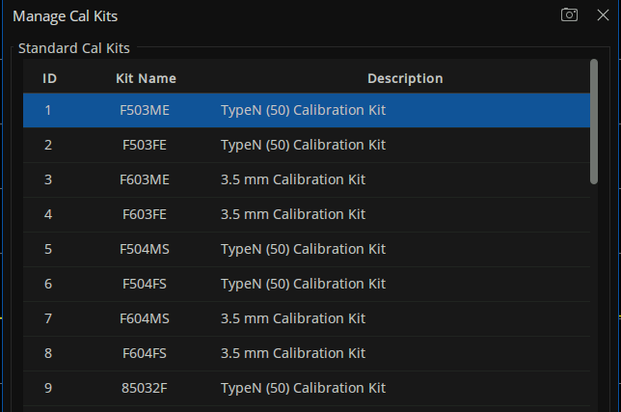
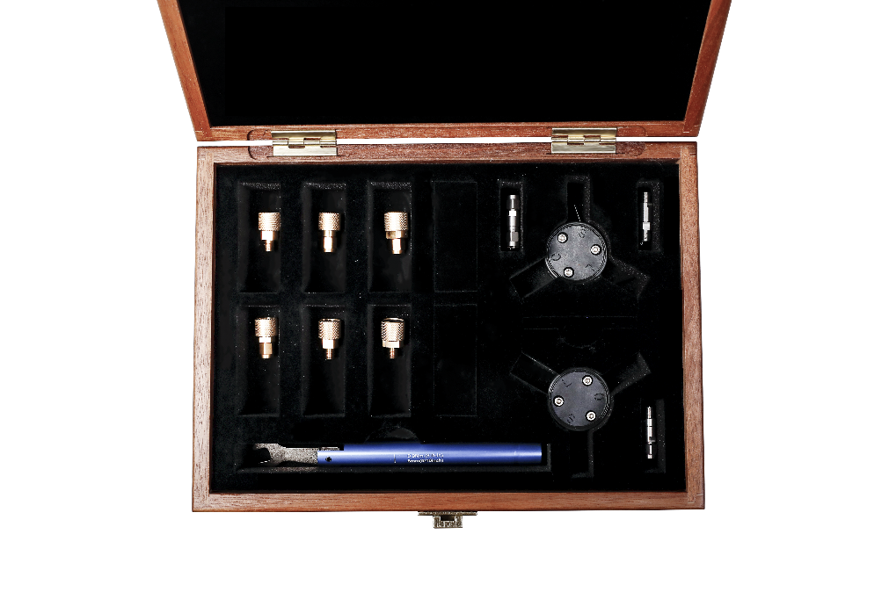
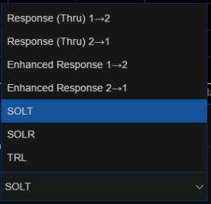





Mechanical Cal. Kit
Calibration types

Slide 32



New Mechanical Cal. Kit
F604TY: Mechanical Calibration Kit: OSLT, DC - 27 GHz, 3.5mm-Male and Female connector
Y504MS: Integrated Mechanical Calibration Kit: OSLT, DC - 9 GHz, N-Male
Y504FS: Integrated Mechanical Calibration Kit: OSLT, DC - 9 GHz, N-Female
NEW

Slide 33

Adding your own Cal. Kit - Summary
Easily add self defined Cal. Kit with import/export function
Export single Cal. Kit with Save
Add single Cal. Kit with Import
Export all Cal. Kits with Save Workspace
Import all Cal. Kits with Recall Workspace
Recover all factory Cal. Kits with Restore Defaults
It is more convenient to edit part of parameters of
original Cal. Kits than add a new Cal. Kit

Slide 34

Save calibration data
Save/Recall -> Save State -> Save Type -> State + Cal Data -> Save State As...
Recall calibration data and state quickly
No connection setup should be changed

Slide 35
SNA5000A 2/4 ports, 4.5/8.5/13.5/26.5 GHz
Vector Network Analyzer
Content
SNA5000A basic info
Features and Benefits
Calibration
Test Examples
Competition Analysis
Future Plans

Slide 36

Antenna test
SWR measurement
Smith chart impedance measurement

Slide 37



Filter test – Frequency Sweep
Preset -> Set Start and Stop frequency -> Set sweep points -> Set IFBW -> Connect cables -> Cal -> Basic Cal... -> Choose Port 1 and Port 2 -> Choose Cal. Kit -> Choose DUT connector type -> Choose Cal. Type as SOLT -> NEXT -> Connect Open, Short, Load, Through -> Finish
Stopband
rejection
Return loss
Insertion loss
Notes:
Shown above are the frequency responses of a filter. On the left and bottom we see the transmission response in log magnitude format, and on the right we see the reflection response (return loss).
The most commonly measured filter characteristics are insertion loss and bandwidth, shown on the lower plot with an expanded vertical scale. Another common parameter we might measure is out-of-band rejection. This is a measure of how well a filter passes signals within its bandwidth while simultaneously rejecting all other signals outside of that same bandwidth. The ability of a test system to measure out-of-band rejection is directly dependent on its system dynamic-range specification.
The return loss plot is very typical, showing high reflection (near 0 dB) in the stopbands, and reasonable match in the passband. Most passive filters work in this manner. A special class of filters exist that are absorptive in both the passband and stopband. These filters exhibit a good match over a broad frequency range.
For very narrowband devices, such as crystal filters, the network analyzer must sweep slow enough to allow the filter to respond properly. If the default sweep speed is too fast for the device, significant measurement errors can occur. This can also happen with devices that are electrically very long. The large time delay of the device can result in the receiver being tuned to frequencies that are higher than those coming out of the device, which also can cause significant measurement errors.

Slide 38

Filter test
Preset -> press Meas ->choose S21 -> Set Marker to the highest point of S21 trace -> press Search ->choose BW Search -> Open
Notes:
Siglent SNA5000A VNA offers a quick measurement of filter BW.

Slide 39




Optimize Filter Measurements with Segment Sweep
Independent Settings Per Segment: Power Level, Sweep Time, IF Bandwidth, Delay, IF Bandwidth Per Port
With Segment sweep, the sweep can be optimized for speed and dynamic range.
More data points for higher data resolution
Lower IF bandwidth for high dynamic range( for example in filter stopbands), but it increases sweep time
The power level can be decreased in the passband and increased in the stopband for DUTs that contain a filter followed by an amplifier
X-Axis Points Spacing
Without it, many data points can be huddled in a small frequency span
With it, data points evenly distributed along the X-Axis
Two same frequency span with different points
Without X-Axis Point Spacing
With X-Axis Point Spacing
Notes:
Many network analyzers have the ability to define a sweep consisting of several individual segments. These segments can have their own stop and start frequency, number of data points, IF bandwidth, and power level. Using a segmented sweep, the sweep can be optimized for speed and dynamic range. Data resolution can be made high where needed (more data points) and low where not needed (less data points); frequency ranges can be skipped where data is not needed at all; the IF bandwidth can be large when high dynamic range is not necessary (in filter passbands, for example), which decreases the sweep time, and small when high dynamic range is required (in filter stopbands, for example); the power level can be decreased in the passband and increased in the stopband for DUTs that contain a filter followed by an amplifier (for example, a cellular-telephone base-station receive filter/LNA combination).

Slide 40


Amplifier test
Power Sweeps – Compression
1 dB compression point
AM to PM conversion
Notes:
Many network analyzers have the ability to do power sweeps as well as frequency sweeps. Power sweeps help characterize the nonlinear performance of an amplifier. Shown above is a plot of an amplifier's output power versus input power at a single frequency. Amplifier gain at any particular power level is the slope of this curve. Notice that the amplifier has a linear region of operation where gain is constant and independent of power level. The gain in this region is commonly referred to as "small-signal gain". At some point as the input power is increased, the amplifier gain appears to decrease, and the amplifier is said to be in compression. Under this nonlinear condition, the amplifier output is no longer sinusoidal -- some of the output power is present in harmonics, rather than occurring only at the fundamental frequency. As input power is increased even more, the amplifier becomes saturated, and output power remains constant. At this point, the amplifier gain is essentially zero, since further increases in input power result in no change in output power. In some cases (such as with TWT amplifiers), output power actually decreases with further increases in input power after saturation, which means the amplifier has negative gain.
Saturated output power can be read directly from the above plot. In order to measure the saturated output power of an amplifier, the network analyzer must be able to provide a power sweep with sufficient output power to drive the amplifier from its linear region into saturation. A preamp at the input of the amplifier under test may be necessary to achieve this.

Slide 41



DC bias tee advantages
No external bias circuit needed
Reduce the influence of environment
Save R&D cost
Measure PA with external bias circuit
Measure PA with DC bias-tee

Slide 42



Mixer test
Conversion Loss / Gain measurements
Conversion Loss / Gain over frequency range of interest
Mixer dynamic range / 1 dB compression point measurement
Conversion Loss / Gain as a function of LO power level

Slide 43


Mixer test
Isolation Measurements
RF and LO port Return Loss Measurements

Slide 44


Other applications
Measurement of transformers
CMRR (Sdd21/Scc21)
Balanced test
Pass/Fail and programming
Notes:
Siglent SNA5000A VNA offers a quick measurement of filter BW.

Slide 45
SNA5000A 2/4 ports, 4.5/8.5 GHz
Vector Network Analyzer
Contents
SNA5000A basic info
Features and Benefits
Calibration
Optional Accessories
Test Examples
Competition Analysis
Future Proof

Slide 46

Dynamic Range
SNA5000A
E5071C

Slide 47


Dynamic Range
Measuring high out-of-band rejection
cavity filter, dynamic range ≥ 125 dB

Slide 48


Filter measurement comparison
SNA5000A
E5071C
SNA5000A: IL=-0.287006dB
In band @2.5GHz S21 Insertion Loss
E5071C: IL=-0.287dB

Slide 49
Filter measurement comparison

Slide 50


Filter measurement comparison
SNA5000A
E5071C
S11 Return Loss Measurement

Slide 51
Filter measurement comparison

Slide 52

Diplexer measurement comparison

Slide 53


Diplexer measurement comparison
SNA5000A
E5071C
TX and RX port isolation

Slide 54
Diplexer measurement comparison

Slide 55
Stability Tests (12 hours)
Repeat tests in 12 hours – Full frequency range

Slide 56
Conformance Tests (12 hours)
Calibration – Running for 24 hours – Turn off – Turn it on again after one hour – Recall calibration data after 30 minutes warm up – Perform measurement again – Measured S21 values differences are within 0.015 dB

Slide 57



Appearance | SIGLENT SNA5000A | Keysight E5071C | R&S ZNL
Frequency Range | 9 kHz~4.5GHz/8.5 GHz; 100 kHz~13.5GHz/26.5 GHz | 9 kHz~3/4.5/6.5/8.5 GHz； 100 kHz~3/4.5/6.5/8.5 GHz； 300 kHz~14/20 GHz | 5 kHz~3/4.5/6/14/20 GHz
Ports | 2/4 | 2/4 | 2
System Dynamic Range (IFBW 10Hz) | SNA5002A/SNA5012A/SNA5004A/SNA5014A 89dB @9 kHz~18 kHz; 92dB @18 kHz~30 kHz; 95dB @30 kHz~100 kHz; 105dB @100 kHz~300 kHz; 120dB @300 kHz~500 kHz; 125dB @500 kHz-5 GHz; 123dB @5 GHz~6.8 GHz; 120dB @6.8 GHz~7.7 GHz; 119dB @7.7 GHz~8 GHz; 117dB @8 GHz~8.5 GHz; SNA5022A/SNA5032A 115dB @100 kHz~10 MHz; 125dB @10 MHz~9 GHz; 118dB @9 GHz~13.5 GHz; 115dB @13.5 GHz~20 GHz; 105dB @20 GHz~26.5 GHz | Option 280/480 97dB @9 kHz~300 kHz; 107dB @300 kHz~10 MHz; 123dB @10 MHz~6 GHz; 117dB @6 GHz~8.5 GHz; Option 2K5/4K5 95dB @300 kHz~1 MHz; 107dB @1 MHz~10 MHz; 120dB @10 MHz~100 MHz; 123dB @100 MHz~6 GHz; 117dB @6 GHz~8.5 GHz; 105dB @8.5 GHz~10.5 GHz; 100dB @10.5 GHz~15 GHz; 96 dB @15 GHz~20 GHz | ZNL3/ZNL4/ZNL6 >85 dB @5 kHz~100 kHz; >100 dB @100 kHz~10 MHz; >110 dB @10 MHz~50 MHz; >120 dB @50 MHz~4.5 GHz; >115 dB @4.5 GHz~6 GHz; ZNL14/ZNL20 >85 dB @5 kHz~100 kHz; >100 dB @100 kHz~10 MHz; >110 dB @10 MHz~14 GHz; >105 dB @14 GHz~16 GHz; >100 dB @16 GHz~20 GHz
Range of IFBW | 10 Hz~3 MHz | 10 Hz~1.5 MHz | 1 Hz~500 kHz
Setting range of output level | -55dBm ~ +10dBm | -55dBm ~ 10dBm | –10dBm ~ –3dBm @5 kHz~50 kHz; -10dBm ~ 0dBm @50 kHz~20 GHz; Option R&S®ZNL-B22 –40dBm ~ –3dBm @5 kHz~50 kHz; –40dBm ~ 0dBm @50 kHz~20 GHz
Level linearity | ±0.5 dB | ±0.75 dB | ≤1 dB @100 kHz~6 GHz; ≤1.5 dB @6 GHz~20 GHz
Noise Floor | SNA5002A/SNA5012A/SNA5004A/SNA5014A -100 dBm/Hz @9 kHz~100 kHz; -110 dBm/Hz @100 kHz~300 kHz; -120 dBm/Hz @300 kHz~500 kHz; -125 dBm/Hz @500 kHz~8.5 GHz; SNA5022A/SNA5032A -115 dBm/Hz @100 kHz~10 MHz; -125 dBm/Hz @10 MHz~20 GHz; -120 dBm/Hz @20 GHz~26.5 GHz | Option 280/480 –97 dBm/Hz @9 kHz~300 kHz; –107 dBm/Hz@300 kHz~10 MHz; –123 dBm/Hz@10 MHz~5 GHz; –124 dBm/Hz@5 GHz~ 6 GHz; –119 dBm/Hz@6 GHz~7 GHz; –120 dBm/Hz@7 GHz~8.5 GHz; Option 2K5/4K5 –97 dBm/Hz @300 kHz~1 MHz; –107 dBm/Hz@1 MHz~10 MHz; –120 dBm/Hz@10 MHz~100 MHz; –123 dBm/Hz@100 MHz~6 GHz; –118 dBm/Hz@6 GHz~8 GHz; –120 dBm/Hz@8 GHz~8.5 GHz; –108 dBm/Hz@8.5 GHz~10.5 GHz; –107 dBm/Hz@10.5 GHz~15 GHz; –106 dBm/Hz@15 GHz~20 GHz | ZNL3/ZNL4/ZNL6 <–95 dBm @5 kHz~100 kHz; <–120 dBm @100 kHz~50 MHz; <–130 dBm @50 MHz~4.5 GHz; <–125 dBm @4.5 GHz~6 GHz; ZNL14/ZNL20 <–95 dBm @5 kHz~100 kHz; <–120 dBm @100 kHz~50 MHz; <–125 dBm @50 MHz~6 GHz; <–120 dBm @6 GHz~16 GHz; <–115 dBm @16 GHz~20 GHz
Display | 12.1-inch,1280*800,touch screen | 10.4-inch,1024*768,touch screen | 10.1-inch,1280*800,touch screen
Size | W×H×D=378×284×126 mm | W×H×D=426×222×472 mm | W×H×D=408×186×235 mm
Weight | 2-port:5.5 kg; 4-port or SNA5032A/SNA5022A:7.4 kg | Option 230/240/260/280 (2-port):18.8 kg; Option 430/480/440/460 (4-port):20.5 kg; Option 2D5/2K5 (2-port):20.4 kg; Option 4D5/4K5 (4-port):22.4 kg | without options:6 kg; with internal battery:7.3 kg

Slide 58


SNA5000A vs. R&S ZNL
SNA5000A | R&S ZNL
Max. Frequency range 26.5GHz | 20 GHz
Dynamic range 125 dB | 120 dB
Setting range of output level -55dBm~10 dBm | -10dBm ~3 dBm optional extend -40dBm~0dBm (cost for opt. ZNL14: 2362,50 € / ZNL20: 2625.-€)
Level linearity ±0.5dB | 1.5dB
12.1'' screen | 10.1''
Standard DC-Bias inputs | Not available
Frequency offset mode/ SMM function (option) | Not available
Notes:
Siglent SNA5000A VNA offers a quick measurement of filter BW.

Slide 59
SNA5000A 2/4 ports, 4.5/8.5 GHz
Vector Network Analyzer
Contents
SNA5000A basic info
Features and Benefits
Calibration
Optional Accessories
Test Examples
Competition Analysis
Future Proof

Slide 60
Future Proof
Description | Expected release date
Pulse Measurements (SW) | Q2/2023
High power Amplifier Measurements(SW) | Q2/2023
Ecal/ Switch matrix(Accessories) | Q2/2023
Vector Mixer Measurements(SW) | Q4/2023
Noise figure Measurements(SW) | Q4/2023
Electromagnetic Material Analysis(SW) | TBD

Slide 61
Thank You
The Best Value in Electronic Test & Measurement
Headquarters
NA
Europe
SIGLENT TECHNOLOGIES CO., LTD.
Add: Blog No.4 & No.5, Antongda Industrial Zone, 3rd Liuxian Road,
Bao’an District, Shenzhen, 518101, China.
Tel:+ 86 755 3688 7876
Fax:+ 86 755 3359 1582
sales@siglent.com
www.siglent.com/ens
SIGLENT Technologies NA, Inc.
Add: 6557 Cochran Rd Solon, Ohio 44139 Tel: 440-398-5800 Toll Free:877-515-5551 Fax: 440-399-1211
info@siglent.com www.siglentna.com
SIGLENT TECHNOLOGIES GERMANY GmbH
Add: Liebigstrasse 2-20, Gebaeude 14, 22113 Hamburg Germany Tel: +49(0)40-819-95946
Mobile: +49 151 40716756 Fax: +49(0)40-819-95947 info-eu@siglent.com www.siglenteu.com

