Slide 1


Slide 2

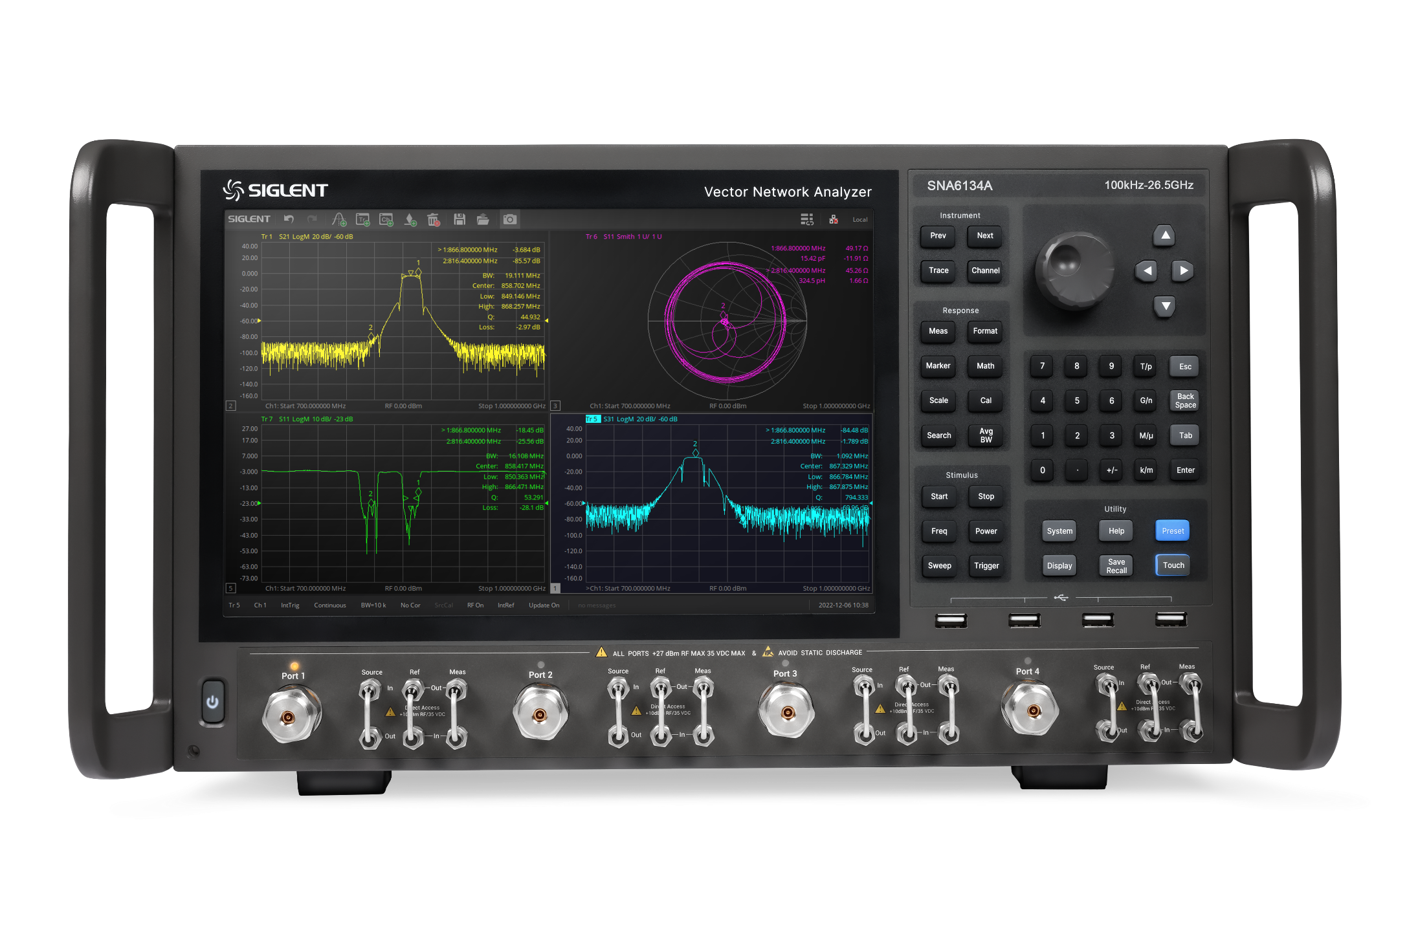
Innovation Flagship
SNA6000A
Vector Network Analyzer

Slide 3
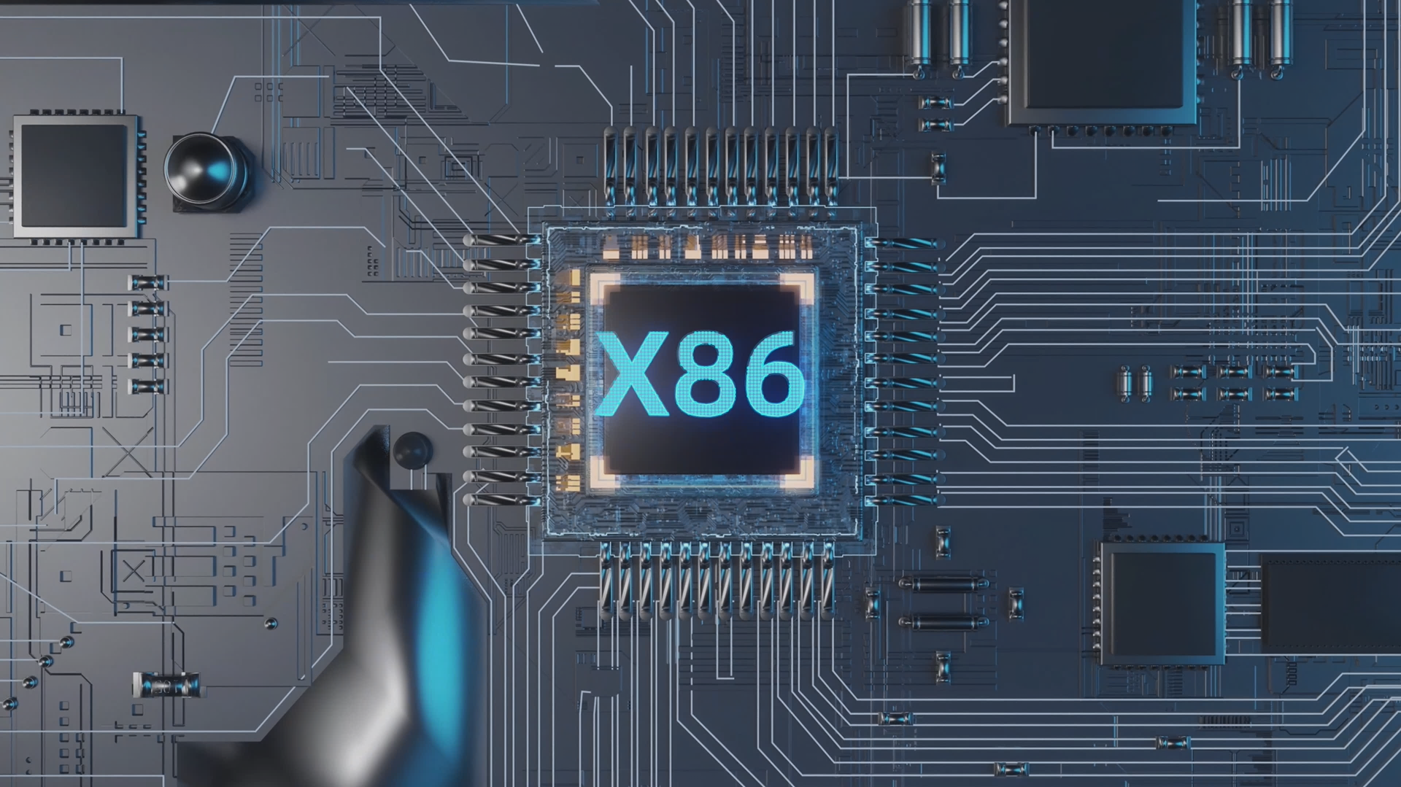
Processor Upgrade
— —
X86

Slide 4

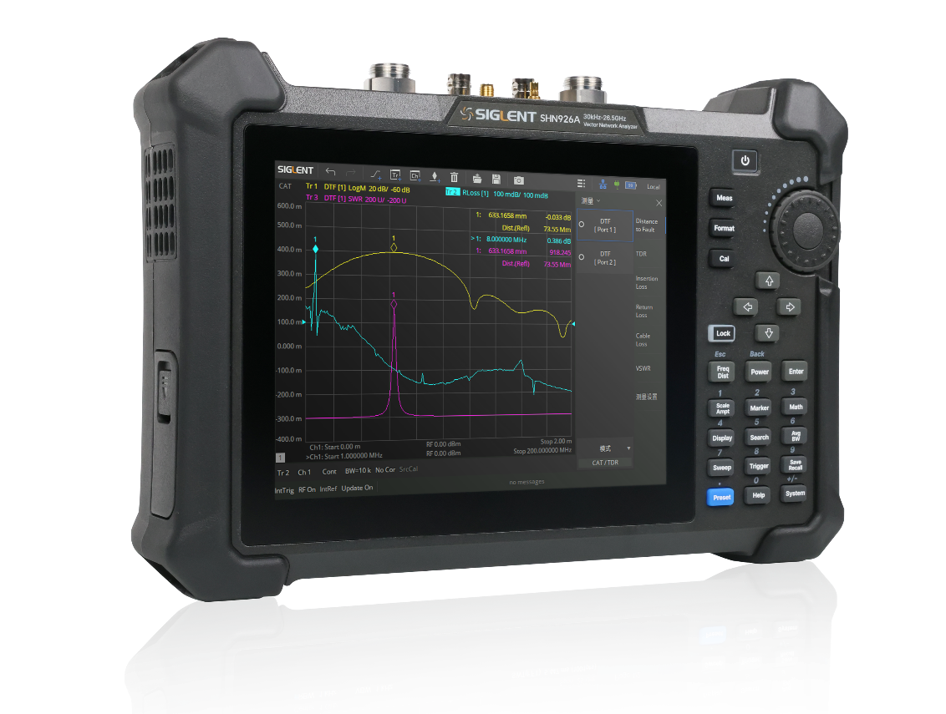
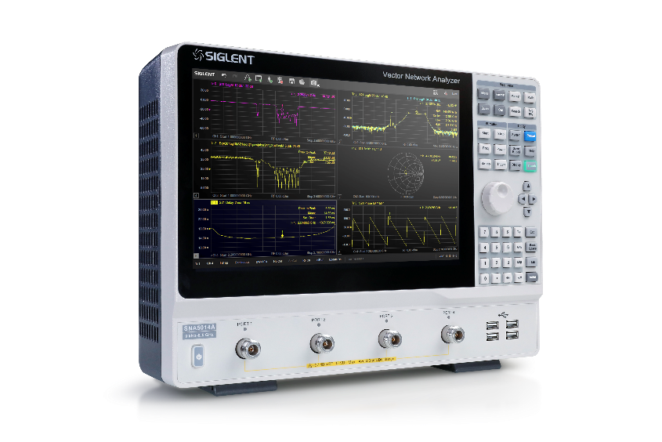
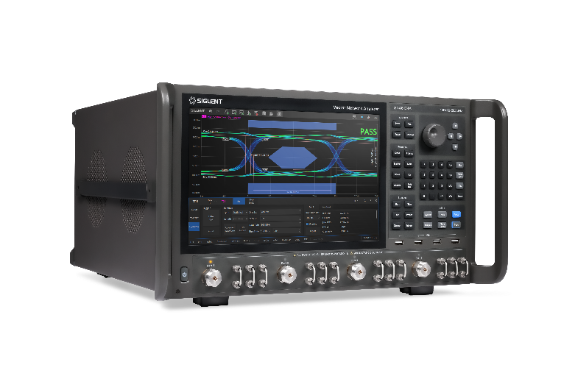
SHN900A
Portable and Functional
Perform Better in the Field

Slide 5

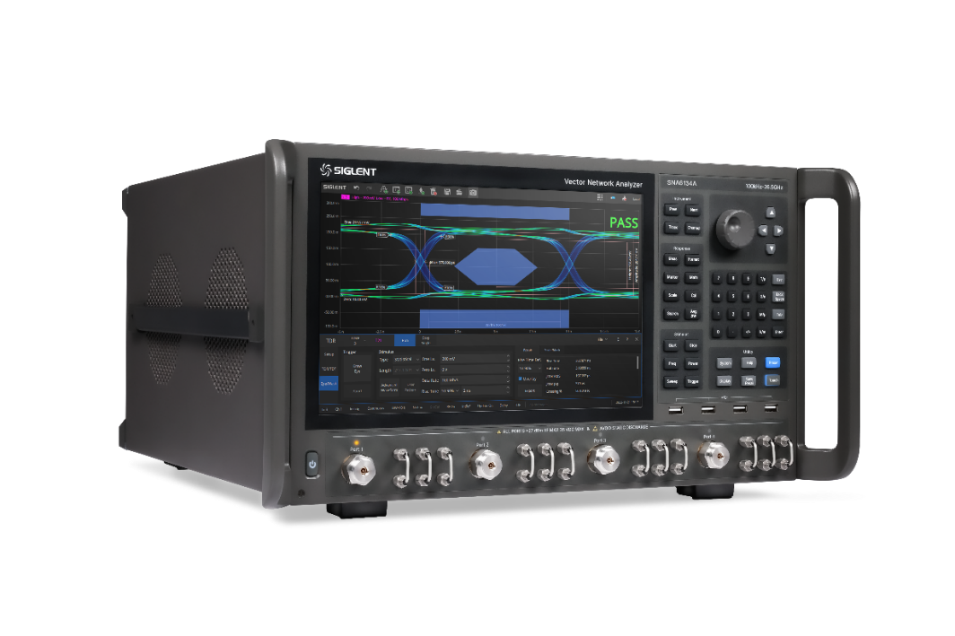
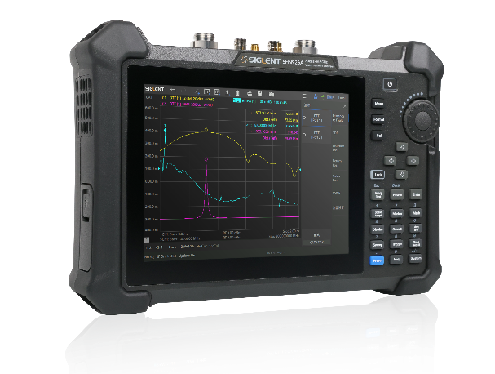
SNA5000A
Meet the Daily RF Test Requirements
Advanced Design Reduces the Test Area

Slide 6


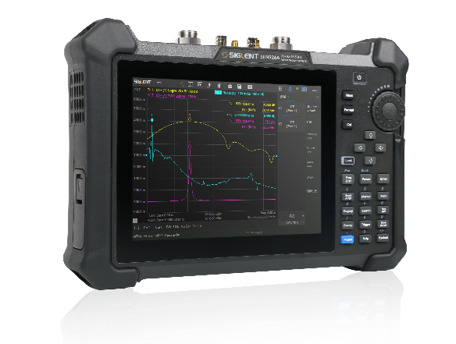
SNA6000A
Intuitive, Speed-Driven Features
Hardware for Exceptional Flexibility

Slide 7
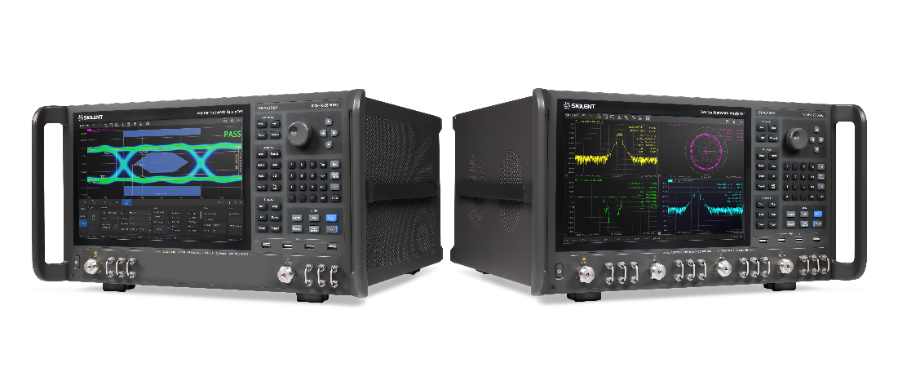
SIGLENT
SNA6000A Vector Network Analyzer
Agenda
Brief Introduction
Technical Highlights
Main Options
Market and Application
Completing the Solution
Analysis of Competition

Slide 8
PART ONE
01
Brief Introduction
Instrument Tour / User friendly in every detail

Slide 9
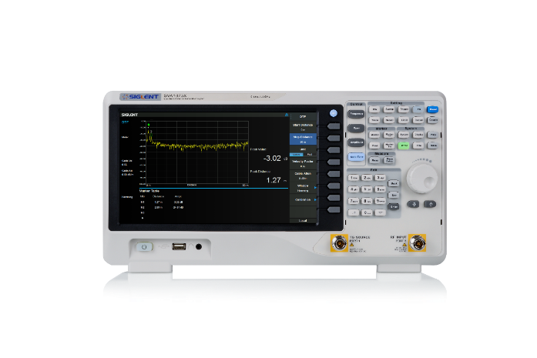
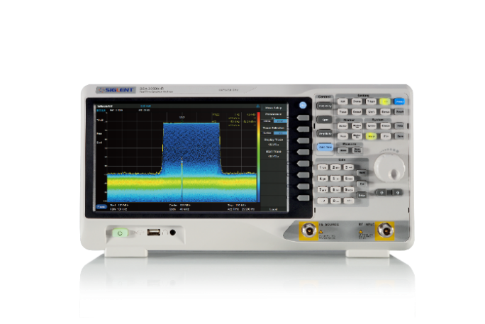
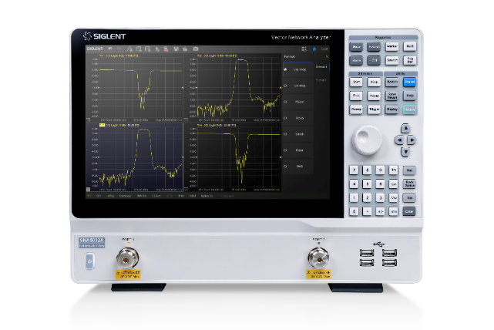
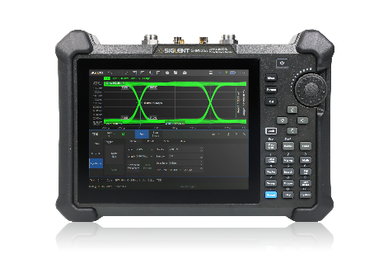
SIGLENT Vector Network Analyzer Technology Roadmap
SIGLENT Vector Network Analyzer is a multi-functional RF measuring instrument, which adopts mature RF and digital IF processing technology, with rich functions, excellent performance and convenient operation.
SVA1000X
SSA3000X-R
SHN900A
SNA5000A
Frequency | 100 kHz ~ 1.5/3.2/7.5 GHz | 100 kHz ~ 3.2/5/7.5 GHz | 30 kHz ~ 14/20/26.5 GHz | 9 kHz ~ 4.5/8.5 GHz 100 kHz ~ 13.5/26.5 GHz
Ports | Tracking Generator Standard | Tracking Generator Standard | 2 | 2/4
IFBW | 10 kHz | 10 kHz | 10 Hz to 3 MHz | 1 Hz to 10 MHz
Output Power | -20 dBm to 0 dBm | -20 dBm to 0 dBm | -45 dBm to +10dBm | -55 dBm to +10 dBm
Dynamic Range | 90 dB | 90 dB | 100 dB | 125 dB
TDR | × | × | Option | Option
DC Bias | × | × | Standard | Standard
Display | 10.1 inch | 10.1 inch | 8.4 inch | 12.1 inch

Slide 10
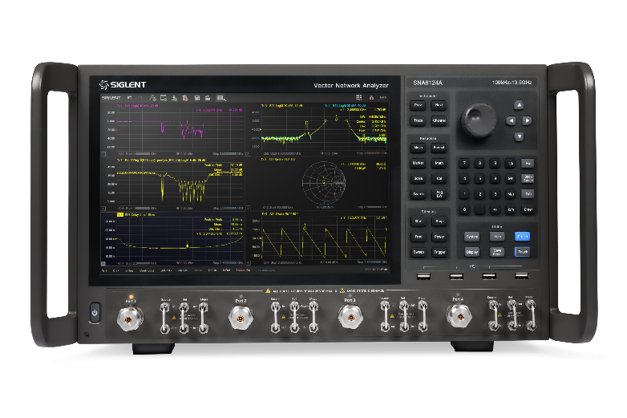
SIGLENT Vector Network Analyzer Technology Roadmap
SIGLENT Vector Network Analyzer is a multi-functional RF measuring instrument, which adopts mature RF and digital IF processing technology, with rich functions, excellent performance and convenient operation.
Model | SNA6034A SNA6134A | SNA6032A SNA6132A | SNA6024A SNA6124A | SNA6022A SNA6122A
Frequency range | 100 kHz - 26.5 GHz |  | 100 kHz - 13.5 GHz
Ports | 4 | 2 | 4 | 2
Frequency resolution | 1 Hz
Level resolution | 0.05 dB
Range of IFBW | 1 Hz ~ 10 MHz
Setting range of output level | -55 dBm ~ +10 dBm
Dynamic range | 135 dB
Bias-Tees | Standard
Interface | LAN, USB Device, USB Host (USB-GPIB)
Remote control | SCPI/Labview/IVI based on USB-TMC/VXI-11/Socket/Telnet/WebServer
Size | W×H×D=426×251×280 mm
Weight/Display | 4 ports, 19 kg, 12.1 inch
SNA6000A
67GHz
44GHz
Frequency | 100 kHz ~ 13.5/26.5 GHz
Ports | 2/4
IFBW | 1 Hz to 10 MHz
Output Power | -55 dBm to +10 dBm
Dynamic Range | 135 dB
TDR | Option
DC Bias | Standard
Display | 12.1 inch

Slide 11
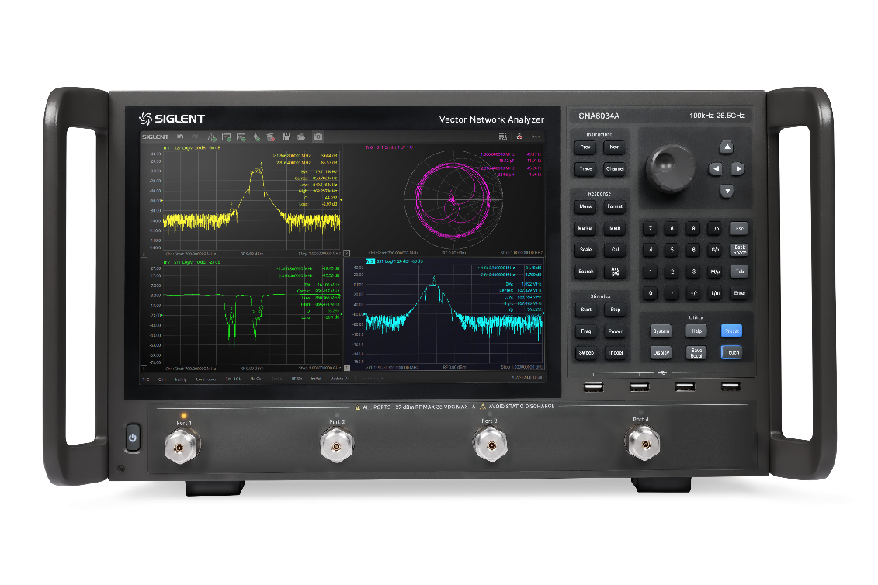
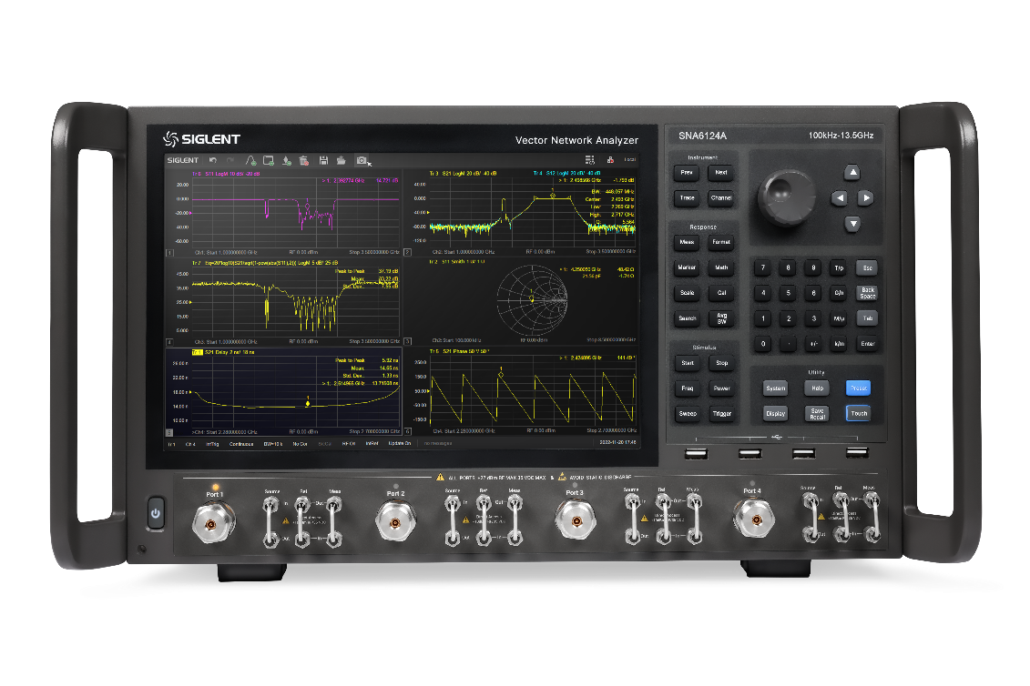


26.5GHz High Performance Vector Network Analyzer
New SIGLENT SNA Series Microwave High Performance Vector Network Analyzer.
Aiming at the application of RF microwave device testing.
The integrated and flexible microwave test engine for measuring amplifiers, mixers, multiport devices, pulse devices, differential devices and so on.
Complete source configuration mode
Dual source configuration, single tone, dual tone, swept frequency dual tone, continuous wave form or pulse modulation form.
Complete test function: linear/nonlinear parameters.
Advanced receiver processing technology, large dynamic range and high test accuracy.
Flexible configuration mode.
Large touch screen display, convenient and simple operation.
built-in two sources

Slide 12

Front Panel Tour
Flexible large screen touch operation
Useful Shortcuts Simplify Setup Steps for Efficient Testing
Knob and Navigation
12.1 inch Big Touch Screen
Numeric Keys
Front Panel Keys
USB Hub
2/4 Ports Available
3.5mm NMD (male)
Jumper Interface
Flexible Use of Couplers
Configurable Test Set Available on All Models

Slide 13
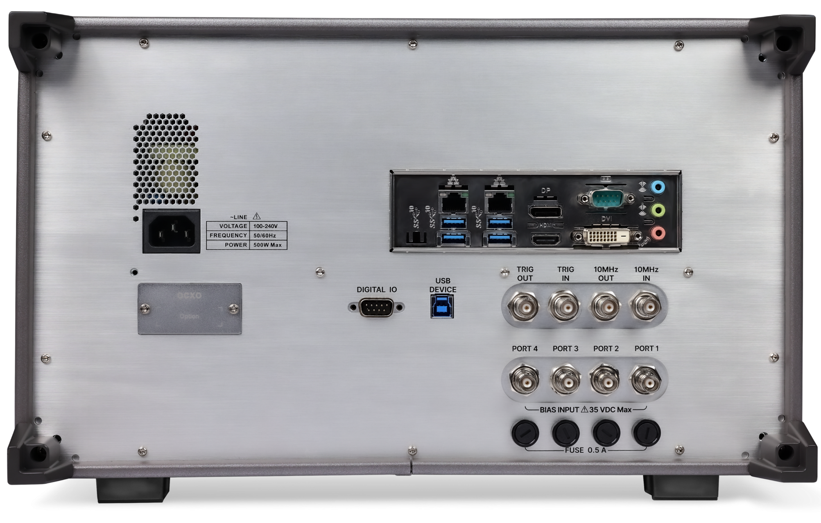
Rear Panel Tour
Multiple control and function extension interfaces
2*LAN
DP
COM
LINE IN
LINE OUT
MIC IN
4*USB 3.1Gen 1/2
HDMI
DVI
DIGITAL I/O
USB DEVICE
TRIN_IN
TRI_OUT
10M_OUT
10M_ IN
OCXO
4*BIAS IN

Slide 14
PART TWO
02
Technical Highlights
Performance parameters and specific advantages of SNA6000A

Slide 15
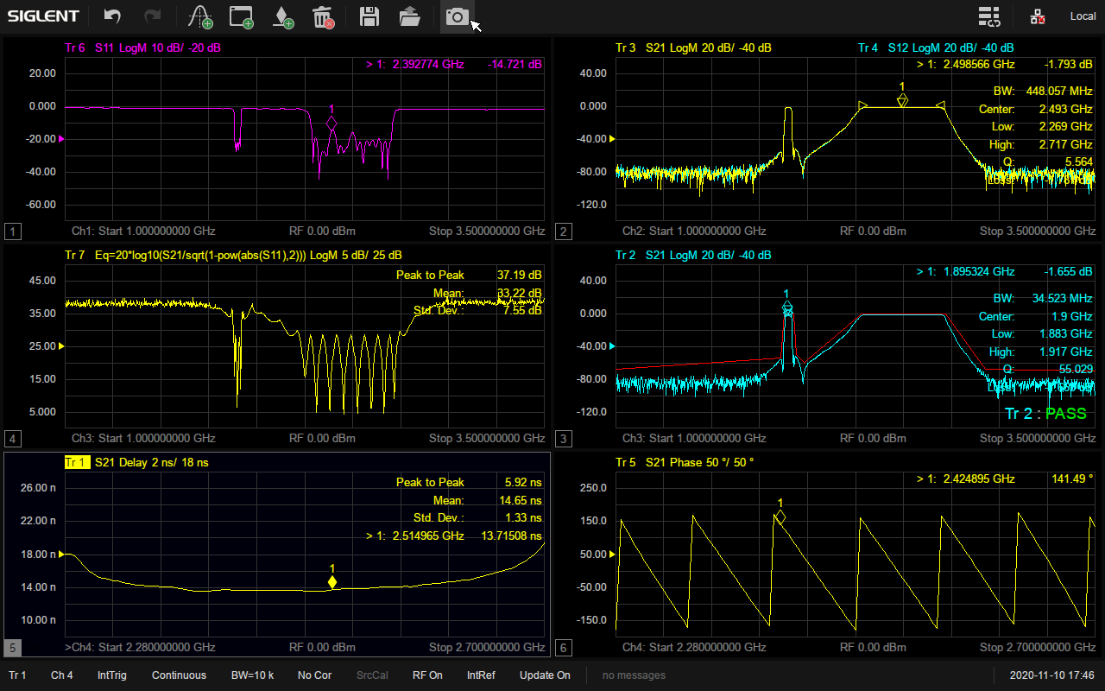
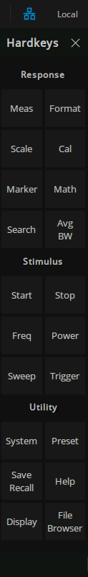
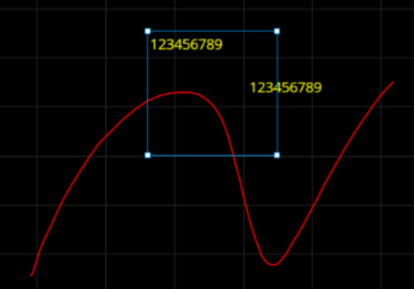
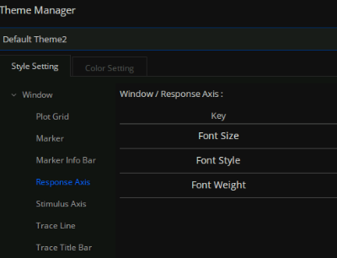
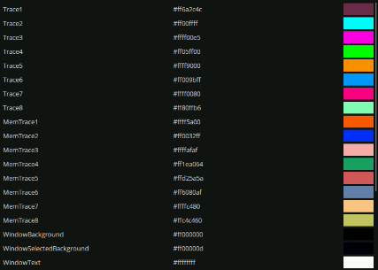
Friendly User Interface
Benefits:
User Friendly
Efficient
Convenient and Complete
Flexible Feature Integration and Shortcut Key Functionality
Virtual Keypad
The instrument can be operated without operating the function buttons on the front panel.
Information Display Area
Touch and click for quick setting of corresponding parameters.
Screensavers
With hibernation power-saving function, hibernation time can be set, effectively extend operating time and battery life.
Graffiti Function
Draw graphics and mark information to help users focus better.
Theme Management
Flexible configuration of trace color thickness, XY axis font style, view grid style and other parameters.
Color Setting
Set the colors of current traces, historical memory traces, test window backgrounds, grid lines, axis text, and other object.
Graffiti Function
Theme Management
Color Setting

Slide 16
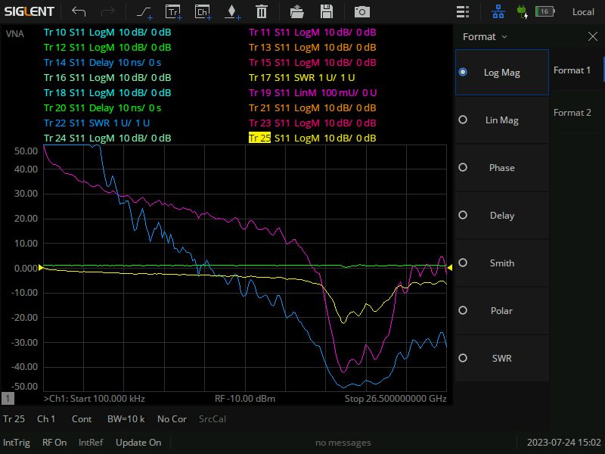
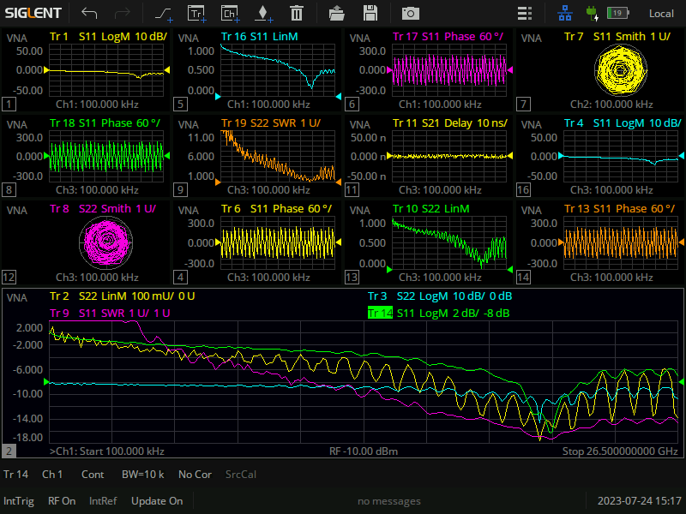
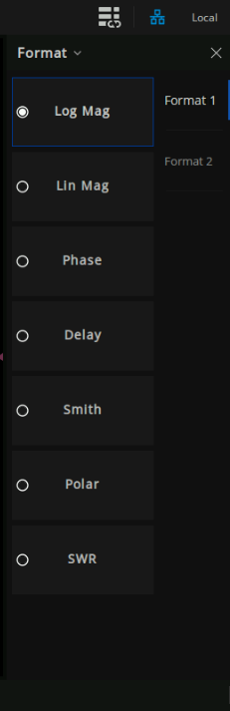
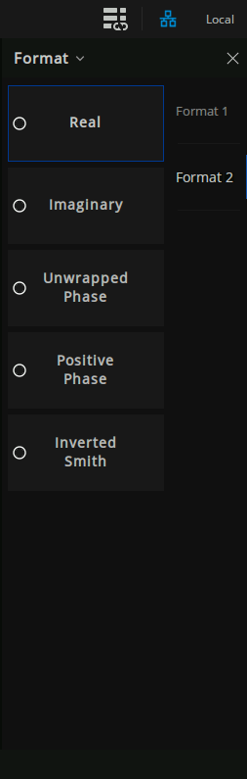
Multi-Window Multi-Trace Multi-Display Formats
Rapid Performance of Complex Test
Multi-window Display
Supports up to 256 channels
Supports up to 256 measurement windows
Each window can display 64 test traces at the same time
Each window can display different measurement formats with independent cursor functions.
The simultaneous display of multiple data formats is helpful to understand DUT from different angles.

Slide 17
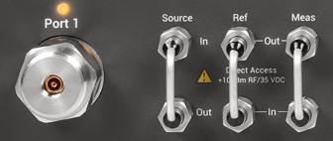
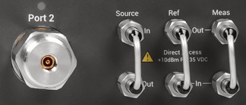
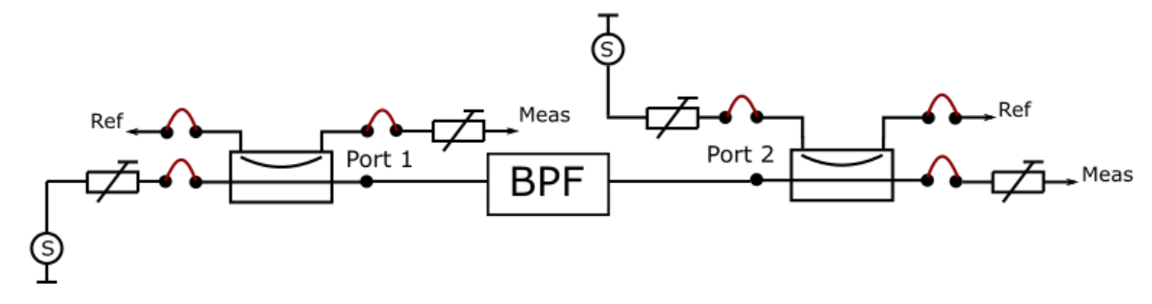
Inversed Coupler Operation
Altered signal routing through the coupler
New arrangement of direct source and receiver access ports
Goal:
Avoid coupling loss in the receive path
Increase receiver sensitivity and dynamic range
Advantage to direct connection to Meas In: Bidirectional calibration & measurement
Sensitivity increased by value of coupling loss
Reduced reverse output power
Setup example with mixed configuration
Port 1
Output signal straight through the coupler
Receive signal through coupling arm
Port 2
Output signal through coupling arm
Receive signal straight through the coupler

Slide 18
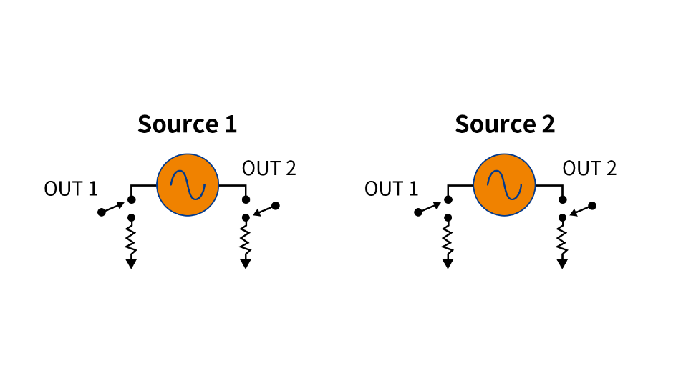
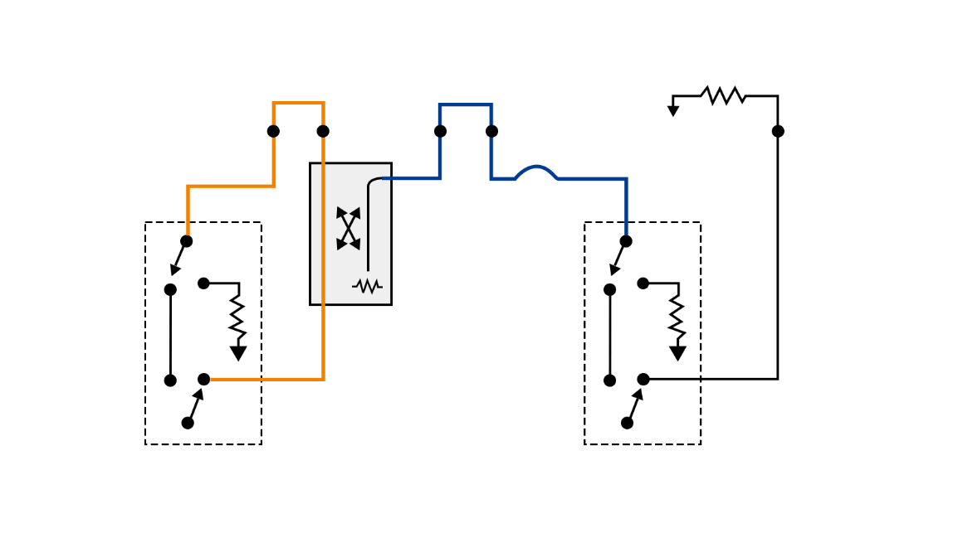
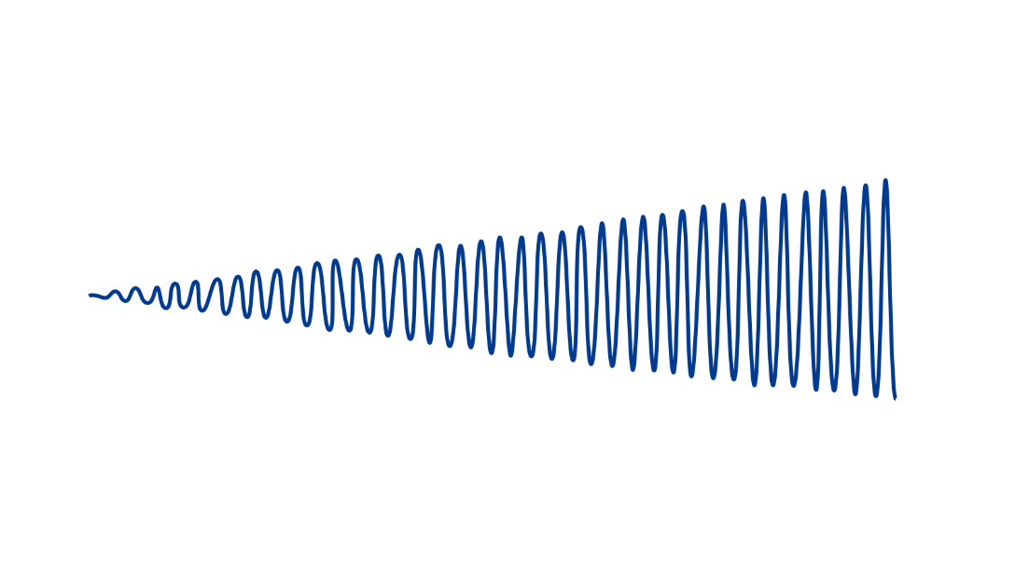
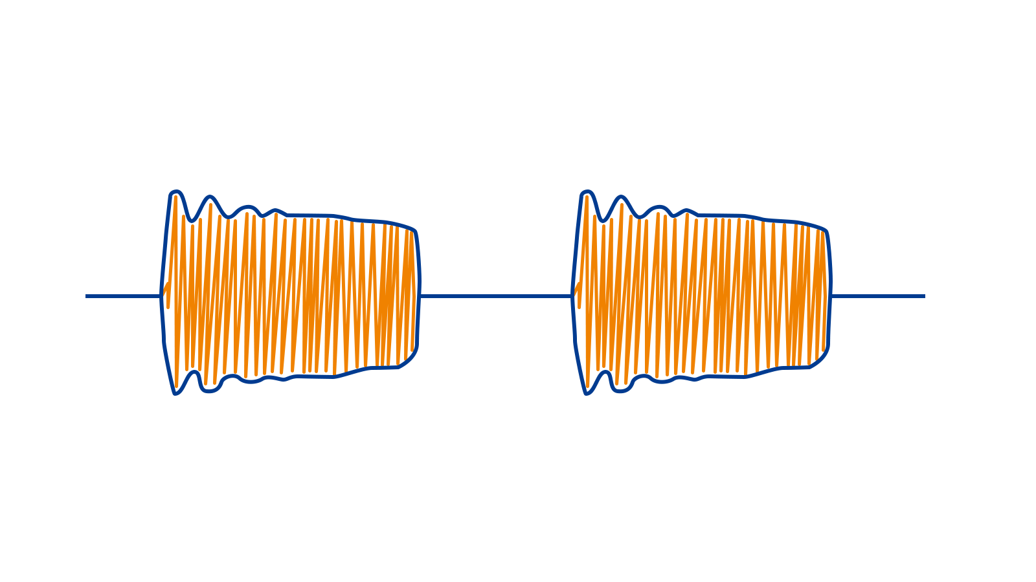
Technical Characteristics of SNA60000A
It can be configured as a dual source structure.
Flexible test configuration
The internal circuit includes switch and combiner, etc.
Extend test port through switch matrix SSM/mechanical switch SSU.
Test power range can be extended by external amplifier or attenuator.
Technical performance of source
High power output (~ +10 dBm)
High spectral purity (harmonic suppression > -30 dBc)
High power scanning range (> 60 dB)
Pulse modulation capability
Built-in pulse modulator and pulse generator.
Technical performance of receiver
Large dynamic range, built-in receiver attenuator, 0.5 dB compression point of 10 dBm.
Wide receiving bandwidth, IFBW max. 10MHz.
Flexible frequency configuration of receiver and source.

Slide 19
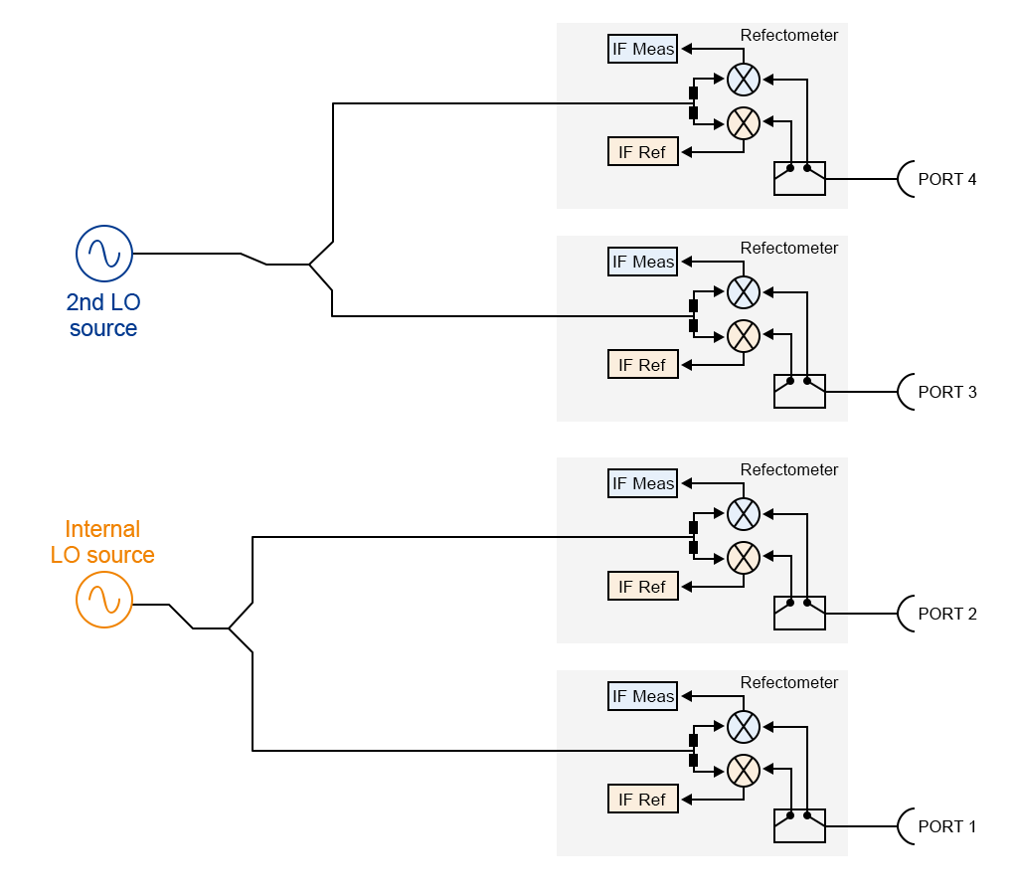
Two Sources and Eight Receivers
Two internal LO sources (4 ports)
Short measurement times
Flexible-to-configure, compact test setups
Fast mixer and converter measurements
Very low trace noise with frequency-converting measurements
Eight receivers with identical architecture (4 ports)
Same high sensitivity for all 8 receivers
Temperature stability for ratios and S- parameters
Multipath DUTs, antenna arrays

Slide 20
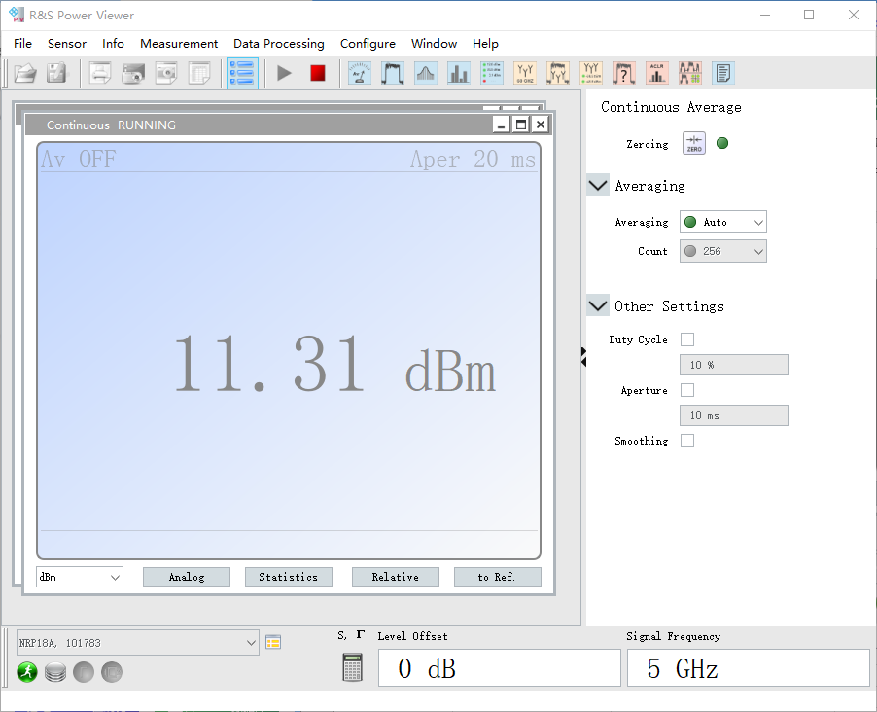
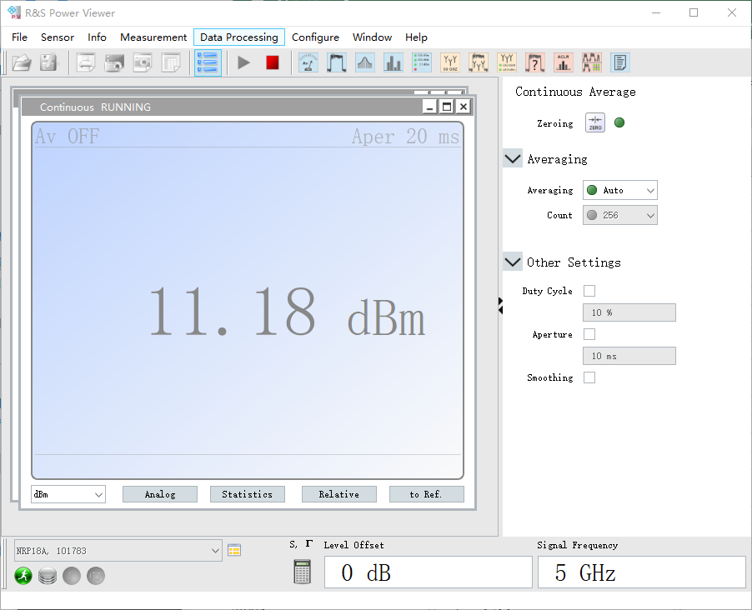
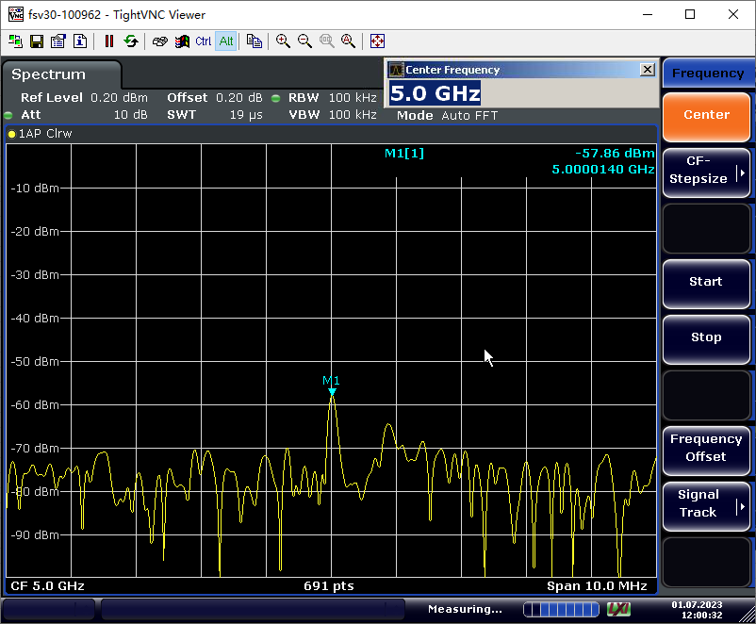
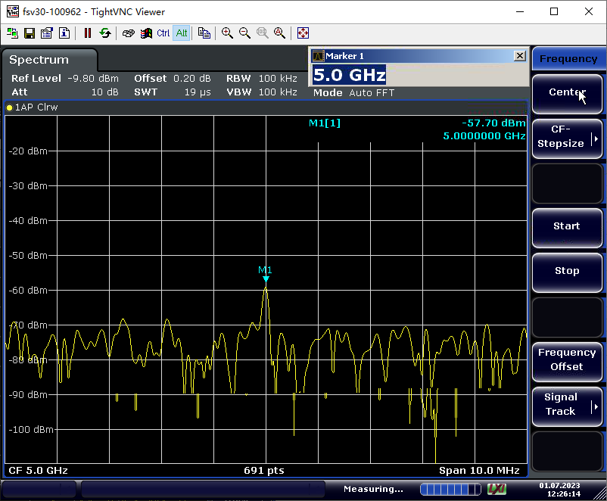
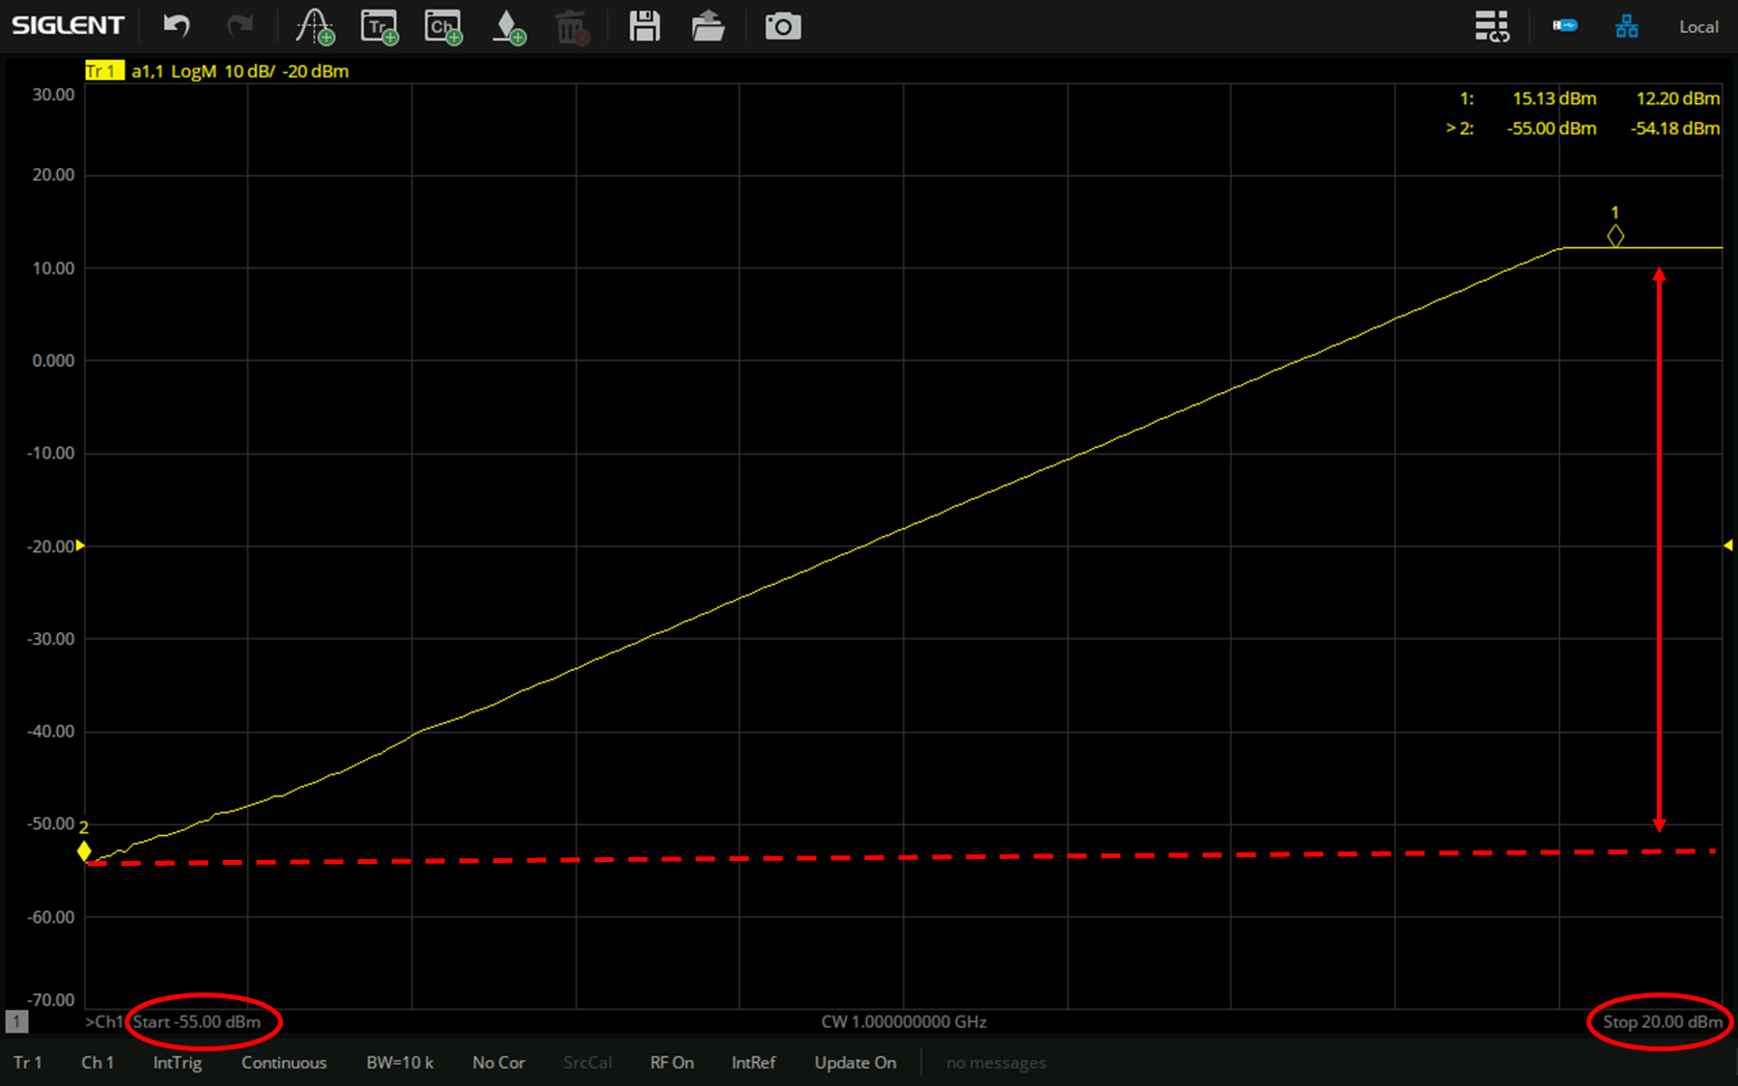
Source Power Performance of SNA6000A
A Perfect Tool to Test the Nonlinearity and Gain Compression of Active Devices.
Provide high-power excitation signal (~ +10 dBm).
Meet the requirements of active circuit testing.
Large power scanning range (-55 dBm to 10 dBm) to drive active devices from linear working region to compression region.
Port1, Freq = 5GHz, Max. power = 11.31dBm
Port2, Freq = 5GHz, Max. power = 11.81dBm
Port1, Freq = 5GHz, Min. power = -57.86dBm
Port2, Freq = 5GHz, Min. power = -57.70dBm
Power Scanning Range | Specification
100 kHz - 1 MHz | -55 dBm to 10 dBm
1 MHz - 500 MHz | -55 dBm to 10 dBm
500 MHz - 1 GHz | -55 dBm to 10 dBm
1 GHz - 20 GHz | -55 dBm to 10 dBm
20 GHz - 24 GHz | -55 dBm to 7 dBm
24 GHz - 26.5 GHz | -55 dBm to 5 dBm
Max. Output Power | Specification
100 kHz - 1 MHz | 10 dBm
1 MHz - 500 MHz | 10 dBm
500 MHz - 1 GHz | 10 dBm
1 GHz - 20 GHz | 10 dBm
20 GHz - 24 GHz | 7 dBm
24 GHz - 26.5 GHz | 5 dBm
>60dB Power Sweep Range
Power Sweep with Freq = 1GHz

Slide 21
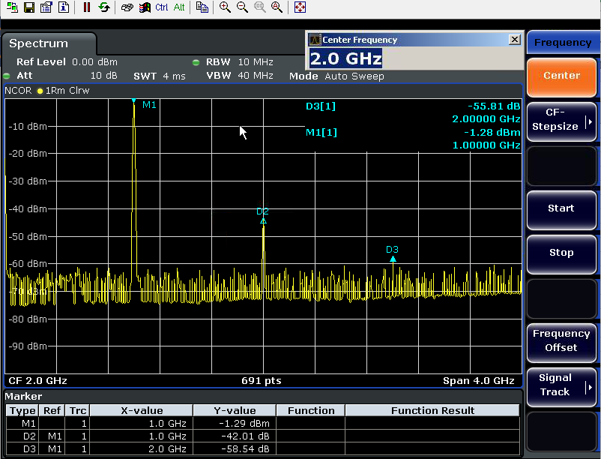
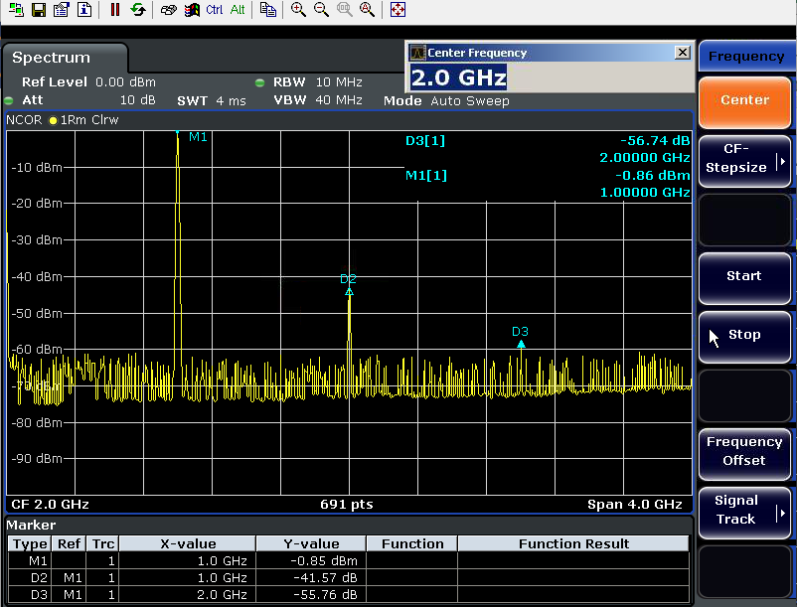
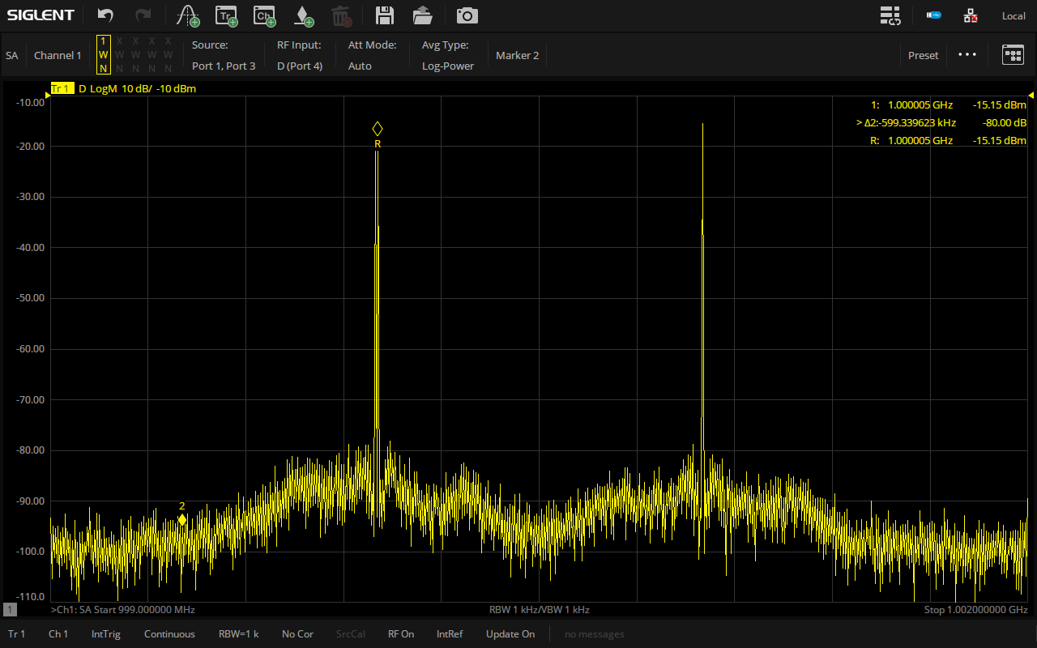
Source Spectrum Performance of SNA6000A
High Source Signal Spectrum Purity, High Clutter and Harmonic Suppression Performance
Ensure the test accuracy of network analyzer.
Ensure the accuracy of the test results of mixer devices.
Ensure the correctness of amplifier intermodulation performance test.
2nd or 3rd Harmonics | Typical
9 kHz to 100 kHz | <–15 dBc
100 kHz to 26.5 GHz | <–25 dBc
Non-harmonic Spurious | Typical
9 kHz to 26.5 kHz | <-30 dBc
Port1, Freq = 2GHz, Harmonic Suppression > -40dBc
Port2, Freq = 2GHz, Harmonic Suppression > -40dBc
Freq = 1GHz, Dual Source, Out-of-band Suppression > -80dBc
Notes:
When measuring harmonic characteristics, network analyzer must ensure that the harmonics generated by its source and receiver will not exceed the measured harmonics. SNA6000A can generate source signals with minimal harmonics for distortion testing.

Slide 22
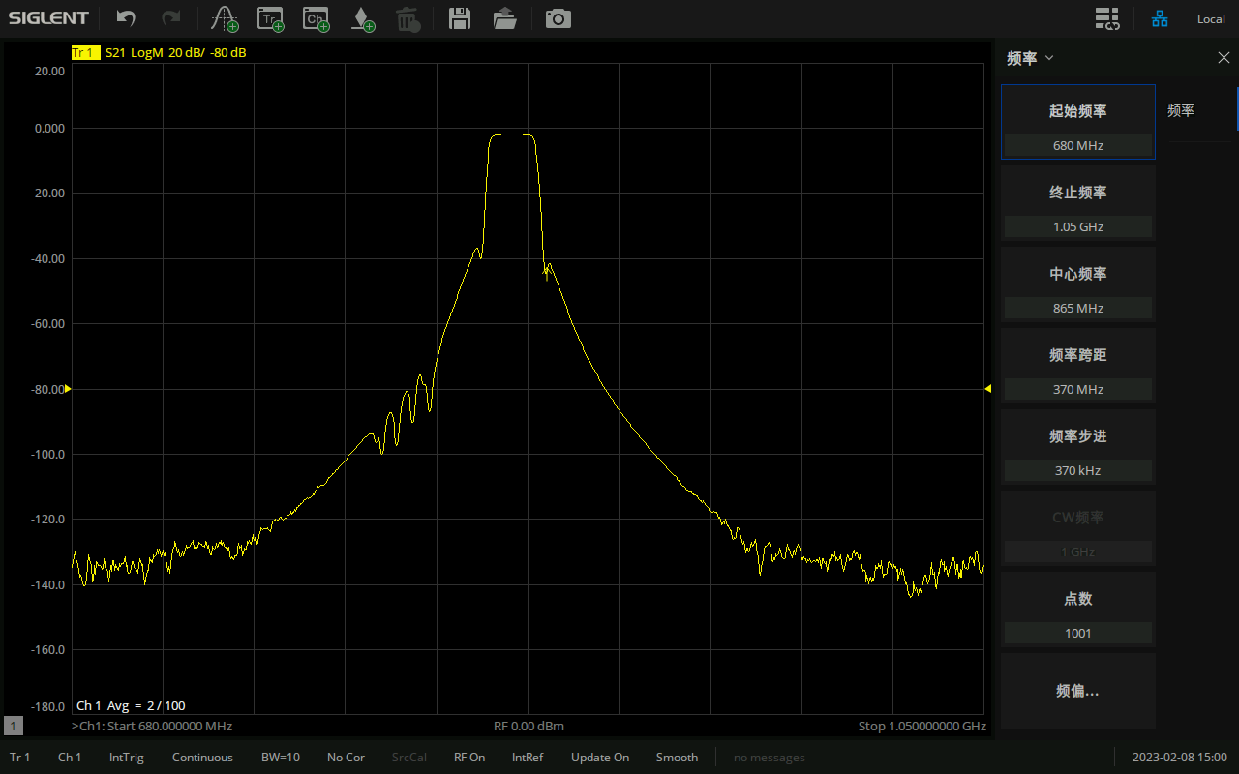
Receiver Performance of SNA6000A
Low Noise and High Performance RF Design Greatly Improves Test Accuracy
The receiver sensitivity ensures the dynamic range and test accuracy.
The high dynamic range of receiver meets more test scenarios, such as measuring narrow-band devices with high rejection like cavity filters.
Low trace noise instrument to improve the accuracy and reliability of test results.
The compression level index is the maximum power level that the receiver can handle before reaching saturation or maximum output.
135 dB Dynamic Range
Receiver Compression Magnitude |  | Spec. (dB)
100 kHz - 13.5 GHz | +10 dBm | 0.5
13.5 GHz - 26.5 GHz | +10 dBm | 1.0
Receiver Compression Phase |  | Spec. (deg)
100 kHz - 13.5 GHz | +10 dBm | 5
13.5 GHz - 26.5 GHz | +10 dBm | 5
Transmission Trace Noise | IFBW | dB rms | deg rms
100 kHz - 10 MHz | 1 kHz | 0.005 | 0.012
10 MHz - 13.5 GHz | 10 kHz | 0.009 | 0.05
13.5 GHz - 26.5 GHz | 10 kHz | 0.015 | 0.05
Reflection Trace Noise | IFBW | dB rms | deg rms
100 kHz - 10 MHz | 1 kHz | 0.005 | 0.01
10 MHz - 13.5 GHz | 10 kHz | 0.009 | 0.05
13.5 GHz - 26.5 GHz | 10 kHz | 0.012 | 0.05
Dynamic Range | IFBW | Spec. (dB)
100 kHz - 1 MHz | 10 Hz | 120
1 MHz - 500 MHz | 10 Hz | 125
500 MHz - 1 GHz | 10 Hz | 130
1 GHz - 20 GHz | 10 Hz | 135
20 GHz - 24 GHz | 10 Hz | 127
24 GHz - 26.5 GHz | 10 Hz | 120

Slide 23
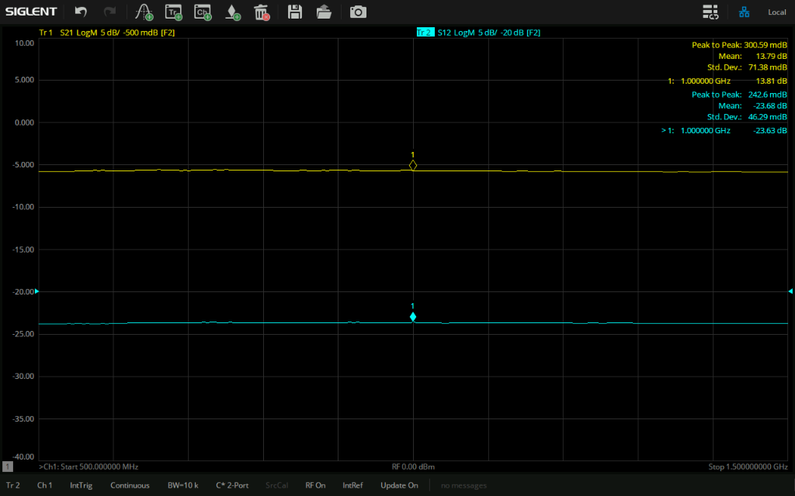
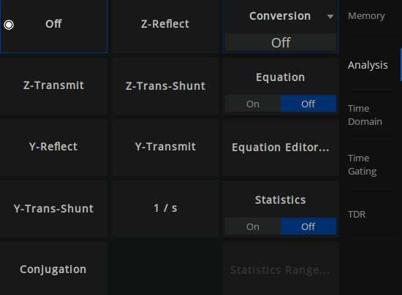
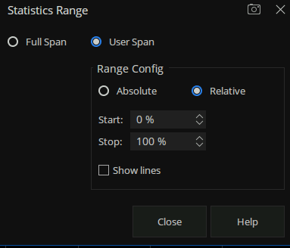
Powerful Math Function
Statistical Data Interface
Statistical Range
Parameter Conversion Type
Trace Statistics
Automatically display the average value, standard deviation and peak value of the current working trace, which is convenient for users to read the value quickly.
Statistical frequency range can be adjusted by setting Statistics Range, and the statistical range can be set as full span or user-defined span.
This function is very useful for in-band index test of band-limited devices (such as filters).
Parameter Conversion
Convert the S parameter of the current trace to the required parameter mode.
SNA6000A supports the following 8 conversion types.
When both fixture simulation function and port impedance function are in the “on” state, SNA6000A will use the value set in the port impedance conversion.
In other cases, the system Z0 (preset value: 50 Ω) will be used.

Slide 24
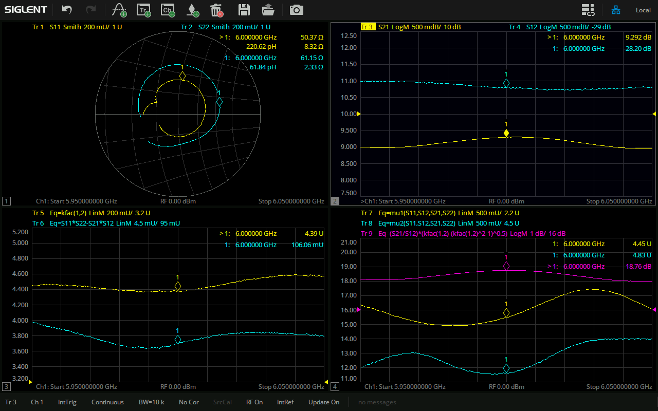
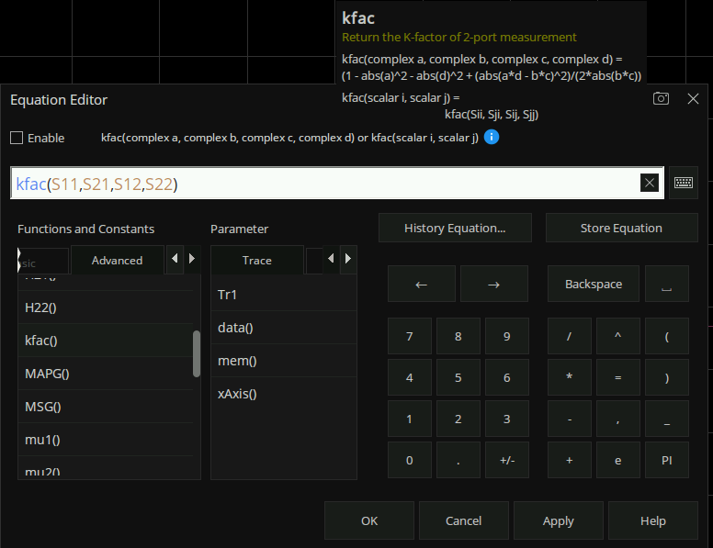
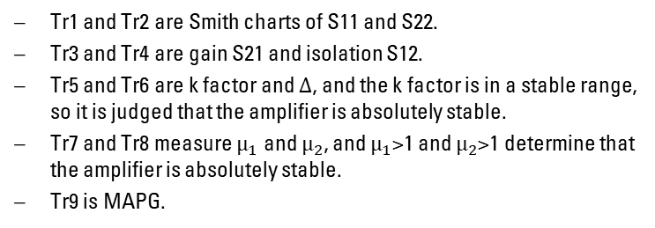
Flexible Equation Editor Function
Equation Editor Interface
Stability Measurement of Amplifier
Equation Editor
Enter standard mathematical operators and algebraic formulas and refer to the data available in the VNA.
Built-in many common functions and advanced functions.
User-friendly parameter prompts are provided.
Tr1 and Tr2 are Smith charts of S11 and S22.
Tr3 and Tr4 are gain S21 and isolation S12.
Tr5 and Tr6 are k factor and ∆, and the k factor is in a stable range, so it is judged that the amplifier is absolutely stable.
Tr7 and Tr8 measure $μ_{1}$ and $μ_{2}$, and $μ_{1}$>1 and $μ_{2}$>1 determine that the amplifier is absolutely stable.
Tr9 is MAPG.

Slide 25
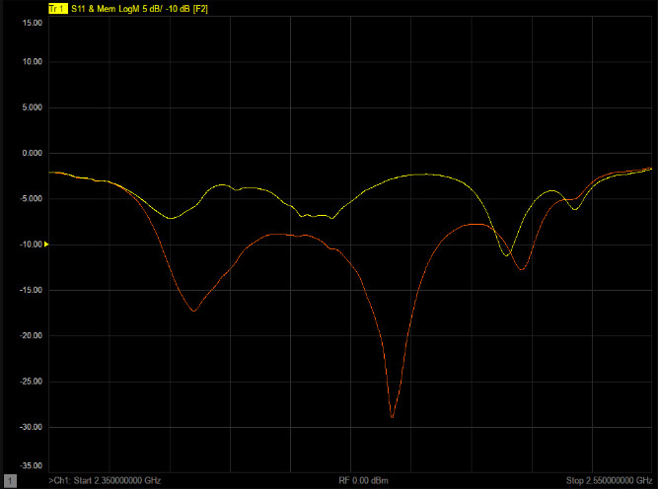


Qualification Judgment, Mass Production Test
Data / Memory
Limit Test
Hold
Data / Memory
Support saving the current data-trace in memory
Facilitate comparison of current and historical data
Three display modes: Display data-trace only, display memory trace and display data-trace and memory trace at the same time
It can perform four kinds of mathematical operations on the current data-trace and memory trace:
Data/Memory, Data*Memory, Data+Memory, Data-Memory
Hold Function
Detailed examination of the test parameters
Pause or resume the current measurement process
Limit Test
A test form that can visualize test data and results
PASS / FAIL
Limit line test, Point limit test, Ripple limit test, Bandwidth limit test
Enables more realistic limit lines and reduce the defect percentage on the finished products for better production yield rates

Slide 26



Frequency Offset Mode
The traditional harmonic measurement is realized by signal source and spectrum analyzer.
Signal source is used as excitation.
Spectrum analyzer measures the signal amplitude of fundamental wave and harmonic wave.
Enable the SNA internal RF signal source and SNA port receiver to operate at different frequencies.
Easy and Quick List Editing
Harmonic Measurement of Amplifier
SNA6000A can generate source signals with minimal harmonics for distortion testing

Slide 27






Fixture Measurement
Cable With Calibration
Add Fixture
With Port Extension ON
Port Extension
Port Extension
Extend the reference plane to the specified measurement plane
A useful way to eliminate fixture errors and improve test accuracy
Fixture Measurement
Fixtures Introduce Measurement Errors
Port match (2-port embedding)
Port impedance conversion
2-port de-embedding
N port embed/ de-embed (port 4/6/8)
Differential port match
Differential port impedance conversion
Common port impedance conversion
Fixture Measurement
Obtaining the Real Parameters of the DUT

Slide 28

Adapter Remove / Insert
Calibration Plane
Calibration Plane
Port 1
Open
Open
Port 1
Short
Short
Load
Load
Adapter
Removal
Adapter
Insert
Perform calibration with adapter
Remove adapter and measure Open, Short, Load values to determine adapter’s characteristics
Remove the adapter characteristics from the error coefficients in a de-embedding fashion
Perform calibration without adapter
Insert adapter and measure Open, Short, Load values to determine adapter’s characteristics
Insert the adapter characteristics from the error coefficients in a embedding fashion

Slide 29

Balanced / Differential Components Measurement
Balanced Measurement Challenges
Conventional two-port VNAs with baluns do not provide common-mode, differential to common mode, and common to differential-mode responses.
Baluns are inherently band-limited devices, which forces multiple test setups for broad frequency coverage.
Phase errors of baluns provide inaccurate differential responses.
Balanced Device | CMRR Parameters
Single - balanced device | Sds21/Scs21 Ssd12/Ssc12
Balanced - balanced device | Sdd21/Scc21
Single - single - balanced device | Sds31/Scs31 Sds32/Scs32
CMRR parameters available when measuring balanced device
SNA6000A Balanced Measurement Provides
An excellent choice for mixed-mode S-parameter measurements, without the need or limitations of using baluns.
Display differential-, common-, and mixed-mode performance, in a variety of trace formats.
Measurement parameters include common-mode-rejection ratio and amplitude and phase imbalance.
Supported port configurations include single-ended-to-balanced and balanced-to balanced topologies.
A high CMRR value indicates more rejection of common mode, which is desirable in a device that transmits information in the differential portion of the signal.
Various stimulus and sweep settings are available in the Balanced DUT Topology dialog

Slide 30
Fast Two-tone IMD Measurements with Simple Setup
IMD Measurement Challenges
Two signal generators, a spectrum analyzer, and an external combiner or a vector source with good intermodulation index are most commonly used, requiring manual setup of all instruments and accessories
Test times are slow when swept-frequency or swept-power IMD is measured
Instruments and test setups may cause measurement errors due to source-generated harmonics, cross-modulation, and phase noise, plus receiver compression and noise floor
Two internal sources with high output power, low harmonics and high-isolation combiner, make SNA6000A an ideal instrument to drive the DUT for two-tone IMD measurements.
SNA6000A IMD Measurement Provides
Quick and easy measurements with simplified hardware setup and intuitive user interface.
Spectrum analyzer mode for troubleshooting or making spurious measurements, eliminating the need for a separate spectrum analyzer.
SNA6000A with IMD measurement replaces two signal generators and a spectrum analyzer in the system rack, simplifying the system configuration and increasing test throughput.
Very clean internal sources and wide receiver dynamic range, minimizing the measurement errors caused by other instruments.
Provide single connection test of differential/active devices, and switch between S parameters and IMD measurement without reconnecting the DUT.

Slide 31





Fast Two-tone IMD Measurements with Simple Setup
SNA6134A vector network analyzer is used
SSG5060X-V vector signal generator and SSA3021X Plus spectrum analyzer are used
To obtain the best accuracy, the number of points should make the frequency step fall on the fundamental frequency and harmonic frequency.
It can be seen that the results of spectrum analyzer and vector network analyzer are basically the same, and the difference is a few tenths of dB.

Slide 32
PART THREE
03
Main Options
Single Connection Multi Parameter Measurement

Slide 33






Single Connection Multi Parameter Measurement
——
Description | Order Number
Time-Domain Analysis | SNA6000-TDA
Enhanced Time-Domain Analysis | SNA6000-TDR
Scalar Mixer Measurement | SNA6000-SMM
Spectrum Analysis | SNA6000-SA
Pulse Measurement | SNA6000-PM
Material Measurement | SNA6000-MT
SNA6000-TDR
SNA6000-TDA
SNA6000-SMM
SNA6000-SA
SNA6000-PM
SNA6000-MT

Slide 34

Solution for High-speed Serial Interconnect Analysis
TDR Measurement Challenges
As bit rates of digital systems increase, fast and accurate analysis of interconnect performance in both time and frequency domains is critical to ensure reliable system performance.
Managing multiple test solutions to completely characterize differential high-speed digital devices is difficult.
SNA6000A TDR Measurement (SNA6000-TDR) Provides
One-box solution for high-speed interconnect analysis, including impedance, S-parameters, and eye diagrams.
Simple and intuitive operation, the user interface is designed to provide a similar look and feel to traditional TDR oscilloscopes.
State-of-the-art error correction techniques enables you to measure your device, not your measurement system.
Determine optimal emphasis and equalization settings for your link.
Simulate real-world signals through jitter insertion.
Impedance analysis of active devices under actual operating conditions with Hot TDR measurements.
Simulated eye diagram analysis capability eliminates the need for a pulse pattern generator

Slide 35
Time Domain Analysis
SNA6000A Time Domain Measurement (SNA6000-TDA) Provides
Time domain analysis is useful for measuring impedance values along a transmission line and for evaluating a device problem (discontinuity) in time or distance.
Time domain analysis continues to be an effective tool and has a wide variety of applications including fault location, identifying impedance variations in connectors, selectively removing unwanted responses, and simplifying filter tuning.
 | TDR | TDA
Same | They are all time-domain responses obtained by lFFT on frequency-domain data. They are all support gatting and deEnbedding. *Buy TDR and get TDA free!
Different | TDR simulates the setup of the traditional time domain reflectometer | No
 | Supports time domain low-pass step and pulse response for reflection and transmission | Supports time domain low-pass step and pulse response and band pass response for reflection and transmission
 | The rise time of the step signal and the width of the pulse signal can be set | No
 | Supports the eye diagram test of transmission | No
Transform: Obtain time-domain characteristics
Gating: Filter the required time domain response
Window: Reduce overshoot and ringing
Coupling: Frequency domain parameters vary with time domain parameters
Marker: Distance parameter is automatically displayed in the marker

Slide 36



Accurate Characterization of Mixers
Mixer Measurement Challenges
Traditional approach with spectrum analyzer and external signal sources is cumbersome, slow, and does not provide phase or group delay information.
Conventional VNAs require an external signal source, which degrades sweep speed.
Attenuators are often used to minimize ripple due to input and output mismatch, at the expense of dynamic range and calibration stability.
with a four port VNA
Mixer measurements with a two port VNA
SNA6000A Mixer Measurement (option SNA6000-SMM) Provides
Simple setup using internal second signal source as a local oscillator (LO) signal
Test time improvement compared to spectrum analyzer- based approach
Input and output mismatch correction reduces ripple and eliminates the need for attenuators or external PA
Simple and intuitive user interface and calibration wizard make complex instruments easier to use

Slide 37

Spectrum Analyzer for Component Characterization
Spectrum analysis challenges for component testing
Measuring spurious performance is time consuming, especially when searching for low-level spurs over a broad frequency range.
Long measurement times may force insufficient test coverage
SNA6000A Spectrum Analyzer (SNA6000-SA) Provides
Fast spurious searches over broad frequency ranges.
A multi-channel SA with internal swept-signal generators for efficient spurious analysis of mixers and converters.
Guide users to complete the measurement process through the operation steps of typical measurement.
SA capability to the SNA6000A’s single-connection, multiple-measurement suite including Occupied BW, Channel Power, ACPR, TOI, CNR, Spectrum Monitor and so on.
SA Measurement Items

Slide 38


Simple, Fast and Accurate Pulsed-RF Measurement
Pulsed-RF Measurement Challenges
Pulse generators and modulators required for pulsed-RF measurements add complexity in test setups.
Max. IF bandwidth of analyzer is often too small for wideband detection.
Narrowband detection is slow, and measurements are noisy for low-duty-cycle pulses.
A simple user interface for full control of internal pulse modulator and internal independent pulse generator
SNA6000A Pulsed-RF Measurement (option SNA6000-PM) Provides
Setting up pulse timing for the pulse modulators and internal IF gates is easy using the built-in pulse generators.
Internal pulse modulators enable integrated pulsed-RF testing over the full frequency range of the instrument, eliminating expensive and bulky external modulators.
Built-in pulse modulator, pulse generator and pulse envelope measurement function are synchronized in the analyzer, which makes the RF test of pulse modulation simple and greatly simplifies the measurement setup.

Slide 39


Measurement of Dielectric Material Properties
Material Measurement Challenges
PCB, antenna, material science, microwave circuit design, biological research, and automotive engineers along with metrology and research institutes must characterize various materials to better understand their effects on electromagnetic wave propagation to achieve more expected designs, or to test manufacturing processes to control product quality, etc.
SNA6000A Material Measurement (SNA6000-MT) Provides
Control of the network analyzer to automate complex permittivity and permeability measurements versus frequency.
The measurement wizard guides the user through the measurement process.
Display of results in a variety of formats: $ε_{r}$, $μ_{r}$, $\tan{δ}$, $ε_{r}^{′′}$, $ε_{r}^{′}$, $μ_{r}^{′}$, $μ_{r}^{′′}$, $\tan{δ_{μ}}$.
A variety of measurement methods and mathematical models to meet most application needs.
SIGLENT deliver a comprehensive material measurement solution ideal for lab, manufacture and university environments, including SNA series precision instruments, MT materials measurement software, KWR42A waveguide calibration kit and fixture.

Slide 40
PART FOUR
04
Market and Application
Capabilities and Functional Highlights

Slide 41

What Types of Devices are Tested
Duplexers
Diplexers
Filters
Couplers
Bridges
Splitters, dividers
Combiners
Isolators
Circulators
Attenuators
Adapters
Opens, shorts, loads
Delay lines
Cables
Transmission lines
Waveguide
Resonators
Dielectrics
R, L, C's
RFICs
MMICs
T/R modules
Transceivers
Receivers
Tuners
Converters
VCAs
Amplifiers
VCOs
VTFs
Oscillators
Modulators
VCAtten’s
Transistors
RFIC test
Frequency Converter Device and Channel Test
Pulsed S-parm.
Pulse Profiling
Gain/Flat.
Phase/GD
Isolation
Rtn Ls/VSWR
Impedance
S-parameters
Compr'n
AM-PM
Permittivity
Permeability
Power Characteristic Test
Pulse Characteristic Test
Low Integration High
Nonlinear Characteristic Test
Antennas
Switches
Multiplexers
Mixers
Samplers
Multipliers
Diodes
Intermodulation
Distortion
Harm. Dist.
Linear Characteristic Test
Test of Device and Channel Characteristics under Complex Excitation
NF
Phase Noise
ACPR
Spectrum
Eye
Noise Characteristic Test
CW Swept freq Swept power Noise 2-tone Multi-tone Time Domain Pulsed- RF
Passive Device type Active
Simple Stimulus type Complex

Slide 42










Complete Solutions for a Wide Range of Applications
Test Application | Requirements for Test Instruments
Power Amplifier Test | High output power capability and wide power scanning range Carrying capacity of instrument for high power, calibration of high power state instrument Hot S22 parameter test
Low Noise Amplifier Test | Complete performance parameter test, including transmission and reflection parameters, etc. Gain compression, IMD, PAE, harmonic, k factor…
Mixer Test | Supply of local oscillator signal of mixer Conversion loss, phase and group delay, the 1 dB compensation point, isolation between ports and port VSWR
Cable Test | High measurement accuracy, good repeatability Support multiport test, automated test capability Return loss, VSWR, impedance, cable loss, DTF…
T/R Component Test | Pulse test application, support multiport test Meet the test requirements of various pulse widths Automated test capability Transmission power, pulse width, linearity…
Balanced Device Test | Differential and common mode S parameter test SNA6xx4A test port can be arbitrarily configured as a single port or a balanced port
Signal Integrity | High speed harmonics increase required frequency range S-parameters, network extraction and de-embedding, eye diagrams in VNAs…
… | …
Material Measurement
Pulse Measurement
VSWR
k Factor
TDR
S Parameter
Harmonic
IMD
Single Connection Realizes Complete Parameter Test

Slide 43

Flexible Architecture
New hardware architecture X86 brings more powerful data testing ability, extraordinary flexibility and faster response. The combination of two internal signal sources, a signal combiner, S-parameter and noise receivers, pulse modulators and generators, and a flexible set of switches and RF access points provide a powerful hardware core for a broad range of linear and nonlinear measurements, all with a single set of connections to your device-under-test (DUT).
With its highly integrated and versatile hardware and re-configurable measurement paths, SNA6000A replaces stacks of equipment with a single instrument.
Network analyzer
Spectrum analyzer
Two signal sources
Pulse modulator/generator
Noise figure meter/analyzer
Power meters
Switch matrix
Benefits of a SNA6000A-based solution
Multiple measurements with a single instrument
Simpler test systems
Lower hardware and software costs
Quicker development time and faster time to manufacturing
Less downtime and lower maintenance costs
Smaller size and lower power consumption
Faster test times
Improved throughput
Higher accuracy
Better yields and better specifications
Flexible hardware
Greater adaptability to future test requirements
…

Slide 44

Active Device Evaluation and Test
Test Challenges
Nonlinear characteristics like harmonic distortion need to tune the receiver to a frequency different from the source.
Input and output frequency of frequency conversion devices (like mixers and frequency converters) are different.
Some measurements, such as harmonic analysis and pulse measurement, need to use multiple test equipment, and the construction and synchronization of the system are very complicated.
Key Characteristics
S-parameter measurement: gain, delay and isolation
Built-in frequency offset mode
Accurate power measurement: source and receiver calibration
Gain compression, AM-AM and AM-PM conversion: power sweep, source and receiver calibration
Built-in DC bias function
Balanced/differential device measurement
Built-in pulse generator and pulse modulator
Hot S-parameters: amplifier test under actual working conditions to eliminate correlation between systems
One connection realize multiple measurements

Slide 45

Passive Device Evaluation and Test
Test Challenges
In high-quality communication systems, high-performance passive devices such as filters, combiners, switches and lines usually require low ripple and insertion loss in the passband and high rejection ratio in the stopband.
Main test challenge is to get accurate data easily. Using a wide frequency range can characterize the operation in multiple frequency bands.
Key Characteristics
Wide dynamic range can provide fast and accurate filter measurement
Wide frequency range can cover both in-band and out-of-band features
Balance-S parameter measurement without a balun
Multi-port test using SSM to improve throughput
Time domain analysis/gating function used for fault diagnosis and simple simulation
Math function including marker and trace operation
Low trace noise and high stability make it suitable for high-quality device test
Unknown-thru calibration can easily and accurately measure non-intrusive devices

Slide 46

Manufacturing Industry
Test Challenges
Scanning speed and data analysis speed are very important for mass manufacturing.
Operator intervention time, device connection and calibration time affect the measurement throughput.
Initial purchase cost, system uptime, maintenance cost and performance upgrade cost affect the overall cost.
Test time of VNA is determined by many links, like scanning speed, data analysis, processing and data transmission.
Key Characteristics
Segment sweep function enables faster testing
Excellent repeatability: low trace noise and high temperature stability
Pass/fail limit test: Simple and fast data analysis
Fast data transmission speed maximizes throughput
Multi-port device test solution: Minimize the number of connections and realize multi-port device testing
Built-in programming function: Customize operation and data analysis
Electronic calibration kit: Simple and fast calibration
De-embedding: Measure real performance of devices
Upgradeable: Make instrument meet the latest requirements

Slide 47
PART FIVE
05
Completing the Solution
Accessories, Calibration Options

Slide 48

Extend the Power to Multiport Devices
Multiport Test Challenges
Many components have more than 4 ports
Moving test cables is slow and prone to errors
Standard two-port calibration doesn’t correct for ports outside the test path, resulting in degraded accuracy
SNA6000A Multiport Test Solutions Provides
Integrated test systems consisting of a network analyzer and an external multiport test set, seamlessly controlled by the SNA’s firmware.
A single set of test connections to the DUT, resulting in high test throughput.
High accuracy with advanced calibration methods.
SSM single unit can expand the output ports to 24 and can be easily integrated, greatly adapt to the automatic test system and production line scenarios.
Typical applications include design, verification and production of antenna, data converter interfaces, automatic test of RF components and other devices, etc.

Slide 49





Advanced Calibration Tools
Calibrating network analyzers is critical for high accuracy measurements and can be particularly challenging in non-coaxial environments. The SNA family supports a broad range of mechanical and electronic calibration kits and offers advanced calibration methods to enhance ease-of-use while providing best-in-class accuracy.
Electronic Calibration Kit
Mechanical Calibration Kit
High-performance two- and four-port ECal modules, covering 9 kHz to 26.5 GHz, with six connector types.
KWR42A waveguide calibration kit covering 18 GHz to 26.5 GHz, capable of conducting through-reflect-line calibration.
N-port calibration for multiport test systems.
SIGLENT protects your investment by supporting the import of calibration kits from other manufacturers and customer-defined calibration kits.
One-piece Calibration Kit
Waveguide Calibration Kit

Slide 50

Adjustable Single-Ended / Differential TDR Probe
The SIGLENT ADP-18/26 Probe Kit includes an 18/26.5 GHz, 100 Ω input impedance, variable pitch, differential passive probe.
The SIGLENT ASP-18/26 Probe Kit includes an 18/26.5 GHz, 50 Ω input impedance, variable pitch, single-ended passive probe.
This ergonomically designed handheld probe interfaces the SNA Option TDR to PCB and components that lack common coaxial high frequency connectors.
The built-in wheel adjusts the pitch between differential tips to make good contact to pads or access points spaced from closed to typical IC pins (2.54 mm).
 | ADP-18/26 | ASP-18/26
Available Bandwidth | 0-18/26 GHz | 0-18/26 GHz
Probe Impedance | 100 Ω | 50 Ω
Probe Spacing | 0-6.5 mm adjustable
Probe Connector | SMA female
Cable Impendence | 50±0.5 Ω
Warranty Period | 6 months

Slide 51






Amplitude-stabilized Phase-stabilized Cable
V26-N35MN35F-25IN
Amplitude recovered after 10 bends
Phase recovered after 10 bends
 | V26-N35MN35F-25IN | V26-N35FA35F-25IN
Frequency | DC ~ 26.5 GHz | DC ~ 26.5 GHz
Impedance | 50 Ω | 50 Ω
VSWR | ≤1.25 | ≤1.25
Insertion loss | ≤2.16 dB | ≤2.16 dB
Mechanical Phase Stability | ≤±2.7° | ≤±2.7°
Mechanical Amplitude Stability | ≤±0.08 dB | ≤±0.08 dB
Length | 635 mm | 635 mm
V26-N35FA35F-25IN

Slide 52
PART SIX
06
Comparison
Comparison of similar products

Slide 53
Item | Description | Price
Product
E5080B | ENA Series vector network analyzer | $ 8,767
Test Set
E5080B-2D0 | 2-port, 9 kHz to 14 GHz | $ 71,591
E5080B-2L0 | 2-port, 100 kHz to 26.5 GHz | $ 92,816
E5080B-4D2 | 4-port, 9 kHz to 14 GHz with second source | $ 106,409
E5080B-4L2 | 4-port, 100 kHz to 26.5 GHz with second source | $ 140,413
Time Base
E5080B-1E5 | Improves frequency accuracy within ± 0.45 ppm | $ 1,982
HW Options
E5080B-093 | Spectrum Analysis, 9 kHz to 14 GHz | $ 10,065
E5080B-095 | Spectrum Analysis, 100 kHz to 26.5 GHz | $ 14,396
E5080B-021 | Add pulse modulator to internal 1st source works only for the port 1 and 2 | $ 5,441
E5080B-022 | Add pulse modulator to internal 2 nd source works only for port 3 and 4 | $ 5,441
E5080B-120 | Bias-Tee, for 2-port available with 20 GHz options only | $ 3,037
E5080B-140 | Bias-Tee, for 4-port available with 20 GHz options only | $ 4,622
E5080B-172 | GPIB Interface | $ 1,586
Item | Description | Price | SNA6 / E5080B
Internal Sources
4-port with internal second source, Standard
Base Unit
SNA6022A | 100 kHz to 13.5 GHz, 2 ports | $ 37,636 | 46.84%
SNA6032A | 100 kHz to 26.5 GHz, 2 ports | $ 51,796 | 55.81%
SNA6024A | 100 kHz to 13.5 GHz, 4 ports | $ 47,216 | 44.37%
SNA6034A | 100 kHz to 26.5 GHz, 4 ports | $ 62,386 | 44.43%
Time Base
SNA6000-HPR | High-performance reference source | $ 1,426 | 71.95%
HW Options
Standard | Spectrum Analysis | $ 0
Standard | Spectrum Analysis | $ 0
Standard | Pulse Modulator | $ 0
Standard | Pulse Modulator | $ 0
Standard | Bias-Tee | $ 0
Standard | Bias-Tee | $ 0
Standard | GPIB Interface | $ 0

Slide 54
Item | Description | Price
SW Options
S96011B | Option TDR, Includes all capabilities of S96010B | $ 18,624.05
S96010B | Time domain analysis Option TDR is a superset of Option 010 Option 011and 010 are mutually exclusive options | $ 8,141.82
S96082B | Scalar mixer/converter measurements | $ 6,976.63
S96090B | Spectrum analysis Requires option 09x | $ 6,123.36
S96025B | Basic pulsed-RF measurements Requires option 021/022 | $ 27,833.03
N1500A-001 | Transmission line and free space method | $ 13,808
Bundle
E5080B-001 | Includes Option 240, S96010B | -$ 15,270
E5080B-002 | Includes Option 490, S96007B, S96011B, S96082B | -$ 36,144
E5080B-003 | Includes Option 4K0, 094, S96007B, S96011B, S96082B, S96090B | -$ 52,138
Item | Description | Price | SNA6 / E5080B
SW Options
SNA6000-TDR | *Buy TDR and get TDA free! | $ 7,156 | 38.42%
SNA6000-TDA | Time-Domain analysis | $ 1,996 | 24.52%
SNA6000-SMM | Scalar mixer measurement | $ 3,216 | 46.10%
SNA6000-SA | Spectrum analysis | $ 2,016 | 32.92%
SNA6000-PM | Pulse measurement | $ 5,976 | 21.47%
SNA6000-MT | Transmission line method | $ 5,606 | 40.60%

Slide 55
Item | Description | Price
Internal Source: 1 source
Product
E5071C | ENA Series vector network analyzer
Test Set
Option 2D5 | 2-port, 300 kHz to 14 GHz
Option 4D5 | 4-port, 300 kHz to 14 GHz
Option 2K5 | 4-port, 300 kHz to 20 GHz
Option 4K5 | 4-port, 300 kHz to 20 GHz
Time Base
E5071C-1E5 | Improves frequency accuracy within ± 0.45 ppm | $ 1,982
HW Options
Standard | Bias-Tee | $ 0
SW Options
S96011B | Option TDR, Includes all capabilities of S96010B | $ 18,624.05
S96010B | Time domain analysis Option TDR is a superset of Option 010 Option 011and 010 are mutually exclusive options | $ 8,141.82
Option 008 | Adds frequency-offset sweep and harmonic measurement capabilities
Item | Description | Price | SNA6 / E5071C
Internal Sources
4-port with internal second source, Standard
Base Unit
SNA6022A | 100 kHz to 13.5 GHz, 2 ports | $ 37,636
SNA6032A | 100 kHz to 26.5 GHz, 2 ports | $ 51,796
SNA6024A | 100 kHz to 13.5 GHz, 4 ports | $ 47,216
SNA6034A | 100 kHz to 26.5 GHz, 4 ports | $ 62,386
Time Base
SNA6000-HPR | High-performance reference source | $ 1,426 | 71.95%
HW Options
Standard | Bias-Tee | $ 0
SW Options
SNA6000-TDR | *Buy TDR and get TDA free! | $ 7,156 | 38.42%
SNA6000-TDA | Time-Domain analysis | $ 1,996 | 24.52%

Slide 56
Item | Description | Price
Internal Sources
ZNB20-B2 | Second internal source, for ZNB20 4-port | € 8,365
ZNB26-B2 | Second internal source, for ZNB26 4-port
Base Unit
ZNB20 | 2 ports, 100 kHz to 20 GHz
ZNB20 | 4 ports, 100 kHz to 20 GHz | € 89,000
ZNB26 | 2 ports, 100 kHz to 26.5 GHz
ZNB26 | 4 ports, 100 kHz to 26.5 GHz | € 99,858
Time Base
ZNB-B4 | Precision frequency reference (OCXO) | € 1,240
HW Options
ZNB20-B22 | Extend power range down to -60dBm, ZNB20 2-port | € 3,220
ZNB20-B24 | Extend power range down to -60dBm, ZNB20 4-port | € 6,310
ZNB26-B22 | Extend power range down to -60dBm, ZNB26 2-port
ZNB26-B24 | Extend power range down to -60dBm, ZNB26 4-port
ZNB-B10 | GPIB Interface | € 720
SW Options
ZNB-K2 | Time domain analysis | € 7,025
ZNB-K20 | Requires R&S®ZNB-K2 Extended time domain analysis | € 7,380
ZNB-K4 | Mixer and frequency converting measurements | € 5,990
ZNB-K17 | 10MHz receiver bandwidth | € 6,605
Item | Description | Price | SNA6 / ZNB
Internal Sources
4-port with internal second source, Standard
Base Unit
SNA6022A | 100 kHz to 13.5 GHz, 2 ports | € 34,135
SNA6032A | 100 kHz to 26.5 GHz, 2 ports | € 45,985
SNA6024A | 100 kHz to 13.5 GHz, 4 ports | € 43,385
SNA6034A | 100 kHz to 26.5 GHz, 4 ports | € 55,895
Time Base
SNA6000-HPR | High-performance reference source | € 1,385 | 111.69%
HW Options
Standard | Power range down to -55dBm | $ 0
Standard | GPIB Interface | $ 0
SW Options
SNA6000-TDR | *Buy TDR and get TDA free! | € 6,865 | 47.66%
SNA6000-TDA | Time-Domain analysis | € 1,915 | 27.26%
SNA6000-SMM | Scalar mixer measurement | € 3,085 | 51.50%
Standard | 10MHz receiver bandwidth | $ 0

Slide 57
Instruments and Important Hardware Options
Items | Order Number | Description | Comments
Instruments | SNA6034A | Vector Network Analyzer, 100 kHz to 26.5 GHz, 4 ports, 3.5mm NMD (m) | ---
整机 | SNA6032A | Vector Network Analyzer, 100 kHz to 26.5 GHz, 2 ports, 3.5mm NMD (m) | ---
 | SNA6024A | Vector Network Analyzer, 100 kHz to 13.5 GHz, 4 ports, 3.5mm NMD (m) | ---
 | SNA6022A | Vector Network Analyzer, 100 kHz to 13.5 GHz, 2 ports, 3.5mm NMD (m) | ---
 | SNA6134A | Vector Network Analyzer, 100 kHz to 26.5 GHz, 4 ports, 3.5mm NMD (m) | Includes front panel jumper interface
 | SNA6132A | Vector Network Analyzer, 100 kHz to 26.5 GHz, 2 ports, 3.5mm NMD (m) | Includes front panel jumper interface
 | SNA6124A | Vector Network Analyzer, 100 kHz to 13.5 GHz, 4 ports, 3.5mm NMD (m) | Includes front panel jumper interface
 | SNA6122A | Vector Network Analyzer, 100 kHz to 13.5 GHz, 2 ports, 3.5mm NMD (m) | Includes front panel jumper interface
Standard Fittings | Quick Start*1, USB Cable*1, Power Cable*1, Calibration Certificate*1
Hardware Options | SNA6000-HPR | High Performance Reference Source | ---

Slide 58
Important Software Options
Items | Order Number | Description | Comments
Software Options | SNA6000-TDA | Time Domain Analysis | Enable VNA analyze DUT in both frequency and time domain
 | SNA6000-TDR | Time Domain Reflectometry ( *Buy TDR and get TDA free! ) | Complete TDR with Eye diagram, for signal integrity measurements
 | SNA6000-SMM | Scalar Mixer Measurement | Virtually arbitrary frequency conversion settings
 | SNA6000-PM | Pulse Measurement | Support wide band pulse profile and point-in-pulse measurements
 | SNA6000-MT | Material Measurement | Support transmission line method and resonant cavity method
 | SNA6000-SA | Spectrum Analysis | Get further insights into the device parameters to display the output spectrum along with S-Parameters

Slide 59
Thank You
Every Bench. Every Engineer. Every Day.
Headquarters
NA
Europe
SIGLENT TECHNOLOGIES CO., LTD.
Add: Blog No.1 & No.4 & No.5, Antongda Industrial Zone, 3rd Liuxian Road, Bao’an District, Shenzhen, 518101, China
Tel:+ 86 755 3688 7876
Fax:+ 86 755 3359 1582
sales@siglent.com
int.siglent.com
SIGLENT Technologies NA, Inc.
Add: 6557 Cochran Rd Solon, Ohio 44139 Tel: 440-398-5800 Toll Free:877-515-5551 Fax: 440-399-1211
info@siglent.com www.siglentna.com
SIGLENT TECHNOLOGIES GERMANY GmbH
Add: Staetzlinger Str. 70 86165 Augsburg, Germany Tel: +49(0)-821-666 0 111 0 Fax: +49(0)-821-666 0 111 22 info-eu@siglent.com www.siglenteu.com

