Slide 1


Slide 2
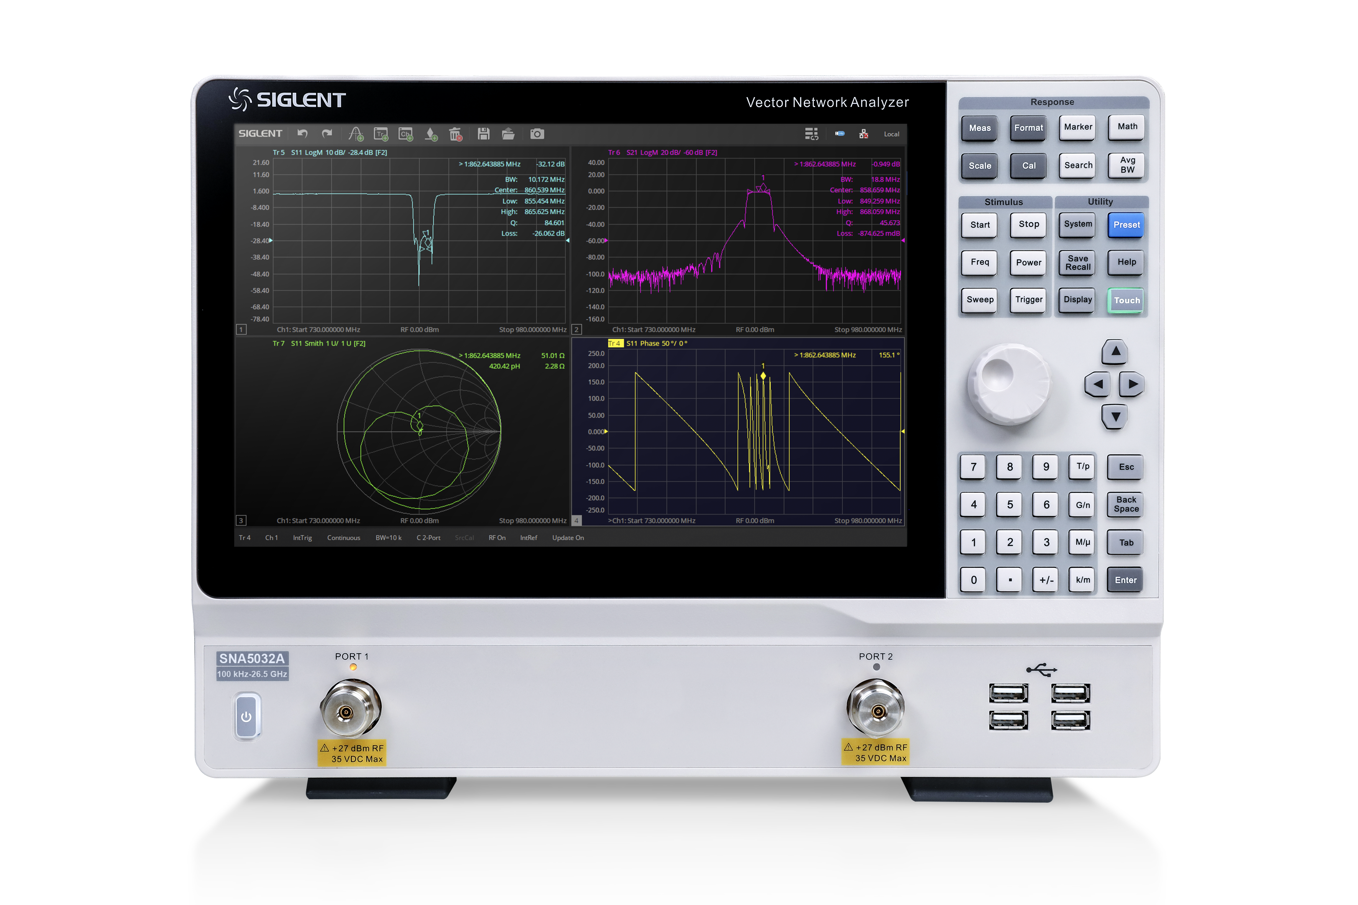
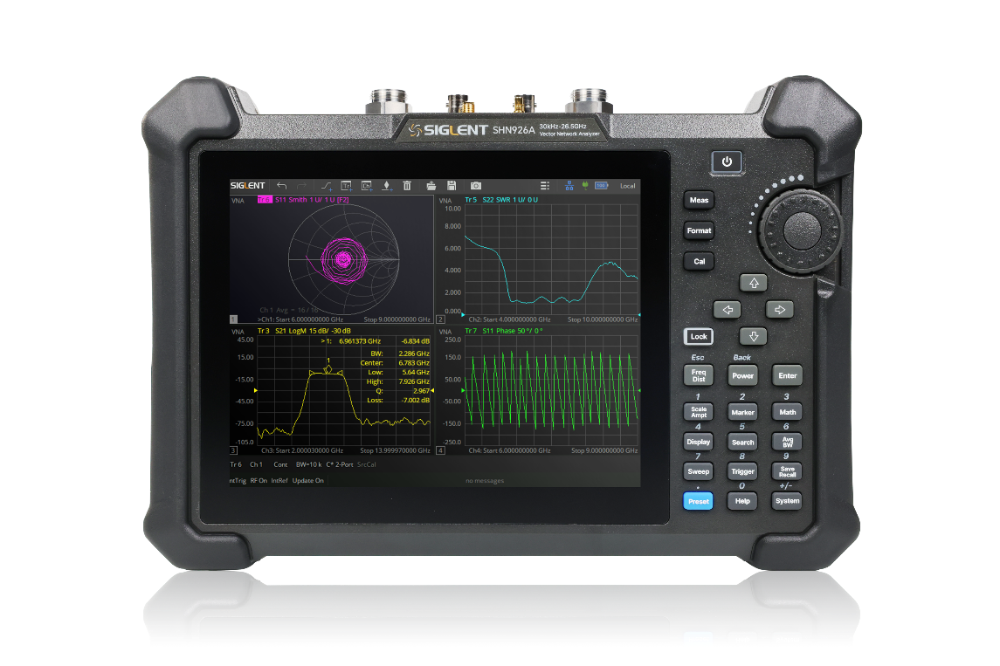
Desktop
For Better Performance
For Daily Testing

Slide 3
Portable
Smaller and Lighter
Portable and Functional
Perform Better in the Field

Slide 4

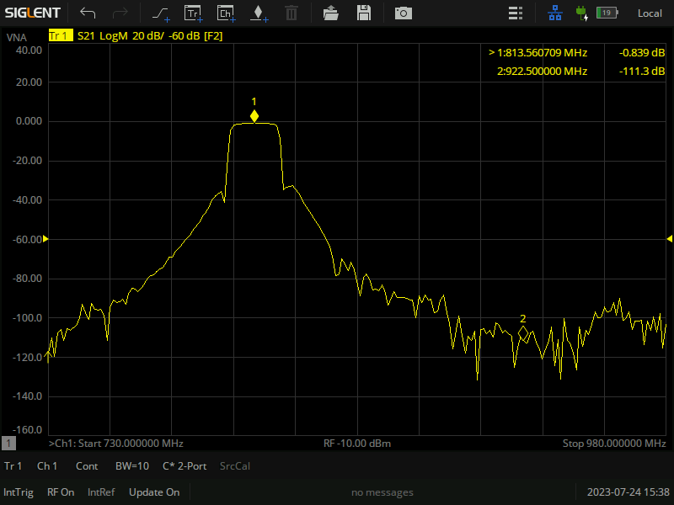
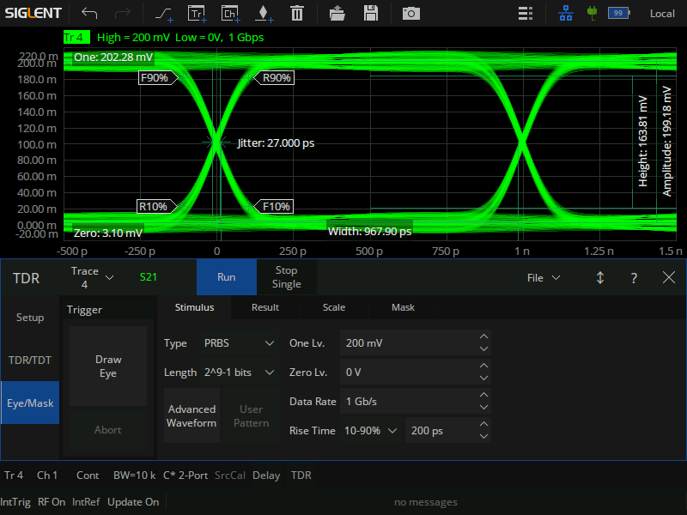
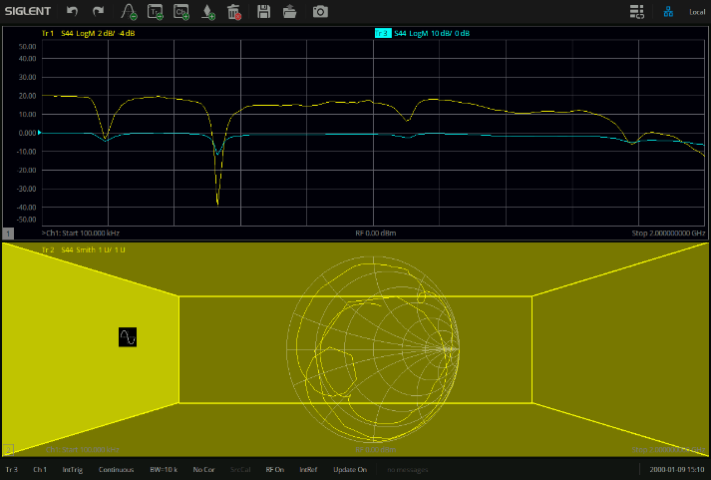
Excellent Performance
Exceptional Functionality
Exquisite Design
High dynamic range
Low trace noise
High accuracy
Large output power range
Output frequency up to 26.5GHz
···
Spectrum analysis (SA)
Impedance conversion
Time domain analysis (TDA)
Enhanced Time-Domain analysis
CAT/DTF measurement (Standard)
···
Better UI
Remote control
Compact design
Large operating screen
Rich communication interface
···
4

Slide 5
PART ONE
01
Brief Introduction
Instrument Tour / User friendly in every detail

Slide 6
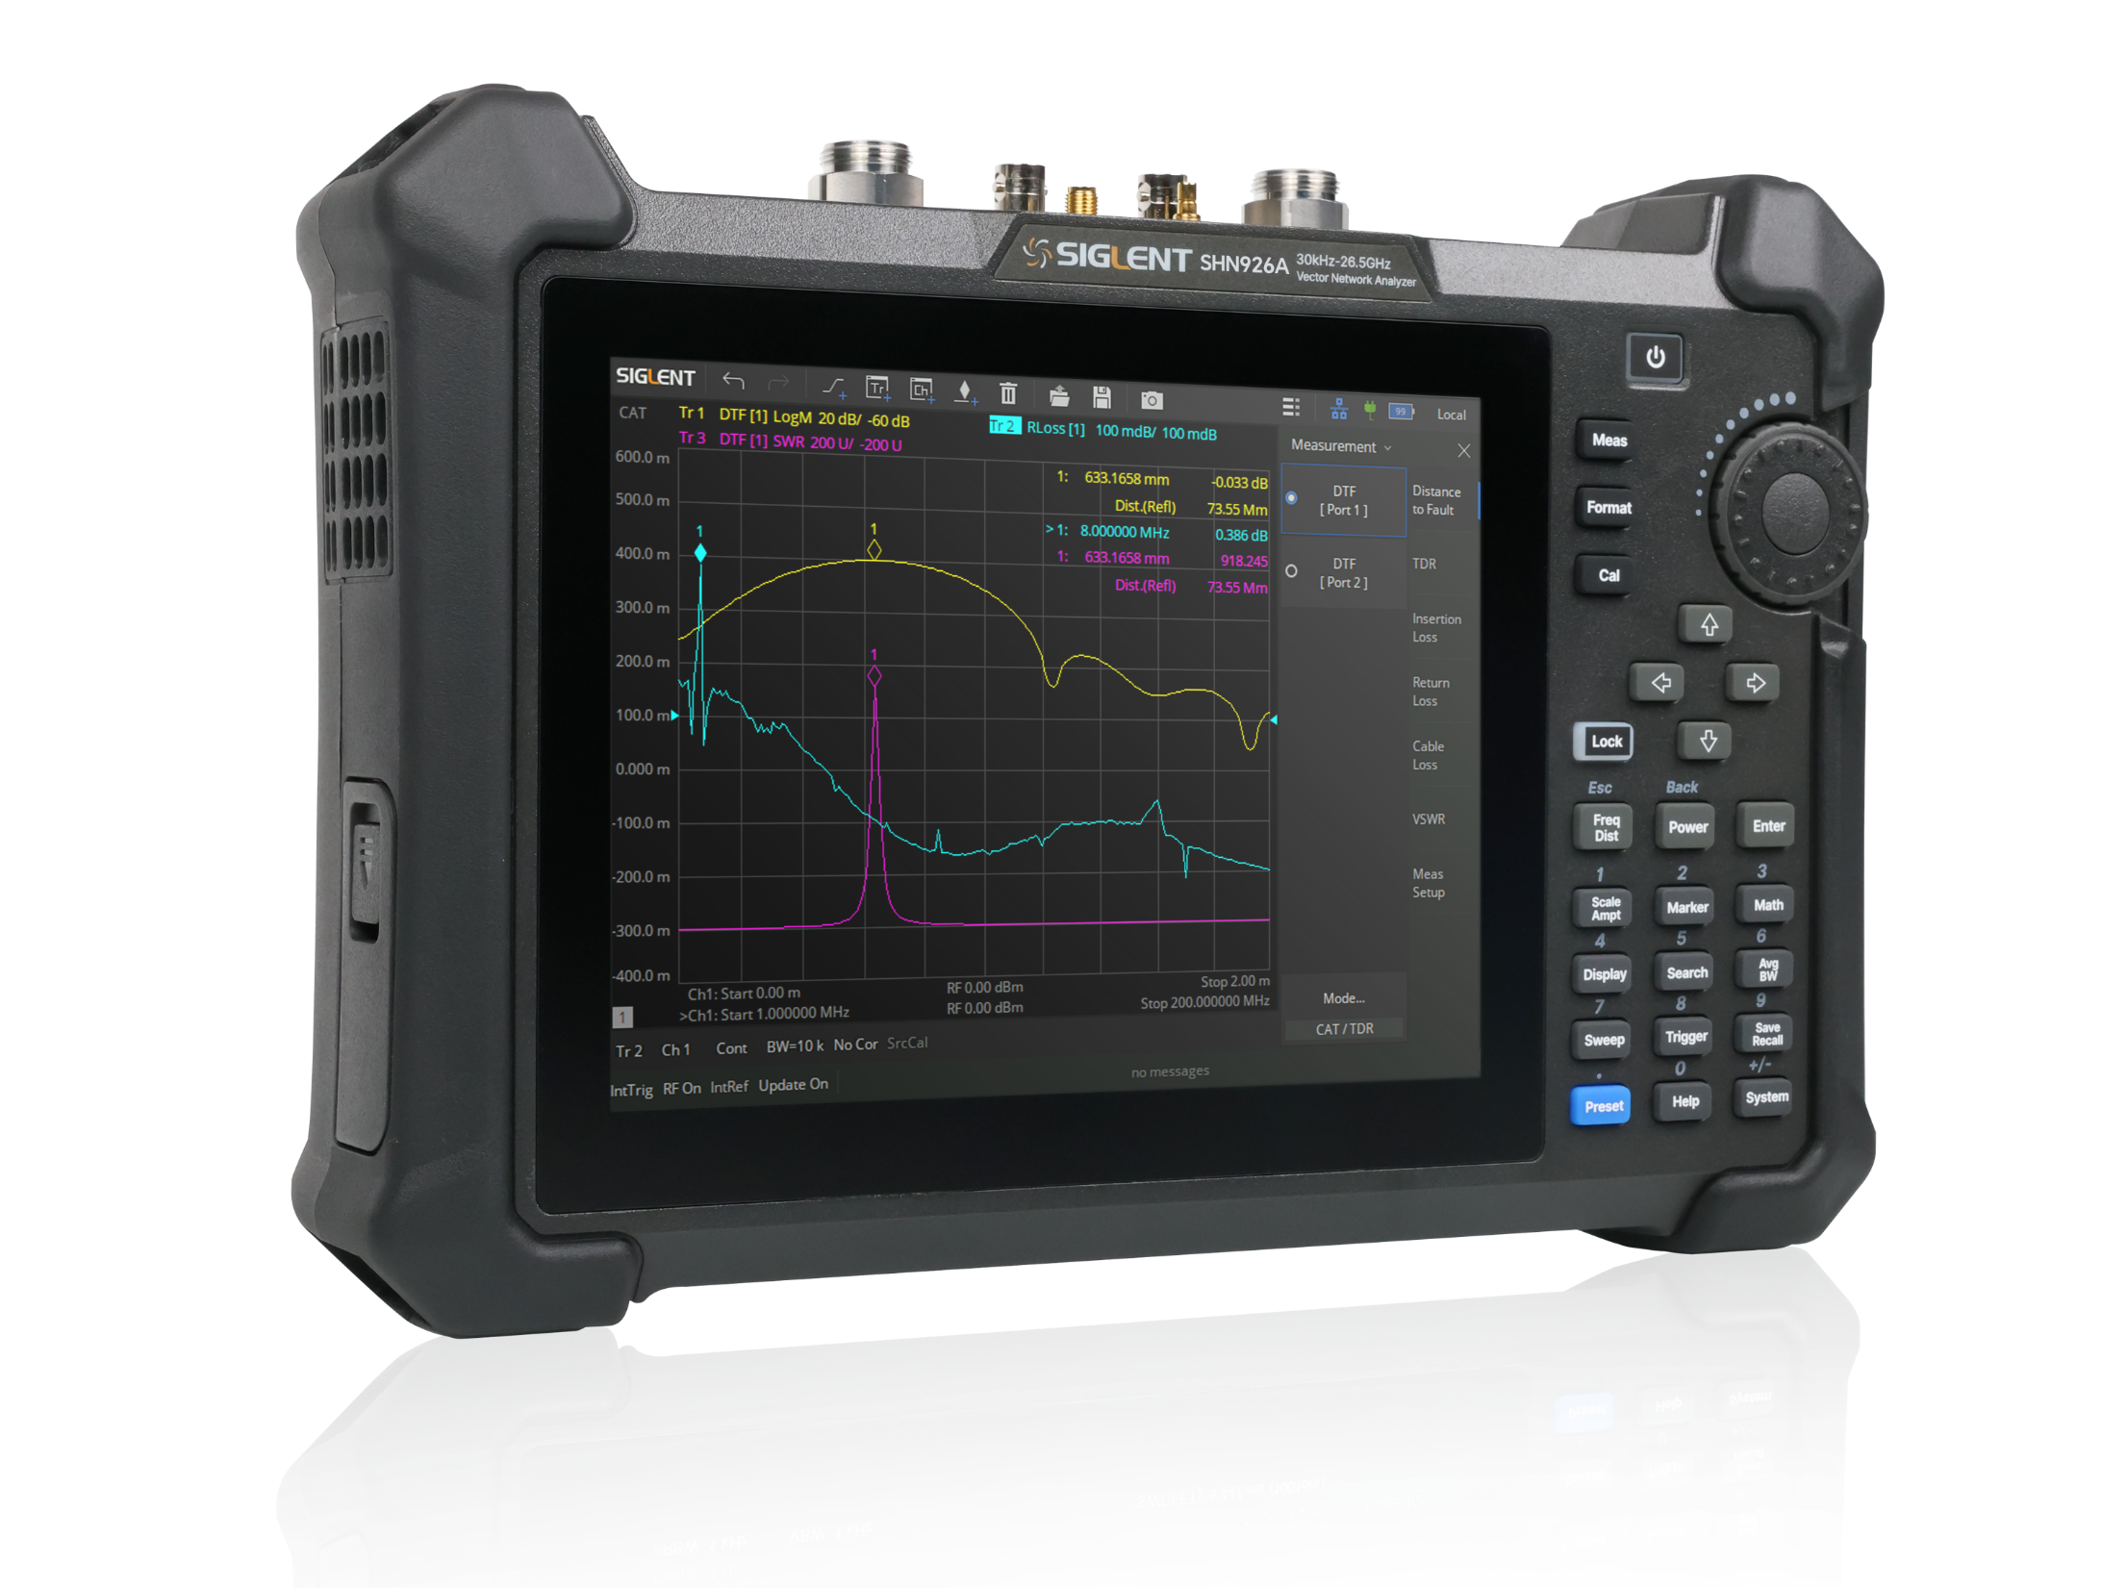
26.5GHz Portable Vector Network Analyzer
Model | SHN914A | SHN920A | SHN926A
Frequency range | 30kHz-14GHz | 30kHz-20GHz | 30kHz-26.5GHz
Ports | 2 | 2 | 2
Frequency resolution | 1Hz
Level resolution | 0.01dB
Range of IFBW | 10 Hz ~ 3 MHz
Setting range of output level | -45 dBm ~ + 10 dBm
Dynamic range | 100dB（Specification） 110dB（Typical）
Types of calibration | Response calibration, Enhanced Response calibration, Full-one port calibration, Full-two port calibration, TRL calibration
Types of measurement | Scattering- parameter measurement, differential-parameter measurement, receiver measurement, time-domain parameter analysis, TDR, limit test, impedance conversion, adapter removal/insertion, spectrum analysis, ripple test, Bandwidth analysis
Bias-Tees | Standard
Interface | LAN, USB Device, USB Host(USB-GPIB)
Remote control | SCPI / LabVIEW / IVI based on USB-TMC / VXI-11 / Socket / Telnet / WebServer | SCPI / Labview / IVI based on USB-TMC / VXI-11 / Socket / Telnet / WebServer
Display | 8.4-inch touch screen
6

Slide 7


SHN900A Front Panel Tour
Flexible large screen touch operation
Useful shortcuts simplify setup steps for efficient testing
8.4 inch multi-touch screen, resolution 800*600
8.4 inch Big Touch Screen
Multiplexed keys for menu selection and numeric entry
New panel design contributes to better operation and the ultimate touch screen experience
Lightweight and portable, designed to meet the needs of field and outdoor operations
7

Slide 8
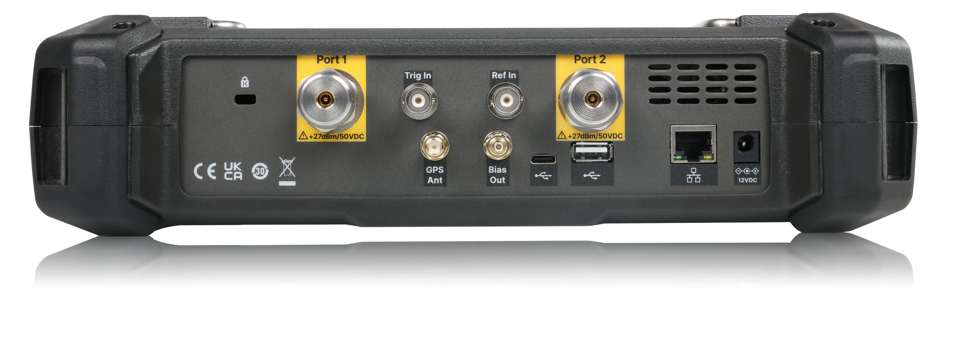
SHN900A Rear Panel Tour
Multiple control and function extension interfaces
1
2
3
4
5
6
7
8
9
10
11
① K-groove
② Port 1, RF signal input and output ports, 50Ω NMD 3.5mm Male Connector
③ Trig In, Trigger Input, BNC Female
④ Ref In, Reference Clock Input, BNC Female
⑤ Port 2, RF signal input and output port, 50Ω NMD 3.5mm Male Connector
⑥ GPS Ant, GPS antenna port, SMA Female Connector, Used to install GPS antenna to receive GPS satellite signals (Standard)
⑦ Bias Out, Bias voltage output port, 50Ω SMB Female Connector (Standard)
⑧ ⑨ ⑩ Type C, USB Host, LAN, remote view and control of analyzer through web browser, keyboard and mouse
⑪ External power supply 12V 4A, for powering devices and charging batteries
⑧ ⑨ Read or store files to external extended memory, Ecal connection
8

Slide 9
PART TWO
02
Technical Highlights
Performance parameters and specific advantages of SHN900A

Slide 10
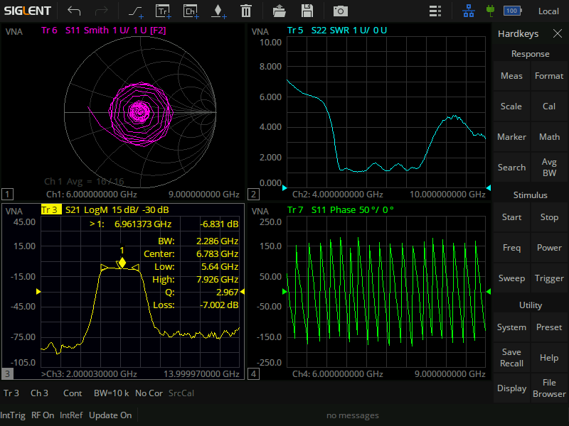
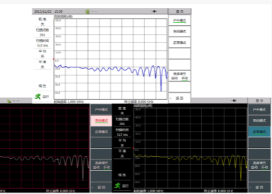
Friendly User Interface
Flexible Feature Integration and Shortcut Key Functionality
Adjustable Intensity of Display
Provides a display that adapts to different environments and provides good visibility under direct sunlight conditions
Virtual Keypad
The instrument can be operated without operating the function buttons on the front panel
Information Display Area
Touch and click for quick setting of corresponding parameters
Screensavers
With hibernation power-saving function, hibernation time can be set to save power, effectively extend the battery operating time and battery life
10

Slide 11
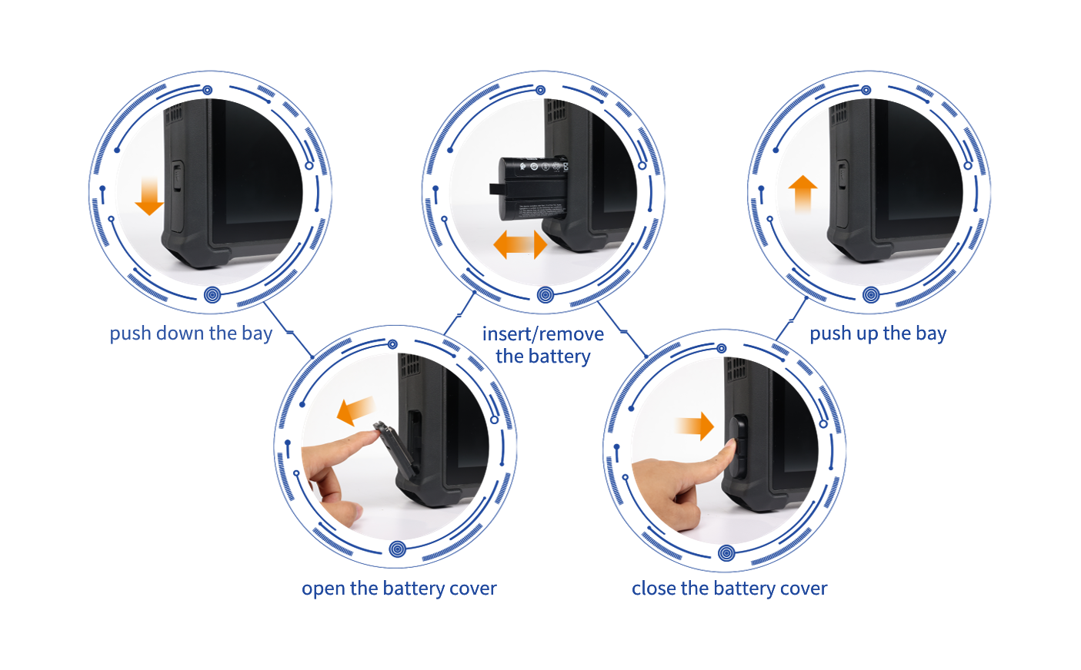
Excellent Battery Life
Unlimited extended runtime
High-capacity lithium-ion rechargeable battery
Up to 4 hours of continuous work
Push-lid battery compartment for easy change
11

Slide 12
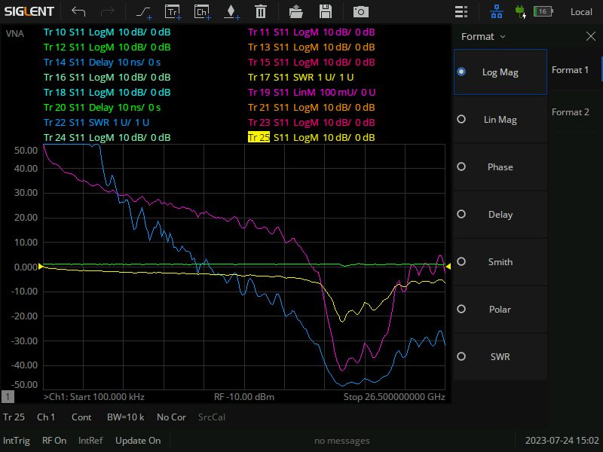
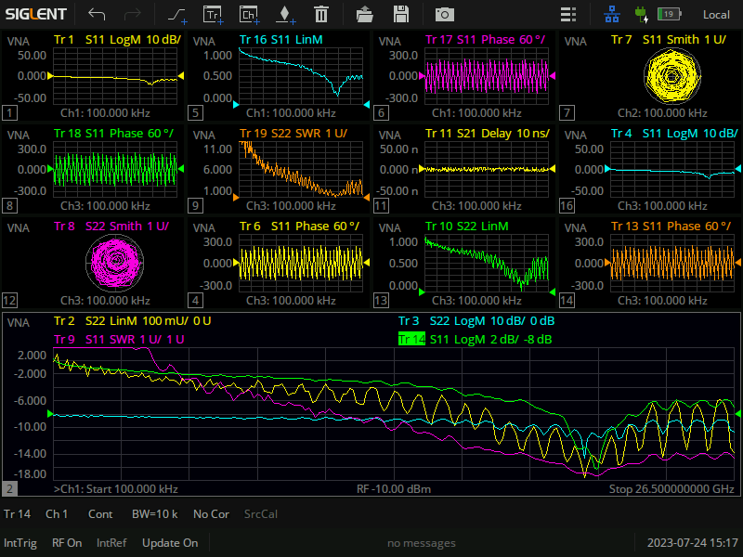
Multi-Window Multi-Trace Display
Rapid Performance of Complex Test
Multi-window display
Supports up to 256 channels
Supports up to 256 measurement windows
Each window can display 64 test traces at the same time
Higher efficiency
Clearer results
Each window can display different measurement formats with independent cursor functions
Rapid execution of complex test solutions
12

Slide 13
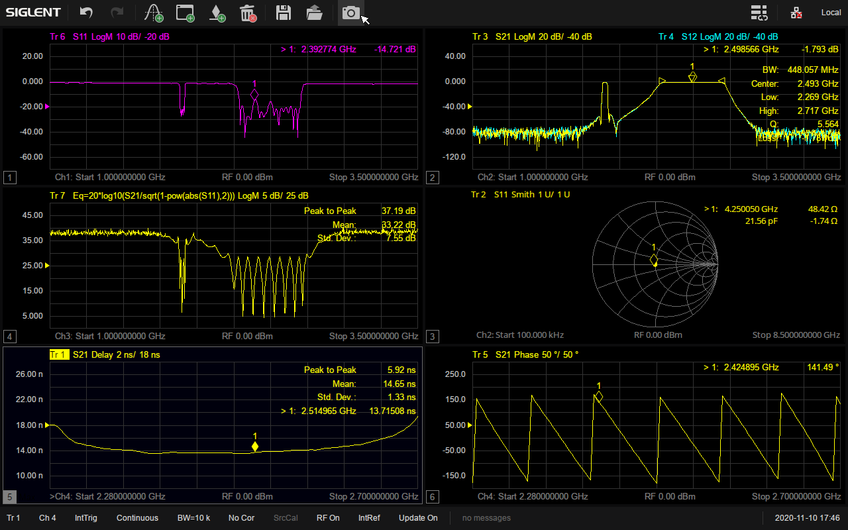
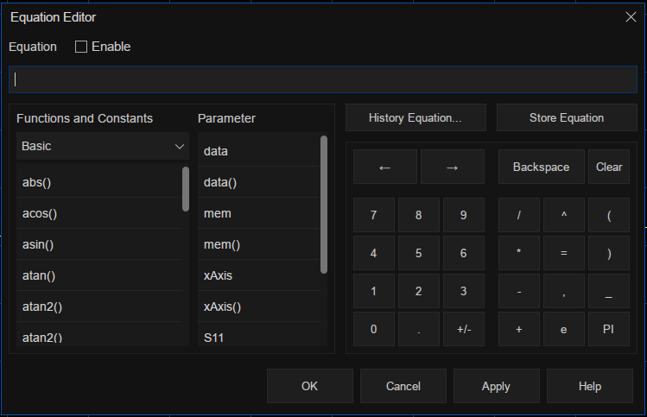
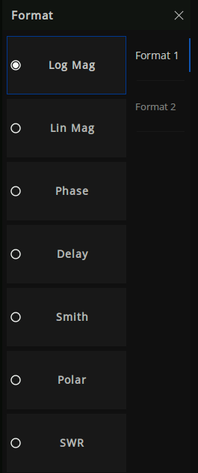
Multiple Data Display Formats
相位
极坐标
群时延
驻波比
对数幅度
线性幅度
史密斯圆图
······
Equation Editor
Simultaneous display of multiple data formats
Helps to understand the DUT from different perspectives
13

Slide 14
High Dynamic Range
Dynamic Range Up to 110dB
Capable of measuring small signals
Meet more high dynamic range test scenarios
Measurement of highly suppressed narrowband devices such as cavity filters
Simultaneous measurement of passband and out-of-band rejection performance of filters
14

Slide 15
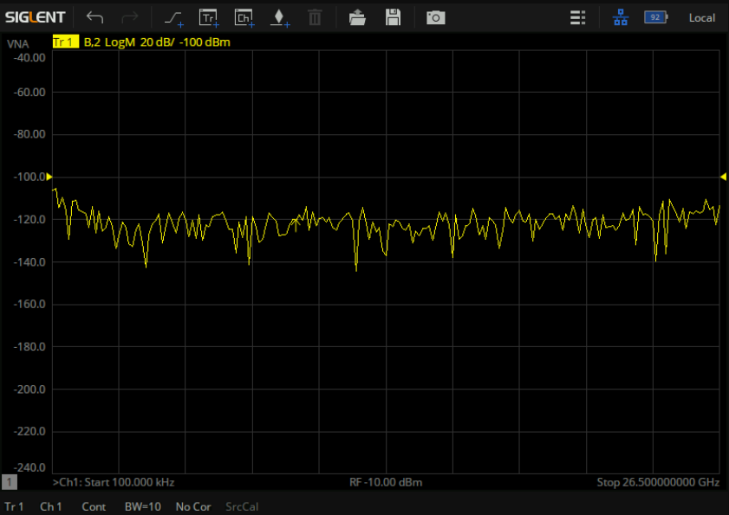
Low Noise Floor
Noise Floor as Low as -120dBm/Hz
Low Noise, High Performance RF Design
High sensitivity improves low signal monitoring
15

Slide 16
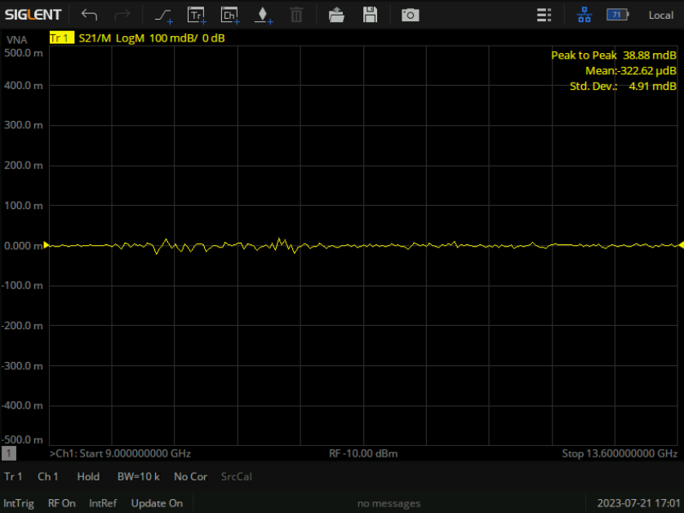
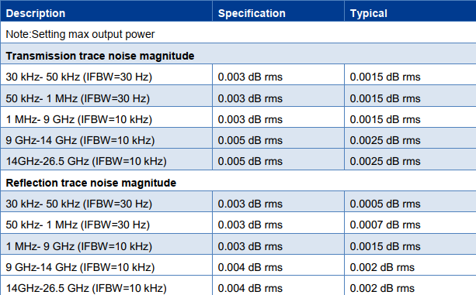
Excellent Trace Noise
l
Meet the Needs of Users for Precise Measurements
Greatly improves the testing accuracy
Especially useful for accurate measurements of small insertion loss devices
16

Slide 17

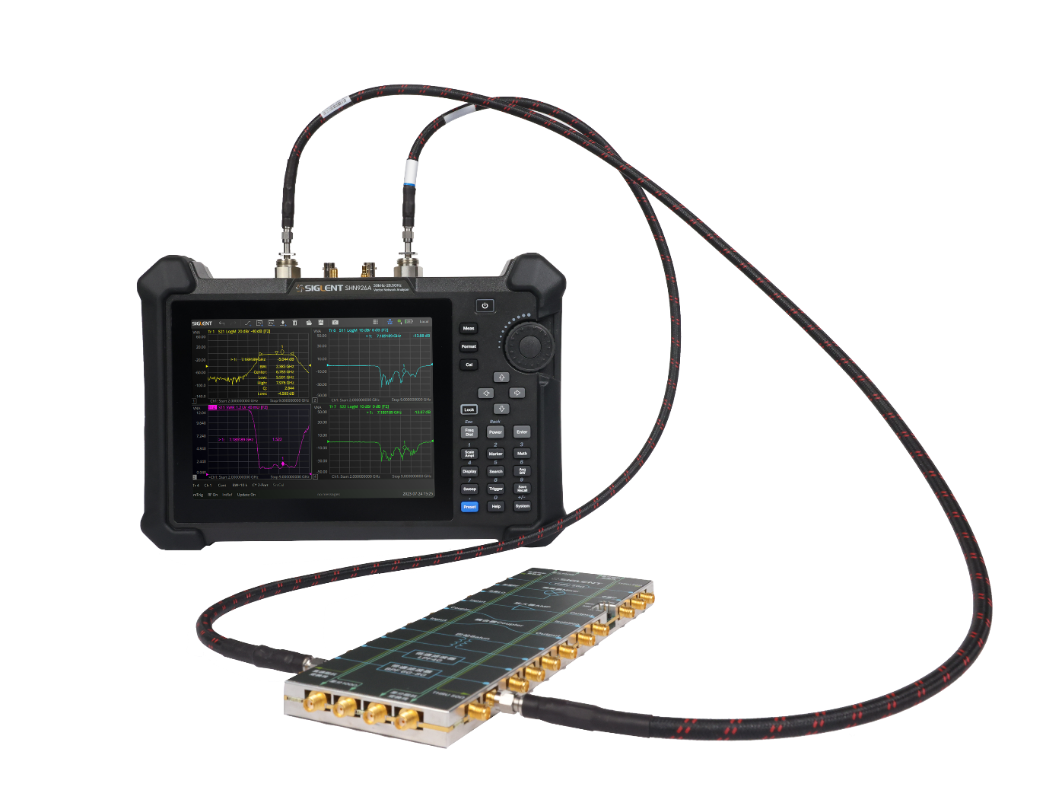
Segment-Sweep Mode
Optimized for Speed and Accuracy
Support Segment-Sweep mode
Ideal for testing filters with high out-of-band rejection
Simultaneous measurement of multiple frequency bands with independent parameters within each band
Different number of points, frequency range, IF bandwidth, etc. can be set for each scanning segment
The list is easy to edit, you can directly click on the parameters to be edited
17

Slide 18
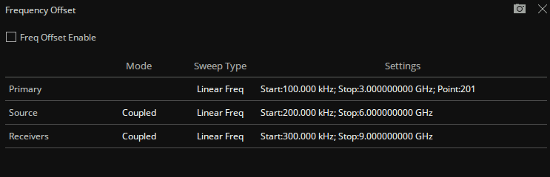
Frequency Offset Mode
Measurement of Device Nonlinear Characteristics
Enabling the internal signal source and receiver to operate at different frequencies
Easy and quick list editing, you can directly click on the parameters to be edited
18

Slide 19
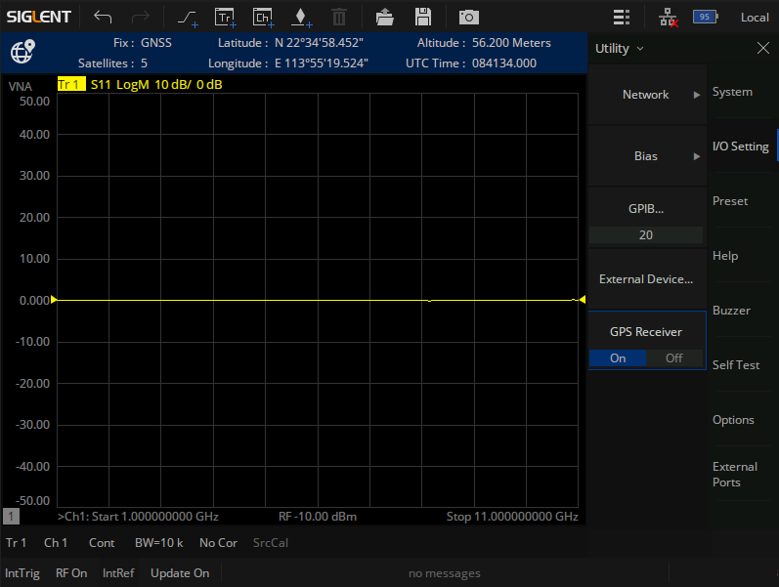
GPS _{(Standard)}
Built-in GPS Receiver
GPS Display Info
Provide geolocation labeling
Fix ：Invalid/GNSS/DGPS/Estimated
Satellites
Latitude
Longitude
Altitude
UTC Time
19

Slide 20
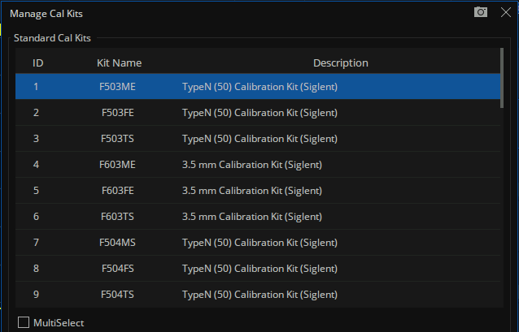
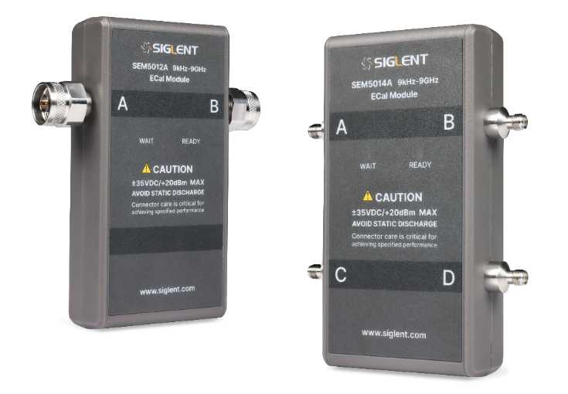
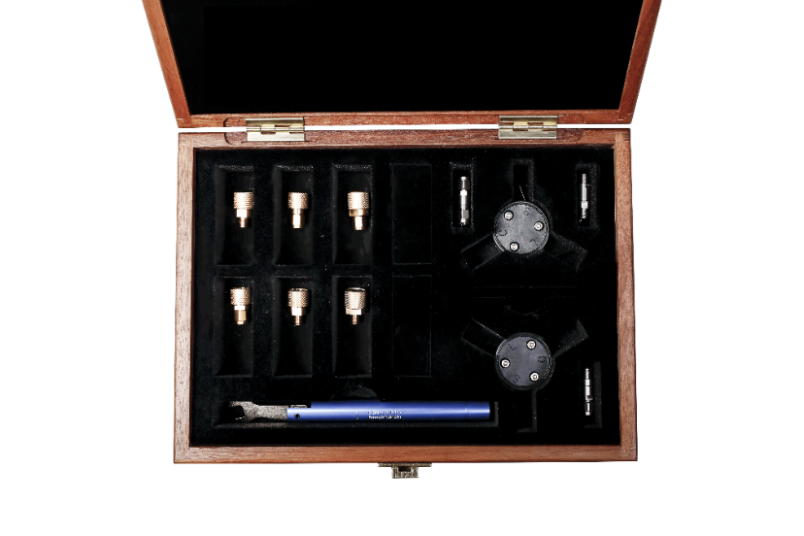
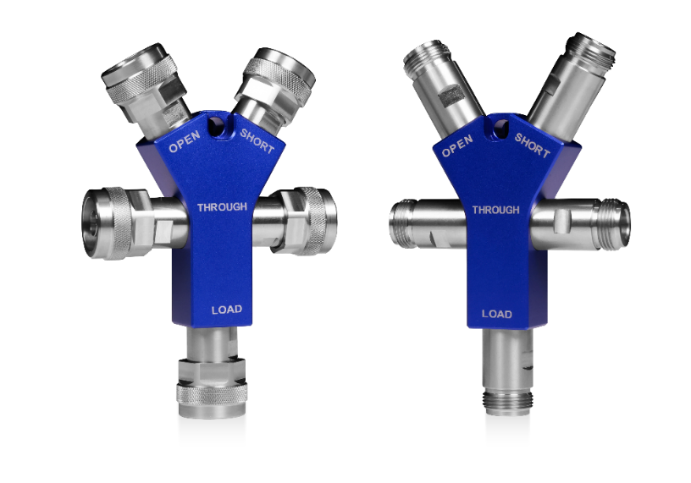
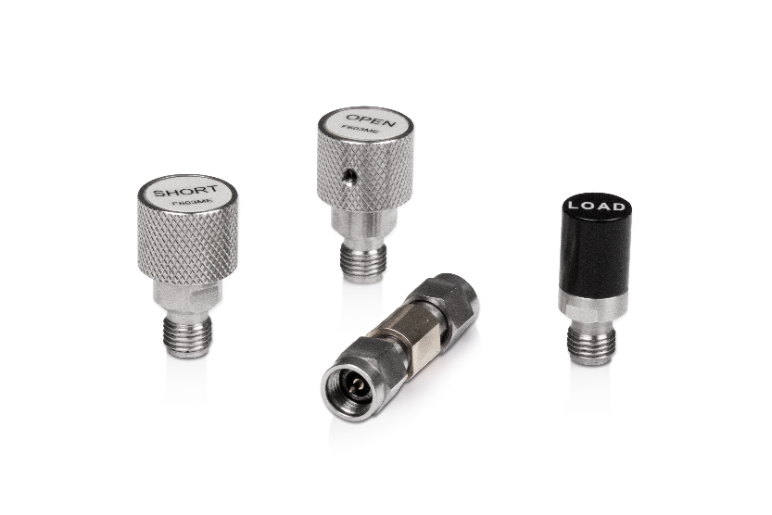
Flexible Calibration Types
Compatible with Multiple Calibrators
Electronic Calibrators
Mechanical Calibration Kit
One-piece Calibrated Parts
Mechanical Calibration Kit
Support for user-defined calibration kits
Facilitates testing of devices with different interface types
20

Slide 21
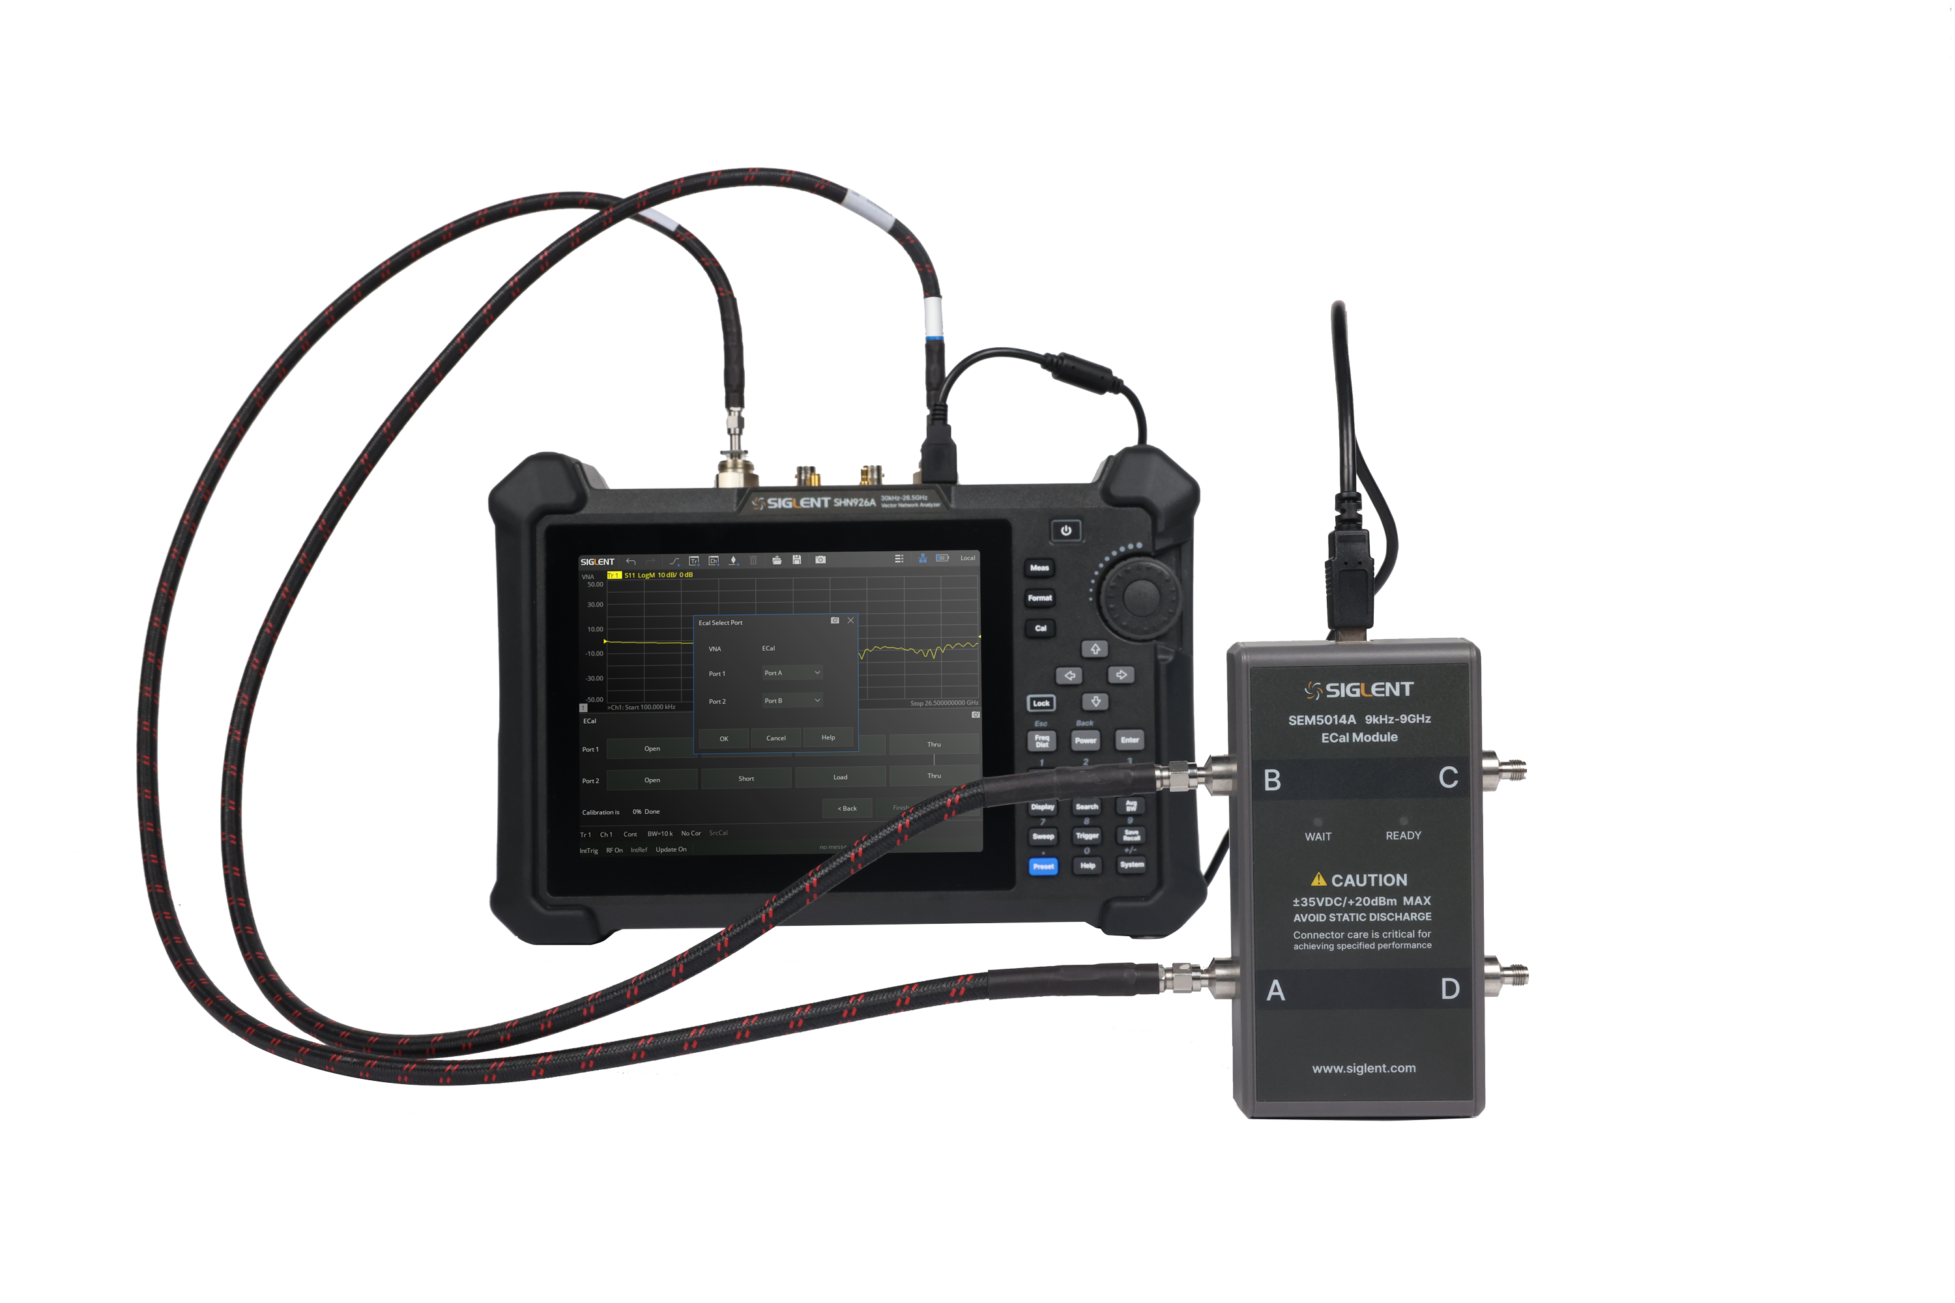
Electronic Calibration
ECal module includes electronic labeling
Calibrated at the factory
Data is stored in the memory of the ECal module
Automatic calibration
Simple calibration process
Electronic calibrators need to be connected to the vector network only once
Less uncertainty in calibration process
Reduce the number of connections in the test
Less human error
Higher precision
Reduced calibration time
Higher Measurement Compliance
21

Slide 22
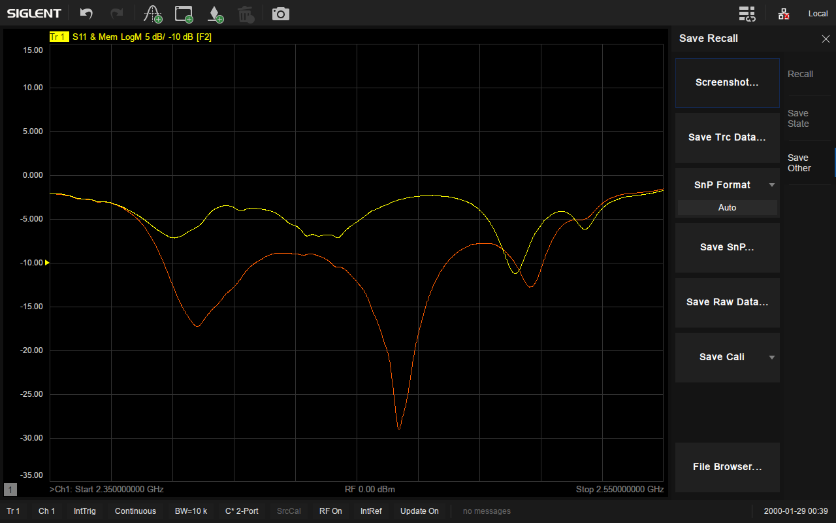
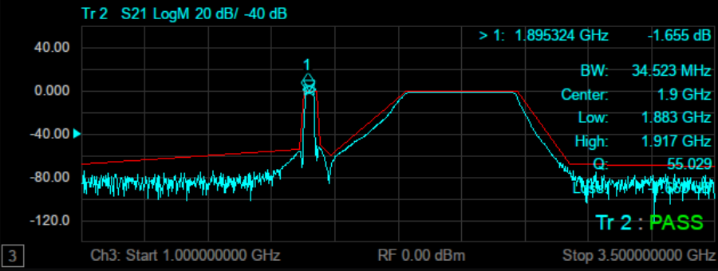
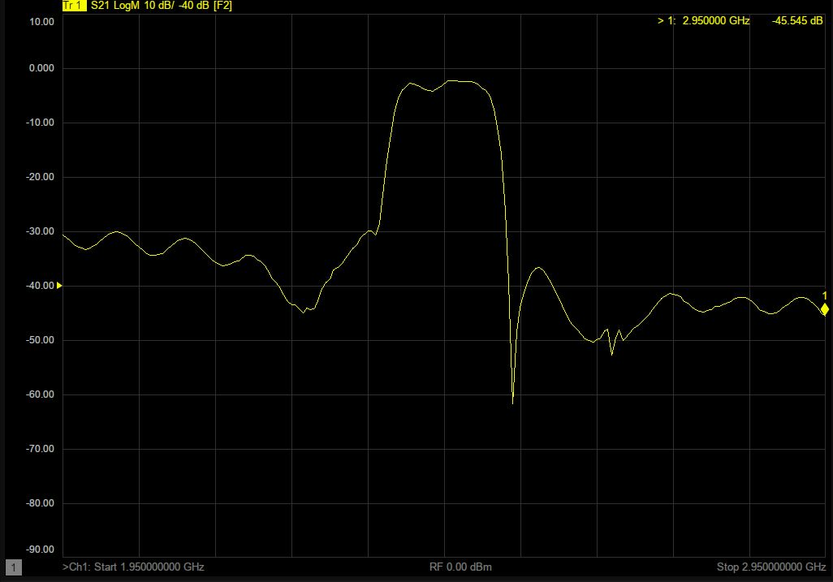
Mass Production Test
＋
＋
Data & Memory
Data traces
Memory trace
Facilitate comparison of current and historical data
Limit Test
Comparison of measured data with defined limits
PASS / FAIL
Test data and result visualization
Hold Function
Pause or resume the current measurement process
Detailed examination of the test parameters
22

Slide 23
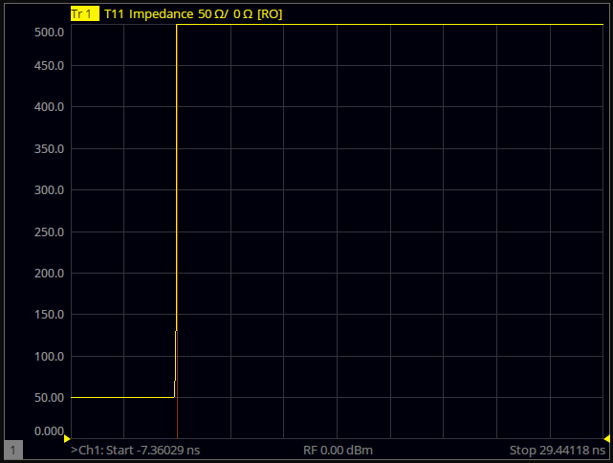
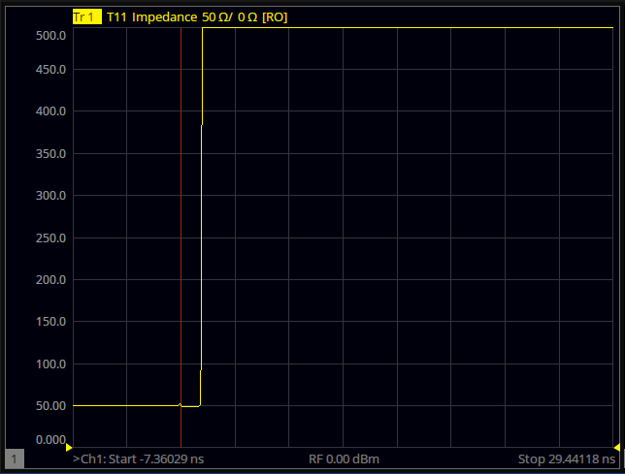
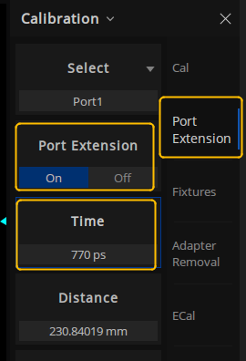
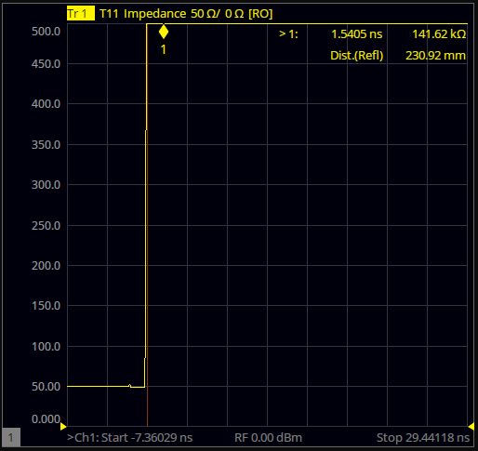
Port Extension
Calibration
Connect the test fixture
Open Port Extension
Improved test accuracy
Eliminate test fixture errors
Extend the reference plane to the specified measurement plane
23

Slide 24
Enhanced Time Domain Analysis _{(Option SHN900-TDR)}
TDR
Time Domain Reflection/Transmission Analysis
Time Domain Analysis
Accurate measurement of the characteristic impedance of the transmission line to locate the point of failure
Time Domain Selection / Gating Function
Analyze the influence of fault on device characteristics
Simulation and Analysis of Eye Charts
Jitter Injection Function
Simulating the effect of input signals with jitter on signal transmission
Signal Integrity Analysis
Internal emulation to generate eye diagrams without additional code generators
Advanced Waveform Simulation Functions
Simulation improves signal transmission on the transmitter and receiver side of the signal
24

Slide 25

Filter Test
Segment-Sweep
Optimized for Speed and Accuracy
The number of scanning points in the passband should be set low and the IFBW large to reduce scanning time
The number of out-of-passband scanning points should be set higher and the IFBW smaller to increase the measurement accuracy
Bandwidth
Set bandwidth to -3dB/ -6dB for one-touch testing
Bandwidth, Center frequency, Q-factor and insertion loss
Transmission and Reflection Parameters
Insertion loss, N dB bandwidth, Out-of-band suppression …
Input/output return loss, Input/Output VSWR …
25

Slide 26
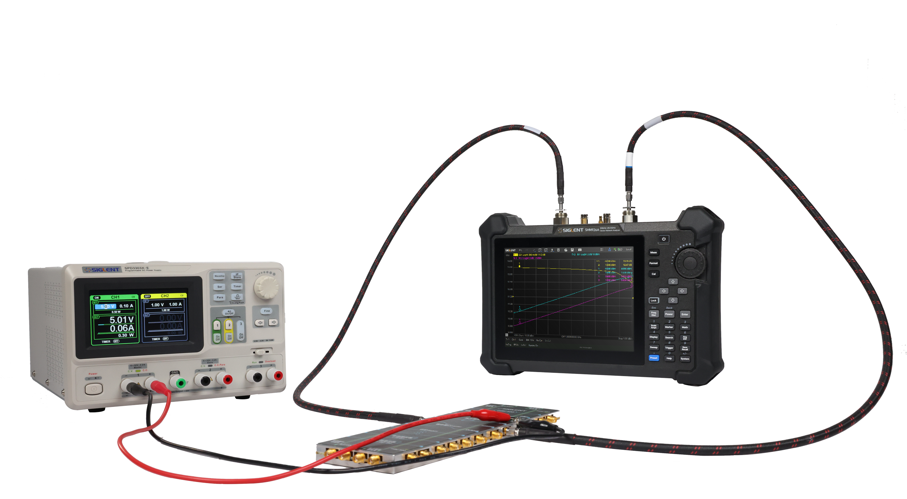
Amplifier Test
In wireless communication systems, the signal usually has a certain bandwidth, if the total power is close to the 1dB compression point, the amplifier nonlinearity tends to be more obvious, it will produce a relatively strong harmonic, cross-talk, which will cause interference to the neighboring or in-band
Active devices such as amplifiers are usually concerned with the position where the actual gain drops by 1 dB from the linear gain
Gain/Isolation
Input/output return loss
1dB compression point
Input/Output Power
…
26

Slide 27
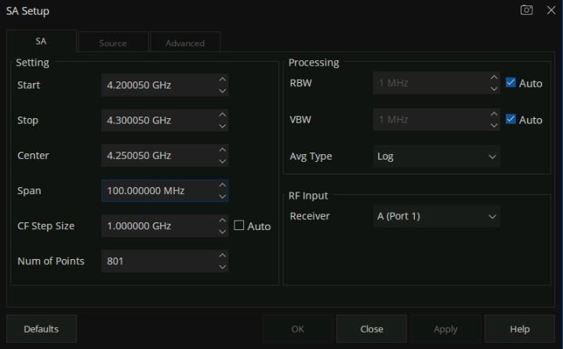
Spectrum Analysis _{(Option SHN900-SA)}
SA Setup
SA Setup
Automate, standardize and optimize test sequences to simplify measurements
The step-by-step instructions for typical measurements guide the user through the measurement process and help the user quickly familiarize themselves with the instrument's operation
A range of standardized, repeatable measurements can be performed quickly and easily, helping to eliminate human error
27

Slide 28
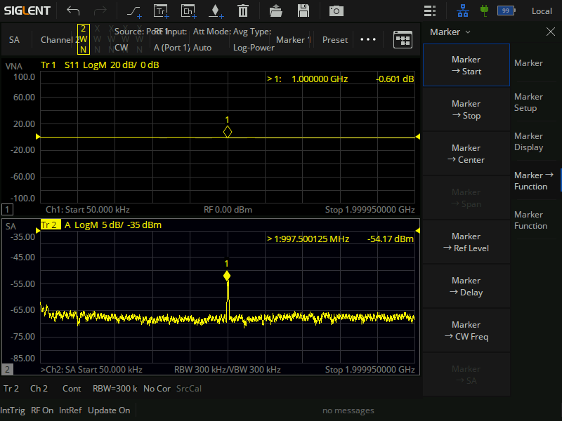
Spectrum Analysis _{(Option SHN900-SA)}
Marker → SA
Marker → SA
The Marker → SA function supports a quick view of the spectrum of a specific frequency point of the S-measurement parameter, making it easier to search and analyze the signal
Measurement of spectral characteristics allows rapid identification of undesirable signal sources in a variety of field test environments, dramatically reducing the amount of work required to locate signals.
SA mode provides an advanced measurement suite
28

Slide 29
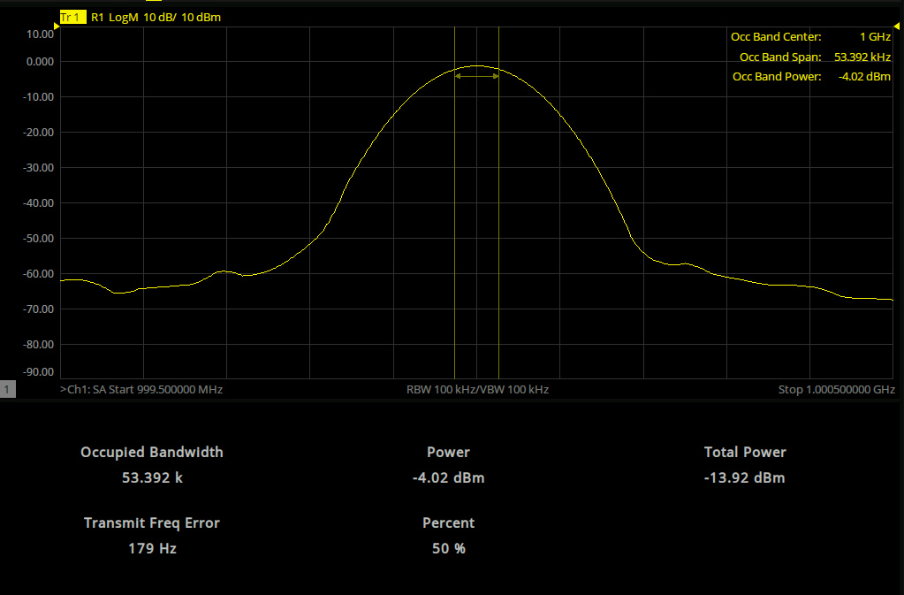
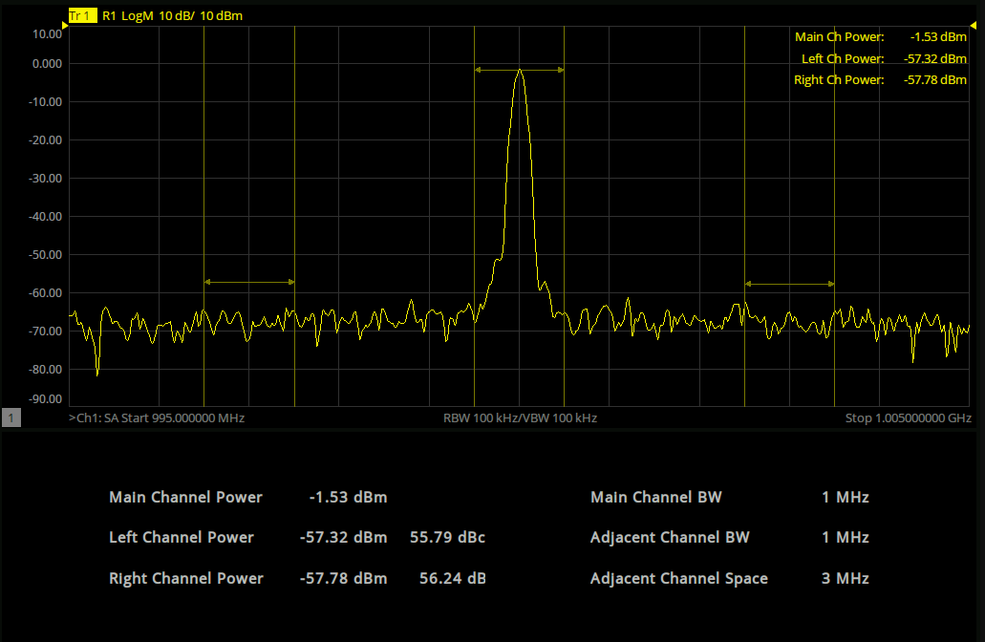
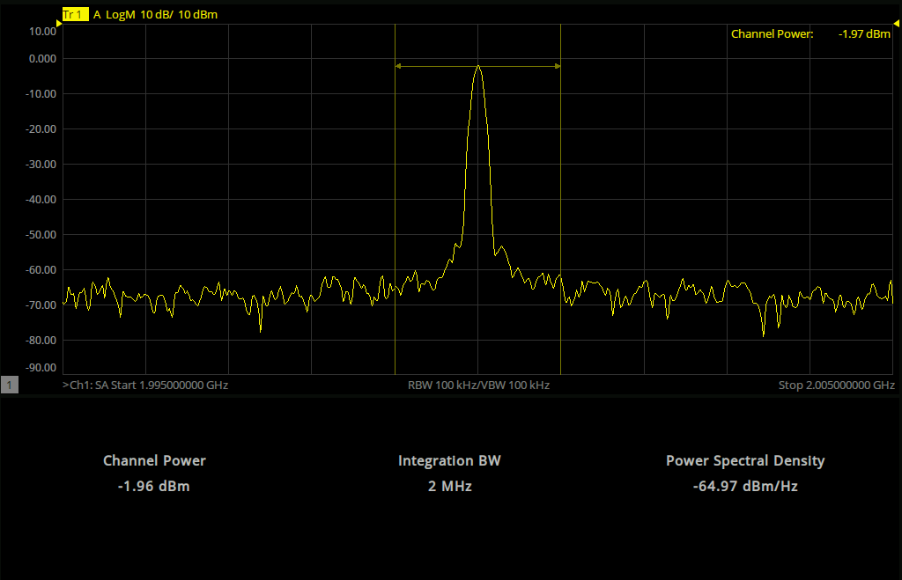
Spectrum Analysis _{(Option SHN900-SA)}
Occupied BW
Adjacent Channel Power Ratio (ACPR)
Channel Power
29

Slide 30
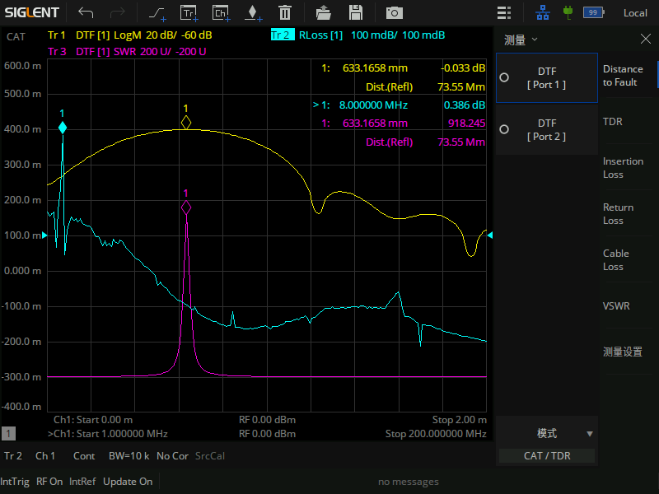
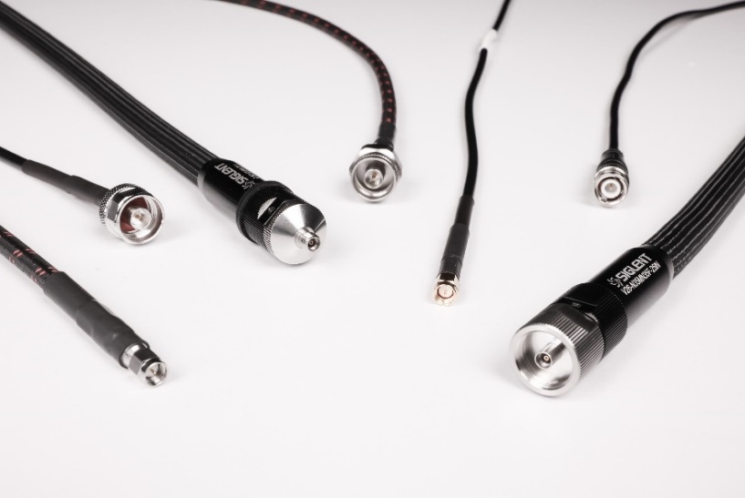
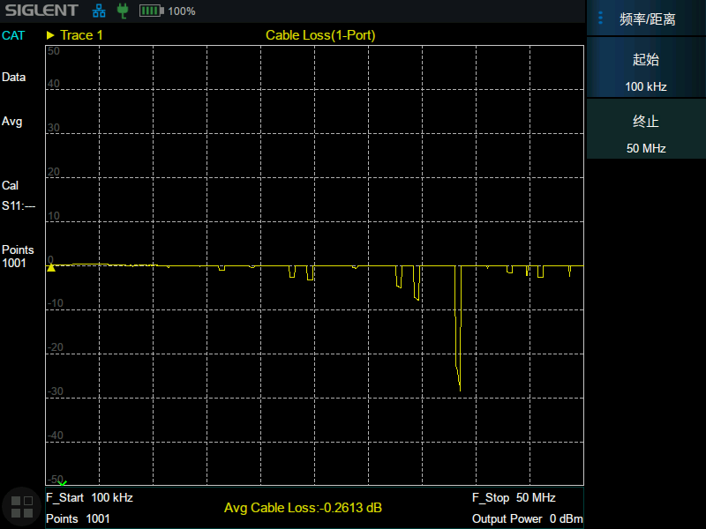
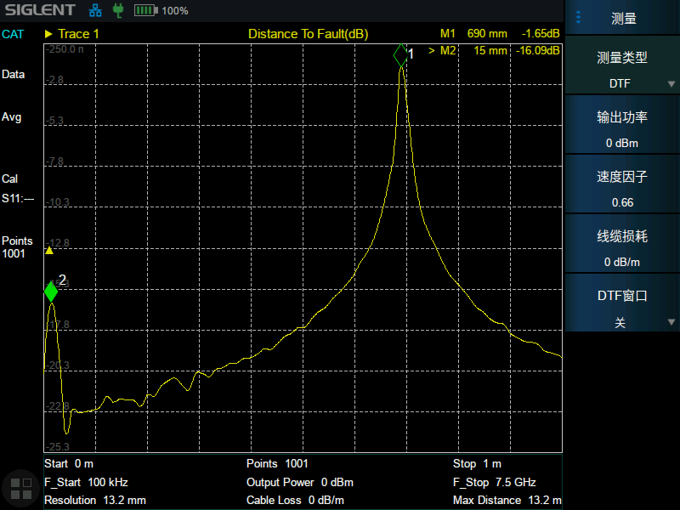
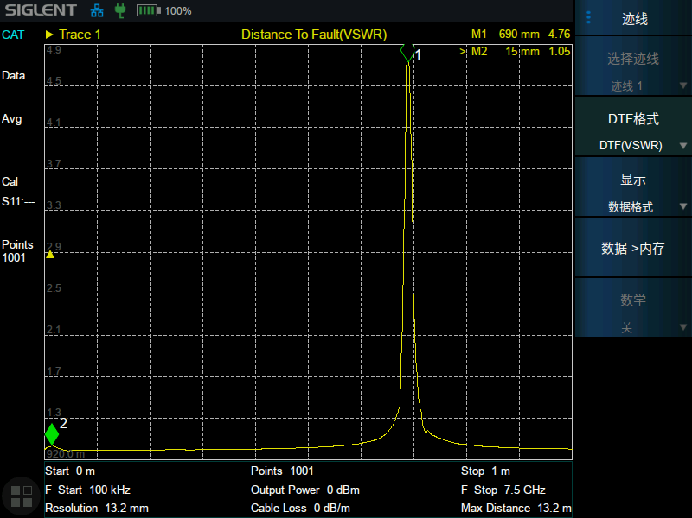
Cable Analysis _{(Standard)}
Cable Test
Cable Loss Test
DTF(dB)
DTF(VSWR)
Faulty cables, loose or damaged connectors in the transmission path can lead to unwanted signal reflections
Provides a variety of measurement formats, return loss, VSWR, impedance, cable loss, fault point distance, etc.
30

Slide 31
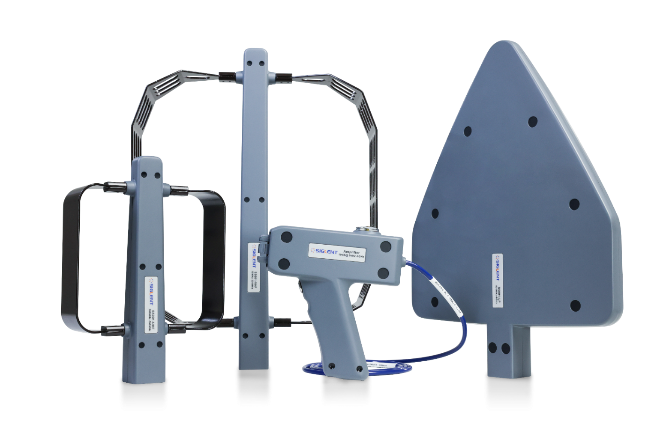

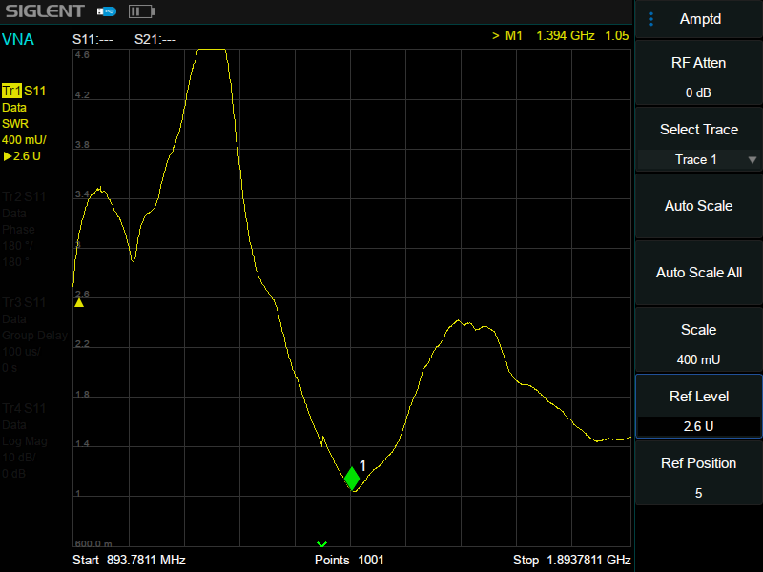
Antenna Analysis _{(Standard)}
Antenna Test
Antenna Test
VSWR Test
Antenna feeder system installation, commissioning and routine maintenance
Mode: Cable and Antenna> Meas: VSWR> Ampt
Mode: Vector Network Analysis> Meas >Measurement Type: S11>Format: VSWR
Antenna matching measurements to quickly assess the condition of transmission lines and antenna systems, improve the maintenance efficiency of operating base stations, and speed up the installation and commissioning process of new base stations
31

Slide 32
PART THREE
03
Market and Application
Capabilities and Functional Highlights

Slide 33
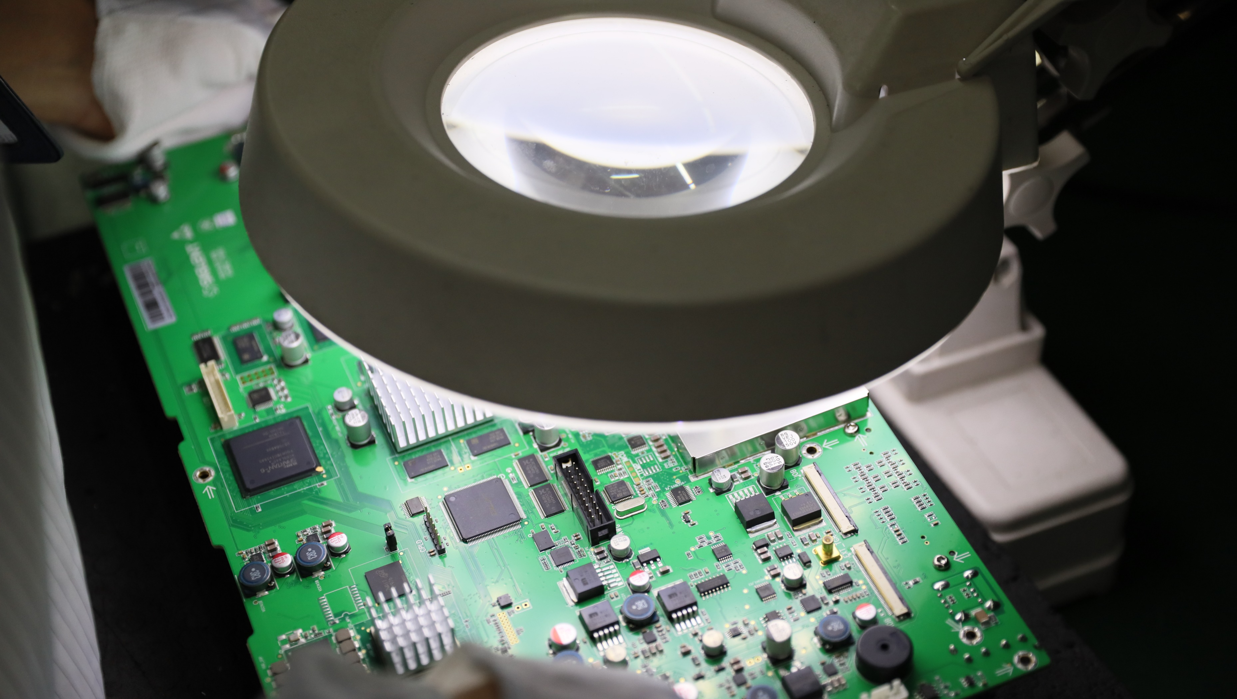
Line Production
Design and characterization of RF devices
Design and characterization of electronic components
Resistors, Capacitors, Inductors...
Filters, cables, mixers, connectors...
Antennas, amplifiers, attenuators...
…
33

Slide 34
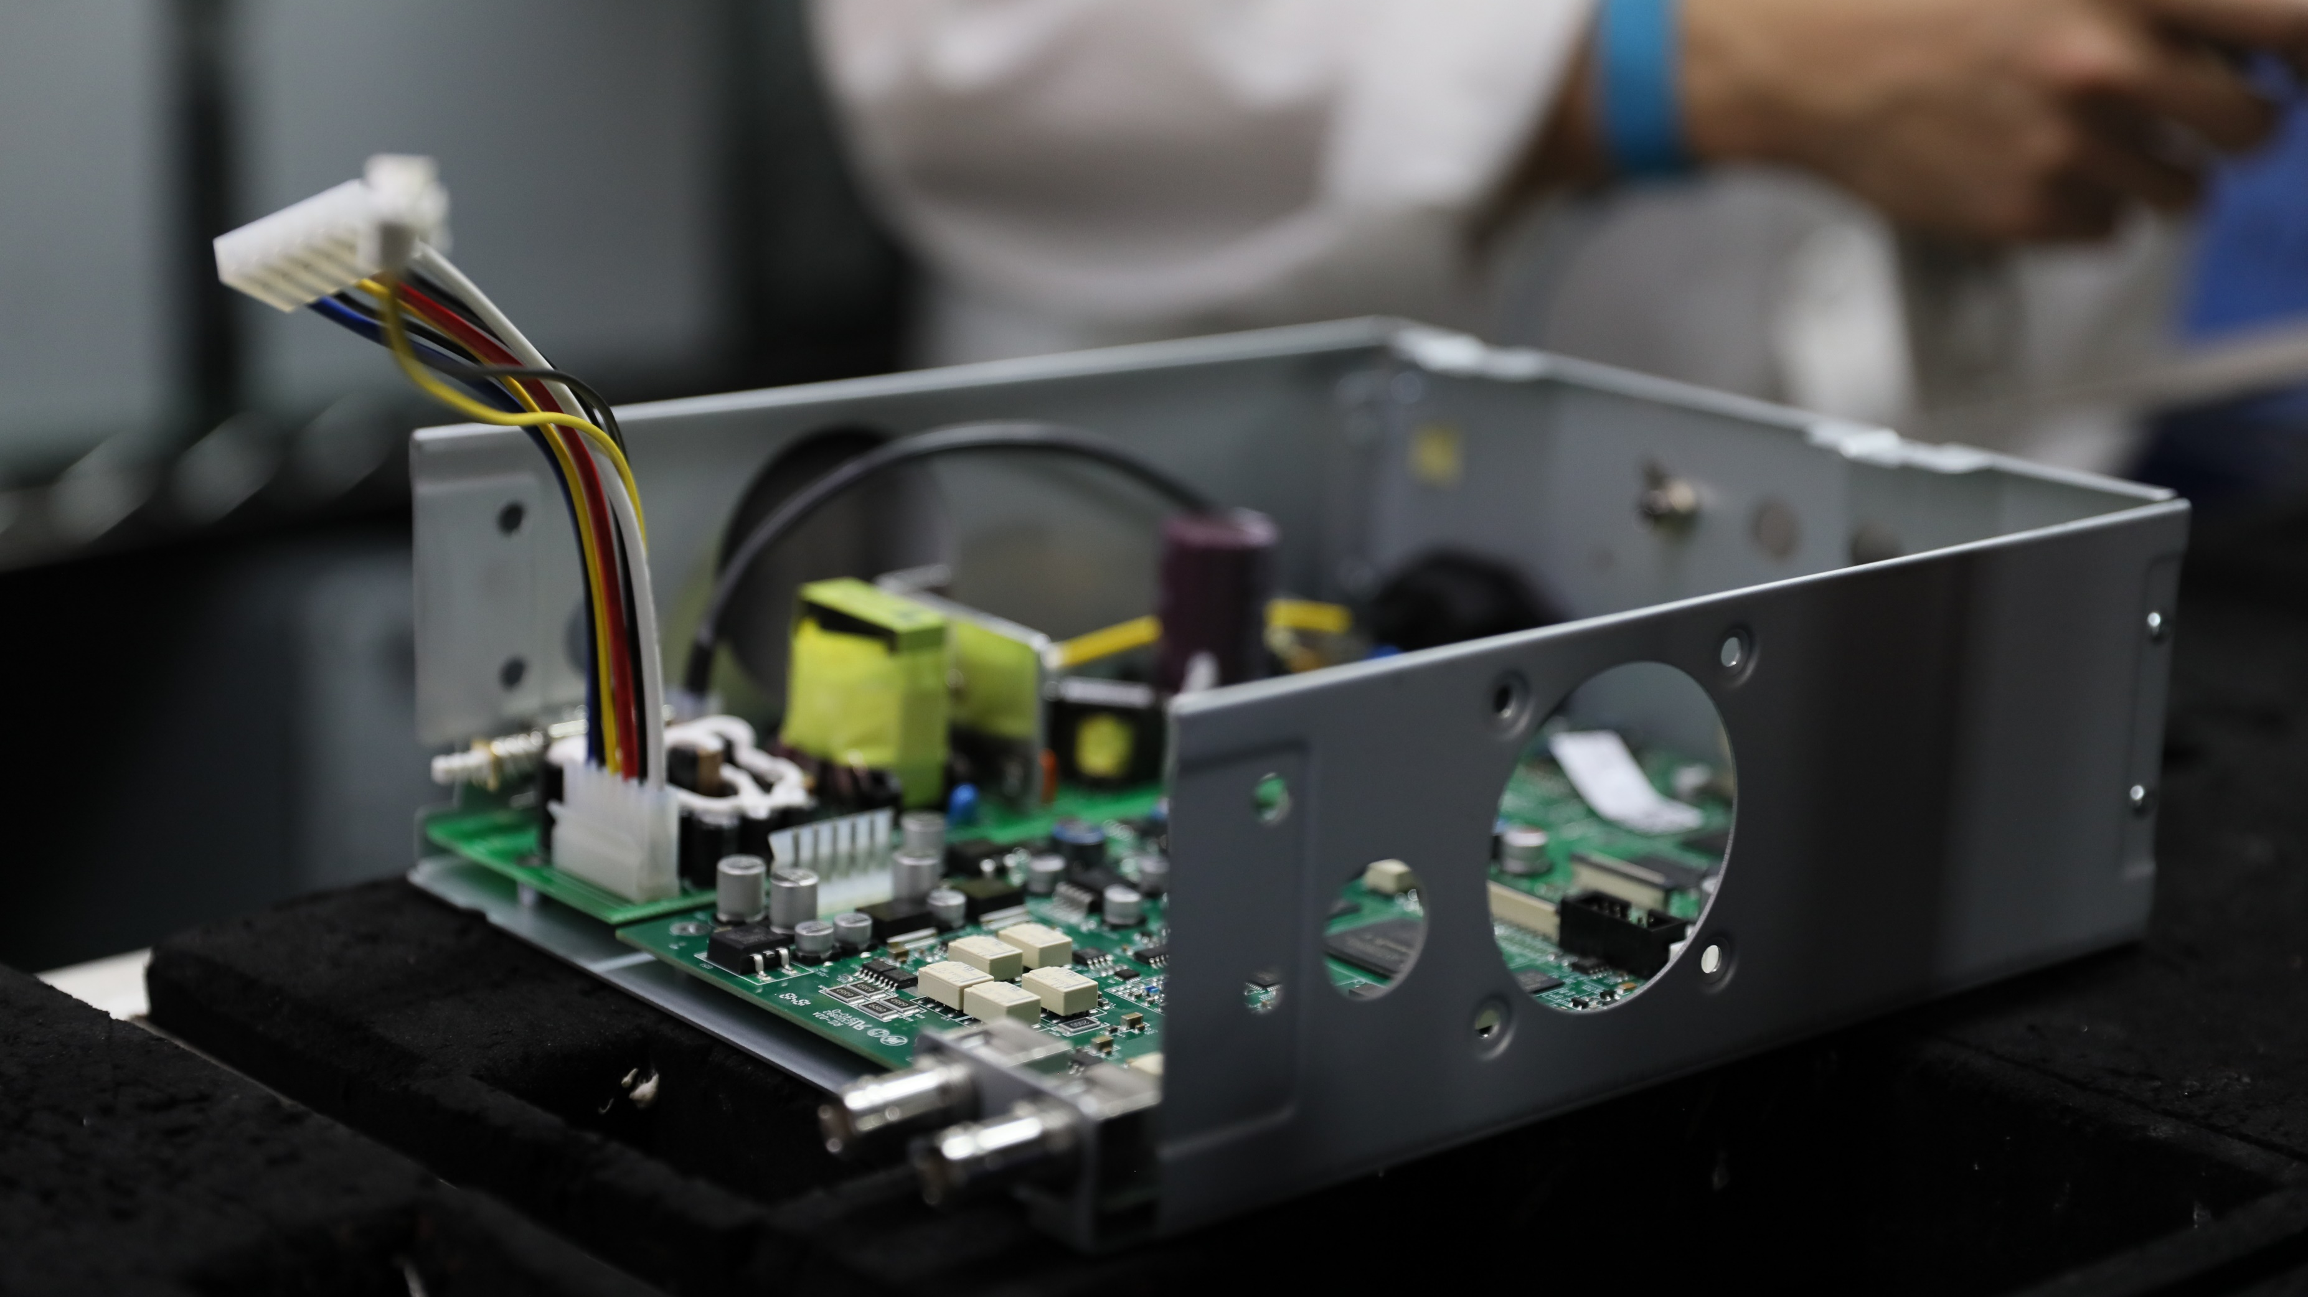
Device Test
Characterization of various RF devices
S-parameters and many other index
Gain, bandwidth...
Insertion loss, isolation...
Out-of-band rejection, input/output power...
…
34

Slide 35
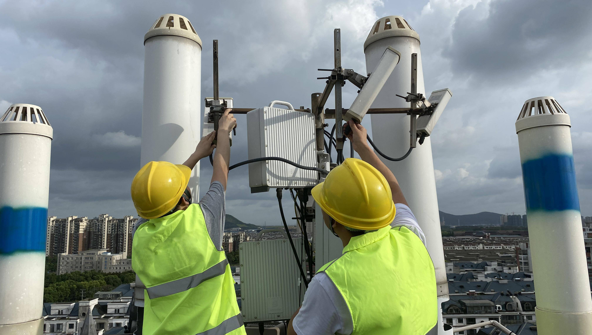
Communication
All phases of the
communication link life cycle
On-site investigation
Radio link system installation
On-site commissioning and acceptance
Fault resolution
Routine maintenance
Realization of VSWR, return loss, cable loss, fault location and other parameters testing
…
35

Slide 36
PART FOUR
04
Comparison
Comparison of similar products

Slide 37





Model | SIGLENT SHN900A |  |  | KEYSIGHT N992xA |  |  | R&S ZNH |  |  | Anritsu MS20xxC |  | Anritsu S820E
Appearance
Frequency range | 30 kHz to 14/20/26.5 GHz |  |  | 30 kHz to 9/14/18/26.5 GHz |  |  | 30 kHz to 4/8/18/26.5 GHz |  |  | 5 kHz to 6/20 GHz |  | 1 MHz to 8 GHz, 14 GHz, 20 GHz, 30 GHz, 40 GHz (frequency option dependent)
Ports | 2 |  |  | 2 |  |  | 2 |  |  | 2 |  | 2
Frequency resolution | 1 Hz |  |  | f ≤ 5 GHz: 1 Hz f ≤ 10 GHz: 1.34 Hz f ≤ 20 GHz: 2.68 Hz |  |  | 1 Hz |  |  | 375 MHz: 1 Hz 6 GHz: 10 Hz 20 GHz: 100 Hz |  | 1 Hz
IFBW | 10 Hz to 3 MHz |  |  | 1/3/10 steps, 3 Hz to 100 kHz |  |  | 1/3/10 steps, 10 Hz to 100 kHz |  |  | 1/3/10 steps, 10 Hz to 100 kHz |  | 10 Hz, 100 Hz, 1 kHz, 100 kHz (standard CAT) 10, 20, 50, 100, 200, 500, 1k, 2k, 5k, 10k, 20k, 50k, 100k (optipn440 VNA)
Level resolution | 0.01 dB |  |  | 0.01 dB |  |  | 0.01 dB |  |  | 0.01 dB |  | 0.01 dB
Dynamic range (dB) | IFBW 10Hz | Spec | Typical | IFBW 300 Hz | Spec | Typical | IFBW 300 Hz | Spec | Typical | IFBW 10Hz | Spec | IFBW 10Hz | Spec | Typical
 |  |  |  | 300 kHz to 9 GHz | 95 | 100
 |  |  |  |  |  |  | 30 kHz to 10 MHz | 73 | 87 | 5 kHz to 2 MHz | 85 | 1 MHz to 10 MHz | 85 | 105
 | 30 kHz to 1 MHz | 90 | 100 |  |  |  | 30 kHz to 10 MHz | 73 | 87 | 5 kHz to 2 MHz | 85 | 1 MHz to 10 MHz | 85 | 105
 |  |  |  | 9 to 14 GHz | 91 | 97
 | 1 MHz to 9 GHz | 100 | 110 |  |  |  | 10 MHz to 8 GHz | 90 | 100 | 2 MHz to 3 GHz | 100 | 10 MHz to 8 GHz | 100 | 115
 |  |  |  | 14 to 18 GHz | 90 | 94
 | 9 GHz to 24 GHz | 100 | 105 |  |  |  | 8 GHz to 18 GHz | 80 | 88 | 3 GHz to 6 GHz | 90 | 8 GHz to 40 GHz | 100 | 110
 | 24 GHz to 26.5 GHz | 95 | 100 |  |  |  | 18 GHz to 20 GHz | 75 | 90 | 6 GHz to 20 GHz | 85
 |  |  |  | 18 to 20 GHz | 87 | 90
 |  |  |  |  |  |  | 20 GHz to 26 GHz | 70 | 81
 |  |  |  | 20 to 25 GHz | 74 | 79
 |  |  |  |  |  |  | 26 GHz to 26.5 GHz | 68 | 83
 |  |  |  | 25 to 26.5 GHz | 65 | 70
Output power | 3 dBm |  |  | 3 dBm |  |  | 3 dBm |  |  | 3 dBm |  | 5 dBm
Directivity after calibration | 30kHz to 3 GHz: 41dB 3GHz to 6 GHz: 39dB 6GHz to 26.5 GH: 37dB |  |  | 0.2 to 500 MHz: 42dB 0.5 to 8 GHz: 38dB 8 to 20 GHz: 36dB 20 to 26.5 GHz: 30dB |  |  | 4 GHz: 48dB 8 GHz: 44dB 26.5 GHz: 41dB |  |  | 5GHz: 42dB 15GHz: 36dB 20*GHz: 32dB |  | 1 MHz to 10 GHz: 42dB 10 GHz to 20 GHz: 36dB 20 GHz to 30 GHz: 32dB 30 GHz to 40 GHz: 30dB
SA | Option 30 kHz ~ 14/20/26.5 GHz |  |  | none |  |  | none |  |  | Standard(For MS2036/38C models only) 9kHz~9/20 GHz |  | none
CAT | Standard |  |  | Option |  |  | one-port cable loss; distance-to-fault |  |  | none |  | Standard
GPS | Standard |  |  | Option |  |  | none |  |  | Option |  | Standard
DC Bias | Standard, 12V-32V |  |  | Option, 1V-32V |  |  | Option, 2V-32V |  |  | Standard, 12V-32V |  | Standard, 11V-14V
Battery | 4 hours |  |  | 3.5 hours |  |  | 4 hours |  |  | 2.5 hours |  | 5 hours

Slide 38





Ordering Information
Items | Order number | Description
Products | SHN914A | 2ports, 14GHz Vector Network Analyzer
整机 | SHN920A | 2ports, 20GHz Vector Network Analyzer
 | SHN926A | 2ports, 26.5GHz Vector Network Analyzer
Standard fittings | Quick Start, USB Type C Line, Rechargeable lithium battery, AC-DC adapter, Portable bag
Software options | SHN900-TDA | Time Domain Analysis
 | SHN900-TDR | Time Domain Reflectometry （*Buy TDR and get TDA free ！）
 | SHN900-SA | Spectrum Analysis
TDR Probe | ADP-18 | TDR Adjustable Differential Probes, DC-18 GHz
 | ADP-26 | TDR Adjustable Differential Probes, DC-26.5 GHz
 | ASP-18 | TDR Adjustable Differential Probes, DC-18 GHz
 | ASP-26 | TDR Adjustable Differential Probes, DC-26.5 GHz
RF Demo Board | SNA-TB01 | RF Test Demo Board
Ecal | SEM5000A | Electronic Calibration Kit
Antenna | ANT-GPS1 | GPS antenna, SMA(M), 1000 mm
38

Slide 39
Thank You
Every Bench. Every Engineer. Every Day.
Headquarters
NA
Europe
SIGLENT TECHNOLOGIES CO., LTD.
Add: Blog No.1 & No.4 & No.5, Antongda Industrial Zone, 3rd Liuxian Road, Bao’an District, Shenzhen, 518101, China
Tel:+ 86 755 3688 7876
Fax:+ 86 755 3359 1582
sales@siglent.com
int.siglent.com
SIGLENT Technologies NA, Inc.
Add: 6557 Cochran Rd Solon, Ohio 44139
Tel: 440-398-5800
Toll Free:877-515-5551
Fax: 440-399-1211
info@siglent.com
www.siglentna.com
SIGLENT TECHNOLOGIES GERMANY GmbH
Add: Staetzlinger Str. 70 86165 Augsburg, Germany
Tel: +49(0)-821-666 0 111 0
Fax: +49(0)-821-666 0 111 22
info-eu@siglent.com
www.siglenteu.com

