Slide 1


Slide 2
PART ONE
01
SEM5000A Series
Electronic Calibration(ECal) Modules

Slide 3
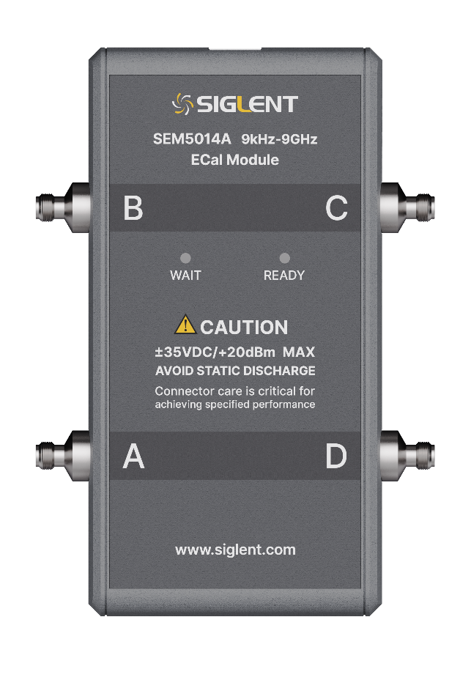
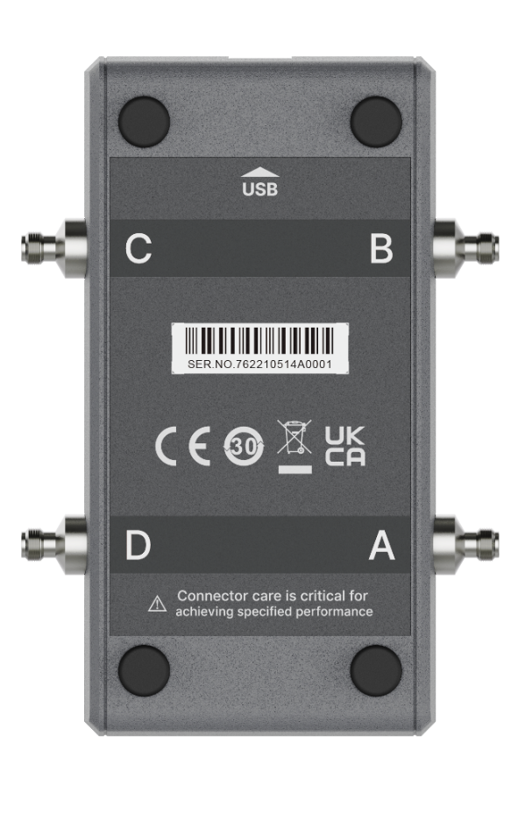




Brief Introduction
SEM5000A Instrument Tour / User friendly in every detail
Front Panel
Rear Panel
 | RF connectors as shown in Table 1 and Table 2
 | Model name and operating frequency range
 | Indicator lights, WAIT indicator (red), READY indicator (green)
 | Cautions
 | Pad
 | USB port
 | Serial number
 | Safety terminology and labelling
3
Notes:
Front Panel
1. RF connectors include SMA female, SMA male, Type-N female, Type-N male, 3.5mm female, 3.5mm male.
3. WAIT light (red) indicates that the instrument has not reached normal operating temperature and needs to wait.
READY light (green) indicates that the instrument has reached its normal operating temperature and is ready for operation.
4. Maximum input power level: ± 20dBm.
Maximum protection DC voltage: ± 35V.
Rear Panel
2. Connect a vector network analyzer with a USB cable to act as a power and control cable.

Slide 4
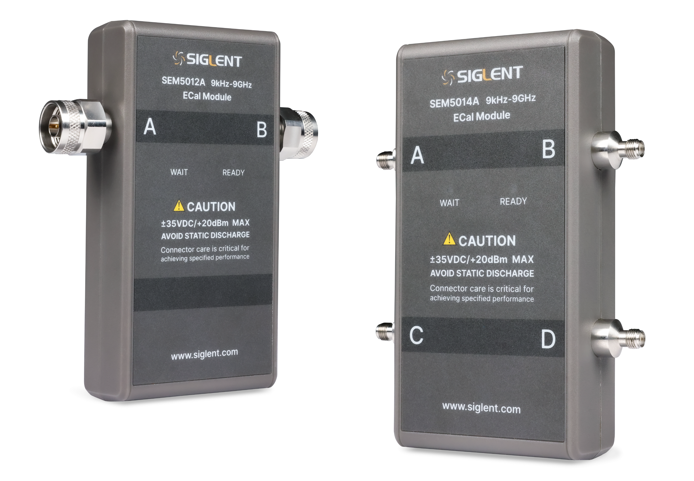
Characteristic Performance
The residual errors in the different operating bands of the ECal
SEM5000A | 9 kHz to 2.5 GHz | 2.5 GHz to 4 GHz | 4 GHz to 6 GHz | 6 GHz to 9 GHz
Directivity (dB) | 44 | 40 | 38 | 35
Source match (dB) | 40 | 34 | 32 | 30
Reflection tracking (± dB) | 0.14 | 0.25 | 0.3 | 0.4
Transmission tracking (± dB)² | 0.12 | 0.17 | 0.20 | 0.23
Load match (dB)² | 33 | 32 | 33 | 30
1. When the input power is greater than 10dBm, the measurement data will be worse.
2. The model number of the vector network analyzer used for this measurement data is SNA5014A.
4

Slide 5
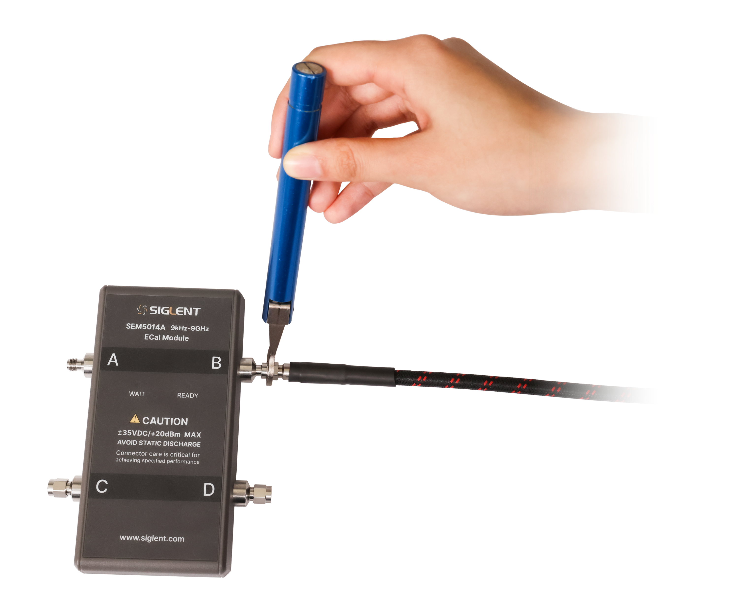
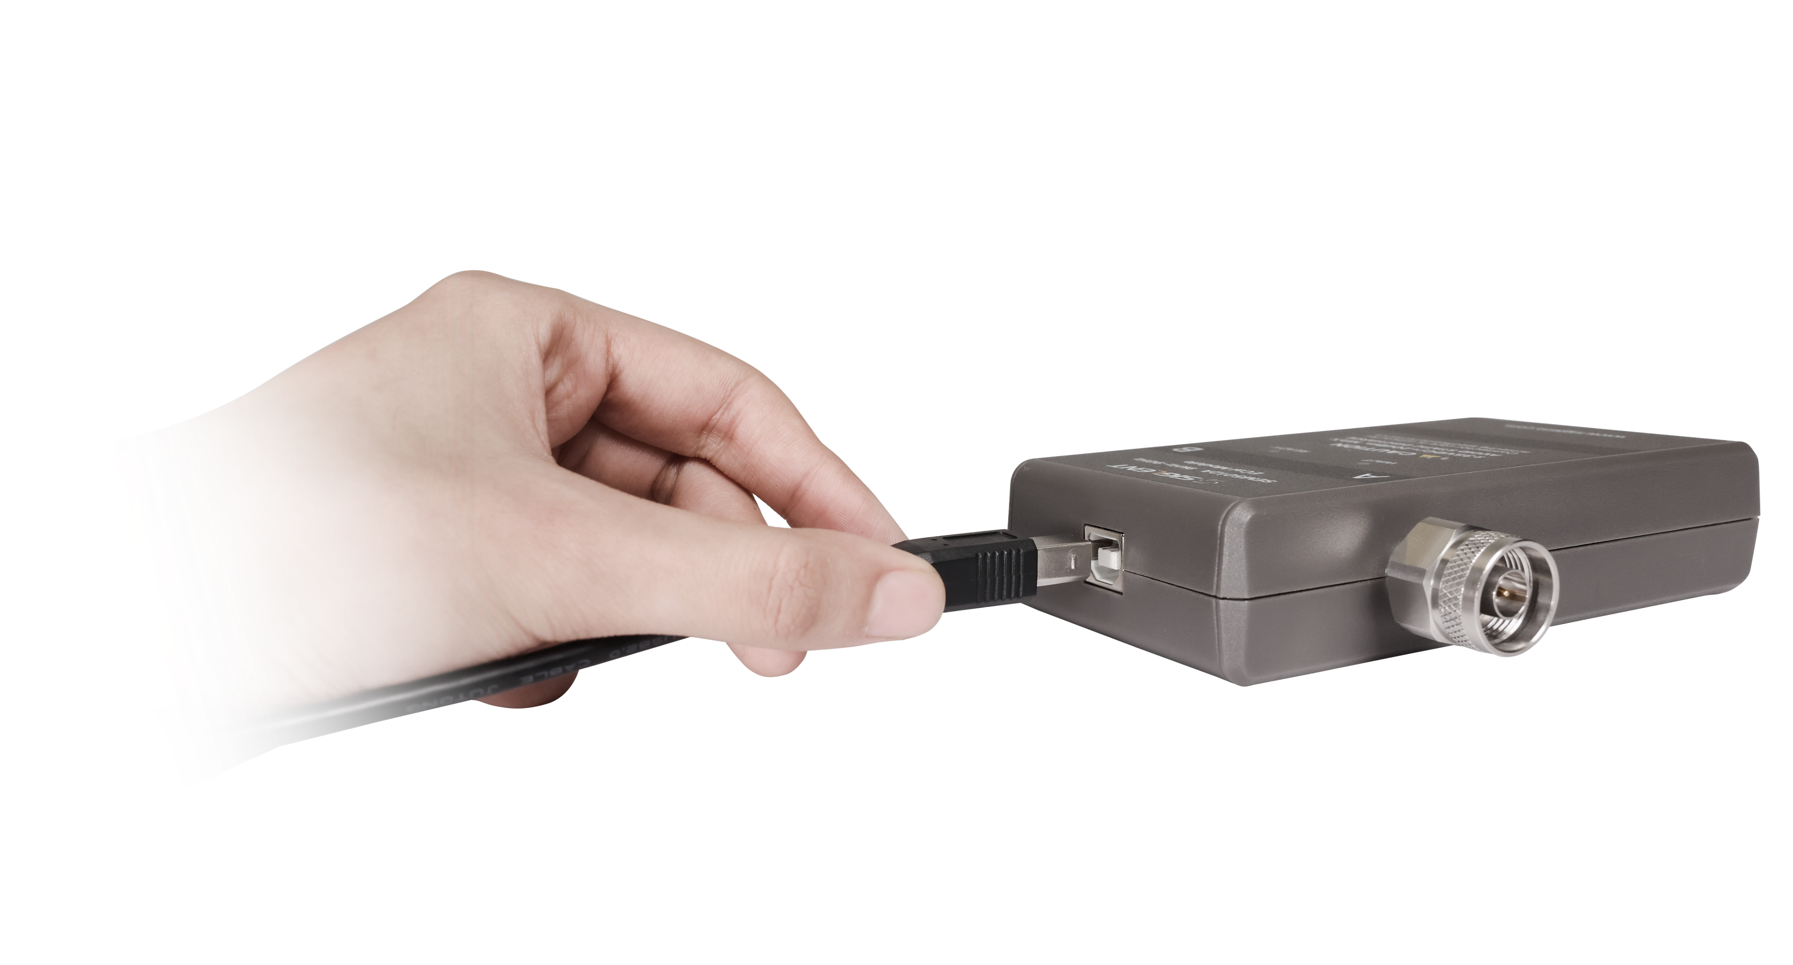


ECal Module Connection
Connected to the VNA through a USB cable (provided with the kit)
Automatically identify the calibration model, frequency range, and connector type
Use a torque wrench in order to protect the RF connector
Wait indicator (red) / Ready indicator (green)
The USB cable is connected to ECal module
The other end of the USB cable is connected to the USB interface of the VNA
5
Notes:
ECal module is connected to the vector network analyzer through a USB cable (provided with the kit), and then the analyzer provides control and power through the cable. The analyzer will automatically identify the calibration piece type, frequency range, and connector type when the connection is completed.
It is also necessary to pay attention to the torque of the torque wrench and connect the RF connector by setting an appropriate torque when using the torque wrench.
When the connection is completed, observe the indicators: Wait indicator (red) and Ready indicator (green). When the indicator is green, it means that Ecal is ready; if the indicator is red, you need to wait until it turns green before starting calibration.

Slide 6

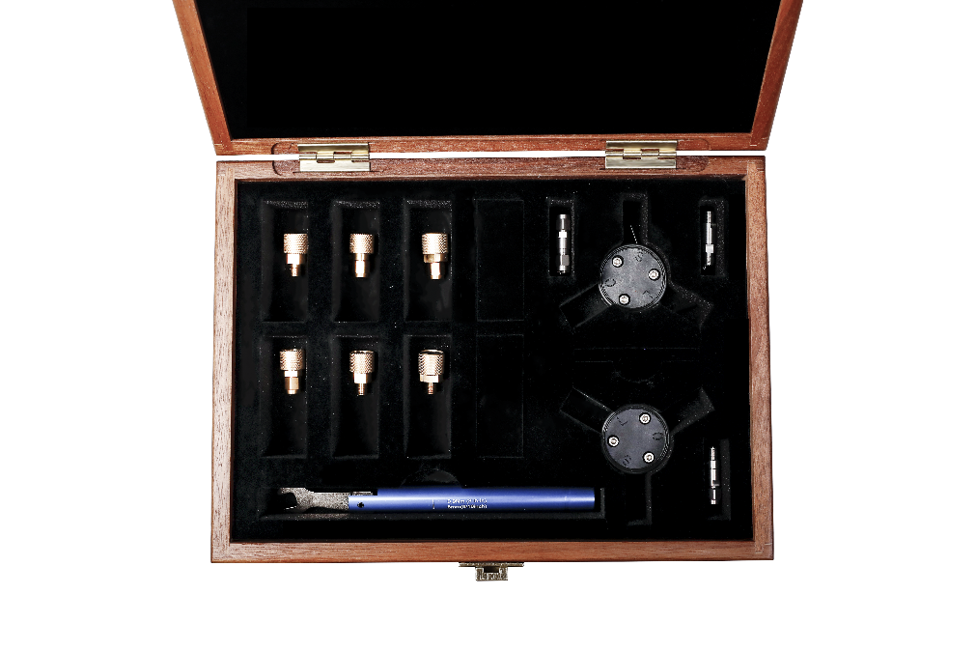
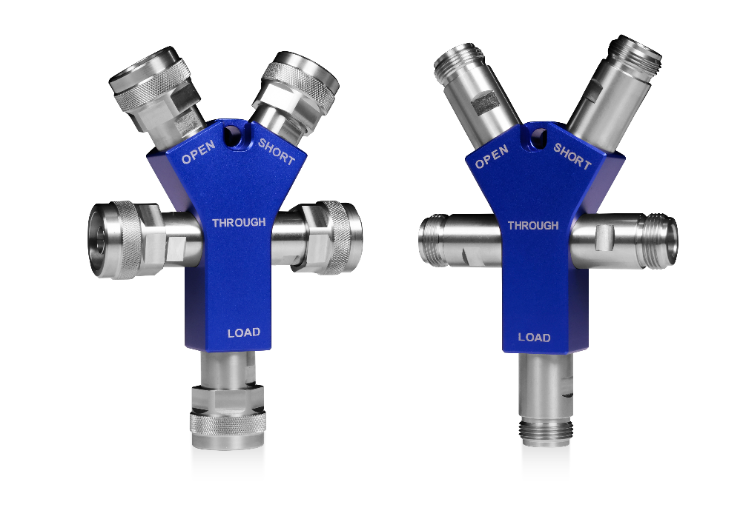
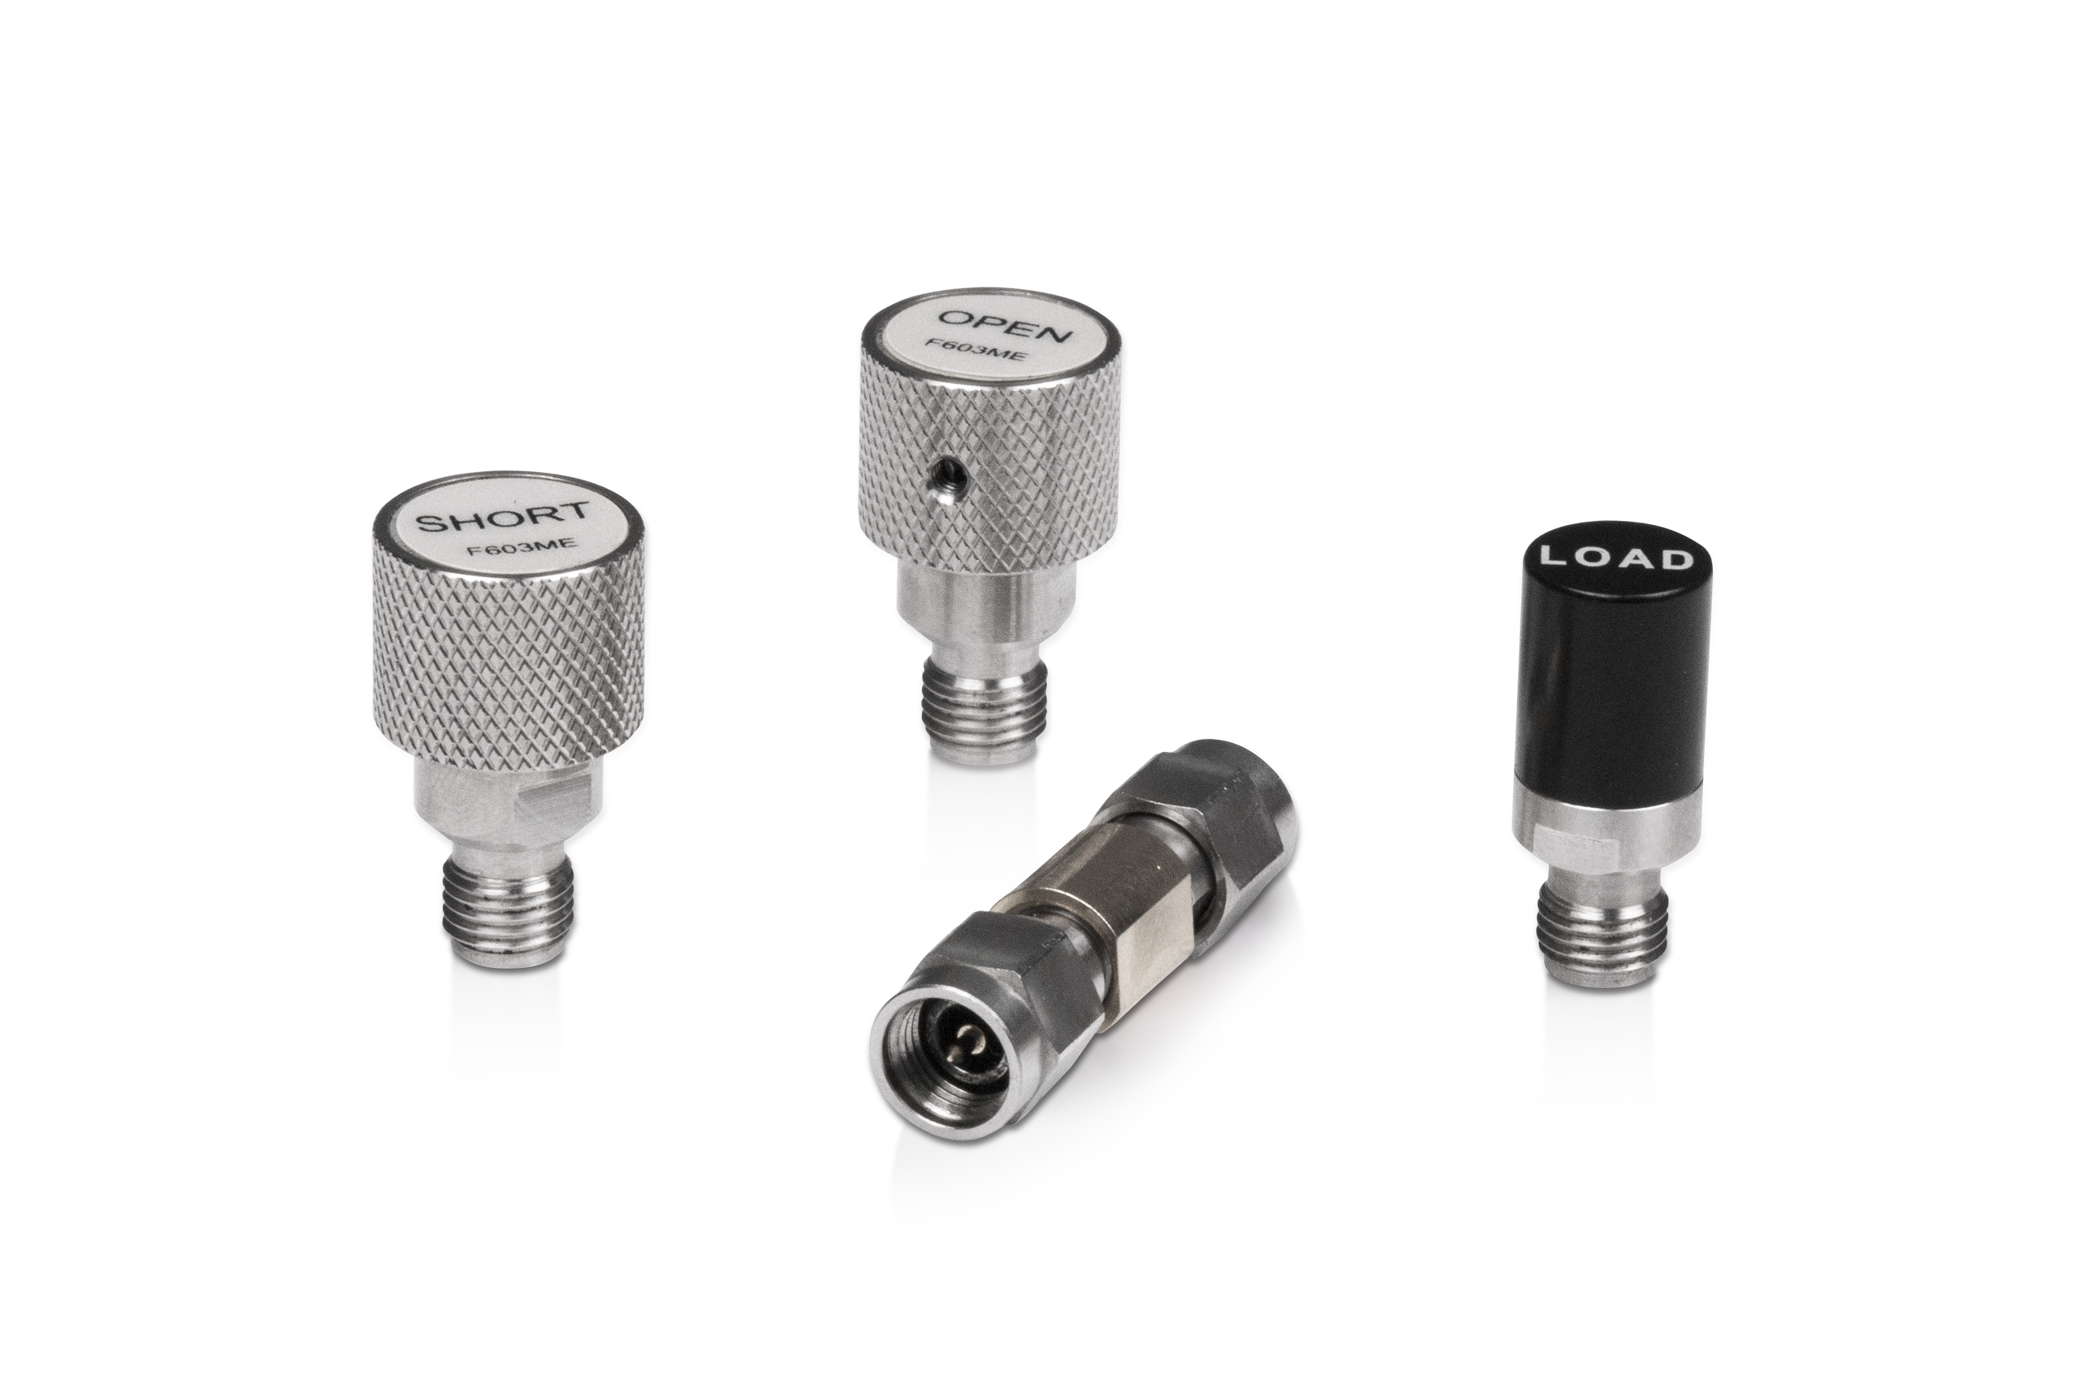
Make Calibration in One Step
Provide great convenience for multi-port tests and factory tests
Mechanical Calibration
Time-consuming
Complicated operation
Electronic Calibration
Reduce the loss of the connector and ensure the calibration accuracy
Significantly reduce the calibration steps and greatly save the time required for calibration
Reduce the uncertainty in calibration process and the measurement consistency is higher
Electronic Calibration Kit
Mechanical Calibration Kit
Integrated Mechanical Calibration Kit
6

Slide 7
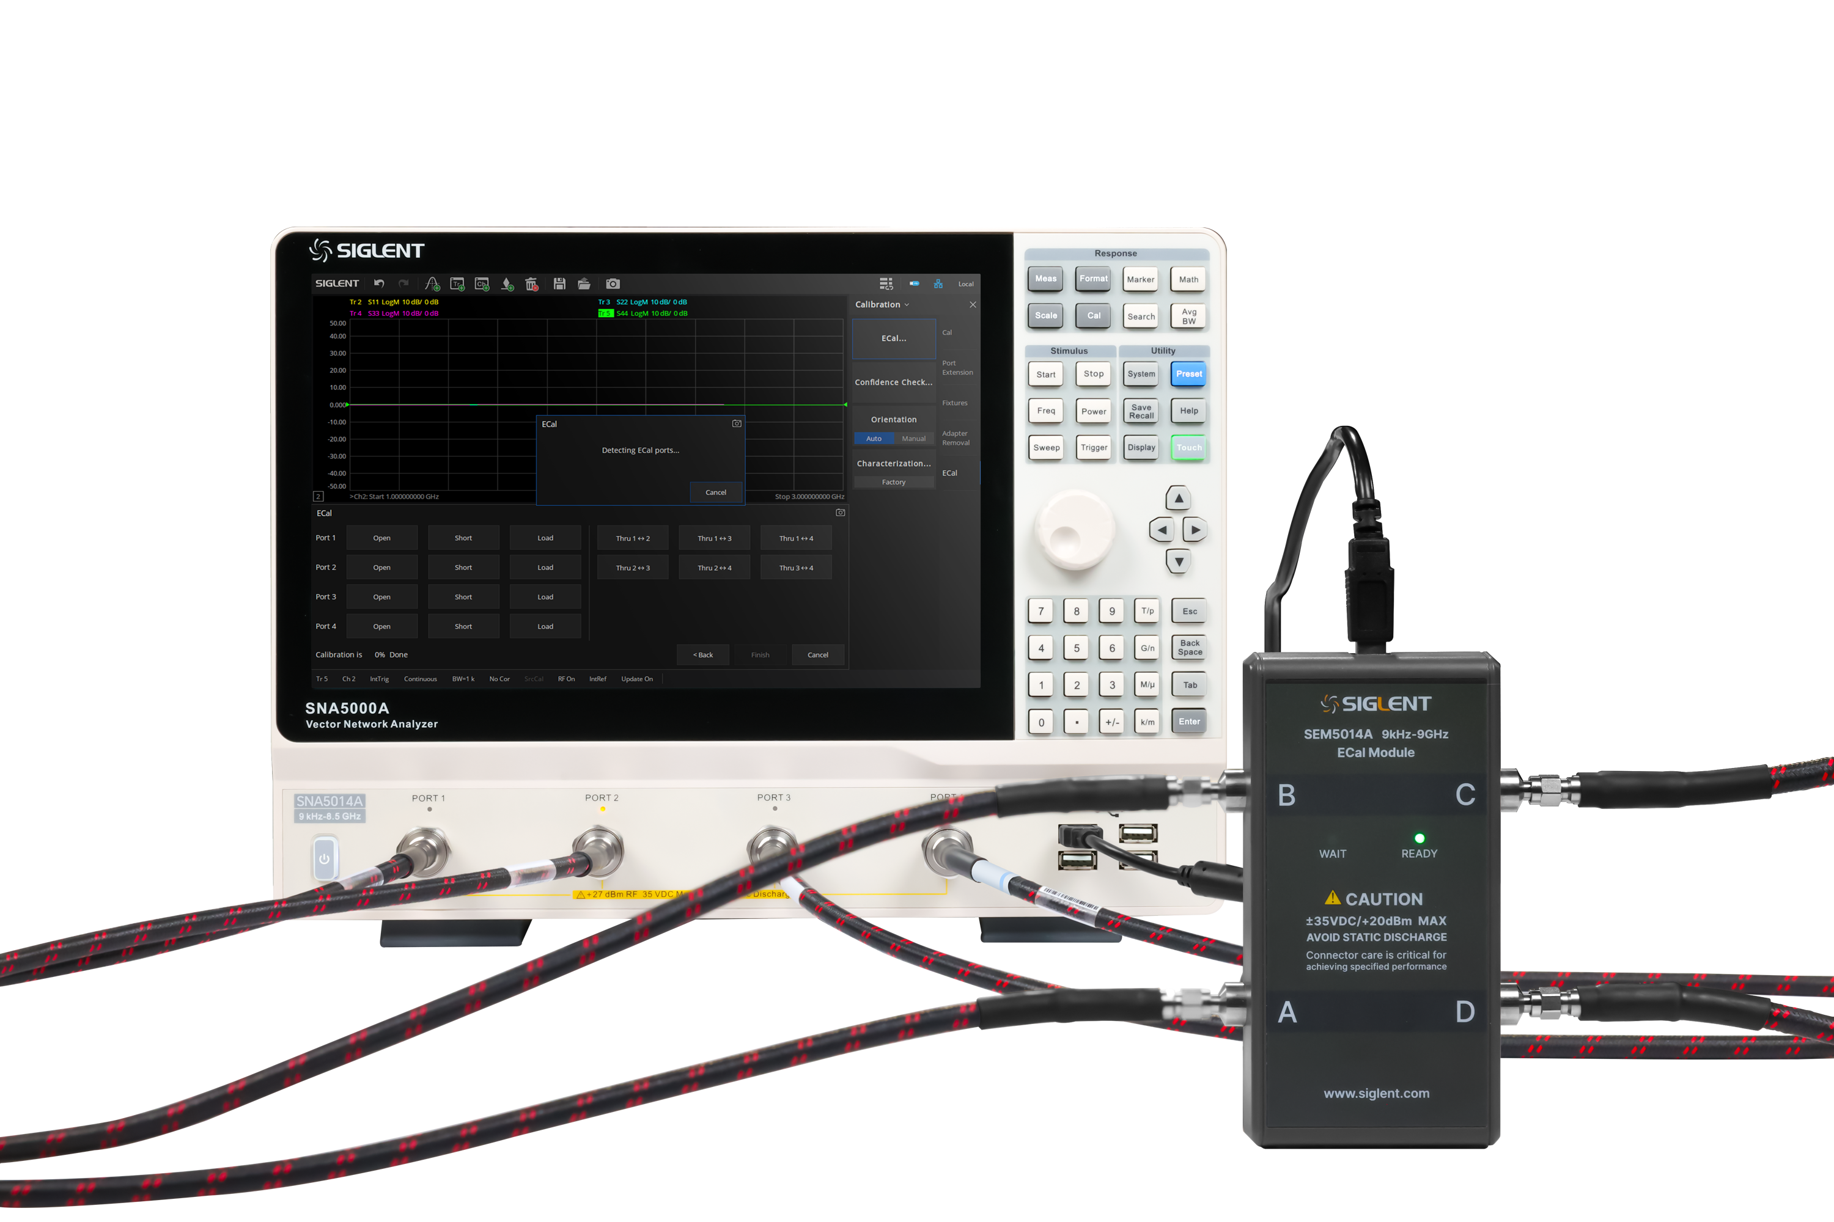
Compatible List of ECal Modules
Adapt to all vector network analyzers of SIGLENT
VNA Models | ECal Models |  | Interface
 | 5002A/5012A/ 5022A/5032A | 5004A/5014A
SNA5000A¹ | YES | YES | USB
SVA1000X² | YES | YES | USB
SHA850A³ | YES | YES | USB
1. Currently, only versions after V1.0.0.2.6 are supported.
2. Currently, only versions after V3.2.2.6.0 are supported.
3. Currently, only versions later than V1.1.2.1.3 are supported.
7

Slide 8
Description of SEM5000A Models
Table 1 / Number of ports / Types of connectors / Operating band
Series | Specific Model | Number of Ports | Connector Type | Operating Frequency | Connector Options
SEM5000A | SEM5002A | 2 | Type-N 50Ω female | 9 kHz-4.5 GHz | 020
 |  |  | SMA female * | 9 kHz-4.5 GHz | 030
 | SEM5012A |  | Type-N 50Ω female | 9 kHz-9 GHz | 020
 |  |  | SMA female * | 9 kHz-9 GHz | 030
 | SEM5022A |  | 3.5mm female * | 100 kHz-13.5 GHz | 010
 | SEM5032A |  | 3.5mm female * | 100 kHz-26.5 GHz | 010
 | SEM5004A | 4 | Type-N 50Ω female | 9 kHz-4.5 GHz | 020
 |  |  | SMA female * | 9 kHz-4.5 GHz | 030
 | SEM5014A |  | Type-N 50Ω female | 9 kHz-9 GHz | 020
 |  |  | SMA female * | 9 kHz-9 GHz | 030
 | SEM5024A |  | 3.5mm female * | 100 kHz-13.5 GHz | 010
 | SEM5034A |  | 3.5mm female * | 100 kHz-26.5 GHz | 010
* indicates the default connector type.
8

Slide 9
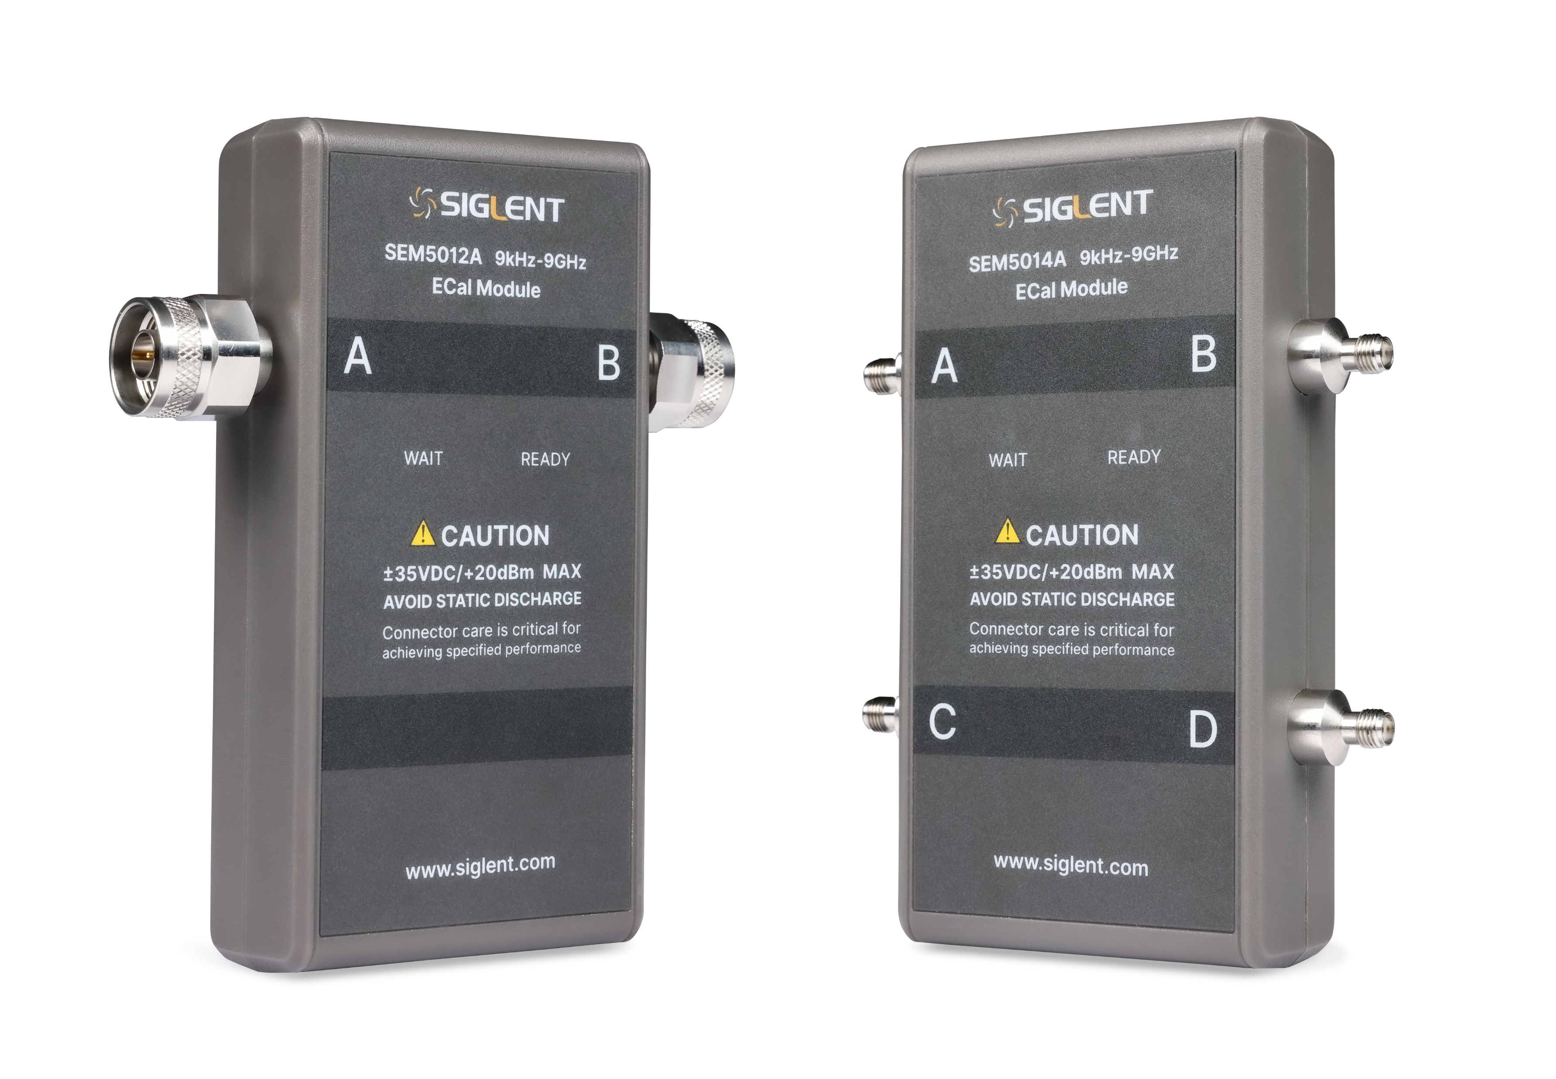
Description of SEM5000A Models
Table 2 / Number of ports / Types of connectors / Operating band
Connector Type | Port A Option | Port B Option | Port C Option | Port D Option
All 3.5mm -f- | 010
All Type-N 50Ω -f- | 020
All SMA -f- | 030
3.5mm -f- | 101 | 201 | 301 | 401
3.5mm -m- | 102 | 202 | 302 | 402
Type-N 50Ω -f- | 103 | 203 | 303 | 403
Type-N 50Ω -m- | 104 | 204 | 304 | 404
SMA -f- | 105 | 205 | 305 | 405
SMA -m- | 106 | 206 | 306 | 406
9

Slide 10
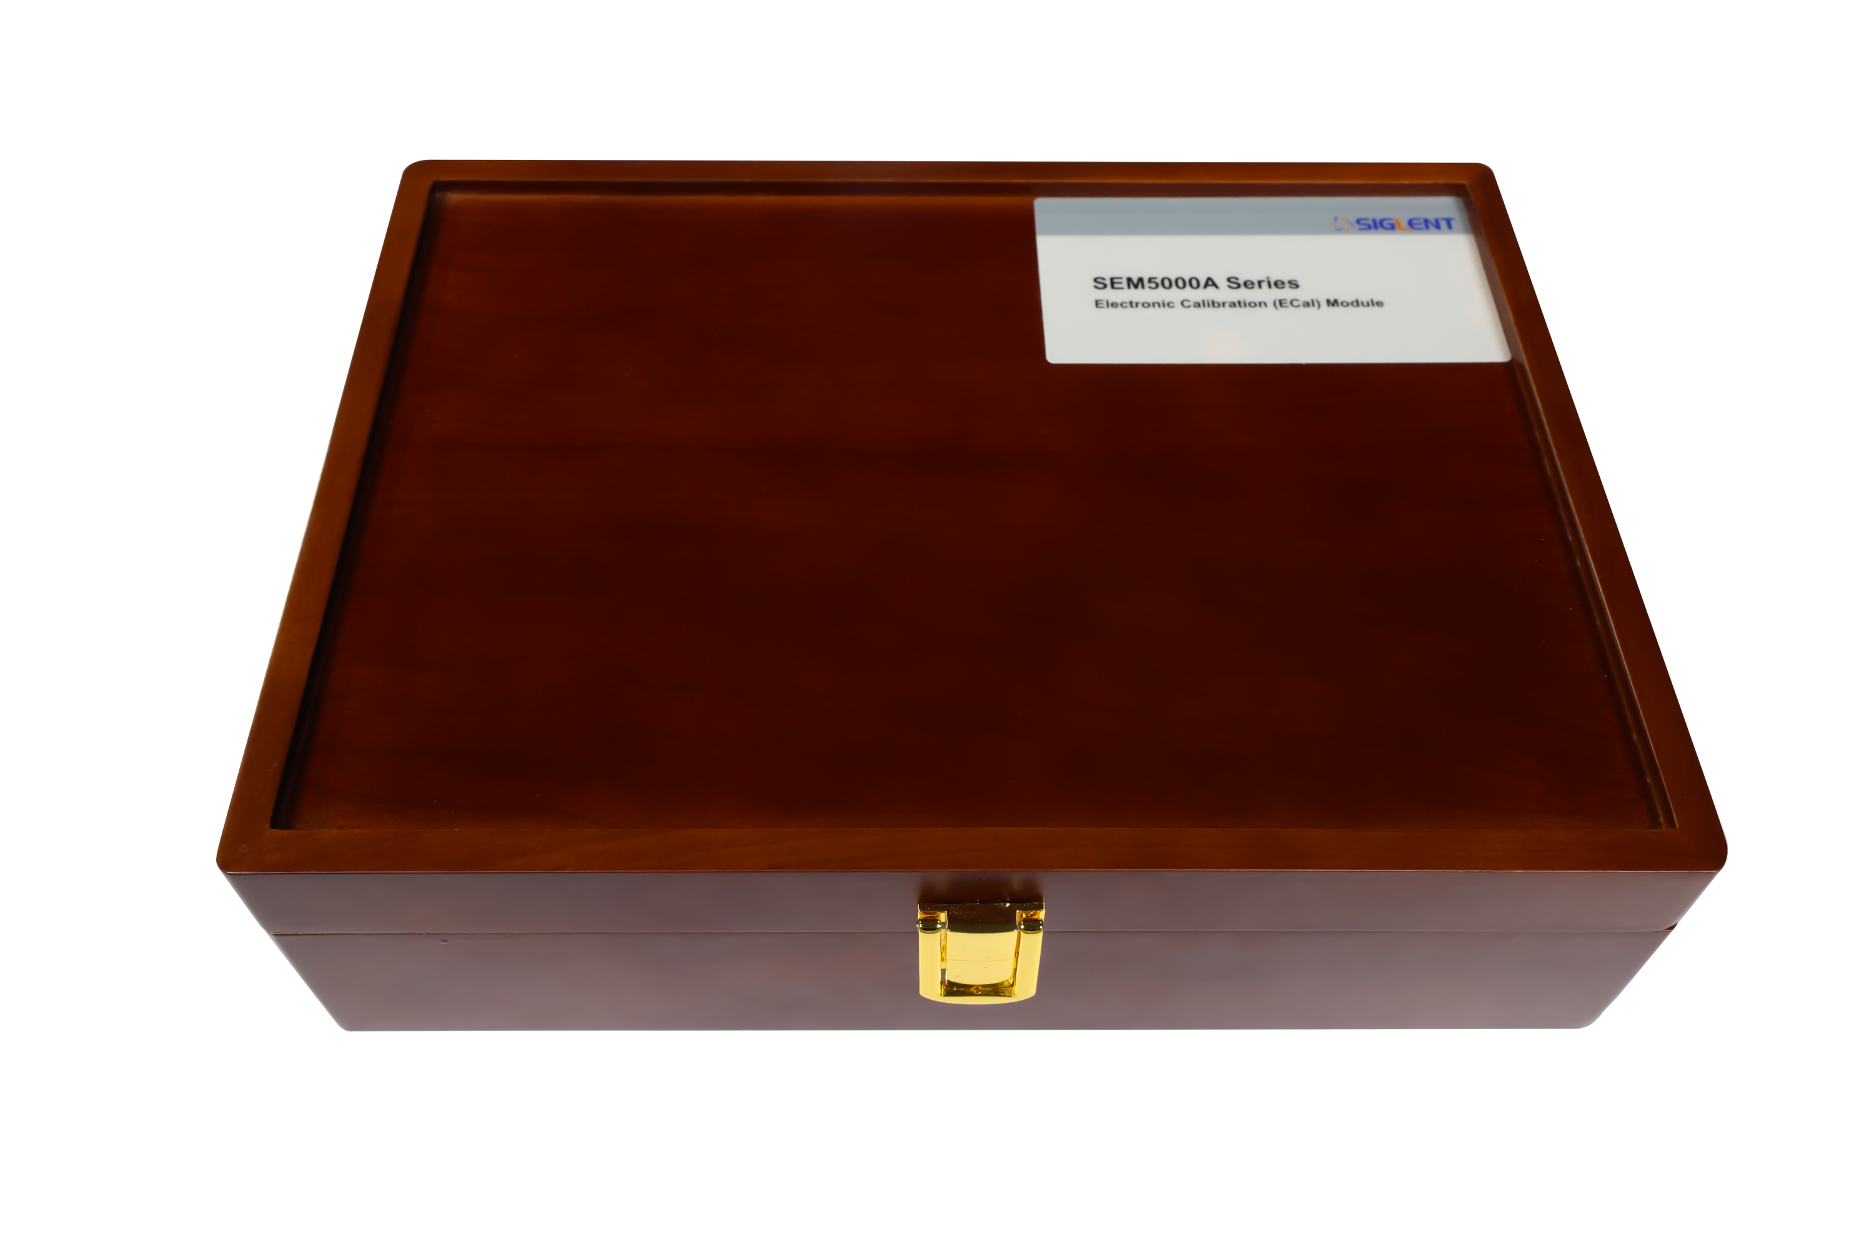
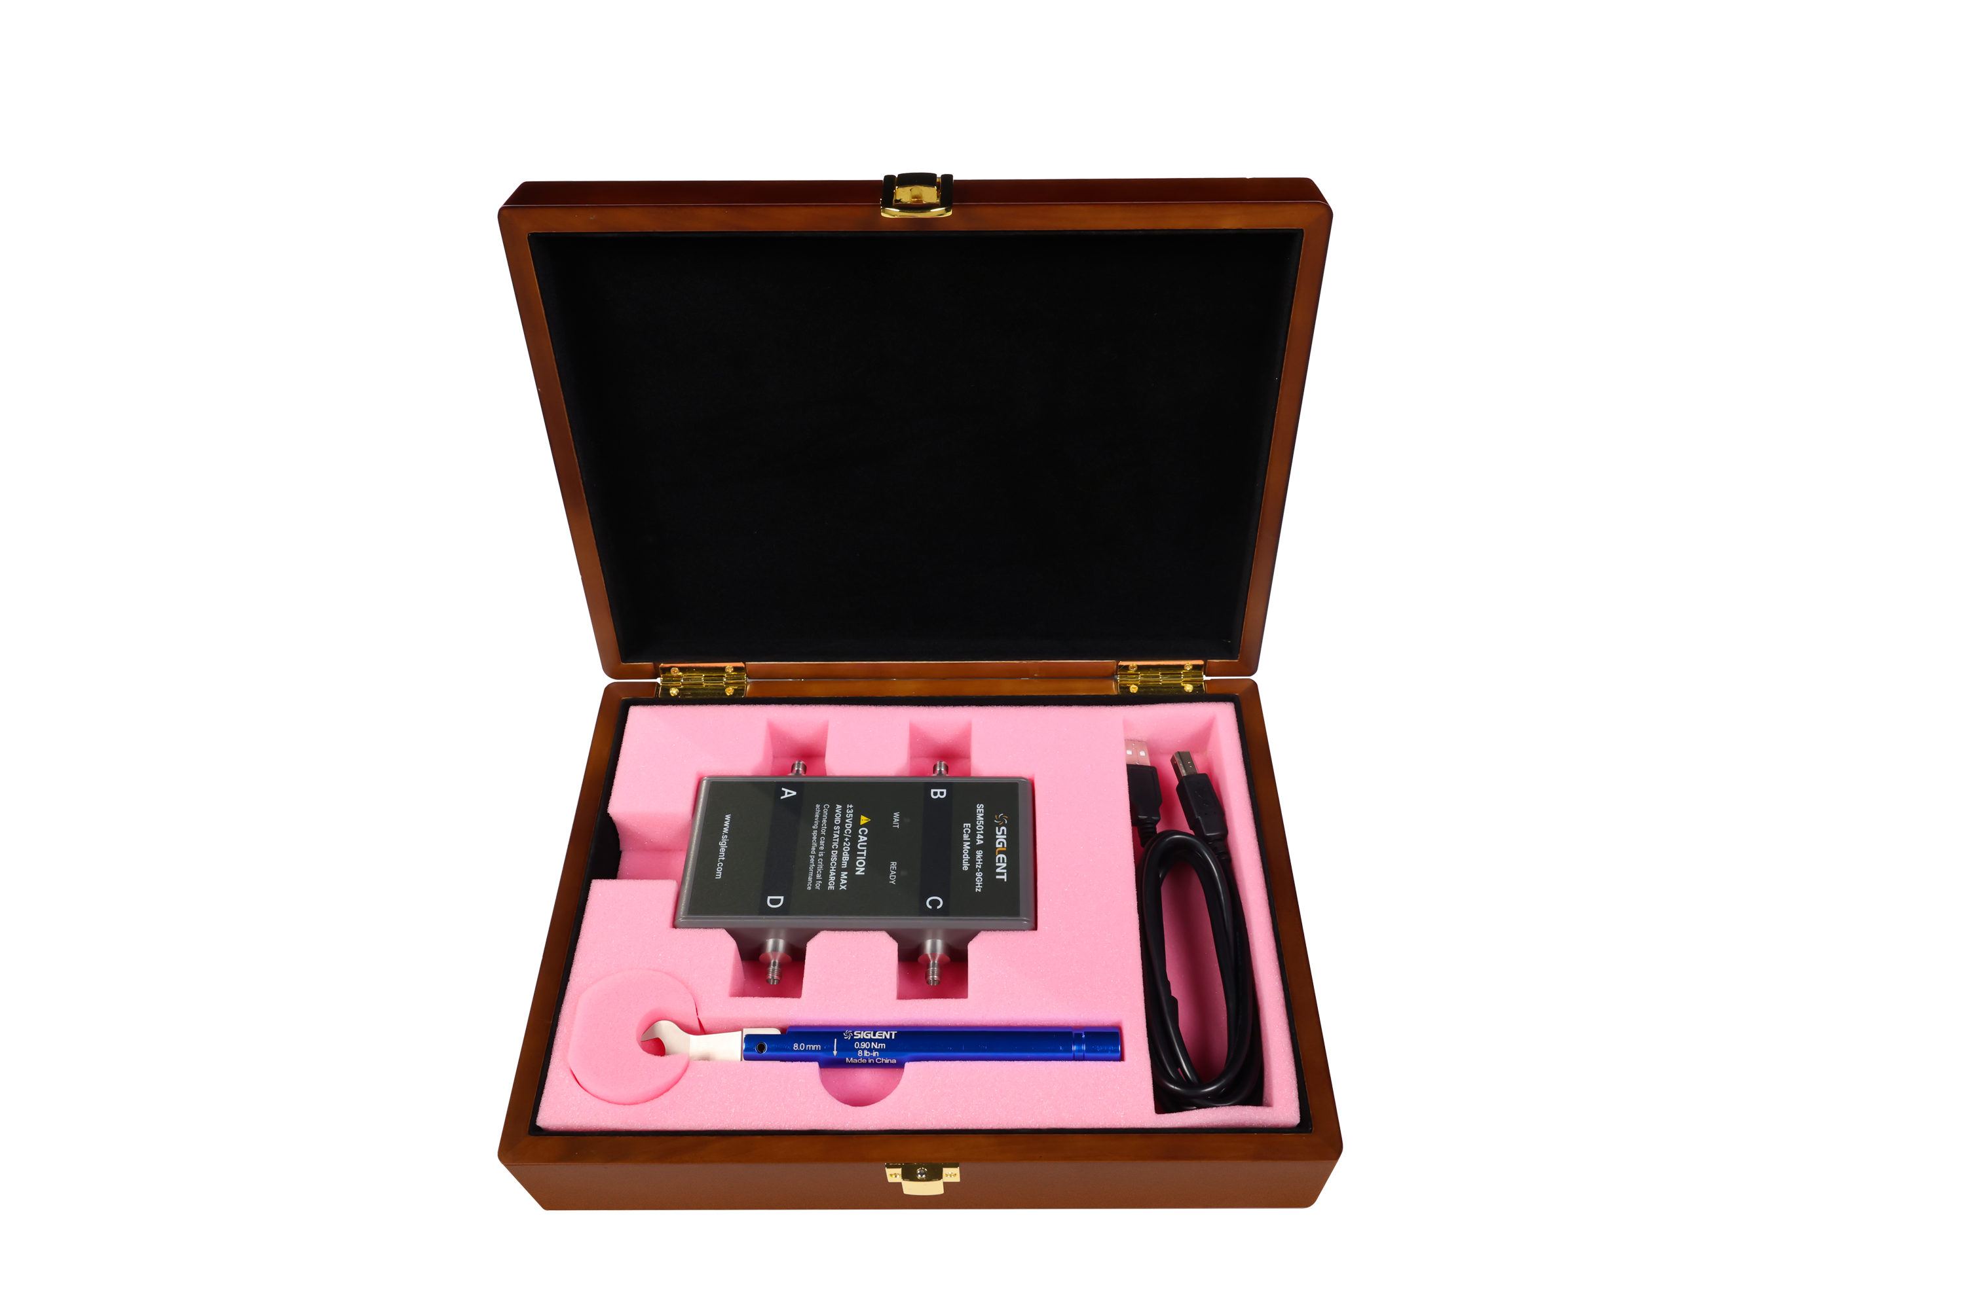
SEM5000A Ordering Information
Specific RF connector selection please refer to Table 1 and Table 2
Description | SEM5000A Series Electronic Calibration(ECal) Modules
Standard Accessories | 1 x Quick-start, 1 x USB 2.0-cable
 | Torque wrench: 8.1 mm, for SMA, 3.5 mm -m-, Torque standard: 0.9±0.04 N.M
Optional Accessories | Torque wrench: 19.1 mm, for type-N, Torque standard: 1.36±0.05 N.M
 | Torque wrench: 20.1 mm, for type-N, Torque standard: 1.36±0.05 N.M
 | RF connector: SMA -m-
 | RF connector: 3.5 mm -m-
 | RF connector: Type-N 50Ω -f-
 | RF connector: Type-N 50Ω -m-
10

Slide 11
PART TWO
02
SSM5000A Series
Switch Matrix

Slide 12
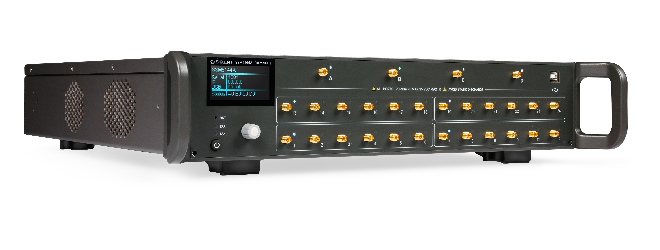
SSM5000A Series
Switch Matrix
Model | Frequency Range | Input | Output
SSM5122A | 9 kHz-9 GHz | 2 | 12
SSM5124A | 9 kHz-9 GHz | 2 | 24
SSM5142A | 9 kHz-9 GHz | 4 | 12
SSM5144A | 9 kHz-9 GHz | 4 | 24
SSM5321A | 100 kHz-26.5 GHz | 2 | 6
SSM5342A | 100 kHz-26.5 GHz | 4 | 12
Screen size: 2.4-inch
RF connector: 3.5mm Female
Maximum input power: 20 dBm
Characteristic impedance: 50 Ω
Maximum input DC voltage: 35 V
Size: W×H×D=88.5×425×417.6mm
12

Slide 13
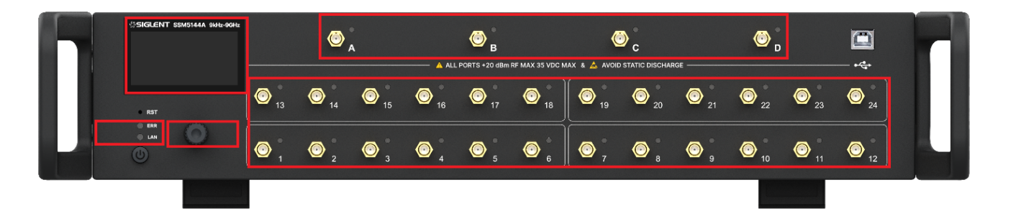




Front Panel Tour
SSM5000A Instrument Tour / User friendly in every detail
1 | LCD Screen | 2.4 inch LCD screen
2 | RF Ports A-D | 3.5mm female RF ports, source group
3 | RF Ports 1-24 | 3.5mm female RF ports, extended group
4 | USB Device | USB port for remote control
5 | Reset | Reboot system
6 | Indicator Lights | Warning indicator and LAN config indicator
7 | Knob | Move a cursor or change a parameter value Press to ‘Enter’
8 | Power Switch | Power on/off
13
Notes:
1. No touch function
2. Usually connect to other instrument such as VNA, SA.
3. Usually connect to the DUT

Slide 14
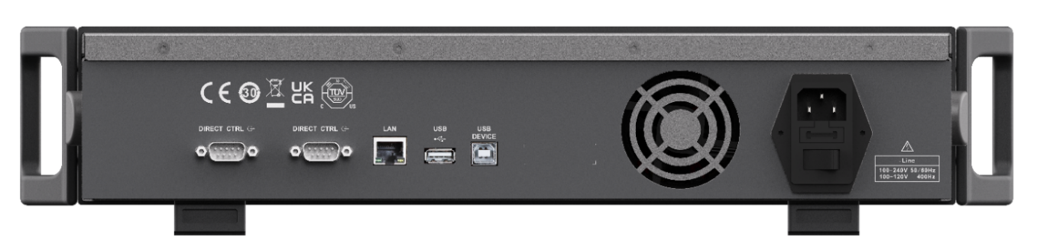
Rear Panel Tour
SSM5000A Instrument Tour / User friendly in every detail
1 | Direct CTRL | Uses TTL voltage to control switches
2 | LAN | Network port for host to remote control
3 | USB | Plugged with U-disk for FW upgrading
 | USB Device | USB port for data exchange with peripherals
4 | Fan | Cool down the instrument
5 | AC Power Port and Fuse | The equipment accepts 100-240V, 50/60Hz AC power supply The current should not exceed the rated current of the fuse
6 | Handle | Move around the instrument conveniently
14

Slide 15
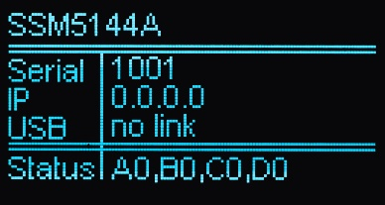
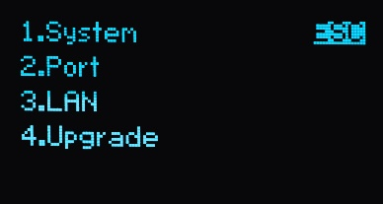
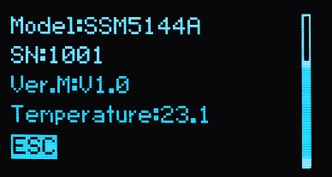
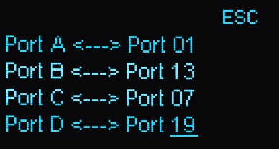
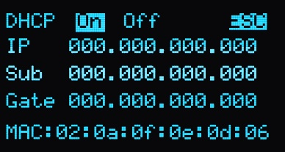
User Interface
SSM5000A Instrument Tour / User friendly in every detail
Status display
1’st setting menu
System menu
Port menu
LAN menu
Upgrade menu
15
Notes:
The first display when instrument starts up. Display the model, serial number, IP address, USB port status, RF ports link status. Push the knob will enter the first setting menu.
Includes 4 sub-menus. Rotating the knob will select one of them, then pushing knob will enter the selected sub-menu.
Display startup times, vendor, model, SN, soft version, mainboard temperature.
Set the link config of ports. Four steps to config: 1. Rotate the knob to select one of the four ports (A-D); 2. push the knob to enter the config mode; 3. Rotate the knob to change the number of linked port; 4. push the knob to finish setting and return.
The instrument supports DHCP and static IP modes. Rotate and push the knob to enter the mode setting (on/off item). When OFF (Static IP) is selected, Rotate and push the knob to config IP/SUB/GATE address.
When U-disk with FW in root directory is plugged in, enter the Upgrade menu to upgrade the system.

Slide 16
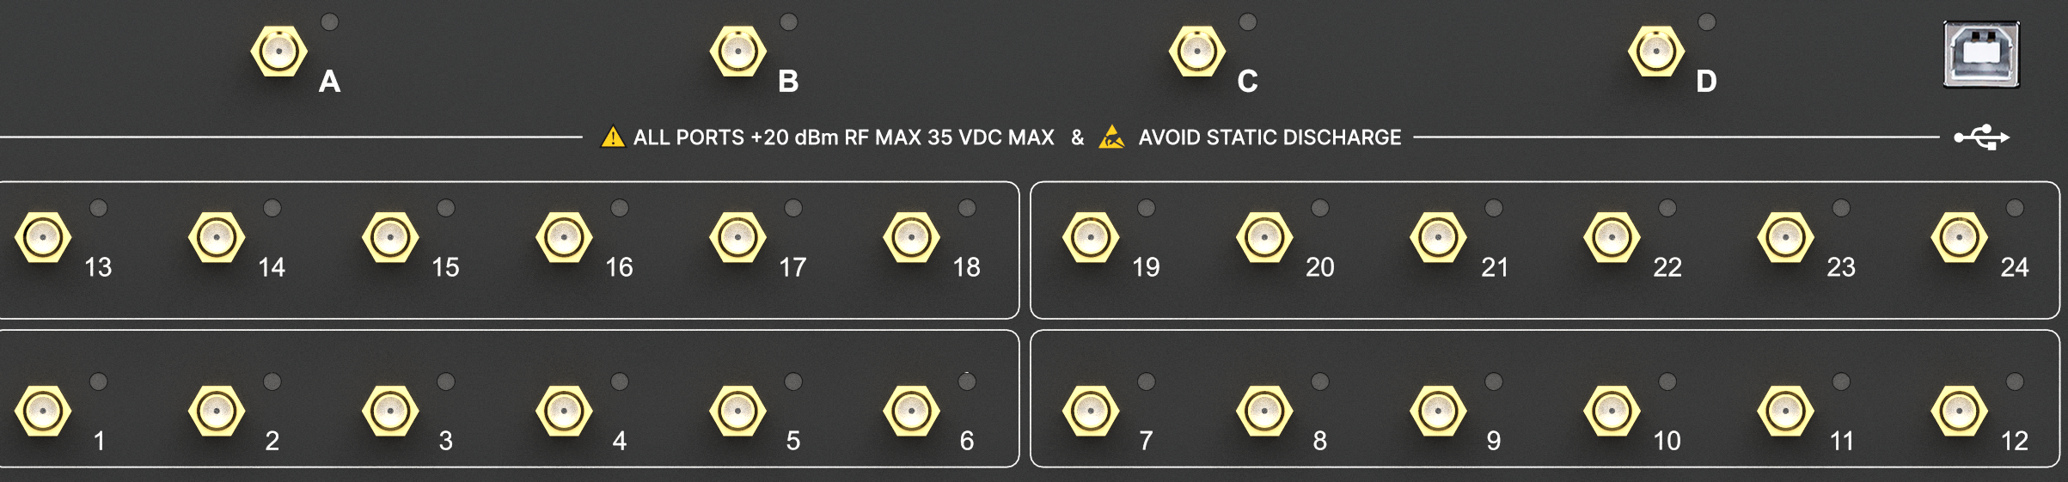
Block Diagrams
SSM5X44A (4 Ports input, 24 Ports Output) B44
A-D are the source group
1-24 are the extended group
A and B could be connected to one of 1-6 or 13-18 ports
C and D could be connected to one of 7-12 or 19-24 ports
Front panel RF connectors
16

Slide 17
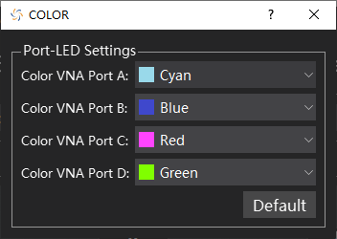
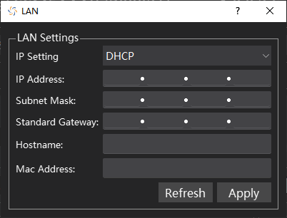
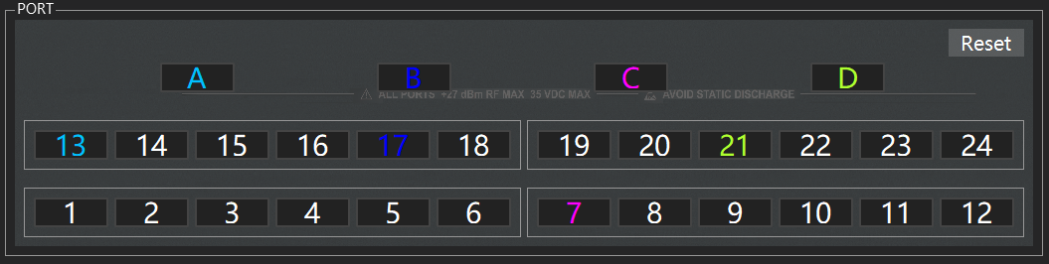
User Friendly
Going into details: make operation more fluent
Host computer interface
Remote network control
The color of RF connectors A-D and 1-24 can be configured through the Tool-Color menu
Port indicator
Network
RF channel
17
Notes:
Click the RF connectors A-D first, and then click the RF connectors 1-24 that can be connected to it to complete a pair of gating channel settings.
Colors can be in different port, but there are only four colors.

Slide 18
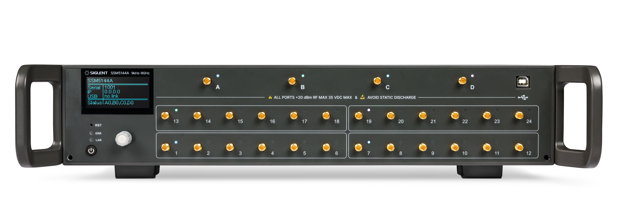
Easily Meet Multi-port Test Requirements
Make the connection of multi-port device test simple
A single unit can expand the output port to 24, and can continue to stack
Used in combination with SIGLENT product series and Support other mainstream instruments
An important part of automatic test system and the production line usage scene, greatly improve the measurement speed
Suitable for 19-inch standard chassis and can be widely used in multi-port test environments such as antennas and 5G component modules
18

Slide 19
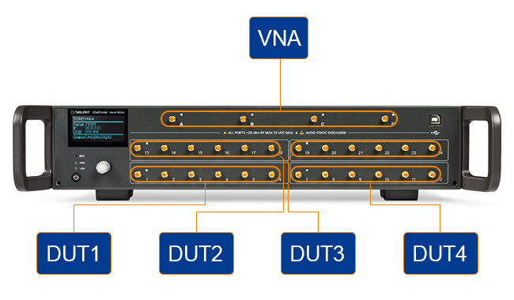
Network Analyzer Test Port Extension
Save cost and improve test efficiency
Used to expand the test ports of VNA and measure S parameters of multiple devices
DUT1 , DUT2 , DUT3 and DUT4 devices can be tested by software, greatly improving the test efficiency
According to the specific test requirements, matrix switch can be extended into 12 full 2 ports, 8 full 3 ports, 6 full 4 ports, 4 full 6 ports, 3 full 8 ports, 2 full 12 ports, etc
4 Full 6 Ports
19

Slide 20
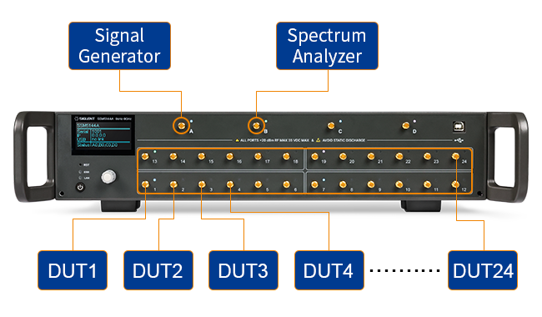
Signal Generator and SA Test Port Extension
Save cost and improve test efficiency
S parameter calibration is not required, only the line loss of each channel needs to be calibrated
Greatly reduce the number of signal source and spectrum analyzer, save cost and improve test efficiency
The signal source and spectrum analyzer are extended to 24 ports, which can be used to test the transmission and reception of multiple DUTs
20

Slide 21
PART THREE
03
SSU5000A Series
Mechanical Switch

Slide 22
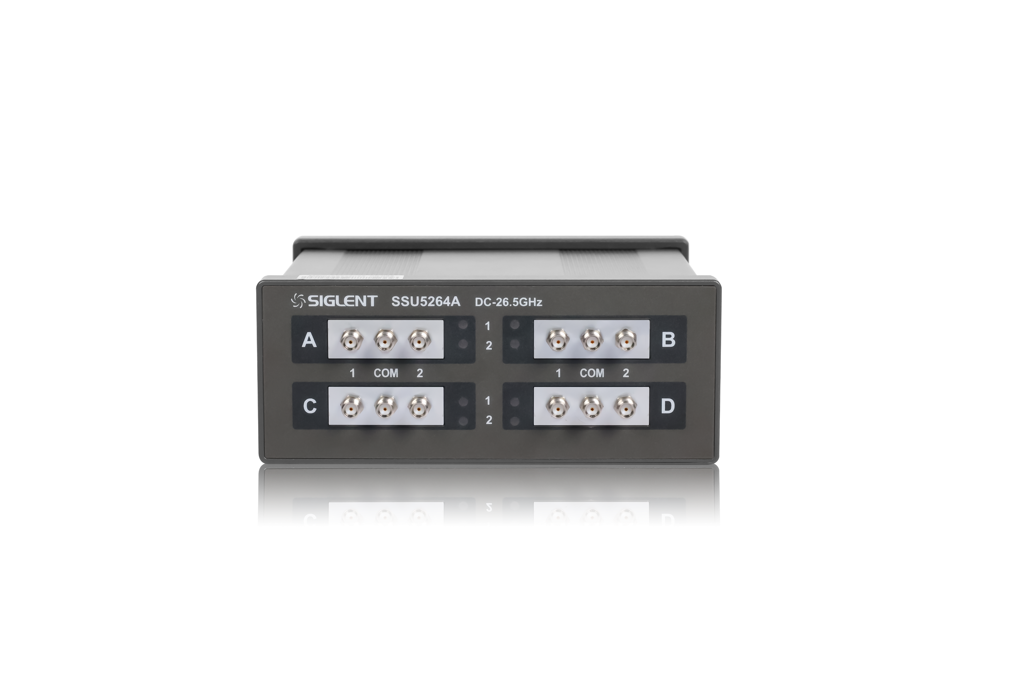
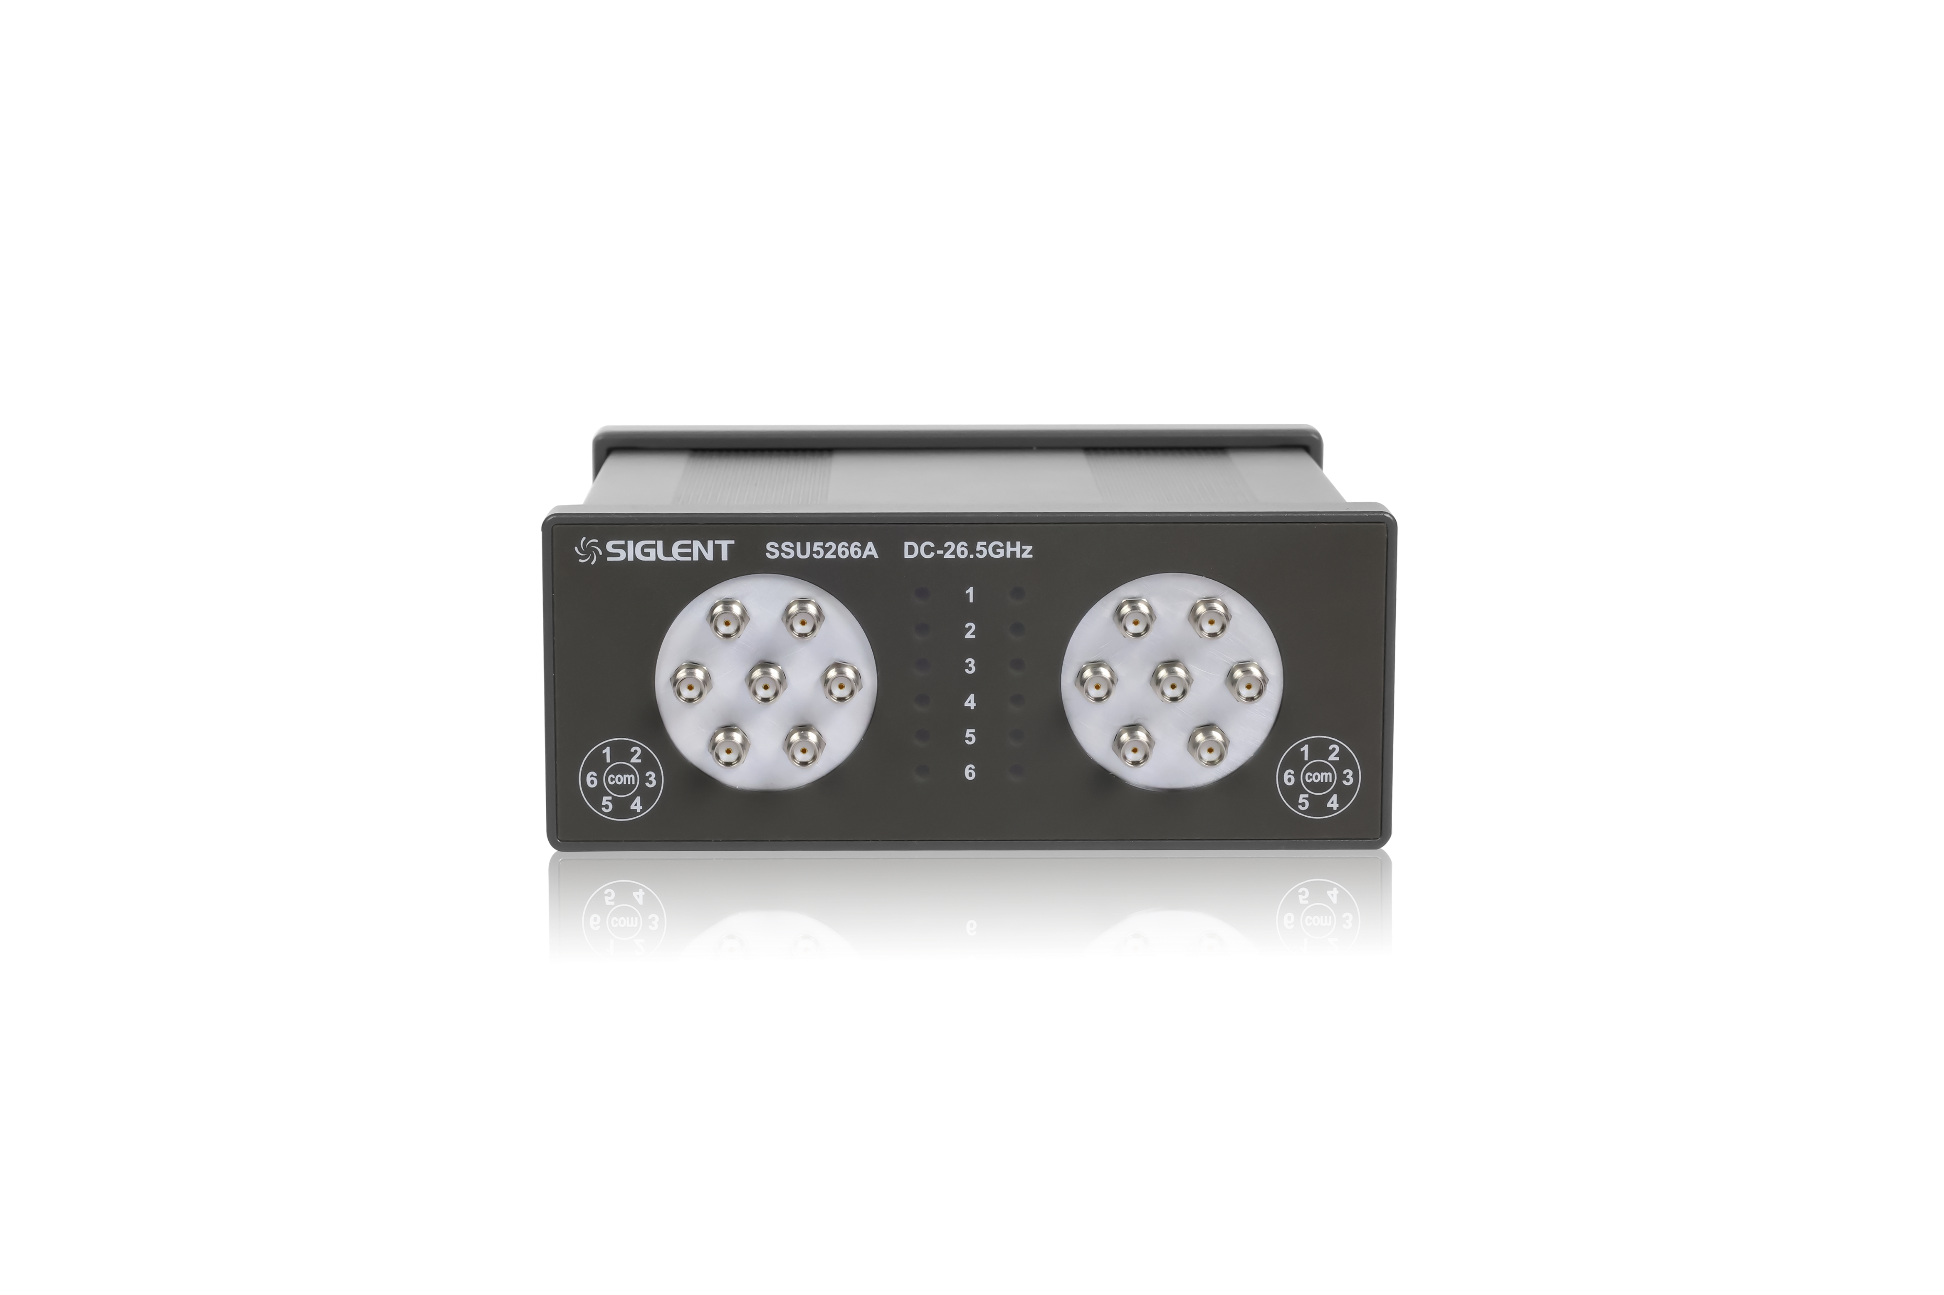
SSU5000A Series
Mechanical Switch
Model | Frequency Range | Number of Switches | Switch Type | RF Connector
SSU5181A | DC-18GHz | 1 | SPDT | SMA female
SSU5182A | DC-18GHz | 2 | SPDT | SMA female
SSU5183A | DC-18GHz | 3 | SPDT | SMA female
SSU5184A | DC-18GHz | 4 | SPDT | SMA female
SSU5261A | DC-26.5GHz | 1 | SPDT | SMA female
SSU5262A | DC-26.5GHz | 2 | SPDT | SMA female
SSU5263A | DC-26.5GHz | 3 | SPDT | SMA female
SSU5264A | DC-26.5GHz | 4 | SPDT | SMA female
SSU5265A | DC-26.5GHz | 5 | SP6T | SMA female
SSU5266A | DC-26.5GHz | 6 | SP6T | SMA female
SSU5501A | DC-50GHz | 1 | SPDT | 2.4mm female
SSU5502A | DC-50GHz | 2 | SPDT | 2.4mm female
SSU5503A | DC-50GHz | 3 | SPDT | 2.4mm female
SSU5504A | DC-50GHz | 4 | SPDT | 2.4mm female
Weight: 885g
Impedance: 50 Ω
Driving voltage: 12V
Maximum driving current: 1.25A
Size: W×H×D=153×62.4×137.5mm
RF connector: SMA female or 2.4mm female
22

Slide 23
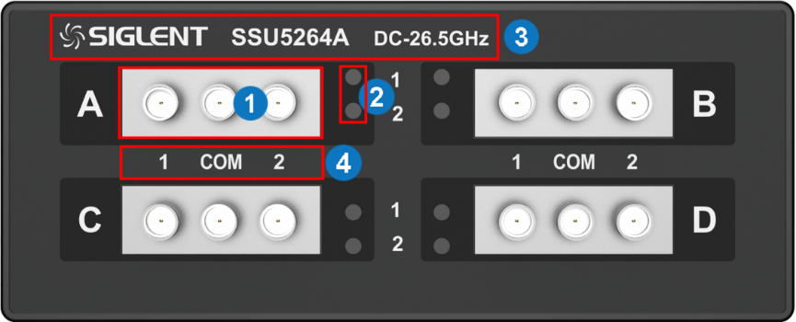
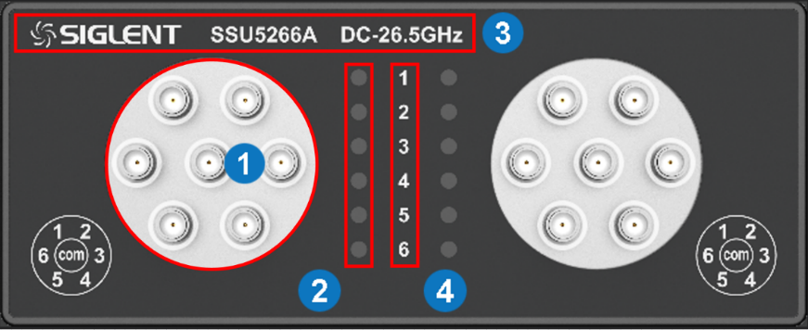
Panel Tour
SSU5000A Instrument Tour / User friendly in every detail
 | RF Connectors | SPDT RF ports and SP6T RF ports
 | Indicator Lights | Indicate which port the middle port links to
 | Model Name | Model name and operation frequency
 | Illustration | Illustration of the indicator lights
 | Fan | Used to cool down internal components of the instrument
 | DC Power Port | 12V DC power supply, 1.25A maxim current
 | USB Device | USB port for data exchange with peripherals
 | Power Switch | Power down or up
 | Serial Number | The label of serial number
Front Panel
Rear Panel
23

Slide 24
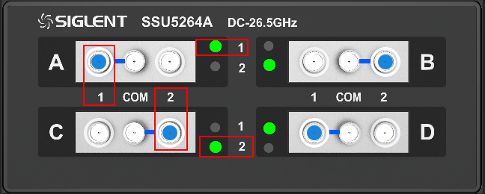
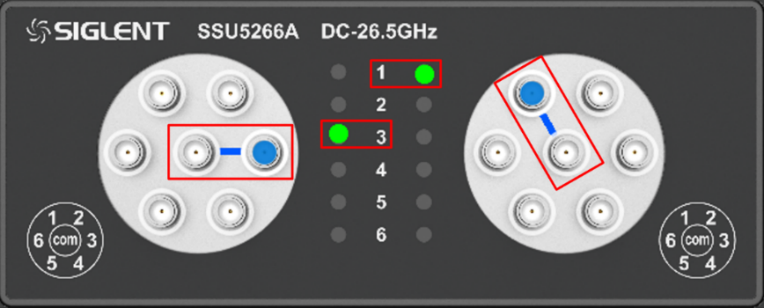
RF Connectors
SSU5000A Instrument Tour / User friendly in every detail
Items | Description
RF Connectors | SSU5264A: 4 groups of RF connectors Every group is an independent SPDT and contains three connectors The middle connector will be linked to left or right connector
 | SSU5266A: 2 groups of RF connectors Every group is an independent SP6T and contains seven connectors The middle connector of the SP6T switch can be configured to connect to one of the six surrounding connectors
Indicator Lights | SSU5264A: Green indicates whether the left connector (green 1) or the right connector (green 2) is connected with the middle connector
 | SSU5266A: Green indicates which of the surrounding connectors is connected with the middle connector
24

Slide 25
PART FOUR
04
Adjustable Probe
Adjustable Single-Ended / Differential Probe

Slide 26
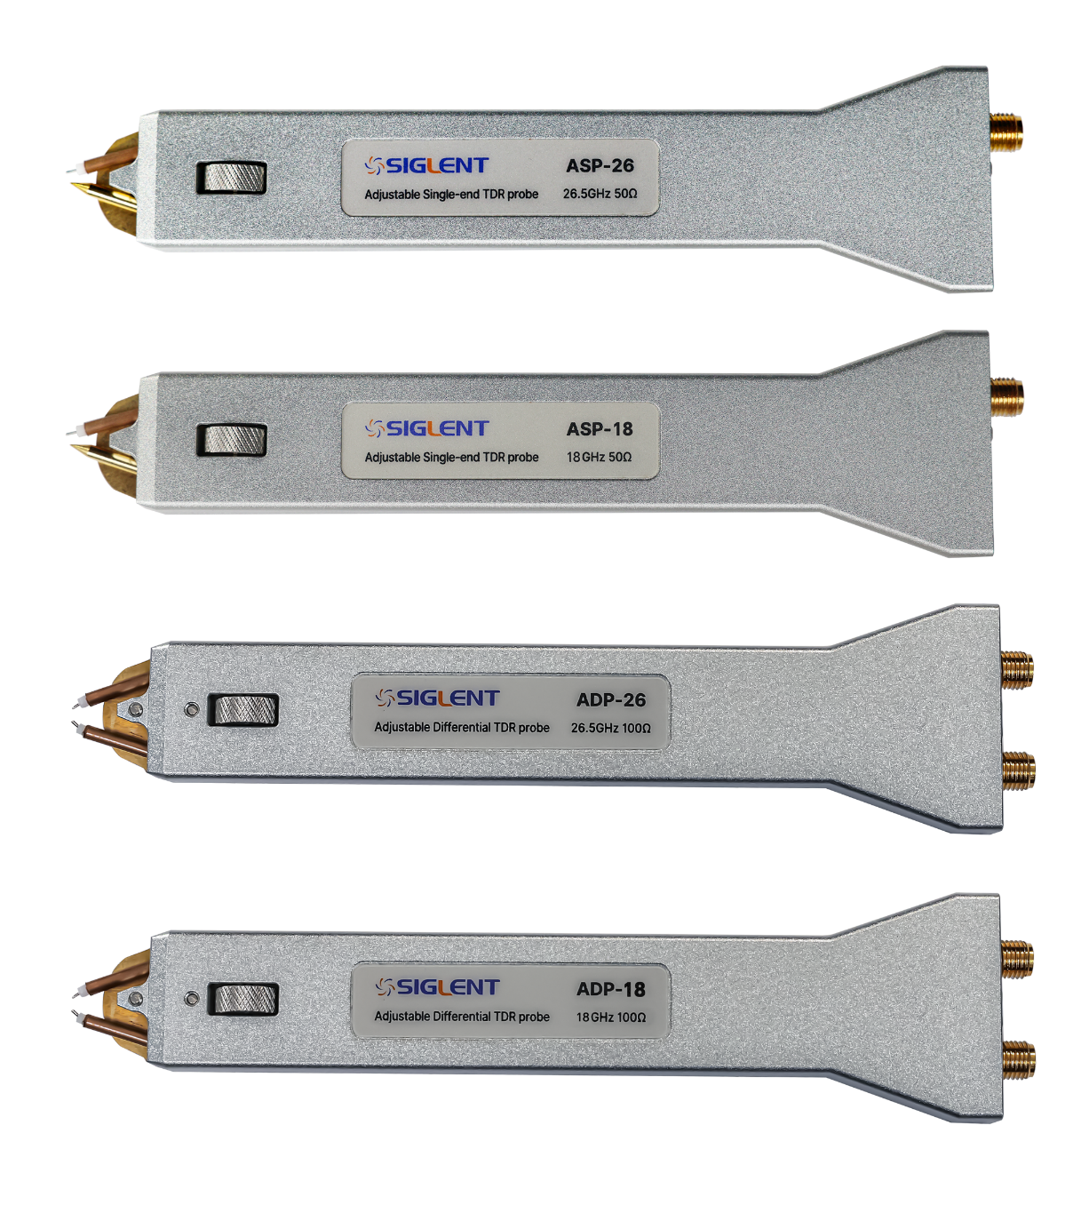
Adjustable TDR Probe
Adjustable Single-Ended / Differential Probe
Connected to printed circuit boards and other devices without connectors
Main features/characteristics:
Model | ADP-18/26 | ASP-18/26
Available Bandwidth | 0-18/26 GHz | 0-18/26 GHz
Probe Impedance | 100 Ω | 50 Ω
Probe Spacing | 0-6.5 mm adjustable
Probe Connector | SMA female
Cable Impendence | 50±0.5 Ω
Warranty Period | 6 months
26

Slide 27
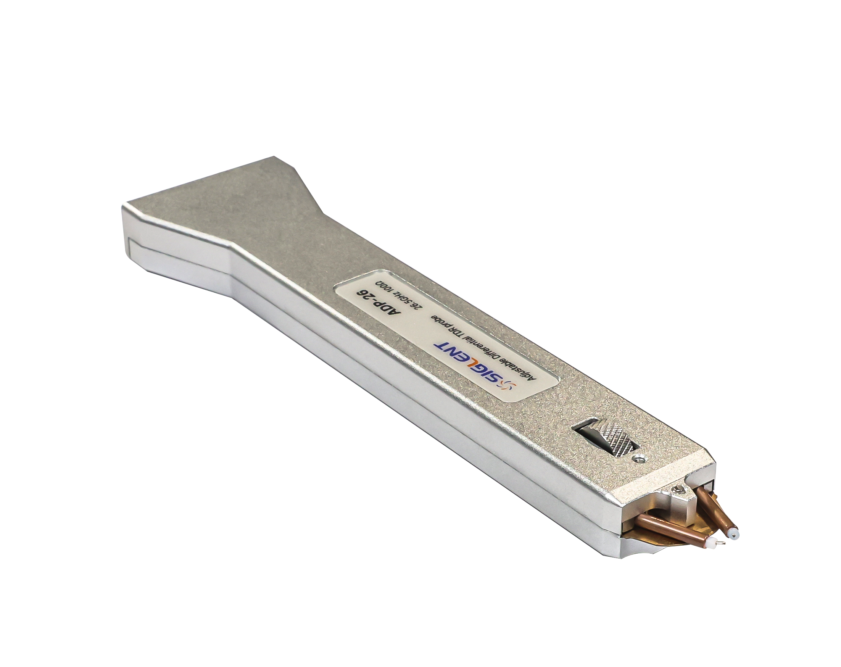
Adjustable TDR Probe
Adjustable Single-Ended / Differential Probe
Great visibility
Slim body and elongated tip
Provides good visibility for the target
Great contact
Small diameter and chamfer design
Hard tooth tips ensure good contact many times
Great contact can be achieved even on small pads or traces
27

Slide 28
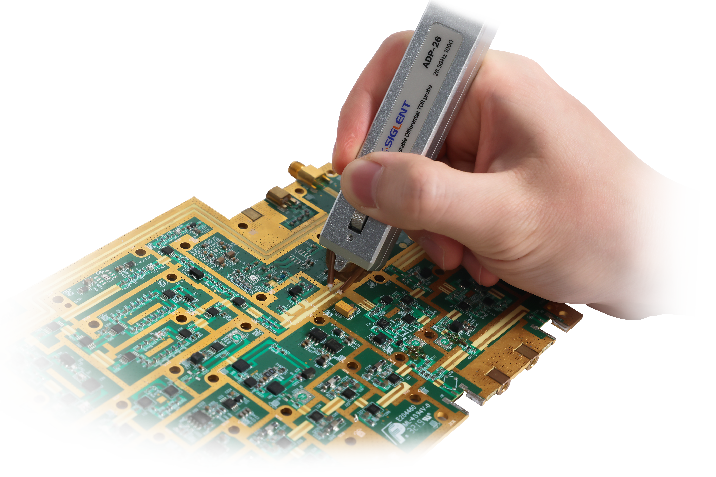
Adjustable TDR Probe
Adjustable Single-Ended / Differential Probe
Light and comfortable
Lightweight and ergonomic design
Feel comfortable even when used in large quantities
One-handed operation
0-6.5 mm adjustable
Typical IC pin spacing (2.54 mm)
The built-in roller allows the probe spacing to be adjusted with only one hand
28

Slide 29
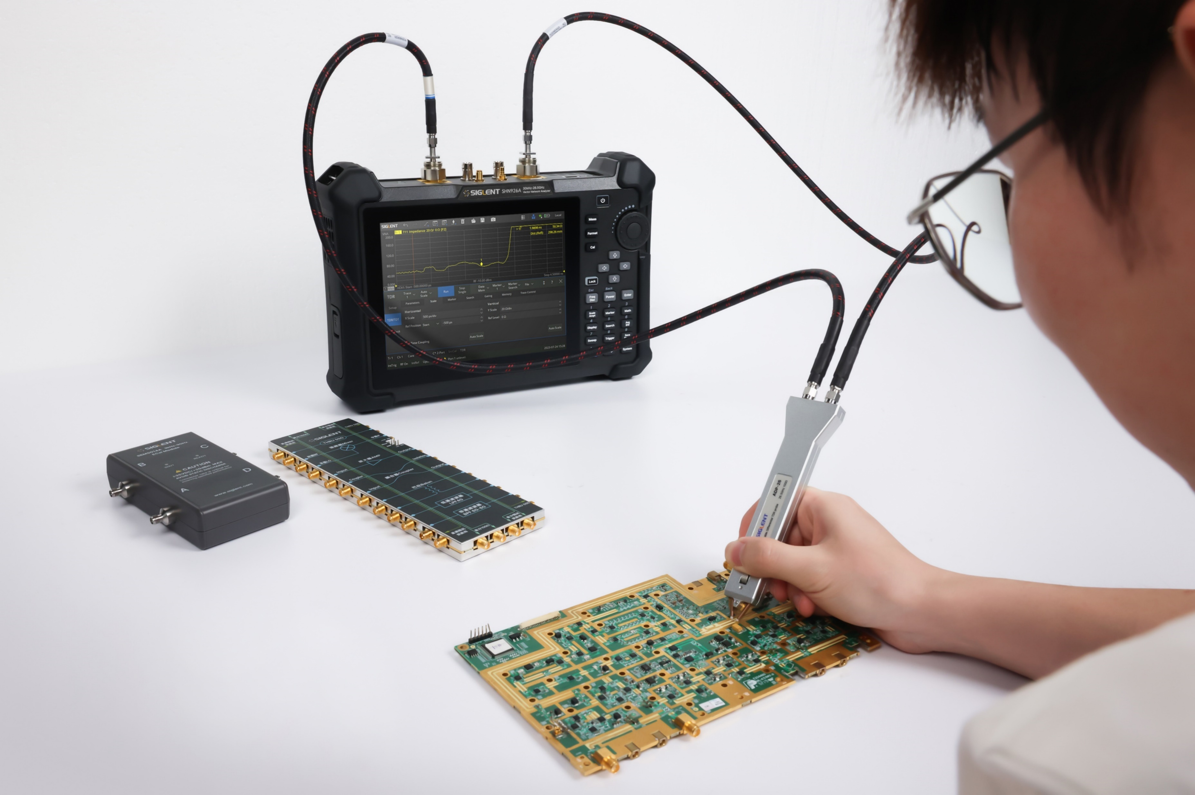
Adjustable TDR Probe
Adjustable Single-Ended / Differential Probe
Better insight
Sdd11, Sdd12, Sdd21 or Sdd22
Time domain (reflected voltage or impedance curve)
Control production process
Manufacture of PCB and passive components
Control process consistency between different batches
Shorten design cycle
High-speed differential electrical channel
Characterize differential impedance, return/ insertion loss
29

Slide 30
Thank You
Every Bench. Every Engineer. Every Day.
Headquarters
NA
Europe
SIGLENT TECHNOLOGIES CO., LTD.
Add: Blog No.1 & No.4 & No.5, Antongda Industrial Zone, 3rd Liuxian Road, Bao’an District, Shenzhen, 518101, China
Tel:+ 86 755 3688 7876
Fax:+ 86 755 3359 1582
sales@siglent.com
int.siglent.com
SIGLENT Technologies NA, Inc.
Add: 6557 Cochran Rd Solon, Ohio 44139 Tel: 440-398-5800 Toll Free:877-515-5551 Fax: 440-399-1211
info@siglent.com www.siglentna.com
SIGLENT TECHNOLOGIES GERMANY GmbH
Add: Staetzlinger Str. 70 86165 Augsburg, Germany Tel: +49(0)-821-666 0 111 0 Fax: +49(0)-821-666 0 111 22 info-eu@siglent.com www.siglenteu.com

