Slide 1


Slide 2
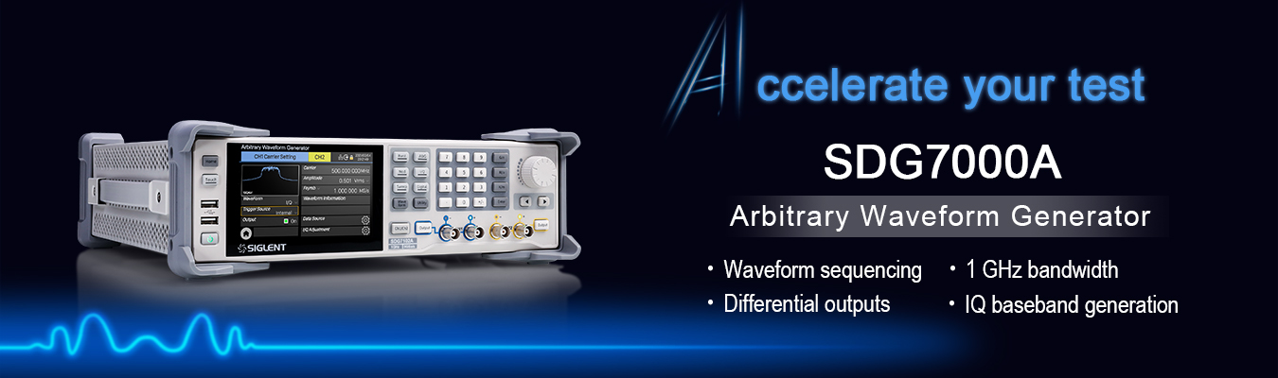

Slide 3
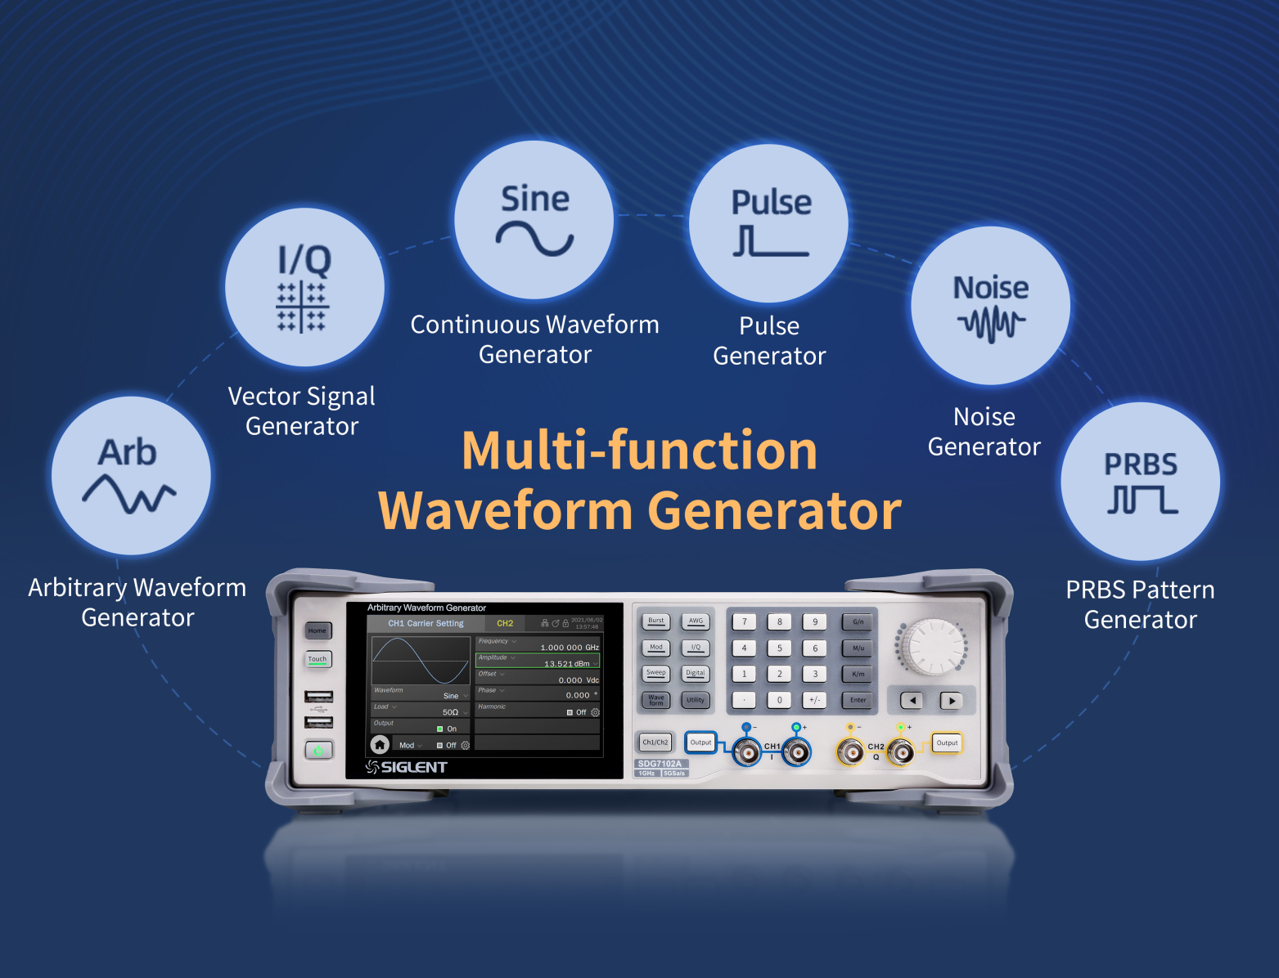


SDG7000A Multi-function Generator
Content
Waveform Types
Features and Benefits
Applications
Competition Analysis

Slide 4
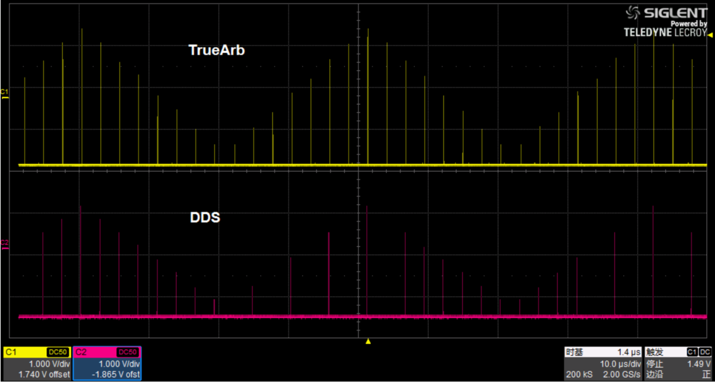
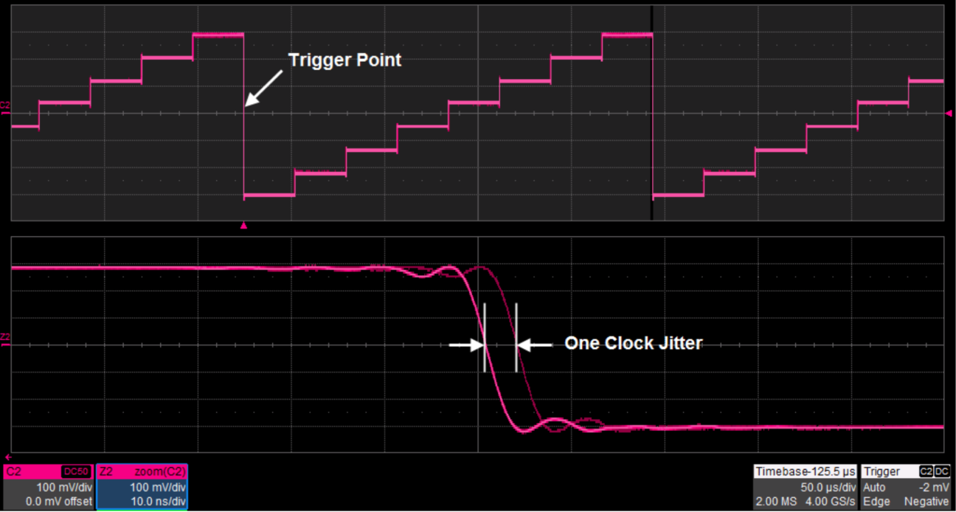
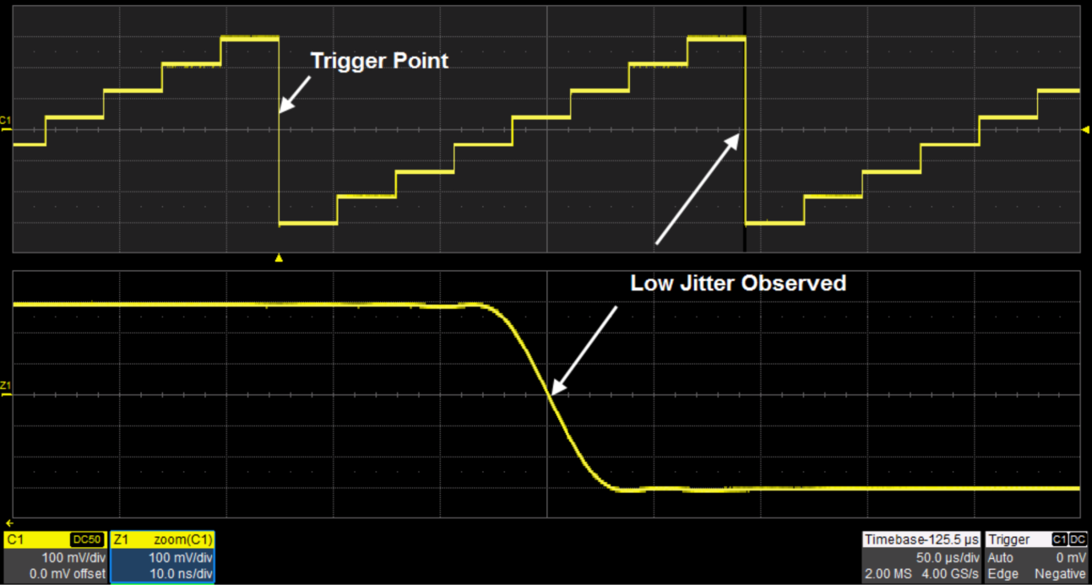
Arbitrary Waveform Generator
AFG mode - DDS
AWG mode - TrueArb technology
Point by point output
0.01 Sa/s ~ 2.5 GSa/s adjustable sample rate
Jitter less than 20 ps
24 pts ~ 512 Mpts/ch memory depth
Notes:
TrueArb enhances the performance of traditional DDS technology by delivering lower jitter and distortion defects.
Deeper memory provides higher resolution in the time domain and enables users to create more detailed waveforms.

Slide 5
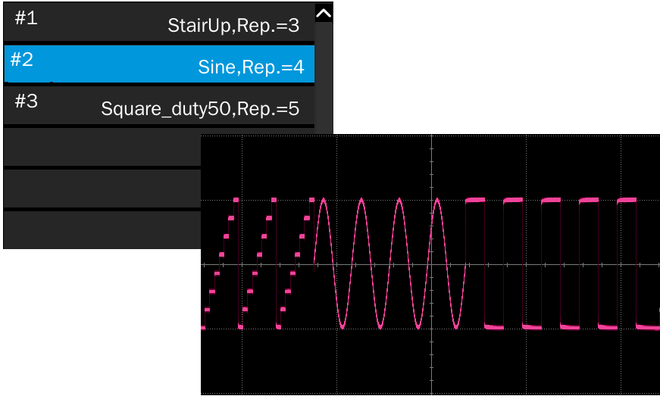
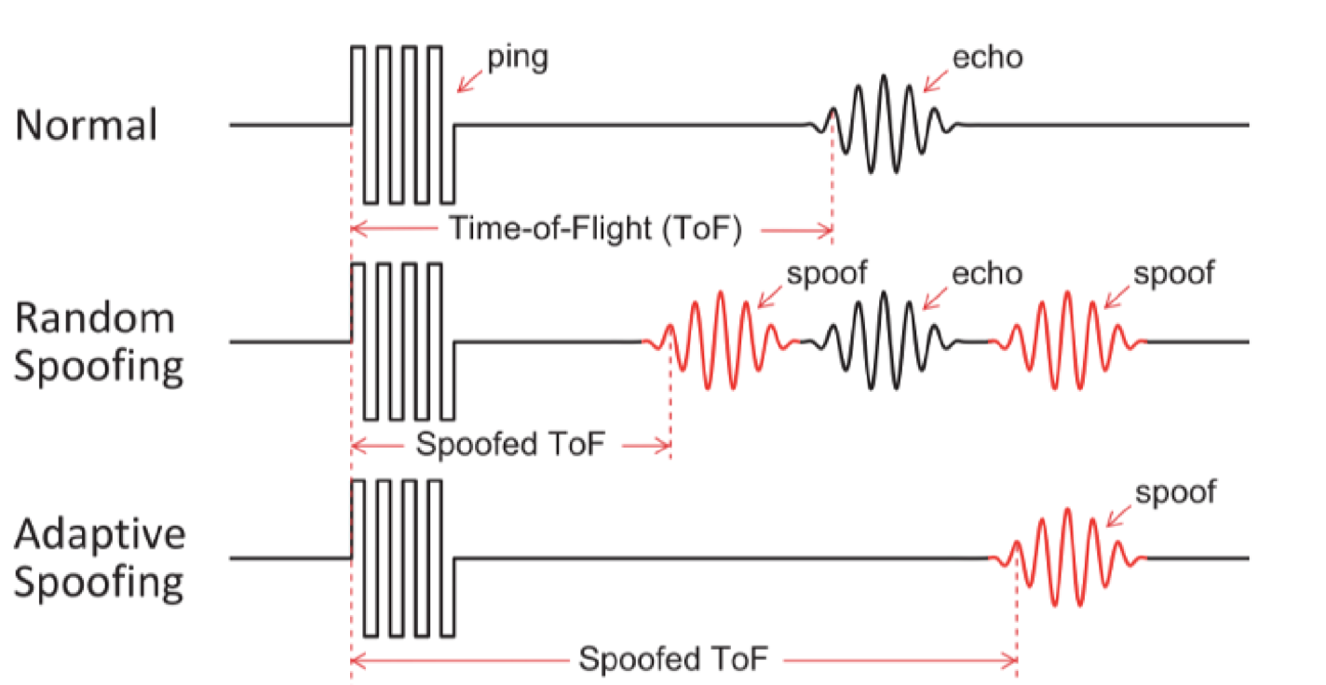
Arbitrary Waveform Generator
Sequence editing and playback
Up to 1024 arbitrary waveform segments
Maximum of 65535 repetitions of each segment
Simulate spoofing attacks on autonomous vehicles sensors
Notes:
When switching between segments, the output seamlessly moves from the last point of the previous segment to the first point of the next segment without generating an idle level. It is suitable for applications with high requirements for waveform switching.

Slide 6
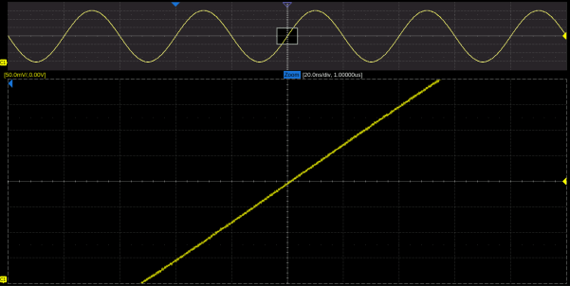
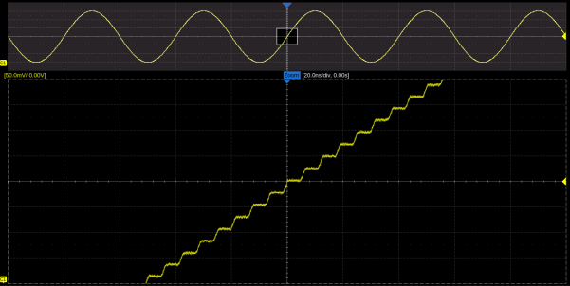
Arbitrary Waveform Generator
Interpolations in AWG mode
Interpolation | Explanation
0-order hold | Zero-order hold
Linear | Linear interpolation
Sinc | Sinx/x interpolation
Sinc27 | Sinx/x interpolation combined with low-pass filter，bandwidth = 0.27 x sample rate
Sinc13 | Interpolation combined with low-pass filter, bandwidth = 0.13 x sample rate
Sinc interpolation
0-order hold interpolation

Slide 7
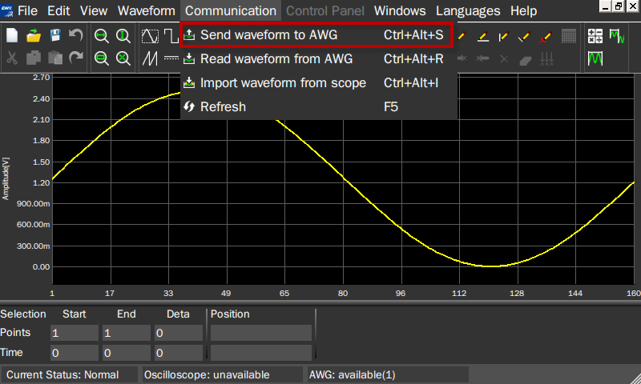
Arbitrary Waveform Generator
EasyWaveX software
Draw arbitrary waveforms
Import and export waveform files

Slide 8
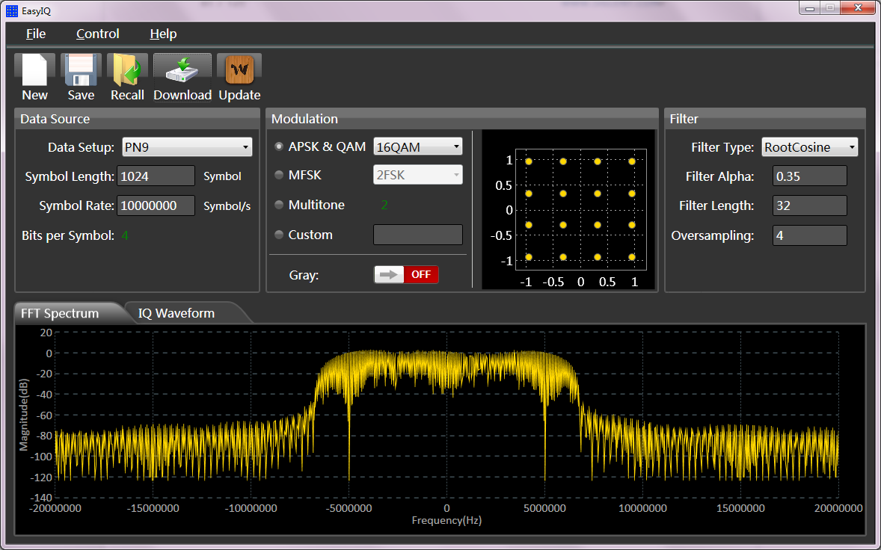
Vector Signal Generator
ASK, PSK, FSK, MSK, multi-tone and QAM
500 MS/s max symbol rate, Carrier DC ~ 1 GHz settable
Sample rate Fs = symbol rate Fsymb * oversampling factor (pts/symbol)
EasyIQ software provides vector signal creation and editing

Slide 9
Vector Signal Generator
Two working Modes：
Baseband I/Q: central frequency (carrier) = 0, CH1 is I-channel, CH2 is Q-channel
IF (Intermediate Frequency): central frequency≠ 0
Notes:
In IF mode, the I and Q data will be sent to the internal quadrature modulator and modulated to the carrier frequency before output. The output of the quadrature modulator is led out from CH1 after broadband compensation.

Slide 10
Continuous Waveform Generator
Up to 1GHz, replace RF signal generator in some applications
Load setting
Signal source can not automatically identify the value of RL, the user needs to inform the signal source of the value by inputting the "load" value

Slide 11
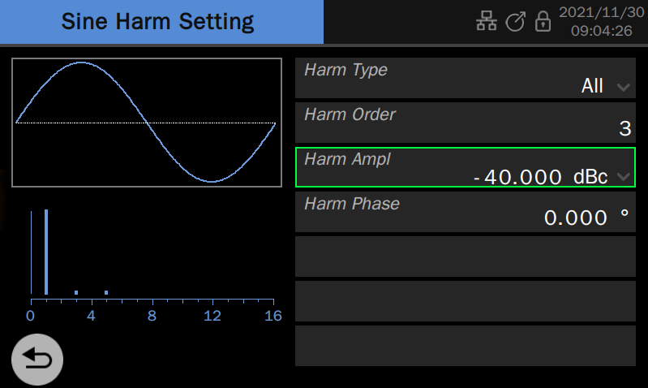
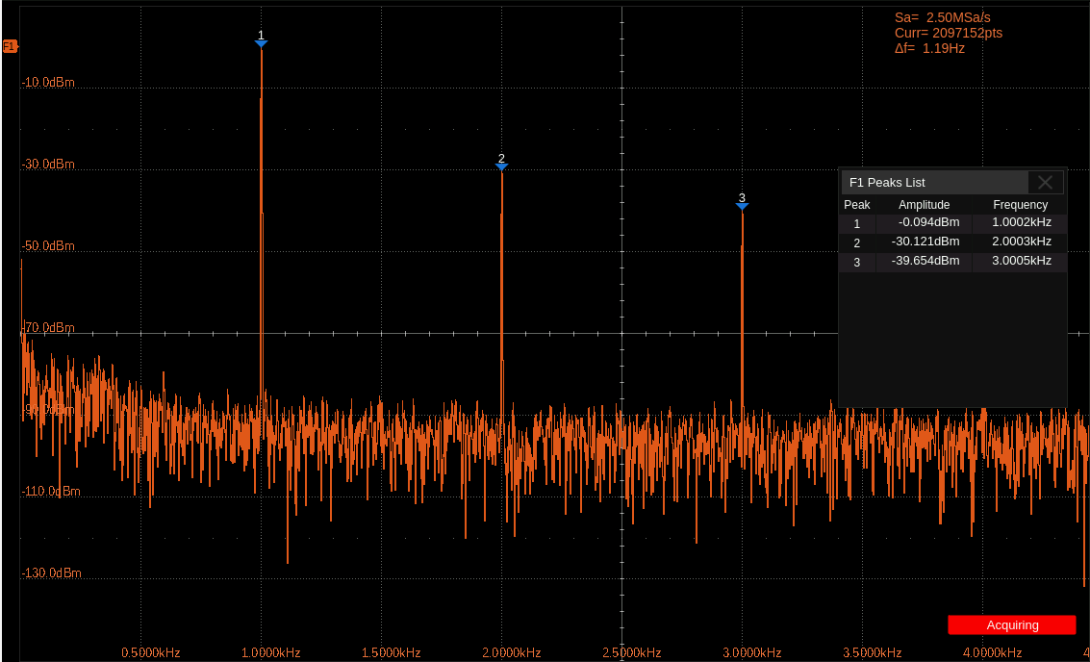
Continuous Waveform Generator
Supports harmonic generation function
Notes:
Harmonic is a sub-function of sine wave generation function. It can output harmonics with specified order, amplitude, and phase settings, which is used to simulate sine waves with non-linearity.

Slide 12
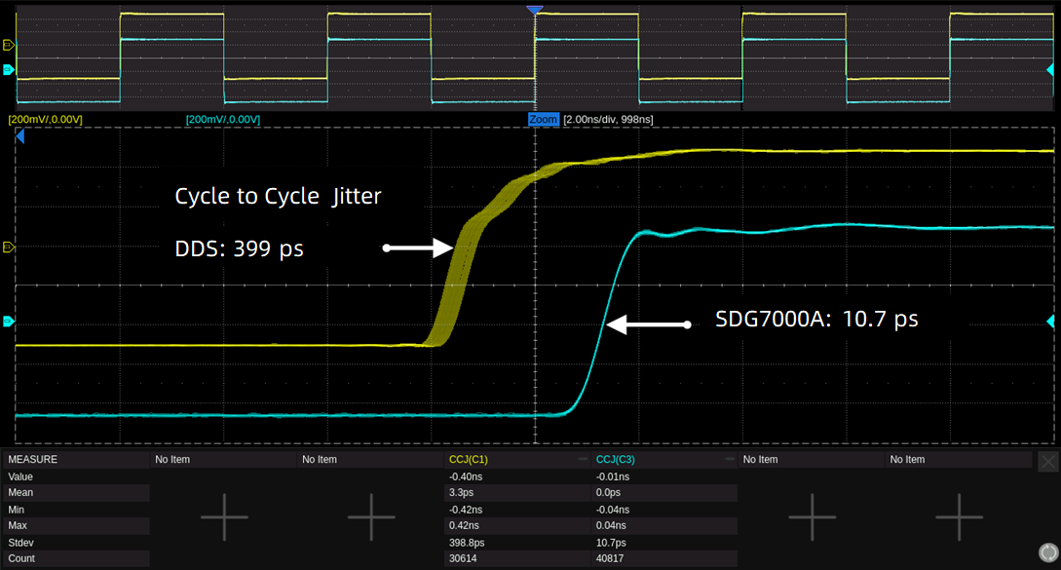
Pulse Generator
Low jitter: EasyPulse technology significantly reduce the jitter.
Notes:
When a Square/Pulse waveform is generated by traditional DDS, there can be additional jitter if the sample rate is not an integer-related multiple of the output frequency. EasyPulse technology successfully overcomes this weakness in DDS designs and helps to produce low jitter Square/Pulse waveforms.
The minimum 1 ns pulse width, can be generated at any frequency. The pulse width can be finely adjusted in steps of 10 ps.
Adjustable fine step resolution to 100 ps. The minimum edge is 500 ps and can be generated at any frequency. The rising/ falling edge can be set respectively and can be used to generate asymmetric pulse

Slide 13
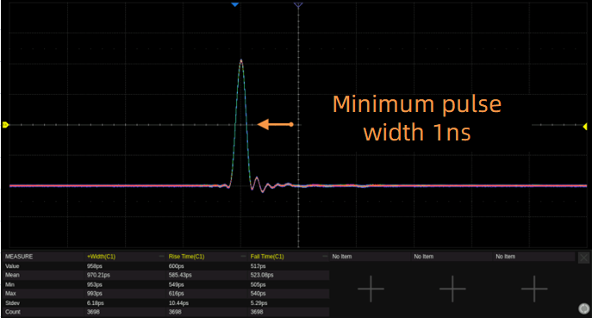
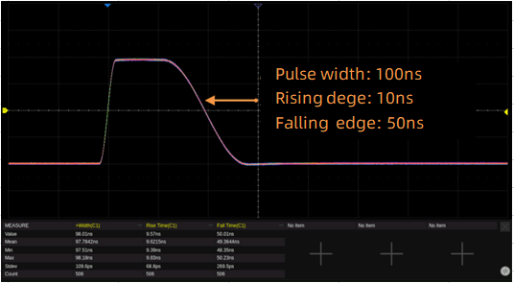
Pulse Generator
High speed: minimum 1 ns pulse width.
Flexible edge: step resolution is 100 ps, minimum edge is 500 ps.
Notes:
When a Square/Pulse waveform is generated by traditional DDS, there can be additional jitter if the sample rate is not an integer-related multiple of the output frequency. EasyPulse technology successfully overcomes this weakness in DDS designs and helps to produce low jitter Square/Pulse waveforms.
The minimum 1 ns pulse width, can be generated at any frequency. The pulse width can be finely adjusted in steps of 10 ps.
Adjustable fine step resolution to 100 ps. The minimum edge is 500 ps and can be generated at any frequency. The rising/ falling edge can be set respectively and can be used to generate asymmetric pulse

Slide 14
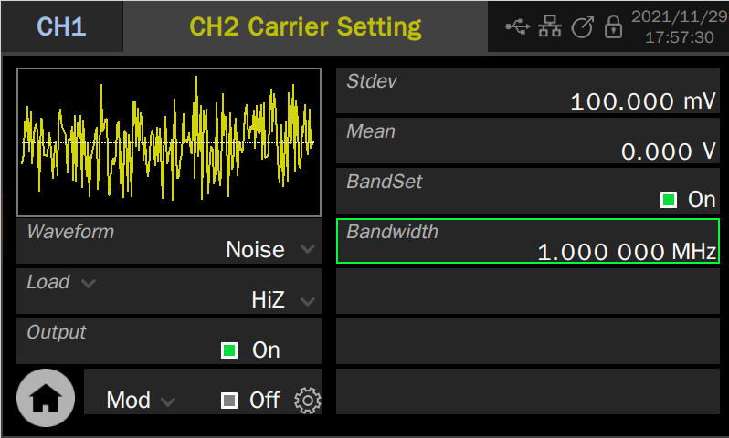
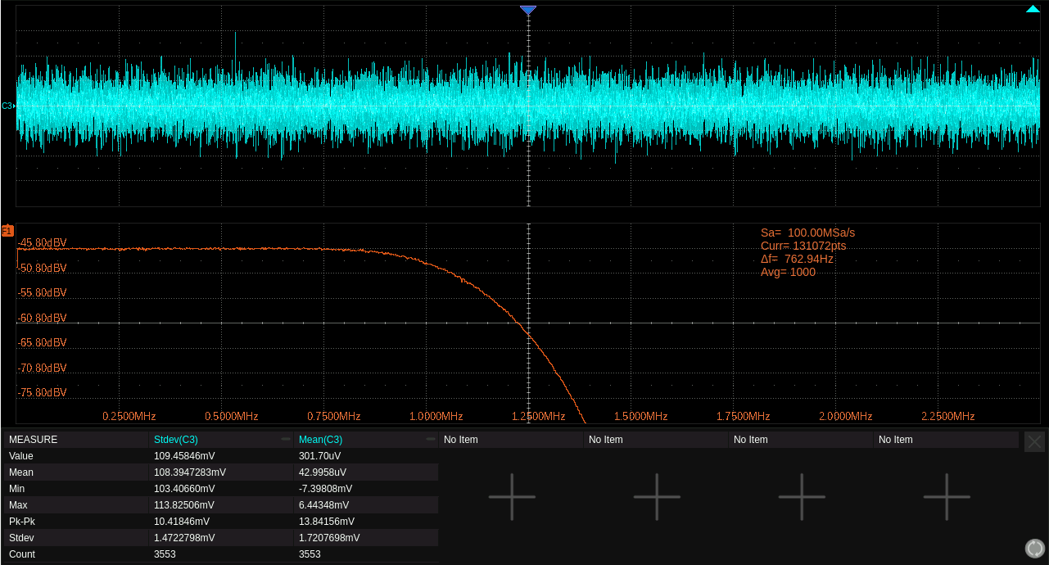
Noise Generator
Gaussian noise with a settable bandwidth to the bandwidth of sine wave.
Load, Stdev, Mean, Bandwidth
Waveform combining: simulate real environment by adding noise to output signal.
Notes:
Waveform Combining Superimposes CH1 and CH2 waveforms internally and provides the combined waveform to a user-selected output. It easily combines basic waveforms, random noise, modulation signals, sweep signals, burst signals, EasyPulse waveforms, and TrueArb waveforms without external connections or complex editing.

Slide 15
PRBS Pattern Generator
Used to verify bit error rate in high speed serial communication
Bit rate 1 μbps ~ 312.5 Mbps. Bit rate (bps)= 1/ Symbol period (s). Length: PRBS-3 ~ 32
Standard logic level
Logic level | Amplitude(Vpp) | Offset(V)
TTL/CMOS | 5.00 | 2.50
LVTTL/LVCMOS | 3.30 | 1.65
ECL | 0.80 | -1.30
LVPECL | 0.80 | 2.00
LVDS | 0.35 | 1.25
Notes:
The preset logic levels in the table are valid only when output mode = single ended.
Because the common mode is limited in (-1 V ~ +1 V), some levels with large common-mode voltages, such as LVDS (1.25 V) and LVPECL (2.0 V), cannot be simulated. An alternative is to simulate the differential output by two complementary single-ended outputs.

Slide 16
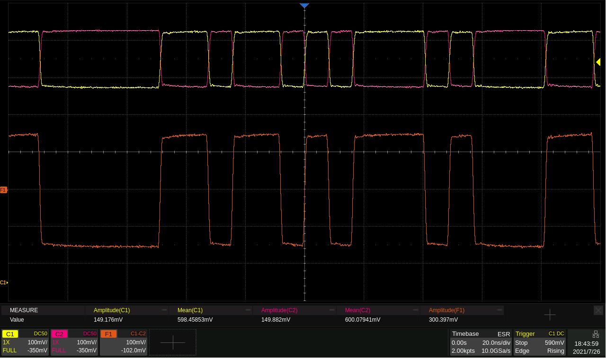
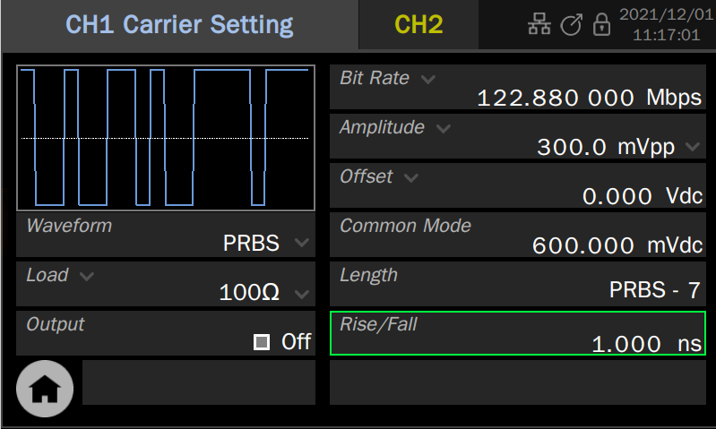
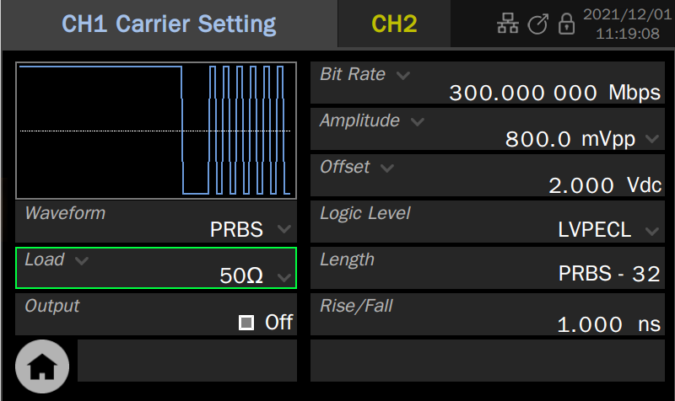
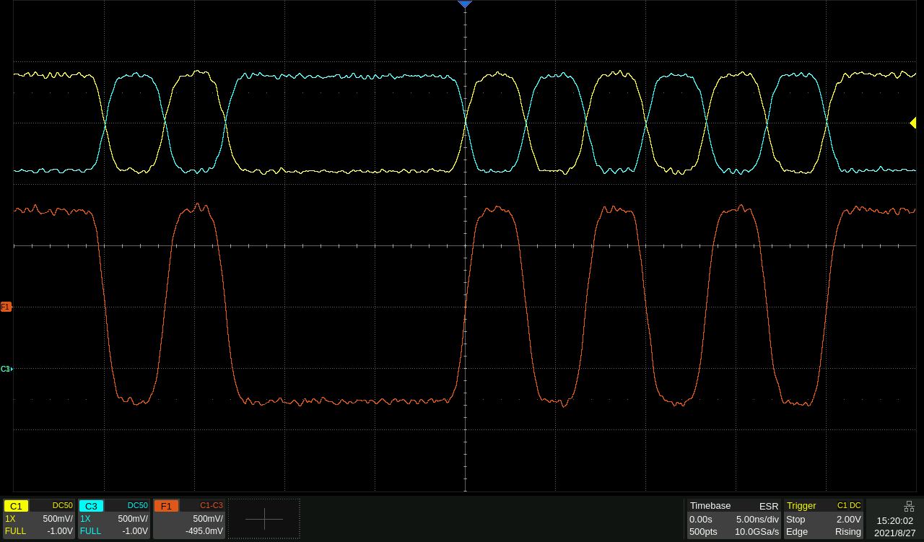
PRBS Pattern Generator
Differential mode (common mode limited to -1 V ~ +1 V)
Two complementary single-ended outputs.
Notes:
The preset logic levels in the table are valid only when output mode = single ended.
Because the common mode is limited in (-1 V ~ +1 V), some levels with large common-mode voltages, such as LVDS (1.25 V) and LVPECL (2.0 V), cannot be simulated. An alternative is to simulate the differential output by two complementary single-ended outputs.

Slide 17
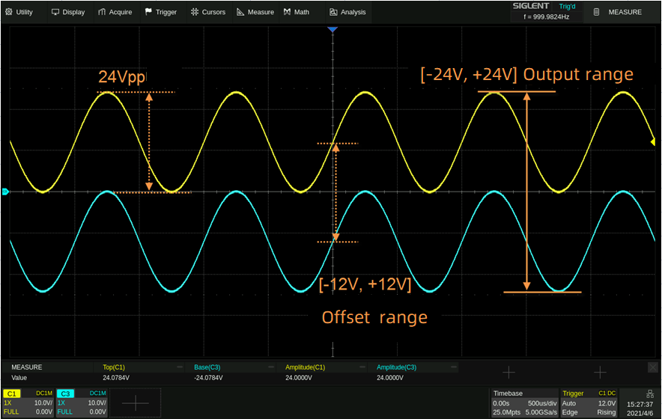
Wide Range Amplitude Output
24 Vpp analog output superimposed with ± 12 Vdc offset, providing a maximum output range of ± 24 V (48 V).
Differential output
20 mVpp ~ 2 Vpp, Differential peak to peak, 100 Ω differential load, common offset = 0 V
Offset -1 ~ +1 V, Differential offset, 100 Ω differential load
Common mode -1 ~ +1 V, Load = HiZ
Notes:
In PRBS generation, because the common mode is limited in (-1 V ~ +1 V), some levels with large common-mode voltages, such as LVDS (1.25 V) and LVPECL (2.0 V), cannot be simulated. An alternative is to simulate the differential output by two complementary single-ended outputs.

Slide 18
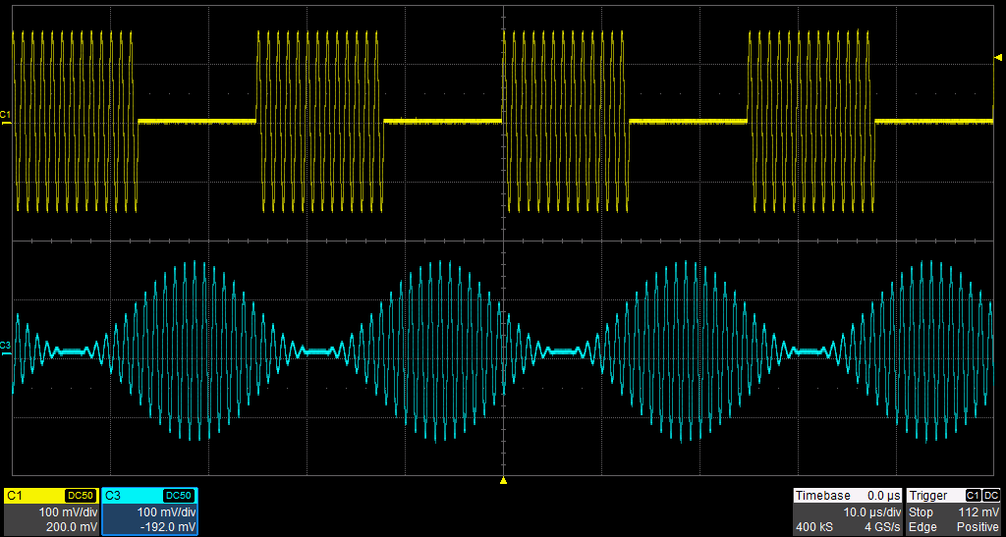
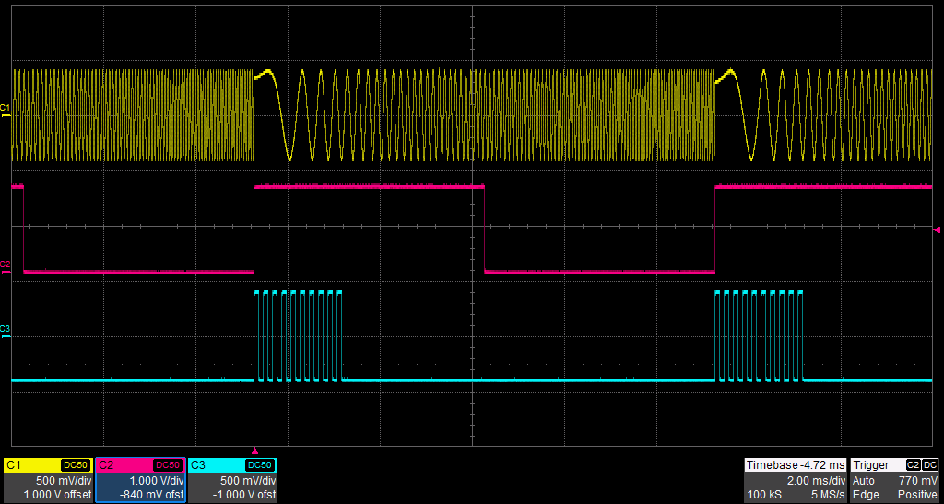
Complex Signal Generator
Modulation A variety of analog and digital modulation modes such as AM, FM, PM, FSK, ASK, PSK, DSB-SC, and PWM are supported. There are three modulation sources: Internal, External, and Channel.
Sweep and Burst Sweep supports "Line" and "Log" modes, while Burst enables "NCycle" and "Gated" modes. Both Sweep and Burst support trigger sources: Internal, External, and Manual.

Slide 19
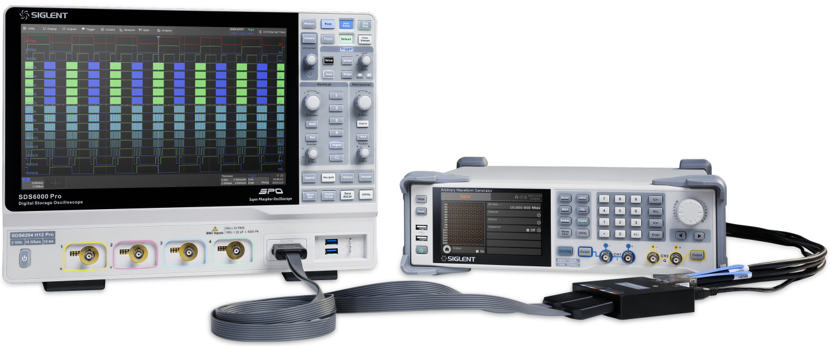
16 Channel Digital Output (Optional)
LVTTL and LVDS
Digital (optional)
Parameter | Min. | Typ. | Max. | Unit | Condition & Note
Bit rate | 1 m |  | 1 G | bps | LVDS
 | 1 m |  | 200 M | bps | LVTTL
Notes:
Purchase the corresponding digital bus kit to get 16-channel LVTTL or LVDS output with a bit rate of 1 μbps ~ 1Gbps.Combine the digital bus with the analog channels to realize mixed-signal outputs.

Slide 20
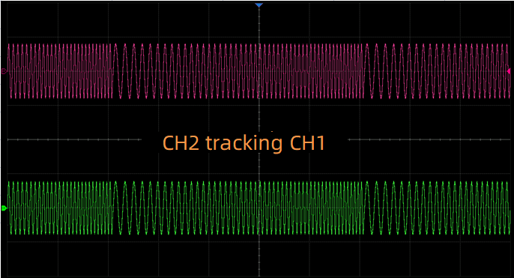
Enhanced Dual Channel Functionality
Independent mode enables the two channels to be used as two independent generators. Independent mode also eliminated the discontinuity on the output when parameters (frequency, amplitude) change.
Phase-Locked mode Automatically aligns the phases of each output.
Track/Copy/Coupling The track, copy, and coupling functions between the two channels can quickly transfer the parameters of one channel to the other which greatly simplifies setup and waveform creation.

Slide 21
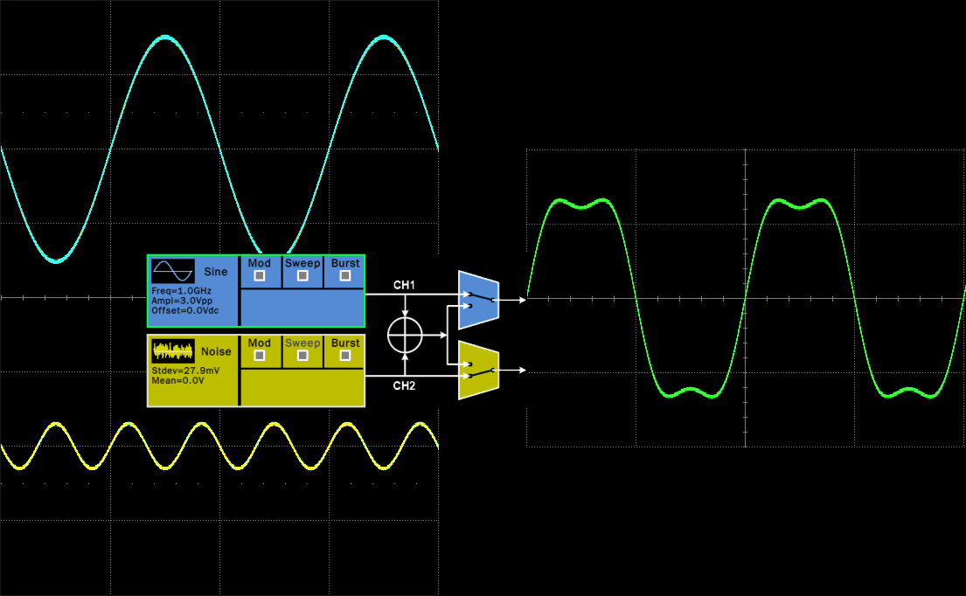
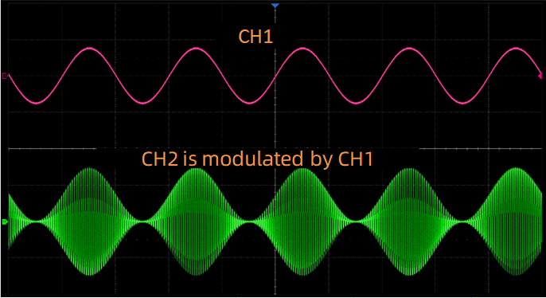
Enhanced Dual Channel Functionality
Waveform Combining Superimposes CH1 and CH2 waveforms internally and provides the combined waveform to a user-selected output. It easily combines basic waveforms, random noise, modulation signals, sweep signals, burst signals, EasyPulse waveforms, and TrueArb waveforms without external connections or complex editing.
Channel Modulation One channel can modulate the other without external connections. This feature provides a easy method for complex modulation waveform creation. The modulating wave channel can be directly output and compared with the modulated signal.

Slide 22
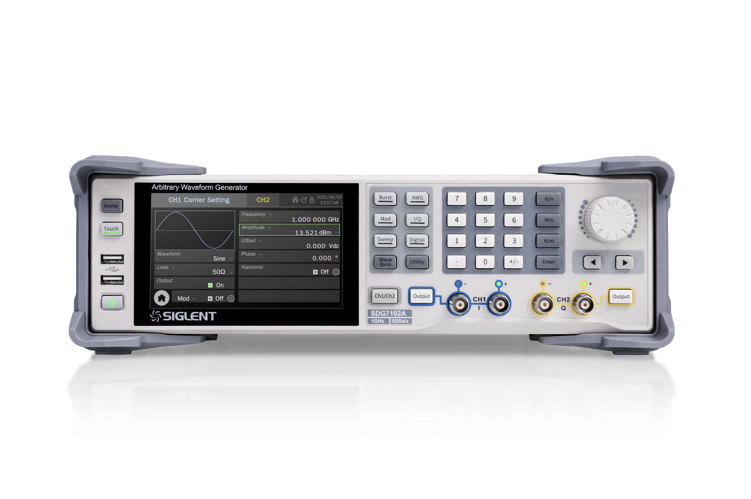
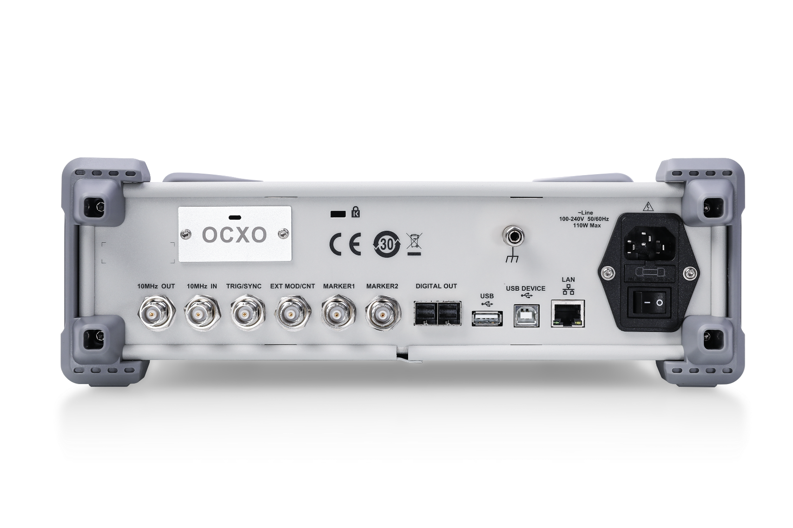
A new UI design
Two differential outputs
New knob design
Two USB ports
(mouse, keyboard, storage)
Digital output
5’’ touch screen
10 MHz OUT/IN
TRIG/SYNC
EXT MOD/CNT
MARKER 1
MARKER 2
USB device/host,
LAN (Web server)

Slide 23
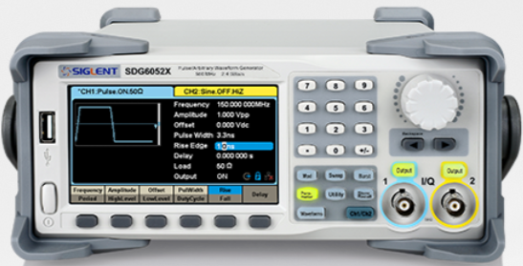
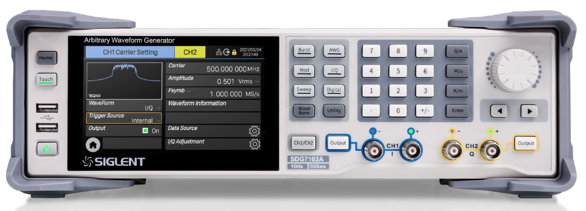
Advantages over SDG6000X
Specs | Siglent SDG6000X |  | Siglent SDG7000A
Output Channel | 2 Single Ended | X | 2 Differential /Single Ended | √
Bandwidth | 500MHz | X | 1GHz | √
Sampling Rate | 2.4GSa/s(2x interpolation) | X | 5GSa/s (2x interpolation) | √
Waveform Length | 2~20Mpts | X | 512Mpts | √
Output Amplitude (50ohm load) | 10 Vpp | X | 12 Vpp | √
Output offset | - | X | Independant of output amplitude -6V ~ +6V，(50ohm load) -12V ~ +12V，(HiZ load) | √
Arbitrary Waveform Sampling Rate | 1uSa/s~300MSa/s TrueArb mode 1.2GSa/s DDS mode | X | 1uSa/s~2.5GSa/s | √
Sequence | - | X | Support | √
IQ Modulation | IQ bandwidth:37.5M | X | 150 MHz IQ BW | √
Auxiliary Interface | Counter, Aux In/Out, 10MHz In, 10 MHz Out | X | External modulation/Counter input: x1; Trigger in/ Out: x1; Ref In: x1, Ref Out: x1; Markers Out: x2 | √
Digital Channel | - | X | 16 bit LVDS/LVTTL | √
Display | 4.3'' touch | X | 5“ touch | √

Slide 24
Applications
Semiconductors
MEMS sensors test
Ultrasound Communication and Range Finder Systems for Sensors
Ultrasound MEMS for Damage Detection
Medical ultrasound imaging CMUT test
Autonomous vehicles
Wireless and RF Devices
Digital Communications
Physics and research
Arb pulses with faster than 1 ns rise time
Scintillator / photomultiplier
Different Arb shapes combined, sequencing is the key
Notes:
A two levels or three level pulse is presented for medical ultrasound imaging applications, particularly those that use capacitive micromachined ultrasonic transducers (CMUT). Waveform Editor tool, allows you to easily create multi-level pulses that are a key-factor of this kind of application. It is also possible to add noise and/or filters to simulate a real-life environment.
Ultrasonic MEMS sensor can address a wide range of applications and they are becoming very popular these days. Semiconductor and digital imaging companies are investing money and research time into this particular market segment; the market forecast is about 6 Billion USD in 2025

Slide 25
Thank You
The Best Value in Electronic Test & Measurement
Headquarters
NA
Europe
SIGLENT TECHNOLOGIES CO., LTD.
Add: Blog No.4 & No.5, Antongda Industrial Zone, 3rd Liuxian Road,
Bao’an District, Shenzhen, 518101, China.
Tel:+ 86 755 3688 7876
Fax:+ 86 755 3359 1582
sales@siglent.com
www.siglent.com/ens
SIGLENT Technologies NA, Inc.
Add: 6557 Cochran Rd Solon, Ohio 44139 Tel: 440-398-5800 Toll Free:877-515-5551 Fax: 440-399-1211
info@siglent.com www.siglentna.com
SIGLENT TECHNOLOGIES GERMANY GmbH
Add: Liebigstrasse 2-20, Gebaeude 14, 22113 Hamburg Germany Tel: +49(0)40-819-95946
Mobile: +49 151 40716756 Fax: +49(0)40-819-95947 info-eu@siglent.com www.siglenteu.com

