Slide 1


Slide 2
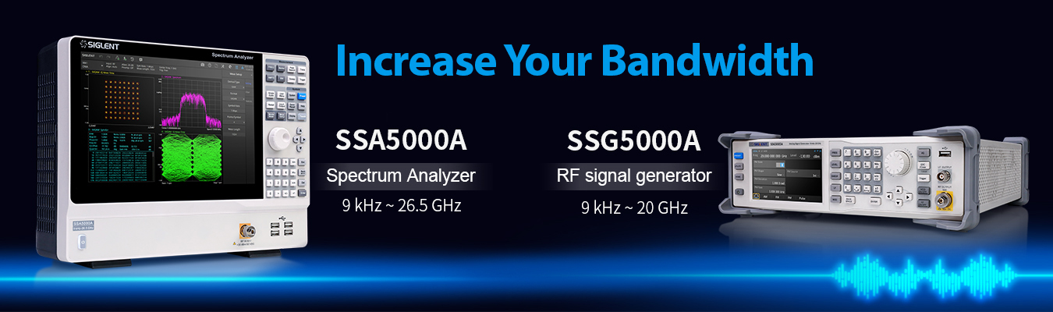

Slide 3
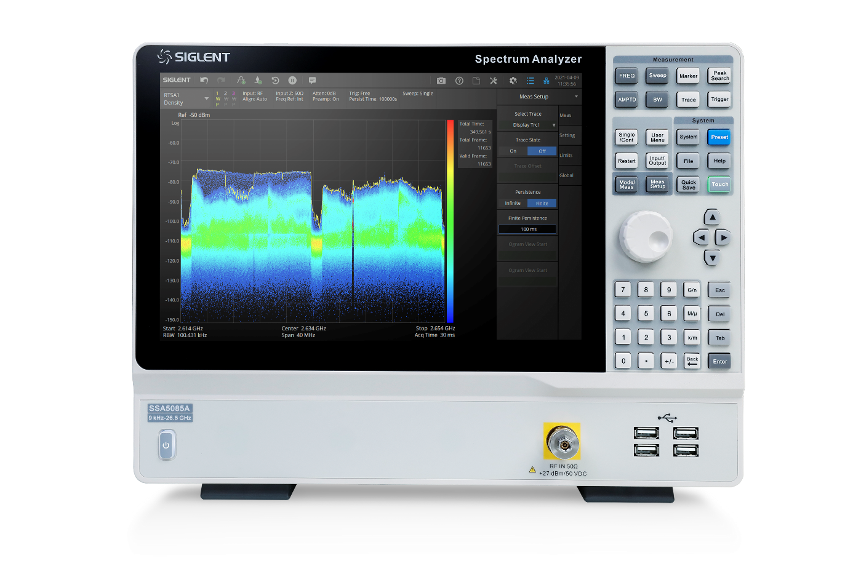
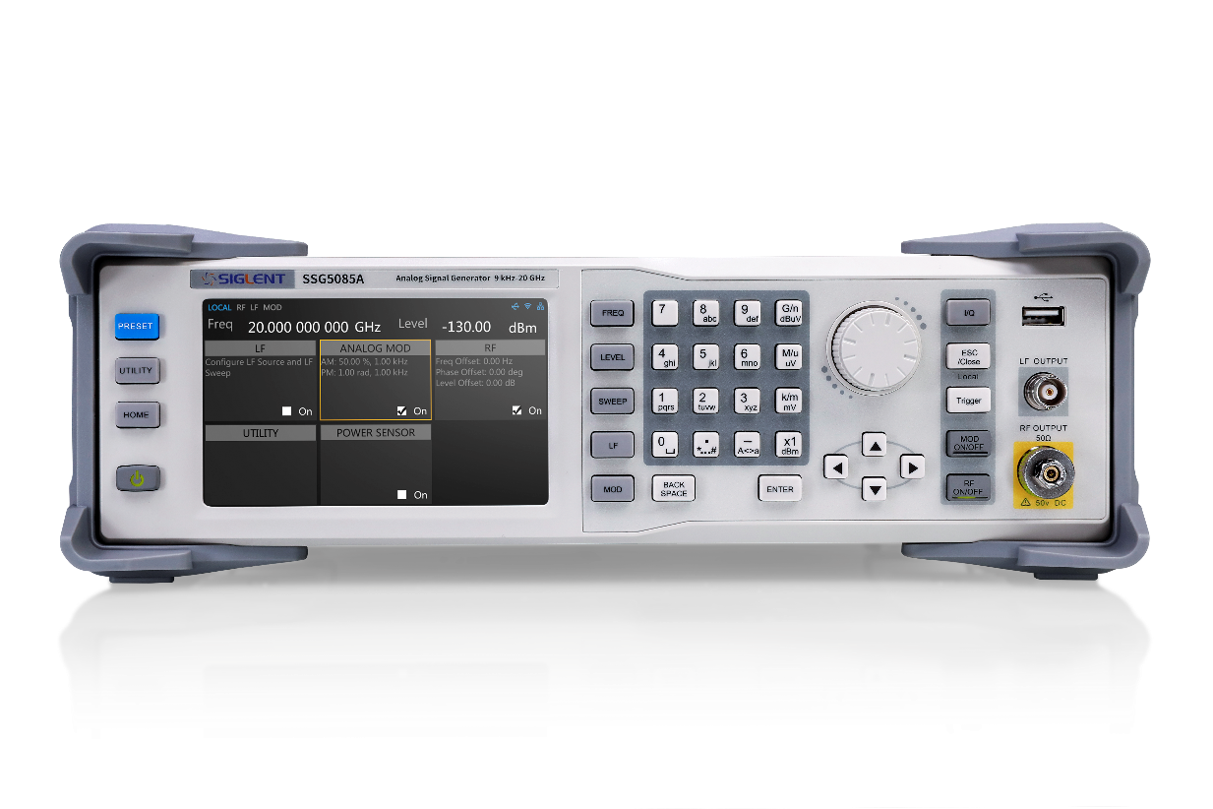


SSA5000A Spectrum Analyzer
SSG5000A RF Signal Generator
Contents
SSA5000A introduction
SSG5000A introduction
Competition Analysis
Applications

Slide 4
SSA5000A main parameters and options
 | SSA5083A | SSA5085A
Frequency range | 9 kHz ~ 13.5 GHz | 9 kHz ~ 26.5 GHz
Displayed Average Noise Level | -165 dBm/Hz
SSB Phase Noise | <-105 dBc/Hz @1 GHz, offset 10 kHz
Analysis Bandwidth | 25 MHz, 40 MHz(opt.)
Screen | 12.1 inch touch screen
Options
SSA5000-AMK | Power Measurement: CHP, Channel Power, ACPR, OBW, T-Power, CNR; Non-Linear Measurement: Harmonic measurement, TOI; Spectrum Monitor Measurement: Spectrogram
SSA5000-AMA | Analog Modulation Analysis: AM, FM, PM
SSA5000-DMA | Digital Modulation Analysis: ASK, FSK, MSK, PSK, DPSK, QAM
SSA5000-RTA1 | Real-Time Spectrum Analysis: 25 MHz analysis bandwidth
SSA5000-B40 | 40 MHz analysis bandwidth (RTA1 option required)
SSA5000-P3 | Pre-amplifier, 9 kHz ~ 13.6 GHz
SSA5000-P5 | Pre-amplifier, 9 kHz ~ 26.5 GHz
SSA5000-F5 | SSA5083A upgrade to SSA5085A
SSA5000-EMI | EMI measurement mode
10M_OCXO_L | OCXO Precise Reference source, Factory installed

Slide 5

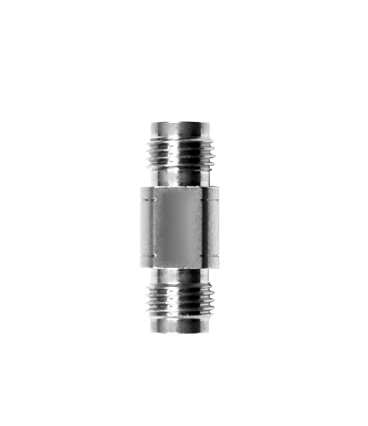
12.1‘’ touch screen
Mouse and Keyboard , Storage
2.92 mm male
RF OUTPUT
2.92F-2.92F connector

Slide 6
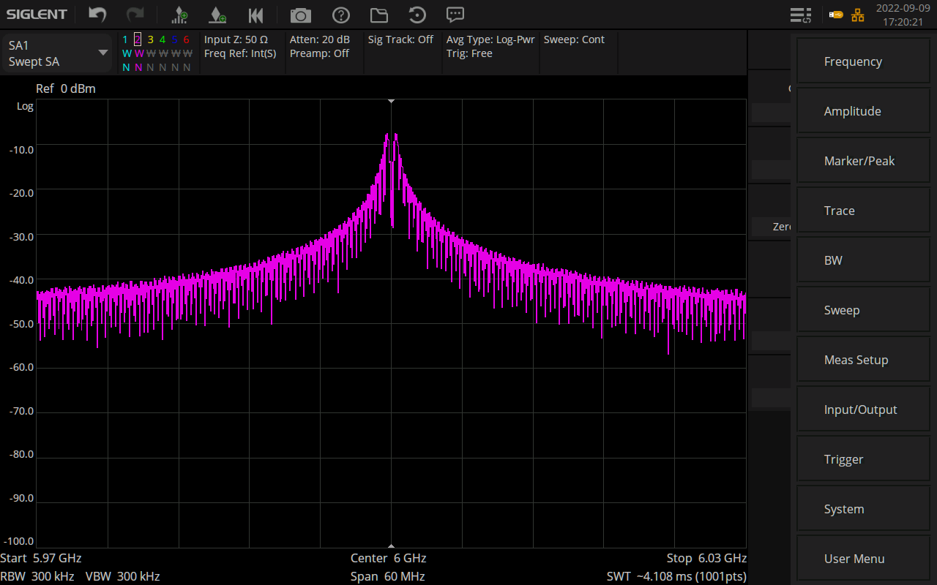
Undo, Redo, Marker, Save/Recall, Log file, Trace, Trigger, Attenuation
Modes switch
Main menus
Quick settings of frequency range, RBW, SPAN

Slide 7
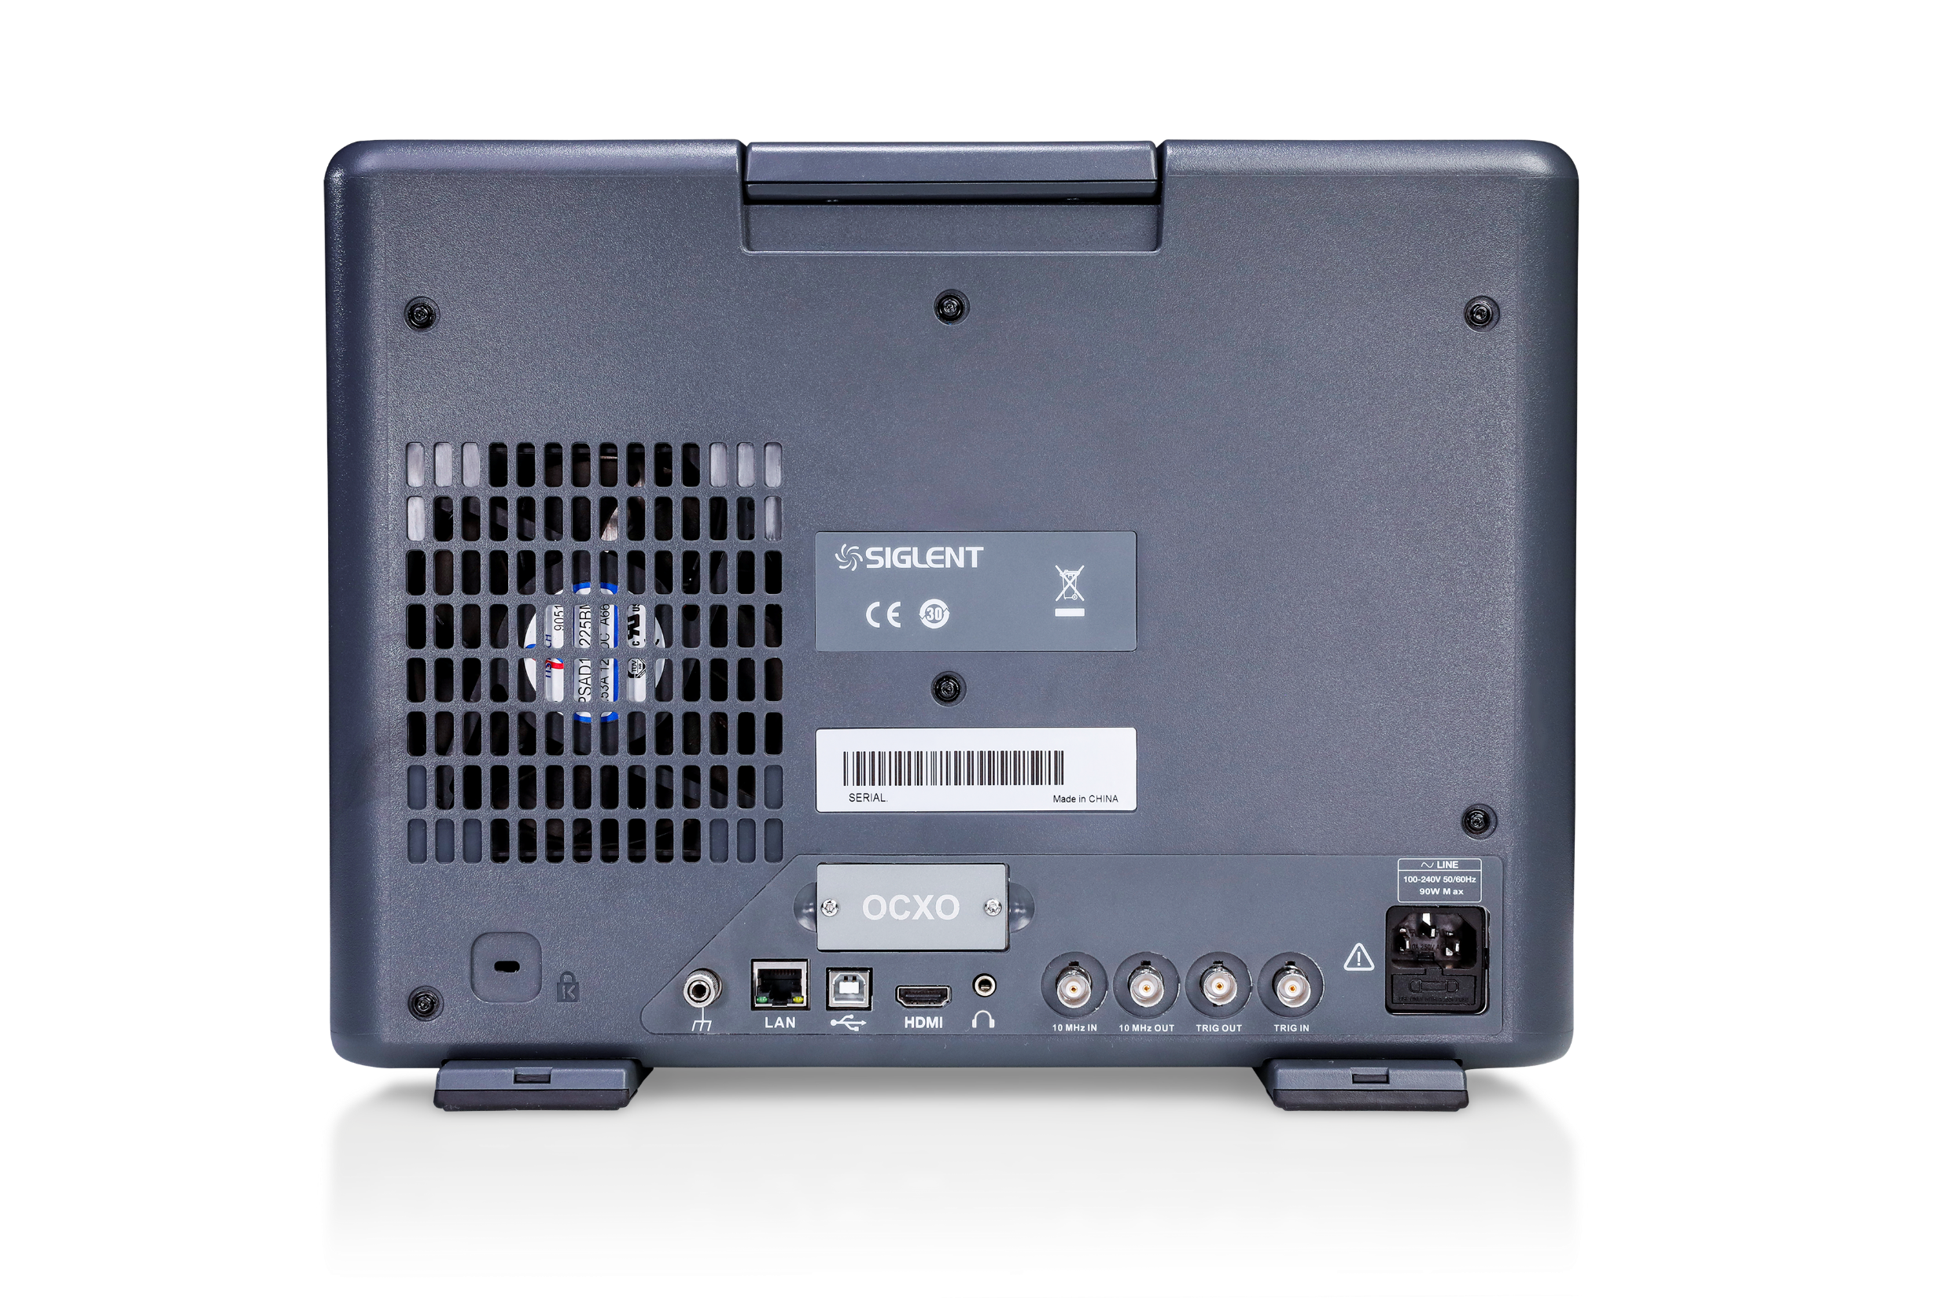
High accuracy clock source, factory installed only
10 MHz IN/OUT,
TRIG IN/OUT
Webserver,
More commands than SSA3000X
HDMI output, easy demonstration

Slide 8
SSA5000A competition analysis
 | SSA5000A | R&S FSL (Discontinued) | Keysight N9323/4C
Frequency Range | 9 kHz ~ 13.6/26.5 GHz | 9 kHz ~ 3/6/18 GHz (overrange 20 GHz) | 1 MHz to 13.6/20 GHz
RBW | 1Hz ~ 10MHz | 300 Hz to 10 MHz; 10 Hz to 10 MHz(R&S®FSL-B7 option) | 10 Hz to 3 MHz
Analysis Bandwidth | Standard 25 MHz, 40 MHz (opt. SSA5000-B40) | Not support | Not support
Displayed average noise level (DANL) | - 165 dBm/Hz best | - 152 dBm/Hz best | - 156 dBm/Hz best
Amplitude Measurement Range | Preamp off: DANL ~ +10 dBm, 100 kHz ~ 1 MHz; DANL ~ +23 dBm, 1 MHz ~ 26.5 GHz | Displayed noise floor to +20 dBm | Preamp off: 1 MHz to 500 MHz DANL to +10 dBm; 500 MHz to 20 GHz DANL to +20 dBm
Storage | Internal (eMMC) 4 GB, external (USB storage device) 32 GB | flash disk (internal), USB memory stick | Internal 64 MB nominal, USB memory devices external
Screen | 12.1 inch TFT-LCD touch screen,1280*800 | 5.8 inch, 640*480 | 6.5 inch touch screen, 640*480
Weight | Net: 7.40 kg | with battery pack < 8 kg | Net 7.9 kg; Shipping 14.5 kg
Dimensions | 378 mm x 284 mm x 126 mm (W×H×D) | 408.8 mm × 158.1 mm × 465.3 mm | 320 mm × 132.5 mm × 400 mm
Price | SSA5083A US$ 18,880; | FSL18 21569 € incl PreAmp | N9323C US$ 17,879;
 | SSA5085A US$ 21,880; |  | N9324C US$ 20,057;
Notes:
SSA5000A is in the same price range of FSL, N9323/4C.
SSA5000A has a modern design features light weight and portability.
SNA5000A has better specifications

Slide 9
SSG5000A main parameters and options
 | SSG5083A | SSG5085A
Frequency range | 9 kHz ~ 13.6 GHz | 9 kHz ~ 20 GHz
Frequency resolution | 0.001 Hz
Amplitude resolution | 0.01 dB
Level setting range | -130 dBm to + 25 dBm
Level error | ≤ 0.7 dB(typ.)
Phase noise | -120 dBc/Hz @1 GHz, offset 20 kHz (typ.)
Clock source | Standard high accuracy 10M_OCXO_L
Screen | 5 inch capacitance touch screen, RGB (800*480)
Options
SSG5080A-PU | Pulse modulation
SSG5080A-PT | Pulse train generator
SSG5080A-LP | 110dB Attenuator module (Assembled and calibrated in factory only)
SSG-RMK | Rack mount kit
SSG5080A-F85 | Upgrade 13.6 GHz to 20 GHz
USB-GPIB | USB-GPIB adapter

Slide 10
SSG5000A competition analysis
 | SSG5000A | Keysight N5173B
Frequency Range | 9 kHz ~ 13.6/20 GHz | 9 kHz to 13/20/31.8/40 GHz
Frequency resolution | 0.001 Hz | 0.001 Hz
Max output power | 9 kHz ≤f＜100 kHz, +3 dBm; 100 kHz ≤f＜1 MHz, +15 dBm; 1 MHz ≤f≤4 GHz, +24 dBm; 4 GHz <f≤6 GHz, +21 dBm; 6 GHz＜f≤15 GHz, +20 dBm; 15 GHz＜f≤20 GHz, +15 dBm | 9 kHz to 3.2 GHz, 18 dBm; 3.2 to 13 GHz, 18 dBm; 13 to 20 GHz, 15 dBm
Maximum reverse power | 1 MHz≤f≤6 GHz, 30 dBm; 6 GHz≤f≤20 GHz, 25 dBm; 50 Vdc | 0.5 W, 0 Vdc
SSB phase noise (dBc/Hz) | at 20 kHz offset: 100 MHz, -122; 1 GHz, -120; 4 GHz, -106; 6 GHz, -105; 10 GHz, -99; 20 GHz, -93 | at 20 kHz offset: 5 to < 250 MHz, –115; 250 MHz, –129; 500 MHz, –124; 1 GHz, –118; 2 GHz, –111; 3 GHz, –105; 4 GHz, -104; 6 GHz, -99; 10 GHz, -97; 20 GHz, -90
AM/FM/PM | Standard | Option N5173B-UNT, $4739
Internal pulse generator | Standard | Option N5173B-UNW, $6801 (narrow pulse modulation)
Screen | 5'' touch screen | Not mentioned
Weight | 6.1 kg net | 14.5 kg net, 29.5 kg shipping
Dimensions | W×H×D=338×113×369 mm | 426 mm W x 88 mm x 489 mm L
Price | SSG5083A, $16,990; SSG5085A, $19,990; SSG5080A-PU, $2,380; SSG5080A-PT, $2,380; SSG5080A-LP, $4,590 | N5173B-513, $24,266； N5173B-520, $28,154; Option N5173B-UNW, $6,801 (narrow pulse modulation); N5173B-1E1 (Step attenuator, 115 dB), $5,634
Notes:
Conclusion:
1) Siglent SSG5000A is a more modern signal generator. It's only 40% the weight of N5173B and occupys 40% less of the desk space. A 5'' touch screen with dedicated UI boosts efficiency to a great extent.
2) With a wider max output power, SSG5000A covers wider application areas. The ability to withstand larger reverse power protect customer investment from accidents.
3) A better SSB phase noise and lower subharmonics make SSG5000A performs better in higher frequency ranges. Common functions like AM/FM/PM, pulse generator are all standard on SSG5000A. It saves customer money and engineers care no chores like installation of options.

Slide 11



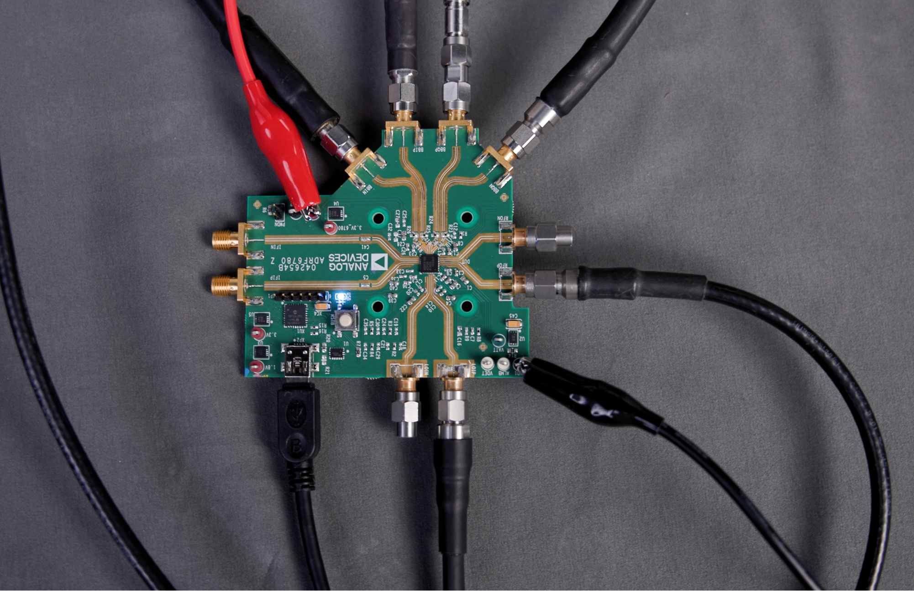
Applications
Radar
Quantum physics
Communication
Components verification

Slide 12
Applications – Components evaluation
SSG5000A can be used as high frequency LO
SSA5000A performs modulation analysis
SSG5000X-V is baseband generator
SSA5000A
Spectrum Analyzer
SPD3303X-E
Power Supply
RF out
DC
GND
I+
Upconverter
SSG5000X-V
BASEBAND INPUTS
I-
Q+
Q-
SSG5000A
LO INPUT

Slide 13
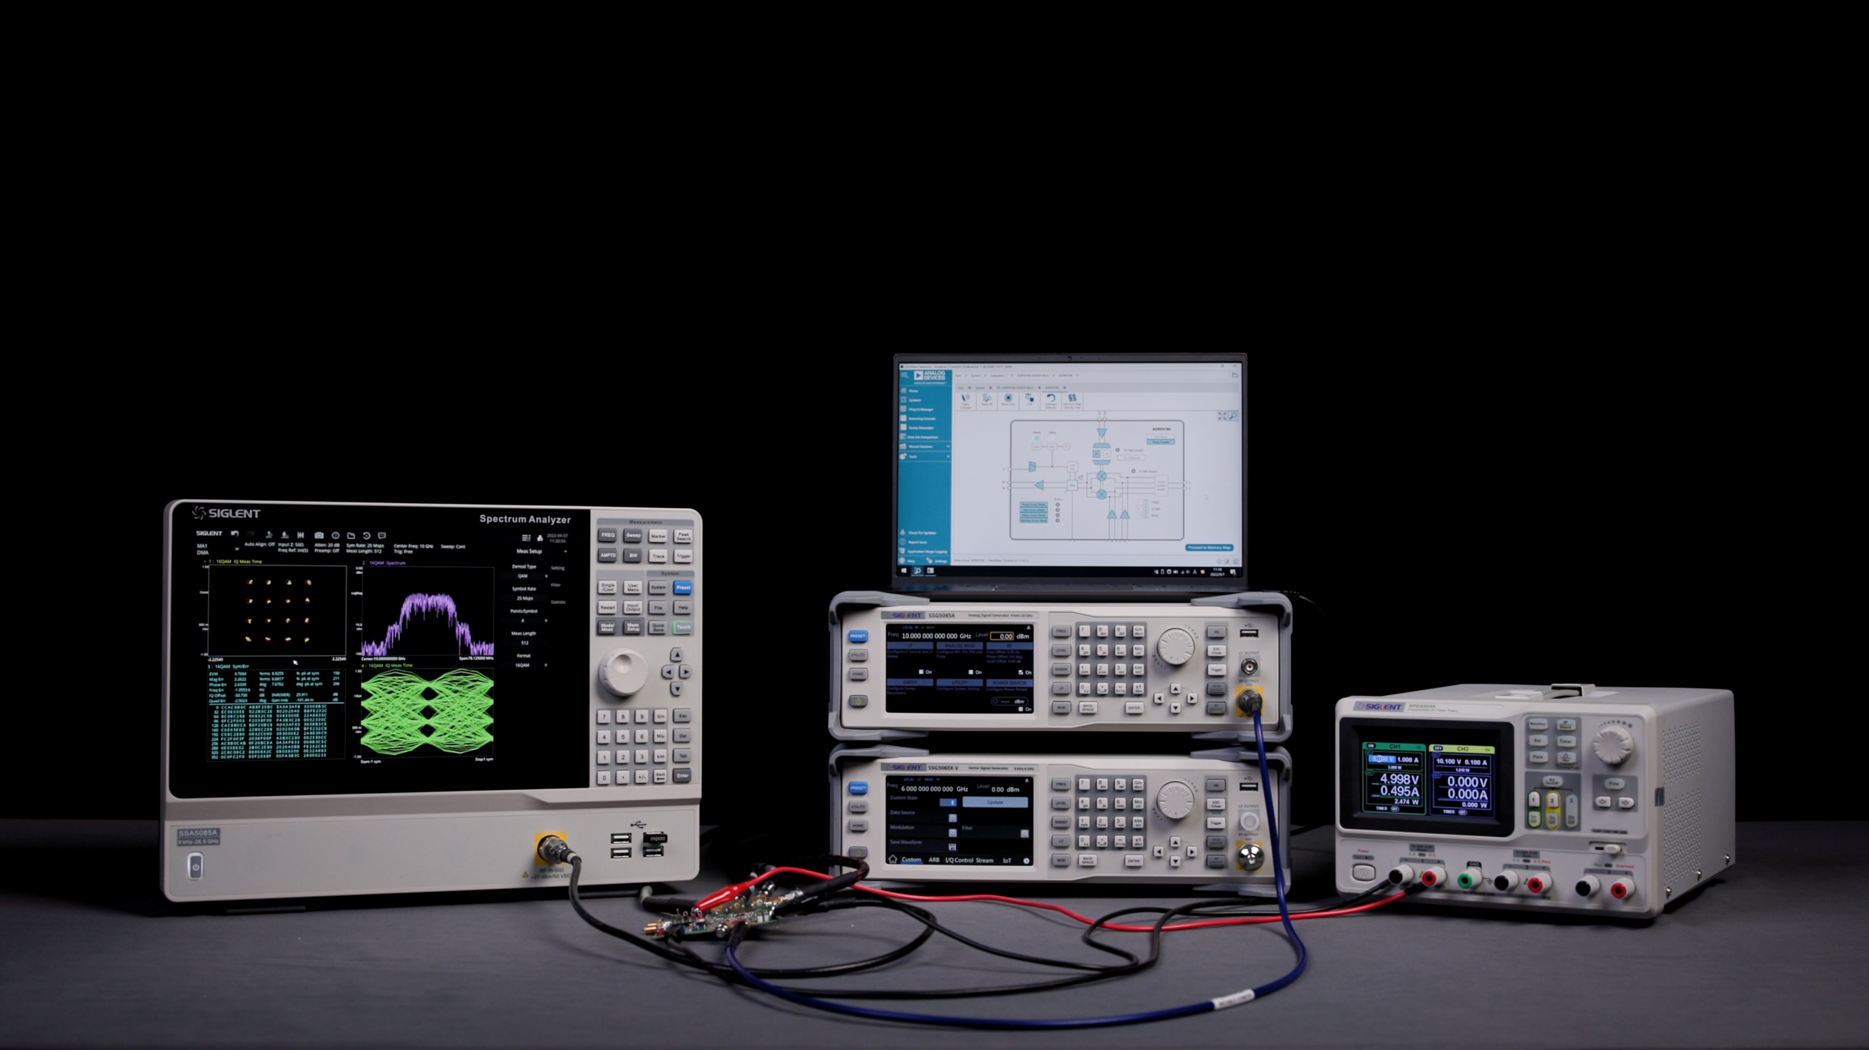
Applications – Components evaluation

Slide 14
Thank You
The Best Value in Electronic Test & Measurement
Headquarters
NA
Europe
SIGLENT TECHNOLOGIES CO., LTD.
Add: Blog No.4 & No.5, Antongda Industrial Zone, 3rd Liuxian Road,
Bao’an District, Shenzhen, 518101, China.
Tel:+ 86 755 3688 7876
Fax:+ 86 755 3359 1582
sales@siglent.com
www.siglent.com/ens
SIGLENT Technologies NA, Inc.
Add: 6557 Cochran Rd Solon, Ohio 44139
Tel: 440-398-5800
Toll Free:877-515-5551
Fax: 440-399-1211
info@siglent.com
www.siglentna.com
SIGLENT TECHNOLOGIES GERMANY GmbH
Add: Liebigstrasse 2-20, Gebaeude 14, 22113 Hamburg Germany
Tel: +49(0)40-819-95946
Mobile: +49 151 40716756
Fax: +49(0)40-819-95947
info-eu@siglent.com
www.siglenteu.com

