Slide 1


Slide 2

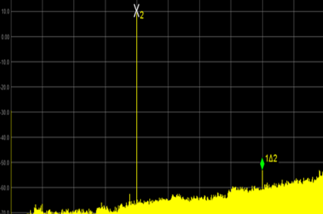
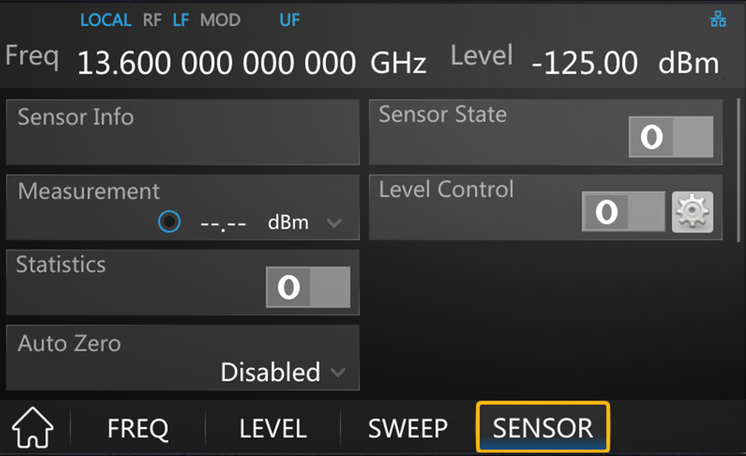
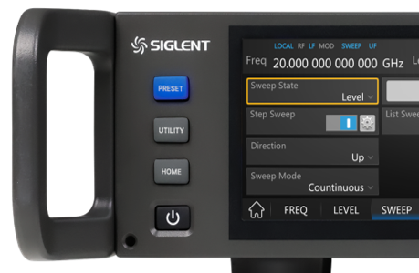
Highlights
Excellent Signal Purity
Exceptional Functionality
Exquisite Design
Excellent SSB phase noise
Low harmonic signal
Low nonharmonic signal
Ultra low broadband noise
Exceptionally high output level
···
AM Modulation
Pulse Generator
Pulse Modulation
Pulse Train Generator
Power Meter Control Kit
···
Remote control
Compact structure
User friendly interface
Large operating screen
Rich communication interface
···
2

Slide 3
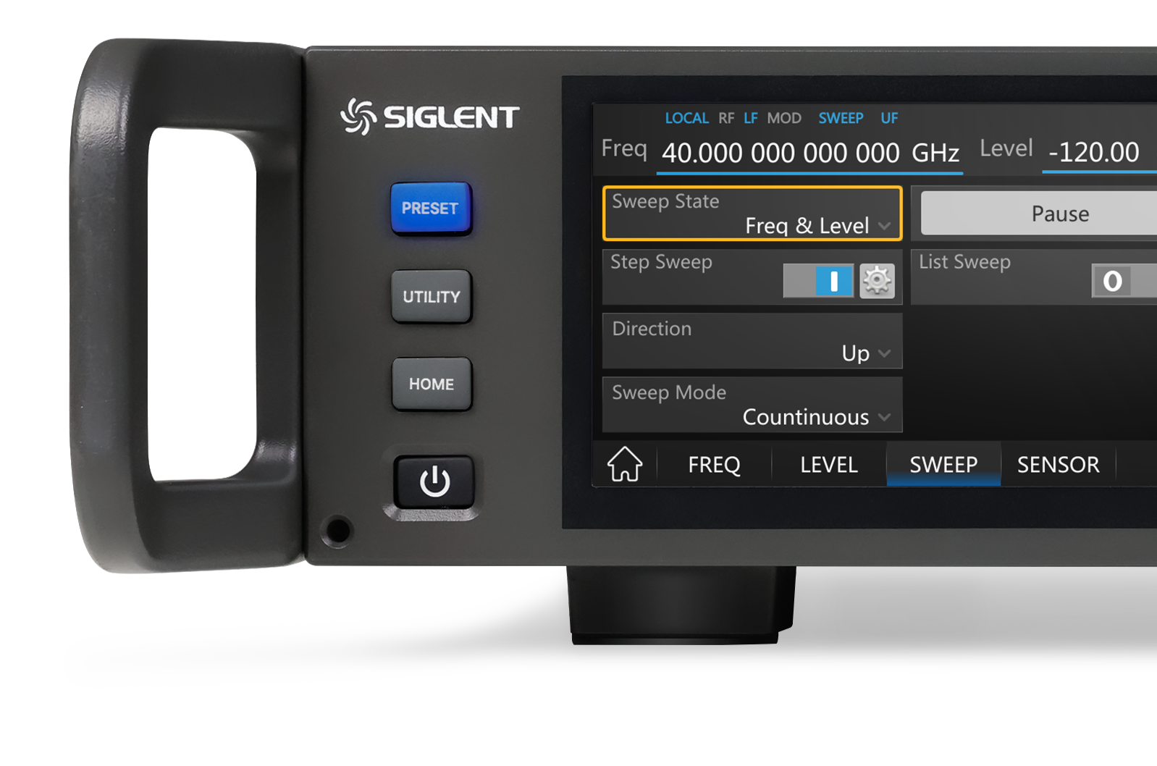
Basic Info
Features and Benefits
CONTENTS
Market and Application
Competition Analysis

Slide 4
PART ONE
01
Brief Introduction
Instrument Tour / User friendly in every detail

Slide 5
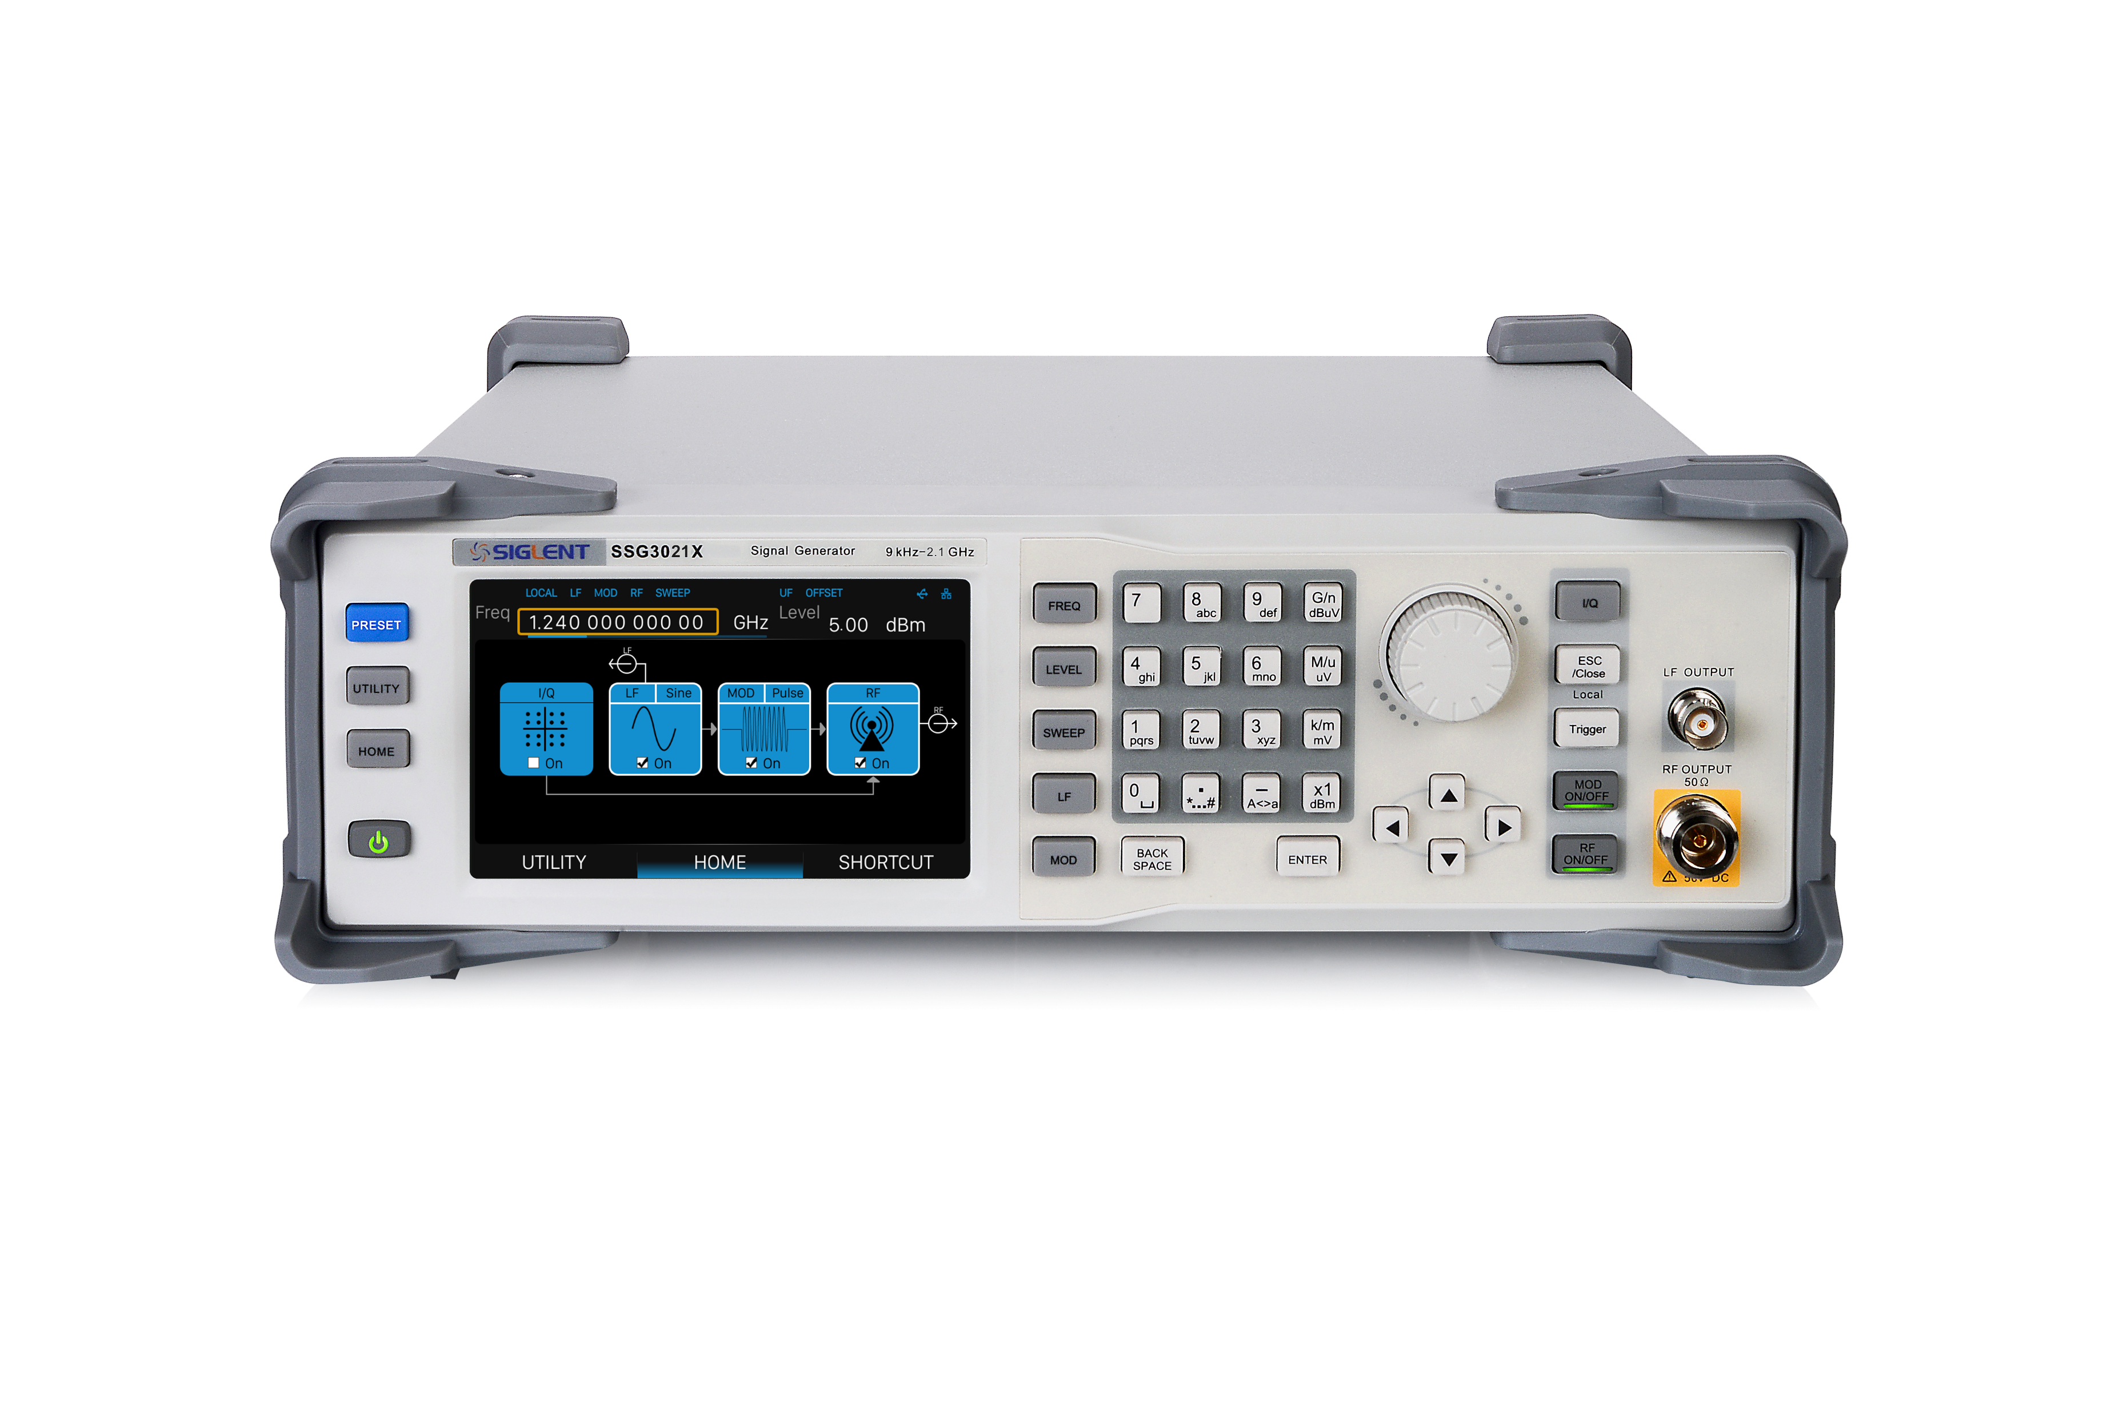
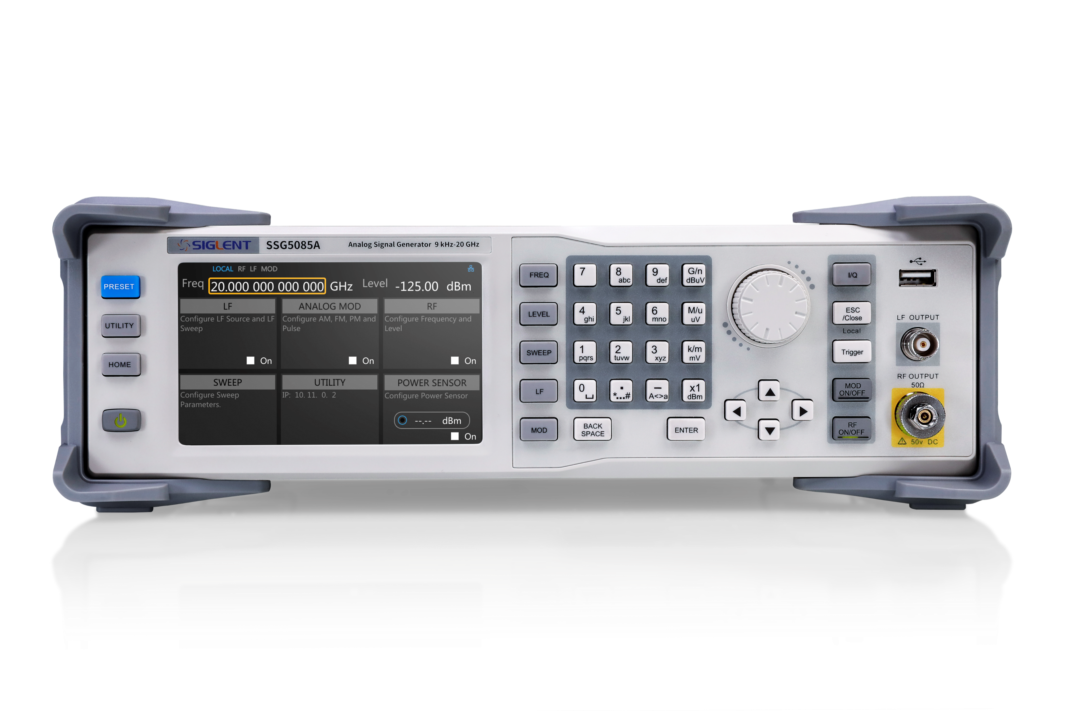

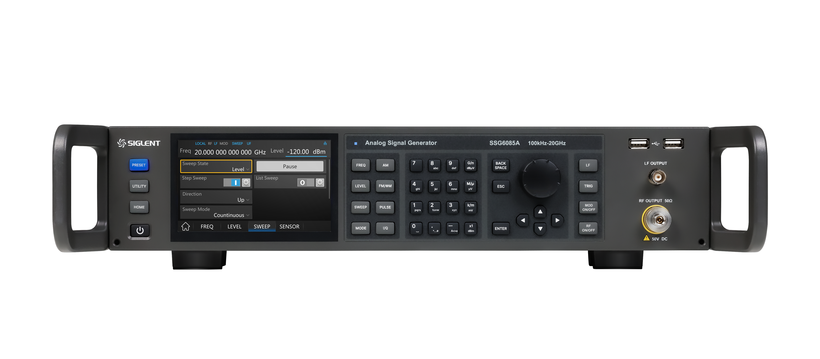
SIGLENT’s RF Signal Source Technology Roadmap
SSG3000X
SSG5000X
SSG5000A
SSG6000A
More
Frequency up to 2.1/3.2 GHz
SSB Phase noise < -110 dBc/Hz
……
Frequency up to 13.6/20 GHz
SSB Phase noise < -120 dBc/Hz
……
Future plans up to a frequency of 67 GHz
……
Frequency up to 4/6 GHz
SSB Phase noise < -120 dBc/Hz
……
Frequency up to 13.6/20/40 GHz
SSB Phase noise < -135 dBc/Hz
……
5

Slide 6
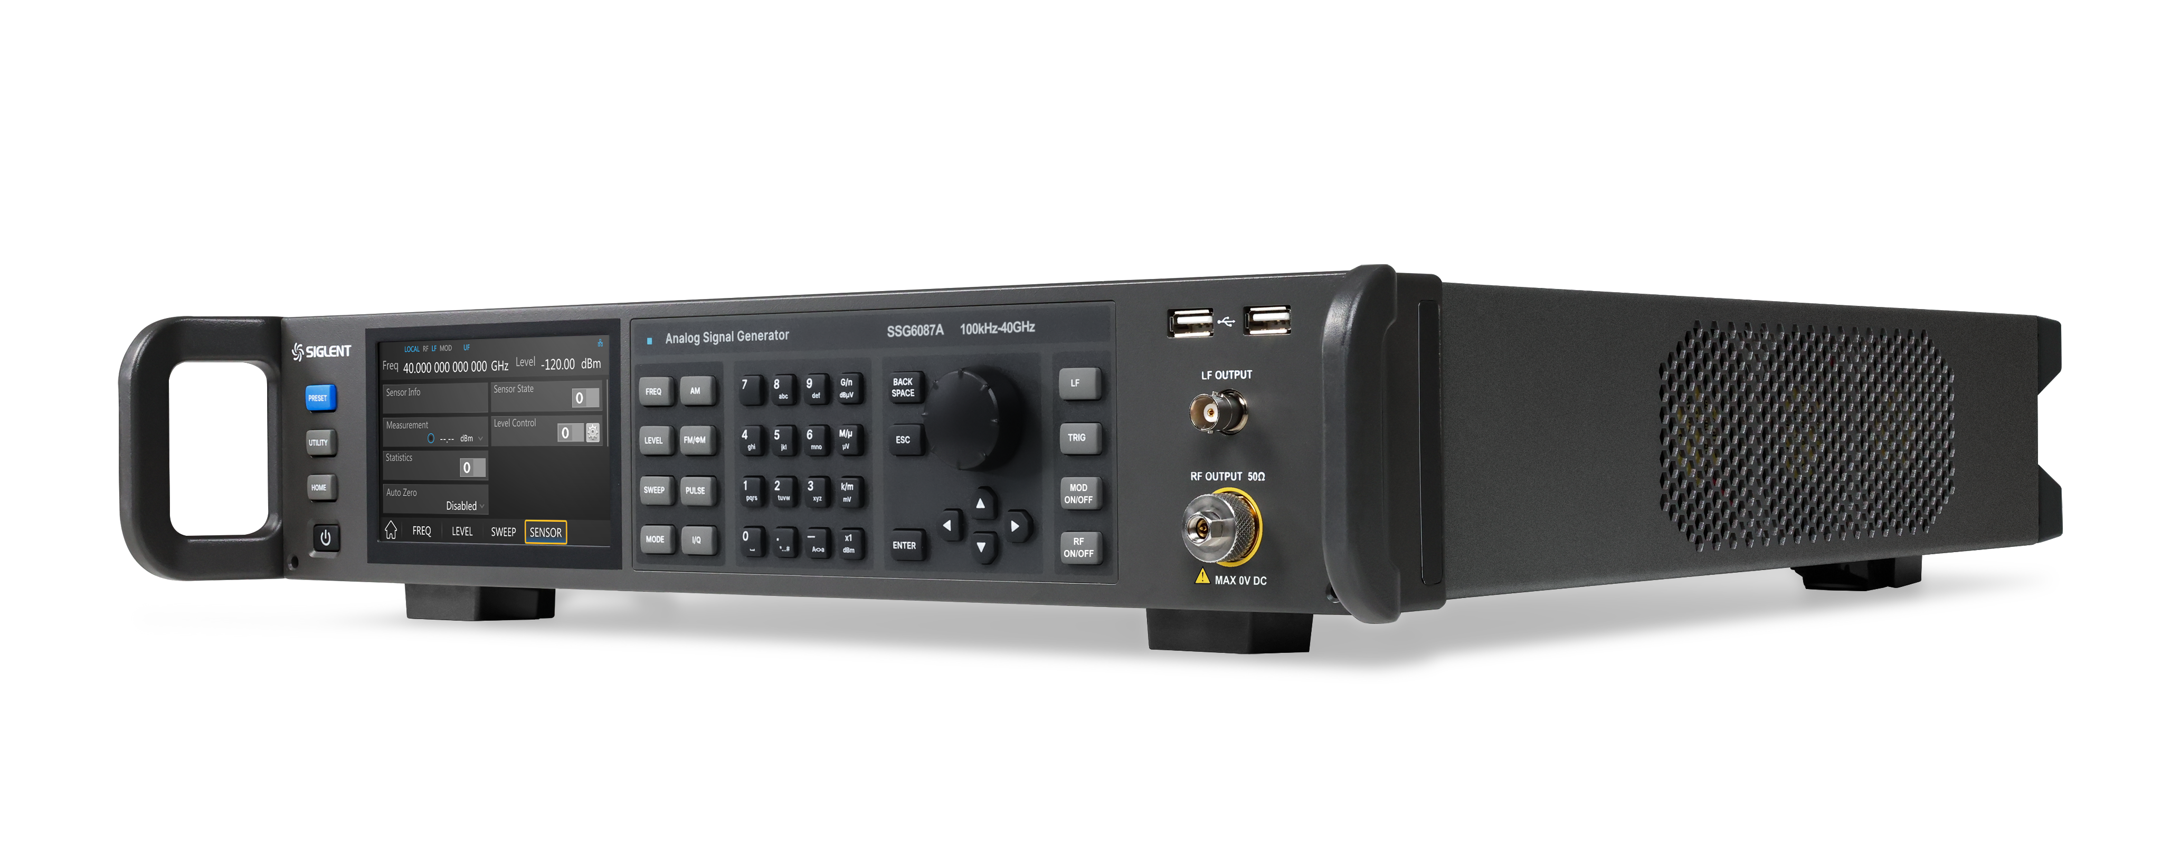
SSG6000A Series
RF Signal Generator
Models | SSG6083A | SSG6085A | SSG6087A
Frequency Range | CW MODE 100 kHz-13.6 GHz | CW MODE 100 kHz-20 GHz | CW MODE 100 kHz-40 GHz
Level setting range | -130 dBm to +24 dBm
Amplitude Resolution | 0.01 dB
Level Accuracy | ≤ 0.7 dB(typ.)
Phase Noise | -135 dBc/Hz @1 GHz, offset 20 kHz (typ.)
Display | 5 inch capacitance touch screen, RGB (800*480)
6

Slide 7

SSG6000A Front Panel Tour Flexible large screen touch operation
Function keys
Knob
USB
LF output
RF output
Main On/Off
Display
Number keypad
Arrow keys
Function
On/Off
7

Slide 8
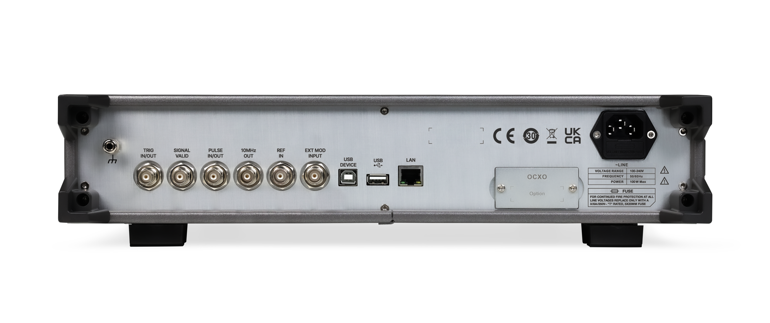
SSG6000A Rear Panel Tour Multiple control and function extension interfaces
Trig
In/Out
Pulse In/Out
USB Device
REF IN
USB
Power Interface
Signal
Valid Out
10 MHz Clock Out
EXT MOD INPUT
LAN
OCXO
8

Slide 9
PART TWO
02
Technical Highlights
Performance parameters and specific advantages of SSG6000A

Slide 10
Features and Benefits
Going into details: make operation more fluent
01
02
03
User Friendly Interface
Abundant Communication Interfaces
Ultra High Output Frequency
5" touch screen
Multiple shortcut keys
Save occupied space and maintain test accuracy
Simplify measurement setup steps and improve test efficiency
Support remote web page control
Support mouse, keyboard, storage and calibration
More connection and control modes: flexible and practical
Up to 13.6/20/40 GHz
Suitable to a wider range of fields, such as radar systems and antenna testing
Perform basic local oscillator up-conversion or continuous wave blocking test
06
05
04
High Performance OCXO
Outstanding SSB Phase Noise
Exceptionally High Output Level
High stability
Pure signal and Pure spectrum
Excellent level accuracy and repeatability
< -135 dBc/Hz @1 GHz, offset 20 kHz (typ.)
Improve close-in phase noise
Very low harmonic signal components over the entire frequency range even at very high output power
Attenuation in the test device can be easily compensated
High-sensitivity receive convenient for testing
Characterization of broadband MW components
10

Slide 11
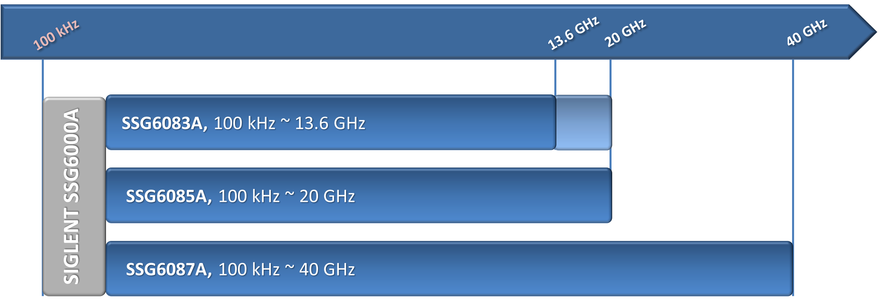


Meet The Test Requirements
ISM band up to 5.7 GHz
Blocking characteristics of CW signal up to 12.75 GHz
Two frequencies up to 20 GHz and up to 40 GHz can cover the microwave frequency range. It is suitable for testing various radar systems in X-band and K-band including testing sensitive broadband receivers
11
Notes:
Upgrade 13.6 GHz to 20 GHz (Option SSG6080A-F85)

Slide 12
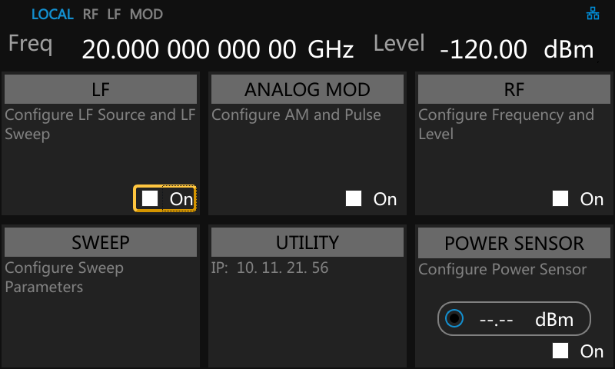
Easy to Navigate & Dependable
Touch screen, Web Control, and front panel buttons including mouse and keyboard can all be used
It has high frequency and power stability in the working temperature range of 0~50 ℃
Long term stability is important in aging and lifecycle tests that can last days or weeks.
Frequency Reference
Temperature stability | ±1 ppb, 0℃ ~50℃
Frequency aging rate | 50 ppb/1 year
12
Notes:
Clearly display the instrument setting parameters and status information, and provide convenient and quick user operation experience.
Large touch screen, supporting keyboard and knob keys to meet the operating habits of most customers. All operations are completed in the first-level menu, and what you see is what you get.

Slide 13
Ultra Fast Switching Speed
Time is money, faster generators shorten the test time and save manufacturing costs
How fast does a generator change from one frequency/ amplitude/ waveform to another?
Main Factors: Type of change, source of commands (SCPI, List/Step Sweep mode)
When it matters: Tests which require fast change of frequency/ amplitude/ waveforms
For example, receiver sensitivity measurements and bit-error-rate (BER) measurements, verify amplifier functionality over variable waveforms, amplifier gain compression tests require various power levels
SSG6000A Frequency and Level Setting Time
Frequency Setting Time | ALC ON <10 ms
 | ALC OFF (S&H) <20 ms
Frequency Sweep Dwell Time | 10 ms~100 s
Level Setting Time | ALC ON <10 ms
 | ALC OFF (S&H) <20 ms
13

Slide 14
Excellent Phase Noise
Excellent phase noise: < –135 dBc/Hz (typ.) for 1 GHz at an offset of 20 kHz
Ideal choice for local oscillator and low jitter clock replacement
Meets the harsh challenges of radar module and system testing with ease
Conduct blockage and adjacent channel selectivity test of high-performance receivers
SSB Phase Noise
14

Slide 15
Low Harmonic Signal Components
Very little wideband noise: < –155 dBc (typ.) at 10 GHz and an offset of 10 MHz
Very low harmonic signal components over the entire frequency range even at very high output power
Let you no longer be troubled by interference signals when testing components, systems and OTA
Harmonics
1 MHz < f ≤ 2 GHz | < -30 dBc
2 GHz < f ≤ 4 GHz | < -50 dBc
4 GHz < f ≤ 20 GHz | < -46 dBc
Sub harmonics
1 MHz < f ≤ 40 GHz | < -80 dBc
Second harmonic versus carrier frequency at level 0 & 10 dBm
Non-harmonics
1 MHz < f ≤ 4 GHz | < -60 dBc
4 GHz < f ≤ 40 GHz | < -50 dBc
15

Slide 16
Exceptionally High Output Power
Ideal choice for high sensitivity receiver testing
Characterization of broadband microwave components, such as filters and amplifiers
If you need a high-power excitation signal in the test, you can get the required test signal without an external amplifier, with higher power accuracy and better stability
SSG6087A
100 kHz ≤ f <3 MHz | 8 dBm
3 MHz ≤ f < 4 GHz | 16 dBm
4 GHz ≤ f ≤ 6 GHz | 12 dBm
6 GHz < f ≤ 15 GHz | 12 dBm
15 GHz < f ≤ 20 GHz | 12 dBm
20 GHz < f ≤ 40 GHz | 12 dBm
SSG6083A & SSG6085A
100 kHz ≤ f < 3 MHz | 13 dBm
3 MHz ≤ f< 1 GHz | 22 dBm
1 GHz ≤ f ≤ 2 GHz | 20 dBm
2 GHz < f ≤ 4 GHz | 18 dBm
4 GHz < f ≤ 6 GHz | 15 dBm
6 GHz < f ≤ 18 GHz | 17 dBm
18 GHz < f ≤ 20 GHz | 14 dBm
16
Notes:
Large output power, low harmonics and step attenuation are closely combined, which is suitable for characterizing broadband microwave components (such as filters and amplifiers).

Slide 17
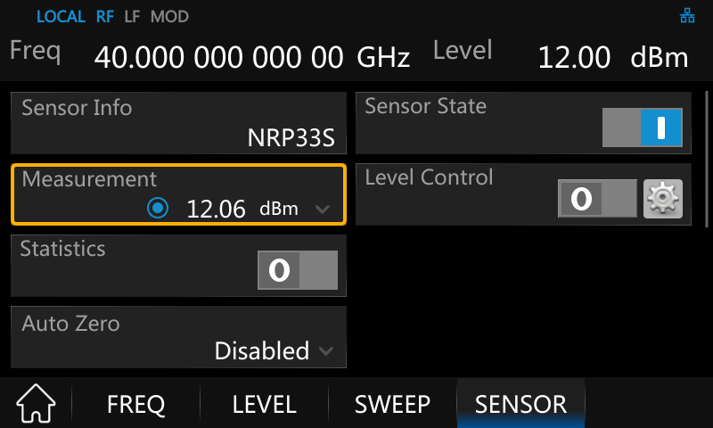
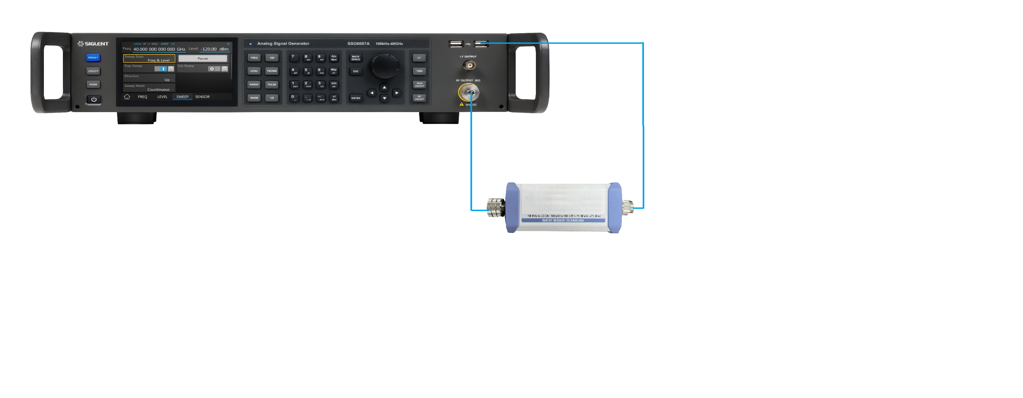
Exceptionally High Output Power
Very high output power even in the wide frequency range
No Need To Use External Amplifier
Microwave frequency range usually requires high output power
The higher the frequency, the greater the attenuation
Different output power levels are provided to compensate for such losses
Test the power of SSG6000A with a power sensor
17

Slide 18
High Absolute Level Accuracy
A signal generator's absolute level accuracy is just as important as its output power
Quantitatively characterize the nonlinear performance of an amplifier (1 dB compression point)
Measured level error versus frequency, Level = 0 dBm
Measured level error versus frequency, Level = 10 dBm
18

Slide 19
High Absolute Level Accuracy
Measured level error versus frequency, Level = -20 dBm
Measured level error versus frequency, Level = -40 dBm
19

Slide 20
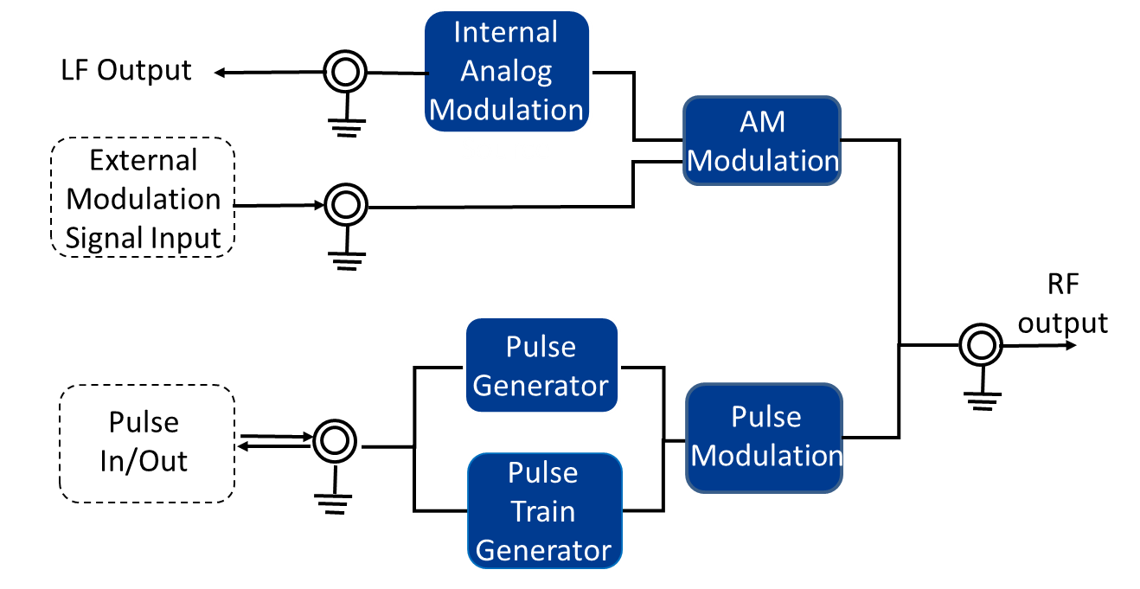
Analog & Pulse Modulation
In addition to continuous wave signals, SSG6000A also provides the most common analog AM modulation mode as a standard configuration
In addition, SSG6000A is equipped with an excellent pulse signal generator and pulse modulator to generate user-programmable pulses
20

Slide 21
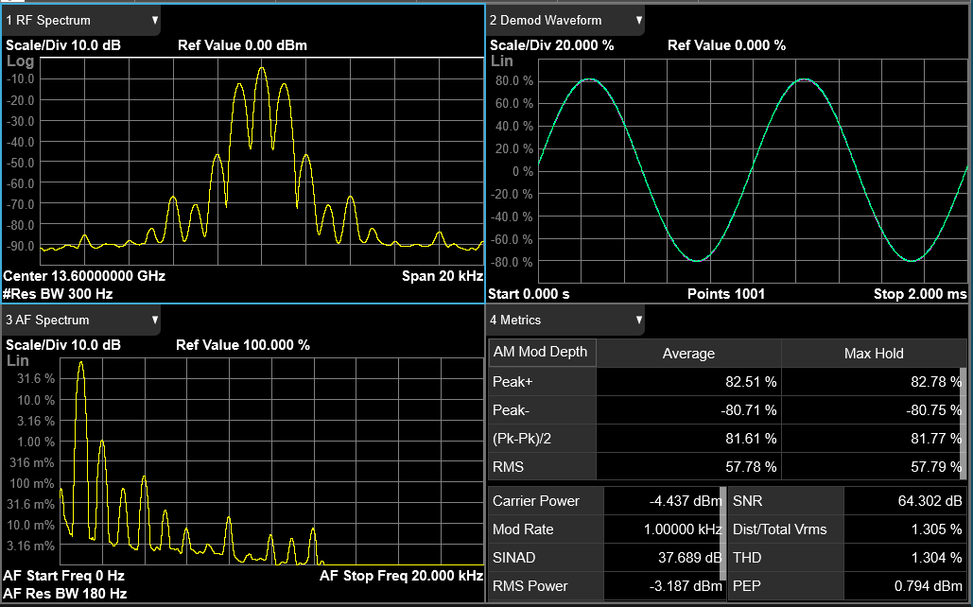
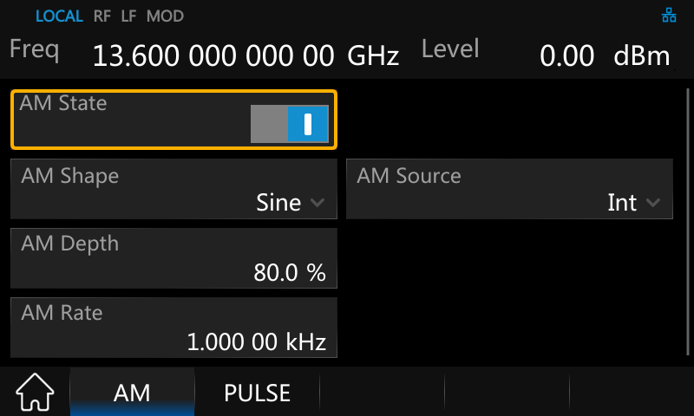
AM Modulation
High signal quality and perfect waveform reproduction
Modulation source:
internal, external, internal + external
21
Notes:
According to the modulation depth set by SSG6000A, it is observed that the error after demodulation is not large.

Slide 22
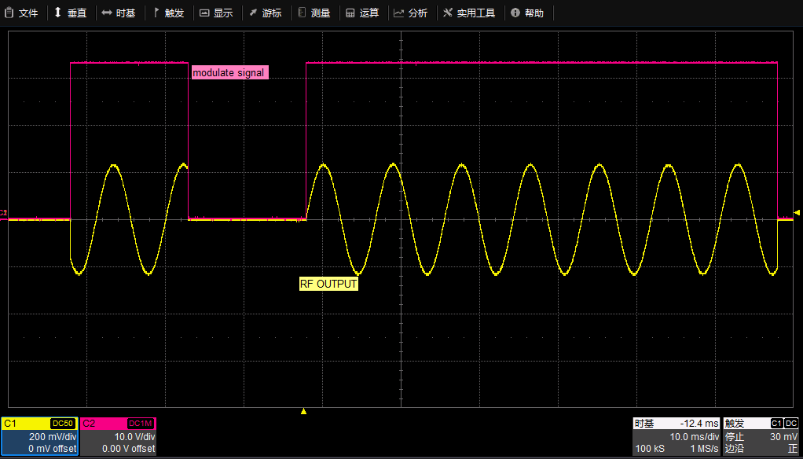
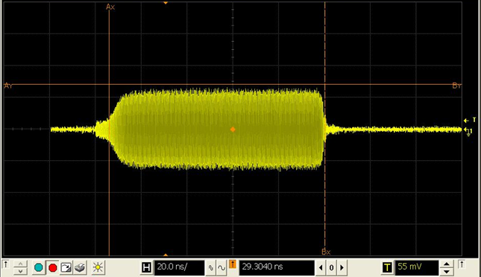
Pulse Modulation (SSG6080A-PU)
Support double pulse modulation
Less pulse width loss and extremely low overshoot probability
At 6GHz,
the pulse width of 100ns is missing
6ns, and there is no overshoot
Above 6GHz,
no pulse width loss, no overshoot
Double Pulse Modulation
Pulse Modulation
Modulation source | Internal, External
Pulse modes | Single pulse, Double pulse
On/off ration | > 80 dBc (typ.)
Rise/fall time (10% / 90%) | < 15 ns (typ.)
Pulse repetition time | 40 ns - 300 s
Less Pulse Width Loss
22
Notes:
The benchmark conditions of keysight are pulse width loss ≤5ns and overshoot ≤15%.
Pulse width loss and overshoot are related to the switch chip used in the instrument.
Pulse width loss means, for example, that a pulse width of 20ns is originally wanted, but after transmission, only 15ns pulse width is complete.

Slide 23
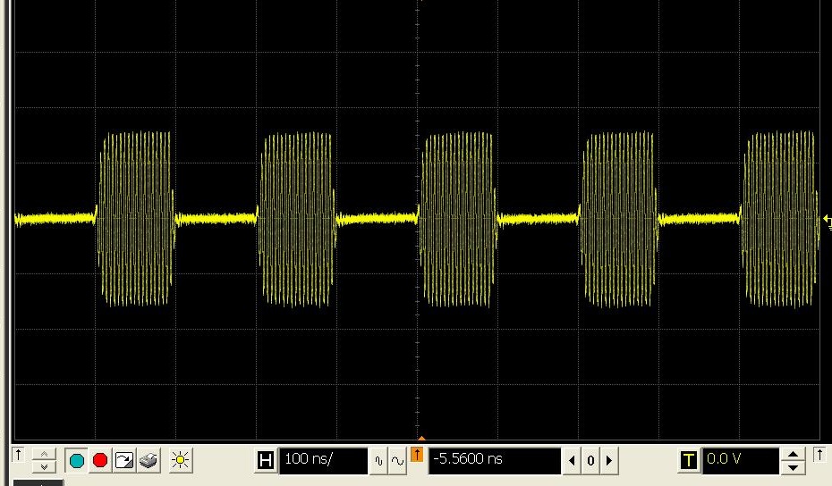
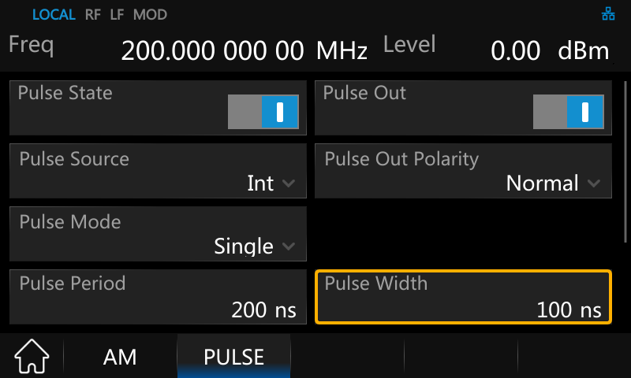
Pulse Generator (SSG6080A-PU)
Output 100 ns pulse, the pulse widths obtained are the same
Controlled by external pulse signal, or use single/ double pulse/ pulse train as modulation signal
23

Slide 24
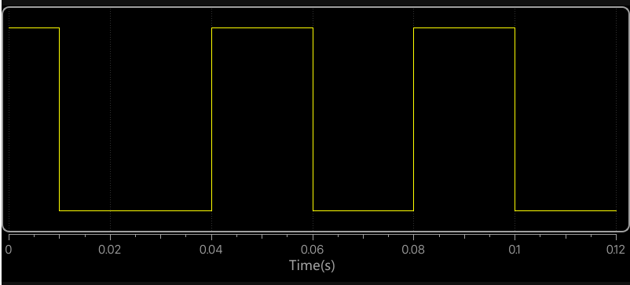

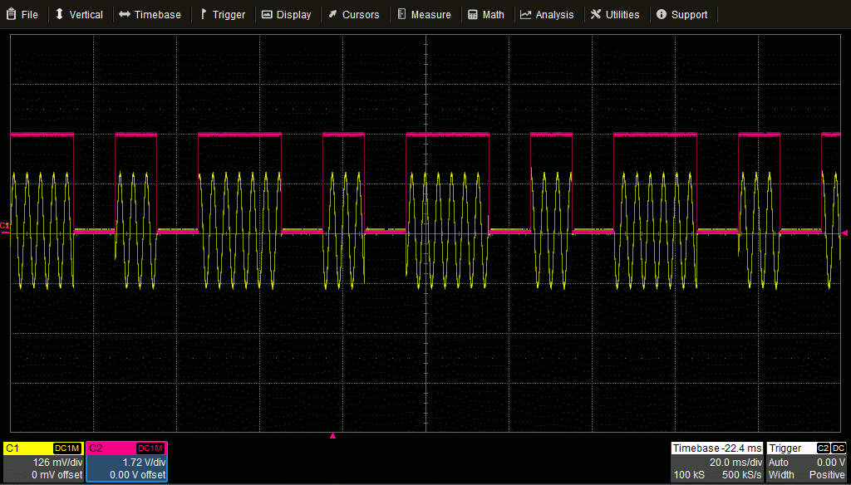
Pulse Train Generator (SSG6080A-PT)
This produces a very long custom pulse train
It can generate staggered pulse groups or jitter pulse widths and pulse pauses
The pulse width and the pulse pause can be set independently and separately for each pulse
Schematic Diagram
Pulse Train
Number of pulses | 1 - 2047
Number of repetitions per pulse | 1 - 65535
Pulse on time and off time setting range | 20 ns - 300 s
Pulse on time and off time setting resolution | 10 ns
Pulse Train
24
Notes:
A pulse train is a combination of different pulses, which may be a periodic or aperiodic pulse group.
There are as many as 2047 different pulses, and the pulse repetition period can be changed from 1 to a maximum of 65,535. This produces a very long pulse train that can be used for testing.

Slide 25
PART THREE
03
Market and Application
Capabilities and Functional Highlights

Slide 26
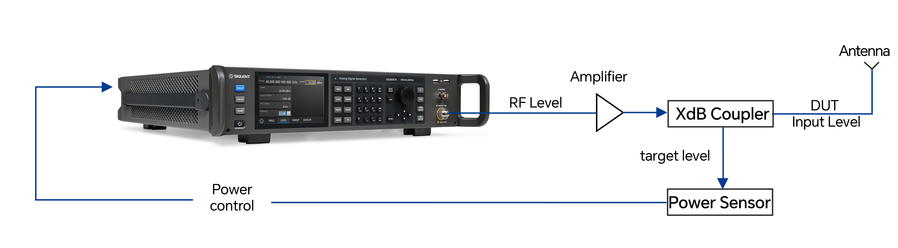
Power Control Obtain highly accurate and stable input power
Power Compensation
Cable Loss
Attenuation of passive network
Signal amplification by power amplifier
The frequency response of each device in the link
…
The power sensor detects the power received by the DUT
The signal source adjusts and compensates the output signal
Closed-loop power control
26
Notes:
The signal power received by DUT is maintained in a stable and reliable range.

Slide 27
Power Control Obtain highly accurate and stable input power
Short frequency and level stabilization time
Excellent level accuracy and repeatability to ensure high yield
No matter what kind of power offset occurs, closed-loop power control can ensure that the tested equipment can obtain highly accurate and stable input power
Closed-loop power control
27

Slide 28
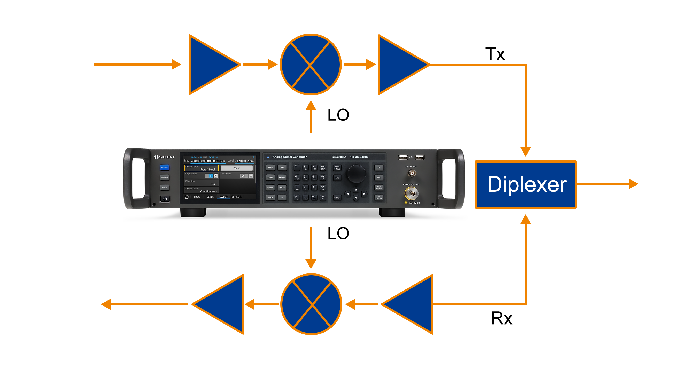
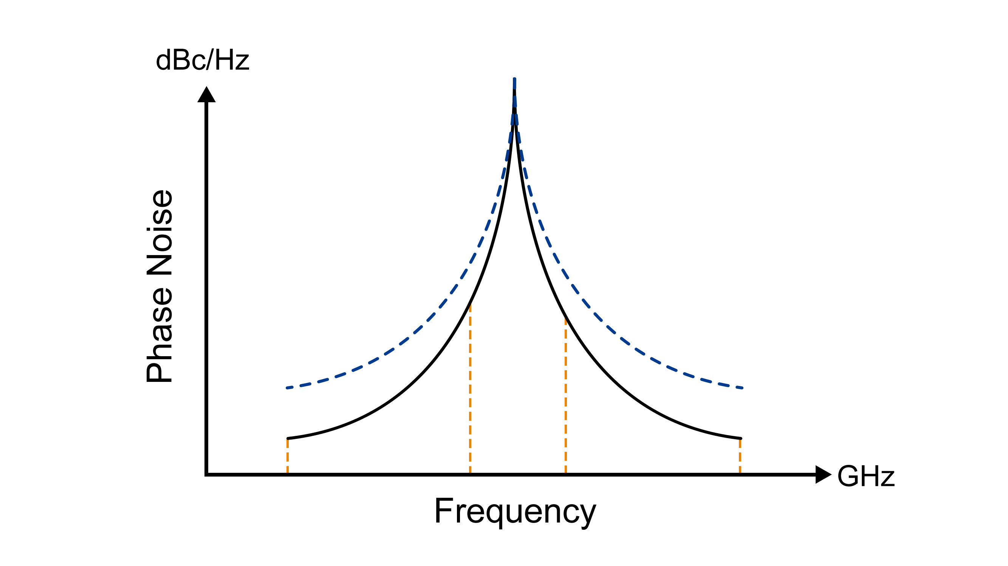
LO in Up/Down Converter Measurement Clean CW Source for Testing Transceivers
Pure LO is important for testing IF up/down converters
Especially when using high-order complex modulation formats
Signal purity of the generator
Low harmonics and spurs
Low integrated phase noise over the signal bandwidth of interest
…
28
Notes:
In many test setups, a signal generator is used as an LO source for up/down conversion of OFDM modulated signals to and from mmWave frequencies. Phase noise of such an LO source needs to be as low as possible since it affects orthogonality of OFDM carriers and contributes to inter-carrier interference (ICI), thus degrading SNR.

Slide 29
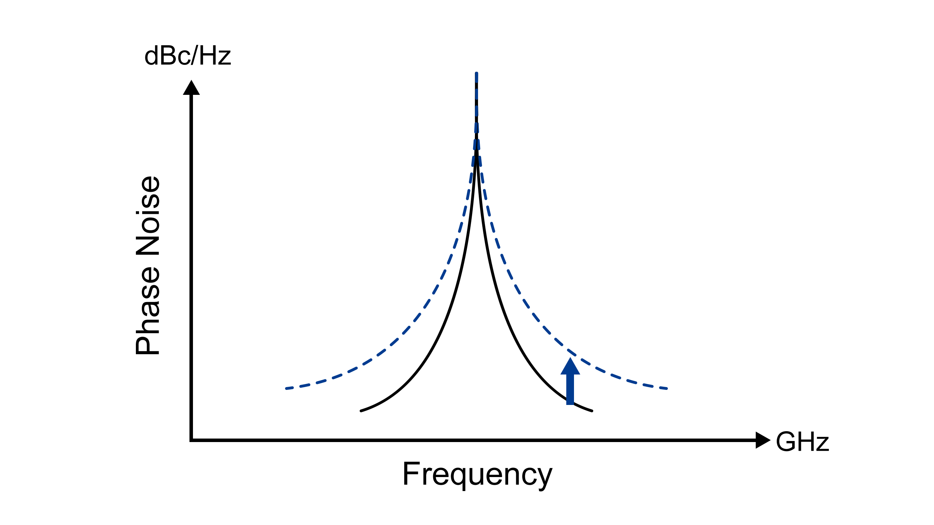
Radar System Measurement
Extremely low phase noise
Used as pulse modulation signal source or LO
The phase noise of signal generator determines the minimum reflected signal that radar can detect
Extremely low phase noise means that the system performance will not be masked by phase noise of signal generator
…
Higher phase noise masks the reflected signal
Radar reflection signal
29

Slide 30
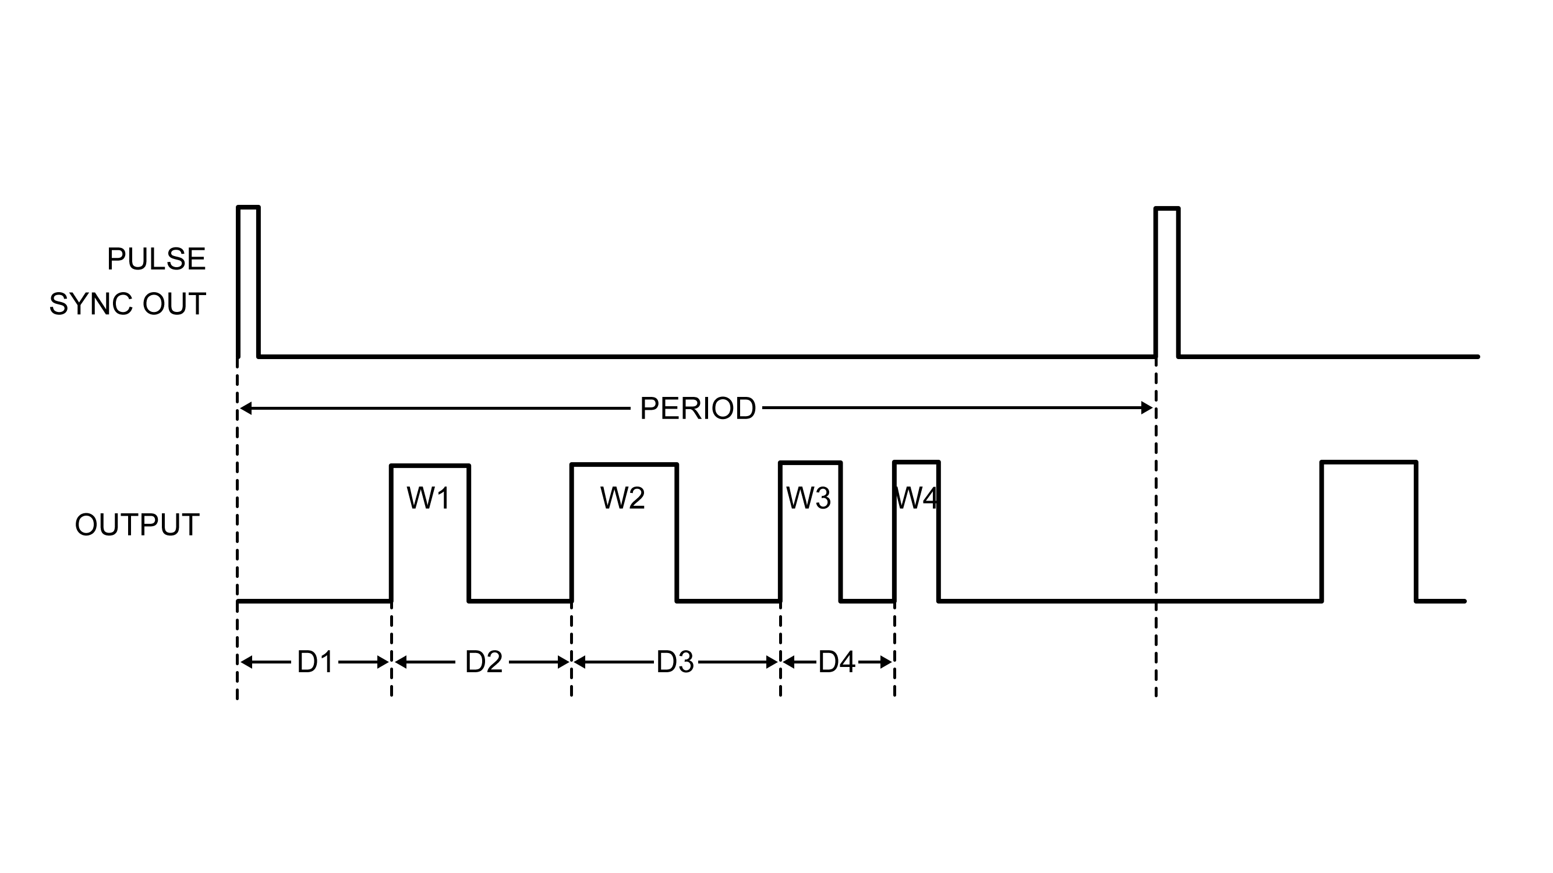
Radar System Measurement
Simulate various radar echo signals
Pulse generator simulates various radar echo signals
One to four target signals returned from different distances
Signals returned from moving targets approaching or leaving
…
30

Slide 31
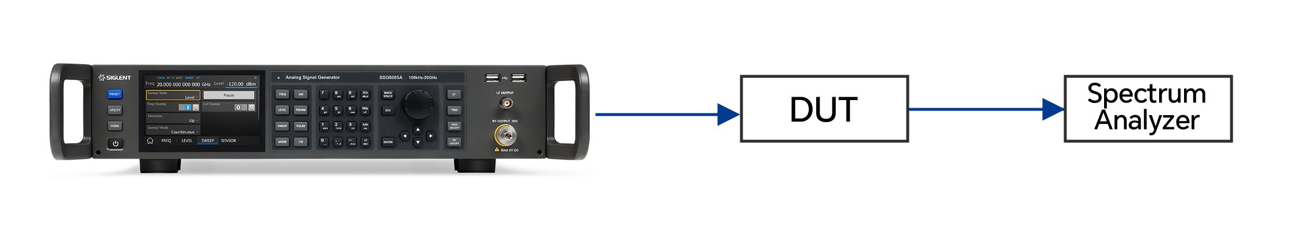
Nonlinear Measurement
Adequately high output power, low harmonics, sub harmonics, and non-harmonics
Harmonics
1 MHz < f ≤ 2 GHz | < -30 dBc
2 GHz < f ≤ 4 GHz | < -50 dBc
4 GHz < f ≤ 20 GHz | < -46 dBc
Typical nonlinear measurements of RF active devices, modules and transceivers
Manufacturers of devices, such as amplifiers and mixers, measure and specify P1 dB compression point and IP2/IP3 intermodulation
In-band and out-of-band interference (C/I, blocking) are another class of nonlinear measurements made on all types of receivers
…
For accurate nonlinear measurement, the harmonics and spurs should be as low as possible
Sub harmonics
1 MHz < f ≤ 40 GHz | < -80 dBc
Non-harmonics
1 MHz < f ≤ 4 GHz | < -60 dBc
4 GHz < f ≤ 40 GHz | < -50 dBc
31
Notes:
For instance, in a two tone IP3 test, if one of the signal generators has a significant second harmonic, it could combine additively with the second harmonic of fundamental generated by DUT and significantly increase the intermodulation products. It is also possible that the two second harmonic components could cancel each other depending on the phase difference between them and reduce the intermodulation products. This could result in an inaccurate IP2/IP3 measurement.

Slide 32
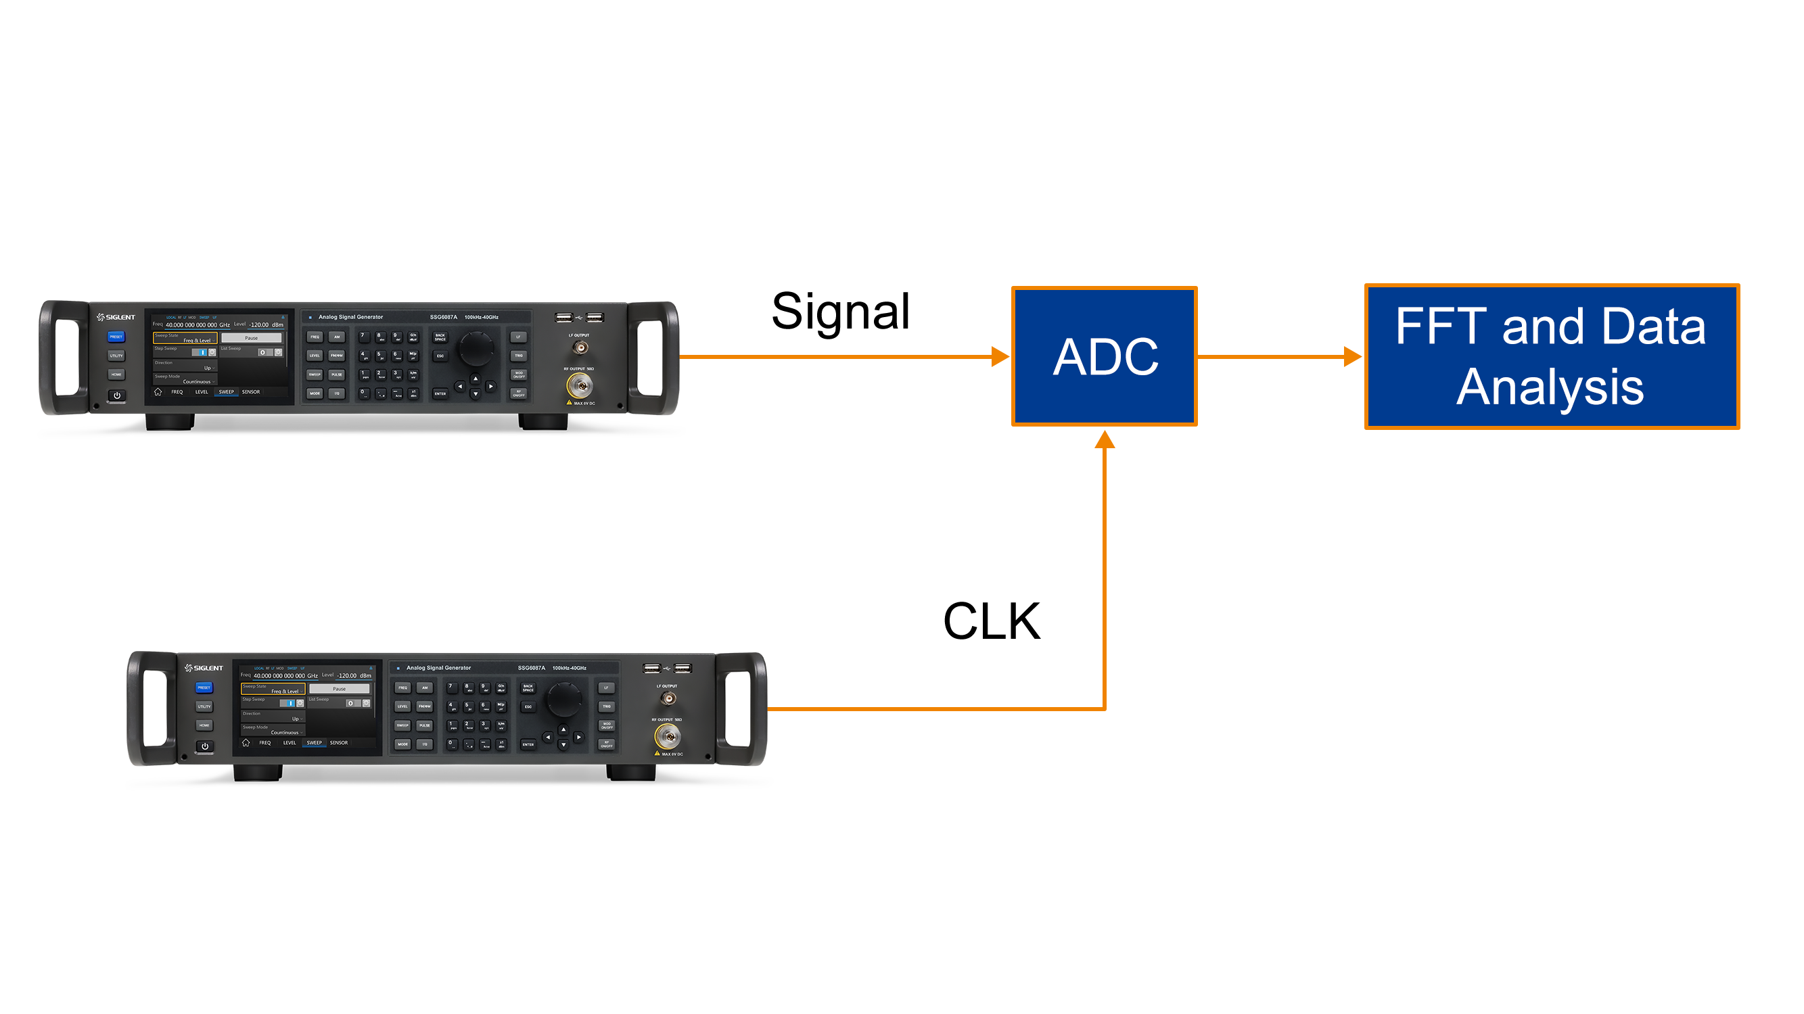
ADC Measurement
Low phase noise, harmonics, sub harmonics, and non-harmonics
Typical ADC measurements include SNR, SFDR and ENOB
As signal source/clock source
The key performance parameters of ADC measurement:
Harmonics and spurs in clock and signal paths
Integrated phase noise /RMS jitter in clock and signal paths
…
ADC Measurement Setup
32
Notes:
RMS jitter of a clock source reduces true SNR of the ADC and hence should be as small as possible. ADC is a sampled system and its analog input signal is convolved with a clock signal in the frequency domain. If the clock signal’s bandwidth is greater than the Nyquist bandwidth at the input of the ADC, which is not uncommon, wideband phase noise of the clock is aliased into ADC output and accumulated many times, thus worsening SNR. The SSG6000A signal generator keeps both jitter and wideband phase noise very low to enable a better measurement.

Slide 33
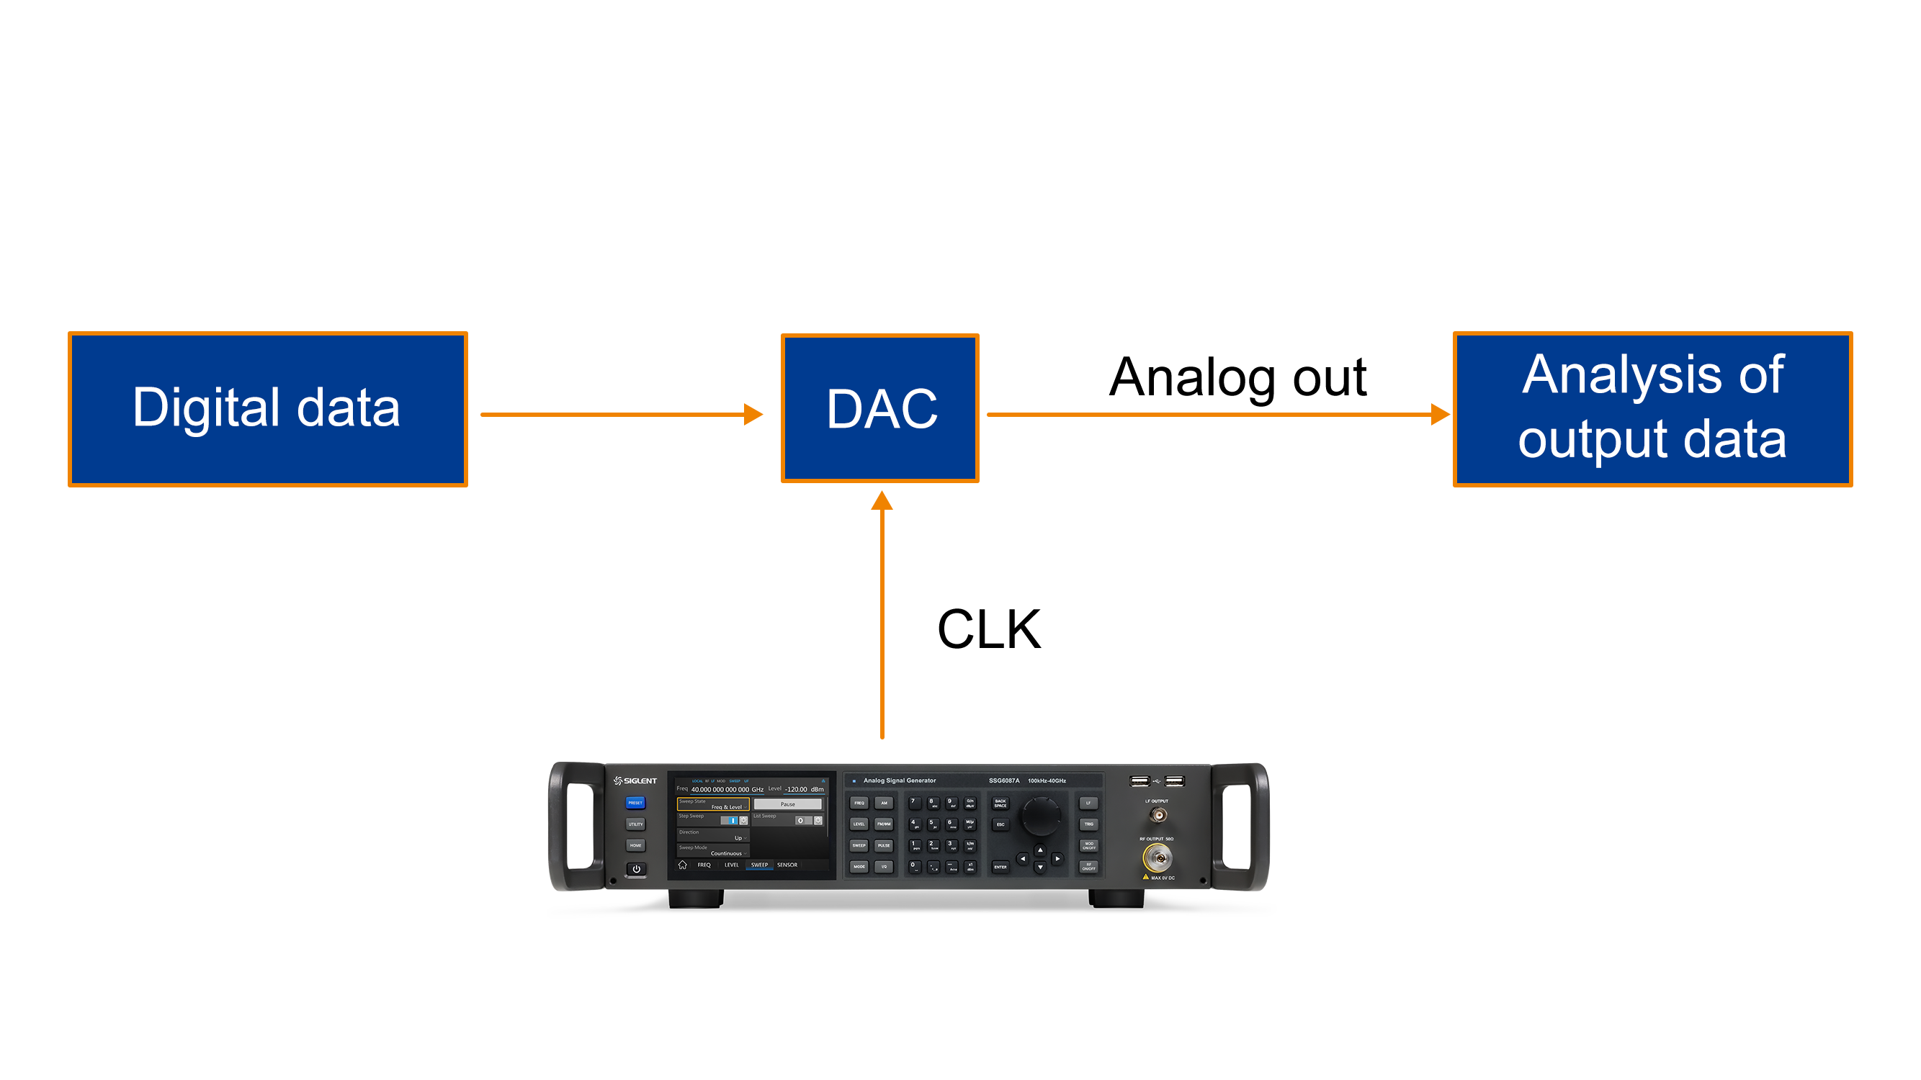
DAC Measurement
Low phase noise, harmonics, sub harmonics, and non-harmonics
Typical DAC measurements include SNR, SFDR and ENOB
As signal source
The key performance parameters of DAC measurement:
Harmonics and spurs in clock and signal paths
Integrated phase noise /RMS jitter in clock and signal paths
…
DAC Measurement Setup
33

Slide 34
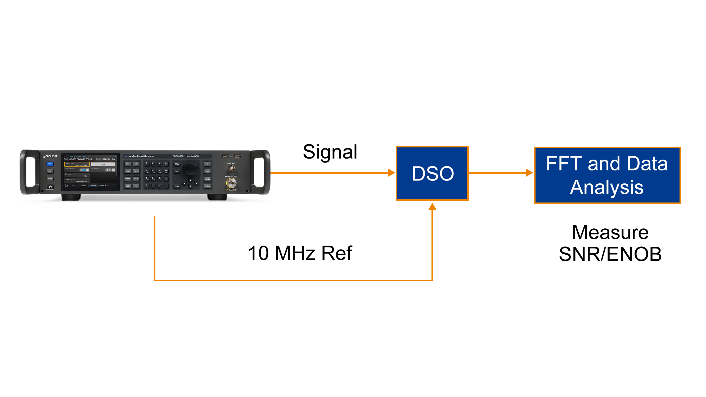
DSO Measurement
Low phase noise, harmonics, sub harmonics, and non-harmonics
Typical DSO measurements include SNR and ENOB at various input frequencies up to 10 GHz and different vertical scale settings
As signal source
The key performance parameters of DSO measurement:
Harmonic and subharmonic in the whole input frequency range of DSO
Integrate phase noise and spurs in the whole input frequency range of DSO
…
DSO Measurement Setup
34

Slide 35
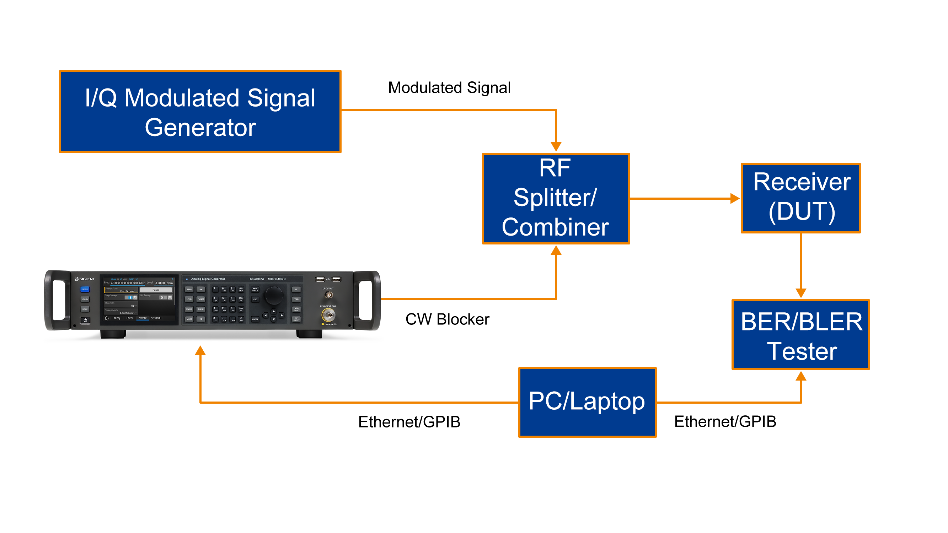
Receiver Blocking Test
Adequately high output power, low harmonics, sub harmonics, and non-harmonics
When a small, wanted signal is received along with a large interfering signal at input of the receiver, the interfering signal desensitizes the front-end subsystem
Blocking tests are intended to measure receiver’s ability to receive, demodulate and decode successfully wanted signals in presence of large interfering signals
Several communication standards specify blocking test for receivers in their conformance test specifi cations
5G NR Base Station Conformance test specifi cation TS 38.141-1
EN 300 328 for equipment operating in 2.4 GHz ISM band which applies to Bluetooth and Wi-Fi
…
A Generic Receiver Blocking Test Setup
35
Notes:
It is common for today’s communication receivers to operate in hostile RF environment where they may have to contend with large unwanted signals whose spectral density is concentrated in narrow frequency band like CW signals. These interfering signals could be within or outside the frequency band in which receiver operates.
When a small, wanted signal is received along with a large interfering signal at input of the receiver, the interfering signal desensitizes the front-end subsystem which consists typically of a LNA and a mixer or ADC. This happens because the large interfering signal pushes LNA in to compressed region of the gain curve thus reducing the gain of much smaller wanted signal. It results in worsening noise figure of rest of the receiver chain and hence overall sensitivity.
It is desirable that receiver maintain ability to receive and demodulate signals successfully even in the presence of such large interfering signals with highly concentrated spectral energy. Blocking tests are intended to measure receiver’s ability to receive, demodulate and decode successfully wanted signals in presence of large interfering signals.
A blocker CW signal from SSG6000A is combined with I/Q modulated signal and input into the receiver which is device under test (DUT). Usually, the modulated signal is maintained at a specific level such as 3 dB to 6 dB above the minimum sensitivity of the receiver (DUT). Minimum sensitivity is defined as the signal level at which receiver output has a certain bit error rate (BER) or block error rate (BLER) considered as quasi error free (QEF).
SSG6000A, which is acting as the blocker signal generator, is set to a known frequency offset from the modulated signal. The output level of SSG6000A is initially set to a low level at which receiver output error rate is not impacted. Then the output level is gradually increased until the receiver output is no longer quasi error free. This level is the max blocker level at which the receiver can output QEF bit rate. Then the output frequency of SSG6000A is moved closer to the modulated signal by a specific step size and the whole measurement is repeated at new blocker frequency. In this way SSG6000A’s output is frequency swept and a graph of blocker frequency vs level is built on either side of the wanted signal for DUT, to assess its robustness against blocker signals.
Blocking tests are used to measure a receiver’s selectivity, i.e. how well a receiver can suppress interferers outside the wanted channel. For example, cellular standards define different blocking scenarios that must be applied to test a base station receiver. Both out-of-band blocking tests and in-band blocking tests are usually performed.
Interfering signals are usually stronger than the wanted signal. Signal generators that deliver the blocking (interfering) signals must therefore offer very good spectral purity. Otherwise the phase noise or wideband noise from the interferer would cover the wanted signal in the receive channel.

Slide 36
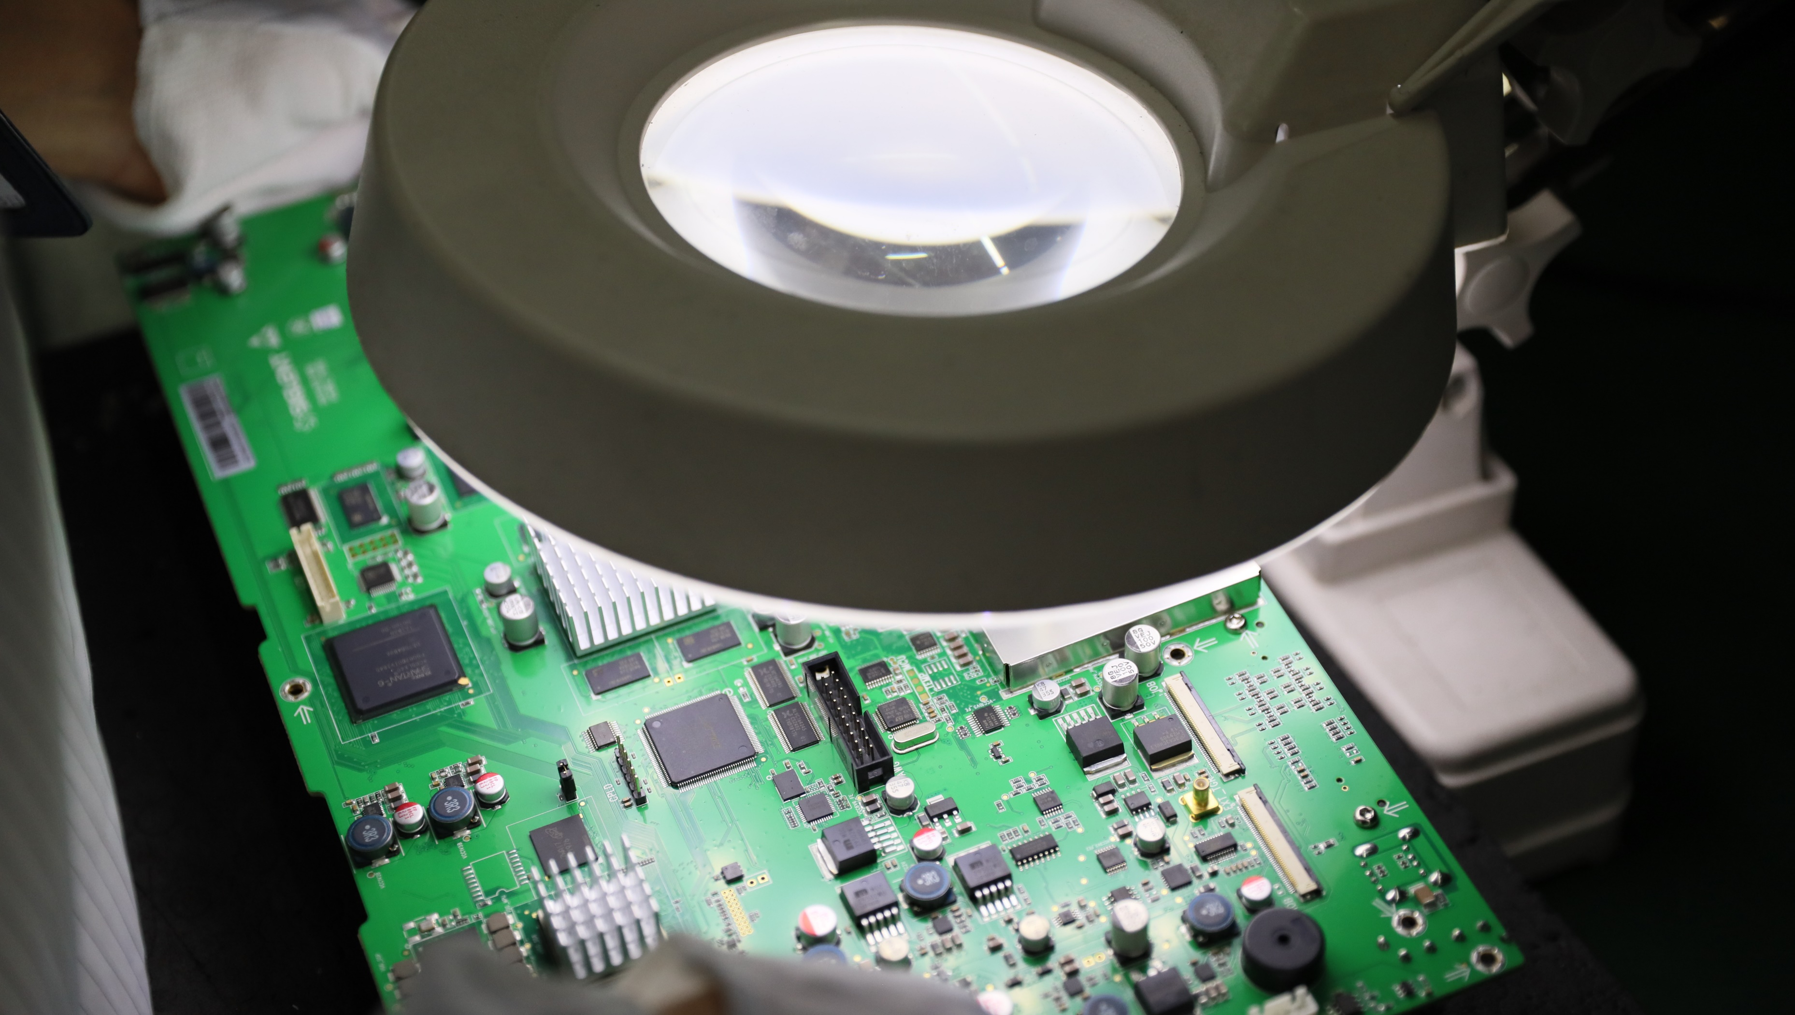
Parametric Test
In order to fully characterize RF components, you need to understand and simulate the performance of input signals and output signals
Use for testing and performance evaluation of various electronic devices and systems, simplifying test challenges including sensitivity, dynamic range and intermodulation distortion
High Power Device Test
No need for external amplifier to overcome the loss of test system with higher accuracy and better stability
36

Slide 37
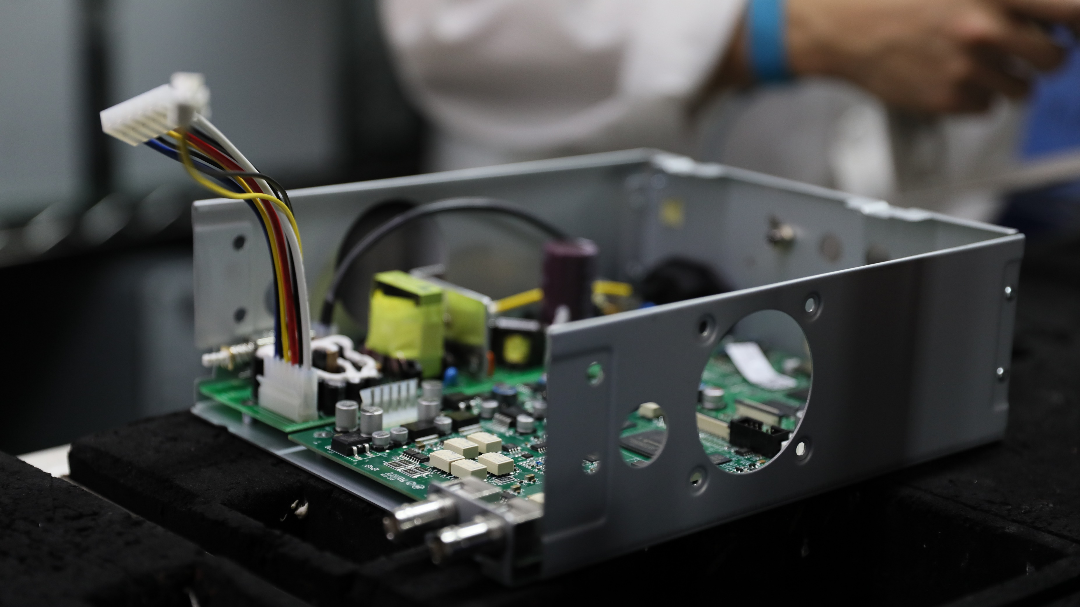
Receiver Test
Characterize the receiver in various test scenarios:
Radiation test or conduction test
Minimum or maximum input level
Interference, blocking, intermodulation and fading
…
Test of frequency range, sensitivity, dynamic range, intermodulation distortion and other indicators
37

Slide 38
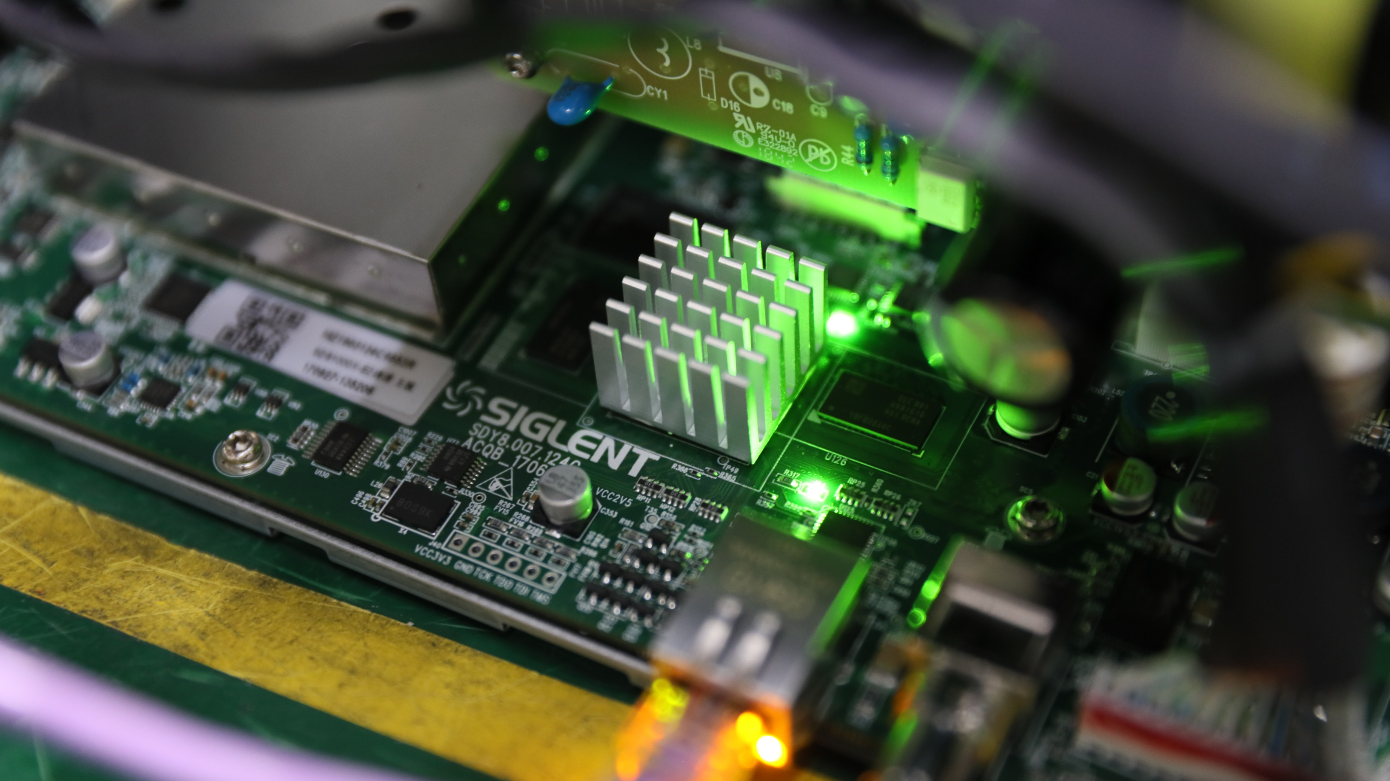
Excitation and LO Substitution
High output power & CW signal purity
Can be used for signal excitation of precision amplifiers
Can be used as an ideal local oscillator to replace the local oscillator in high performance transmitters and receivers
38

Slide 39
PART FOUR
04
Comparison
Comparison of similar products

Slide 40
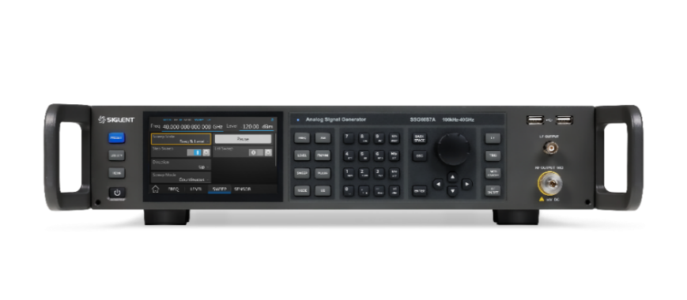
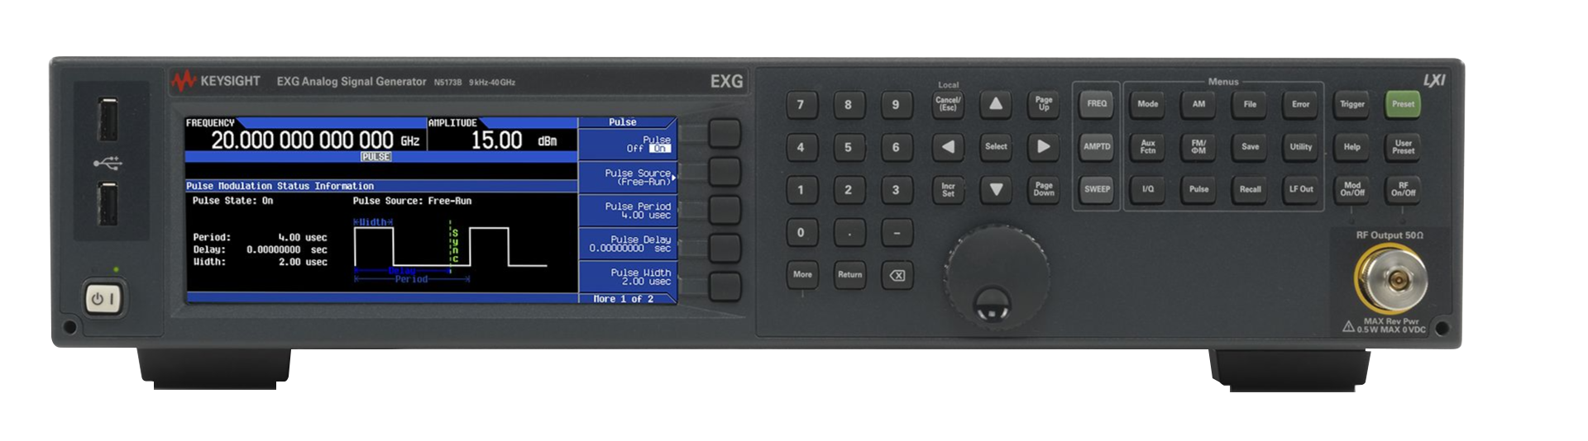
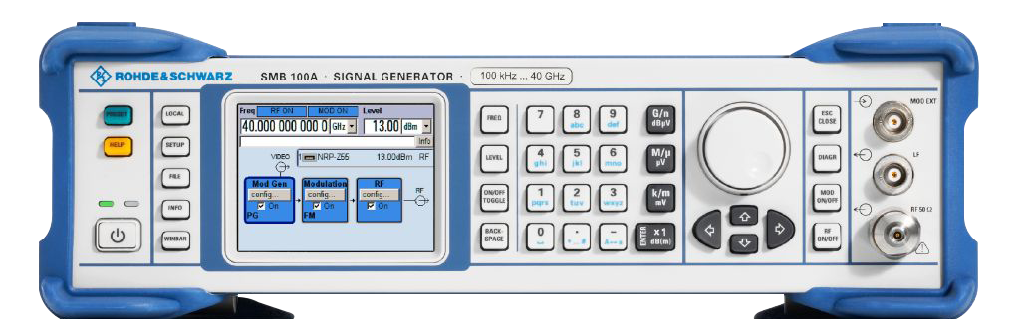
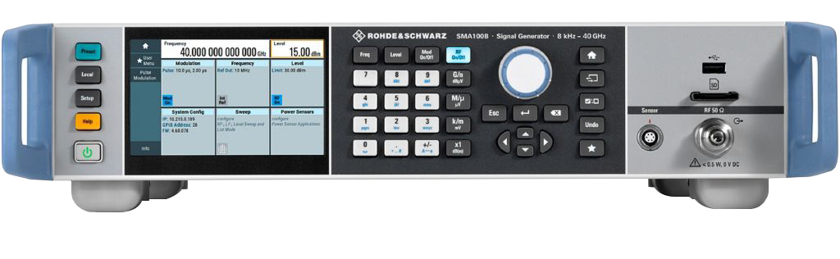
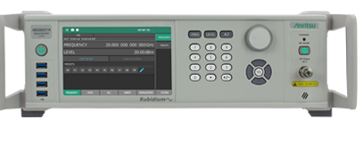
Para/Model | SIGLENT SSG6000A | KEYSIGHT N5183B | KEYSIGHT N5173B | R&S SMB100A | R&S SMA100B | Anritsu MG362x1A
Appearance
Frequency Range | 100 kHz-13.6/20/40 GHz | 9 kHz-13/20/31.8/40 GHz | 9 kHz-13/20/31.8/40 GHz | 100 kHz-12.75/20 /31.8/40 GHz | 8 kHz-3/6/12.75/20 /31.8/40/50/67 GHz | 9 kHz-20/43.5/70 GHz
Level Setting Range | -130 dBm to +24 dBm | -135 dBm to 30 dBm (with Option 1E1 and 1EA) -20 dBm to 19 dBm (without 1E1 and 1EA) | -135 dBm to 30 dBm (with Option 1E1 and 1EA) -20 dBm to 19 dBm (without 1E1 and 1EA) | –145 dBm to 3 dB above max | –145 dBm to +16 dBm | ----
Level Resolution | 0.01 dB | 0.01 dB | 0.01 dB | 0.01 dB | 0.01 dB | 0.01 dB
Maximum output power | 22 dBm | +18 dBm (Standard) +23 dBm (Option 1EA) | +18 dBm (Standard) +23 dBm (Option 1EA) | 18 dBm | 19 dBm | 21 dBm
Full amplitude accuracy | < 0.7 dB | ± 0.6 dB | ± 0.6 dB | < 0.5 dB | < 0.7 dB | ----
Phase Noise@1GHz （20 kHz offset） | -135 dBc/Hz (typ.) | -130 dBc/Hz (spec.) | -118 dBc/Hz (spec.) | 10 kHz offset -128 dBc/Hz (typ.) | -140 dBc/Hz (typ.) | -10 kHz offset -138 dBc/Hz (typ.)
Harmonic (1MHz<f<2GHz) | < -30 dBc | < –48 dBc, 9 kHz to 200 MHz < –33 dBc,200 MHz to 2 GHz | < –48 dBc, 9 kHz to 200 MHz < –33 dBc,200 MHz to 2 GHz | < -30 dBc | < -30 dBc | –35dBc, 9 kHz to ≤ 31.25 MHz –58dBc,31.2MHz to ≤ 1.3 GHz
Sub Harmonics | < -80 dBc | < –75 dBc, >1.5 to 3.2 GHz < –67 dBc, >3.2 to 10 GHz < –56 dBc, >10 to 20 GHz < –53 dBc, >20 to 40 GHz | < –75 dBc, >1.5 to 3.2 GHz < –67 dBc, >3.2 to 10 GHz < –56 dBc, >10 to 20 GHz < –53 dBc, >20 to 40 GHz | None, < 6.375 GHz < –55 dBc, 6.375 to 20 GHz < –50 dBc, 20 to 40 GHz | < –85 dBc, ≤ 5 GHz < –60 dBc, > 5 GHz | ----
Analog Modulation | Standard | Option UNT | Option UNT | Standard | SMAB-K720 option | Option 12

Slide 41
Para/Model | SIGLENT SSG6000A | KEYSIGHT N5183B | KEYSIGHT N5173B | R&S SMB100A | R&S SMA100B | Anritsu MG362x1A
Appearance
Sweep Modes | Frequency step, Arbitrary list | Frequency step, Arbitrary list | Frequency step, Arbitrary list | ---- | ---- | Frequency step, Arbitrary list
Number Of Points | Step sweep: 2-65535 List sweep: 1-500 | Step sweep: 2-65535 List sweep: 1-3201 | Step sweep: 2-65535 List sweep: 1-3201 | ---- | ---- | 2 to 65535
Step Attenuator | 0 to 110 dB, 10dB step | (Option 1E1) 0 to 115 dB, 10 dB step | (Option 1E1) 0 to 115 dB, 10 dB step | Option | Option | Option 2, 10 dB step 110 dB on models 43.5 GHz
Pulse Modulation | SSG6080A-PU | Option UNW or UW2 | Option UNW or UW2 | SMB-K21 | SMAB-K22 | Option 26
Pulse On/Off Ration | >80 dB | >80 dB | >80 dB | >80 dB | >80 dB | >80 dB
Pulse Generator | SSG6080A-PU | Option UNW or UW2 | Option UNW or UW2 | SMB-K23 | SMAB-K23 | Option 27
Pulse Train Generator | SSG6080A-PT | Option UNW or UW2 | Option UNW or UW2 | SMB-K27 | SMAB-K27 | ----
Number Of Pulses | 1-2047 | 1-2047 | 1-2047 | 1-2047 | 1-2047 | ----
Pulse On Time And Off Time Setting Range | 20 ns to 300 s | 20ns to 42s | 20ns to 42s | 10 ns to 5 ms | 5 ns | ----
OCXO | Standard | Standard | Standard | Option | Option | Standard/ Option3/ Option56
RF Output | 2.92mm male | Option 513/520: 3.5 male, or Type-N with Option 1ED; Option 532/540: 2.4 mm male; plus 2.4-2.4 mm and 2.4-2.9 mm female adapters |  | B112/B120: 3.5 mm female B131/B140: 2.92 mm female | B103/-B106: N female B112/-B120/B131/B140: 2.92 mm female | 20.0 GHz: 2.92 mm K(m) 43.5 GHz: 2.92 mm K(m) 70 GHz: 1.85 mm V(m)

Slide 42
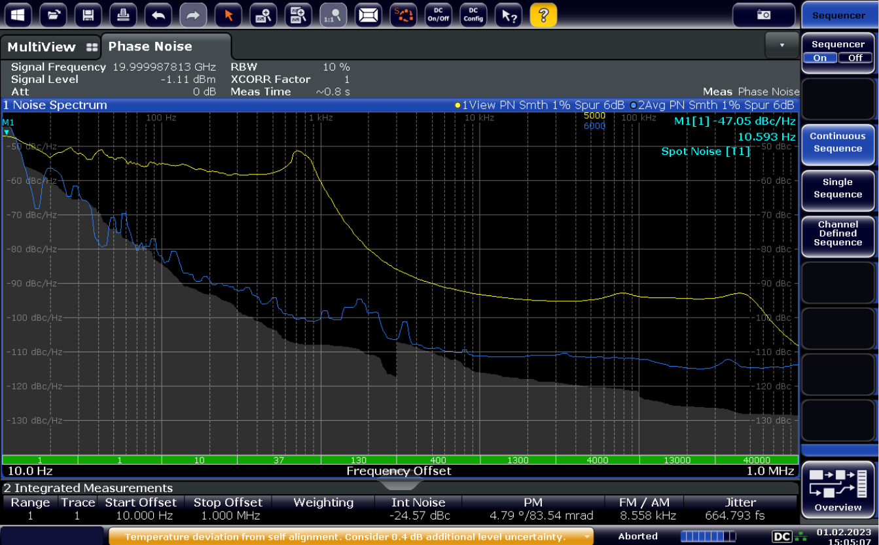
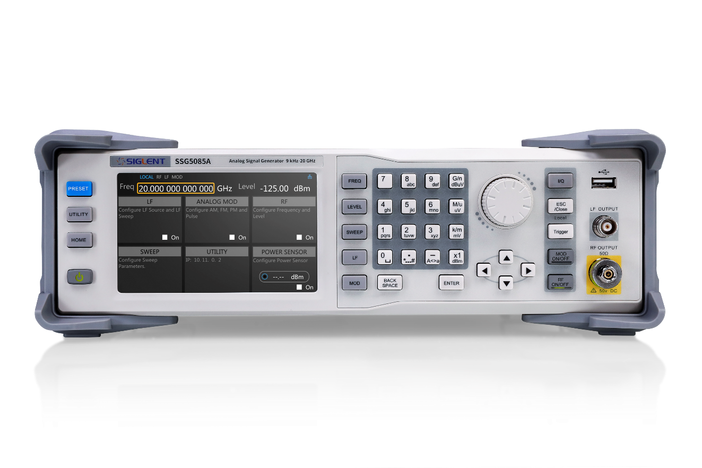
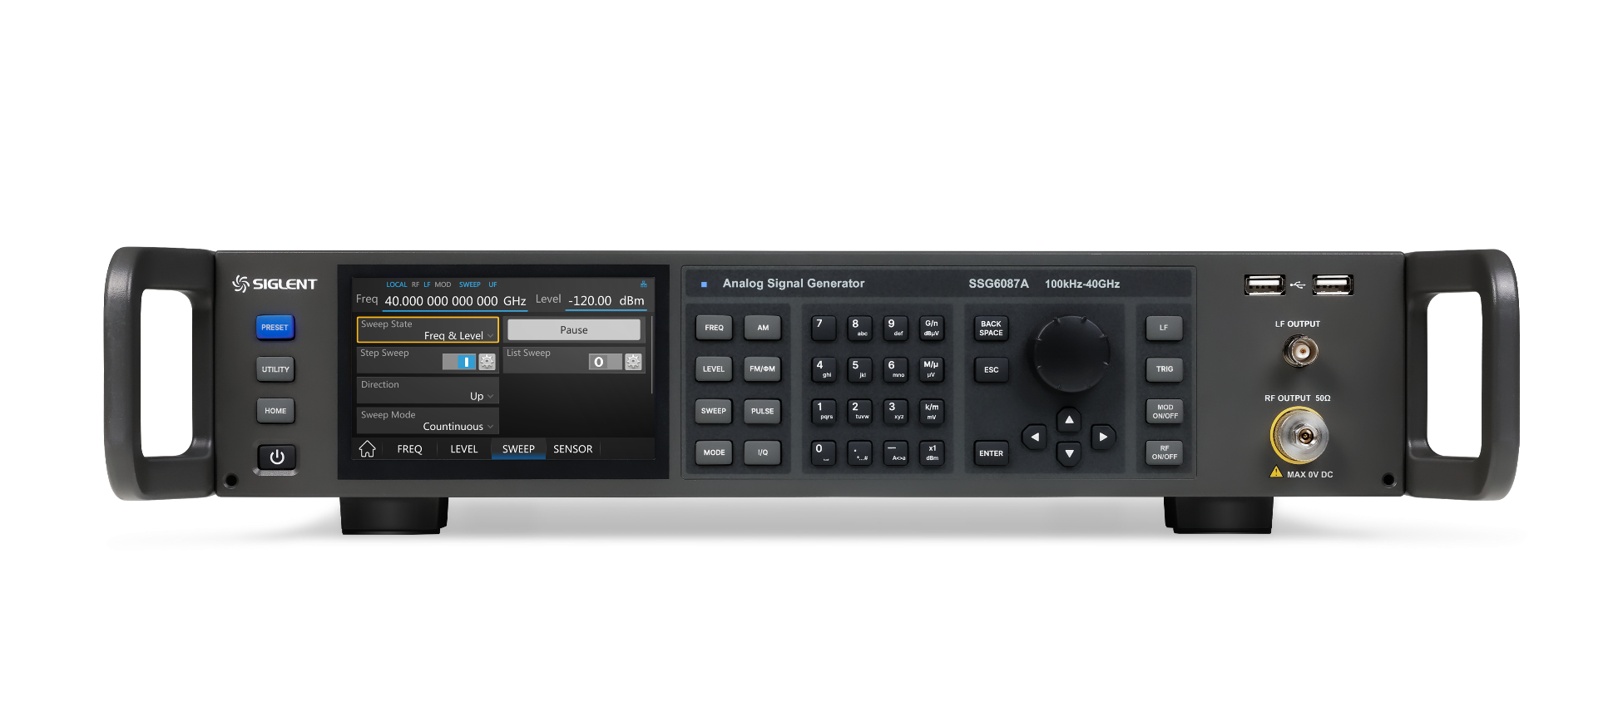
SSG5000A versus SSG6000A
Frequency offset = 20 GHz phase noise
42

Slide 43
Keys For Accuracy
01
Impedance Matching
The output impedance of SSG6000A is 50Ω, and impedance mismatch will lead to signal amplitude reduction and high voltage standing wave ratio
When SSG6000A is used in 75Ω, an impedance matching attenuator should be added for matching
02
Periodic Calibration
The output frequency accuracy of SSG6000A will change with time, so it is recommended to recalibrate it annually
43
Notes:
Microwave signal generator is a kind of expensive and complicated testing instrument with high frequency stability and accuracy, so some problems should be paid attention to when using it.

Slide 44
Keys For Accuracy
03
Time Base Preheating
SSG6000A uses the high-stability crystal oscillator as the time reference, and the instrument must be preheated for a period of time, so that the high-stability crystal oscillator can reach its predetermined technical index before use, and the output can meet the specified stability and accuracy index
04
High-power Reverse Irrigation
It is easy to burn the internal microwave circuit when the large signal is input back, and it is also easy to burn the internal microwave circuit when the DC voltage is input, so special attention should be paid when the output is connected to the external power amplifier
44

Slide 45
Ordering Information
Product Description | SSG6000A Signal Generator | Order Number
Product Code | Analog Signal Generator 100 kHz~13.6 GHz | SSG6083A
整机 | Analog Signal Generator 100 kHz~20 GHz | SSG6085A
 | Analog Signal Generator 100 kHz~40 GHz | SSG6087A
Standard Configurations | Quick start, USB cable, Calibration certificate, Power cord, 2.92mm female to female adapter
Option | Pulse modulation | SSG6080A-PU
 | Pulse train generator | SSG6080A-PT
 | Rack mount kit | SSG6000A-RMK
 | USB-GPIB adapter | USB-GPIB
 | Upgrade 13.6 GHz to 20 GHz | SSG6080A-F85
45

Slide 46
Thank You
Every Bench. Every Engineer. Every Day.
Headquarters
NA
Europe
SIGLENT TECHNOLOGIES CO., LTD.
Add: Blog No.1 & No.4 & No.5, Antongda Industrial Zone, 3rd Liuxian Road, Bao’an District, Shenzhen, 518101, China
Tel:+ 86 755 3688 7876
Fax:+ 86 755 3359 1582
sales@siglent.com
int.siglent.com
SIGLENT Technologies NA, Inc.
Add: 6557 Cochran Rd Solon, Ohio 44139 Tel: 440-398-5800 Toll Free:877-515-5551 Fax: 440-399-1211
info@siglent.com www.siglentna.com
SIGLENT TECHNOLOGIES GERMANY GmbH
Add: Staetzlinger Str. 70 86165 Augsburg, Germany Tel: +49(0)-821-666 0 111 0 Fax: +49(0)-821-666 0 111 22 info-eu@siglent.com www.siglenteu.com

