Slide 1
SIGLENT TECHNOLOGIES
EVERY BENCH. EVERY ENGINEER. EVERY DAY.
www.int.siglent.com

Slide 2
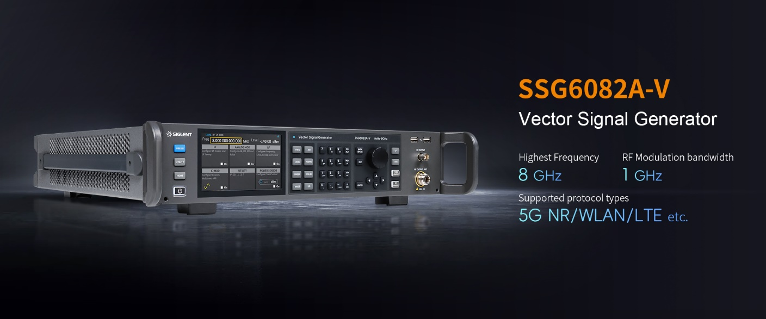

Slide 3
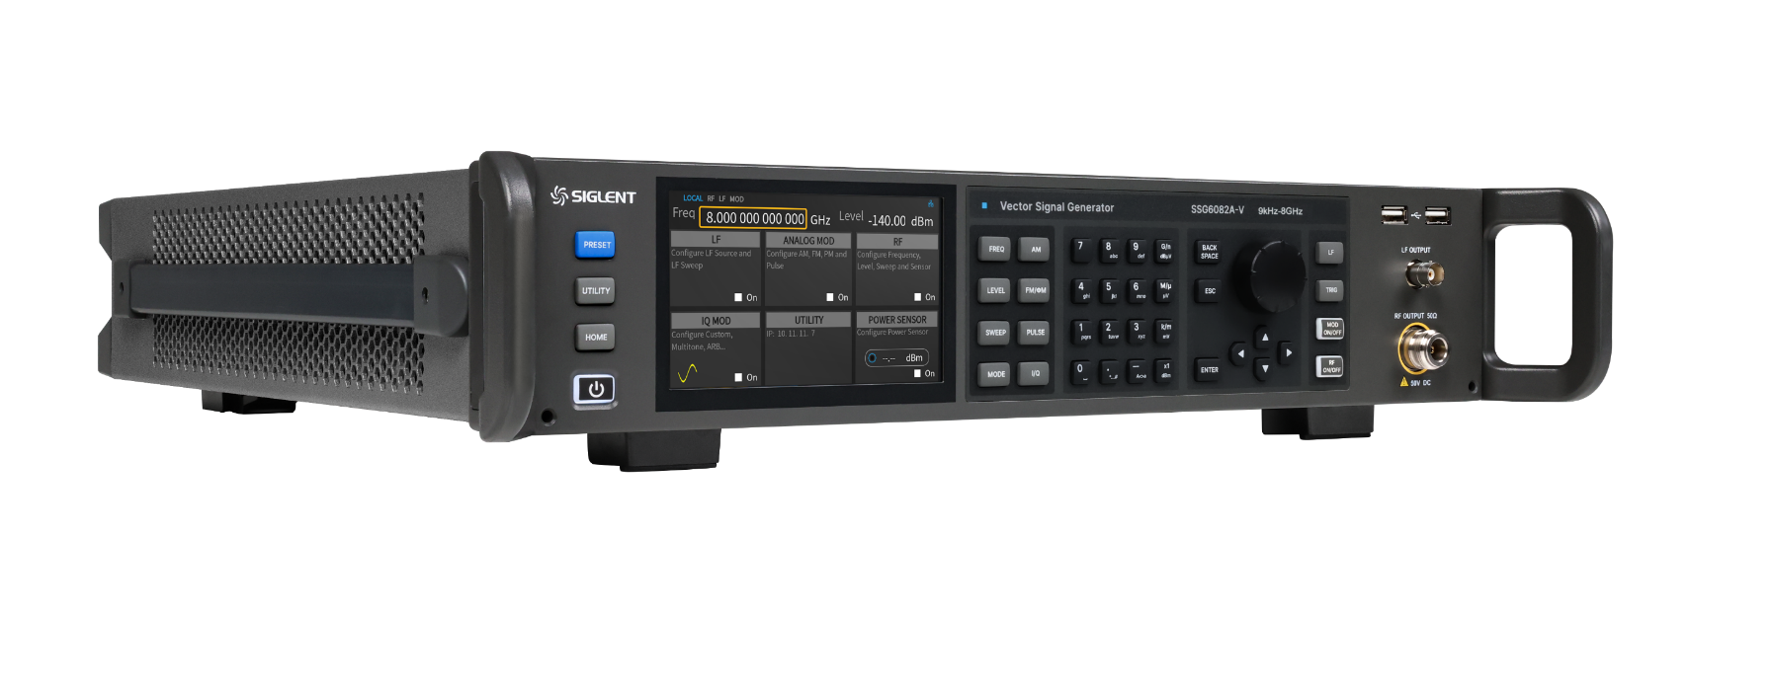


SSG6082A-V
Vector Signal Generator
Contents
Basic Information
Features & Strengths
Applications
Comparison
Ordering Information

Slide 4
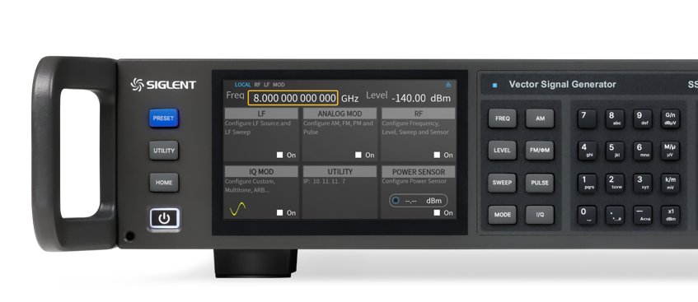
1
Part 1
Basic
Information

Slide 5
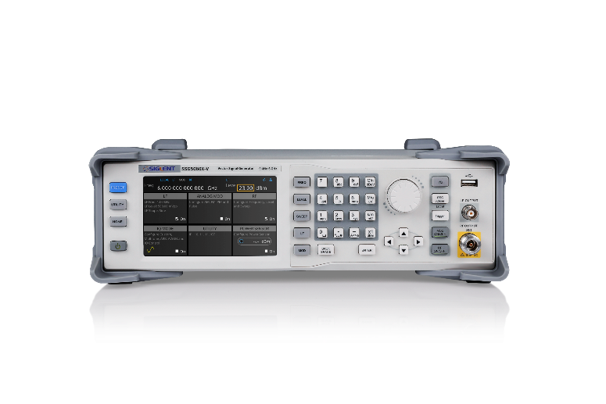
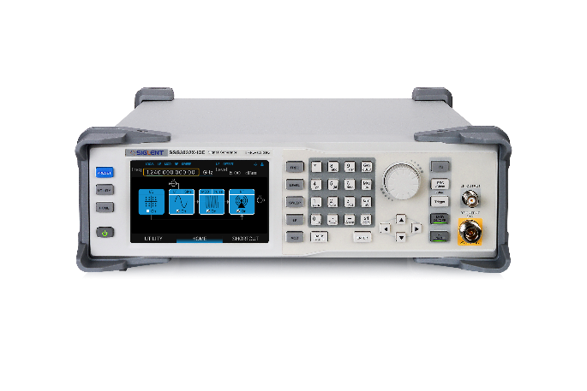
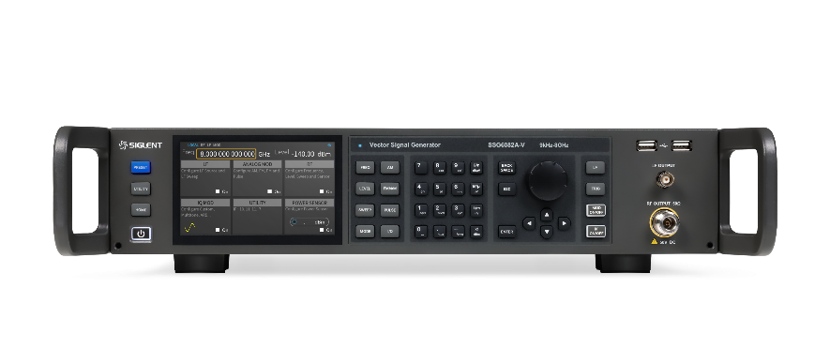
SIGLENT Vector Signal Generator Series
SSG3000X-IQE
SSG5000X-V
SSG6000A-V
Frequency range | 9kHz~3.2GHz(CW Mode) 10MHz~3.2GHz(IQ Mode) | 9 kHz - 6 GHz (CW Mode) 10 MHz - 6 GHz (IQ Mode) | 9 kHz ~ 8 GHz (CW Mode) 10MHz~8 GHz(IQ MODE)
Frequency resolution | 0.01Hz | 0.001Hz | 0.001Hz
Amplitude resolution | 0.01dB | 0.01dB | 0.01dB
Amplitude accuracy(typ,) | 0.7dB | 0.7dB | 0.7dB
Phase noise(typ.) @1GHz | -110dBc/Hz，offset 20kHz | -120dBc/Hz，offset 20kHz | -132dBc/Hz，offset 10kHz
RF bandwidth | 200MHz（External） | 200MHz（External） 150Mhz（internal） | 1GHz（External） 1GHz（internal）

Slide 6
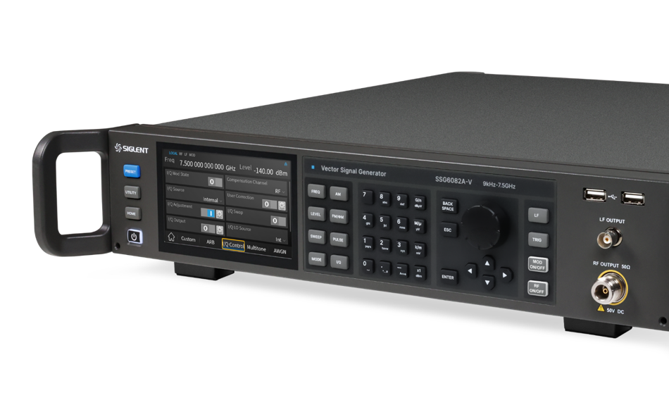
A
At a Glance
SSG6082A-V
8 GHz
Highest
Frequency
1GHz
RF bandwidth
-133
dBc/Hz
Phase noise
<0.7dB
amplitude accuracy
0.001Hz frequency resolution
0.01dB Amplitude resolution

Slide 7
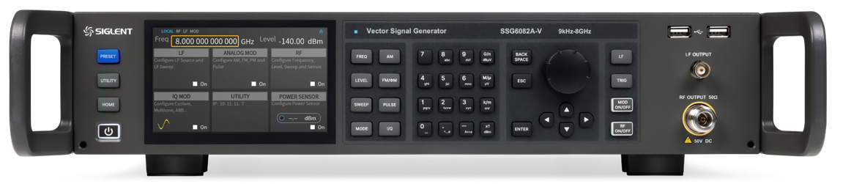
Front Panel Introduction
5”Capacitive Touch
Screen 800*480 (RGB)
Softkey Control
Mechanical Knob
Preset
N Type Connector
Power
VECTOR

Slide 8
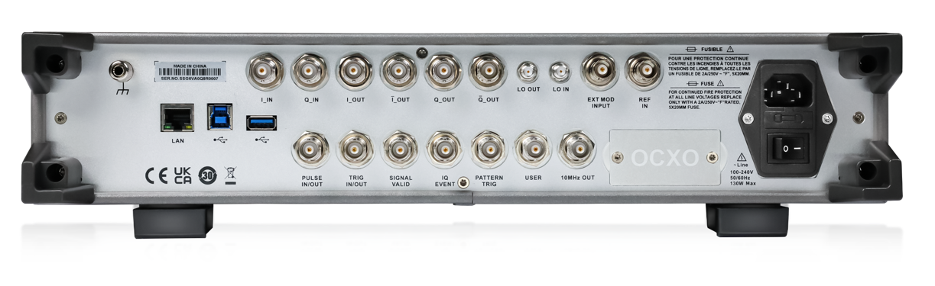
Rear Panel Introduction
I/Q IN
Differential IQ output
GND
High Stability
Oven Controlled
Crystal Oscillator
LAN Web server
USB host & slave
Control interfaces
VECTOR

Slide 9
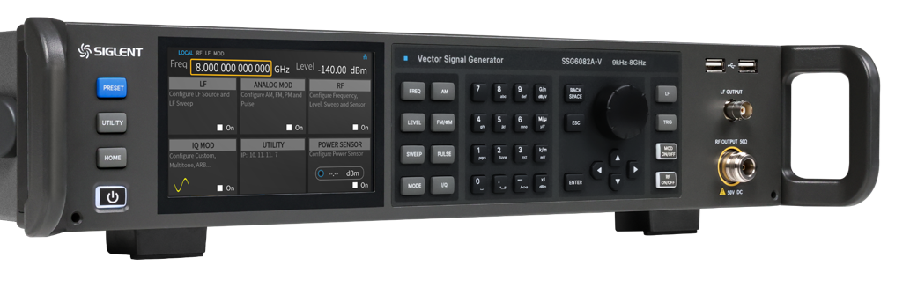
2
Part 2
Features &
Strengths

Slide 10
Exactly the right Frequency Range
There are several things to consider when selecting a signal generator.
When testing receivers, it is necessary to test their sensitivity to out-of-band signals. SSG6082A-V has a maximum output frequency of 8 GHz in order to meet the future challenges of testing in the IMT (International Mobile Telecommunications, including 5G/6G) bands and WiFi 7.
Models | SSG5060X-V | SSG6082A-V
Frequency range | 9 kHz - 6 GHz (CW Mode) 10 MHz - 6 GHz (IQ Mode) | 9 kHz ~ 8 GHz (CW Mode) 10MHz~8GHz(IQ MODE)
Frequency resolution | 0.001Hz
Reference frequency | 10.000000 MHz
Initial calibration accuracy | ＜0.2 ppm | ± 100 ppb (±0.1ppm)
Temperature stability | ＜1 ppm/year, 0℃ ~50℃ | ± 1 ppb，0℃~50℃
Frequency aging rate | ＜0.5 ppm/first year, 3.0 ppm/20 years | 50 ppb per year
8GHz

Slide 11
High Precision Frequency Reference
For RF signal generators, the frequency accuracy is determined by the stability of the oscillator and the calibration data.
The SSG6082A-V is standardly equipped with a high-precision Oven Controlled Crystal Oscillator(OCXO) for more stable output frequency.
Models | SSG5060X-V | SSG6082A-V
Frequency range | 9 kHz - 6 GHz (CW Mode) 10 MHz - 6 GHz (IQ Mode) | 9 kHz ~ 8 GHz (CW Mode) 10MHz~8GHz(IQ MODE)
Frequency resolution | 0.001Hz
Reference frequency | 10.000000 MHz
Initial calibration accuracy | ＜0.2 ppm | ± 100 ppb (±0.1ppm)
Temperature stability | ＜1 ppm/year, 0℃ ~50℃ | ± 1 ppb,0℃~50℃
Frequency aging rate | ＜0.5 ppm/first year, 3.0 ppm/20 years | 50 ppb per year
8GHz

Slide 12
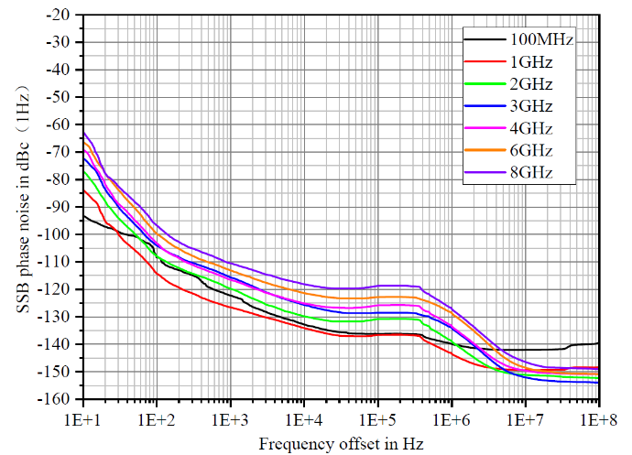
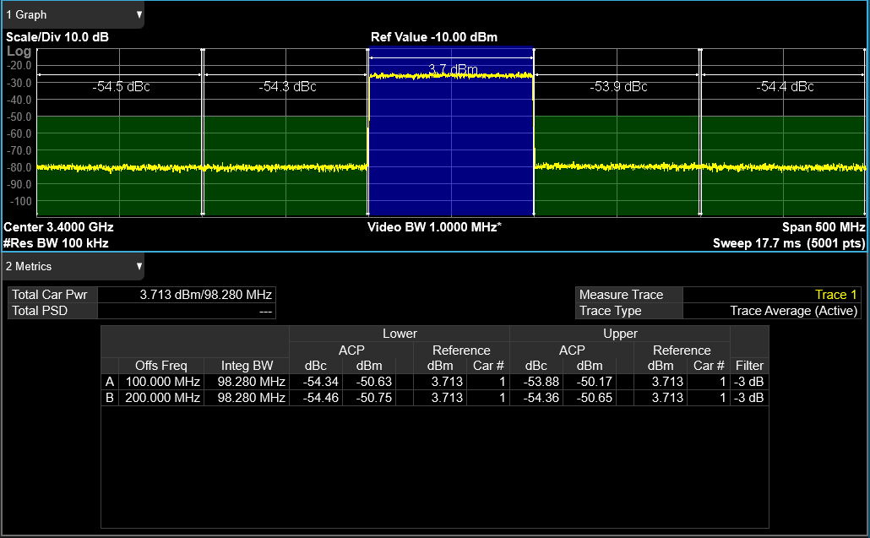
Pure Output
SSB phase noise as low as -135dBc/Hz in continuous wave mode (@1GHz 10kHz offset)
SSG6082A-V has lower harmonics and sub-harmonics and higher signal quality. The impact on adjacent communication systems can be reduced during testing.
Excellent ACPR with high quality broadband output signal in IQ mode.
Phase noise at different carrier frequencies
5G NR TM1.1 100M bandwidth ACP test

Slide 13
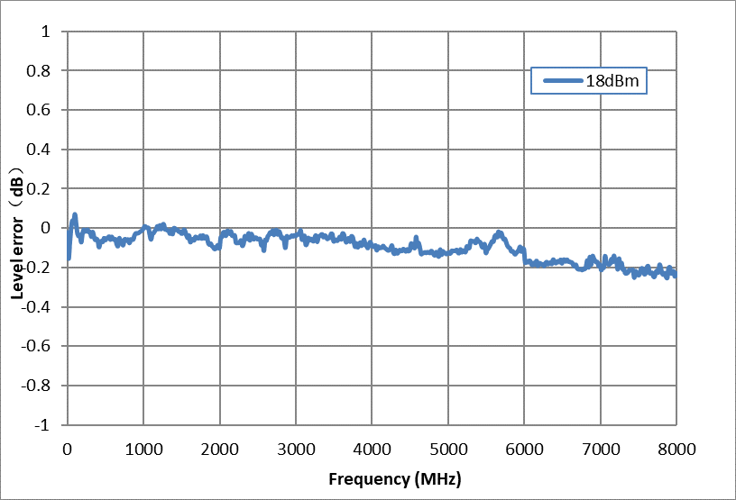
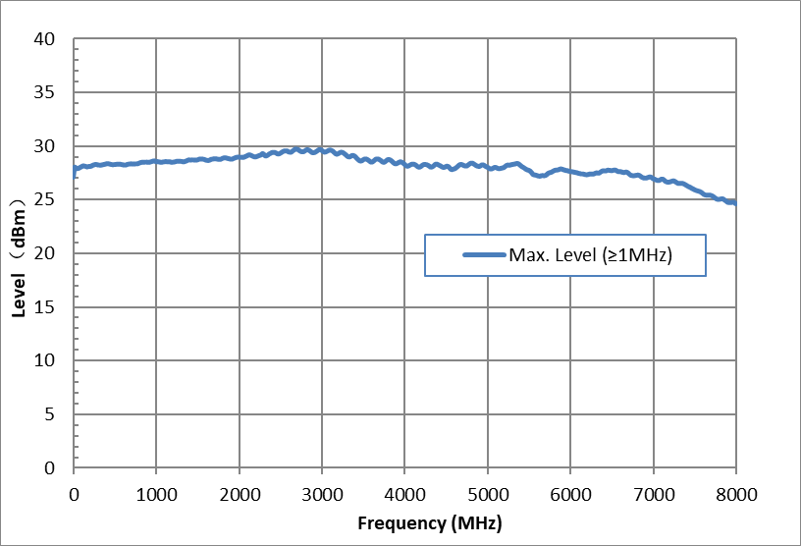
Precise Level Settings
The SSG6082A-V has a large output range while applying ALC control circuits to ensure accurate level output. Level error <0.7 dBm, SSG6082A-V can quickly respond according to the set level, the response time is less than 5ms.
Support step scanning and list scanning, dwell time 10ms~100s
5ms
Level error at high output power
Maximum output amplitude versus frequency

Slide 14
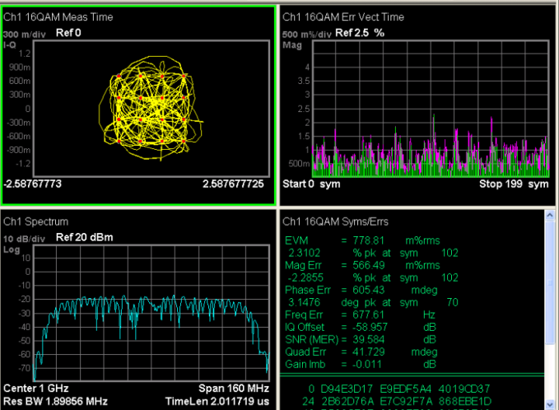
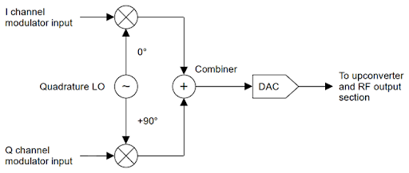
Custom mode with High Symbol Rate
625 MHz symbol rate
Supports common digital IQ modulation signals QAM/PSK/ASK/FSK, etc. Supports higher order modulation up to 1024QAM. Easily handle complex signals.
Internal modulation generator
16QAM signal testing

Slide 15
Wider RF Modulation Bandwidth
Supports internal and external ±500 MHz modulation bandwidths.
<1dB In-band response.
protocol types | Maximum required modulation bandwidth
LTE FDD&TDD | 20MHz
LTE TDD | 20MHz
5G NR | 100MHz
WiFi 6 | 160MHz
WiFi 7 | 320 MHz
Models | SSG6082A-V
Modulation bandwidth | external
 | 10 MHz ＜f＜ 2 GHz | ± 25% carrier frequency
 | 2 GHz ＜f＜ 8 GHz | ± 500 MHz
 | internal
 | 10 MHz ＜f＜ 2 GHz | ± 25% carrier frequency
 | 2 GHz ＜f＜ 8 GHz | ± 500 MHz
Modulation bandwidth frequency response | external
 | < 9 dB
 | internal
 | < 1 dB
1GHz

Slide 16
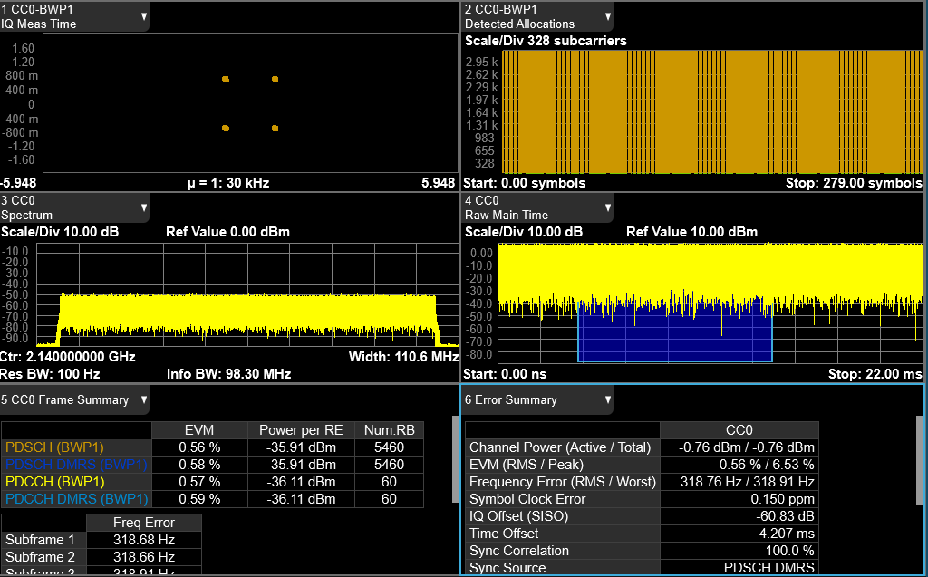
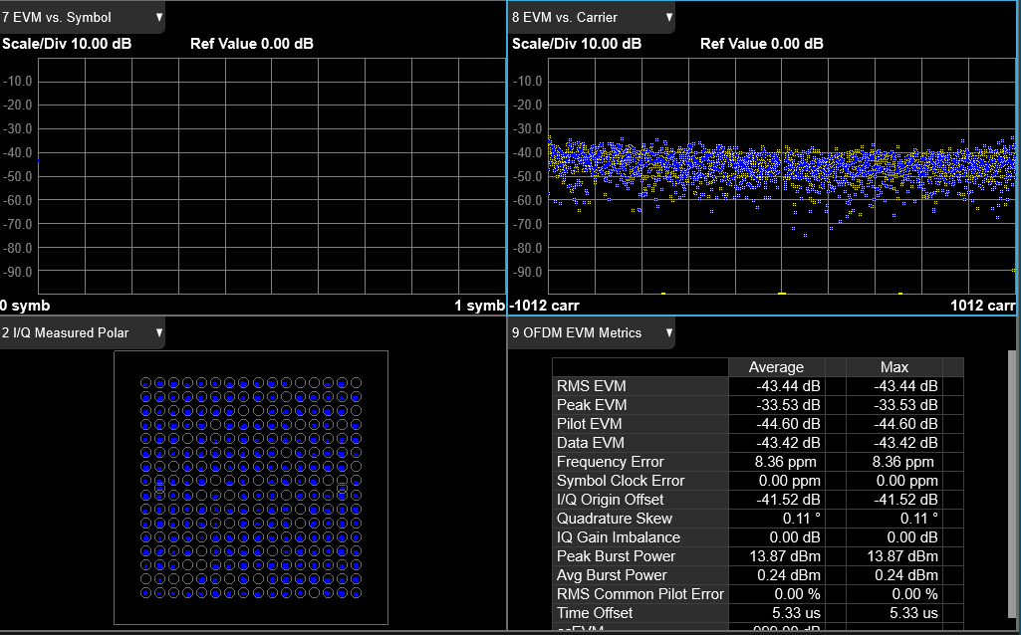
ARB mode
With SigIQPro you can generate signals for Bluetooth, WiFi6, WiFi7, and many other common communication protocols. More convenient for channel and receiver testing. High quality output with EVM<1% for all test cases.
EVM Performance
Format | W-CDMA | LTE FDD | GSM | EDGE | CDMA2000
Modulation type | QPSK | 64 QAM | GMSK (burst) | 3 pi/ 8PSK (burst) | QPSK
Modulation rate | 3.84 Mcps | 10 MHz BW | 270.833 Ksps | 70.833 Ksps | 1.2288 Mcps
Channel configuration | 1 DPCH | E-TM 3.1 | 1 timeslot | 1 timeslot | Pilot channel
Frequency | 1800 to 2200 MHz | 1800 to 2200 MHz | 800 to 900 MHz 1800 to 1900 MHz | 800 to 900 MHz 1800 to 1900 MHz | 800 to 900 MHz 1800 to 1900 MHz
EVM power level | < 4 dBm
EVM | < 0.4% | < 0.45% | < 0.4 % | < 0.8% | < 1.1%
5G NR Test Mode TM1.1 100M Bandwidth 3.9G Carrier, EVM Test Value
IEEE 802.11ax 160M Bandwidth, Carrier Frequency 6GHz, EVM Test Value

Slide 17
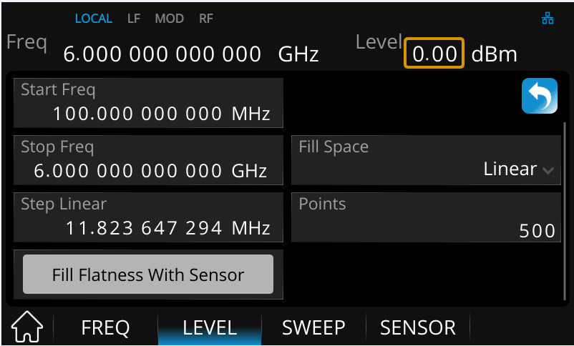
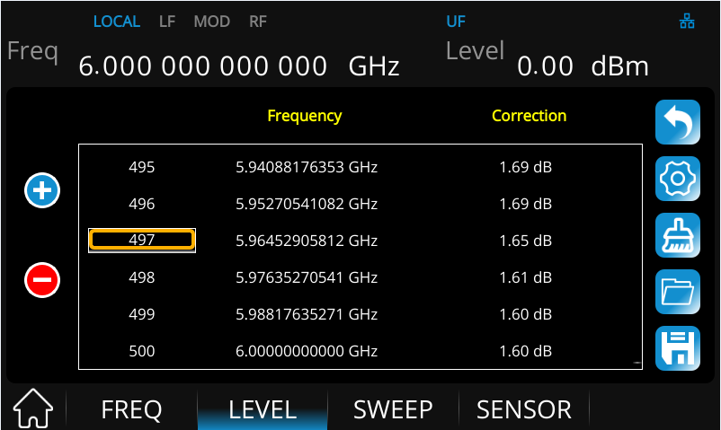
Compensation for Line Loss using Power Meter
In a test setup, as the frequency increases, the influence of the transmission line on the quality of the signal can't be ignored more and more. In order to ensure that the signal has accurate power and good flatness at the end of the cable, as well as at the input port of the DUT. We can use a power meter to correct the output power, which makes it easier to correct the line loss.
Frequency scanning to obtain compensation data
Correction of line losses point by point

Slide 18
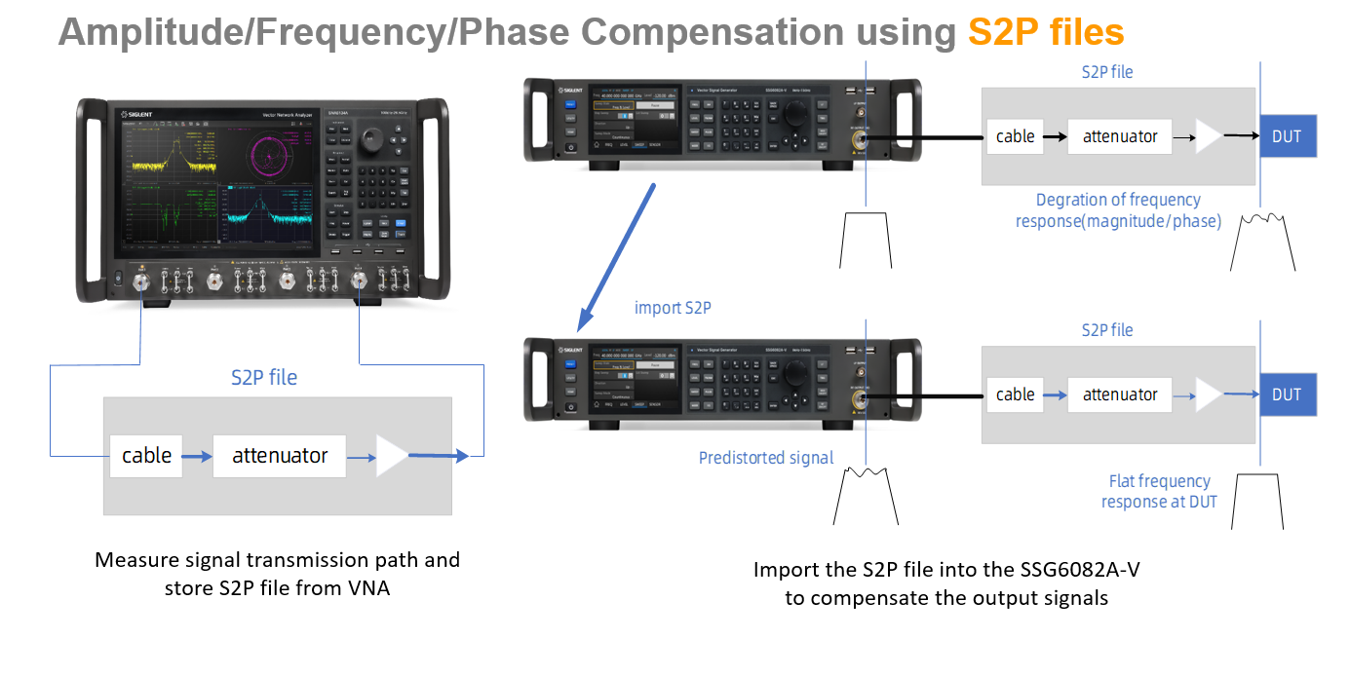
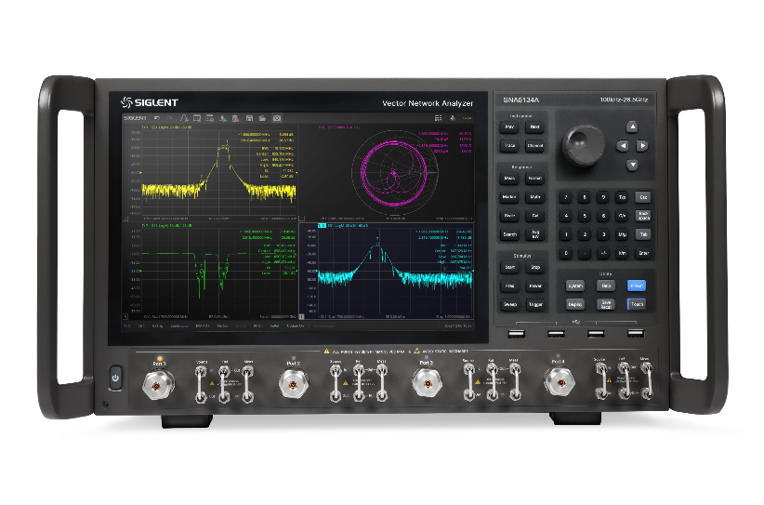
Amplitude/Frequency/Phase Compensation using S2P files
Measure signal transmission path and store S2P file from VNA
Import the S2P file into the SSG6082A-V to compensate the output signals

Slide 19
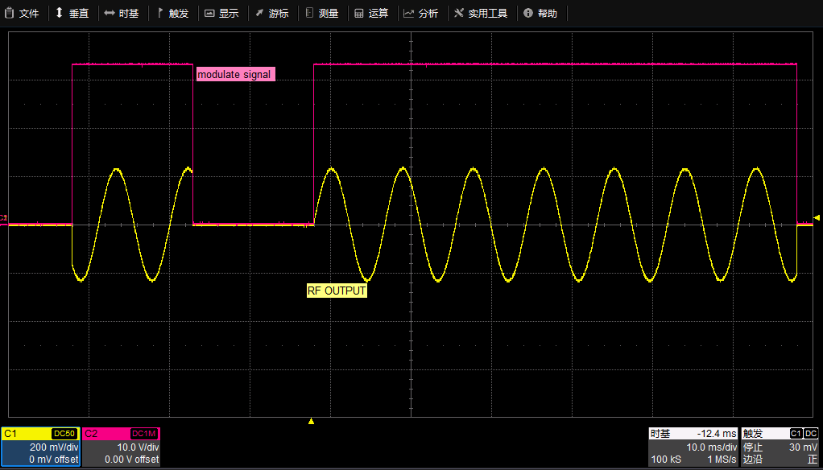
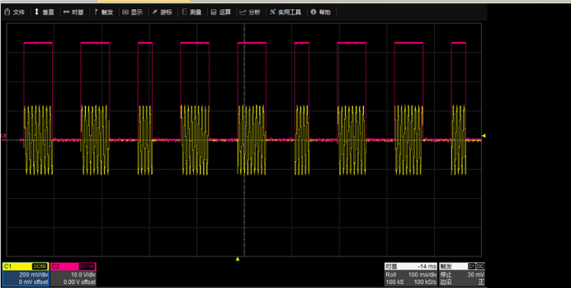
Pulse Modulation and Pulse Train Generator
Pulse modulation has been widely used in many fields such as communication, electronics, and motor control because of its characteristics such as strong anti-interference ability, high output power, and suitability for long-distance transmission.
The SSG6082A-V supports pulse modulation up to 8 GHz carrier. It has high dynamic range with on-off ratio >80dBc and rise-fall time <15ns.
Using the pulse train generator, you can output a burst of up to 2047 customized pulses.
Pulse modulation using the SSG6082A-V
Output Pulse train using SSG6082A-V

Slide 20
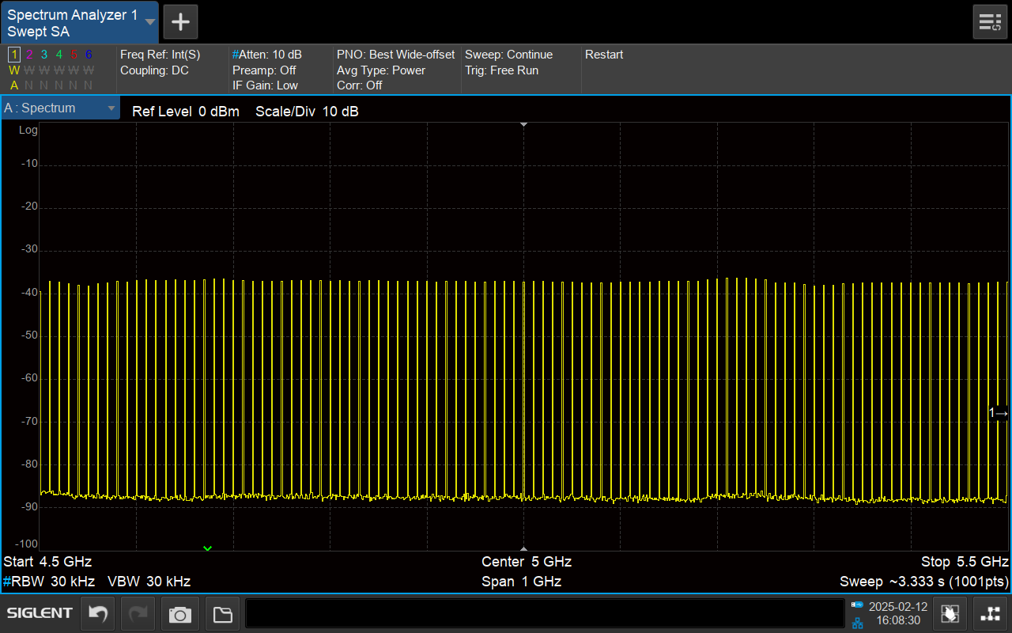
Multi-tone
Multi-tone have important applications in many areas, especially in communications.
Wireless communication system testing: Tests the receiver's linearity, intermodulation distortion, blocking performance and other characteristics. Tests the receiver's ability to select a specific frequency signal in the presence of multiple frequency signals to ensure that it is not subject to excessive interference from adjacent frequency signals.
Device Testing: In some active devices such as amplifiers, when multiple frequency signals pass through the amplifier at the same time, new frequency components (intermodulation products) may be created. The multi-tone output can be used to evaluate the performance of an amplifier in generating intermodulation distortion.
Multi-tone signals with a frequency range of 1G

Slide 21
3
Part 3
Applications

Slide 22
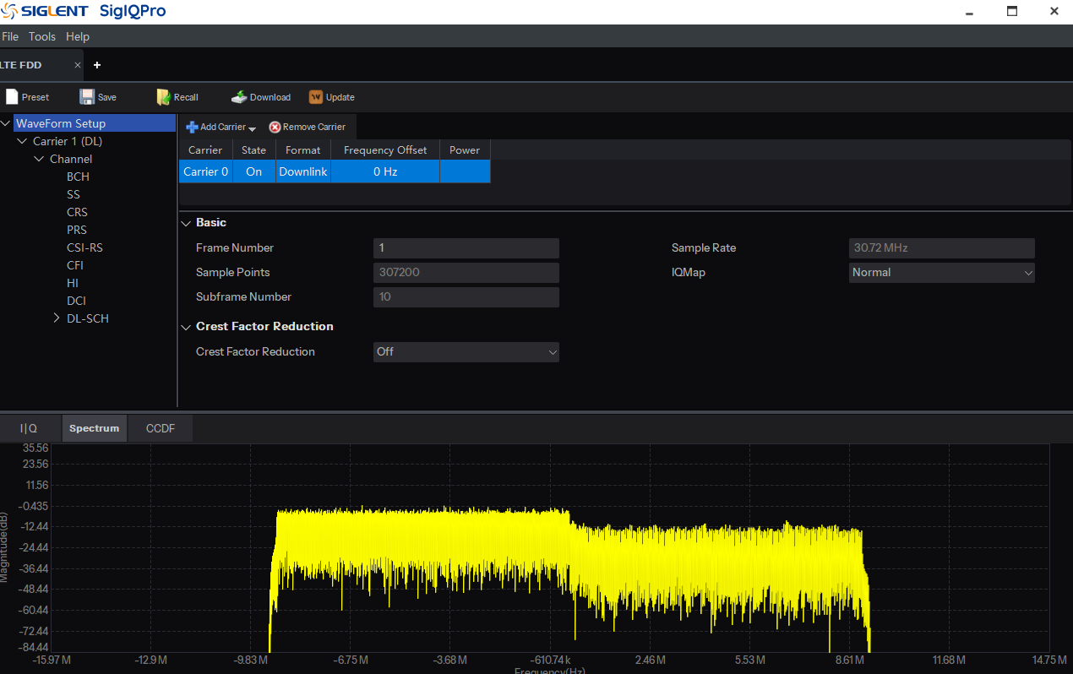
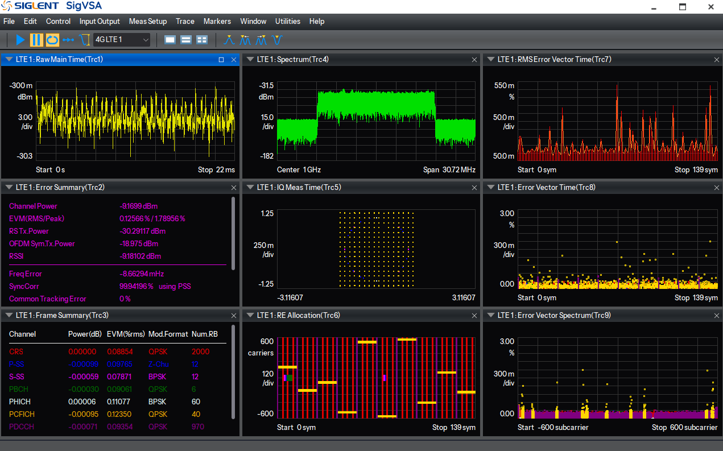
LTE TDD/FDD Test
Support LTE/LTE-A FDD and TDD modulation quality analysis;
Supports flexible configuration of frame structure and user-defined configuration
Supports automatic cell ID detection;
Modulation method :QPSK,16QAM,64QAM,256QAM,1024QAM;
Bandwidth: 1.4MHz, 3MHz, 5MHz, 10MHz, 15MHz, 20MHz;
TM Test mode:
Generating LTE FDD Signals with SigIQPro
E-TM 1.1, E-TM 1.2, E-TM 2, E-TM 2a, E-TM 3.1, E-TM 3.1a, E-TM3.2, E-TM 3.3
*note: This feature is a function of SigIQPro, and the SSG6082A-V is only used to playback baseband signals
LTE FDD Signal Testing with SSG6082A-V

Slide 23
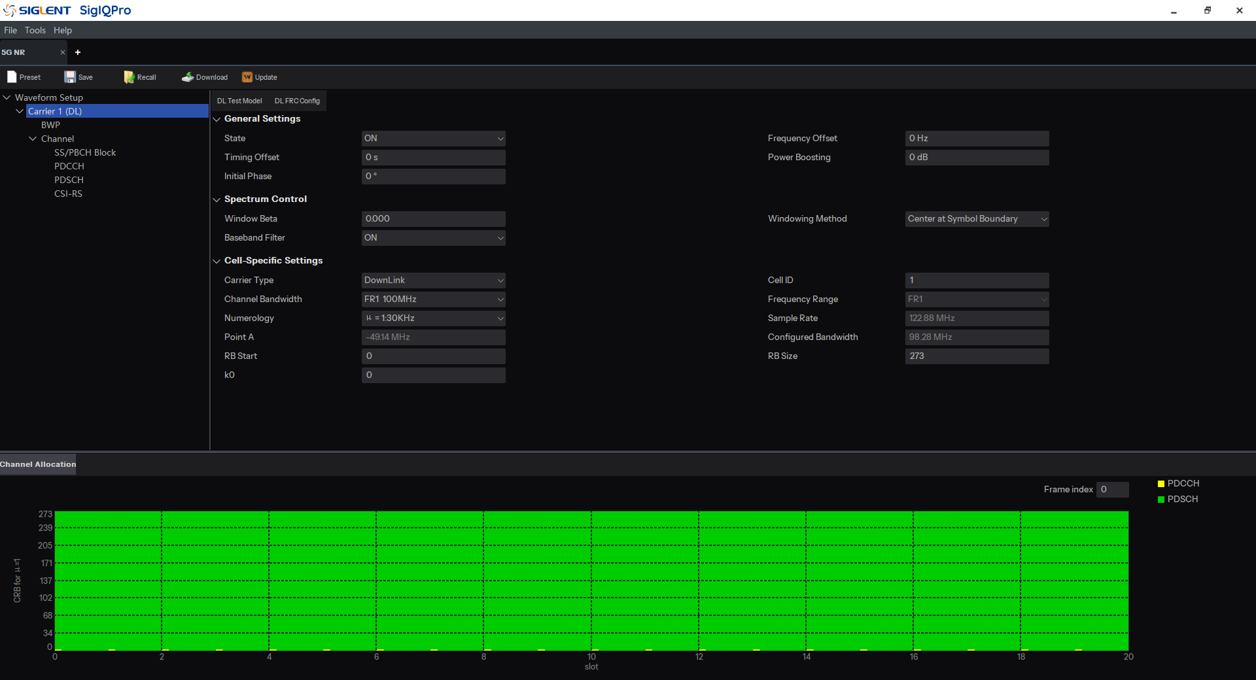
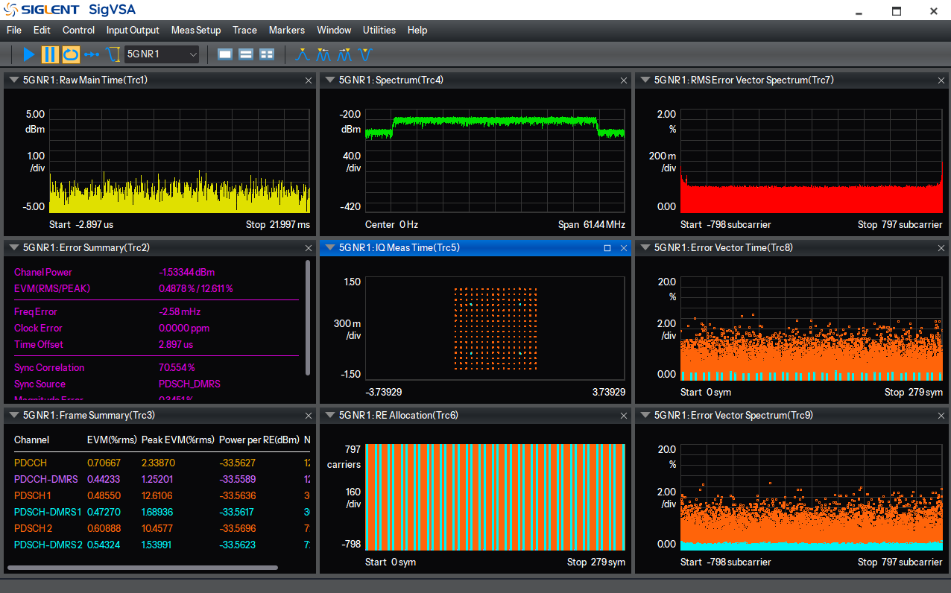
5G NR test
Supports 5G NR uplink and downlink modulation quality analysis;
Supports flexible configuration of frame structure and user-defined configuration;
Supported signal bandwidth :
FR1: 5MHz, 10MHz, 15MHz, 20MHz, 25MHz, 30MHz, 35MHz, 40MHz, 45Hz, 50MHz, 60MHz, 70MHz, 80MHz, 90MHz, 100MHz;
FR2-1: 50MHz, 100MHz, 200MHz, 400MHz;
FR2-2: 100MHz, 400MHz, 800MHz, 1600MHz, 2000MHz;
Generating 5G NR Signals with SigIQPro
TM Test Mode:
FR1: TM1.1, TM1.2, TM2.0, TM2.0a, TM2.0b, TM3.1, TM3.1a, TM3.1b, TM3.2, TM3.3
FR2: TM1.1, TM2.0, TM2.0a, TM3.1, TM3.1a
*note: This feature is a function of SigIQPro, and the SSG6082A-V is only used to playback baseband signals
5G NR Signal Testing with SSG6082A-V

Slide 24
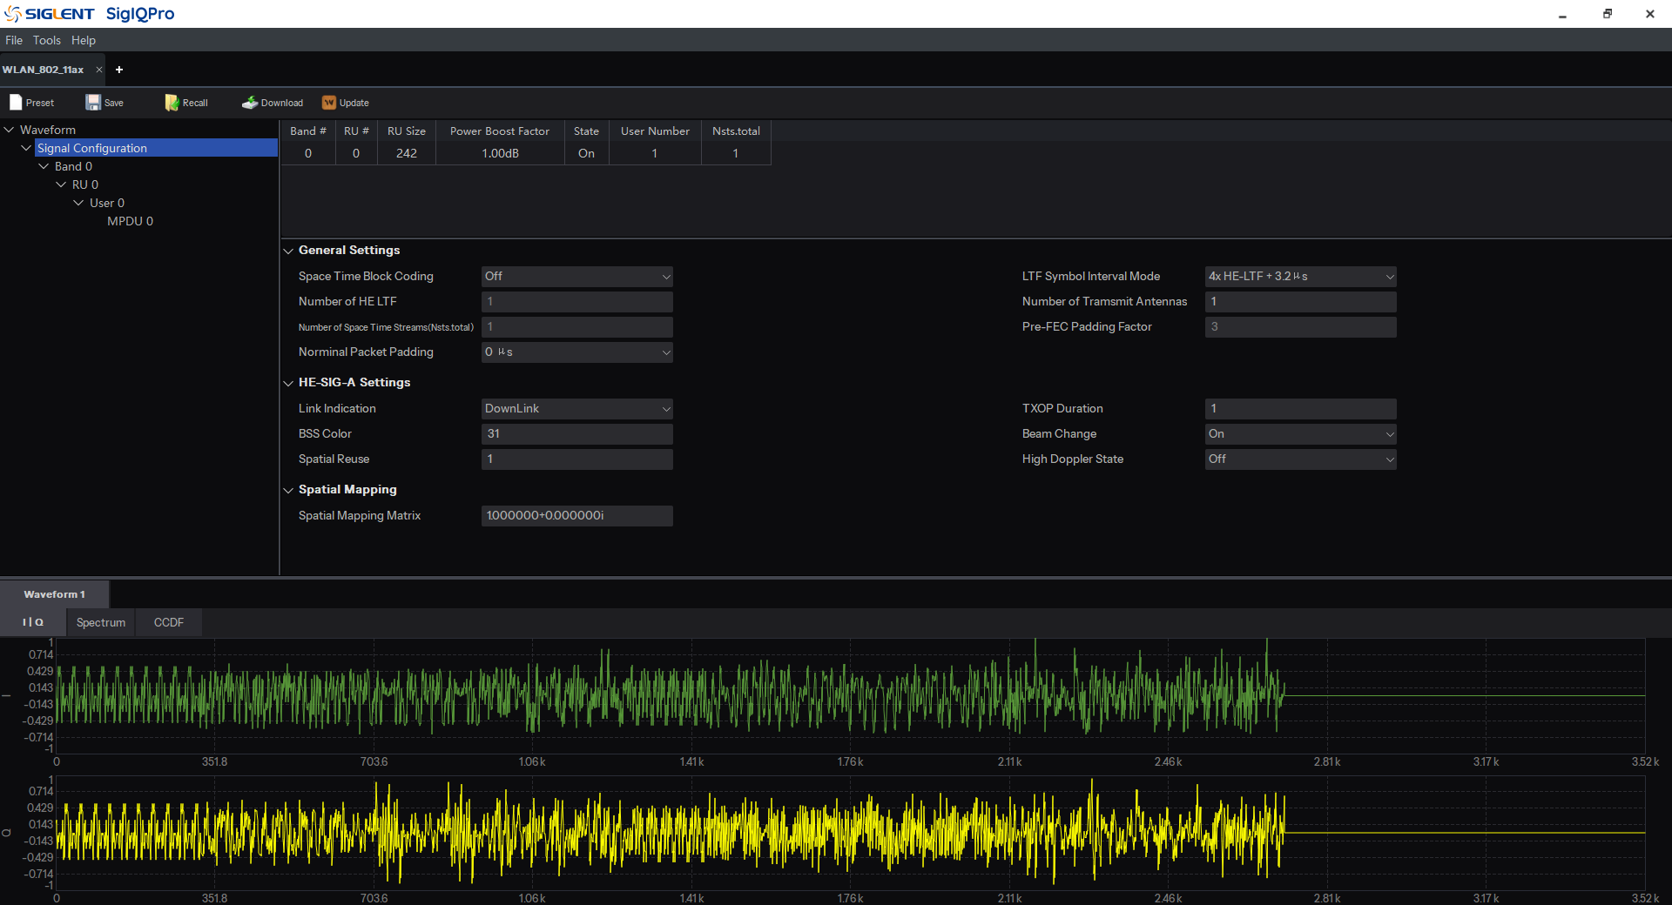
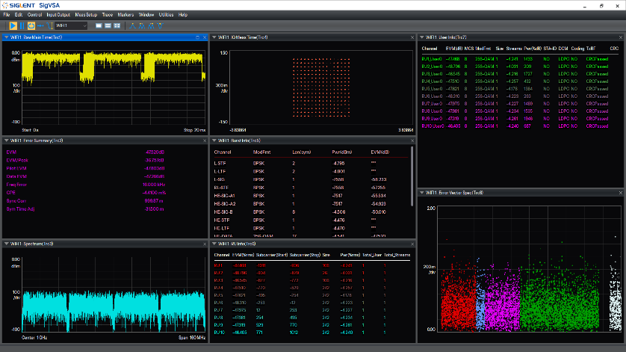
WLAN test
Support IEEE802.11b/a/g/n/ac/ax
Support IEEE802.11 be
Supports multiple signal types:
IEEE 802.11a/g: BPSK, QPSK, 16QAM, 64QAM
IEEE 802.11b/g: DSSS 1Mbps, DSSS 2Mbps, CCK5.5Mbps, CCK11Mbps,
PBCC 5.5Mbps, PBCC 11Mbps;
IEEE 802.11n: BPSK, QPSK, 16QAM, 64QAM;
IEEE 802.11ac: BPSK, QPSK, 16QAM, 64QAM, 256QAM;
IEEE 802.11ax: BPSK, QPSK, 16QAM, 64QAM, 256QAM, 1024QAM;
IEEE 802.11be: BPSK, QPSK, 16QAM, 64QAM, 256QAM, 1024QAM; 4096QAM
Generating WLAN Signals with SigIQPro
Bandwidth: 20MHz, 40MHz, 80MHz, 160MHz, 320MHz
*note: This feature is a function of SigIQPro, and the SSG6082A-V is only used to playback baseband signals
WLAN Signal Testing with SSG6082A-V

Slide 25
4
Part 4
Competition Comparison

Slide 26
… vs Keysight N5186A MXG
 | SSG6082A-V | Keysight N5186A MXG
Frequency range（IQ mode） | 9 kHz to 8 GHz | N5186A-503: 9 kHz to 3 GHz N5186A-506: 9 kHz to 6 GHz N5186A-508: 9 kHz to 8.5 GHz＄48214
Level setting range | -140dBm~30dBm | -135dBm~20dBm(std) -135dBm~20dBm(opt.)
Level setting time | <5 ms (typ.), ALC ON（S&H）,CW mode <10 ms (typ.), ALC OFF (S&H) ,IQ mode | <6 ms (typ.)
SSB phase noise（@1GHz 10kHz offset） | -132dBc/Hz | -134dBc/Hz
Analog modulation | Standard | Optional ＄2554.32/year
Pulse modulation | Optional | Optional＄1714
Pulse train generator | Optional | N/A
S-parameter compensation | Standard | Optional ＄6721.89
Baseband generator Sample rate | 400 Hz to 625 MHz 400 Hz to 1250 MHz (SSG6080AV-B1000 option) | 312.5 MHz (Option B2X) 625 MHz (Option B5X) 1.2 GHz (Option B9X)
RF bandwidth(I+Q) | 1GHz | 900MHz
Arbitrary waveform memory | 2GSa Std. | 256 MSa, Std. 512 MSa, Option M05 1024 MSa, Option M10 2048 MSa, Option M20 ＄10583
Multi-tone | Standard | Optional ＄2554.32/year
Supported protocol types | Bluetooth、LoT、5G NR、LTE TDD/FDD、WLAN | Bluetooth、LoT、5G NR、LTE TDD/FDD、WLAN

Slide 27
… vs R&S SMBV100B
 | SSG6082A-V | R&S SMBV100B
Frequency range（IQ mode） | 9 kHz to 8 GHz | B103 : 8 kHz to 3 GHz B103+B106: 8 kHz to 6 GHz
Level setting range | -110 dBm to 9 dBm, 9 kHz to 100 kHz -110 dBm to 15 dBm, 100 kHz to 1 MHz -140 dBm to 30 dBm, 1 MHz to 8 GHz | –145 dBm to 8 dBm, 8 kHz to 100 kHz –145 dBm to 13 dBm, 100 kHz to 300 kHz –145 dBm to 18 dBm, 300 kHz to 1 MHz –145 dBm to 20 dBm, 1 MHz to 6 GHz
SSB phase noise（@1GHz 10kHz offset） | -132dBc/Hz | -134dBc/Hz
harmonic | -30dBc 1MHz~8 GHz，≤13dBm | -30dBc 1MHz~6GHz，≤13dBm
Sub-harmonic | ＜-80 dBc, 1 MHz to 8 GHz, ≤13 dBm | ＜-75 dBc, 3 GHz to 6 GHz, ≤10 dBm
Analog modulation | Standard | Optional ＄915
Pulse modulation | Optional | Optional＄2180
Pulse source | external, internal | external, Std external, internal, K23 option
Pulse train | Optional | Optional ＄2705
S-parameter compensation | Standard | Optional
Baseband generator Sample rate | 400 Hz to 625 MHz Std. 400 Hz to 1250 MHz Opt. | 400 Hz to 150 MHz Std. 400 Hz to 1200 MHz, Opt.
RF bandwidth(I+Q) | 500 MHz std. 1000 MHz (SSG6080AV-B1000 option) | 120 MHz std. 1 GHz, Option K523 and K524 and K525
Arbitrary waveform memory | 2GSa Std | 64 MSa, Std 2048 MSa, Option 511 and 512 and 513
Multi-tone | Standard | Optional
AWGN | Standard | Optional
Digital Modulation | Standard | Optional
Supported protocol types | Bluetooth、LoT、5G NR、LTE TDD/FDD、WLAN | Bluetooth、LoT、5G NR、LTE TDD/FDD、WLAN

Slide 28
Ordering information
 | Product Description | Order Number | Price
Base Model |  | SSG6082A-V | € 27,680
Standard accessories | Quick start, an USB cable, calibration certificate, power cord
 | Product Description | Order Number | Price
Options | Pulse modulation | SSG6080AV-PU | € 1,220
 | Pulse train generator | SSG6080AV-PT | € 1,520
 | 1G RF bandwidth | SSG6080AV-B1000 | € 7,380
 | Rack Mount Kit | SSG6000A-RMK | € 335
 | USB-GPIB Conversion Adapter | USB-GPIB | € 123
 | Bluetooth Signal Playback | SigIQPro-BT | € 4,910
 | IOT Signal Playback | SigIQPro-IOT | € 4,910
 | General OFDM Signal Playback | SigIQPro-OFDM | € 4,910

Slide 29
We Empower You!

