Slide 1
SHA860A
Handheld Signal Analyzer
EVERY BENCH. EVERY ENGINEER. EVERY DAY.
www.siglent.com

Slide 2
01
02
03
04
Basic Info
Features
Applications
Comparison

Slide 3

01
BASIC INFO

Slide 4
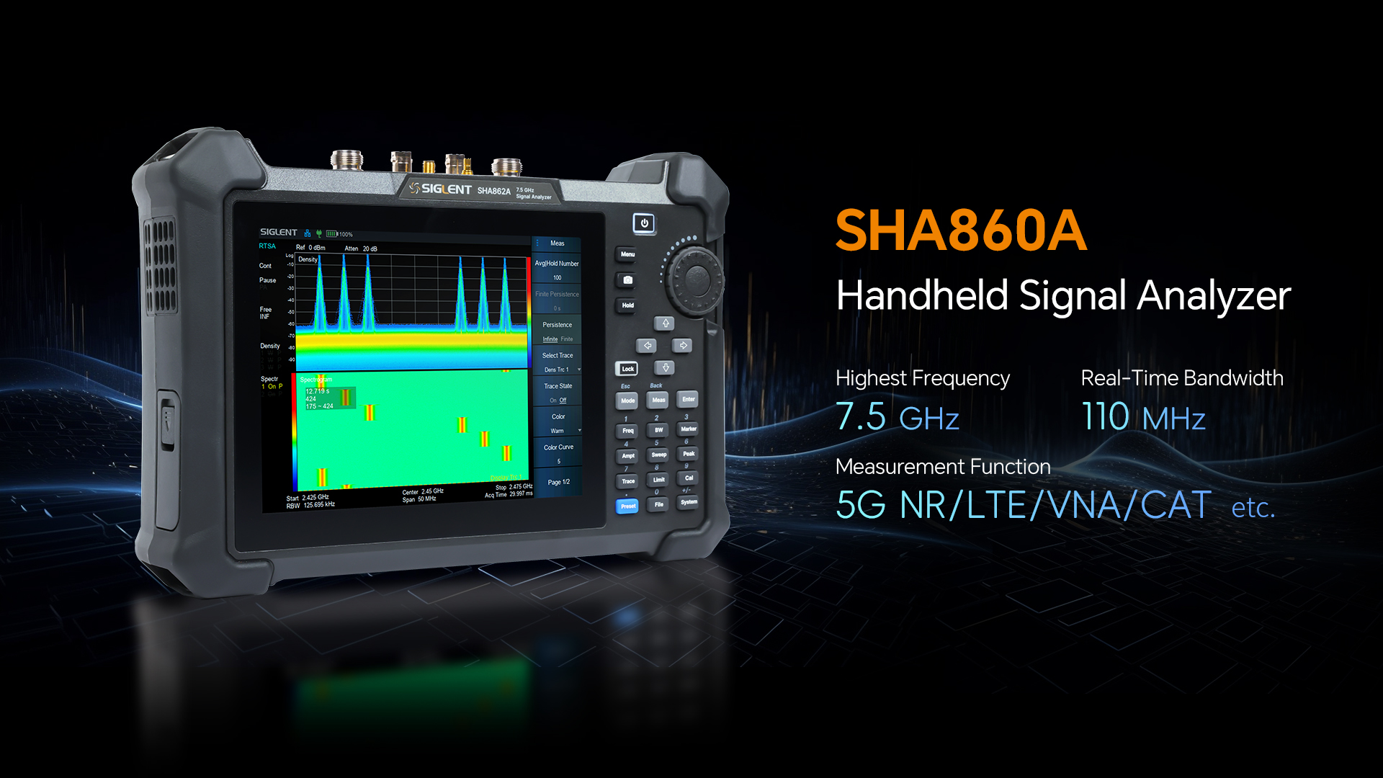

Slide 5
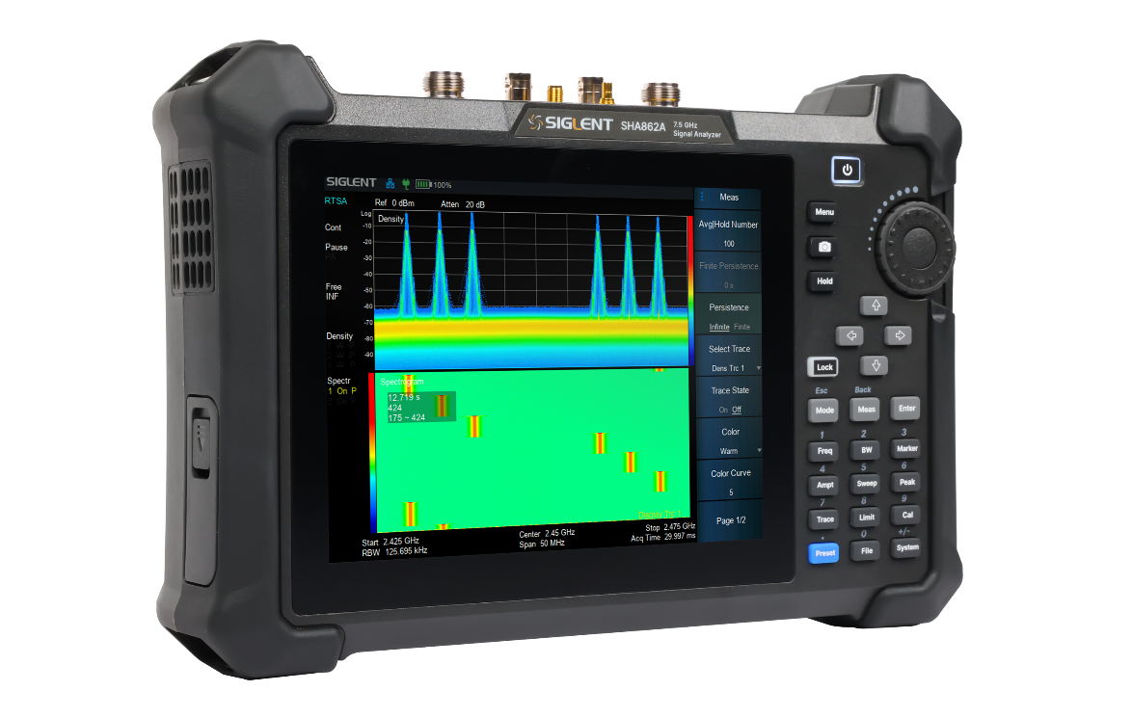
SHA860A Handheld Signal Analyzer
Key Characteristics
Frequency Range 9 kHz~3.6/7.5 GHz, 5 kHz usable
DANL up to -165 dBm/Hz
Phase Noise -104 dBc/Hz at 1 GHz, 10 kHz offset
Analysis Bandwidth 40/110 MHz
5G NR OTA Measurement, multi-PCI and multi-beam analysis
LTE FDD and TDD OTA Measurement, multi-PCI analysis
Channel Power, Occupied Bandwidth, SHI and TOI etc.
IQ Data Acquisition in 110 MHz Band Width
Real-Time Spectrum Analysis, 100% POI time 3.51 µs
Pulse Profile Measurements
Indoor and outdoor map for Coverage Mapping
Trace Recording/Playback with GNSS location
AM/FM/PM Analog Modulation Analysis
ASK/FSK/PSK/MSK/QAM Digital Modulation Analysis
1-Path 2-Ports S11 and S21 Network Analysis
Cable and Antenna Test, Distance To Fault and Time Domain Analysis
TTA test, bias out 12V to 32V DC
Chargeable Battery working time 2.5 hours, 3.2 kg net weight
Technical Highlights
Portability: Compact design for on-site mobility.
Versatility: Combines multiple critical measurement modes in one device.
Precision: High dynamic range and GPS enhanced timing for reliable field results.
SHA860A redefines field testing efficiency, empowering engineers to tackle 5G/LTE deployment challenges with cutting-edge tools in a handheld form factor.
Whether installing the RF system, conducting on-site maintenance and fault diagnosis, monitoring spectrum or finding interference, SHA860A can provide you with the best performance.

Slide 6
Model | SHA860A | SHA850A
Frequency Range | 9 kHz to 3.6/7.5 GHz | 9 kHz to 3.6/7.5 GHz
RBW (-3 dB) | 1 Hz to 10 MHz, in 1-3-10 sequence | 1 Hz to 3 MHz, in 1-3-10 sequence
Measurement Range | DANL to +23 dBm, 1 MHz to 7.5 GHz, Preamp off | DANL to +20 dBm, 1 MHz to 7.5 GHz, Preamp off
Input Attenuation | 0 to 50 dB, in 1 dB steps | 0 to 50 dB, in 2 dB steps
Preamplifier | 25 dB, nominal | 25 dB, nominal
Number of Traces | 6 | 6
Analysis Bandwidth | 40 MHz / 110 MHz (Option SHA860-B1A) | -
Frequency Upgrade | SHA860-F2: SHA861A to SHA862A | SHA850-F2: SHA851A to SHA852A
Battery | 10.8 V, 74 Wh, Lithium ion, 2.5 hours | 10.8 V, 74 Wh, Lithium ion, 4 hours
Analysis Function | Spectrum Analysis Vector Network Analysis Cable and Antenna Test IQ Data Acquisition Advanced Measurement Kit Analog Modulation Digital Modulation Source Bias Out GPS Receiver Outdoor/Indoor Map EMI Measurement 5G NR OTA LTE TDD/FDD OTA Pulse Profile Analysis Real-Time Spectrum Analysis | Spectrum Analysis Vector Network Analysis Cable and Antenna Test IQ Data Acquisition Advanced Measurement Kit Analog Modulation Digital Modulation Source Bias Out GPS Receiver Outdoor/Indoor Map EMI Measurement

Slide 7
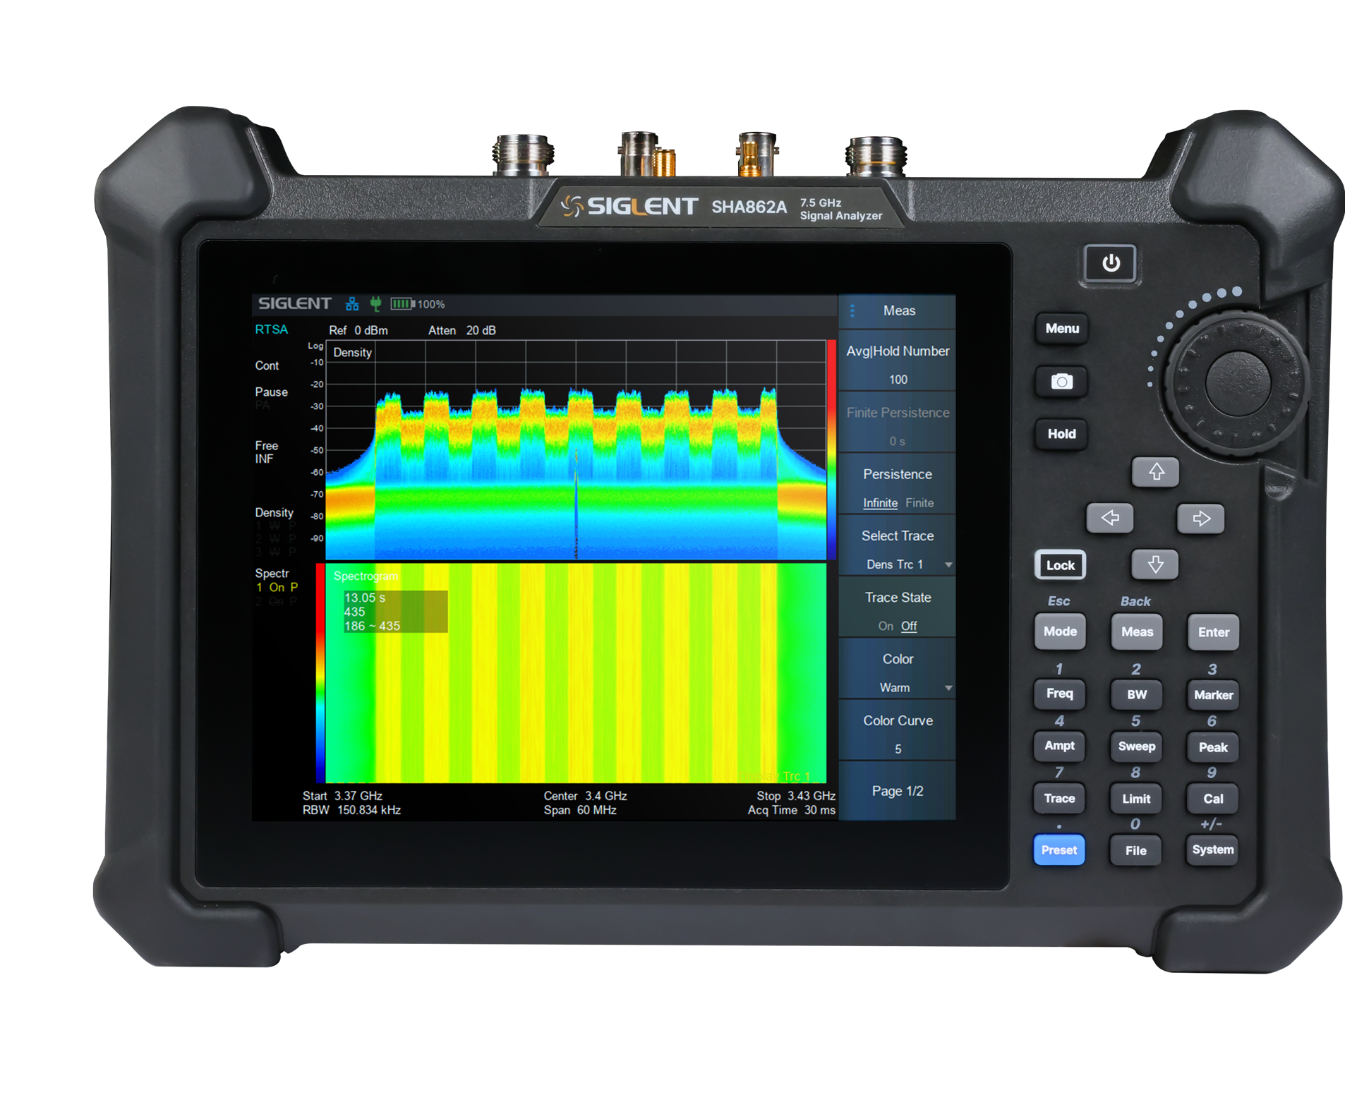
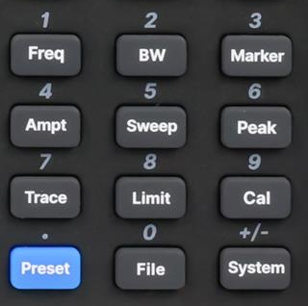
Indicate the Current Operating Mode
8.4 inches TFT-LCD (800 * 600)
Touch Screen
Shortcut Screenshot
Pause or Resume the Current Test Process
Keypad Hard Keys
“1” / Frequency
“2” / Bandwidth
“3” / Marker
“4” / Amplitude
“5” / Sweep
“6” / Peak
“7” / Trace
“8” / Limit
“9” / Calibration
“0” / File
Touch Screen Lock Control
Selection of Operating Mode
(SA/VNA/CAT/5G/LTE, etc.)
Selection of Measurement Function
Multiplexed Keys for Menu Selection and Numeric Entry

Slide 8
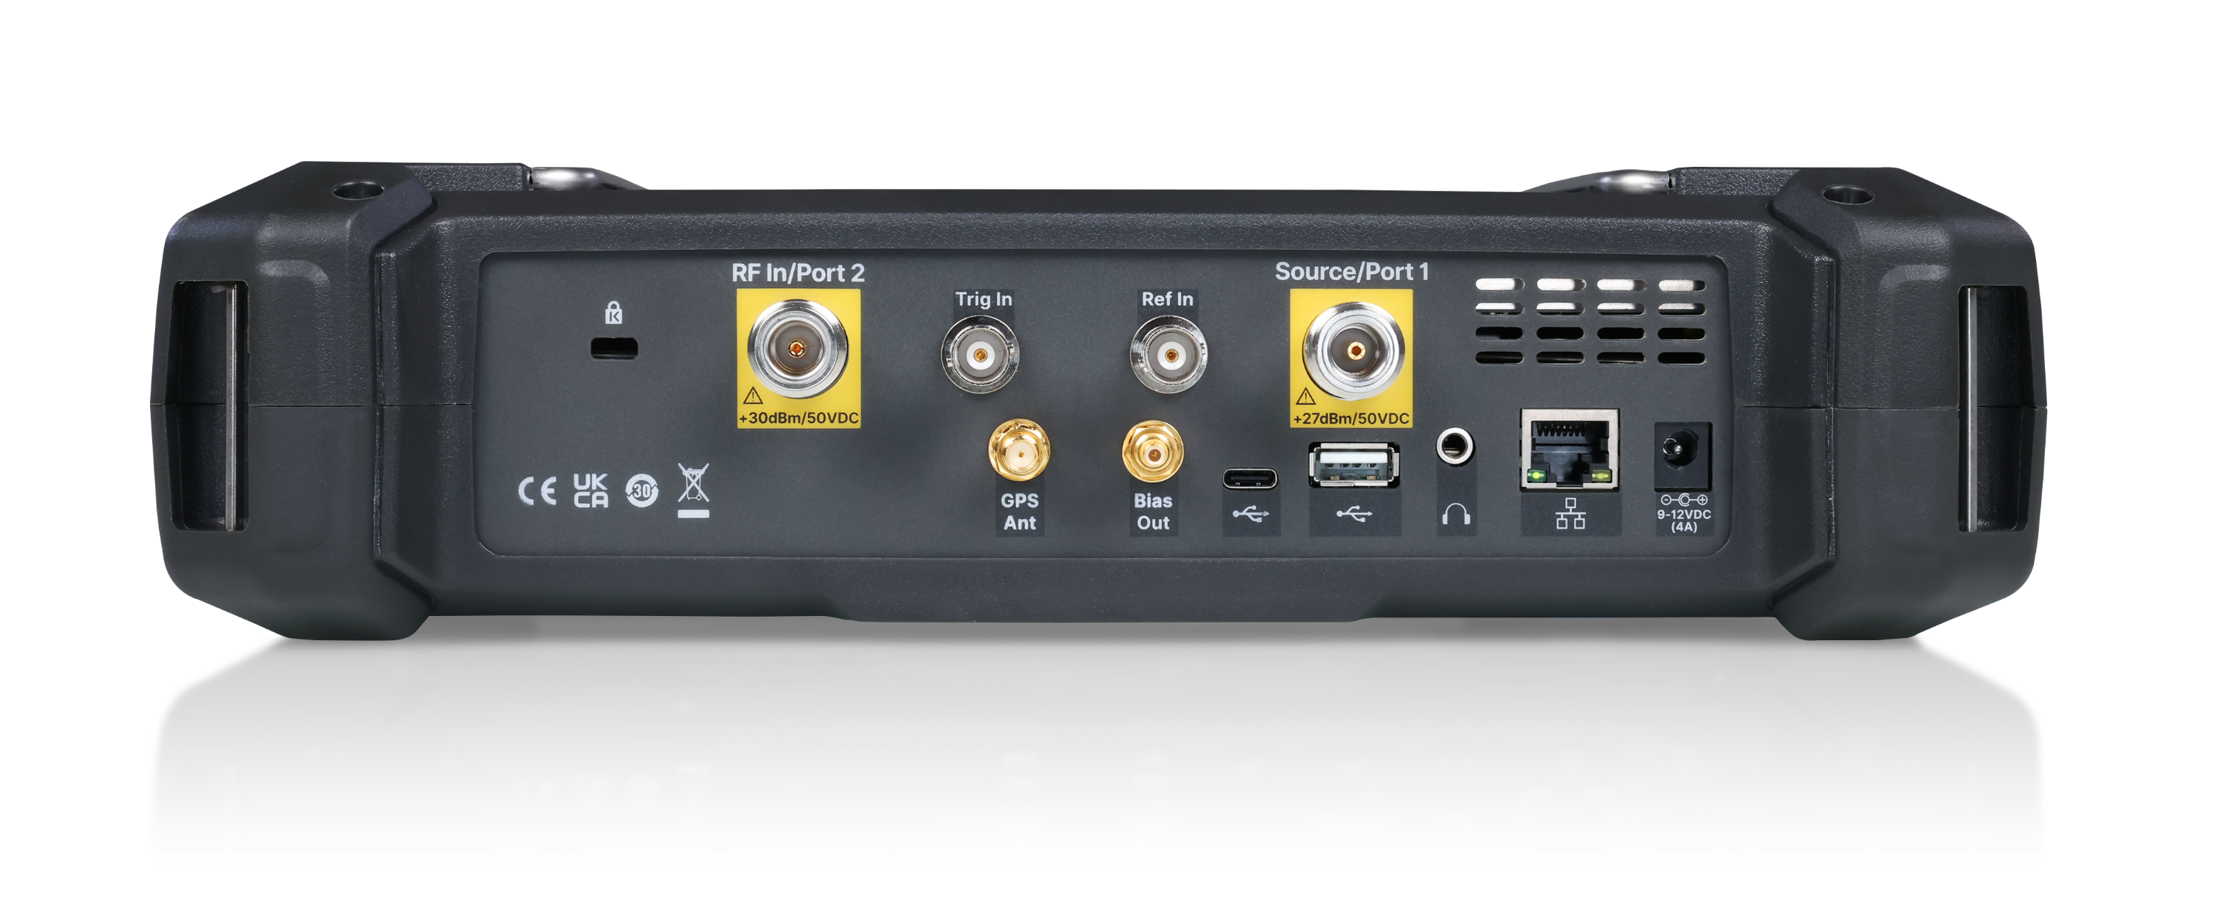
10MHz Ref Clock Input
BNC Female
Establish Clock Sync Between Multiple Instruments
Signal Input: 50Ω N Female
Maximum Input ±50 VDC, + 30 dBm
Trigger Input
BNC Female
Establish Event
Synchronization
Signal Output and Input
50Ω N Female
SA: Signal Output as an Independent Signal Source (SHA860-SOR)
VNA: Built-in Coupler to Achieve a Single Port VNA Function S21/S11
GPS Antenna Port
SMA Female
Location, Sync, Timing
SHA860-GPS
SHA860-MAP
EasyMap
Directional Antenna: ANT-DA1
GPS Antenna: ANT-GPS1
USB Device/Host
LAN
Bias Out
SMB Female
12V-32V
0.1V step
SHA860-BIAS
Ear Phone Jack
3.5 mm
External
Power Supply

Slide 9
02
FEATURES

Slide 10
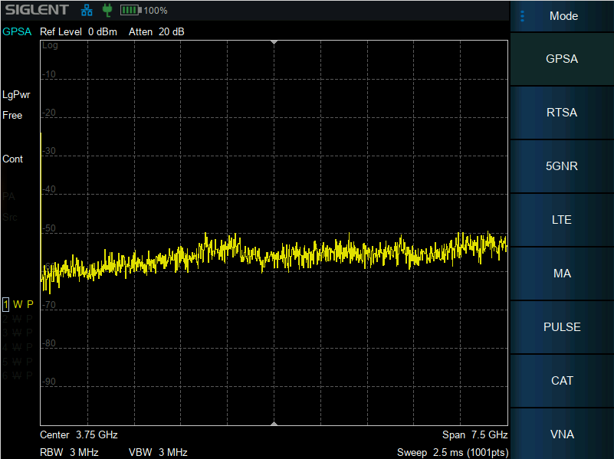
Intuitive Control Experience
Large touchscreen + physical knobs, buttons, and keypad for flexible operation.
Glove-friendly oversized buttons and horizontal screen layout.
Logical functional zoning with dedicated panel keys for quick access.
Compact & Lightweight: Saves space while maintaining testing accuracy.
Dual USB Ports: Connect storage devices, peripherals, or external controllers
Smart Operation Features
⏸️ Measurement Control: Hold/Pause/Resume measurements with one-touch action.
🔒 Lock Function: Disable touchscreen/keypad to prevent accidental inputs during critical tests.

Slide 11
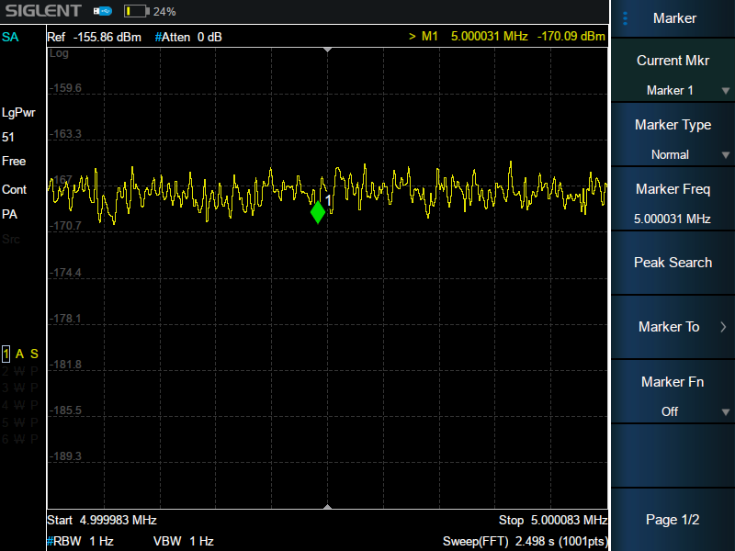
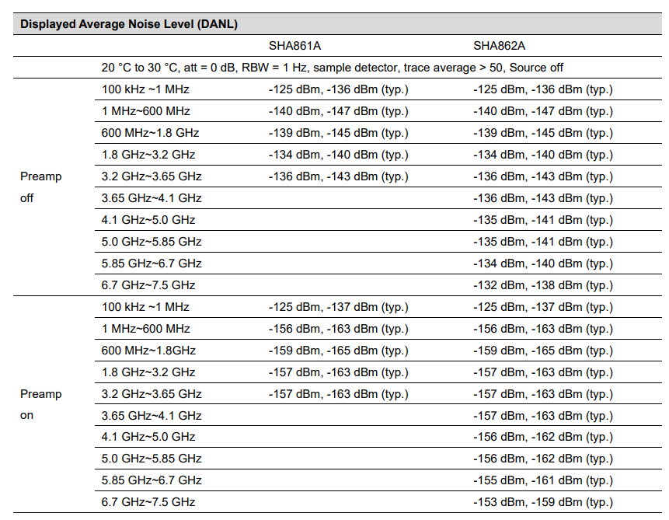
Ultra-Low Noise Performance
Low DANL: -165 dBm/Hz
Low-Noise Architecture: Minimizes internal noise for precise measurements.
High Sensitivity: Enhanced monitoring of low-level RF signals.

Slide 12
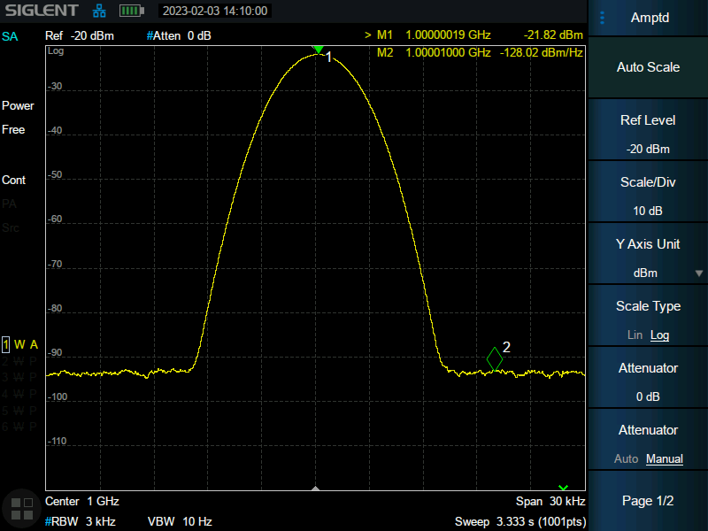
Low SSB Phase Noise
-104 dBc/Hz at 10 kHz offset (fc = 1 GHz).
Critical metric for evaluating oscillator stability and spectral purity.
Excellent phase noise is an important index for evaluating spectrum analyzer.
Model | SSA5000A | SSA3000X-R
Phase Noise 1 GHz, offset 10 kHz | < -105 dBc/Hz (typ.) | < -99 dBc/Hz (typ.)
Model | SVA1000X SSA3000X Plus | SHA860A
Phase Noise 1 GHz, offset 10 kHz | < -98 dBc/Hz (typ.) | < -104 dBc/Hz (typ.)

Slide 13
Test Basic Settings
Parameter Setting | Specifications | Instrument State | Impact | Tips
RBW | 1 Hz ~ 10 MHz, in 1-3-10 sequence | 3dB bandwidth of the IF filter | 1. Frequency resolution 2. Instrument noise floor 3. Sweep speed | 1. Trade-off between test speed and accuracy 2. Use Marker to measure signal power within the current RBW range.
VBW | 1 Hz ~ 10 MHz, in 1-3-10 sequence | Low-pass filter bandwidth for post-detection voltage | 1. Smoothing of displayed noise 2. Sweep speed | 1. Using VBW for noise smoothing may introduce errors in average power measurements. 2. Easy to extract CW signal under noise background.
Reference Level | -200 dBm to +23 dBm, 1 dB steps | Gain of the IF amplifier | Vertical shift of displayed traces | Set the reference level so the measured signal is close to it for optimal visibility.
Attenuator | 0 to 50 dB, in 1 dB steps | Input attenuation linked to IF amplifier gain | 1. Instrument noise floor 2. Instrument internal distortion | Adjust attenuation to verify the authenticity of displayed signals (e.g., check for compression).
Sweep Time | 1 ms to 4000 s | Speed of LO (local oscillator) and display sweep | Test speed | In auto mode, sweep time is set to the fastest possible under current conditions.
Detector Mode | Positive-peak, Negative-peak, Sample, Normal, Average (Voltage/RMS/Video) | Method for extracting frequency/amplitude data | Accuracy for different signal types (e.g., noise vs. CW) | Use RMS detector for noise-like signals to ensure accurate power measurements.

Slide 14
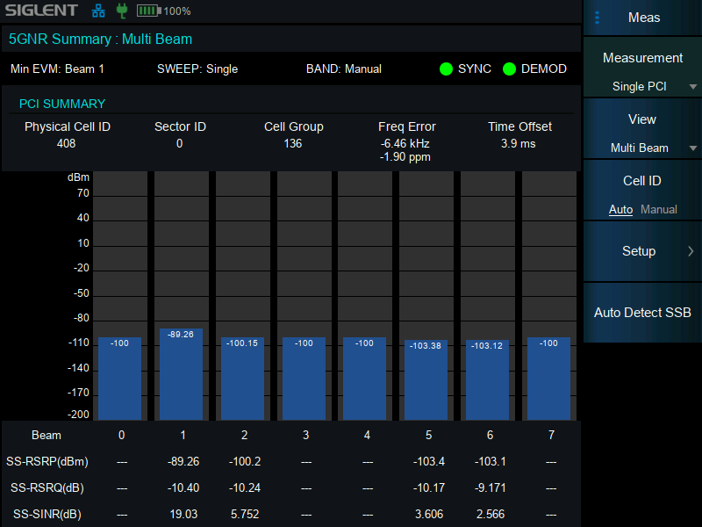
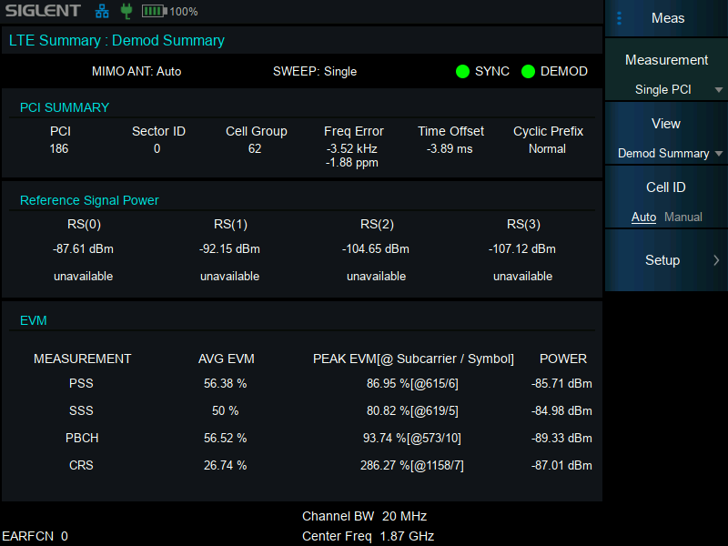
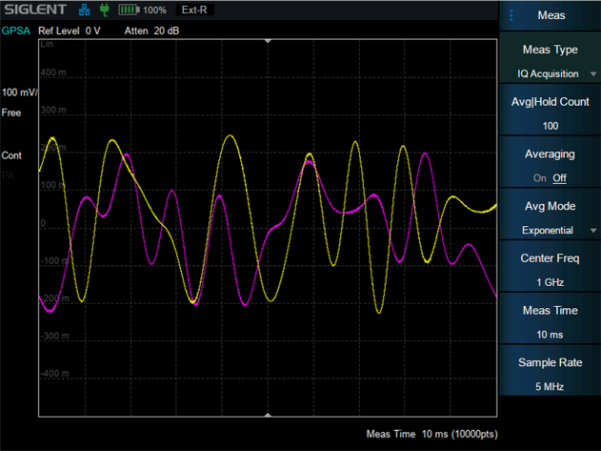
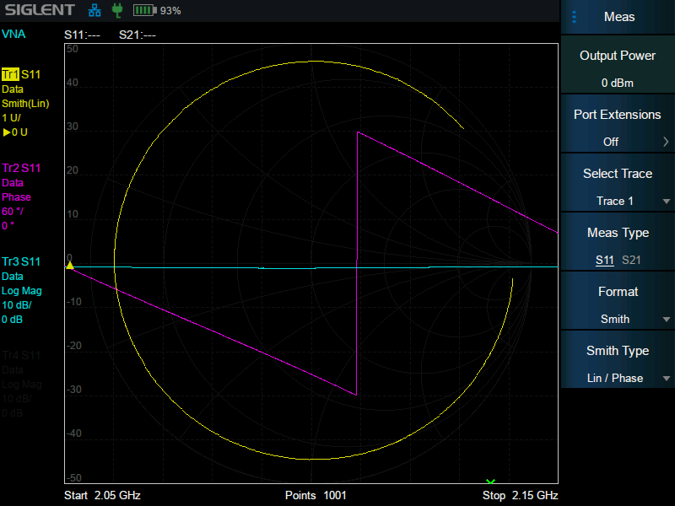
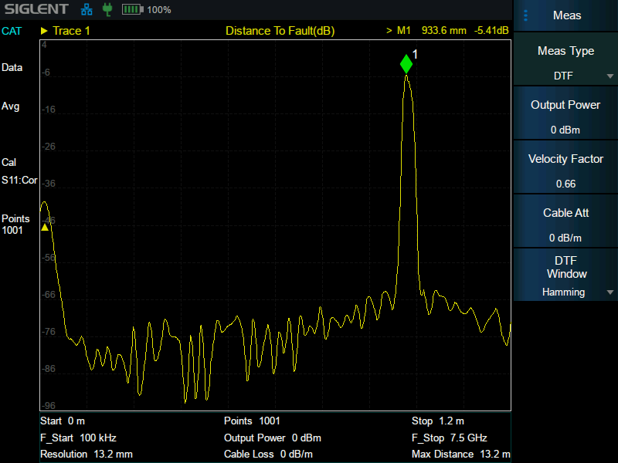
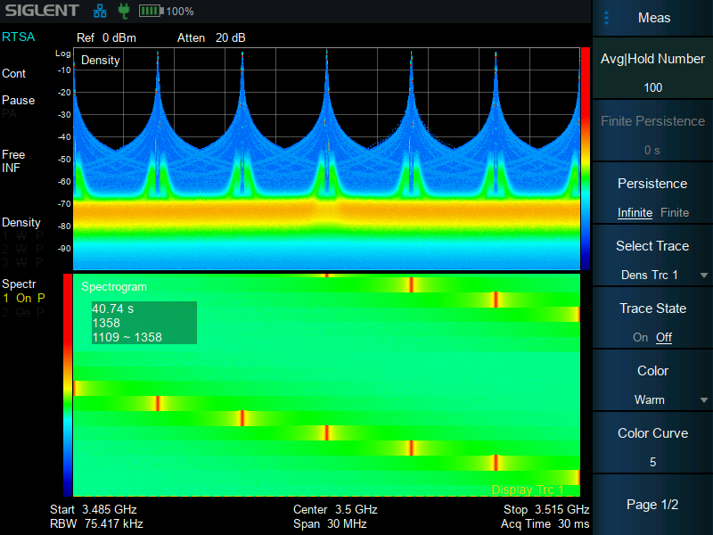
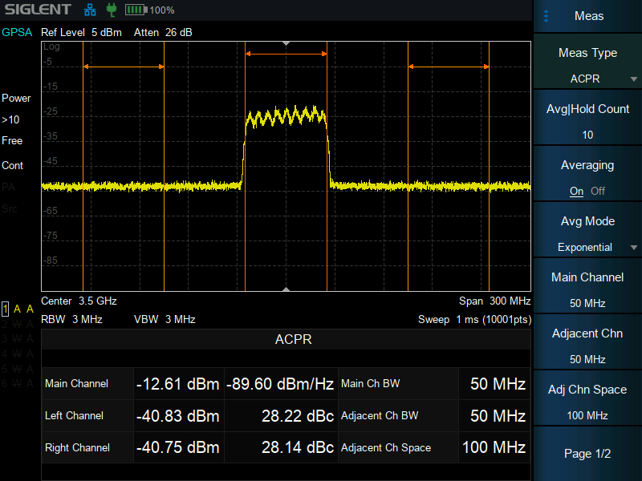
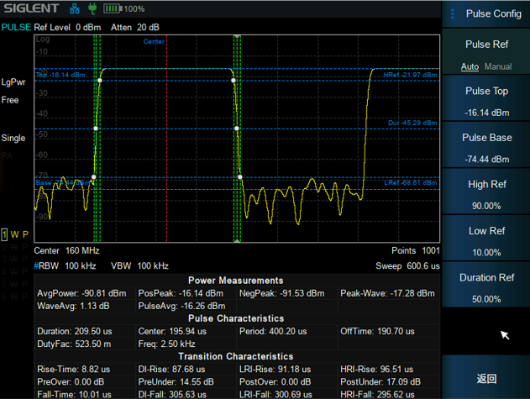
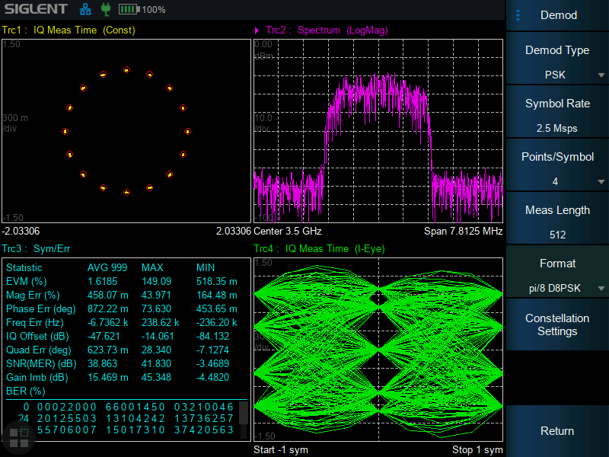
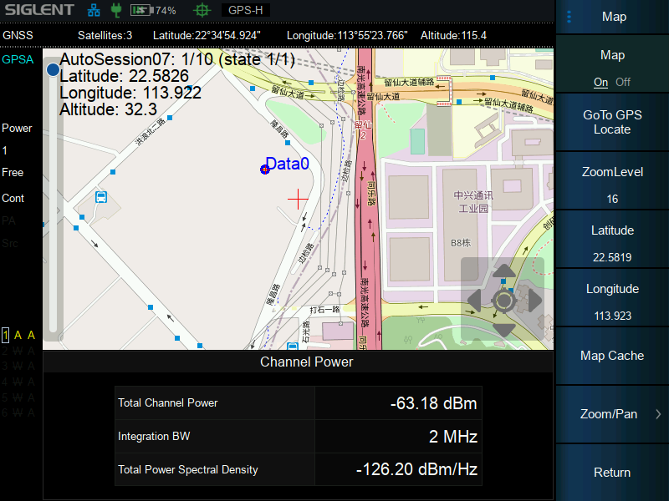
Measurement Function
Efficiently Meet User's Field Test Requirements
5G NR OTA Measurement
LTE OTA Measurement
IQ Data Acquisition
Vector Network Analysis
Cable and Antenna Test
Real-Time Spectrum Analysis
Advanced Measurement Kit
Pulse Profile Measurements
Analog and Digital Modulation
Indoor and Outdoor Map

Slide 15
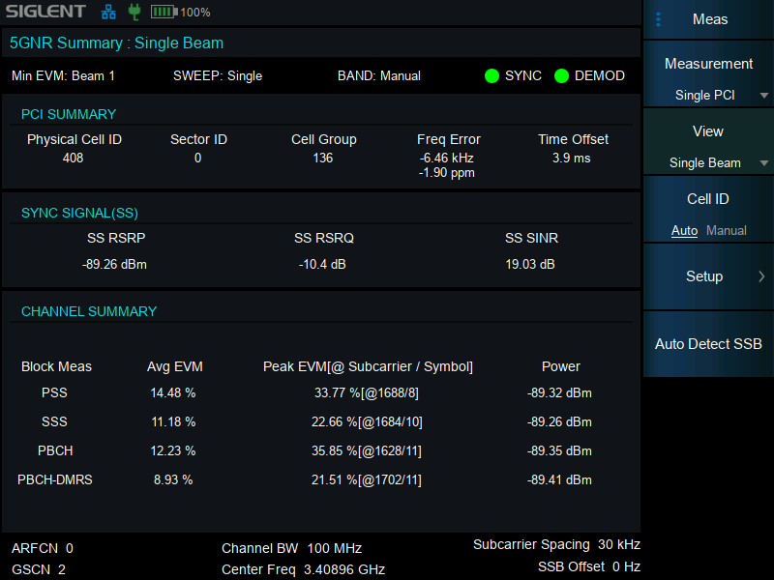
5G NR OTA Measurement
*Requires NR Option
Core Features for 5G Deployment
Network & Beam Validation:
  Measures channel power, SSB Index, frequency error, and beam performance.
  Multi-cell OTA testing: Detects PCI, beam ID, GSCN, SS-RSRP/RSRQ/SINR, and RSSI.
Key Metrics:
  RSRP, RSRQ, RSSI, and cell count (LTE + 5G NSA mode support).
  SSB EVM with constellation display for signal quality.
  Automatic SSB detection for beam-specific analysis.
Advanced Tools
GNSS Sync: 1PPS-triggered Gate Scan for stable spectrum analysis (uplink interference, channel power).
Frame Timing: Precise 4G/5G frame latency measurement.
RAT Interworking: Validates 5G NR + LTE FDD handover.
Applications
5G base station deployment and optimization.
Beamforming performance validation.
Coverage mapping (5G vs. LTE).

Slide 16
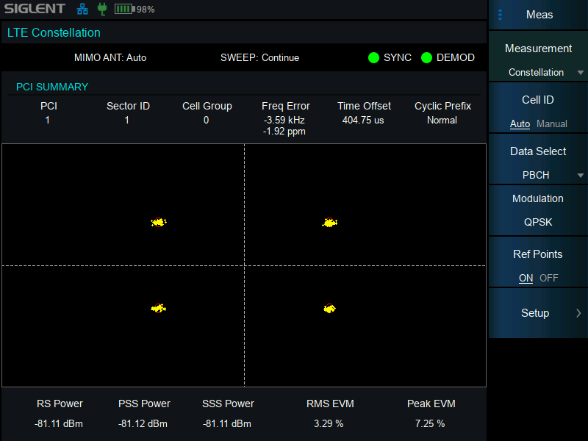
LTE TDD/FDD OTA Measurement
*Requires LTE Option
Core Features for LTE Networks
Critical Metrics:
  PCI, sector ID, cell group, frequency/time offset.
  Power & EVM: PSS/SSS/CRS/PBCH power levels and error analysis.
  Avg/peak EVM with constellation visualization.
Synchronization:
  Sync status and timing alignment for network stability.
Advanced Analysis
OTA Testing:
  Measures CRS/PBCH signal quality and interference.
  Identifies coverage gaps and handover issues.
Multi-Cell Monitoring:
  Detects nearby LTE cells and frequency conflicts.
Applications
LTE network optimization and troubleshooting.
Pre-5G NSA mode readiness validation.
Interference hunting and site acceptance testing.

Slide 17
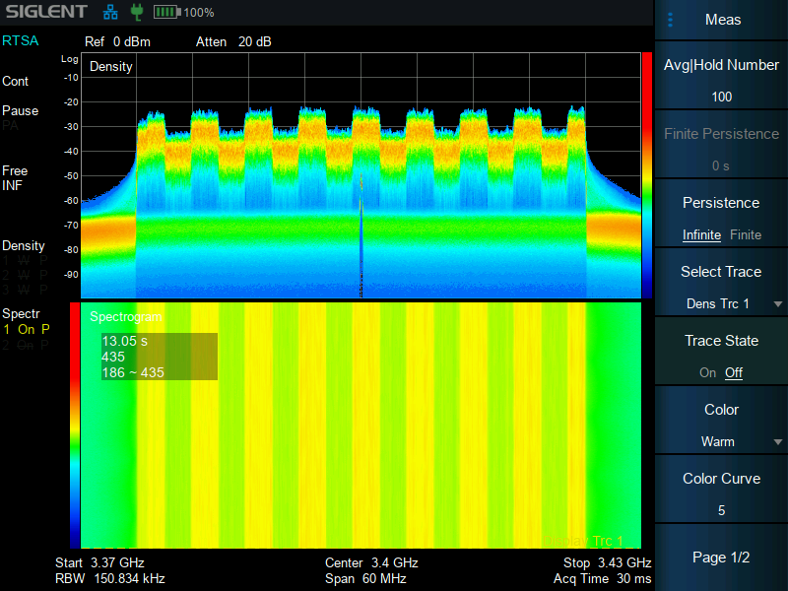
Real-Time Spectrum Analysis
*Requires RTSA Option
Interference
Uplink noise floor rise (no heavy traffic)
Connection failures / High SNR anomalies
Traditional Analyzer Limitations
Long Dead Time: Miss transient signals
Blind Spots: Unpredictable gaps during scanning
Only effective for: Constant signals or max-hold intermittent signals
SHA860 RTSA Advantages
300,000 FFT/s: Real-time capture (zero dead time).
Persistence Display: Catch sporadic signals (infinite mode).
Spectrogram + 125k-frame playback: Time-frequency analysis.
Frequency Mask Trigger (FMT): Trigger & capture IQ data for events.
Key Applications
5G/IoT: Dynamic signal environments
Industrial: Burst interference analysis

Slide 18
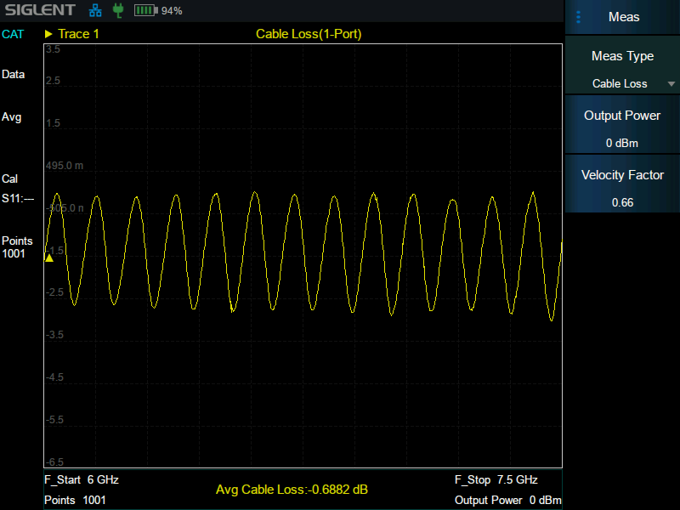
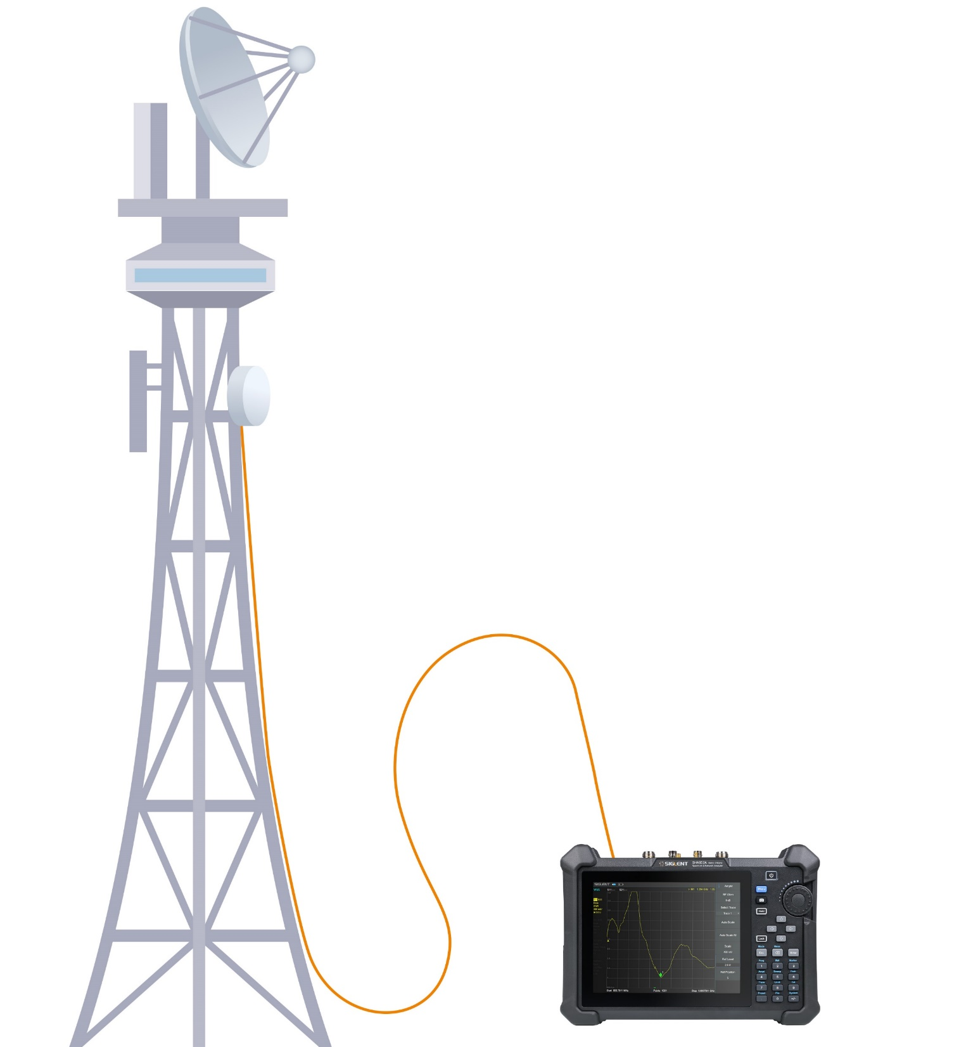
Cable and Antenna Test
*Requires CAT Option
Impact of Component Failures
⚠️ Degraded Performance:
  Reduced signal strength ➔ Coverage shrinkage.
  Call drops & low data rates at cell edges.
⚠️ Revenue Loss: Poor customer experience ➔ Operator churn.
⚠️ Hardware Risks: Antenna mismatch/cable damage ➔ Transmitter failure.
SHA860 Measurement Capabilities
Quick & Accurate:
  Single-port tests: Cable loss, VSWR, Distance-to-Fault (DTF), return loss.
  Instant results for antenna systems & transmission lines.
Critical for:
  Base station deployment, maintenance, and troubleshooting.
  Preventing costly downtime and hardware damage.
Key Benefits
  Efficiency: Streamlines field installation & repairs.
  Precision: Identifies faults (e.g., cable breaks, connector issues).
  Reliability: Ensures optimal RF performance for 4G/5G networks.

Slide 19
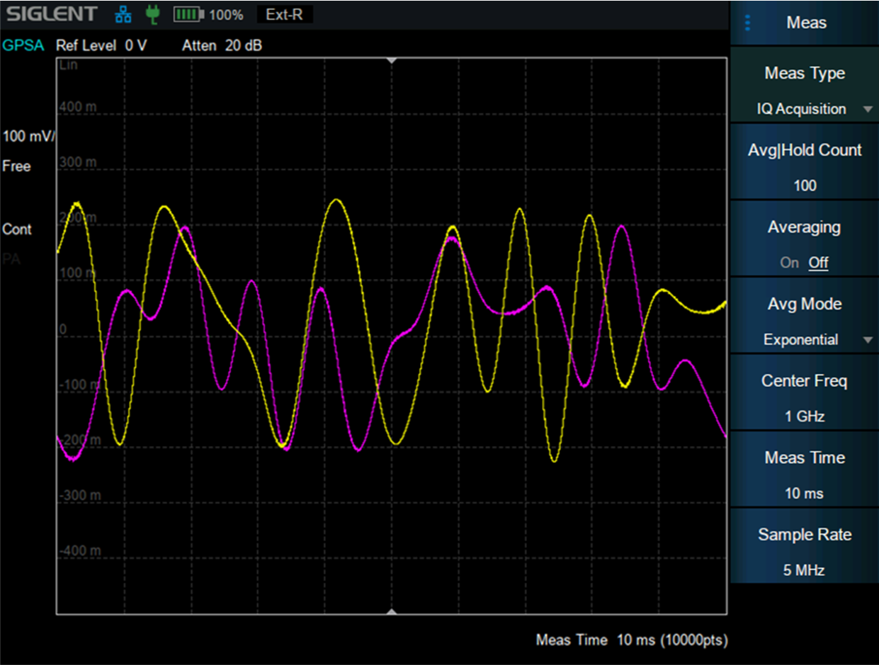
IQ Data Acquisition
*Requires IQA Option
Core Functionality
IQ Data Capture:
  Spectrum Analyzer Mode: Capture raw IQ data with 300 MHz sampling rate and 110 MHz bandwidth.
  Storage: Save to internal memory or external USB.
Signal Reproduction:
  Replay captured signals in the lab using vector signal generators.
Technical Specifications
Hardware Power:
  1 GB RAM, 300 MHz sample rate, 110 MHz bandwidth, 16-bit resolution.
Data Transfer:
  Export IQ data via USB or LAN for offline analysis.
Key Applications
Field Troubleshooting:
  Capture abnormal RF signals for lab-based root-cause analysis.
Signal Visualization:
  Reconstruct and analyze signals with high clarity (time/frequency domains).
R&D Validation:
  Validate device performance under real-world electromagnetic conditions.

Slide 20


Pulse Profile Measurements
*Requires PU Option
Core Functionality
10,001 measurement points
Analyzes power, pulse transitions, and dynamic signal characteristics.
Positive/Negative Peak, Sample, Average, and Conventional detection.
Key Applications
RF Device Validation:
  Test performance under real-world conditions (e.g., burst signals).
  Validate pulse integrity and transient response.
Signal Characterization:
  Capture rise/fall times, overshoot, and pulse stability.
Key Benefits
Ensure compliance with stringent RF standards.
Ideal for R&D, production testing, and field troubleshooting.

Slide 21
Indoor and Outdoor Map
*Requires GPS and MAP Option, Antennas
Core Capabilities
Geotagging: GPS coordinates for all measurements.
GPS Status: Satellite lock indicator & real-time positioning.
Dynamic Mapping:
  Outdoor maps (zoom levels 1-19) + indoor/outdoor
  Track PCI, sector/group IDs, signal power per location
Network Optimization Tools
Coverage Analysis:
  Locate base stations, antenna orientation/height.
  Identify weak coverage zones or interference hotspots.
Data Logging & Playback:
  Record and replay field measurements with ±0.01 ppm accuracy (post-GPS lock).
Key Applications
5G/LTE indoor/outdoor coverage mapping.
Site surveys for network expansion or densification.
Troubleshooting signal gaps in urban/rural environments.

Slide 22
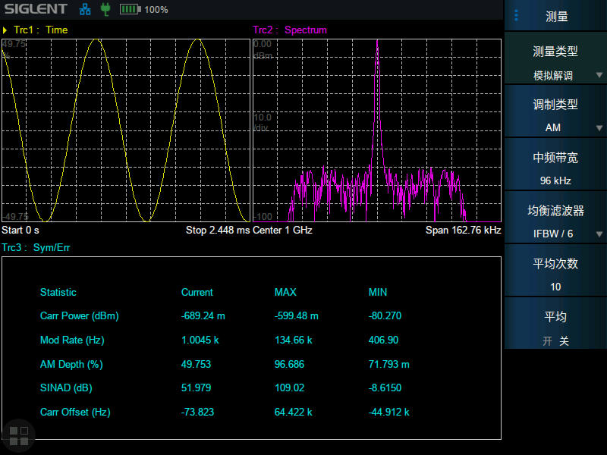
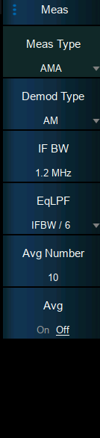
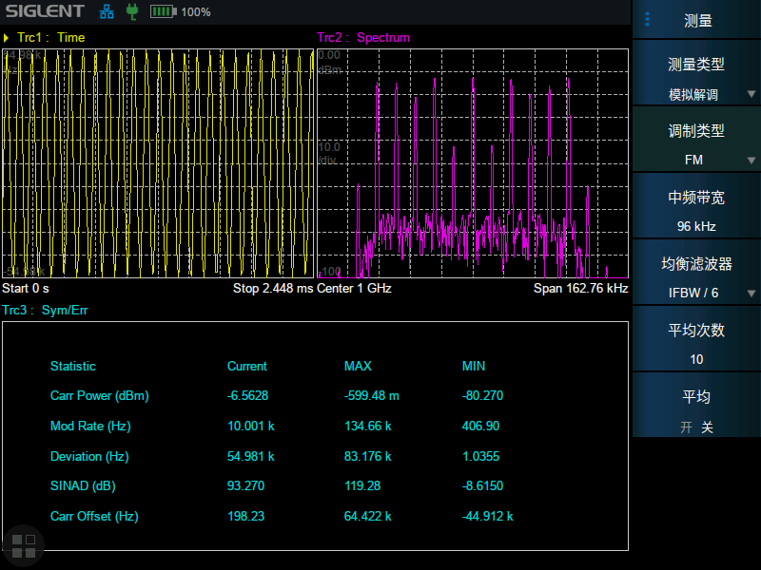
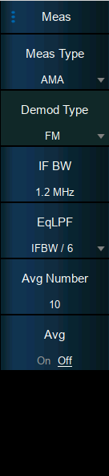
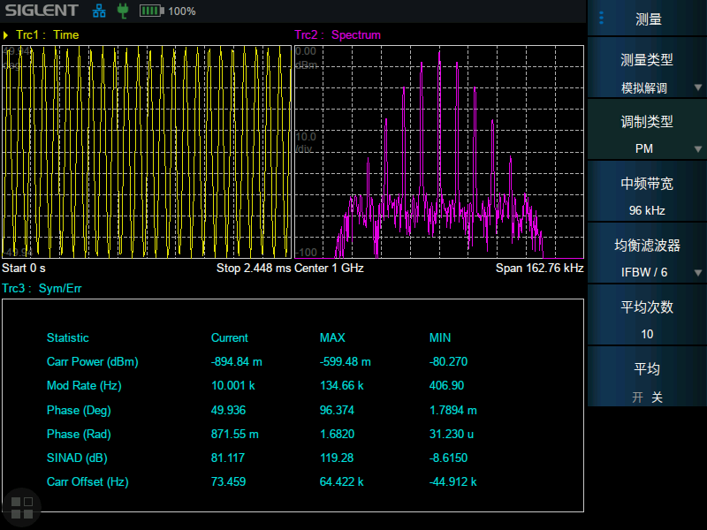
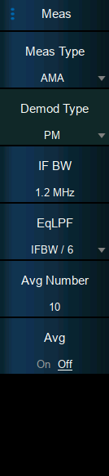
Analog Modulation Analysis
*Requires AMA Option
AM
FM
PM

Slide 23
Digital Modulation Analysis
*Requires DMA Option
EVM (Error Vector Amplitude) calculation
Transmission quality factors, visualization mode including eye diagram and constellation, extend troubleshooting to complex signals and systems.
ASK（2ASK）
FSK：2FSK，4FSK，8FSK，16FSK
MSK（GMSK）
PSK：BPSK，QPSK，OQPSK，8PSK
DPSK：DBPSK，DQPSK，D8PSK，π/4-DQPSK π/8-D8PSK
QAM：16，32，64，128，256

Slide 24
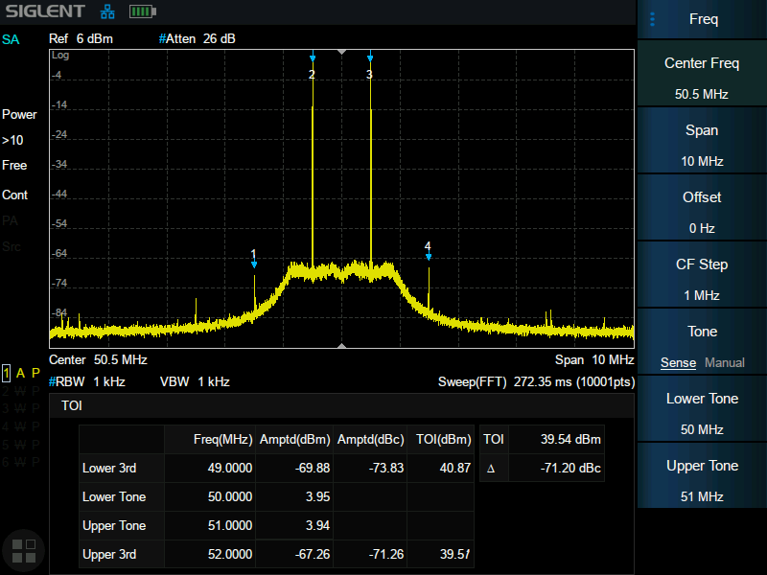
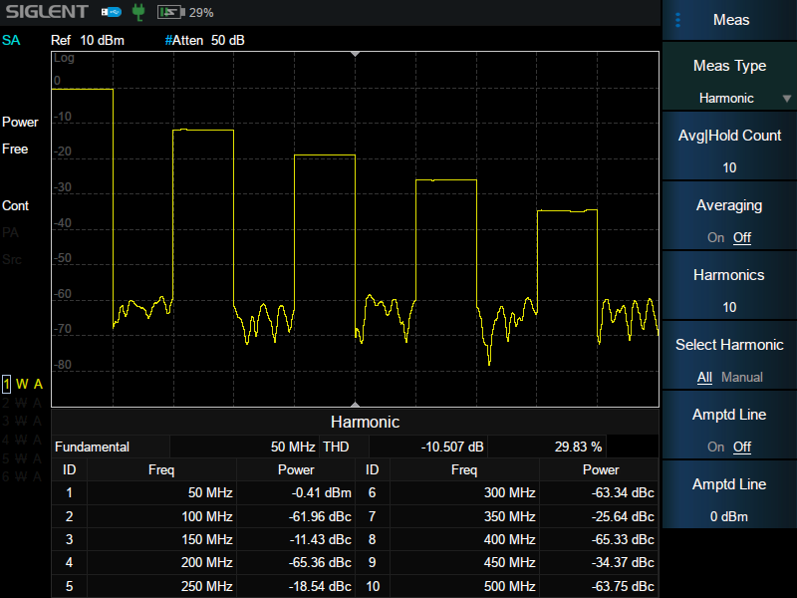
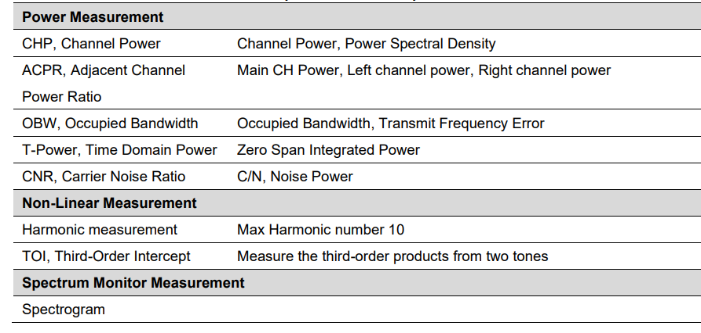
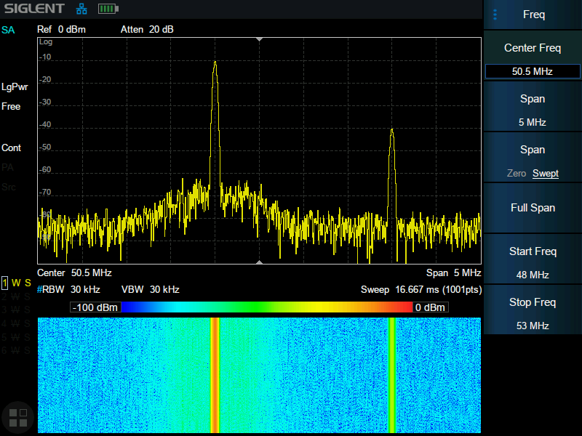
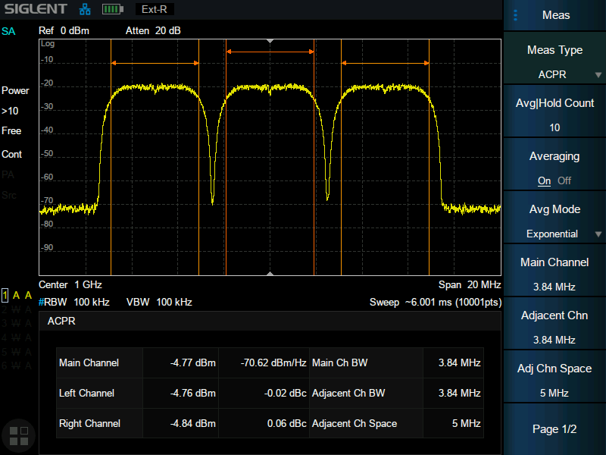
Spectrum Analysis
*Standard / Requires AMK (Advanced Measurement Kit) Option

Slide 25
Vector Network Analysis
*Requires VNA Option
S11 & S21 (magnitude/phase) with Smith Chart impedance visualization.
114dB dynamic range for high-precision characterization.
Up to 10,001 measurement points.
VSWR, out-of-band rejection, insertion loss, return loss…
Port Extension: Eliminates test fixture errors by extending reference planes.
Calibration & Accuracy
Mechanical (open/short/load) and electronic calibration kits.
Ensures traceable results for R&D and production testing.

Slide 26
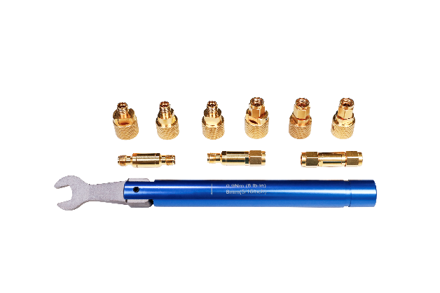
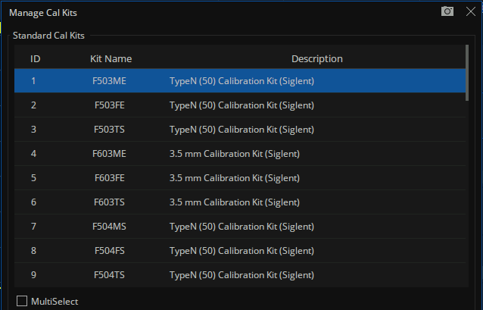
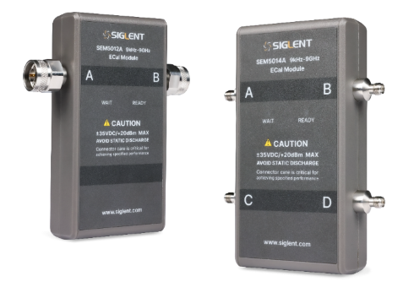
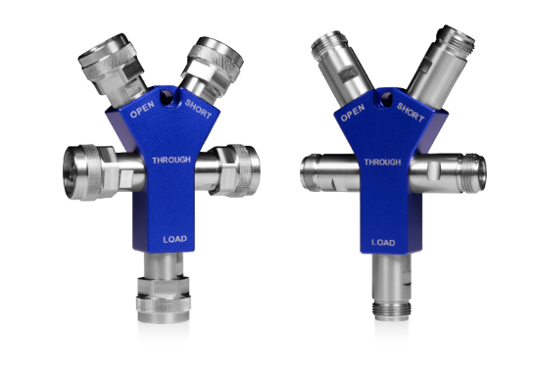
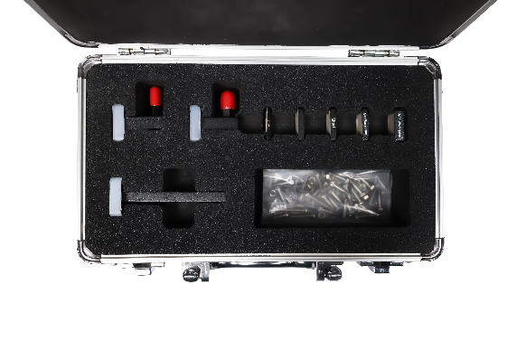
Advanced Calibration Tools
Calibrating network analyzers is critical for high accuracy measurements and can be particularly challenging in non-coaxial environments. The SHA family supports a broad range of mechanical and electronic calibration kits and offers advanced calibration methods to enhance ease-of-use while providing best-in-class accuracy.
Compatible with Various Calibration Pieces
Electronic Calibration Kit
Mechanical Calibration Kit
One-piece Calibration Kit
Waveguide Calibration Kit
SIGLENT protects your investment by supporting the import of calibration kits from other manufacturers and customer-defined calibration kits.

Slide 27
03
APPLICATIONS

Slide 28


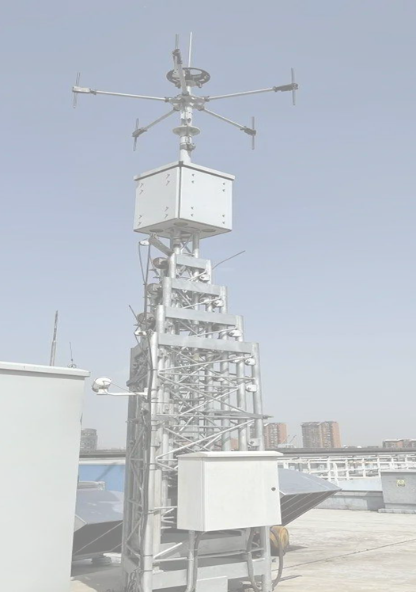
SHA860A Field Application Scenarios
Network Deployment & Optimization
📶 Signal Management:
  Comparative signal power measurement, interference hunting, field strength mapping.
  Telecom drive testing (coverage analysis, handover validation).
📡 Installation & Maintenance:
  Base station setup, antenna/cable testing, DTF analysis.
RF Device & Component Testing
🔧 Device Characterization:
  Amplifiers, filters, mixers:
  bandwidth, linearity, intermodulation distortion.
  Passive components: resistors, capacitors, cables, connectors (VSWR, insertion loss).
📊 Performance Validation:
  RF subsystems (antennas, attenuators) and active/passive component compliance.
Site Engineering & Troubleshooting
🏗️ Site Operations:
  Radio link installation, site surveys, acceptance testing.
  Fault diagnosis (design flaws, assembly errors, signal integrity).
🔍 Critical Scenarios:
  Real-time spectrum analysis for interference, signal drops, or hardware failures.

Slide 29
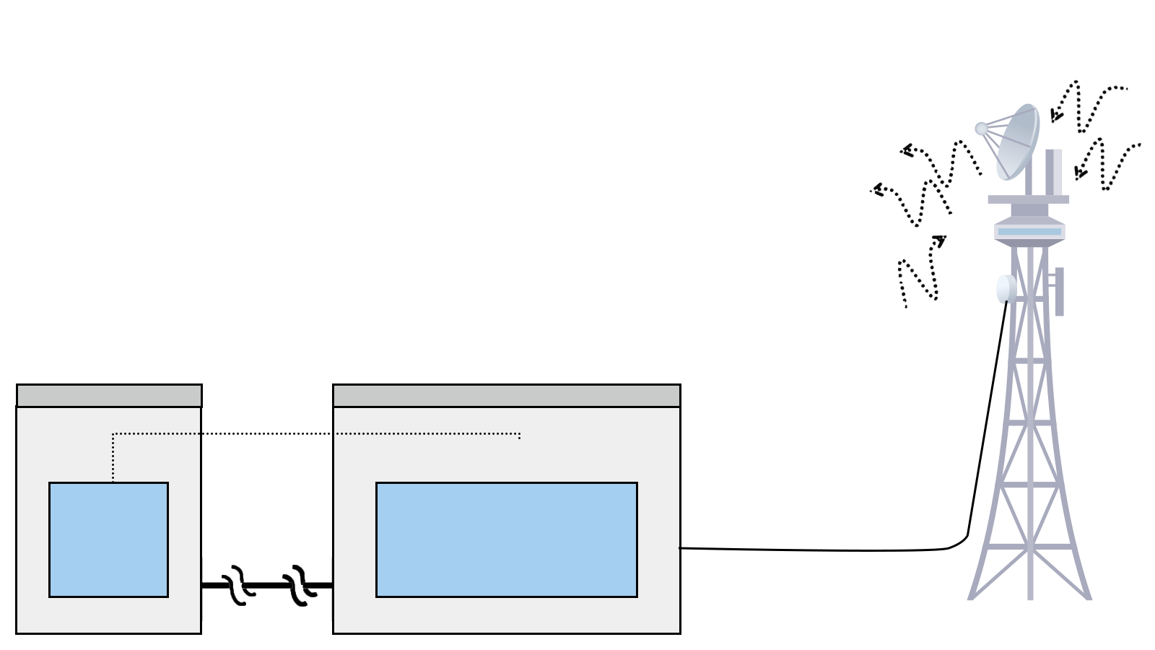
Performance, Portability and Ease of Use
5. Spectrum detection and interference analysis through air signal measurement
6. Use directional antenna to find the position / direction of interference source
Installation and Maintenance of Base Station
Signal Intensity Distribution
Set the best position of antenna, base station
Optimal coverage
…
Transmission Signal Analysis
Spectrum Analysis
Power
Antenna Gain/Isolation
Amplifier Gain
Occupy Bandwidth
Modulation
…
1. Network management found base station traffic problems.
2. The user complaint center found that users complained in some areas.
3. Road test found signal coverage problems in some areas.
Received Signal Analysis
Out-of-band and In-band Spurious Signals
Unattended Transmission Signal
Signal Interference
…
Switching Centre
Base Station
Transmission Side
Transmit
Receive
4. Measuring the characteristics of interference signal through base station antenna
Antenna Tower

Slide 30
04
COMPARISON

Slide 31
Model | SHA861A | SHA862A | N9913B | N9914B | N9915B | FSH4. model .04 | FSH4. model .14 | FSH8. model .08 | FSH8. model .18 | FSH4. model .24 | FSH8. model .28
SA | 9 kHz – 3.6/7.5 GHz (usable to 5 kHz) |  | 9 kHz - 4/6.5/9 GHz (usable to 5 kHz) |  |  | 9 kHz – 3.6/8 GHz |  |  | 100 kHz – 3.6/8 GHz | 100 kHz – 3.6/8 GHz
VNA / CAT | 100 kHz – 3.6/7.5 GHz (usable to 30 kHz) |  | 30 kHz - 4/6.5/9 GHz |  |  | — |  |  | 300 kHz – 3.6/8 GHz | 300 kHz – 3.6/8 GHz
DANL (typ.) | -165 dBm/Hz |  | -163 dBm/Hz |  |  | -165 dBm/Hz
Phase Noise (typ.) | fc = 1 GHz, offset 10 kHz -104 dBc/Hz |  | fc = 1 GHz, offset 10 kHz -117 dBc/Hz |  |  | fc = 500 MHz, offset 30 kHz -105 dBc/Hz
RBW (-3 dB) | 1 Hz to 10 MHz in 1-3-10 sequence |  | 10 Hz to 5 MHz, 1, 3, 10 sequence, Zero span 1 Hz to 5 MHz, Non-zero span |  |  | 1 Hz to 5 MHz in 1/3 sequence 10 MHz, 20 MHz additionally, zero span
VBW (-3 dB) | 1 Hz to 10 MHz in 1-3-10 sequence |  | 1 Hz to 5 MHz, 1, 1.5, 2, 3, 5, 7.5, 10 sequence |  |  | 1 Hz to 3 MHz in 1/3 sequence 10 MHz additionally, zero span
Attenuation | 0 to 50 dB, in 1 dB steps |  | 0 to 40 dB, in 5 dB steps |  |  | 0 dB to 40 dB, in 5 dB steps
Preamplifier | 25 dB, nominal |  | 20 dB |  |  | N/A
Weight | Net: 3.20 kg (7.0 lb) |  | 3.34 kg or 7.35 lb. including battery (approx.) |  |  | 3 kg (6.6 lb)
Battery | 10.8 V, 74 Wh, Lithium ion 2.5 hours |  | 10.8 V, 6.4 A-h, 70 Wh, Lithium ion 4 hours (typical), mode dependent |  |  | nom. 7.2 V, Lithium ion HA-Z204 (standard): 4.2 Ah, 3 h; HA-Z206 (option): 6.3 Ah, 4.5 h
Spectrum Analysis | √ |  | ● |  |  | √
Vector Network Analysis | ● |  | ● |  |  | — | — | — | — | ● | ●
Cable and Antenna Test | ● |  | √ |  |  | — | — | — | — | — | —
EMI Measurement | ● |  | ● |  |  | —
Tracking Generator | — |  | ● |  |  | — | √ | — | √ | √ | √
Preamplifier | √ |  | ● |  |  | √ | √ | √ | √ | √ | √
Source | ● |  | N/A |  |  | —
Bias Out | ● |  | ● |  |  | —
Analog Modulation | ● |  | ● |  |  | —
Digital Modulation | ● |  | — |  |  | —
IQ Data Acquisition | ● |  | ● |  |  | —
Analysis Bandwidth | 40 MHz √ 110 MHz● |  | 10 MHz √ 40 MHz● 100/120 MHz● |  |  | —
LTE OTA | ● |  | ● |  |  | ●
5G NR OTA | ● |  | ● |  |  | —
Pulse Profile Analysis | ● |  | ● |  |  | ●
GPS | ● |  | ● |  |  | ●
Outdoor/Indoor Map | ● |  | ● |  |  | ●
Frequency Upgrade | ● |  | — | — | — | —
Price | $8,880 | $12,980 | $18,310 | $20,418 | $22,381 | $11,415 | $13,905 | $14,850 | $16,900 | $17,230 | $23,420
Standard √ Option ● None —

Slide 32
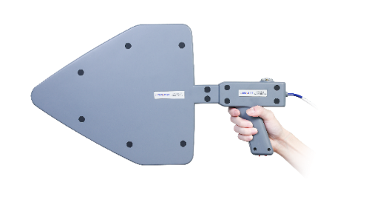
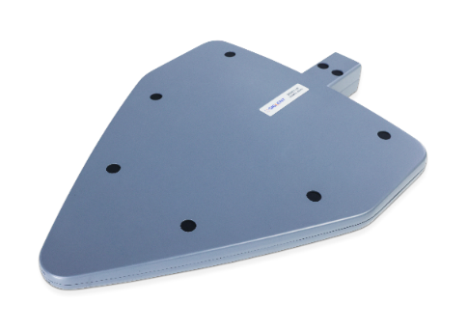
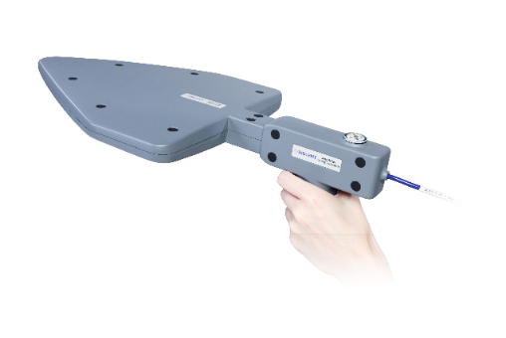
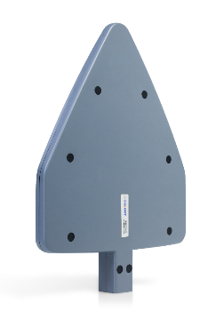
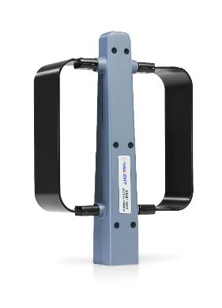
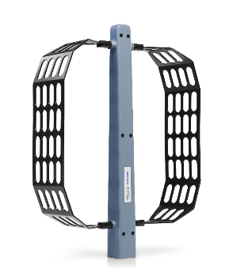
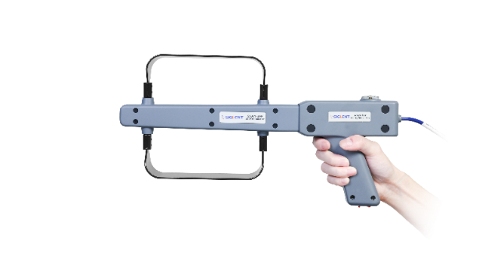





ANT-DA1 Directional Antenna Set
Model | ANT-DA13 (S5001-LP) | ANT-DA12 (S5001-UHF) | ANT-DA11 (S5001-VHF)
Frequency Range | 500 MHz-8 GHz | 200 MHz-500 MHz | 10 MHz-200 MHz
Appearance
Antenna Gain | 10 dB (typ.)
SWR | ＜1:1.9 (typ.)
Direction Of Polarization | horizontal, vertical
RF Interface | 50Ω/N type, female
Handle Radio Frequency Wire | 1.5m /N type, male
Handle Amplifier Gain | 12dB @1GHz, more than 50 hours
Dimensions | 470 x 400 x 240mm
Rough Weight | 4.8kg (including packing box) | 4.8kg (including packing box) | 4.8kg (including packing box)
Net Weight | 0.45kg (including handle 0.96kg) | 0.32kg (including handle 0.83kg) | 0.50kg (including handle 1.01kg)

Slide 33





Type | Model Name | Description | Price | Availability
Product Code | SHA861A | Spectrum Analyzer 9 kHz~3.6 GHz, BW 40MHz | $8,880 | 4-6 weeks
 | SHA862A | Spectrum Analyzer 9 kHz~7.5 GHz, BW 40MHz | $12,980 | 4-6 weeks
Standard Accessories | Quick Start, USB type-C Cable, Power Cord, AC-DC Adapter, Rechargeable Lithium Battery, Portable Bag
Options | SHA860-F2 | SHA861A to SHA862A | $5,180 | Stock
测量选件 | SHA860-B1A | Analysis Bandwidth 110 MHz | $4,580 | Stock
测量选件 | SHA860-AMK | Advanced Measurement Kit | $580 | Stock
测量选件 | SHA860-EMI | EMI Measurement | $780 | Stock
测量选件 | SHA860-NR | 5G NR OTA Measurement | $4,280 | Stock
测量选件 | SHA860-LTE | LTE TDD/FDD OTA Measurement | $2,680 | Stock
 | SHA860-RTA | Real-Time Spectrum Analysis | $3,780 | Stock
测量选件 | SHA860-IQA | IQ Data Acquisition | $3,780 | Stock
测量选件 | SHA860-PU | Pulse Profile Analysis | $1,180 | Stock
测量选件 | SHA860-DMA | Digital Modulation Analysis | $850 | Stock
 | SHA860-AMA | Analog Modulation Analysis | $480 | Stock
 | SHA860-SOR | Source | $420 | Stock
 | SHA860-CAT | Cable and Antenna Test | $1,280 | Stock
 | SHA860-VNA | Vector Network Analysis | $1,580 | Stock
 | SHA860-BIAS | Bias Out | $200 | Stock
 | SHA860-GPS | GPS Receiver | $280 | Stock
 | SHA860-MAP | Outdoor/Indoor Map | $980 | Stock
 | EasyMap | Outdoor/Indoor Map Tile Download PC Software | $580 | Stock

Slide 34
Type | Model Name | Description | Price | Availability
Product Code | SHA861A | Spectrum Analyzer 9 kHz~3.6 GHz, BW 40MHz | € 8,520 | 4-6 weeks
 | SHA862A | Spectrum Analyzer 9 kHz~7.5 GHz, BW 40MHz | € 12,460 | 4-6 weeks
Standard Accessories | Quick Start, USB type-C Cable, Power Cord, AC-DC Adapter, Rechargeable Lithium Battery, Portable Bag
Options | SHA860-F2 | SHA861A to SHA862A | € 4,980 | Stock
测量选件 | SHA860-B1A | Analysis Bandwidth 110 MHz | € 4,380 | Stock
测量选件 | SHA860-AMK | Advanced Measurement Kit | € 550 | Stock
测量选件 | SHA860-EMI | EMI Measurement | € 750 | Stock
测量选件 | SHA860-NR | 5G NR OTA Measurement | € 4,100 | Stock
测量选件 | SHA860-LTE | LTE TDD/FDD OTA Measurement | € 2,580 | Stock
 | SHA860-RTA | Real-Time Spectrum Analysis | € 3,630 | Stock
测量选件 | SHA860-IQA | IQ Data Acquisition | € 3,630 | Stock
测量选件 | SHA860-PU | Pulse Profile Analysis | € 1,130 | Stock
测量选件 | SHA860-DMA | Digital Modulation Analysis | € 820 | Stock
 | SHA860-AMA | Analog Modulation Analysis | € 460 | Stock
 | SHA860-SOR | Source | € 400 | Stock
 | SHA860-CAT | Cable and Antenna Test | € 1,230 | Stock
 | SHA860-VNA | Vector Network Analysis | € 1,520 | Stock
 | SHA860-BIAS | Bias Out | € 190 | Stock
 | SHA860-GPS | GPS Receiver | € 270 | Stock
 | SHA860-MAP | Outdoor/Indoor Map | € 940 | Stock
 | EasyMap | Outdoor/Indoor Map Tile Download PC Software | € 550 | Stock

Slide 35
EVERY BENCH. EVERY ENGINEER. EVERY DAY.

