Slide 1
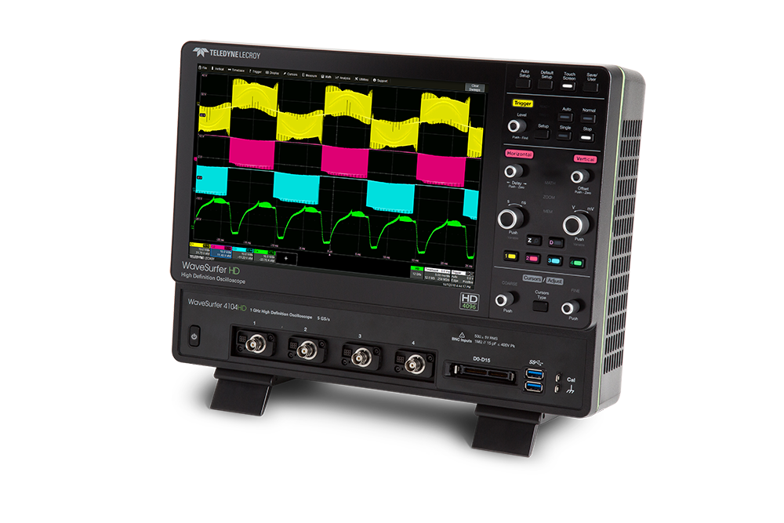
WaveSurfer 4000HD Oscilloscopes Public Release – November 5, 2019
Notes:
Welcome to NPI

Slide 2
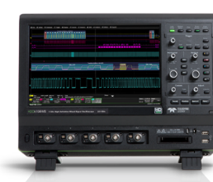
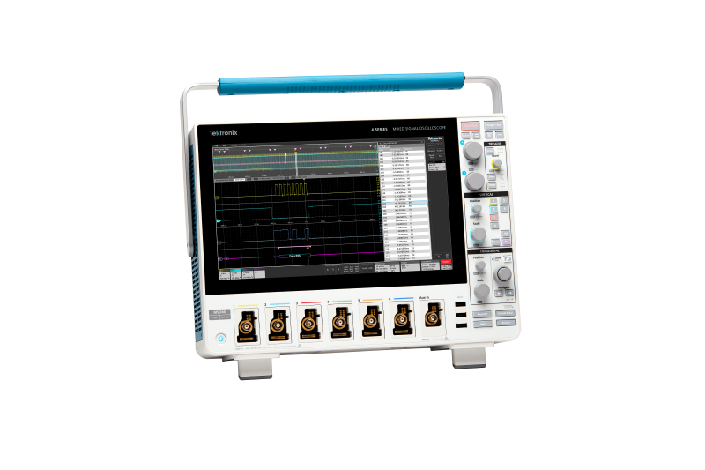
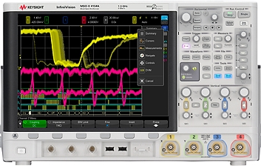
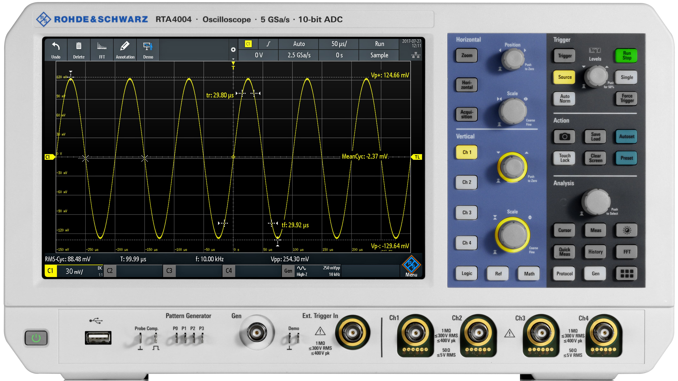
High Resolution “Economy” or “Premium Economy” Oscilloscopes None of the competitors can match 12 bits all the time
2011
2012
2013
2014
2015
2016
2017
2018
2019
HDO4000
12 bits,
200 MHz - 1 GHz
HDO4000A
12 bits
200 MHz - 1 GHz
12 bits
Tektronix 4 series
12-bit ADC*
200 MHz – 1.5 GHz
*Defaults to 8-bits.
10-bit noise performance in High Res mode
10 bits
Rohde & Schwarz RTA4000
10-bit Resolution*
200 MHz – 1 GHz
*advertised as 10 bits but has 8-bit resolution noise performance
Keysight 4000 X Series
8 bits
200 MHz – 1.5 GHz
8 bits
Teledyne LeCroy
First to market with 12-bit systems (HD4096)
Systems approach for 12 bits all the time
Keysight
No product in this price/performance range with claims of > 8 bits performance.
Rohde & Schwarz
Advertised as 10 bit resolution, but noise performance is worse than 8-bit resolution oscilloscopes.
Tektronix
Last to enter “high resolution” market
4 Series has 12-bit ADC with 12-bit resolution claims, but noise performance is only 10 bits in High Resolution mode
Notes:
Econ = Distributor stocks filtered. There is a Need for a HD4096 technology oscilloscope in the Premium Econ space.

Slide 3
Introducing WaveSurfer 4000HD

Slide 4
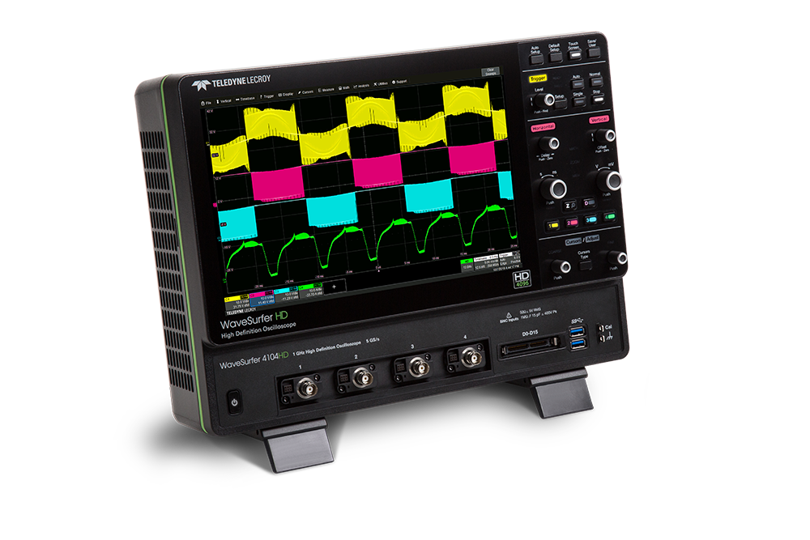
Introducing WaveSurfer 4000HD Unrivaled Performance, Unbeatable Value
Unrivaled Performance
Resolution: 12 bits
Bandwidth: 200 MHz - 1 GHz
Sampling Rate: 5 GS/s
Memory: 25 Mpts
Unbeatable Value
Starting at $7,490
Comprehensive Probe Support
ProBus interface
30 probes over 9 categories
Notes:
12 bits all the time and 30% cheaper than current entry-level 12-bit product
ProBus

Slide 5
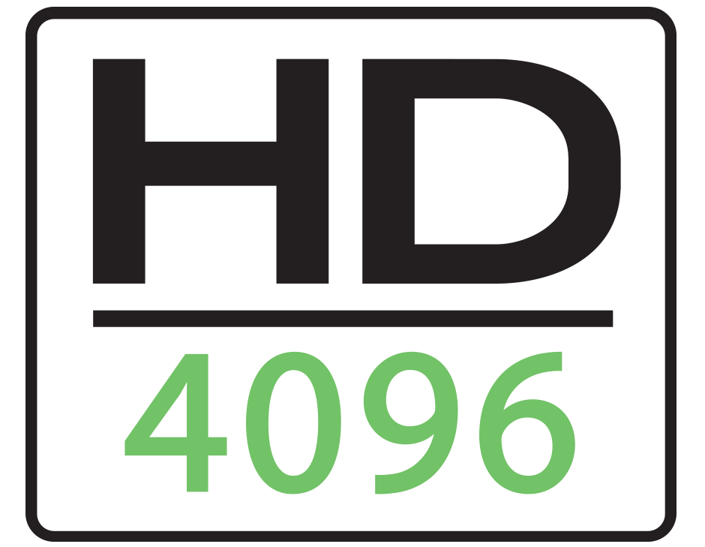
Unrivaled Performance, Unbeatable Value Most compelling and obvious differentiation
Unrivaled Performance
Unbeatable Value
12 bits all the time
12 bits for the price of 8 bits
Notes:
This is the story you want to tell customers. This is the compelling and obvious differentiation.

Slide 6
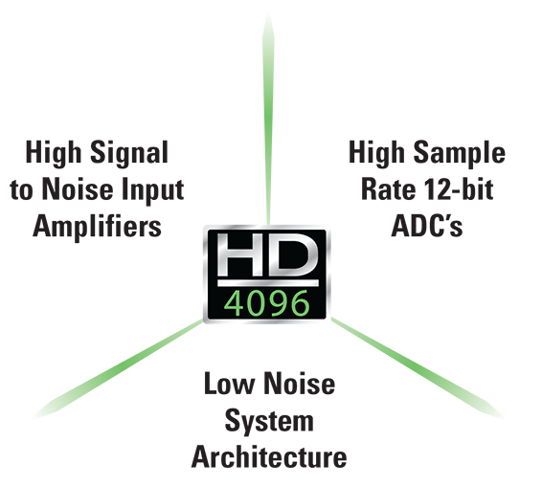
Teledyne LeCroy HD4096 Brand Messaging Only Teledyne LeCroy takes a systems approach to achieve best high resolution performance
System Approach = “12 bits all the time”
Analog-to-Digital Converter
Front-end Amplifier
System Architecture
Benefits = “16x closer to perfect”
Clean, crisp waveforms
Low baseline noise
High effective number of bits (ENOB)
More signal details
4096 vertical levels (vs. 256)
Unmatched measurement precision
0.5% gain accuracy
High channel-channel isolation
Notes:
What is Systems approach? Our recipe to achieve best performance

Slide 7
WaveSurfer 4000HD has lots of capability Differentiation against competition is not achieved here
Unrivaled Performance
Unbeatable Value
12 bits all
the time
Multi-instrument
Probe support
170,000 wfms/sec
Dedicated MSO
Arbitrary Wfm Gen
Spectrum Analyzer
Digital Voltmeter
MAUI OneTouch
12 bits for the price of 8 bits
Notes:
Focus on the Story… not on the overlap stuff. Those are the checkbox items.
Reason why customer should like WS4KHD should be the story. That’s the differentiation. Everyone has the capability.

Slide 8
Focus on the most compelling and obvious differentiation
Unrivaled Performance
Unbeatable Value
12 bits all
the time
Multi-instrument
Probe support
170,000 wfms/sec
Dedicated MSO
Arbitrary Wfm Gen
Spectrum Analyzer
Digital Voltmeter
MAUI OneTouch
12 bits for the price of 8 bits
Notes:
Focus on the Story… not on the overlap stuff. Those are the checkbox items.
Reason why customer should like WS4KHD should be the story. That’s the differentiation. Everyone has the capability.

Slide 9
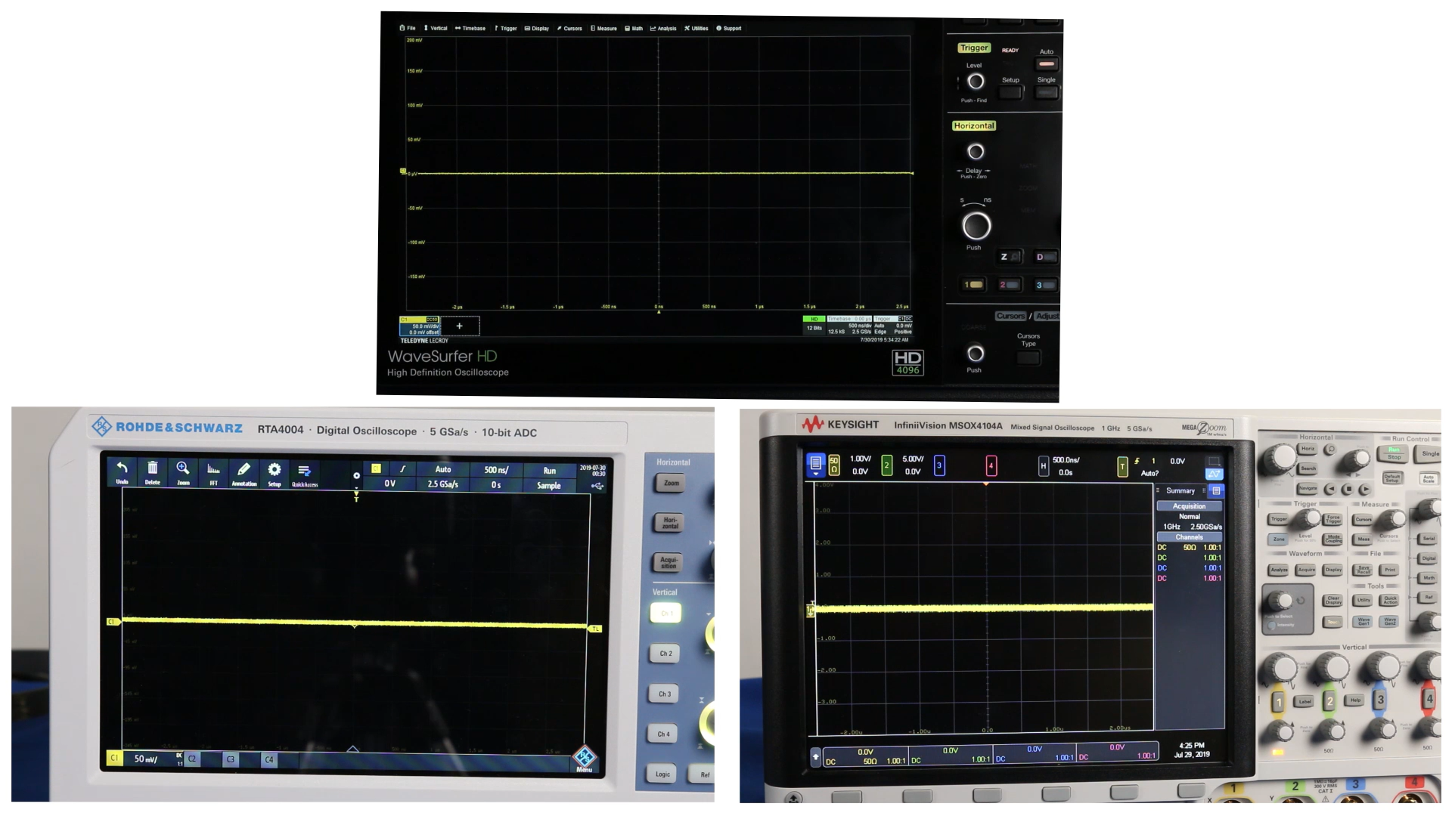
WaveSurfer 4000HD has Unrivaled Performance We have the lowest baseline noise and best accuracy
12 bits all the time
16x better resolution than 8-bit oscilloscopes
4x better than true 10-bit oscilloscopes
Lowest baseline noise
8x better than R&S
4x better than KeySight
3x better than Tek
Highest accuracy
3-5x better at 1mV/div
Large native offset
5 mV/div: +/- 4V
50 mV/div: +/- 16V
5 V/div: +/- 400V
Thinner trace is better
Teledyne LeCroy
Rohde & Schwarz
Keysight
200 MHz scope but noise is worse than 1 GHz Keysight
Notes:
HD4096 technology means lowest noise for us.
Competitors’ baseline noise makes NO sense. Why is R&S 10-bit ADC worse than Keysight 8 bits?

Slide 10
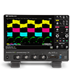
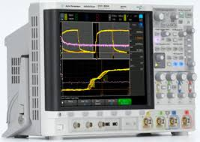
WaveSurfer 4000HD: Unrivaled Performance, Unbeatable Value Same price as competitors charge for 8-bit performance
 | Teledyne LeCroy | Tektronix MSO44 | Keysight 4000X | R&S RTA4000
Vertical Resolution | 12 bits | 8 bits: 6.25 GS/s 12 bits: 3.125 GS/s | 8 bits | 10 bits
Baseline Noise, 5 mV/div | 130 µV_{RMS} | 305 µV_{RMS} | 301 µV_{RMS} | 270 µV_{RMS}
Baseline Noise, 50 mV/div | 324 µV_{RMS} | 800 µV_{RMS} | 1370 µV_{RMS} | 2400 µV_{RMS}
Baseline Noise, 100 mV/div | 567 µV_{RMS} | 1620 µV_{RMS} | 2240 µV_{RMS} | 4600 µV_{RMS}
Baseline Noise, 1 V/div | 5.69 mV_{RMS} | 13.00 mV_{RMS} | 22.35 mV_{RMS} | 31.40 mV_{RMS}
DC Vertical Gain Accuracy | ±0.5% F.S. | ±2.5% ≤1mV/div ±1% >1 mV/div derated at 0.1%/°C above 30°C | ±2% F.S. | ±2.5% F.S. (<1 mV/div), ±1.5% F.S. (1-5 mV/div), ±1% F.S. (>5 mV/div)
Price (1 GHz model) | $17,490 | $19,100 | $17,982 | $17,800
WaveSurfer 4000HD provides 12-bit performance for the same price as competitors charge for 8-bit performance
Notes:
Highlighting the unbeatable price

Slide 11
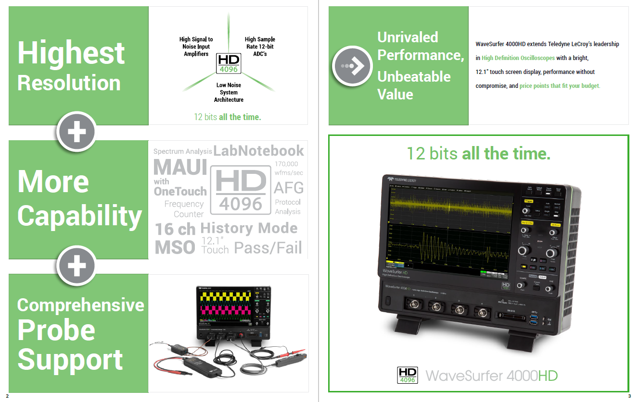
WaveSurfer 4000HD - Unrivaled Performance, Unbeatable Value
Notes:
Datasheet has the 3 key messages. However, always remember that the story is Unrivaled Performance, Unbeatable Value. Everything else is there to check the boxes.

Slide 12

WaveSurfer 4000HD has more capability than you imagined
Multi-instrument capability
MSO
DVM/Frequency Counter
Spectrum Analyzer
Arbitrary Waveform Generator
Protocol Analyzer
However, don’t lose sight of the most compelling and obvious differentiation
12 bits all the time
12 bits for the price of 8 bits
Notes:
Unbeatable value extends to multi-instrument capability

Slide 13
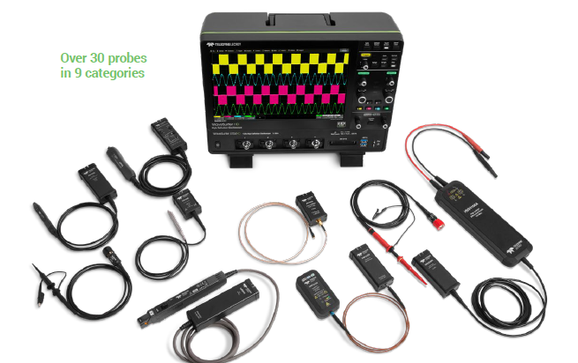
WaveSurfer 4000HD has Comprehensive Probe Support
Same interface over 20 years
Teledyne LeCroy probes with ProBus interface are supported
30 probes over 9 categories
Active, Passive, Differential, Single-Ended, Fiber Optic, High Voltage, and more
MSO option for digital channels
View 16 digital channels without sacrificing analog channels
Notes:
ProBus – unchanged over 20 years

Slide 14
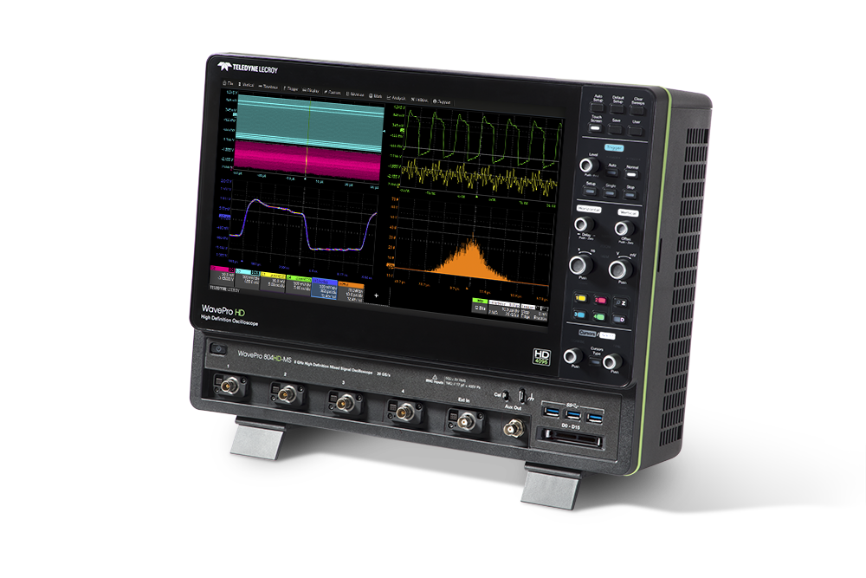
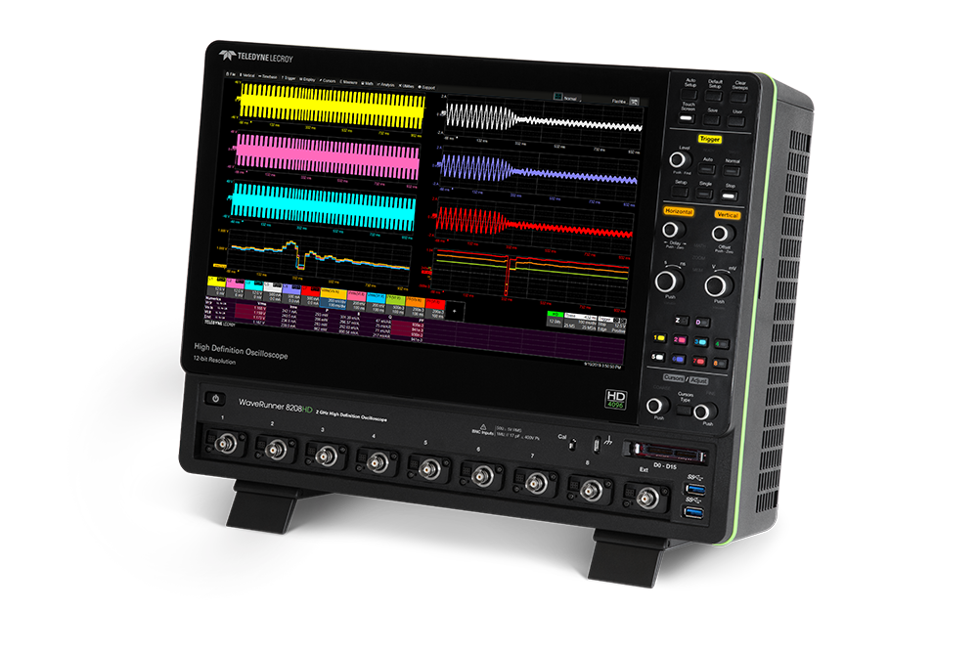
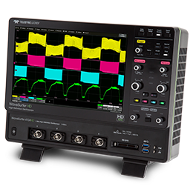
Teledyne LeCroy has innovated with new industrial design
WavePro HD
WaveRunner 8000HD
WaveSurfer 4000HD
Smaller footprint
Color-coded Front Panel indicators
Sleek, bezel-less display
Notes:
WPHD industrial design now incorporated across product lines

Slide 15
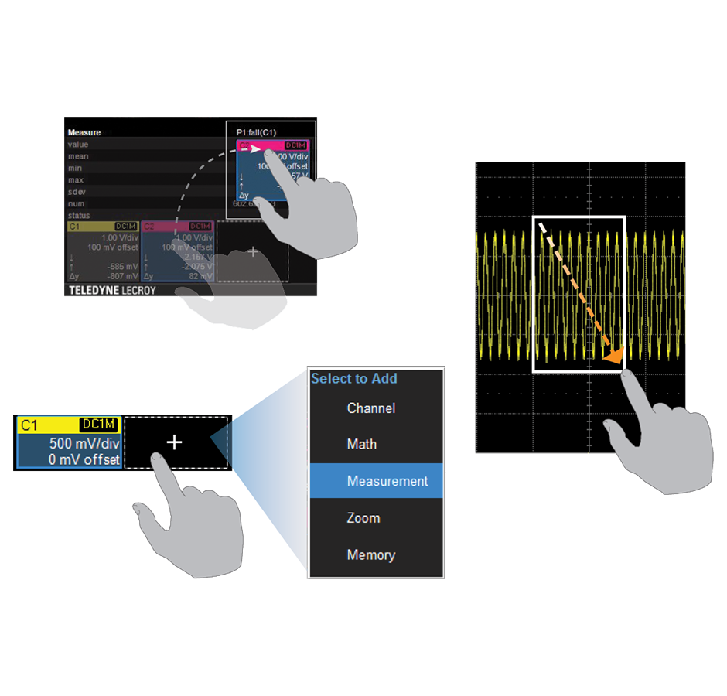
WaveSurfer 4000HD has MAUI with OneTouch Instinctively interact with the oscilloscope and dramatically reduce setup time
OneTouch features | WaveSurfer 4000HD
Touch | ✓
Drag | ✓
Pan | ✓
Swipe | ✗
Pinch | ✗
Flick | ✗

Slide 16
WaveSurfer 4000HD has MAUI with OneTouch MAUI with OneTouch is limited on Embedded OS
OneTouch features | WaveSurfer 4000HD
Touch | ✓
Drag | ✓
Pan | ✓
Swipe | ✗
Pinch | ✗
Flick | ✗

Slide 17
Notable enhancements on the WaveSurfer 4000HD
WaveSource Arbitrary Waveform Generator is available
Same functions as WaveSurfer 3000z available plus added functions
LabNotebook
Save/Recall menu is harmonized
MAUI with OneTouch
Support for common gestures added
Axis labels for easy readout on display
Ride on cursors functionality
Vertical zoom functionality

Slide 18
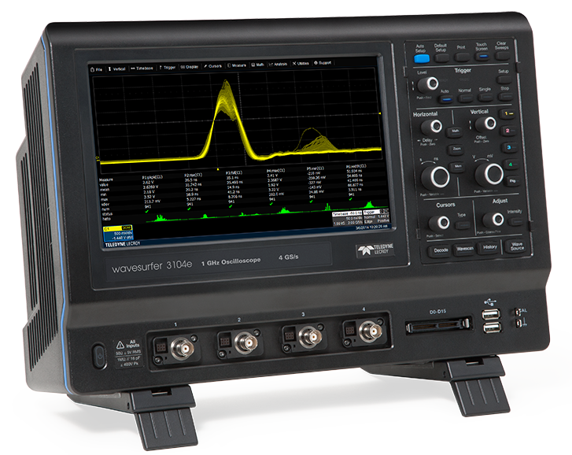
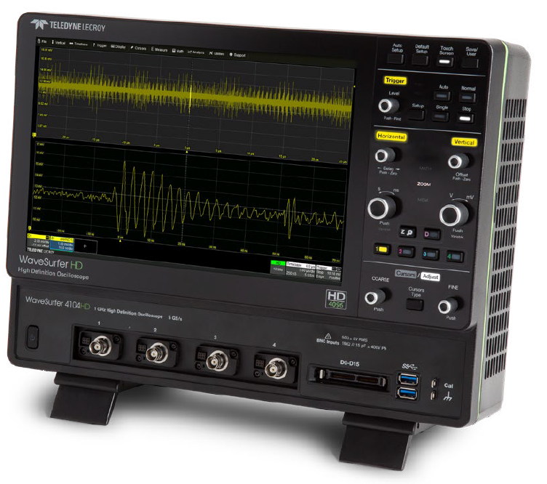
Economy/Premium Economy product offering: November 4, 2019
 | Teledyne LeCroy WaveSurfer 3000z | Teledyne LeCroy HDO4000A | Teledyne LeCroy WaveSurfer 4000HD
Starting Price | $3,700 | $10,403 | $7,490
Launch date | 2018 | 2017 | 2019
Bandwidth range | 100 MHz – 1 GHz | 200 MHz – 1 GHz | 200 MHz – 1 GHz
Resolution | 8 bits | 12 bits | 12 bits
Baseline noise (100mV/div) | 993 uVrms | 500 uVrms | 500 uVrms
Accuracy | 1% | 0.5% | 0.5%
Update Rate | 130,000 wfms/sec | N/A | 170,000 wfms/sec
Operating System | Embedded OS | Windows | Embedded OS
Industrial design | 2012 | 2012 | 2019
Multi-instrument capability | Yes | N/A | Yes

Slide 19
Economy/Premium Economy product offering: November 5, 2019
 | Teledyne LeCroy WaveSurfer 3000z | Teledyne LeCroy HDO4000A | Teledyne LeCroy WaveSurfer 4000HD
Starting Price | $3,700 | $10,923 | $7,490
Launch date | 2018 | 2017 | 2019
Bandwidth range | 100 MHz – 1 GHz | 200 MHz – 1 GHz | 200 MHz – 1 GHz
Resolution | 8 bits | 12 bits | 12 bits
Baseline noise (100mV/div) | 993 uVrms | 500 uVrms | 500 uVrms
Accuracy | 1% | 0.5% | 0.5%
Update Rate | 130,000 wfms/sec | N/A | 170,000 wfms/sec
Operating System | Embedded OS | Windows | Embedded OS
Industrial design | 2012 | 2012 | 2019
Multi-instrument capability | Yes | N/A | Yes
Notes:
WS4KHD will be added to this offering

Slide 20
WaveSurfer 4000HD has high performance at a great price point
 | Teledyne LeCroy WaveSurfer 3000z | Teledyne LeCroy HDO4000A | Teledyne LeCroy WaveSurfer 4000HD
Starting Price | $3,700 | $10,923 | $7,490
Launch date | 2018 | 2017 | 2019
Bandwidth range | 100 MHz – 1 GHz | 200 MHz – 1 GHz | 200 MHz – 1 GHz
Resolution | 8 bits | 12 bits | 12 bits
Baseline noise (100mV/div) | 993 uVrms | 500 uVrms | 500 uVrms
Accuracy | 1% | 0.5% | 0.5%
Update Rate | 130,000 wfms/sec | N/A | 170,000 wfms/sec
Operating System | Embedded OS | Windows | Embedded OS
Industrial design | 2012 | 2012 | 2019
Multi-instrument capability | Yes | N/A | Yes
WaveSurfer 4000HD and HDO4000A have same 12-bit performance
But WaveSurfer 4000HD has 30% lower entry price
WaveSurfer 3000z is an excellent 8-bit instrument for those unwilling to pay for 12-bit performance
Notes:
Simple takeaway

Slide 21
WaveSurfer 4000HD Unrivaled Performance, Unbeatable Value
Questions: william.kaunds@teledyne.com

Slide 22
Appendix A
WaveSurfer 4000HD Options and Pricing

Slide 23
Base Oscilloscope Models
Part Number | Price
WaveSurfer 4024HD | $7,490
WaveSurfer 4034HD | $10,990
WaveSurfer 4054HD | $14,490
WaveSurfer 4104HD | $17,490

Slide 24
Software Options
Part Number | Price
WS4KHD-Audiobus (I2S, LJ, RJ, and TDM) | $1,020
WS4KHD-AUTO (CAN, CAN FD, LIN, FlexRay) | $1,850
WS4KHD-EMB (I2C, SPI, UART-RS232) | $1,850
WS4KHD-MSO | $2,090
WS4KHD-MSO-LICENSE | $515
WS4KHD-FG | $515
WS4KHD-PWR | $1,020

Slide 25
Advanced Active Probe Interface
 | Part Number
High Voltage Fiber Optic Probe | HVFO103
Power/Voltage Rail Probe | RP4030
Active Voltage Probes | ZS1000
 | ZS1500
Current Probes | CP030 / CP031
 | CP030A / CP031A
 | CP150
 | CP500
 | DCS025
Differential Probes (<= 1.5 GHz) | AP033
 | ZD200, ZD500
 | ZD1000, ZD1500
High Voltage Differential Probes | HVD3102A, HVD3106A, HVD3206A, HVD3605A
 | AP031, AP033
 | ADP300, ADP305
High Voltage Probes | HVP120
 | PPE4KV, PPE5KV, PPE6KV

Slide 26
Competitive compare
 | Teledyne LeCroy WaveSurfer 4000HD | Teledyne LeCroy HDO4000A | Keysight DSOX4000A | Tektronix MSO44 | Rohde & Schwarz RTA4000
Bandwidth Models | 200MHZ - 1 GHz | 200 MHz - 1 GHz | 200 MHz – 1.5 GHz | 200 MHz – 1.5 GHz | 200 MHz - 1 GHz
Channels | 4 | 4 | 2 / 4 | 6 | 2 / 4
ADC Resolution | 12-bit | 12-bit | 8-bit | 12-bit | 10-bit
Sampling rate | 2.5 / 5 GS/s | 10 GS/s ESR (No interleaving) | 2.5 / 5 GS/s | 6.25 GS/s (No Interleaving) | 2.5 / 5 GS/s
Memory | 12.5 Mpts / 25 Mpts | 12.5 Mpts / 25 Mpts | 2 Mpts / 4 Mpts | 31.25 Mpts | 40 Mpts / 80 Mpts
Update Rate | 170,000 wfms/sec | N/A | 1,000,000 wfms/sec | 500,000 wfms/sec | 64,000 wfms/sec
Display | 12.1” | 12.1” | 12.1” | 13.3" | 10.1”
List Price (USD) 4 Channel Models
200 MHz | $7,490 | $10,923 | $6,003 | $7,550 | $6,020
350 MHz | $10,990 | $12,112 | $11,184 | $11,800 | $11,000
500 MHz | $14,490 | $15,681 | $14,487 | $15,500 | $14,300
1 GHz | $17,490 | $18,926 | $17,982 | $19,100 | $17,800

Slide 27
Appendix B
WaveSurfer 4000HD Applications
Note: WaveSurfer 4000HD is good for these applications. However, do not forget the compelling and obvious differentiation.

Slide 28
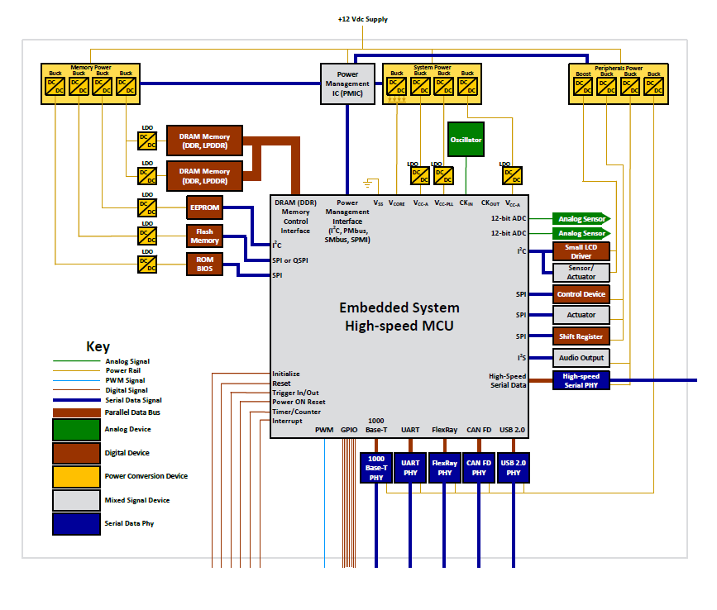
Block diagram of a Deeply Embedded System (e.g. IoT applications)
Consists of
Analog signals
Power rails
PWM signals
Digital signals
Serial data signals
Power supplies
Notes:
Application areas for the WaveSurfer 4000HD

Slide 29
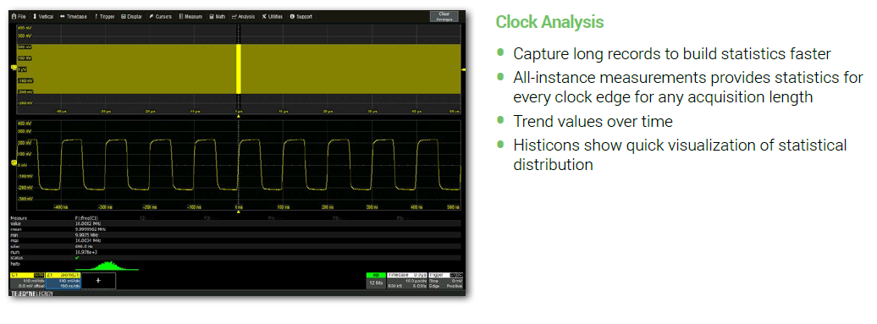
WaveSurfer 4000HD does it all

Slide 30
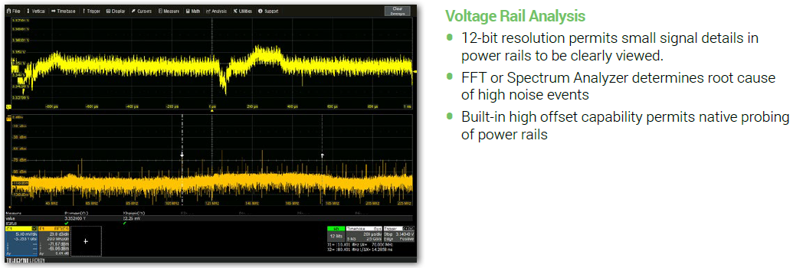
WaveSurfer 4000HD does it all

Slide 31
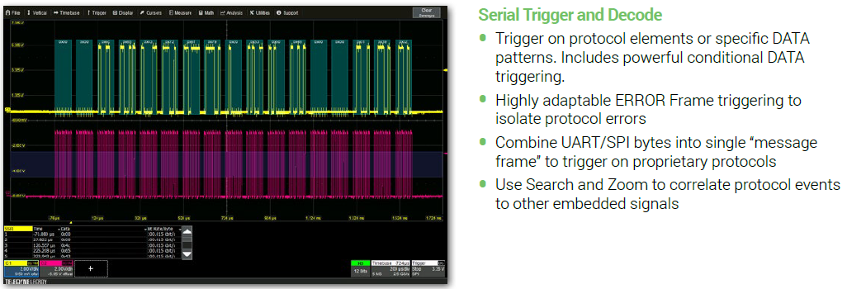
WaveSurfer 4000HD does it all

Slide 32
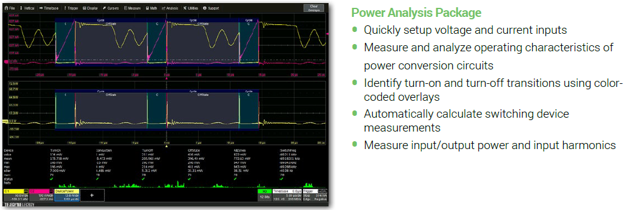
WaveSurfer 4000HD does it all

Slide 33
HD4096 technology with 12-bit resolution is the best differentiator Teledyne LeCroy has
Teledyne LeCroy innovated with 12 bits, we are the best, we are 12 bits all the time

Slide 34
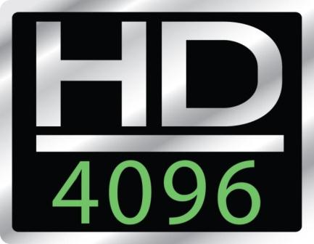
High Resolution Oscilloscopes: Successful since 2011
Teledyne LeCroy is THE INNOVATOR in high resolution (12-bit high definition) oscilloscopes
We were first – competitors followed much later, if at all
We remain the best – our total “system” approach provides the best performance
Teledyne LeCroy is still the BEST in high resolution 12-bit oscilloscopes
Competitor marketing hype can’t hide lesser competitor performance
Competitor’s have “qualifiers” – “10-bit ADC”, “high-resolution mode”, “hypersampling”, “linear noise reduction technology”, etc.
Our system approach is superior
Competitive oscilloscopes, honestly evaluated, will often be seen to be very compromised in high-resolution performance
Bandwidth, noise, sample rate, etc.
Notes:
For people not familiar

Slide 35
Teledyne LeCroy HD4096 Brand Messaging Only Teledyne LeCroy takes a systems approach to achieve best high resolution performance
System Approach = “12 bits all the time”
Analog-to-Digital Converter
Front-end Amplifier
System Architecture
Benefits = “16x closer to perfect”
Clean, crisp waveforms
Low baseline noise
High effective number of bits (ENOB)
More signal details
4096 vertical levels (vs. 256)
Unmatched measurement precision
0.5% gain accuracy
High channel-channel isolation
Notes:
What is Systems approach? Our recipe to achieve best performance

Slide 36
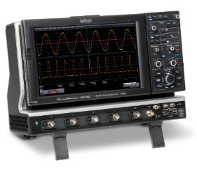
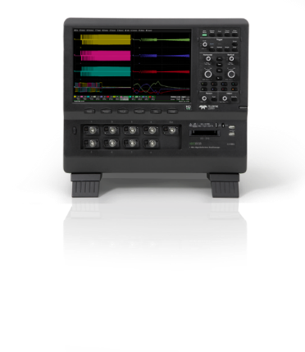
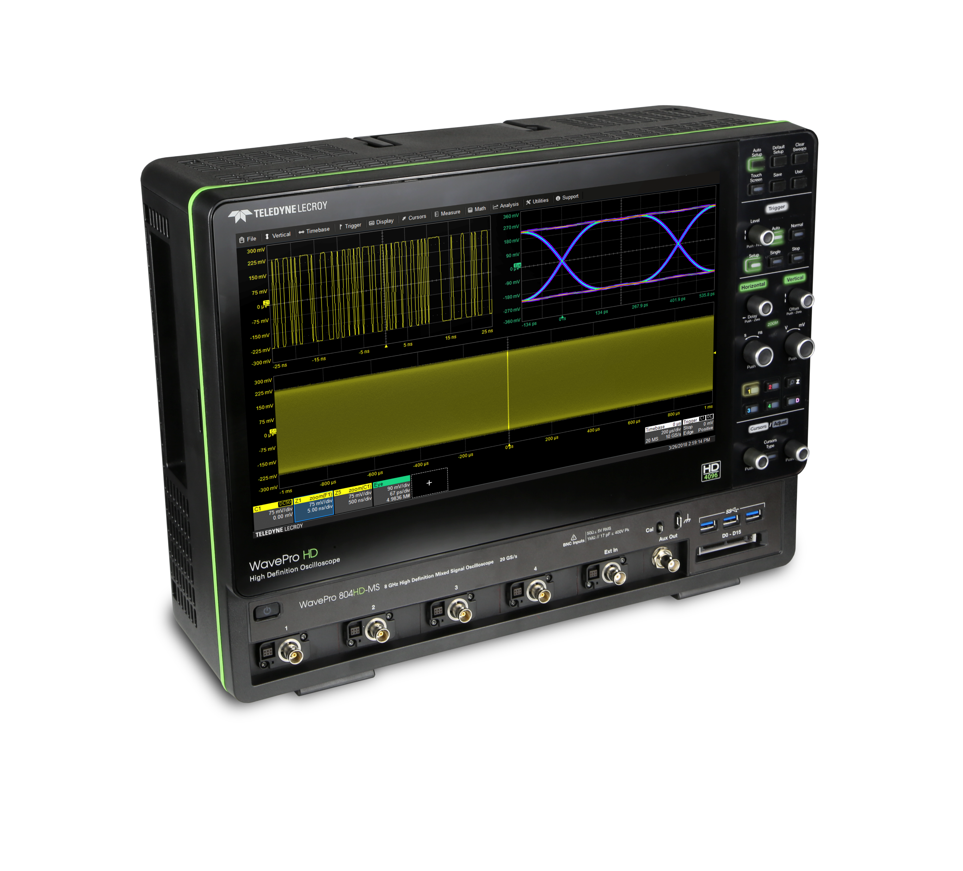
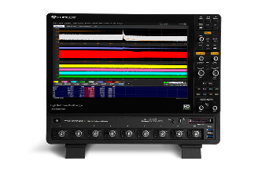
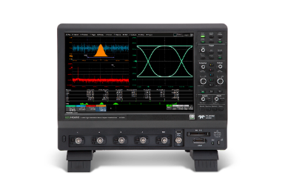
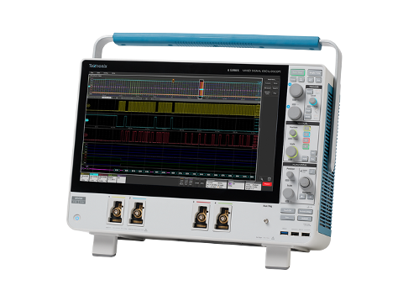
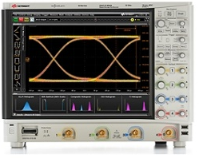
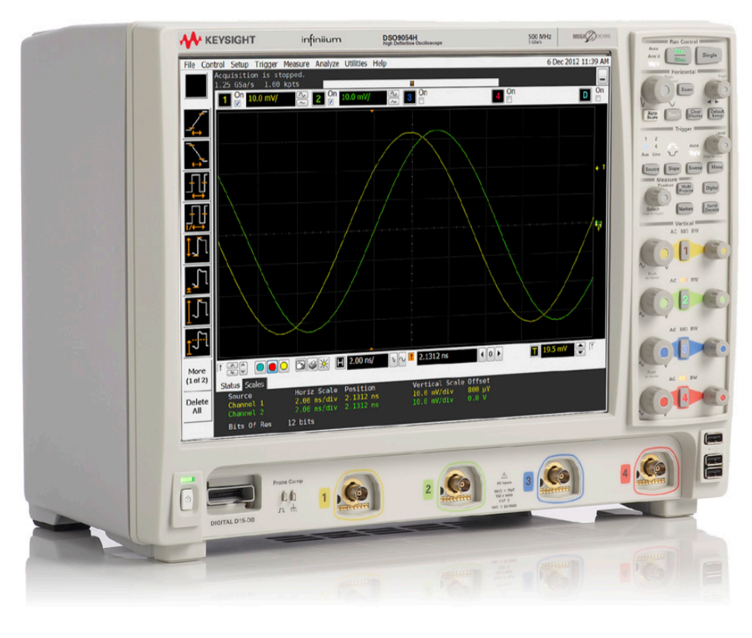
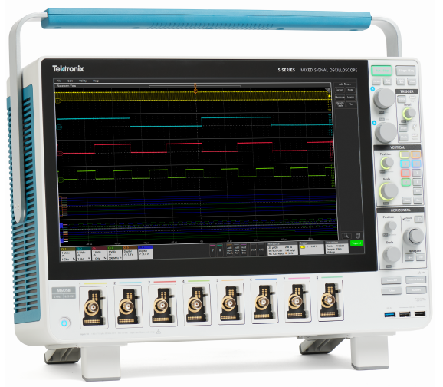
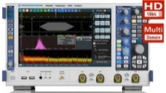
High Resolution Oscilloscope Launch Timeline Teledyne LeCroy has led, all competitors have lagged
2011
2012
2013
2014
2015
2016
2017
2018
2019
2019
HDO4000/HDO6000
12 bits, 1 GHz
HDO8000
12 bits, 1 GHz
8 channels
12 bits
WavePro HD
12 bits, 8 GHz
WaveRunner 8000HD
12 bits, 2 GHz
8 channels
WaveRunner HRO
12 bits, 600 MHz
Keysight S series
8-10 bits, 8 GHz
HDO9000
10 bits, 4 GHz
Tektronix 6 series
12-bit ADC*, 8 GHz
*10-bit noise performance
10 bits
Keysight 9000H
8 bits + software “hypersampling”
Rohde & Schwarz RTO2000
8 bits + software “HD mode”
Tektronix 5 series
8 bits + software “hi res” mode
8 bits
Teledyne LeCroy
First to market with 12-bit systems (HD4096)
Systems approach for 12 bits all the time
Keysight
Second to market (2-1/2 years later)
Initial products were 8-bit HW with software filtering
Now 10-bit HW that functions as 8 bits sometimes, with software post-processing for >10 bits
Rohde & Schwarz
High Definition (HD) “mode” software options
8-bit HW with software filtering
Tektronix
Last to enter “high resolution” market
5 Series is 8-bit HW with 12-bit claims that are not credible
6 Series is 12-bit ADC with 10-bit noise performance
Notes:
Evolution… no match even today. Even the imitations from competitors are poor.

Slide 37
High Resolution “Economy” or “Premium Economy” Oscilloscopes None of the competitors can match 12 bits all the time
2011
2012
2013
2014
2015
2016
2017
2018
2019
HDO4000
12 bits,
200 MHz - 1 GHz
HDO4000A
12 bits
200 MHz - 1 GHz
12 bits
Tektronix 4 series
12-bit ADC*
200 MHz – 1.5 GHz
*Defaults to 8-bits.
10-bit noise performance in High Res mode
10 bits
Rohde & Schwarz RTA4000
10-bit Resolution*
200 MHz – 1 GHz
*advertised as 10 bits but has 8-bit resolution noise performance
Keysight 4000 X Series
8 bits
200 MHz – 1.5 GHz
8 bits
Teledyne LeCroy
First to market with 12-bit systems (HD4096)
Systems approach for 12 bits all the time
Keysight
No product in this price/performance range with claims of > 8 bits performance.
Rohde & Schwarz
Advertised as 10 bit resolution, but noise performance is worse than 8-bit resolution oscilloscopes.
Tektronix
Last to enter “high resolution” market
4 Series has 12-bit ADC with 12-bit resolution claims, but noise performance is only 10 bits in High Resolution mode
Notes:
Econ = Distributor stocks filtered. There is a Need for a HD4096 technology oscilloscope in the Premium Econ space.

Slide 38
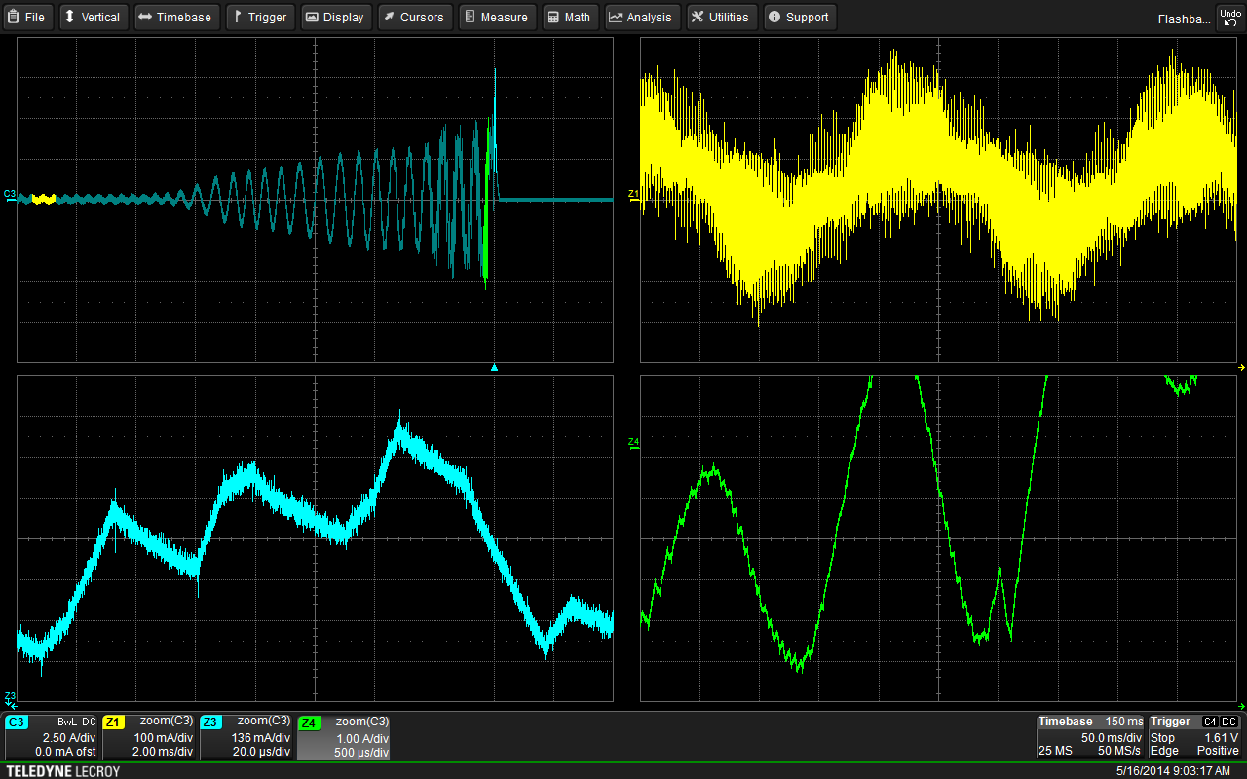
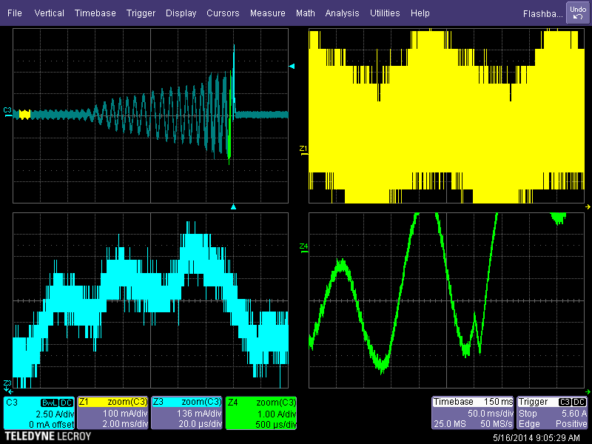
HD4096 Technology vs. Conventional 8-bit One acquisition, with zooms, dramatically demonstrates the differences
Conventional 8-bit Oscilloscope
HD4096 12-bit High Definition Oscilloscope
Notes:
8 bit has more quant noise

Slide 39

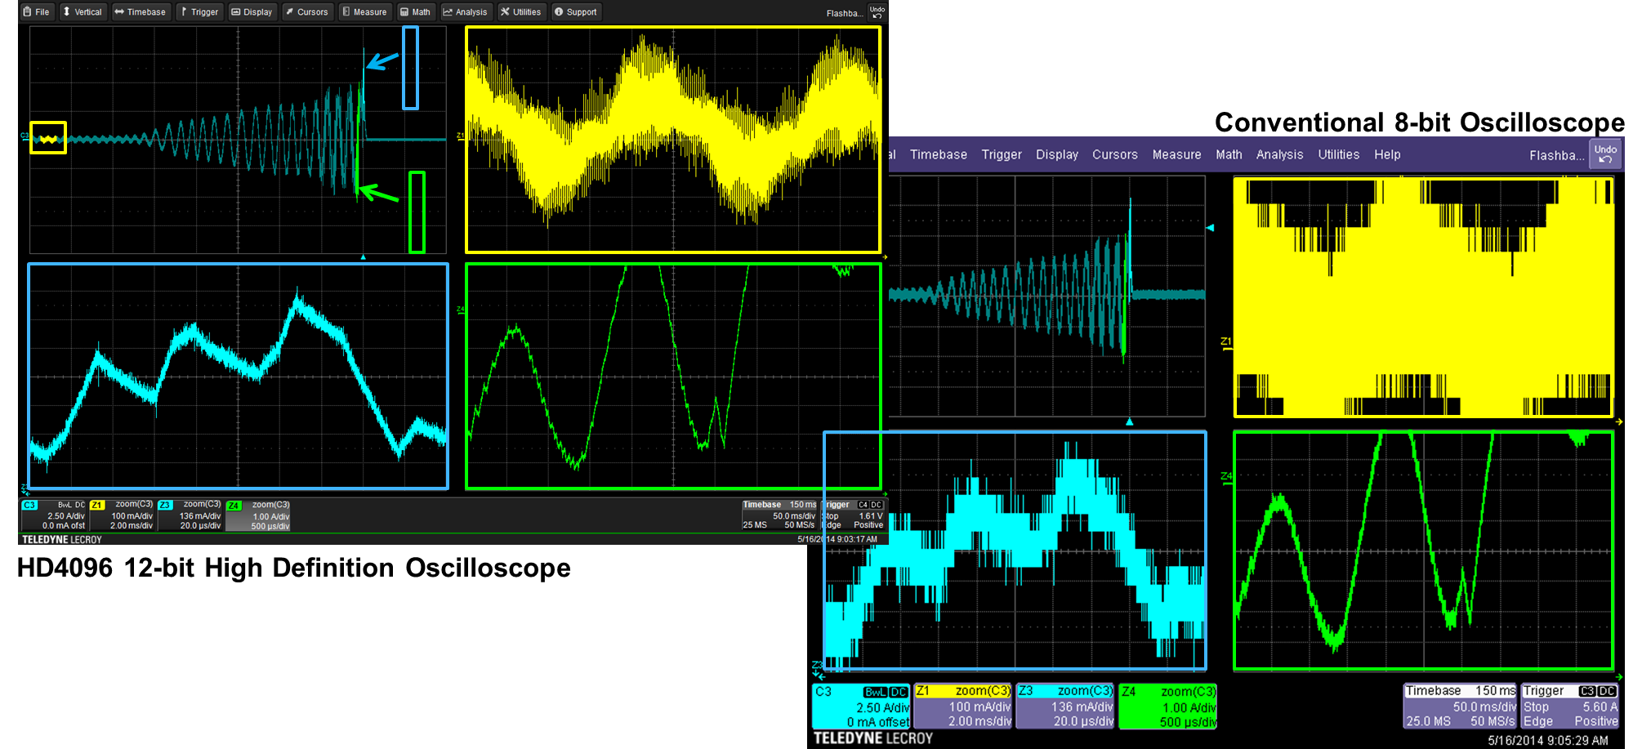
Market is demanding 12 bits. Teledyne LeCroy is well positioned.
Estimated (Internal) Electronic T&M Market for High-Resolution Oscilloscopes
2017
2020

