Slide 1
Product overview
Introduction to the
OHB Austria product family

Slide 2
OHB
GNSS & interferences
GIDAS
XPLORA
Fields of Applications

Slide 3

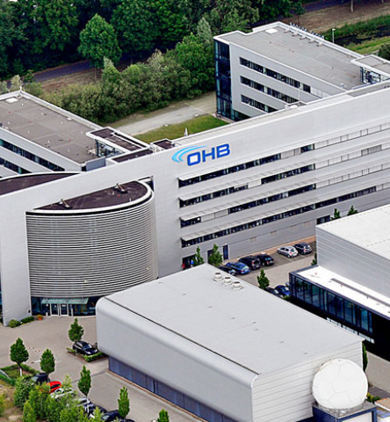
OHB
HQ in Bremen, germany
Group covers entire satellite lifetime from idea > design > assembly > orbit > deorbit
More than 3500 employees around the globe, mostly in Germany
One of top three European companies in the space industry
OHB Austria since 2019 part of OHB offices in Graz and Vienna, ~20 employees

Slide 4
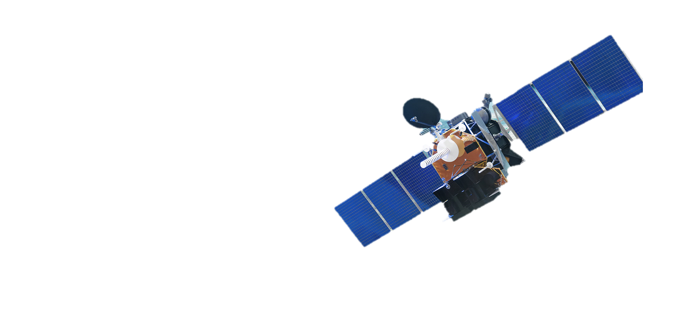

What does Gnss mean?
Some basics
GPS best-known example of GNSS (Global Navigation Satellite System)
Networks of satellites providing geolocation & time globally, free of charge Other examples: Galileo, BeiDou, NavIC,…
Require at least 4 signals to determine Lat, Lon, Height and Time
The signal is weak, making it vulnerable
Notes:
Free of charge and globally available, making it a critical technology for various applications.
Unfortunately, due to its nature, there are many vulnerabilities inherent in it

Slide 5
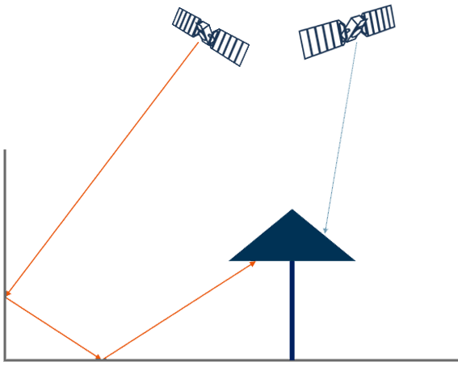
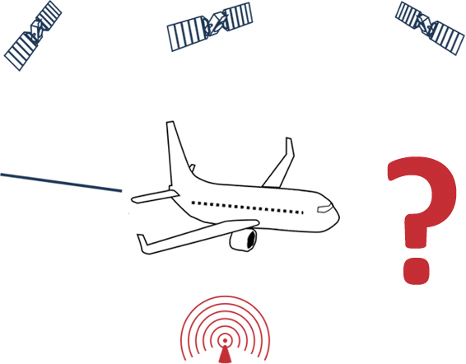
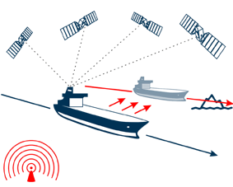
GNSS Interferences
Some context
Unintentional
Intentional
e.g. Multipath
Jamming
Spoofing

Slide 6
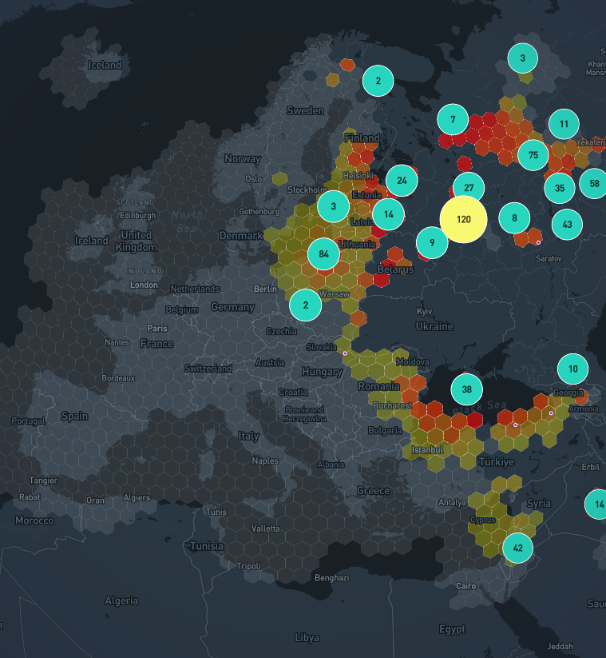
Spoofing
And its effects
500%
Source: gpswise.aero Dez 1st 2025 , 24h

Slide 7
Spoofing
And its effects
500% increase* of events within 2024
Europe and Middle East most affected, other theaters e.g. Kashmir arising
Unpredictable Effects on unsecured systems
*Source: Report of the 2024 GPS Spoofing Workgroup by OPSGroup
Source: gpswise.aero Dez 1st 2025 , 24h

Slide 8
GIDAS

Slide 9
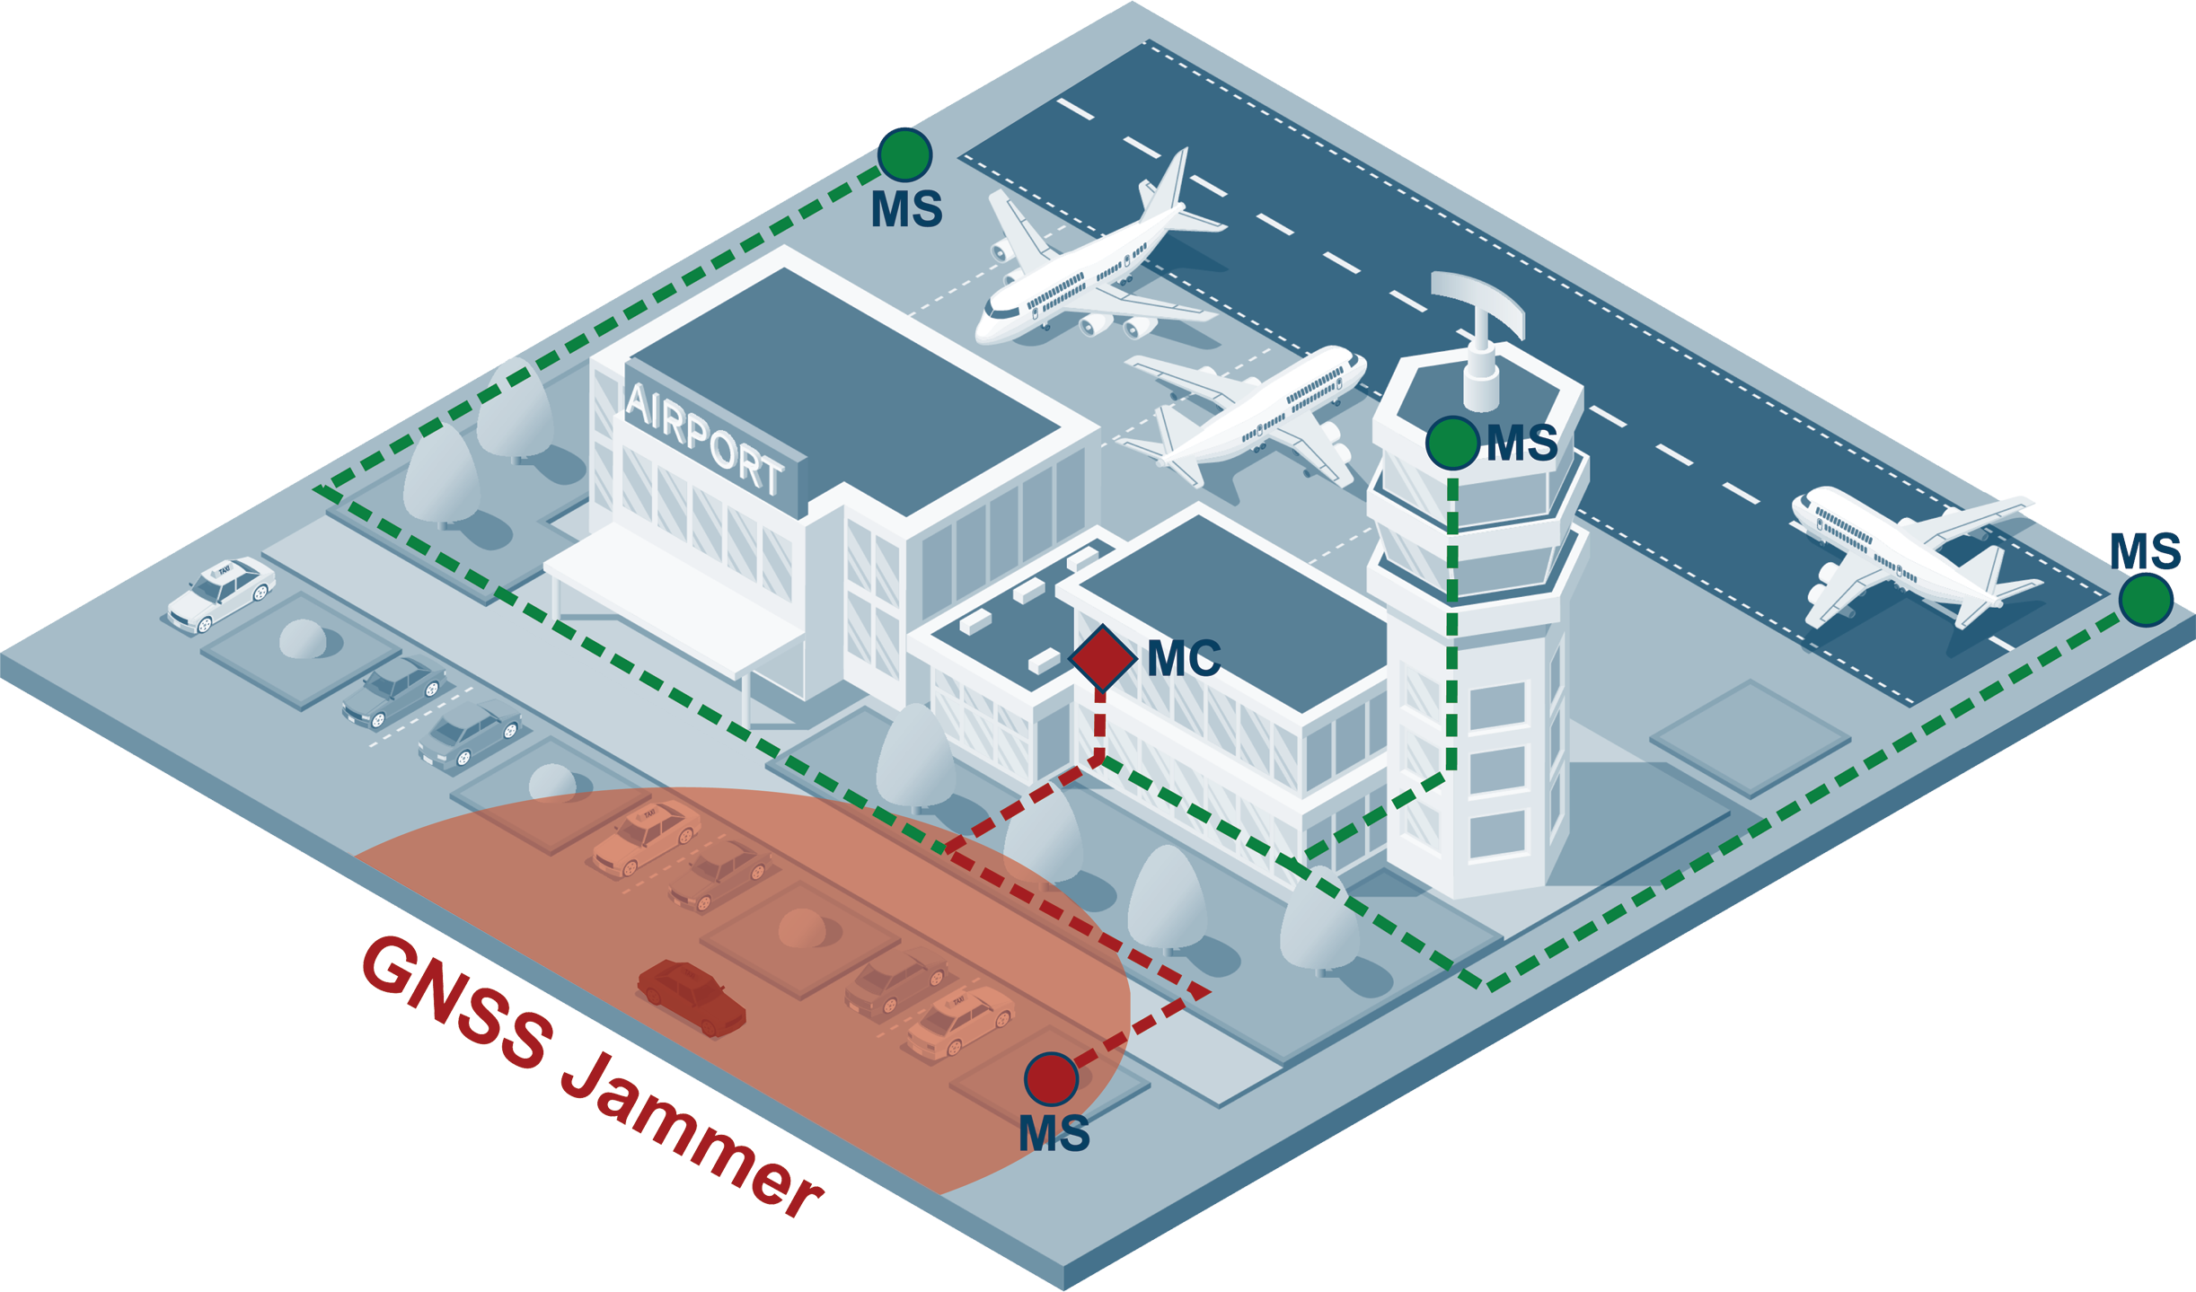
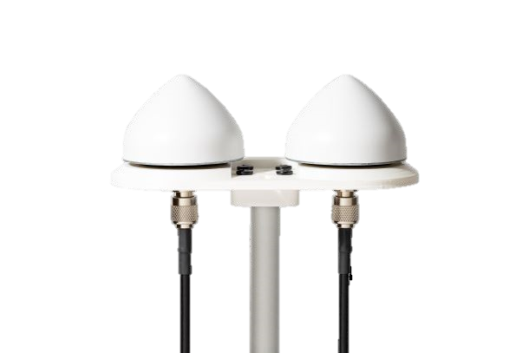
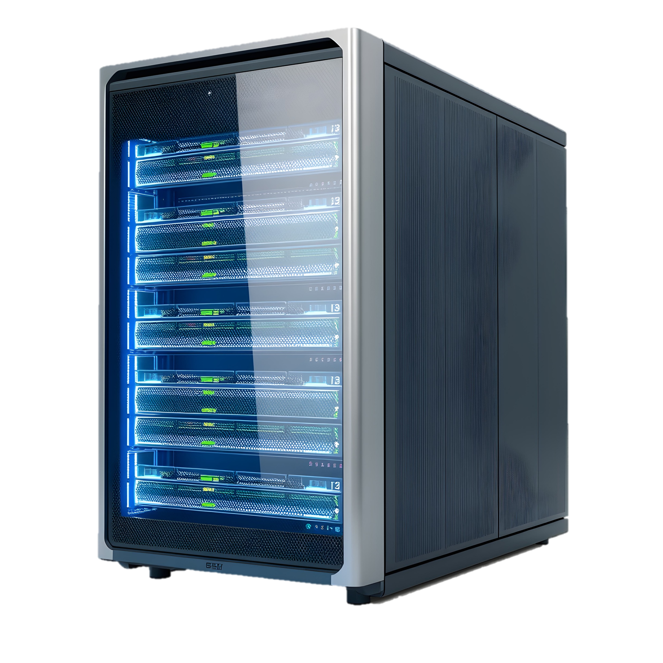
GIDAS
GNSS Interference Detection & Analysis System
GIDAS is our solution for
GNSS signal monitoring, interference detection, classification & alert with up to 10 independent detectors
Analysis and comparison of interferences
Highly customizable to fit your specific needs
Offline, no cloud solution Web-application, available for all devices in the same network
All civil GNSS Frequency bands with extension also GSM/LTE Band
Algorithm developed under ESA contract with technical reviews conducted by ESA (Link)
MS – Monitoring Sensor MC – Monitoring Center

Slide 10






functionality
Analyze with
auto-generated statistics
Store all detected interferences
Localize the source
Real-time alerts via GUI and REST API
Detect Jamming/Spoofing
Monitor GNSS environment 24/7

Slide 11
functionality
Localize the source
Store all detected interferences
Analyze with
auto-generated statistics
Monitor GNSS environment 24/7
Detect Jamming/Spoofing
Real-time alerts via GUI and REST API
via GUI to user
MS – Monitoring Sensor
MC – Monitoring Center

Slide 12
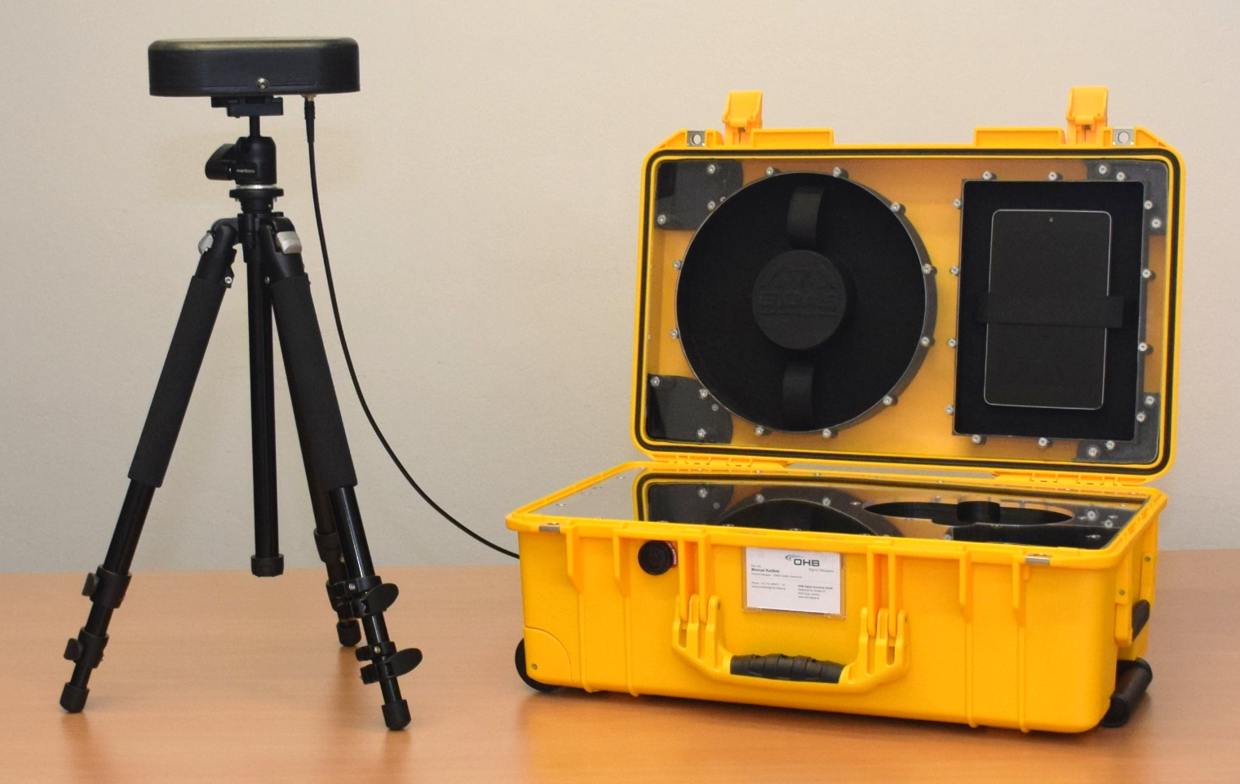
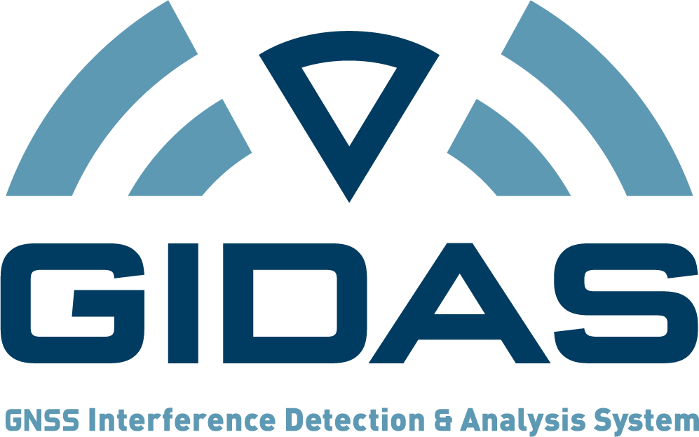
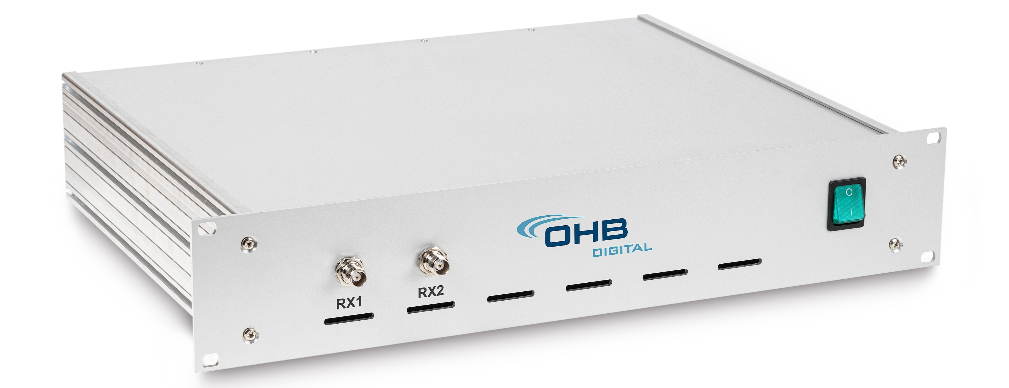
GIDAS
Product family
STATIONARY
EMBEDDED*
PORTABLE
RACKMOUNT
*GIDAS algorithm directly integrated into your system

Slide 13
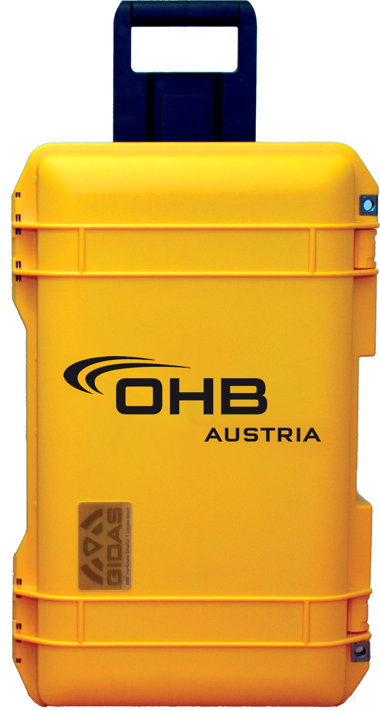
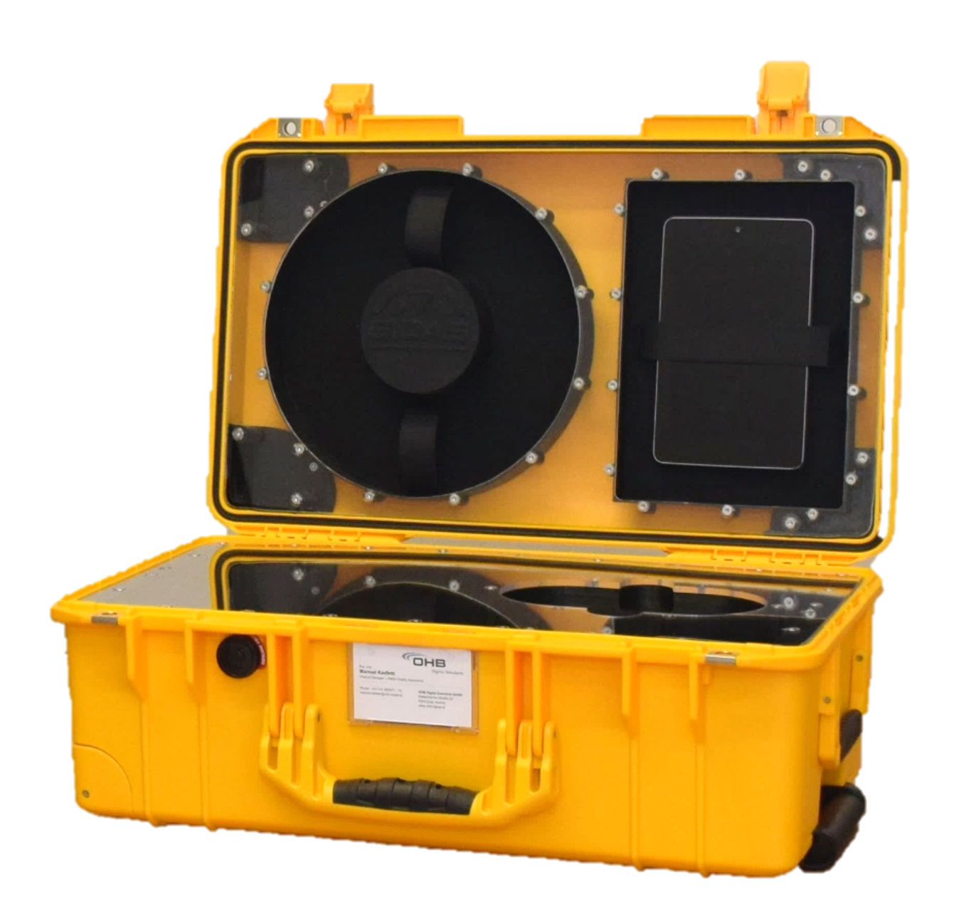
Summary GIDAS
GIDAS is used to monitor the GNSS environment
It gives out alerts if intentional interference is present and records vital data
GIDAS does NOT protect against jamming or spoofing! Mitigation must be done on another level. We offer the basis for procedures or decisions on how to (re)act
It can be used in any application where positioning or time synchronization are crucial or where interferences imply the presence of malicious intent
It is modular and can be adapted to specific needs

Slide 14
XPLORA

Slide 15
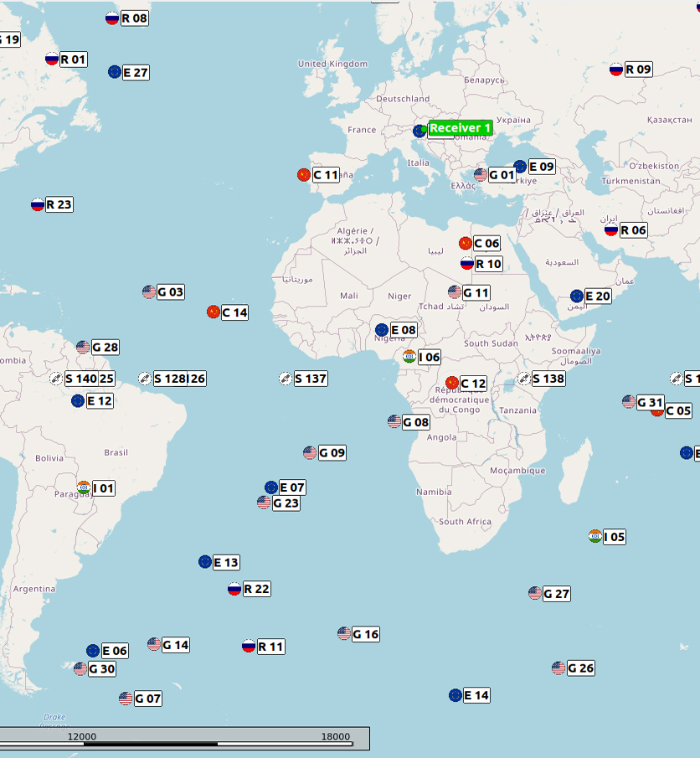
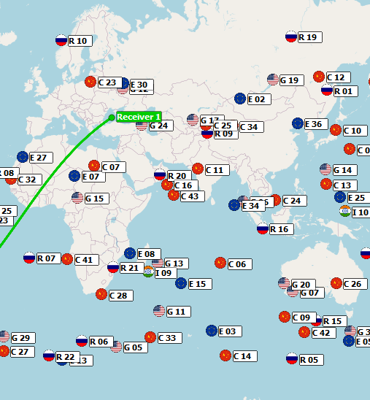
XPLORA
Gnss signal simulator
XPLORA is our solution to provide controlled & repeatable GNSS environments
Jamming & Spoofing possible
Atmospheric errors, Multipath, Urban Environment & Reflectometry
Highly customizable scenarios including multiple receivers, highly dynamic e.g. rockets or satellites
Simulation of custom constellations and manipulation of existing constellations e.g. malfunction
Lunar applications possible

Slide 16
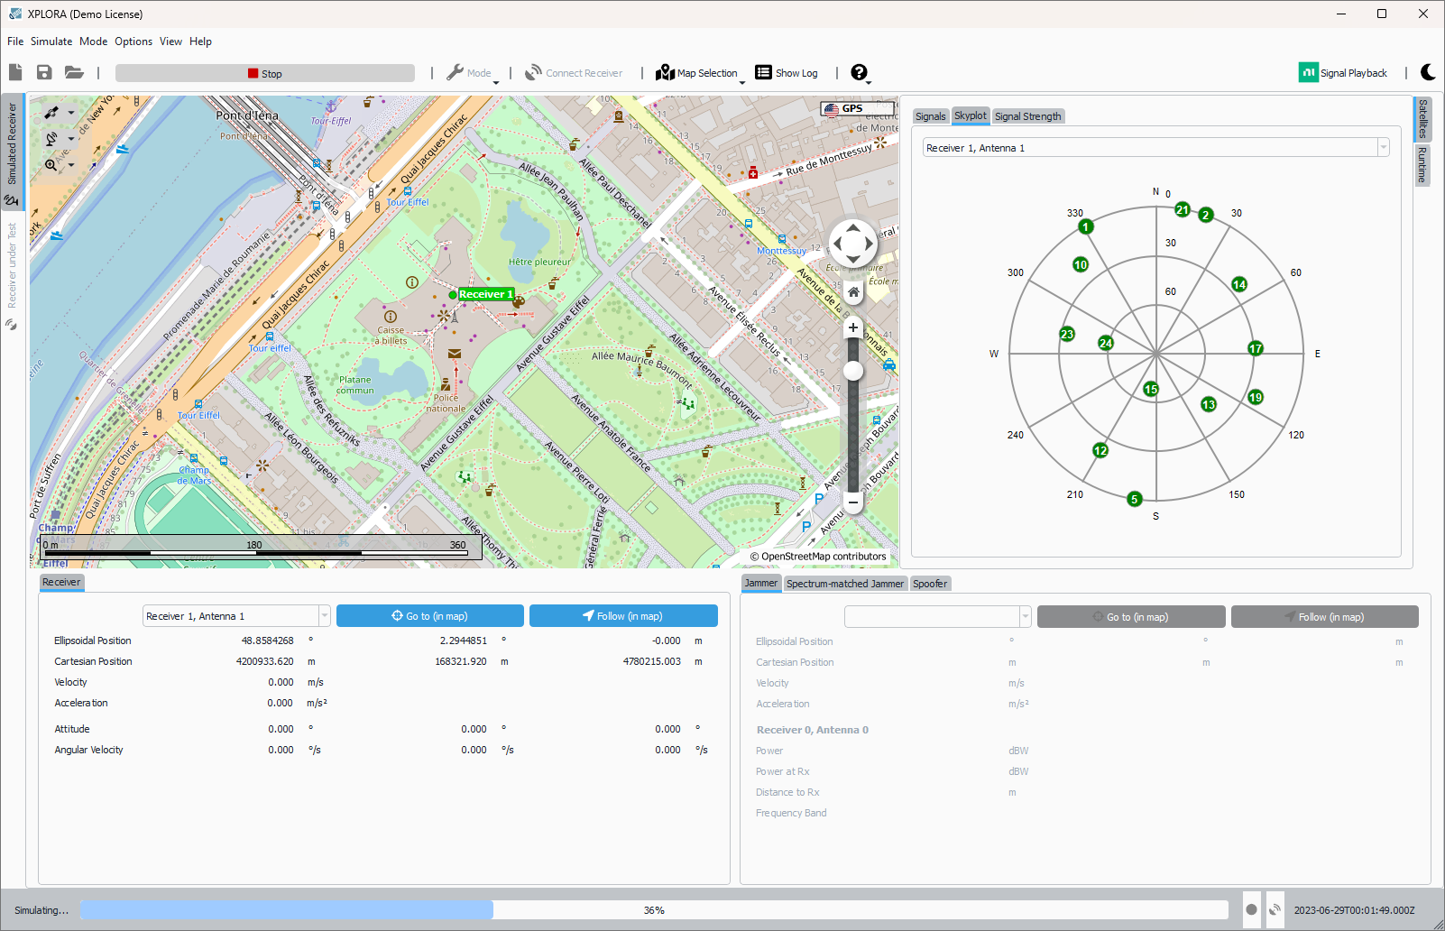
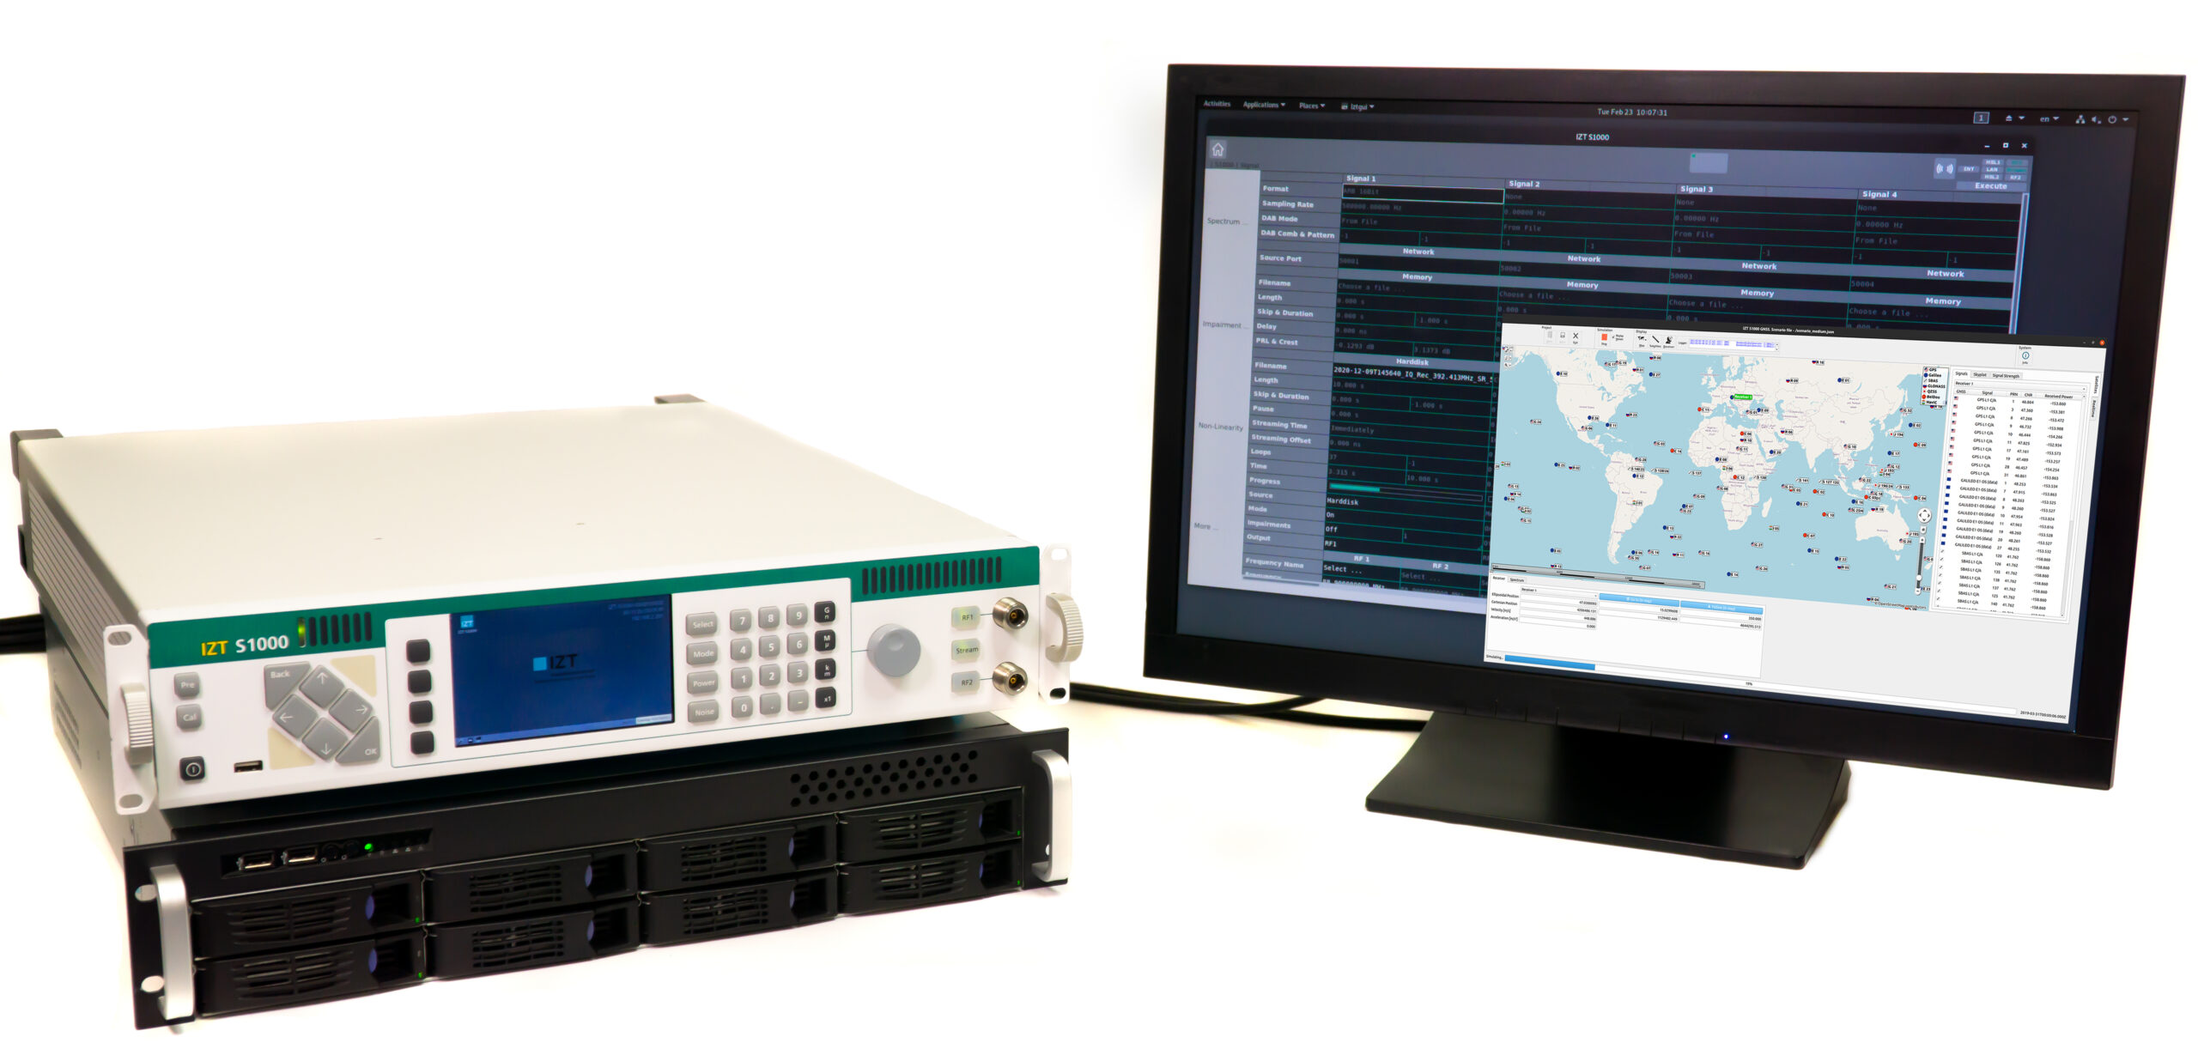
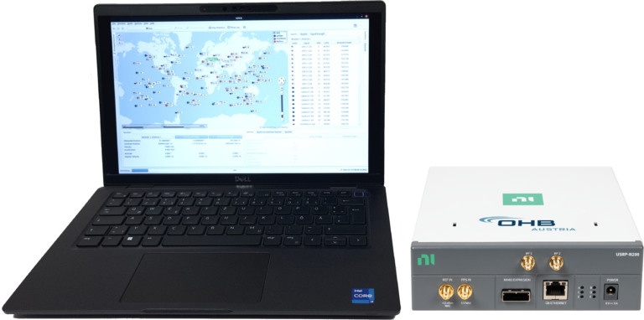
XPLORA
Product family
XPLORA Core (Software)
IZT S1000
Ettus N200/X300
XPLORA One
Non-real-time
Windows, Linux
Customer‘s COTS laptop/PC
Cost effective
XPLORA Pro
Real-time simulation and modifications
Hardware in the Loop
No further HW necessary

Slide 17
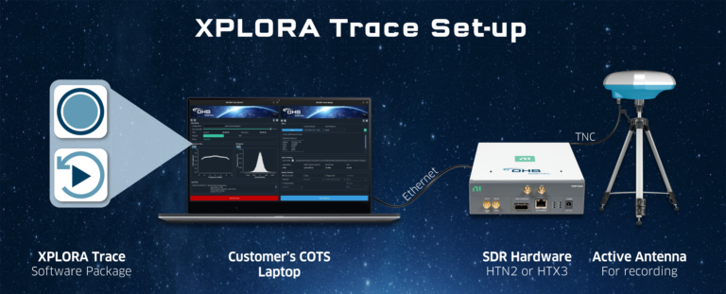
XPLORA Trace
For recording and replaying GNSS environments within the xplora family

Slide 18
Fields of application

Slide 19

Success story: toll collection
Some countries use GNSS for toll collection
Some drivers try to circumvent this by disturbing their own receivers
GIDAS can determine if the signal was disturbed at the given location and time and detect if jammers are on the move
Increased incentive to pay toll

Slide 20
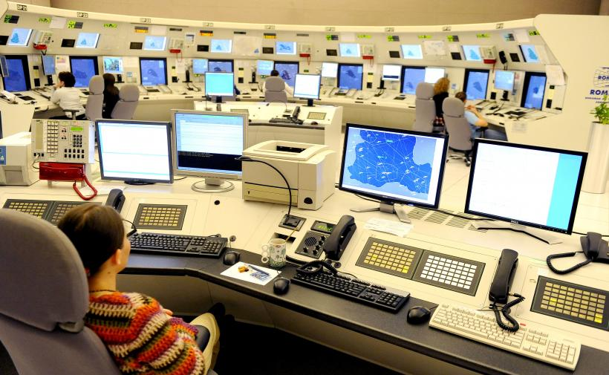
Success story: ROMATSA
Nationwide GNSS monitoring and interference detection system on airports using GIDAS in Romania
16 airports feeding data into a centralized nationwide airport monitoring
24/7 real-time GNSS signal monitoring, jamming and spoofing detection, alert, analysis & documentation
GIDAS enables Point in Space landing decisions, less costs in installation and maintenance than ILS, higher safety

Slide 21
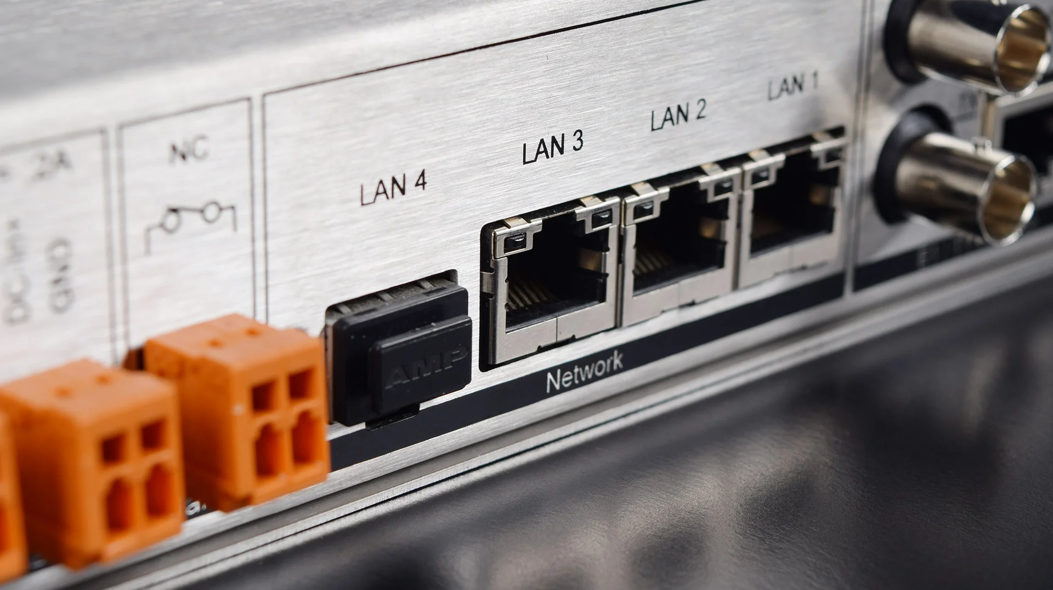
Success story: timeservers
Mobatime integrated GIDAS Embedded into the DTS 4160 & DTS 4210
Alerts to the user of occurring interferences
GIDAS ensures the time server does not rely on compromised signals
For time-critical applications like power plants, financial institutions and others

Slide 22
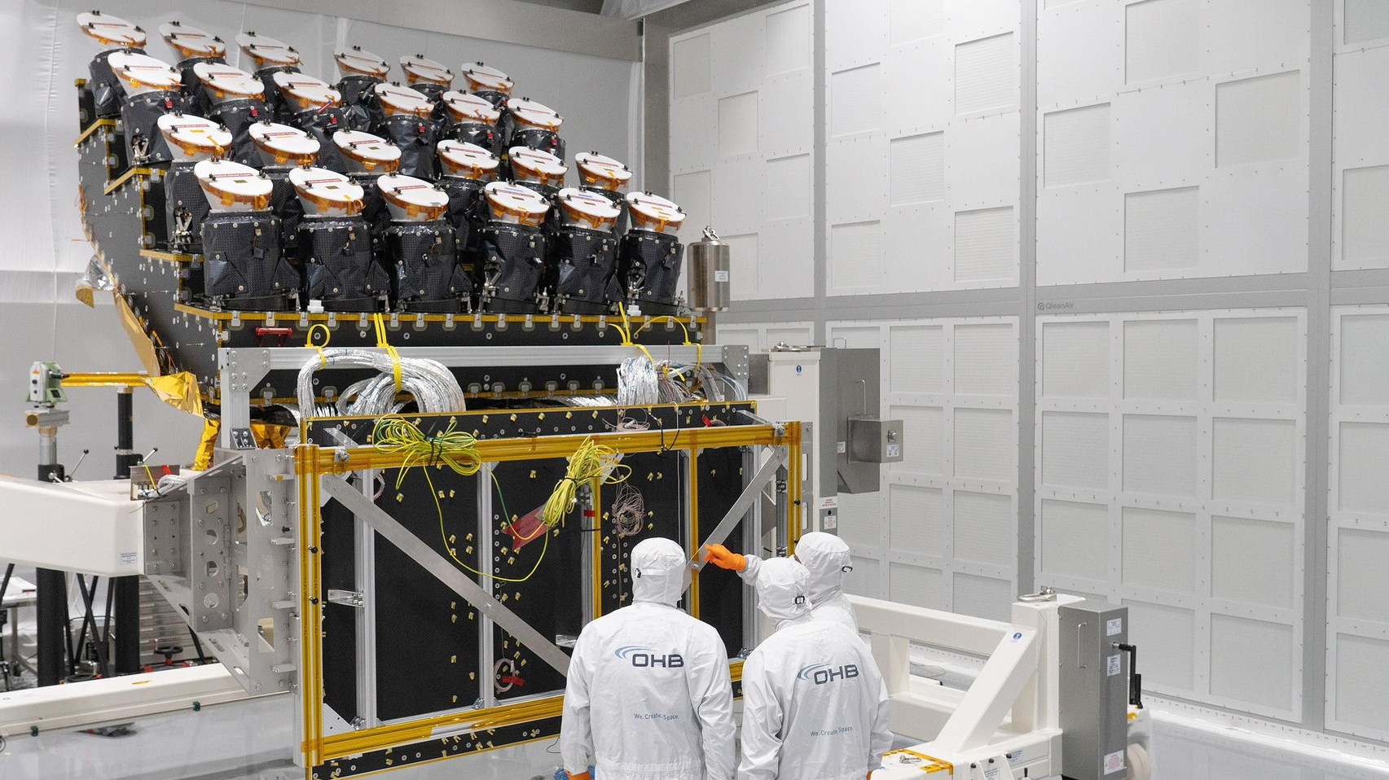
Success story: spaceborn resilience (ESA)
Risk assessment for space-borne GNSS receivers using XPLORA in different missions and scenarios
XPLORA enabled simulation of Jamming & Spoofing
GEO satellites especially vulnerable due to low C/N0 ratio and nadir pointing antennas
Reflectomety, occultation and timing in GEO vulnerable to interferences

Slide 23
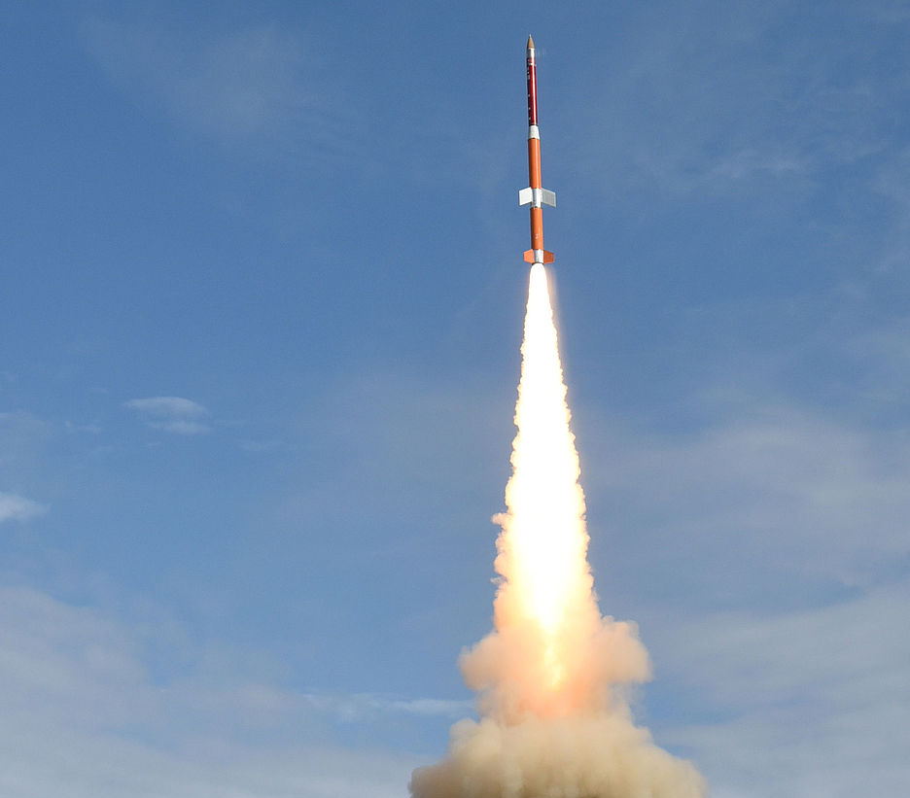
Success story: Sounding rockets
Simulation of flight path using XPLORA testing of navigational flight hardware in the lab
Rocket Factory Augsburg & OHB (TEXUS)
Hardware design for TEXUS for more resilience against interference & lower power needed onboard

Slide 24
Thank you
OHB Austria GmbH
Kärntner Straße 7b/1 A-8020 Graz Austria
Phone: +43-316-890971-0 Email: office@ohb-austria.at Web: ohb-austria.at

